Slide 1


Plasma Wakefield Acceleration and the AWAKE Experiment at CERN
Edda Gschwendtner, CERN
CAS course on Basics of Accelerator Physics and Technology
10 – 14 March 2025, Ferney-Voltaire, France

Slide 2
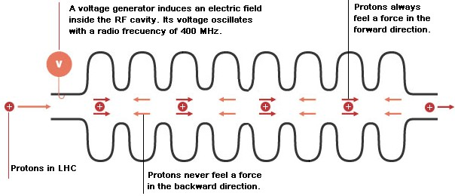
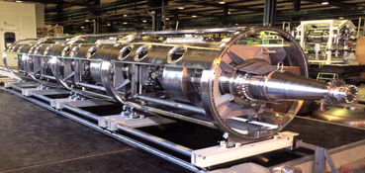
Conventional Acceleration Technology
  (invention of Gustav Ising 1924 and Rolf Wideroe 1927)
LHC cavity
Typical gradients:
  LHC: 5 MV/m
  ILC: 35 MV/m
  CLIC: 100 MV/m
Very successfully used in all accelerators (hospitals, scientific labs,…) in the last 100 years.
E. Gschwendtner, CERN
2

Slide 3
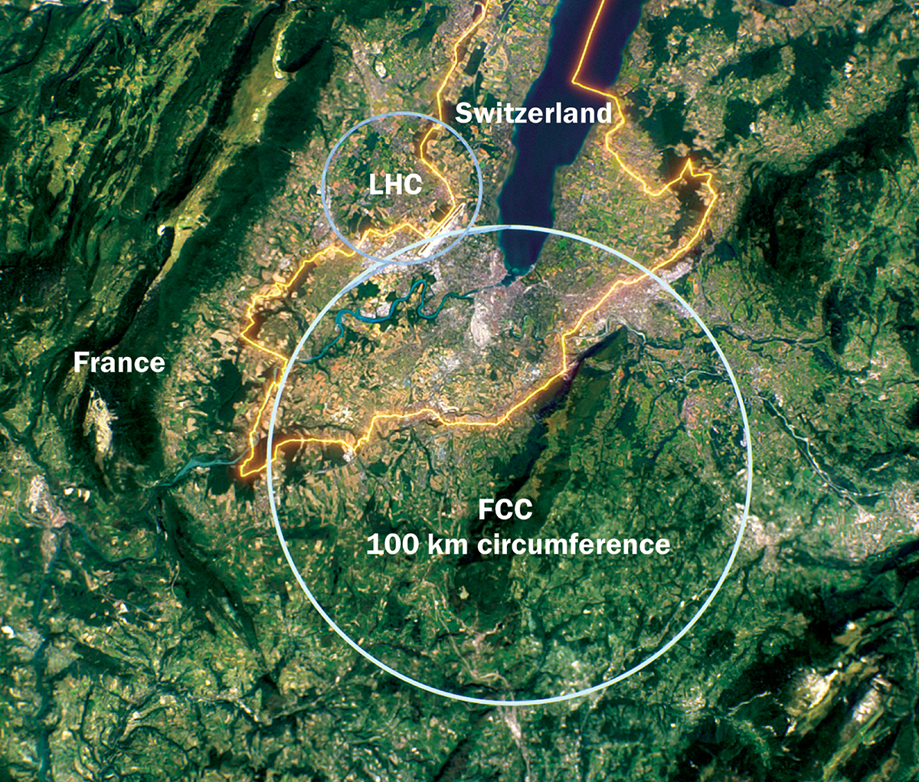

Circular Accelerators
To discover new physics: accelerate particles to even higher energies
Conventional RF cavities ok for circular colliders:
beam passes accelerating section several times.
Limitations of electron-positron circular colliders:
Circular machines are limited by synchrotron radiation in the case of electron-positron colliders.
These machines are unfeasible for collision energies beyond ~350 GeV in case of FCCee.
Notes:
For hadron colliders, the limitation is magnet strength. Ambitious plans like the FCC call for 16 T magnets in a 100 km tunnel to reach 100 TeV proton-proton collision energy.

Slide 4
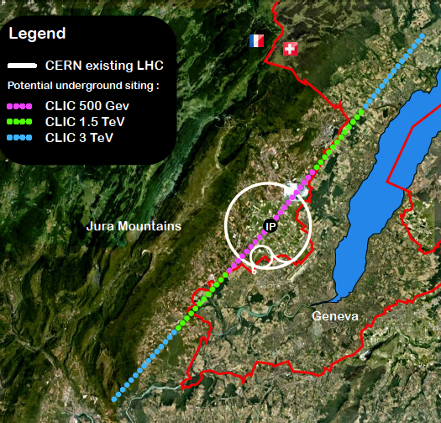
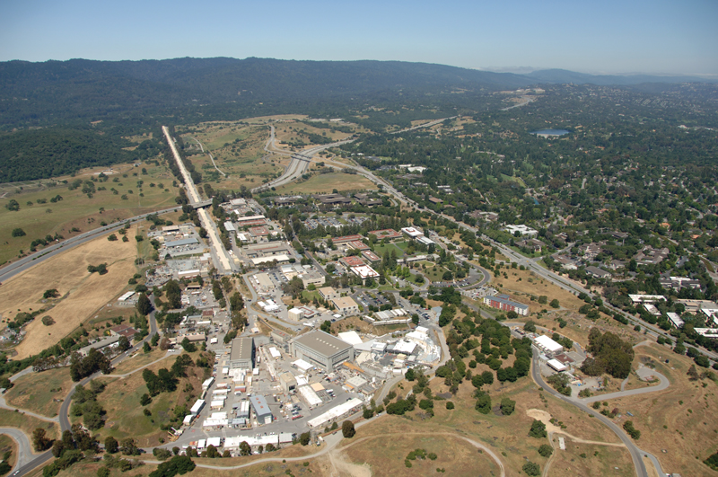
Linear Colliders
Accelerating cavities
→ 48 km
Favorable for acceleration of low mass particles to high energies.
Limitations to linear colliders:
Linear machines accelerate particles in a single pass. The amount of acceleration achieved in a given distance is the accelerating gradient. This number is limited to 100 MV/m for conventional copper cavities.
CLIC, electron-positron collider with 3 TeV energy
Stanford Linear Collider
50 GeV → 3.2 km
Particle energy = accelerating gradient*distance
e.g. accelerate electrons to 1 TeV (10¹² eV):
100 MeV/m x 10000 m or
100 GeV/m x 10 m

Slide 5
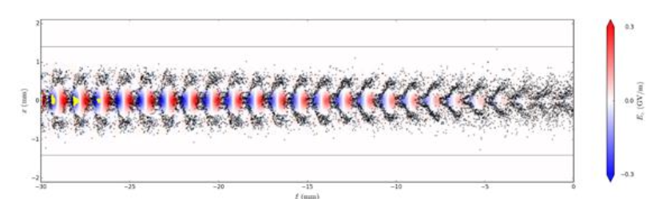
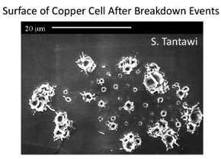
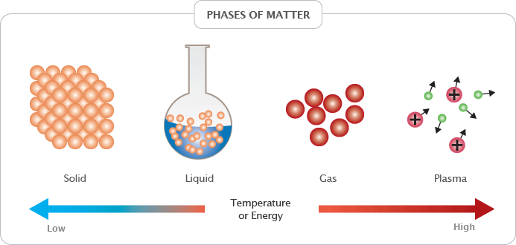
Accelerating Gradient
Conventional RF Cavities
Plasma Acceleration
Accelerating fields are limited to <100 MV/m
In metallic structures, a too high field level leads to break down of surfaces, creating electric discharge.
Fields cannot be sustained; structures might be damaged.
Plasma is already ionized or “broken-down” and can
sustain electric fields up to three orders of magnitude higher gradients
→ order of 100 GV/m.
→ ~1000 factor stronger acceleration!
E. Gschwendtner, CERN
5

Slide 6
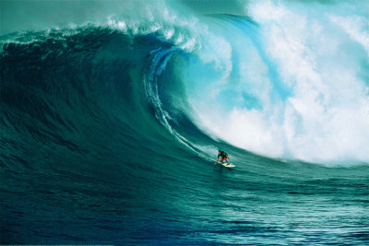
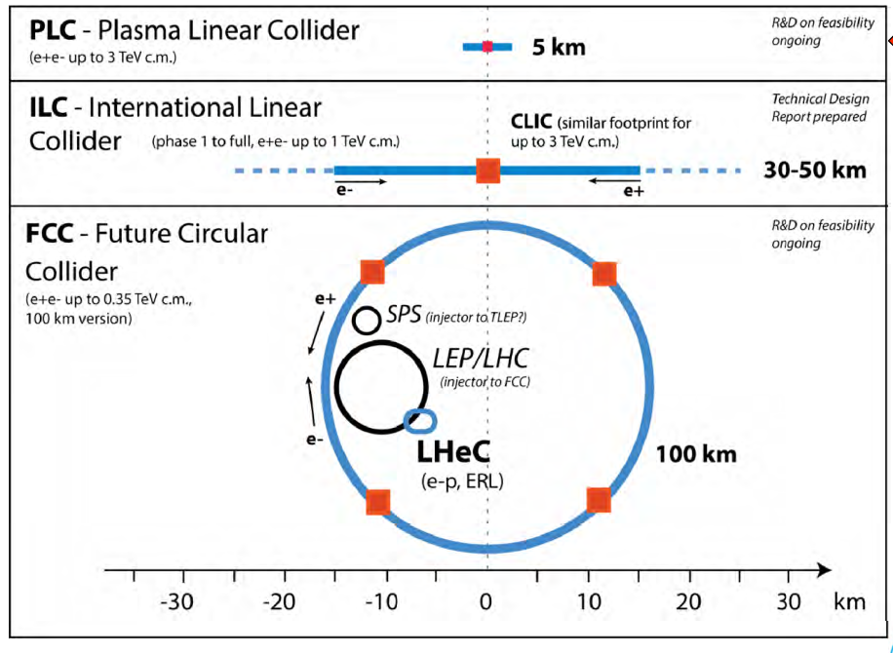
Plasma Wakefield Acceleration
The high gradient of plasma wakefield acceleration makes this technology very interesting for reducing the size (and cost) for future linear colliders.
100 MV/m ➔ 100 GV/m
MC
10 TeV

Slide 7
Plasma Wakefield Acceleration
PLASMA is the 4th state of matter
Quasi-neutrality: the overall charge of a plasma is about zero.
Collective effects: Charged particles must be close enough together
that each particle influences many nearby charged particles.
Electrostatic interactions dominate over collisions or ordinary gas kinetics.
Plasma WAKEFIELDS are the fields created by collective motion of plasma particles are called.
ACCELERATION of charged particles when they experience an electric field.
Strength of the acceleration:
‘Accelerating gradient’ : ~MV/m

Slide 8
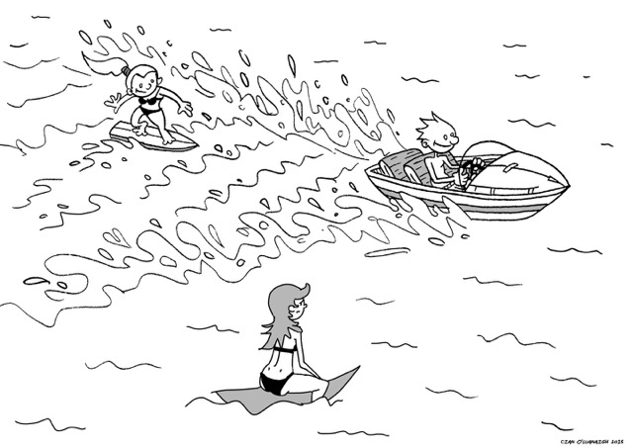
How to Create a Plasma Wakefield?
surfer
boat
Analogy:
lake → plasma
Boat → particle beam (drive beam)
Surfer → accelerated particle beam (witness beam)
lake
E. Gschwendtner, CERN

Slide 9
How to Create a Plasma Wakefield?
What we want:
Longitudinal electric field to accelerate charged particles.
Our Tool:
Boat
Lake
Surfer
e
Rb⁺
e
Rb⁺
Rb⁺
Rb⁺
e
drive-beam
e⁻ acceleration
Rb⁺
e⁻
e
e
e
e
e
Rb⁺
e
Rb⁺
Rb⁺
Rb⁺
e
Rb⁺
Single ionized rubidium plasma
Using plasma to convert the transverse electric field of the
drive bunch into a longitudinal electric field in the plasma.
The more energy is available, the longer (distance-wise) these
plasma wakefields can be driven.
Charged particle bunches or laser beam carry almost purely transverse Electric Fields.

Slide 10
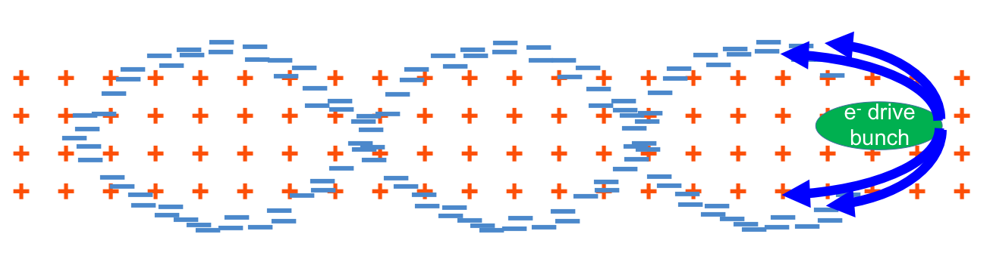
Principle of Plasma Wakefield Acceleration
Drive beam (boat):
Laser drive beam
Charged particle drive beam
Plasma wave/wake excited by relativistic particle bunch
Plasma e⁻ are expelled by space charge force
Plasma e⁻ rush back on axis
Ultra-relativistic driver – ultra-relativistic wake → no dephasing
Acceleration physics identical for LWFA, PWFA
plasma wavelength λ_{pe} = mm-scale

Slide 11
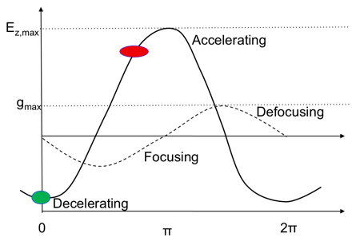
Where to Place the Witness Beam (Surfer)?
Accelerating for e⁻
Decelerating for e⁻
e⁻
Focusing for e⁻
Defocusing for e⁻
Longitudinal and transverse wakefields are π/2 out of phase.
➔ Only ¼ of the electron oscillation length is focusing and accelerating for charged particles!

Slide 12


Slide 13
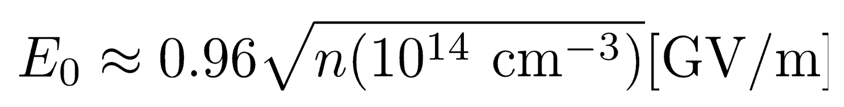

Plasma Wakefield, Density Scaling
Drive bunch traveling inside a plasma perturbs the plasma electron distribution.
→ oscillation with $ω_{pe}=\sqrt{\frac{n_{pe}e^{2}}{m_{e}ε_{0}}}$
λ_{pe}
c
=
2π
ω_{pe}
The plasma oscillation leads to a longitudinal accelerating field:
The maximum accelerating field (wave-breaking field) is:
Example: n_{pe} = 1x10¹⁸ cm⁻³ ➔ E_{WB} = ~100 GV/m ➔ λ_{pe} = ~30 µm
Example: n_{pe} = 7x10¹⁴ cm⁻³ (AWAKE) ➔ E_{WB} = 2.5 GV/m ➔ λ_{pe} = 1.2 mm
Maximum accelerating gradient increases with increasing plasma density.
Plasma electron wavelength decreases with increasing plasma density.

Slide 14
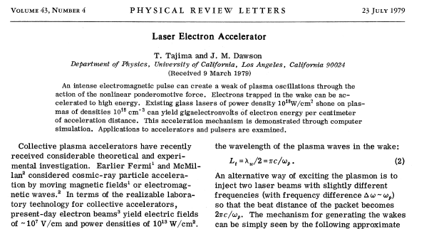
Seminal Paper 1979, T. Tajima, J. Dawson
Use a plasma to convert the transverse space charge force of a beam driver into a longitudinal electrical field in the plasma

Slide 15
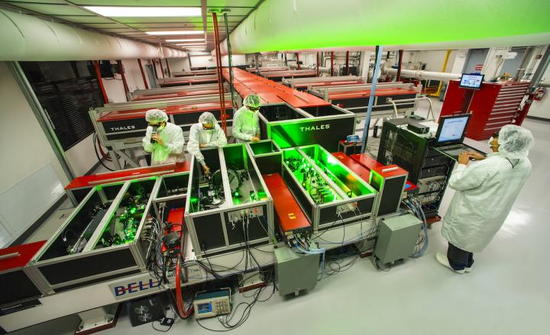
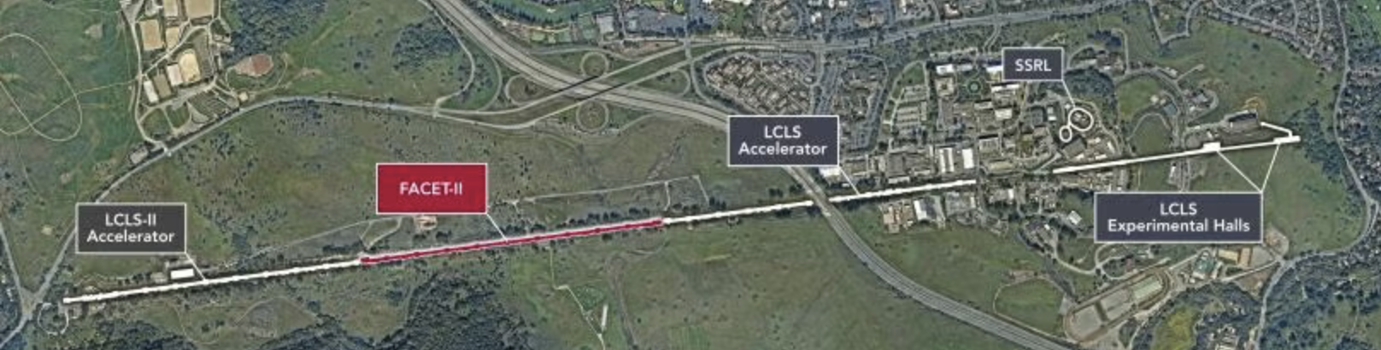
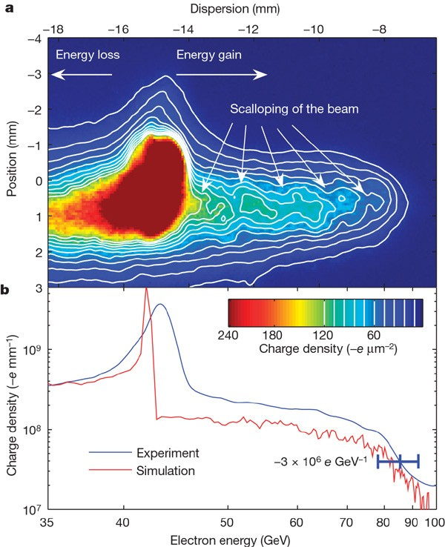
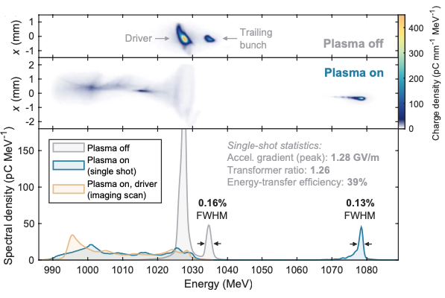
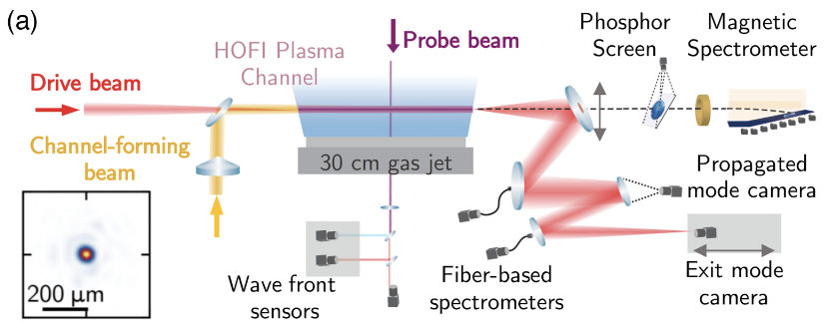
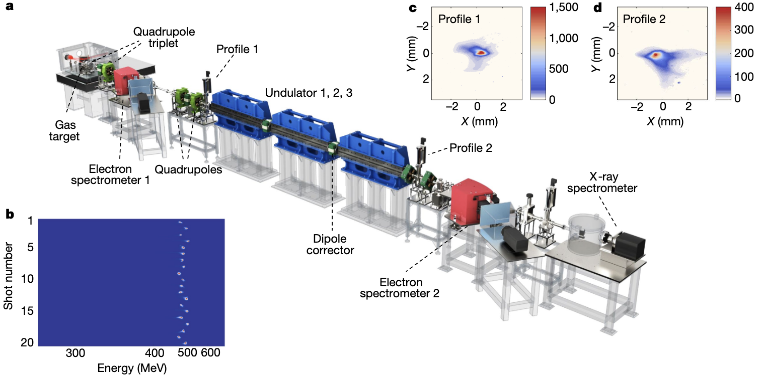
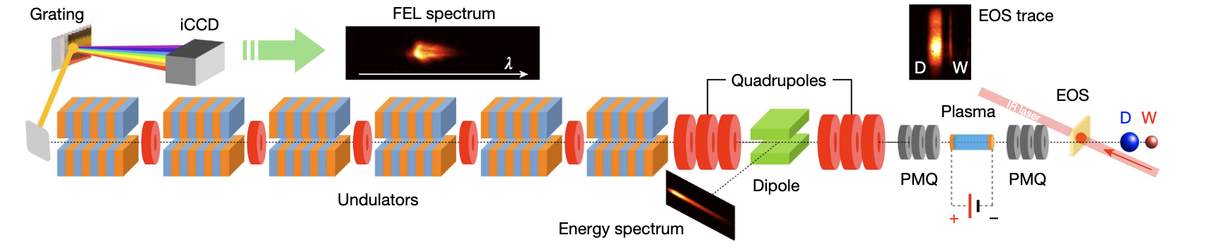
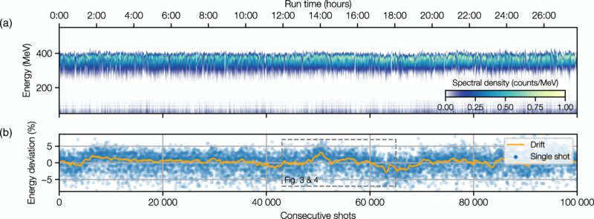
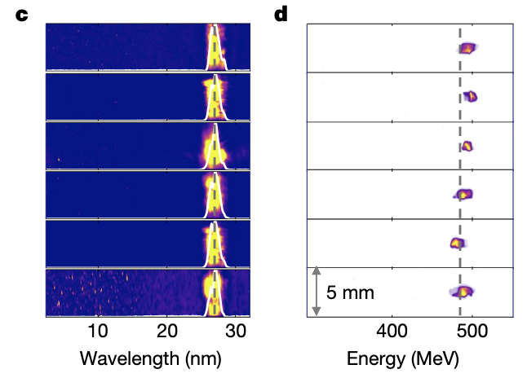
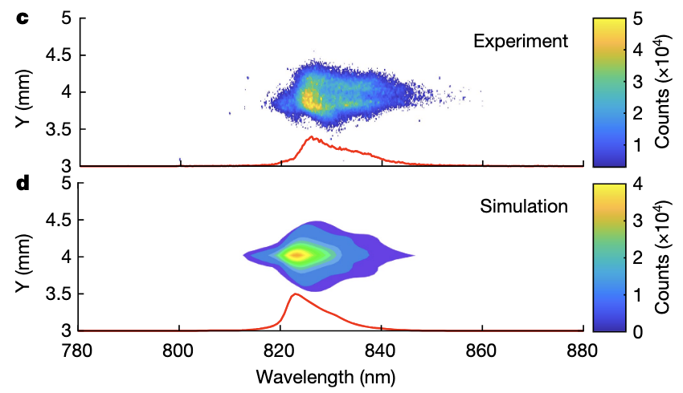
State-of-the-Art
Transfer efficiency 42+/-4% with 0.2% energy spread, up to 70% with energy spread increase
9.2 GeV in 30 cm → 30.7 GeV/m
42 GeV in 85 cm → 52 GeV/m
Laser Driven
FACET, SLAC, USA
FLASHForward, DESY
BELLA, Berkeley Lab, USA
Electron Driven
Electron Driven
I. Blumenfeld et al, Nature 455, p 741 (2007)
A. Picksley et al., PRL 133, 255001 (2024)
C.A. Lindstrøm et al., Phys.Rev.Lett. 126, 014801 (2021)
Stable 24hr operation
Laser Driven based FEL: First demonstration
Electron Driven based FEL: First demonstration
LUX laser plasma accelerator, DESY
500 MeV electrons from LWFA
Sparc-Lab
Laser Driven
China
94 MeV electrons from PWFA
FEL lasing at 830 nm
FEL lasing amplification of 100 reached at 27nm wavelength
R. Pompili et al., Nature 605, 659-662 (2022)
Since then two more groups: Soleil/HZDresden, Berkeley
A. Maier et al., Phys. Rev. X 10, 031039 (2020)
W.T. Wang, K. Feng, et al., Nature, 595, 561 (2021)
Notes:
FLASHForward: ≲ 1.25 GeV energy with a few 100 pC at ~100 fs rms bunch duration, up to 1MHz repetition rate, few kW average power
63ns

Slide 16
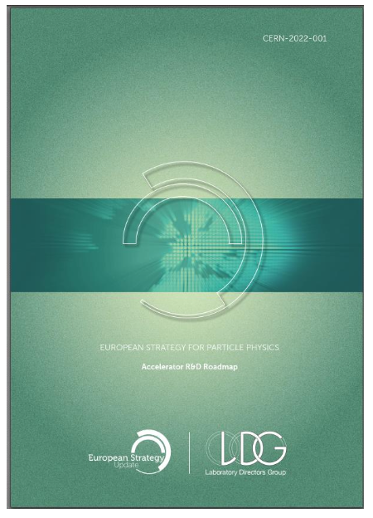

State of the Art and Goals for HEP Collider
ESPP 2020:
Plasma R&D Roadmap
R&D Efforts
US Snowmass and P5
➔ Requires international, multi-dimensional R&D efforts.

Slide 17
Towards Higher Energies – Electron/Laser Drivers
Witness beams (Surfers):
Electrons: 10¹⁰ particles @ 1 TeV ~few kJ
Drive beams (Boat):
Lasers: ~40 J/pulse
Electron drive beam: 30 J/bunch
To reach TeV scale:
Electron/laser driven PWA: need several stages, and challenging wrt to relative timing, tolerances, matching, etc…
  effective gradient reduced because of long sections between accelerating elements….
Plasma cell
Plasma cell
Plasma cell
Plasma cell
Plasma cell
Plasma cell
Witness beam
Drive beam: electron/laser

Slide 18
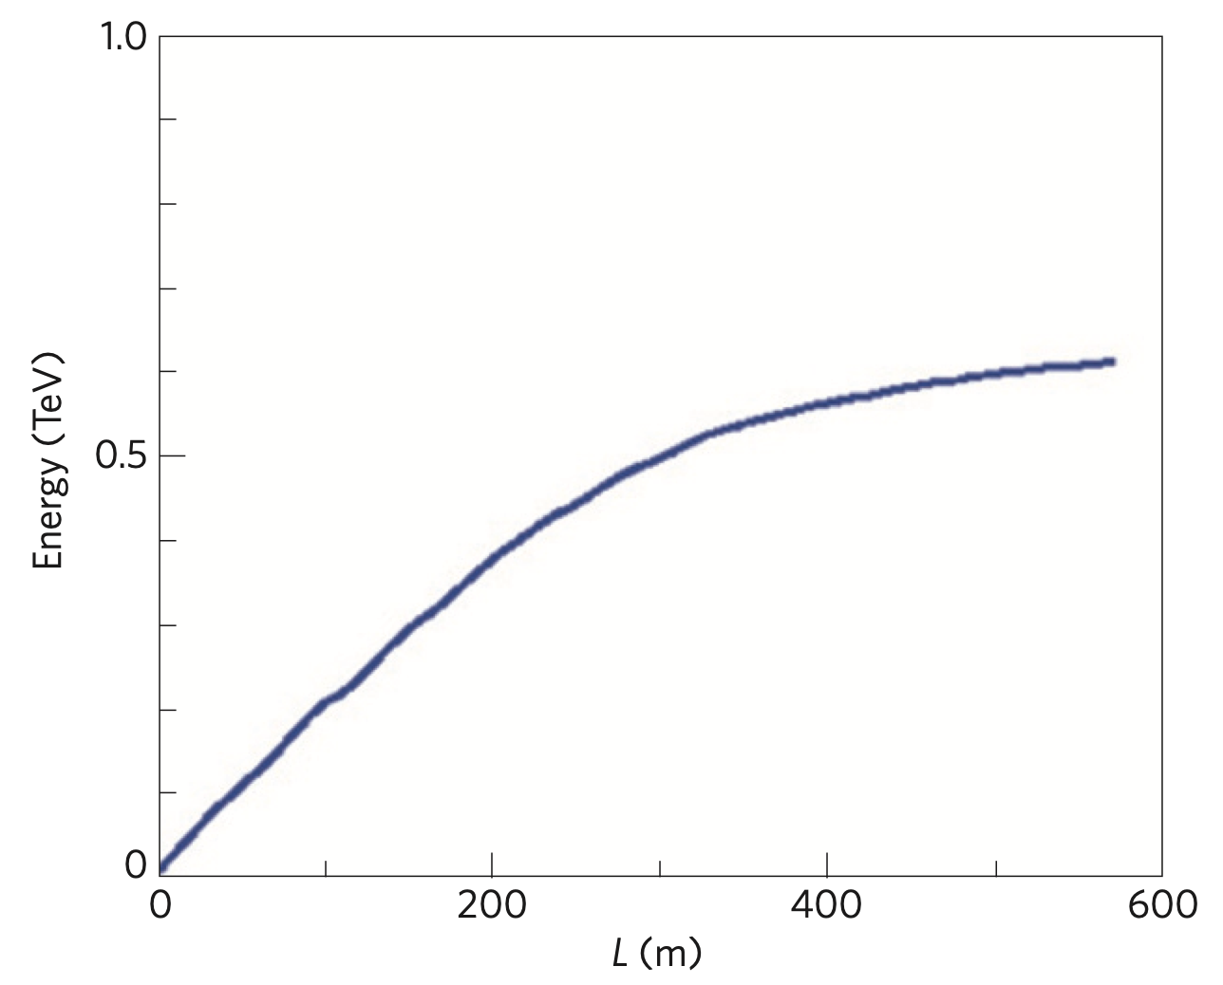
Towards Higher Energy – Proton Drivers
Witness beams (Surfers):
Electrons: 10¹⁰ particles @ 1 TeV ~few kJ
Drive beams (Boat):
Lasers: ~40 J/pulse
Electron drive beam: 30 J/bunch
Proton drive beam: SPS 19kJ/pulse, LHC 300kJ/bunch
To reach TeV scale:
Proton drivers: large energy content in proton bunches → allows to consider single stage acceleration:
  A single SPS/LHC bunch could produce an ILC bunch in a single PDWA stage.
Plasma cell
Witness beam
Drive beam: protons
Witness bunch energy along plasma.
With existing proton beams the energy frontier with electrons can be reached!
SPS p⁺ (450 GeV): accelerate to 200 GeV electrons.
LHC p⁺ can yield to 3 TeV electrons.
1 TeV proton driver
A. Caldwell et al., Nature Phys. 5, 363–367 (2009)

Slide 19
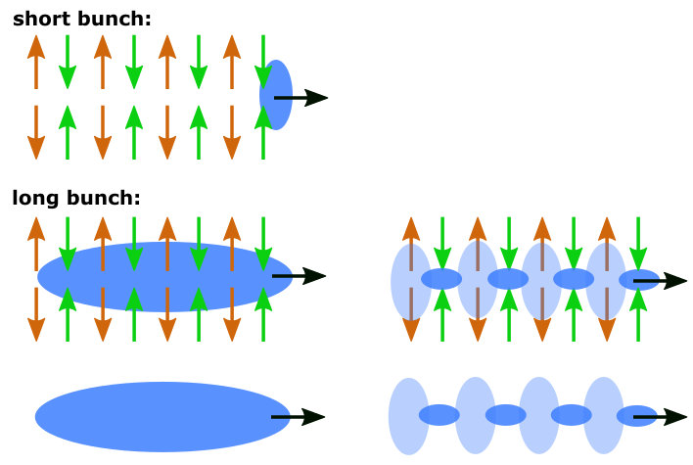
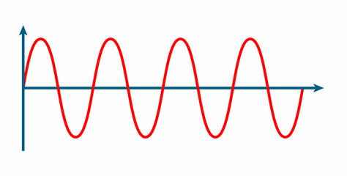
Proton Bunch as a Drive Beam
  In order to create high wakefield amplitudes, the drive bunch length must be in the order of the plasma wavelength.
  CERN SPS proton bunch: very long! (σ_{z} = 6 - 10 cm) → much longer than plasma wavelength (λ = 1mm)
  → Would create only small wakefield amplitudes.

Slide 20


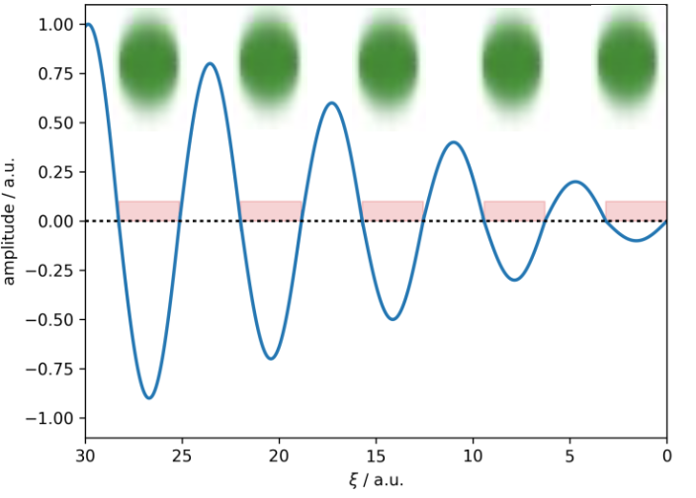
Self-Modulation of the Proton Bunch
Self-Modulation Instability:
p⁺ bunch
Density modulation on-axis → micro-bunches.
  Micro-bunches separated by λ_{pe}.
  Resonant wakefield excitation
  Large wakefield amplitudes
Initial transverse wakefields
Periodic focusing/defocusing fields
Radial bunch and plasma density modulation
Stronger wakefields
Full modulation
➔ Immediate use of SPS proton bunch for driving strong wakefields!

Slide 21
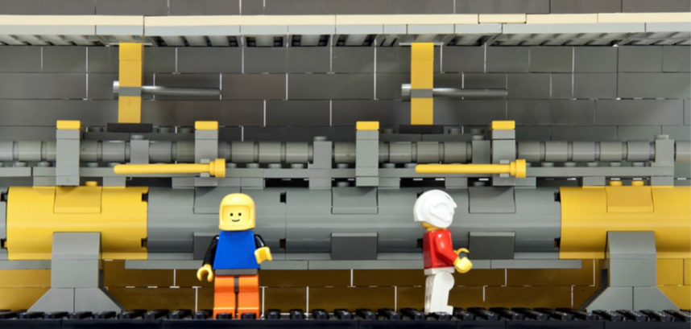
The AWAKE Experiment

Slide 22




















AWAKE is an International Collaboration
Strong commitment from 19 institutes

Slide 23

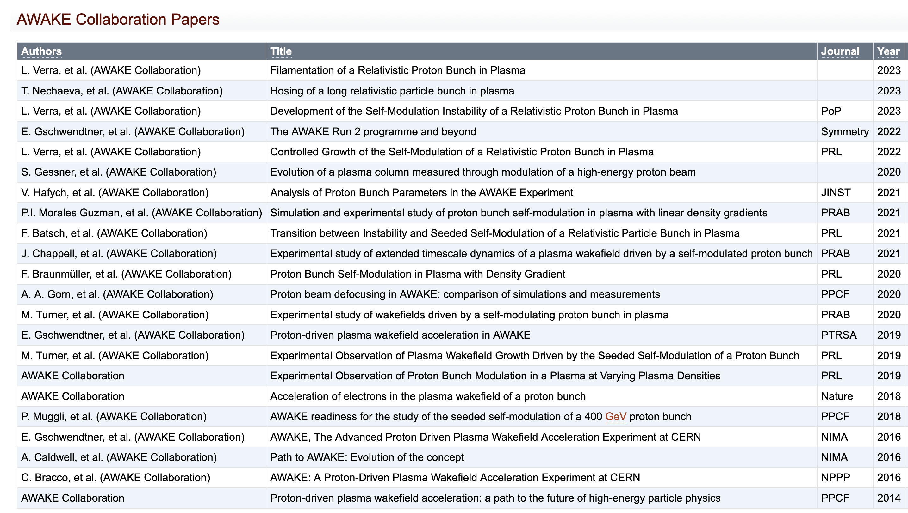



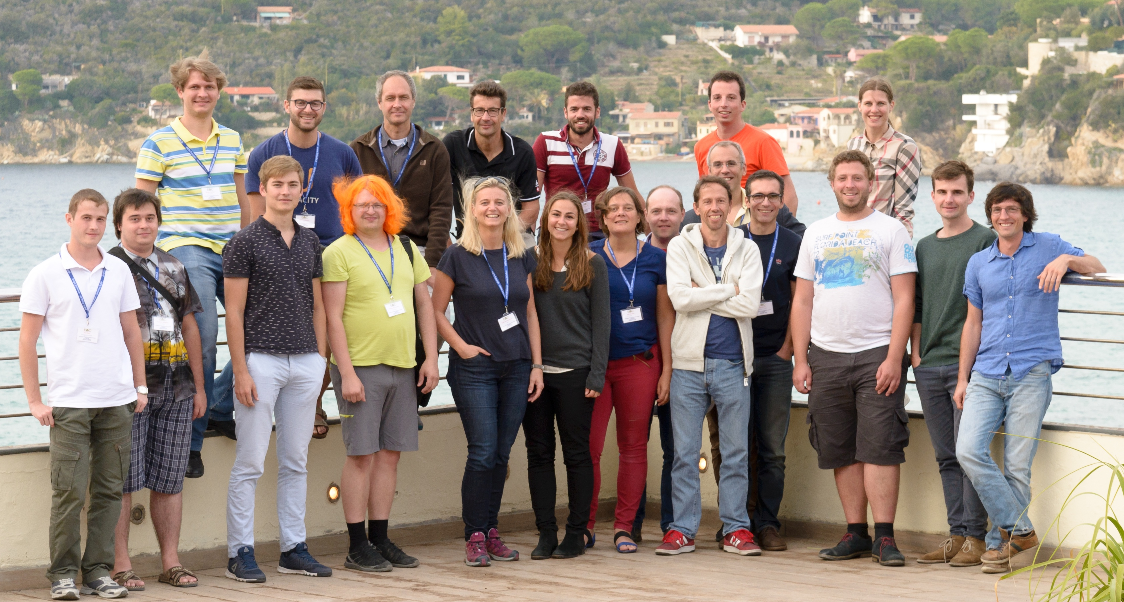
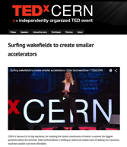
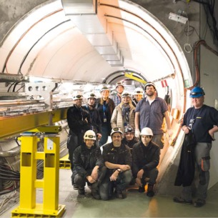


AWAKE’s Strong Scientific and Educational Output
23 AWAKE Collaboration papers in high-level journals
AWAKE courses and seminars
> 70 papers related to AWAKE
> 90 Conference proceedings and papers
CERN Teacher Program
USPAS, JUAS, CAS
➔ 5 doctoral thesis prizes, 2 early career awards!
Outreach: Newspapers, TEDX, …
> 28 PhD students
> 11 Master students
> 20 Post-docs

Slide 24
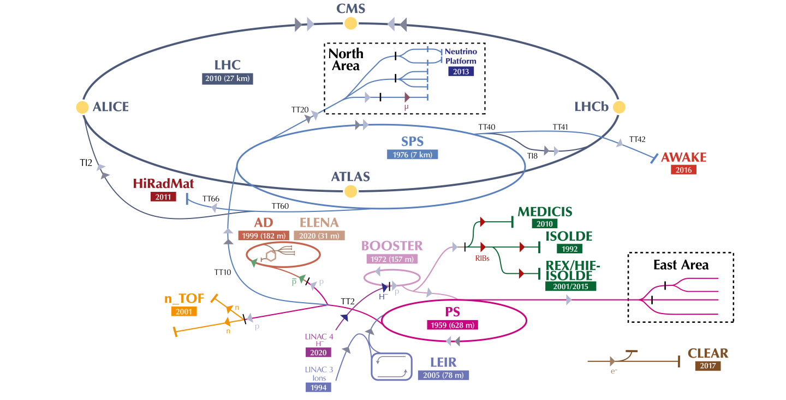
AWAKE at CERN
Advanced WAKEfield Experiment
Accelerator R&D experiment.
Unique facility driving wakefields in plasma with 400 GeV proton bunch from the SPS.
Accelerating externally injected electrons to GeV scale.
The only proton driven plasma wakefield acceleration experiment worldwide.
High energy gain possible because the high-energy driver is available today.
E. Gschwendtner, CERN

Slide 25
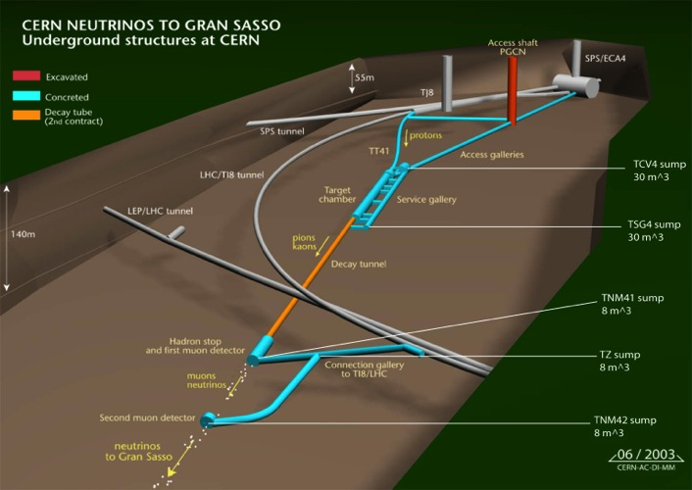
AWAKE at CERN
AWAKE
~50m
Control
room
protons
SPS
~1000m
AWAKE experiment
LHC
~1100m
beam dump
AWAKE installed in CERN underground area

Slide 26

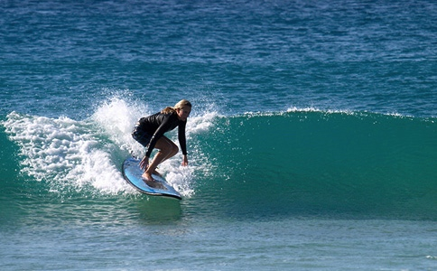
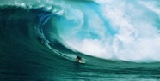

AWAKE has a Well-Defined Program
RUN 1 (2016-2018)
p+ self-modulation
2 GeV e- acceleration
RUN 2 (2021-2033)
e- acceleration to several GeV,
beam quality control, scalability
First applications >2034
➔ Move from proof-of-concept towards an accelerator

Slide 27
AWAKE Experiment until Today
RUN 1 (2016-2018)
p+ self-modulation
2 GeV e- acceleration
RUN 2 (2021-2033)
e- acceleration to several GeV,
beam quality control, scalability

Slide 28
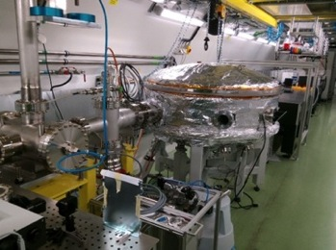
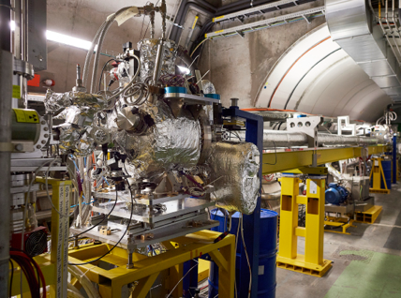
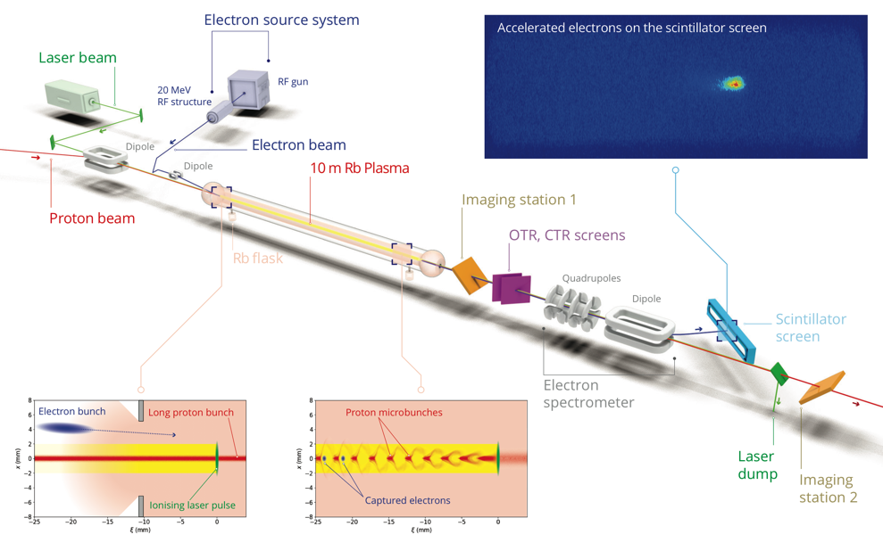
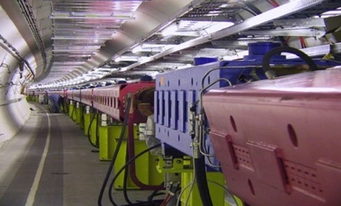
AWAKE Experiment and Results
Ti: Sapphire Laser
10m Plasma source in AWAKE tunnel
Ti:Sapphire
500mJ
120 fs
Rubidium vapour
Density: 10¹⁴ – 10¹⁵ cm⁻³
Density uniformity < 0.2%
750m proton beam line
400 GeV
3x10¹¹ p
400ps

Slide 29
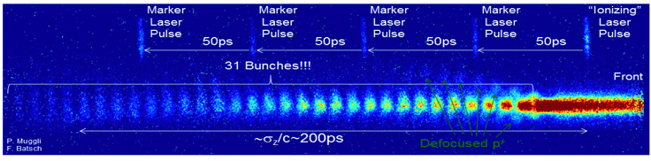

AWAKE Experiment and Results
Ti: Sapphire Laser
10m Plasma source in AWAKE tunnel
Ti:Sapphire
500mJ
120 fs
750m proton beam line
#1: Demonstration of Seeded Self-Modulation of the Proton bunch
400 GeV
3x10¹¹ p
400ps
400 GeV
3x10¹¹ p
400ps
AWAKE Collaboration, Phys. Rev. Lett. 122, 054802 (2019).
M. Turner et al. (AWAKE Collaboration), Phys. Rev. Lett. 122, 054801 (2019).
M. Turner, P. Muggli et al. (AWAKE Collaboration), Phys. Rev. Accel. Beams 23, 081302 (2020)
F. Braunmueller, T. Nechaeva et al. (AWAKE Collaboration), Phys. Rev. Lett. July 30 (2020).
A.A. Gorn, M. Turner et al. (AWAKE Collaboration), Plasma Phys. Control Fusion, Vol. 62, Nr 12 (2020).
F. Batsch, P. Muggli et al. (AWAKE Collaboration), accepted in Phys. Rev. Lett. (2021)

Slide 30
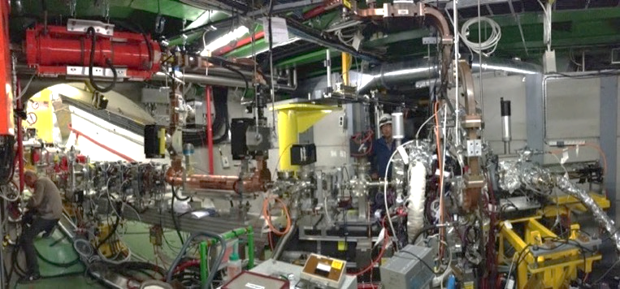
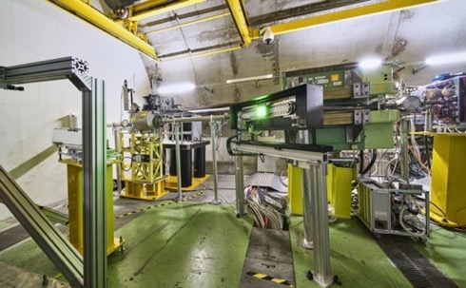
AWAKE Experiment and Results
Laser line
Transfer line
Diagnostics and booster structure
Electron source
20 MeV electron line
Diagnostics

Slide 31
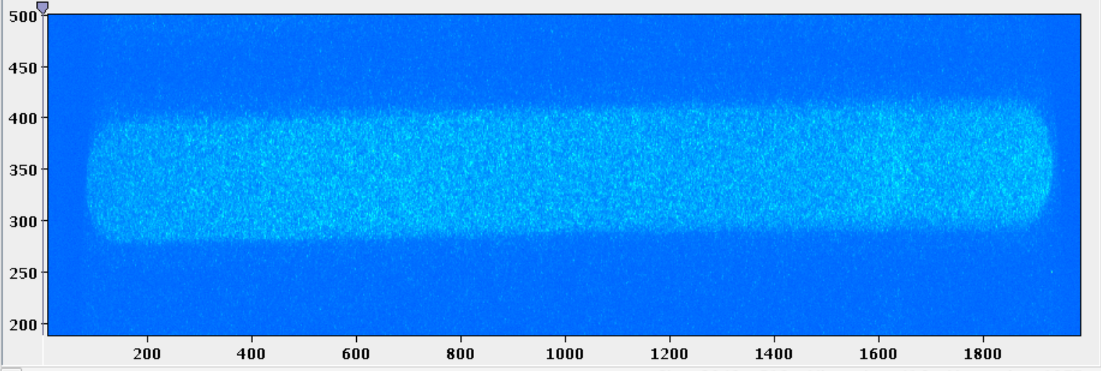
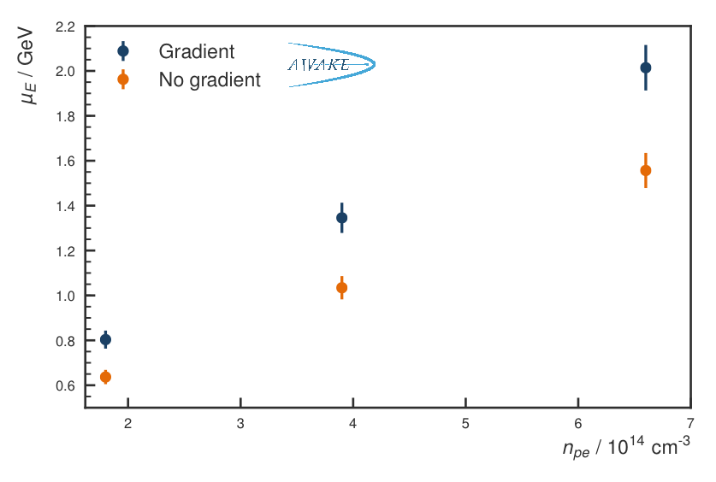
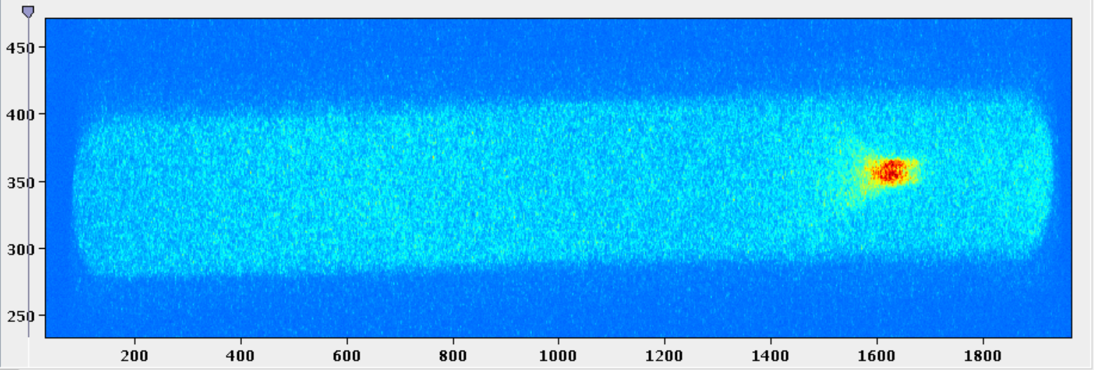
Results: Electron Acceleration
#2: Demonstration of Electron Acceleration in Plasma Wakefield
Acceleration up to 2 GeV has been achieved.
Charge capture up to 20%.
No accelerated electrons
Accelerated electrons
AWAKE Collaboration, Nature 561, 363–367 (2018)
Convert pixel-size and dipole setting to energy
E. Gschwendtner, CERN

Slide 32
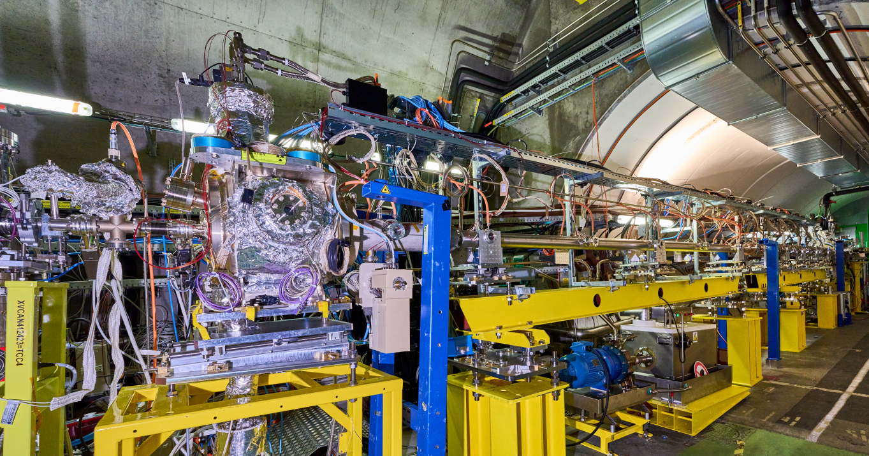

Run Results – Stabilizing Large Wakefield Amplitudes
New Rubidium vapour source with density step installed in 2023
Introducing a density step in the plasma cell
stabilization of the micro-bunches
Increased wakefield amplitudes after SSM saturation
K. V. Lotov, Physics of Plasmas 22, 103110 (2015)
K. V. Lotov and P. V. Tuev 2021 PPFC 63 125027
Length: ~ 10 m, independent electrical heater of 50 cm from 0.25 to 4.75 m, Step height up to ±10%
10 diagnostic viewport ➔ to measure light emitted by wakefields dissipating after the passage of the proton bunch

Slide 33
Run 2b - Stabilizing Large Wakefield Amplitudes
Accelerated electrons
Effect of density step in the plasma source
AWAKE Collaboration
Optimizing the proton bunch self-modulation

Slide 34






Other Scientific Results
Seeding with relativ. ionization front
Wakefield growth due to SM
Seeding with electron bunch
L. Verra et al. (AWAKE Collaboration), Phys. Rev. Lett. 129, 024802 (2022)
F. Batsch, P. Muggli et al. (AWAKE Collaboration), Phys. Rev. Lett. 126, 164802 (2021).
M. Turner et al. (AWAKE Collaboration), ‘Phys. Rev. Lett. 122, 054801 (2019).
All milestones achieved – plus additional ones.
  Relevant studies for general plasma wakefield acceleration concepts.
AWAKE
collaboration
Ion motion, Sim/Meas
Filamentation instability
Beam-hose instability
preliminary
L. Verra, et al. (AWAKE Collaboration), Phys. Rev. E 109, 055203 (2024).
T. Nechaeva, et al. (AWAKE Collaboration), Phys. Rev. Lett. 132, 075001 (2024).
M. Turner, CERN, AWAKE Collaboration

Slide 35
AWAKE: What’s Next?
RUN 2 (2021-2033)
e- acceleration to several GeV,
beam quality control, scalability

Slide 36

AWAKE Run 2 – Electron Beam Quality
Demonstrate electron acceleration and emittance control of externally injected electrons.
Start in 2029
New electron beam: 150 MeV, 200 fs, 100 pC, σ = 5.75 µm
bunch length shorter than plasma wavelength
On-axis injection, Blow-out regime, Beam loading: reach small ∂E/E, Match electron beam transverse properties to the plasma
Self-modulator plasma
on-axis e-beam injection
Accelerator plasma
Expected accelerated electron beam parameters:
Normalized emittance: (2-30) mm mrad
Q_{e} = 100 pC
dE/E: 5-8 %
Run 2c: E ~ 4-10 GeV in 10 m
E. Gschwendtner, CERN
Notes:
beam size at injection of 5.75 µm (for an emittance of 2 µm and beta of 4.8 mm)

Slide 37




Preparing for AWAKE Run 2 during LS3
CERN Neutrino Gran Sasso area content (~600m³):
~500 large shielding blocks (0,05-0,6 mSv/h)
A few high dose-rate elements (50mSv/h)
70-meter-long aluminum He-tank
Various supports, ducts…

Slide 38
AWAKE Run 2: New Layout, New Components
➔ Installation during LS3
Laser system

Slide 39
AWAKE Run 2: New Layout, New Components
➔ Physic Run starts in 2029 after LS3
Laser system

Slide 40
AWAKE Run 2 – Demonstrate Scalability
Development of scalable plasma sources to 100s meters length with sub-% level plasma density uniformity
Expected accelerated electron beam parameters:
Normalized emittance: (2-30) mm mrad
Q_{e} = 100 pC
dE/E: 5-8 %
Run 2c: E ~ 4-10 GeV in 10 m
Run 2d: E > 10 GeV in 10+ m
1m Helicon Plasma Source
Self-modulator plasma
Accelerator plasma
Scalable plasma source
10m Discharge Plasma Source → prototype successfully tested in 2023
E. Gschwendtner, CERN

Slide 41
Once AWAKE Run 2 is Demonstrated
First applications >2034

Slide 42

First Applications of AWAKE Technology
Requirements on emittance are moderate for first applications.
    First applications to high energy physics for 50 GeV beam:
      Beam-dump experiments to e.g. search for dark photons.
      Use for collider, e.g. ep collider, which would be like a low-luminosity LHeC.
      Interaction with high-power laser to investigate strong-field QED.
        Can investigate new region with high energy.
        Currently no competitors.
        Only modest laser needed.
        Increasing laser power ➔ probe more phase space.
Experimental conditions modeled on NA64 experiment.

Slide 43





Collider Concepts Based on Plasma Wakefield
e+ e- collider, 1 TeV c.o.m., laser driven
e+e- collider, e+ 31GeV (conventional), e- 500 GeV (electron driven)
HALHF
B. Foster, R. D’Arcy, C. Lindstrom, 2023, New J.Phys. 25 093037
250 GeV c.o.m.
C.B.Schroeder et al., 2023, JINST 18 T06001, arXiv:2203.08366
➔ international, multi-dimensional R&D efforts
e+e- collider, 1 TeV c.o.m., electron driven
e+ e- collider, 250 GeV c.o.m.
proton driven
Fixed target dark matter experiment.
50 GeV electrons, proton-driven
E. Gschwendtner et al. (AWAKE Collaboration), Symmetry 2022,14,1680
E. Adli et al., 2013, arXiv:1308.1145
J. Farmer, A. Caldwell, A. Pukhov, 2024, arXiv:2401.14765

Slide 44
Summary
Plasma wakefield acceleration have demonstrated significant achievements and an enormous potential. Reaching higher energies (>10 GeV) with plasma wakefield acceleration require either plasma staging when using laser/electron drive beams, or using a proton driver in a single plasma source such as in AWAKE.
The AWAKE Run 2 experiment exploits the unique possibilities of the CERN injector complex, adds to the diversity of the CERN experiments and addresses key challenges relevant for plasma-based accelerator community.
The community has moved from proof-of-concept towards designing accelerators for applications and colliders. Coordinated R&D programs take shape within the Particle Physics planning exercises. Technology R&D is crucial to advance the programs.

