Slide 1
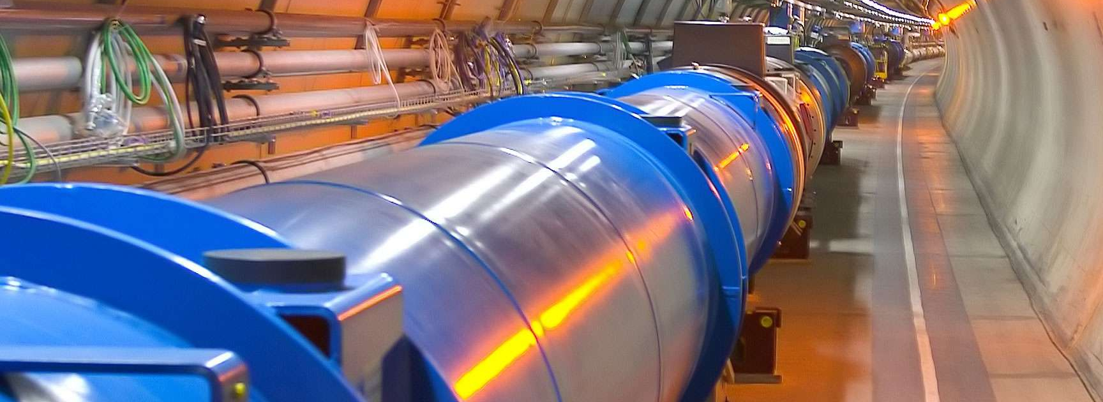

Collective effects in particle accelerators
Dr. Xavier Buffat
Beams Department – Accelerator and Beam Physics
Collective Effects and Impedances
CERN, Switzerland, Geneva
CERN Accelerator School – 13th March 2025

Slide 2

Copyright statement and speaker’s release for video publishing
The author consents to the photographic, audio and video recording of this lecture at the CERN Accelerator School. The term “lecture” includes any material incorporated therein including but not limited to text, images and references.
The author hereby grants CERN a royalty-free license to use his image and name as well as the recordings mentioned above, in order to post them on the CAS website.
The material is used for the sole purpose of illustration for teaching or scientific research. The author hereby confirms that to his best knowledge the content of the lecture does not infringe the copyright, intellectual property or privacy rights of any third party. The author has cited and credited any third-party contribution in accordance with applicable professional standards and legislation in matters of attribution.

Slide 3

Collective forces
Dome of the Swiss Federal Palace
One for all: The motion of each individual particles define the collective force
All for one: The collective force affects the motion of each individual particle
[Wiki]
The collective forces can affects beams in several ways
→ They usually limit the quality of the beams that can be achieved with a given machine, such that understanding and control of collective effects directly relates to performance reach
→ In some cases the collective force is used to achieve a given purpose

Slide 4
Content
Collective instabilities
  Study case: Electromagnetic wake fields and the head-tail instability
  Damping mechanisms
Non-linear collective effects
  Poincaré section, resonances and chaos
  Beam-beam and space-charge effects
Scattering effects
Summary

Slide 5

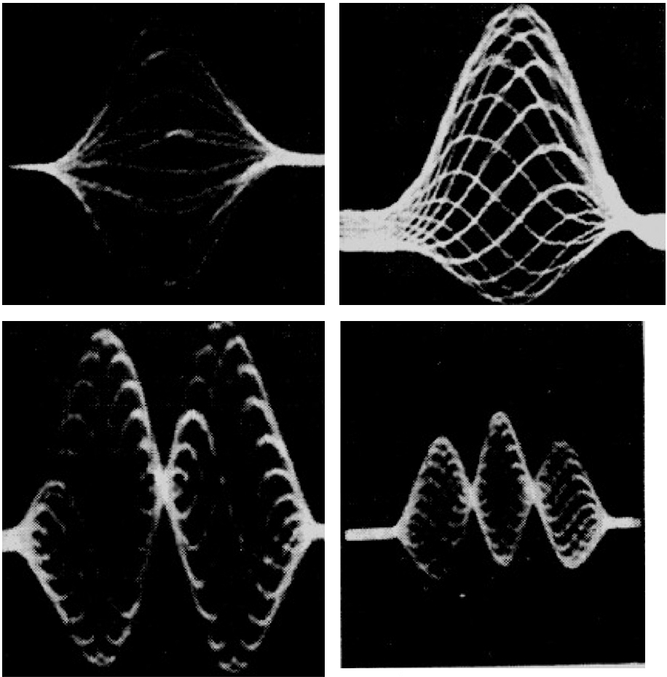
Real life instability vs beam instabilities
[HT]
Transverse position
Longitudinal position
At high speed, the motorbike holds a lot of energy flowing in a given direction
If a mechanism allows for even a small transfer of this energy to a mode of oscillation of the bike, the pilot has no chance to contain the oscillation
→ instability
Particle beams also holds a lot of energy flowing in a given direction
Several mechanism can transfer the longitudinal energy into modes of oscillation
Beams have much more modes of oscillation than bikes...

Slide 6

Wake fields on Lake Neuchatel
Witness
Source

Slide 7
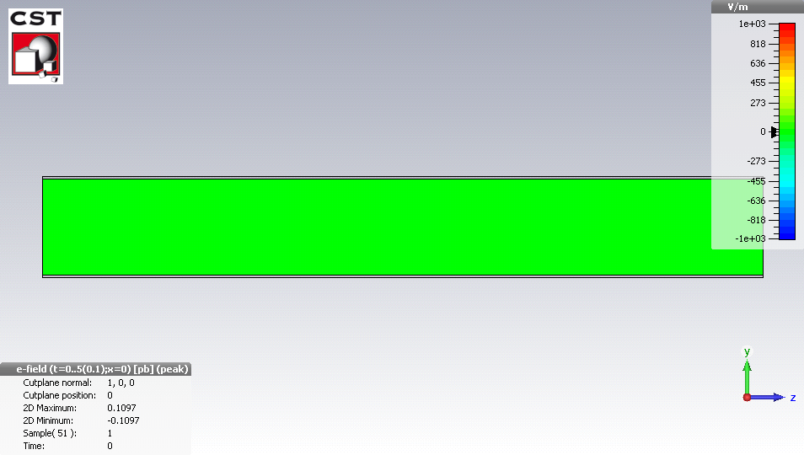
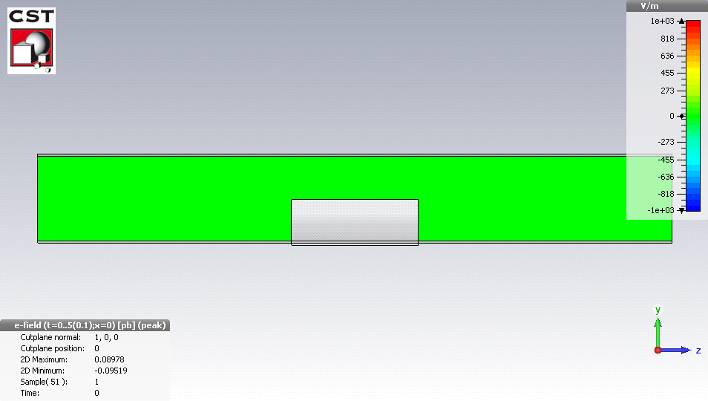
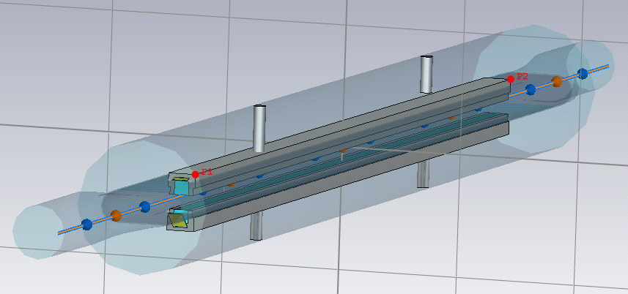
Wake fields in particle beams
[Wake]
Just like a boat travelling on a lake, a charge particle travelling through space generates a wake, in the form of an electromagnetic field rather than a wave on water
→ For particles travelling close to the speed of light, the wake affects only particles behind the source
Structures in/around the beam pipe can generate complex behaviour (electromagnetic waves, trapped modes, …)
LHC collimator model

Slide 8

Wake fields: A naive but effective approach
Image charges are attracted by the beam at the surface of surrounding elements
  These charges interact with the material, which depends on its property (resistivity, capacity, shape, smoothness, … )

Slide 9
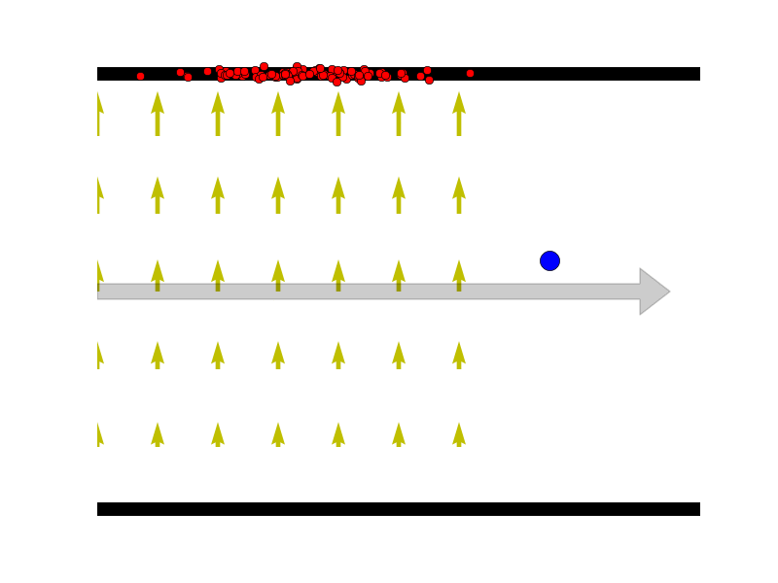
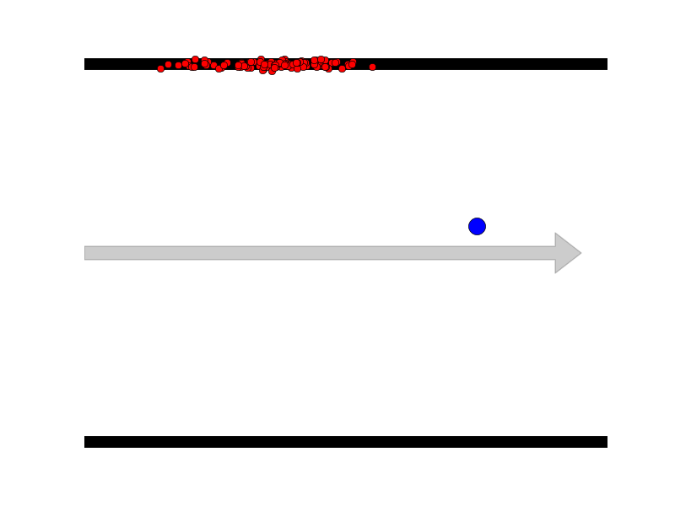
Wake fields: A naïve but effective approach
If the beam oscillates, the density of the image charges vary on both sides with its oscillation
  → The fields generated behind the source particle also varies, with the natural frequency of the source particle!

Slide 10
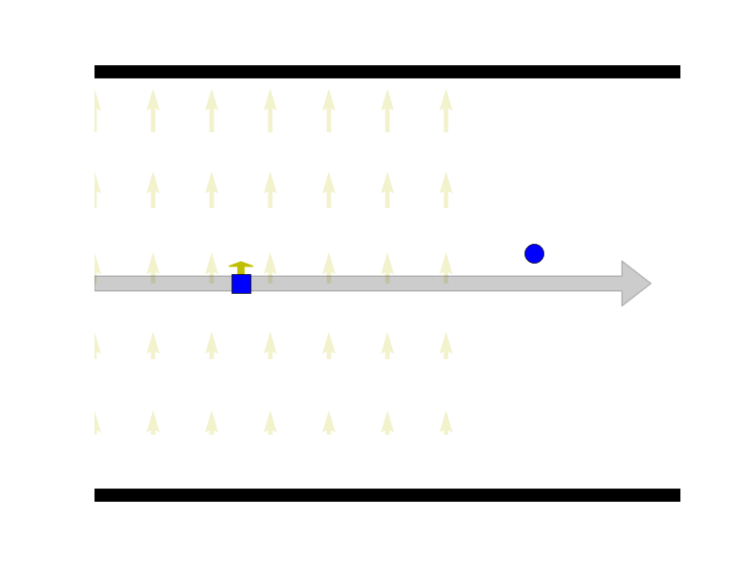
Beam breakup
In a LINAC (or a machine featuring slow synchrotron motion), the particles do not oscillate longitudinally
→ A trailing particle feels the oscillating field
→ Since its natural frequency is the same as the one of the source particle, it is driven to higher and higher amplitude

Slide 11
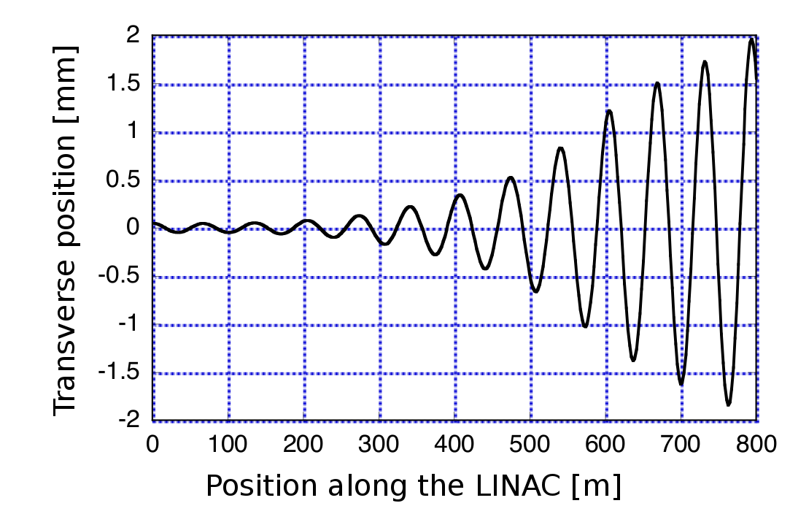
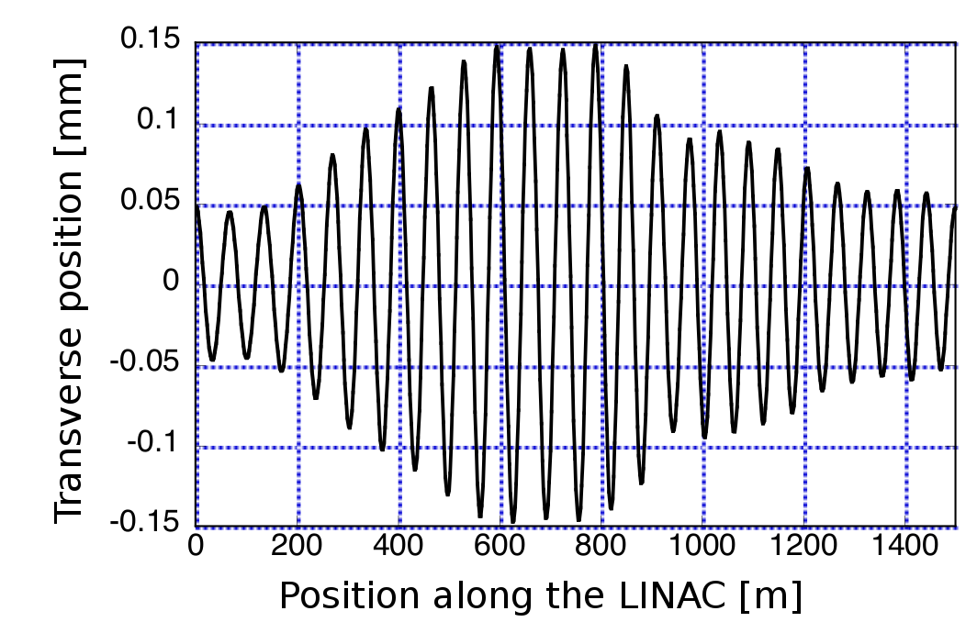
Beam breakup
[BBU]
~const.
x10
x10
An initial perturbation is amplified through the LINAC
Mitigations involve:
  Minimising wake fields (i.e. electromagnetic design of the elements in the beam line)
  Minimising misalignments
  Minimising initial perturbations (injection steering)
  Introducing a spread in frequency with non-linear fields (BNS damping)

Slide 12
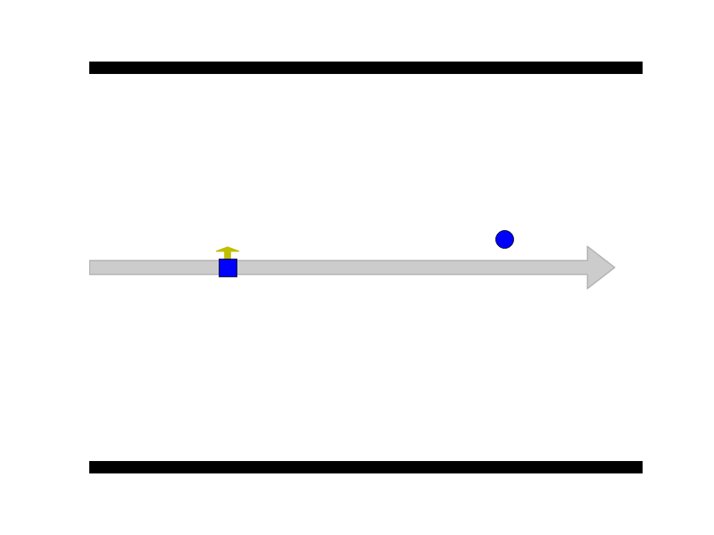
The head-tail instability
Considering longitudinal oscillation:
  When the square particle is trailing, it is driven by the round particle's wake field, and vice-versa when it overtakes the round particle
  The amplitude of the two particles is self-amplified → Collective instability

Slide 13
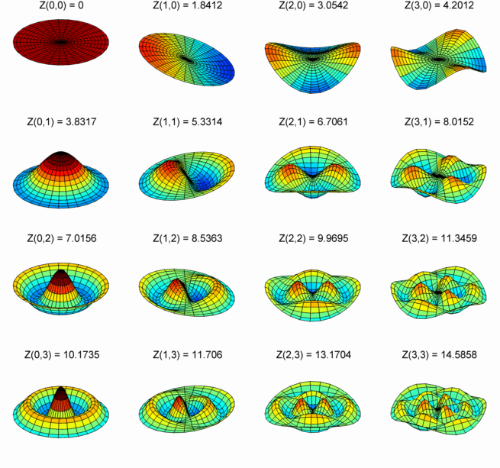
The head-tail instability
In practice we have more than 2 particles: we need to consider distributions of particles and their modes of oscillations
  → Most theories start with Vlasov / Fokker-Plank equations and a decomposition of the motion in radial and azimuthal mode in phase space
[Wiki]

Slide 14
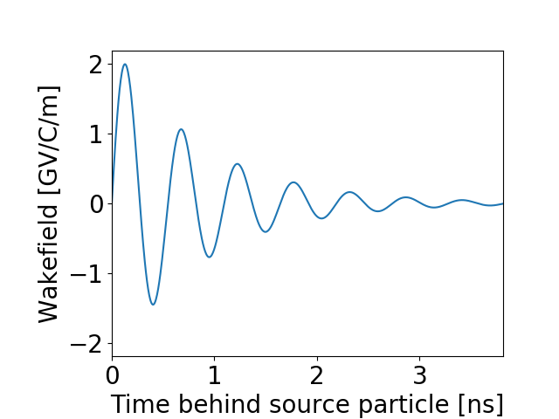
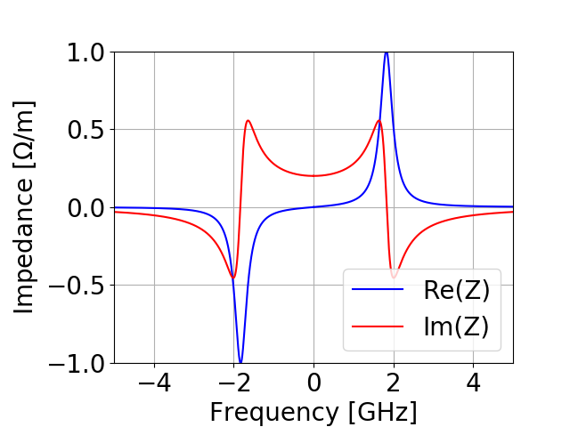
Wakefield, impedance and effective impedance
The wake fields are often described in term of their Fourier transform → The beam coupling impedance
Example: Resonator

Slide 15
Wakefield, impedance and effective impedance
The impedance is a particularly interesting quantity, as its impact on a given mode of oscillation be estimated based on its product with the mode spectrum → Sacherer tune shift [Sacherer]
Frequency and growth rate of the instability
Chromaticity plays an important role for head-tail instabilities
Impedance
Oscillation spectrum

Slide 16
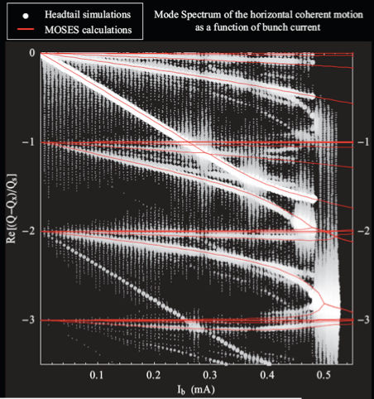
The strong head-tail instability
or Transverse Mode Coupling Instability (TMCI)
In the high intensity regime, the effect is no longer linear with the intensity / impedance
  → The various modes are strongly perturbed
  → Mode coupling generates strong instabilities
Self-consistent models or macro-particle simulations are needed to describe such configurations
[TMCI]

Slide 17
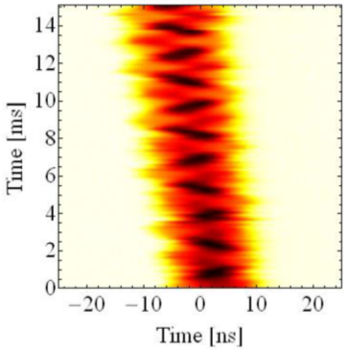
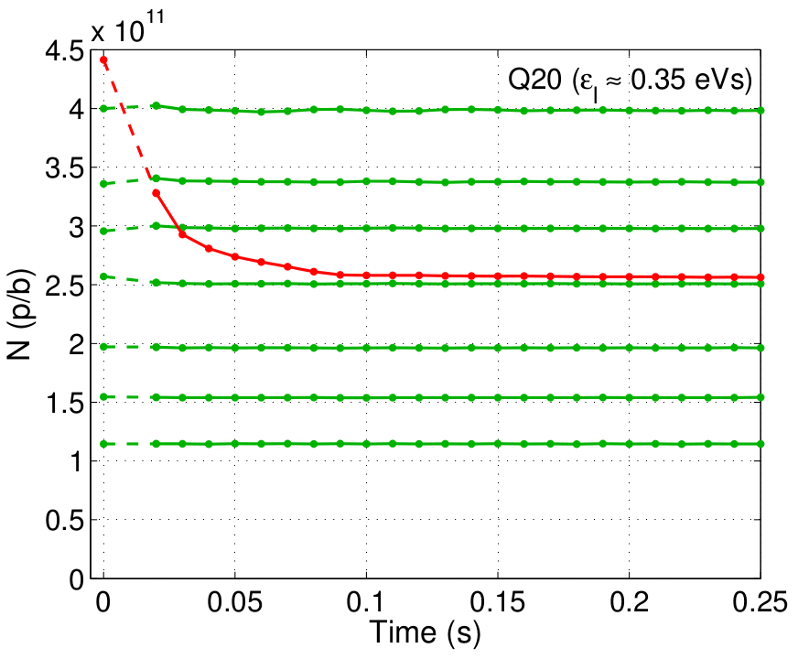
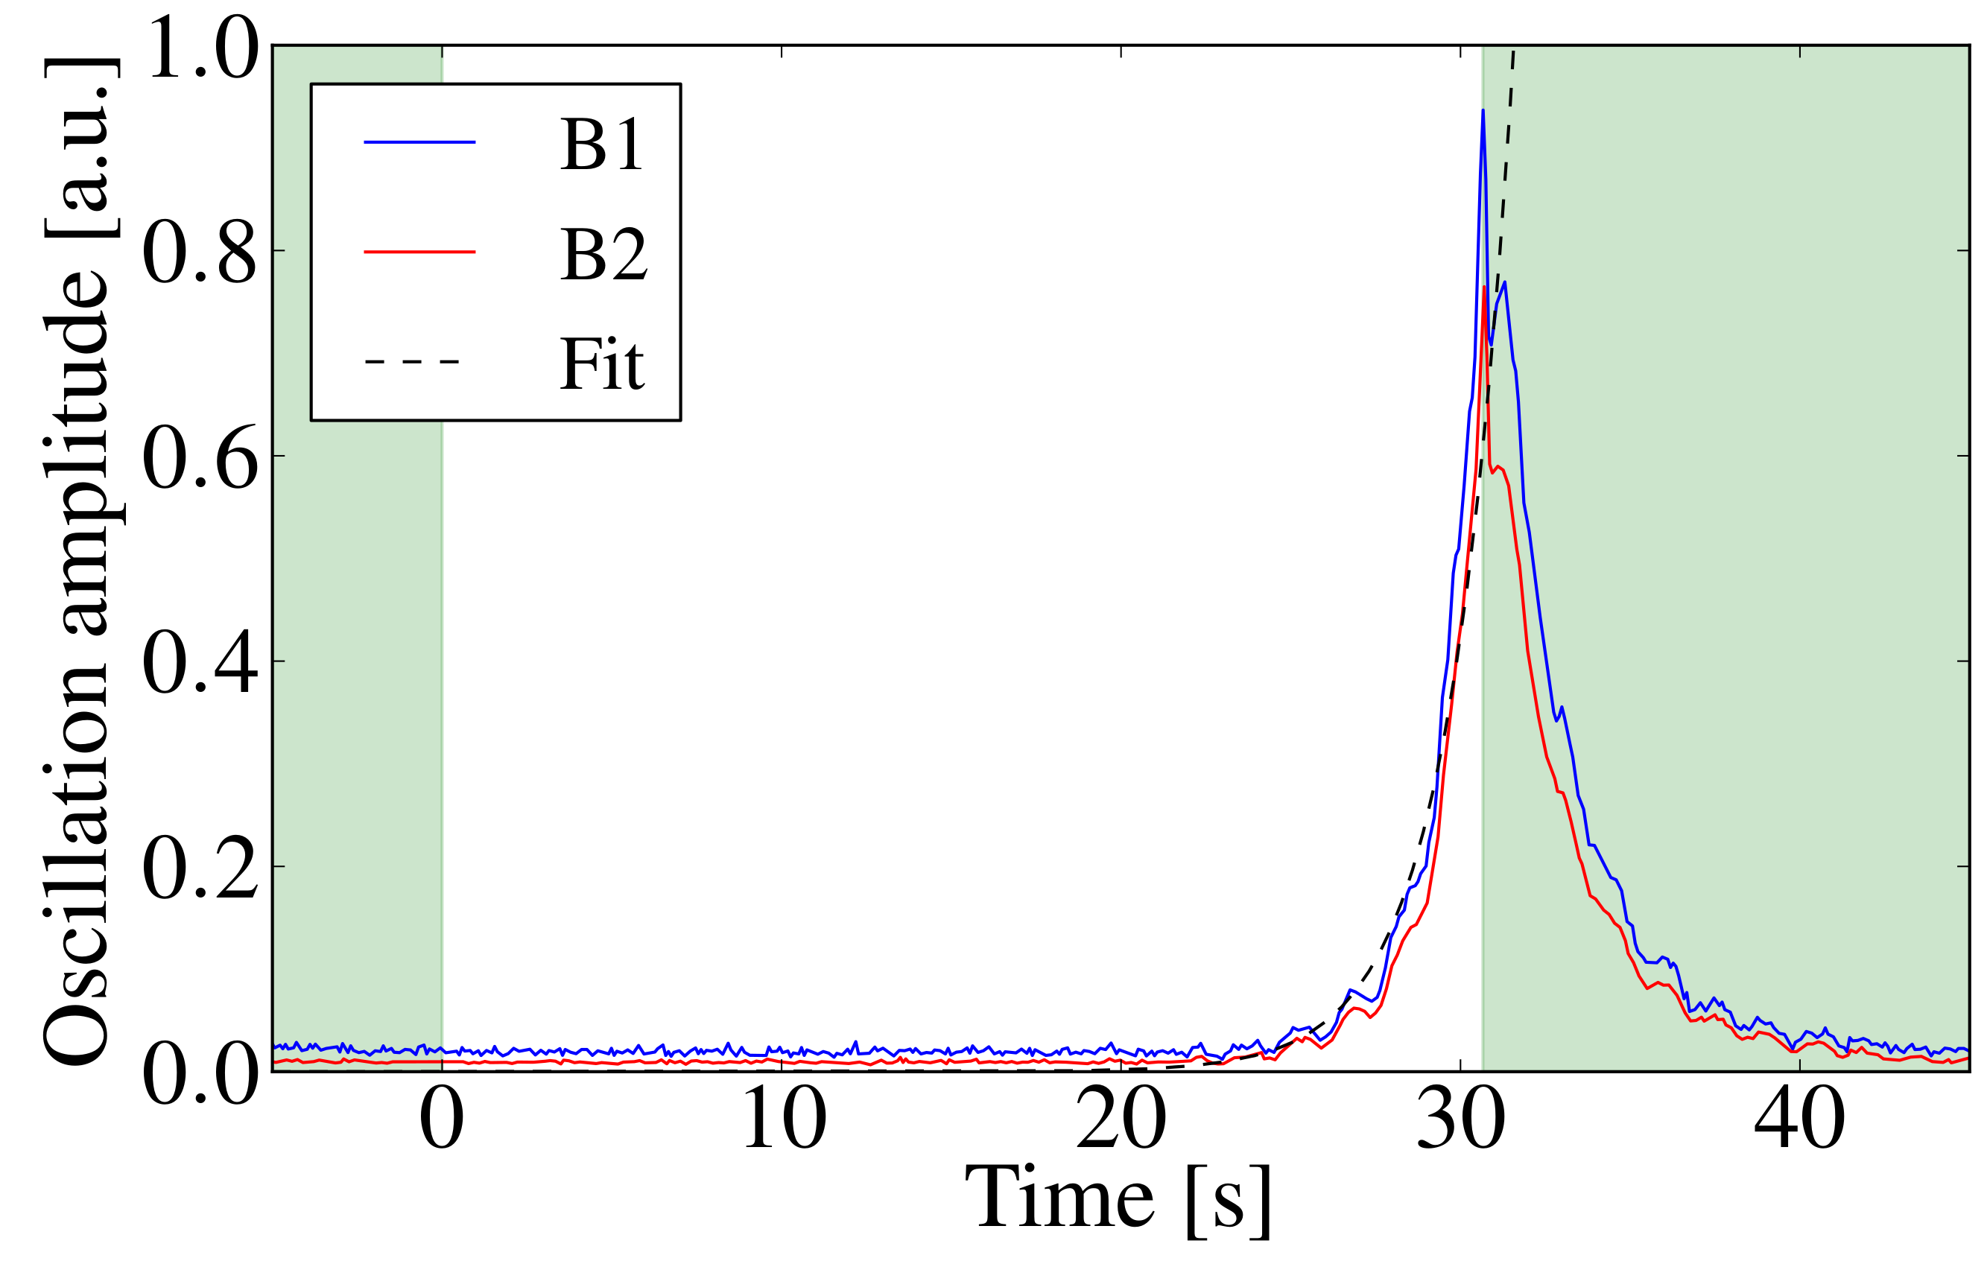
Experimental characteristics
[PSLONG]
[HT]
Oscillation of the density or transverse position along the bunch / beam
Transverse position
Longitudinal position
  'Fast' losses and/or emittance growth
Unstable
  Exponentially growing amplitude
Stable
[LHCBB]
Stable
Stable
Stable
[SPSTMCI]

Slide 18
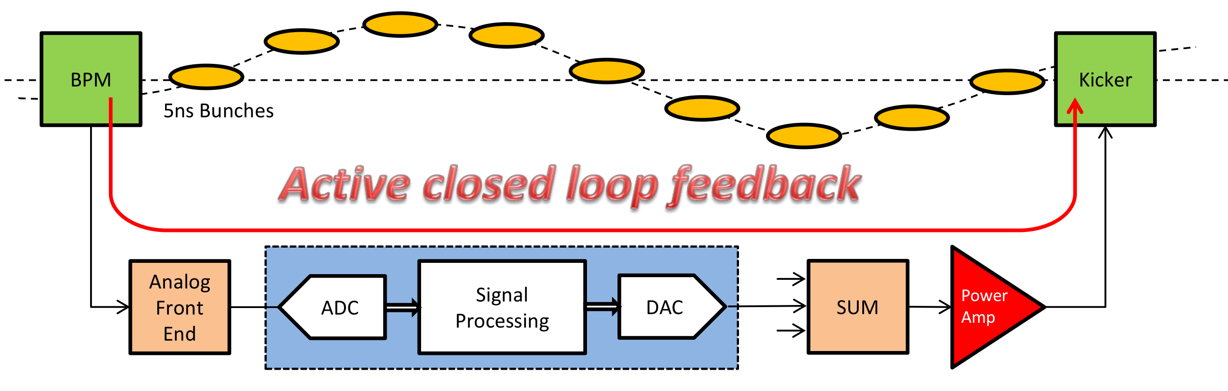

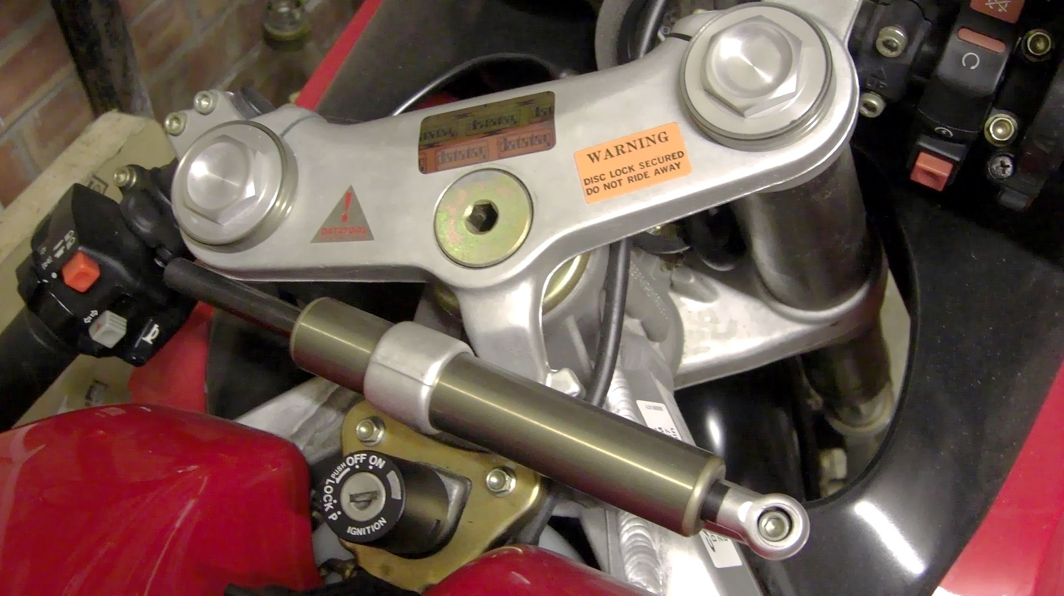
Active feedbacks (dampers)
There exists a variety of instabilities generated by wake fields. In addition, other collective interactions generate even more instability mechanisms... → Stabilisation is always needed!
[Damper]
By measuring the beam position and acting back on the beam (within the next few turns), several instabilities can be suppressed
  Most coupled bunch instabilities are cured with an active feedback
  Instabilities with intrabunch motion are technologically more challenging (high bandwidth)
  → Landau damping is still needed in most machines

Slide 19

Decoherence and Landau damping
In the presence of a tune spread, the particles tend to desynchronize in time
  Organised motion slowly get dis-organised as times goes
  → decoherence
By dis-organizing the particles, the tune spread prevents collective instabilities
→ Landau damping
  Initially discovered in plasmas, Landau damping is essential to most particle accelerators

Slide 20
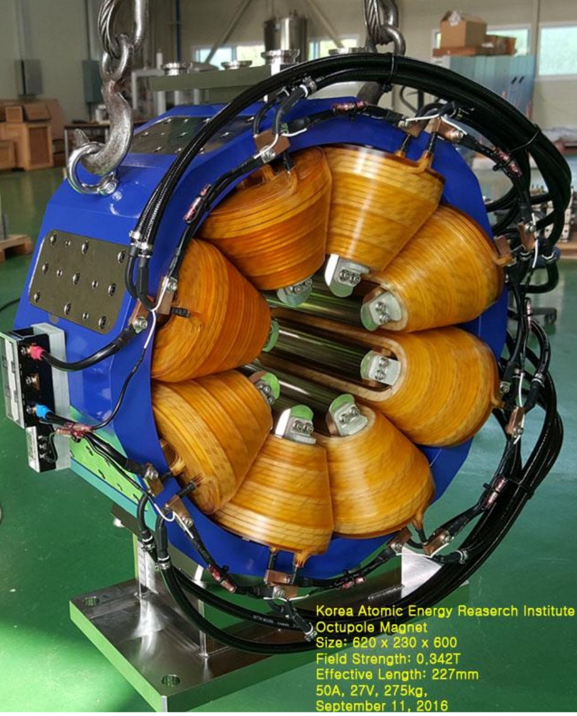
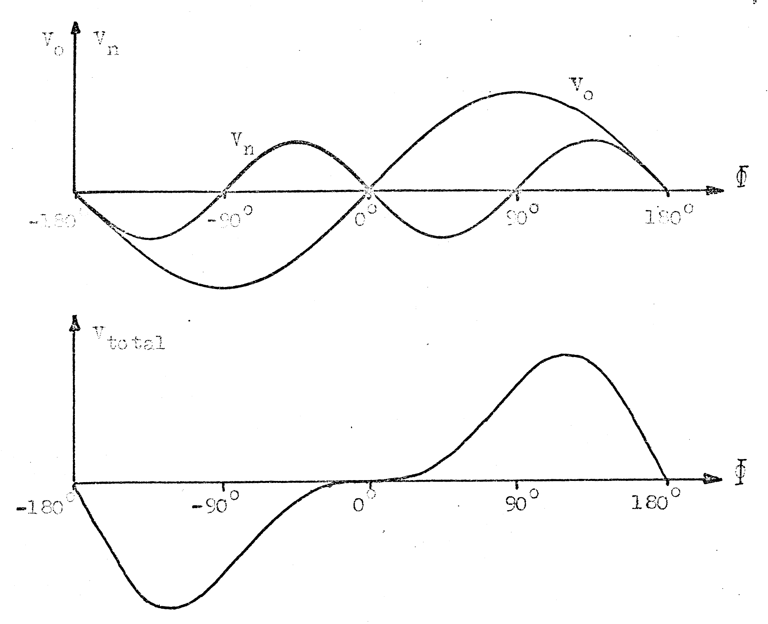
Landau cavities and octupoles
In order to increase the longitudinal tune spread, RF cavities of higher frequencies can be used to enhance the non-linear behaviour → Landau cavities
In order to increase the transverse tune spread, non-linear magnets can be used → Landau octupoles
Landau cavity
Main RF
Total voltage
[LandauRF]
[Octupole]
Some collective forces generate a significant tune spread (space-charge, beam-beam) that generates Landau damping → They can be beneficial !

Slide 21
Content
Collective instabilities
  Study case: Electromagnetic wake fields and the head-tail instability
  Damping mechanisms
Non-linear collective effects
  Poincaré section, resonances and chaos
  Beam-beam and space-charge effects
Scattering effects
Summary

Slide 22
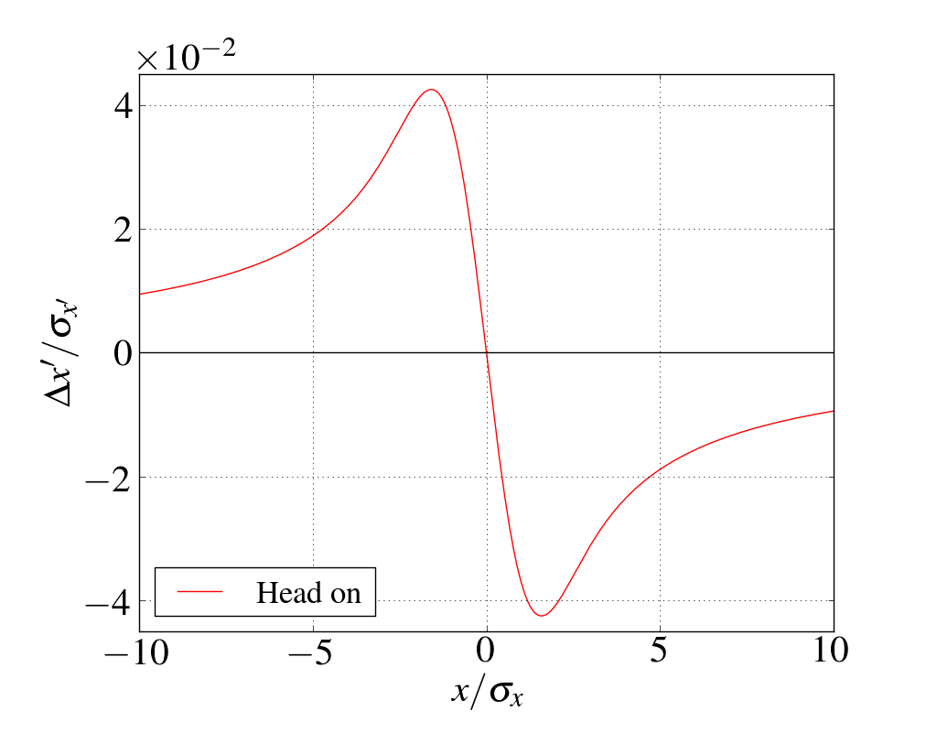
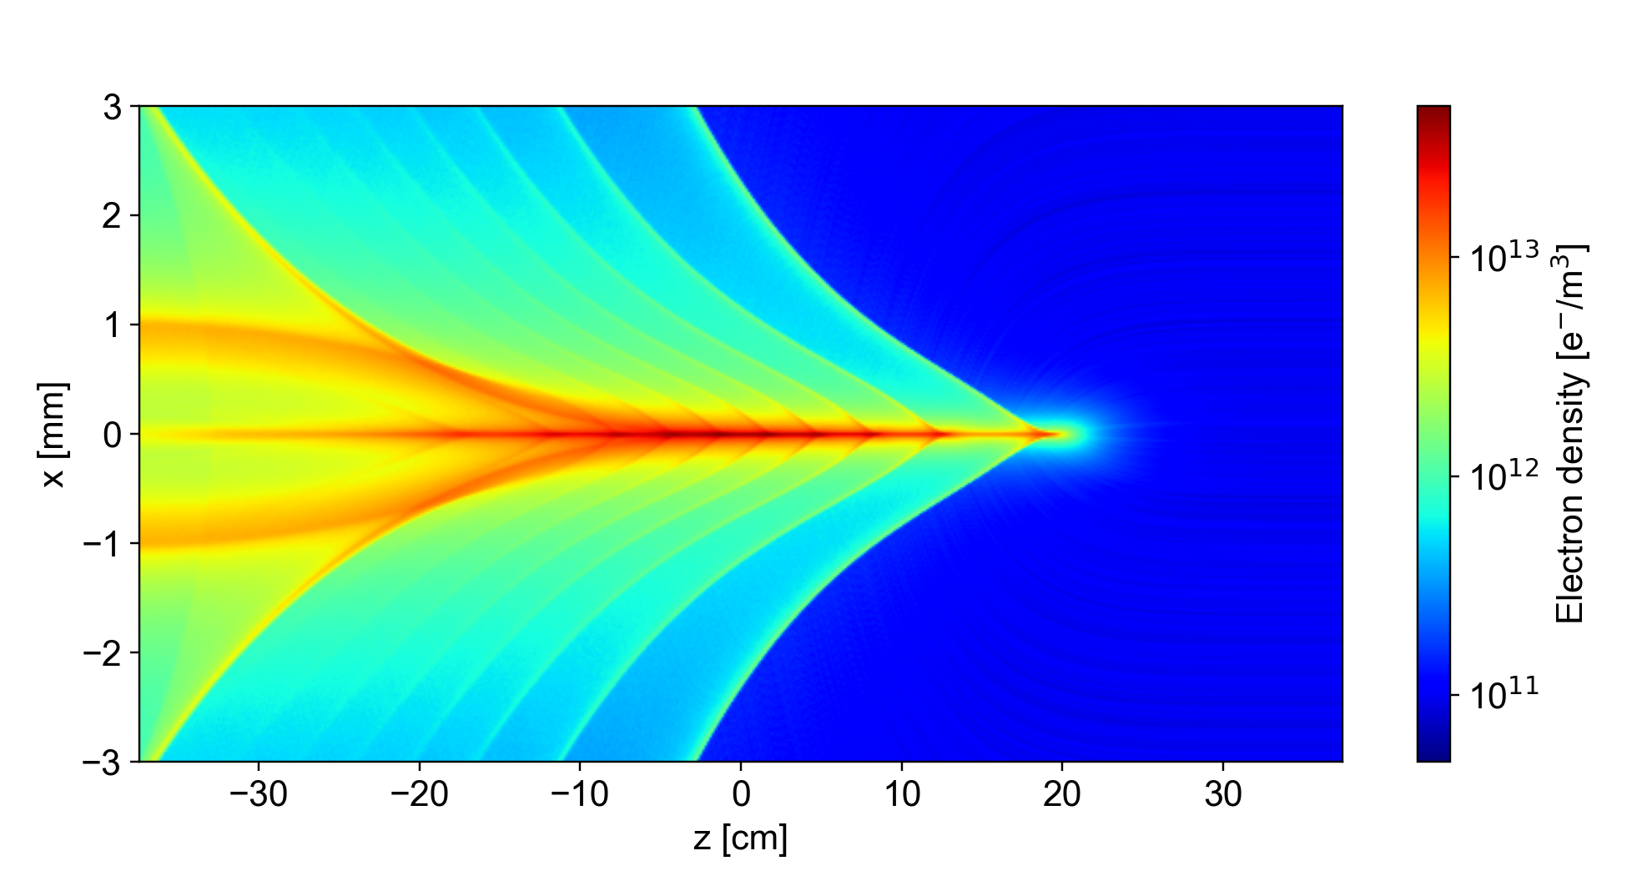
Non-linear collective force
Beam-beam
Space charge
Electron cloud
pinch
[Pinch]

Slide 23
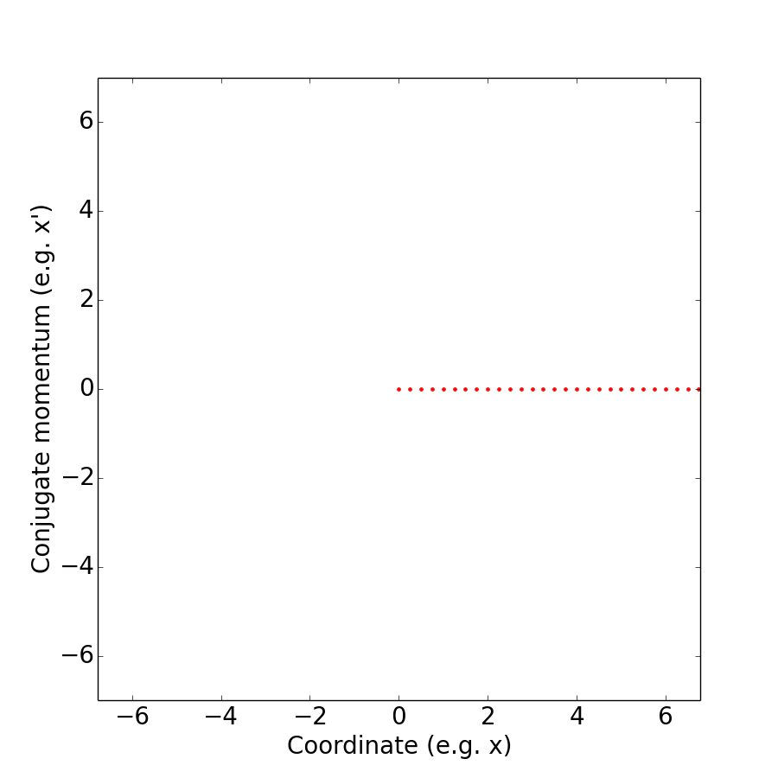
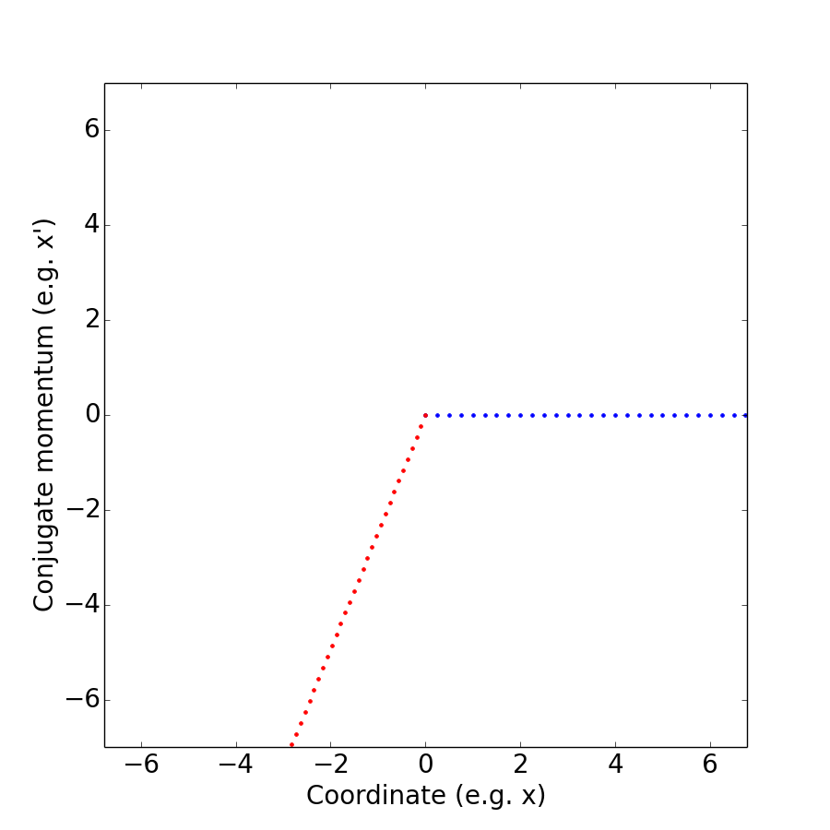
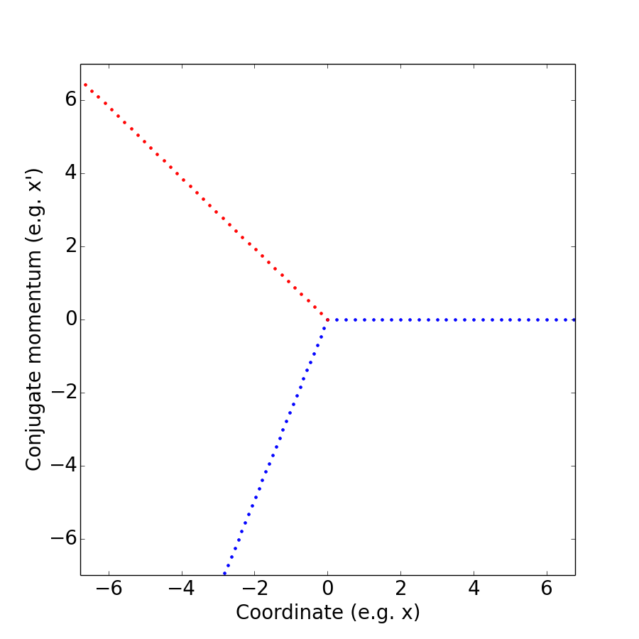
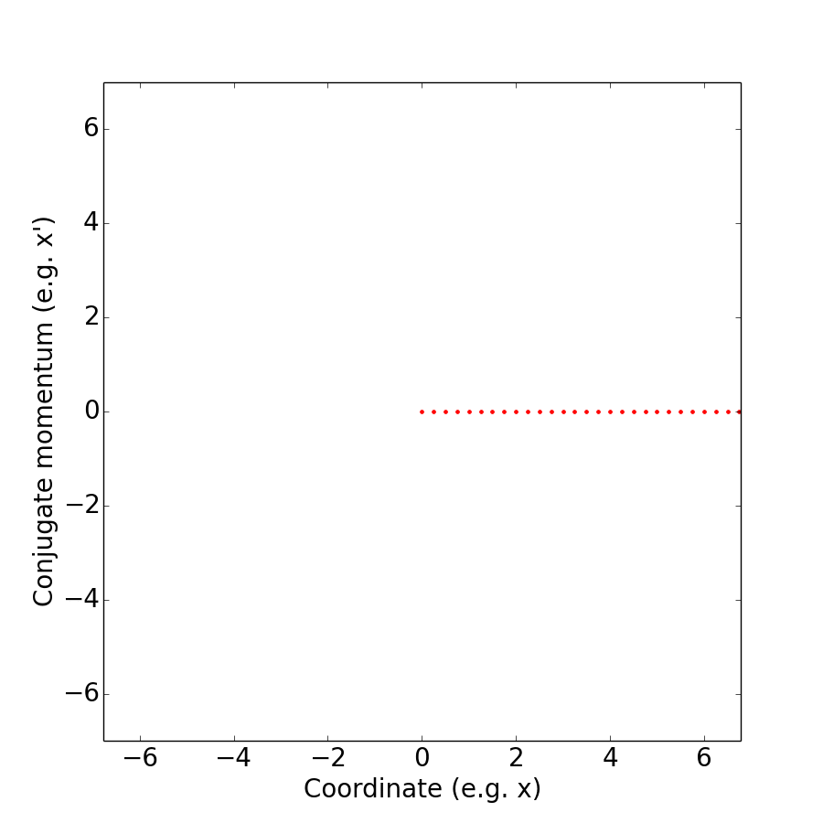
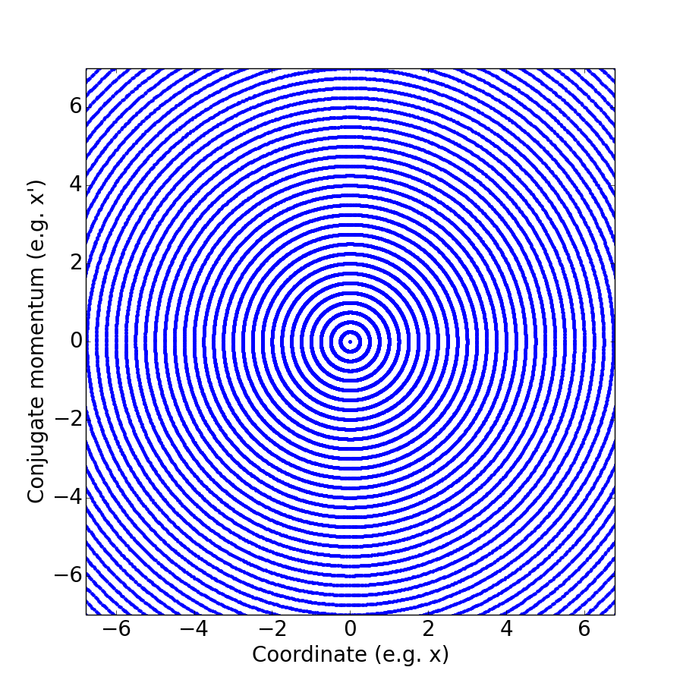

Poincaré section (phase space)
Regular trajectories → Long beam lifetime
3rd turn
Our 'test' particle's coordinates at the 1st turn
2nd turn
Rotation by 2πQ

Slide 24
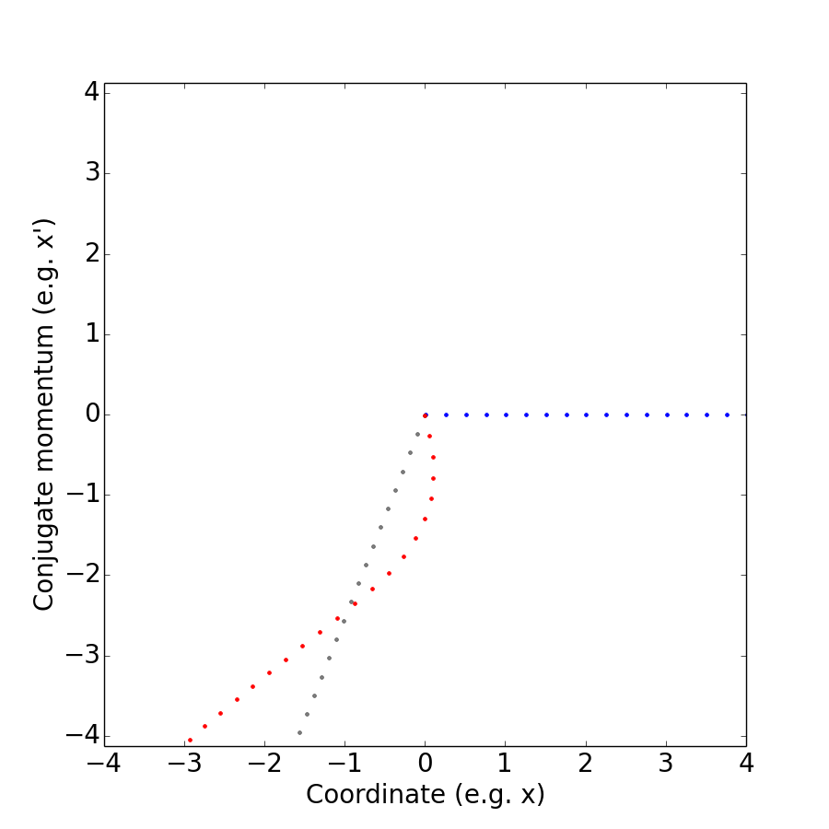
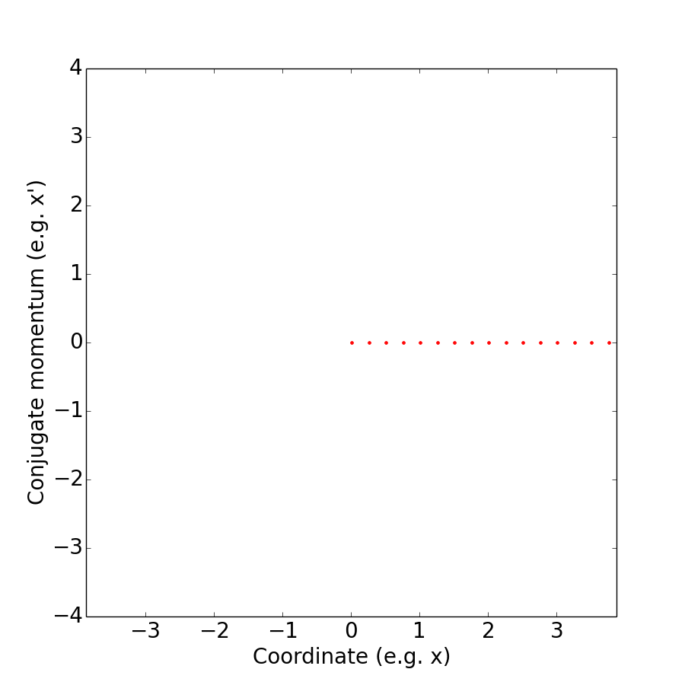
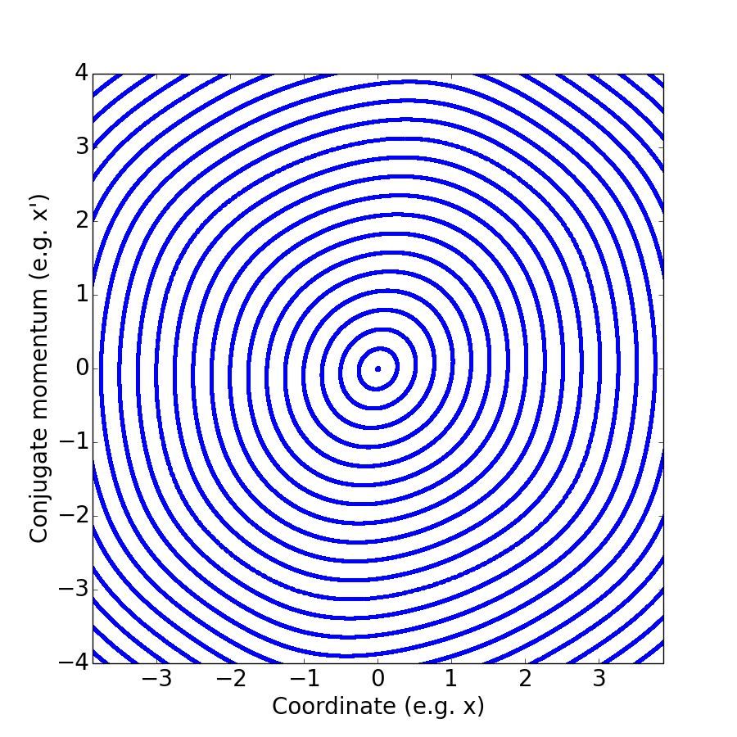
'Weakly' non-linear motion
The non-linearity generates a 'tune spread', i.e. particles oscillate at different frequencies
→ Landau damping!
Due to the non-linearity, some particles rotated a little faster, others a little slower
Nevertheless the trajectories can remain regular and the beam lifetime preserved

Slide 25
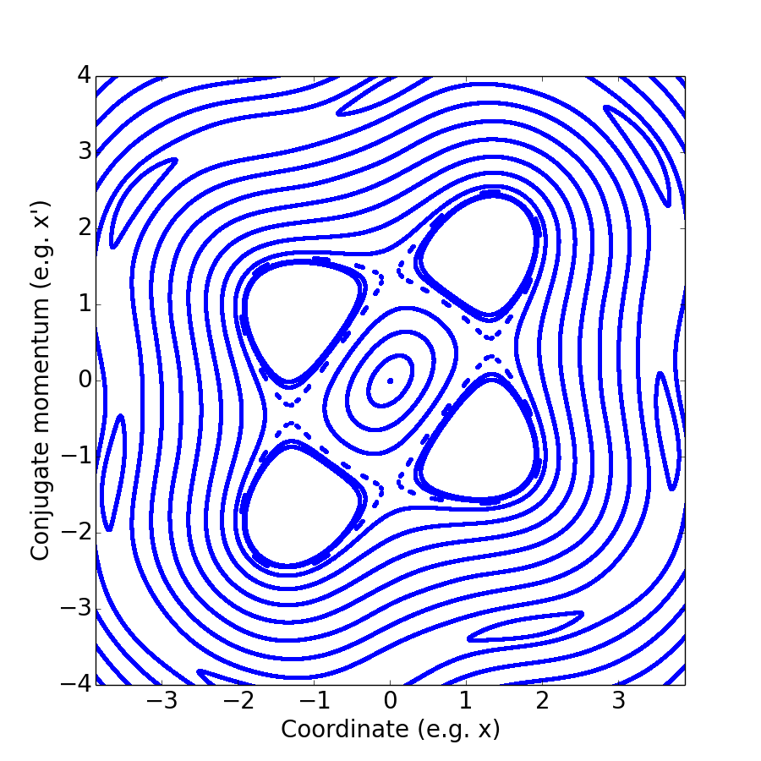
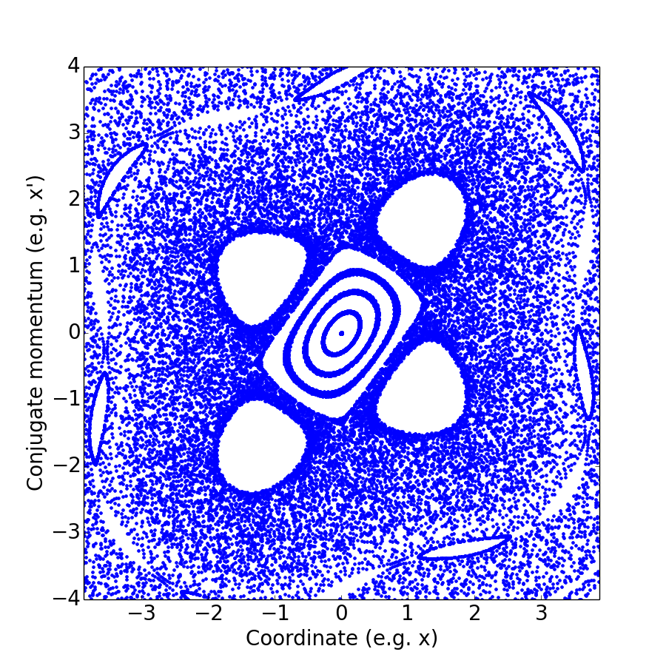
Resonances and chaos
The limit of regular motion is called the dynamic aperture
4th order resonance
Resonances distort the particles' trajectories
Under some conditions, the trajectories become chaotic
→ Emittance growth and beam losses

Slide 26
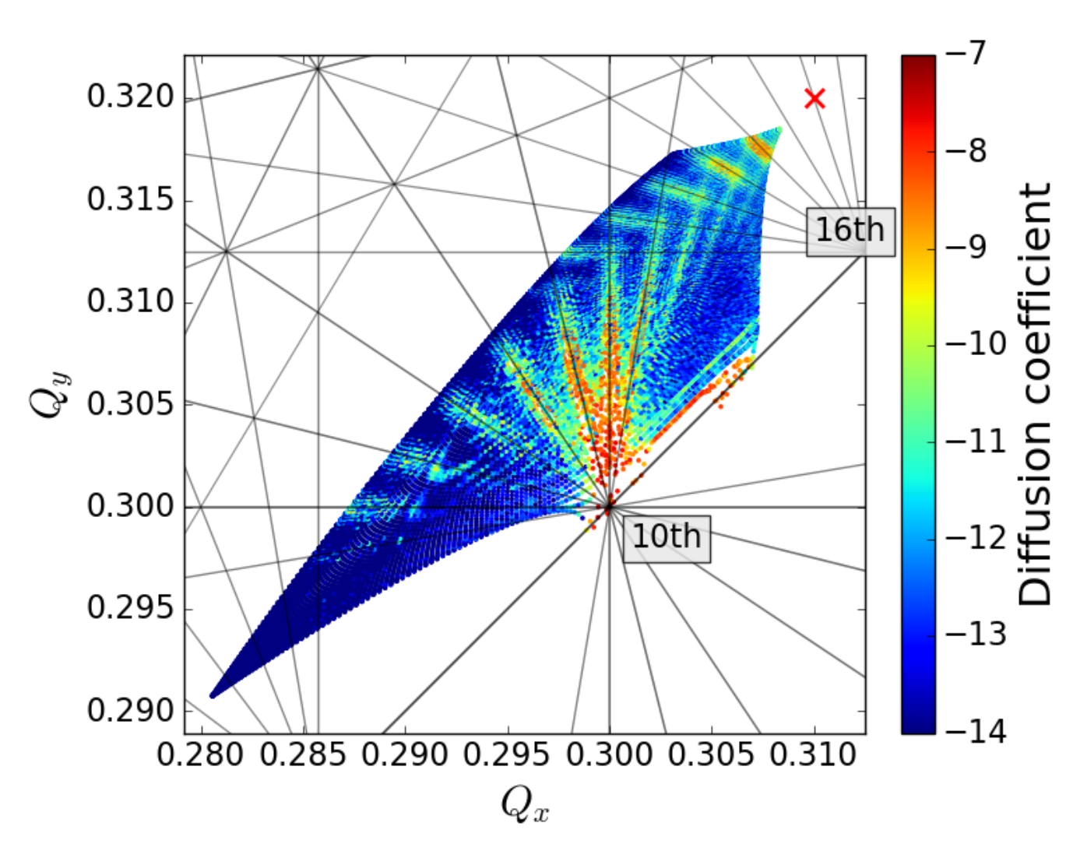
Tune footprint
[BB]
High luminosity usually comes with strong beam-beam effects
  The non-linearity of the force generates a tune spread that can be visualised in a 'tune diagram' and compared to resonance conditions
  It is not possible to avoid all resonance, but some are worst than others
In a comparable manner, space-charge forces limit the brightness of the beam in low energy machines (i.e. low relativistic gamma)
A careful design allows for a minimisation of these effects is key to achieve high performance (working point, injection energy, separation scheme, ...)
  In addition, several compensation schemes exists for either space-charge or beam-beam effects, usually acting on the tune spread and/or the resonances with special devices (multipole magnet, electron lens, wires)

Slide 27
Content
Collective instabilities
  Study case: Electromagnetic wake fields and the head-tail instability
  Damping mechanisms
Non-linear collective effects
  Poincaré section, resonances and chaos
  Beam-beam and space-charge effects
Scattering effects
Summary

Slide 28
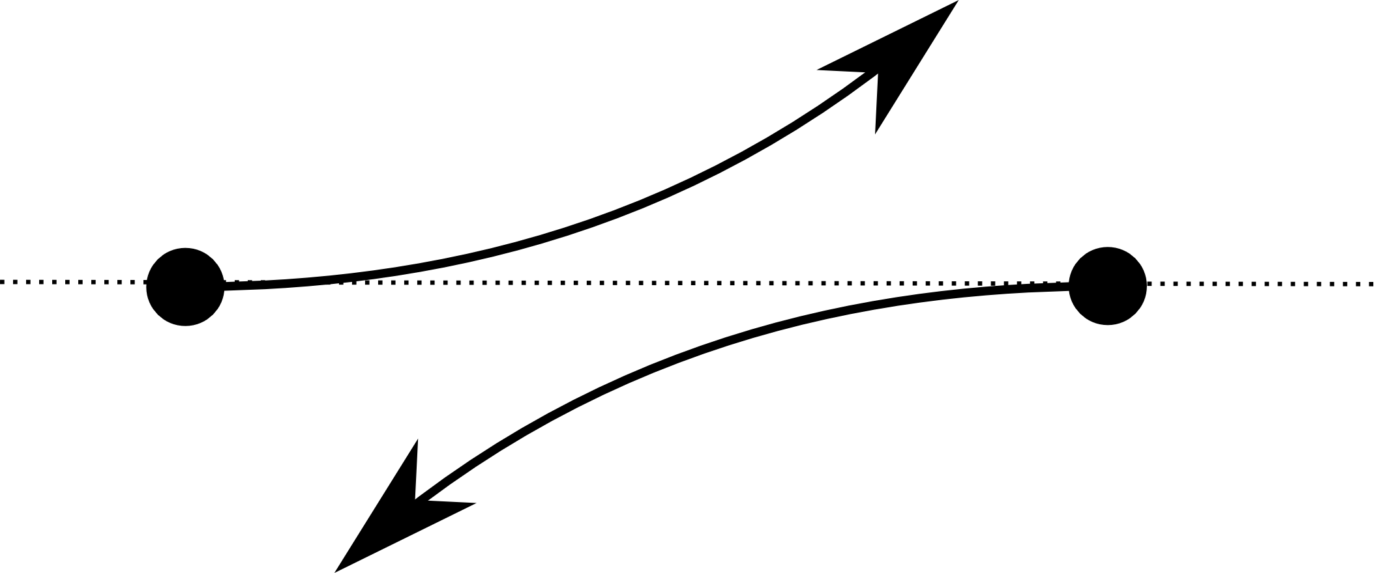
Scattering
'Far' interactions between particles in a beam are well modeled by the space-charge fields, however close interactions (scattering events) lead to a redistributions of the momentum in 3D
  → Multiple random small angle deflections: Emittance growth! (Intrabeam scattering)
  → One single deflection may send one of the particles out of the machine acceptance: Beam losses! (Touschek scattering)
The amount of these events depends on the beam property (scattering is more likely in denser beam, i.e. at lower relativistic gamma)
The redistribution, thus the IBS growth rates in the different planes, depends on the machine optics (dispersion, transverse coupling)
Other types of scattering can lead to emittance growth or losses (e.g. small angle deflections in beam-beam interactions or on rest gas particles)

Slide 29
Summary : Collective interactions
Direct electromagnetic interaction of the particles in the beams : Space-charge effects, intrabeam scattering / Touschek scattering
Electromagnetic interaction with other species : Electron clouds, ions
Electromagnetic interaction of the particles in the beams through an interaction with surrounding elements (Vacuum chamber, beam screen, RF cavities, collimators, beam instrumentation, …) : Wake fields / Impedance
Electromagnetic interaction with another beam : Beam-beam effects, electron cooling, electron lens

Slide 30
Summary: Impact on the beam
Collective force can deteriorate the beam quality in several ways
  Beam instabilities
  Non-linear effects
  Scattering effect
The performance of a machine is usually limited by collective effects, their understanding and mitigation is the key to maximise the potential of a given machine
  Optics (tune, chromaticity, transition energy, ... )
  Active feedbacks
  Passive mitigations (Landau cavities, Landau octupoles, resonance and/or tune spread compensators)
  Electromagnetic design of every element
  Surfaces exposed to the beam

Slide 31
Not treated today
Dissipation of the collective force (Beam loading, RF/electron cloud heating)
Wake field acceleration → see E. Gschwendtner tomorrow morning
Beam-beam disruption → see S. Stapnes tomorrow afternoon
Free electron laser
Coherent synchrotron radiation

Slide 32
Good lecture notes on this topic
Proceedings of the CAS-CERN Accelerator School on Intensity Limitations in Particle Beam https://e-publishing.cern.ch/index.php/CYRSP/issue/view/37
A. Chao, Physics of Collective Beam Instabilities in High Energy Accelerators (Wiley, 1993) and Lecture Notes on Special Topics in Accelerator Physics (SLAC-PUB-9574) https://www.slac.stanford.edu/~achao/
A. Wolski, Beam dynamics in high energy particle accelerators (Imperial College Press, 2014) https://catalogue.library.cern/literature/4wt8x-2r482

Slide 33
References
[Wiki] http://www.wikipedia.org
[HT1] J. Gareyte, F. Sacherer, CERN-MPS-DL-74-4, 1974
[Wake] B. Salvant, private communication
[BBU] M. Ferrario, CAS on Intensity limitations, CERN, 2015
[TMCI] B. Salvant, PhD Thesis 4585, EPFL, 2010
[PSLONG] H. Damerau, et al., Proceedings of the Injector MD Days 2017, Geneva, Switzerland
[LHCBB] X. Buffat, PhD Thesis 6321, EPFL, 2014
[SPSTMCI] H. Bartosik, PhD Thesis, TU Vienna, 2013
[Damper] G. Kotzian, LIU-SPS Wideband Feedback Review, CERN, 2016
[LandauRF] P. Bramham, et al., ISR-RF-TH-AH-cr
[Octupole] Y.-M. Kim, NIM-A 950 (2020) 162971
[Pinch] http://ecloud.web.cern.ch/
[BB] S. Furuseth, et al., Phys. Rev. Accel. Beams 21 081002

