Slide 1
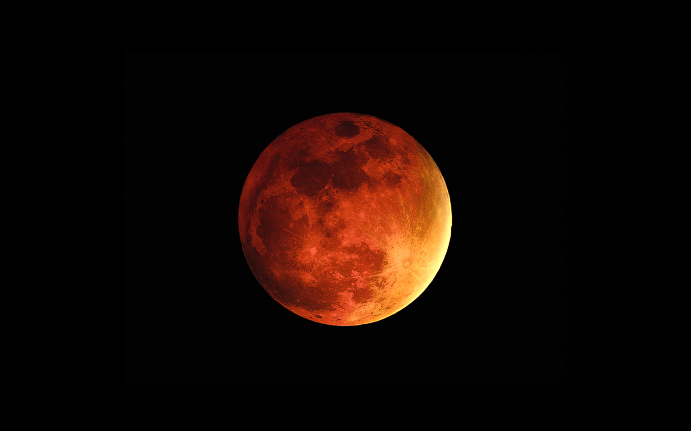
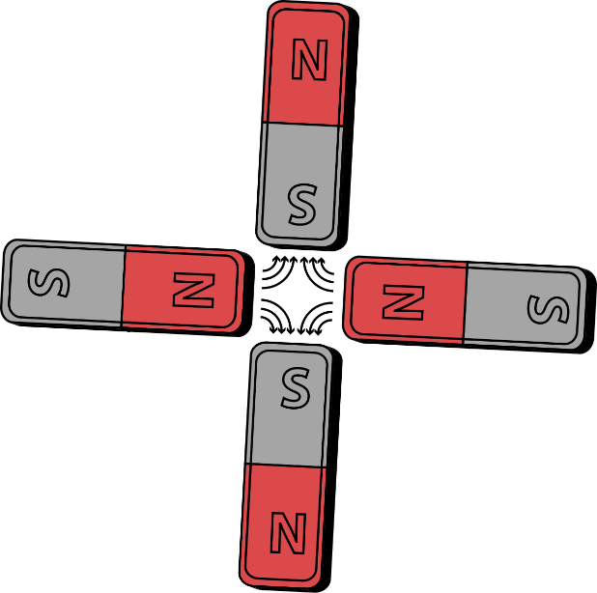
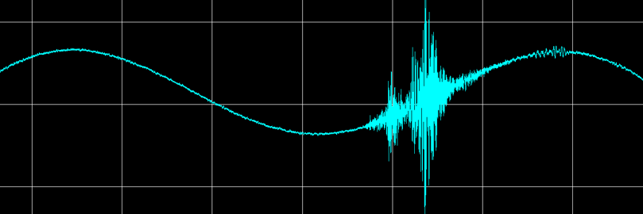

Linear
Imperfections
CAS course on
Basics of Accelerator Physics and Technology,
10 – 14 March 2025
Jörg Wenninger
CERN Beams Department
Operation group / LHC

Slide 2
Introduction
Imperfection - sources
Orbit perturbations
Linear imperfections, geology and vibrations
Summary

Slide 3
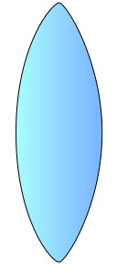
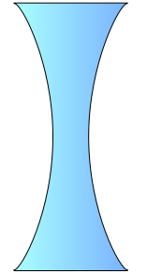
Accelerator lattice cell
An accelerator is typically build using a number of basic ‘cells’.
The cell layouts of accelerators come in many variants.
For today we consider a simple FODO cell containing:
  Dipole magnets to bend the beams,
  Quadrupole magnets to focus the beams,
  Beam position monitors (BPM) to measure the beam position,
  Small dipole corrector magnets for beam steering.
Quadrupole
(focussing)
Quadrupole
(de-focussing)
Dipole corrector
Dipole
Dipole
Dipole corrector
beam
Beam position monitor
Beam position monitor
Schematic of a ½ cell

Slide 4
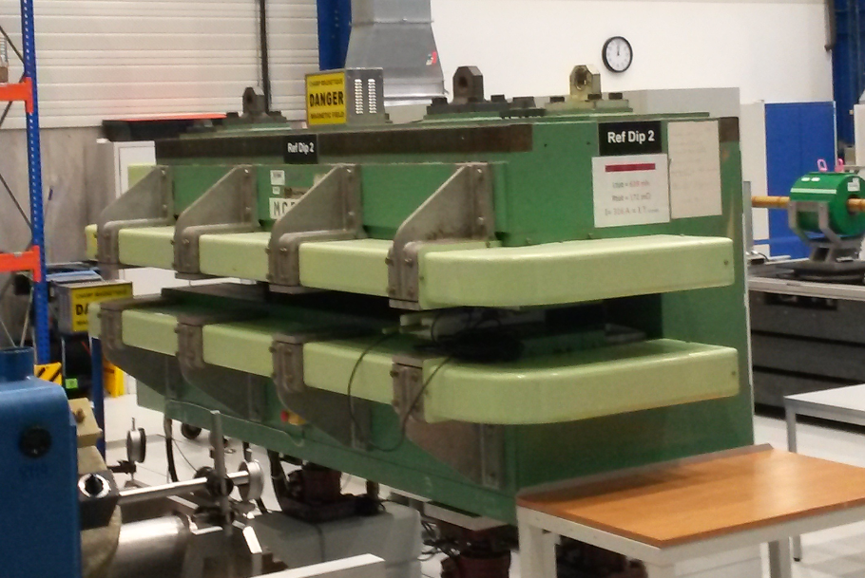
Dipole magnet
The dipole has two magnetic poles and generates a homogeneous field providing a constant force on all beam particles – used to deflect the beam.
  A dipole corrector is just a small version of such a magnet, dedicated to steer the beam.
Lorentz force:
y
Horizontal deflection
Vertical deflection
orthogonal to the speed and magnetic field directions
90° rotation
x
B_{y}
x
F_{y}
F_{x}
x
B_{x}

Slide 5
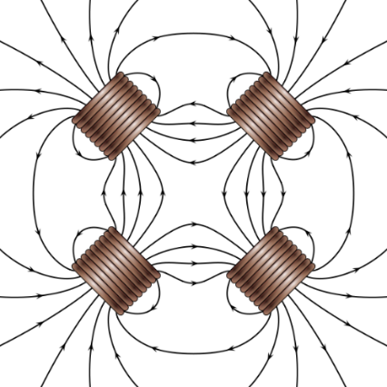
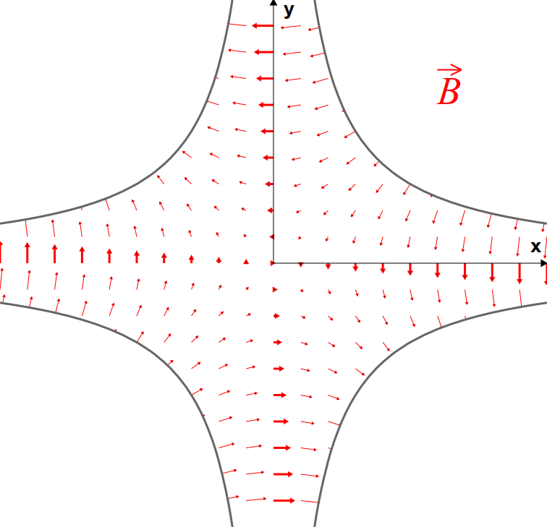
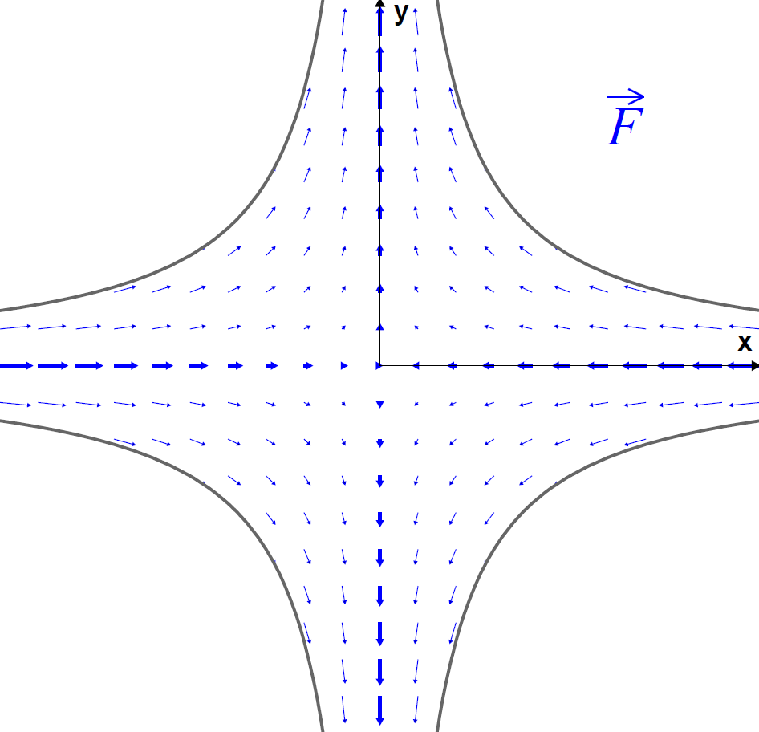
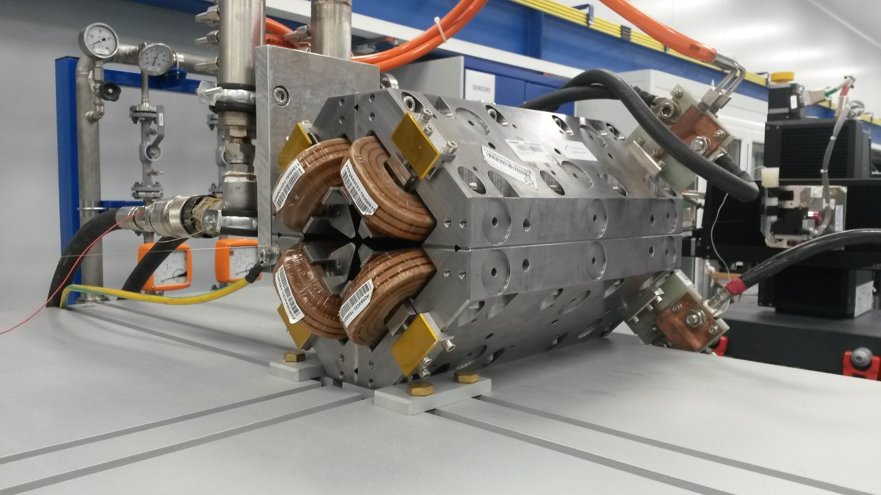


Quadrupole magnet
A quadrupole has 4 magnetic poles.
A quadrupole provides a field (force) that increases linearly with the distance to the quadrupole centre – provides focussing of the beam.
  Similar to an optical lens, but a quadrupole is focussing in one plane, defocussing in the other plane.
Force pushes the particle towards the center → focussing
$$F_{x}=−k x$$
$$F_{y}=k y$$
Force pushes the particle away from the center → defocussing

Slide 6
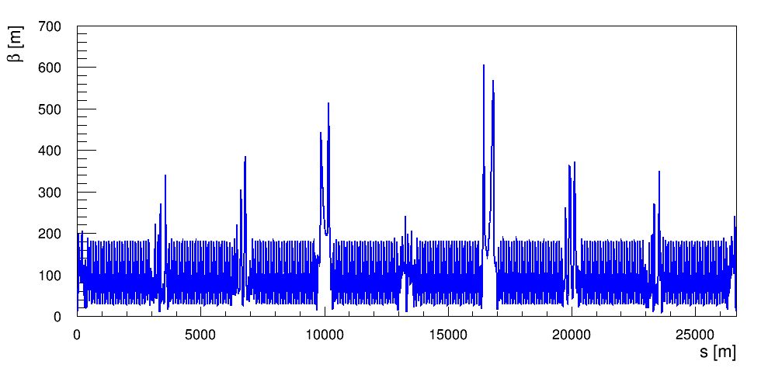
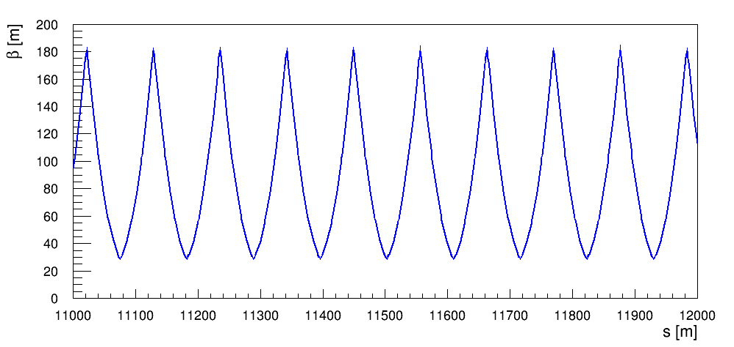
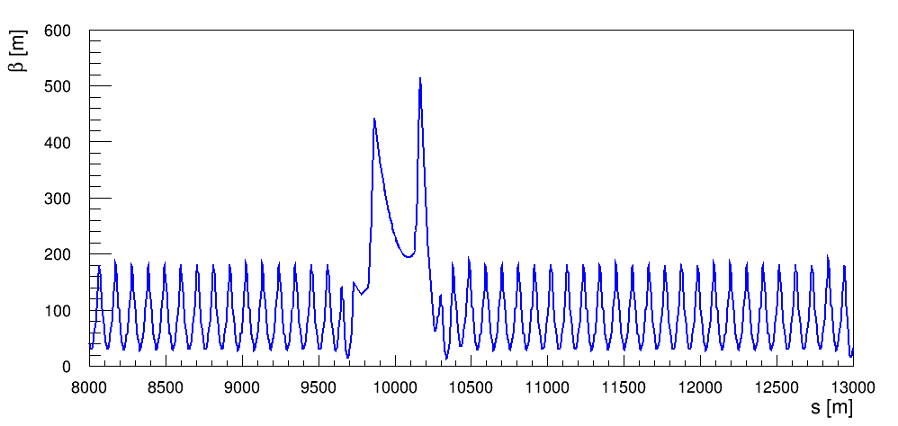
Recap on beam optics
Quantities related to a beam optics in a circular accelerator will be needed for the lecture:
  The betatron function (β) that defines the beam envelope,
    Beam size / envelope is proportional to √β
  The betatron phase advance (μ) that defines the phase of an oscillation.
LHC optics at injection
one cell
zoom
zoom

Slide 7
Recap on beam optics
Consider a particle moving in a section of the accelerator lattice. The focussing elements make it bounce back and forth.
one cell
one cell
…
Another section of the accelerator
Another section of the accelerator
This periodic oscillation is called the betatron oscillation.

Slide 8
Recap on beam optics for pedestrians
The number of oscillation periods over one machine turn is called the machine tune (Q) or betatron tune.
  In this example Q is around 2.75 – 2 periods and ¾ of a period.
position
1 period
1 period
1 period
Longitudinal coord. s
With a coordinate change (from longitudinal position in meters to betatron phase advance in degrees) this ‘rocky’ oscillation is transformed into a sinusoidal oscillation.
  Convenient and simple way to analyse the beam motion.
position/√β
Betatron phase μ

Slide 9
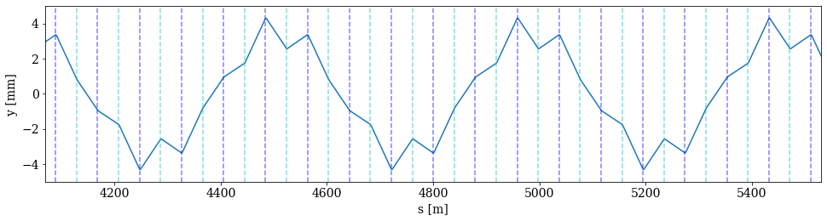
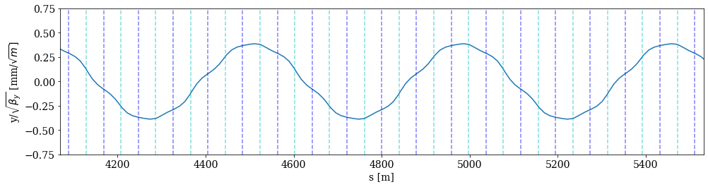
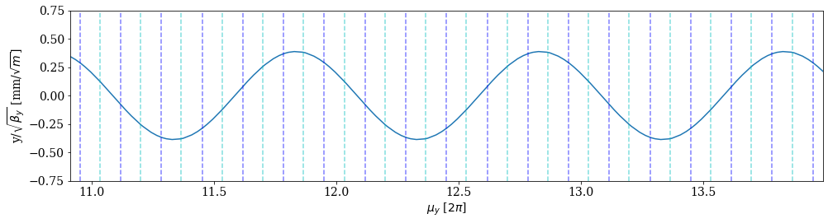
Physical and normalized coordinates
Observe how focusing quadrupoles bend the beam towards y = 0, while the opposite holds for de-focusing quadrupoles
Example of coordinate transformation for trajectory in a LEP arc lattice
Focusing quadrupoles
De-focusing quadrupoles
Physical coordinate : the is the real trajectory !
y position versus longitudinal position
Normalized coordinate :
y position normalized to √β versus longitudinal position
Normalized coordinate :
y position normalized to √β versus phase advance

Slide 10
Introduction
Imperfection - sources
Orbit perturbations
Linear imperfections, geology and vibrations
Summary

Slide 11
Imperfections
The first step in the design phase of an accelerations consists in building an “ideal” accelerator where all magnets have nominal fields and are perfectly aligned along the design trajectory.
But the designer must soon confront the real world, and tolerances on errors (= imperfections) must be defined to provide specifications for component design, manufacturing and alignment.
  What is the precision on field quality?
  What is the precision and stability of the power converter that feeds current into a magnet?
  What is the tolerance on the component alignment?
  What about vibrations, ie non-static errors?
  …
This lecture will discuss the impact of the simplest form of imperfections, the linear imperfections.
  And among the linear imperfections, I will focus on imperfections due to dipole fields.

Slide 12
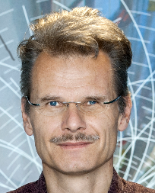
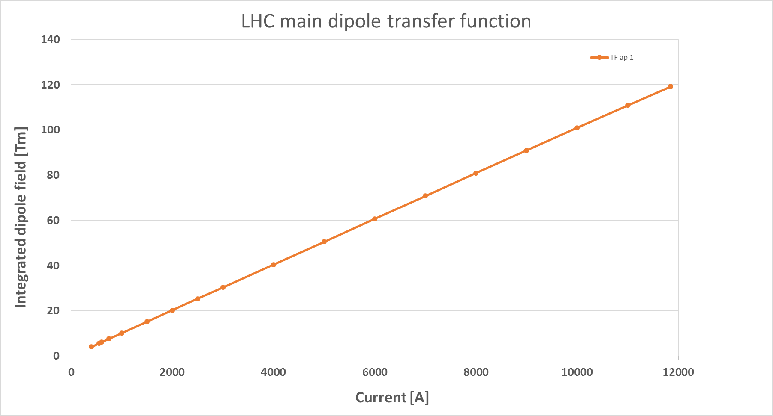
From model to reality - fields
The physical units of the machine model defined by the accelerator physicist must be converted into magnetic fields and eventually into currents for the power converters that feed the magnets.
Imperfections (= errors) in the real accelerator optics can be introduced by uncertainties or errors on:
  Beam momentum, magnetic field model and power converter regulation.
Magnet strength
(angle, focal length…)
Magnetic field or gradient
(T, T/m, T/m²…)
Requested current
(A)
Actual magnet current
(A)
Accelerator physicist
Beam momentum
Magnet
calibration curve (transfer function)
Power converter
Example of the LHC main dipole calibration curve

Slide 13
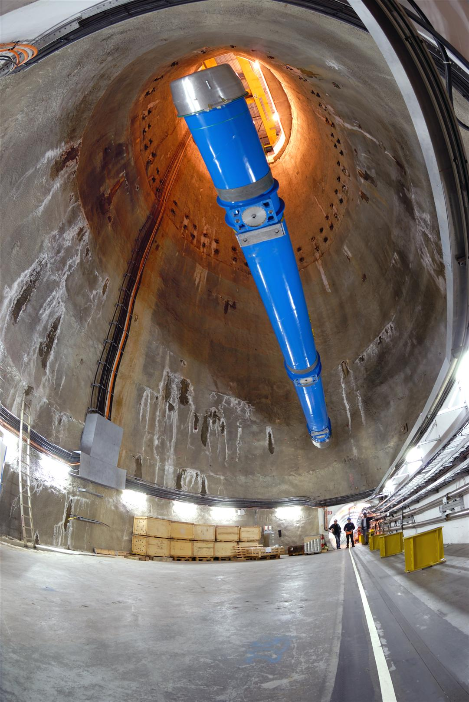
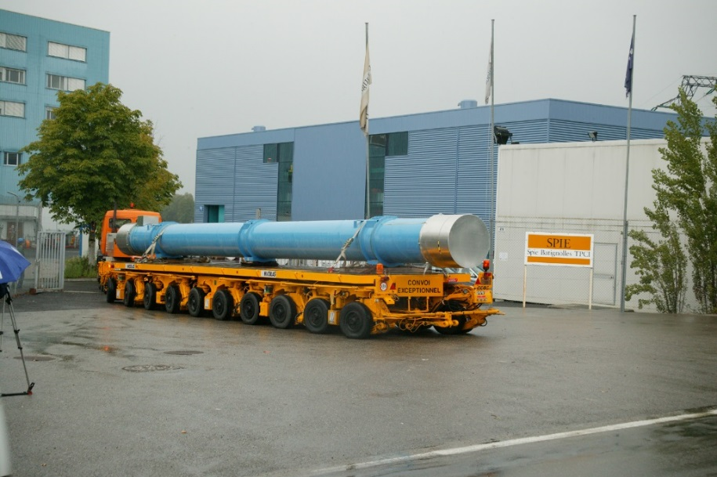
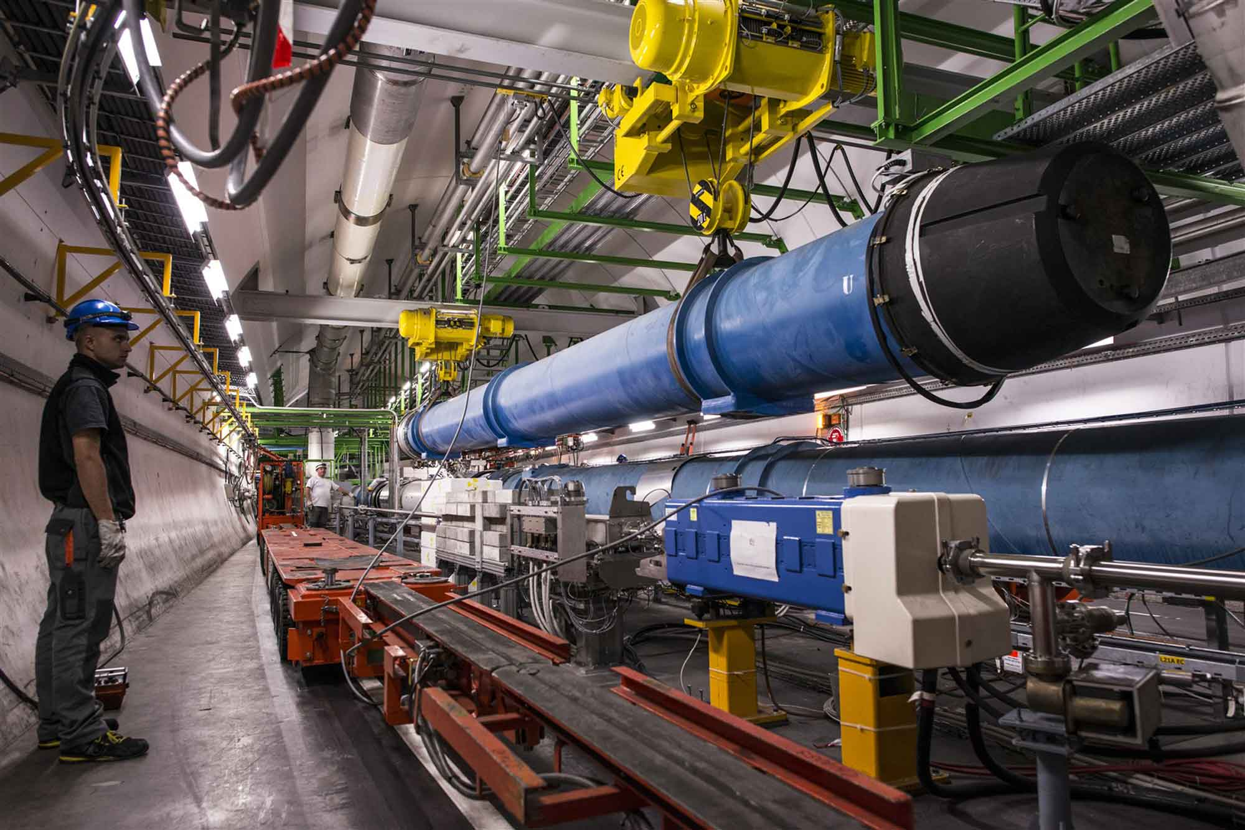
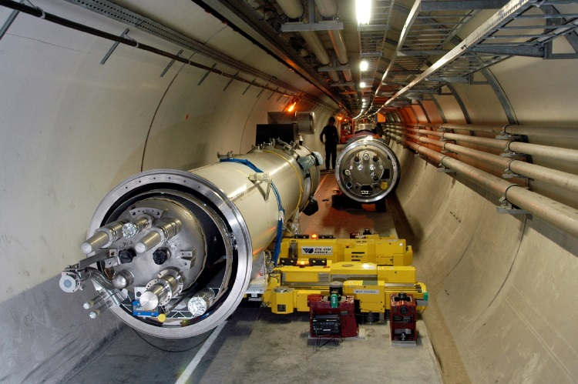
From the lab to the tunnel

Slide 14
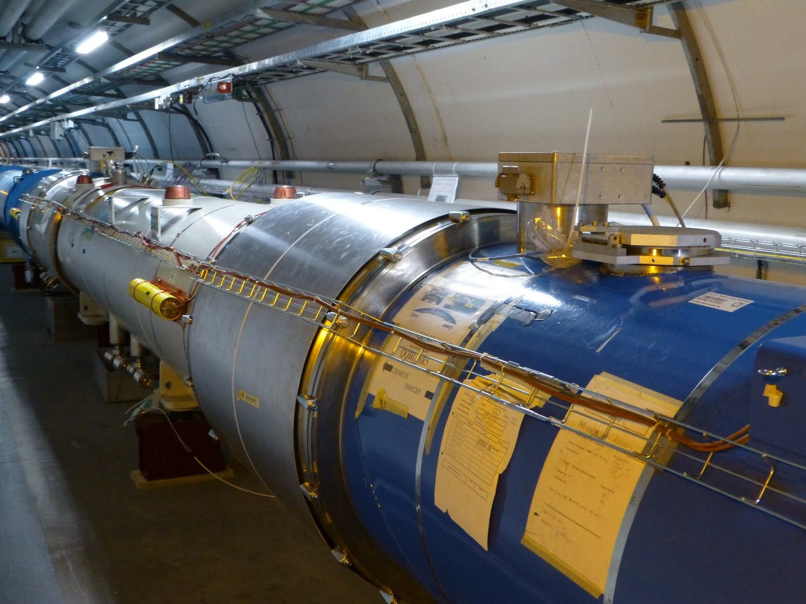
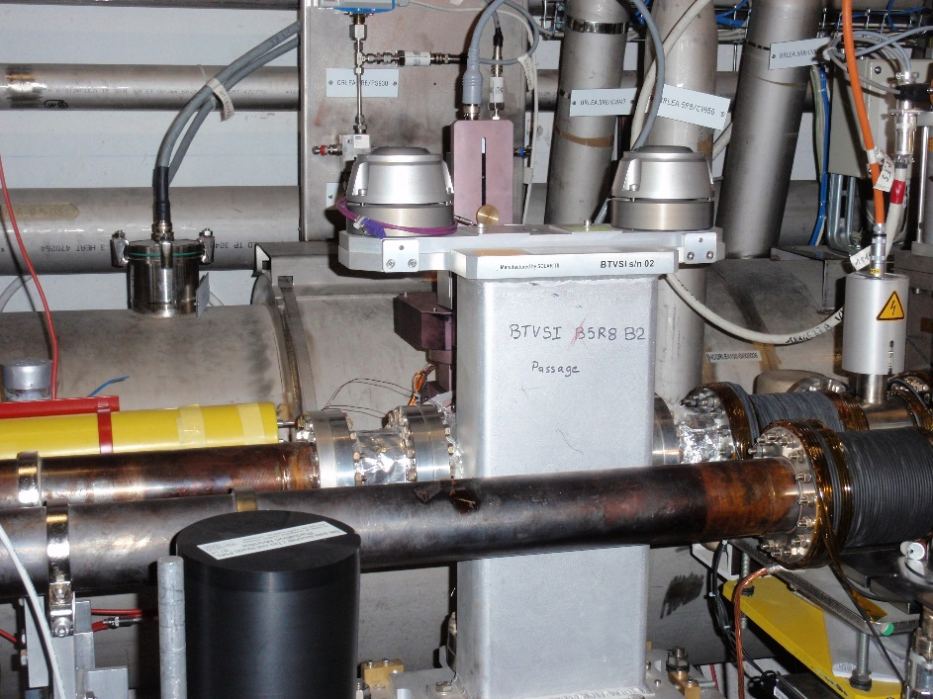
From model to reality - alignment
To ensure that the accelerator elements are in the correct position the alignment must be precise – to the level of micrometres for a linear collider like CLIC !
  At the CERN hadron machines we aim for accuracies of around 0.1-0.3 mm.
The alignment process implies:
  Precise measurements of equipment in the laboratory with reference to the element alignment markers used by the survey group: for example, the magnetic axis.
  Precise in-situ alignment (position and angle) of the element in the tunnel.
Alignment errors (and vibrations) are a common source of imperfections.

Slide 15
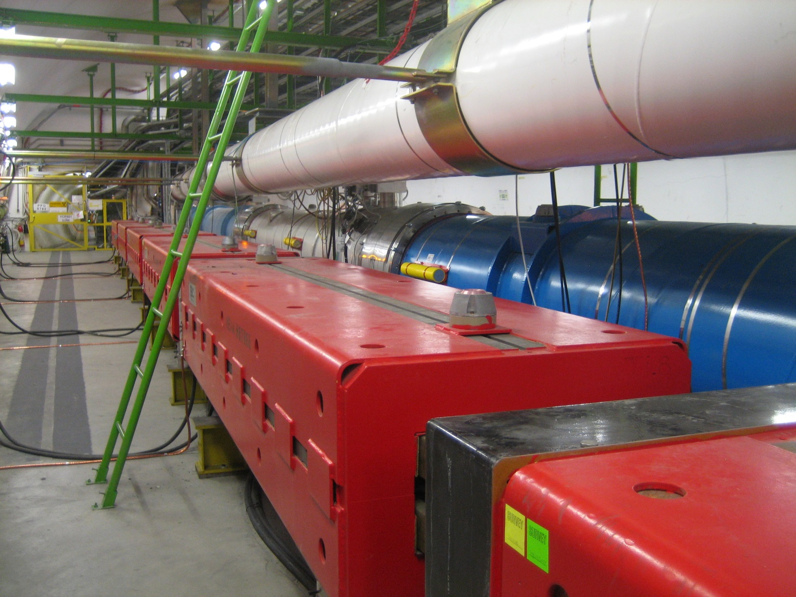


A good attitude in the tunnel
Always remember that accelerator components in the CERN tunnels are carefully aligned, please treat them with respect !
Please use the ladder !
(also, for your own safety)

Slide 16
Introduction
Imperfection - sources
Orbit perturbations
Linear imperfections, geology and vibrations
Summary

Slide 17
Imperfection – undesired deflection
Linear imperfections are the simplest form of machine errors involving dipole and quadrupole fields – we will focus today solely on dipole fields.
The presence of an unintended deflection along the path of the beam is a first category of imperfections.
This case is also in general the first one that is encountered when beam is first injected into a machine, or when a beam is launched into a linac.
The dipole orbit corrector is added to the accelerator cells to compensate the effect of unintended deflections.
  With the orbit corrector we can generate a deflection of opposite sign and amplitude that compensates locally the imperfection.
What are causes of unintended deflection?

Slide 18
Unintended deflection
The first source is a field error (deflection error) of a dipole magnet.
This can be due to an error in the magnet current or in the calibration table (measurement accuracy etc).
  The imperfect dipole can be expressed as a perfect one + a small error.
real dipole
ideal dipole
small dipole error
=
+
A small rotation (misalignment) of a dipole magnet has the same effect, but in the other plane.
real dipole
ideal dipole
small dipole error
=
+

Slide 19
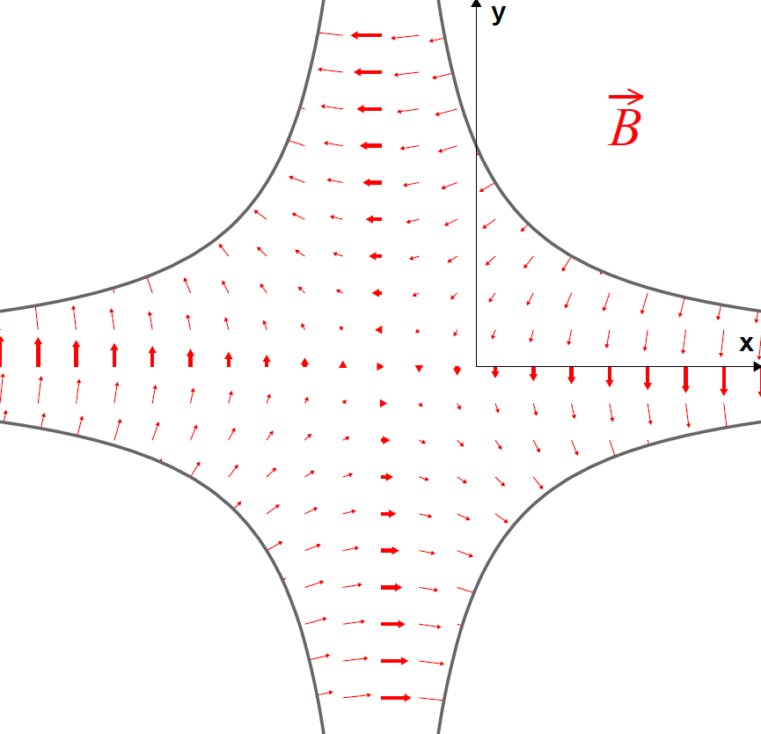
Unintended deflection
The second source is a misalignment of a quadupole magnet.
  The misaligned quadrupole can be represented as a perfectly aligned quadrupole plus a small deflection.
real quadrupole
ideal quadrupole
small dipole error
=
+
Non-zero magnetic field on the beam axis !
No magnetic field on the beam axis

Slide 20
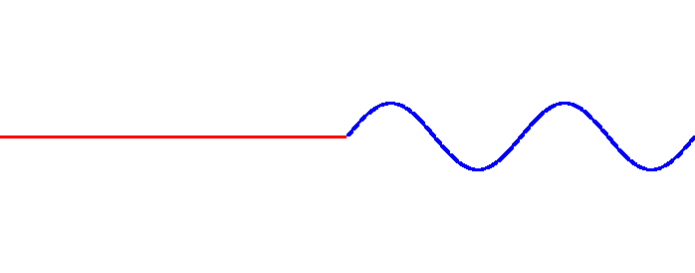
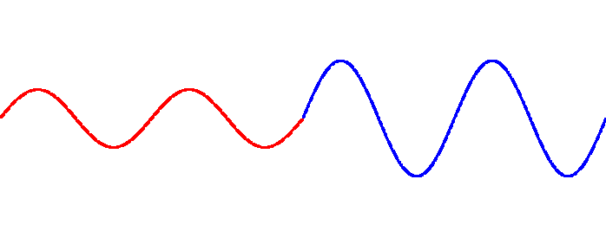
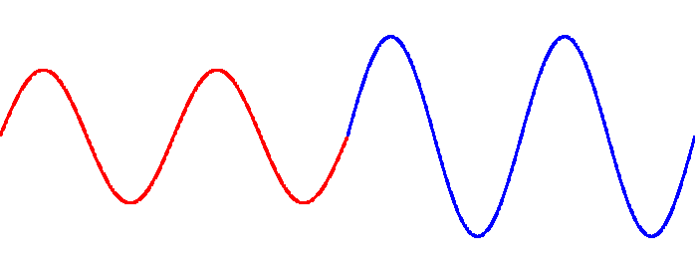
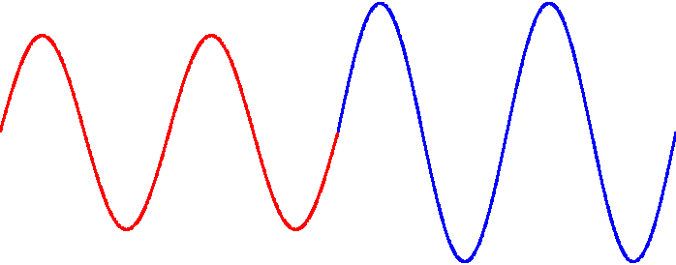
Effect of a deflection
Deflection
Particle direction
We set the machine tune to an integer value:
  Q = n ∈N
Turn no 1
When the tune is an integer number, the deflections add up on every turn !
  The amplitudes diverge, the particles do not stay within the accelerator vacuum chamber.
Turn no 2
Turn no 3
  We just encountered our first resonance – the integer resonance that occurs when Q = n ∈N
Turn no 4

Slide 21
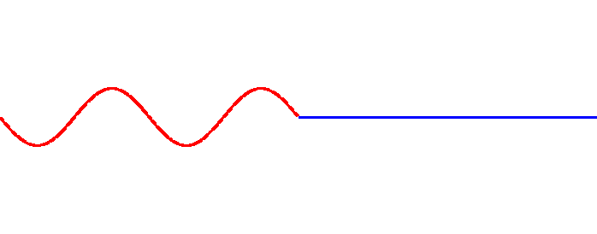
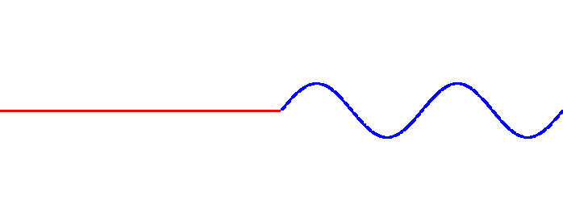
Effect of a deflection
Deflection
Particle direction
We set the machine tune to a half integer value:
  Q = n+0.5, n ∈N
Turn no 1
Turn no 2
For half integer tune values, the deflections compensate on every other turn !
  The amplitudes are stable.
Turn no 3
  This looks like a much better working point for Q!
Turn no 4

Slide 22
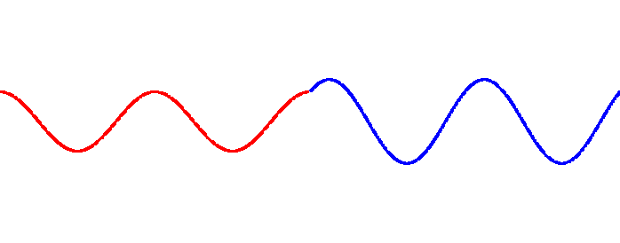
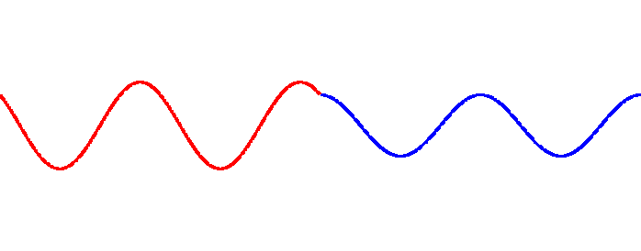
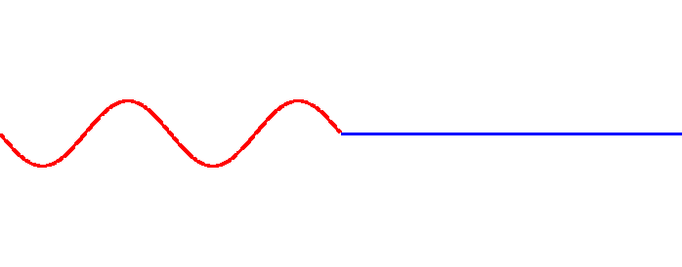
Effect of a deflection
Deflection
Particle direction
We set the machine tune to a quarter integer value:
  Q = n+0.25, n ∈N
Turn no 1
Turn no 2
For quarter tune values, the deflections compensate every four turns !
  The amplitudes are stable.
Turn no 3
  Also a reasonable working point for Q!
Turn no 4

Slide 23
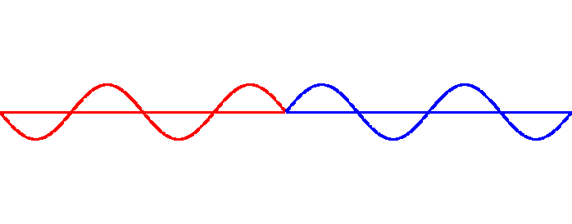
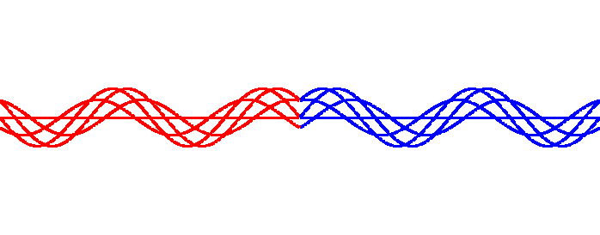

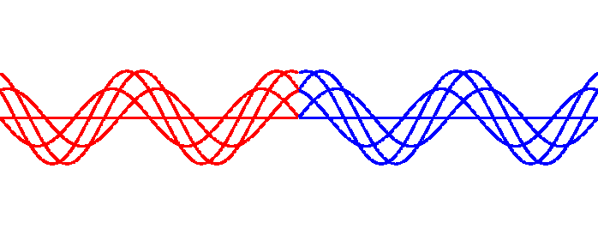
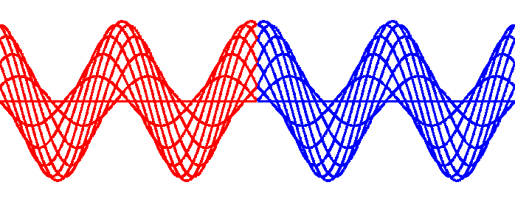
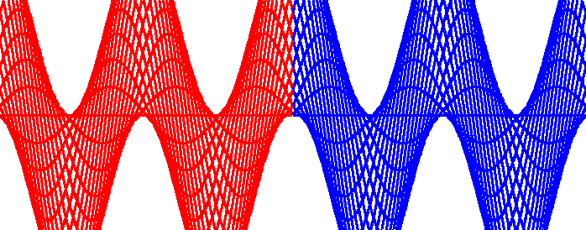
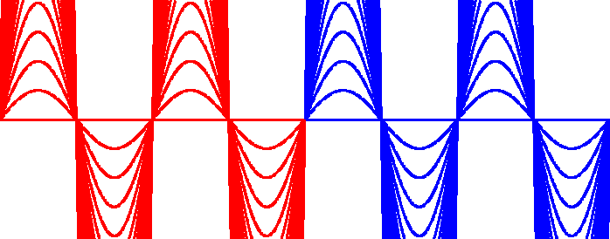
Many turns reveal something
Let’s plot the 50 first turns on top of each other and change Q.
  All plots are on the same scale
Q = n + 0.5
Q = n + 0.4
Q = n + 0.3
Q = n + 0.2
Q = n + 0.1
Q = n + 0.05
Q = n
The particles oscillate around a stable mean value (Q ≠ n)!
The amplitude diverges as we approach Q = n → integer resonance

Slide 24
The closed orbit
The stable mean value around which the particles oscillate is called the closed orbit.
  Every particle in the beam oscillates around the closed orbit.
  As we have seen the closed orbit ‘does not exist’ when the tune is an integer value.
The general expression of the closed orbit x(s) in the presence of a deflection θ is:
kink at the location of the deflection
oscillating term
amplitude modulated by the envelope β
Orbit response
divergence for Q = n

Slide 25
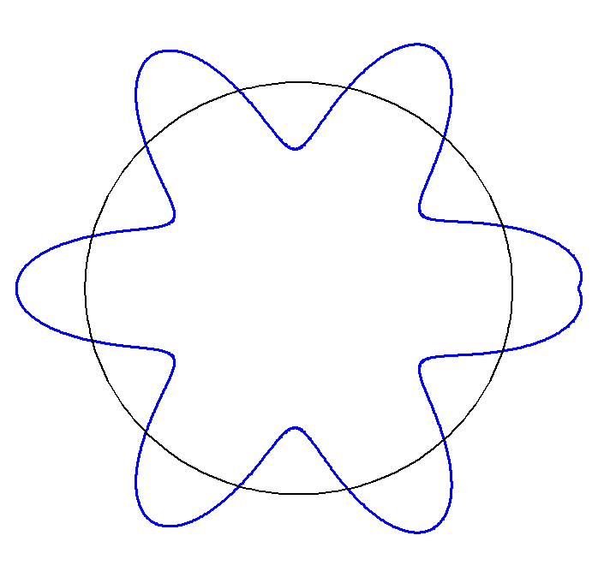
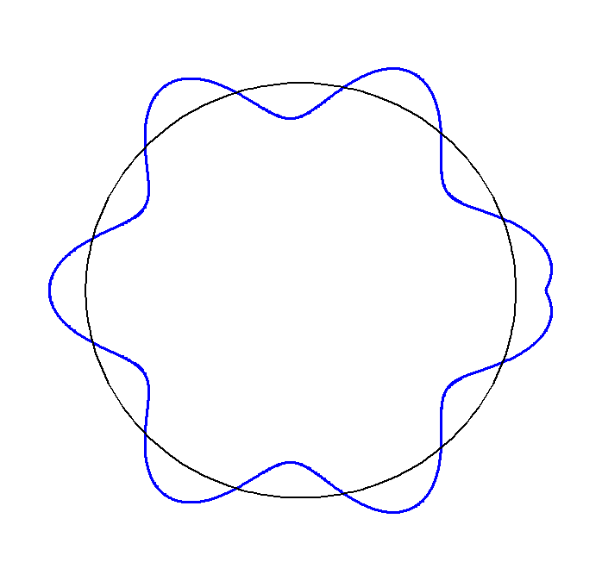
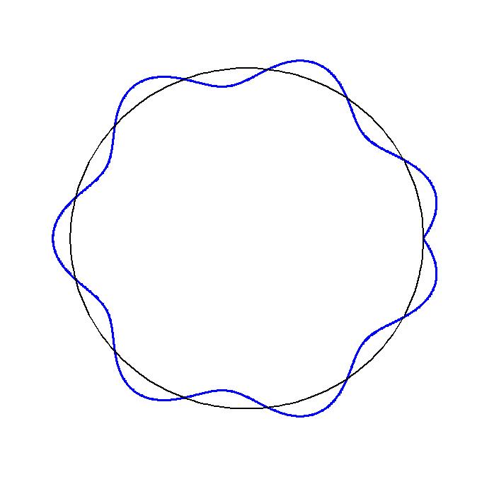
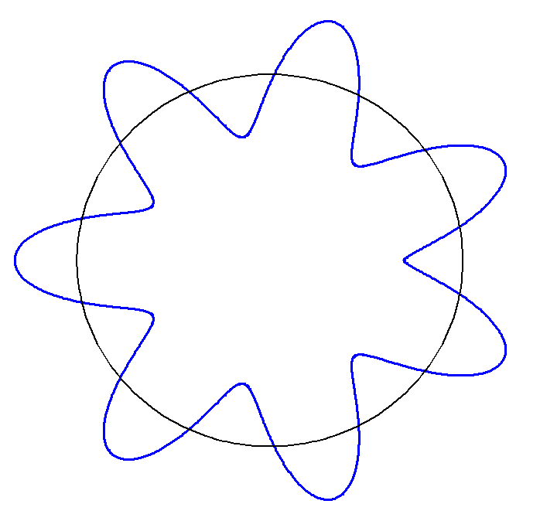
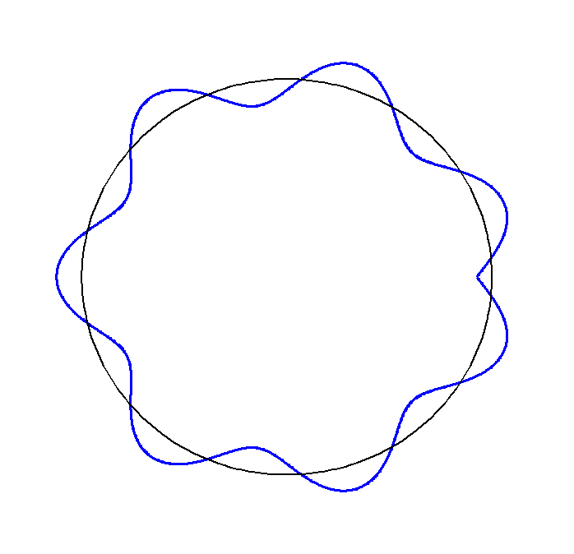
Closed orbit example
Example of the horizontal closed orbit for a machine with tune Q = 6 + q.
The kink at the location of the deflection (→) can be used to localize the deflection (if it is not known) → can be used for orbit correction.
Q = 6.1
Q = 6.2
Q = 6.5
Q = 6.9
Q = 6.7

Slide 26
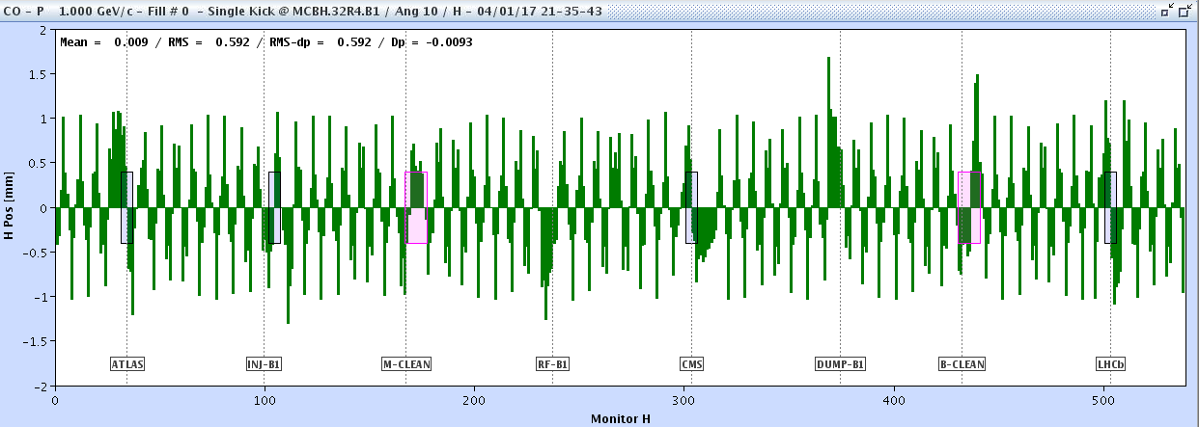
A deflection at the LHC
In the example below for the 26.7km long LHC, there is one undesired deflection, leading to a perturbed closed orbit.
Beam position x (mm)
BPM index along the LHC circumference
This is what you see in the control room
Where is the location of the deflection?

Slide 27
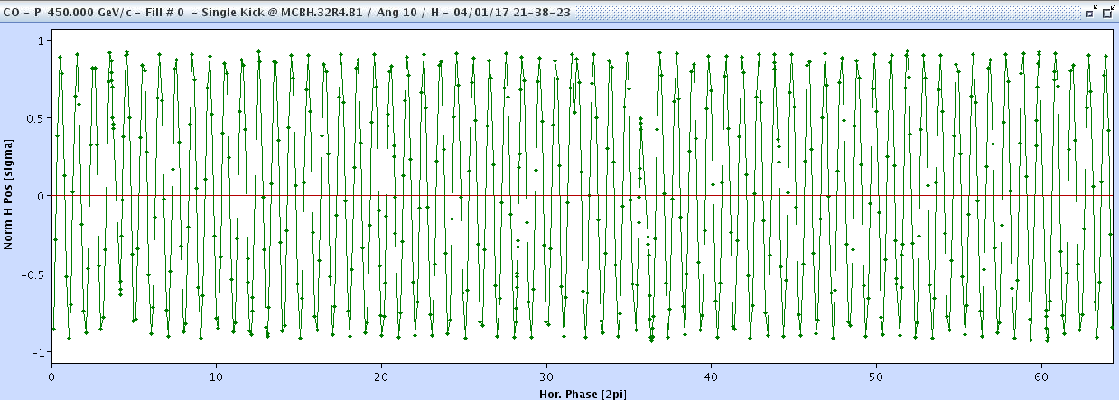
A deflection at the LHC
To make our life easier we divide the position by √β(s) and replace the BPM index by its phase μ(s) → to normalized coordinates.
Beam position x/√β
Betatron phase μ
Can you localize the deflection?

Slide 28
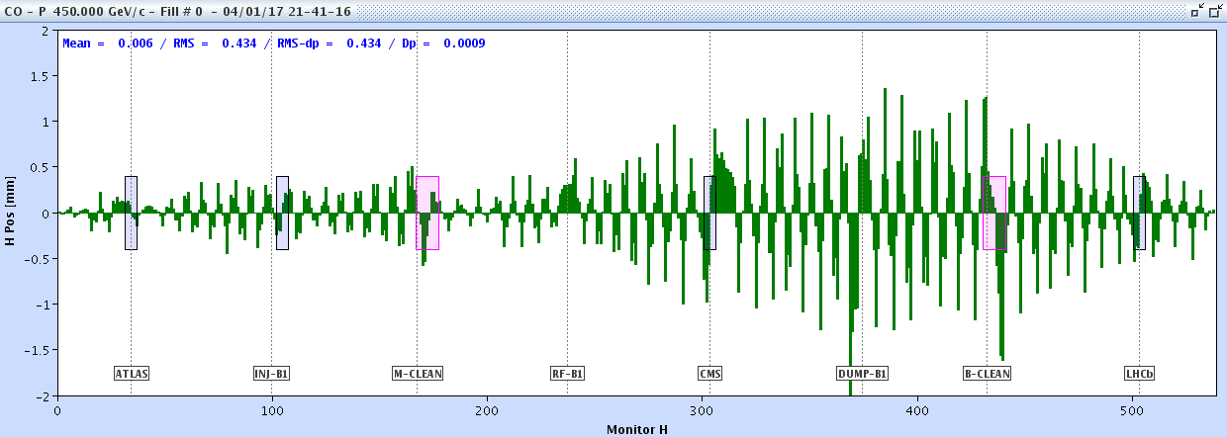
A more realistic case at LHC
Now a more realistic orbit with 100’s of deflections.
How do we proceed to correct?

Slide 29
Orbit correction
Nowadays there are two main approaches for orbit correction:
  Matrix inversion algorithms relying on the knowledge the response R(s).
    R(s) is measured or calculated.
    Popular algorithms: MICADO and SVD (Singular Value Decomposition), both come with many variants.
  Machine learning with a neural network that is trained to find a solution.
    The training may be based on data or on a model, or on continuous reward-like training.
Inversion algorithms have the advantage of higher intrinsic flexibility (correction quality and flexibility, noise reduction,…), they can be reused at different machines without need for tuning – they are in a sense ‘universal’.
  Good convergence even for error on β of 30%.
Machine learning based technique are adapted to situations where models are difficult to establish, change over time, for example in low energy machines and some linacs. A model trained on a certain machine cannot be reused elsewhere.

Slide 30
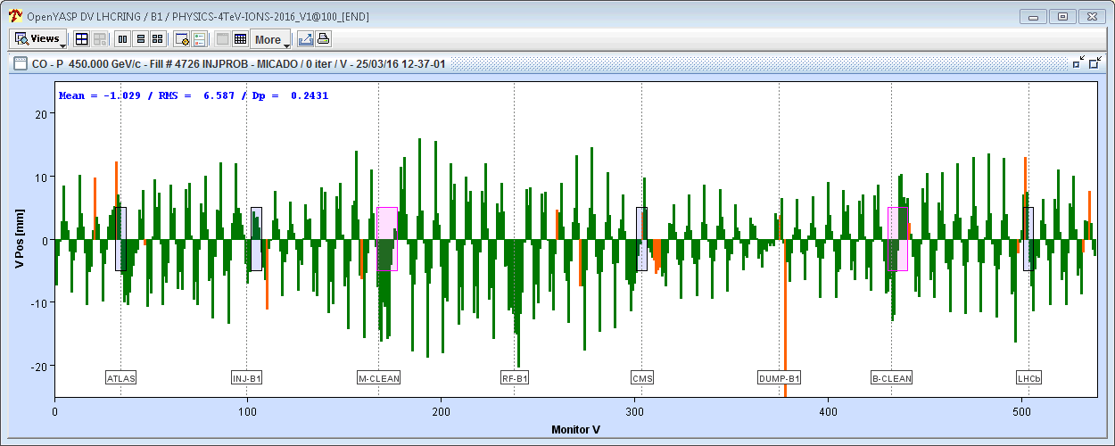


LHC orbit correction example
The raw orbit at the LHC can have huge errors, correction reduce the errors by > factor 20.
  Tuning the LHC orbit takes ~2-4 hours for both beams and planes (with fine features around experiments)
Uncorrected horizontal orbit of ring 1
50 mm
MICADO & SVD
LHC vacuum chamber
Corrected horizontal orbit of ring 1
50 mm
At the LHC a good orbit correction is a key to good performance !
34 mm
44 mm

Slide 31

Linear imperfection,geology
and vibrations
Image: NASA/NOAA
Deep Space Climate Observatory (DSCOVR) satellite

Slide 32
Static and dynamic
So far, we have considered the imperfections (deflections) as “static”.
In the real world, imperfections evolve over time:
  The ground is moving around components → quadrupoles deflections will vary over time.
  The current sources of a magnet may not deliver a perfectly constant current, for example due to regulation ripple or imperfect filtering (50 Hz and many of its harmonics).
  …
The problem of imperfections, for example those impacting trajectories and orbits, is dynamic, extending over a large frequency range.

Slide 33

Vibrating Earth
The ground below our feet is in constant movement over a large range of frequencies.
  Slow deformations due to tectonic movements, daily deformations due to tides,
  Vibrations due to ocean waves, seismic activity, human activity…
  The amplitudes generally decrease at higher frequencies.
Ground motion spectrum of the LHC tunnel
Vertical scale corresponds to (amplitude)² ~ power
The integrated ground movement due to noise > 1 Hz is ~1-20 nm.
  This is (seems) to be a very small number.
  No problem for LHC…
  Can be problematic for FCCee or for a linear collider, due to the very tiny vertical beam emittances (sizes).
1 μm
1 nm
Ocean wave peak
10s
1s
0.1s
C. Collette et al, PRAB 13, 072801

Slide 34


Accelerator component girders
The mechanical properties of components and of girders have an important impact on the stability due to mechanical resonances !
Example for a mock-up of the FCCee quadrupole assembly (for simulation benchmarking)
The movement of the quadrupole is amplified by up to a factor 100 at certain frequencies
Improvements needed !!
Amplitudes are driven by the support jacks
Quadrupole
Ground

Slide 35



Civil engineering impact
HL-LHC has built huge underground structures in LHC points 1 and 5.
Civil engineering is not famous for working ‘quietly’ !
Noise and vibrations !
CMS experiment cavern
~100 m underground
LHC beam line = LHC magnets

Slide 36


Civil engineering impact
In the early part of the CE work, a lot of soil was moved around and compacted while LHC was operating.
Ground compactors compact soil by… vibrating.
…and they managed to shake the beams colliding at the IP ~100 m underground.
Mechanism:
The vibrations with frequencies ~20 Hz were transmitted through 100 m of rock to the tunnel magnets and their girders which resonate in the frequency range 8-22 Hz.
The resonant excitation generated micrometer amplitude beam movements that were clearly visible on the CMS experiments luminosity (= rate of collisions).
vibrations
Luminosity = collision rate
Beam loss rates

Slide 37



Waves from earthquakes
Different types of body (Pressure, Shear) and surface waves (Raleigh, Love), multiple paths and reflections produce a complex signature of earthquakes at seismic measurement stations – also at accelerators like the LHC.
L. Braille (Purdue U.) / The IRIS (Incorporated Research Institutions for Seismology) consortium

Slide 38





Costa Rica earthquake (2012) – LHC as seismograph
A magnitude 7.6 earthquake in Costa Rica (05/09/2012 @ 14:42:10 UTC) ‘struck’ the LHC with stable colliding beams.
  Arrival of the first waves at CERN ~15:06 UTC.
1 hour !
Surface waves
P
zoom
The arrival of the different waves can be observed on the radial beam position – equivalent to ~0.5-1 mm circumference oscillations.
The stable collisions continued while the waves moved across the ring.

Slide 39

Vibrating quadrupoles at LHC?
For many years, a class of rare beam loss events remained un-explained at the LHC.
Signature: the beams suddenly oscillate transversely at 8-10 Hz leading to beam abort due to beam losses exceeding tolerable thresholds.
The analysis of the orbits before beam loss (see earlier slides) pointed in all cases to well defined source, consistent with micrometer amplitude oscillations of a single quadrupole.
  The LHC quadrupole have mechanical resonances in the range 8-20 Hz.
  The sources are not randomly distributed, in 2023 there were only 2 locations for 7 events.
  What could be a trigger ???
Max orbit change in such events (modulated at ~10 Hz)
Source point

Slide 40



LHC vibrating quadrupoles (2)
One location was instrumented with vibrations sensors in February 2024.
Observations…
The offline analysis of many signals pointed eventually towards a cryogenic valve used to re-pressurize the cold magnets with liquid Helium at 3.5 bar. Refill frequency depends on … leaks.
Vibration of the cryostat at 8 and 10 Hz !

Slide 41


Slow ground movements – days to years
In large tunnels (LEP/LHC, future FCC) geology has an important impact.
Geological fault lines can degrade the stability locally by more than an order of magnitude.
  From ~70 μm drift / year in ‘quiet’ areas to many mm around active faults.
LEP(LHC) map with fault lines
Evolution of LEP element positions from 1993 to 1999 (one line / year)
R. Pitthan, CLIC note 422

Slide 42


FCC tunnel preparation
The 91 km long FCC tunnel placement must be studied carefully (location, depth) to minimize the complications due to geologic structures (change of rock type, fault lines, lakes and rivers, ...
  Depth is ~200-400 m compared to 50-140m for LHC.
  Ongoing measurement campaign (seismic with vibrating trucks, test drilling).
Tribune de Geneve, 19.12.2024

Slide 43



Earth tides
Tide bulge of a celestial body of mass M at a distance d
Such Earth tides alter the accelerator circumferences:
The Moon contributes 2/3, the Sun 1/3.
Not resonance-driven (unlike Sea tides !).
Accurate predictions possible (~%).
θ = angle(vertical, the celestial body)
induces surface deformations and affects the water levels of the oceans, like a deformed ballon.
LEP tide predictions for Nov. 1992
The relative circumference change amounts to ~10⁻⁸ ~ 1 mm – resolution ~ 0.01-0.001 mm.
Gravitational wave detectors achieve sensitivities of ~10⁻²¹ !

Slide 44


LHC circumference observations
Tides are observed very clearly on the LHC circumference by measuring the mean radial (=horizontal) beam position.
Measurements
Model
Tide observations (from orbit changes) over one week at 4 TeV in 2016
(expressed in energy change Δp/p)
Earthquake in New Zealand
The pressure waves induce a modulation of the circumference
dp/p
10⁻⁴

Slide 45
Summary
Magnetic field and misalignments errors of accelerator components induce errors on the beam orbits over a large frequency range.
The errors are often sufficiently large that modern machines operate poorly or not at all.
Fortunately, ever improving tools and algorithms have been developed over the past 50 years to correct errors.
To minimize the imperfections from the start it is important to have:
  the best possible magnet (component) design,
  carefully measured magnetic fields,
  precise power converters,
  the best possible machine alignment,
  a quiet environment.
Thank you for your perfect attention !

