Slide 2
Injection and extraction
P. Arrutia, CERN, Geneva, Switzerland (SY-ABT-BTP)
with material from past and current members of the ABT group as well as F. Tecker

Slide 3

Copyright statement and speaker’s release for video publishing
The author consents to the photographic, audio and video recording of this lecture at the CERN Accelerator School. The term “lecture” includes any material incorporated therein including but not limited to text, images and references.
The author hereby grants CERN a royalty-free license to use his image and name as well as the recordings mentioned above, in order to post them on the CAS website.
The material is used for the sole purpose of illustration for teaching or scientific research. The author hereby confirms that to his best knowledge the content of the lecture does not infringe the copyright, intellectual property or privacy rights of any third party. The author has cited and credited any third-party contribution in accordance with applicable professional standards and legislation in matters of attribution.

Slide 4
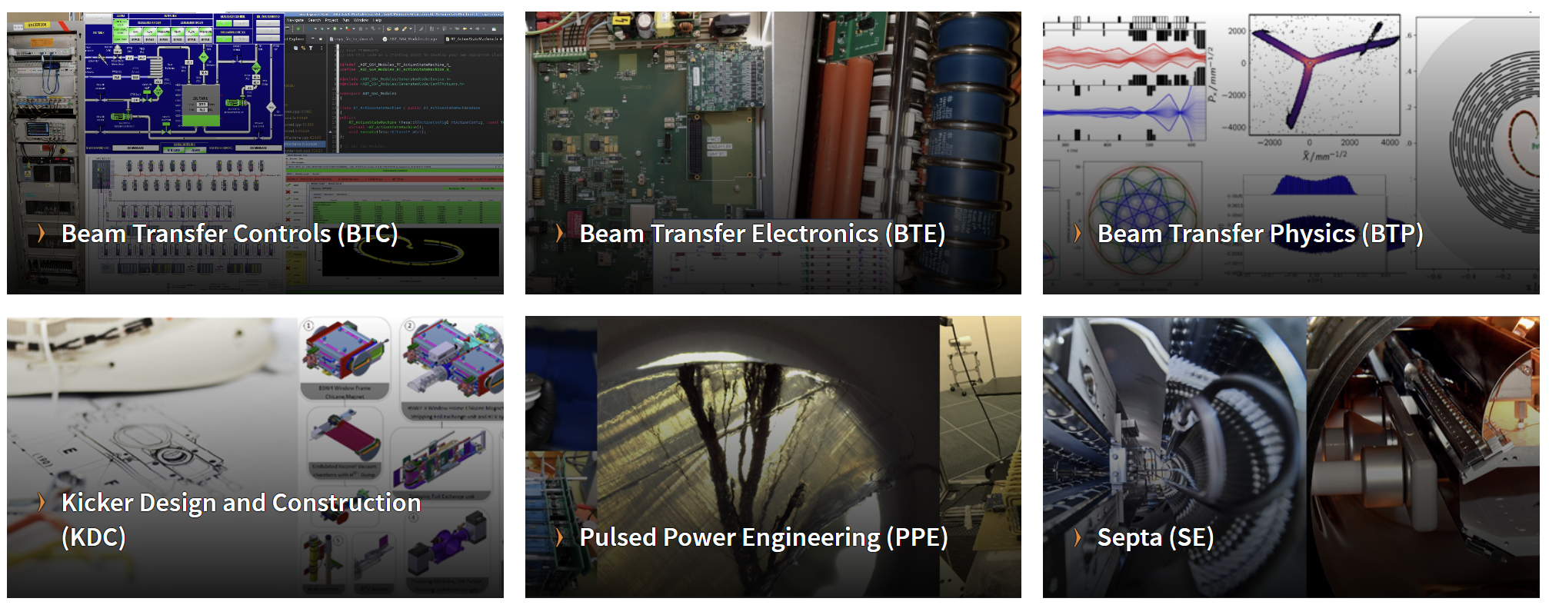
Injection-Extraction @CERN
CERN Accelerator Beam Transfer group: website

Slide 5
Introduction
Accelerators have limited ranges of energies: particles get accelerated in a chain of accelerators.
Injection and extraction between stages needs careful consideration
  To deliver beams with required properties to users.
The limits of this lecture: mostly focused on synchrotrons!

Slide 6
Layout
Basic principle + hardware
Injection techniques
  Fast injection
    Normalized phase space
    Imperfect injection
  Multi-turn injection
  Charge exchange technique
  Lepton injection
Extraction techniques
  Fast extraction
  Multi-turn extraction
  Resonant multi-turn extraction
  Resonant slow extraction
Transfer between machines
R&D example
Conclusion
Extraction
Transfer
Injection

Slide 7
Layout
Basic principle + hardware
Injection techniques
  Fast injection
    Normalized phase space
    Imperfect injection
  Multi-turn injection
  Charge exchange technique
  Lepton injection
Extraction techniques
  Fast extraction
  Multi-turn extraction
  Resonant multi-turn extraction
  Resonant slow extraction
Transfer between machines
R&D example
Conclusion
Extraction
Transfer
Injection

Slide 8
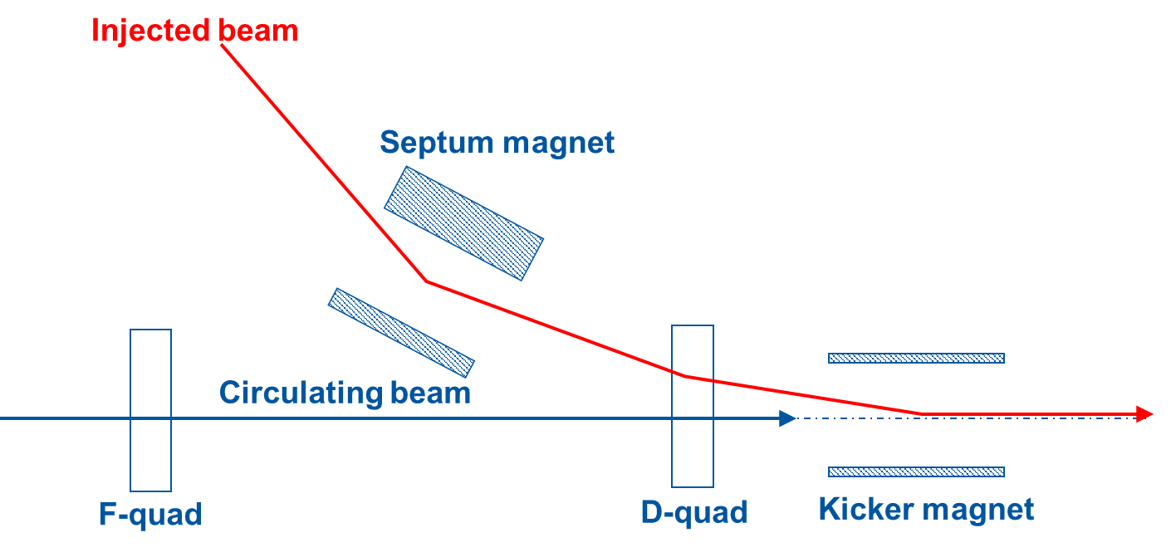
Basic principle

Slide 9
Basic principle
intensity
injected
beam
kicker field
t
Kickers produce fast pulses, rising their field within the particle-free gap in the circulating beam (temporal separation)

Slide 10
Basic principle
intensity
injected
beam
kicker field
t
Kickers produce fast pulses, rising their field within the particle-free gap in the circulating beam (temporal separation)
Septa compensate for the relatively low kicker strength, and approach closely the circulating beam (spatial separation)

Slide 11
Basic principle: Kicker
Aperture dimensions constrained by beam size at kicker location.
Short rise time: < 100 ns –few ms: low inductance.
Maximise horizontal kick: small vertical aperture.
HV conductor
Return conductor
Ferrite
HV
Vertical aperture, V_{ap}
B
μ₀
μ_{r}
Horizontal
aperture, H_{ap}

Slide 12

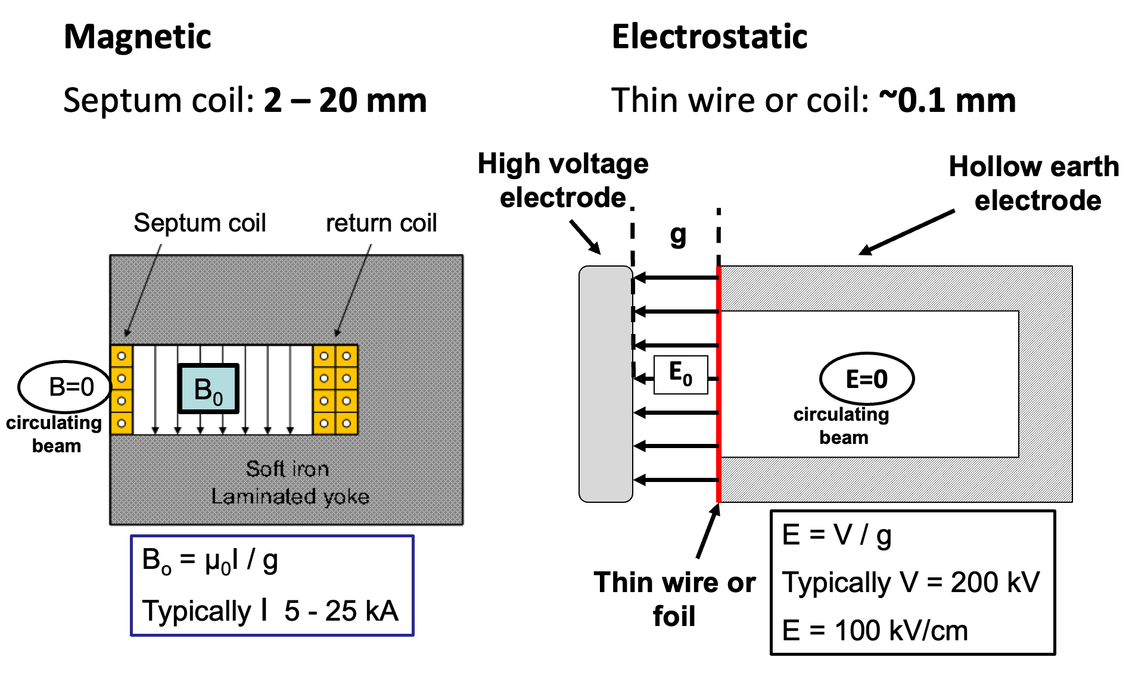
Basic principle: septum

Slide 13
Layout
Basic principle + hardware
Injection techniques
  Fast injection
    Normalized phase space
    Imperfect injection
  Multi-turn injection
  Charge exchange technique
  Lepton injection
Extraction techniques
  Fast extraction
  Multi-turn extraction
  Resonant multi-turn extraction
  Resonant slow extraction
Transfer between machines
R&D example
Conclusion
Extraction
Transfer
Injection

Slide 14
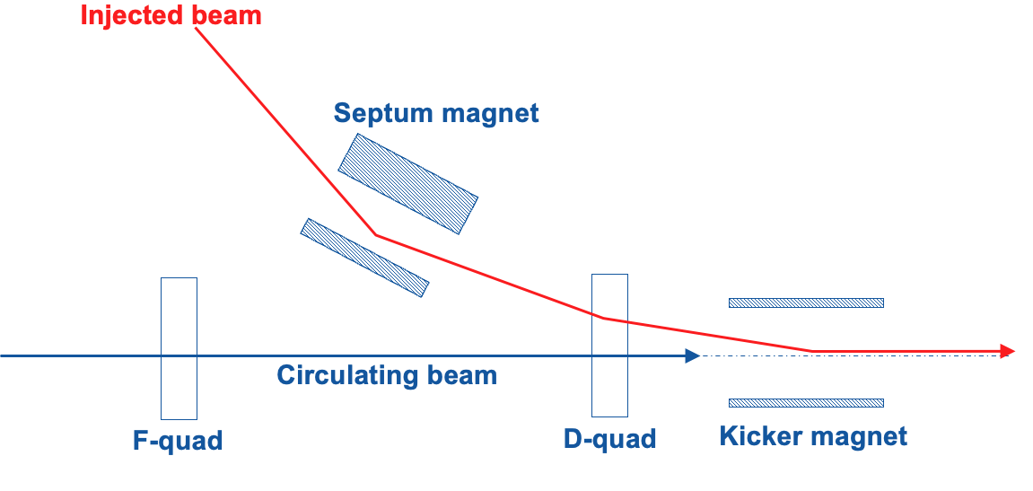
Fast injection: concept
‘boxcar’ stacking
intensity
injected
beam
kicker field
t
Septum + kicker work together to put beam onto reference trajectory.
Several trains can be stacked (e.g. from smaller ring to larger).
Slow bumpers may be used to minimize necessary kicks.
Applications: PS, SPS, LHC, etc. (“Bread and butter” of injection.)

Slide 15
Layout
Basic principle + hardware
Injection techniques
  Fast injection
    Normalized phase space
    Imperfect injection
  Multi-turn injection
  Charge exchange technique
  Lepton injection
Extraction techniques
  Fast extraction
  Multi-turn extraction
  Resonant multi-turn extraction
  Resonant slow extraction
Transfer between machines
R&D example
Conclusion
Extraction
Transfer
Injection

Slide 16
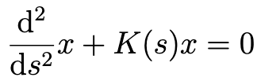
Normalized phase space: concept
E
E
Hill’s equation describes oscillator whose amplitude and frequency vary with s coordinate.
ds
~K(s0)
~K(s1)
x
x

Slide 17
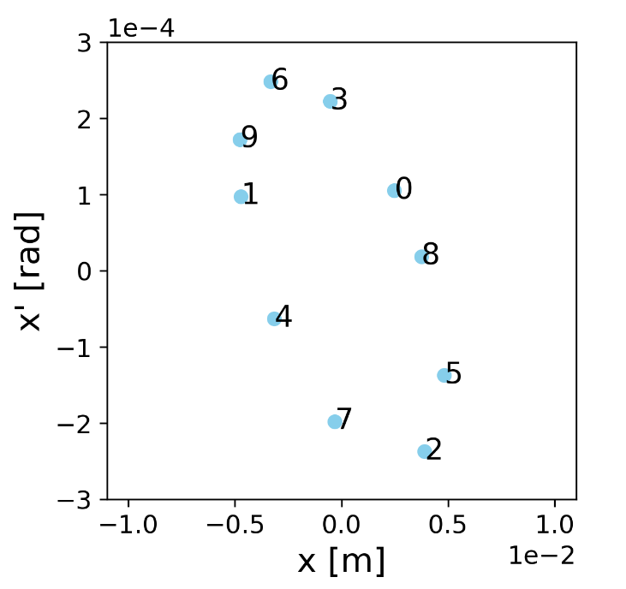
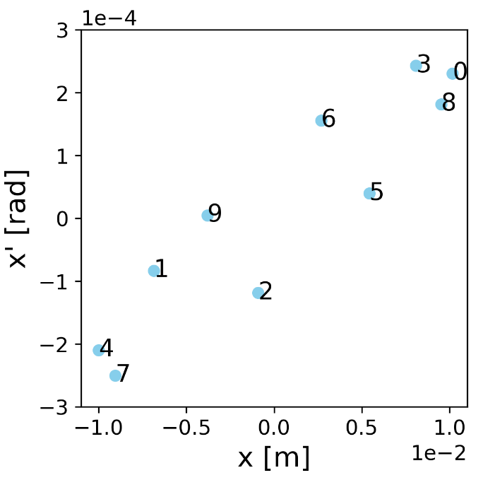
Normalized phase space: concept
E
E
Hill’s equation describes oscillator whose amplitude and frequency vary with s coordinate.
ds
~K(s0)
~K(s1)
x
x

Slide 18
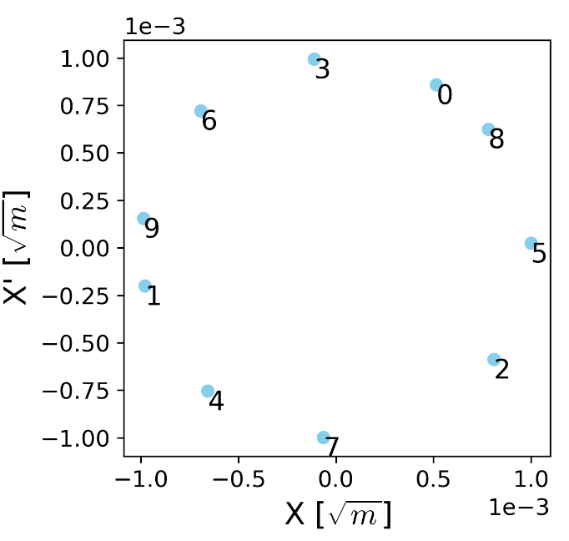
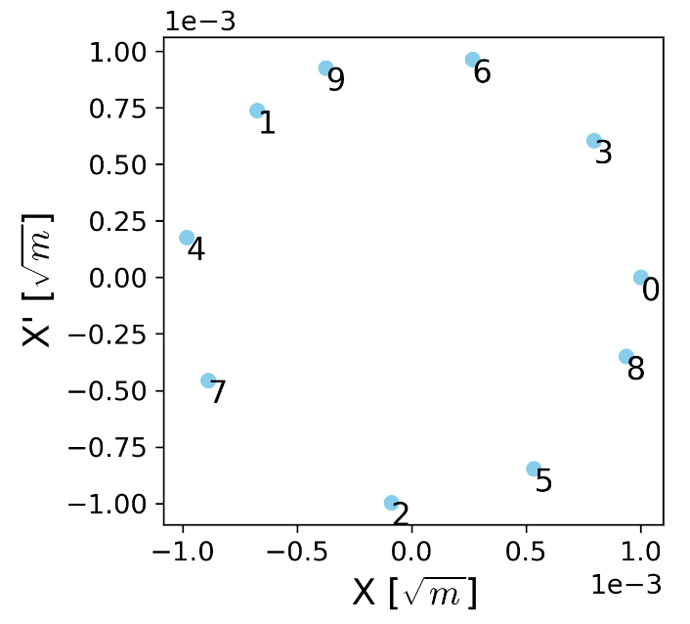
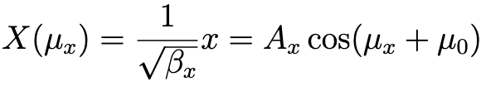
Normalized phase space: concept
E
E
Hill’s equation describes oscillator whose amplitude and frequency vary with s coordinate.
dμ
s0
s1
dμ
X
X

Slide 19
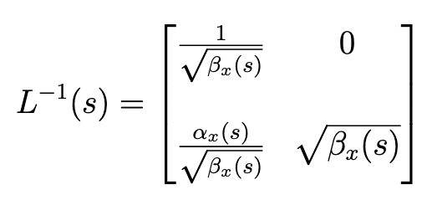
Normalized phase space: math
Real phase space
Normalised phase space
x’(s)
⇒
x(s)
Area = πε
Area = πε
Normalization matrix

Slide 20
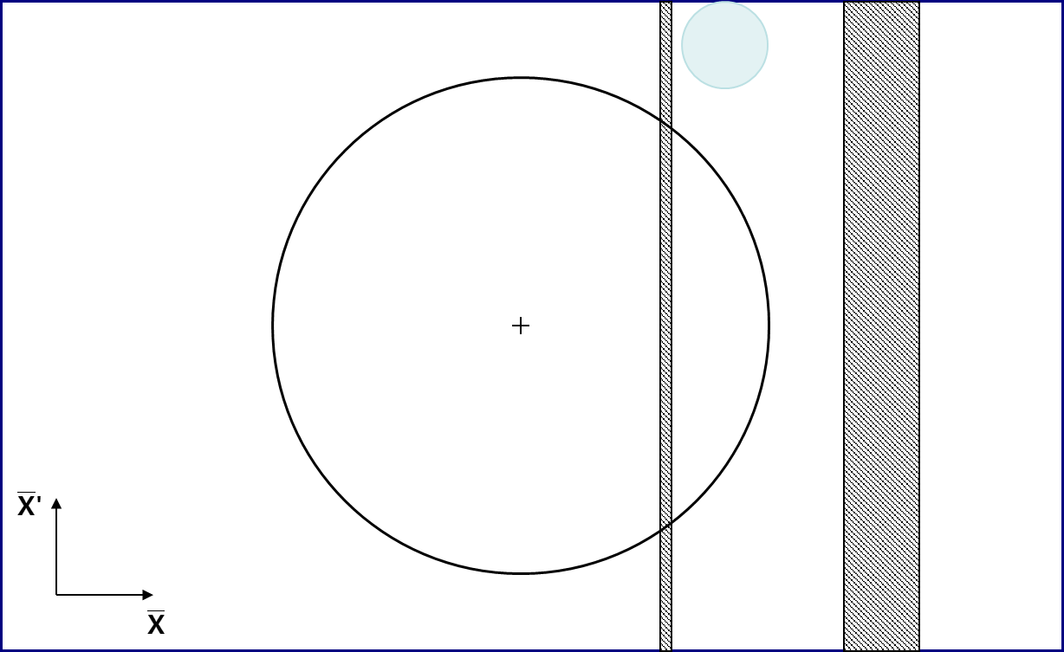
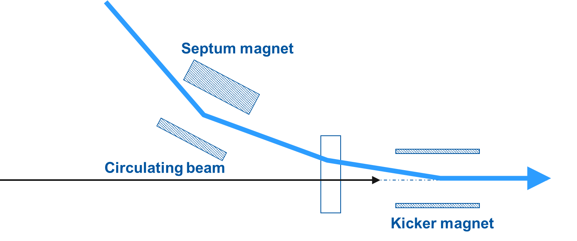
Fast injection: normalized phase space
Seen from the ring
  in the normalized transverse phase space in the plane of injection

Slide 21
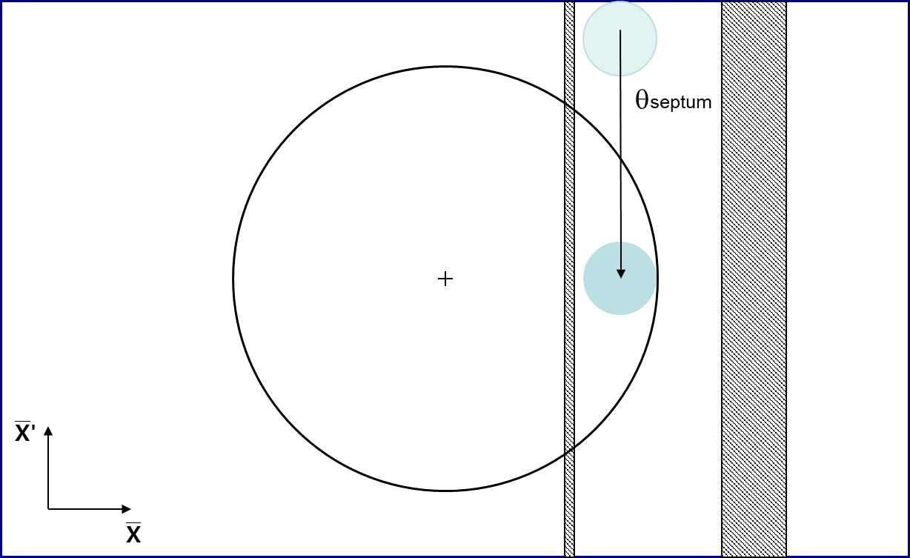
Fast injection: normalized phase space
Seen from the ring
  in the normalized transverse phase space in the plane of injection

Slide 22
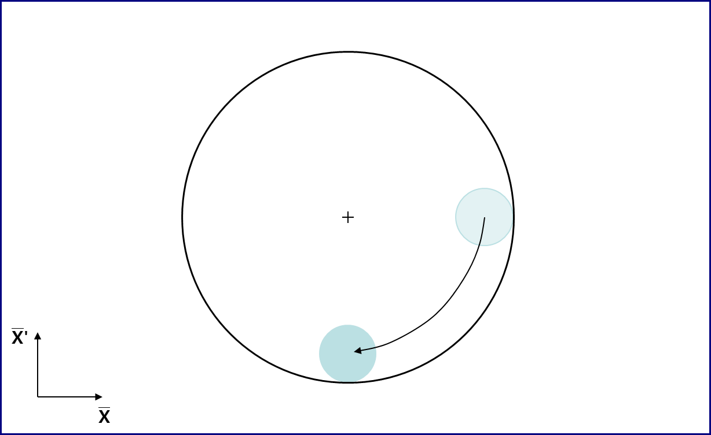
Fast injection: normalized phase space
Seen from the ring
  in the normalized transverse phase space in the plane of injection

Slide 23
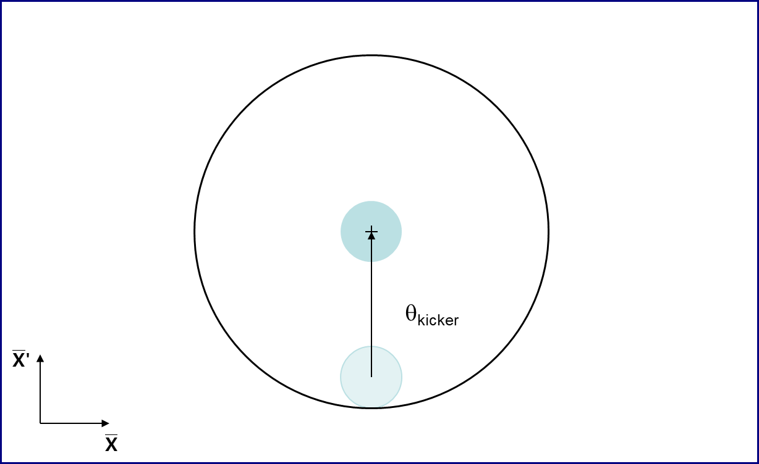
Fast injection: normalized phase space
Seen from the ring
  in the normalized transverse phase space in the plane of injection

Slide 24
Layout
Basic principle + hardware
Injection techniques
  Fast injection
    Normalized phase space
    Imperfect injection
  Multi-turn injection
  Charge exchange technique
  Lepton injection
Extraction techniques
  Fast extraction
  Multi-turn extraction
  Resonant multi-turn extraction
  Resonant slow extraction
Transfer between machines
R&D example
Conclusion
Extraction
Transfer
Injection

Slide 25
Imperfect injection: injection oscillations
Challenges
  Injected beam needs to be matched and aligned to the lattice and trajectory of the ring.
  Injection kicker(s) needs to be fast enough to deflect only the injected beam.

Slide 26
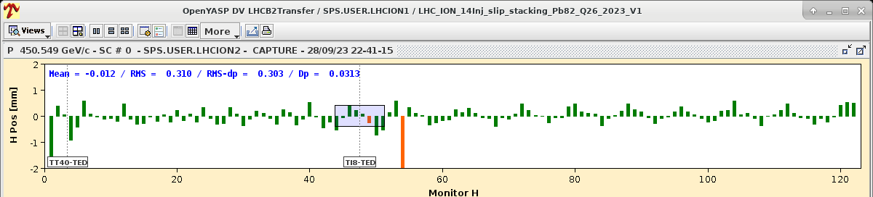
Imperfect injection: injection oscillations
Challenges
  Injected beam needs to be matched and aligned to the lattice and trajectory of the ring.
  Injection kicker(s) needs to be fast enough to deflect only the injected beam.
Injection oscillations at LHC injection
SPS
TI8 transfer line
First arc of LHC (P8 to P7)

Slide 27
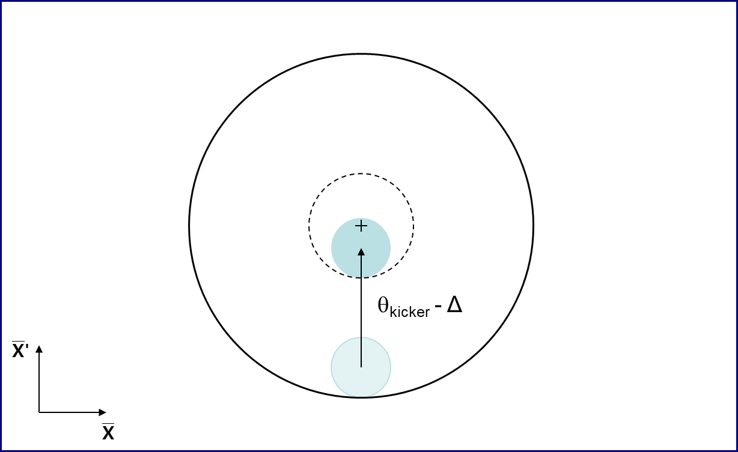
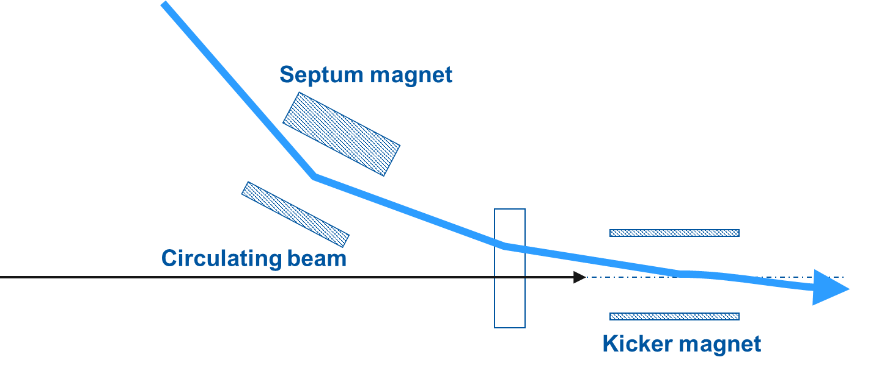
Imperfect injection: injection oscillations
Injection with a dipole error, here of Δ in angle at the kicker

Slide 28
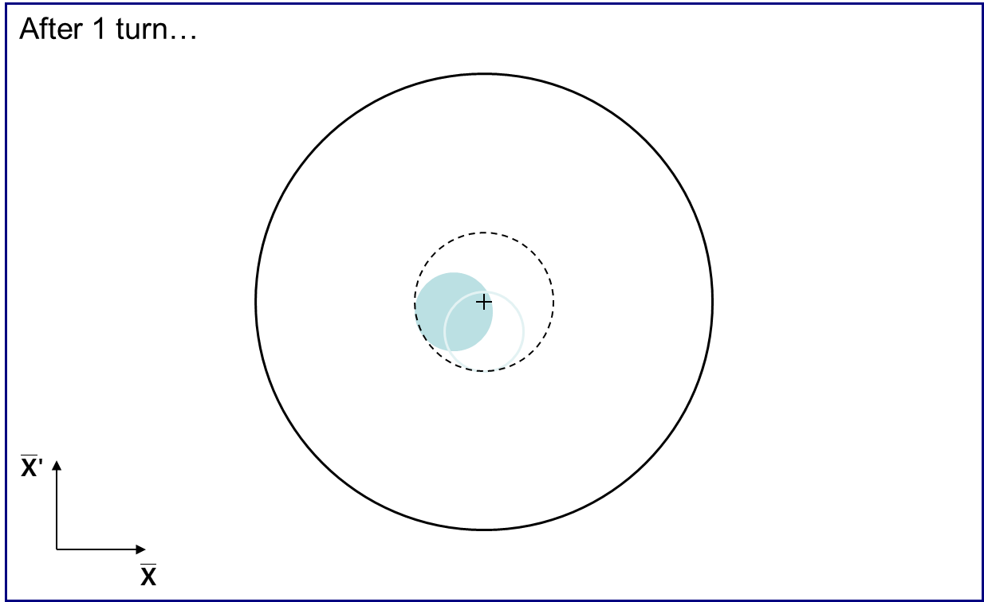
Imperfect injection: injection oscillations
In the normalized phase space
  The beam rotates around the closed orbit

Slide 29
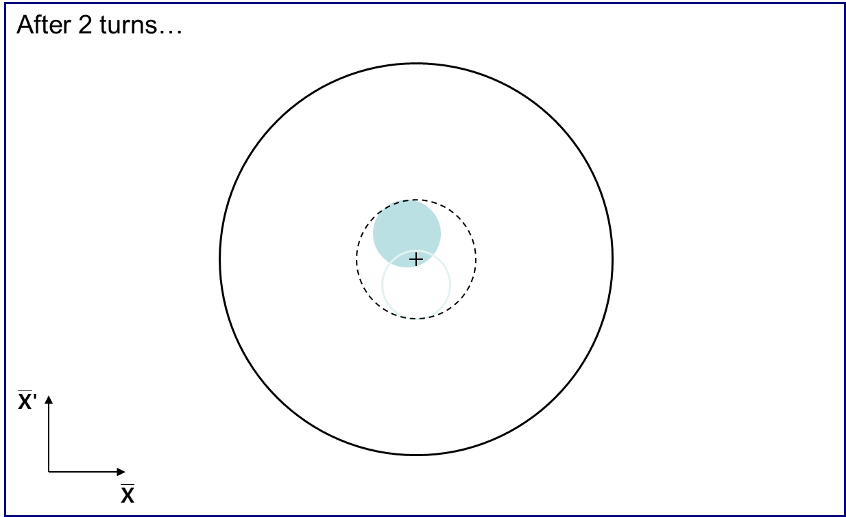
Imperfect injection: injection oscillations
In the normalized phase space
  The beam rotates around the closed orbit

Slide 30
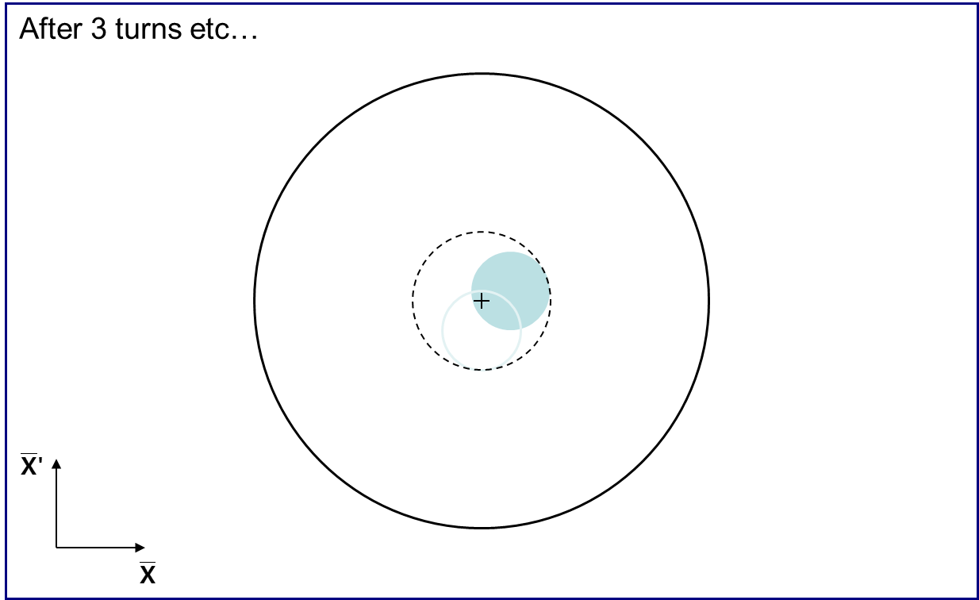
Imperfect injection: injection oscillations
In the normalized phase space
  The beam rotates around the closed orbit

Slide 31
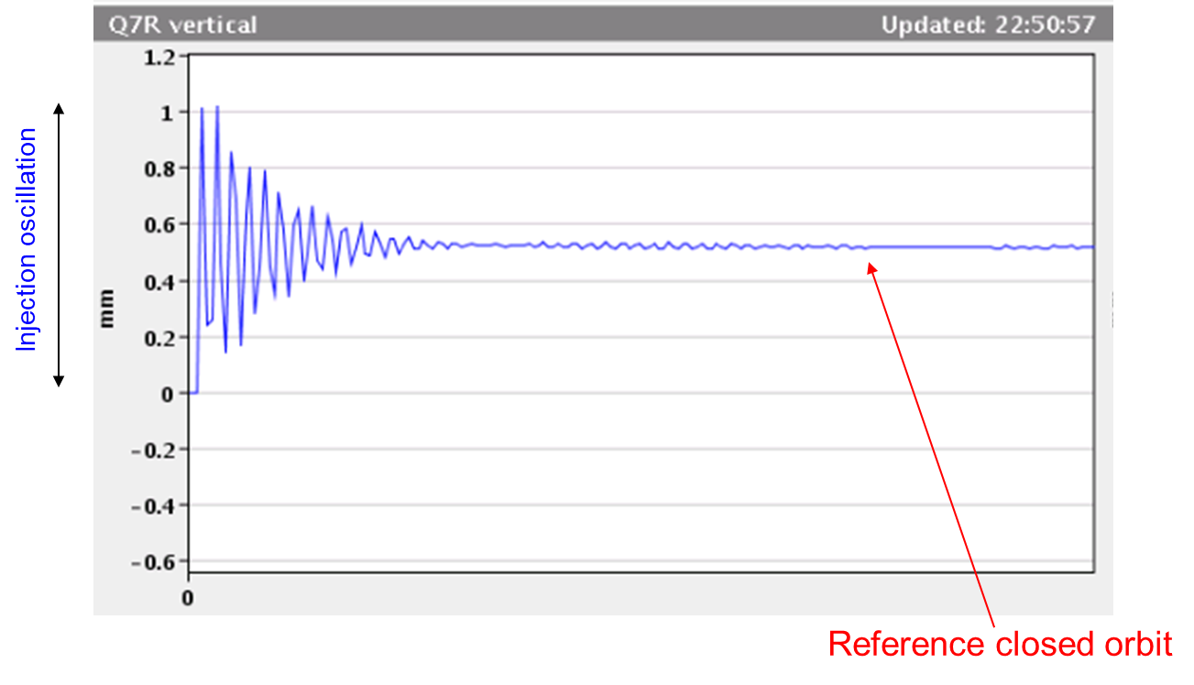
Imperfect injection: Filamentation
If injection oscillation is left uncorrected, it might disappear after several turns.
BPM signal over many turns
Turn #

Slide 32
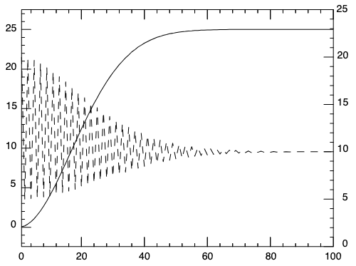
Imperfect injection: Filamentation
If injection oscillation is left uncorrected, it might disappear after several turns.
However, it has been “exchanged” for an r.m.s. emittance blow-up.
BPM signal over many turns
emittance
orbit
Turn #
Turn #

Slide 33
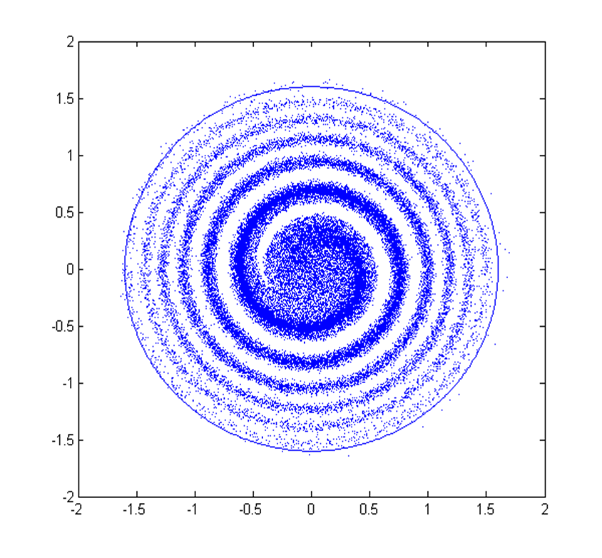
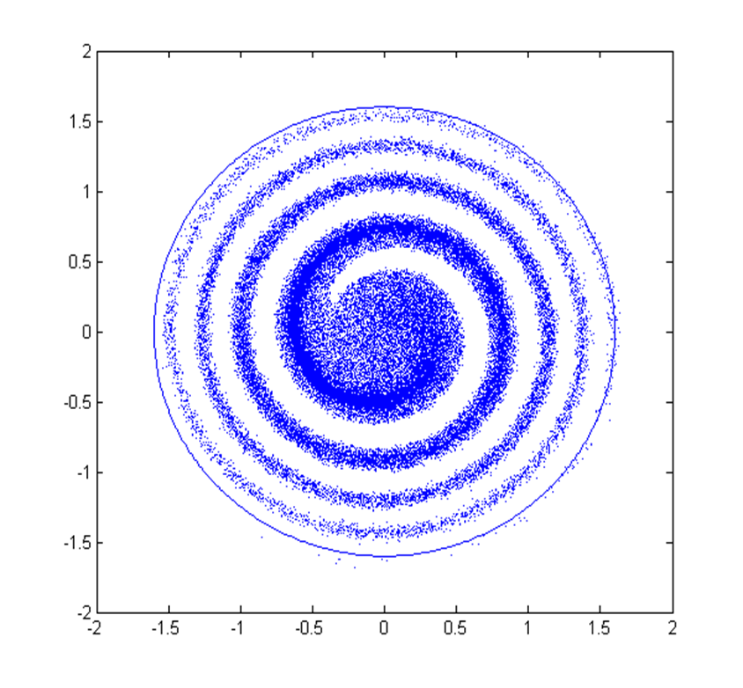
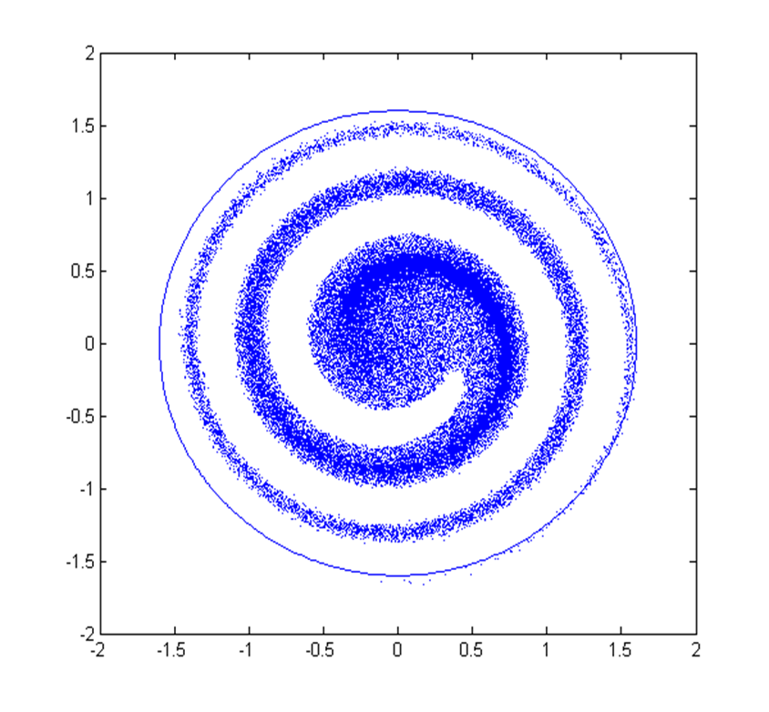
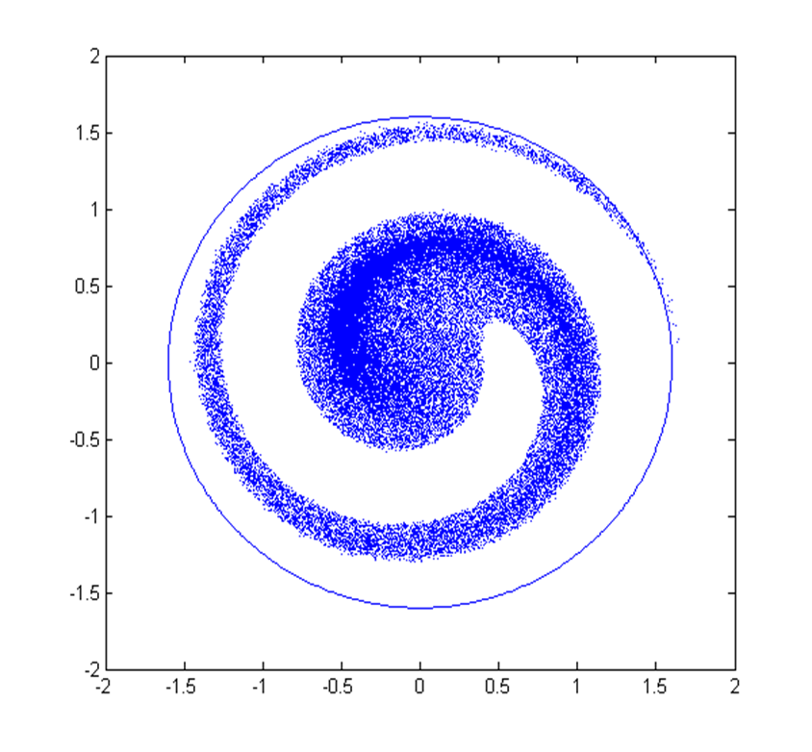
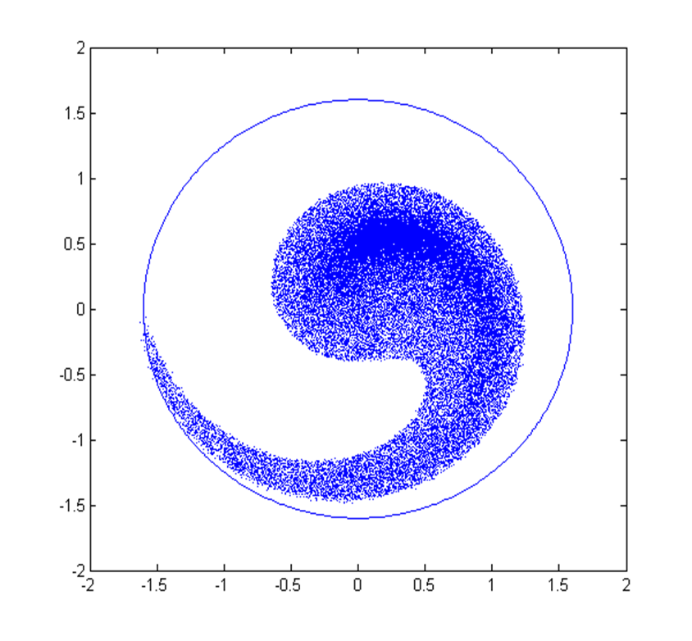
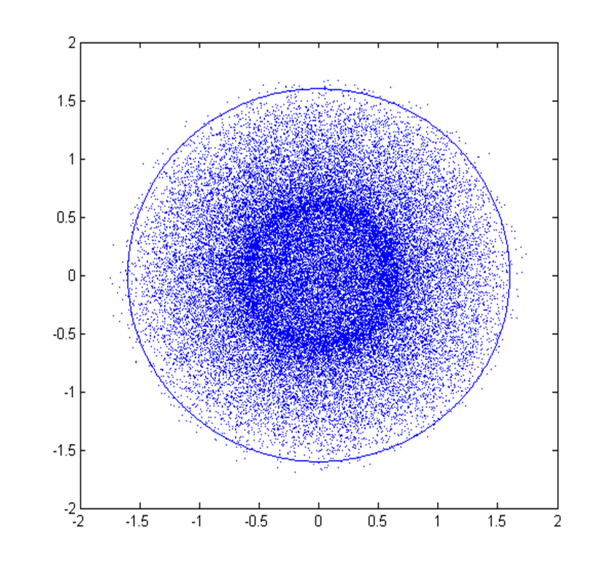
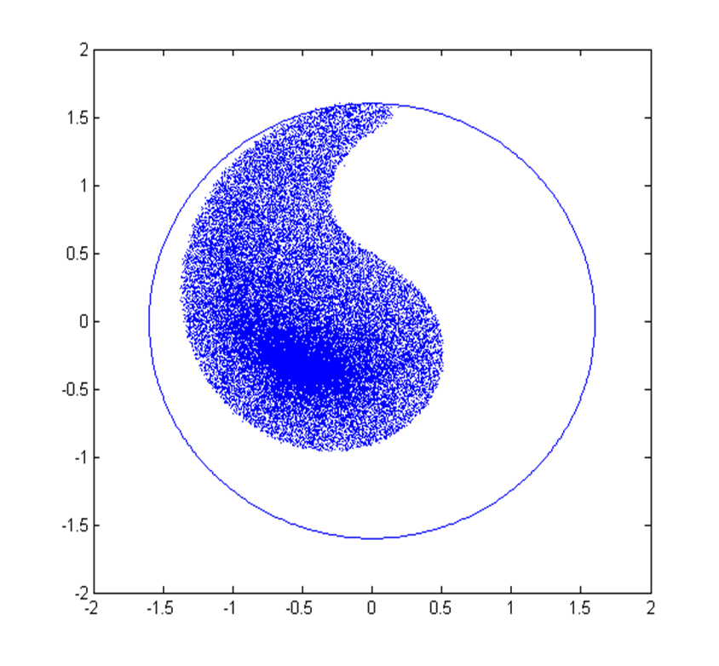
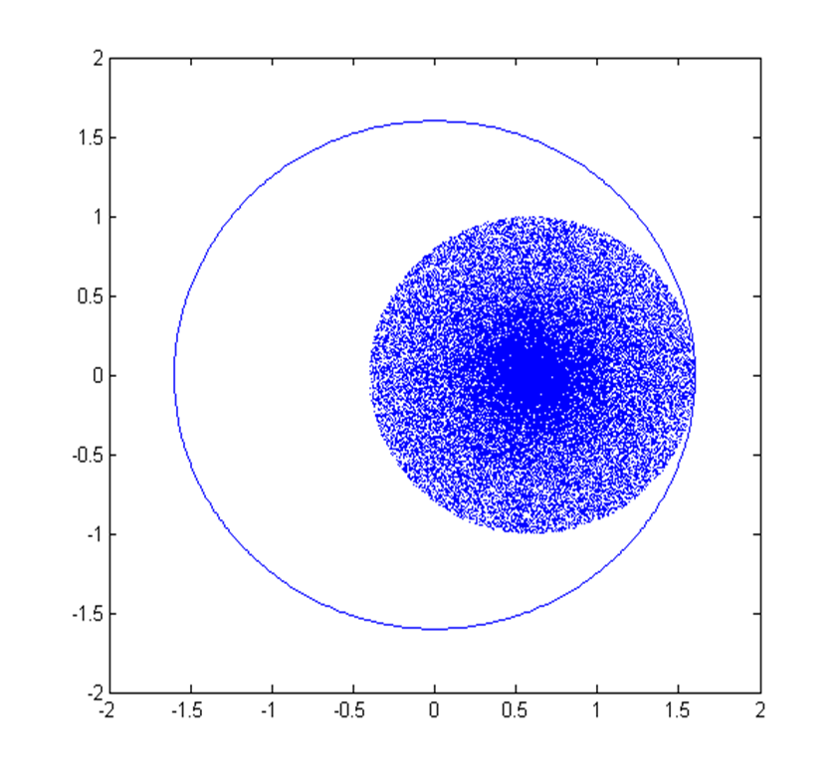
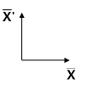
Imperfect injection: Filamentation
  Mismatch between the injected beam and closed orbit -> injection oscillations

Slide 34
Imperfect injection: Filamentation
  Mismatch between the injected beam and closed orbit -> injection oscillations
  Non-linearities -> particles at different transverse amplitudes rotate at different speeds.

Slide 35
Imperfect injection: Filamentation
  Mismatch between the injected beam and closed orbit -> injection oscillations
  Non-linearities -> particles at different transverse amplitudes rotate at different speeds.
  Beam distribution “wraps around” closed orbit.

Slide 36
Imperfect injection: Filamentation
  Mismatch between the injected beam and closed orbit -> injection oscillations
  Non-linearities -> particles at different transverse amplitudes rotate at different speeds.
  Beam distribution “wraps around” closed orbit.
  Rms emittance increases + injection oscillations are damped.

Slide 37
Imperfect injection: Filamentation
  Mismatch between the injected beam and closed orbit -> injection oscillations
  Non-linearities -> particles at different transverse amplitudes rotate at different speeds.
  Beam distribution “wraps around” closed orbit.
  Rms emittance increases + injection oscillations are damped.

Slide 38
Imperfect injection: Filamentation
  Mismatch between the injected beam and closed orbit -> injection oscillations
  Non-linearities -> particles at different transverse amplitudes rotate at different speeds.
  Beam distribution “wraps around” closed orbit.
  Rms emittance increases + injection oscillations are damped.

Slide 39
Imperfect injection: Filamentation
  Mismatch between the injected beam and closed orbit -> injection oscillations
  Non-linearities -> particles at different transverse amplitudes rotate at different speeds.
  Beam distribution “wraps around” closed orbit.
  Rms emittance increases + injection oscillations are damped.

Slide 40
Imperfect injection: Filamentation
  Mismatch between the injected beam and closed orbit -> injection oscillations
  Non-linearities -> particles at different transverse amplitudes rotate at different speeds.
  Beam distribution “wraps around” closed orbit.
  Rms emittance increases + injection oscillations are damped.

Slide 41
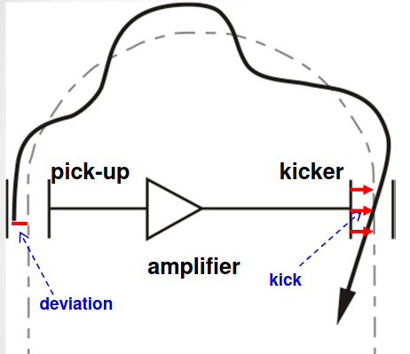
Imperfect injection: Filamentation
  Mismatch between the injected beam and closed orbit -> injection oscillations
  Non-linearities -> particles at different transverse amplitudes rotate at different speeds.
  Beam distribution “wraps around” closed orbit.
  Rms emittance increases + injection oscillations are damped.
  Effect can be partially mitigated by using transverse damper -> pick-up + kicker feedback system inside ring.

Slide 42
Layout
Basic principle + hardware
Injection techniques
  Fast injection
    Normalized phase space
    Imperfect injection
  Multi-turn injection
  Charge exchange technique
  Lepton injection
Extraction techniques
  Fast extraction
  Multi-turn extraction
  Resonant multi-turn extraction
  Resonant slow extraction
Transfer between machines
R&D example
Conclusion
Extraction
Transfer
Injection

Slide 43
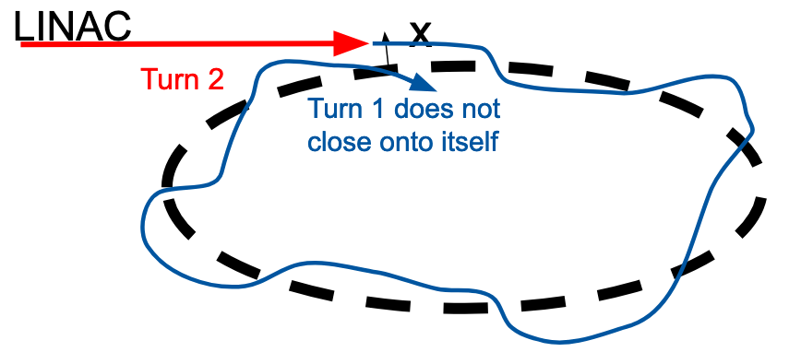
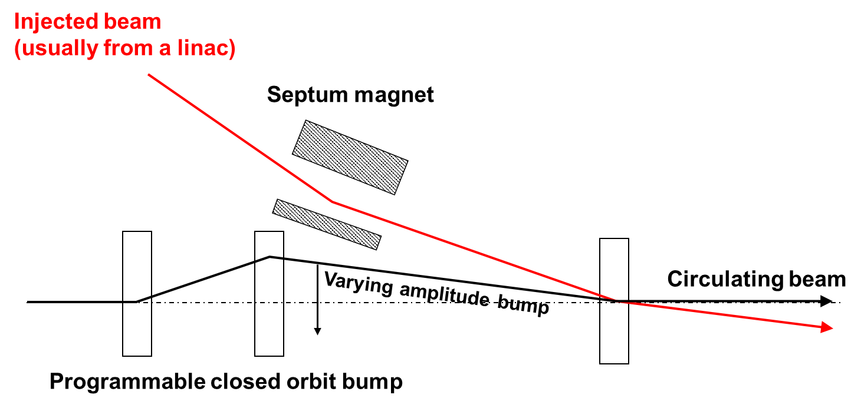
Multi-turn injection: concept
Principle
  Injected beam is injected in a small part of the available phase space.
  The injected trajectory is moved relative to the closed orbit during the injection process.
  Allows to accumulate intensity and `paint` the phase space with a beam smaller than the available ring acceptance, typically from a linac to a ring.
Applications
  At CERN PSB until LS2 and at LEIR presently.
  At GSI SIS18 heavy ions injection.

Slide 44
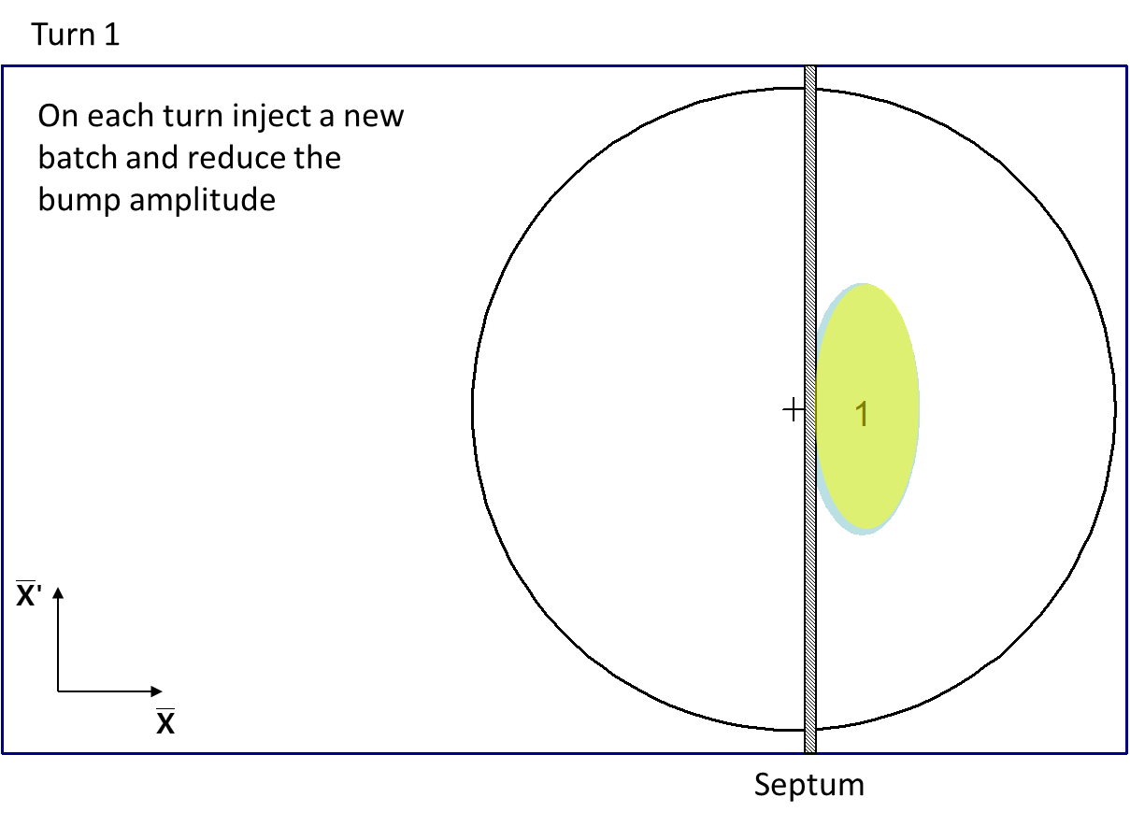
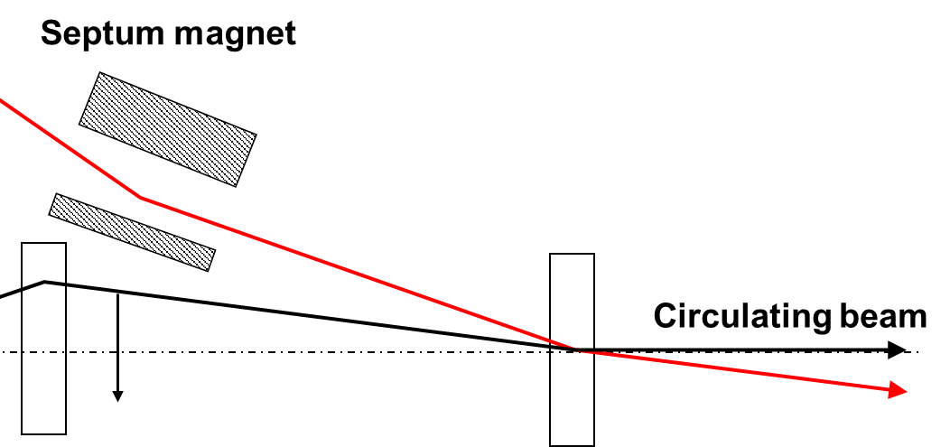
Multi-turn injection: normalized phase space
PSB (pre-LS2): horizontal injection with tune ~ 0.25

Slide 45
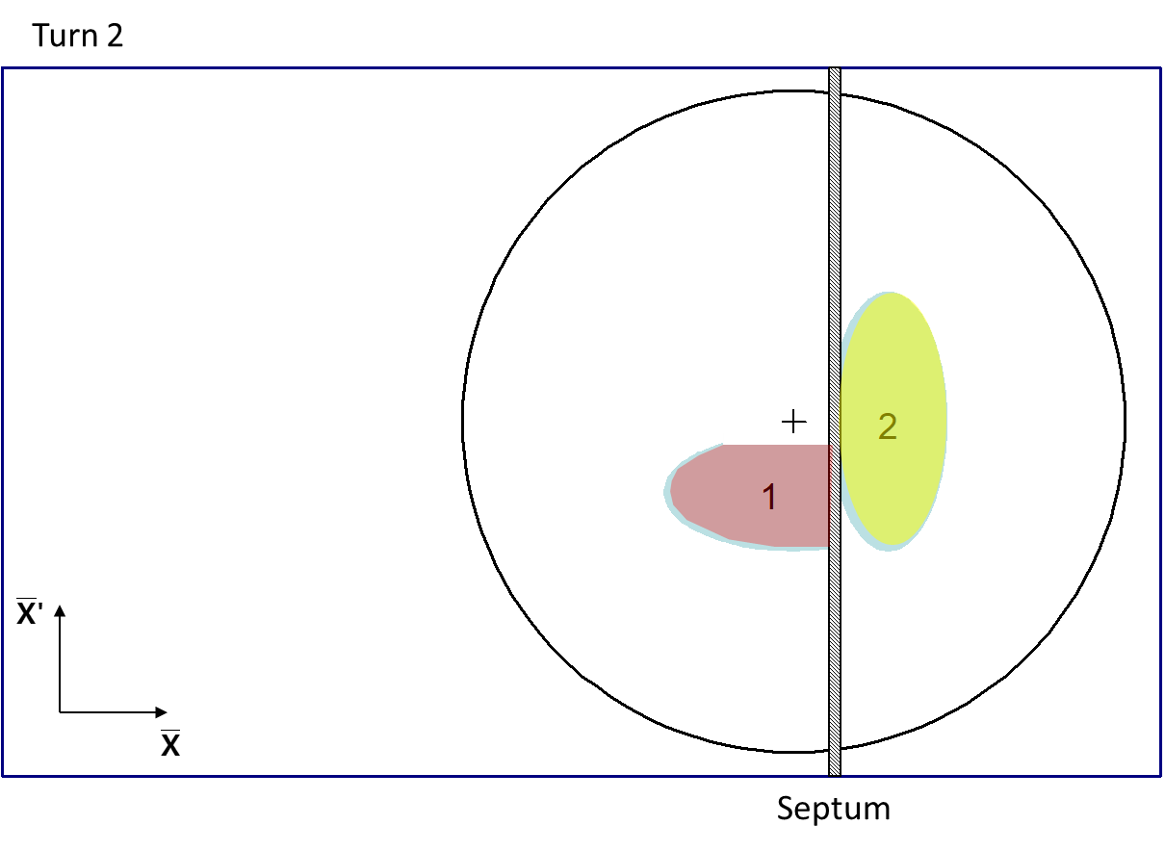
Multi-turn injection: normalized phase space
PSB (pre-LS2): horizontal injection with tune ~ 0.25

Slide 46
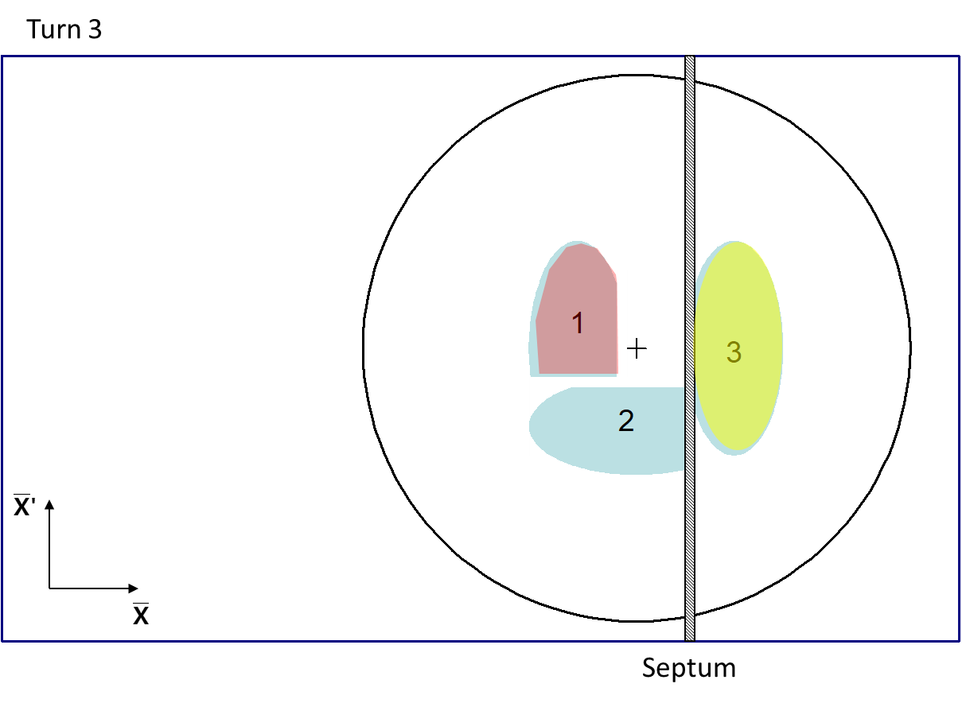
Multi-turn injection: normalized phase space
PSB (pre-LS2): horizontal injection with tune ~ 0.25

Slide 47
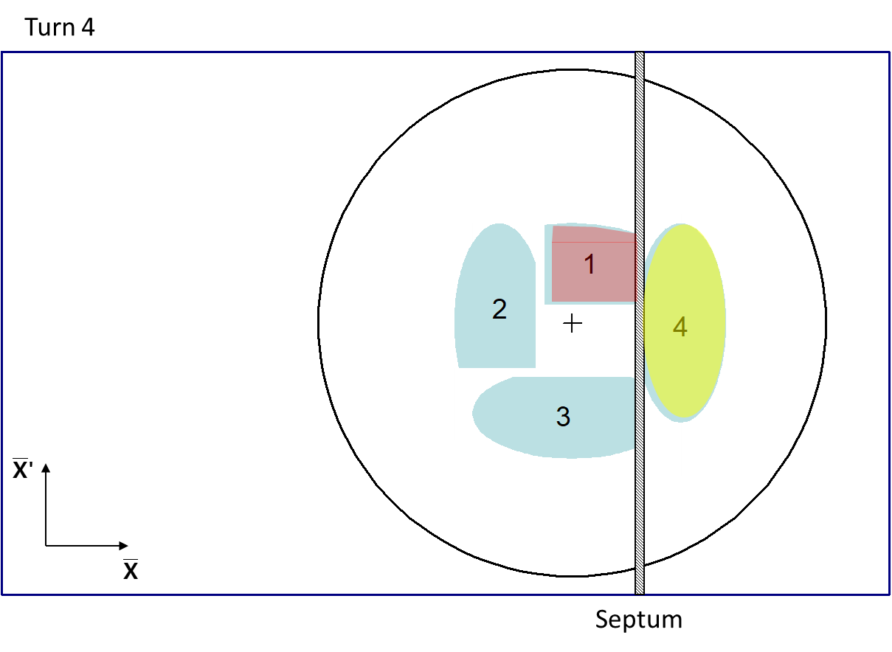
Multi-turn injection: normalized phase space
PSB (pre-LS2): horizontal injection with tune ~ 0.25

Slide 48
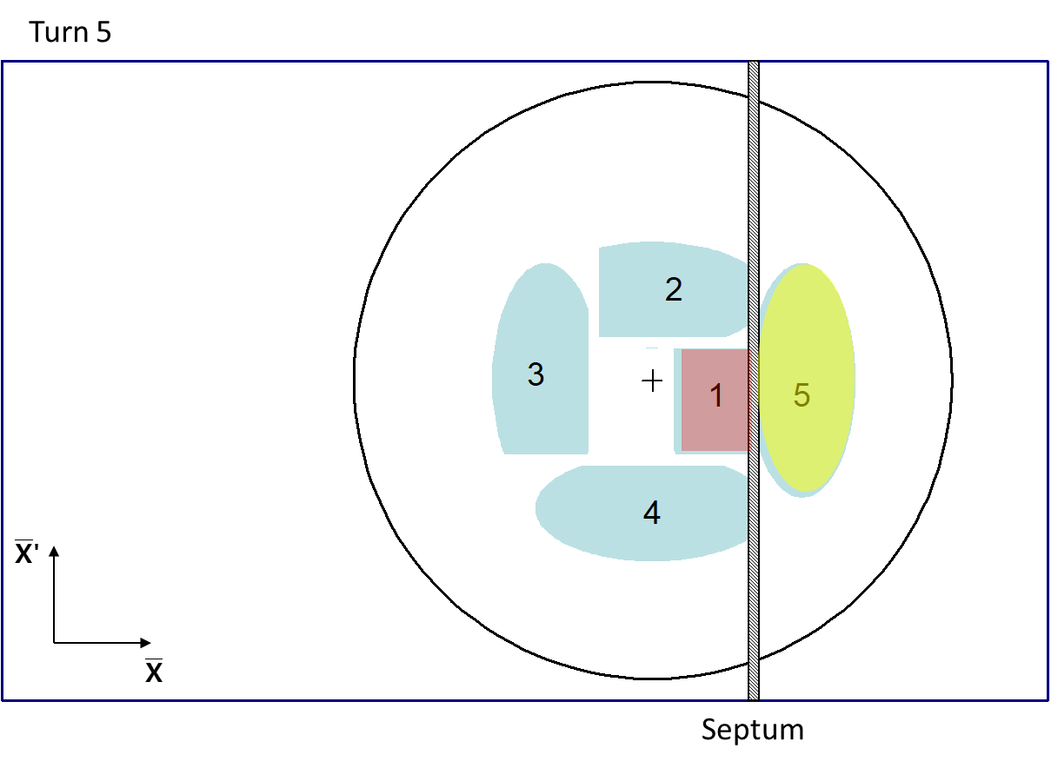
Multi-turn injection: normalized phase space
PSB (pre-LS2): horizontal injection with tune ~ 0.25

Slide 49
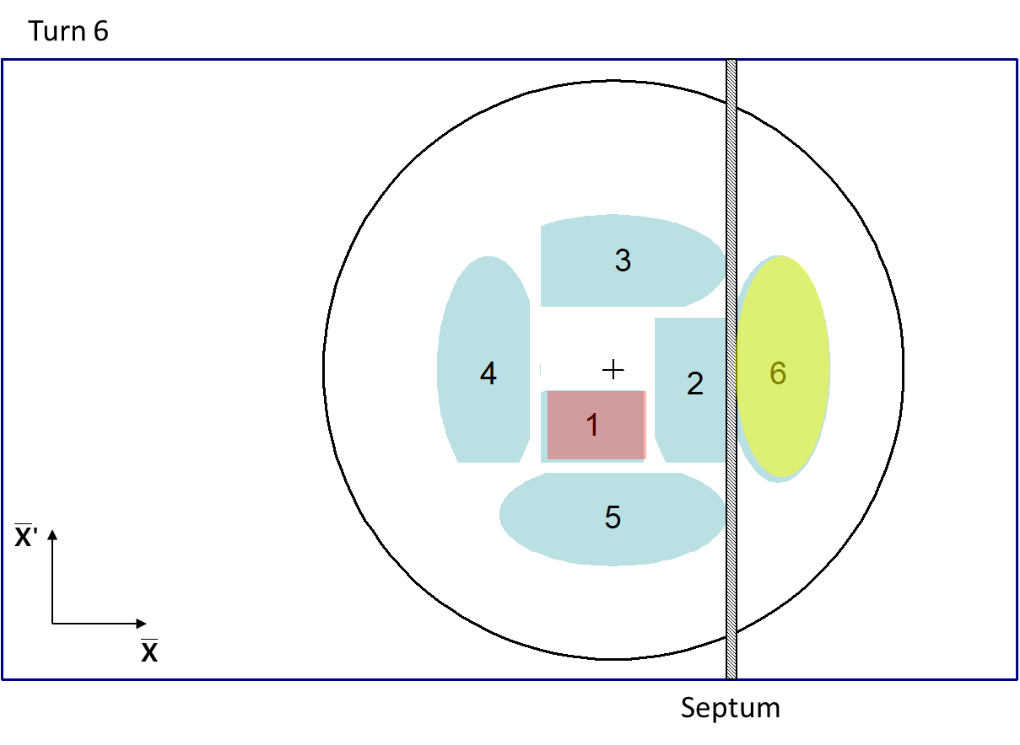
Multi-turn injection: normalized phase space
PSB (pre-LS2): horizontal injection with tune ~ 0.25

Slide 50
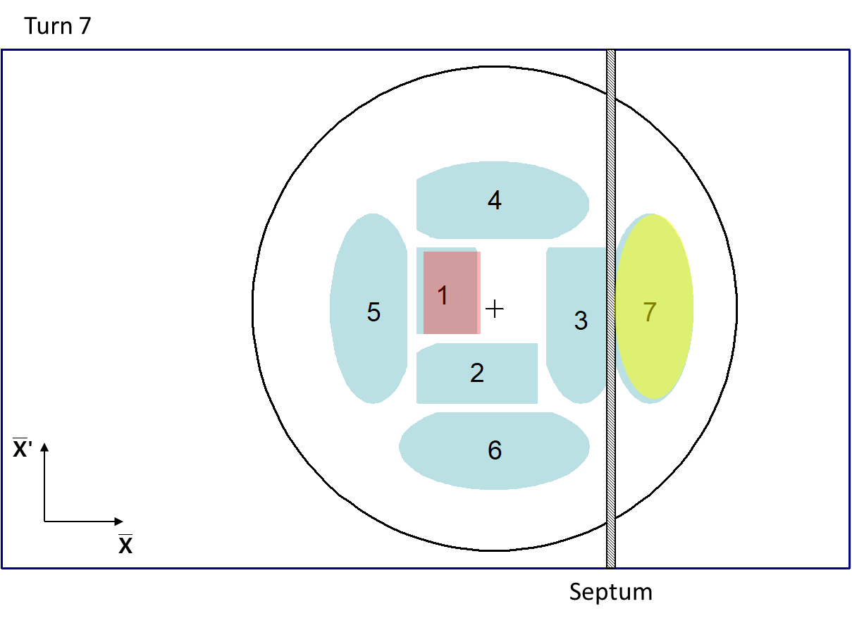
Multi-turn injection: normalized phase space
PSB (pre-LS2): horizontal injection with tune ~ 0.25

Slide 51
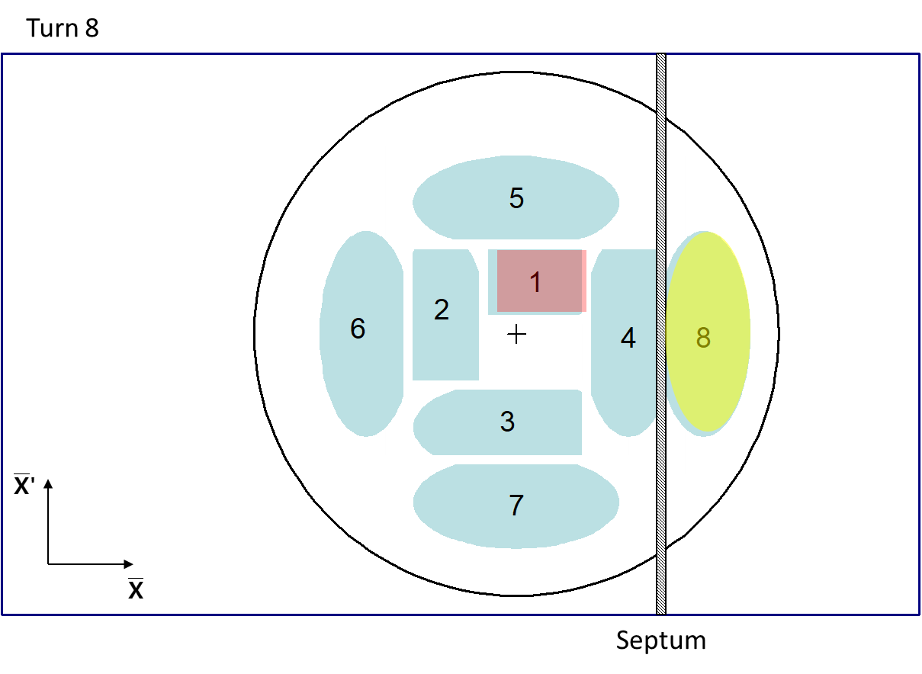
Multi-turn injection: normalized phase space
PSB (pre-LS2): horizontal injection with tune ~ 0.25

Slide 52
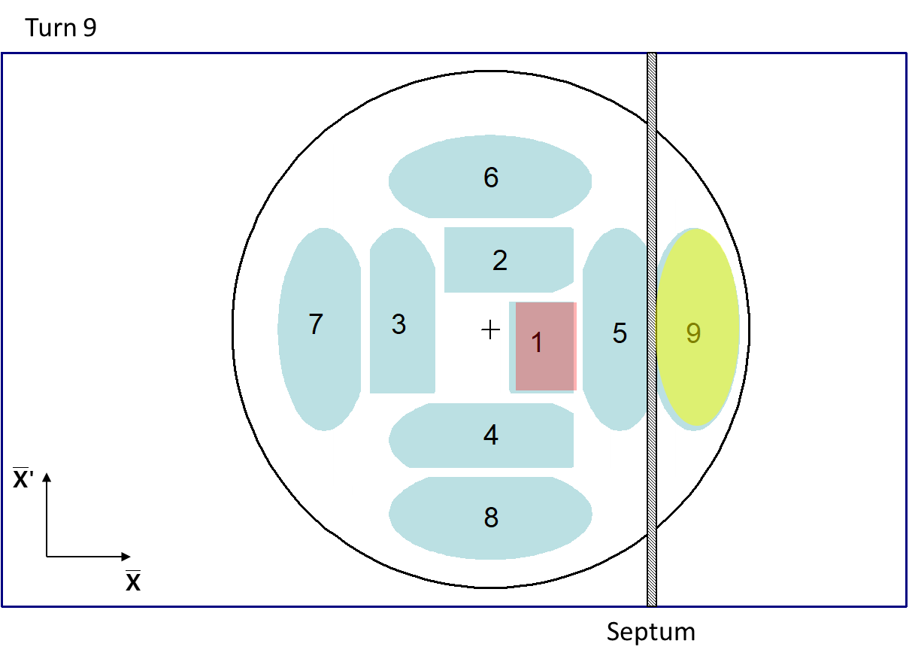
Multi-turn injection: normalized phase space
PSB (pre-LS2): horizontal injection with tune ~ 0.25

Slide 53
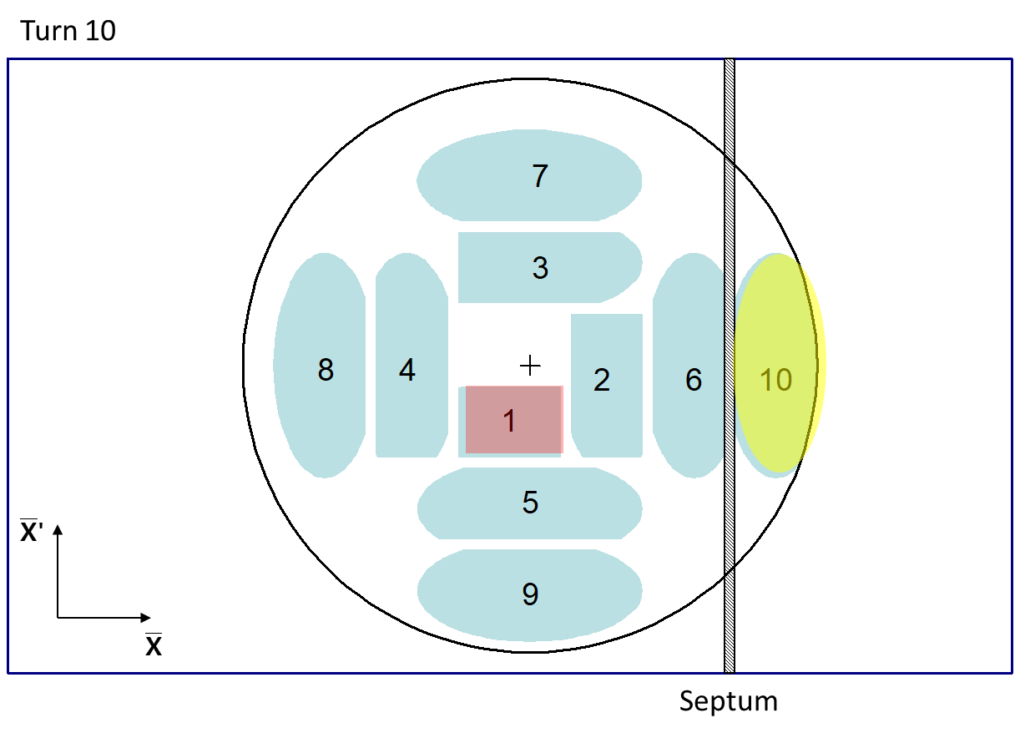
Multi-turn injection: normalized phase space
PSB (pre-LS2): horizontal injection with tune ~ 0.25

Slide 54
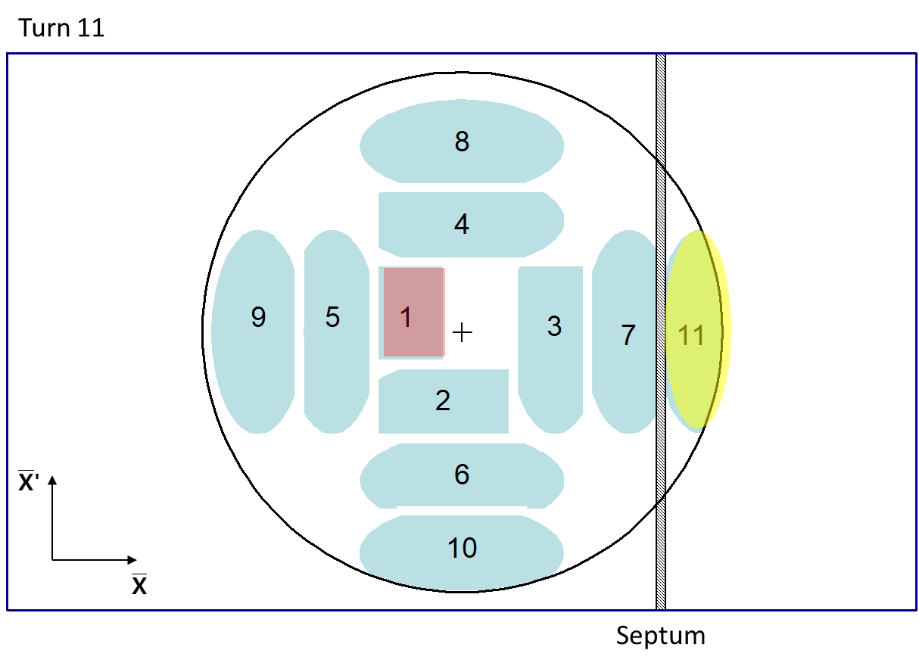
Multi-turn injection: normalized phase space
PSB (pre-LS2): horizontal injection with tune ~ 0.25

Slide 55
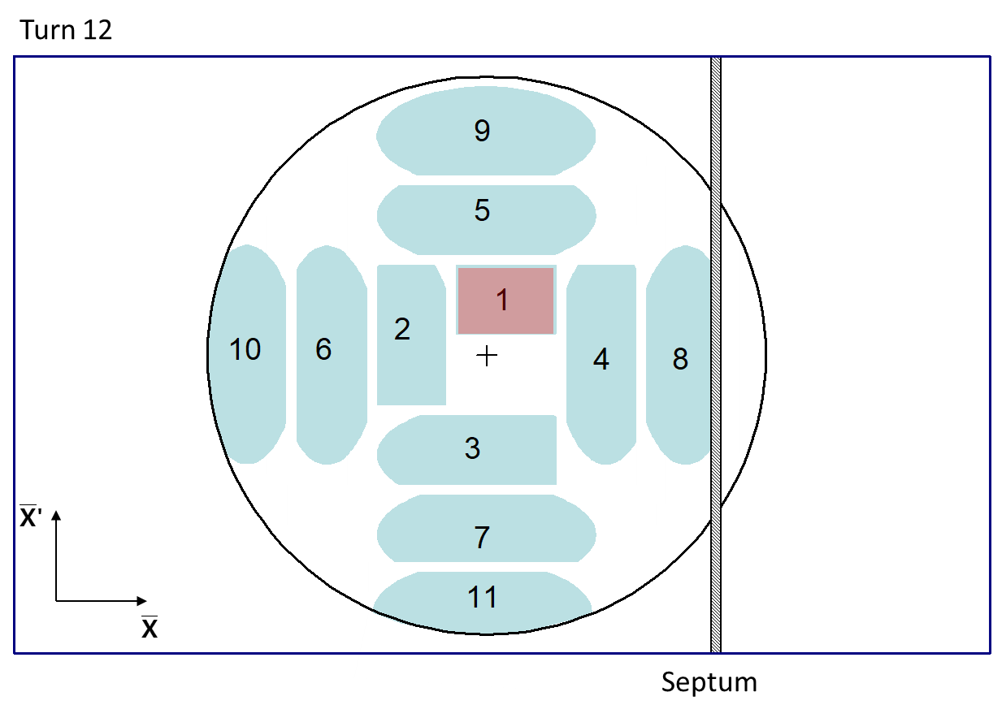
Multi-turn injection: normalized phase space
PSB (pre-LS2): horizontal injection with tune ~ 0.25

Slide 56
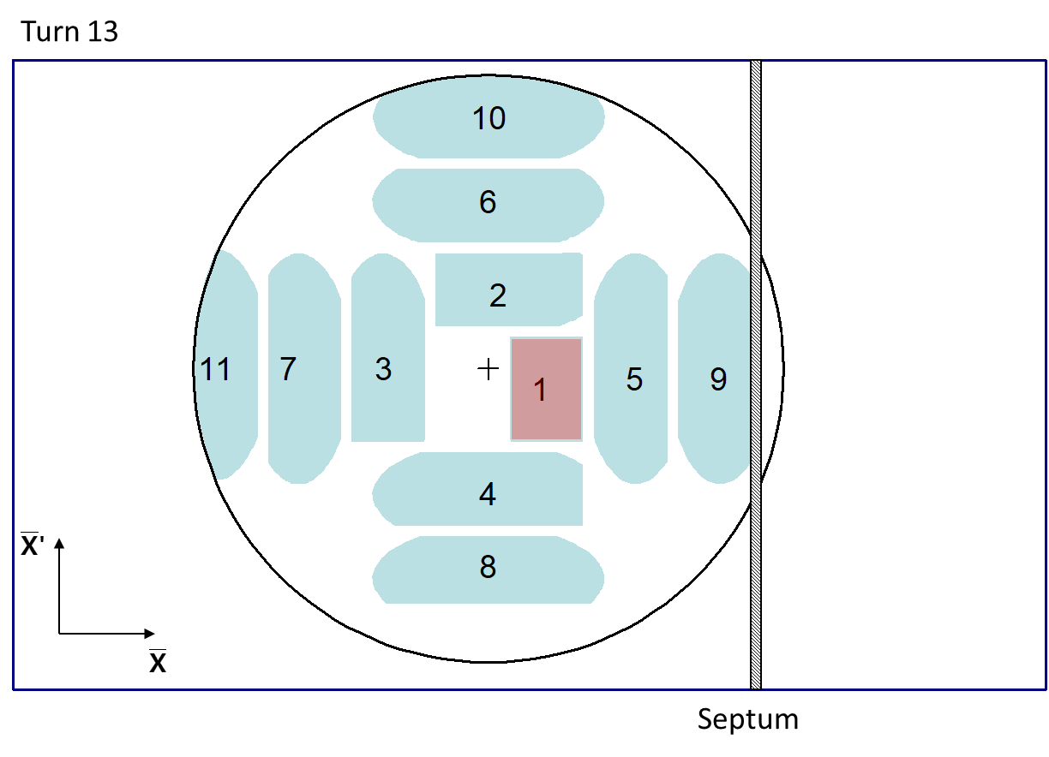
Multi-turn injection: normalized phase space
PSB (pre-LS2): horizontal injection with tune ~ 0.25

Slide 57

Multi-turn injection: normalized phase space
PSB (pre-LS2): horizontal injection with tune ~ 0.25

Slide 58

Multi-turn injection: normalized phase space
PSB (pre-LS2): horizontal injection with tune ~ 0.25

Slide 59

Example: Multi-turn injection in LEIR
X-Y Physical space
By tilting the septum, both horizontal and vertical planes can be filled.
Challenges:
  Very complicated optimization processes.
  Inevitably lossy at injection septum.
  LEIR efficiency ~70%.
Limitations:
  Phase space density must be conserved, so resulting beam will inevitably be much larger than injected beam.

Slide 60

Example: Multi-turn injection in LEIR
X-Y Physical space
By tilting the septum, both horizontal and vertical planes can be filled.
Challenges:
  Very complicated optimization processes.
  Inevitably lossy at injection septum.
  LEIR efficiency ~70%.
Limitations:
  Phase space density must be conserved, so resulting beam will inevitably be much larger than injected beam.

Slide 61
Layout
Basic principle + hardware
Injection techniques
  Fast injection
    Normalized phase space
    Imperfect injection
  Multi-turn injection
  Charge exchange technique
  Lepton injection
Extraction techniques
  Fast extraction
  Multi-turn extraction
  Resonant multi-turn extraction
  Resonant slow extraction
Transfer between machines
R&D example
Conclusion
Extraction
Transfer
Injection

Slide 62

Charge exchange: concept
Phase space density must be conserved
under conservative forces
Principle
  Injected beam changes charge states through stripping in the injection region
  Since both injected and circulating beam can cross the same space at the same time, longer injection times and higher brightness are reachable
Applications
  At CERN PSB since 2020
  At BNL AGS-Booster since the 1992

Slide 63

E. Renner, CERN proton booster (PSB), SY-ABT-BTP (2018)

Slide 64




Charge exchange: painting
By carefully controlling the bumper settings, different phase space paitings can be produced.
E. Renner

Slide 65


Charge exchange: painting
By carefully controlling the bumper settings, different phase space paitings can be produced.
E. Renner

Slide 66
Layout
Basic principle + hardware
Injection techniques
  Fast injection
    Normalized phase space
    Imperfect injection
  Multi-turn injection
  Charge exchange technique
  Lepton injection
Extraction techniques
  Fast extraction
  Multi-turn extraction
  Resonant multi-turn extraction
  Resonant slow extraction
Transfer between machines
R&D example
Conclusion
Extraction
Transfer
Injection

Slide 67

Lepton injection: concept
Phase space density must be conserved
under conservative forces
Principle
  In a synchrontron-radiation dominated lepton ring one can take advantage of the fast damping of oscillations (transverse and/or longitudinal).
  Possible to perform “top-up” injection for continuous operation.
Applications
  At CERN LEP injection
  In most synchrotron light sources
  In FCCee
E
dE
dμ
X, dp/p

Slide 68

Lepton injection: off-axis
Septum magnet
Beam is injected with an angle with respect to the closed orbit.
Injected beam performs damped betatron oscillations about the closed orbit.
Injected beam
Circulating
beam
Closed orbit bumpers or kickers

Slide 69
Lepton injection: on-axis
RF bucket
Injected beam
Injection 2 (turn N + Q_{s}/2)
p = p₀ + Δp
Septum magnet
Stored beam
E
Injection 1 (turn N)
Φ
p = p₀
x_{s}
Bumped circulating beam
x_{s} = D_{x ·} Δp/p₀
Closed orbit bumpers or kickers
Beam injected parallel to circulating beam, onto dispersive orbit of offset Δp/p.
Injected beam makes damped synchrotron oscillations (2x faster damping than transverse).
No betatron oscillations -> No offset at locations with Dx=0, e.g. interaction points.

Slide 70
Injection techniques : Summary
Several different techniques using kickers, septa and bumpers:
  Single-turn injection for hadrons
    Boxcar stacking: transfer between machines in accelerator chain
    Angle / position errors ⇒ injection oscillations
    Uncorrected errors ⇒ filamentation ⇒ emittance increase
  Multi-turn injection for hadrons
    Phase space painting to increase intensity
    H- injection allows injection into same phase space area
  Lepton injection
    May take advantage of SR damping
    Injection errors translates into lower efficiency

Slide 71
Layout
Basic principle + hardware
Injection techniques
  Fast injection
    Normalized phase space
    Imperfect injection
  Multi-turn injection
  Charge exchange technique
  Lepton injection
Extraction techniques
  Fast extraction
  Multi-turn extraction
  Resonant multi-turn extraction
  Resonant slow extraction
Transfer between machines
R&D example
Conclusion
Extraction
Transfer
Injection

Slide 72


Fast extraction: concept
Principle
  Mirror of the fast injection technique.
  Circulating beam is moved close to the septum magnet.
  A fast kicker magnet imparts a final deflection to channel the beam towards the septum aperture and the extraction line.
Challenges
  Higher energies require stronger elements than for injection.
Applications
  At CERN PSB, SPS, AD and more.
  At many other synchrotrons around the world.

Slide 73

Example: LEIR extraction
Septum
Kicker
Gis link and panoramic

Slide 74
Layout
Basic principle + hardware
Injection techniques
  Fast injection
    Normalized phase space
    Imperfect injection
  Multi-turn injection
  Charge exchange technique
  Lepton injection
Extraction techniques
  Fast extraction
  Multi-turn extraction
  Resonant multi-turn extraction
  Resonant slow extraction
Transfer between machines
R&D example
Conclusion
Extraction
Transfer
Injection

Slide 75

Multi-turn extraction: concept
Principle
  Somewhat mirrors the principle of multi-turn injection.
  Circulating beam is brought close to an electrostatic septum and partially pushed through using fast kicker.
  The beam is shaved over a few turns .
Applications
  At CERN PS until 2015

Slide 76

Multi-turn extraction: normalized phase space
CERN PS to SPS: 5-turn continuous transfer

Slide 77

Multi-turn extraction: normalized phase space
CERN PS to SPS: 5-turn continuous transfer

Slide 78

Multi-turn extraction: normalized phase space
CERN PS to SPS: 5-turn continuous transfer

Slide 79

Multi-turn extraction: normalized phase space
CERN PS to SPS: 5-turn continuous transfer

Slide 80

Multi-turn extraction: normalized phase space
CERN PS to SPS: 5-turn continuous transfer

Slide 81
Layout
Basic principle + hardware
Injection techniques
  Fast injection
    Normalized phase space
    Imperfect injection
  Multi-turn injection
  Charge exchange technique
  Lepton injection
Extraction techniques
  Fast extraction
  Multi-turn extraction
  Resonant multi-turn extraction
  Resonant slow extraction
Transfer between machines
R&D example
Conclusion
Extraction
Transfer
Injection

Slide 82
Resonant multi-turn extraction: concept
E
Challenges from non-resonant multi-turn extraction
  The electrostatic septum is used for its thin blade (down to a few tens of um), but limited effect on high energy beams.
  This scheme is intrinsically lossy and will create activation around the extraction elements, and in particular the electrostatic septum.
  Large inefficiency, ~15% losses.
Principle of stable “islands”
    Use non-linear fields (sextupoles and octupoles) to create islands of stability in phase space.
    A slow crossing of a transverse resonance drives particles into the islands (capture).
X
E
X

Slide 83

Resonant MTE: normalized phase space
Unperturbed beam
Increasing non-linear fields
Beam captured in stable islands
Islands separated and beam bumped across septum – extracted in 5 turns
Courtesy M. Giovannozzi: MTE Design Report, CERN-2006-011, 2006

Slide 84

Resonant MTE: normalized phase space
Unperturbed beam
Increasing non-linear fields
Beam captured in stable islands
Islands separated and beam bumped across septum – extracted in 5 turns
Bump vs. turn
1 2 3 4 5
Courtesy M. Giovannozzi: MTE Design Report, CERN-2006-011, 2006

Slide 85
Layout
Basic principle + hardware
Injection techniques
  Fast injection
    Normalized phase space
    Imperfect injection
  Multi-turn injection
  Charge exchange technique
  Lepton injection
Extraction techniques
  Fast extraction
  Multi-turn extraction
  Resonant multi-turn extraction
  Resonant slow extraction
Transfer between machines
R&D example
Conclusion
Extraction
Transfer
Injection

Slide 86


Resonant slow extraction: concept
Principle
  Tune adjusted close to nth order betatron resonance (typically q=1/3).
  Multipole magnets excite resonance strength and beam is slowly pushed into instability.
  Particles are “peeled” from circulating beam and jump over septum to provide a continuous spill.
Applications
  At CERN PS and SPS
  At BNL AGS until 2000 and Booster
  At medical synchrotrons
Courtesy M. Giovannozzi: MTE Design Report, CERN-2006-011, 2006

Slide 87


Slow extraction: normalized phase space
3rd order resonances: Sextupole fields distort the circular normalised phase space.
Stable area defined, delimited by unstable Fixed Points.
Stable area can be reduced by scanning the machine tune Qh (or sextupole str.)
Unstable particles grow in amplitude and jump over the septum (spiral step).
R_{fp}
Courtesy M. Giovannozzi: MTE Design Report, CERN-2006-011, 2006

Slide 88


Slow extraction: normalized phase space
Evolution of the phase space for slow extraction
Courtesy M. Giovannozzi: MTE Design Report, CERN-2006-011, 2006

Slide 89

Slow extraction: normalized phase space
Evolution of the phase space for slow extraction
Courtesy M. Giovannozzi: MTE Design Report, CERN-2006-011, 2006

Slide 90

Slow extraction: normalized phase space
Evolution of the phase space for slow extraction
Courtesy M. Giovannozzi: MTE Design Report, CERN-2006-011, 2006

Slide 91


Slow extraction: normalized phase space
Evolution of the phase space for slow extraction
Courtesy M. Giovannozzi: MTE Design Report, CERN-2006-011, 2006

Slide 92

Slow extraction: normalized phase space
Evolution of the phase space for slow extraction
Courtesy M. Giovannozzi: MTE Design Report, CERN-2006-011, 2006

Slide 93

Slow extraction: normalized phase space
Evolution of the phase space for slow extraction
Courtesy M. Giovannozzi: MTE Design Report, CERN-2006-011, 2006

Slide 94
Extraction techniques : Summary
Single-turn fast extraction:
  for transfer between machines in accelerator chain, beam abort, etc.
Non-resonant (fast) multi-turn extraction
  slice beam into equal parts for transfer between machine over a few turns.
Resonant low-loss (fast) multi-turn extraction
  create stable islands in phase space: slice off over a few turns.
Resonant (slow) multi-turn extraction
  create stable area in phase space and slowly drive particles into resonance →long spill over many thousand turns.

Slide 95
Layout
Basic principle + hardware
Injection techniques
  Fast injection
    Normalized phase space
    Imperfect injection
  Multi-turn injection
  Charge exchange technique
  Lepton injection
Extraction techniques
  Fast extraction
  Multi-turn extraction
  Resonant multi-turn extraction
  Resonant slow extraction
Transfer between machines
R&D example
Conclusion
Extraction
Transfer
Injection

Slide 96
Transfer between machines
Extract a beam out of one machine ➔ initial beam parameters
Transport this beam towards the following machine (or experiment)
Inject this beam into a following machine with a predefined optics
  ➔ Transfer line optics has to produce required beam parameters for matching
Extraction
(α_{x}, β_{x}, D_{x}, D’_{x}
α_{y}, β_{y}, D_{y}, D’_{y})₁
Transfer
M_{1➔2}
s
(α_{x}, β_{x}, D_{x}, D’_{x}
α_{y}, β_{y}, D_{y}, D’_{y})₂
Injection

Slide 97

Example: SPS to LHC
Initial
matching
section
Final
matching
section
SPS
LHC
Regular lattice (FODO)
Extraction
point
SPS to LHC Transfer Line (3 km)
Injection
point

Slide 98
Imperfect matching
Mismatch in optical parameters will lead to emittance blow-up via filamentation:
Time
Turn 0
Turn N
x’
x

Slide 99
Imperfect matching
Mismatch in optical parameters will lead to emittance blow-up via filamentation:
Time
Turn 0
Turn N
x’
x

Slide 100
Imperfect matching
Mismatch in optical parameters will lead to emittance blow-up via filamentation:
Time
Turn 0
Turn N
x’
x

Slide 101

Layout
Basic principle + hardware
Injection techniques
  Fast injection
    Normalized phase space
    Imperfect injection
  Multi-turn injection
  Charge exchange technique
  Lepton injection
Extraction techniques
  Fast extraction
  Multi-turn extraction
  Resonant multi-turn extraction
  Resonant slow extraction
Transfer between machines
R&D example
Conclusion
Extraction
Transfer
Injection

Slide 102


The SHiP experiment (i)
Dark matter offers a possible explanation to several mysterious observations.
SHiP will be hosted at CERN to search for long-lived dark-matter particles that would rarely interact with regular matter.
Galaxy rotation speed
Bullet cluster
Dark matter Visible matter

Slide 103



The SHiP experiment (ii)
Dark matter offers a possible explanation to several mysterious observations.
SHiP will be hosted at CERN to search for long-lived dark-matter particles that would rarely interact with regular matter -> slow extraction onto dense target.
By 2032, the SPS will quintuple the # of protons delivered to the North Area!

Slide 104


Problem: septum radioactivation
During extraction, ~3% of the beam inevitably shaved on wires of electrostatic septum:
Septum already highly activated. Situation will become unacceptable with increase in extracted protons.
Difficult to perform interventions, risk of sparking, material damage…
Circulating beam Extracted beam

Slide 105



Solution: bent silicon crystals
High-energy beams can be deflected with bent silicon crystals.
In the SPS, a thin crystal shadows the septum wires during slow extraction, kicking particles away from the blade.
This solution required intersection of manufacturing technology, beam dynamics, machine learning, etc., to succeed!
Amorphous
scatter
Volume reflection
dechannel
Unaffected beam
To North Area
up
deflected
ZS
x
Deflected beam
down
To SPS
s
channel
F. Velotti et al, 2019

Slide 106
Layout
Basic principle + hardware
Injection techniques
  Fast injection
    Normalized phase space
    Imperfect injection
  Multi-turn injection
  Charge exchange technique
  Lepton injection
Extraction techniques
  Fast extraction
  Multi-turn extraction
  Resonant multi-turn extraction
  Resonant slow extraction
Transfer between machines
Conclusion
Extraction
Transfer
Injection

Slide 107



Conclusion
Reviewed injection and extraction techniques, from tried-and-true fast injection/extraction to more sophisticated techniques.
There is often a trade-off between robustness and flexibility.
Key figures of merit include emittance preservation and beam loss minimization.
Many aspects we haven’t discussed, e.g. can we mirror all injection/extraction techniques?
Charge exchange extraction
Island injection
Slow injection?

Slide 108
Further reading (with the formulae !), and resources
ABT group is on the 865 building, my office 865/1D26
CAS 2017 on Beam injection, extraction and transfer at https://indico.cern.ch/event/451905/
  Overlooked here, timing and synchronization by RF expert H. Damerau next week
  Detailed talk on resonant slow extraction by P. Bryant https://indico.cern.ch/event/451905/contributions/2159064/
  Exotic extraction methods that discuss all the possibilities overlooked here by B. Goddard https://indico.cern.ch/event/451905/contributions/2159103
This CAS lecture on Kickers and Septa by M. Barnes https://indico.cern.ch/event/1018359/contributions/4312229
CERN GIS machine portal https://gis.cern.ch/gisportal/Machine.htm

Slide 109
Thank you

Slide 110
EXTRA SLIDES

Slide 112

Slow-Extraction R&D at CERN
Collider-Accelerator Department Seminar
(40’ + 20’)
Pablo Arrutia
Slow-Extraction R&D at CERN
P. Arrutia
June 28th 2024

Slide 113

CERN

Slide 114
Machines performing slow extraction (SX):
Super Proton Synchrotron (SPS)
Destination: North Area
7 km circumference
p+ and heavy ions
Up to 400 GeV/c SX
Up to 4e13 p per spill
Proton Synchrotron (PS)
Destination: East Area
626 m circumference
p+, heavy/light ions
Up to 24 GeV/c SX
Up to 6e11 p per spill

Slide 115


Beam delivery scheme
Transverse resonance is excited to slowly ‘peel’ particles from the circulating beam.
The extraction rate is controlled by ramping magnets.
Particles at large amplitude are kicked out by septum.
x
sextupole
Beam
*Largely exaggerated excursion
Slow-Extraction R&D at CERN
P. Arrutia
June 28th 2024

Slide 116
SPS

Slide 117

Dark matter. What is it? Where is it?
Several observations point towards the existence of dark matter…
R. Jacobsson 2024

Slide 118

Search for Hidden Particles (SHiP)
Direct search for long-lived weakly-coupled particles
Long decay volume
Beam dump facility (BDF)
Tons of events needed
Slow-Extraction R&D at CERN
P. Arrutia
June 28th 2024
R. Jacobsson 2024

Slide 119

High-Intensity ECN3
Experiment will be hosted in CERN’s North Area in the ECN3 experimental hall.
4e19 protons on target per year at 400 GeV/c, slow-extracted from SPS in 1 s spills.
High-Intensity ECN3 project to prepare accelerator complex (Operation starting in 2030).
R&D towards low beam loss and excellent spill quality.
SPS p+
Slow-Extraction R&D at CERN
P. Arrutia
June 28th 2024
M. Fraser 2024

Slide 120

SPS extraction channel
Beam resonantly extracted, ~5% of the beam inevitably shaved on wires of electrostatic septum (ZS):
ZS already highly activated. Situation will become unacceptable with increase in extracted protons.
Difficult to perform interventions, risk of sparking, material damage…
Slow-Extraction R&D at CERN
P. Arrutia
June 28th 2024

Slide 121




Dose rate predictions
Radiation hazards of future operational scenarios can be planned with predictive models:
Physics-based
Residual dose rate at ZS
Data-driven
Slow-Extraction R&D at CERN
P. Arrutia
June 28th 2024
F. Velotti 2023

Slide 122

More protons, same dose?
Goal to keep dose unchanged, even when POT will be significantly increased for high-intensity facility -> approx. factor 4 reduction
Several efforts already bearing fruits in 2022, 2023 data:
Re-alignment of electrostatic septum (ZS) wires.
Crystal shadowing of septum blade.
Other efforts ongoing or in the pipeline…
Slow-Extraction R&D at CERN
P. Arrutia
June 28th 2024

Slide 123

New septum materials
Hazards related to residual dose can be tackled by looking for viable low-Z materials for different septum components.
M. Fraser 2019
Slow-Extraction R&D at CERN
P. Arrutia
June 28th 2024

Slide 124




New septum materials (ii)
Current
Dream world
20x reduction!
Residual dose rate after 1 week
H. Vincke 2023
Slow-Extraction R&D at CERN
P. Arrutia
June 28th 2024

Slide 125


New septum materials (iii)
Efforts focused on tank material. Best candidate: feasible + 2x dose reduction.
Selection of alloy -> Al 5083
design of low-Z flanges -> Bimetallic flange
buckling tests -> mass reduction of 2.7x w.r.t. current tank
Manufacturing -> mock-up + welding tests
Before Aug 2024: develop, manufacture and assembly of full tank
F. Pirozzi 2023
Slow-Extraction R&D at CERN
P. Arrutia
June 28th 2024

Slide 126


Crystal shadowing
“Crystals to rule them all”
High-energy beams can be deflected with bent silicon crystals.
Several applications, e.g. ion collimation system in LHC, positron extraction in DAFNE.
In the SPS, A local (TECS) and non-local (TECA) crystal shadow the ZS wires during slow extraction.
TECA (LSS4)
TECS (LSS2)
Unaffected beam
To TT20
deflected
(...)
up
x
Deflected beam
Deflected beam
ZS
circulating
down
To SPS
s
Slow-Extraction R&D at CERN
P. Arrutia
June 28th 2024

Slide 127

Crystal shadowing (ii)
Two regimes can be exploited for bending:
Channelling: large kick, low efficiency
Volume reflection: small kick, high efficiency
SPS crystal
at 400 GeV/c
Amorphous
scatter
Volume reflection
dechannel
channel
Slow-Extraction R&D at CERN
P. Arrutia
June 28th 2024

Slide 128




Crystal shadowing (iii)
Double-crystal setup in SPS achieves over 2x loss reduction.
Behaviour very reproducible year to year, after position and angular re-alignment is performed.
Bayesian optimisation being exploited to speed up alignment process -> Important to pursue similar approaches for other aspects of operation.
EI - Expected improvement
RGPE: Rank-weighted GP
F. Velotti 2024
Slow-Extraction R&D at CERN
P. Arrutia
June 28th 2024

Slide 129


Septumless extraction
Conceptual studies ongoing to replace ZS with crystal:
Long way to go to achieve efficiency and reliability + manufacturing of suitable crystals required…
… but huge promise: 15 m of high-voltage hardware replaced by a few mm of silicon?!
Non resonant
Resonant [1]
Push
[1] D. Veres 2023
Slow-Extraction R&D at CERN
P. Arrutia
June 28th 2024

Slide 130


In-house crystals
DECRYCE (DEvelopment of CRYstals for Collimation and Beam Extraction) project established for CERN’s crystal needs [1]: LHC collimation, septum shadowing…
Procurement of crystal wafers
Cutting and polishing
Bender system and integration
Validation with X-ray and particle beams
Simulation: SPS with MVR array [2]
Multi-volume reflection
Slow-Extraction R&D at CERN
P. Arrutia
June 28th 2024
[1] G. Daher, L. Esposito 2024
[2] F. Velotti 2024

Slide 131




Spill quality
“The beam sees everything”
Undesired ripple (power converters, RF, etc.) modulates the rate of particle extraction.
Flux fluctuations can negatively impact experimental performance.
[1]
Slow-Extraction R&D at CERN
P. Arrutia
June 28th 2024
[1] R. Jacobsson

Slide 132

Transfer function
Improve inputs
Control theory
Modify transfer function
Mitigation approaches
Process can be modelled as transfer function.
Power converter current
Extracted beam current
Transfer function
Input
output
Slow extraction
Slow-Extraction R&D at CERN
P. Arrutia
June 28th 2024

Slide 133




Hysteresis control
Magnetic-history effects have impact on extracted spill.
ML models (Temporal Fusion transformers, xLSTM, etc.) being explored to model I-to-B curve as a function of time.
Slow-Extraction R&D at CERN
P. Arrutia
June 28th 2024
A. Lu 2024

Slide 134



50/100 Hz control
Bayesian model (Gaussian Processes) to correct 50/100 Hz ripple via focusing quads.
Successfully tracks long term variations by treating “time” as additional parameter.
Running on GPU for fast prediction time.
Slow-Extraction R&D at CERN
P. Arrutia
June 28th 2024
V. Kain 2024

Slide 135

RF Techniques
Ripple
(...)
Pulsed
RK kicks (either transverse or longitudinal with non-zero chromaticity) can be used to affect the time particles need to reach the septum once they are resonant.
Rate (arb.)
Time (arb.)
Slow-Extraction R&D at CERN
P. Arrutia
June 28th 2024

Slide 136

RF Techniques
Ripple
(...)
Pulsed
RK kicks (either transverse or longitudinal with non-zero chromaticity) can be used to affect the time particles need to reach the septum once they are resonant.
Rate (arb.)
… i.e. low-pass filter effect
Time (arb.)
Smoothed
Rate (arb.)
Time (arb.)
Slow-Extraction R&D at CERN
P. Arrutia
June 28th 2024

Slide 137



RF techniques (ii)
Since 2023, the SPS uses its 800 MHz RF system to give small longitudinal kicks to the beam (RF phase displacement [1]).
RF off
RF on
Slow-Extraction R&D at CERN
P. Arrutia
June 28th 2024
[1] Cappi, Steinbach 1981

Slide 138




RF techniques (iii)
Simulation models extremely useful at predicting relevant properties [1].
Now moving towards GPU use with xsuite [2].
Plans to exploit differentiable physics models for optimisation tasks.
Horizontal size
Ripple suppression
RF time structure
Slow-Extraction R&D at CERN
P. Arrutia
June 28th 2024
[1] P. Arrutia 2024
[2] xsuite

Slide 139




Instrumentation
For high-frequency data, efficient transfer and storage solutions needed.
Typically, only short chunks (~10 ms) along spill are needed
Proposed: Cryogenic current comparator [1]
Optical transition radiation
Secondary emission
Main “spill quality” device [2]
Diamond BLMs
Up to 10 GHz for SHiP
Power
# of protons
f=0
Frev
43 kHz
2xFrev
86 kHz
(2 injections from PS)
Main RF
200 MHz
RF 2
800 MHz
f, freq
Power converters
Broad-band: 10Hz-10kHz
Narrow: k*50Hz
Slow-Extraction R&D at CERN
P. Arrutia
June 28th 2024
[1] J. Tan 2024
[2] F. Roncarolo 2024

Slide 140
PS

Slide 141




HEARTS
High-Energy Accelerators for Radiation Testing and Shielding:
Other labs (e.g. GSI, NSRL) not enough availability.
Existing CHARM infrastructure can be exploited in PS -> CHIMERA.
R&D towards flexibility: ion energy, ion flux, beam size, ion species.
Pb beam in Si
HEARTS

Slide 142


Variable energy
The PS provides a very interesting energy range: 10-40 MeVcm2/mg for Pb ions [1]
Extraction energy controlled by single high-level knob -> scales flattop B-field [2]
[1] R. Garcia 2024
[2] E. Johnson 2024

Slide 143



Variable flux
Hard to significantly reduce injected intensity -> Not enough signal for RF feedback loops.
Scraping at flattop: poor shot-to-shot reproducibility during extraction.
Alternative: Keep lattice fixed, push beam into resonance with transverse RF exciter -> learning from medical machines

Slide 144


Variable flux (ii)
Remaining challenges:
RF gain to be varied as function of time to keep flux constant -> PID controller being tested.
Current RF signal imprints too much high-frequency structure on spill.
Feedforward, feedback
[1]
Charges in ring
Target
Time (ms)
[1] P. Niedermayer 2024

Slide 145


Variable beam size
Current mode of operation: blow up Gaussian beam + collimate tails.
Inspired by NSRL -> exploring octupole folding.
Simulation
Y (m)
X (m)
X (m)
Y (m)
E. Johnson 2024

Slide 146


Variable species (i)
Currently only one ion source (ECR)
Solid to gas ~ 1 week
Gas to gas ~ 1 day
Goal: ~10 minutes, ~4 species*
Existing ECR source
New EBIS source?
*Still very modest compared to NSRL

Slide 147

Variable species (ii)
Additionally, HEARTS operation would ideally be decoupled from SPS/LHC ion + proton program…
HEARTS@PS
HEARTS@LEIR
Ion hall
South hall

Slide 148

Medical
collaborations
TU Wien
MedAustron
CERN

Slide 149



Hadron therapy
“Bragg peak” exploited to target tumour and spare healthy tissue.
Plenty of R&D synergies, e.g. spill quality, variable flux, variable energy.
MedAustron summary [2]
Central nervous system,
[1]
[1] Samsung hospital
[2] G. Guidoboni 2024

Slide 150


Mixed beams
E. Renner 2024

Slide 151



Mixed beams (ii)
The extraction scheme must
Keep an approximately constant fluence ratio between species (~5-15% He).
Be robust across treatment energies.

Slide 152


FLASH
Conventional particle/radiotherapy relies on differential repair response between cancer and healthy tissue.
FLASH effect: differential effect increases if ultra-high dose rate (~1000x conventional).
Tissue sparing [1]
[1] MC Vozenin 2019

Slide 153

FLASH
FLASH mechanism not fully understood…
Rule of thumb ~40 Gy/s, but is it sufficient?
Does time micro-structure have an impact?
[1] MC Vozenin 2019

Slide 154


FLASH (ii)
SX process naturally fights against fast pulses…
Rapid-cycling fast-extraction schemes become attractive?
E. Renner 2024

Slide 155


Conclusion
Slow extraction has become a major tool in experimental physics, radiation testing and medicine.
Varied R&D programme at CERN, targeting high-energy high-intensity frontier + flexible and efficient operation.
Plenty of opportunities to share expertise with BNL :)
Hereward 1961
CERN + BNL

Slide 156
Extra slides

Slide 157
Beam loss
North Area/ HI-ECN3
RP predictions
Spill quality
New ZS materials
High energy
High intensity
Crystal shadowing
“Unconventional beams”
RF channelling
Crystal extraction
Controllers
Instrumentation
Bunched SX
Mixed beams
RFKO
Pulsed SX
East Area/
HEARTS
Variable energy
Variable flux
Variable spill length
Variable species
Medical

Slide 158


Slide 159


Slide 160


Operational implementation
Spill KPI with EBC
Aug 2023: EBC is put in operation. Running successfully until end of proton run.
In combination with Adaptive Bayesian Optimisation (See Michael’s talk [1]), we reach the SPS spill-quality KPIs [2].
No need for explicit alignment: tune adjustment performed by operators also aligns EBC.
Suppresses all low-frequency ripple (50, 100, 150 Hz…)
Courtesy of F. Velotti
Spill ripple (6 days of data)
Ripple amplitude
Next step is to implement EBC monitoring tool via UCAP node to facilitate operation and post-mortem analysis.
[1] M. Schenk (JAPW 2023)
[2] V. Kain (IPP 2023)

Slide 161


SPS power-converter analysis
Low-frequency spill quality suddenly got worse at 9:34 12/5/2022. Investigations launched to find root cause [1].
Comprehensive analysis of power converters but no smoking gun found: request to characterise measurement noise when magnets are off.
Spill monitor (BSI) differs from NA62 detector (GTK) when comparing spectra before and after 12/5/2022 -> Second spill monitor needed on ATS side (OTR PMT).
(NA62)
(SY-BI)
[1] I, II, III (SLAWG 2023)

Slide 162



Latest results
High-level controller implemented, which allows to employ numerical optimisers reliably.
The absolute position and angle measurements are used via PID controller (limited by the minimum step size of the motor).
TECA aligned with Bayesian optimisation in <60 cycles (potential to cut in half with surrogate optimisation).

Slide 163

Beamlet

Slide 164

Latest results (ii)
TECA can reduce losses by factor 2 at high intensity, but controller is essential to recover loss reduction after machine stop or supercycle change.

Slide 165


Splitters
Two Lambertson septa splitters in TT20 provide simultaneous beam to targets.
Beam is physically split on TCSC collimator blade.
Activation is high. New device (more compliant with ALARA) is part of NA-CONS.
Front face of TCSC
T2 + T4
Collimator
LOSSES
T6
SPS

Slide 166
R&D: Crystal shadowing of splitter
In the future, the splitter blade could be shadowed by a crystal, as done for the ZS (but in v-plane)
~25% loss reduction expected with same crystal as those we have in the SPS (TECS/TECA).
Discussions ongoing with STI to specify technical details, location and optimised crystal parameters.
TCSC.211708
Unaffected beam
up
Deflected beam
down
y
s

Slide 167

R&D: Non-linear folding
Non-linear folding being pursued for loss reduction both at the ZS and at the splitters.
Octupole folding for ZS loss reduction already demonstrated in the past (MD time to be requested in 2024 to follow this up) [1].
Similar strategies can be used for splitter:
  Deplete core of vertical distribution inside SPS.
  Deform distribution in transfer line [2].
  PhD student will start in ABT in 2024, with synergies with Machine Learning topics.
[1] PRAB 2019
[2] PRAB 2013

Slide 169
SPS Slow Extraction: Septum R&D

Slide 170
SPS Slow Extraction: crystal R&D

Slide 171
SPS Slow Extraction: more protons, please!

Slide 172

CERN complex
Fast extraction
Charge exchange H- injection
Resonant slow extraction
Multi-turn extraction
Multi-turn injection

Slide 173


Slow extraction: spiral step and beam loss
Eventually, the resonant kicks add up and particles are pushed over the septum.
Distance travelled over last 3 turns is called “spiral step”.
Still, a few particles interact with the septum blade and are lost.
Septa tanks
Courtesy M. Giovannozzi: MTE Design Report, CERN-2006-011, 2006

Slide 174


Slow extraction: spill quality
Slow extraction is a resonant process -> amplifies any perturbation.
Ripple of a few parts per million on quadrupole current can significantly modulate extracted intensity.

Slide 175

Extraction techniques : Resonant extraction, slow extraction from the SPS
Septa tanks
electrostatic septum (ES)
extraction
bumper
TPST
mask
magnetic
septum (MST)
magnetic septum (MSE)
To NA
QFA
QDA
QFA
extracted beam
circulating beam
Septum wires

Slide 176
Extraction techniques : Resonant extraction, slow extraction from the SPS
electrostatic septum (ES)
extraction
bumper
TPST
mask
magnetic
septum (MST)
QFA
magnetic septum (MSE)
QFA
QDA

Slide 177


Injection techniques : Charge exchange
Example of the PSB
  Paint uniform transverse phase space density by modifying closed orbit bump and steering injected beam
  Foil thickness calculated to double-strip most ions (≈99%)
    200 μg.cm⁻² (≈ 1 μm of C!)
    Carbon foils generally used – very fragile
  Injection chicane reduced or switched off after injection, to avoid excessive foil heating and beam blow-up
PSB injection
4 rings stacked
Foils cassette developed by SY-ABT

Slide 178
Injection techniques : Fast injection, dipole error and correction
Measured
Displacements
δ_{1,2}
At kicker location
Angle errors
Δθ_{s,k}
kicker
septum
δ₁
Δθ_{s,}
Δθ_{k,}
phase μ
δ₂
∼π/2
∼π/2
∼π/2
bpm1
bpm2

Slide 179
Injection techniques : Fast injection, dipole error and correction
At BPM1 location
Measured
Displacements
δ_{1,2}
Angle errors
Δθ_{s,k}
kicker
septum
δ₁
Δθ_{s,}
Δθ_{k,}
phase μ
δ₂
∼π/2
∼π/2
∼π/2
bpm1
bpm2
δ₁ = Δθ_{s} √(β_{s}β₁) sin (μ₁ – μ_{s}) + Δθ_{k} √(β_{k}β₁) sin (μ₁ – μ_{k}) ≈ Δθ_{k} √(β_{k}β₁)
δ₂ = Δθ_{s} √(β_{s}β₂) sin (μ₂ – μ_{s}) + Δθ_{k} √(β_{k}β₂) sin (μ₂ – μ_{k}) ≈ -Δθ_{s} √(β_{s}β₂)

Slide 180


Hardware system : PFL & PFN
Pulse Forming Network (PFN)
Artificial coaxial cable made of lumped elements
For low droop and long pulses > 3 μs
Each cell individually adjustable: adjustment of pulse flat-top difficult and time consuming.
Pulse Forming Line (PFL)
Low-loss coaxial cable
Fast and ripple-free pulses
Attenuation & droop becomes problematic for pulses > 3 μs
Above 40 kV SF6 pressurized PE tape cables are used at CERN
Bulky: 3 μs pulse ~ 300 m of cable

