Slide 1


RF Systems
H. Damerau
CERN
CAS Basics of Accelerator Physics and Technology
12 March 2025

Slide 2
Outline
Introduction
Choice of parameters
  Frequency and voltage
RF cavity parameters
  Shunt impedance, beam loading, power coupling
Power amplifiers
  Tube or solid state
Low-level RF system
  Beam phase control
Summary

Slide 3
Outline
Introduction
Choice of parameters
  Frequency and voltage
RF cavity parameters
  Shunt impedance, beam loading, power coupling
Power amplifiers
  Tube or solid state
Low-level RF system
  Beam phase control
Summary

Slide 4

Introduction
Beam
The radiofrequency (RF) system transforms a string of magnets into an accelerator
Cavity most is the most visible part of an RF system
  On top of the RF system food chain
  Interacts directly with beam
Cavity
Power amplifier
Low-level RF
system
What is below?
How are RF signals generated which make the beam feel comfortable?
Beam

Slide 5
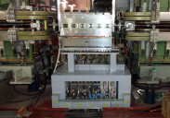
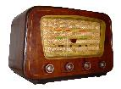
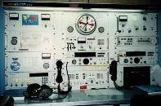
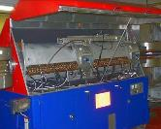
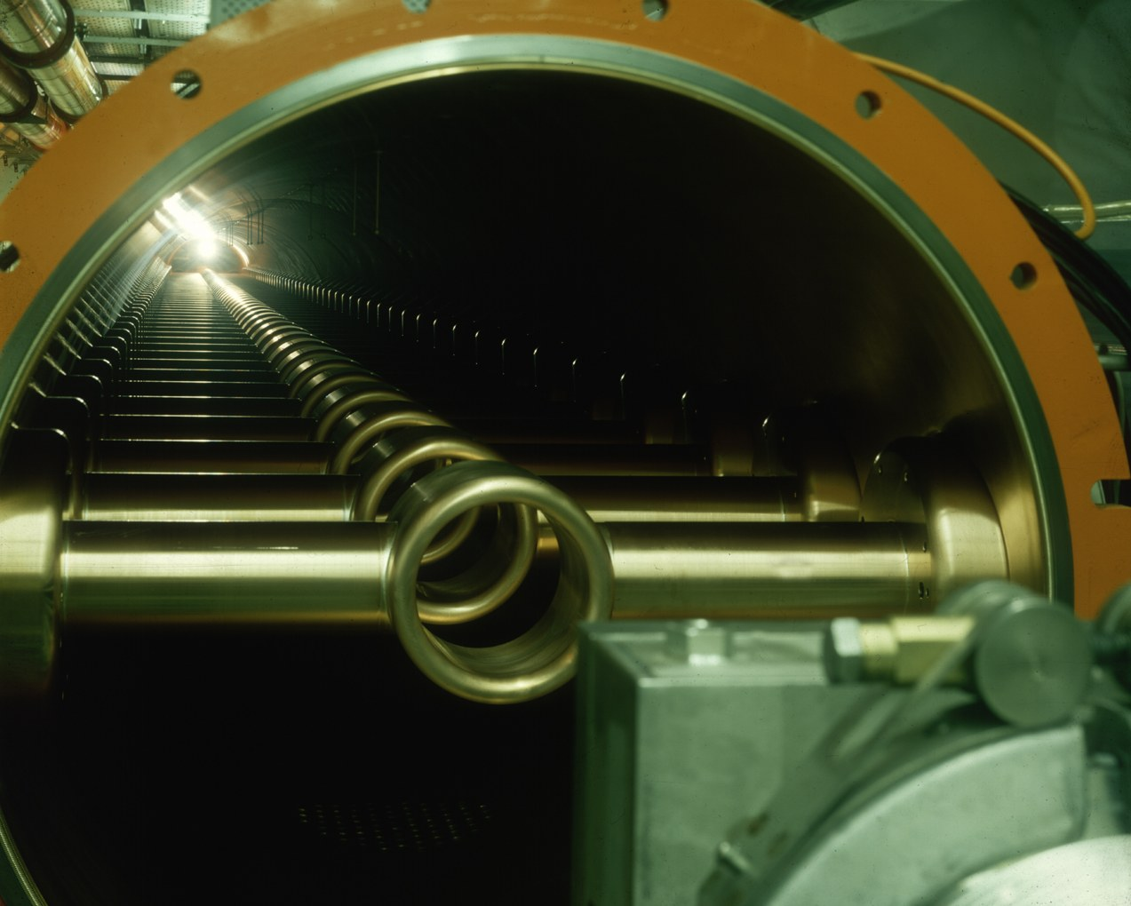
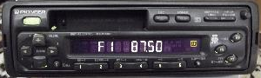

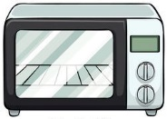
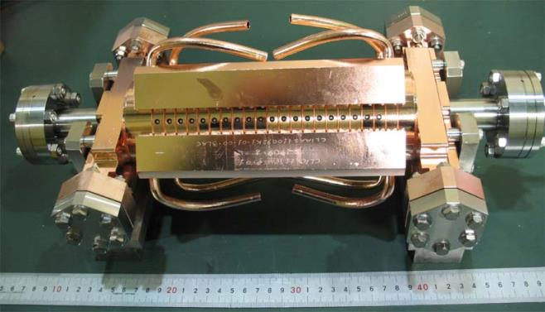

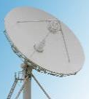
Frequency and wavelength ranges
PS longitudi- nal damper
100 kHz
3 km
Long wave
1 MHz
300 m
PS main RF system
Medium/ short wave
10 MHz
30 m
100 MHz
3 m
SPS 200 MHz
1 GHz
30 cm
VHF
10 GHz
3 cm
100 GHz
3 mm
Microwave links
CLIC 12 GHz

Slide 6
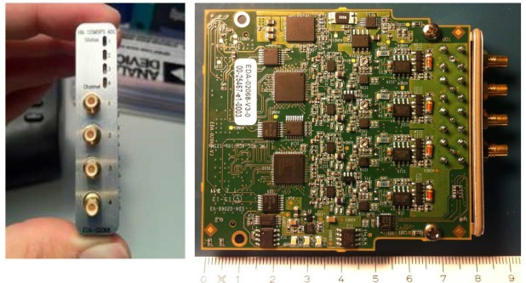
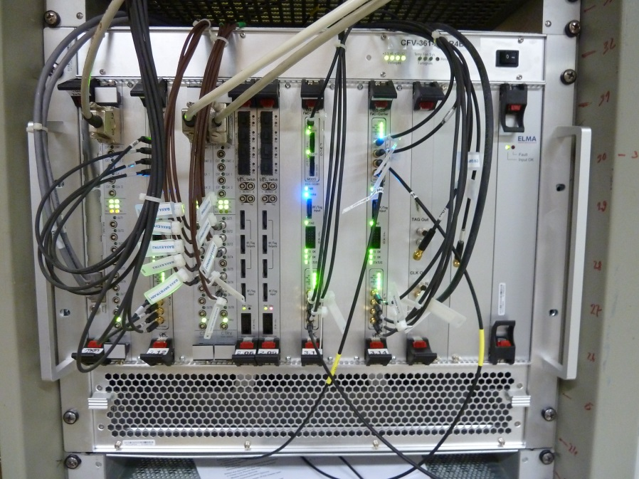
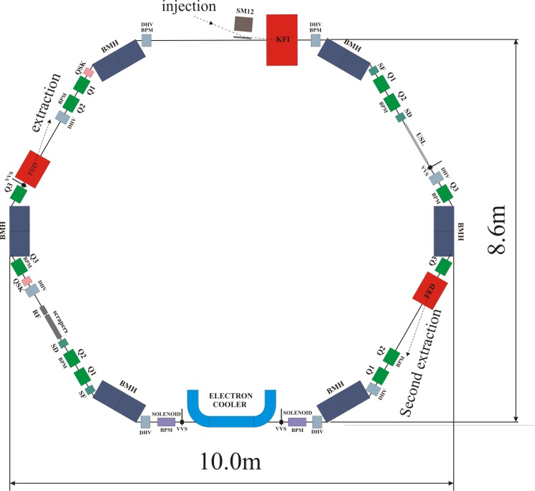
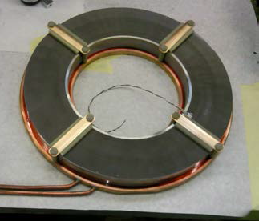
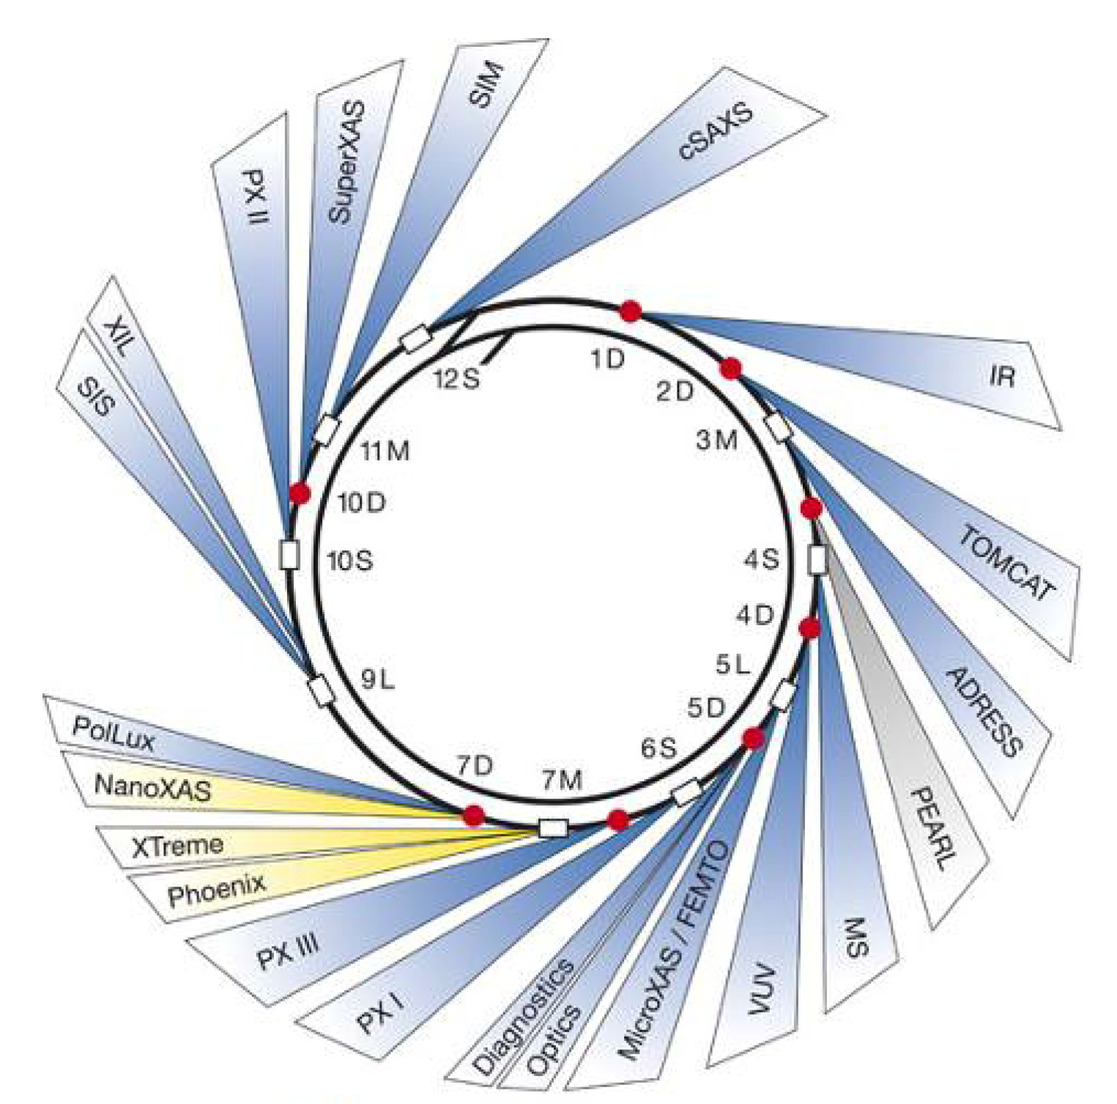
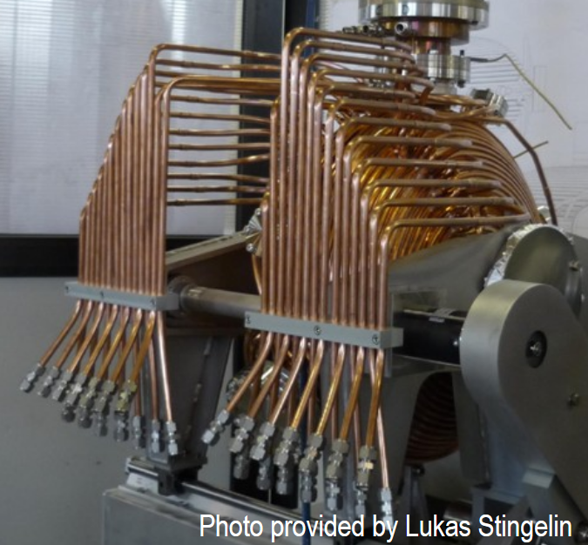
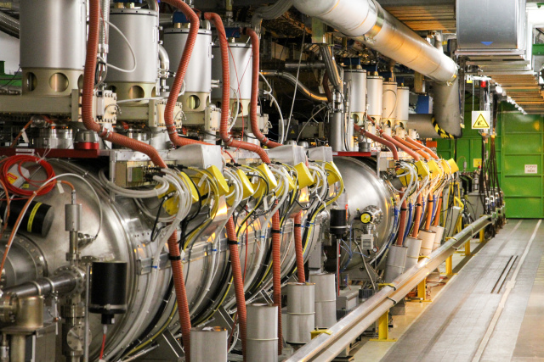
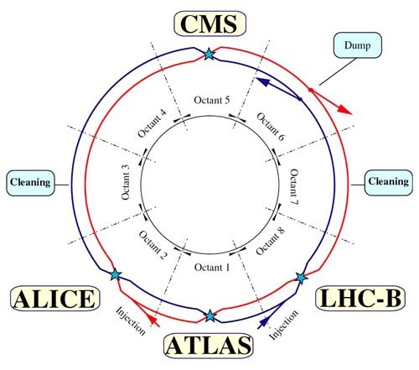
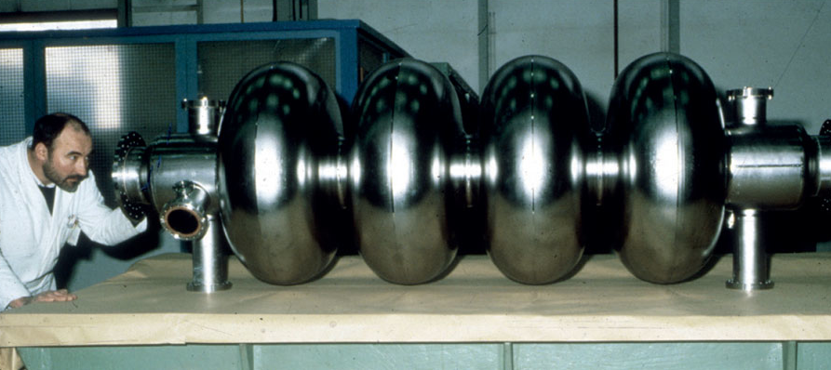
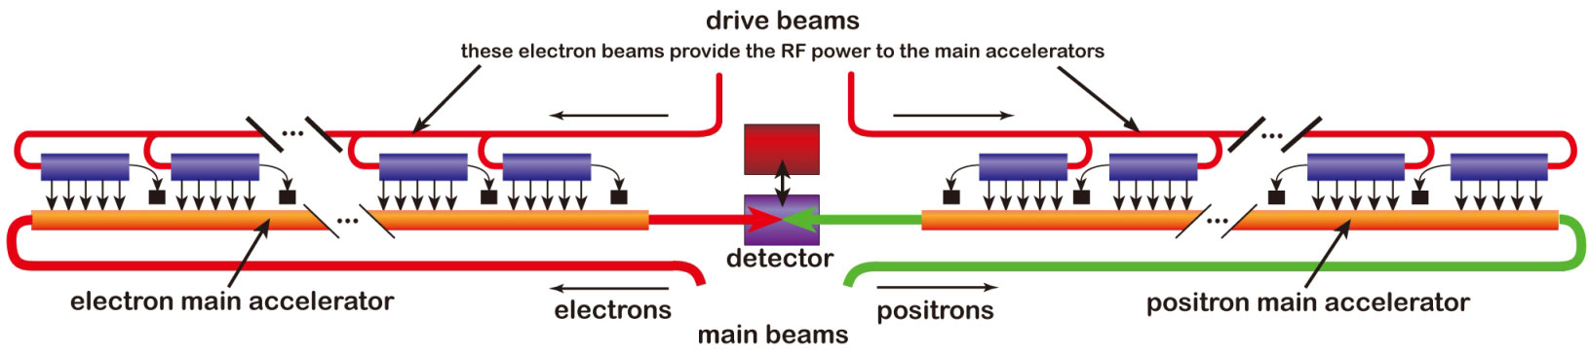
Amplitude ranges
Signals from beam pick-ups
1 μV
1 mV
Cooled hadron beams (ELENA)
LLRF systems
Low/Medium energy hadron RF
1 V
Electron light
sources
SLS
1 kV
1 MV
LHC: 16 MV
LHC
1 GV
LEP: 3.6 GV total
ILC and CLIC: several TV

Slide 7
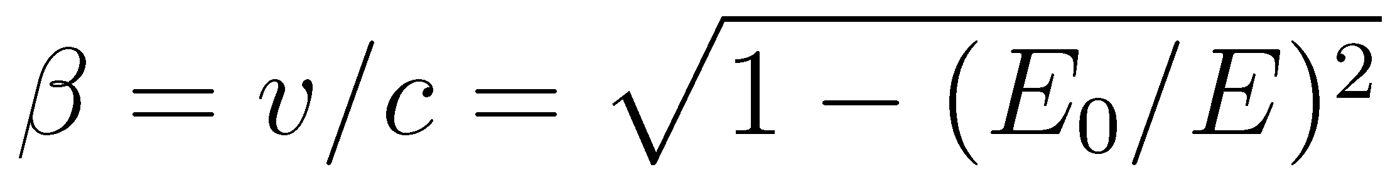
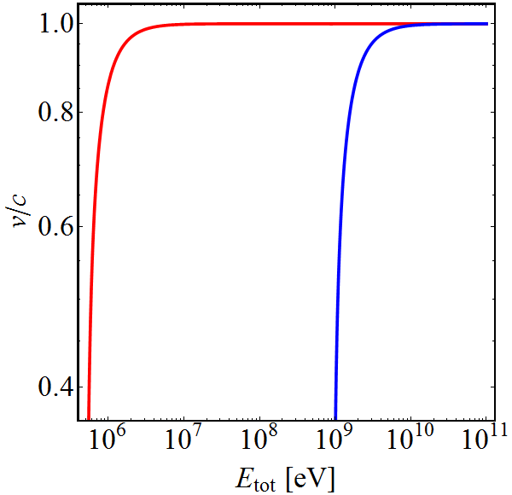
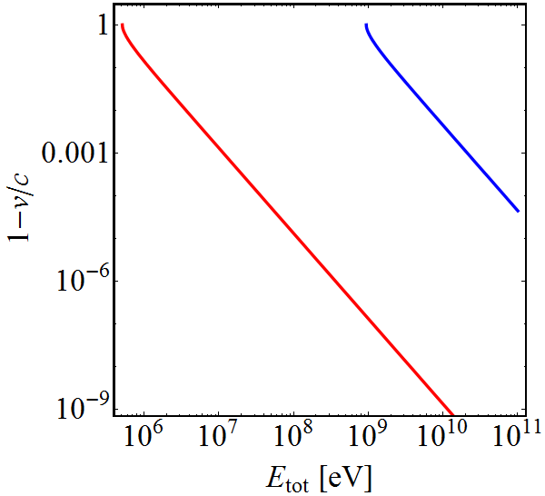

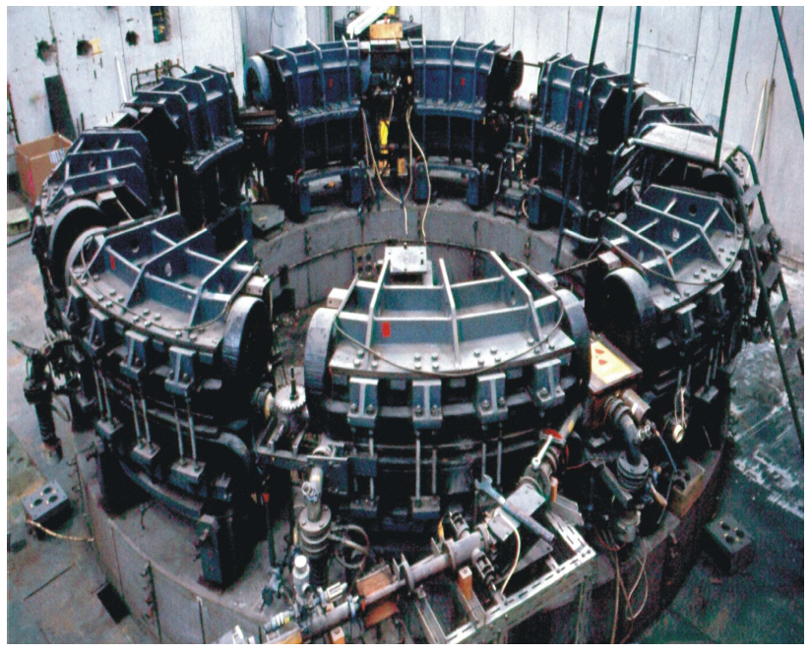
Particle velocity
Particle velocity depends on its type:
Old television set (30 kV): Electrons at 30% of c₀
            Protons just at 0.7%
Small synchrotron (500 MeV): Electrons at 99.99995%
              Protons at 75.8%
Most electron accelerators at ‘fixed’ frequency
e⁻
p⁺
e⁻
p⁺

Slide 8
Outline
Introduction
Choice of parameters
  Frequency and voltage
RF cavity parameters
  Shunt impedance, beam loading, power coupling
Power amplifiers
  Tube or solid state
Low-level RF system
  Beam phase control
Summary

Slide 9

RF system for high-energy accelerators
Accelerator type
Linear
Circular
(single pass)
(multi-pass)
Electron
Hadrons
Electron
Hadrons
Compensate synchrotron radiation losses
Sweep frequency with beam
Maximum RF voltage, constant velocity
Maximum RF voltage, variable velocity
*
*Exceptions (rare) exist

Slide 10
Outline
Introduction
Choice of parameters
  Frequency and voltage
RF cavity parameters
  Shunt impedance, beam loading, power coupling
Power amplifiers
  Tube or solid state
Low-level RF system
  Beam phase control
Summary

Slide 11
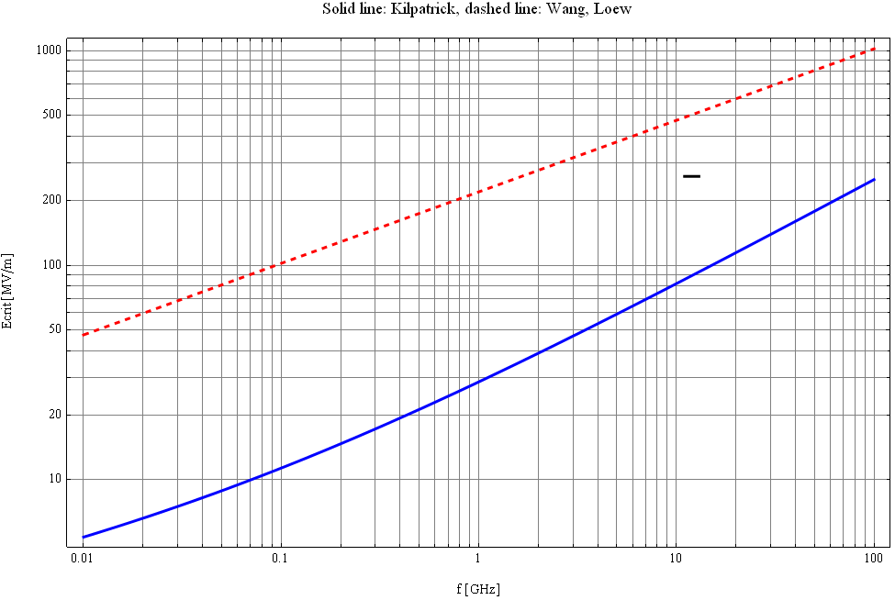
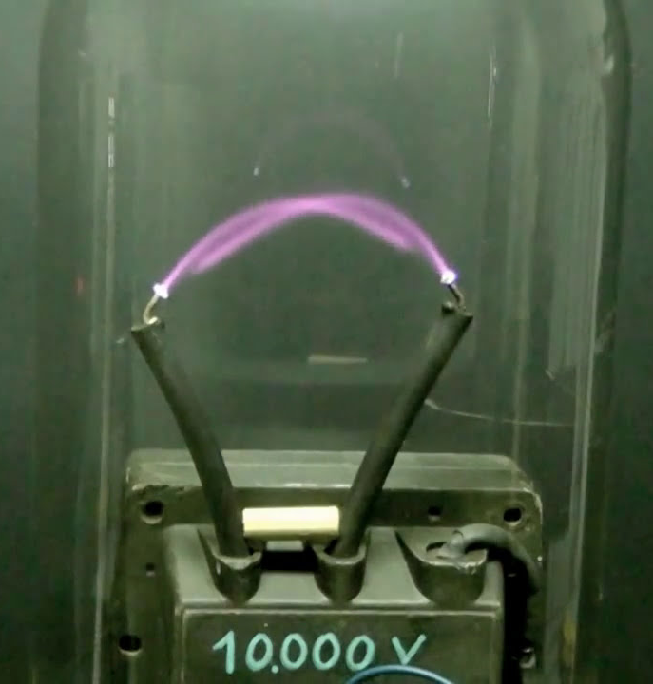
Limits to maximum gradient
Surface electric field in vacuum
1000
E. Jensen
500
Wang & Loew,
SLAC-PUB-7684, 1997
200
100
E_{crit} [MV/m]
50
Kilpatrick 1957,
f in GHz, E_{crit} in MV/m
20
10
0.01
0.1
1
10
100
f [GHz]
High frequencies generally preferred for large gradient

Slide 12
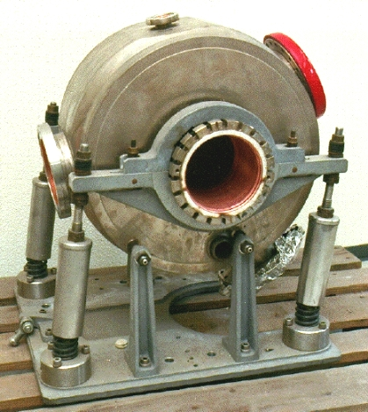

Choice of RF frequency
Why not high RF frequencies all the time?
Transverse beam size and aperture Particles are getting faster during acceleration | RF cavity scales with λ_{RF} = 1/f_{RF} f_{RF} must sweep Tunable or wideband cavities Technology only below ~100 MHz
500 MHz
1.5 GHz
  Some hadron linear accelerators
  Cyclotrons
  Low- and medium energy hadron synchrotrons
  RF frequencies below
  ~200 MHz for
  Linear accelerators
  Electron storage rings
  High energy hadron storage rings
  RF frequencies above
  ~200 MHz used for

Slide 13
Outline
Introduction
Choice of parameters
  Frequency and voltage
RF cavity parameters
  Shunt impedance, beam loading, power coupling
Power amplifiers
  Tube or solid state
Low-level RF system
  Beam phase control
Summary

Slide 14
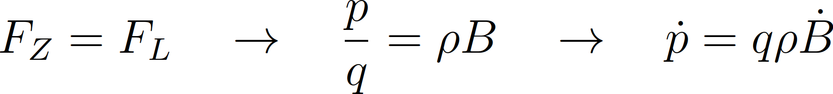
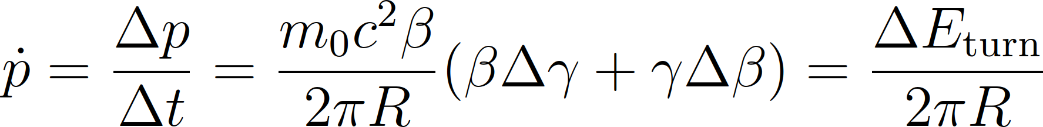
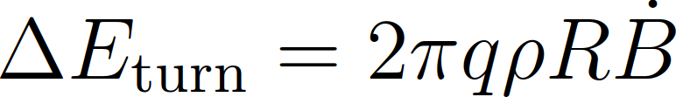
Minimum voltage requirement
(for circular accelerators)
The RF system must compensate
Energy gain per turn due to changing magnetic field, B
: bending, : average radius

Slide 15
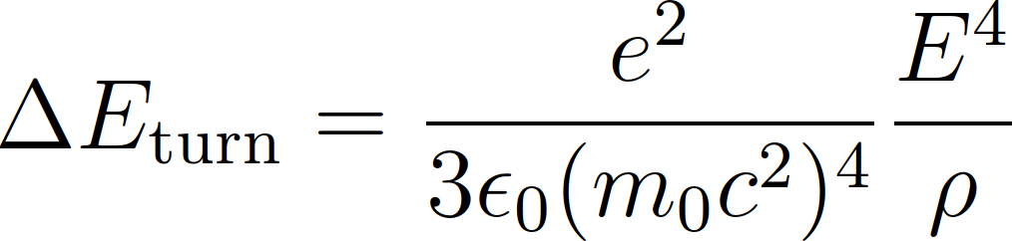
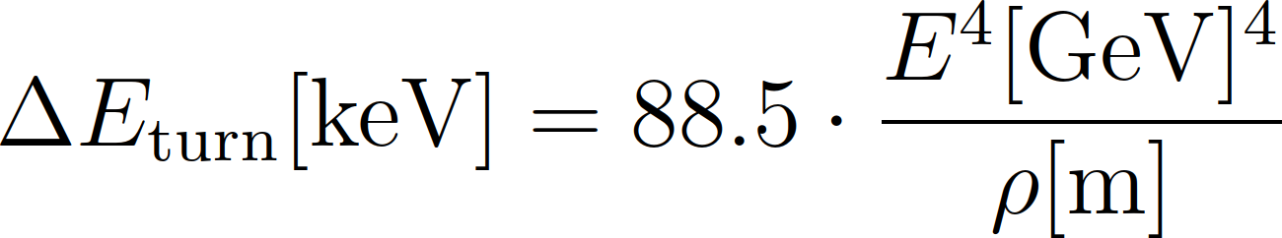
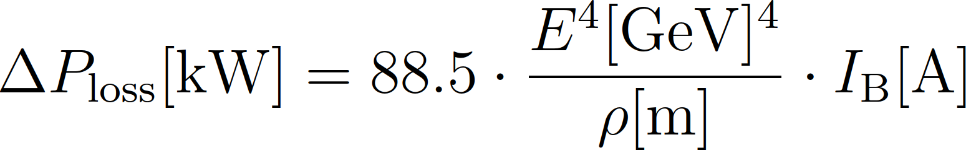
Minimum voltage requirement
(for circular accelerators)
The RF system must compensate
Energy loss, e.g., due to synchrotron radiation (electrons or positrons)
(m_{p}/m_{e})⁴ = 1836⁴ ~ 1.1 ∙ 10¹³ times less for protons

Slide 16

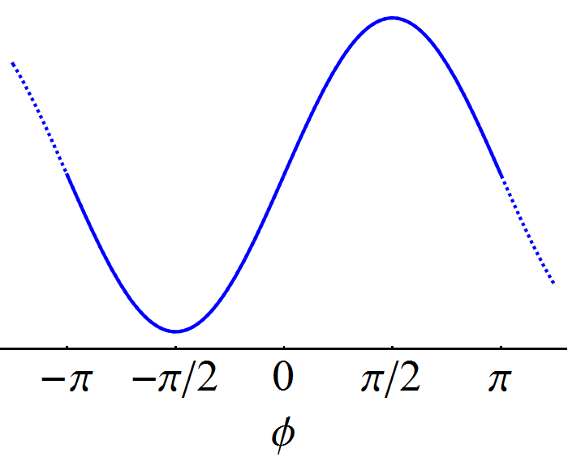


Minimum voltage requirement
RF system expected to provide given energy gain
On-crest acceleration
Used in some linear accelerators
Insufficient in a circular accelerator
More voltage provided to avoid on-crest acceleration
Off-crest acceleration
Needed for circular accelerator
Higher voltage for given energy gain
→

Slide 17
RF system overview
Beam
Cavity
Convert RF power into longitudinal electric field
Amplify low-power signal from beam control to kW, MW or GW
Provide RF signals with correct frequency, amplitude and phase
Power amplifier
Low-level RF
system
Beam

Slide 18
RF system overview
Beam
Cavity
Convert RF power into longitudinal electric field
Amplify low-power signal from beam control to kW, MW or GW
Provide RF signals with correct frequency, amplitude and phase
Power amplifier
Low-level RF
system
Beam

Slide 19
Outline
Introduction
Choice of parameters
  Frequency and voltage
RF cavity parameters
  Shunt impedance, beam loading, power coupling
Power amplifiers
  Tube or solid state
Low-level RF system
  Beam phase control
Summary

Slide 20
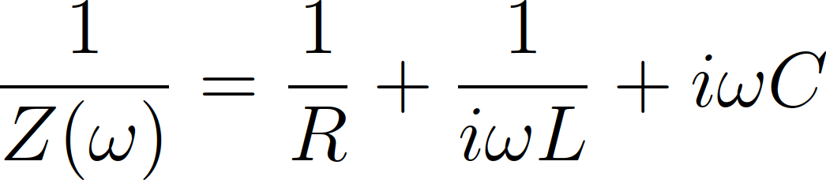
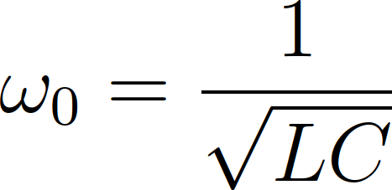
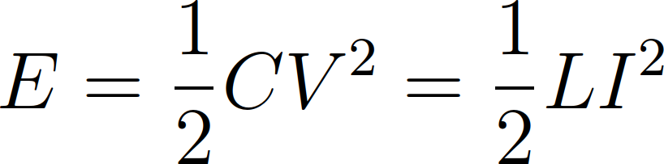
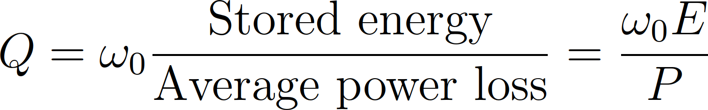
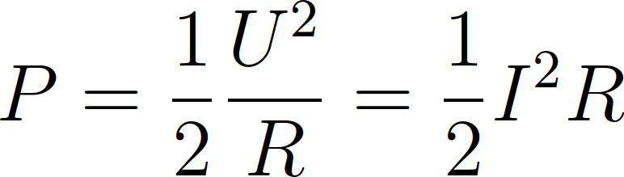
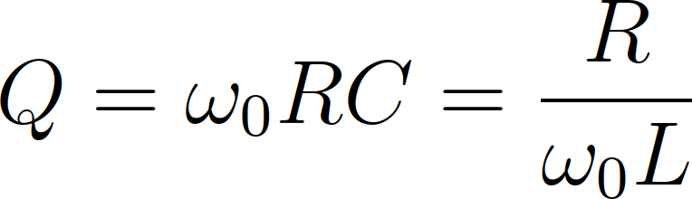
Cavity parameters
The resonance of a cavity can be understood as simple parallel resonant circuit described by R, L, C
L
R
C
Z(ω)
with

Slide 21
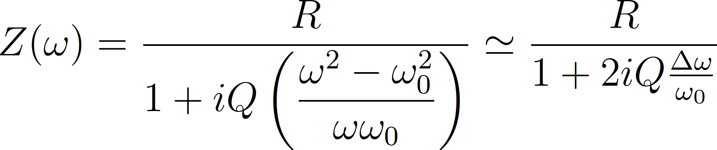
Cavity parameters
The resonance of a cavity can be understood as simple parallel resonant circuit described by R, L, C
L
R
C
Z(ω)
with

Slide 22
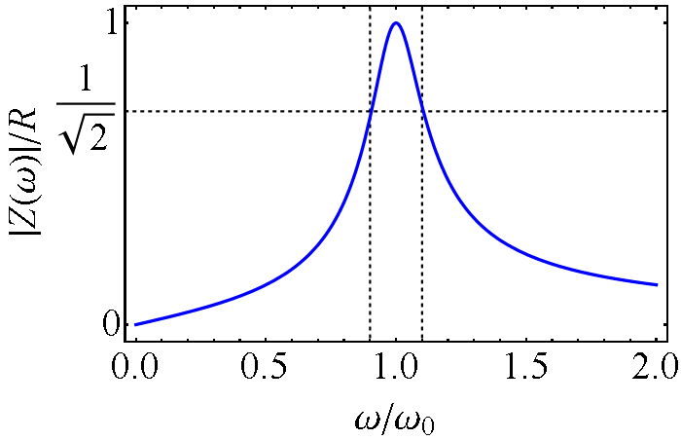
Cavity parameters
The resonance of a cavity can be understood as simple parallel resonant circuit described by R, L, C
Resonant circuit can also be described by R, R/Q, ω₀ or any other set of three parameters
L
R
C
Z(ω)
Δω

Slide 23
Cavity parameters
Most common choice by cavity designers ω₀, R, R/Q – why?
Resonance frequency, ω₀
  Exactly defined for given application, e.g. hf_{rev}
Shunt impedance, R
  Power required to produce a given voltage without beam
“R-upon-Q”, R/Q
  Defined only by the cavity geometry
  Criterion to optimize a geometry
  Detuning with beam proportional to R/Q

Slide 24
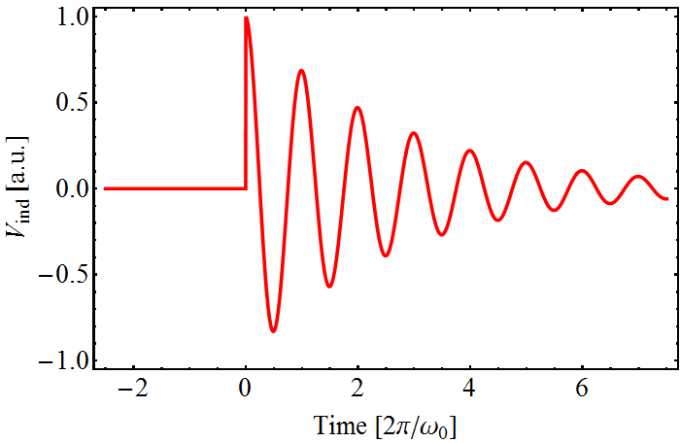

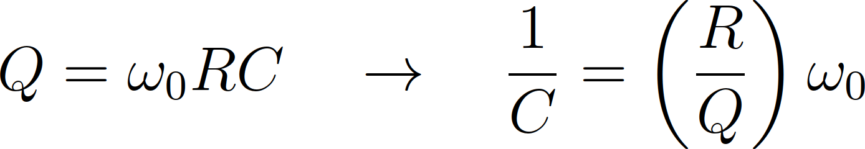
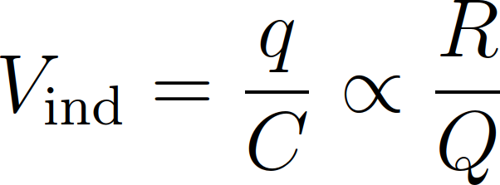
Why R/Q?
Charged particle experiences cavity gap as capacitor
Cavity geometry with small R/Q to reduce beam loading
Cavity
Beam induced voltage
q

Slide 25
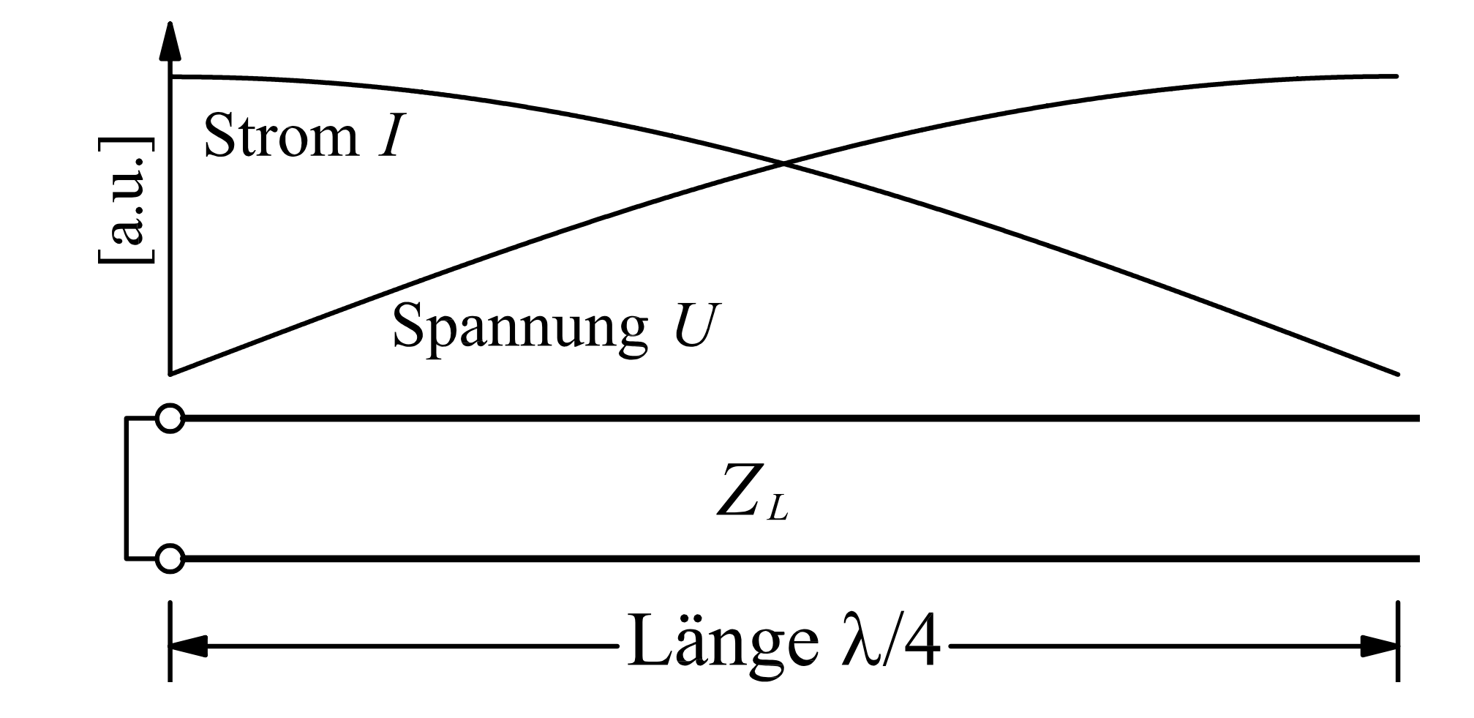
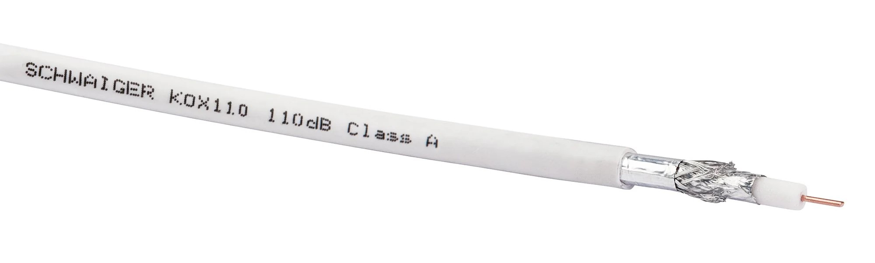
RF cavities in low frequency range
RF wavelength large below ~10 MHz: >30 m
Would need huge cavities → too large for accelerators
Line resonators: λ/4 resonator
  Short circuit on one side → Voltage is zero
  Open end on other → No current but voltage
Why is this resonator so common in particle accelerators?
Voltage
Current
Z(ω)
Transmission line, impedance Z_{L}
Short-
circuit
λ/4 length

Slide 26
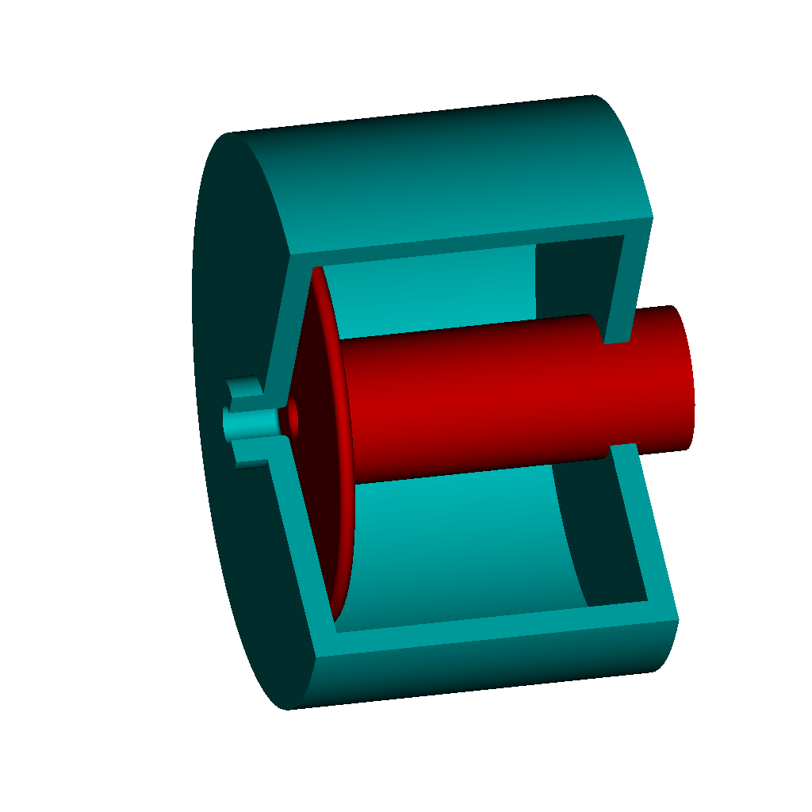
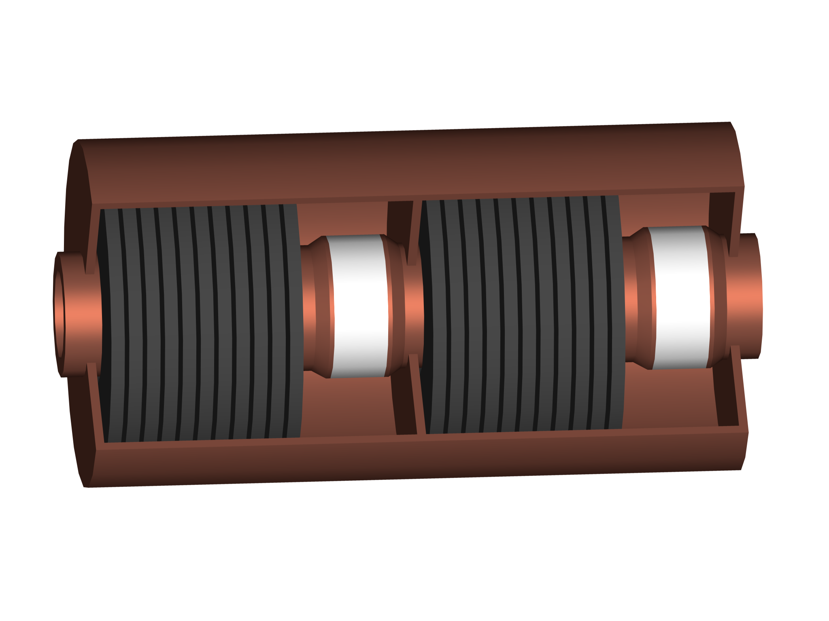
RF cavities in low frequency range
Coaxial structure with inner conductor as beam pipe
Z(ω)
Beam axis
Short-
circuit
Accelerating gap, isolated
Still rather long geometry, 7.5 m at 10 MHz
Add capacitive or inductive shortening
Plate
capacitor
Ferrite
inductivity

Slide 27
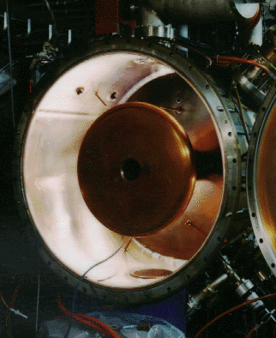
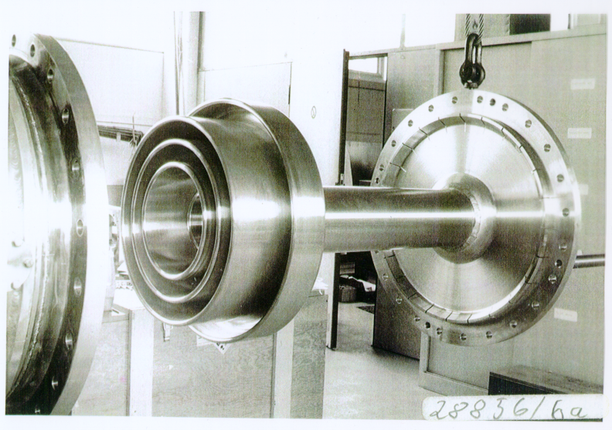

Capacitive loading
Add capacitor at gap of cavity to shorten the resonator
NSLS, 52.88 MHz
DESY PIA, 10.4 MHz, inner cond.
Outer cond.
~1 m
M. Nagl
Significantly reduces cavity size
Fixed frequency only
Small losses due to capacitor
Cavity in vacuum

Slide 28


Inductive loading
Inductive loading with magnetic material shortens resonator from tens of meters to a device, lossy though
CERN PS, double gap, 2.8-10 MHz
CERN PSB Finemet cav., 0.6-18 MHz
M. Paoluzzi
Additional advantage: permeability of ferrite can be controlled by DC bias current → variable inductivity
  Cavity with programmable resonance frequency
  Essential for hadron acceleration in low-energy accelerators

Slide 29


Further increase frequency
Remove inner conductor from coaxial set-up
The resonator becomes a pill-box cavity
The basis for cavity resonators
Beam axis
DORIS cavity
Electric field, TM₀₁₀-mode
Magnetic field, TM₀₁₀-mode
Beam axis
E. Jensen

Slide 30


Example: 400 MHz cavities in LHC
Reduce beam loading in RF cavities
Shunt impedance, R, low for small R/Q with normal conducting cavities → superconducting cavities in LHC
Bell shape: R/Q ~ 44 Ω, 400 MHz
2×8 cavities, 5.3 MV/m
16 MV/beam

Slide 31
Outline
Introduction
Choice of parameters
  Frequency and voltage
RF cavity parameters
  Shunt impedance, beam loading, power coupling
Power amplifiers
  Tube or solid state
Low-level RF system
  Beam phase control
Summary

Slide 32




Coupling power into a cavity magnetically
Attack inductivity or capacitance of resonator, or combined
Coupling loop forms transformer with resonator inductivity
L
R
C
RF power
L_{c}
M
Main coupler
PSI cyclotron
~1 MW at 50 MHz
A. Rodchenko
L. Stigelin

Slide 33

Coupling power into a cavity electrically
Attack inductivity or capacitance of resonator, or combined
Capacitive divider to gap to
transform generator impedance
to cavity shunt impedance
Beam also couples
capacitively via the gap
L
R
C
C_{c}
Beam
RF power
Coupler of CERN PS 40 MHz
Coupler forms one half of capacitor with the gap

Slide 34

Coupling power into a cavity electrically
Attack inductivity or capacitance of resonator, or combined
L
R
C
300 kW power coupler of LHC 400 MHz cavities
C_{c}
Beam
RF power
RF power
Coupler antenna transmits directly into the cavity
Most common electrical coupler

Slide 35
RF system overview
Beam
Cavity
Convert RF power into longitudinal electric field
Amplify low-power signal from beam control to kW, MW or GW
Provide RF signals with correct frequency, amplitude and phase
Power amplifier
Low-level RF
system
Beam

Slide 36
Outline
Introduction
Choice of parameters
  Frequency and voltage
RF cavity parameters
  Shunt impedance, beam loading, power coupling
Power amplifiers
  Tube or solid state
Low-level RF system
  Beam phase control
Summary

Slide 37






How much power is required?
Power to accelerate beam → Wanted
Compensate beam-induced voltage → Refl. P
Compensate electrical losses in cavity → Heat
Compensate electrical losses in distribution → Heat
P_{out} = g ∙ P_{in} or
V_{out} = $\sqrt{g}$ ∙ V_{in}
(ideally)

Slide 38
Basics of grid tube
From diode to tetrode amplifier
Vacuum tube
Heater + Cathode
  Heated cathode
    Coated metal, carbides, borides,…
  thermionic emission
  Electron cloud
Anode
Diode
U_{a}*
anode
e-
e-
e-
e-
I_{a}
e-
e-
e-
e-
e-
e-
e-
Cathode and filament
*For tube amplifier designs voltages are named U instead of V
E. Montesinos

Slide 39
Basics of grid tube
From diode to tetrode amplifier
Vacuum tube
Heater + Cathode
  Heated cathode
    Coated metal, carbides, borides,…
  thermionic emission
  Electron cloud
Anode
Diode
U_{a}
anode
I_{a}
e-
e-
e-
Cathode and filament
E. Montesinos

Slide 40

Basics of grid tube
From diode to tetrode amplifier
https://en.wikipedia.org/wiki/Triode
Triode
  Modulating the grid voltage proportionally modulates
  the anode current
  Transconductance
    Voltage at grid
    Current at anode
  Limitations
    Parasitic capacitor from anode to control grid (g1)
    Tendency to oscillate
U_{a}
anode
e-
e-
e-
e-
U_{g1}
control grid
e-
e-
e-
Cathode and filament
E. Montesinos

Slide 41

Basics of grid tube
From diode to tetrode amplifier
https://en.wikipedia.org/wiki/Beam_tetrode
Tetrode
  Screen grid
    Positive (lower anode)
    Decouple anode and g1
    Higher gain
  Limitations
    Secondary electrons
    Anode treated to reduce secondary emission
U_{a}
anode
e-
e-
e-
e-
U_{g2}
Screen grid
U_{g1}
Control grid
e-
e-
e-
e-
e-
Cathode and filament
E. Montesinos

Slide 42



Example: Tetrode amplifier driving SPS RF
Two transmitters, 2 × 1 MW at 200 MHz (almost continuous)
Eight tetrodes per amplifier
RS2004 tetrode
Amplifier trolley
Complete transmitter
E. Montesinos

Slide 43
Basics of RF solid state amplifiers
In a push-pull circuit the RF signal is applied to two devices
  One of the devices is active on the positive voltage swing and off during the negative voltage swing
  The other device works in the opposite manner so that the two devices conduct half the time
  The full RF signal is then amplified
Needs two different type of devices
V_{DC}
NPN BJT
V_{in}
V_{out}
PNP BJT
BJT: Bipolar Junction Transistor
E. Montesinos

Slide 44

Basics of RF solid state amplifiers
Another push-pull configuration is to use a balun (balanced-unbalanced)
  Power splitter, equally dividing the input power between the two transistors
  Balun keeps one port in phase and inverts the second port in phase
Since the signals are out of phase only one device is On at a time
This configuration is easier to manufacture since only one type of device is required
Vdc
0 ⁰
NPN BJT
0 ⁰
Input balun
(Unbalanced-Balanced)
Output balun
(Balanced-Unbalanced)
V_{in}
V_{out}
180 ⁰
180 ⁰
NPN BJT
NXP Semi-
conductors AN11325
2-way Doherty amplifier with BLF888A
E. Montesinos

Slide 45





Example: Soleil 45 kW, 352 MHz
Electron storage ring running at 352 MHz
DU1029UK
330 W amplifier module
600 W, 300 V_{DC}/30 V_{DC} converter

Slide 46

Example: SPS
200 MHz solid state amplifiers: 2 × 1.6 MW peak power,
2 × 16 towers per amplifier
From LLRF
1.6 MW at cavity input
1/16 splitter
80 modules per tower, 1280 modules with 5120 transistors
per amplifier
Presently the largest RF installation in a particle accelerator
E. Montesinos

Slide 47
How to choose the right RF amplifier?
Prefer tube amplifier, when | Prefer solid-state amplifier, when
Amplifier must be installed in the accelerator tunnel Expecting important spikes from beam induced voltage Large output power of a single device is required, without combiners Not much space is available High peak power in pulsed mode Amplifier must be compact and/or close to cavity | Amplifier can be located in non-radioactive environment Circulator can be installed to protect the amplifier Delay due to unavoidable combiner stages is little issue Sufficient space can be made available Continuous operation Amplifier can be separate from the cavity
Mostly no hard criteria → decide on case by case basis

Slide 48
Outline
Introduction
Choice of parameters
  Frequency and voltage
RF cavity parameters
  Shunt impedance, beam loading, power coupling
Power amplifiers
  Tube or solid state
Low-level RF system
  Beam phase control
Summary

Slide 49



Generate the right RF signal
Get amplitude, frequency and phase right

Slide 50

Electronic phase-locked loop
Frequency re-generation and multiplication
Voltage controlled oscillator (VCO) locked in phase to input
Loop filter, H(ω)
f_{in}, φ_{in}
Δφ
VCO
f_{out}, φ_{out}
~φ_{in} - φ_{VCO}
φ_{VCO}
RF
Slow signal
Fixed phase relationship: φ_{out} – φ_{in} = const.
Locked frequencies: f_{out} = f_{in}

Slide 51

Electronic phase-locked loop
Lock two signals: frequency re-generation and multiplication
Voltage controlled oscillator (VCO) locked in phase to input
Loop filter, H(ω)
f_{in}, φ_{in}
Δφ
VCO
f_{out}, φ_{out}
~φ_{in} - φ_{VCO}
φ_{VCO}
1
n
RF
Slow signal
Fixed phase relationship: φ_{out}/n – φ_{in} = const.
Optional divider: f_{out} = n · f_{in}

Slide 52
Beam phase loop
RF cavity
RF
Phase pick-up
Slow signal
h f_{rev} (digital)
Δφ
Power amplifier
Beam phase
Cavity phase
f_{RF}
RF
source
Direct digital
synthesizer (DDS)
Synchronous phase, φ_{s}
+
Loop filter
φ_{err} ~Δf
-
h · f_{rev}, from B, p

Slide 53
Beam phase loop
RF cavity
RF
Phase pick-up
Slow signal
h f_{rev} (digital)
Δφ
Power amplifier
Beam phase
Cavity phase
f_{RF}
RF
source
Direct digital
synthesizer (DDS)
Synchronous phase, φ_{s}
+
Loop filter
φ_{err} ~Δf
Loop corr.
-
f_{out} = f_{in} ± Δf
Precision VCO
h · f_{rev}, from B, p
Phase-locked loop with beam phase as reference for RF system

Slide 54

Beam phase loop
RF cavity
RF
Phase pick-up
Slow signal
h f_{rev} (digital)
Δφ
Power amplifier
Beam phase
Cavity phase
f_{RF}
RF
source
Direct digital
synthesizer (DDS)
Synchronous phase, φ_{s}
+
φ_{err} ~Δf
Move the wave!
-
Loop filter
Loop corr.
f_{out} = f_{in} ± Δf
Precision VCO
h · f_{rev}, from B, p
Fast control of RF frequency to cavities (no slow corrections)

Slide 55


Effect of beam phase loop at injection
Example: Injection of a bunch from PS Booster into PS
90° error, phase loop off
90° error, phase loop on
Bucket centre
Bucket centre
Essential in hadron accelerators to keep RF locked to beam
How does this look like in longitudinal phase space?

Slide 56


Effect of beam phase loop at injection
Essential in hadron accelerators to keep RF locked to beam
Bunch in rigid bucket, no loop
Injection with phase loop
Even large transients (injection, transition) are controlled
Only minor longitudinal perturbation

Slide 57
Summary
RF system parameters
  Choose frequency and voltage wisely
Parameters of RF cavities
  R, R/Q
  No ‘one-size fits’ all
Power amplifier
  Tube or solid-state based
Beam control as global feedback
  Beam phase
The beam is the reference - make it feel comfortable!

Slide 58
Thank you very much for your attention!

Slide 59
A big Thank You
to all colleagues providing support, material and feedback
Maria-Elena Angoletta, Philippe Baudrenghien, Thomas Bohl, Giorgia Favia, Jörn Jacob, Erk Jensen, John Molendijk, Eric Montesinos, Gerry McMonagle, Mauro Paoluzzi, Damien Perrelet, Bernhard Schriefer, Lukas Stingelin, Fumihiko Tamura, Frank Tecker, Daniel Valuch and many more…

Slide 60
References
D. Boussard, Design of a Ring RF System, CERN SL/91-2 (RFS, rev.), 1991, http://cds.cern.ch/record/1023436/files/CM-P00065157.pdf
E. Montesinos, Accelerators for Medical Applications - Radio Frequency Powering, CERN-2017-004-SP, http://cds.cern.ch/record/2315172/files/1804.08535.pdf
R. Garoby, Low level rf building blocks, CERN-1992-003, 1991, http://cds.cern.ch/record/225609/files/CM-P00059483.pdf
J. W. Wang, G. A. Loew, Field Emission and RF Breakdown in High-Gradient Room-Temperature Linac Structures, SLAC-PUB-7684, 1997, http://www.slac.stanford.edu/cgi-wrap/getdoc/slac-pub-7684.pdf
W. D. Kilpatrick, Criterion for vacuum sparking designed to include both rf and dc, Rev. Sci. Instrum. 28 (1957), 1957, http://inspirehep.net/record/44645
H. Damerau, Radio-Frequency (RF) Systems, CAS, Introduction to Accelerator Physics, https://arxiv.org/abs/2108.06237

Slide 61
Some standard frequencies
If exact RF frequency not critical, choose standard value
Off-the-shelf RF components easily available in frequency ranges used by industry
Exchange of developments and equipment amongst research laboratories
Accelerator | Frequency
Hadron synchrotrons (PSB, PS, JPARC RCS, MR) | <10 MHz
Hadron accelerators and storage rings (RHIC, SPS) | ~200 MHz
Electron storage rings (LEP, ESRF, Soleil) | 352 MHz
Electron storage rings (DORIS, BESSY, SLS,…) | 499.6…499.8 MHz
Superconducting electron linacs and FELs (X-FEL, ILC) | 1300 MHz
Normal conducting electron linacs (SLAC) | 2856 MHz
High-gradient electron linac (CLIC) | 11.99 GHz

Slide 62
RF power amplifier
Power capability of commercially available amplifier types
E. Jensen

Slide 63

Why choose a low RF frequency?
Advantages | Disadvantages
Large beam aperture Long RF buckets, large acceptance Wide-band or wide range tunable cavities possible Power amplification and transmission straightforward | Bulky cavities, size scales $∝$ 1/f, volume $∝$ 1/f³ Lossy material to downsize cavities Moderate or low acceleration gradient Short particle bunches difficult to generate
  Some hadron linear accelerators
  Cyclotrons
  Low- and medium energy hadron synchrotrons
  RF frequencies below
  ~200 MHz for

Slide 64

Why choose a high RF frequency?
Advantages | Disadvantages
Cavity size scales $∝$ 1/f, volume $∝$ 1/f³ Break down voltage increases High gradient per length Particle bunches are short | Maximum beam available aperture scales $∝$ 1/f No technology for wide-band or tunable cavities Power amplifiers more difficult Power transmission losses
  Linear accelerators
  Electron storage rings
  High energy hadron storage rings
  RF frequencies above
  ~200 MHz used for

Slide 65


Bucket area dependence on stable phase
In a circular accelerator the area in energy-time phase space (bucket area) depends on the stable phase
Below transition, φ_{S} = 0…90°
Above transition, φ_{S} = 90°…180°
Typical synchronous phase with respect to 0° or 180°
  Hadron accelerators: < 40°
  Electron storage rings: ~ 20°

Slide 66
RF system overview
Beam
Cavity
Convert RF power into longitudinal electric field
Amplify low-power signal from beam control to kW, MW or GW
Provide RF signals with correct frequency, amplitude and phase
Power amplifier
Low-level RF
system
Beam

Slide 67
Outline
Introduction
Choice of parameters
  Frequency and voltage
RF cavity parameters
  Shunt impedance, beam loading, power coupling
Power amplifiers
  Tube or solid state
  Local feedback
Low-level RF system
  Beam phase control
Summary

Slide 68


Reciprocity
Antennas work in transmission and reception
RF cavities transfers energy to the beam, but it also works in the opposite, unwanted direction

Slide 69



Reduction of cavity impedance
Energy transfer from cavity to beam, but from beam to cavity
Both, RF generator and beam can induce voltage in cavity
Reduce beam induced voltage by reducing R, but not efficient
  Obviously needs more power → $$$
Feedback to decrease the apparent impedance for the beam
  Use amplifier to counteract beam induced voltage
L
R
C
Drive
Final amp
Beam
I_{G}
I_{B}

Slide 70

Reduction of cavity impedance
Energy transfer from cavity to beam, but from beam to cavity
Both, RF generator and beam can induce voltage in cavity
Compare drive signal (no beam) with gap (beam and generator)
Amplify inverted difference
V
FB ret.
L
R
C
-
+
Final amp
Beam
+
I_{G}
I_{B}
Drive

Slide 71

Example: 10 MHz RF system in CERN PS
Transfer function with and without feedback
Feedback gain of 24 dB
Equivalent impedance,
Z_{eq}(ω) reduced
Impedance for amplifier remains unchanged, Z(ω)
~24 dB
Gain [dB]
Frequency [MHz]
Cavity, amplifier with feedback
Z(ω)
Z_{eq}(ω)
Asymmetric cavity optimized for energy flow to beam

Slide 72
RF system overview
Beam
Cavity
Convert RF power into longitudinal electric field
Amplify low-power signal from beam control to kW, MW or GW
Provide RF signals with correct frequency, amplitude and phase
Power amplifier
Low-level RF
system
Beam

