Slide 1

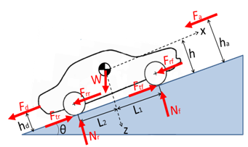

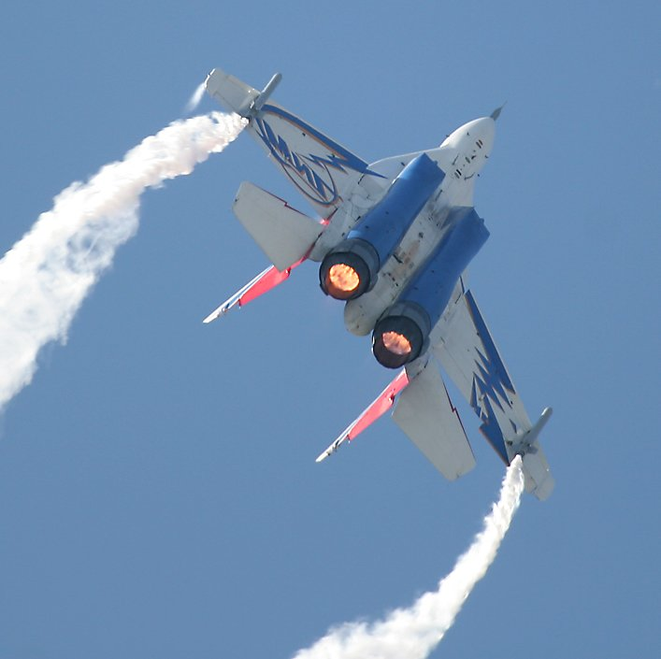
LONGITUDINAL
DYNAMICS
Frank Tecker
CERN, ATS-DO
Basics of Accelerator Physics and Technology
10-14 March 2025

Slide 2
Scope and Summary of the 2 lectures:
The goal of an accelerator is to provide a stable particle beam.
The particles nevertheless perform transverse betatron oscillations.
We will see that they also perform oscillations in the longitudinal plane and in energy.
We will look at the stability of these oscillations, and their dynamics.
Acceleration methods
Accelerating structures
Linac: Phase Stability +
Energy-Phase oscillations
Circular accelerators:
Cyclotron / Synchrotron
Stability in a Synchrotron
Longitudinal Phase Space Motion
Bunch and Bucket
Injection Matching + Filamentation
RF manipulations in the PS
More related lectures:
  Linacs – Alessandra Lombardi
  RF Systems - Heiko Damerau

Slide 3
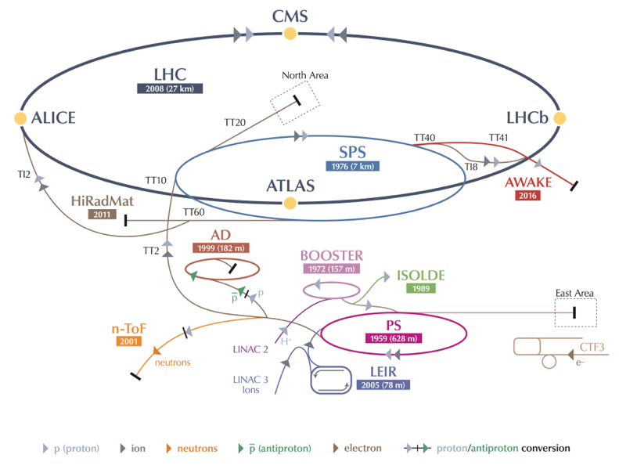
The CERN Accelerator Complex
-> 7 TeV
-> 450 GeV
160 MeV-> 2 GeV
Linear accelerators scale in size and cost(!) ~linearly with the energy.
Circular accelerators can each turn reuse
  the accelerating system
  the vacuum chamber
  the bending/focusing magnets
  beam instrumentation, …
-> economic solution to reach higher particle energies
But each accelerator has a limited energy range.
-> 25 GeV
-
4

Slide 4
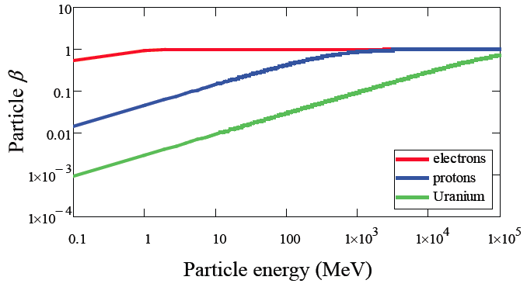
Particle types and acceleration
The evolution of the particle velocity depends on the particle type:
• electrons reach a constant velocity (~speed of light) at relatively low energy
• heavy particles reach a constant velocity only at very high energy
-> we need different types of cavities, optimized for different velocities
-> the revolution frequency will vary, so the RF frequency will be changing
-> magnetic field needs to follow the momentum increase
Particle rest mass m₀:
electron 0.511 MeV/c²
proton 938 MeV/c²
²³⁹U ~220000 MeV/c²
Total Energy:
Relativistic
gamma factor:
Momentum:

Slide 5
Revolution frequency variation
The revolution and RF frequency will be changing during acceleration
Much more important for lower energies (values are kinetic energy - protons).
PS Booster: 50 MeV (β= 0.314) -> 1.4 GeV (β=0.915)
(pre LS2) 602 kHz -> 1746 kHz => 190% frequency increase
(post LS2): 160 MeV (β= 0.520) -> 2 GeV (β=0.948) => 95% increase
PS: 1.4 GeV (β=0.915) -> 25.4 GeV (β =0.9994)
(pre LS2) 437 KHz -> 477 kHz => 9% increase
(post LS2): 2 GeV (β=0.948) -> 25.4 GeV (β =0.9994) => 5% increase
SPS: 25.4 GeV -> 450 GeV (β=0.999998)
=> 0.06% frequency increase
LHC: 450 GeV -> 7 TeV (β= 0.999999991)
=> only 2 10⁻⁶ increase
RF system needs more flexibility in lower energy accelerators.

Slide 6

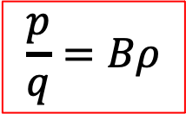
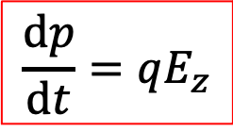
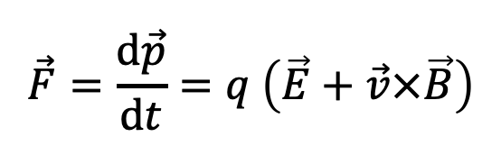
Acceleration: May the force be with you
To accelerate, we need a force in the direction of motion!
Newton-Lorentz Force on a charged particle with charge q
$$\vec{F}=\frac{d\vec{p}}{dt}=q \left(\vec{E}+\vec{v}×\vec{B}\right)$$
2nd term always perpendicular to motion => no acceleration
Hence, it is necessary to have an electric field E
(preferably) along the direction of the initial momentum (z),
which changes the momentum of the particle.
The 2nd term - larger at high velocities – is used for:
- BENDING: generated by a magnetic field perpendicular to the plane of the particle trajectory. The bending radius ρ obeys the relation :
$$\frac{dp}{dt}=qE_{z}$$
$$\frac{p}{q}=Bρ$$
in practical units for q=e:
- FOCUSING: the bending effect is used to bring the particles trajectory closer to the axis, hence to increase the beam density.

Slide 7
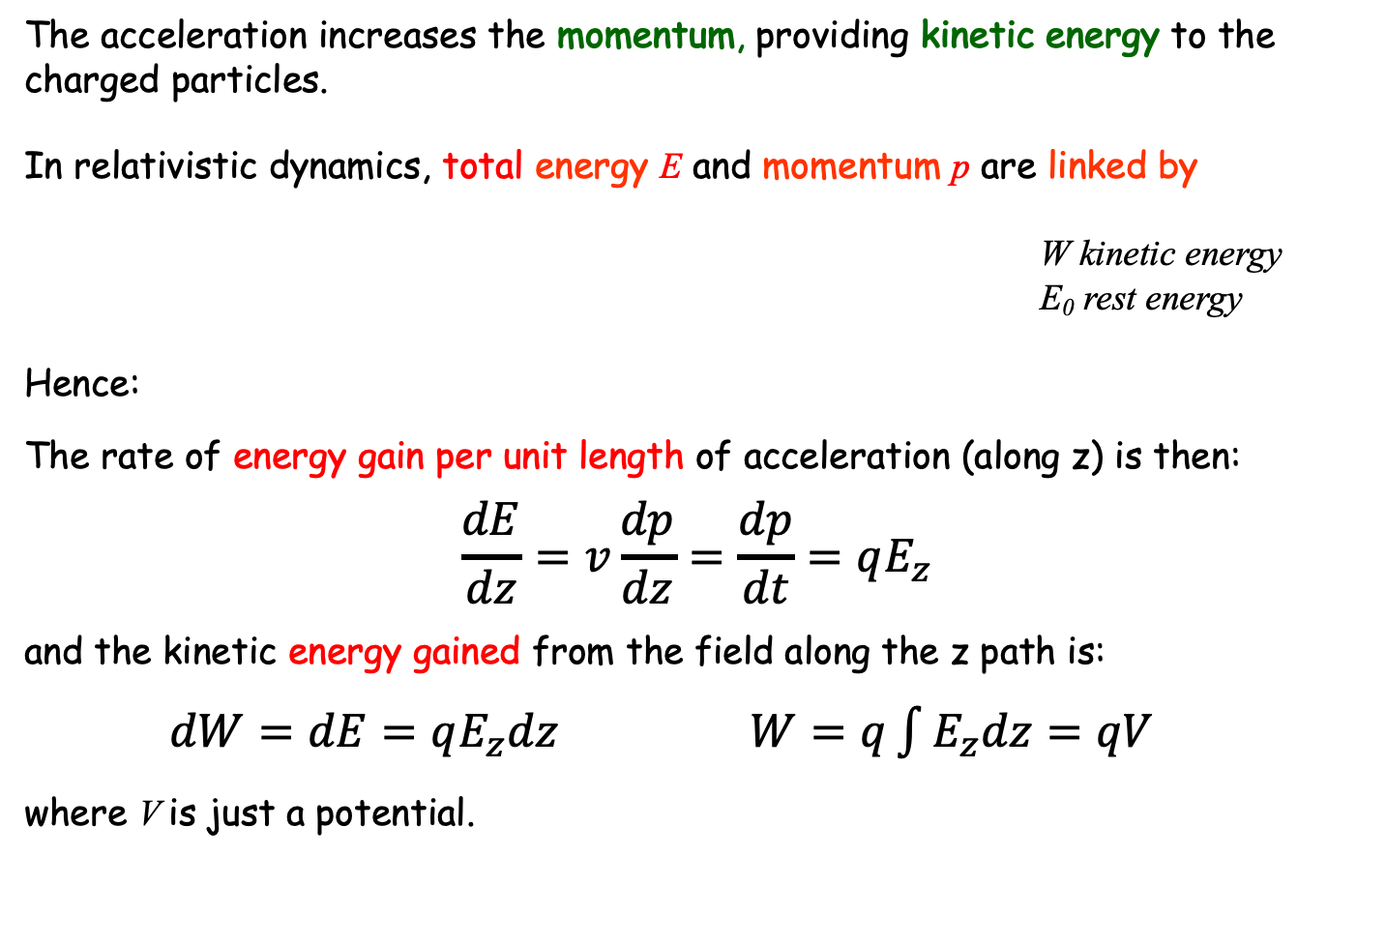
Energy Gain
The acceleration increases the momentum, providing kinetic energy to the charged particles.
In relativistic dynamics, total energy E and momentum p are linked by
W kinetic energy
E₀ rest energy
Hence:
The rate of energy gain per unit length of acceleration (along z) is then:
$$\frac{dE}{dz}=v\frac{dp}{dz}=\frac{dp}{dt}=qE_{z}$$
and the kinetic energy gained from the field along the z path is:
$dW=dE=qE_{z}dz$ $W=q\int{E_{z}dz=qV}$
where V is just a potential.

Slide 8
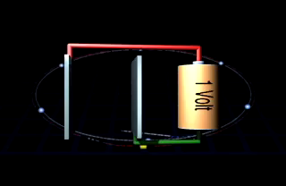
Unit of Energy
Today’s accelerators and future projects work/aim at the TeV energy range.
LHC: 7 TeV -> 14 TeV
CLIC: 3 TeV
FCC-hh: ~100 TeV
In fact, this energy unit comes from acceleration:
Basic Unit: eV (electron Volt)
kilo keV = 1000 eV = 10³ eV
mega MeV = 10⁶ eV (million)
giga GeV = 10⁹ eV (billion)
tera TeV = 10¹² eV (trillion)
LHC = ~450 Million km of AA batteries!!!
3x distance Earth-Sun
1 eV (electron Volt) is the energy that 1 elementary charge e (like one electron or proton) gains when it is accelerated in a potential (voltage) difference of 1 Volt.

Slide 9
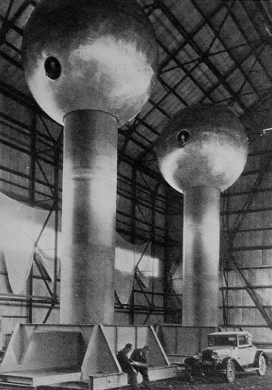
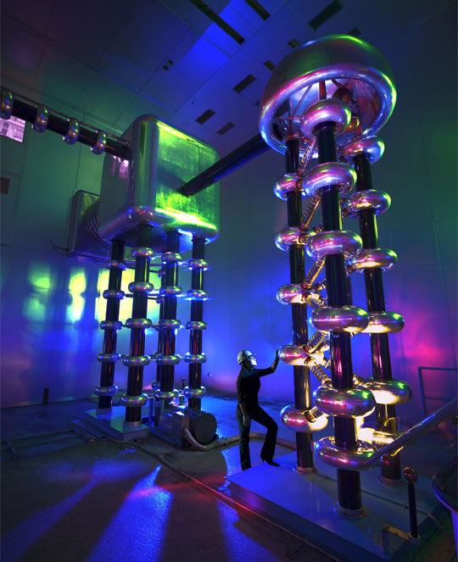
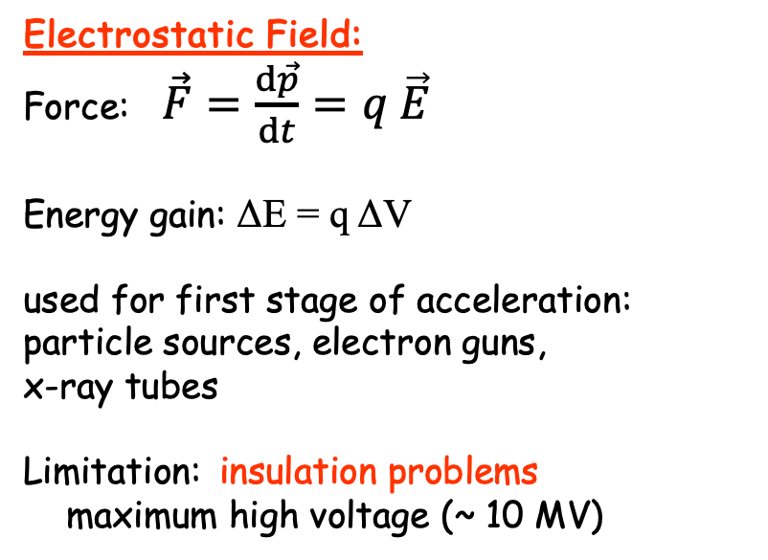
Electrostatic Acceleration
E
source
ΔV
vacuum envelope
Electrostatic Field:
Force: $\vec{F}=\frac{d\vec{p}}{dt}=q \vec{E}$
Energy gain: ΔE = q ΔV
used for first stage of acceleration: particle sources, electron guns,
x-ray tubes
Limitation: insulation problems
maximum high voltage (~ 10 MV)
750 kV Cockroft-Walton generator
at Fermilab (Proton source)
Van-de-Graaf generator at MIT

Slide 10
Radio-Frequency (RF) Acceleration
Electrostatic acceleration limited by insulation possibilities => use time-varying fields
1924: Ising suggests drift-tubes with time-varying fields
1928: Widerøe builds first demonstration linac
G.Ising
R.Widerøe
P.Lebrun

Slide 11
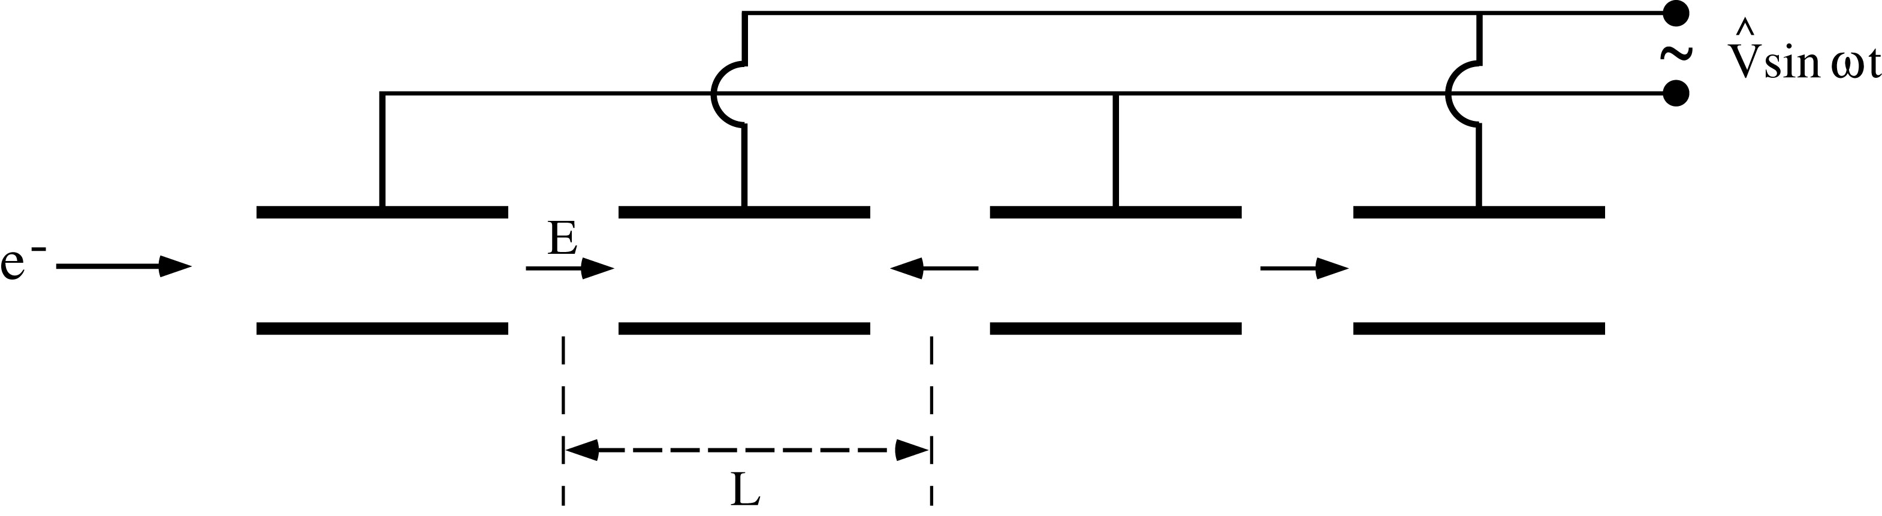
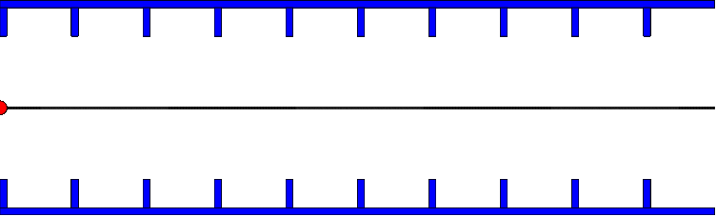
Radio-Frequency (RF) Acceleration
Widerøe-type
structure
Animation: https://phyanim.sciences.univ-nantes.fr/Meca/Charges/linac.php
Cylindrical electrodes (drift tubes) separated by gaps and fed by a RF generator, as shown above, lead to an alternating electric field polarity
Synchronism condition L = v T/2
v = particle velocity
T = RF period
Consequence: We can only accelerate bunched beam!
Similar for standing wave cavity as shown (with v≈c)
D.Schulte

Slide 12
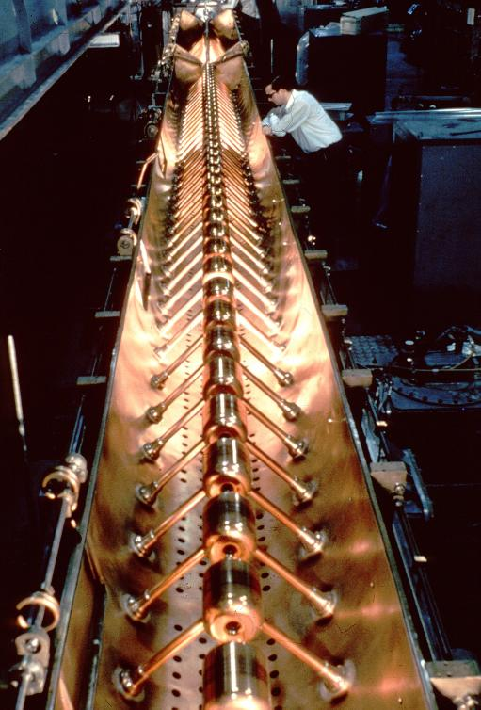
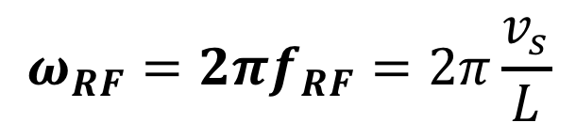
RF acceleration: Alvarez Structure
g
Used for protons, ions (50 – 200 MeV, f ~ 200 MHz)
L₁
L₂
L₃
L₄
L₅
RF generator
LINAC 1 (CERN)
Synchronism condition
$$ω_{RF}=2πf_{RF}=2π\frac{v_{s}}{L}$$

Slide 13
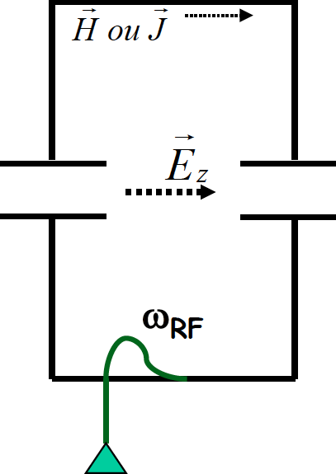
Resonant RF Cavities
Considering RF acceleration, it is obvious that when particles get high velocities the drift spaces get longer and one looses on the efficiency.
=> Use a higher operating frequency.
The power lost by radiation, due to circulating currents on the electrodes, is proportional to the RF frequency.
=> Enclose the system in a cavity which resonant frequency matches the RF generator frequency.
The electromagnetic power is now constrained in the resonant volume
Each such cavity can be independently powered from the RF generator
Note however that joule losses will occur in the cavity walls (unless made of superconducting materials)

Slide 14
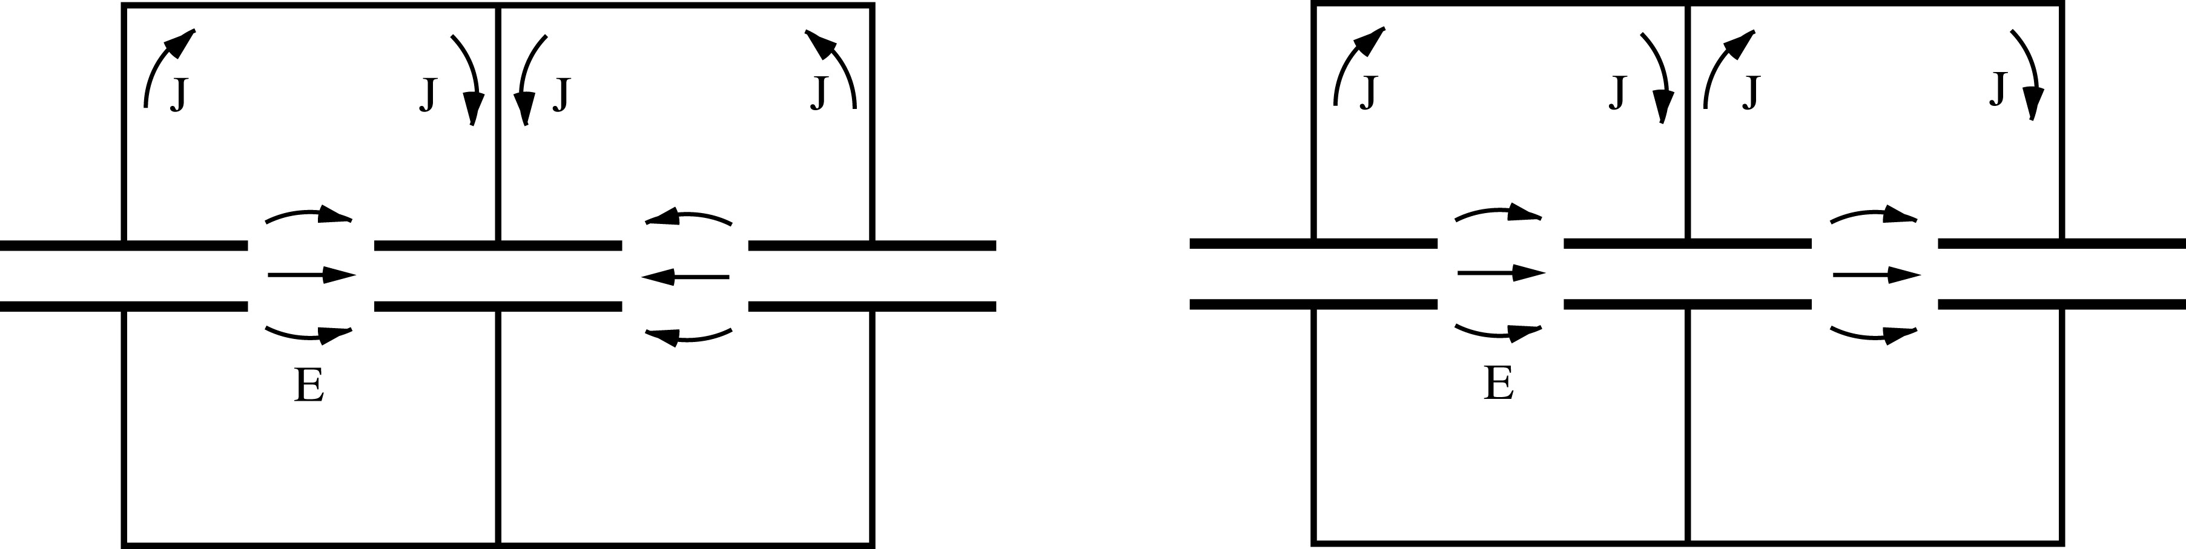
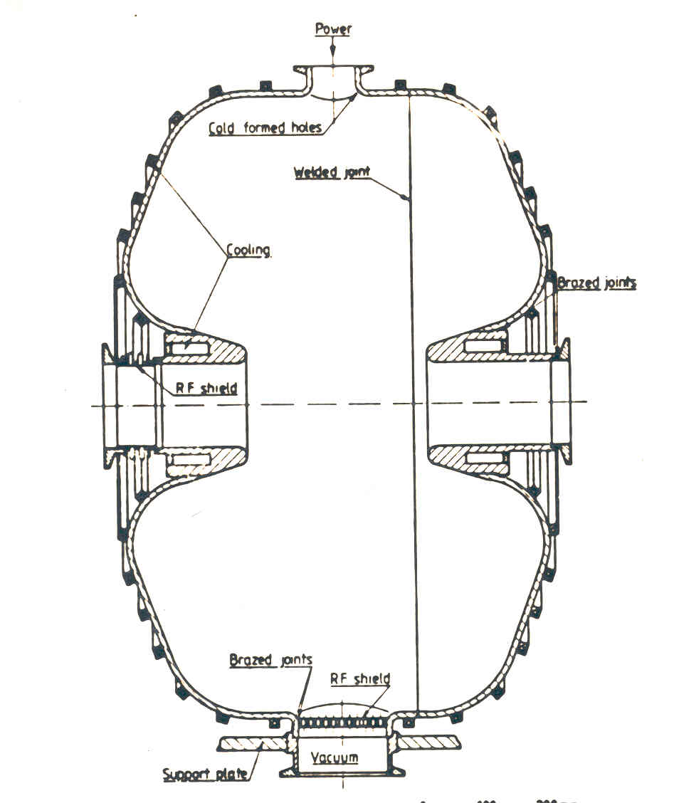
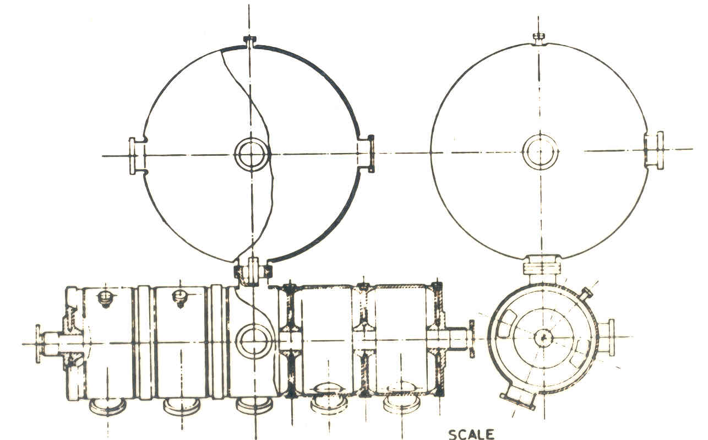
Some RF Cavity Examples
L = vT/2 (π mode) L = vT (2π mode)
More in RF Systems
Single Gap Multi-Gap

Slide 15
Common Phase Conventions
For circular accelerators, the origin of time is taken at the zero crossing of the RF voltage with positive slope
For linear accelerators, the origin of time is taken at the positive crest of the RF voltage
Time t= 0 chosen such that:
1
2
φ₁
φ₂
3. I will stick to convention 1 in the following to avoid confusion

Slide 16
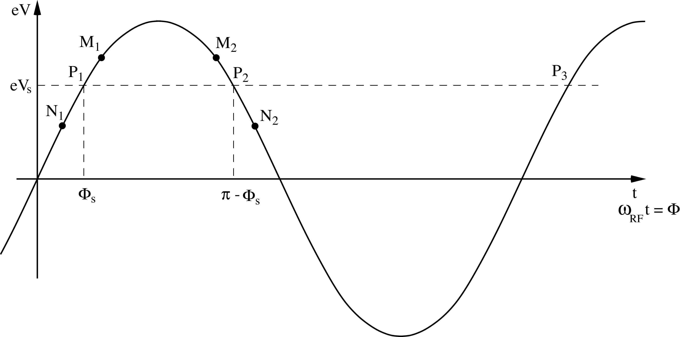
Principle of Phase Stability (Linac)
Let’s consider a succession of accelerating gaps, operating in the 2π mode, for which the synchronism condition is fulfilled for a phase Φs .
is the energy gain in one gap for the particle to reach the
next gap with the same RF phase: P₁ ,P₂, …… are fixed points.
energy
gain
early
late
For a 2π mode, the electric field is the same in all gaps at any given time.
stable acceleration
If an energy increase is transferred into a velocity increase =>
M₁ & N₁ will move towards P₁ => stable
M₂ & N₂ will go away from P₂ => unstable
(Highly relativistic particles have no significant velocity change)
Notes:
Edwin McMillan of UC Berkley, and the Russian V.I. Veksler independently discovered Phase stability in 1945.

Slide 17
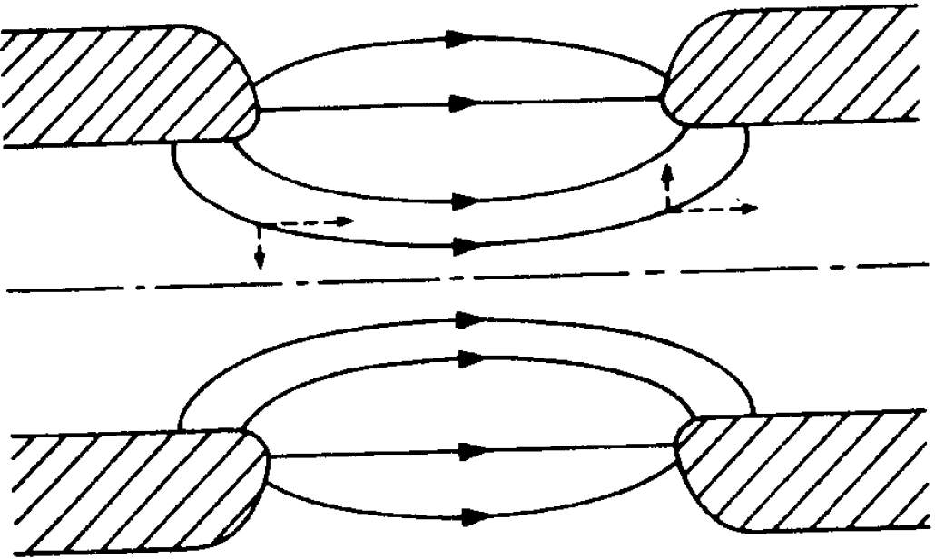
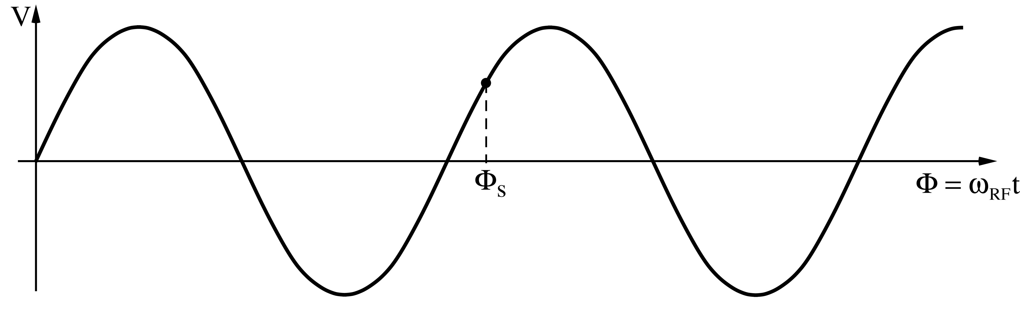
A Consequence of Phase Stability
The divergence of the field is zero according to Maxwell :
Transverse fields
focusing at the entrance and
defocusing at the exit of the cavity.
Electrostatic case: Energy gain inside the cavity leads to focusing
RF case: Field increases during passage => transverse defocusing!
External focusing (solenoid, quadrupole) is then necessary

Slide 18
Energy-phase Oscillations (Small Amplitude) (1)
- Rate of energy gain for the synchronous particle (q=e):
- Use reduced variables with respect to synchronous particle
Energy gain:
- Rate of phase change with respect to the synchronous one:
Leads finally to:

Slide 19
Energy-phase Oscillations (Small Amplitude) (2)
Combining the two 1st order equations into a 2nd order equation gives the equation of a harmonic oscillator:
with
Slower for higher energy!
Stable harmonic oscillations imply:
hence:
cos (φ_{s})
And since acceleration also means:
V_{RF}
synchronous
phase
You finally get the result for the stable phase range:
Positive rising
RF slope!
acceleration

Slide 20
Summary up to here…
Acceleration by electric fields, static fields limited
=> time-varying fields
Synchronous condition needs to be fulfilled for acceleration
Particles perform oscillation around synchronous phase
Stable acceleration on the rising slope in a linac.
Electrons are quickly relativistic, speed does not change
Protons and ions need changing structure geometry and certain RF frequency range

Slide 21
Circular accelerators
Betatron
Cyclotron
Synchrotron

Slide 22
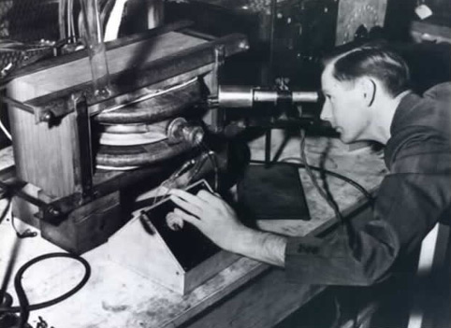
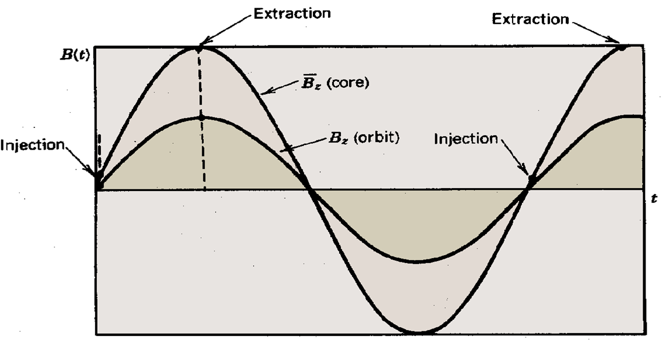
Acceleration by Induction: The Betatron
A ramping magnetic field
Guides particles on a circular trajectory and
Creates a tangential electric field that accelerates the particles
Limited by saturation in iron (~300 MeV e-)
Used in industry and medicine, as they are
compact accelerators for electrons
side view
vacuum pipe
beam
B_{f}
iron yoke
coil
E
top
view
beam
R
time
B
Donald Kerst with the first betatron, invented at the University of Illinois in 1940
B_{f}

Slide 23

Circular accelerators: Cyclotron
Courtesy: EdukiteLearning, https://youtu.be/cNnNM2ZqIsc

Slide 24
Circular accelerators: Cyclotron
Used for protons, ions
B = constant
ω_{RF} = constant
RF generator, ω_{RF}
Synchronism condition
B
g
Ion source
Cyclotron frequency
γ increases with the energy ⇒ no exact synchronism
if v << c ⇒ γ ≅ 1
Extraction electrode
Cyclotron Animation
Ion trajectory
Animation: https://phyanim.sciences.univ-nantes.fr/Meca/Charges/cyclotron.php

Slide 25
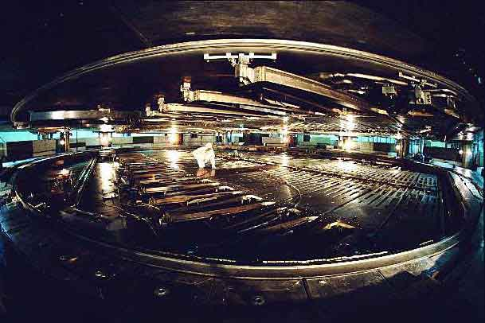
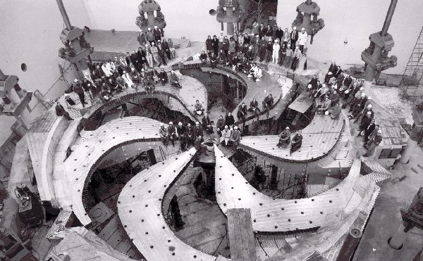
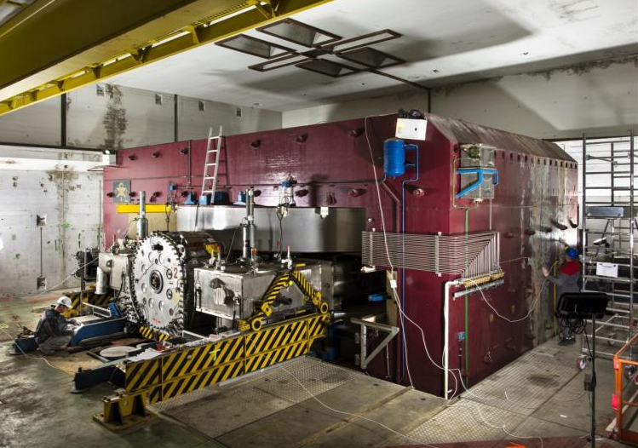
Cyclotron / Synchrocyclotron
TRIUMF 520 MeV cyclotron Vancouver - Canada
CERN 600 MeV synchrocyclotron
Synchrocyclotron: Same as cyclotron, except a modulation of ω_{RF}
B = constant
  γ ω_{RF} = constant
ω_{RF} decreases with time
Allows to go beyond the
non-relativistic energies
The condition:

Slide 26
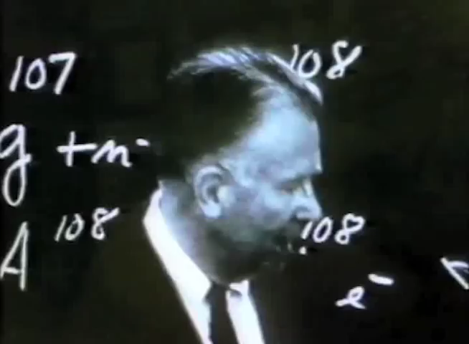
Circular accelerators: Cyclotron
Courtesy Berkeley Lab, https://www.youtube.com/watch?v=cutKuFxeXmQ

Slide 27

Circular accelerators: The Synchrotron
RF generator
Constant orbit during acceleration
To keep particles on the closed orbit, B should increase with time
ω and ω_{RF} increase with energy
B
RF cavity
E
Bending
magnet
R=C/2π
injection
extraction
RF frequency can be
multiple of revolution frequency
ρ
bending
radius
$$ω_{RF}=hω$$
h integer,
harmonic number:
number of RF cycles
per revolution
Synchronism condition
h is the maximum number of bunches in the synchrotron.
Normally less bunches due to gaps for kickers, collision constraints,…

Slide 28
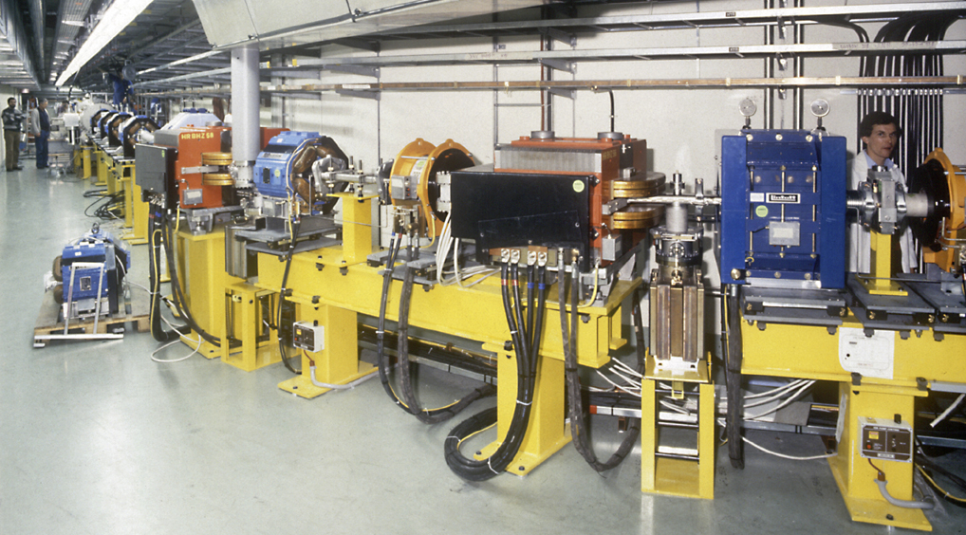
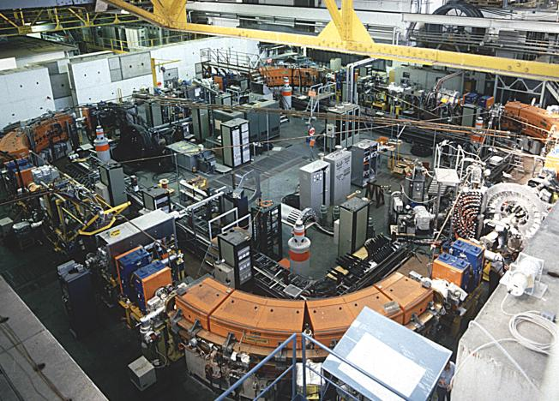
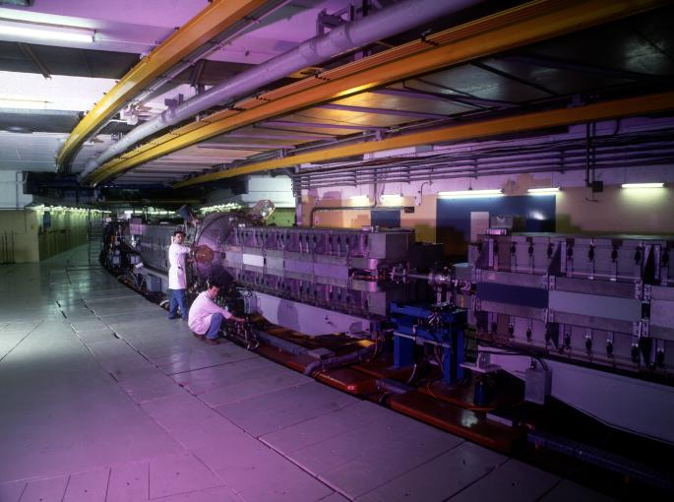
Circular accelerators: The Synchrotron
EPA (CERN)
Electron Positron Accumulator
LEIR (CERN)
Low Energy Ion Ring
© CERN Geneva
© CERN Geneva
Examples of different proton and electron synchrotrons at CERN
+ LHC (of course!)
PS (CERN)
Proton Synchrotron
© CERN Geneva

Slide 29

The Synchrotron – Important Parameters
The synchrotron is a synchronous accelerator since there is a synchronous RF phase for which the energy gain fits the increase of the magnetic field at each turn. That implies the following operating conditions:
E
Energy gain per turn
Synchronous particle
RF synchronism
(h - harmonic number)
Constant orbit
Variable magnetic field
B
Bending
magnet
R=C/2π
injection
extraction
$$ω_{RF}=hω$$
ρ
bending
radius
If v≈c, ω hence ω_{RF} remain constant (ultra-relativistic e⁻ )

Slide 30
The Synchrotron – LHC Operation Cycle
The magnetic field (dipole current) is increased during the acceleration.
beam dump
energy ramp
coast
coast
7 TeV
start of the ramp
injection phase
preparation and access
450 GeV
L.Bottura

Slide 31
The Synchrotron – Energy ramping
Energy ramping by increasing the B field (frequency has to follow v):
ρ const.
With
Synchronous phase φ_{s} changes during energy ramping
The synchronous phase depends on
  the change of the magnetic field
  and the RF voltage
φ_{s}

Slide 32
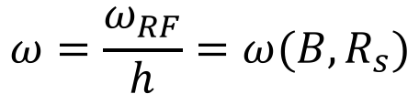
The Synchrotron – Frequency change
During the energy ramping, the RF frequency increases to follow the increase of the revolution frequency :
$$ω=\frac{ω_{RF}}{h}=ω(B,R_{s})$$
Hence: ( using )
Since the RF frequency must follow the variation of the B field with the law
RF frequency program during acceleration determined by B-field !

Slide 33
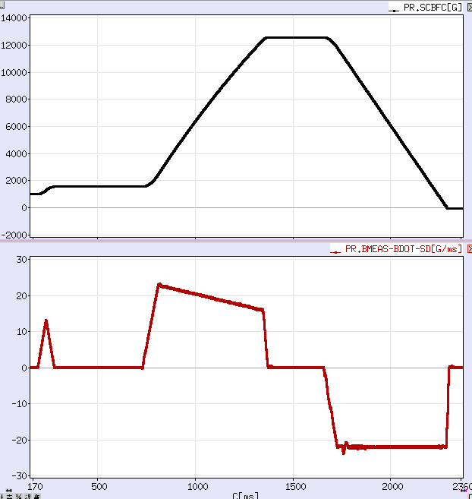
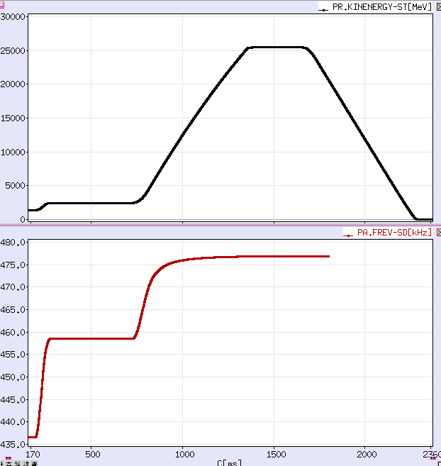
Example: PS - Field / Frequency change
During the energy ramping, the B-field and the revolution frequency increase
B-field
kinetic
energy
‘B-dot’
B-field change
revolution frequency
time (ms)
time (ms)

Slide 34

Overtaking in a roundabout
Finally a real-life problem: what is the fastest way through a roundabout?
Most CERN people encounter this near the French entrance to CERN.
www.formula1.com

Slide 35
Optimize the roundabout!
www.formula1.com
The magic roundabout in Swindon, UK!
Video: https://www.youtube.com/watch?v=6OGvj7GZSIo

Slide 36
Overtaking in a Formula 1 Race
www.formula1.com

Slide 37

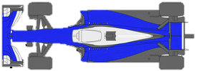
Overtaking in a Formula 1 Race

Slide 38
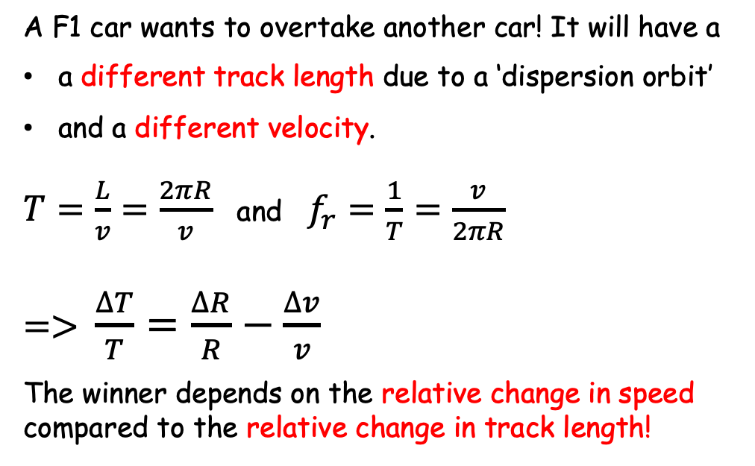
Overtaking in a Formula 1 Race
A F1 car wants to overtake another car! It will have a
a different track length due to a ‘dispersion orbit’
and a different velocity.
$T=\frac{L}{v}=\frac{2πR}{v}$ and $f_{r}=\frac{1}{T}=\frac{v}{2πR}$
=> $\frac{∆T}{T}=\frac{∆R}{R}−\frac{∆v}{v}$
The winner depends on the relative change in speed compared to the relative change in track length!
slow
fast
Circumference
2πR
v=speed of the car
R=track physical radius
T=revolution period
f_{r}=revolution frequency
If the relative change in speed is larger than the relative change in track length => the red car will win!

Slide 39
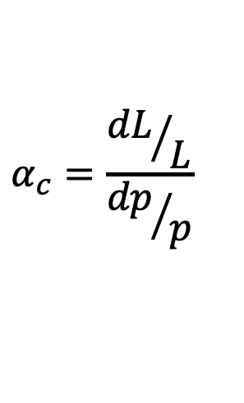
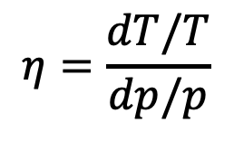
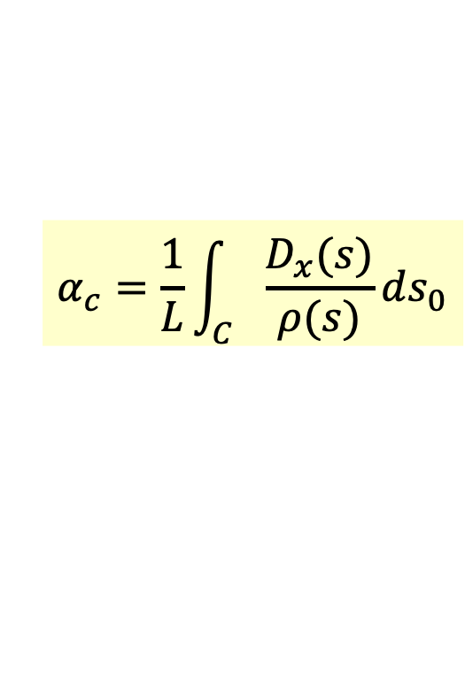
Overtaking in a Synchrotron
A particle slightly shifted in momentum will have a
dispersion orbit and a different orbit length
(higher momentum => less bent in magnet)
a different velocity.
cavity
E
Circumference
2πR
As a result of both effects the revolution frequency changes with a “slip factor η”:
E+δE
$$η=\frac{dT/T}{dp/p}$$
p=particle momentum
R=synchrotron physical radius
f_{r}=revolution frequency
Note: you also find η defined with a minus sign!
$$α_{c}=\frac{{dL}/L}{{dp}/p}$$
Effect from orbit defined by Momentum compaction factor:
Property of the transverse
beam optics:
(derivation in Appendix)
$$α_{c}=\frac{1}{L}\int_{C}{\frac{D_{x}(s)}{ρ(s)}ds_{0}}$$

Slide 40
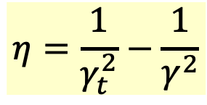
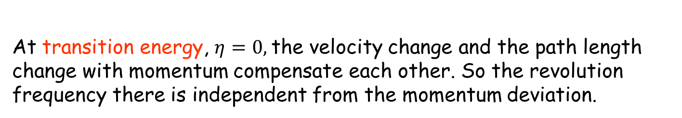
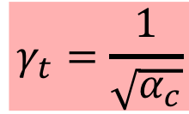
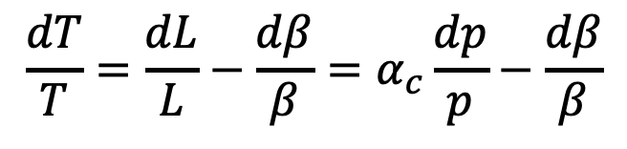
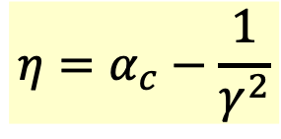
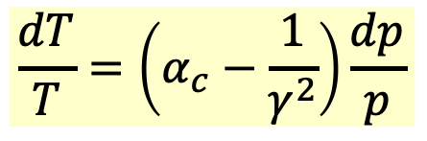
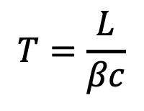
Dispersion Effects – Revolution Period
The two effects of the orbit length and the particle velocity
change the revolution period as:
$$T=\frac{L}{βc}$$
$$\frac{dT}{T}=\frac{dL}{L}−\frac{dβ}{β}=α_{c}\frac{dp}{p}−\frac{dβ}{β}$$
⇒
definition of momentum compaction factor
$$\frac{dT}{T}=\left(α_{c}−\frac{1}{γ^{2}}\right)\frac{dp}{p}$$
Slip factor:
$$η=α_{c}−\frac{1}{γ^{2}}$$
$$η=\frac{1}{γ_{t}^{2}}−\frac{1}{γ^{2}}$$
$$γ_{t}=\frac{1}{\sqrt{α_{c}}}$$
or
with
Note: you also find η defined with a minus sign!
At transition energy, $η=0,$the velocity change and the path length change with momentum compensate each other. So the revolution frequency there is independent from the momentum deviation.

Slide 41
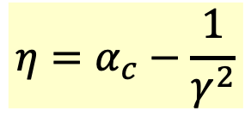

Phase Stability in a Synchrotron
From the definition of η it is clear that an increase in momentum gives
- below transition (η < 0) a higher revolution frequency
(increase in velocity dominates) while
- above transition (η > 0) a lower revolution frequency (v ≈ c and longer path)
where the momentum compaction (generally > 0) dominates.
Energy
Gain
eV
stable synchr. particle for η > 0
above transition
eV_{s}
η < 0
Stable below transition
φ_{s}
π−φ_{s}
early
late
$$\text{f}={\text{w}}_{\text{RF} }\text{t}$$
$$η=α_{c}−\frac{1}{γ^{2}}$$

Slide 42
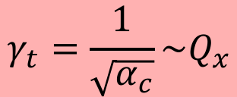
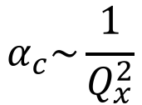
Crossing Transition
At transition, the velocity change and the path length change with momentum compensate each other. So the revolution frequency there is independent from the momentum deviation.
Crossing transition during acceleration makes the previous stable synchronous phase unstable. The RF system needs to make a rapid change of the RF phase, a ‘phase jump’.
$$α_{c}\sim \frac{1}{Q_{x}^{2}}$$
$$γ_{t}=\frac{1}{\sqrt{α_{c}}}\sim Q_{x}$$
In the PS: γ_{t} is at ~6 GeV
In the SPS: γ_{t}= 22.8, injection at γ=27.7
=> no transition crossing!
In the LHC: γ_{t} is at ~55 GeV, also far below injection energy
Transition crossing not needed in leptons machines, why?

Slide 43

Dynamics: Synchrotron oscillations
Simple case (no accel.): B = const., below transition
$$γ<γ_{t}$$
The phase of the synchronous particle must therefore be φ₀ = 0.
Φ₁ - The particle B is accelerated
- Below transition, an energy increase means an increase in revolution frequency
- The particle arrives earlier – tends toward φ₀
B
φ₂
φ₀
φ₁
φ₂ - The particle is decelerated
- decrease in energy - decrease in revolution frequency
- The particle arrives later – tends toward φ₀

Slide 44
Synchrotron oscillations
A
V
time
B
1st revolution period
600th revolution period
700th revolution period
800th revolution period
200th revolution period
300th revolution period
400th revolution period
500th revolution period
100th revolution period
Particle B performs Synchrotron Oscillations around synchronous particle A.
The amplitude depends on the initial phase and energy.
The oscillation frequency is much slower than in the transverse plane.
It takes a large number of revolutions for one complete oscillation.
The restoring electric force is smaller than the magnetic force.
- proton synchrotrons of the order of 1000 turns
- electron storage rings of the order of ~10 turns

Slide 45
The Potential Well
A
Cavity voltage
Potential well
B
phase

Slide 46
Longitudinal phase space
The energy – phase oscillations can be drawn in phase space. Similar to transverse, but here it’s TIME and ENERGY!
ΔΕ, Δp/p
ΔΕ, Δp/p
acceleration
move
forward
move
backward
φ, t
deceleration
φ, t
reference
The particle trajectory in the phase space (Δp/p, φ) describes its longitudinal motion.
Emittance: phase space area including all the particles
NB: if the emittance contour correspond to a possible orbit in phase space, its shape does not change with time (matched beam)

Slide 47
Longitudinal Phase Space Motion
Particle B oscillates around particle A in a synchrotron oscillation.
Plotting this motion in longitudinal phase space (time, energy) gives:
ΔE
higher energy
early arrival
late arrival
Δt (or φ)
lower energy

Slide 48
Synchrotron oscillations – No acceleration
φ₂
φ₀
φ₁
Phase space picture
stable region
unstable region
separatrix

Slide 49




Synchrotron motion in phase space
Dynamics of a particle
Non-linear, conservative oscillator → e.g. pendulum
ΔE-φ phase space of a stationary bucket (when there is no acceleration)
Particle inside the separatrix:
Particle at the
unstable fix-point
Bucket area: area enclosed by the separatrix
The area covered by particles is the longitudinal emittance
Particle outside the separatrix:

Slide 50
(Stationary) Bunch & Bucket
The bunches of the beam fill usually a part of the bucket area.
ΔE
Bunch
Bucket
ΔE
Δt (or φ)
Δt
Bucket area = longitudinal Acceptance [eVs]
Bunch area = longitudinal beam emittance = 4π σ_{E} σ_{t} [eVs]
Attention: Different definitions are used!

Slide 51

Synchrotron motion in phase space
The restoring force is non-linear.
speed of motion depends on position in
phase-space
(here shown for a stationary bucket)

Slide 52
Synchrotron oscillations (with acceleration)
Case with acceleration B increasing
$$γ<γ_{t}$$
1
φ
2
φ_{s}
Phase space picture
stable region
unstable region
The symmetry of the case B = const. is lost
separatrix

Slide 53

RF Acceptance versus Synchronous Phase
The areas of stable motion (closed trajectories) are called “BUCKET”. The number of circulating buckets is equal to “h”.
The phase extension of the bucket is maximum for
φ_{s} =180º (or 0°) which means no acceleration.
During acceleration, the buckets get smaller, both in length and energy acceptance.
=> Injection preferably without acceleration.

Slide 54
Longitudinal Dynamics in Synchrotrons
Now we will look more quantitatively at the “synchrotron motion”.
The RF acceleration process clearly emphasizes two coupled variables, the energy gained by the particle and the RF phase experienced by the same particle.
Since there is a well-defined synchronous particle which has always the same phase φ_{s}, and the nominal energy E_{s}, it is sufficient to follow other particles with respect to that particle.
So let’s introduce the following reduced variables:
revolution frequency : Δf_{r} = f_{r} – f_{rs}
particle RF phase : Δφ = φ - φ_{s}
particle momentum : Δp = p - p_{s}
particle energy : ΔE = E – E_{s}
azimuth angle : Δθ = θ - θ_{s}
Look at difference from synchronous particle

Slide 55



Equations of Longitudinal Motion
In these reduced variables, the equations of motion are (see Appendix):
$$\frac{∆E}{ω_{0}}=\frac{p_{0}R}{hηω_{0}}\dot{φ}$$
$$2π\frac{d}{dt}\left(\frac{∆E}{ω_{0}}\right)=e \hat{V}\left(\sin{φ}−\sin{φ_{s}}\right)$$
deriving and combining
$$\frac{d}{dt}\left[\frac{{−p}_{0}R}{hηω_{0}}\frac{dφ}{dt}\right]+\frac{e \hat{V}}{2π}\left(\sin{φ}−\sin{φ_{s}}\right)=0$$
This second order equation is non-linear. Moreover the parameters within the bracket are in general slowly varying with time.
We will study some cases in the following…

Slide 56



Small Amplitude Oscillations
Let’s assume constant parameters R, p₀, ω₀ and η:
$$Ω_{s}^{2}=\frac{−q{\hat{V}}_{RF}ηhω_{0}}{2πRp_{0}}\cos{φ_{s}}$$
with
Consider now small phase deviations from the reference particle:
(for small Δφ)
and the corresponding linearized motion reduces to a harmonic oscillation:
where Ω_{s} is the synchrotron angular frequency.
The synchrotron tune $ν_{s}$ is the number of synchrotron oscillations per revolution:
$$ν_{s}=Ω_{s}/ω_{0}$$
Typical values are <<1, as it takes several 10 - 1000 turns per oscillation.
- proton synchrotrons of the order 10⁻³
- electron storage rings of the order 10⁻¹

Slide 57







Stability condition for ϕ_{s}
$$Ω_{s}^{2}=\frac{−q{\hat{V}}_{RF}ηhω_{0}}{2πRp_{0}}\cos{φ_{s}}$$
$$Ω_{s}^{2}=ω_{0}^{2}\frac{−q{\hat{V}}_{RF}ηh}{2πβ^{2}E}\cos{φ_{s}}$$
with
$$⇔$$
$$Rp=\frac{β^{2}E}{ω}$$
Stability is obtained when Ω_{s} is real and so Ω_{s}² positive:
cos (φ_{s})
V_{rf}
$$Ω_{s}^{2}>0$$
$$⇔$$
$$η cos{φ_{s}<0}$$
𝛾 < 𝛾_{t}
𝛾 > 𝛾_{t}
𝛾 > 𝛾_{t}
𝛾 < 𝛾_{t}
Stable in the region if
acceleration
deceleration

Slide 58

Energy Acceptance
From the equation of the separatrix, we can calculate (see appendix) the acceptance in energy:
$${\left(\frac{ΔE}{E_{s}}\right)}_{max}=±β\sqrt{\frac{−q\hat{V}}{πhηE_{s}}G\left(φ_{s}\right)}$$
This “RF acceptance” depends strongly on φ_{s} and plays an important role for the capture at injection, and the stored beam lifetime.
It’s largest for φ_{s}=0 and φ_{s}=π (no acceleration, depending on η).
It becomes smaller during acceleration, when φ_{s} is changing
Need a higher RF voltage for higher acceptance => need more $€ ☹

Slide 59
RF Acceptance versus Synchronous Phase
The areas of stable motion (closed trajectories) are called “BUCKET”. The number of circulating buckets is equal to “h”.
The phase extension of the bucket is maximum for
φ_{s} =180º (or 0°) which means no acceleration.
During acceleration, the buckets get smaller, both in length and energy acceptance.
=> Injection preferably without acceleration.

Slide 60






Injection: Bunch-to-bucket transfer
Bunch from sending accelerator into the bucket of receiving
Advantages:
Particles always subject to longitudinal focusing
No need for RF capture of de-bunched beam in receiving accelerator
No particles at unstable fixed point
Time structure of beam preserved during transfer

Slide 61

Effect of a Mismatch
Injected bunch: short length and large energy spread
after 1/4 synchrotron period: longer bunch with a smaller energy spread.
W
W
φ
φ
For larger amplitudes, the angular phase space motion is slower
(1/8 period shown below) => can lead to filamentation and emittance growth
W
W
φ
φ
W.Pirkl
restoring force is
non-linear
stationary bucket
accelerating bucket

Slide 62


Effect of a Mismatch (2)
Long. emittance is only preserved for correct RF voltage
Matched case
Longitudinal mismatch
Bunch is fine, longitudinal emittance remains constant
Dilution of bunch results in increase of long. emittance

Slide 63


Effect of a Mismatch (3)
Evolution of an injected beam for the first 100 turns.
For a mismatched transfer, the emittance increases (right).
matched beam
mismatched beam – phase error

Slide 64

Bunch Rotation
Phase space motion can be used to make short bunches.
Start with a long bunch and extract or recapture when it’s short.
initial beam

Slide 65

Capture of a Debunched Beam with Fast Turn-On

Slide 66

Capture of a Debunched Beam with Adiabatic Turn-On

Slide 67

Generating a 25ns Bunch Train in the PS
Use double splitting at 25 GeV to generate 50ns bunch trains instead

Slide 68



Production of the LHC 25 ns beam
1. Inject four bunches
~ 180 ns, 1.3 eVs
Wait 1.2 s for second injection
2. Inject two bunches
3. Triple split after second injection
~ 0.7 eVs
4. Accelerate from 1.4 GeV (E_{kin}) to 26 GeV

Slide 69


Production of the LHC 25 ns beam
5. During acceleration: longitudinal emittance blow-up: 0.7 – 1.3 eVs
6. Double split (h21 → h42)
7. Double split (h42 → h84)
~ 0.35 eVs, 4 ns
10. Fine synchronization, bunch rotation → Extraction!

Slide 70



The LHC25 (ns) cycle in the PS
Eject 72 bunches
(sketched)
h = 21
Inject 4+2 bunches
h = 7
γ_{tr}
h = 84
Triple splitting after 2nd injection
Split in four at flat-top energy
2nd injection
1.4 GeV
26 GeV/c
→ Each bunch from the Booster divided by 12 → 6 × 3 × 2 × 2 = 72

Slide 71

Triple splitting in the PS

Slide 72

Two times double splitting in the PS
Two times double splitting and bunch rotation:
Bunch is divided twice using RF systems at
h = 21/42 (10/20 MHz) and h = 42/84 (20/40 MHz)
Rotation: first part h84 only + h168 (80 MHz) for final part

Slide 73
Summary
Cyclotrons/Synchrocylotrons for low energy
Synchrotrons for high energies, constant orbit, rising field and frequency synchronously
Particles with higher energy have a longer orbit (normally) but a higher velocity
  at low energies (below transition) velocity increase dominates
  at high energies (above transition) velocity almost constant
Particles perform oscillations around synchronous phase
  synchronous phase depending on acceleration
  below or above transition
Bucket is the stable region in phase space inside the separatrix
Bunch is the area filled with beam
Matching the shape of the bunch to the bucket is essential

Slide 74
Bibliography
S.Y. Lee Accelerator Physics
(World Scientific, 2011)
M. Conte, W.W. Mac Kay An Introduction to the Physics of particle Accelerators
        (World Scientific, 1991)
P. J. Bryant and K. Johnsen The Principles of Circular Accelerators and Storage Rings
        (Cambridge University Press, 1993)
D. A. Edwards, M. J. Syphers An Introduction to the Physics of High Energy Accelerators
        (J. Wiley & sons, Inc, 1993)
H. Wiedemann Particle Accelerator Physics
(Springer-Verlag, Berlin, 1993)
M. Reiser Theory and Design of Charged Particles Beams
        (J. Wiley & sons, 1994)
A. Chao, M. Tigner Handbook of Accelerator Physics and Engineering
        (World Scientific 1998)
K. Wille The Physics of Particle Accelerators: An Introduction
        (Oxford University Press, 2000)
E.J.N. Wilson An introduction to Particle Accelerators
        (Oxford University Press, 2001)
And CERN Accelerator Schools (CAS) Proceedings
In particular: https://arxiv.org/abs/2011.02932
Longitudinal Beam Dynamics in Circular Accelerators

Slide 75

Acknowledgements
I would like to thank everyone for the material that I have used.
In particular (hope I don’t forget anyone):
- Joël Le Duff (from whom I inherited the course)
- Rende Steerenberg
- Gerald Dugan
- Heiko Damerau
- Werner Pirkl
- Genevieve Tulloue
- Mike Syphers
- Daniel Schulte
- Roberto Corsini
- Roland Garoby
- Luca Bottura
- Berkeley Lab
- Edukite Learning
End of our
crash course in
longitudinal dynamics
www.formula1.com

Slide 76
Appendix
Summary Relativity and Energy Gain
Velocity, Energy, and Momentum
Momentum compaction factor
Synchrotron energy-phase oscillations
Stability condition
Separatrix stationary bucket
Large amplitude oscillations
Bunch matching into stationary bucket

Slide 77
Appendix: Relativity + Energy Gain
Newton-Lorentz Force
2nd term always perpendicular to motion => no acceleration
Relativistics Dynamics
RF Acceleration
(neglecting transit time factor)
The field will change during the passage of the particle through the cavity
=> effective energy gain is lower

Slide 78
Appendix: Velocity, Energy and Momentum
normalized velocity
electrons
normalized velocity
=> electrons almost reach the speed of light
very quickly (few MeV range)
protons
total energy
rest energy
total energy
rest energy
electrons
protons
Momentum
=> Magnetic field needs to follow
the momentum increase

Slide 79



Appendix: Momentum Compaction Factor
$$α_{c}=\frac{p}{L}\frac{dL}{dp}$$
x
dθ
The elementary path difference from the two orbits is:
definition of dispersion D_{x}
leading to the total change in the circumference:
< >_{m} means that the average is considered over the bending magnet only
$$α_{c}=\frac{1}{L}\int_{C}{\frac{D_{x}(s)}{ρ(s)}ds_{0}}$$
With ρ=∞ in straight sections we get:
$$α_{c}=\frac{{\left\langle D_{x}\right\rangle }_{m}}{R}$$

Slide 80



Appendix: First Energy-Phase Equation
v
Δθ
particle ahead arrives earlier
=> smaller RF phase
θ_{s}
R
For a given particle with respect to the reference one:
$$η=−\frac{p_{0}}{ω_{0}}{\left(\frac{dω}{dp}\right)}_{s}$$
Since:
and
$$ΔE=v_{s}∆p=ω_{0}RΔp$$
$$\frac{∆E}{ω_{0}}=\frac{p_{0}R}{hηω_{0}}\frac{d(Δφ)}{dt}=\frac{p_{0}R}{hηω_{0}}\dot{φ}$$
one gets:

Slide 81


Appendix: Second Energy-Phase Equation
The rate of energy gained by a particle is:
The rate of relative energy gain with respect to the reference particle is then:
$$2πΔ\left(\frac{\dot{E}}{ω_{0}}\right)=e \hat{V}\left(\sin{φ}−\sin{φ_{s}}\right)$$
Expanding the left-hand side to first order:
leads to the second energy-phase equation:
$$2π\frac{d}{dt}\left(\frac{∆E}{ω_{0}}\right)=e \hat{V}\left(\sin{φ}−\sin{φ_{s}}\right)$$

Slide 82
Appendix: Stability condition for ϕ_{s}
$$Ω_{s}^{2}=\frac{−q{\hat{V}}_{RF}ηhω_{0}}{2πRp_{0}}\cos{φ_{s}}$$
$$Ω_{s}^{2}=ω_{0}^{2}\frac{−q{\hat{V}}_{RF}ηh}{2πβ^{2}E}\cos{φ_{s}}$$
with
$$⇔$$
$$Rp=\frac{β^{2}E}{ω}$$
Stability is obtained when Ω_{s} is real and so Ω_{s}² positive:
cos (φ_{s})
V_{rf}
$$Ω_{s}^{2}>0$$
$$⇔$$
$$η cos{φ_{s}<0}$$
𝛾 < 𝛾_{t}
𝛾 > 𝛾_{t}
𝛾 > 𝛾_{t}
𝛾 < 𝛾_{t}
Stable in the region if
acceleration
deceleration

Slide 83

Appendix: Stationary Bucket - Separatrix
This is the case sinφ_{s}=0 (no acceleration) which means φ_{s}=0 or π . The equation of the separatrix for φ_{s}= π (above transition) becomes:
Replacing the phase derivative by the (canonical) variable W:
W
W_{bk}
and introducing the expression for Ω_{s} leads to the following equation for the separatrix:
φ
0
π
2π
with C=2πR_{s}

Slide 84
Stationary Bucket (2)
Setting φ=π in the previous equation gives the height of the bucket:
This results in the maximum energy acceptance:
The area of the bucket is:
Since:
one gets:

Slide 85
Appendix: Large Amplitude Oscillations
For larger phase (or energy) deviations from the reference the second order differential equation is non-linear:
(Ω_{s} as previously defined)
Multiplying by and integrating gives an invariant of the motion:
which for small amplitudes reduces to:
(the variable is Δφ, and φ_{s} is constant)
Similar equations exist for the second variable : ΔE∝dφ/dt

Slide 86

Large Amplitude Oscillations (2)
When φ reaches π-φ_{s} the force goes to zero and beyond it becomes non restoring.
Hence π-φ_{s} is an extreme amplitude for a stable motion which in the
phase space( ) is shown as
closed trajectories.
Equation of the separatrix:
Second value φ_{m} where the separatrix crosses the horizontal axis:

Slide 87

Energy Acceptance
From the equation of motion it is seen that reaches an extreme
when , hence corresponding to .
Introducing this value into the equation of the separatrix gives:
That translates into an acceptance in energy:
$${\left(\frac{ΔE}{E_{s}}\right)}_{max}=±β\sqrt{\frac{e\hat{V}}{πhηE_{s}}G\left(φ_{s}\right)}$$
This “RF acceptance” depends strongly on φ_{s} and plays an important role for the capture at injection, and the stored beam lifetime.
It’s largest for φ_{s}=0 and φ_{s}=π (no acceleration, depending on η).
Need a higher RF voltage for higher acceptance.

Slide 88
Bunch Matching into a Stationary Bucket
A particle trajectory inside the separatrix is described by the equation:
φ_{s}= π
W
The points where the trajectory crosses the axis are symmetric with respect to φ_{s}= π
W_{bk}
W_{b}
0
π
φ
π
2π
φ_{m}
2π-φ_{m}

Slide 89
Bunch Matching into a Stationary Bucket (2)
Setting φ = π in the previous formula allows to calculate the bunch height:
or:
This formula shows that for a given bunch energy spread the proper matching of a shorter bunch (φ_{m} close to π, small)
will require a bigger RF acceptance, hence a higher voltage
For small oscillation amplitudes the equation of the ellipse reduces to:
Ellipse area is called longitudinal emittance

