Slide 1
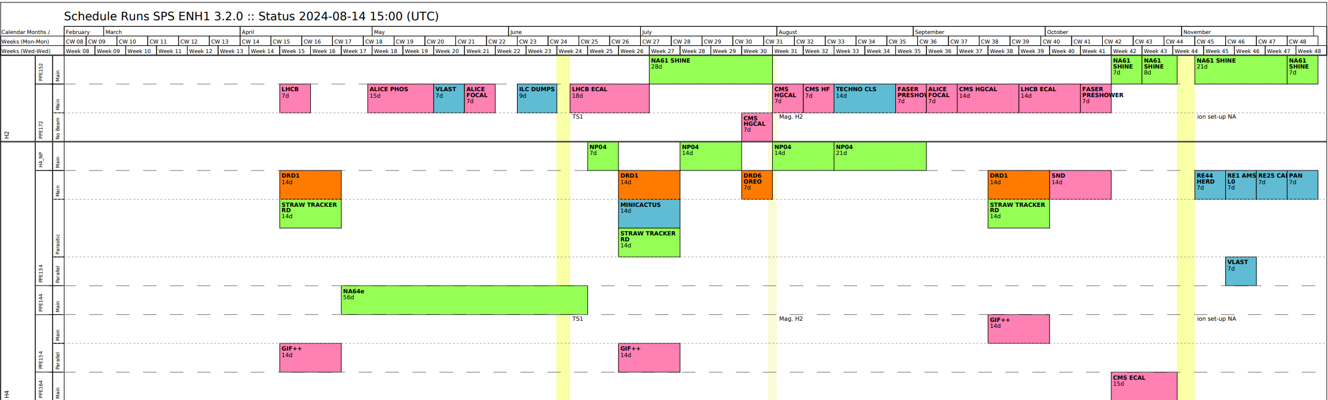
DRD1 H4(PPE134) 2024 Test Beam​
Yorgos Tsipolitis: +41754118992
Karl Jonathan Flöthner: +41754110839
Generic and Application driven R&D
  Technologies: Micromegas, uRGroove, GEM
  Application: High Rate, Timing, Calorimetry, Tracking in Magnetic Field
FE electronics and DAQ
  Tigers, Mu2e, ASD. GEMROC, SAMPIC
Wed. 18/09/2024 – Wed. 02/10/2024

Slide 2
Beam Conditions
Muon: perfectly satisfying our needs (up to few 1e5 mu/spill)
Pion: short run of a few hours, up to ~5e+6 pi/spill
Magnet: three successful night shifts up to 1.5T
Huge thanks to Nikos and Bastien for helping with the Beam Tuning and the Magnet. Thanks to GIF for the flexible arrangement of Pion and Magnet runs.

Slide 3
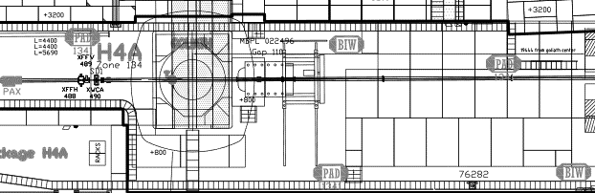
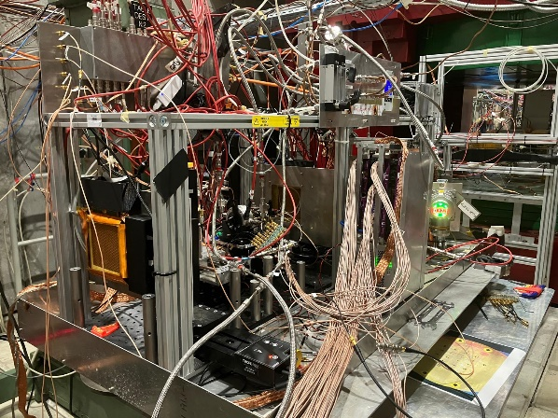
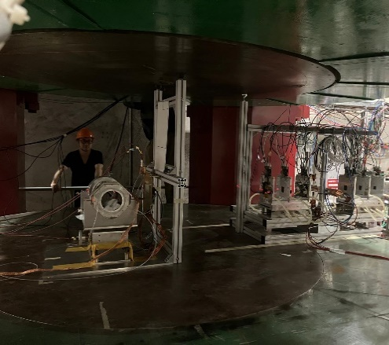
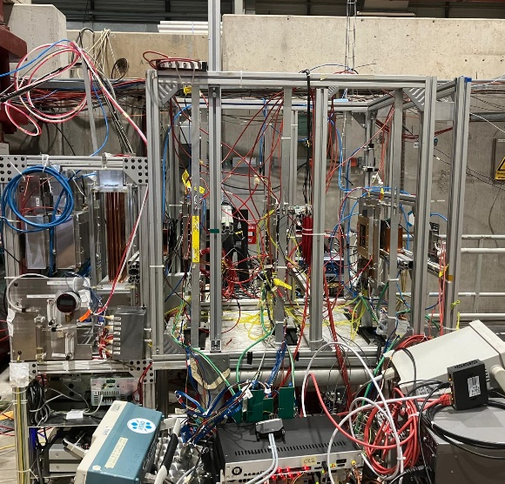
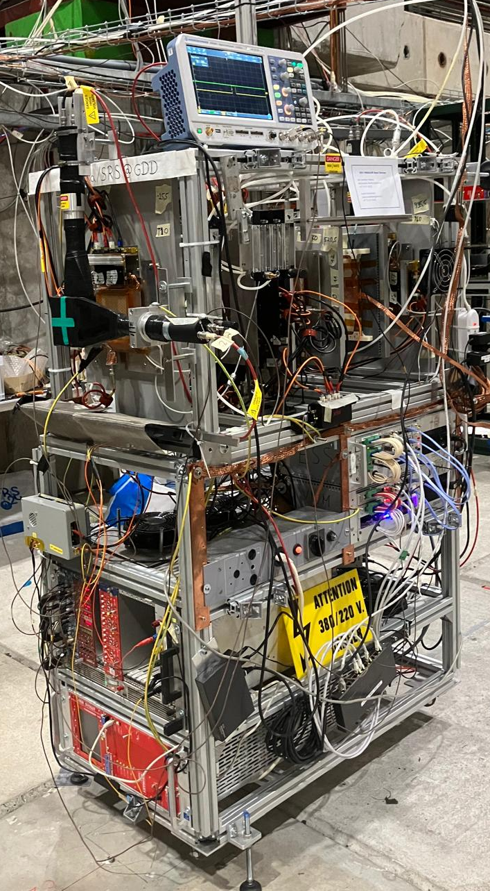
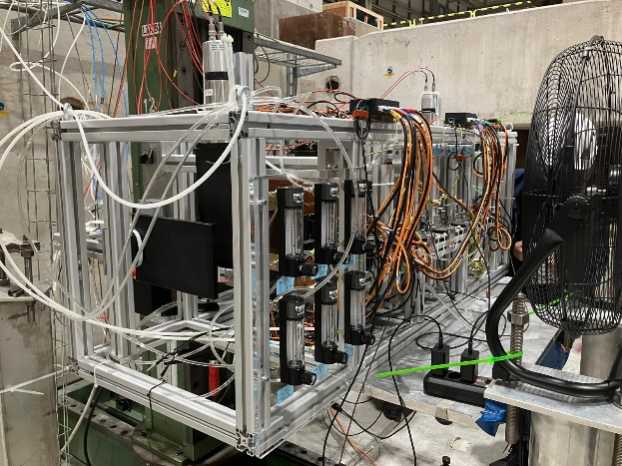
BEAM H4, PPE134 – INSTALLATION (DRD1, Sept 18 – Oct 2)
SETUP
A
SETUP
B
SETUP
C
SETUP
D
SETUP
E
SETUP
F
SETUP
G
PICOSEC
USTC
USTC
STRAW
STRAW
GDD/
DRD1
Tracker
MPGDs comparative studies
SETUP A: PICOSEC (F. Brunbauer)
SETUP B: USTC (Y. Zhou)
SETUP C: STRAW (T. Enik, K. Kuznetsova)
SETUP D: Cylindrical TPC - DUT not ready -> plans to come next year
SETUP E: GDD/RD51 Tracker (L. Scharenberg, K. Floethner)
SETUP F: Saclay - Did not manage to come -> plans to come next year
SETUP G: MPGD comp. Studies (Darina Zavazieva)

Slide 4
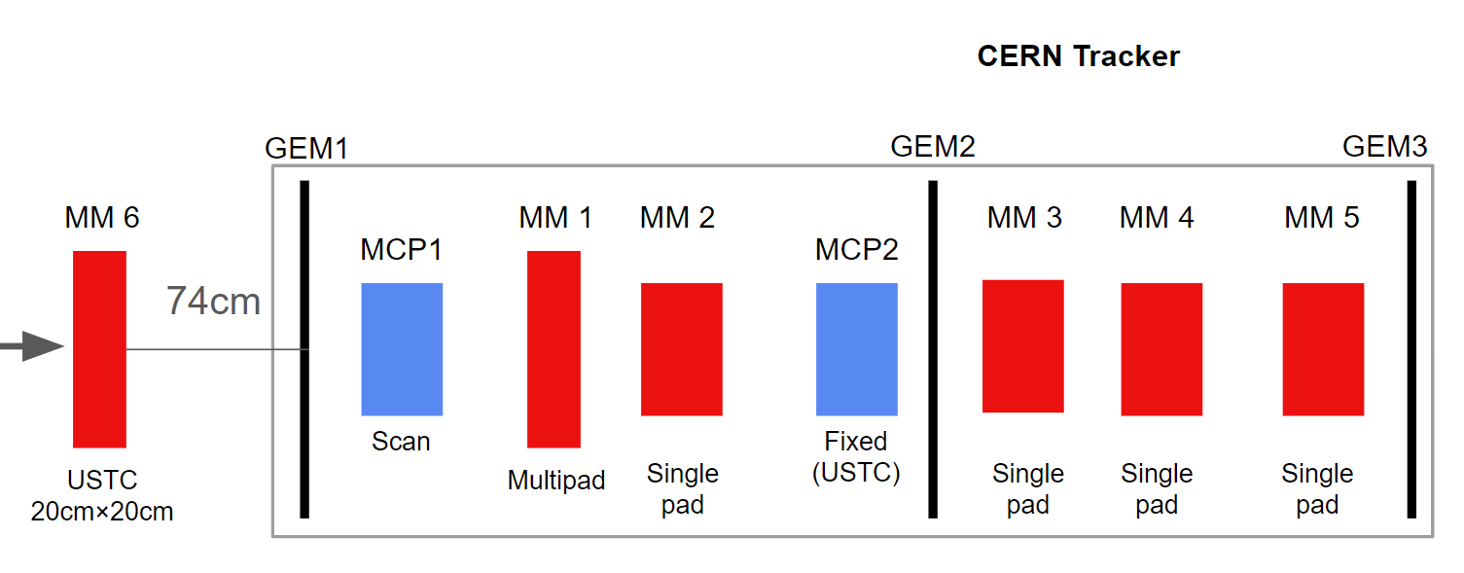
PICOSEC – Test Beam Setup and Detectors under Test
Telescope layout comprises of :
GEM for tracking
MCP – PMT as time reference device
MMX – Detectors Under Test
Detectors Under Test
Single Channel prototype → 1cm diameter active zone (circular)
7- Channel prototype → 1cm single cell (hexagons)
96-Channel prototype → 1cm single cell (square)
100-Channel prototype → 1cm single cell (square)
400-Channel prototype → 1cm single cell (square)
COMPASS Gas Mixture (80% Ne – 10%C2H2 – 10% CF4)

Slide 5
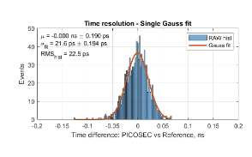
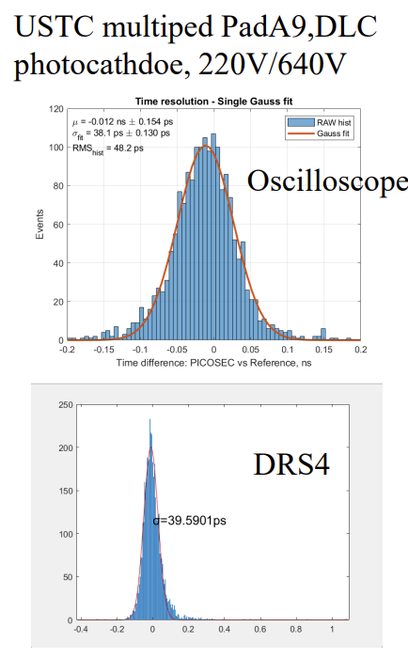
PICOSEC - Block of Measurements and Highlight Preliminary Results
Robust & Efficient prototypes
Resistive prototypes ~ 10MO, 20MO, 50MO
DLC single and double layers to explore better charge vertical evacuation
Voltage scans → Stable operation voltage in a high rate
Timing runs on individual pads
Long scan for uniformity map on amplitude and timing
10x10cm2 Double DLC with CsI ~ 21ps at a center of a pad
Spatial Resolution studies
15mm diameter active zone splitted in hexagonal pads
(medium and high granularity prototypes)
Alternative photocathodes
Graphene single, double and triple layer on a contactive thin layer
Alternative digitizers
SAMPIC and DRS4
Radiation Hardness
High intensity pion beam (from 8kHz up to 1MHz)
Stable operation through the whole run both for the detector and for the photocathode
20x20 cm2 with DLC ~ 38ps at a center of a pad and agreement with different digitizers

Slide 6
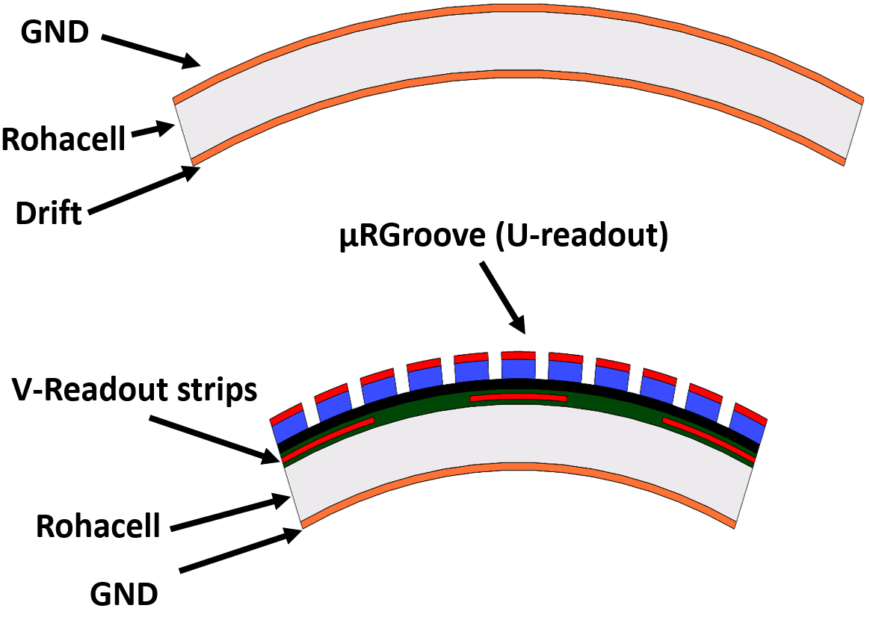
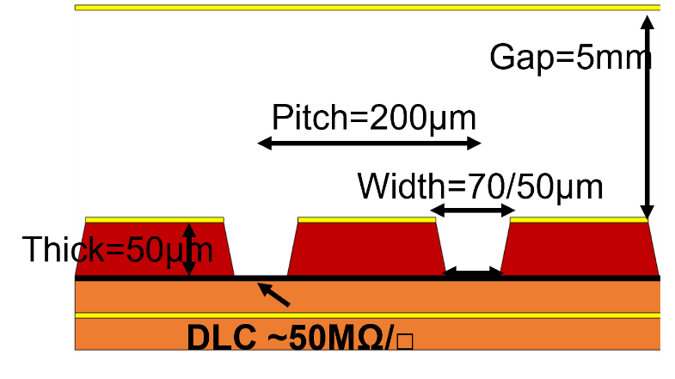
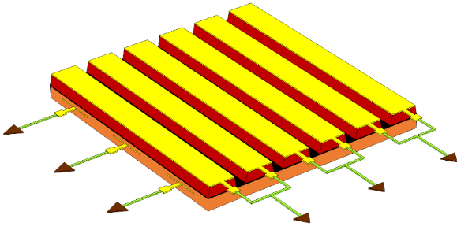
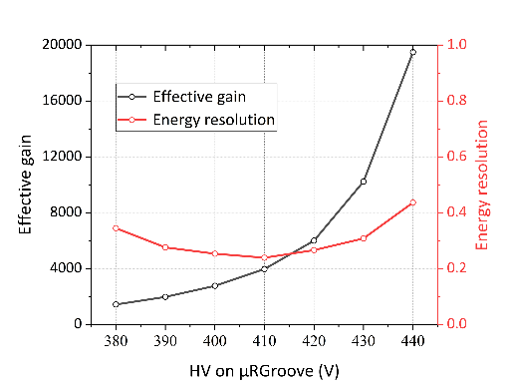
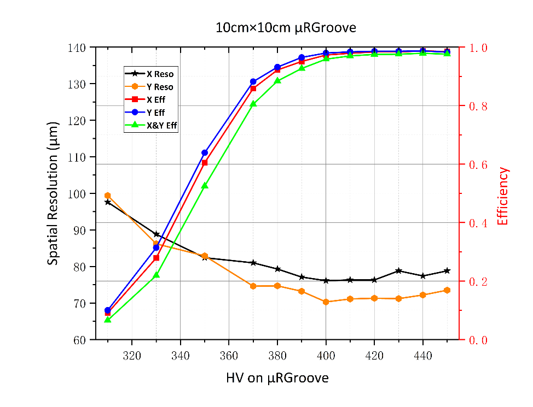
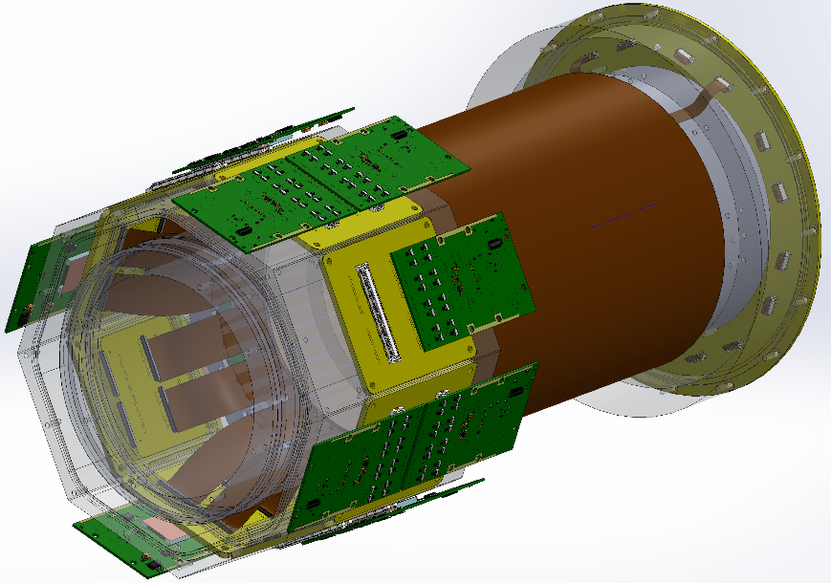
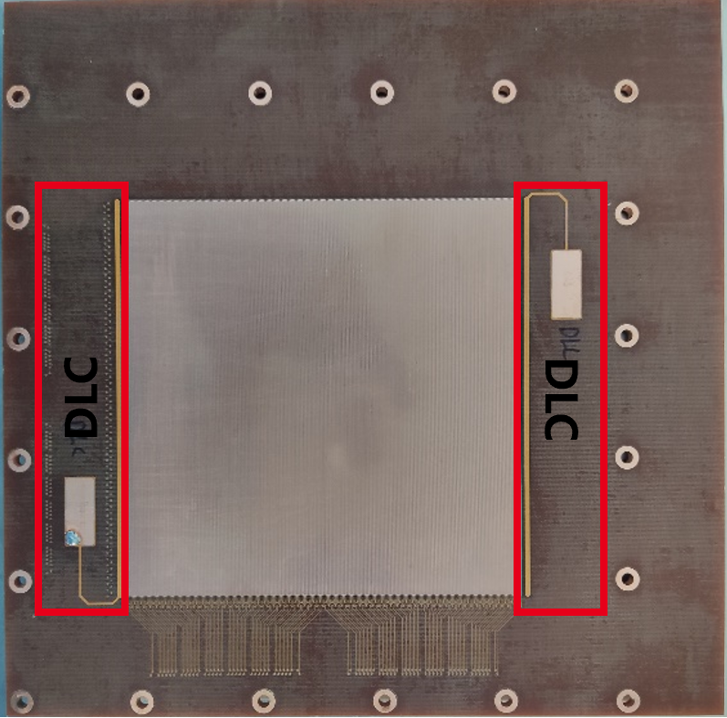
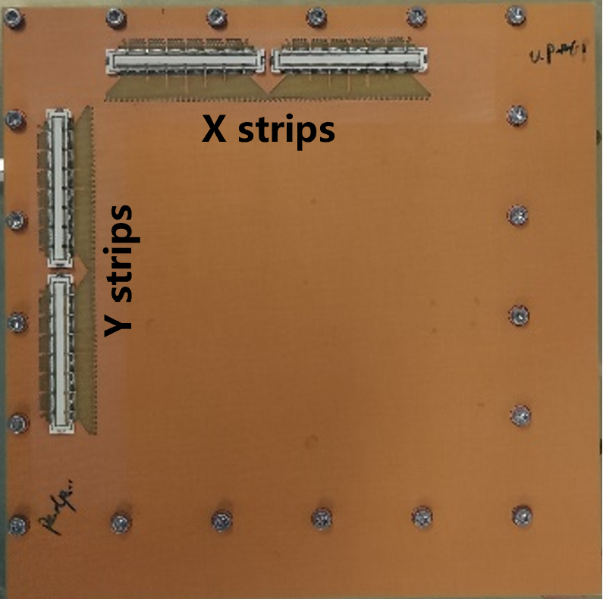
Cylindrical μRGroove
μRGroove
C-μRGroove
DLC HV
Drift HV
V readout
U readout
Active area: Diameter=131.0mm, Length=100.0mm.

Slide 7
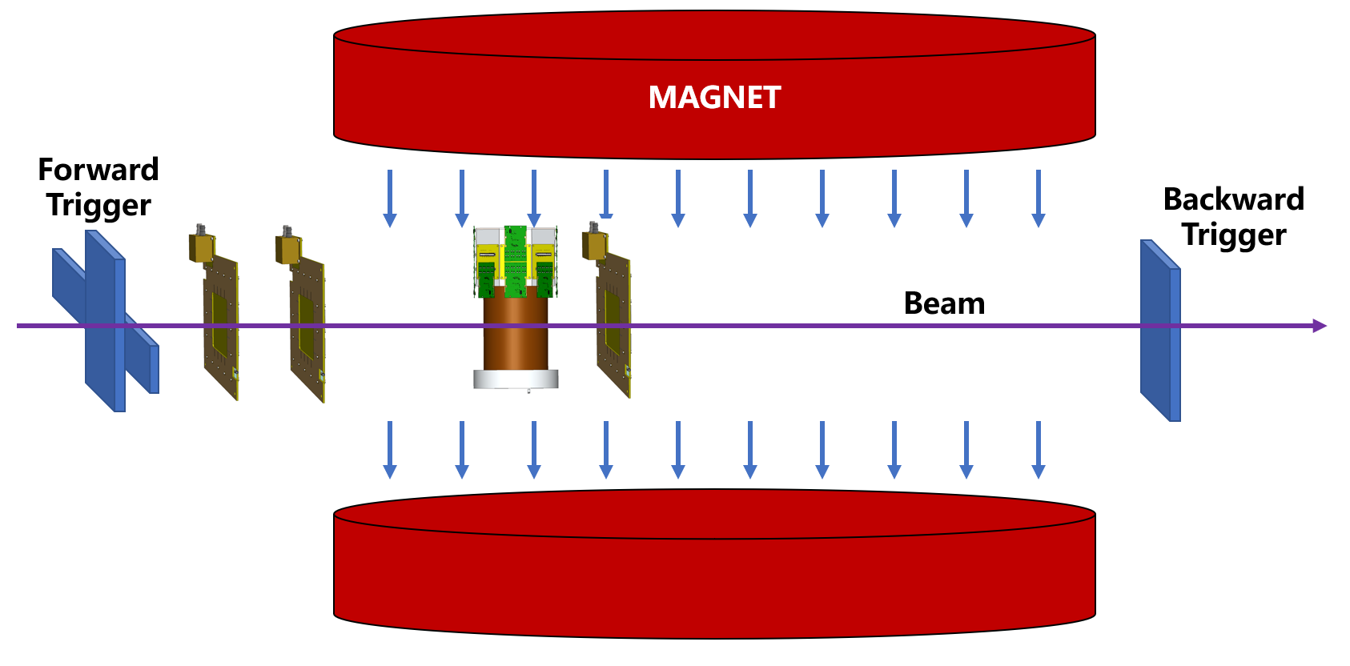
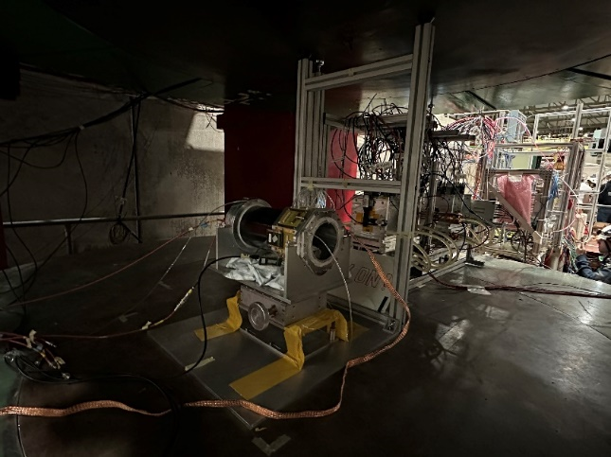
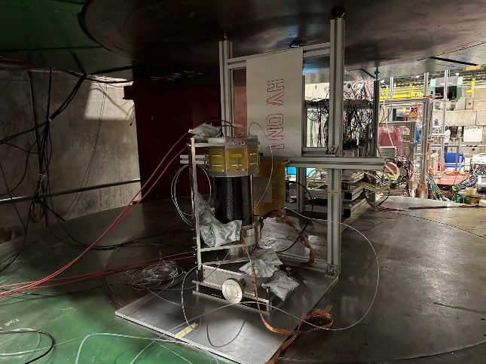
Setup
  Gas: Ar/CF₄/CO₂ (45/40/15)
  Particle: 150GeV/c muon
  X-strip readout; V grounded
  APV25+SRS+mmDAQ
  3 μRGroove Trackers
  0.5-1T magnetic field
Spatial resolution without magnet：~100μm；
Measure the detection and spatial resolution in 1Tesla magnetic field
Analysis ongoing (Correction for track bending and Lorentz angle to be applied correctly).
Results looks promising (below 100um spatial resolution at 1T).
Can be repeated in 2025 if final results will not satisfy requirements.

Slide 8
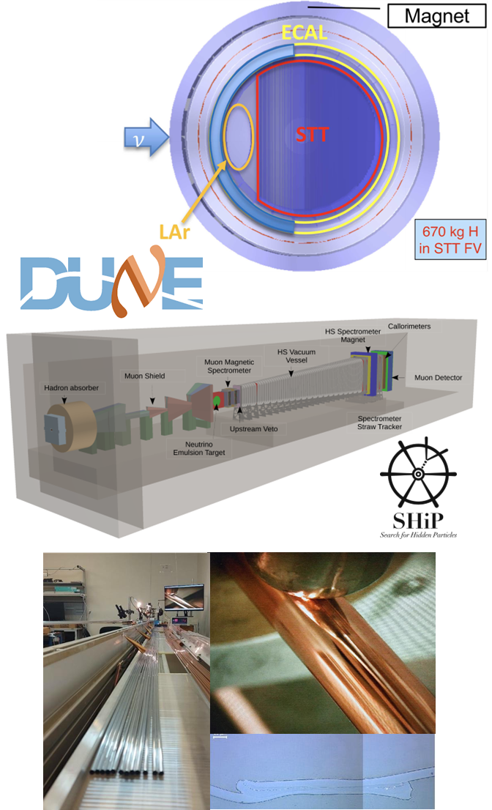
Straws R&D Setups
@H4 September-October 2024
DUNE near detector SAND for neutrino beam monitoring including flux shape changes [200k+ straws upto 4 m long]
SHiP Spectrometer Straw Tracker (STT) for track and vertex reconstruction [10k channels]
As well for DRD1-WP3, SPD NICA, COMET
Ultrasonic welding technology for the Straws
Test beam measurements
Tracker prototyping
Study of read-out electronics

Slide 9
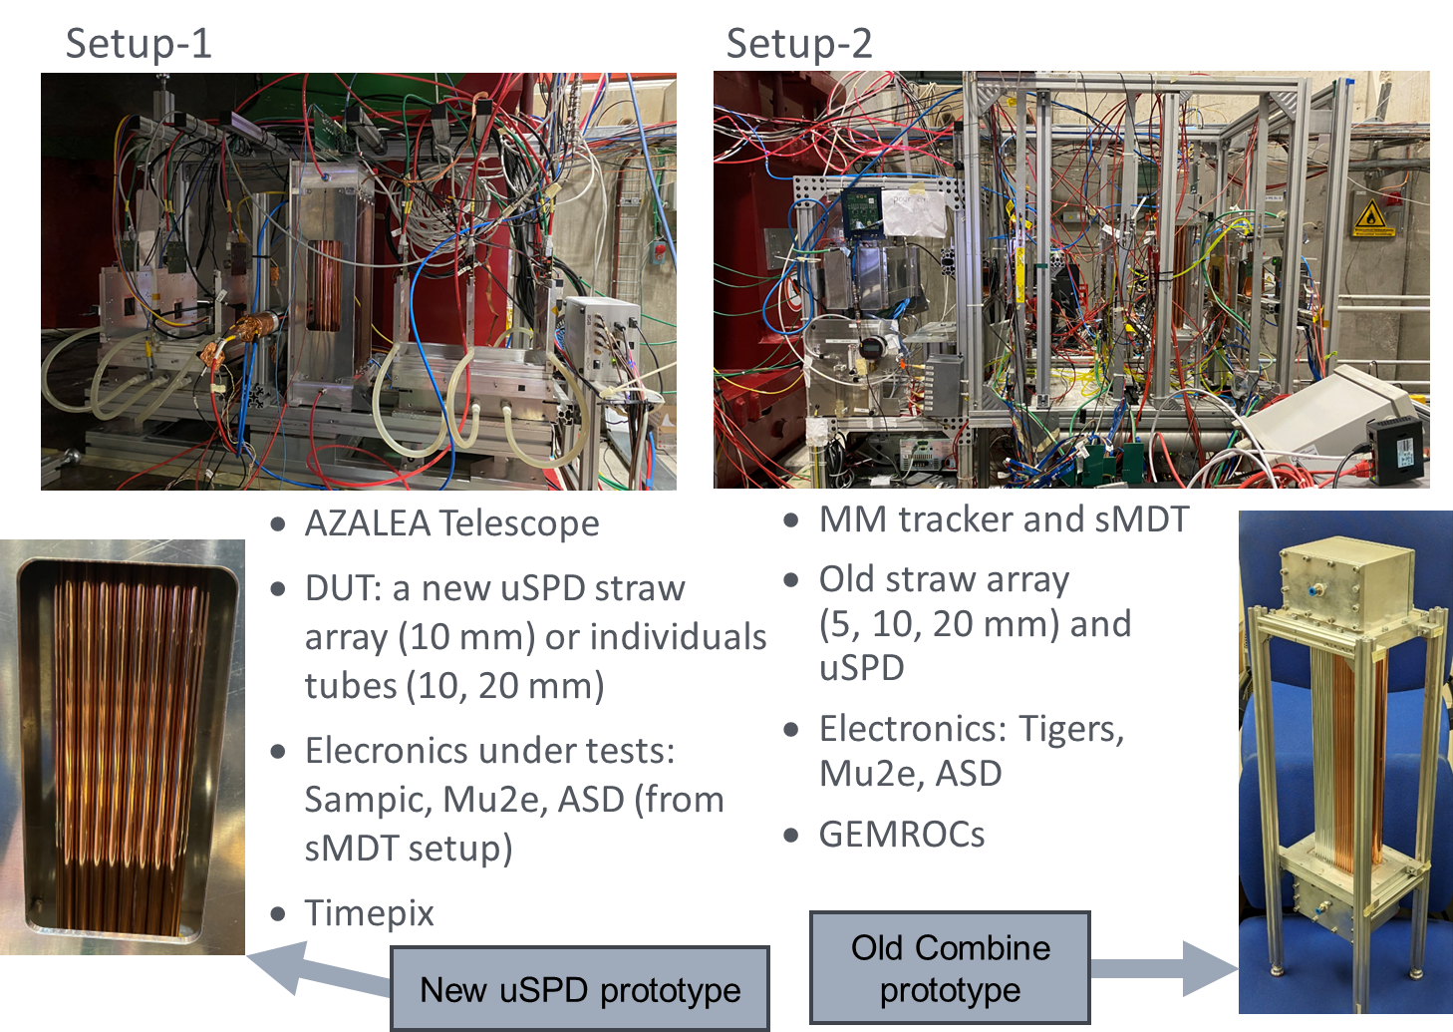
Straw setups
Operation modes:
  Large acceptance (sMDT + MM reference tracking 9x9 cm2) – resolution ~100 um
  Small acceptance (1x2 cm2) high resolution (~5um) – AZALEA telescope
Straw tracker prototypes and straw
  Combined 5-10-20 straw (ASD and VMM3 -based readouts) – readout performance studies
  10mm with 2degree stereo angles (ASD and VMM3 -based readout) – readout performance and tracking studies
  Stand-alone 10 and 20 mm straws (custom PA + SAMPIC digitizer)
Test in magnetic field 1 and 1.5 T with ASD and SAMPIC readouts
Data analysis ongoing
Many thanks to DRD1 and GIF++ colleagues for their collaboration and patience, to Nikos Charitonidis for the great beam intensity, and to Andre Rummler for AZALEA support!

Slide 10
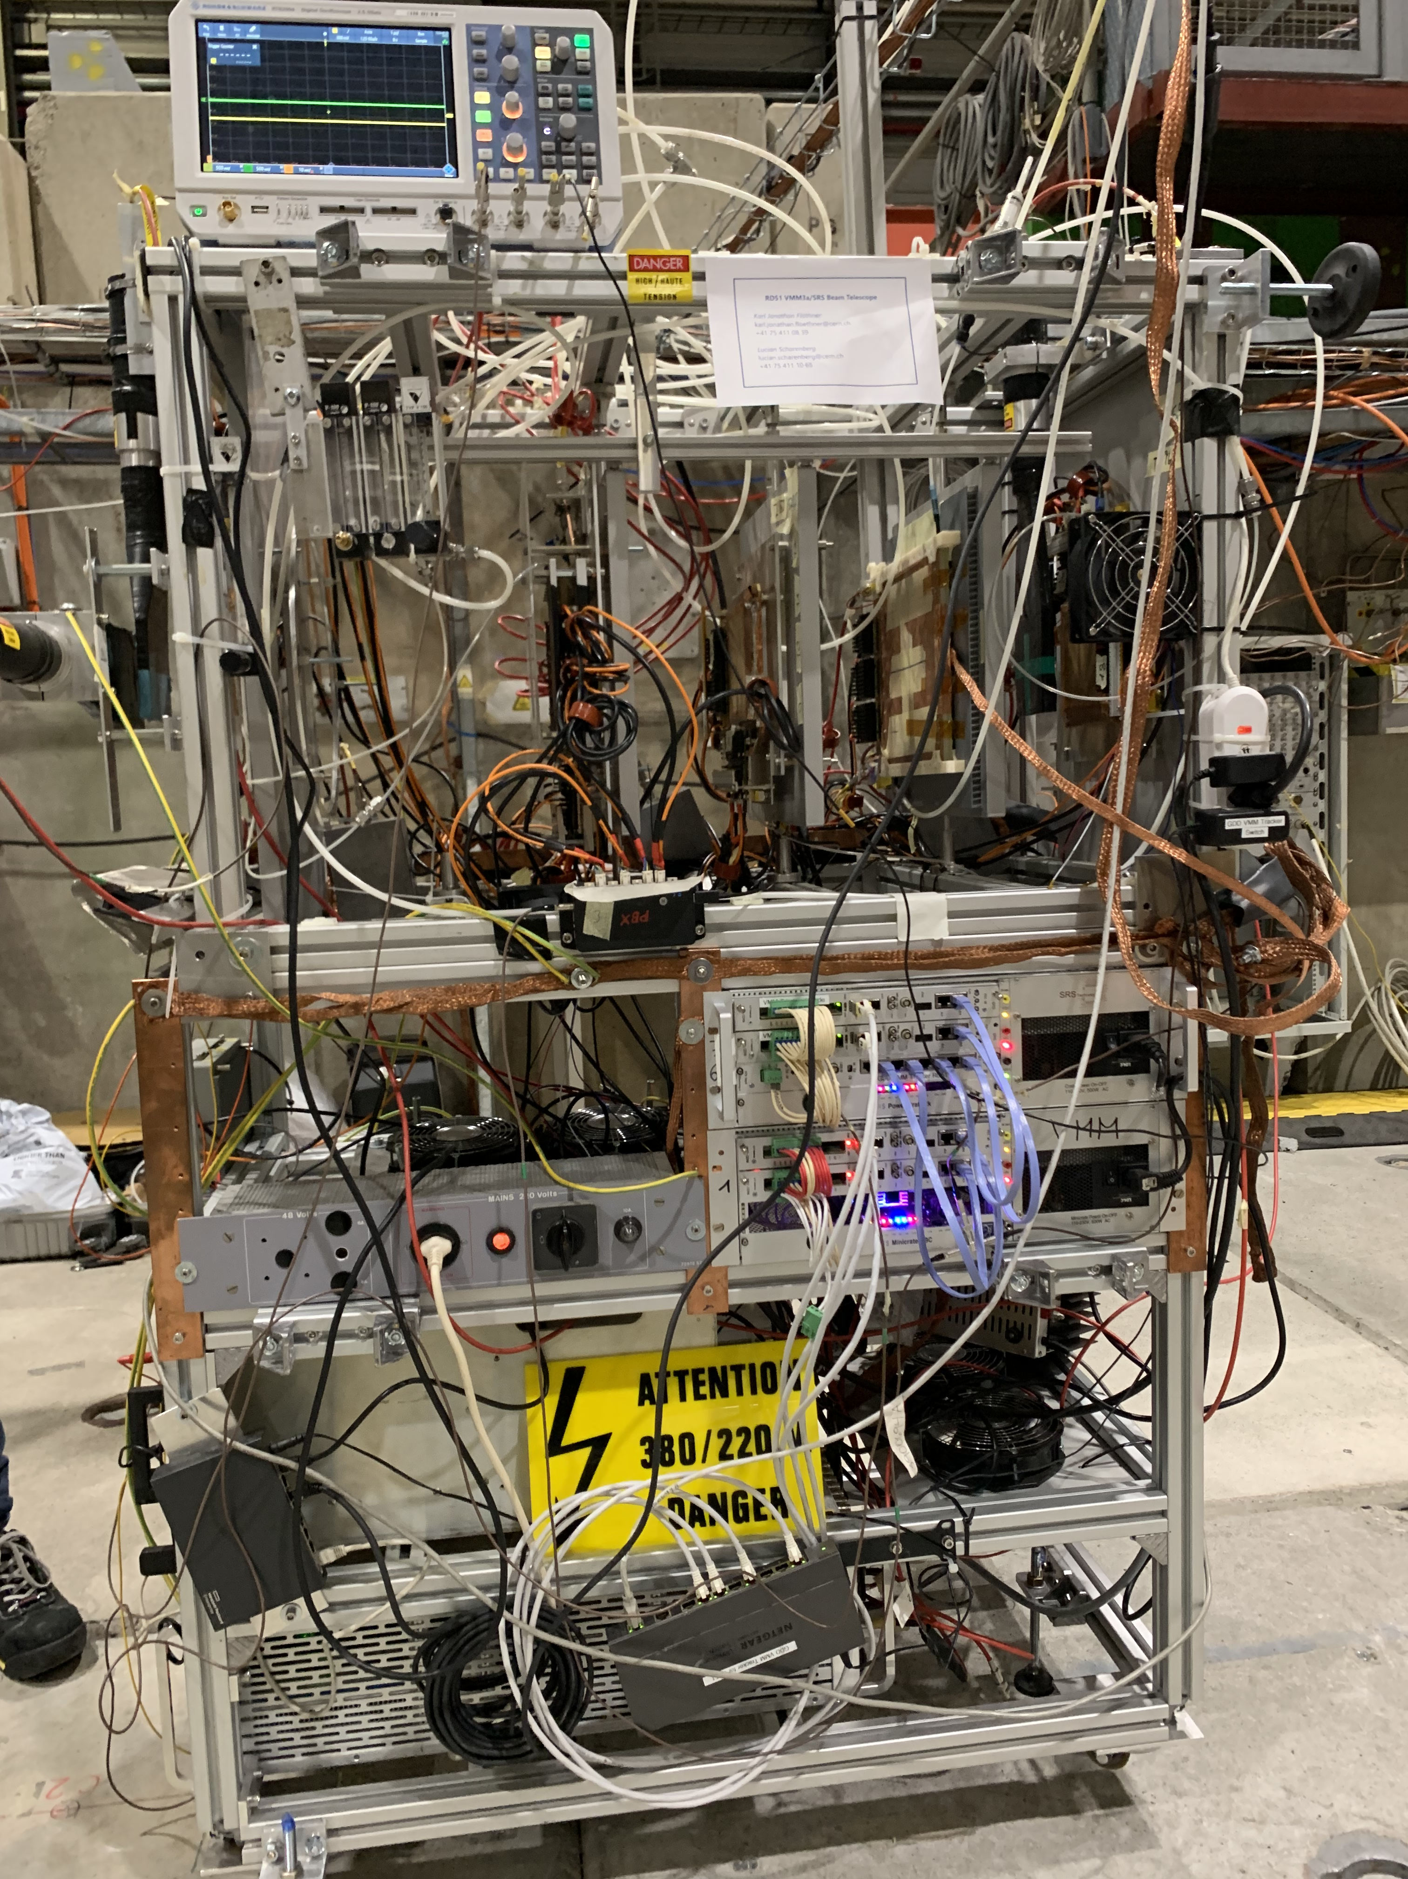
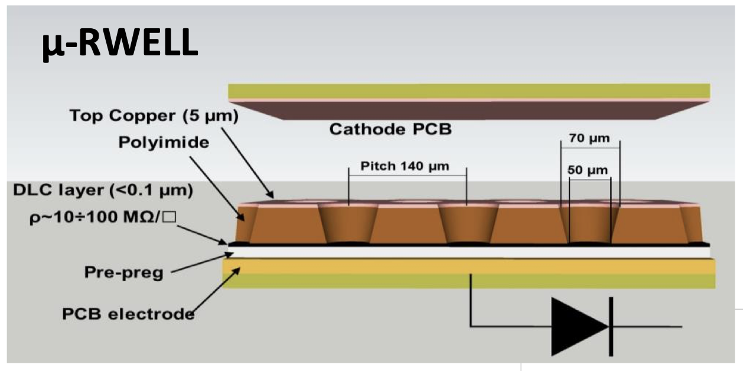


DRD1 VMM3a/SRS Telescope
Set-up
Tracker 1
DUT1
PAD $μ$-RWELL 20x20 cm²
3 scintillators in coincidence trigger
3 triple GEM trackers for reference
3 detectors under test
SCINT.
Tracker 3
PAD $μ$-RWELL 10x10 cm²
Tracker 2
SCINT.
Scope
A) Repeat performance evaluation of recently implemented externally triggered readout mode
B) Test of VMM3a front-end for ​MPGD-based DHCAL for future muon colliders and compare with APV25 front-end, reading out 20 x 20 cm² µRWELL prototype detector
C) Test of 10 x 10 cm² µRWELL detector for studies on alternative, eco-friendly gases

Slide 11
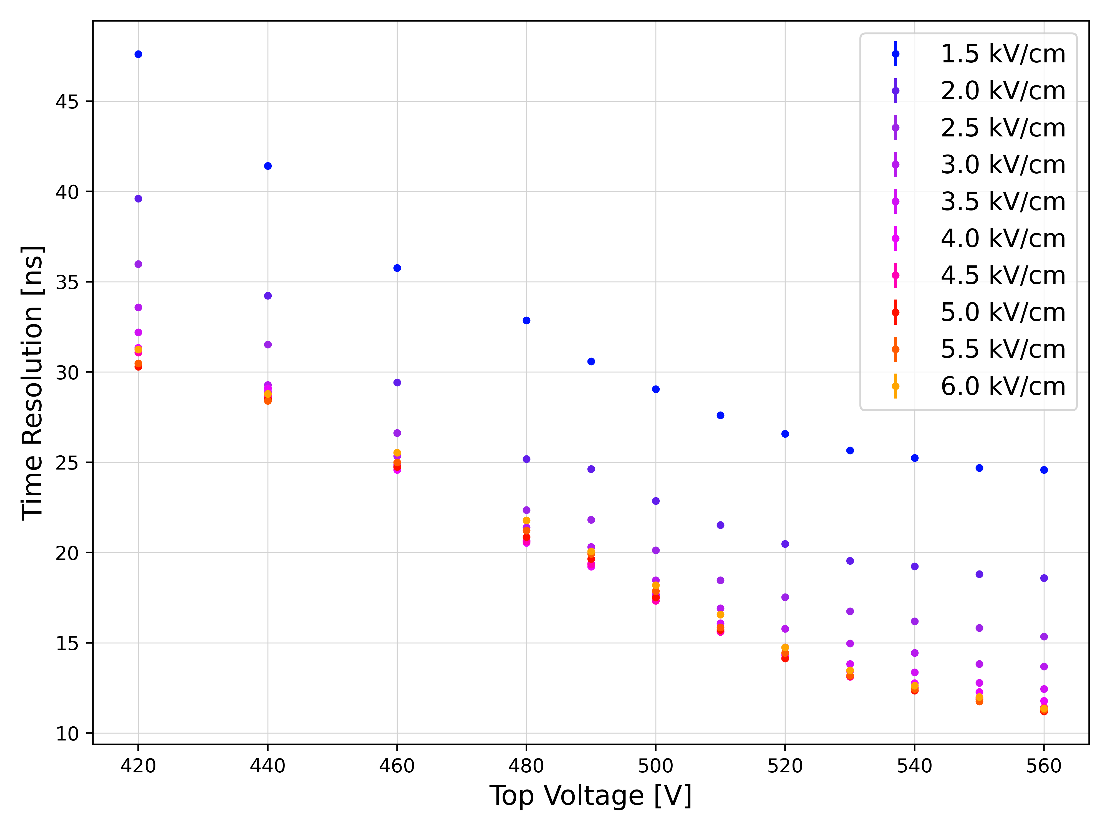
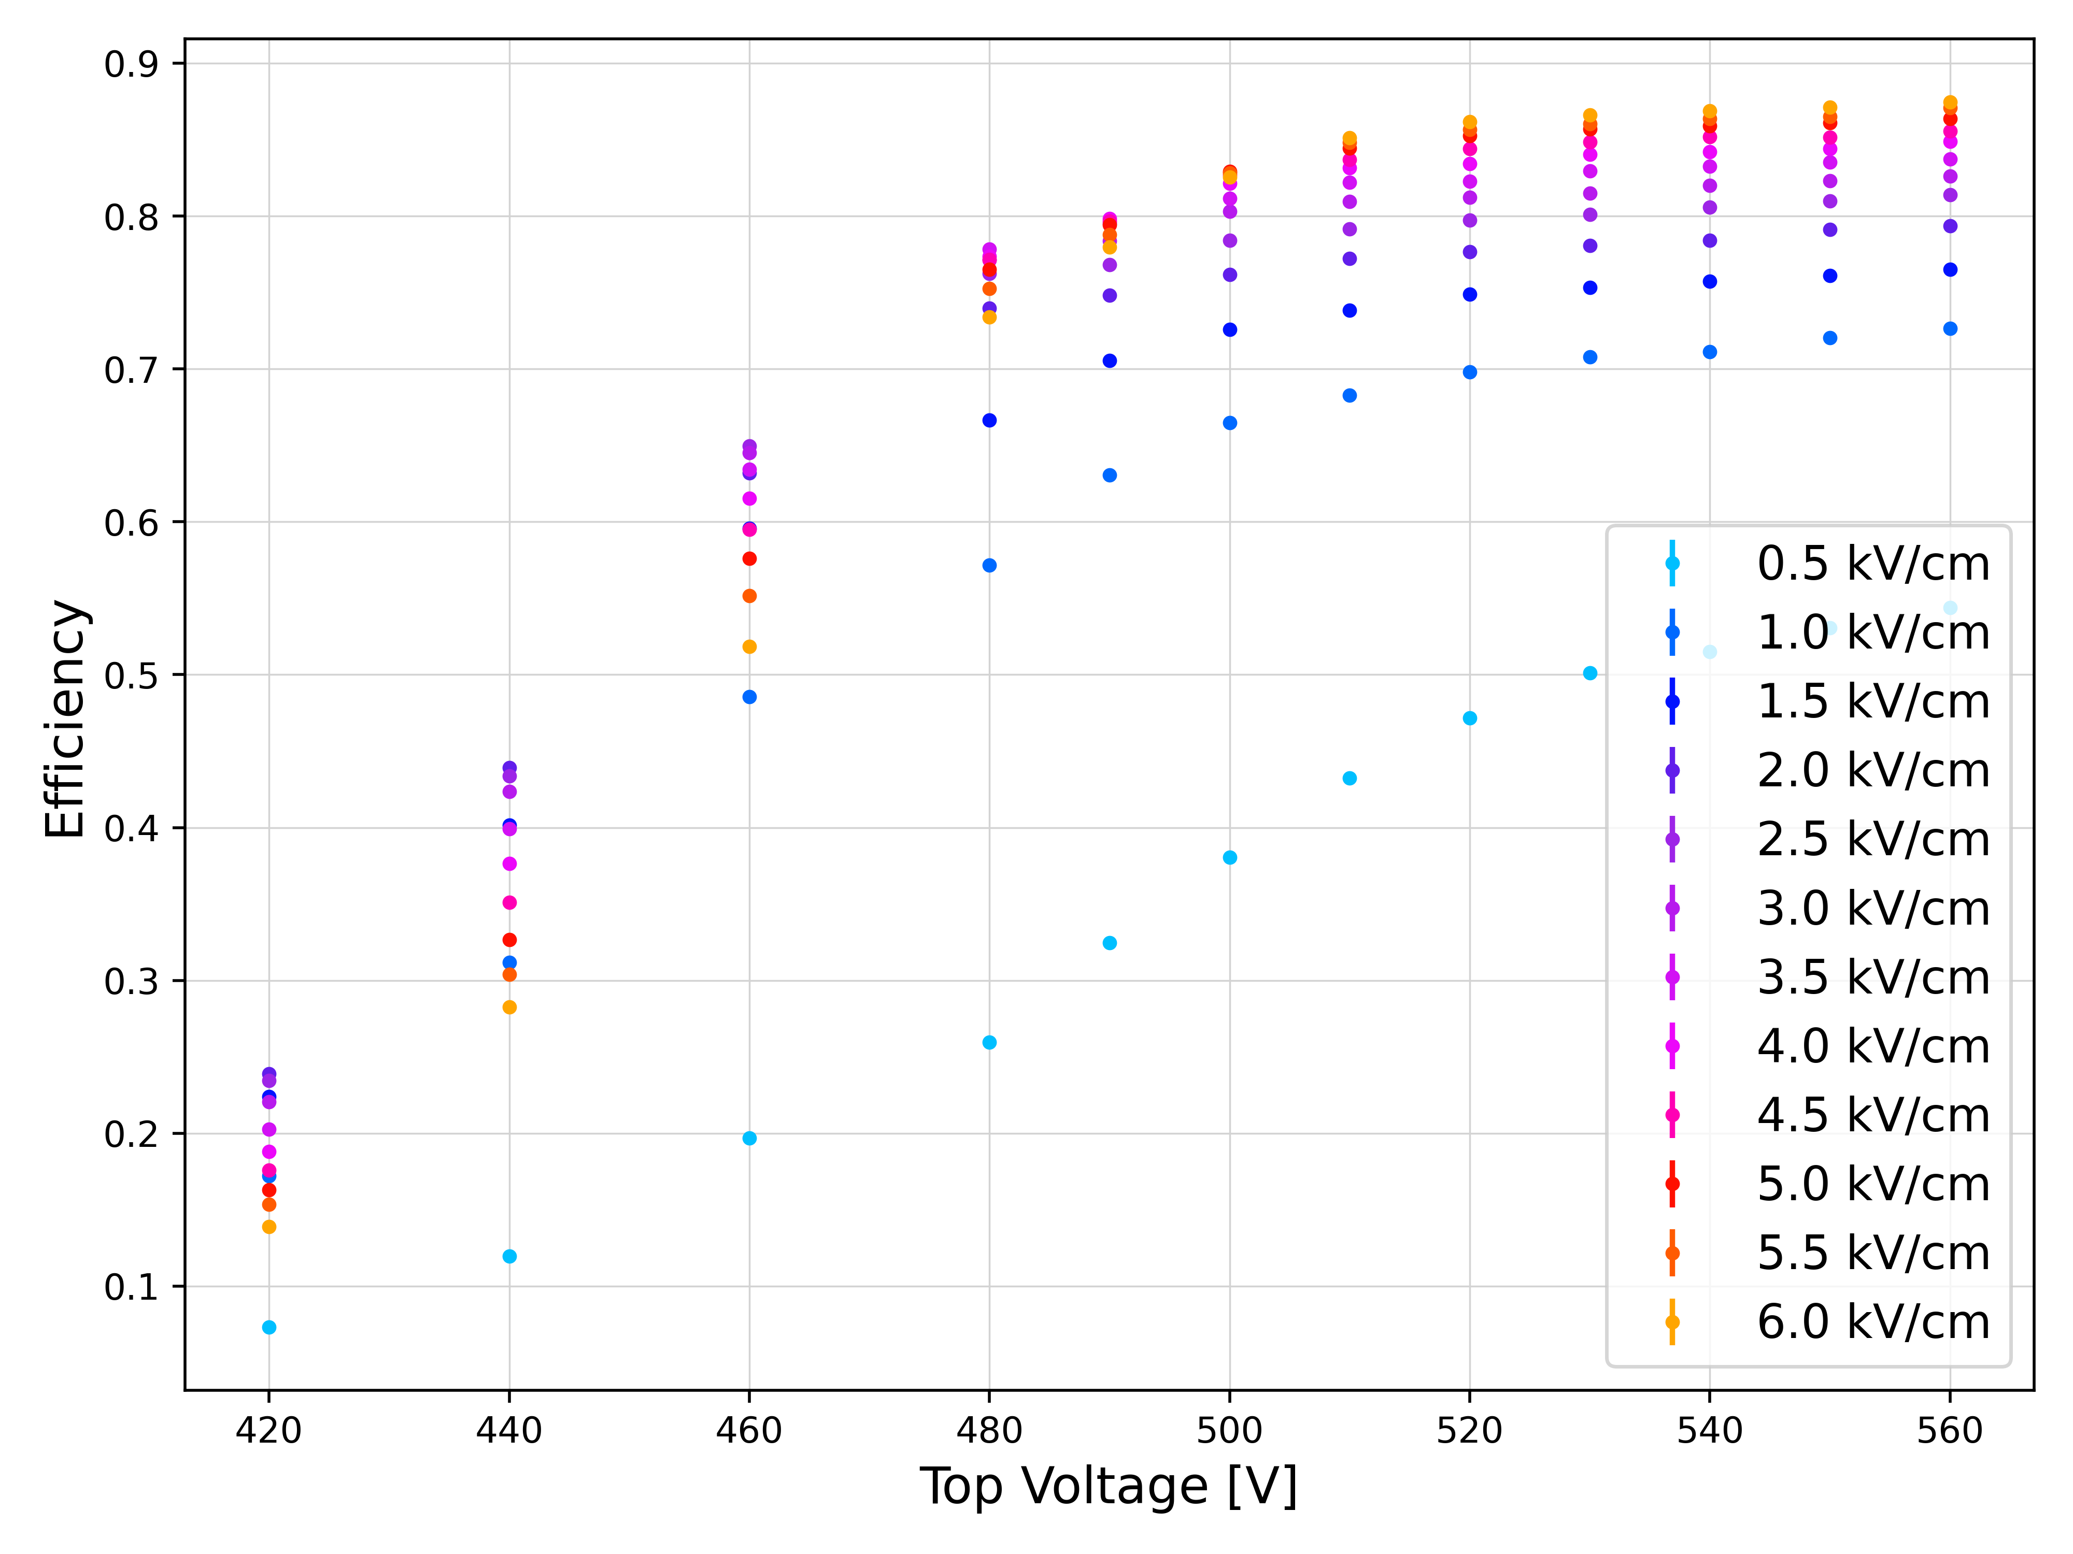
DRD1 VMM3a/SRS Telescope
Results, 20 x 20 cm² µ-RWELL
1×1 cm² pad area
384 pads → 3 hybrids
Drift Gap: 5 mm
DLC grounded, TOP and DRIFT connected to HV
Gas Mixture Ar CO₂ CF₄ 45/15/40

Slide 12
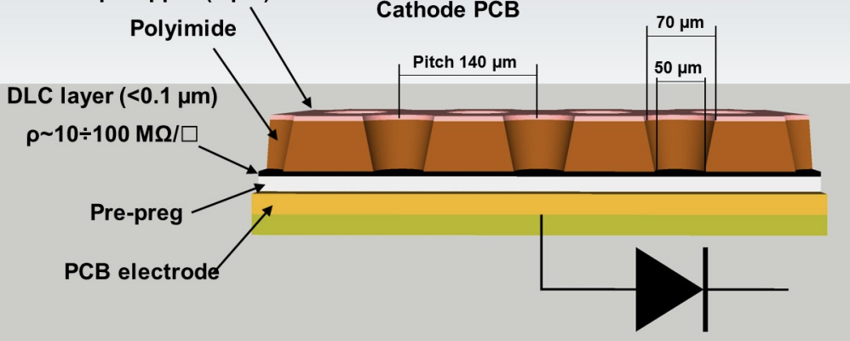
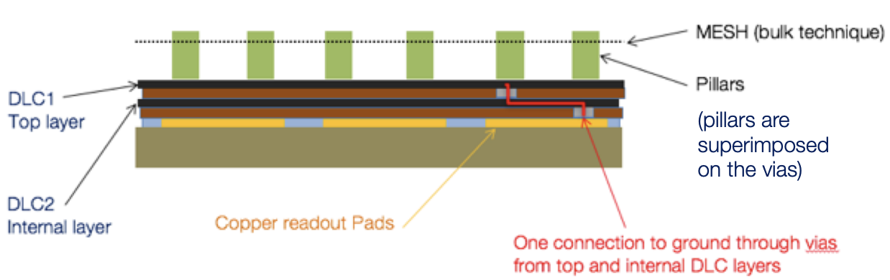
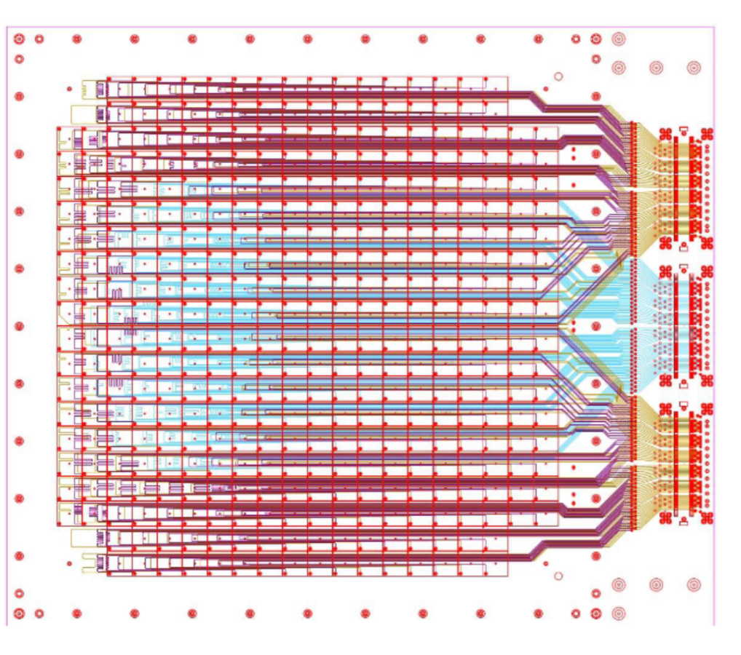
Weizmann Institute of Science setup
Comparative study of resistive MPGD technologies
Micromegas, MM
uRWELL
RPWELL
Single stage resistive MPGD:
Single stage amplification
Lower material budget
Simpler power supplying scheme
Resistive layer/plate to protect the electronics from discharges
Potentially a sampling element digital hadronic calorimeters with fine 3D segmentation
in fact, it is a complementary study to RD51 Common project [1])
No systematic characterization in controlled environment
→ Goal of the study: to compare the performance of the three technologies with identical readout in similar operational conditions
[1] https://indico.cern.ch/event/1368231/timetable/?view=standard#33-mpgd-hgcal-multipattern-gas

Slide 13
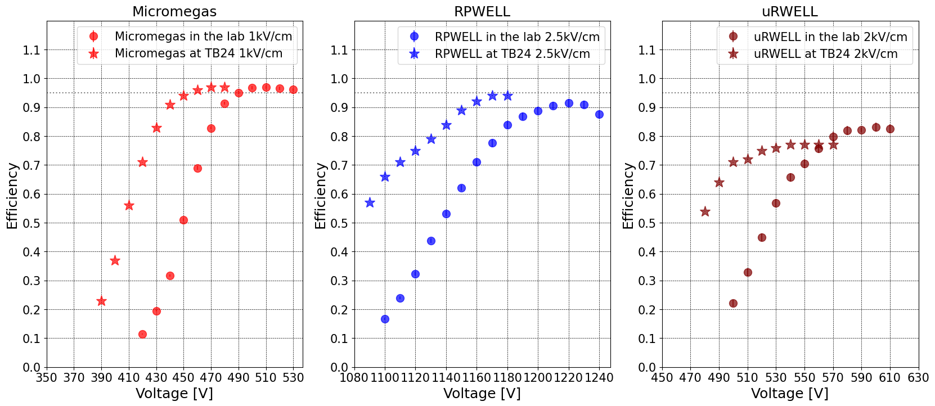
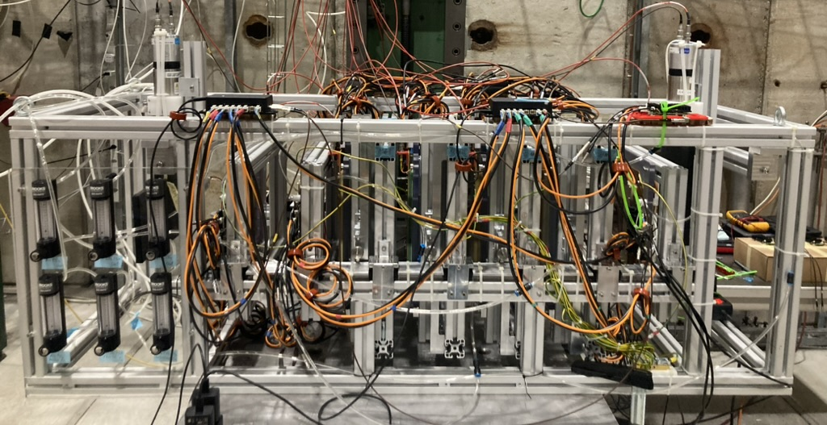
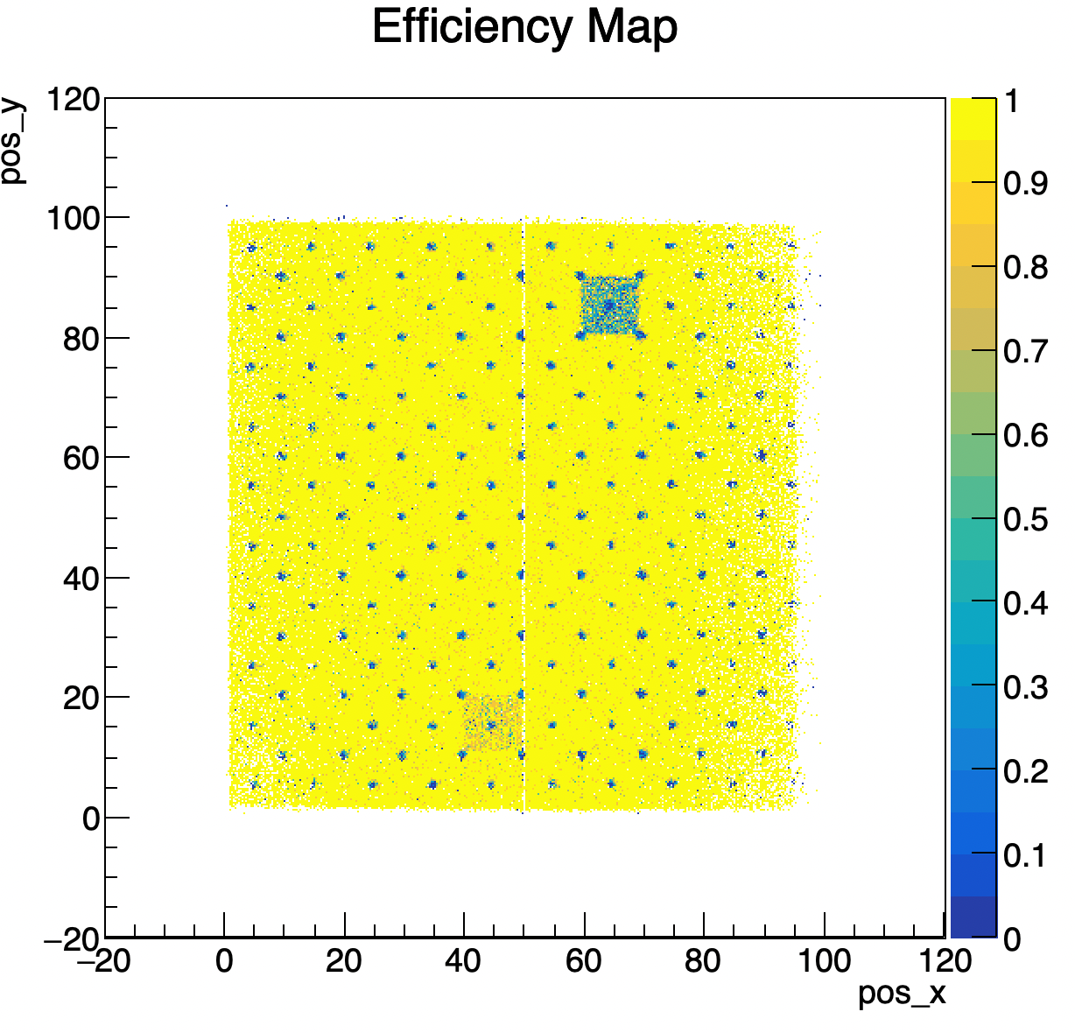
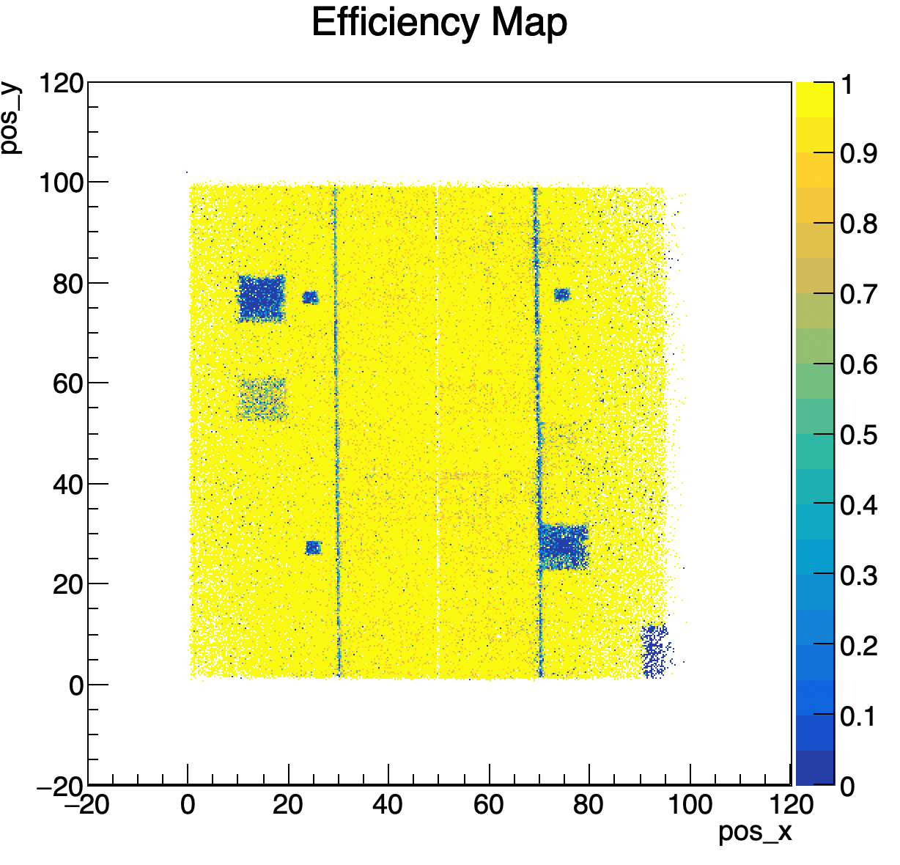
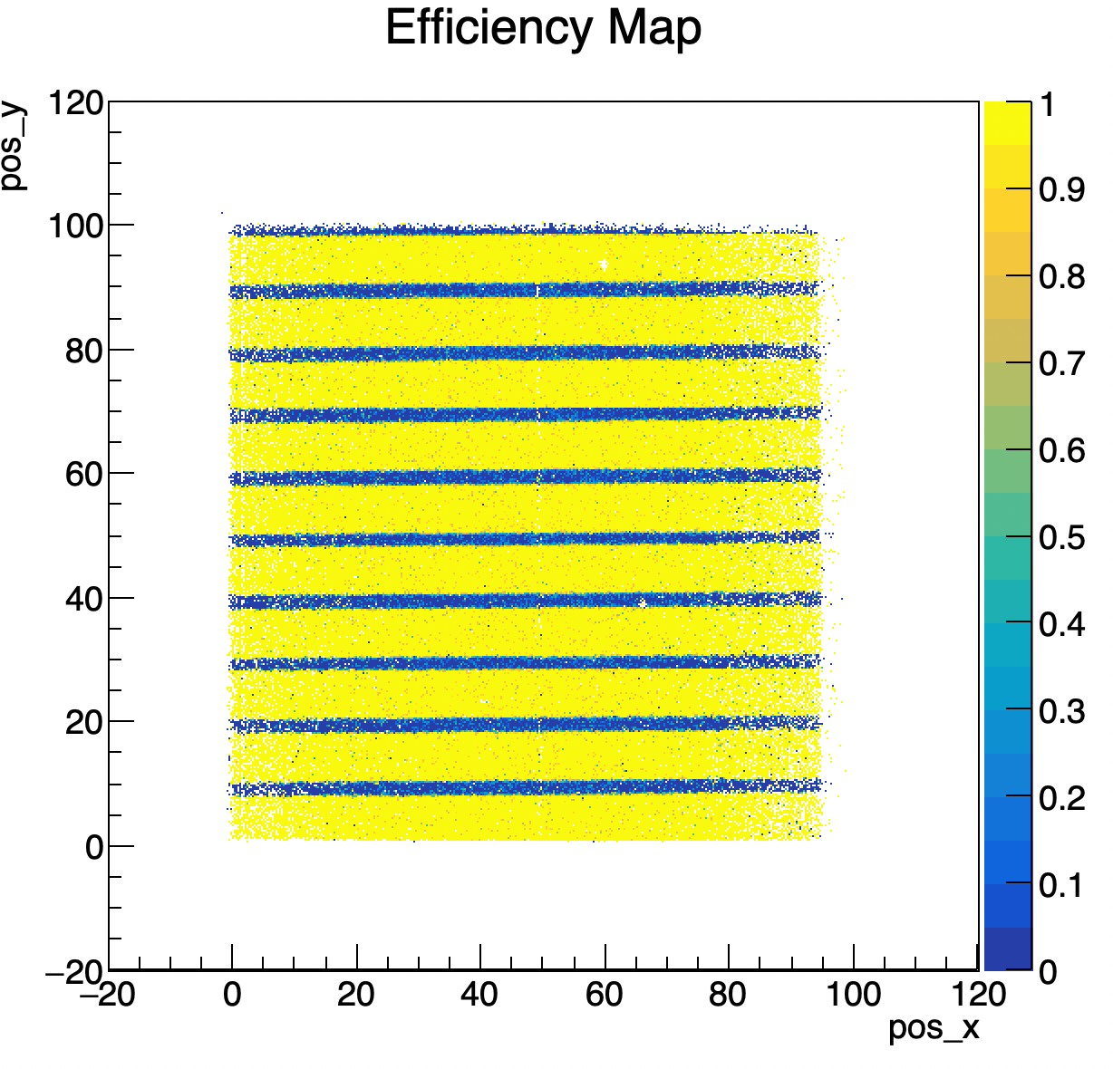
Weizmann Institute of Science setup
Comparative study of resistive MPGD technologies
Common VMM3a-SRS readout
DRD1 (triple GEM) tracker
2688 total channels
Mounted on DESY table
Gas mixtures: ArCO2iC4H10, ArCO2, ArCO2CF4
Measurements
  Efficiency scan (vs. amplification voltage, vs drift field) with muons
  Rate scan with pions
  Uniformity scan across the area

Slide 14
Setup Removal
As usual, huge thanks to the RP and Crane teams for their prompt help.
Some equipment was left in PPE134 (needed for the 2025 TB campaign). It can be removed at any time if needed.
We hope we did not interfere too much with the SND installation (the area was completely free only before lunch due to the large amount of equipment).
Beam Sharing with GIF++
Good Sharing as usual (at least on our side… we hope GIF++ will share the comment)
Optimized collimator settings in case of three spills and GIF access (PAXNA14404 has reduced limit in access)
Special thanks to
Nikolaos Charitonidis (beam), Bastien Rae (magnet), Michael Lazzaroni, Sylvain Girod, Vincent Marchand, Francois Grenouilleau et l’equipe, Silvia Schuh-Erhard (Installation and infrastructure), Alexandre Beynel, Jakub Michal Polak(Survey), David Jaillet, Thierry Erisay, Lionel Degasparis (Gas Support), Letizia Di Giulio, Henric Wilkens, Nicolas Broca, Romain Bonnard, (Flammable Gases and safety) Frederic Lionel Aberle, Yann Pierre Pira (RP), Alex Schouten (Safety), Martin Jaekel, Paolo Martinengo, Giuseppe Pezzullo (GIF++).... and to everyone we forgot by mistake

Slide 15
Backup

Slide 16
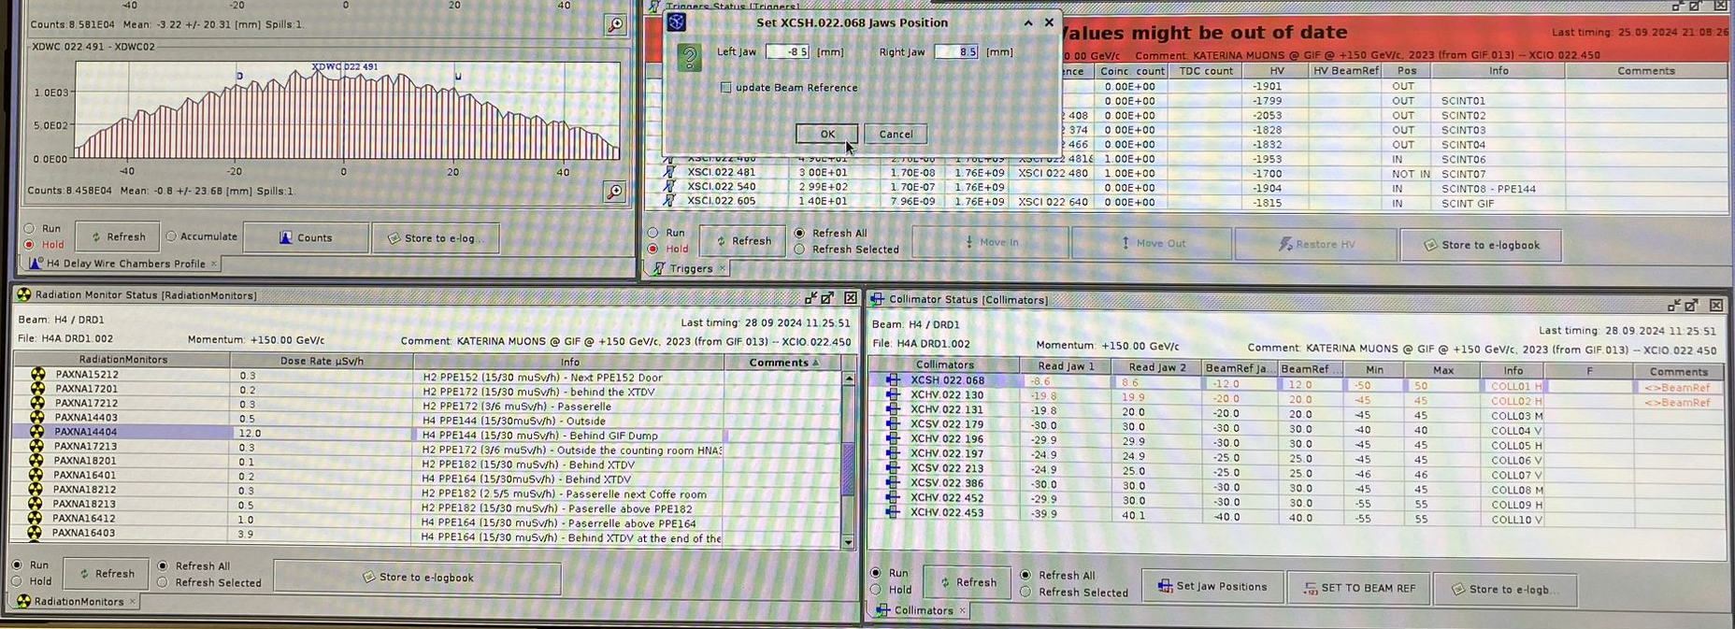
3 Spills + GIF access (PAXNA14404 reduces to 15uSv/h)
-> XCSH.022.068 to –8.5 & 8.5 (beam ref -12/12)
(don't forget to remove the cross for 'update beam ref')

