Slide 1

Completing MQXFB production – screenshot of current status
Susana Izquierdo Bermudez

Slide 2
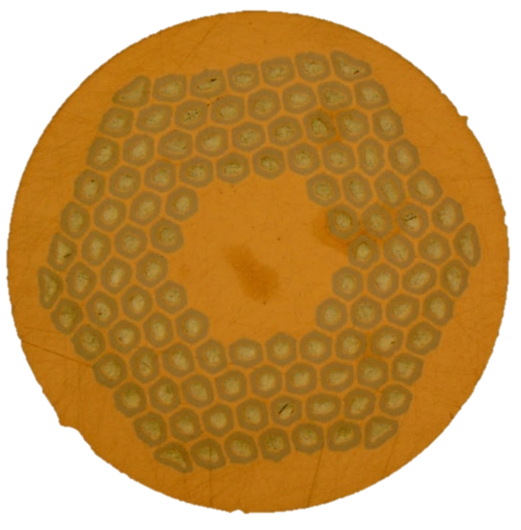
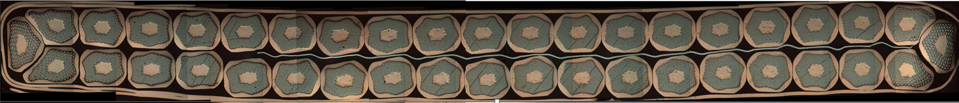
Conductor and cable
90 %
MQXF coils are made with a Rutherford-type cable composed of 40 strands x 0.85 mm
  Procurement of ≈ 3000 km of wire, with UL 840 m
    460 km for the prototypes
    2160 km for the series (90 % received and accepted)
    340 km additional order as strategic stock, to be delivered in 2025 (Am7)
  8 RRP prototype cables and 55 series cables have been produced so far, with only two rejected cables
    The 5 remaining cables to produce the baseline number of coil will be completed early 2025.
  Counting on the margin on Am2-Am6, we might have strand to produce 2 additional ULs.
    To be checked with Thierry, I guess they did not take long ULs to produce 12 T cable
Bruker-OST RRP 108/127
Dashboard https://edms.cern.ch/document/2772430

Slide 3
Coil fabrication
70 %
In total, 63 coils have been already wound. Since the re-start of the coil production in September 2022, 22 coils have been completed and 4 coils are in fabrication.
To complete the baseline number of coils, 16 more coils need to be wound.
Exceptional coil yield, in the last 2 years there was not a critical nonconformity during coil fabrication which led to coil rejection.
New generation coils
Coil dashboard: https://edms.cern.ch/document/3052807

Slide 4
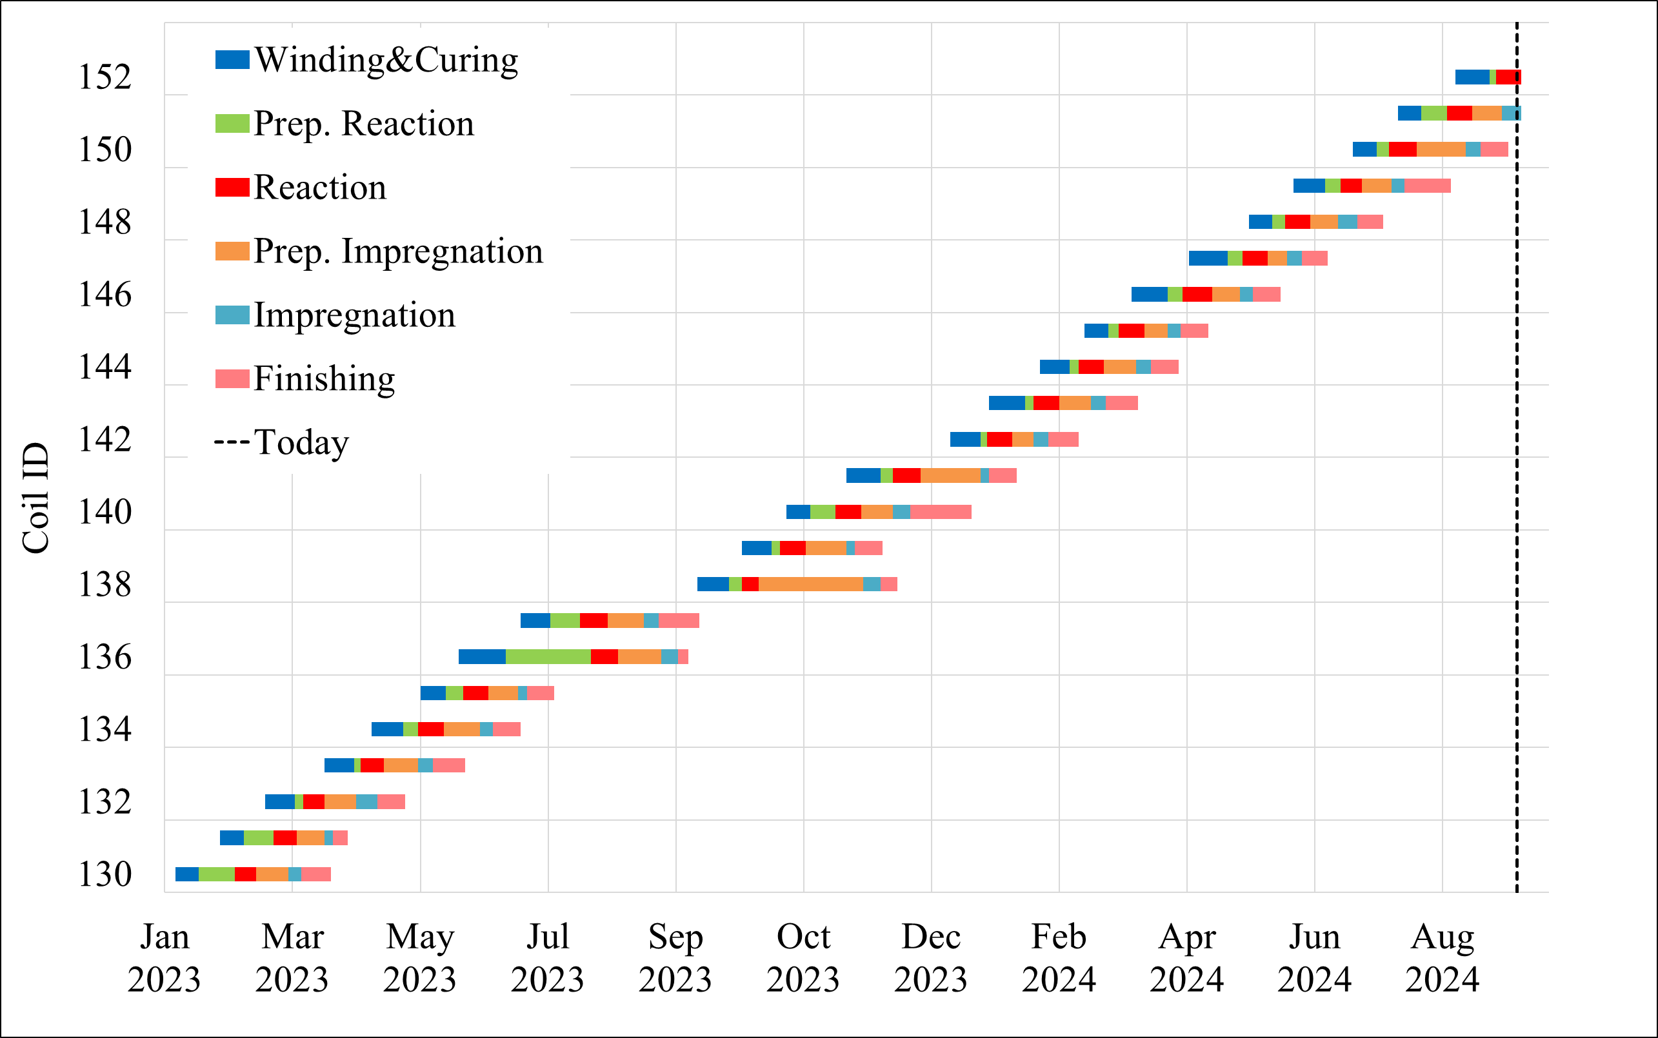
Coils
MQXFB07
MQXFB06
MQXFB05
MQXFB04
Coil dashboard: https://edms.cern.ch/document/2374378

Slide 5
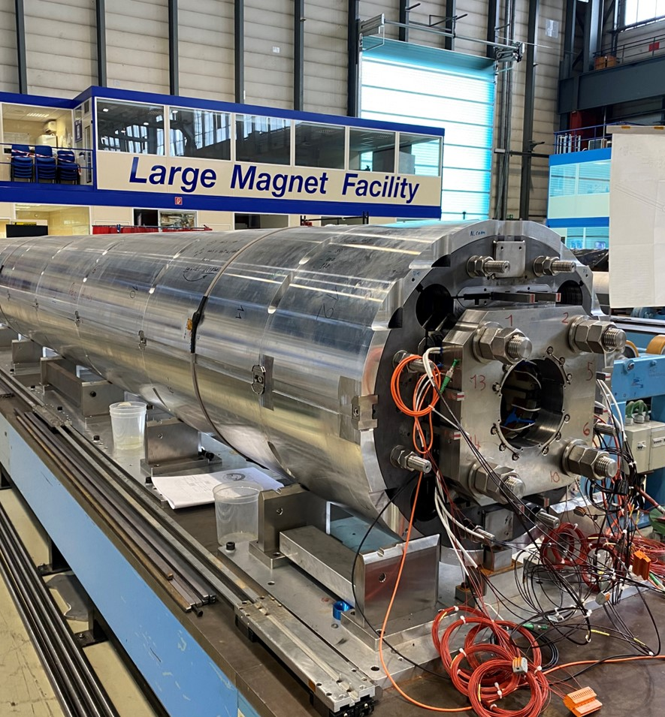
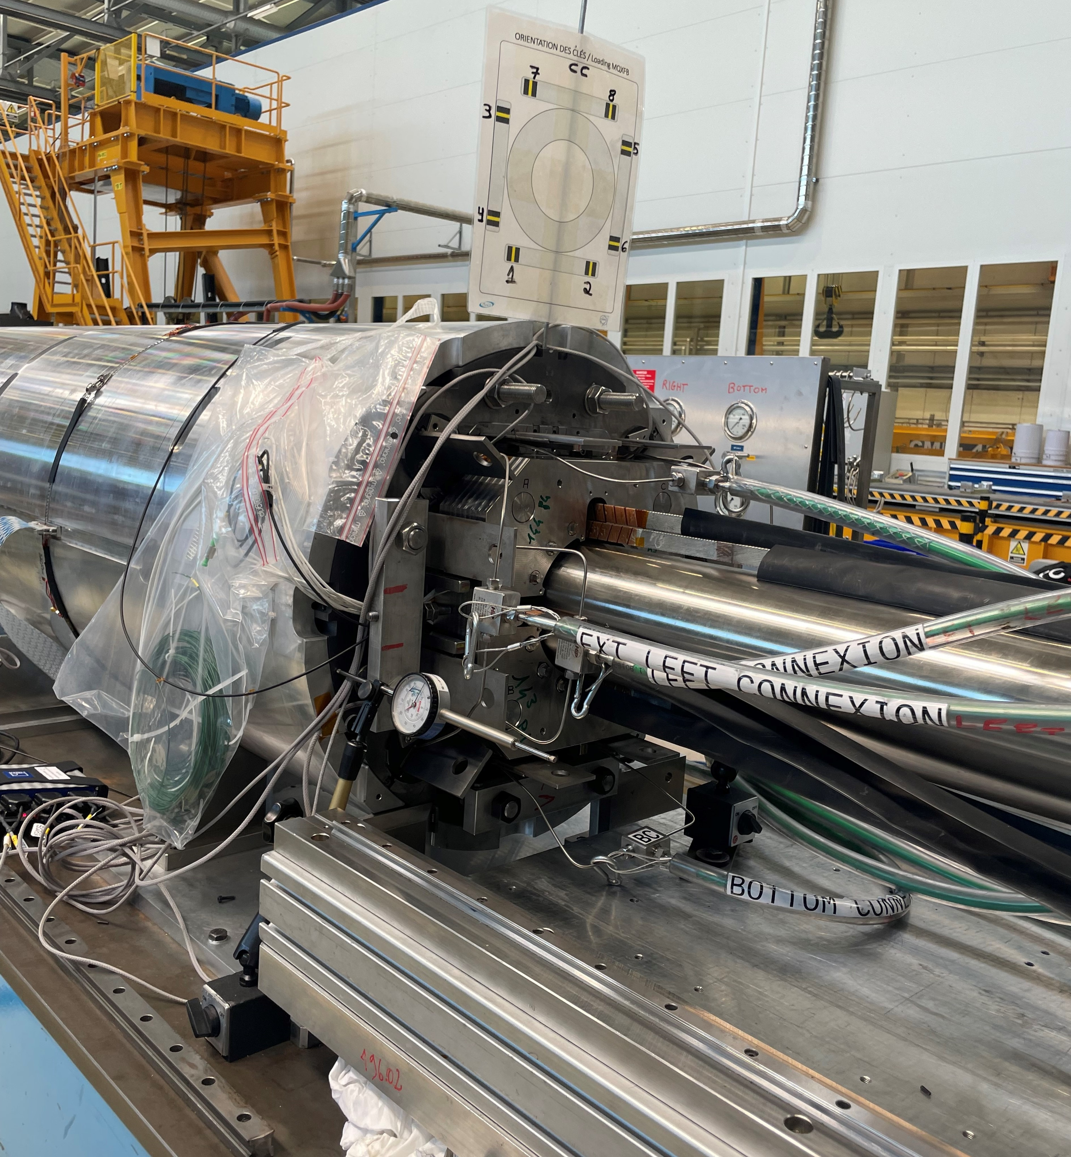
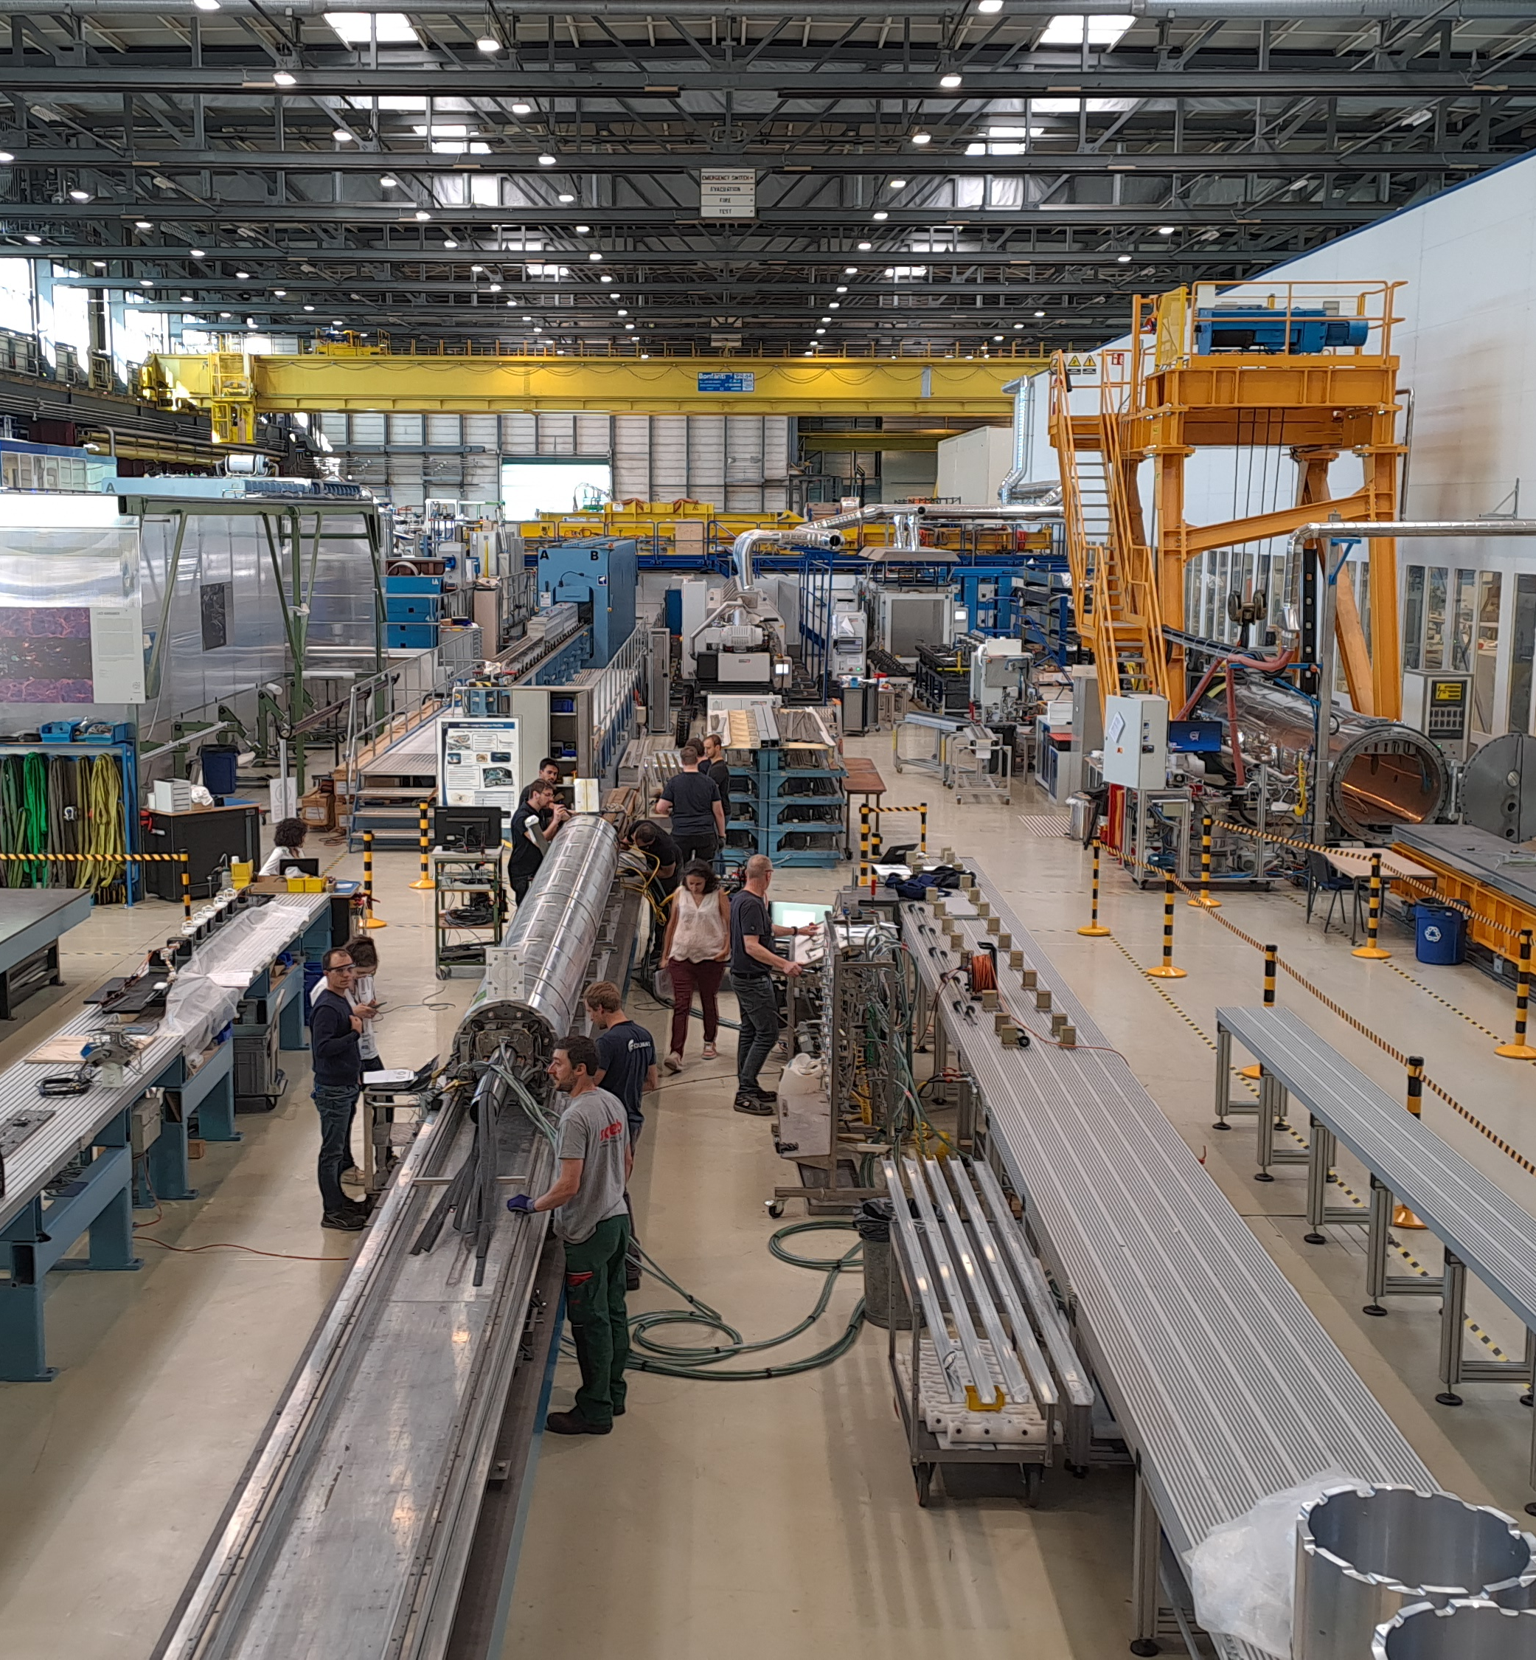
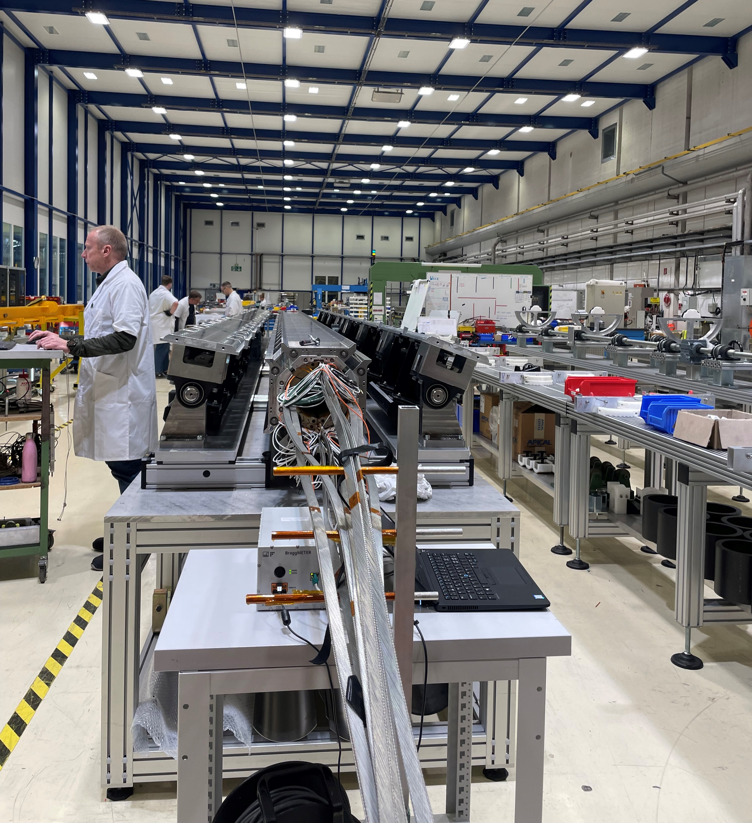
Last 12 months
3.5 magnets assembled last year, all following the new assembly procedure with auxiliary bladders in the cooling hole channels and all having the ‘new generation’ coils
1 magnet disassembled (due to NCR 2940210, QH to coil short in coil 124)
MQXFB04
MQXFB02
MQXFB05
MQXFB06
MQXFB07
Sept-Oct 2023
Nov 2023 (disassembly)
Feb-Mar 2024
May-June 2024
Sept-Oct 2024
DRAFT!!!!

Slide 6
Coils vs Magnets
BP1 | proto structure 1 |  | structure dismantled and not usable | CR104/CR105/CR107/CR108
BP2 | proto structure 2 |  | structure used in BP2 for the IT string | CR110/CR111/CR112/CR113
BP3 | series structure 1 |  | structure used in BP3 for the IT string | CR115/CR117/CR118/CR119
B02 | series structure 2 |  | structure to be reused in another magnet | CR121/CR123/CR124/CR125
B03 | series structure 3 |  | ok. CR | CR128/CR129/CR130/CR131
B04 | series structure 4 |  | ok | CR132/CR133/CR134/CR135
B05 | series structure 5 |  | ok | CR136/CR137/CR139/CR140
B06 | series structure 6 |  | ok | CR141/CR142/CR143/CR144
B07 | series structure 7 |  | ok | CR138/CR145/CR146/CR147/
B08 | series structure 8 |  | ok | CR148/CR149/CR150/CR151
B09 | series structure 9 |  | ok | CR152/CR153/CR154/CR155/
B10 | series structure 10 |  | ok | CR156/CR157/CR158/CR159/
B11 | series structure 2 |  | ok (reused from B02) | CR160/CR161/CR162/CR163/
B12 | missing |  |  | CR164/CR165/CR166/CR167/
 |  |  |  | CR168/CR169
coil left with approved number of coils*
*strand and components for 2 extra coils, but these are not in the baseline (margin to lose a cable on cabling/insulation)
completed OK
in fabrication
on hold

Slide 7
Cold mass/cryostat/test
50 %
2 Q2 cryo-assemblies ready, or in the very final preparation state, before being installed in the HL-LHC string^{1,2} (MQXFBP2 and MQXFBP3)
1 Q2 cryo-assembly fully qualified for HL-LHC installation (MQXFB04)
1 Q2 cryo-assemblies ready to be tested (MQXFB03 (already tested in temporary cold mass)
1 Q2 cryo-assembly is being tested (MQXFB05)
1 cold mass under fabrication (MQXFB06) and 1 magnet being assembled (MQXFB07)
4 to 5 more magnets to be built
Magnet/cold mass dashboard: https://edms.cern.ch/document/3052807

