Slide 1
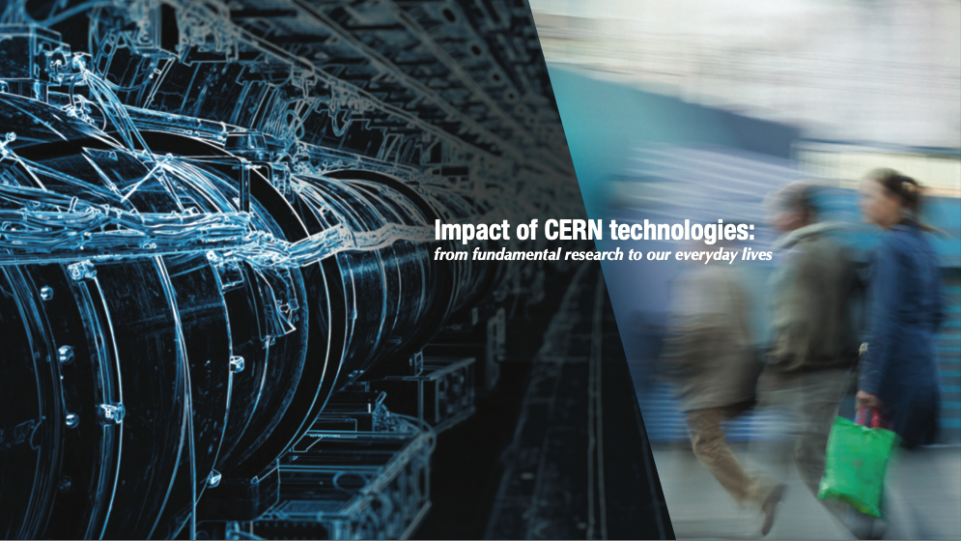
From CERN technologies to impactful innovations
Photo: CERN
Manuela Cirilli,
Medical Applications Adviser
CERN Knowledge Transfer group
Photo: CNAO treatment room

Slide 2
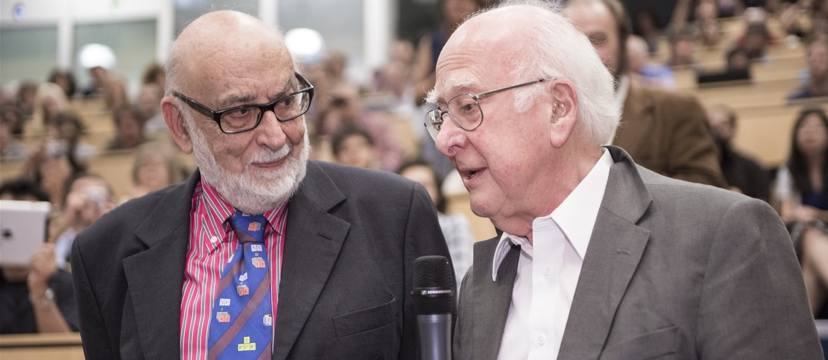
CERN: where the Higgs boson was discovered
François Englert and Peter Higgs. With Robert Brout, they proposed the mechanism in 1964.

Slide 3
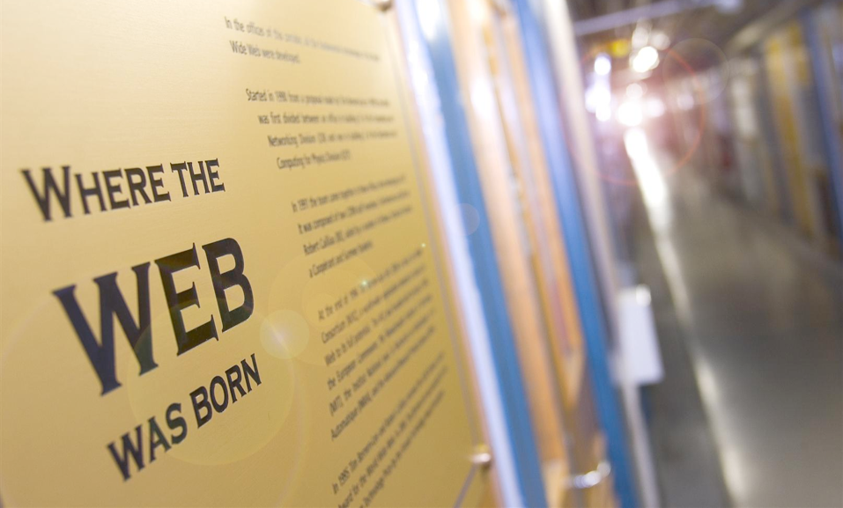

Slide 4
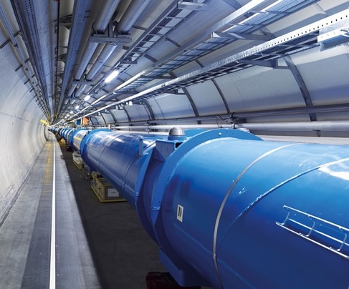
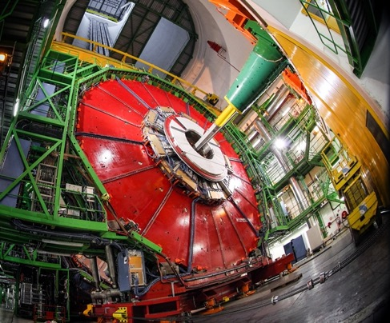
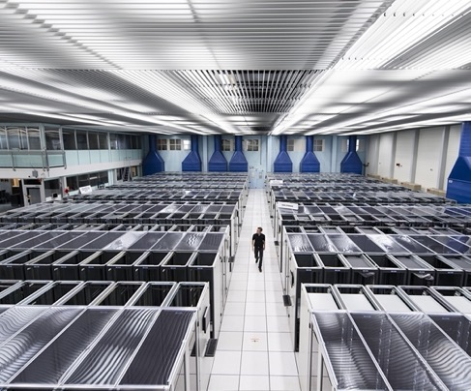
Particle physics technologies
ACCELERATORS
DETECTORS
COMPUTING

Slide 5
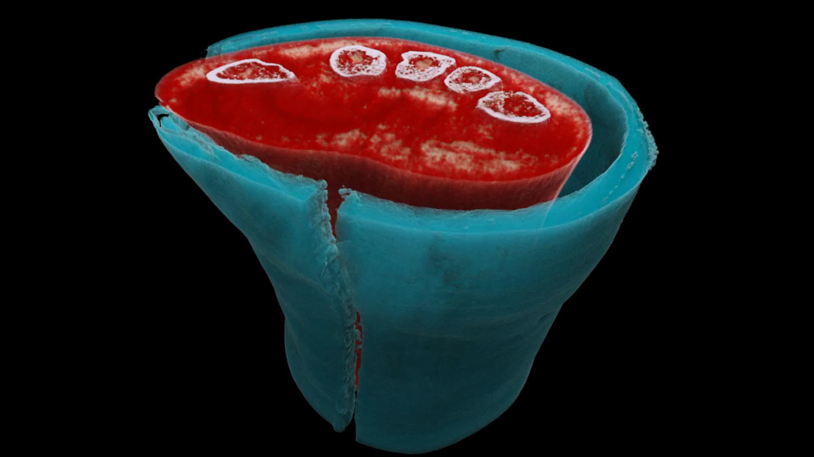



Slide 6
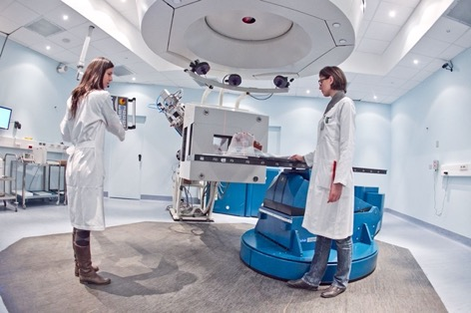
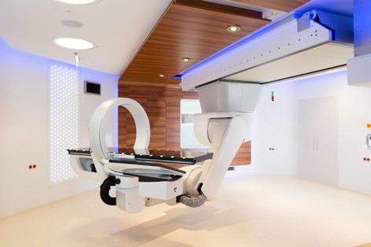


Hadron therapy: cancer radiotherapy with protons and other ions
Active since the 1990s:
- synchrotrons for C-ion therapy
- linear accelerators for innovative proton and Carbon ion therapy systems
Recent years: focus on innovative technologies for multi-ion therapy
4400 patients treated 2011-2022
1680 patients treated 2017-2022
Notes:
Hadrontherapy: a bit like drugs for rare diseases; they cost a fortune, but for a small number of people they might represent a life-death difference, or a chance to lead a normal life after treatment

Slide 7

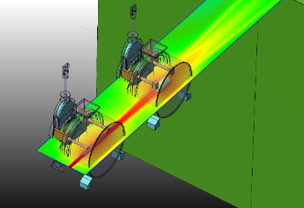
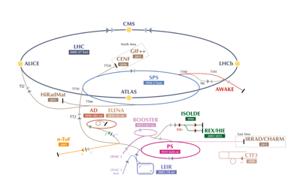
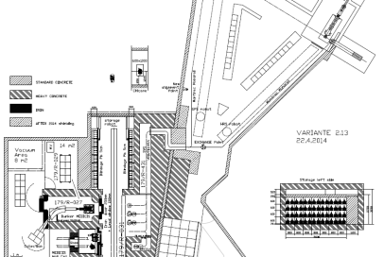
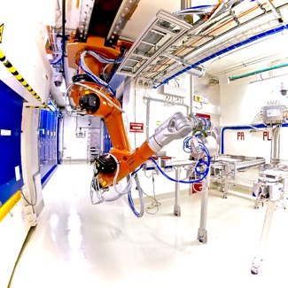
CERN-MEDICIS
Non-conventional isotopes collected by mass separation for new medical applications
MEDICIS Target Irradiation
MEDICIS
1.4 GeV protons
ISOLDE
“Free” proton beam
(otherwise lost in the dump)
Rail
Conveyor
System
MEDICIS Laboratory
Manuela.Cirilli@cern.ch
7

Slide 8
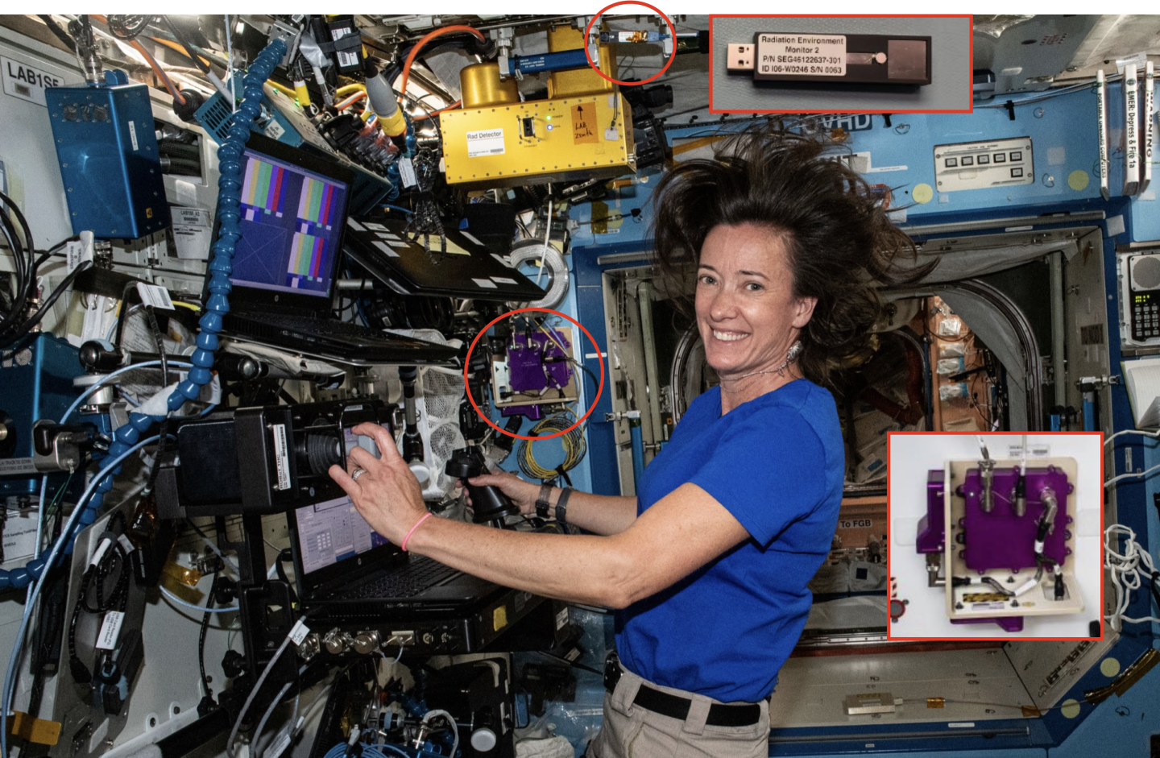
NASA astronaut Megan McArthur in the International Space Station - along with the HERA detector (Image: NASA)

Slide 9
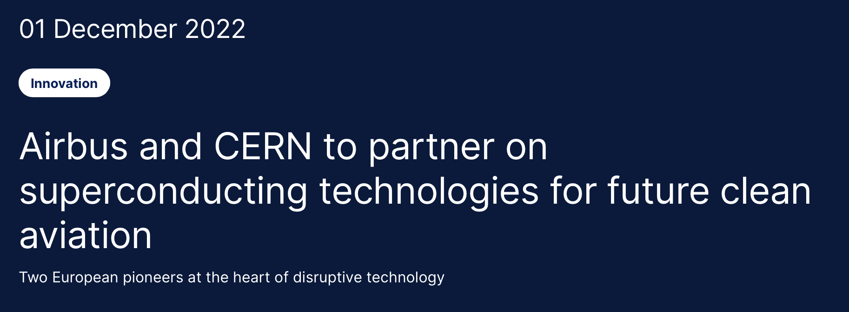
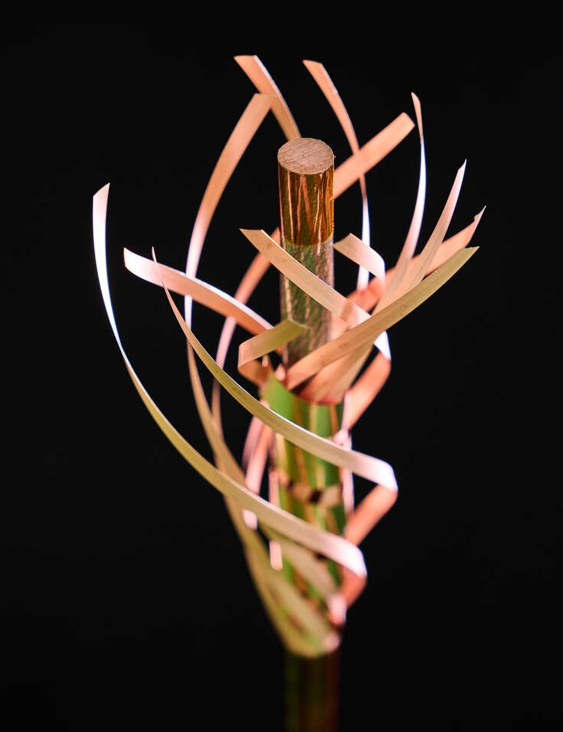
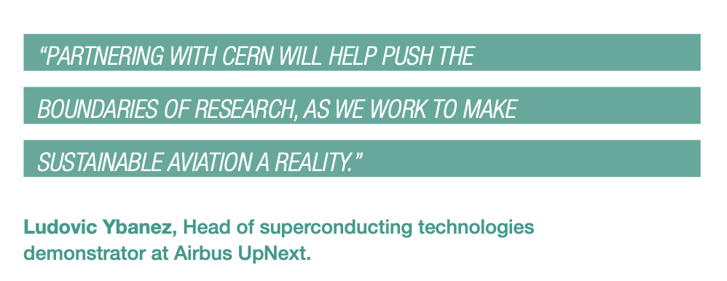
CERN and Airbus UpNext, a wholly owned subsidiary of Airbus, are exploring the potential use of superconducting technologies developed by CERN in the electrical distribution systems of future hydrogen-powered aircraft.

Slide 10
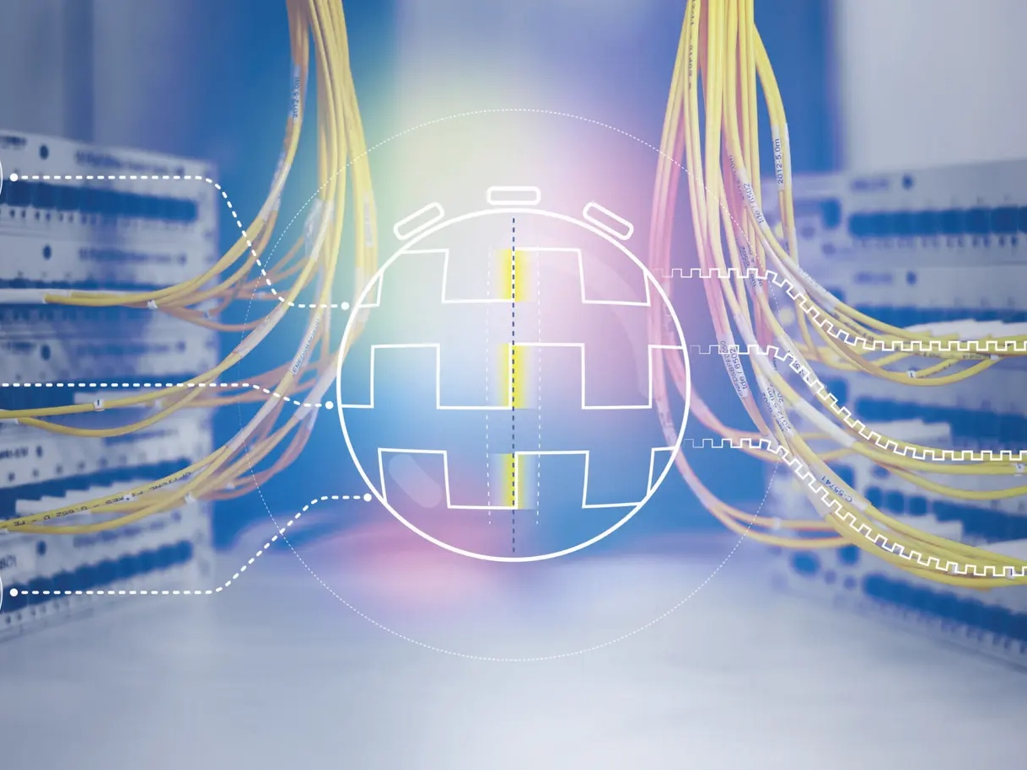
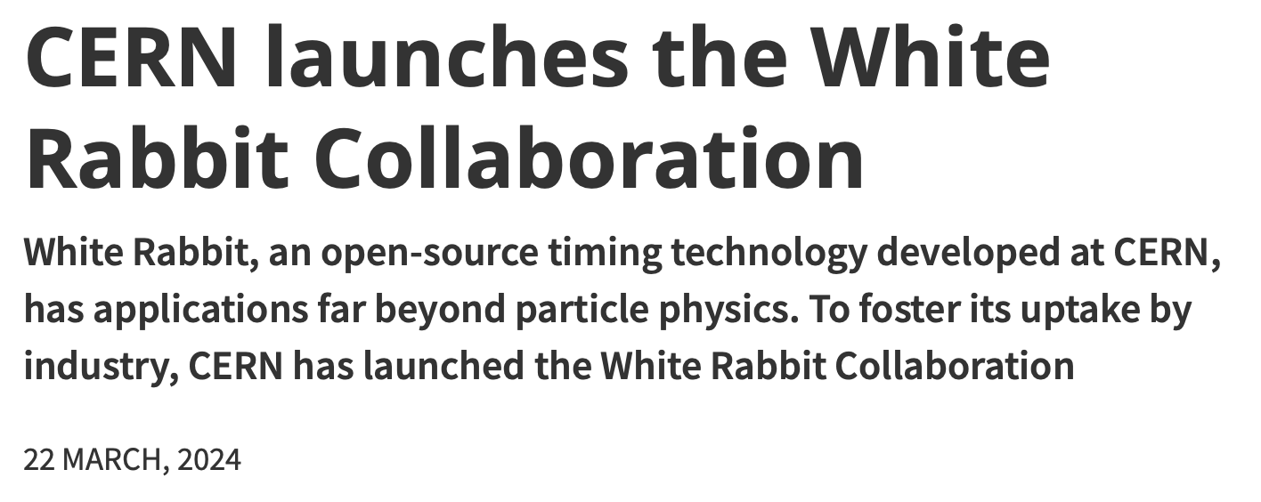
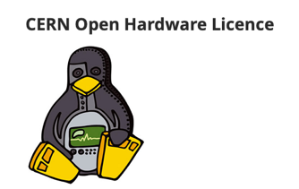
White Rabbit
A novel time- synchronisation system that offers sub-nanosecond accuracy and precision of a few picoseconds.
Fully open hardware and software
Since 2020, included in the worldwide IEEE industry standard called Precision Time Protocol (PTP)

Slide 11
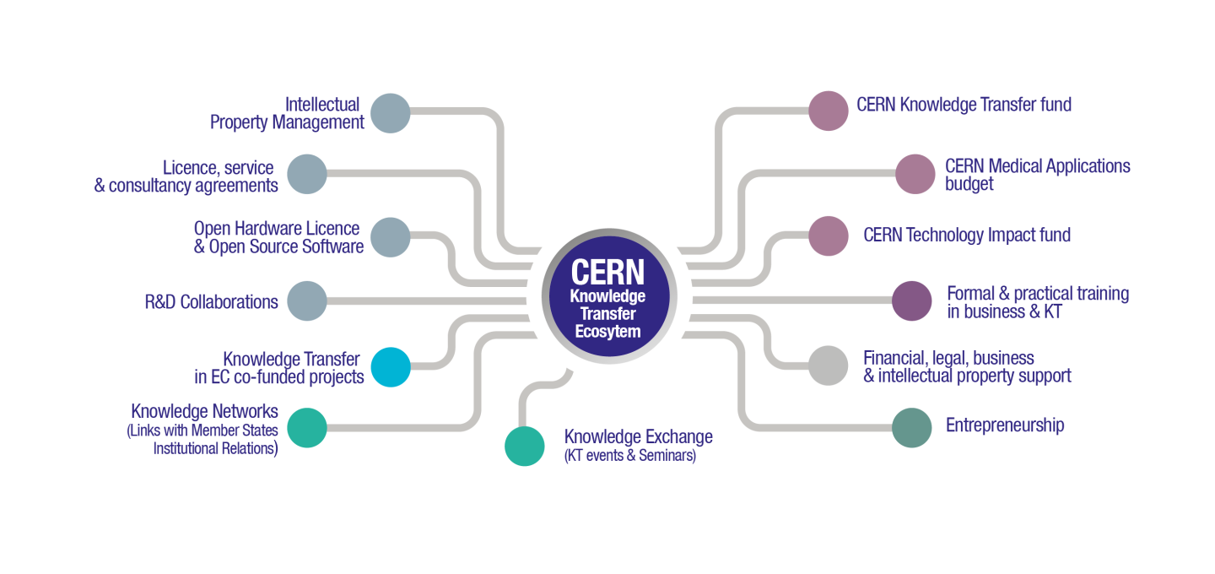

Slide 12
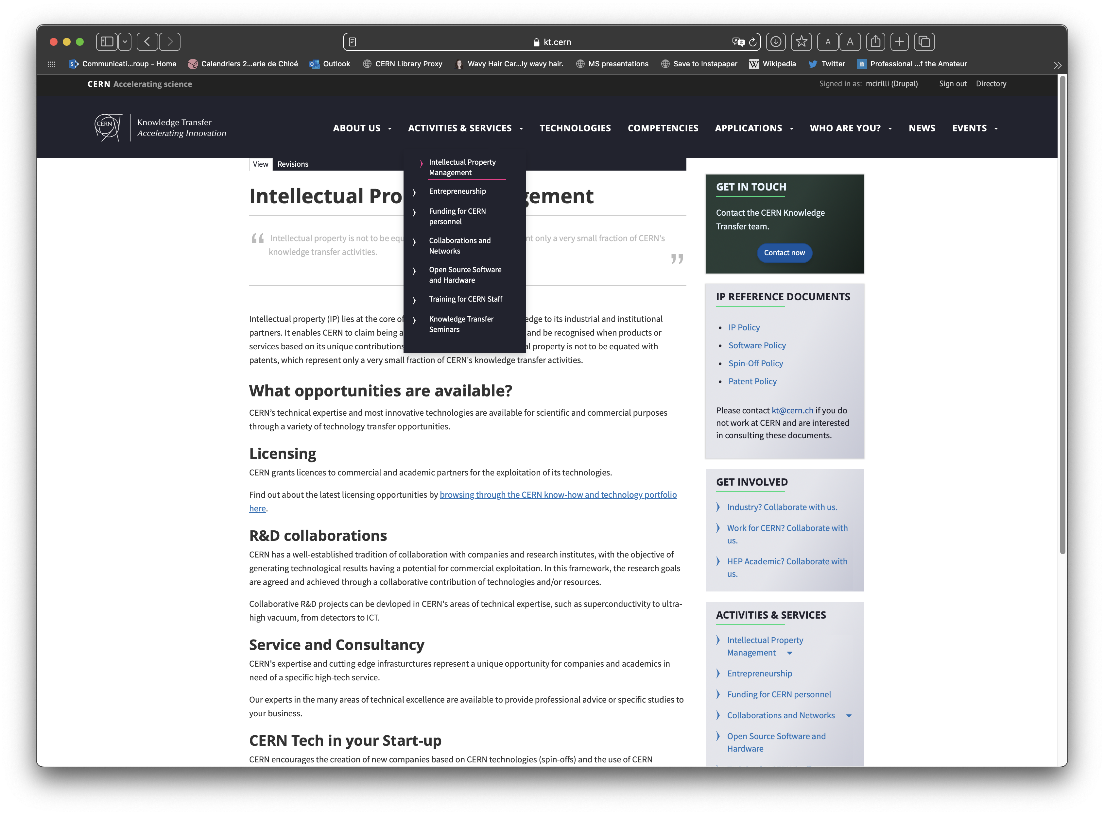
https://kt.cern/activities-services/intellectual-property-management

Slide 13
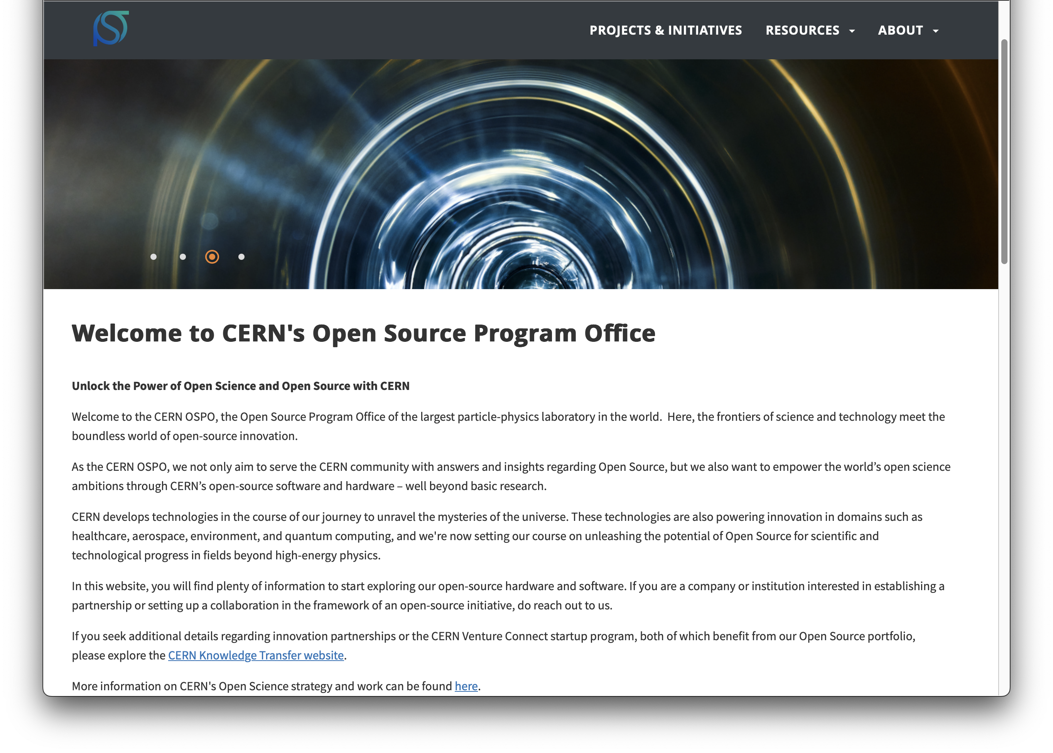

https://opensource.web.cern.ch

Slide 14
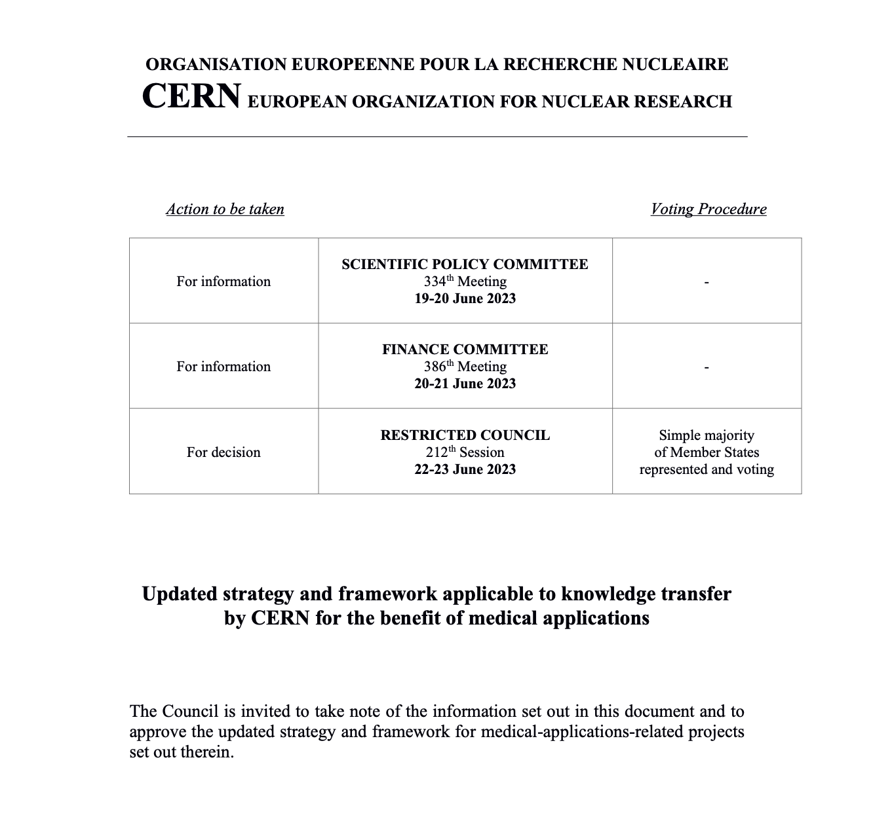
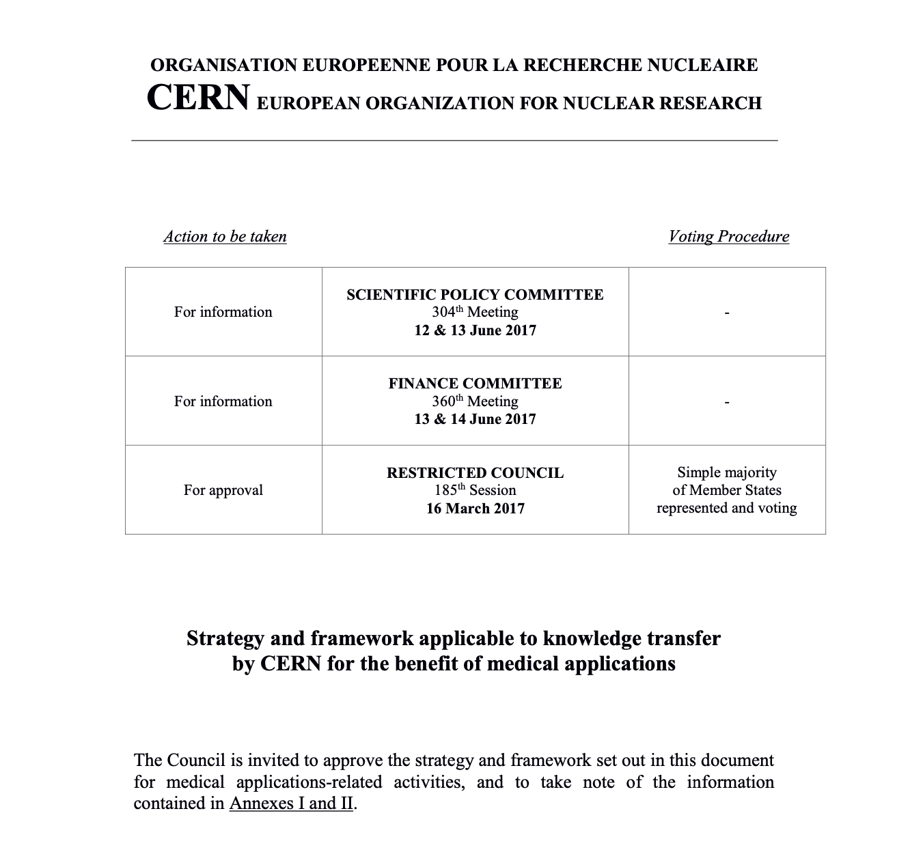
https://cds.cern.ch/record/2864317?ln=en
Notes:
The Knowledge Transfer group at CERN aims to engage with experts in science, technology and industry in order to create opportunities for the transfer of CERN’s technology and know-how.
The ultimate goal is to accelerate innovation and maximise the global positive impact of CERN on society. This is done by promoting and transferring the technological and human capital developed at CERN.
The CERN KT group promotes CERN as a centre of technological excellence, and promotes the positive impact of fundamental research organisations on society.
Additional resources:
https://kt.cern/about-us

Slide 15
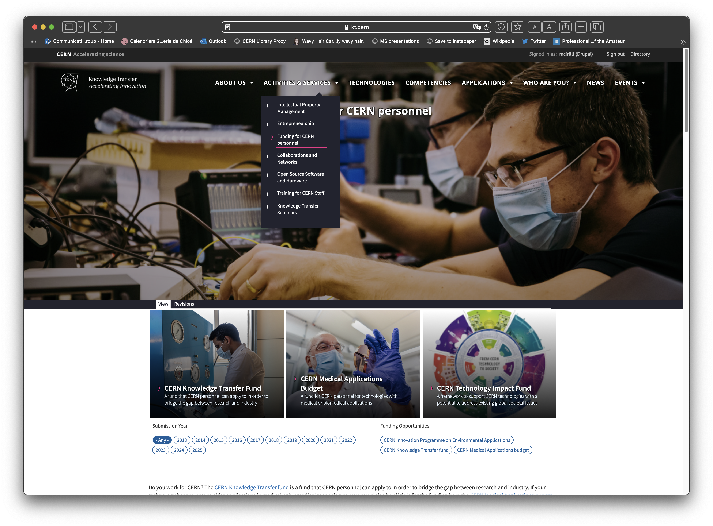
https://kt.cern/activities-services/funding-cern-personnel
Notes:
The Knowledge Transfer group at CERN aims to engage with experts in science, technology and industry in order to create opportunities for the transfer of CERN’s technology and know-how.
The ultimate goal is to accelerate innovation and maximise the global positive impact of CERN on society. This is done by promoting and transferring the technological and human capital developed at CERN.
The CERN KT group promotes CERN as a centre of technological excellence, and promotes the positive impact of fundamental research organisations on society.
Additional resources:
https://kt.cern/about-us

Slide 16





CERN Venture Connect
Connect with investors
and venture startup economy
Access breakthrough
CERN technologies
Get 0% equity,
express agreements
2% royalty only
revenues higher than 1MCHF

Slide 17
Our mission
Accelerate innovation, primarily in the CERN Member and Associate Member States, through:
identifying unmet needs and shaping innovation partnerships in selected
domains together with startups, industry and institutes
ensuring the effective transfer of its technology and know-how
to societal applications
maintaining a strong and diverse IP portfolio, and scouting for innovative and potentially disruptive technologies and know-how at CERN
enabling economic growth for startups and established businesses
increasing political support and funding opportunities for knowledge transfer activities at CERN

Slide 18
CERN Knowledge Transfer vision
Our vision is for CERN to be a world-recognised actor
in achieving a society that can collaboratively harness
basic research’s inventiveness, know-how, and technology
to tackle the most pressing global challenges
Notes:
The Knowledge Transfer group at CERN aims to engage with experts in science, technology and industry in order to create opportunities for the transfer of CERN’s technology and know-how.
The ultimate goal is to accelerate innovation and maximise the global positive impact of CERN on society. This is done by promoting and transferring the technological and human capital developed at CERN.
The CERN KT group promotes CERN as a centre of technological excellence, and promotes the positive impact of fundamental research organisations on society.
Additional resources:
https://kt.cern/about-us

Slide 19
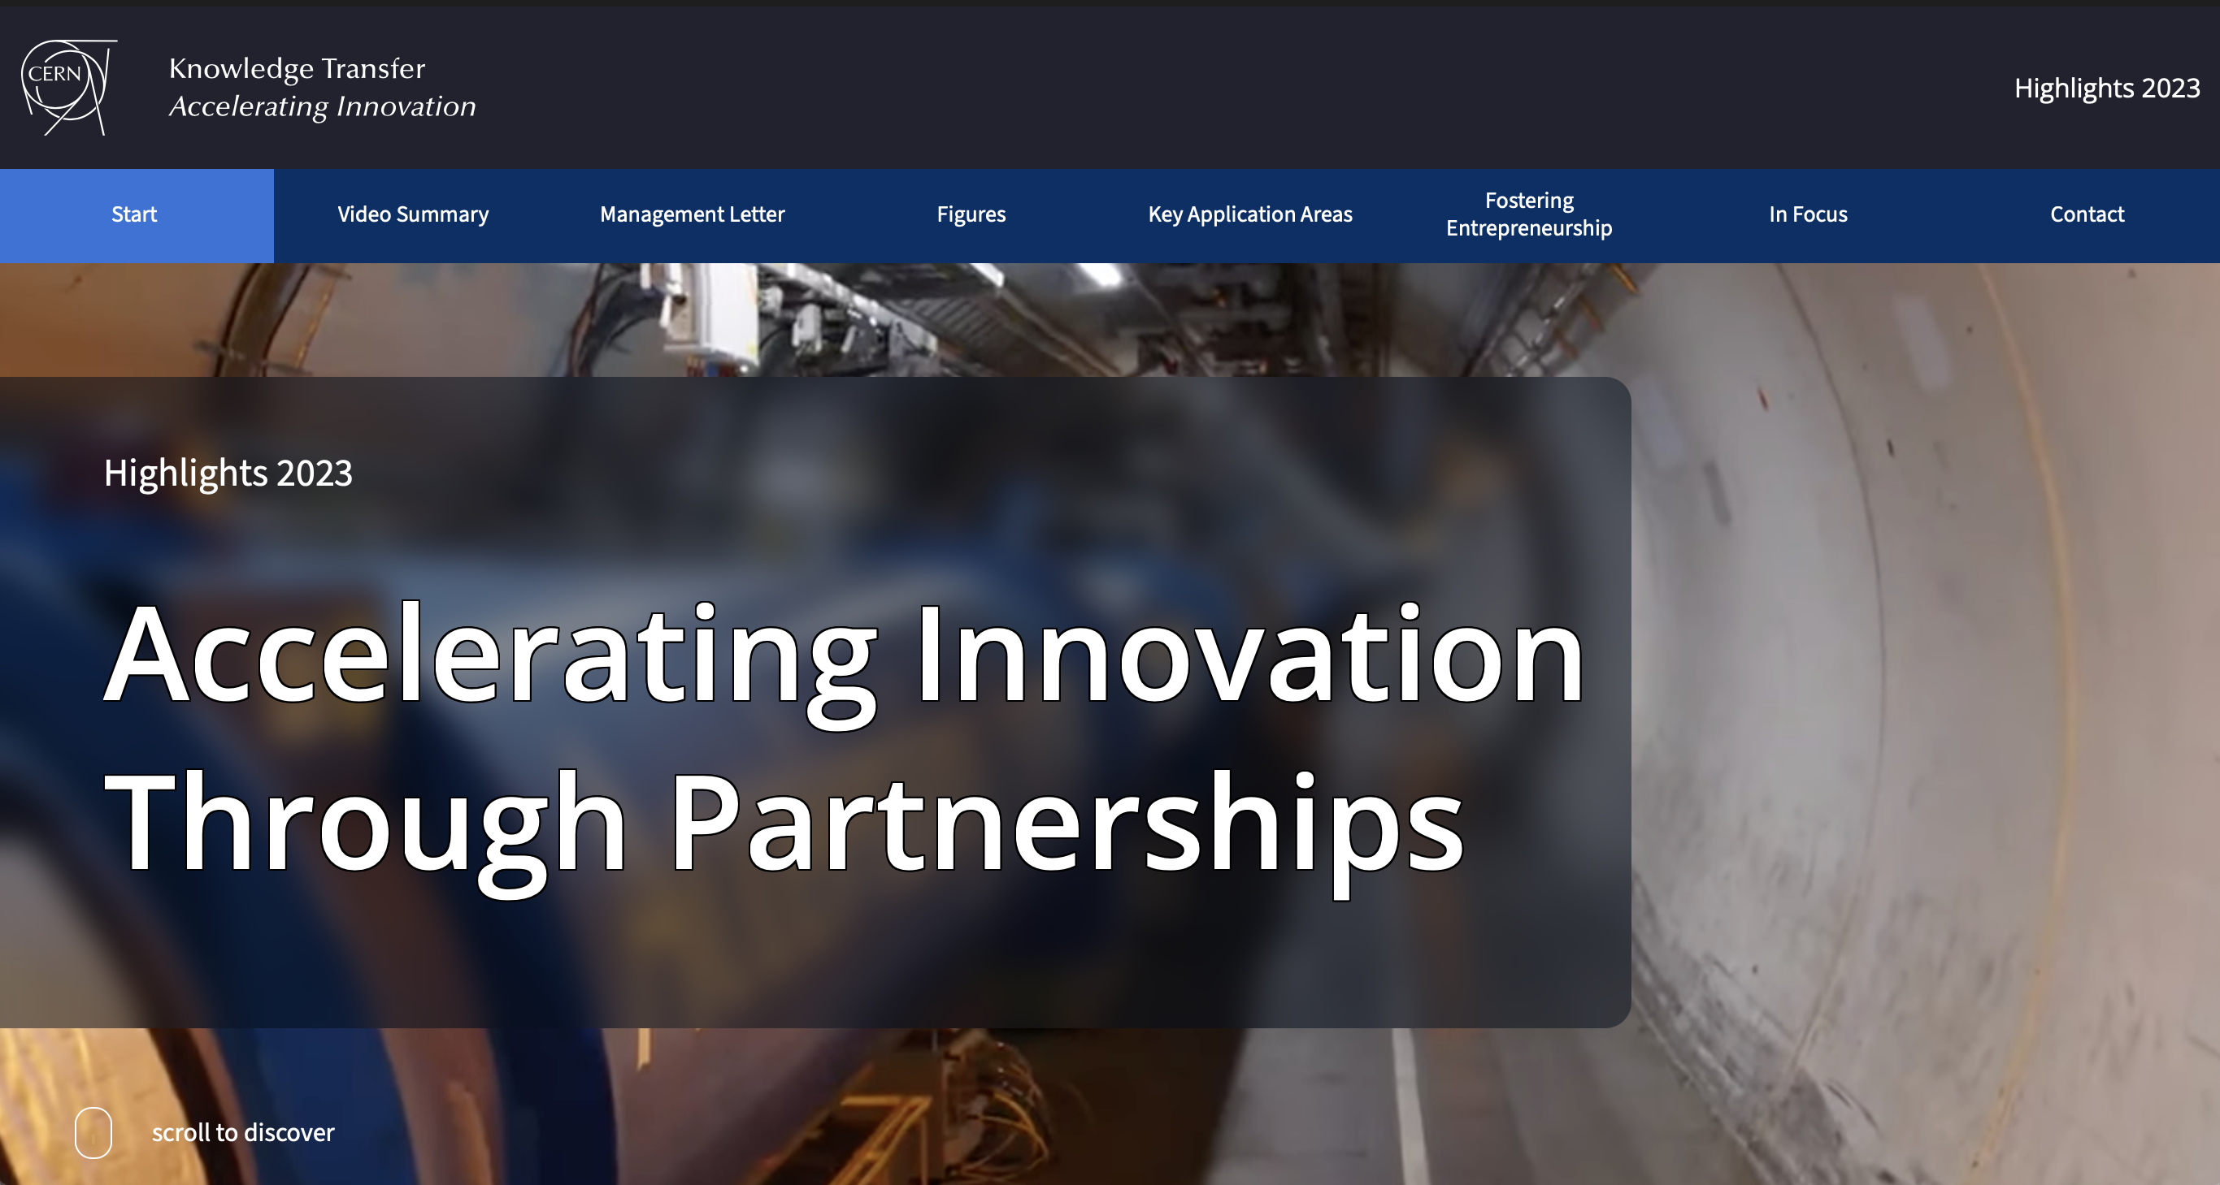
https://report2023-kt.web.cern.ch
Follow us on LinkedIn
https://www.linkedin.com/showcase/cern-innovation-partnerships/

