Slide 1
The CERN Scientific Program
A tour around the laboratory
CERN is the largest laboratory in the world for particle physics
CERN has the world’s highest energy accelerator (the LHC)
CERN has a very broad scientific program
Experimental Physics Department (EP)
Richard Hawkings, slides originally from Manfred Krammer

Slide 2
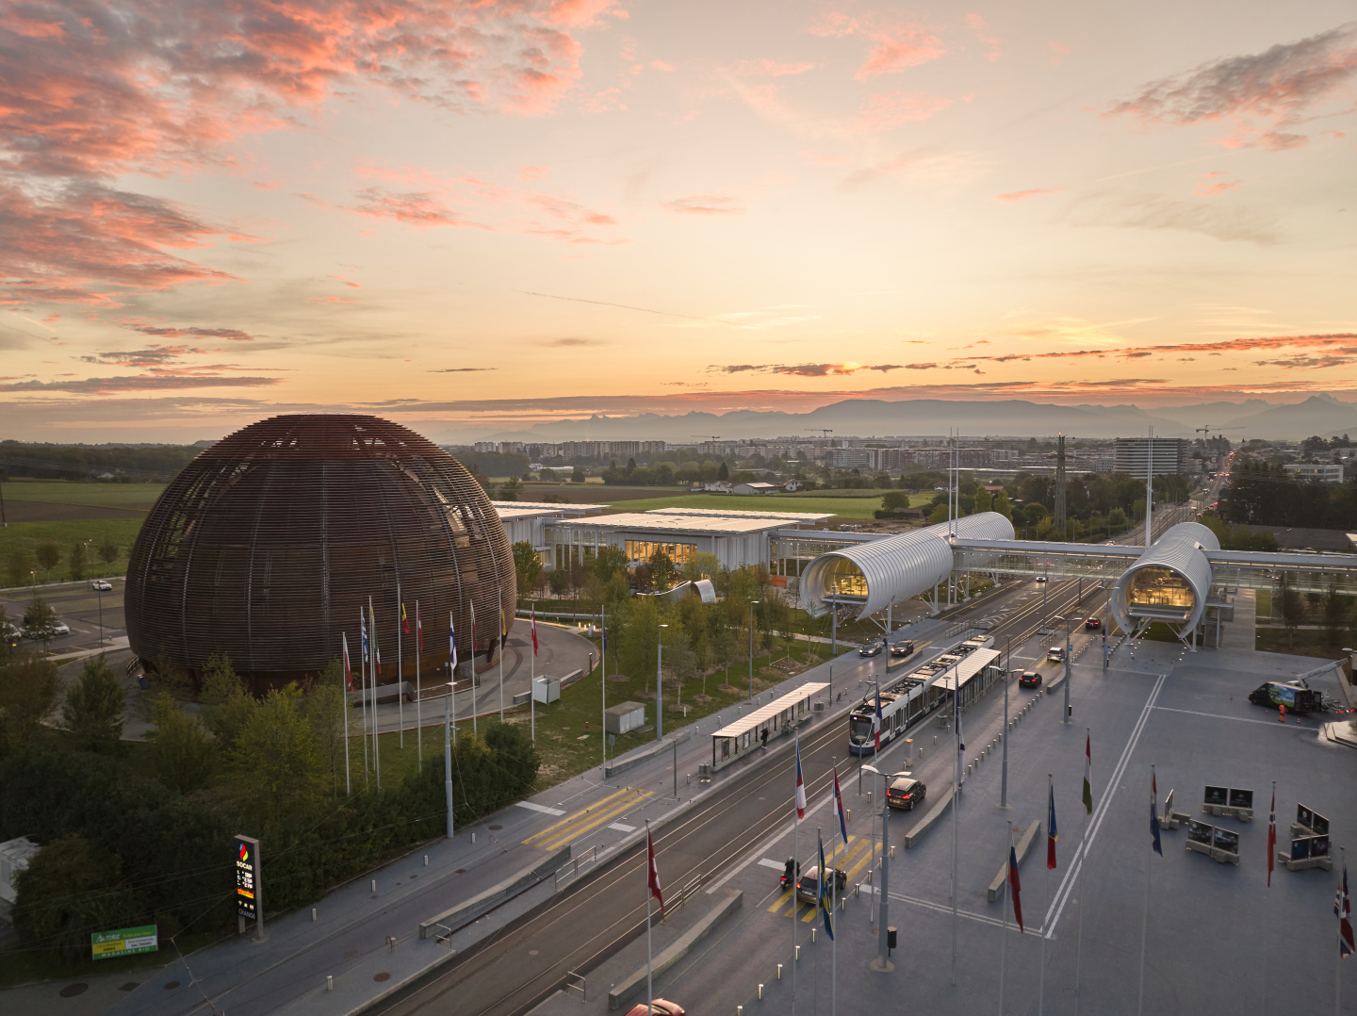

CERN was founded 1954: 12 European States
“Science for Peace”
Today: 24 Member States
Member States: Austria, Belgium, Bulgaria, Czech Republic, Denmark, Estonia, Finland, France, Germany, Greece, Hungary, Israel, Italy, Netherlands, Norway, Poland, Portugal, Romania, Serbia, Slovakia, Spain, Sweden, Switzerland, United Kingdom
Associate Member: Brazil, Croatia, Cyprus, India, Latvia, Lithuania, Pakistan, Slovenia, Turkey, Ukraine
Observers to Council: Japan, Russia (suspended), United States of America, JINR (suspended), European Commission,UNESCO
~ 2600 staff
~ 1800 other paid personnel
~ 12500 scientific users
Notes:
New background picture + CERN logo + more transparent and harmonised text boxes

Slide 3

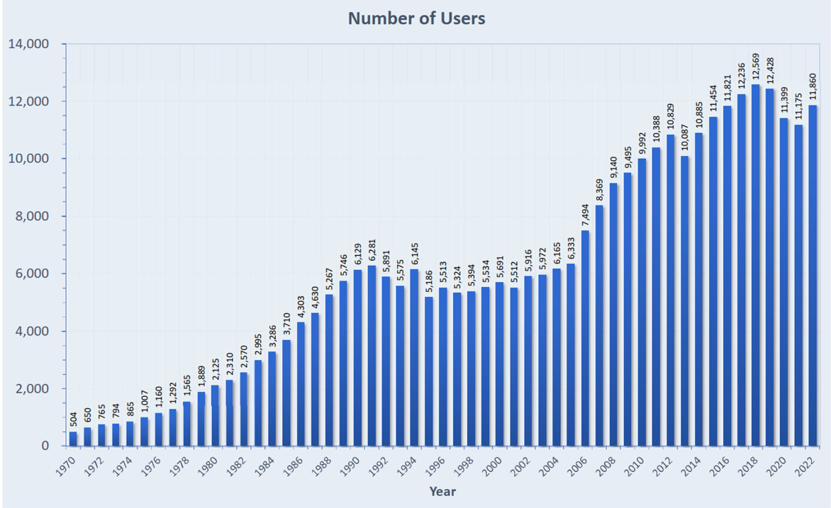
CERN attracts scientists from all over the world
Distribution of all CERN Users by the country of their home institutes as of 31 December 2023
Geographical & cultural diversity
Users of 110 nationalities
22.5 % women
Member States 7467
Austria 86 – Belgium 129 – Bulgaria 46 – Czech Republic 252
Denmark 47 – Esttonia 29 – Finland 88 – France 842 – Germany 1296 – Greece 112 – Hungary 80 – Israel 74 – Italy 1609 – Netherlands 167 Norway 77 – Poland 322 – Portugal 105 – Romania 113 – Serbia 38 – Slovakia 67 – Spain 413 – Sweden 106
Switzerland 419 – United Kingdom 950
Associate Member States
in the pre-stage to membership 40
Cyprus 14 – Slovenia 26
Associate Member States 541
Brazil 135 – Croatia 37 – India 145 – Latvia 21 – Lithuania 17 – Pakistan 30 Türkiye 129 – Ukraine 27
Observers 3005
Japan 219 – Russia (suspended) 779 – United States of America 2007
Non-Member States and Territories 1317
Algeria 2 – Argentina 16 – Armenia 16 – Australia 26 – Azerbaijan 3 – Bahrain 3 – Canada 206 – Chile 45
China 414 – Colombia 24 – Costa Rica 3 – Cuba 3 – Ecuador 4 – Egypt 24 – Georgia 34 – Hong Kong 15
Iceland 3 – Indonesia 7 – Iran 14 – Ireland 4 – Jordan 3 – Kazakhstan 3 – Kuwait 2 – Lebanon 7 – Madagascar 1
Malaysia 4 – Malta 1 – Mexico 56 – Montenegro 3 – Morocco 18 – New Zealand 2 – Nigeria 2 – Oman 1
Palestine 1 – Peru 3 – Philippines 1 – Republic of Korea 168 – Saudi Arabia 6 – South Africa 61 – Sri Lanka 10
Taiwan 52 – Thailand 17 – Tunisia 4 – United Arab Emirates 10 – Vietnam 1
Notes:
Based on VIP Presentation

Slide 4
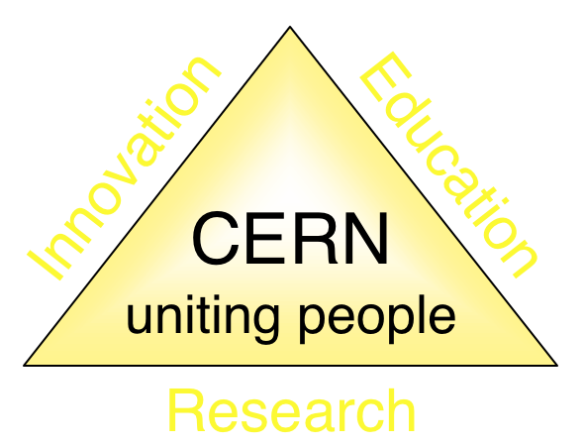
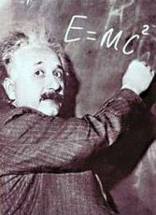
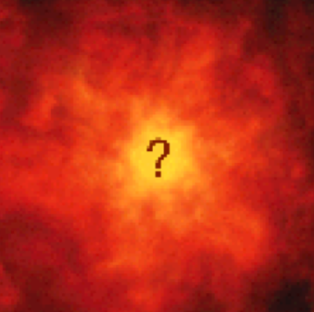


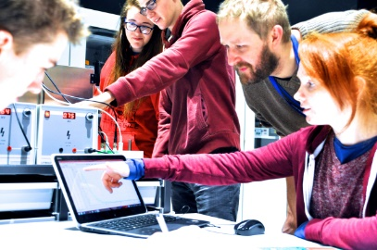

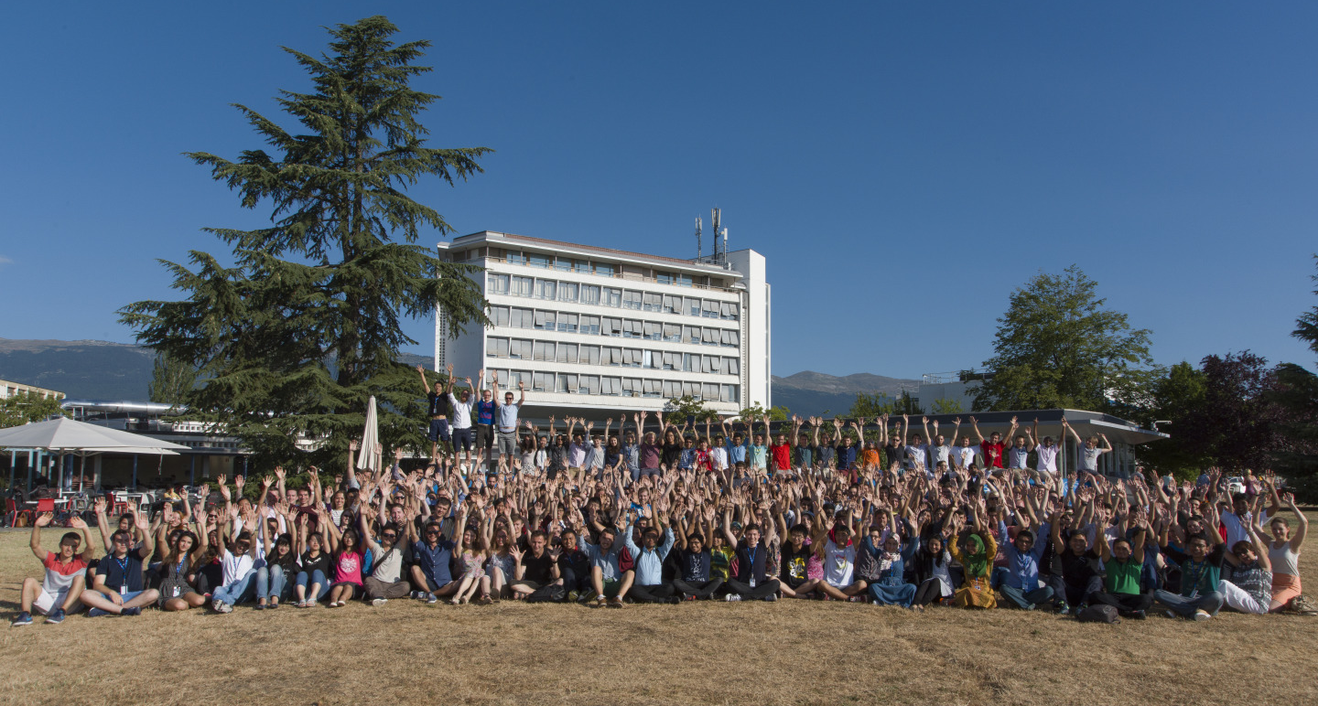
The mission of CERN
Push back the frontiers of knowledge
Studying the structure of matter on the smallest distances/highest energies… what was the matter like in the first moments of the Universe’s existence?
Develop new technologies for accelerators and detectors
Benefits for society: e.g. accelerator technology, detectors for medicine, the WWW and the GRID
Train scientists and engineers of tomorrow
Unite people from different countries
and cultures
Notes:
4

Slide 5
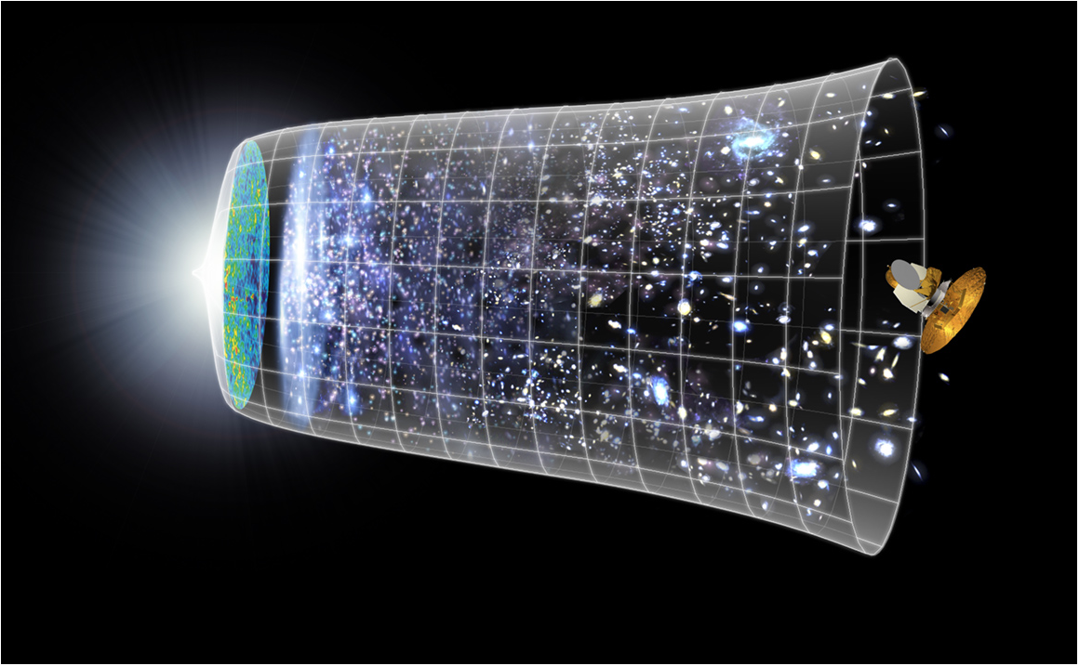
Physics at CERN:
Understanding the Universe
Big Bang
13.7 billion years
Today
10²⁸ cm
Germany and CERN | May 2009

Slide 6
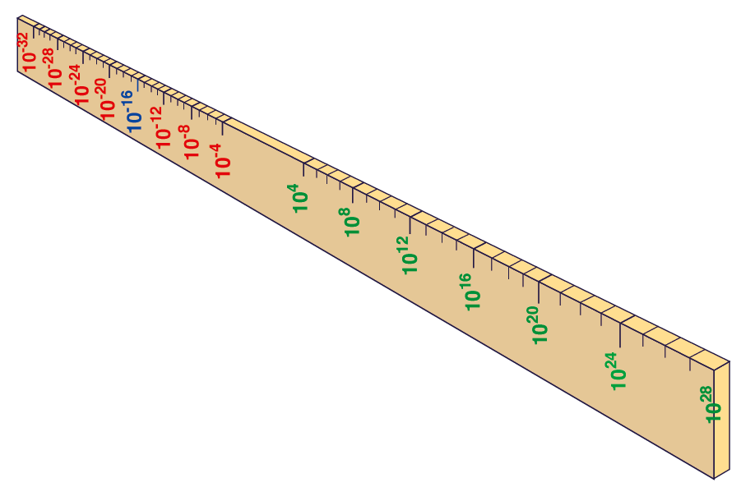
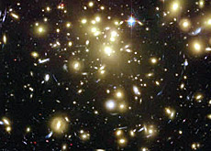


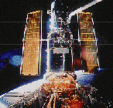

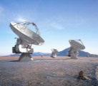

From the smallest to the largest Structures
Big Bang
Proton
Atom
Radius of Earth
Earth to Sun
LHC
Radius of Galaxies
Universe
Accelerators act as super-microscopes
cm
Study laws of physics at first moments after Big Bang
Increasing symbiosis between Particle Physics,
Astrophysics and Cosmology
Hubble
WMAP
ALMA
Germany and CERN | May 2009
VLT
Notes:
6
60 Grössenordnungen

Slide 7
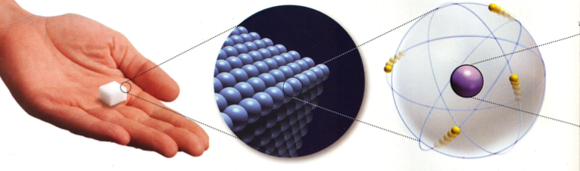
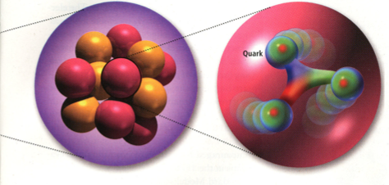
Composition of Matter
All matter built from Atoms
Atoms consist of a Nucleus and Electrons
The Nucleus consists of Neutrons and Protons
Neutrons and Protons consist of Up and Down Quarks
Fundamental Matter Particles: Electrons, Up Quarks, Down Quarks

Slide 8

The Standard Model of Particle Physics
Fermions (spin ½) quarks and leptons: the building blocks of matter
Bosons (integer spin) carry the forces: electromagnetic (Photon), weak force (W, Z) and strong force (Gluons)
Higgs Boson (spin 0), gives mass to particles
Sufficient to explain the matter around us
Plus antimatter partners of each particle.

Slide 9
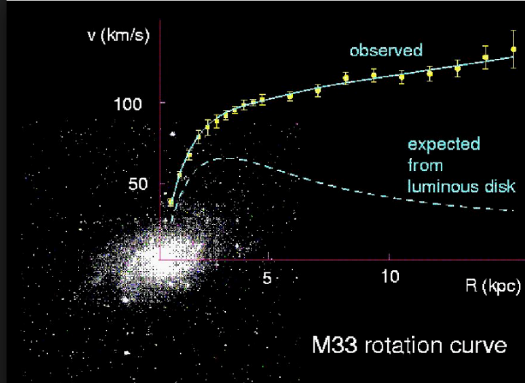
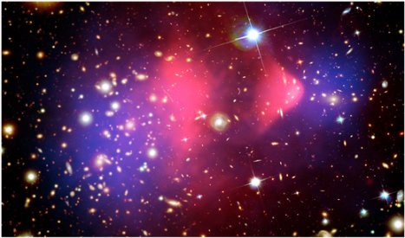
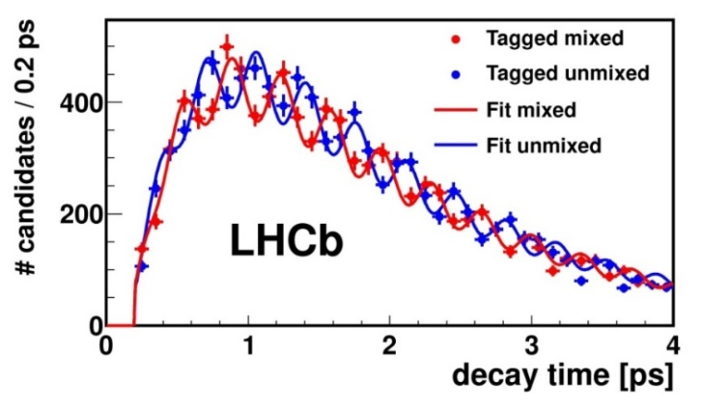
What is missing?
Several observations and mysteries point to the fact that the Standard Model is not the final theory:
Dark matter (as “seen” in Astrophysics) not explained: need new particles? 5x more dark matter than “standard” matter.
Matter Antimatter asymmetry: Why is the Universe made of matter, when matter and antimatter would be equally produced in the Big Bang?
Mass of the neutrinos not explained by the SM: 3 different “flavour” of neutrinos – changing flavour, hence have to have mass.
…
And finally, inclusion of Gravity in the final theory.
Still a lot to explore, to measure and to collect Nobel prizes!

Slide 10
Research in Particle Physics needs:
Theories
Accelerators - Engineering
Experiments - Computing
People
People
People
People

Slide 11
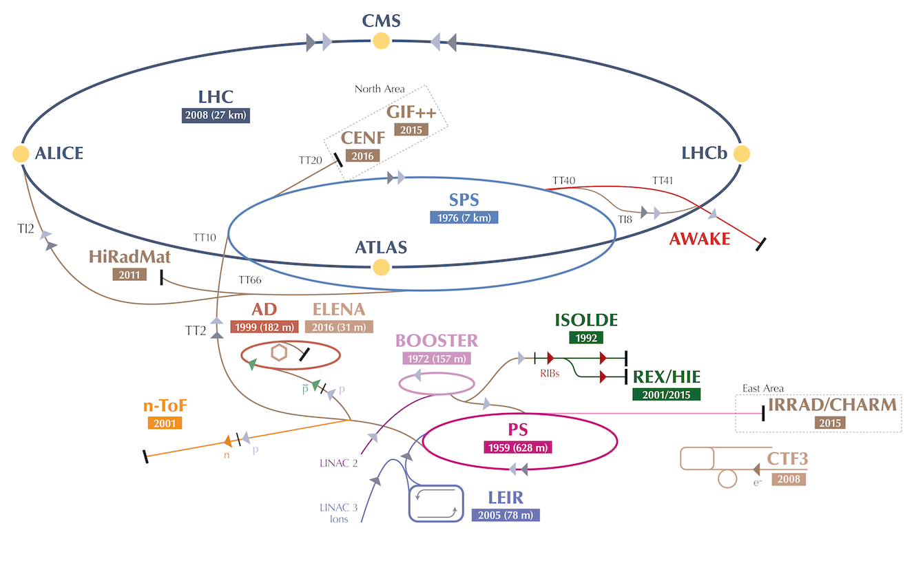

CERN Accelerators
LINAC 4

Slide 12

The Large Hadron Collider
Search for (and study!) the Higgs boson, study Standard Model particles and search for physics beyond the Standard Model
Exploration of a new energy frontier in p-p and Pb-Pb collisions

Slide 13
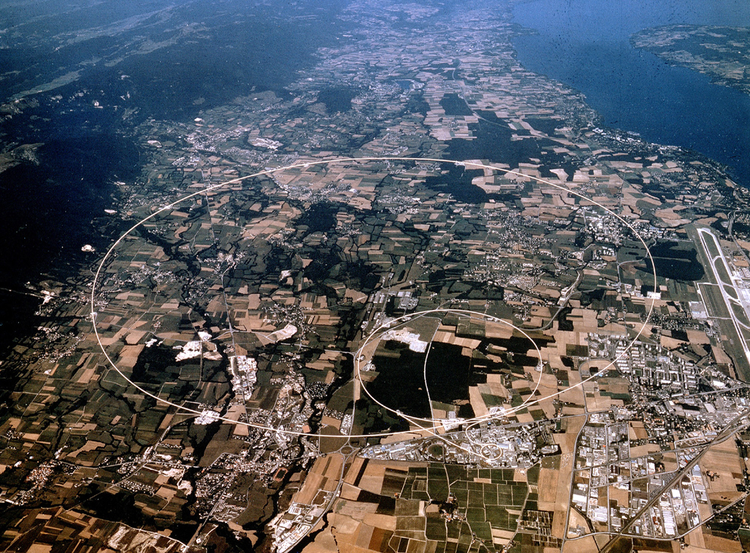
Experiments at the LHC
CMS
LHCb
ALICE
ATLAS
+ TOTEM, LHCf, MoEDAL, FASER, SND@LHC

Slide 14
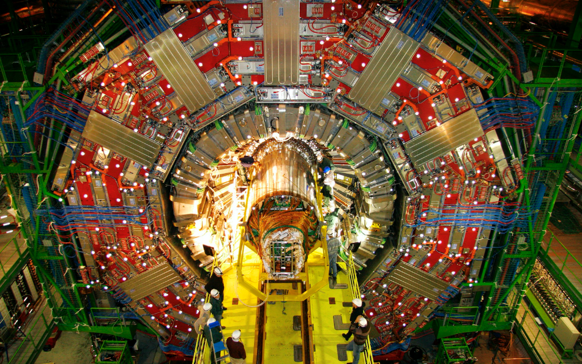

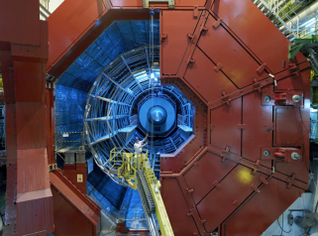
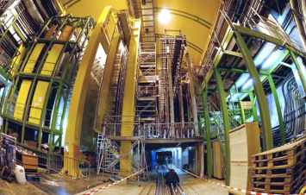
Experiments at the LHC
Four major experiments
CMS
ATLAS
ALICE
Dedicated to heavy ion physics
~ 1 month/year
Pb-Pb collisions
LHCb
Dedicated to flavour physics (b and c quarks)
Notes:
14

Slide 15
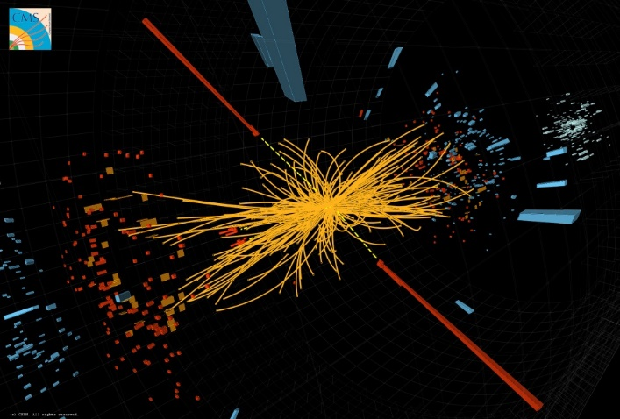
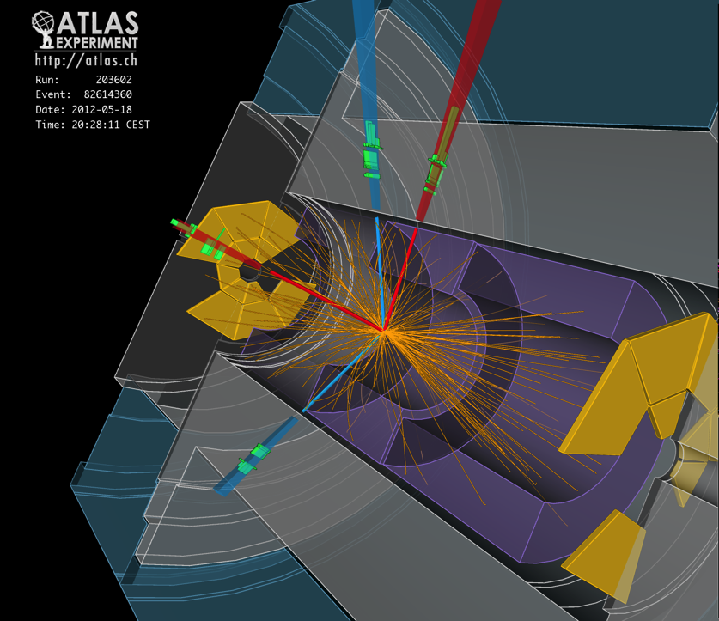
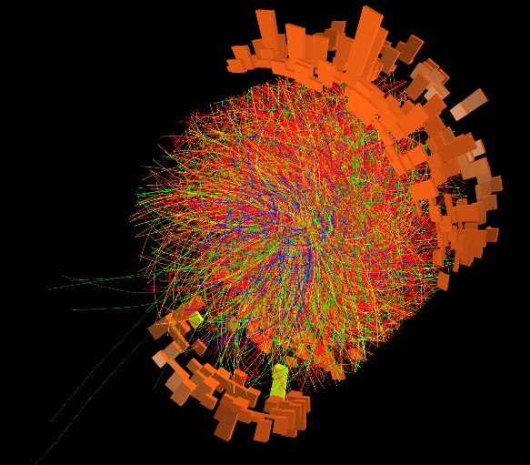
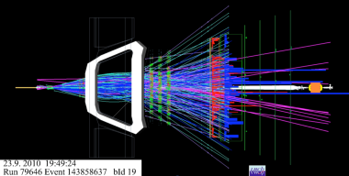


Experiments at the LHC
Brilliant performance of the LHC, the experiments and the Grid computing: Run1 2010-2012: E_{cm} = 7– 8 TeV Run2 2015-2018: E_{cm} = 13 TeV
Run3 started on 5/7/2022: E_{cm} = 13.6 TeV, and will continue until end June 2026
HL-LHC operation approved until 2041
CMS
ATLAS
ALICE
LHCb

Slide 16

H ➔γγ
candidate

Slide 17
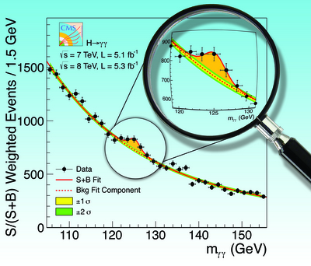
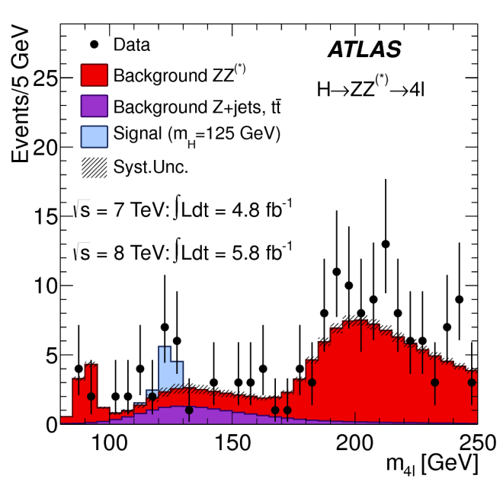

July 2012: “ATLAS and CMS observe a new particle compatible with the Higgs Boson”

Slide 18
CERN is not only the LHC !

Slide 19
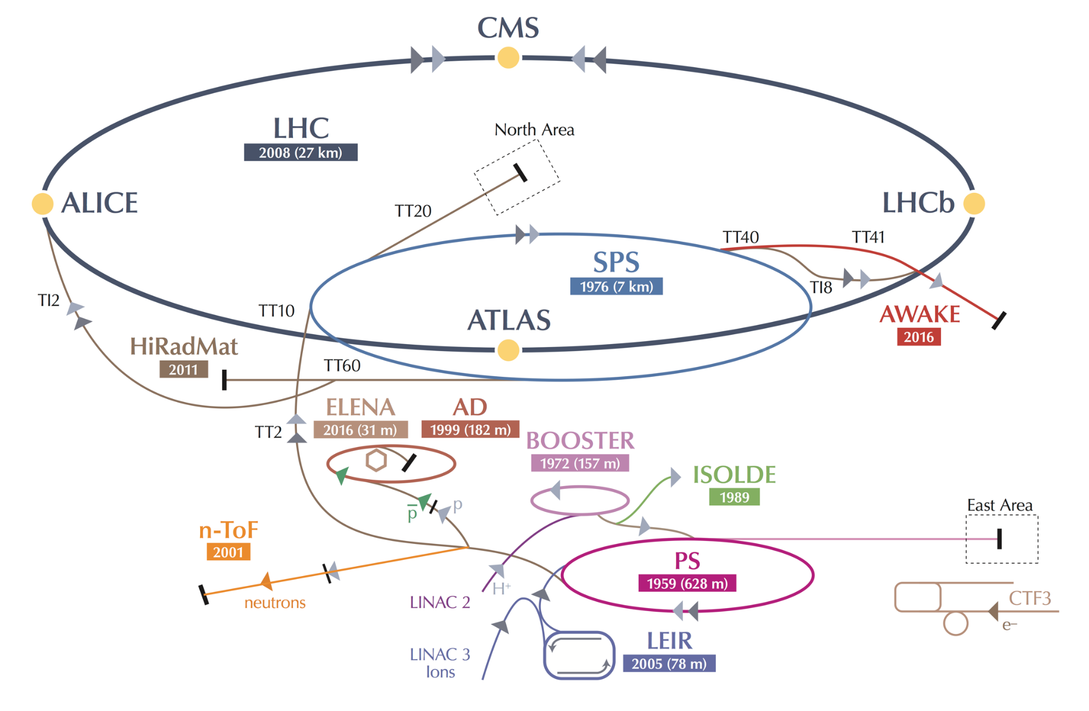
SPS: Injector for the LHC and accelerator for experiments in the North Area
In CERN Prévessin
LINAC 4

Slide 20
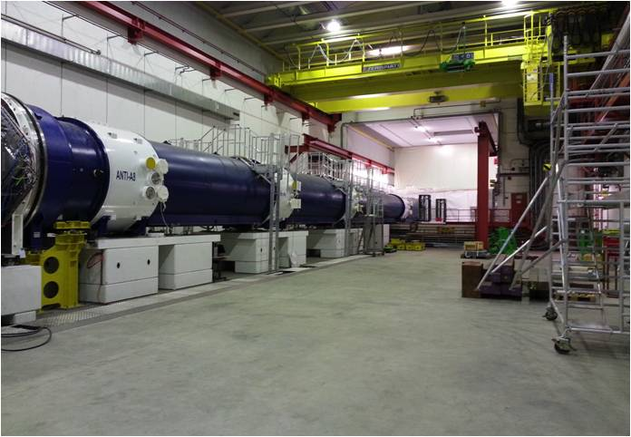
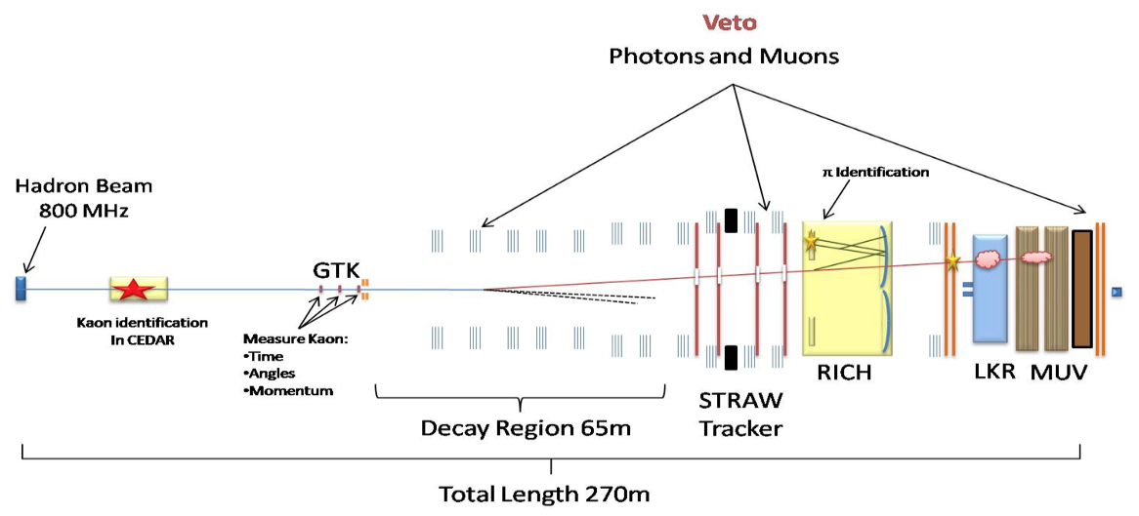
Fixed Target Physics
Lower energy experiments at PS or SPS (in 1 - 400 GeV range) allow precision measurements and comparison with theory. Deviations can be sign of new physics at higher energies.
5 current experiments:
NA61 (SHINE): strong interaction, quark gluon plasma, neutrino and cosmic ray program
NA62: rare K decays BR(K⁺ → π⁺νν) ≈ 1 10⁻¹⁰
NA63: electromagnetic processes in strong crystalline fields
NA64: search for dark sectors in missing energy events
NA66 (AMBER): proton radius, antiproton production, pion/kaon structure
-
Example NA62:
COMPASS in North Hall
(60 m long)

Slide 21
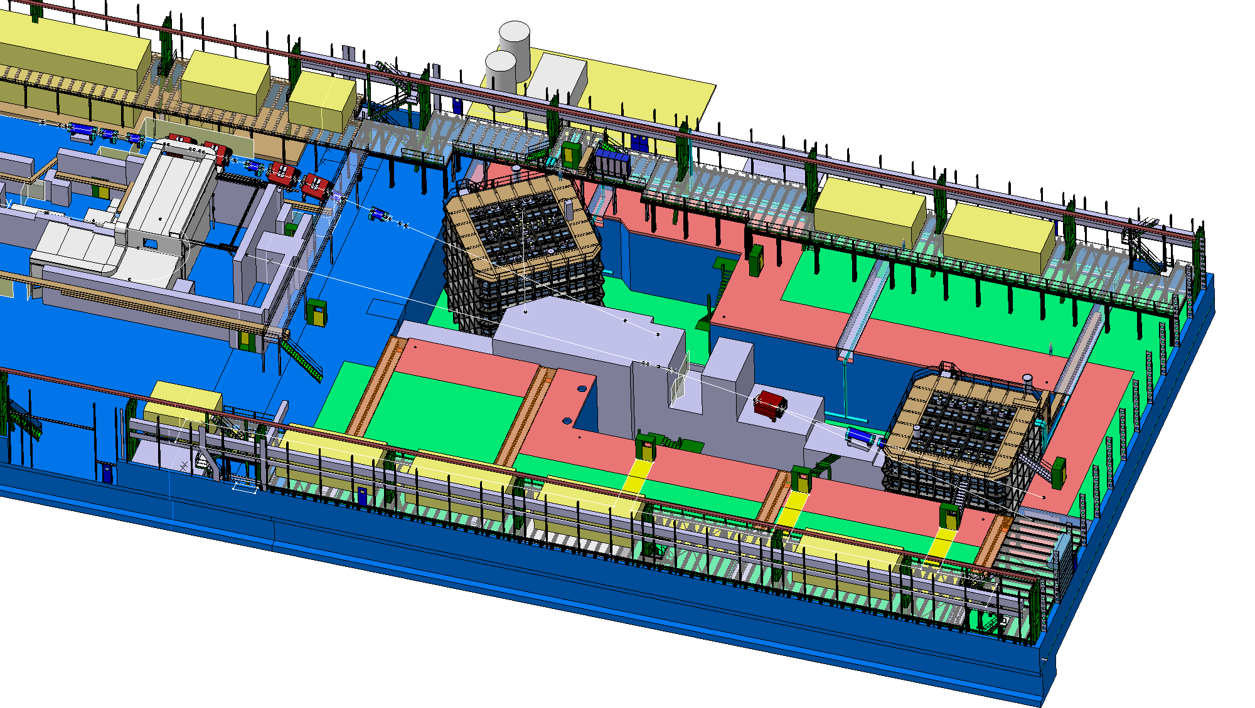
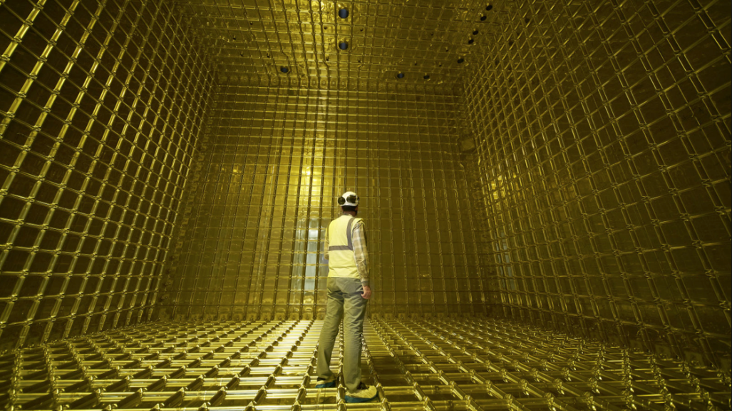
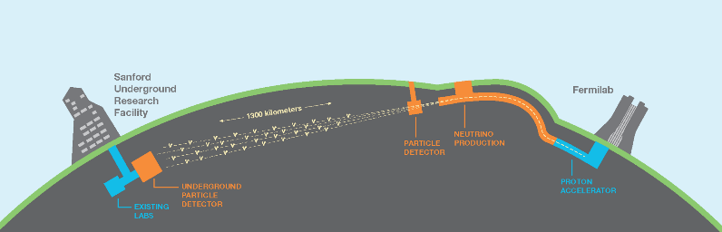
Neutrino Platform (extension of North Area)
Like quarks, neutrinos exist in different flavors ν_{e} ν_{μ} ν_{τ}
but their flavour oscillates ν_{μ}⇔ ν_{τ} ν_{μ}⇔ ν_{e}
Has been studied with ν_{μ} beam sent from CERN to Gran Sasso in Italy (CNGS).
Neutrino platform as a test area with charged beams for neutrino detectors (e.g. R&D for large liquid argon detectors). The experiments will take place in the US and Japan.
LBNF/DUNE in the US:

Slide 22
ISOLDE and nTOF
LINAC 4

Slide 23
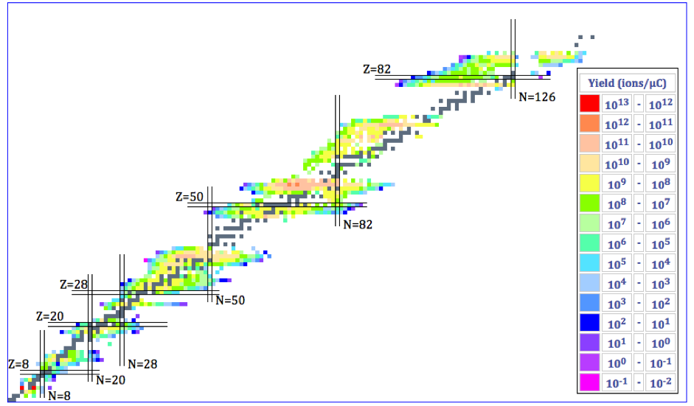
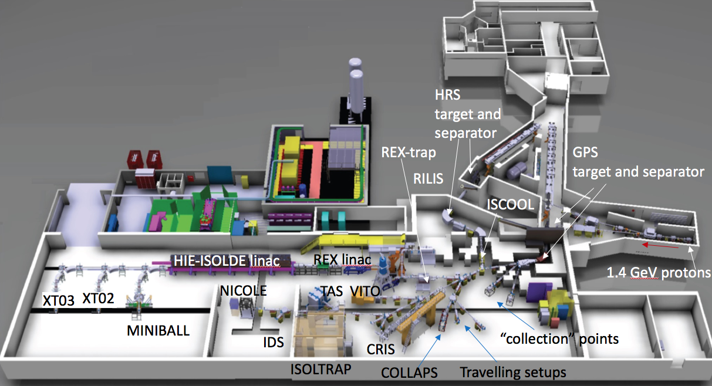
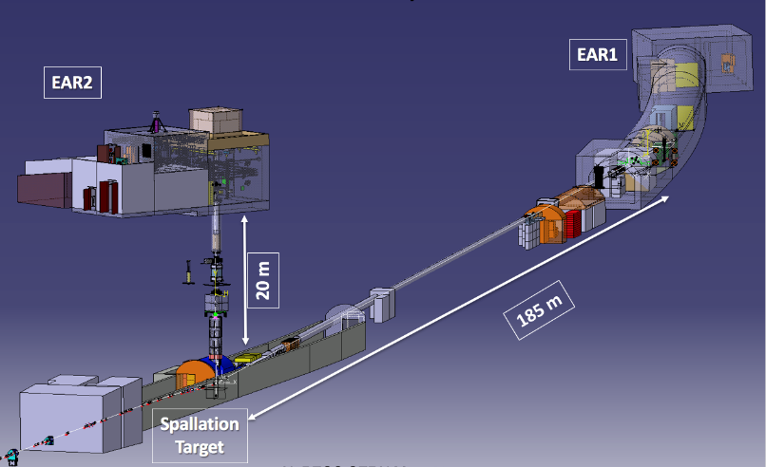
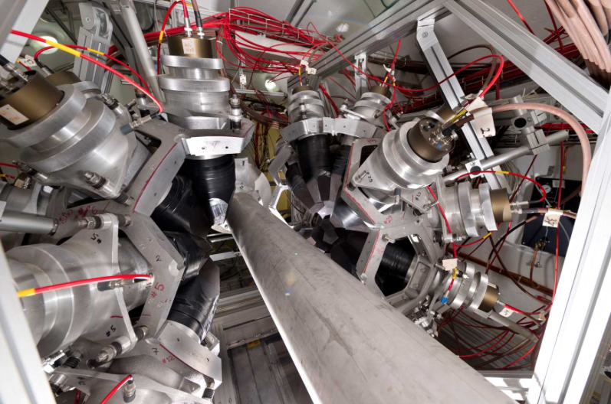
Nuclear Physics: ISOLDE & nTOF
ISOLDE: radioactive ion beams
1000 nuclides of over 75 elements produced, about 50 experiments every year
Nuclear physics
Fundamental interactions
Nuclear Astrophysics
Applications (Medicine, Material Science)
MEDICIS
Over 20 Target materials:
carbides, oxides, solid metals, molten metals
and molten salts (U, Ta, Zr, Y, Ti, Si, …)
3 types of ion sources: surface, plasma, laser
HIE-ISOLDE (post acceleration up to 10 MeV/nucleon)
nTOF (neutron time-of-flight)
Neutron cross-section measurements
Astrophysics
Nuclear Physics
Medical Applications
Nuclear Waste Transmutation

Slide 24
Antiproton & Antihydrogen Physics

Slide 25
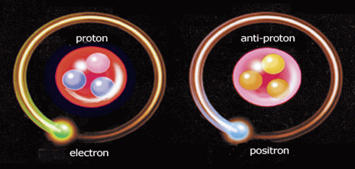
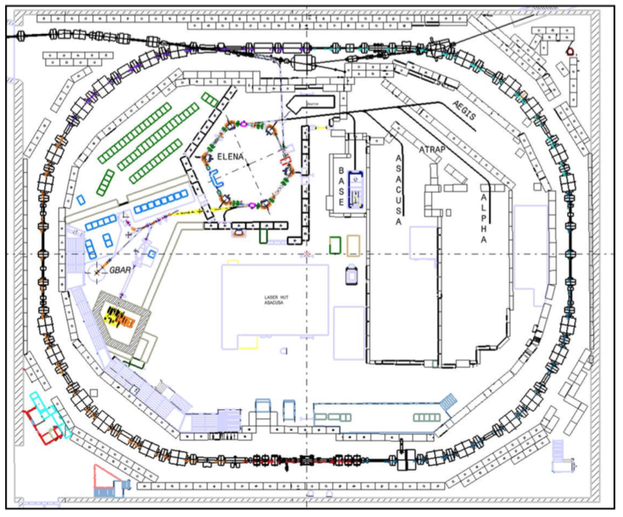
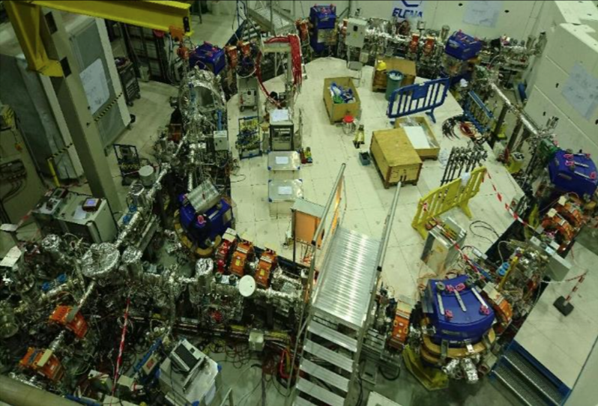
Antiproton & Antihydrogen Physics
Matter-Antimatter comparison
Test CPT invariance, the most fundamental Symmetry in relativistic quantum field theory
Test of the Weak Equivalence Principle by measuring the gravitational behavior of antimatter
Measurements of antihydrogen and related systems: antiprotonic helium, positronium, protonium
The Antiproton Decelerator (AD): antiprotons at 5.3 MeV
ELENA
H
H
ELENA (Extra Low Energy Antiprotons)
Reduces energy of antiprotons to 100 keV
→10-100 x larger trapping efficiency
→ Parallel running of experiments

Slide 26
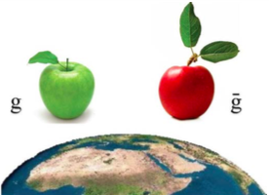
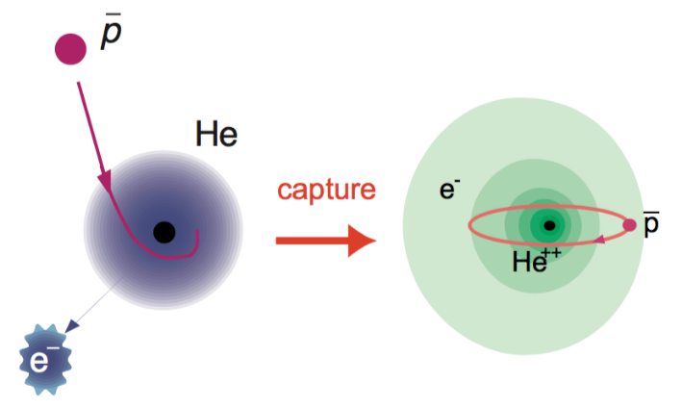
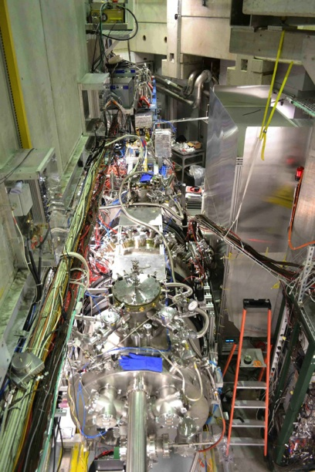
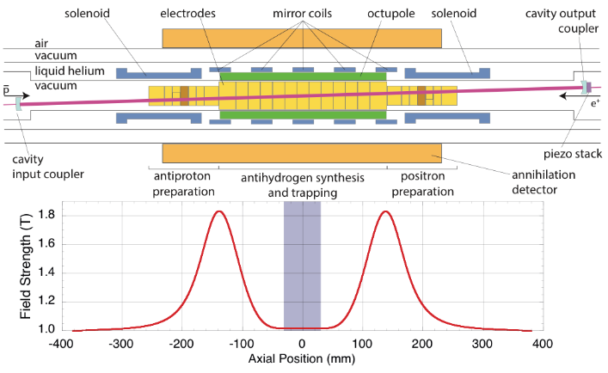
Antiproton & Antihydrogen Physics
Matter-Antimatter comparison
Fundamental in the current theory
of physics: m = m, g = g
6 experiments:
ASACUSA spectroscopy of exotic atoms
(antiprotonic Helium), and nuclear
collision cross section
BASE magnetic moment of the antiproton
ALPHA/ALPHA-g spectroscopy and gravity
AEgIS spectroscopy, antimatter gravity
experiment
GBAR antimatter gravity experiment
PUMA transporting antiprotons from the AD to ISOLDE
ASACUSA
AEgIS
AEgIS
PUMA
New! Approved in March 2021
ALPHA

Slide 27
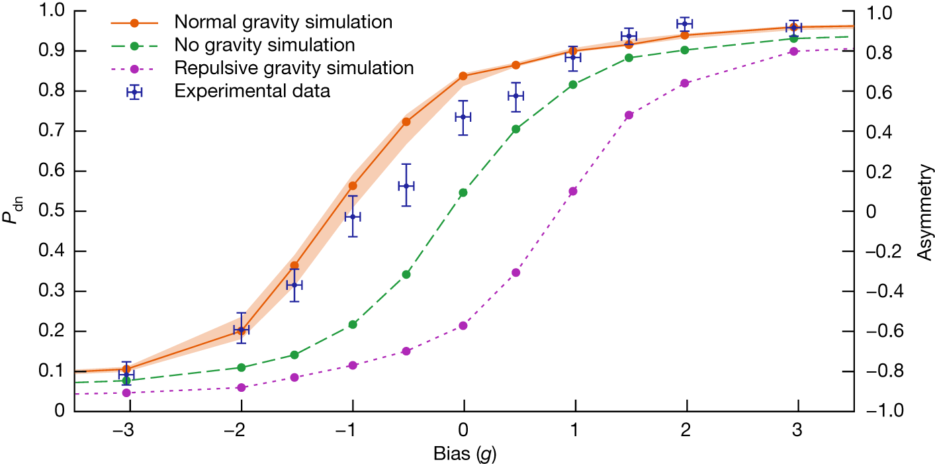
Antiproton & Antihydrogen Physics
Matter-Antimatter comparison
Fundamental in the current theory
of physics: m = m, g = g
ALPHA-g: gravity on antihydrogen
Form antihydrogen, trap in vertical trap
Release from trap – how many atoms fall up/down?
Measure as a function of a magnetic bias simulating gravity
6 experiments:
ASACUSA spectroscopy of exotic atoms
(antiprotonic Helium), and nuclear
collision cross section
BASE magnetic moment of the antiproton
ALPHA/ALPHA-g spectroscopy and gravity
AEgIS spectroscopy, antimatter gravity
experiment
GBAR antimatter gravity experiment
PUMA transporting antiprotons from the AD to ISOLDE
Nature 621 (2023) 716
g_{antimatter} = (0.75 ± 0.13 ±0.16) g_{matter}
ALPHA
Antimatter falls down !

Slide 28
PS East Hall
LINAC 4

Slide 29
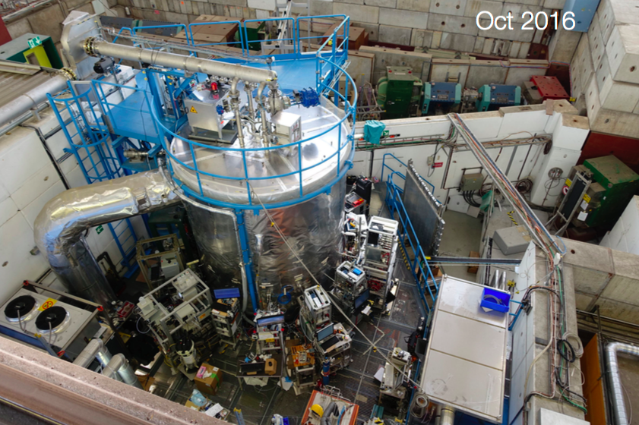
Environmental Physics
CLOUD - Study effect of cosmic rays on cloud formation
Clouds created in a large climatic chamber
Study influence of natural and man made aerosols on the development of clouds, cosmic rays “simulated” by PS beam,
CLOUD breakthroughs:
Cloud formation was higher
than expected in pre-industrial times and influenced by cosmic rays.
Result important to reduce uncertainties climate model.
CLOUD continues to study atmospheric physics (e.g. effect of aerosols)

Slide 30
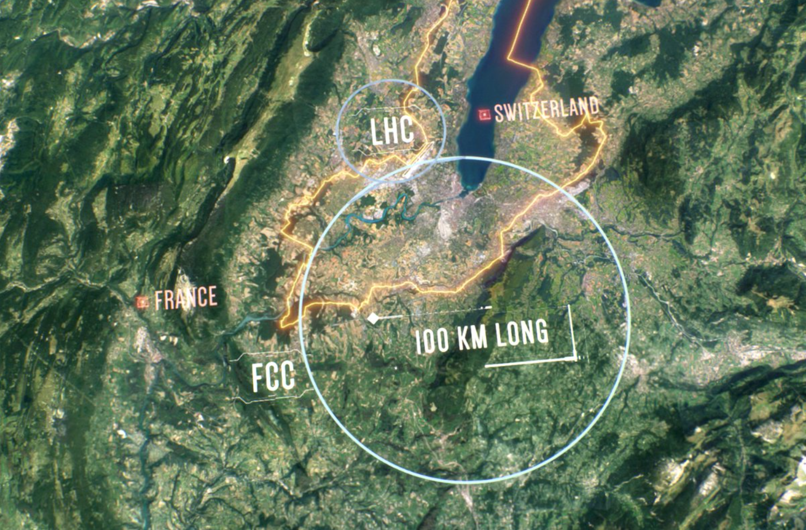
Future accelerators and experiments at CERN
LHC, and its upgrade to higher luminosity,
is central to CERN program for next decade(s)
But need to prepare for what will come after.
Following the Update of the European Strategy for Particle Physics in June 2020, continue with two studies:
FCC – Future Circular Collider
Feasibility study for a ~100 km circumference machine
Possible first stage as an e⁺e⁻ collider (90-365 GeV, Higgs factory) followed by a pp collider at >100 TeV.
Physics beyond Colliders
Study to explore possibilities using the
non-collider part of the CERN accelerator
complex

Slide 31
Summary
  The CERN scientific program is:
  Rich and diverse
  Covers a wide range of energies from atomic physics to the highest energy frontier
  Strong in transfer of technology, education and relevance to issues in wider society (information, health, climate, energy, …)
  CERN’s success is built on its personnel
  Welcome, join the adventure! Bienvenue!

Slide 32


Thank you for your attention !

