Slide 1
LS3

Slide 2
Table of Contents
  Roadmap towards LS3
  Answer for the moment given by the groups
  Timeline to evaluate the request, considering the wish

Slide 3
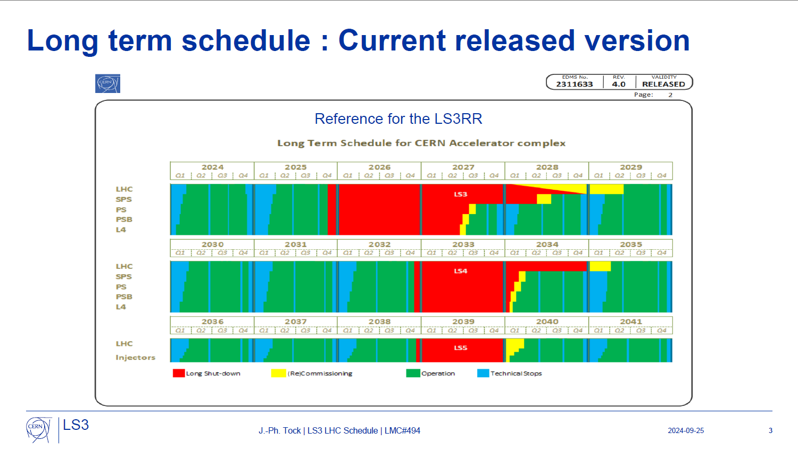
Long-term master schedule

Slide 4
Injectors Road Map towards LS3
2023 |  |  | 2024 |  |  |  |  |  |  |  |  |  |  |  | 2025 |  |  |  |  |  |  |  |  |  |  |  | 2026 | 2027 | 2028 | 2029
Q3’23 |  |  | Q1’24 |  |  | Q2’24 |  |  | Q3’24 |  |  | Q4’24 |  |  | Q1’25 |  |  | Q2’25 |  |  | Q3’25 |  |  | Q4’25 |  |  | 2026 | 2027 | 2028 | 2029
O | N | D | J | F | M | A | M | J | J | A | S | O | N | D | J | F | M | A | M | J | J | A | S | O | N | D
TODAY
LS3 preparation
Meetings with groups (EYETS feedback, EYETS24-25 activities and LS3 activities)
LS3 Other projects approval
Master Schedule LS3 Draft
LS3 Readiness Review
Master Schedule LS3 approved
LS3 Baseline draft 1st version
LS3 Baseline draft 2nd version
LS3 Work Packages Analysis
LS3 Baseline fixed
INTEGRATION STUDIES FOR LS3
FOLLOW-UP
UPDATE
LS3 Integration studies completed
Start LS3 ECR submission
Last LS3 ECR approved
Start LS3 IST submission
Last LS3 IST approved
STUDIES FOR EYETS24-25
FOLLOW-UP
UPDATE
LS3 starts 17/11/25
EYETS24-25 Integration studies completed
Last EYETS24-25 ECR approved
LS3 coordination
EYETS 23-24 coordination
Last EYETS24-25 IST approved
TS
End EYETS 23-24
Master Schedule 24-25 Draft 1
Master Schedule 24-25 approved
(E)YETS
EYETS24-25 Baseline draft version
LS
EYETS24-25 Baseline for approval
End Closure Year
EYETS 24-25 coordination
End EYETS 24-25
EYETS 23-24
TS1’24 prep.
EYETS 24-25
TS1’25 prep.
LS3
EYETS 24-25
LS3

Slide 5
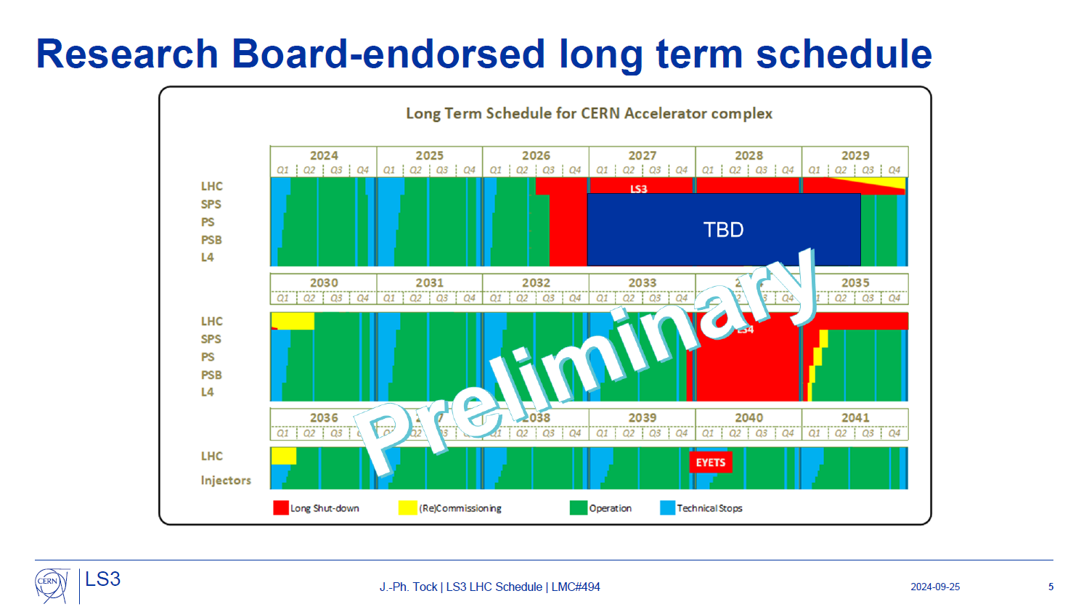
News since last week
  LS3 start date:
    LHC: July 2026
    Injectors: September 2026
  NOTE:
  The priority now is:
    1st optimize the LHC to make it fit in 47 months
    2nd fit the restrictions coming from the LHC optimization, and the consequences on the groups resources availability to define the injectors planning (the duration of LS3 in the injectors may change due to this and this is why there is TBD)

Slide 6
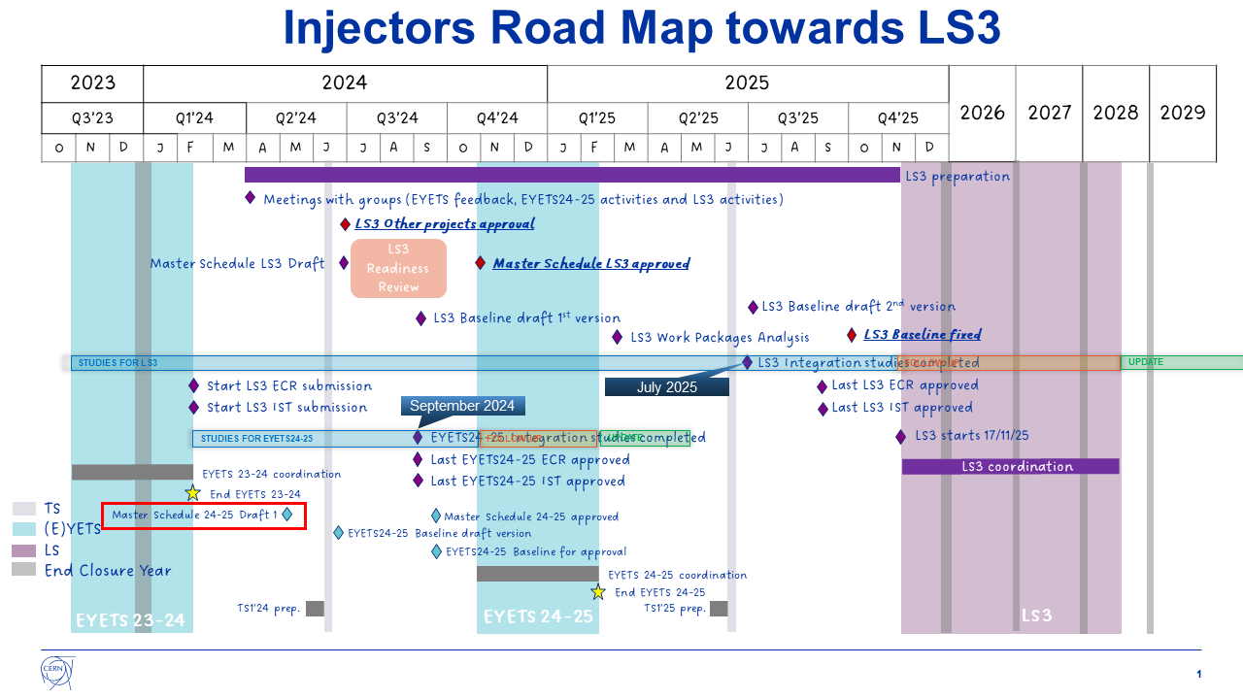
LS3 shift
  LS3 start date:
    LHC: July 2026
    Injectors: September 2026
To be revised

Slide 7
FACILITY: MADMAX
GOALS & JUSTIFICATION: List of the main objectives that you want to achieve with this request. MADMAX uses a new concept (dielectric haloscope) to search for axion dark matter in a mass range centered around 100 μeV, favored by post-inflationary scenarios and not yet explored. A prototype of the final experiment, including a stainless steel cryostat, is presently being build and will be inserted in the Morpurgo magnet of the H8 line. Explain why it needs to be done during the LS3 and the consequences if your request is not approved. The MADMAX prototype run in the Morpurgo magnet requires the complete absence of beam. The stainless steel cryostat was designed to fit in the Morpurgo magnet.
SCOPE: Usage of the Morpurgo magnet of the H8 line including the upstream zone of H8B (PPE158) and the platform downstream of the magnet.
SCHEDULING: A long run for physics of the order of six months is preferred. Overall if we could stay on the Morpurgo site for one year to prepare (3 months), run (6 months) and dismantle (3 months), that would be great. Include any scheduling constrains that need to be taken into account. The preferred period is Dec. 2025 to Dec. 2026: i) preparation Dec. 2025- Mar 2026, ii) run with Morpurgo magnet at 1.6 T: Apr-Sep 2026, iii) Dismantling: Oct-Nov 2026.
SERVICES REQUIRED: More details provided in EDMS 2477727
EN/CV | Mixed water for cooling (required during cooldown of the Morpurgo magnet and the physics run)
TE/CRG | Cooling of the MORPURGO magnet LHe / LN2 storage dewars from Cryolab / external company + recovery lines (He, N2) for cryostat cooldown. 2 vacuum pump units, cryocoolers and 5 compressor units, circulation pump for gHe, water chiller
EP/ADO-SO | Usage of Morpurgo magnet
BE/EA-DC | Crane to install the cryostat and its rails. Working place Tent set-up installation
OTHER RELEVANT INFORMATION: Include any other information that you consider important to evaluate your request. Morpurgo magnet zone is already used by the MADMAX group for tests during the Beam shutdown period since 2022. All installations in this area have already been foreseen to perform the test with the stainless steel cryostat
No RP impact
M. Van Dijk on behalf of the MADMAX collaboration, List of requests received to run during LS3, IEFC, 19.04.2024

Slide 8
Unresolved issue – Operation requests

Slide 9
Summary / Conclusions
  The shift of LS3 has a considerable impact on the preparation
  We don’t know yet how the groups will be affected by the LHC optimization (we need to gain 4.5 months with respect to the actual time needed to perform all the works);
  In the NA we have some works that have to be analysed in detail with the concerned groups before we can confirm that it is possible to provide you all the services in the periods that you want to RUN – some of the concerned groups are the ones that will be the most affected by the LHC optimization
  We would like to keep October 2025 as the deadline to have a solid LS3 planning for the NA-CONS (it will not be the baseline as defined today), and at that moment we should be able to give you a well analysed answer to your request

