Slide 1


The Silicon Tracker L0 Upgrade of the AMS-02 experiment on the ISS
G. Ambrosi
INFN Perugia
ASAPP 2025, May 12th 2025

Slide 2
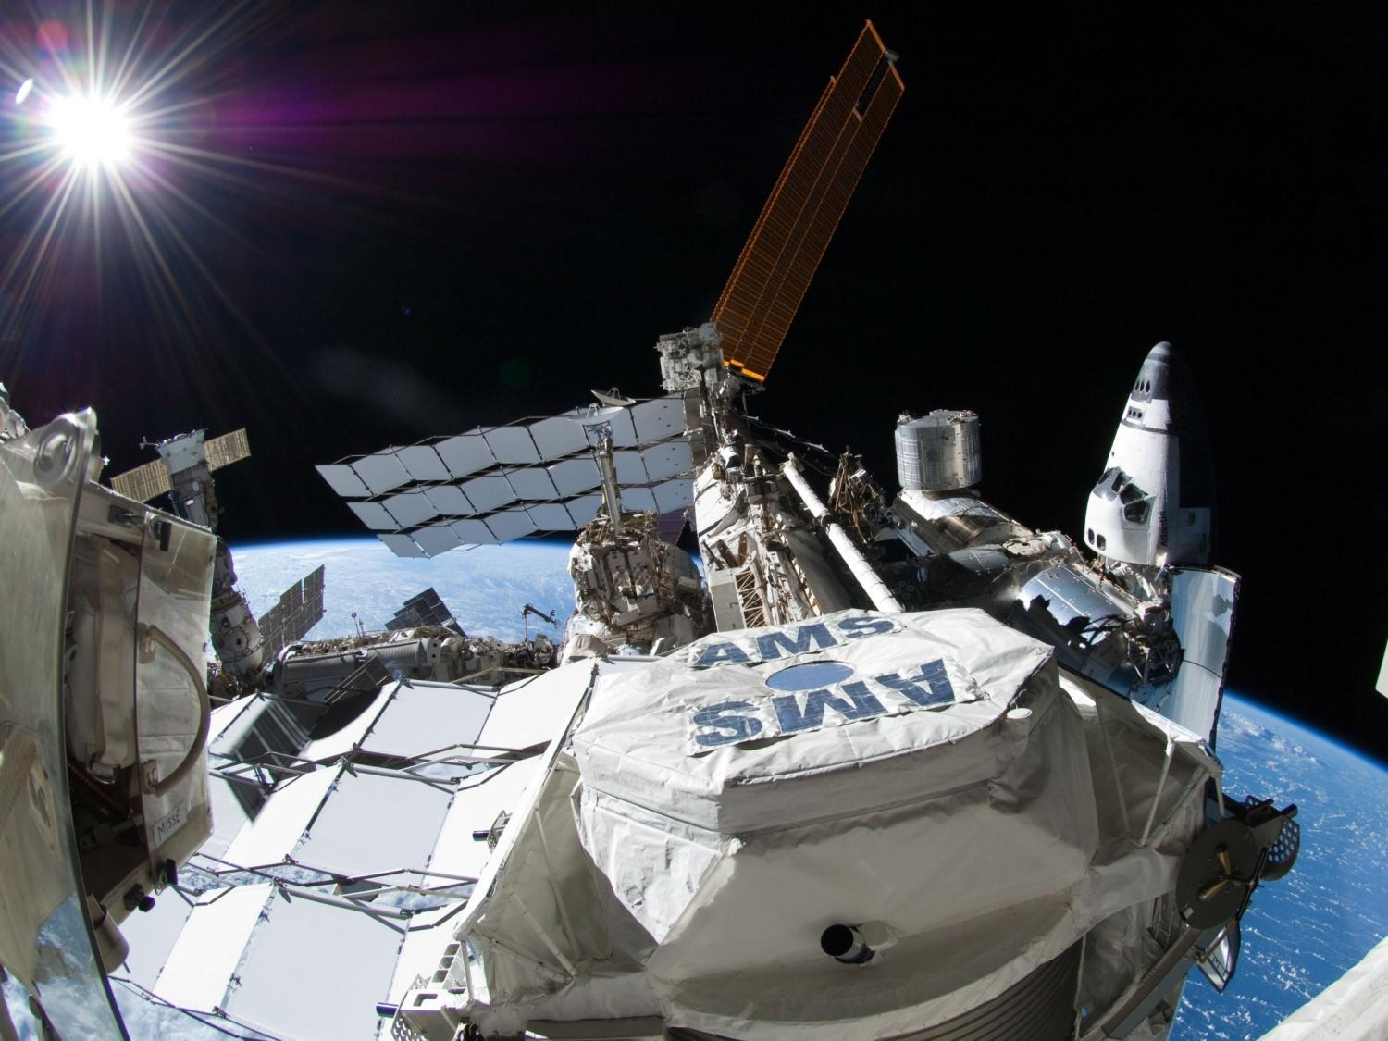
A tracking layer to be added to the existing ones

Slide 3
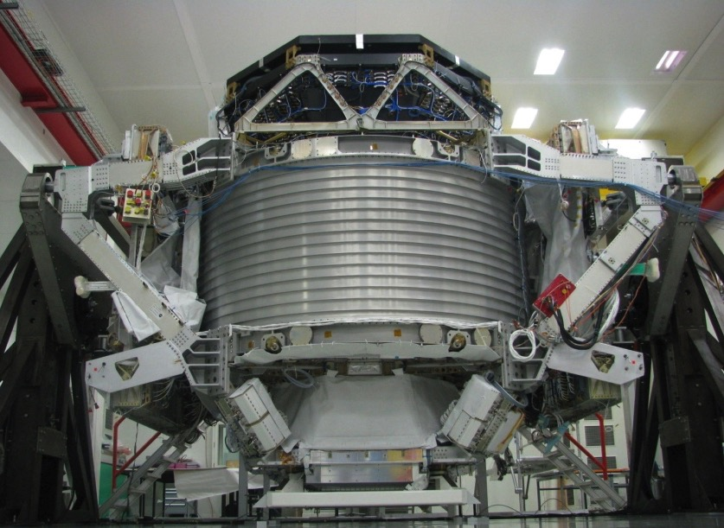
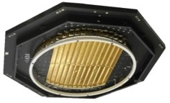
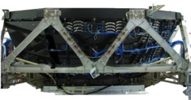


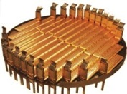

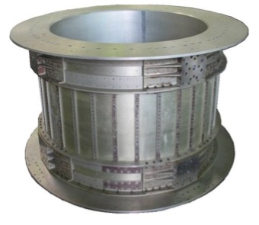
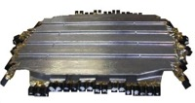
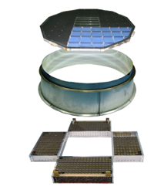

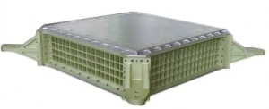
Tracker
TRD
TOF
Tracker
ACC
MAGNET
ACC
MAGNET
TOF
RICH
Tracker
ECAL

Slide 4
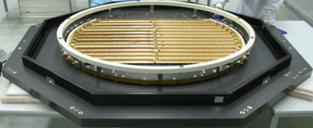
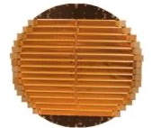
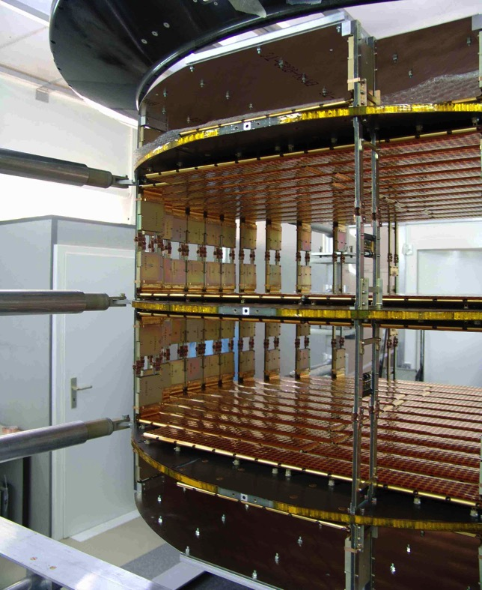
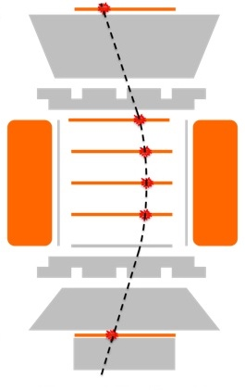

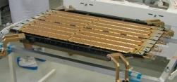
The layout of the AMS-02 Tracker
1
2
3
4
5
6
7
8
ECAL
9
6 m² of silicon detector

Slide 5
The layout of the AMS-02 Tracker
1
2
3
4
5
6
7
8
ECAL
9
L0: 8 m² of silicon detector

Slide 6
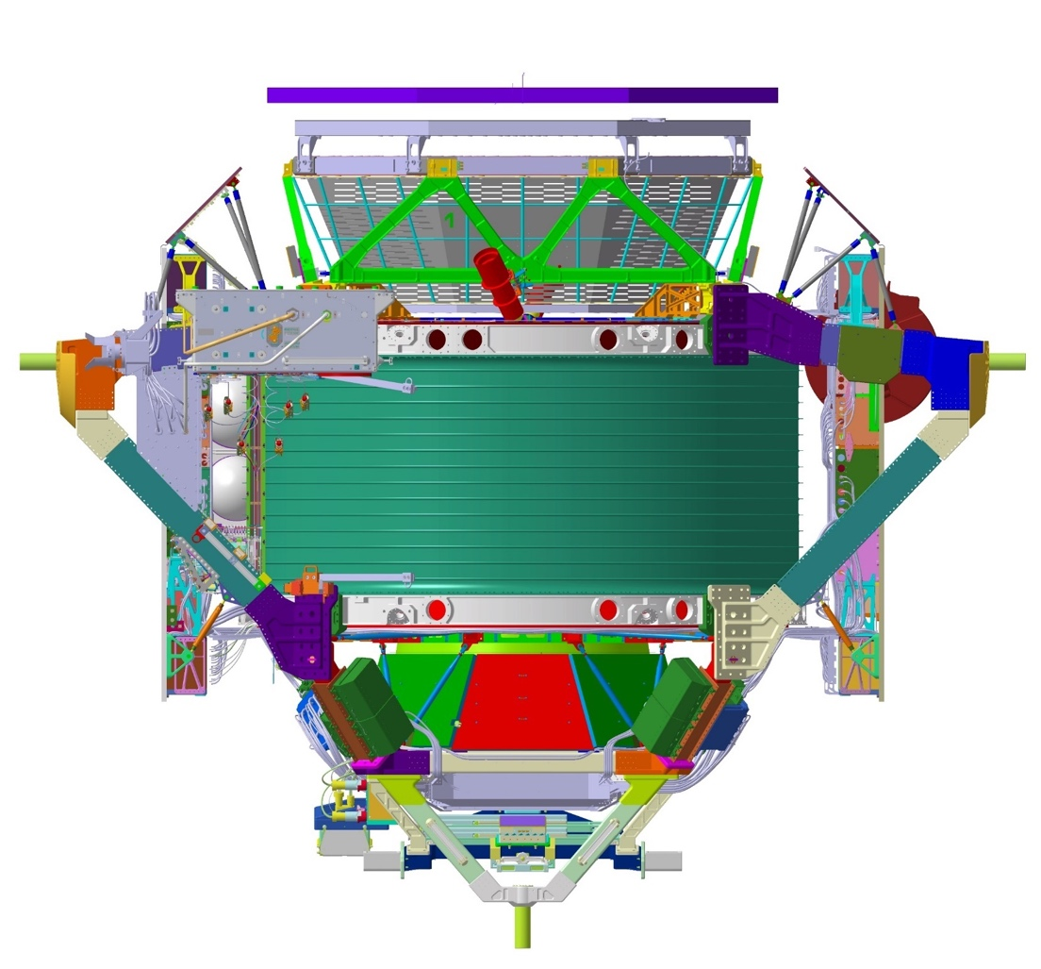




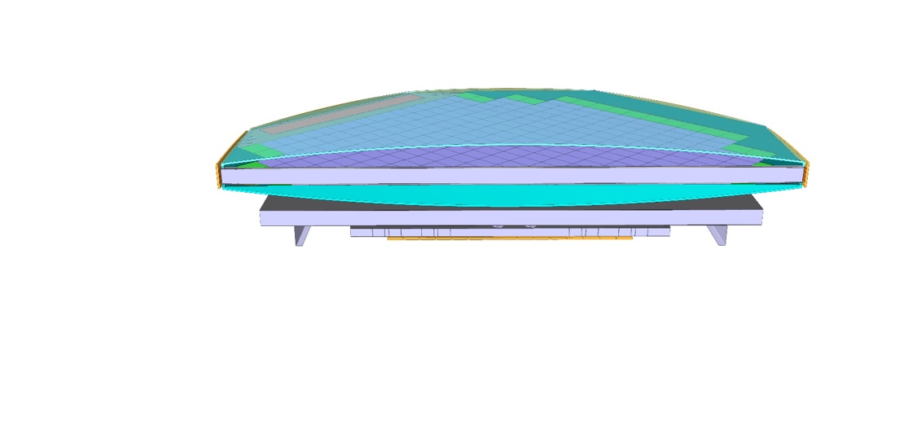
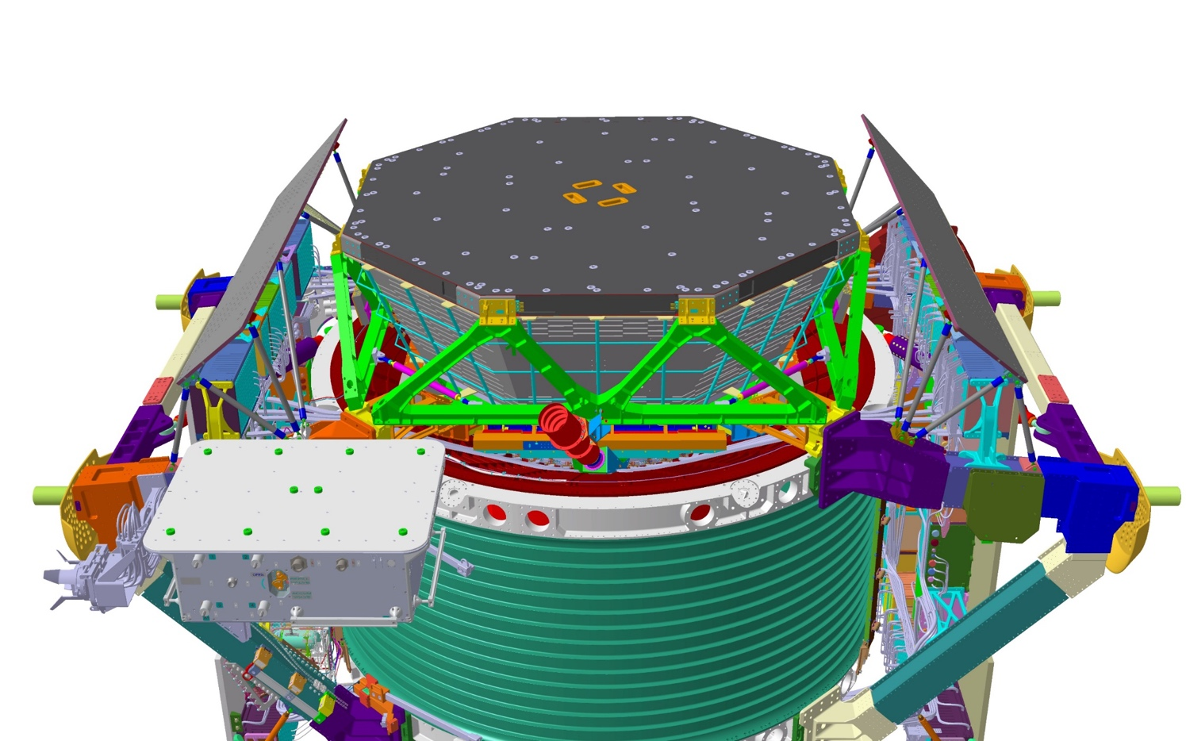
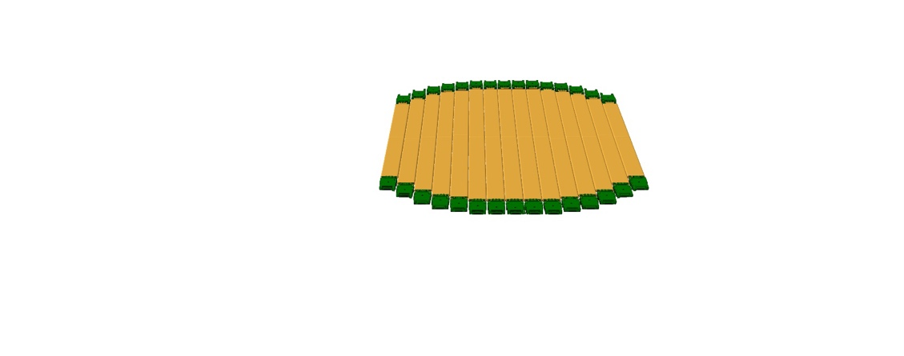


A tracking layer to be added to the existing ones
New L0
New Tracker Layer 0
L1
Layer 1
L2
L3/4
L5/6
L7/8
L9
Z
Increase of the detector acceptance by 300%
X
Y

Slide 7
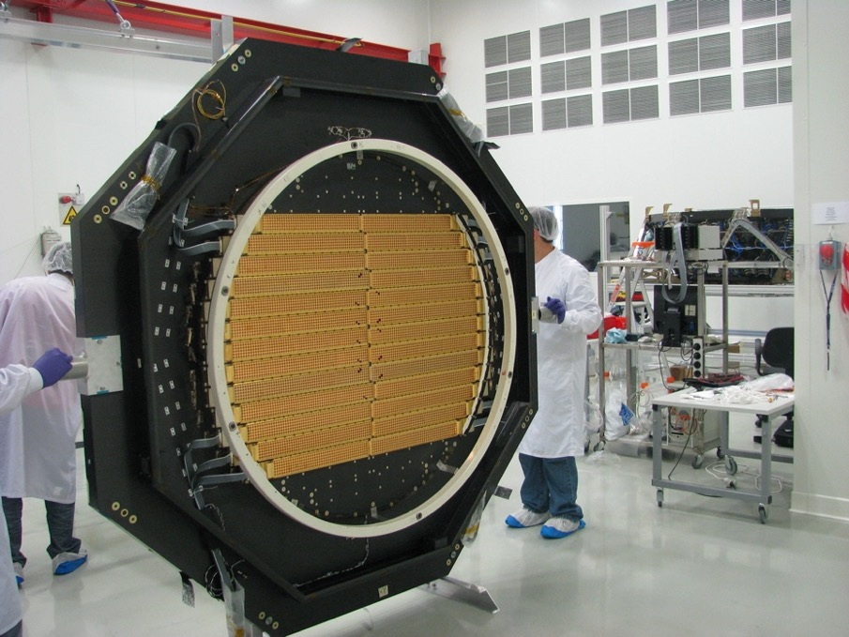
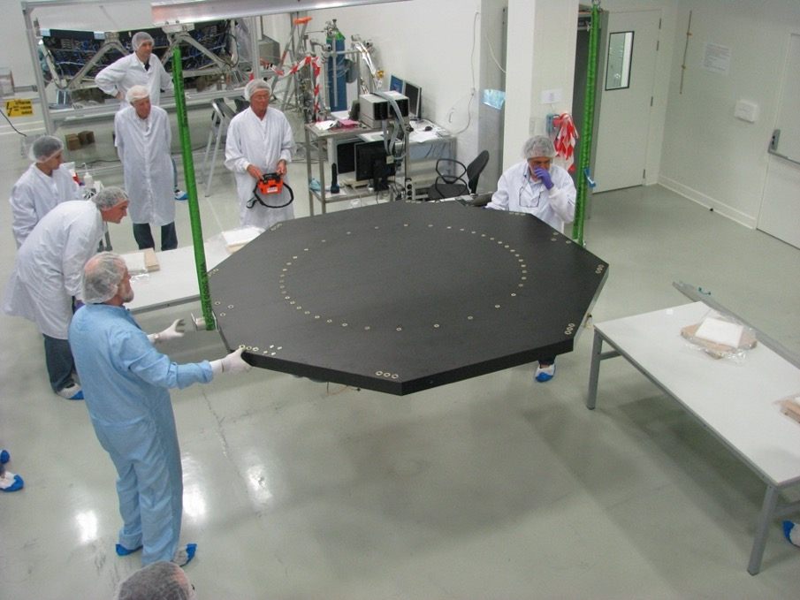
Layer 1
AMS-02 integration activities, 2010

Slide 8
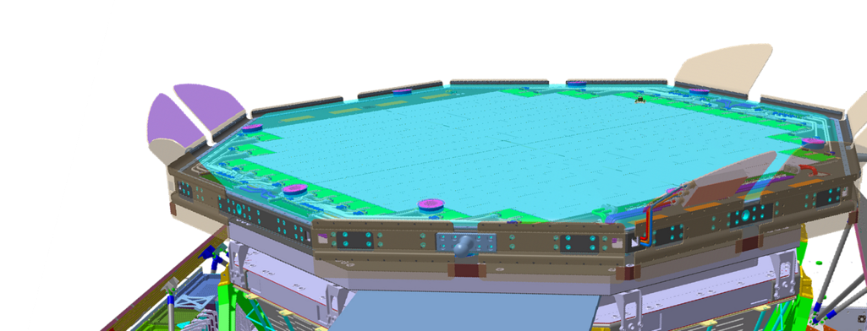
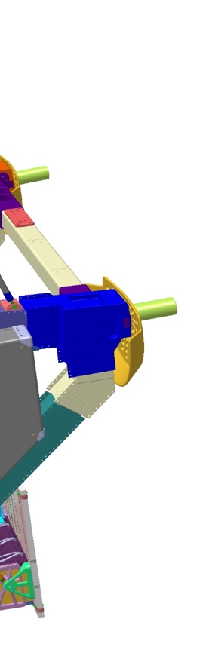
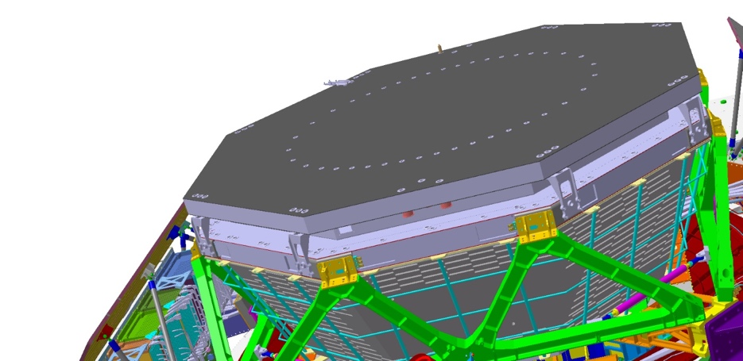
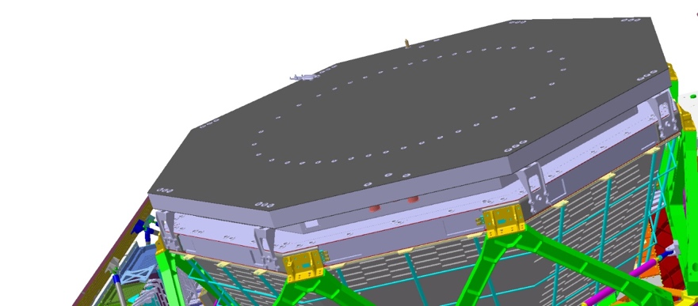
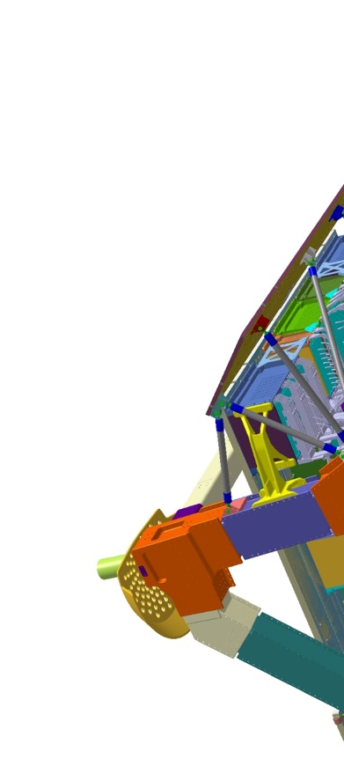
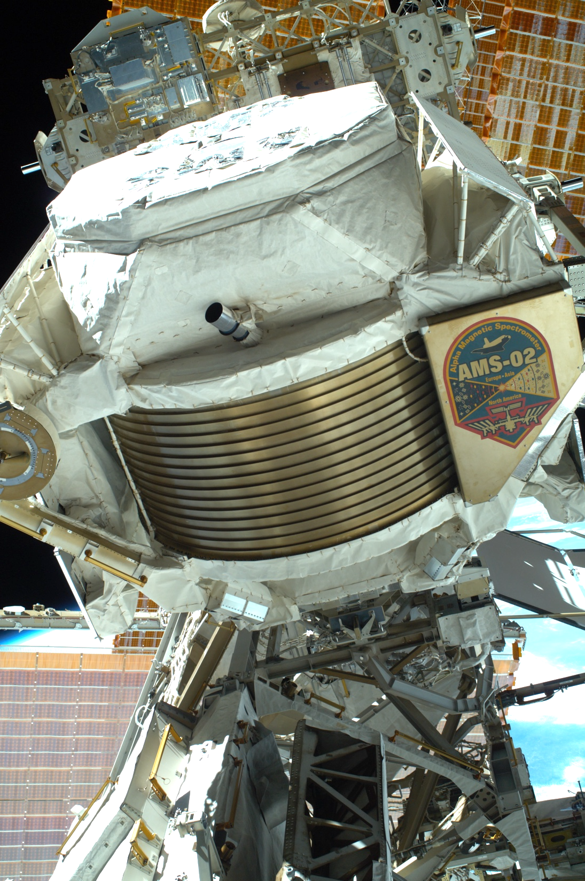
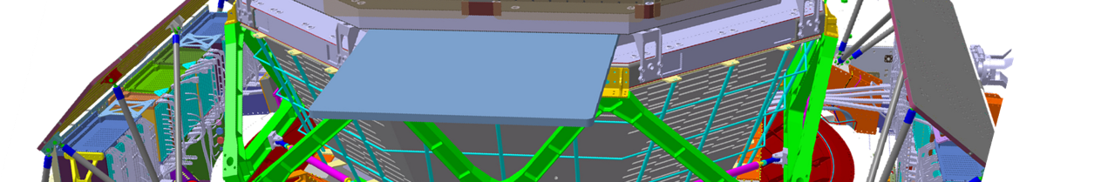
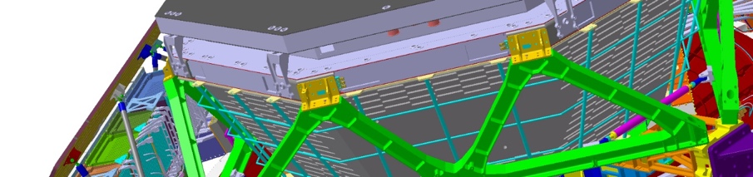
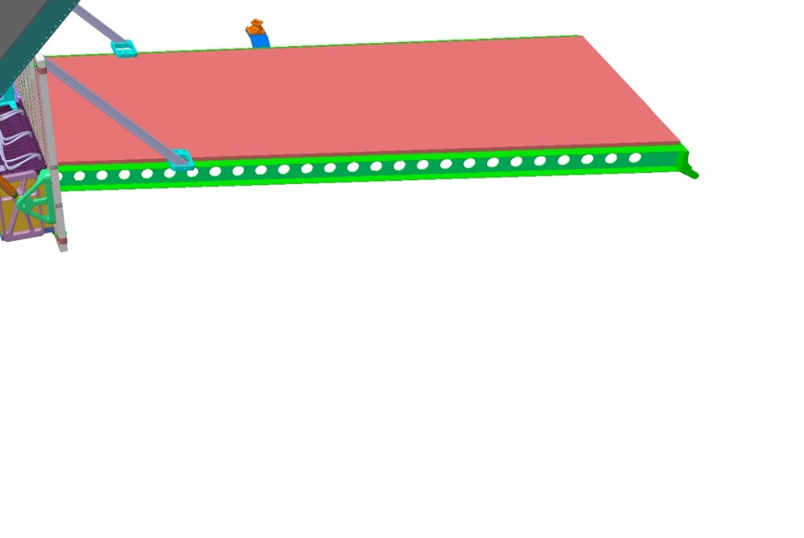
AMS-02 L0 upgrade ... in 1 slide
C. Gargiulo

Slide 9
AMS-02 L0 upgrade ... in 1 slide
AMS-02 decision in December 2021 ...
... ready for flight
March 2026
C. Gargiulo

Slide 10
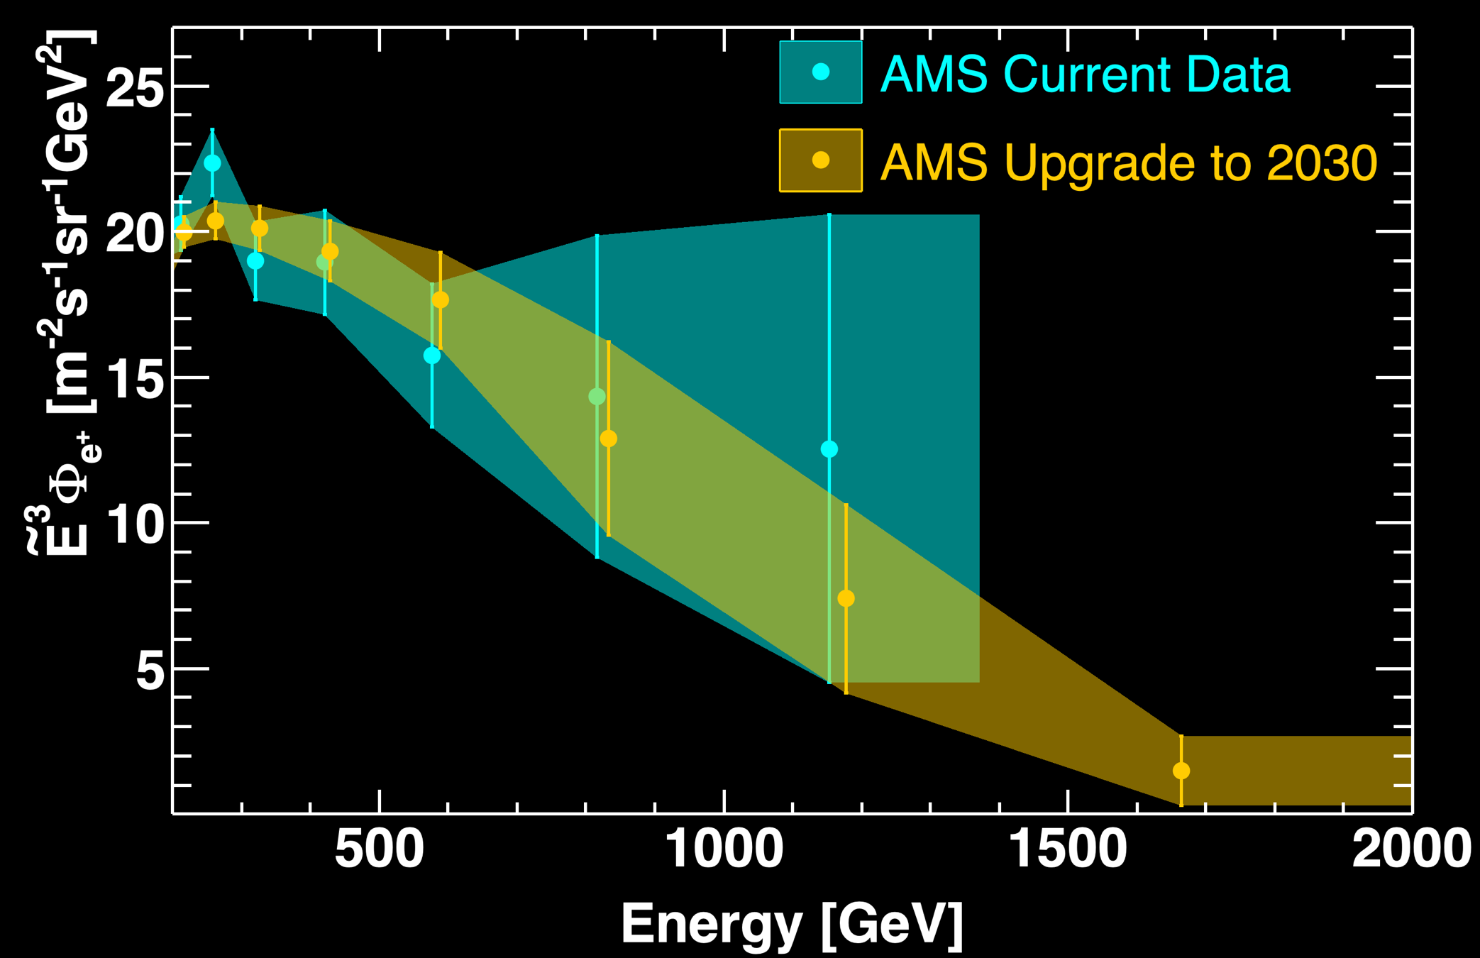

By 2030, AMS will extend the energy range
of the positron flux measurement from 1.4 to 2 TeV
and reduce the error by a factor of two compared to current data
10
10

Slide 11
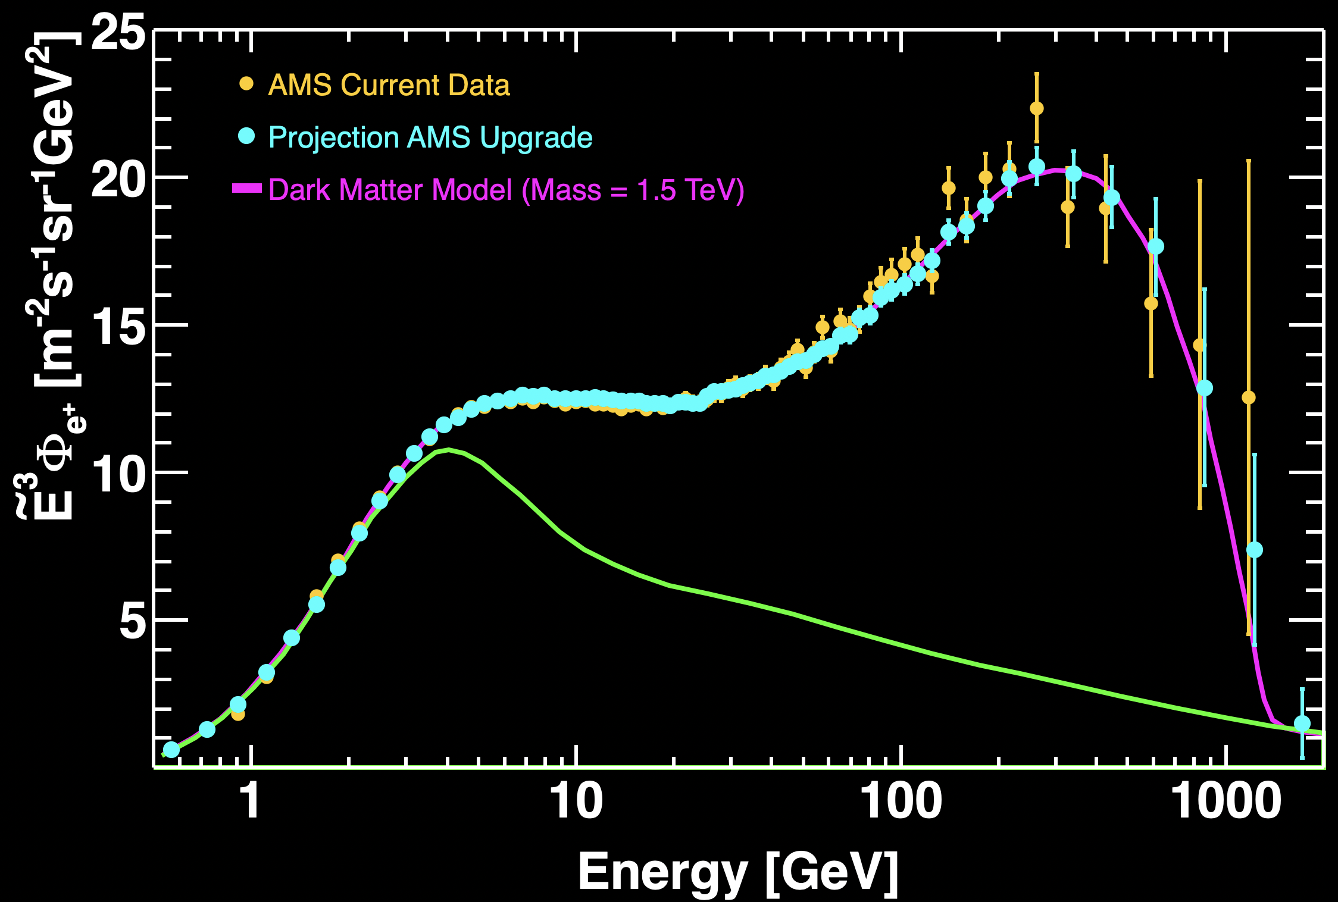
Determination of the Origin of Cosmic Positrons by 2030
AMS will ensure that the measured high energy positron spectrum indeed drops off quickly and, at the highest energies, the positrons only come from cosmic ray collisions
as predicted by dark matter models
by 2030
Positrons from
Cosmic Ray Collisions
11
Notes:
Voyager was launched 1977 and left solar system

Slide 12
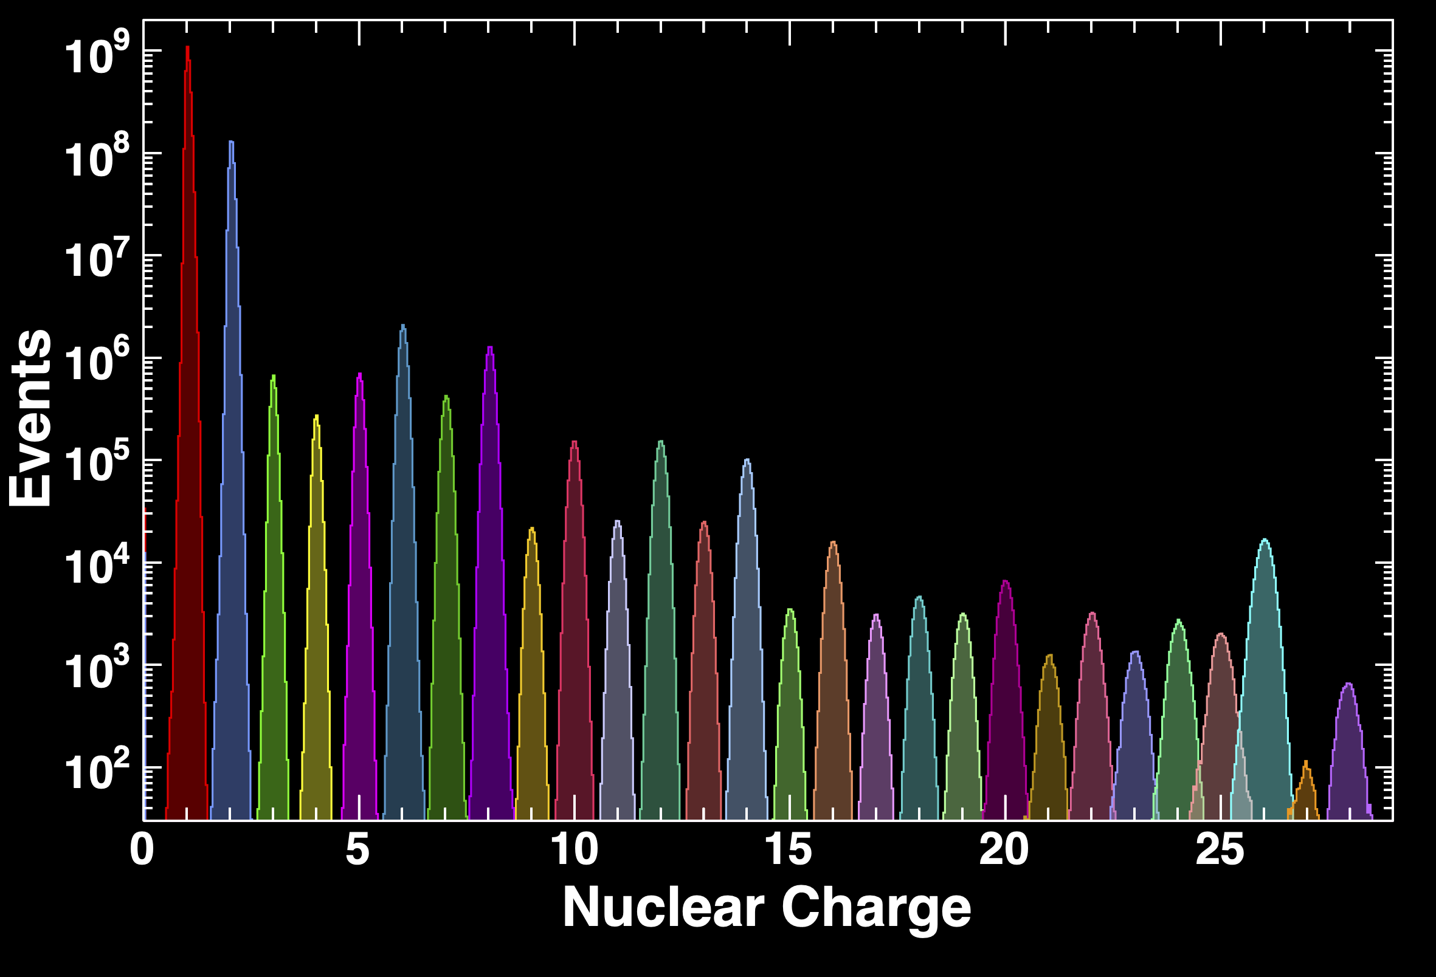
Cosmic Ray Nuclei by 2030
H
He
C
Li
B
O
Be
N
Ne
Mg
Si
F
Na
Al
S
Fe
Ar
Ca
Cr
P
Cl
K
Ti
V
Mn
Sc
Ni
Co

Slide 13
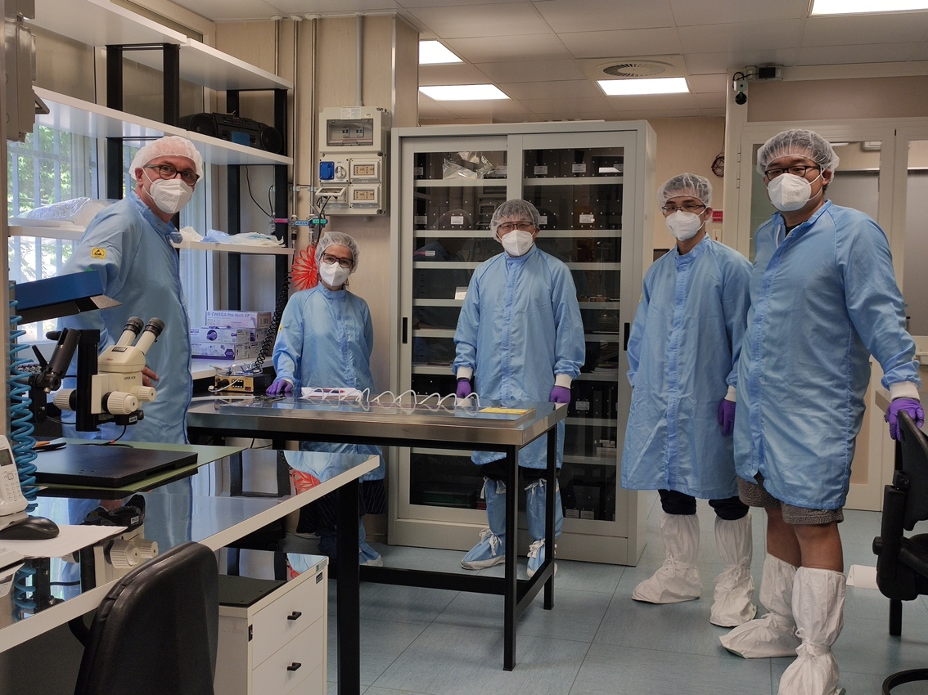
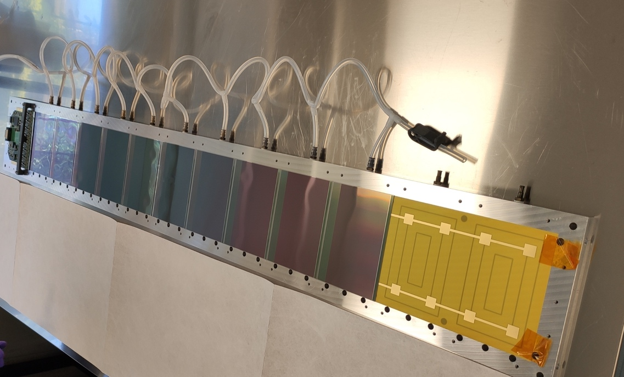
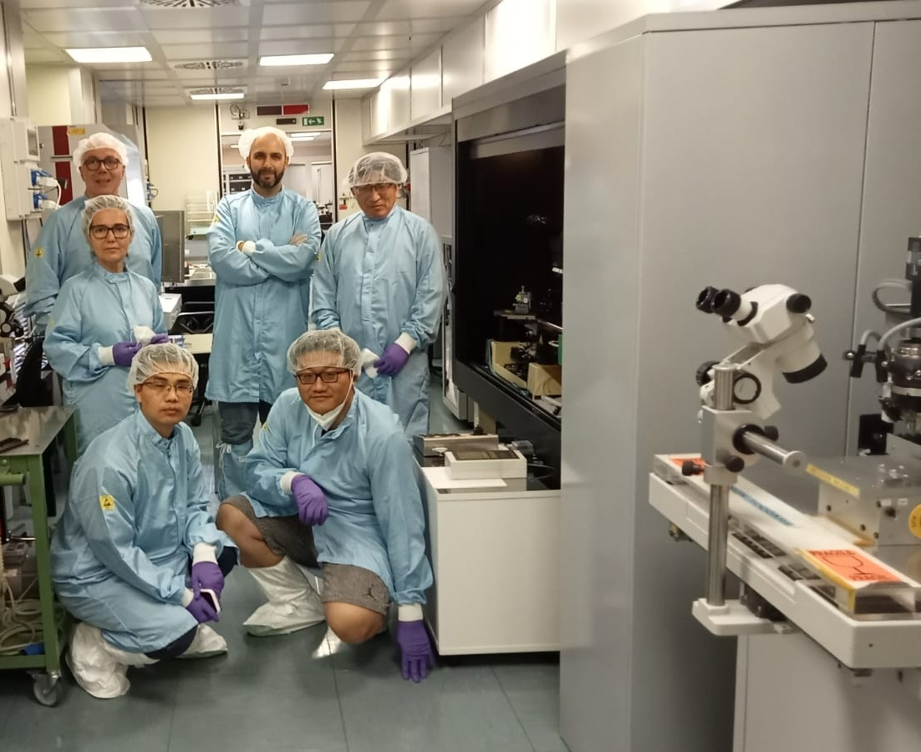
L0 first detector prototype
INFN, IHEP SDIAT
Joint Italian and Chinese
team in Perugia (July 2022)
Notes:
Mention Institute of High Energy Physics in Beijing and Shandong University

Slide 14
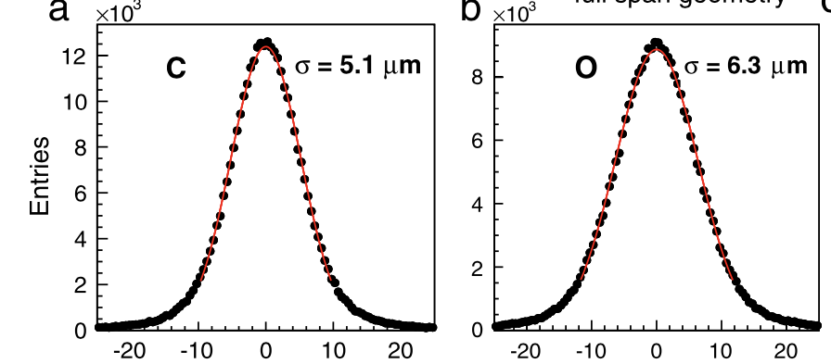
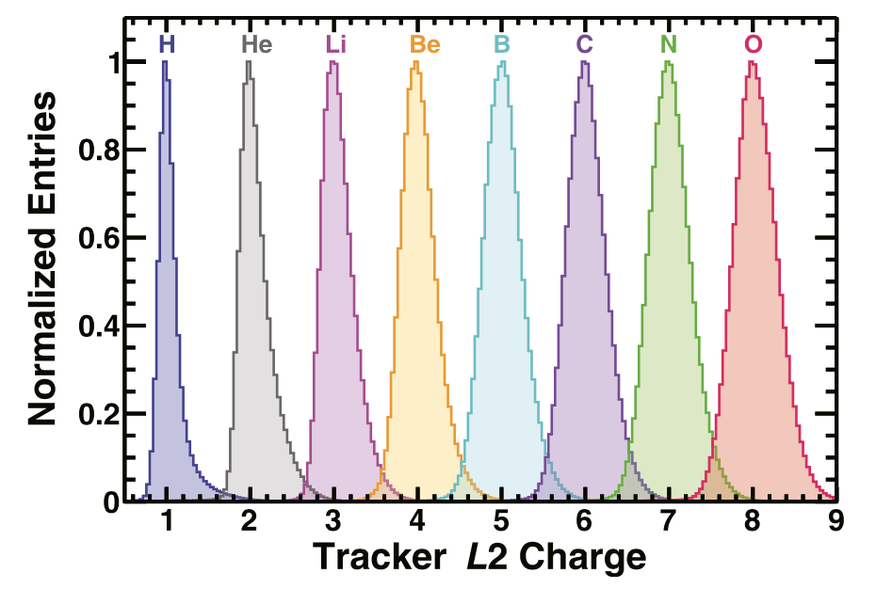
design criteria
increase acceptance by 300%
measure both charge and position of the incoming particles with performance as existing AMS (charge and position resolution)
charge measurement
position resolution
residual [µm]
residual [µm]

Slide 15
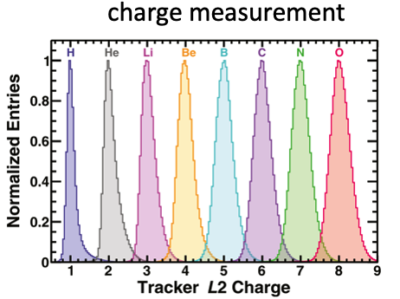
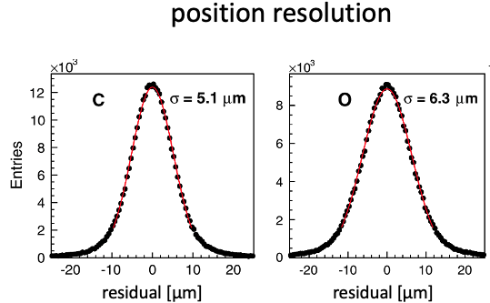
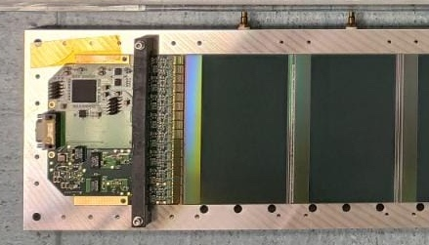
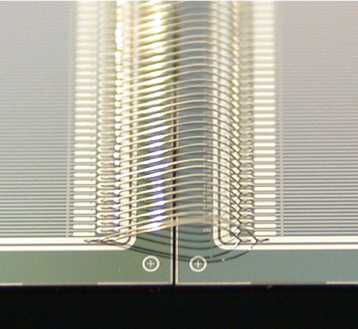
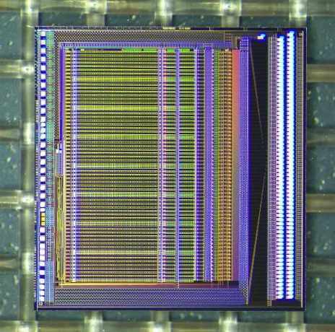
AMS Tracker performance
electronics specs
detector specs
VA1140
high dynamic range
readout pitch 110 µm

Slide 16
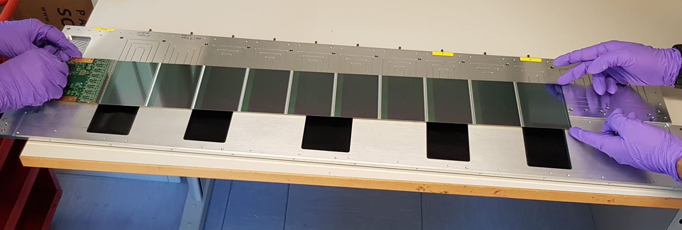
The Ladder
the basic element of the detector that define the performance
the detecting part: 8, 10 and 12 sensors
the readout
electronics
active area: 113x640; 113x800, 113x960 mm²

Slide 17
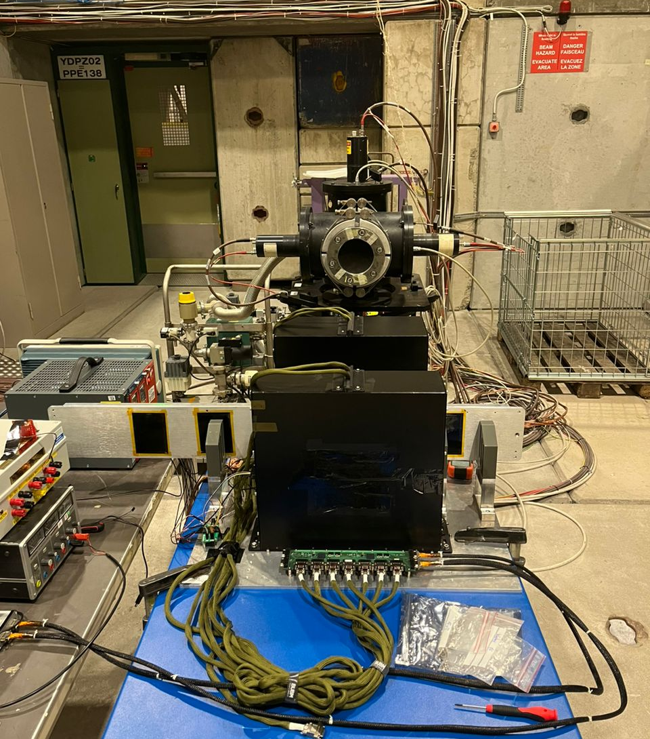

test beam:
CERN North Area
2023 - 2024

Slide 18
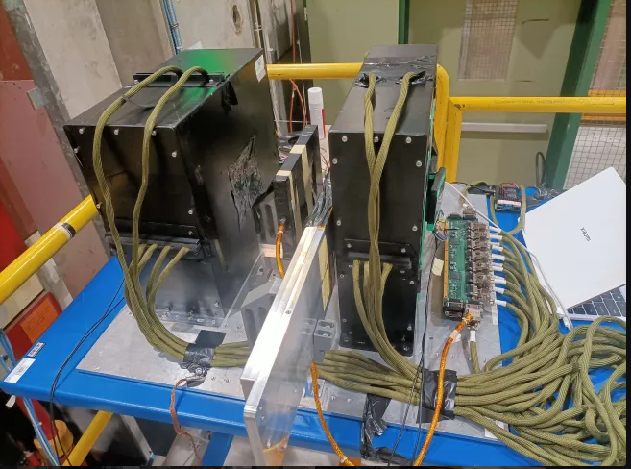
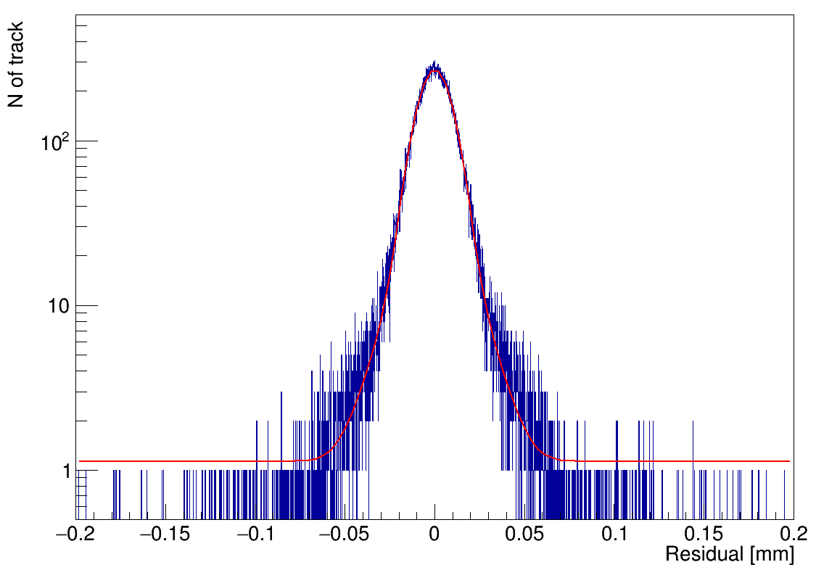
beam test results: position resolution
beam monitor detector
𝜎 = 8.3 μm
see Y. Jiang, rapid talk today + poster

Slide 19
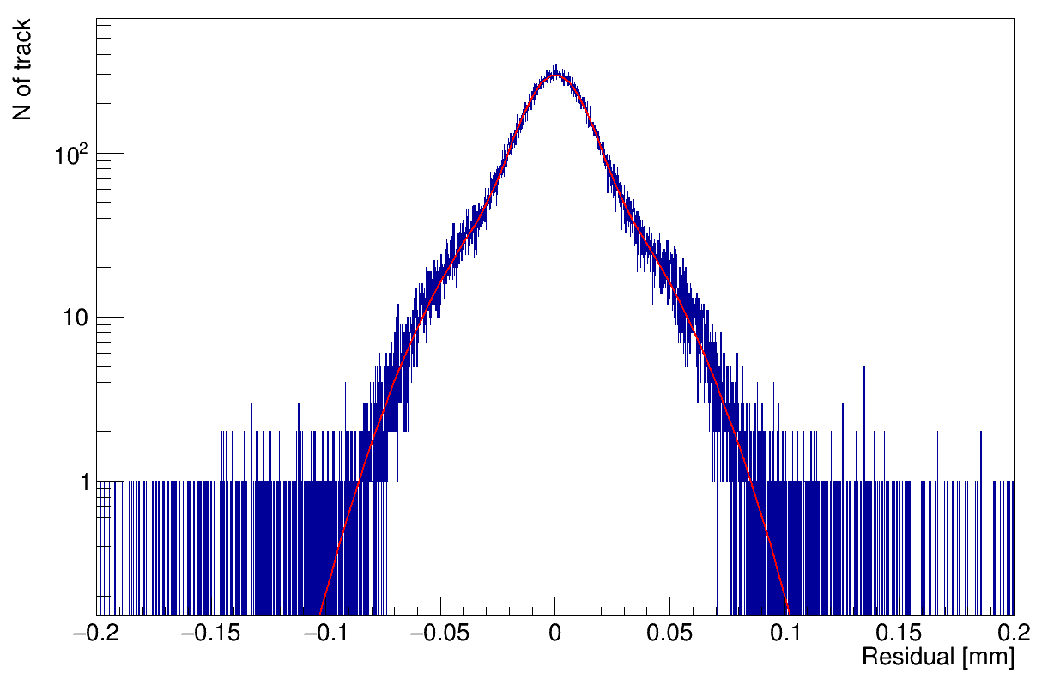
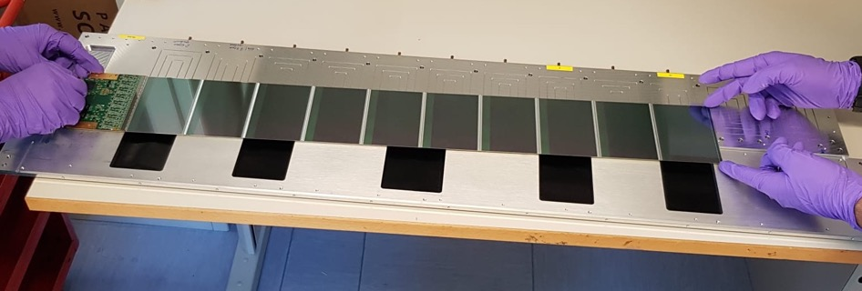
beam test results: position resolution
flight ladder
𝜎 = 11.3 μm
see Y. Jiang, rapid talk today + poster

Slide 20
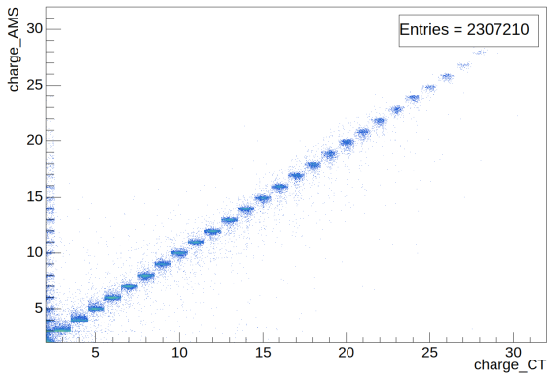
beam test results: charge identification
flight ladder

Slide 21
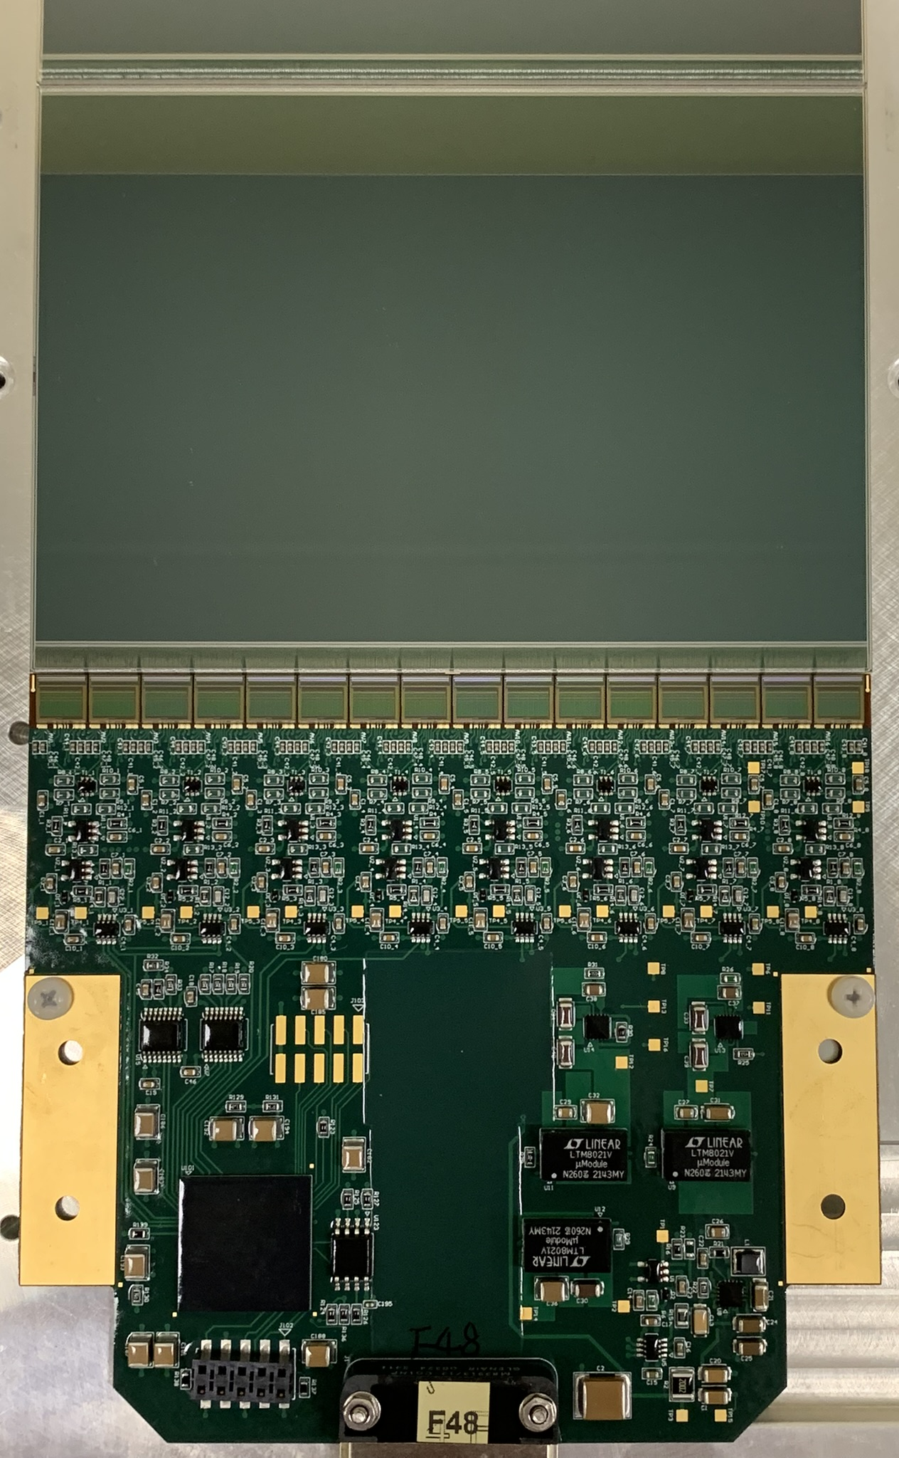
L0 detector in numbers
72 ladders:
  74 k readout channels
  1152 front end chips
  768 Silicon Strip Detector
72 data compression processors
  150 kB per raw event
  0.3 kB per compressed event
  150 kB per second bandwidth
110 W power

Slide 22




















Flight Model
Electronics
72/72 Front End Board flight production completed
8/8 Intermediate Board flight production completed
1 flight Interface board and 2 Power board flight in production
8 QLs
Flight QLs are already assembled, metrology ongoing
72 Ladder
flight production completed
Full plane
CABLES
Cables flight production completed

Slide 23





Electronics
1 Interface Board (LINJ)
Distributed at the periphery of the sensors
2 Power Board
72 Front End Board (LEF)
8 Intermediate Board (LINF )
23

Slide 24

L0 ladder production completed
IHEP, Beijing

Slide 25

SSD positioning precision

Slide 26


Quarter Layer (QL) assembly

Slide 27
Quarter Layer (QL) assembly

Slide 28

all Quarter Layers (QL) are assembled
UniPG, INFN

Slide 29
all Quarter Layers (QL) are assembled
UniPG, INFN

Slide 30

all Quarter Layers (QL) are assembled
UniPG, INFN

Slide 31


QL tests
thermo vacuum test
electrical test

Slide 32


ladder positioning precision
ladder distance
measurements at the CERN metrology lab
200 um

Slide 33

ladder positioning precision
ladder distance
measurements at the CERN metrology lab
200 um

Slide 34

ladder positioning precision
ladder ’planarity’
measurements at the CERN metrology lab
200 um

Slide 35
QL tests
thermo vacuum test
electrical test

Slide 36

QL electrical quality

Slide 37

¼ plane assembled

Slide 38

¼ plane vibration

Slide 39

¼ plane
Thermal
Vacuum

Slide 40


L0 vibration test (QM unit)

Slide 41

L0 vibration test (QM unit)

Slide 42


L0 vibration test preparation

Slide 43

4/4 EDU (Qualification Model, QM)
¼ Layer glued on Plane0 in CERN clean room

Slide 44






Layer-0 Flight TEST
VIB
CERN
Sep
ITALY
METROLOGY
Oct
EMI
Nov
Dec
ITALY
CERN
CERN
TVT
Dec
Jan
ITALY

Slide 45
Conclusions
after 3.5 years of very intense and successful activities we are almost ready:
  mechanics, detector and electronics are completed
  integration activities will start as soon as people is back from ASAPP
  a full test campaign (metrology, vibration, thermo-vacuum, beam test) is planned in the Fall/Winter season 2025/2026
  launch and installation in Spring 2026

Slide 47

INFN/UniPG laboratory for space qual
Terni, Italy

Slide 48






View from Mir during STS-91 Mission
2-12 Jun 1998
AMS 01
Assembly at KSC
Final processing at KSC in SSPF for STS-91
AMS-01 is the precursor experiment which flew on the shuttle Discovery on the STS-91 mission, from 2nd to 12th of June 1998.

