Slide 1






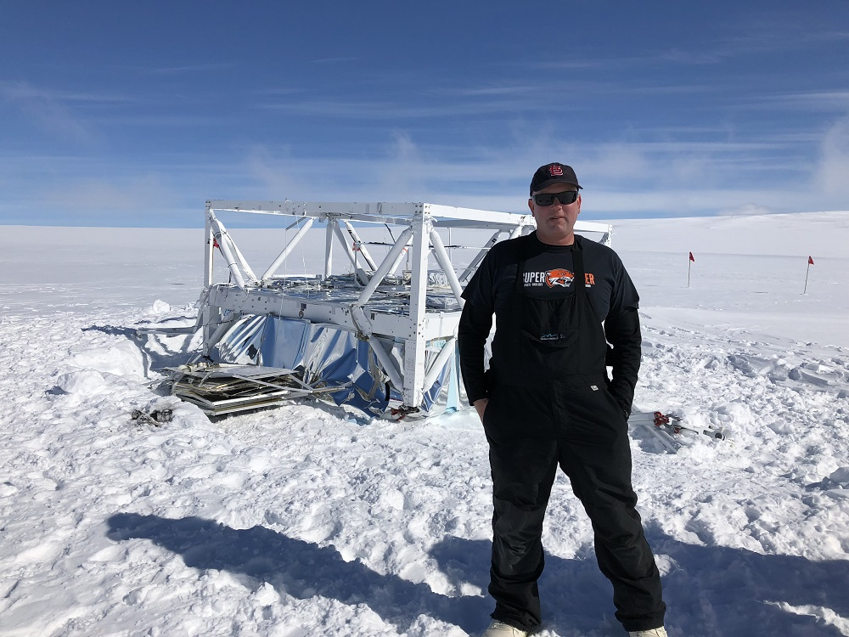
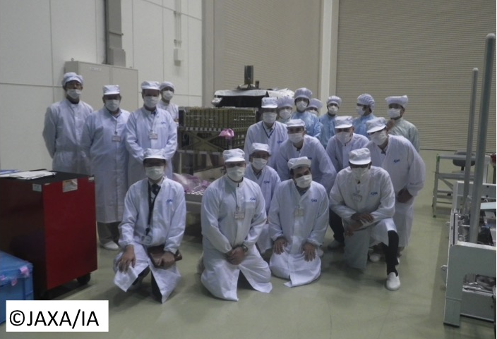
The TIGERISS Galactic
Cosmic Ray Mission
Instrumentation and missions for direct high-energy CR measurements
Brian Flint Rauch
May 13, 2025

Slide 2

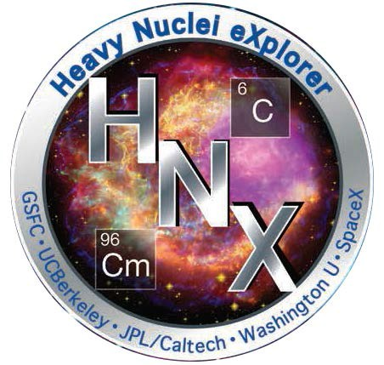
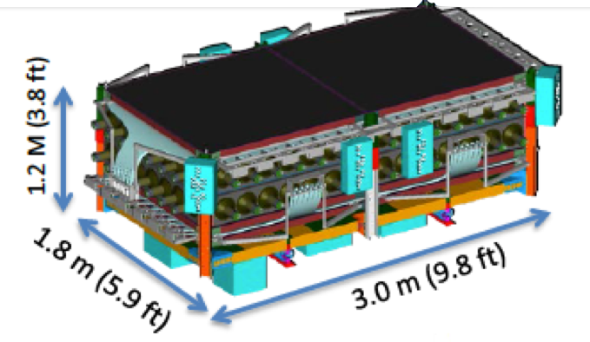
The Trans-Iron Galactic Element Recorder for the International Space Station (TIGERISS)
A NASA Astrophysics Pioneers Mission
Brian Rauch WUSTL– PI
TIGERISS Collaboration
Washington University in St. Louis
NASA Goddard Space Flight Center
NASA Wallops Flight Facility
University of Maryland, Baltimore County
Howard University
Pennsylvania State University
Northern Kentucky University
Instrument: 1.0 m × 0.9 m × 0.43 m
TIGERISS - Heritage
TIGERISS - SOX payload

Slide 3
TIGERISS Collaboration
Trans-Iron Galactic Element Recorder for the International Space Station
H. Allen,¹ R. F. Borda,² R. G. Bose,³ D. L. Braun,³ J. Calderon,⁴ Z. Campbell,⁵ N. W. Cannady,⁶ R. M. Caputo,⁶ M. Clark,⁷ J. Coldsmith,⁸ S. Coutu,¹ G. A. de Nolfo,⁹ T. Forstmeier,¹ M. Fratta,⁵ P. Ghosh,^{2, 6, 10} S. Graham,⁸ S. Jones,⁴ J. F. Krizmanic,⁶ W. Labrador,³ L. Lisalda,³ J. V. Martins,² M. P. McPherson,⁷ J. G. Mitchell,⁹ J. W. Mitchell,⁶ S. I. Mognet,¹ A. Moiseev,^{11, 6, 10} T. L. Ng,⁵ S. Nutter,⁴ N. Osborn,³ M. Pant,⁴ I. M. Pastrana,³ D. Radomski,³ B. F. Rauch,³ H. Salmani,⁷ M. Sasaki,^{11, 6, 10} G. E. Simburger,³ S. Smith,⁷ H. A. Tolentino,⁷ Y. Tufail,⁵ D. Washington,¹ T. Widmyer,⁵ L. Williams,⁸ W. V. Zober,³
1) Pennsylvania State University
2) University of Maryland, Baltimore County
3) Department of Physics and McDonnell Center for the Space Sciences, Washington University in St. Louis
4) Northern Kentucky University
5) NASA Wallops Flight Center
6) NASA Goddard Space Flight Center, Astrophysics Science Division
7) Howard University
8) NASA Goddard Space Flight Center
9) NASA Goddard Space Flight Center, Heliophysics Science Division
10) Center for Research and Exploration in Space Sciences and Technology II
11) University of Maryland, College Park

Slide 4
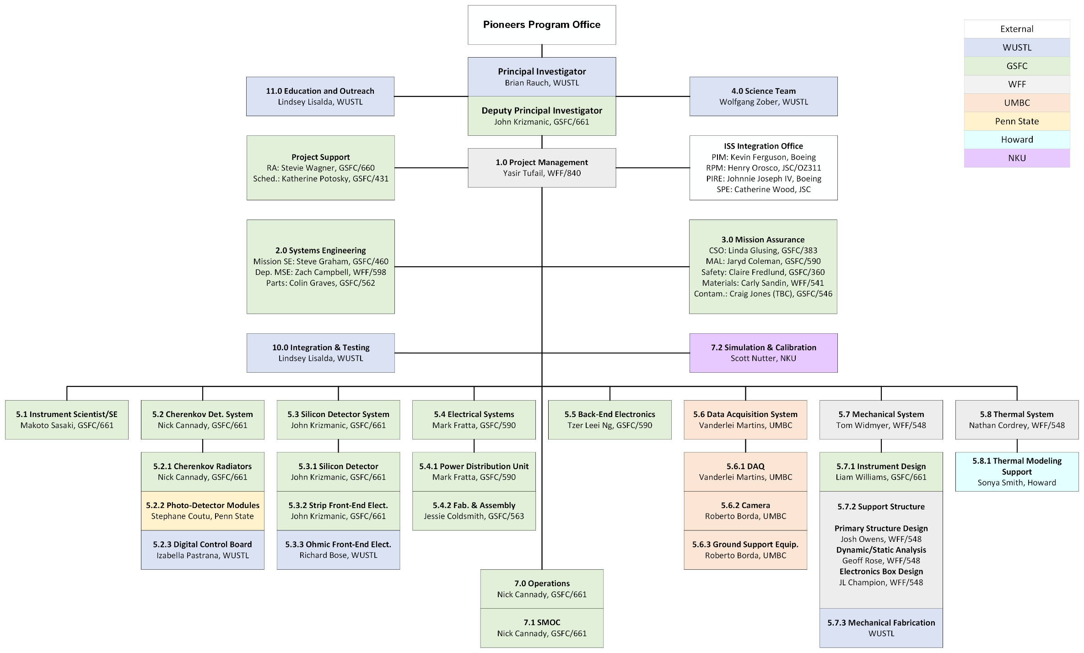
TIGERISS Collaboration Org Chart

Slide 5
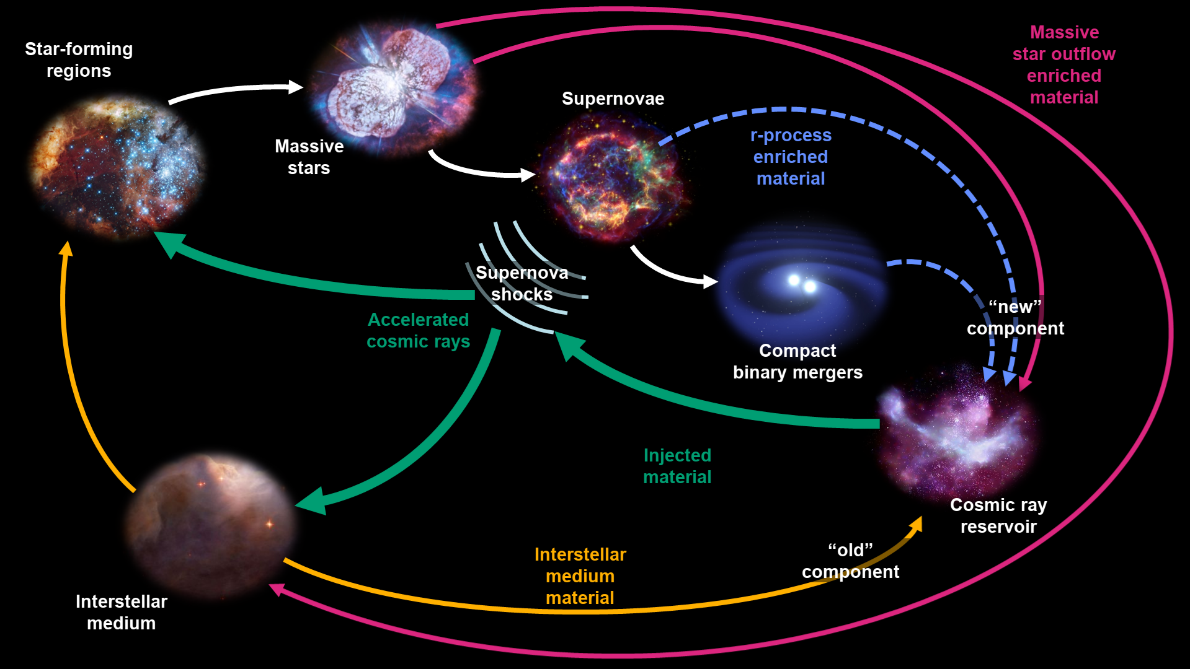
Cosmic Rays in the Grand Cycle of Matter
The overall TIGERISS mission goal is to increase our understanding of how the Galaxy produces and distributes the elements. These goals come from the NASA decadal survey’s questions:
Where is main site of r-process nucleosynthesis?
How the “injection of energy, momentum, and metals from stars” circulates matter?

Slide 6
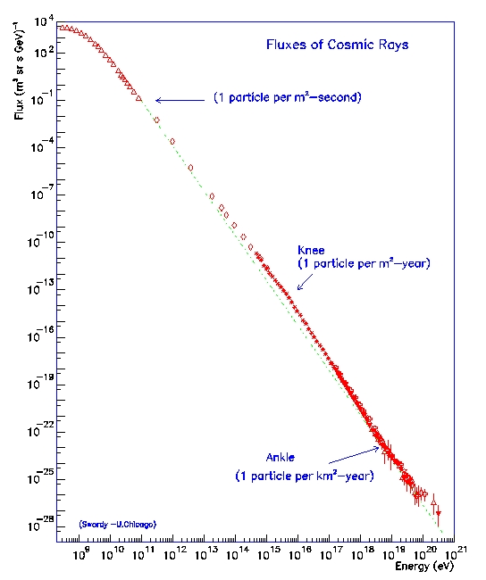
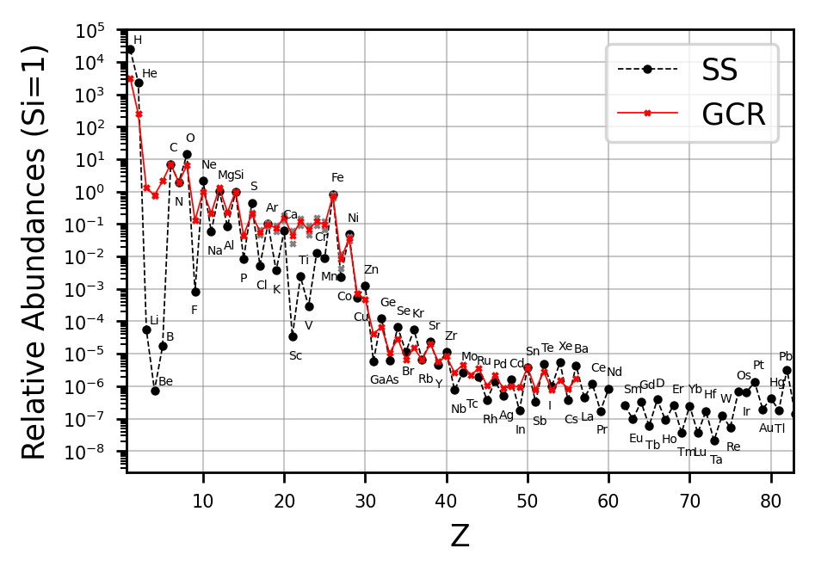

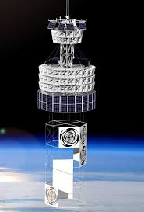
Ultra-Heavy Galactic Cosmic Rays (UHGCRs)
Extra-
Galactic?
ANITA/
PUEO
SuperTIGER
TIGERISS
CALET
SuperTIGER
TIGERISS

Slide 7
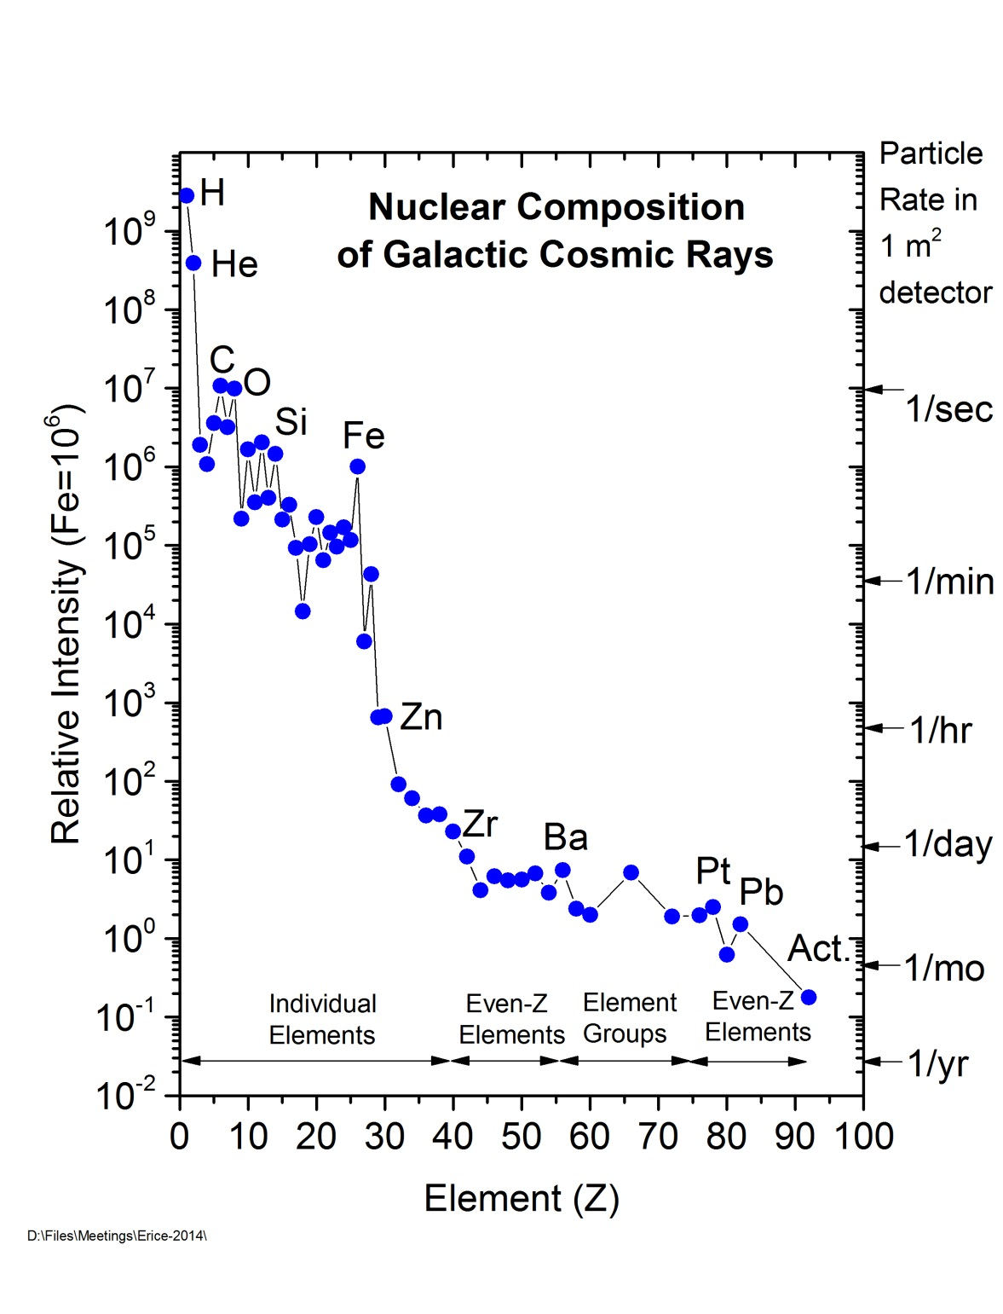
Cosmic Rays and Atomic Number
Relative abundances depend on nucleosynthetic sources
  Big Bang: ₁H and ₂He
  Fusion: up to ₂₆Fe
  r- and s-process neutron capture:
  past ₂₆Fe
  Cosmic-ray spallation: ₃Li, ₄Be, and ₅B
What source for s-process neutron capture versus atomic number
  Massive star outflow prior to supernovae
  ?
What source for r-process neutron capture versus atomic number
  Supernovae (SNe)
  Compact binary merger (CBM), e.g., binary neutron star mergers (BNSM)
  ?
TIGERISS
HEAO-3-HNE
ACE-CRIS
CALET
SuperTIGER

Slide 8
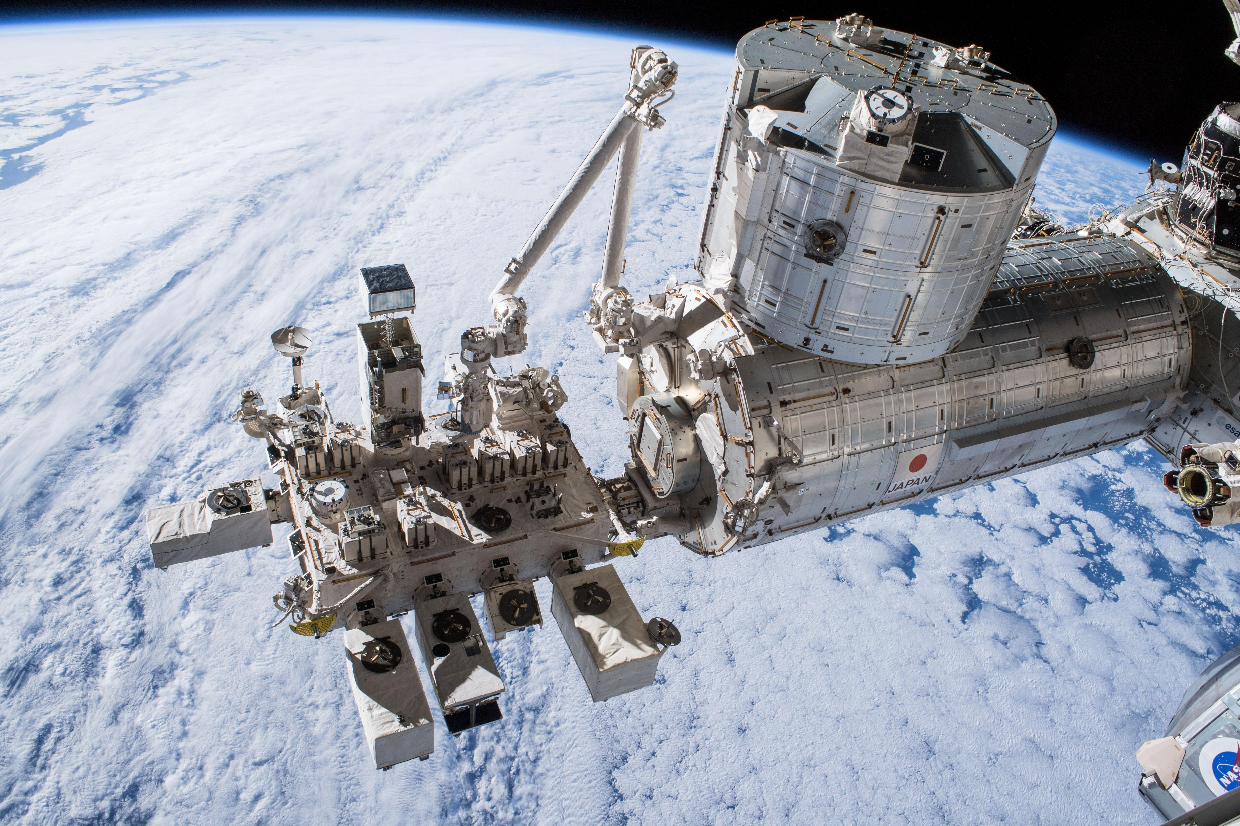
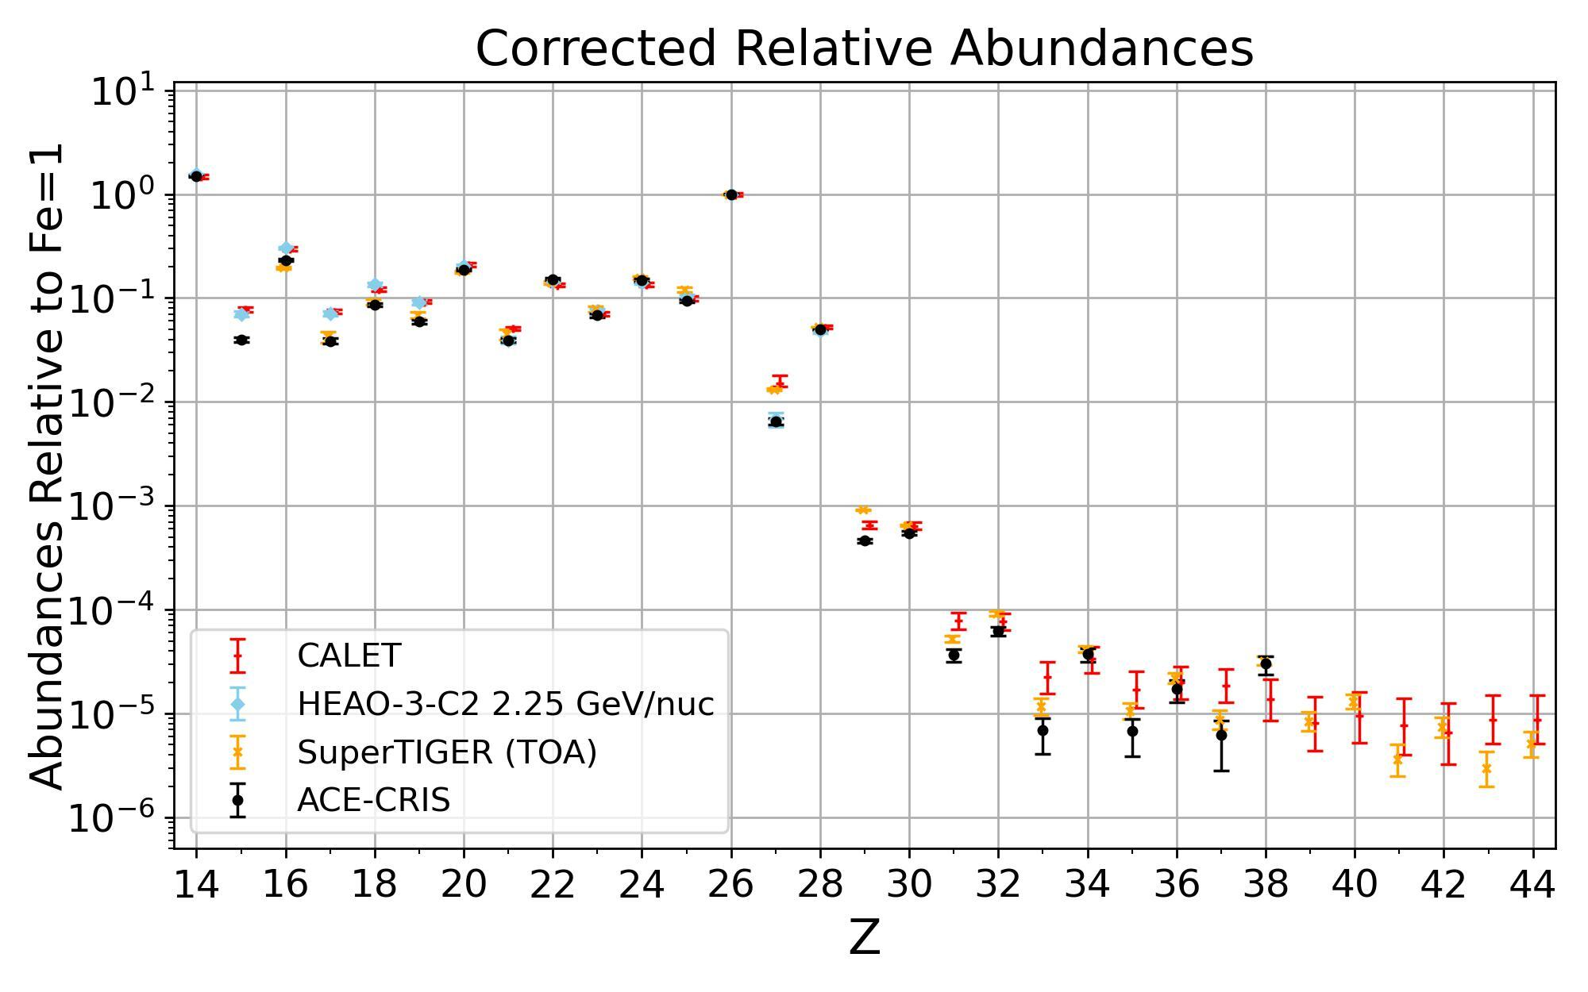
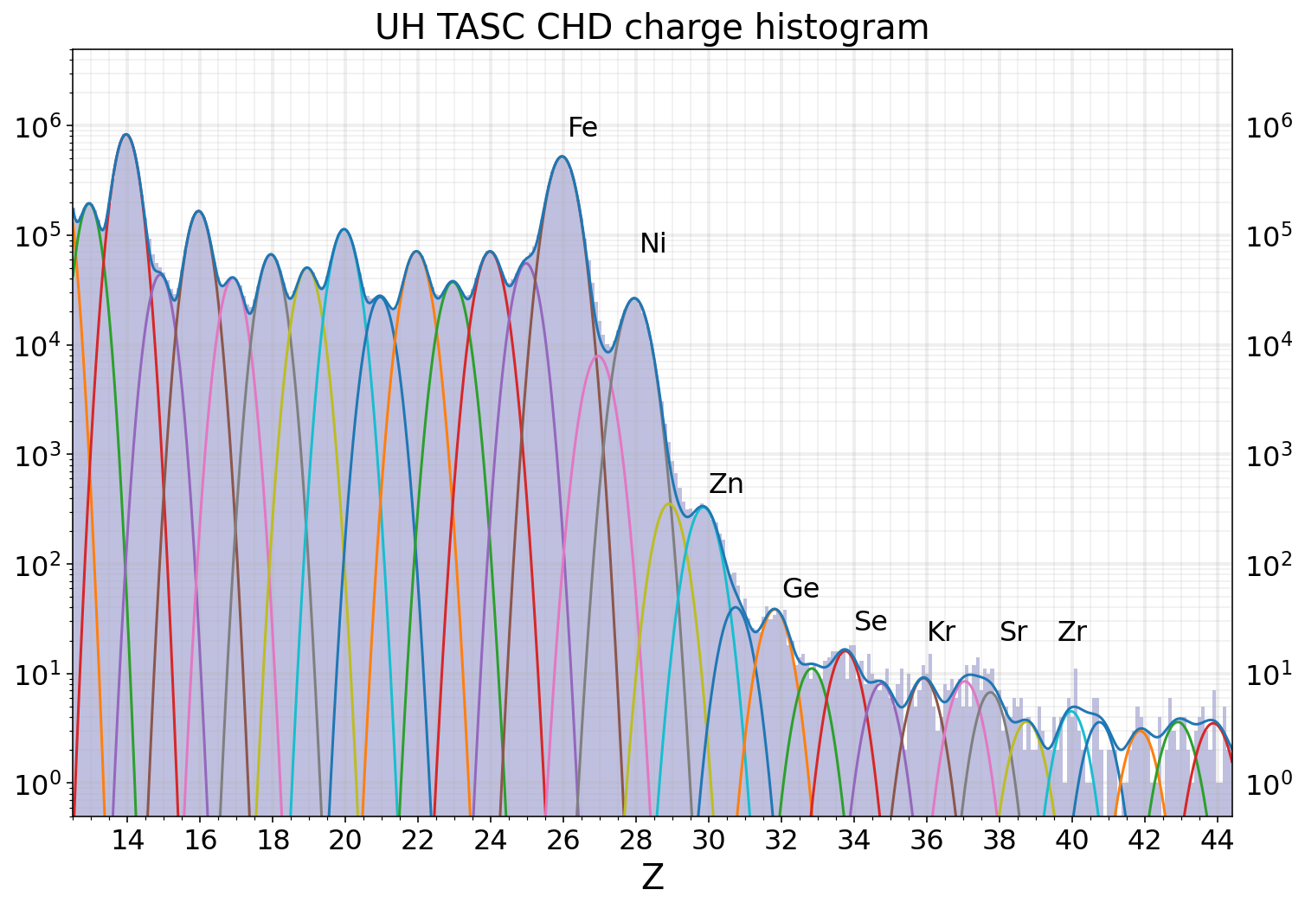

Calorimetric Electron Telescope (CALET)
Preliminary
CALET
Preliminary
Wolfgang Zober’s APJ CALET UHGCR paper submitted and nearly through review.

Slide 9
Previous Ultra-Heavy Cosmic Ray Results
HEAO-HNE
Ariel 6
Left Figure is the chare histogram from HEAO-HNE (Sep. 1979 – Jan. 1981), which resolved only even-odd pairs for Z < 60 (Binns et al. 1983)
Right Figure is the charge histogram from Ariel 6 (June 1979 - Feb. 1982), which also had limited resolution (Fowler et al. 1987)

Slide 10
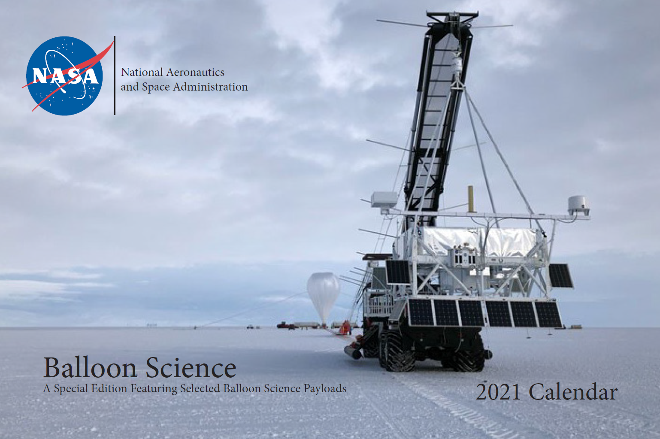
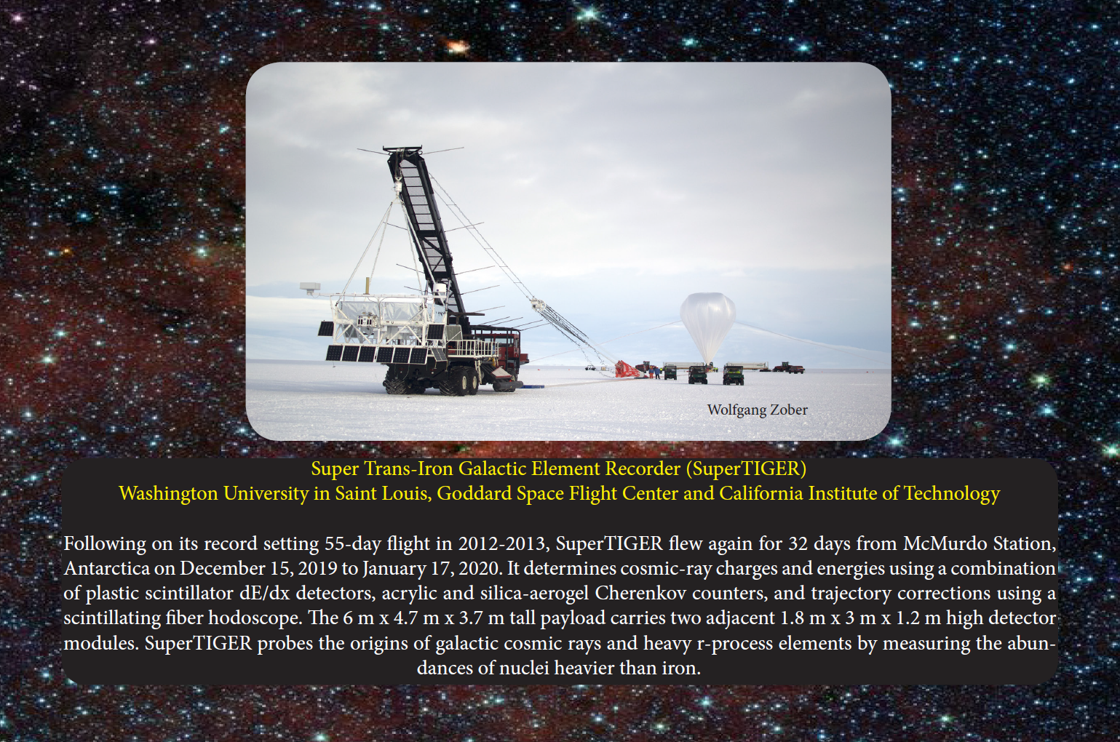
New Measurements Needed:
Instrument Development with Balloons
Economical access to near space for large payloads up to ~6,000 lbs, possible reflight.
Student involvement spanning entire project life and include many project roles.

Slide 11
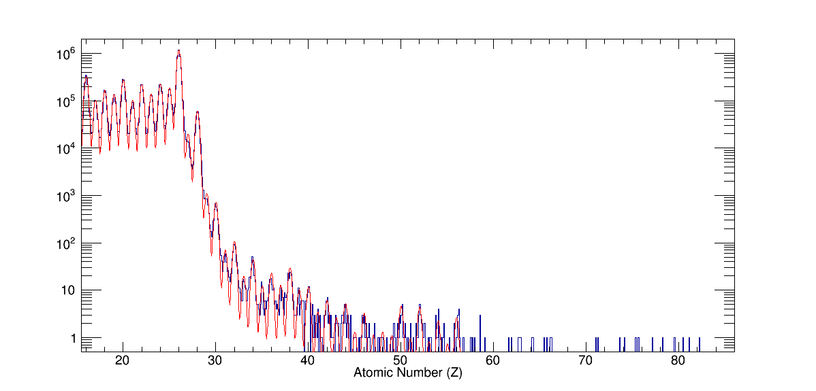
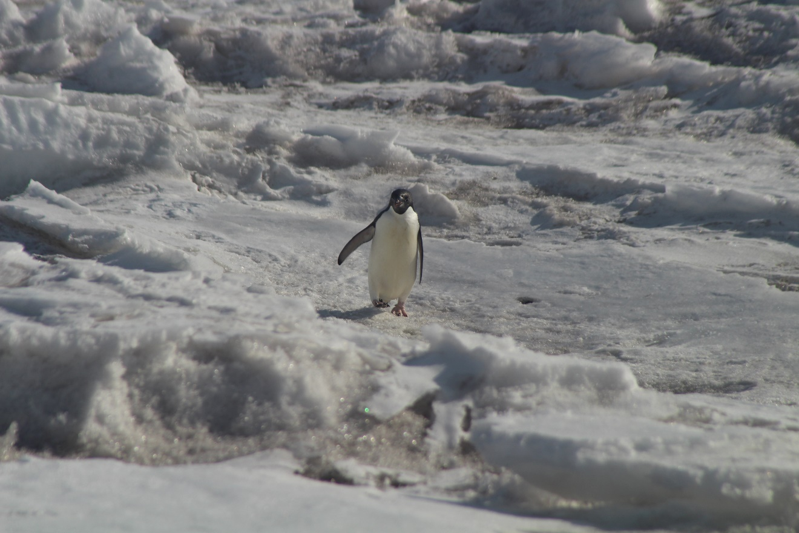
SuperTIGER Cosmic Ray Abundances
Record 55-day flight
~8 times the UHGCR data collected with the two TIGER flights
Best measurement of
30 ≤ Z ≤ 56
- Nathan Elliot Walsh, SuperTIGER Elemental Abundances for the Charge Range 41≤Z≤56, PhD thesis, Washington University in St. Louis, 2020.

Slide 12
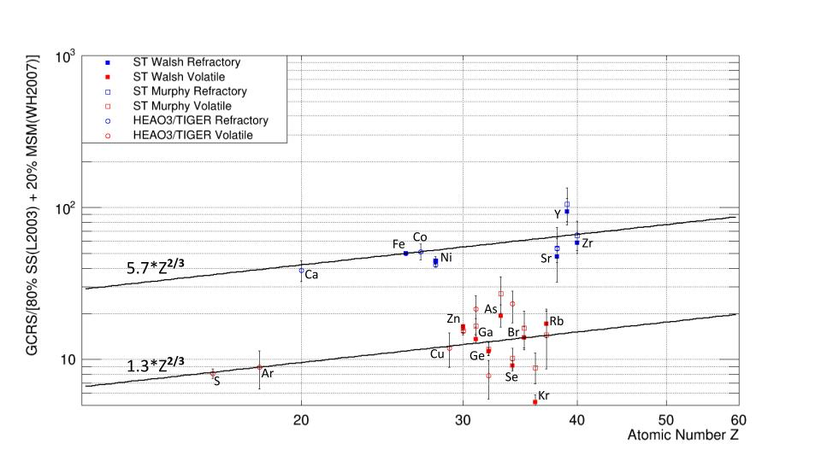
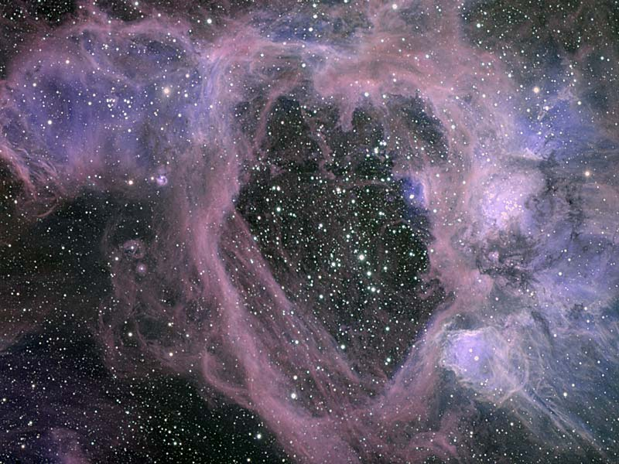
OB Association Source Model Good Z≤40
Current OB association Galactic cosmic ray source (GCRS) model predictions:
  GCRS = ~80% ISM + ~20% MSM
  interstellar medium (ISM) is similar in composition to Solar System (SS) material
  massive star material (MSM) includes stellar wind outflow and supernova (SN) ejecta
Refractory elements more likely in dust grains than volatiles preferentially injected into the accelerator
Z^{2/3} injection dependence from grain sputtering cross sections seen for both refractories and volatiles
N44 Superbubble in LMC
Credit: Gemini Observatory, AURA, NSF
- Nathan Elliot Walsh, SuperTIGER Elemental Abundances for the Charge Range 41≤Z≤56, PhD thesis, Washington University in St. Louis, 2020.
- Rauch et al. 2009
- Murphy et al. 2016

Slide 13
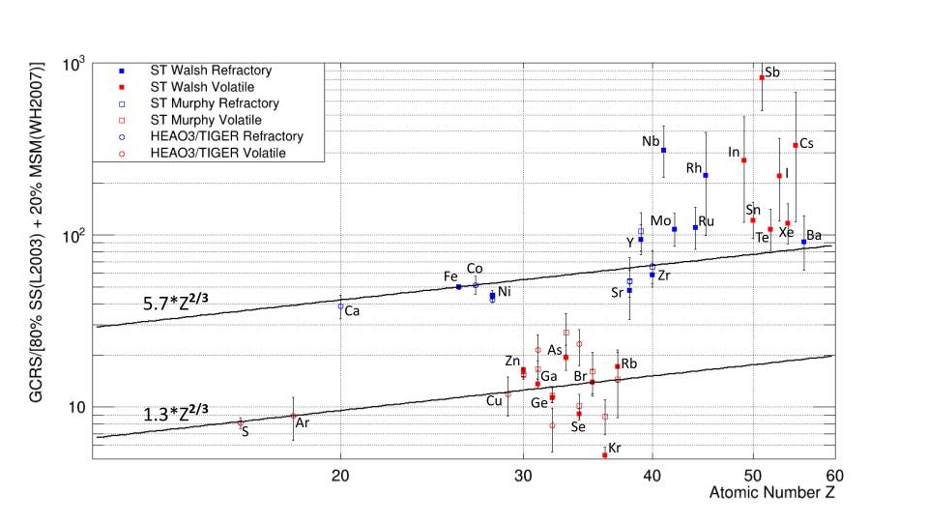
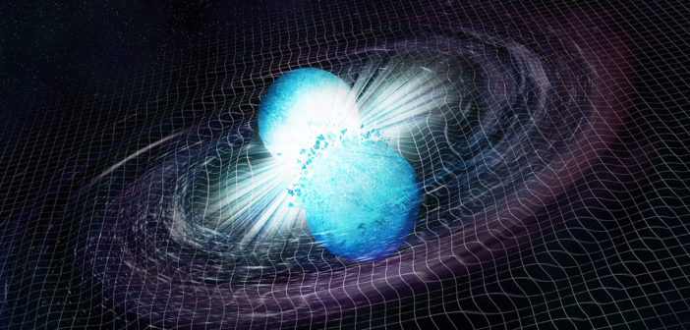
Apparent Model Breakdown for Z>40
SuperTIGER Z>40 abundances elevated over refractory line: Model is missing something
  Change in acceleration mechanism?
  New source component, e.g., neutron star mergers? (Observed in ejecta from GW170817 )
Artist’s illustration of the merger of two neutron stars. [NASA/CXC/M.Weiss]
- Nathan Elliot Walsh, SuperTIGER Elemental Abundances for the Charge Range 41≤Z≤56, PhD thesis, Washington University in St. Louis, 2020.

Slide 14
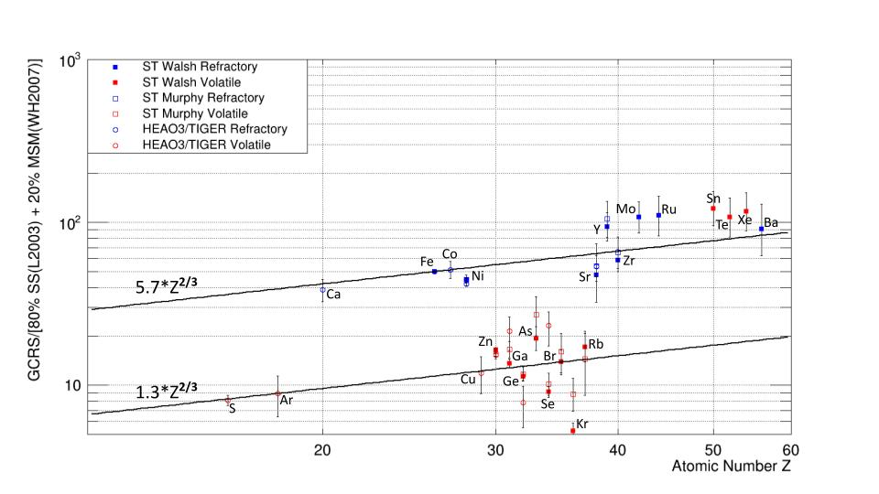
Apparent Model Breakdown for Z>40
Even Elements Only
  Odd elements likely overestimated due to contamination from even-element peak spill over
  Elevated volatile elements largely r-process
r- ,s-, and p-process decomposition of solar system abundances
West & Heger (2013) ApJ 774:75

Slide 15
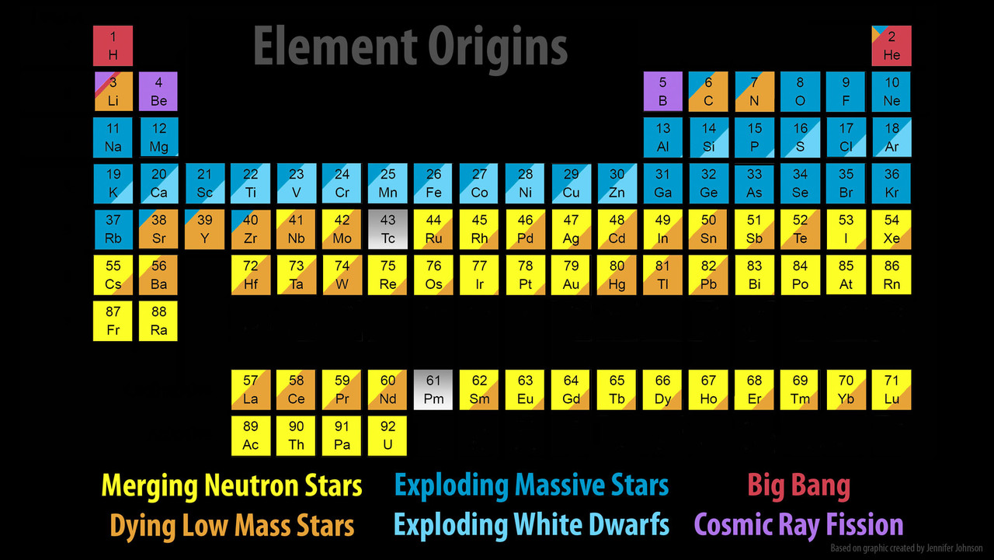
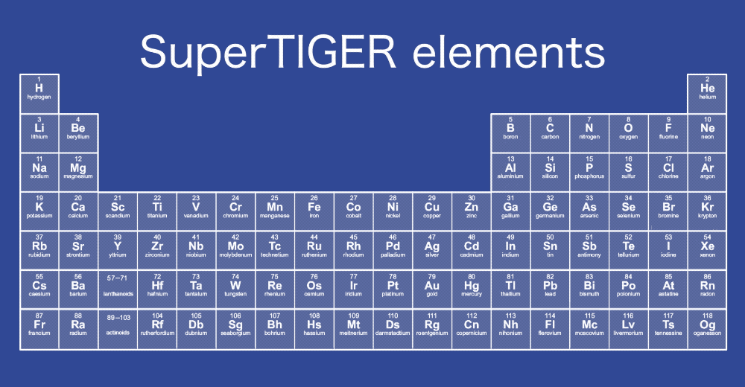
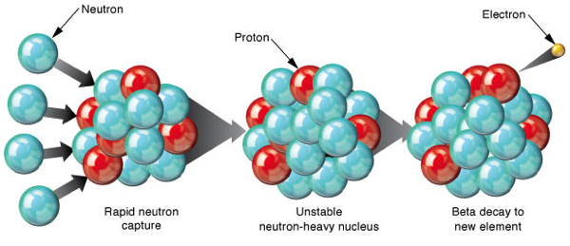
Heavy Element Production vs. ST Reach
Explosive nucleosynthesis r-process AND/OR Neutron star merger r-process : signature in elemental ratios.
1 year of TIGERISS Data
₅₀Sn + ₅₆Ba (s-process: 63; r-process 19)
₅₂Te + ₅₄Xe (s-process: 12; r-process 60)
r-process neutron capture

Slide 16
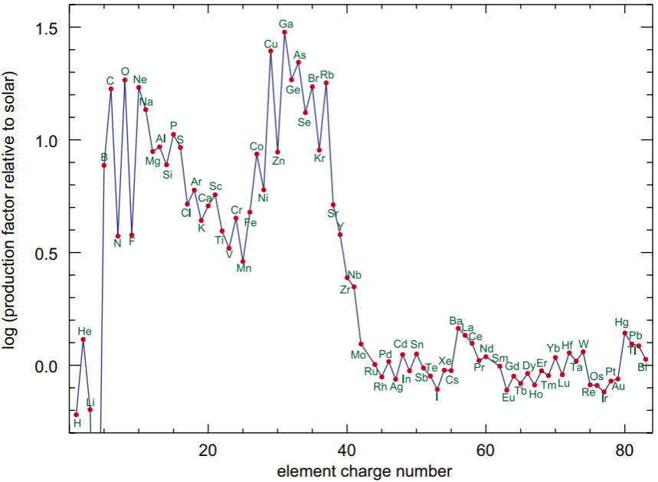
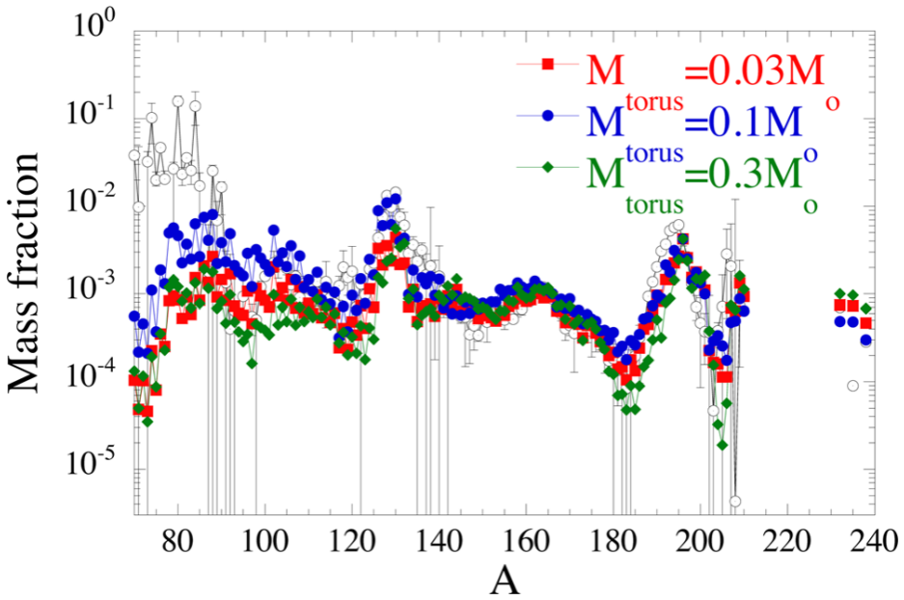
Heavy Element Production Models
How and where are the heaviest elements created?
Absolute and relative abundances of r- & s-process elements probe NSM physics and contributions to GCRs – part of a multi-messenger approach
SuperTIGER measured part of the transition region between SN and NSM production at Z~40 (A~90)
Nathan’s dissertation results paved the way for TIGERISS, which will reach ₇₈Pt-₈₂Pb region with single element resolution and further constrain NSM production models
OB association production
NSM production
Supernova (SN) production relative to solar composition Woosley & Heger (2007) PhR 442:269W
Neutron star merger (NSM) production model compared to solar composition (open circles)
Just et al. (2015) MNRAS 448:541J

Slide 17
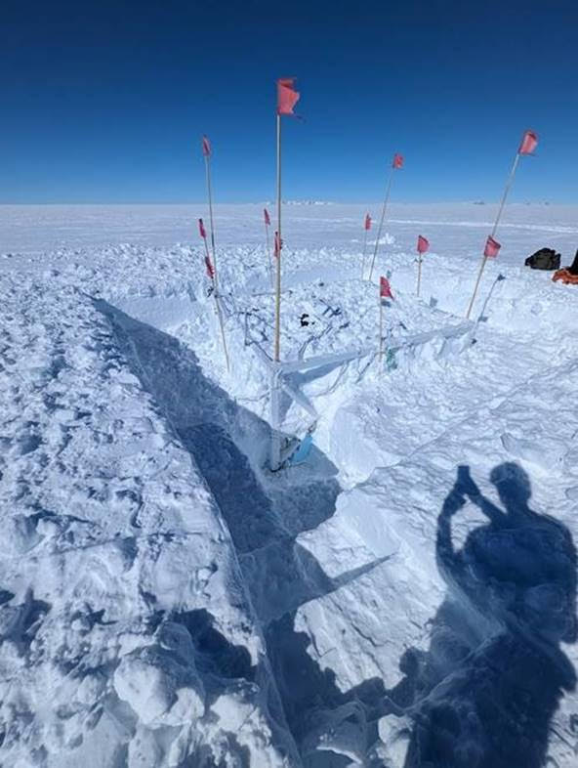
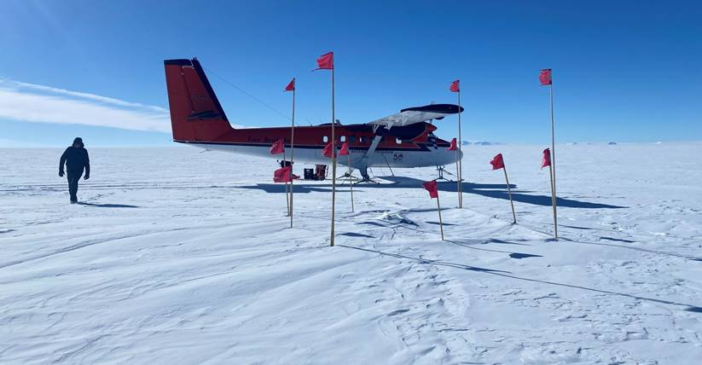
ST-2.3 Recovery Preparations
SuperTIGER-2.3 02-04-2023
SuperTIGER-2.3 12-06-2023

Slide 18
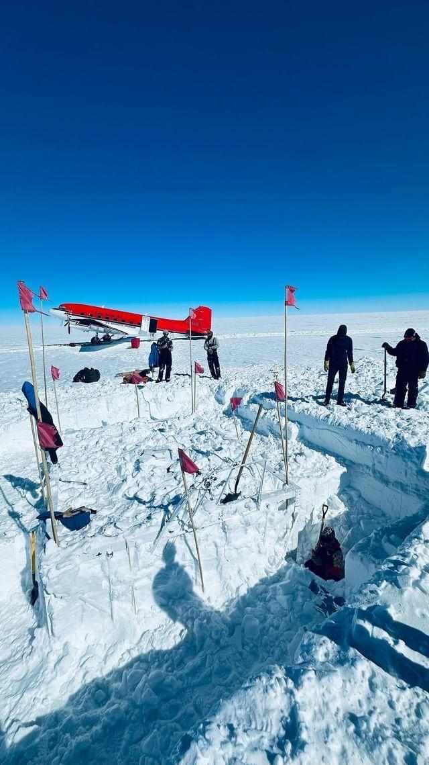
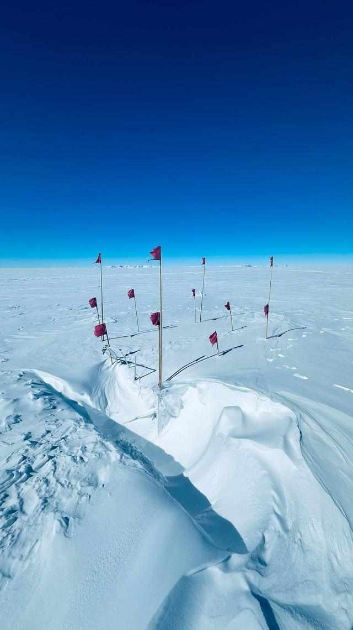
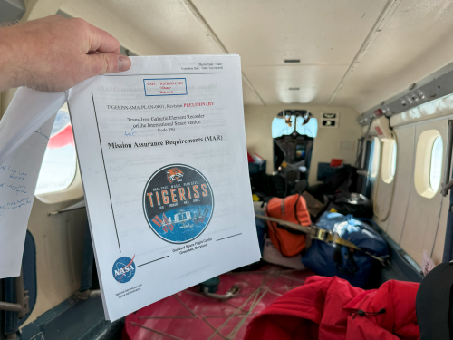
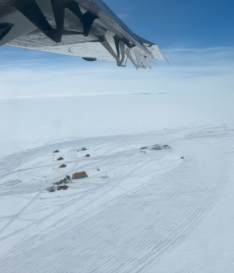
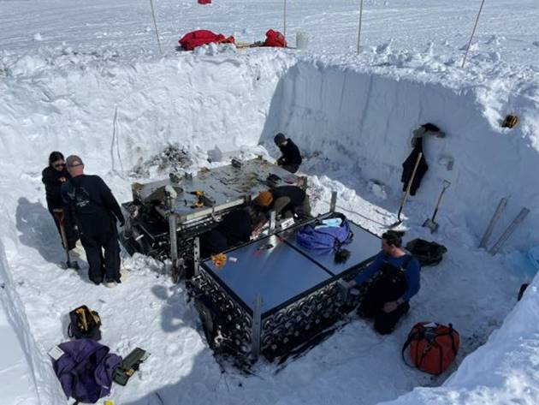
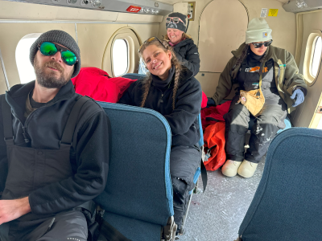
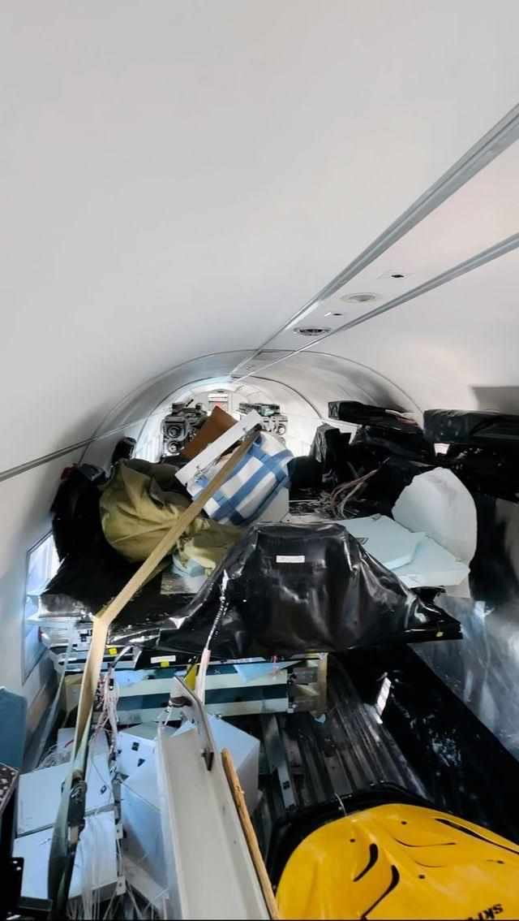
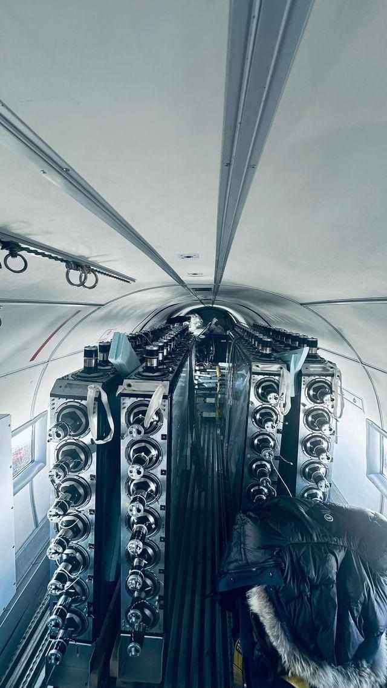
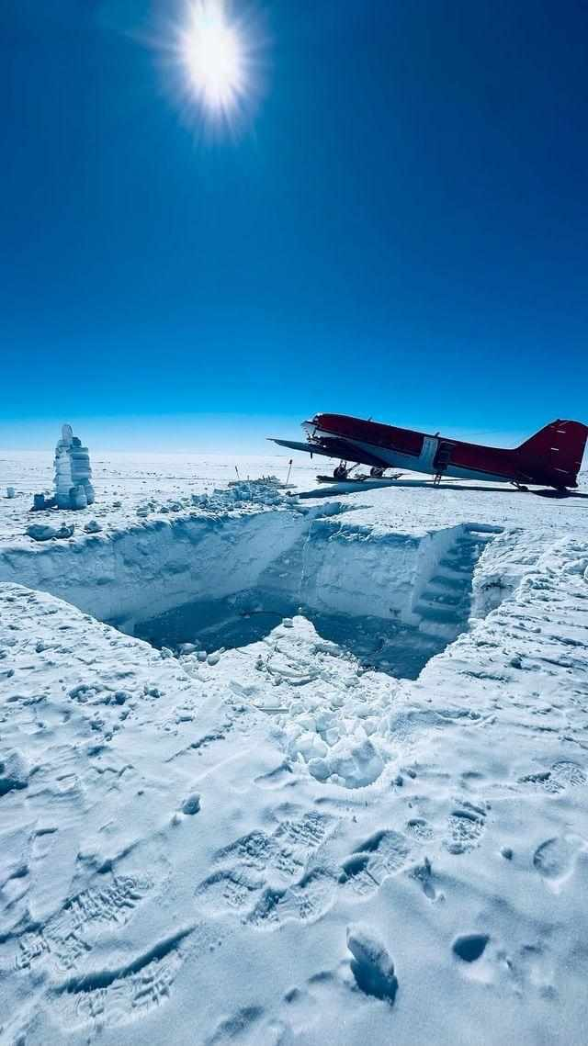
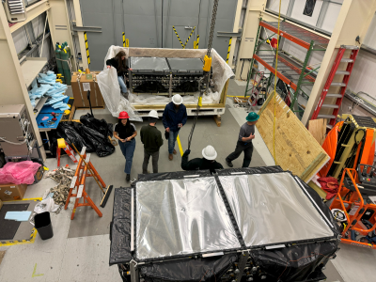
ST-2.3 Recovery

Slide 19
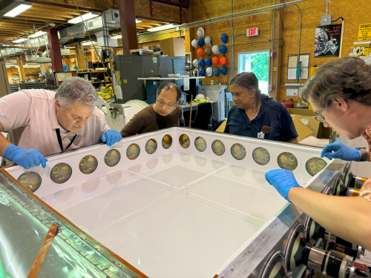
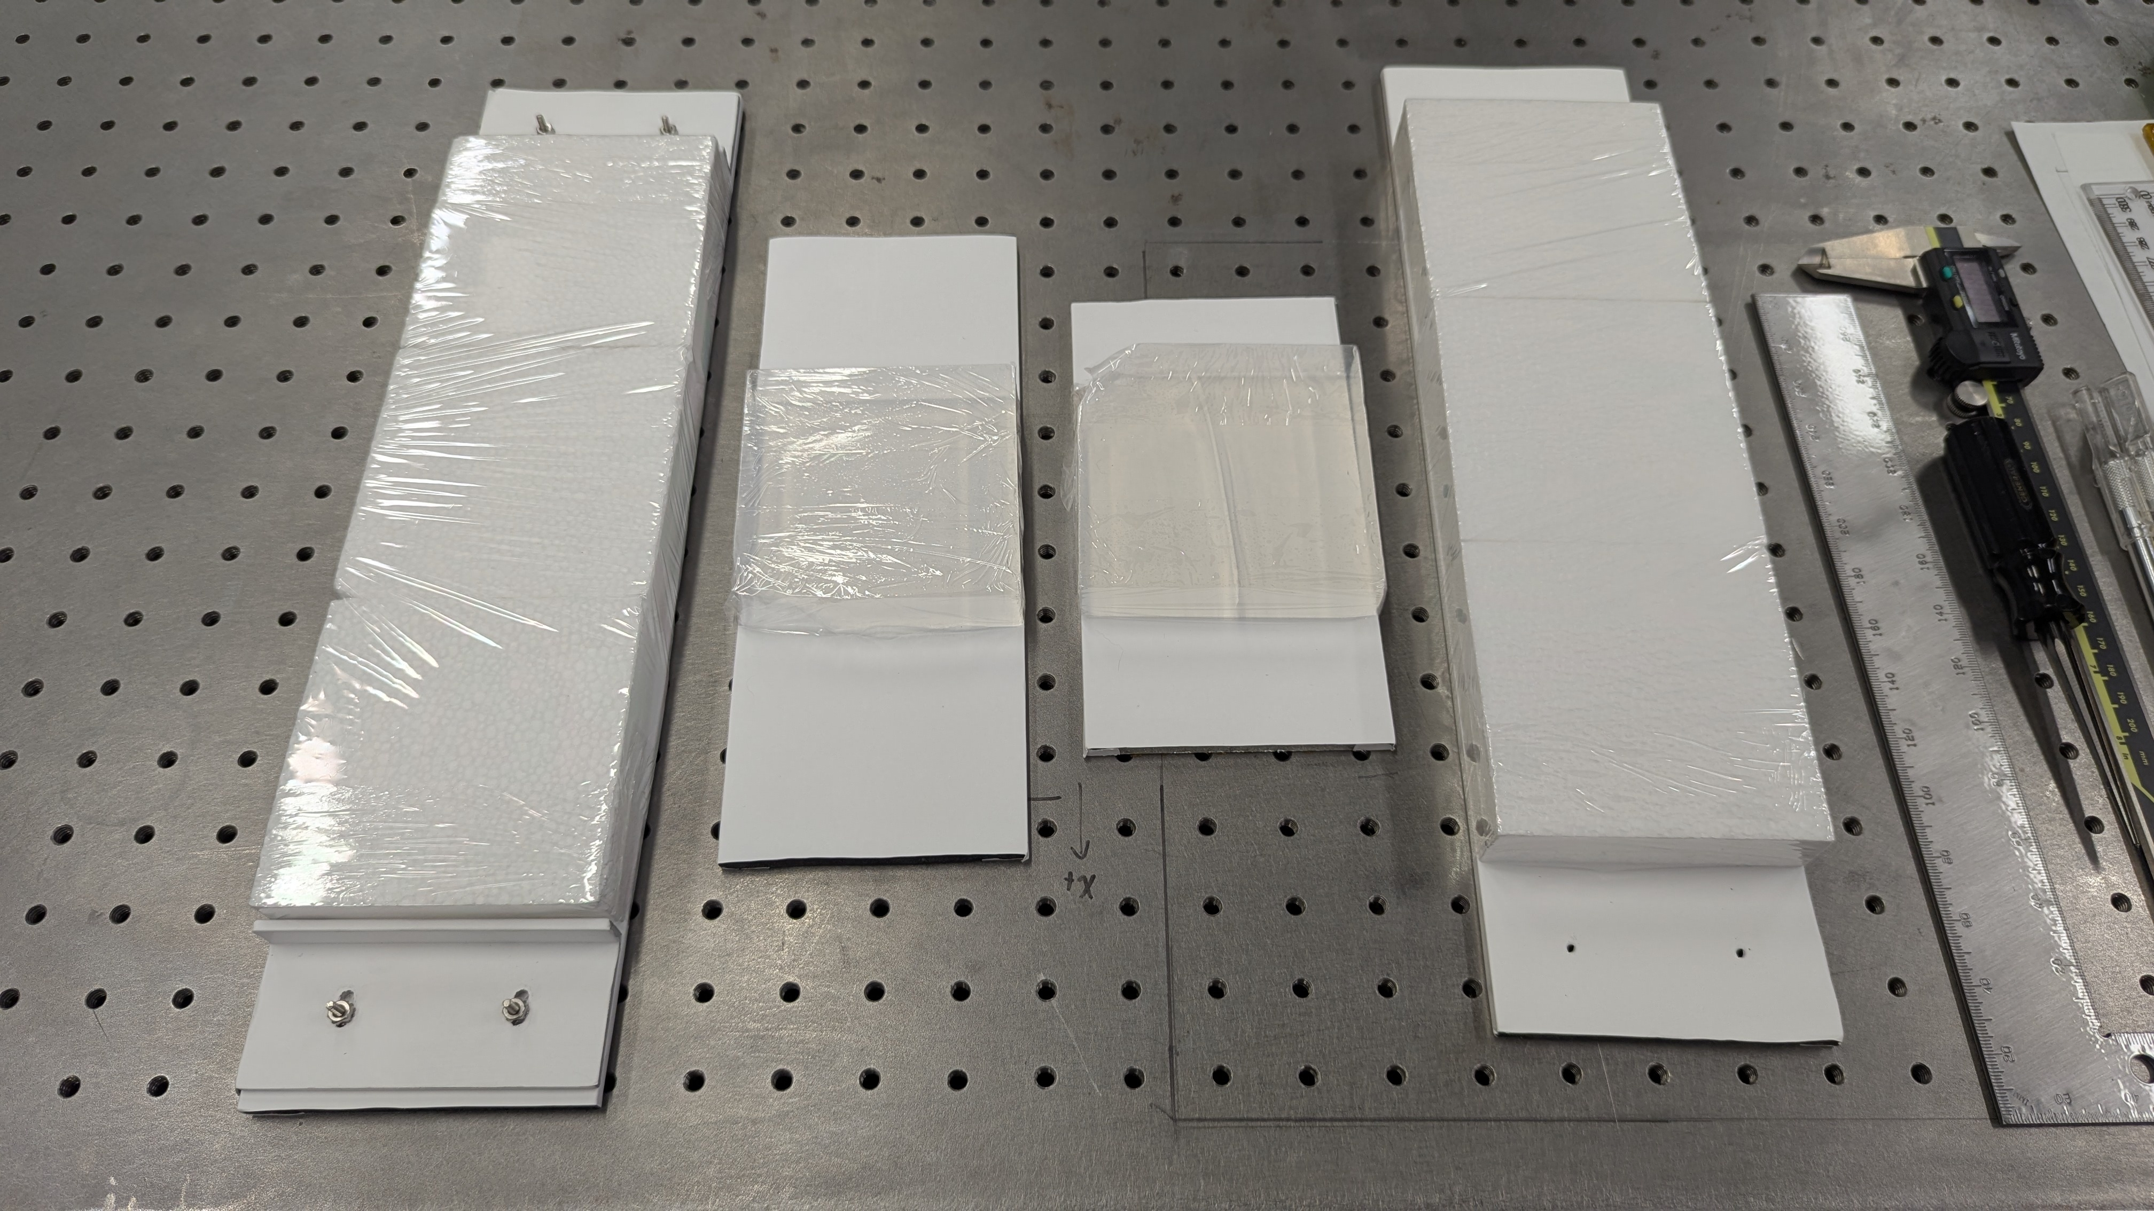
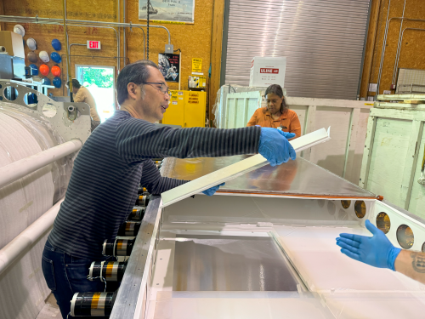
SuperTIGER vs TIGERISS Aerogel Mounting

Slide 20
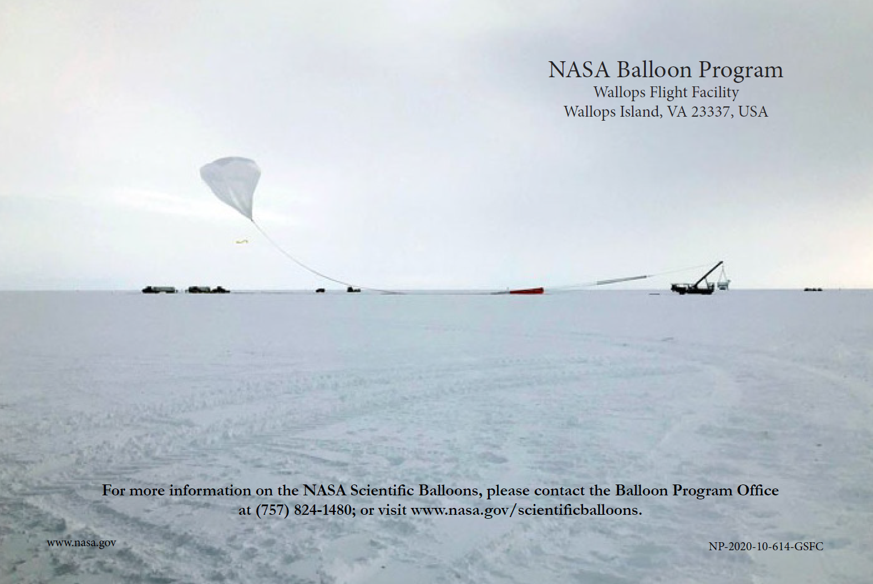

Slide 21
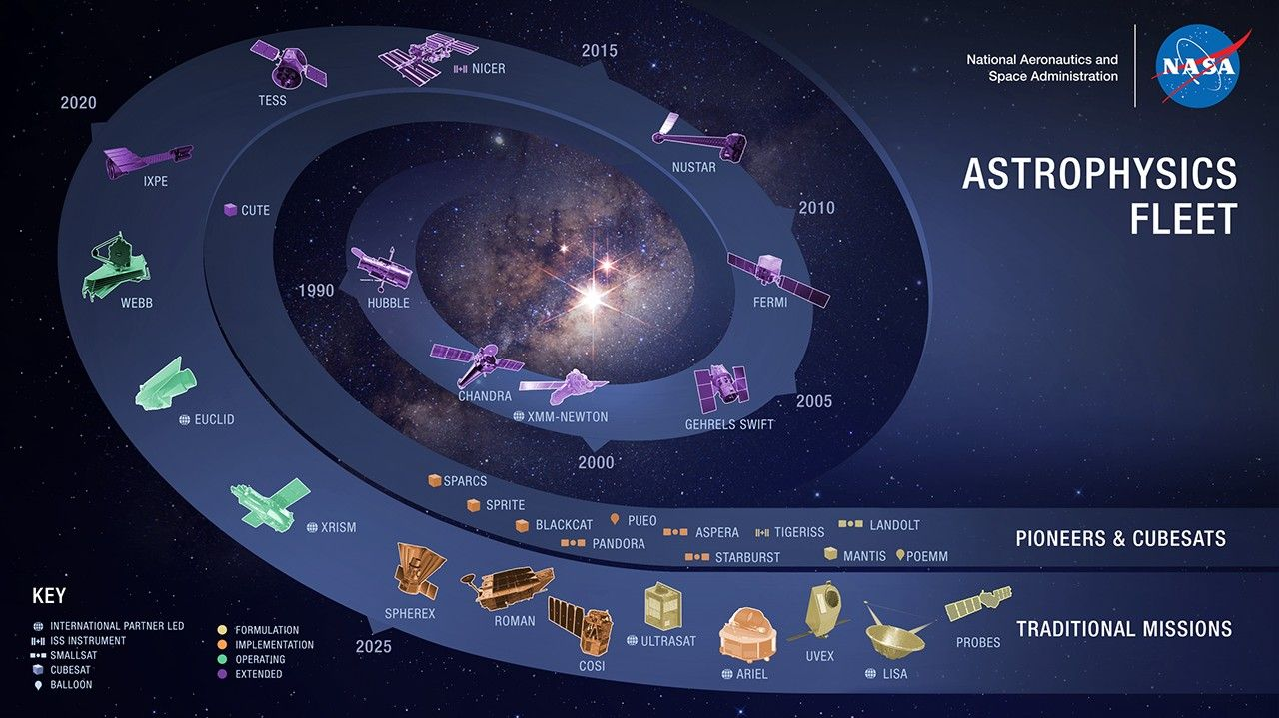
TIGERISS – A Pioneers Mission

Slide 22
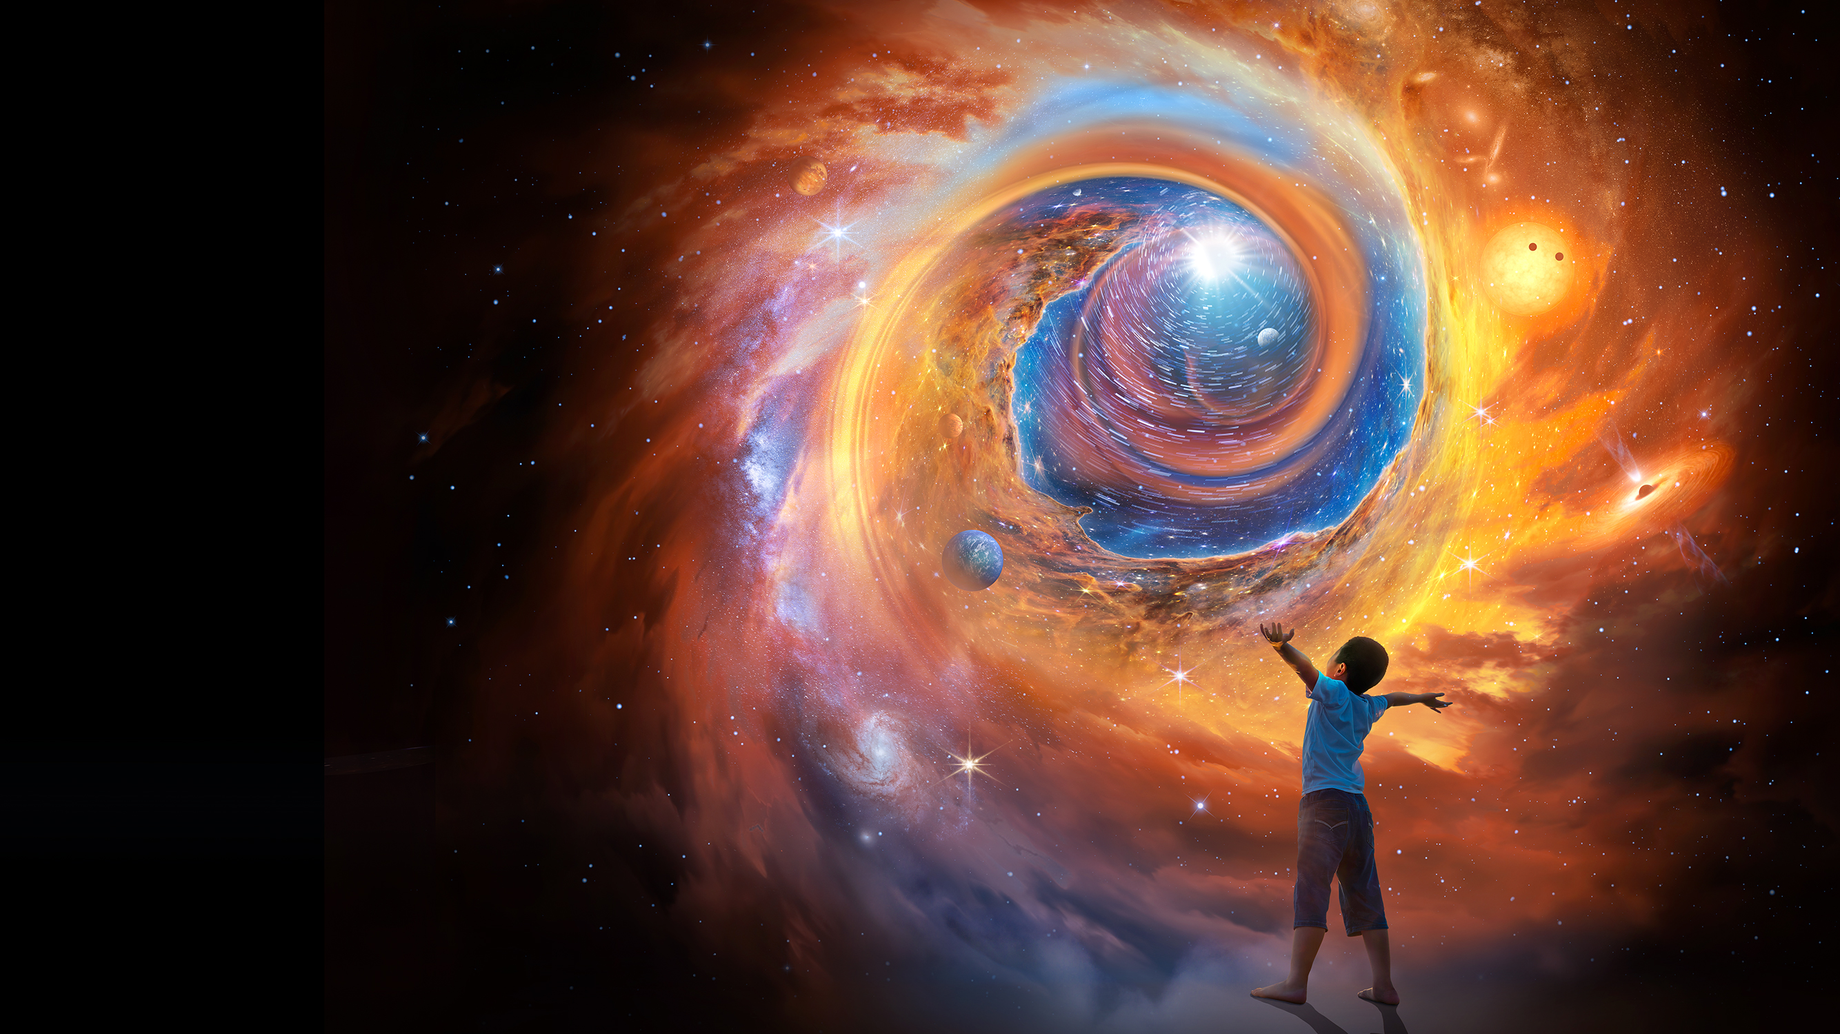

Rosa Avalos-Warren
SCaN Updates
July 2024
TIGERISS SRR/MDR division Program Management Panel (dPMP) August 27, 2024

Slide 23
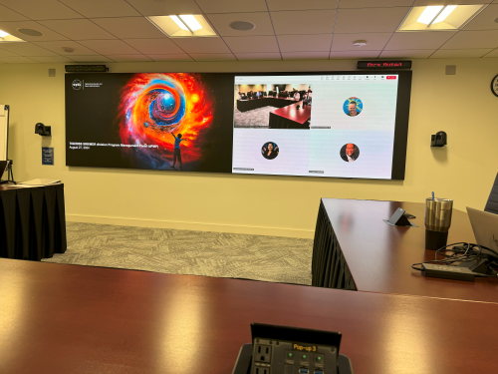
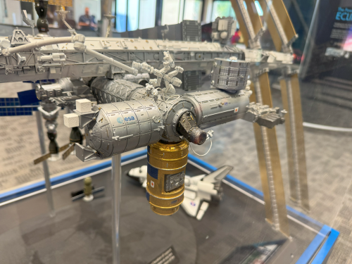
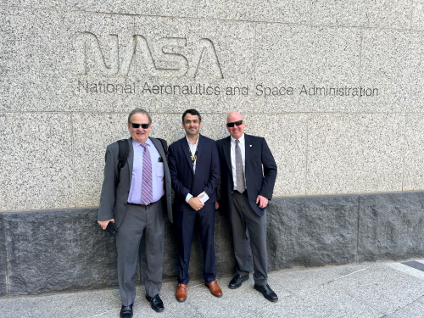
TIGERISS Past First Key Decision Point
Assigned Columbus-SOX 12/20/2024
Alternate JEM-EFU7

Slide 24
TIGERISS Schedule
Critical Path
Funded Schedule Margin
Milestones

Slide 25
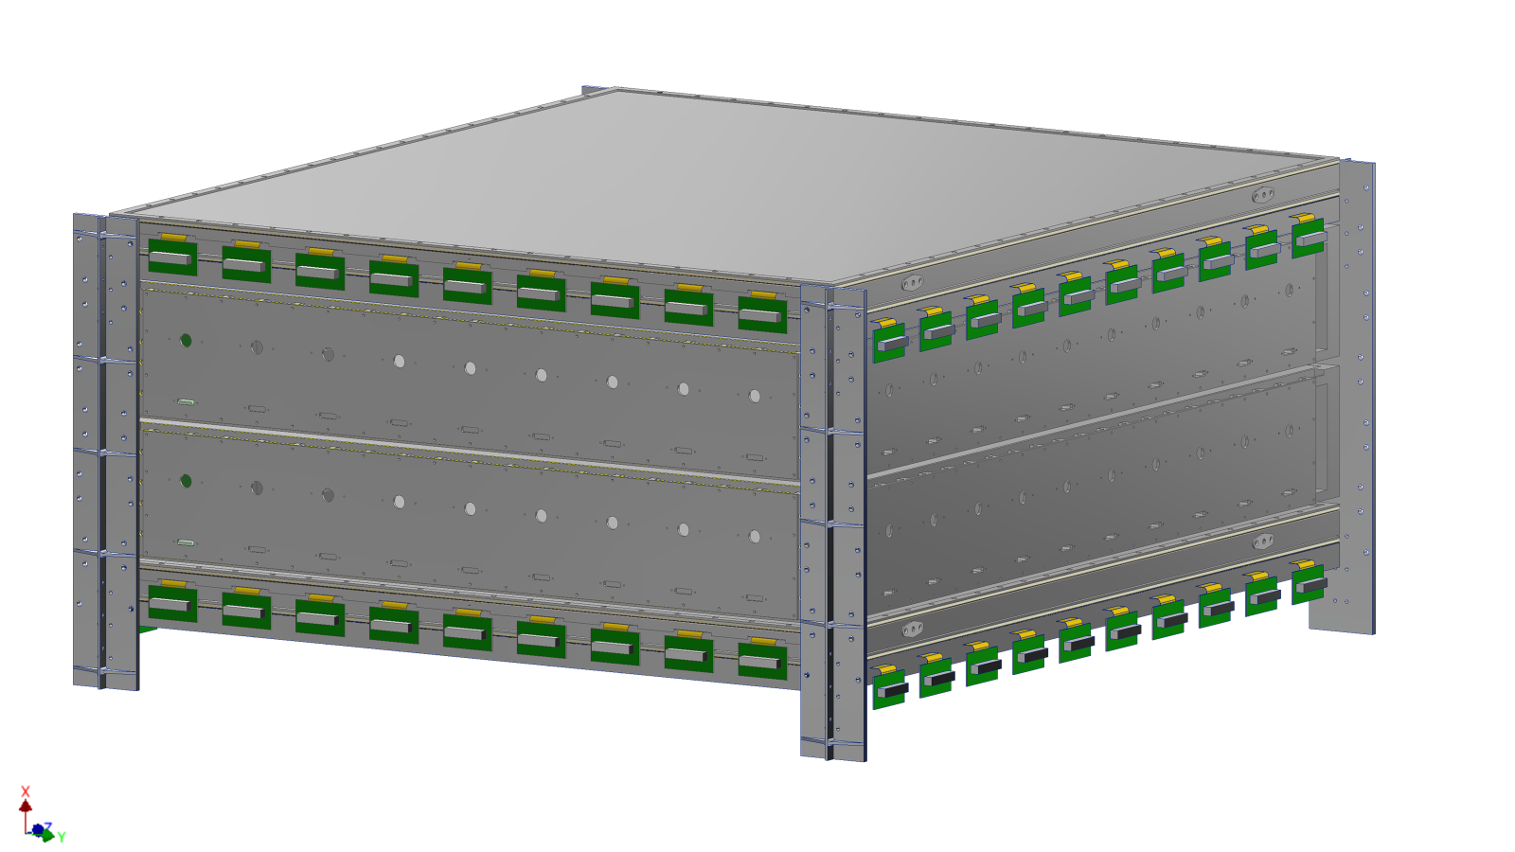
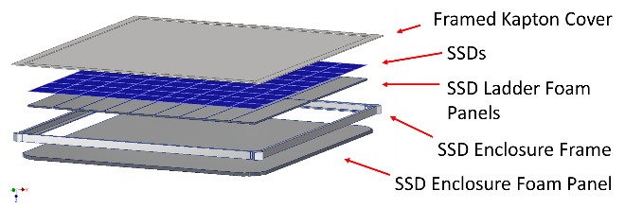



TIGERISS Columbus SOX Instrument

Slide 26

TIGERISS Measurement Method
Silicon strip detector (SSD) for precision charge measurement σ_{Q} < 0.24e for 5 ≲ Z ≤ 82 and SiPM Cherenkov detector readout based on CERN testing.
SSD CERN Pb Test Beam Results
dE/dx vs. Acrylic Cherenkov
0.33 to 2.12 GeV/nucleon
Acrylic Cherenkov vs. Silica Aerogel Cherenkov > 2.12 GeV/nucleon
Acrylic Cherenkov Detectors
n = 1.5
β ≥ 0.67
KE ≥ 325 MeV/nucleon
SiPM readout
Silica Aerogel Cherenkov Detectors
n = 1.05
β ≥ 0.0.95
KE ≥ 2.12 GeV/nucleon
SuperTIGER data for dE/dx from scintillator detectors
  σ_{Q} < 0.19e up to ₃₀Zn - measured
  σ_{Q} < 0.20e up to ₅₆Ba - measured
  σ_{Q} < 0.21e up to ₈₂Pb - extrapolated
TIGERISS with reduced saturation in SSD will do better

Slide 27


Beam Tests Comparing SuperTIGER Scintillators with Silicon Strip Detectors
TIGERISS will use Silicon Strip Detectors (SSDs)
  better signal saturation than scintillators - demonstrated at CERN beam tests
  provide both position and charge information
TIGERISS will use silicon photomultipliers (SiPMs) that operate at ~50 V instead of PMTs at HV (~1000 V) to mitigate HV concerns – also tested at CERN beam runs

Slide 28


TIGERISS Columbus SOX Payload Model
Thermal Radiators
CEPA (FRAM)
Instrument Cover
Primary Structure
1
1
3
1
4
1
Launch Requirements
Shock
Vibration
Acoustic
2
1

Slide 29


TIGERISS Columbus SOX Electronics
1
1
FOV Camera & DAQ
SSD Front End Electronics
PDM Electronics
Back End Electronics/Power Distribution
Power Unit
DAQ
2
1
6
1
3
1
5
1
4
5
1
TIGERISS mounted at Columbus-SOX
1

Slide 30


TIGERISS Mechanical Modeling
Payload Level Model Update
Finite Element Model (FEM) of Updated Primary Structure

Slide 31

TIGERISS Mechanical Modeling

Slide 32

TIGERISS – 1 Year of Observations
The Trans-Iron Galactic Element Recorder for the International Space Station (TIGERISS)
In one-year TIGERISS will have:
Comparable statistics to SuperTIGER-1
~1/2 statistics for HEAO-3-HNE charge group measurements (Binns et al. 1989) with individual element resolution

Slide 33

TIGERISS – 3 Years of Observations
The Trans-Iron Galactic Element Recorder for the International Space Station (TIGERISS)

Slide 34
TIGERISS – Summary
  TIGERISS will make revolutionary measurements that will transform our understanding of galactic nucleosynthesis.
  Key to answer are measurements of abundances of Ultra-Heavy Galactic Cosmic Rays: UHGCRs: Z > 28 (above Nickel)
  Astro2020 Decadal Survey Questions:
    “Are neutron star mergers the main site of r-process nucleosynthesis, or are there supernovae and other core collapse events that contribute significantly to the r-process budget of the universe?”
    scientists “may be able to use heavy cosmic-ray abundance measurements in the Milky Way to constrain sites of r-process nucleosynthesis.”
  TIGERISS will accomplish this by measuring the elemental composition from ⁵B through ⁸²Pb.

Slide 35





Acknowledgements and Disclaimer
NASA grants for CALET (NNX11AE02G, NNX16AC02G, and 80NSSC20K0399) and SuperTIGER (NNX15AC23G and 80NSSC20K0405), and a cooperative agreement for TIGERISS (80NSSC22M0299).
The ANITA, SuperTIGER and TIGERISS efforts has been supported at Washington University in St. Louis by a grant from the Peggy and Steve Fossett Foundation and by the McDonnell Center for the Space Sciences.
We thank the NASA Columbia Scientific Balloon Facility, the NASA Balloon Program Office, the NSF United States Antarctic Program, and the Antarctic Support Contract for the record long-duration balloon flight for SuperTIGER-1, the successful recovery efforts, and the 32-day SuperTIGER-2.3 flight providing scientific and technical background for TIGERISS.
The material contained in this document is based upon work supported by a National Aeronautics and Space Administration (NASA) grant or cooperative agreement. Any opinions, findings, conclusions, or recommendations expressed in this material are those of the author and do not necessarily reflect the views of NASA.
Peggy and Steve Fossett Foundation
35

