Slide 1


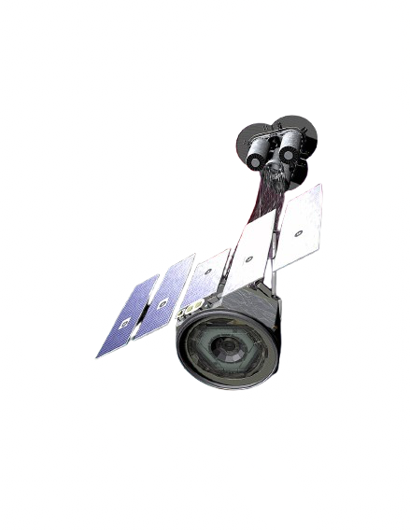





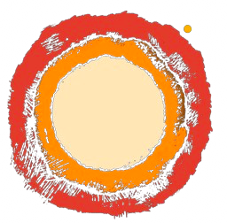



IXPE Gas Pixel Detector test and characterization with the X-ray Calibration Facility
Stefano Tugliani
Simone Maldera, Andrea Frassà, Raffaella Bonino,
Nicolò Cibrario, Luca Latronico, Alessio Gorgi

Slide 2
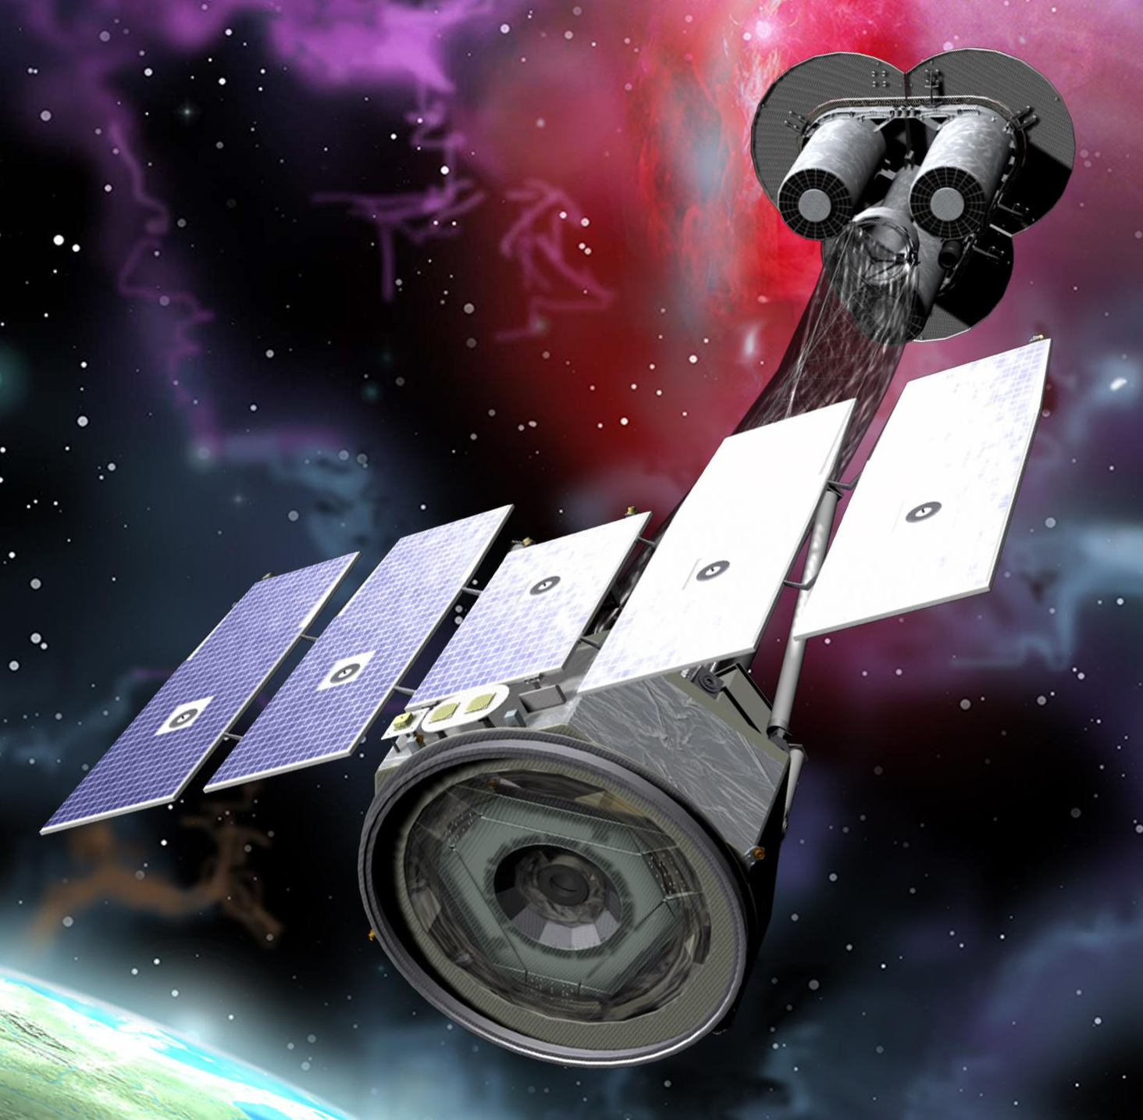
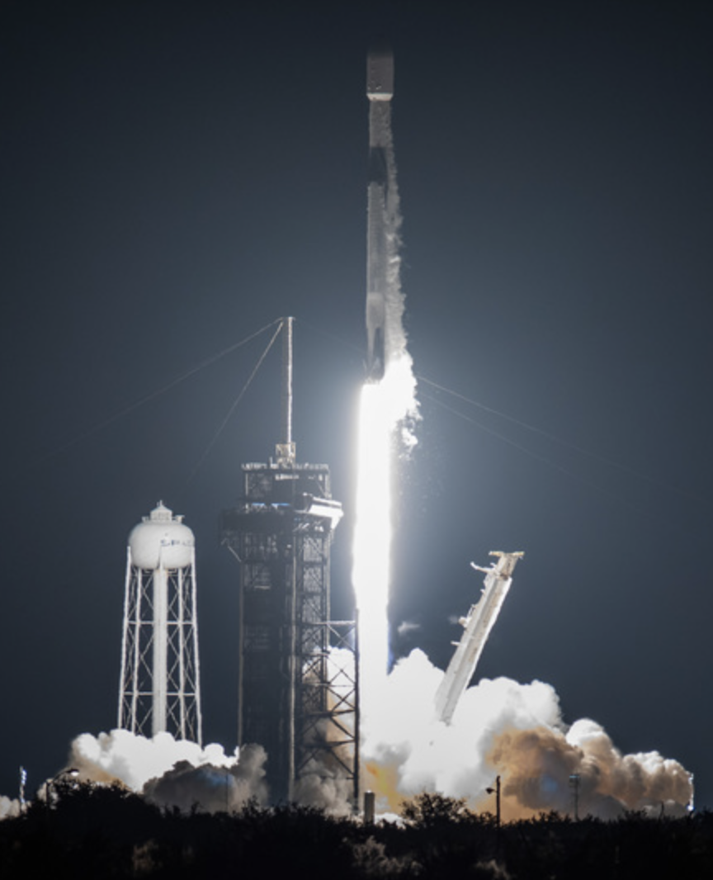
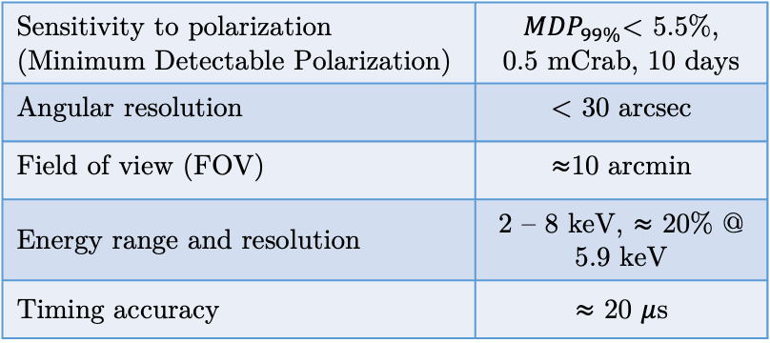

IXPE: Imaging X-ray Polarimetry Explorer
X-ray Astrophysics: study of the high energy Universe.
Orbiting telescopes because of atmospheric opacity to X-rays.
$$⟹$$
Weisskopf et al. (2021)
Characteristics of celestial sources
The state-of-art of X-ray polarimetry: Imaging X-ray Polarimetry Explorer, IXPE, a space mission (NASA and ASI collaboration), launched on 9 December 2021 (equatorial orbit at 600 km) that measures the linear polarization of different astrophysical sources in the energy range 2-8 keV
Electromagnetic Radiation
spatial, spectral, timing and polarization properties
Sensitivity to polarization (Minimum Detectable Polarization) | ${MDP}_{99\%}$< 5.5%, 0.5 mCrab, 10 days
Angular resolution | < 30 arcsec
Field of view (FOV) | $≈$10 arcmin
Energy range and resolution | 2 – 8 keV, $≈$ 20% @ 5.9 keV
Timing accuracy | $≈$ 20 $μ$s
Information about the geometry both of the emitting matter and of magnetic and gravitational fields.
15/05/2025
IXPE GPD test and characterization with the XCF
Stefano Tugliani
2

Slide 3
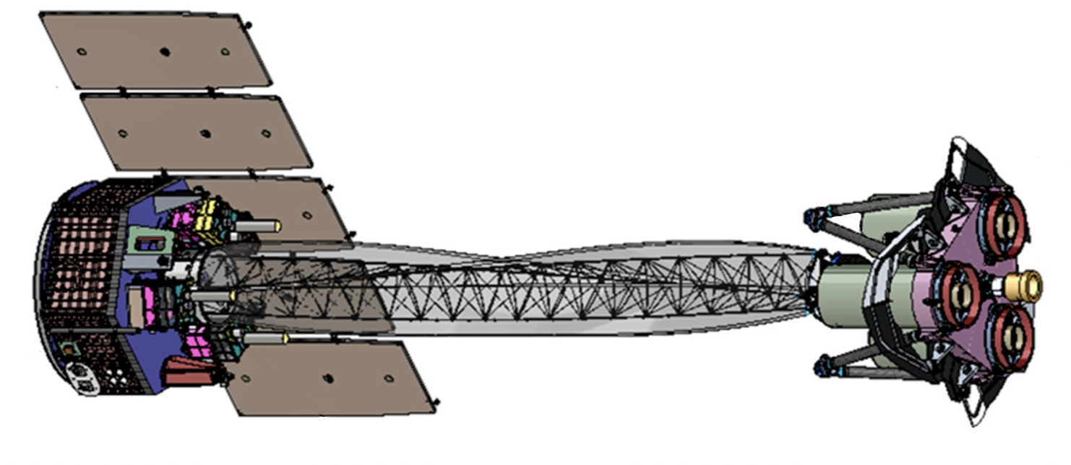
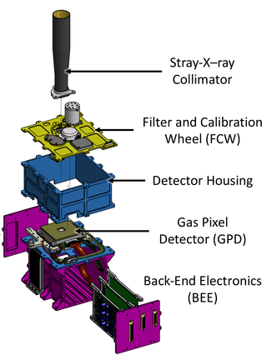
IXPE: Imaging X-ray Polarimetry Explorer
Mirror Module Assembly (x3) (Wolter I)
Boom w/ thermal Sock deployed
Detector Unit (x3)
Forward star tracker
X-ray Shields (x3) deployed
Solar array
15/05/2025
IXPE GPD test and characterization with the XCF
Stefano Tugliani
3

Slide 4
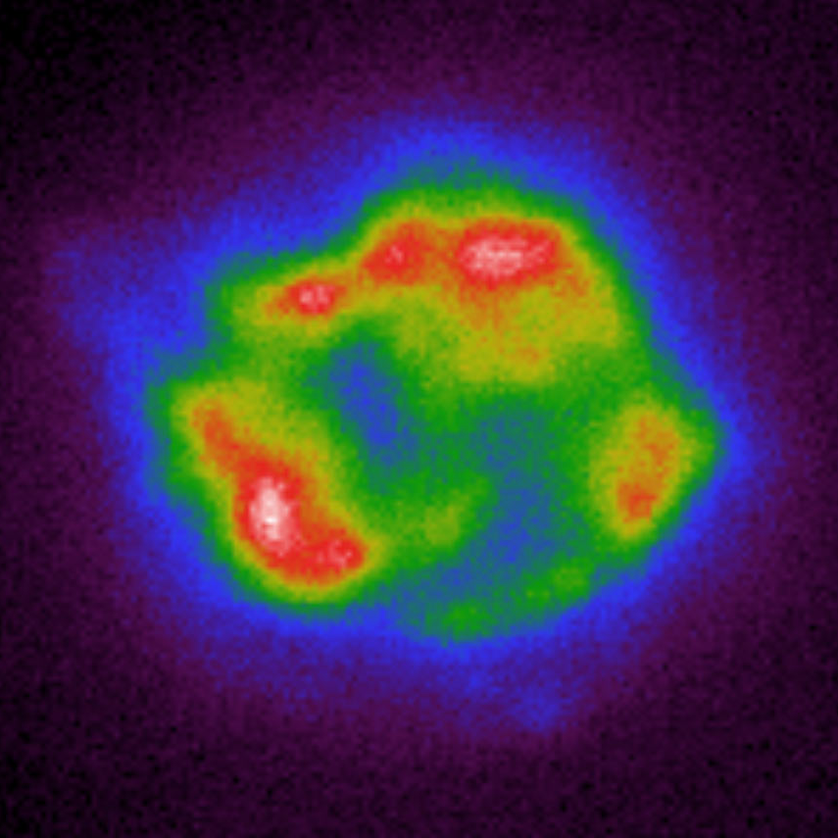


IXPE: Imaging X-ray Polarimetry Explorer
Detector
Unit
15/05/2025
IXPE GPD test and characterization with the XCF
Stefano Tugliani
4

Slide 5
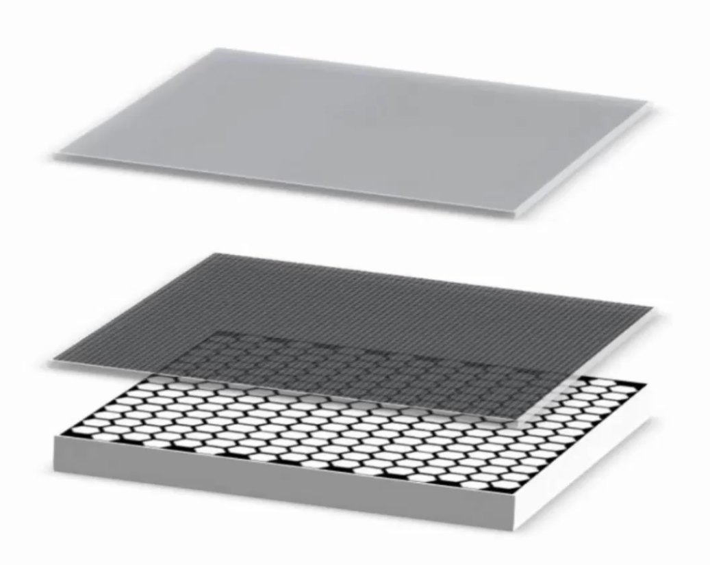
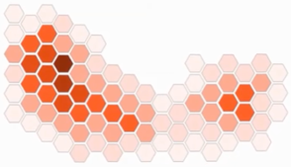

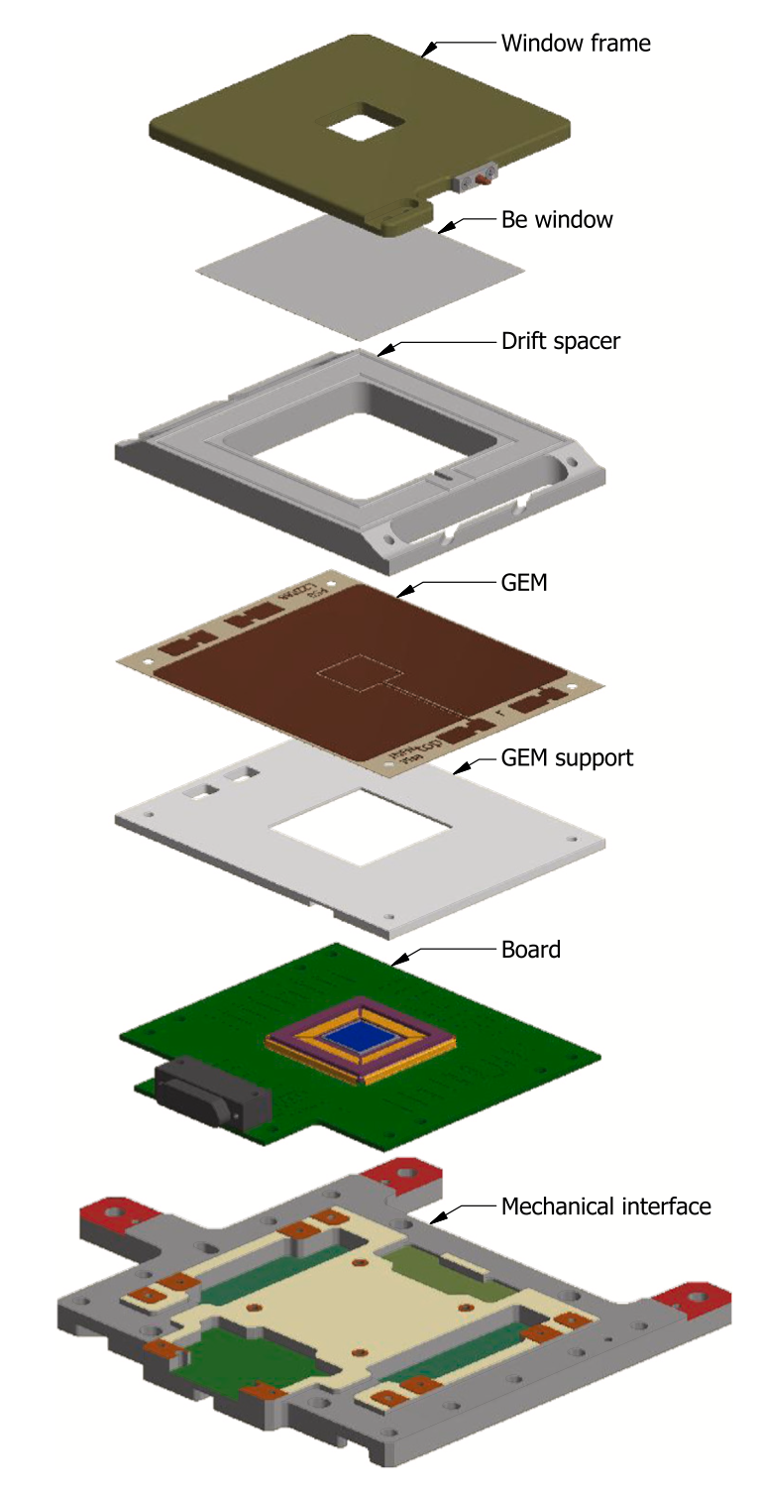
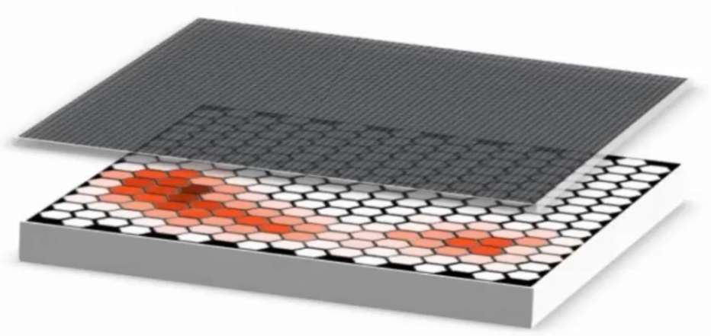

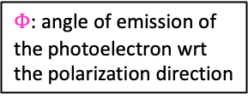

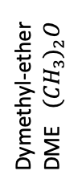
The Gas Pixel Detector
DRIFT PLANE
V drift = -2800 V
Interaction point
$Φ$: angle of emission of the photoelectron wrt the polarization direction
Interaction point
$$\vec{E}$$
Dymethyl-ether
DME ${(CH_{3})}_{2}O$
Photoelectron
emission direction
V top = -840 V
$$Φ$$
10
mm
Emission direction
Detector
Unit
GEM
V bottom = -400 V
0.7
mm
ASIC
V ASIC = 0 V
ADC
Interaction point
Baldini et al. (2021)
15/05/2025
IXPE GPD test and characterization with the XCF
Stefano Tugliani
5

Slide 6
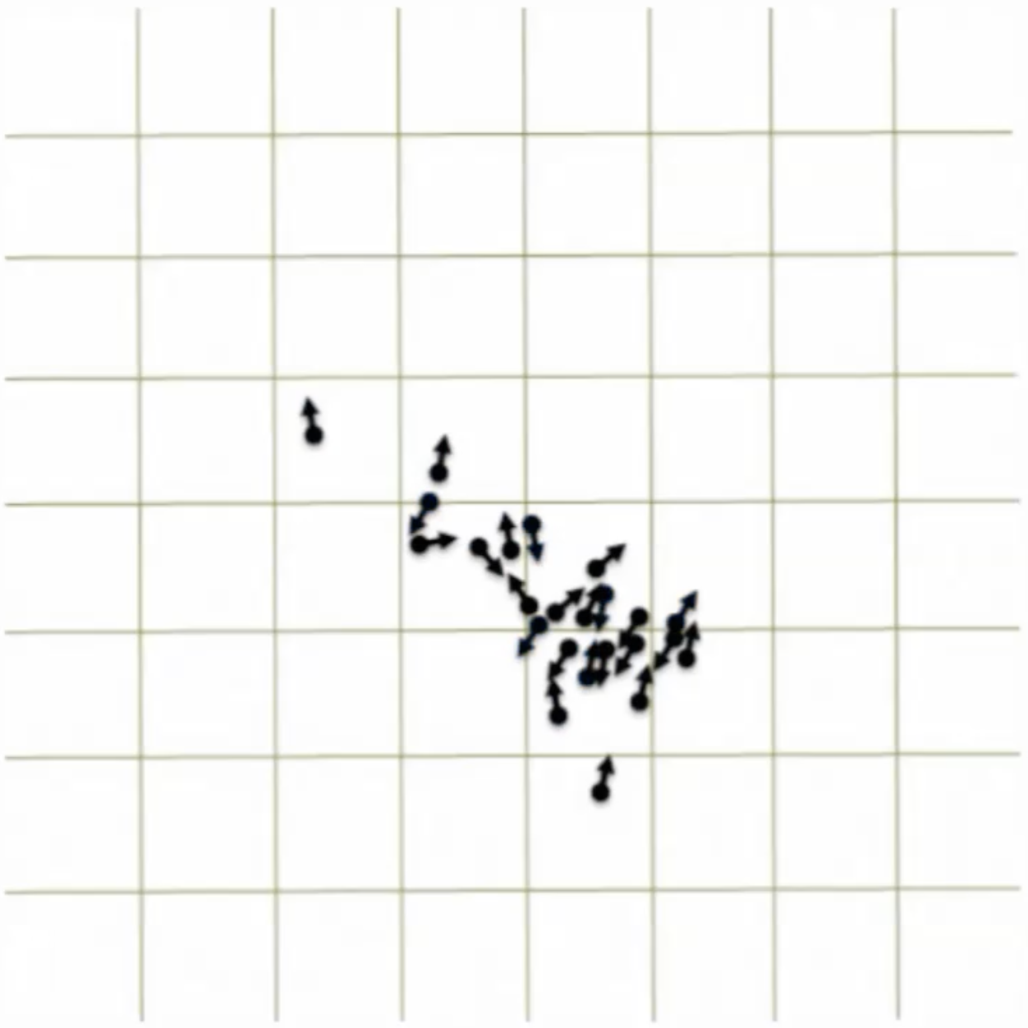
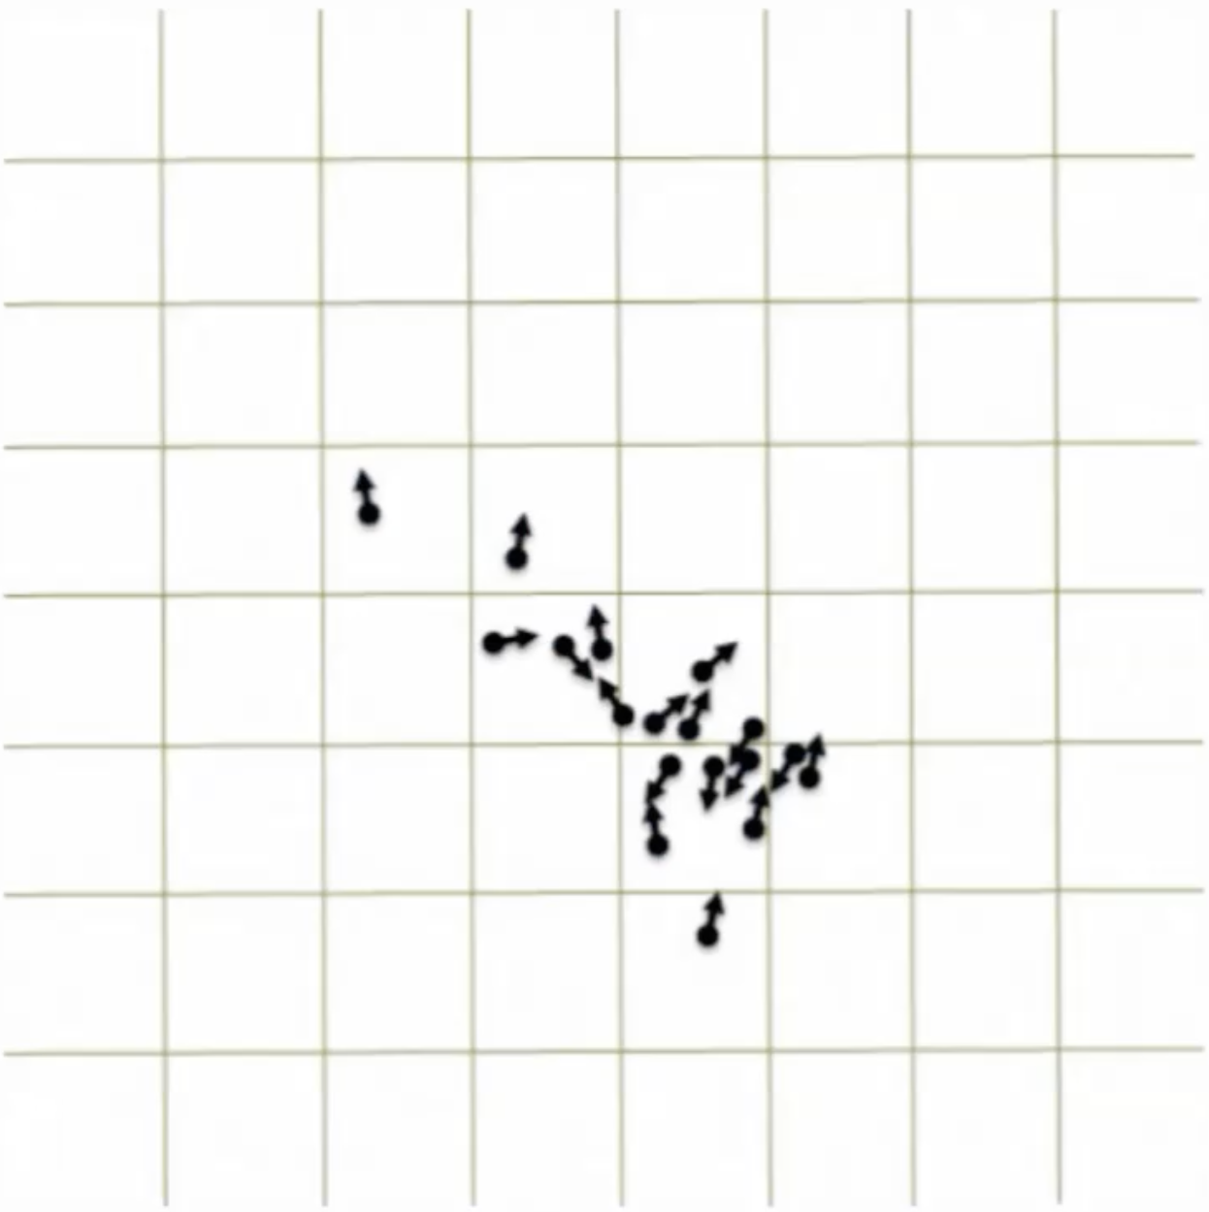
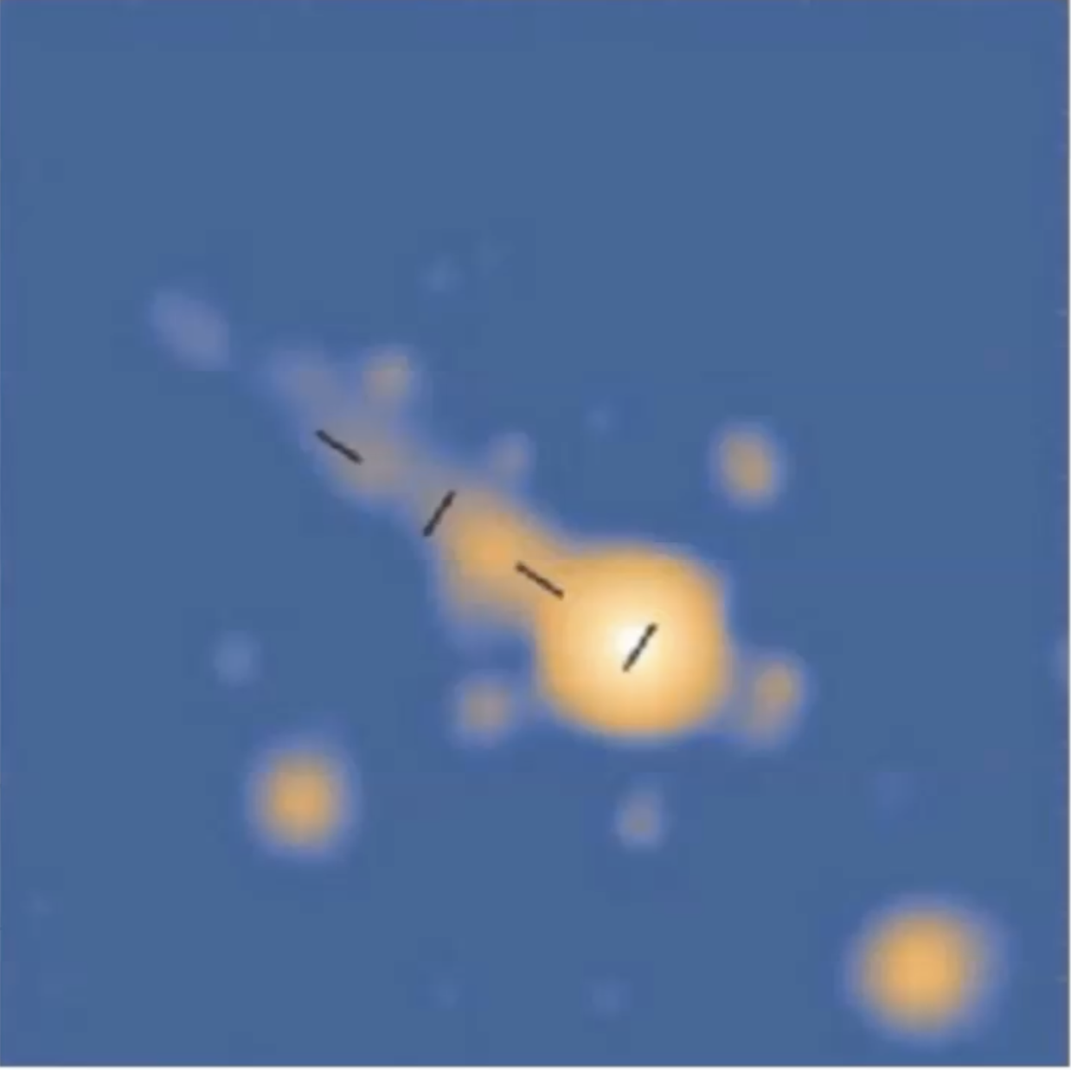
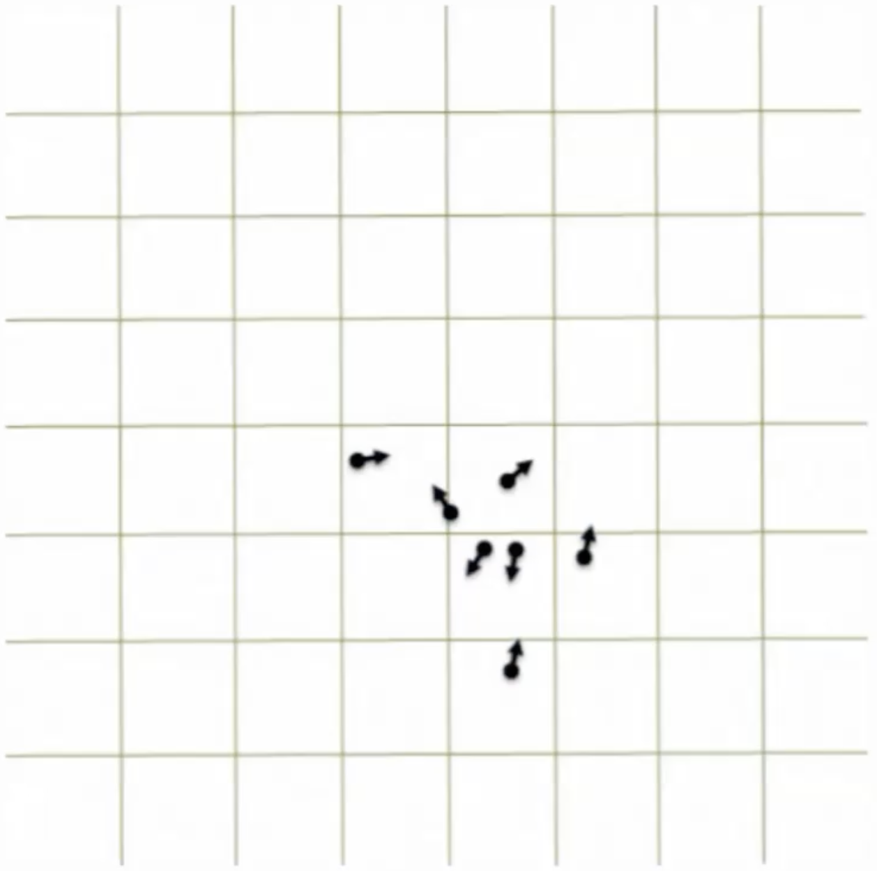
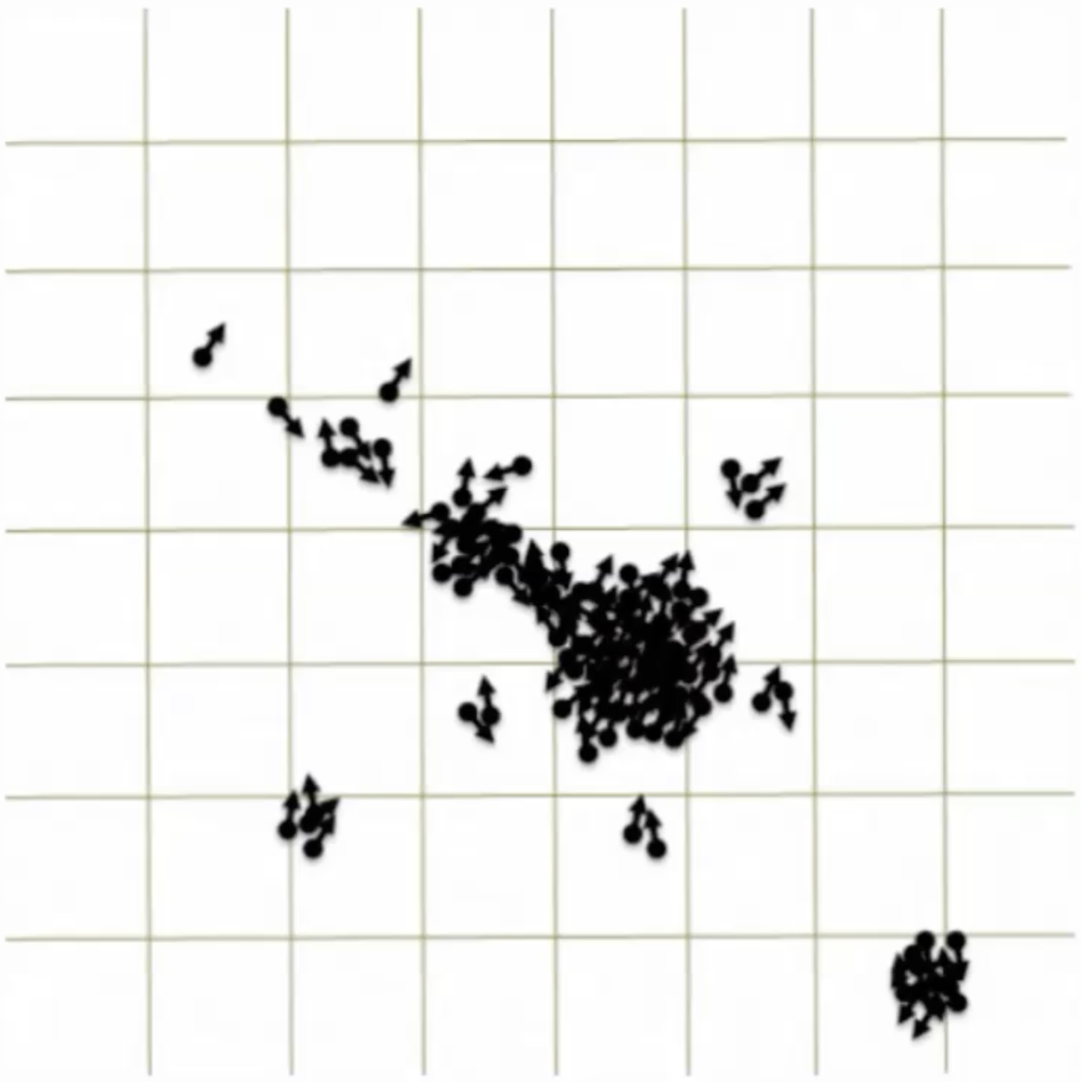



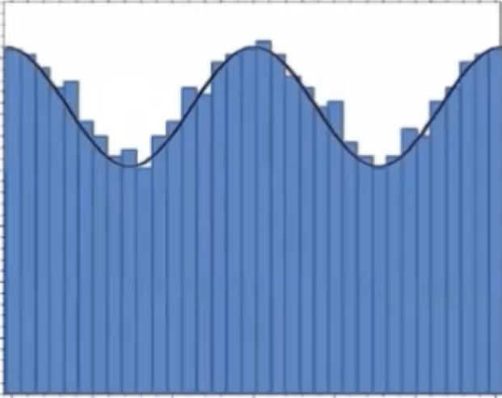
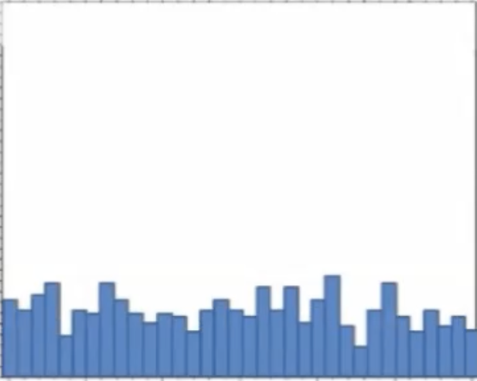
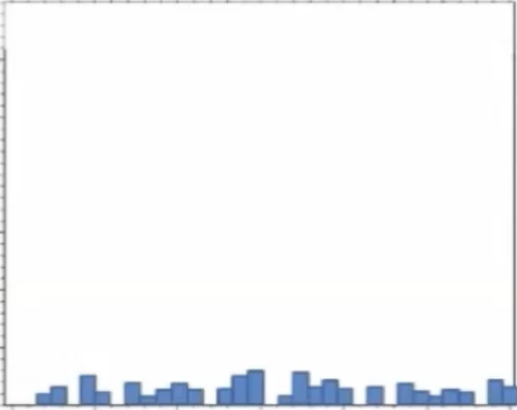
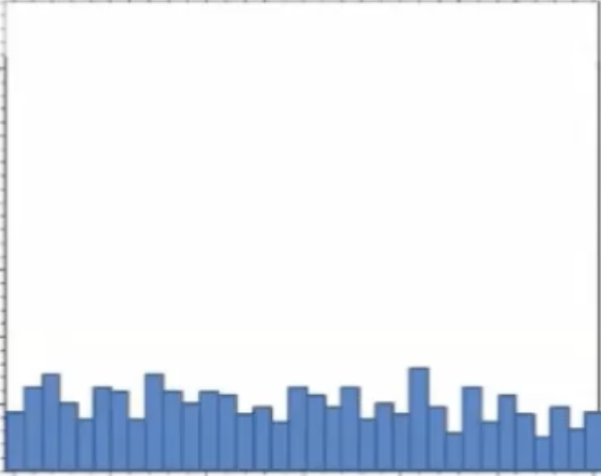
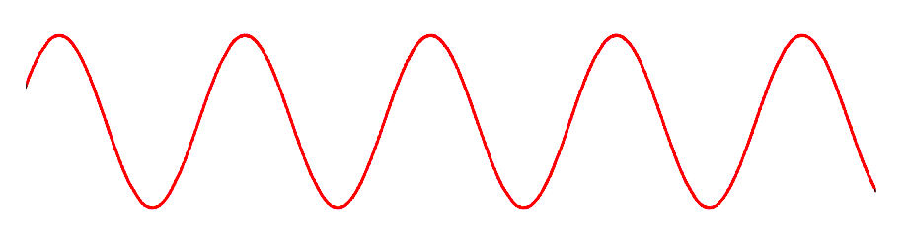
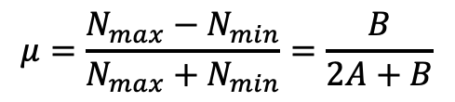
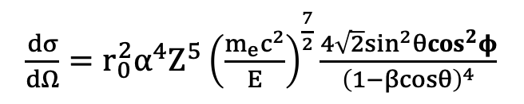

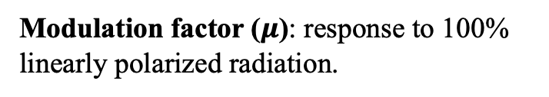
IXPE polarization measurement
Event in Celestial Coordinates
Event in Detector Coordinates
Polarization information: recovered on a statistical basis from the azimuthal distribution of the photoelectron directions of emission ($φ$).
$\frac{dσ}{dΩ}=r_{0}^{2}α^{4}Z^{5}{\left(\frac{m_{e}c^{2}}{E}\right)}^{\frac{7}{2}}\frac{4\sqrt{2}\sin^{2}θ\cos^{2}φ}{{\left(1−βcosθ\right)}^{4}}$
Photoelectric differential cross section:
The total counts are modulated as:
Polarization angle
$$N\left(φ\right)=A+B\cos^{2}(φ−φ_{0})$$
Modulation factor ($μ$): response to 100% linearly polarized radiation.
B
$$μ=\frac{N_{max}−N_{min}}{N_{max}+N_{min}}=\frac{B}{2A+B}$$
A
Muleri & Fabiani (2014), Muleri (2014), Kislat et al. (2015)
15/05/2025
IXPE GPD test and characterization with the XCF
Stefano Tugliani
6

Slide 7


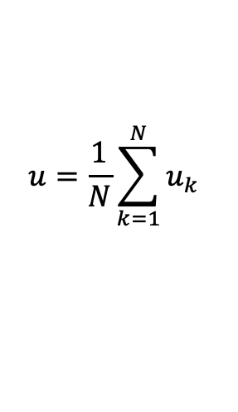


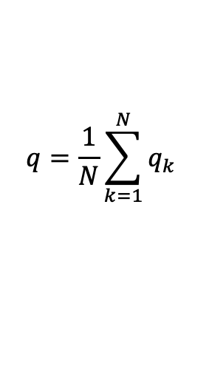
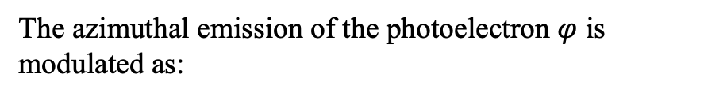


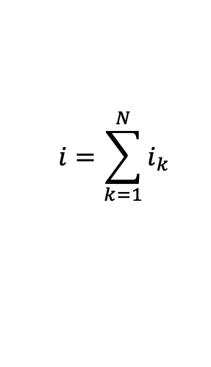



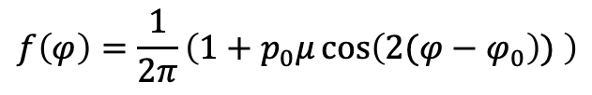
GPD polarization measurement
The azimuthal emission of the photoelectron $φ$ is modulated as:
$$f\left(φ\right)=\frac{1}{2π}\left(1+p_{0}μ\cos\left(2(φ−φ_{0}\right)) \right)$$
z
Incoming photon
Polarization direction
For each event k:
$$\vec{E}$$
$$i_{k}=1$$
$$q_{k}=2\cos{(2φ_{k})}$$
$$u_{k}=2\sin{(2φ_{k})}$$
For N selected events:
$$θ$$
$$u=\frac{1}{N}\sum_{k=1}^{N}{u_{k}}$$
$$φ$$
y
$$i=\sum_{k=1}^{N}{i_{k}}$$
$$q=\frac{1}{N}\sum_{k=1}^{N}{q_{k}}$$
Photoelectron emission direction projection
Plane // to detector
x
Polarization Degree
Polarization Angle
Ejected
photoelectron
$$p_{0}=\frac{1}{μ}\sqrt{q^{2}+u^{2}}$$
$$φ_{0}=\frac{1}{2}\tan^{−1}{\frac{u}{q}}$$
Kislat et al. (2015), Rankin et al. (2022)
15/05/2025
IXPE GPD test and characterization with the XCF
Stefano Tugliani
7

Slide 8
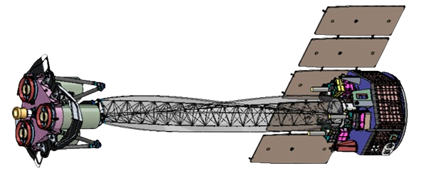


Towards the X-ray Calibration Facility
IXPE
Space
GPDs
Only space-qualified detectors currently used for X-ray polarization
3 GPDs (DUs)
Physics Department Turin (ITA)
Ground
4 spare GPDs
Before launch: calibration and qualification of the detectors.
After launch:
systematic testing and monitoring on spare GPDs
Essential in view of future X-ray polarimeters
We need a facility that provides photon beams with various spatial and energy configurations and offering both unpolarized and linearly polarized beams
XCF
15/05/2025
IXPE GPD test and characterization with the XCF
Stefano Tugliani
8

Slide 9
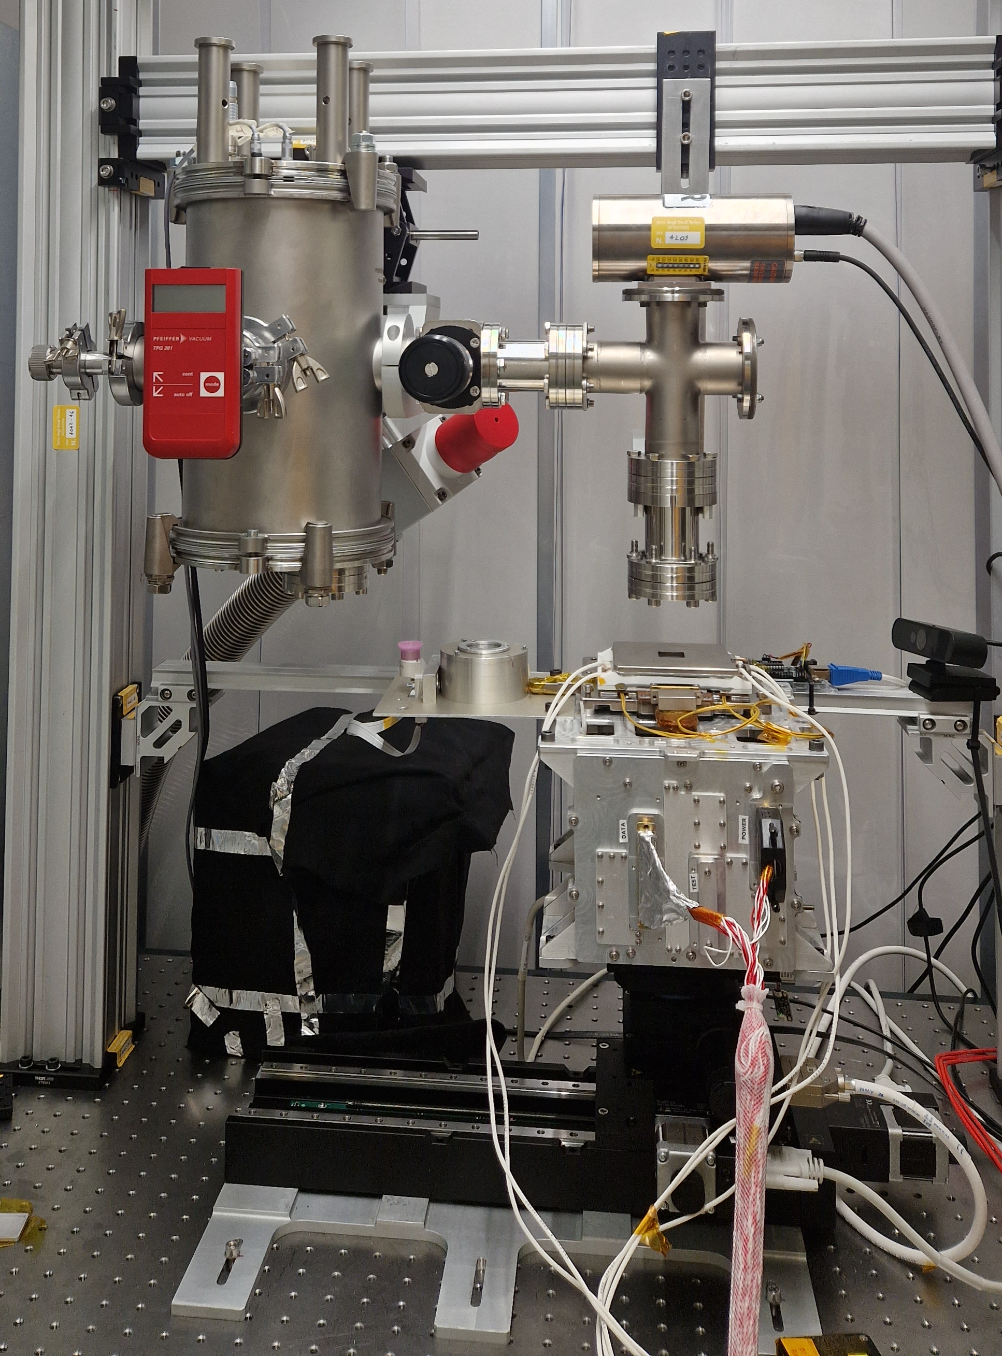
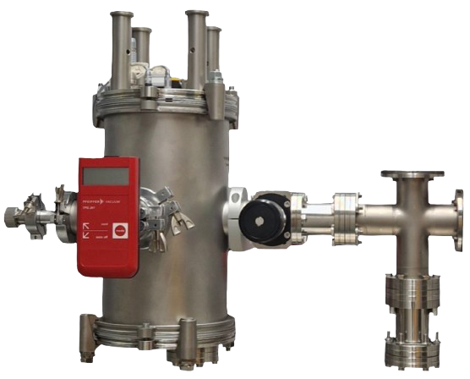
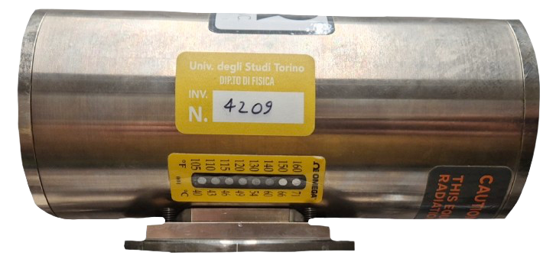
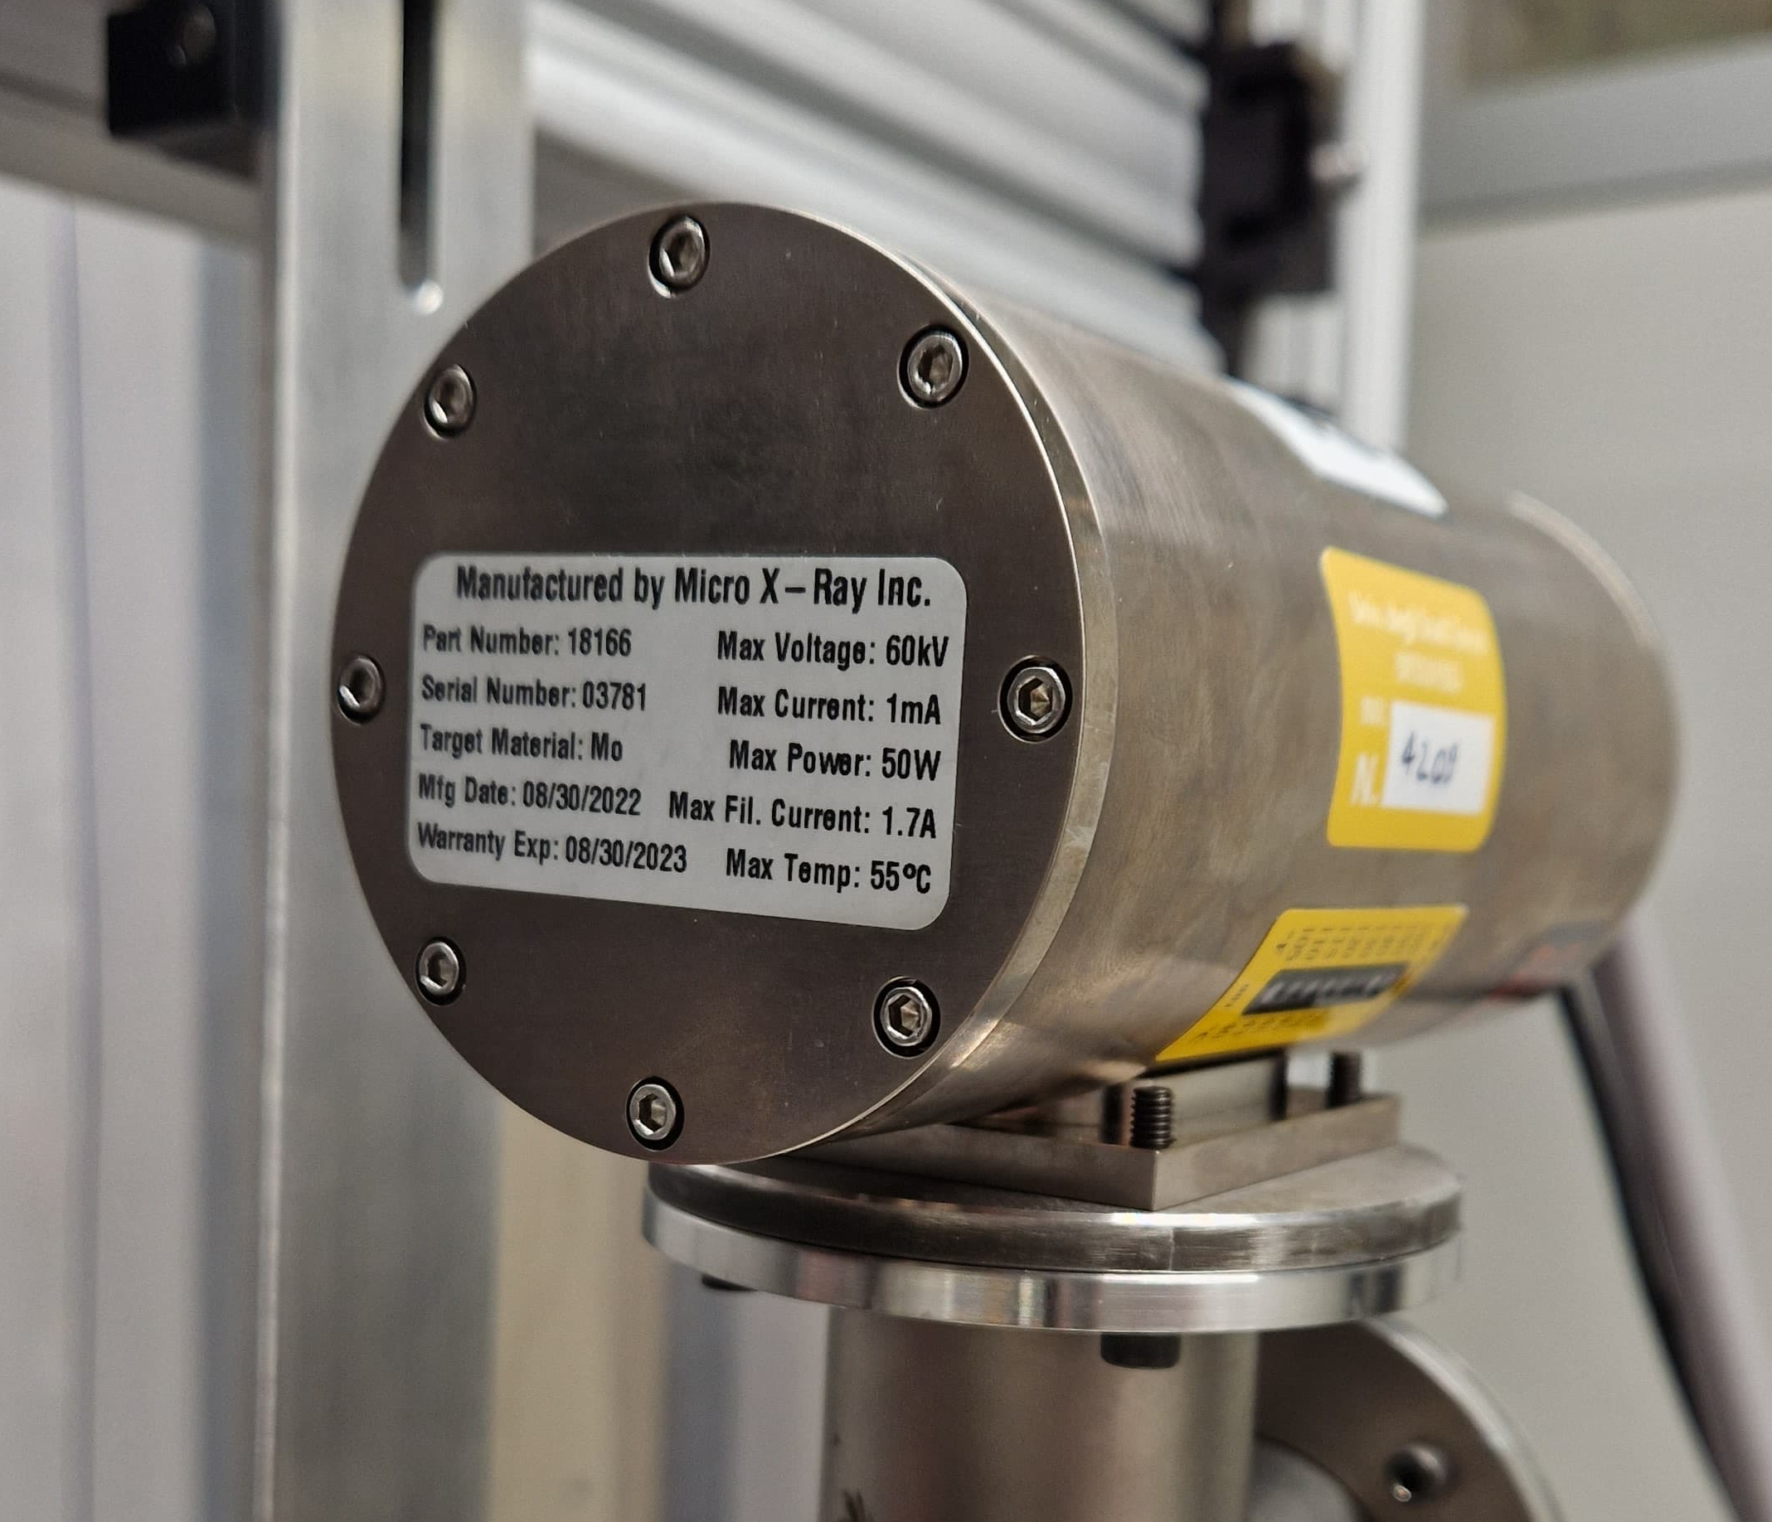
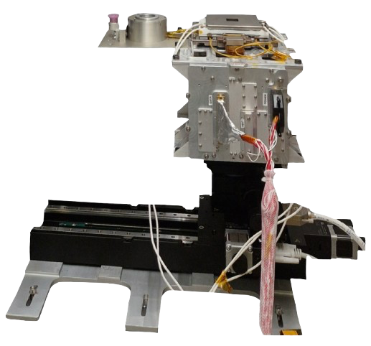
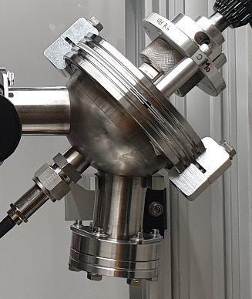
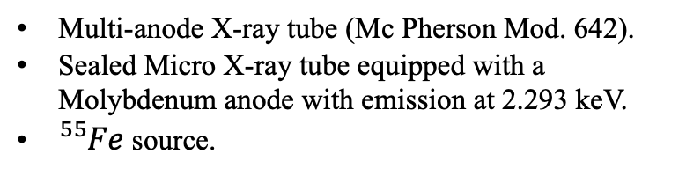
The X-ray Calibration Facility
The X-ray Calibration Facility XCF is an irradiation setup at the University of Turin to test and characterize:
IXPE Gas Pixel Detectors, monitoring their performance.
Future position- energy- and polarization-sensitive X-ray detectors.
X-ray tube: radiation source
Tugliani et al. (2024a), (2024b)
Radiation source:
Multi-anode X-ray tube (Mc Pherson Mod. 642).
Sealed Micro X-ray tube equipped with a Molybdenum anode with emission at 2.293 keV.
${}_{}^{55}{Fe}$ source.
Vacuum system:
Pfeiffer scroll and turbo pumps
Handling system:
  PiMicro to move the detectors and the polarizing crystal inside the cylinder
Handling system
15/05/2025
IXPE GPD test and characterization with the XCF
Stefano Tugliani
9

Slide 10
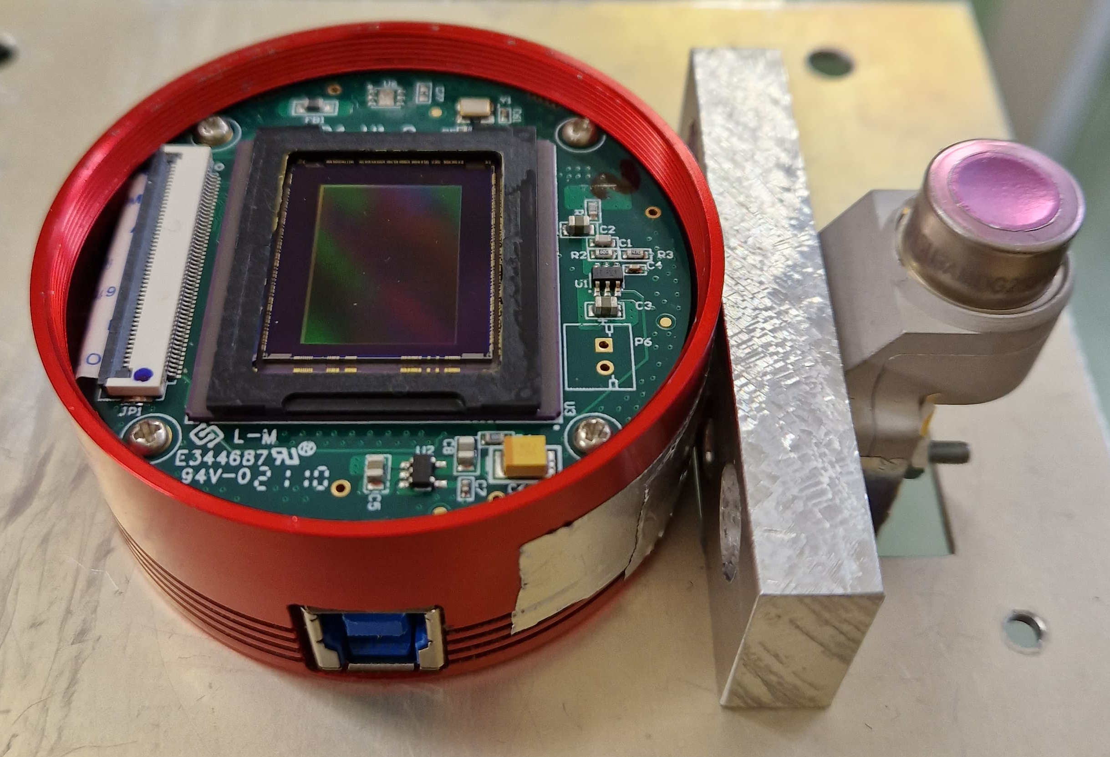
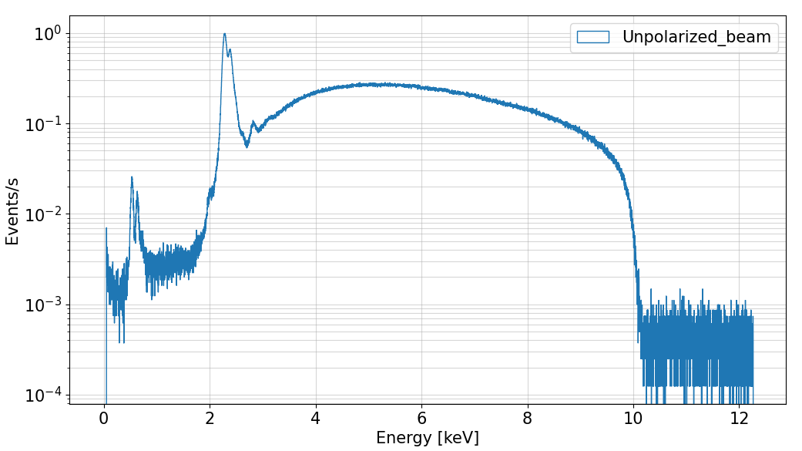


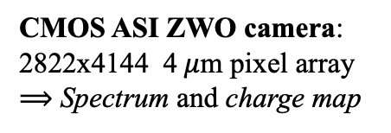
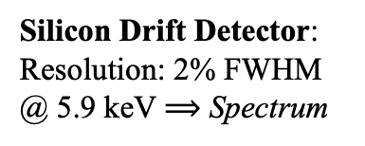
The X-ray Calibration Facility
X-RAY BEAMS MONITORS
X-ray tube: radiation source
CMOS ASI ZWO camera:
2822x4144 4$μ$m pixel array
$⟹$ Spectrum and charge map
Silicon Drift Detector:
Resolution: 2% FWHM @ 5.9 keV $⟹$ Spectrum
Unpolarized beam line
Mo L$α$
Mo L$β$
Mo escape peak
SDD
GPD
CMOS camera
Handling system
Tugliani et al. (2024a), (2024b)
15/05/2025
IXPE GPD test and characterization with the XCF
Stefano Tugliani
10

Slide 11
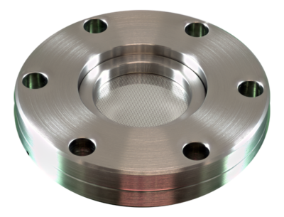

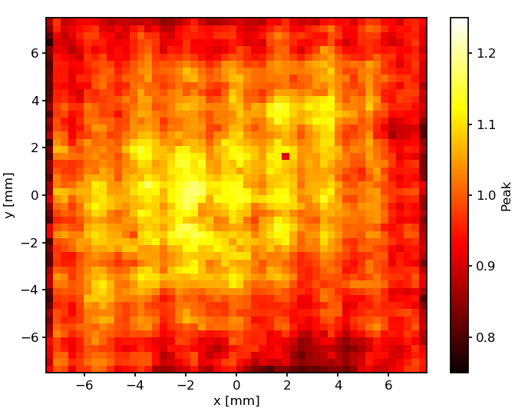
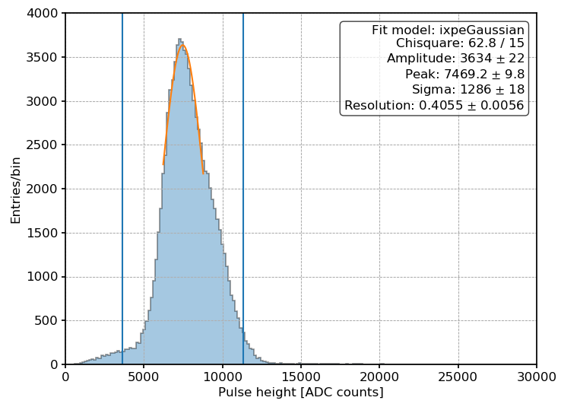
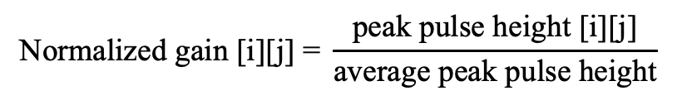
GPD equalization map with XCF
Study of the uniformity of the GPD response
Gain map
Baldini et al. (2021)
Flat field using the unpolarized beam
For each bin [i][j] of the map:
$$\text{Normalized} \text{gain}\text{ [}\text{i}\text{][}\text{j}\text{] = }\frac{\text{peak} \text{pulse} \text{height}\text{ [}\text{i}\text{][}\text{j}\text{]}}{\text{average} \text{peak} \text{pulse} \text{height}}$$
GPD 35
GPD
15/05/2025
IXPE GPD test and characterization with the XCF
Stefano Tugliani
11

Slide 12














Spurious modulation
The azimuthal emission of the photoelectron $φ$ is modulated as:
For N selected events:
$$f\left(φ\right)=\frac{1}{2π}\left(1+p_{0}μ\cos\left(2(φ−φ_{0}\right)) \right)$$
$$q=\frac{1}{N}\sum_{k=1}^{N}{2\cos{(2φ_{k})}}$$
$$u=\frac{1}{N}\sum_{k=1}^{N}{2\sin{(2φ_{k})}}$$
Entries/bin
Polarized beam
Entries/bin
Simulated unpolarized beam
Entries/bin
Real unpolarized beam
$φ$ [rad]
$φ$ [rad]
$φ$ [rad]
$$F\left(φ\right)=\frac{1}{2π}\left[2πf\left(φ\right)+S(φ)\right]$$
$$q_{source}=q_{meas}−q_{sm}$$
$$S\left(φ\right)=ε_{sm}\cos{(2\left(φ−φ_{sm}\right))}$$
$$u_{source}=u_{meas}−u_{sm}$$
Rankin et al. (2022)
15/05/2025
IXPE GPD test and characterization with the XCF
Stefano Tugliani
12

Slide 13








Spurious modulation studies with XCF
How to measure the spurious modulation?
Spurious modulation:
source
source
SM
$$q_{sm}=\frac{q_{0°}+q_{90°} }{2}$$
90° rotation
SM
$$u_{sm}=\frac{u_{0°}+u_{90°} }{2}$$
Source modulation:
$$q_{90°}=q_{sm}+q_{source}(\text{GPD}\text{ @ 90}\text{°}\text{)}$$
$\text{=}q_{sm}−q_{source}(\text{GPD}\text{ @ 0}\text{°}\text{)}$
$$q_{source}=\frac{q_{0°}−q_{90°} }{2}$$
$$q_{0°}=q_{sm}+q_{source}(\text{GPD}\text{ @ 0}\text{°}\text{)}$$
$$u_{90°}=u_{sm}+u_{source}(\text{GPD}\text{ @ 90}\text{°}\text{)}$$
$\text{=}u_{sm}−u_{source}(\text{GPD}\text{ @ 0}\text{°}\text{)}$
$$u_{source}=\frac{u_{0°}−u_{90°} }{2}$$
$$u_{0°}=u_{sm}+u_{source}(\text{GPD}\text{ @ 0}\text{°}\text{)}$$
Rankin et al. (2022)
15/05/2025
IXPE GPD test and characterization with the XCF
Stefano Tugliani
13

Slide 14


Spurious modulation: XCF first results
GPD 30
GPD 35
MEAN SPURIOUS MODULATION:
0.0144 ± 0.0002
MEAN INTRINSEC MODULATION:
0.0517 ± 0.0002
MEAN SPURIOUS MODULATION:
0.0022 ± 0.0002
MEAN INTRINSEC MODULATION:
0.0531 ± 0.0002
GPD 30 and GPD 35 have different GEMS
Additional hint that spurious modulation is correlated to the GEM
GPD 30 has a higher spurious modulation and more features in the Stokes maps, compared to GPD 35
15/05/2025
IXPE GPD test and characterization with the XCF
Stefano Tugliani
14

Slide 15












The X-ray Calibration Facility
Polarizing the beam:
Polarizing crystal
X-ray tube: radiation source
Bragg diffraction
$$E=\frac{nhc}{2d\sin{θ}}$$
$$∥$$
$$θ=45°$$
$$⊥$$
Polarization:
Unpolarized incident radiation
$$P=\frac{1−k}{1+k}$$
$$k=\frac{R_{E}^{∥}}{R_{E}^{⊥}}$$
Polarized beam line
$$⊥$$
Diffracted polarized radiation
Plane of incidence
SDD
GPD
For a totally polarized radiation:
k=0 e $θ$=$θ_{Bragg}$=45°.
CMOS camera
Handling system
Henke et al. (1993), Muleri & Fabiani (2014), Ferrazzoli et al. (2020)
15/05/2025
IXPE GPD test and characterization with the XCF
Stefano Tugliani
15

Slide 16









The X-ray Calibration Facility
Polarized spectrum with SDD
Polarizing crystal
X-ray tube: radiation source
Mo L$α$
Mo L$β$
Mo escape peak
2xMo L$α$
In L$α_{1}$
Sb L$β$
3xMo L$α$
Polarized beam line
4xMo L$α$
SDD
GPD
CMOS camera
$$E=\frac{nhc}{2d\sin{θ}}$$
peaks at integer multiples of E
fluorescence lines of the crystal
Handling system
Tugliani et al. (2024b)
15/05/2025
IXPE GPD test and characterization with the XCF
Stefano Tugliani
16

Slide 17





Polarizing the beams
InSb 111
XCF is equipped with a set of 6 crystals which are matched with specific energies so that the Bragg condition is satisfied.
Modulation
2.28 keV
Crystal | Energy [keV] | $θ$ Bragg | P [%]
InSb 111 | 2.28 | 46.6 ° | $\sim$99
Ge 111 | 2.62 | 46.5 ° | $\sim$99
Si 111 | 2.82 | 44.4 ° | $\sim$99
Si 220 | 4.45 | 46.6 ° | $\sim$98
Si 400 | 6.32 | 46.3 ° | $\sim$99
Ge 422 | 7.43 | 46.2 ° | $\sim$99
The Bragg arc
Tugliani et al. (2024b)
15/05/2025
IXPE GPD test and characterization with the XCF
Stefano Tugliani
17

Slide 18









XCF polarized beam studies
PRELIMINARY RESULTS
$$A$$
$$+$$
$$\cos^{2}(φ−φ_{0})$$
$$N\left(φ\right)=$$
$$B$$
B
Low energies
High energies
A
Tugliani et al. (2024a), (2024b)
Compact tracks
Elongated tracks
The track length increases with increasing energy and the photoelectron emission direction is better reconstructed
The modulation factor increases with energy
15/05/2025
IXPE GPD test and characterization with the XCF
Stefano Tugliani
18

Slide 19







Spurious modulation: XCF first results
GPD long term studies: secular pressure decrease
Secular decrease of the pressure in the sealed gas cell, due to internal adsorption of DME with a time scale of months.
$$p\left(t;τ,Δ_{p}\right)=p_{0}−Δ_{p}(1−e^{−\left(t−t_{0}\right)/τ})$$
The pressure decrease can be retrieved analyzing:
Increase of track
length
Increase of gain
Decrease of rate
Source: ${}_{}^{55}{Fe}$
$$L\left(t;τ,Δ_{p}\right)=L_{0}{\left(\frac{p\left(t\right)}{p_{0}}\right)}^{−α_{L}}$$
$$G\left(t;τ,Δ_{p}\right)=G_{0}exp\left\{−\frac{p\left(t\right)−p_{0}}{p_{scale}}\right\}$$
5.9 keV
$$R\left(t;τ,Δ_{p}\right)∝p(t)$$
Tomaiuolo et al. (2024)
15/05/2025
IXPE GPD test and characterization with the XCF
Stefano Tugliani
19

Slide 20
Conclusions
Unpolarized beam:
Gain and equalization maps;
Systematics in the detector.
Polarized beam:
Response to polarized radiation;
Calibration.
Initially conceived as a calibration source to qualify GPDs, the XCF can satisfy evolving requirements to support R&D programs of innovative position, energy and polarization-sensitive X-ray detectors.
Tugliani et al. (2024a), (2024b)
15/05/2025
IXPE GPD test and characterization with the XCF
Stefano Tugliani
20

Slide 21
Thank you for your attention

Slide 22
References
Weisskopf et al. The Imaging X-Ray Polarimetry Explorer (IXPE): Pre-Launch. 2021. doi: 10.48550/ARXIV.2112.01269.
Baldini et al. “Design, construction, and test of the Gas Pixel Detectors for the IXPE mission”. In: Astroparticle Physics 133 (2021), p. 102628. issn: 0927-6505. doi: https:// doi.org/10.1016/j.astropartphys.2021.102628.
Fabio Muleri Sergio Fabiani. Astronomical X-ray Polarimetry. Aracne, 2014.
Fabio Muleri. “ON THE OPERATION OF X-RAY POLARIMETERS WITH A LARGE FIELD OF VIEW”. In: The Astrophysical Journal 782.1 (Jan. 2014), p. 28. doi: 10.1088/ 0004-637x/782/1/28.
Tugliani et al. “IXPE Gas Pixel Detectors characterization using the X-ray Calibration Facility”. In: Nuovo Cim. C 47.3 (2024), p. 141. doi: 10.1393/ncc/i2024-24141-9.
Tugliani et al. “IXPE Gas Pixel Detector characterization with the X-ray Calibration Facility”. In: Nuclear Instruments and Methods in Physics Research Section A: Accelerators, Spec- trometers, Detectors and Associated Equipment 1069 (2024), p. 169800. issn: 0168-9002. doi: https://doi.org/10.1016/j.nima.2024.169800.
Kislat et al. “Analyzing the data from X-ray polarimeters with Stokes parameters”. In: Astroparticle Physics 68 (Aug. 2015), pp. 45–51. doi: 10.1016/j.astropartphys.2015. 02.007.
Ferrazzoli et al. “In-flight calibration system of imaging x-ray polarimetry explorer”. In: Journal of Astronomical Telescopes, Instruments, and Systems 6.04 (Oct. 2020). doi:10.1117/1.jatis.6.4.048002.
B.L. Henke, E.M. Gullikson, and J.C. Davis. “X-Ray Interactions: Photoabsorption, Scattering, Transmission, and Reflection at E = 50-30,000 eV, Z = 1-92”. In: Atomic Data and
Nuclear Data Tables 54.2 (1993), pp. 181–342. issn: 0092-640X. doi: https://doi.org/10.1006/adnd.1993.1013.
John Rankin et al. “An Algorithm to Calibrate and Correct the Response to Unpolarized Radiation of the X-Ray Polarimeter Onboard IXPE”. In: The Astronomical Journal 163.2
(Jan. 2022), p. 39. doi: 10.3847/1538-3881/ac397f.
C. Tomaiuolo et al. " Time-dependent instrumental effects in IXPE: Pressure variation and GEM charging inside GPDs ". In: Nuclear Instruments and Methods in Physics Research Section A: Accelerators, Spectrometers, Detectors and Associated Equipment, 1069 (2024), p. 169881. issn: 0168-9002. doi: https://doi.org/10.1016/j.nima.2024.169881.
15/05/2025
IXPE GPD test and characterization with the XCF
Stefano Tugliani
22

Slide 23


IXPE data processing
3 Detector
Units
Star Tracker:
Celestial
Coordinates system
Detector Coordinates
Level 1 data:
Event reconstruction
in detector coordinates
Level 2 data:
Data in sky coordinates
DU1
DU2
Celestial Coordinates
DU3
15/05/2025
IXPE GPD test and characterization with the XCF
Stefano Tugliani
23

Slide 24





Polarizing the beams
Choose an energy
emission line
Find the polarizing crystal
Rotate the crystal at the Bragg angle
$$θ=\sin^{−1}{\frac{hc}{2dE}}$$
The capillary plate selects $\sim ±0.5°$
There is no peak in the intensity
Preferred energy
Preferred angle
Bragg arc
CMOS camera
2.293 keV (Mo L$α$)
Henke et al. (1993), Muleri & Fabiani (2014), Tugliani et al. (2024b)
15/05/2025
IXPE GPD test and characterization with the XCF
Stefano Tugliani
24

Slide 25



Polarizing the beams
Choose an energy
e.g. 4.5 keV
In the Bremsstrahlung continuum
Find the polarizing crystal
Rotate the crystal at 45° to maximize the polarization
$$E=\frac{nhc}{2d\sin{θ}}$$
The capillary plate selects $\sim ±0.5°$
The intensity peaks at the emission line
No preferred energy
No preferred angle
4.5 keV
No Bragg arc
CMOS camera
Henke et al. (1993), Muleri & Fabiani (2014), Tugliani et al. (2024b)
15/05/2025
IXPE GPD test and characterization with the XCF
Stefano Tugliani
25

Slide 26





XCF polarized beam studies
InSb 111
Si 220
Si 400
$$E_{n=1}$$
$$E_{n=2}$$
6.32 keV
2.28 keV
1.74 keV
It is possible to observe also the energy correspondent to the second diffraction order: the obtained $μ$is coherent with the one expected at that energy:
In addiction to the diffracted polarized X-ray, the spectra show features at the fluorescence energy of the crystal: these photons are not polarized.
Tugliani et al. (2024b)
15/05/2025
IXPE GPD test and characterization with the XCF
Stefano Tugliani
26

