Slide 1







ARTIFICIAL INTELLIGENCE FOR ASTRO-PARTICLE PHYSICS
Luca Tabarroni
luca.tabarroni@roma2.infn.it

Slide 2
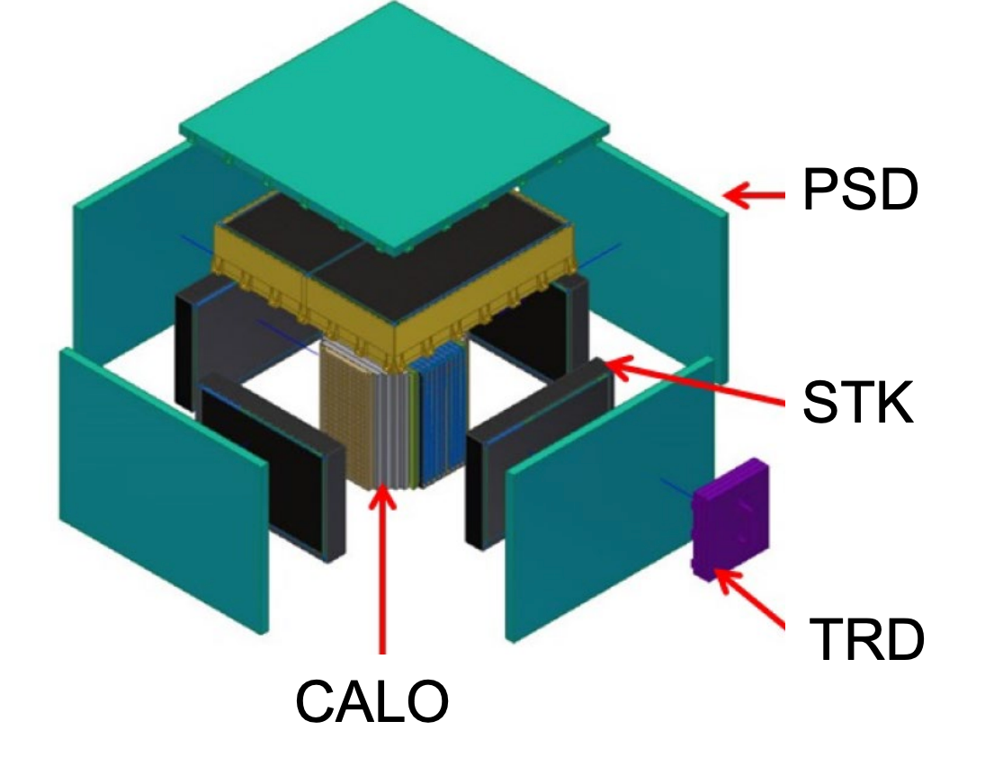

Leptonic vs hadronic selection at high-energies
We want to perform Hadronic vs Leptonic classification in CRs at energies: 100GeV-10TeV
We want to study Leptonic flux excesses to measure possible new physics hints. In CRs we have about 1 Lepton every 10.000 Protons
To detect Leptonic events above 10TeV we need:
  To exploit the CR isotropy increasing the acceptance of the instrument
  To keep an ~1% of energy resolution
HERD is a new kind of 3D calorimeter planned to be installed on the Chinese Space Station on 2027
Tipically detectors need ~${10}^{4}$ rejection power to precisly measure lepton fluxes

Slide 3
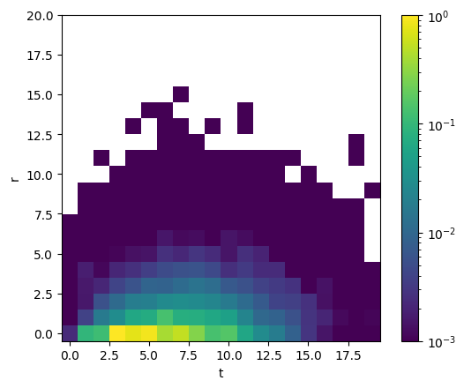
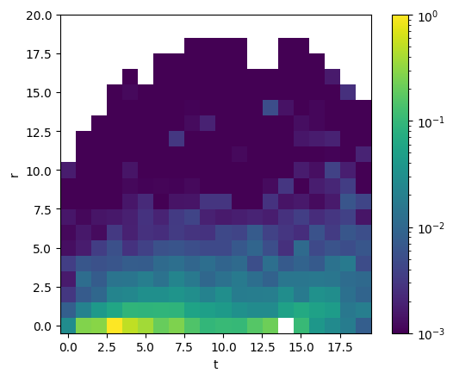
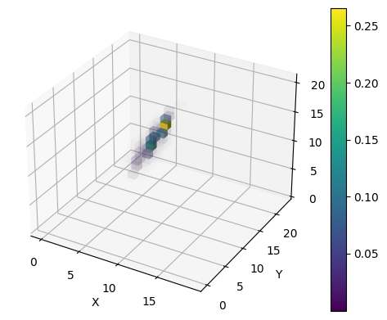
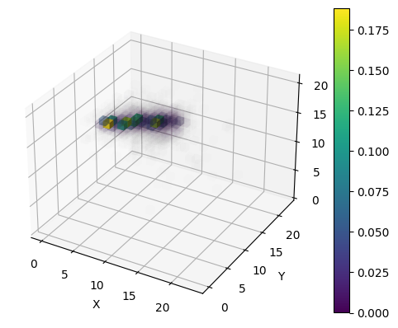
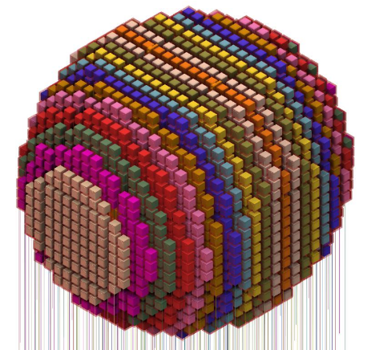
DATASET:
Electrons (2.038.132 events)
Protons (3.090.406 events)
CONVOLUTIONAL
NEURAL NETWORK
Proton and electron particle showers in the HERD electromagnetic calorimeter, with energies ranging from 100 GeV to 20 TeV.

Slide 4
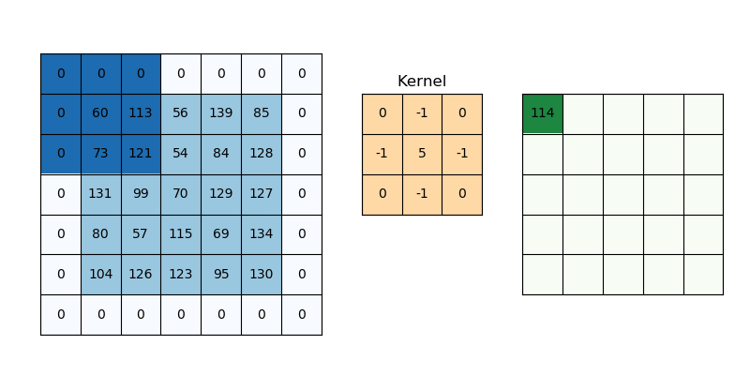
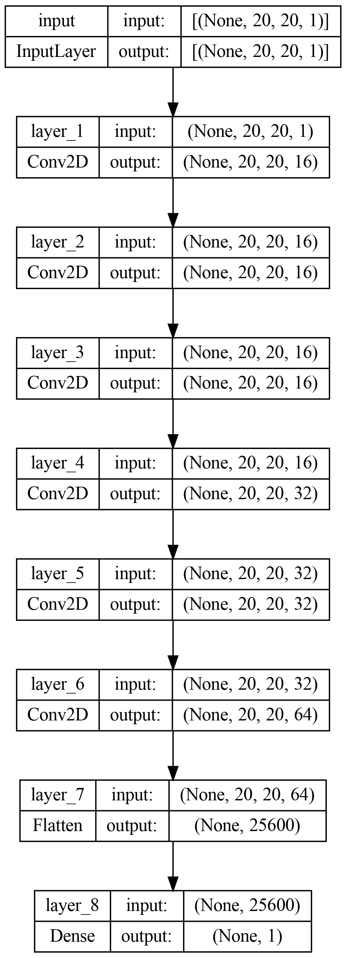
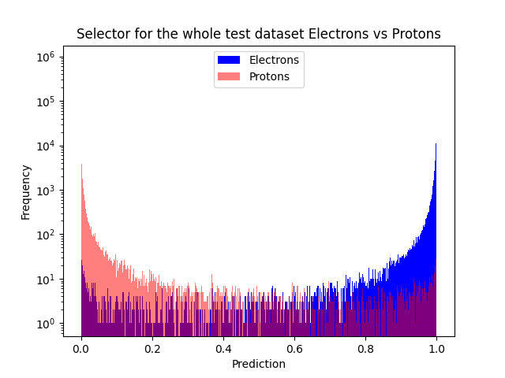
CONVOLUTIONAL
NEURAL NETWORK
Convolutional NN are made stacking convolutional layers
2D images are given to the Neural Network
Convolutional layers looks for correlations
The one dimensional output is used for classification

Slide 5
CONVOLUTIONAL
NEURAL NETWORK
_________________________________________________________________
Layer (type) Output Shape Param #
=================================================================
input_18 (InputLayer) [(None, 20, 20, 1)] 0
conv2d_194 (Conv2D) (None, 20, 20, 16) 160
conv2d_195 (Conv2D) (None, 20, 20, 42) 6090
conv2d_196 (Conv2D) (None, 20, 20, 68) 25772
conv2d_197 (Conv2D) (None, 20, 20, 94) 57622
conv2d_198 (Conv2D) (None, 20, 20, 120) 101640
conv2d_199 (Conv2D) (None, 20, 20, 146) 157826
conv2d_200 (Conv2D) (None, 20, 20, 172) 226180
conv2d_201 (Conv2D) (None, 20, 20, 198) 306702
conv2d_202 (Conv2D) (None, 20, 20, 224) 399392
conv2d_203 (Conv2D) (None, 20, 20, 256) 516352
flatten_32 (Flatten) (None, 102400) 0
dense_32 (Dense) (None, 1) 102401
=================================================================
Total params: 1,900,137
Trainable params: 1,900,137
Non-trainable params: 0
_________________________________________________________________
CNN
x
Binary-Cross Entropy

Slide 6
CONVOLUTIONAL
NEURAL NETWORK
_________________________________________________________________
Layer (type) Output Shape Param #
=================================================================
input_18 (InputLayer) [(None, 20, 20, 1)] 0
conv2d_194 (Conv2D) (None, 20, 20, 16) 160
conv2d_195 (Conv2D) (None, 20, 20, 42) 6090
conv2d_196 (Conv2D) (None, 20, 20, 68) 25772
conv2d_197 (Conv2D) (None, 20, 20, 94) 57622
conv2d_198 (Conv2D) (None, 20, 20, 120) 101640
conv2d_199 (Conv2D) (None, 20, 20, 146) 157826
conv2d_200 (Conv2D) (None, 20, 20, 172) 226180
conv2d_201 (Conv2D) (None, 20, 20, 198) 306702
conv2d_202 (Conv2D) (None, 20, 20, 224) 399392
conv2d_203 (Conv2D) (None, 20, 20, 256) 516352
flatten_32 (Flatten) (None, 102400) 0
dense_32 (Dense) (None, 1) 102401
=================================================================
Total params: 1,900,137
Trainable params: 1,900,137
Non-trainable params: 0
_________________________________________________________________
CNN
x
Binary-Cross Entropy
True Label

Slide 7
CONVOLUTIONAL
NEURAL NETWORK
_________________________________________________________________
Layer (type) Output Shape Param #
=================================================================
input_18 (InputLayer) [(None, 20, 20, 1)] 0
conv2d_194 (Conv2D) (None, 20, 20, 16) 160
conv2d_195 (Conv2D) (None, 20, 20, 42) 6090
conv2d_196 (Conv2D) (None, 20, 20, 68) 25772
conv2d_197 (Conv2D) (None, 20, 20, 94) 57622
conv2d_198 (Conv2D) (None, 20, 20, 120) 101640
conv2d_199 (Conv2D) (None, 20, 20, 146) 157826
conv2d_200 (Conv2D) (None, 20, 20, 172) 226180
conv2d_201 (Conv2D) (None, 20, 20, 198) 306702
conv2d_202 (Conv2D) (None, 20, 20, 224) 399392
conv2d_203 (Conv2D) (None, 20, 20, 256) 516352
flatten_32 (Flatten) (None, 102400) 0
dense_32 (Dense) (None, 1) 102401
=================================================================
Total params: 1,900,137
Trainable params: 1,900,137
Non-trainable params: 0
_________________________________________________________________
CNN
x
Binary-Cross Entropy
True Label
Sigmoid Activation

Slide 8
CONVOLUTIONAL
NEURAL NETWORK
_________________________________________________________________
Layer (type) Output Shape Param #
=================================================================
input_18 (InputLayer) [(None, 20, 20, 1)] 0
conv2d_194 (Conv2D) (None, 20, 20, 16) 160
conv2d_195 (Conv2D) (None, 20, 20, 42) 6090
conv2d_196 (Conv2D) (None, 20, 20, 68) 25772
conv2d_197 (Conv2D) (None, 20, 20, 94) 57622
conv2d_198 (Conv2D) (None, 20, 20, 120) 101640
conv2d_199 (Conv2D) (None, 20, 20, 146) 157826
conv2d_200 (Conv2D) (None, 20, 20, 172) 226180
conv2d_201 (Conv2D) (None, 20, 20, 198) 306702
conv2d_202 (Conv2D) (None, 20, 20, 224) 399392
conv2d_203 (Conv2D) (None, 20, 20, 256) 516352
flatten_32 (Flatten) (None, 102400) 0
dense_32 (Dense) (None, 1) 102401
=================================================================
Total params: 1,900,137
Trainable params: 1,900,137
Non-trainable params: 0
_________________________________________________________________
Train dataset ∽ 50%
Validation dataset ∽ 20%
Test dataset ∽ 30%
CNN
x
Binary Cross Entropy
True Label
Sigmoid Activation

Slide 9
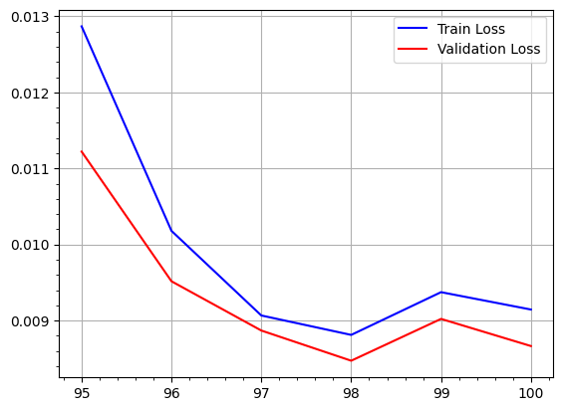
CONVOLUTIONAL
NEURAL NETWORK
_________________________________________________________________
Layer (type) Output Shape Param #
=================================================================
input_18 (InputLayer) [(None, 20, 20, 1)] 0
conv2d_194 (Conv2D) (None, 20, 20, 16) 160
conv2d_195 (Conv2D) (None, 20, 20, 42) 6090
conv2d_196 (Conv2D) (None, 20, 20, 68) 25772
conv2d_197 (Conv2D) (None, 20, 20, 94) 57622
conv2d_198 (Conv2D) (None, 20, 20, 120) 101640
conv2d_199 (Conv2D) (None, 20, 20, 146) 157826
conv2d_200 (Conv2D) (None, 20, 20, 172) 226180
conv2d_201 (Conv2D) (None, 20, 20, 198) 306702
conv2d_202 (Conv2D) (None, 20, 20, 224) 399392
conv2d_203 (Conv2D) (None, 20, 20, 256) 516352
flatten_32 (Flatten) (None, 102400) 0
dense_32 (Dense) (None, 1) 102401
=================================================================
Total params: 1,900,137
Trainable params: 1,900,137
Non-trainable params: 0
_________________________________________________________________
Train dataset ∽ 50%
Validation dataset ∽ 20%
Test dataset ∽ 30%
CNN
x
Binary Cross Entropy
MINIMUM VALIDATION LOSS CONFIGURATION
True Label
Sigmoid Activation

Slide 10
CONVOLUTIONAL
NEURAL NETWORK
Systematic Study:
Fixed kernel dimensions: (3x3)
Fixed number of kernels in first layer: 16
Number of Convolutional layers spans: [4, 6, 8, 10, 12]
Last layer number of kernels spans: [16, 32, 64, 128, 256]
For each model a Receiver Operating Characteristic curve can be drawn.

Slide 11
CONVOLUTIONAL
NEURAL NETWORK
Systematic Study:
Fixed kernel dimensions: (3x3)
Fixed number of kernels in first layer: 16
Number of Convolutional layers spans: [4, 6, 8, 10, 12]
Last layer number of kernels spans: [16, 32, 64, 128, 256]
For each model a Receiver Operating Characteristic curve can be drawn.

Slide 12
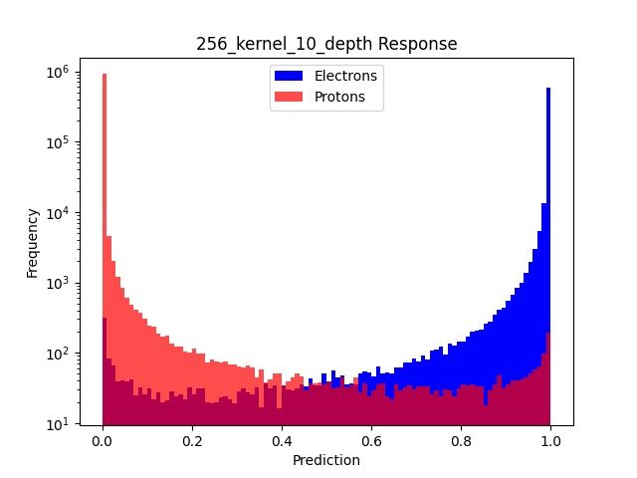
CONVOLUTIONAL
NEURAL NETWORK
Systematic Study:
Fixed kernel dimensions: (3x3)
Fixed number of kernels in first layer: 16
Number of Convolutional layers spans: [4, 6, 8, 10, 12]
Last layer number of kernels spans: [16, 32, 64, 128, 256]
For each model a Receiver Operating Characteristic curve can be drawn.

Slide 13
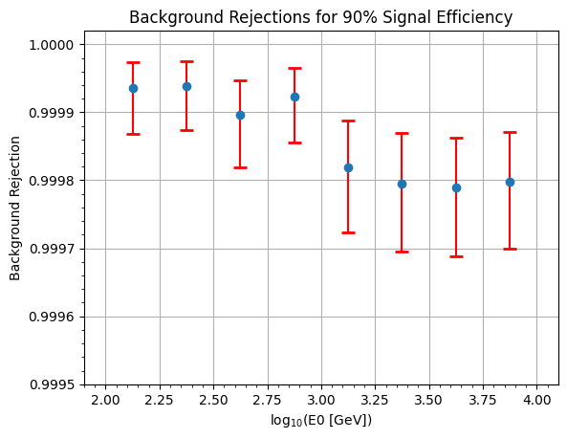
RESULTS
Study over the simulated Principal Component Energy in the calorimeter

Slide 14
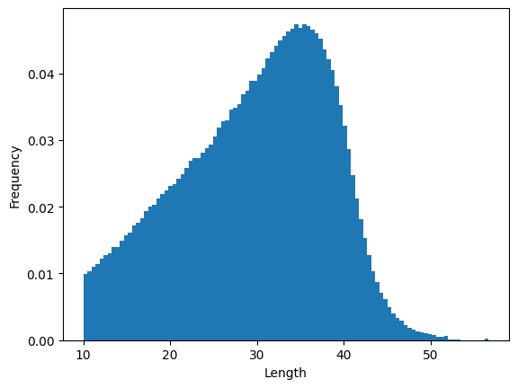
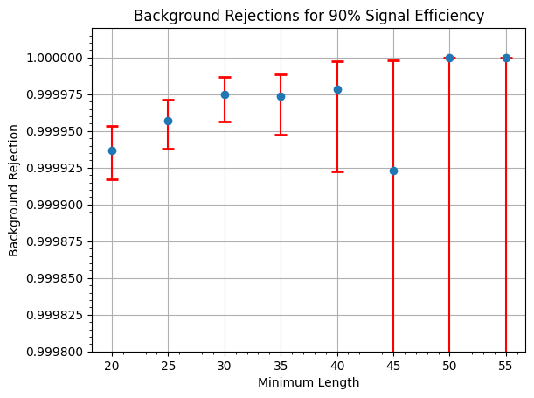
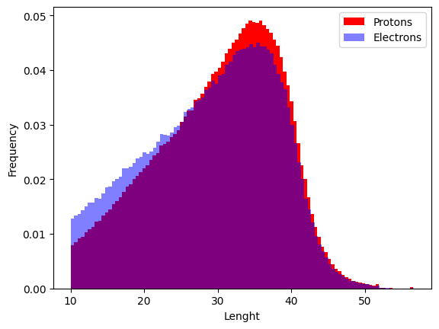
RESULTS
Study over the Length in the calorimeter

Slide 15
RESULTS
Rubustness Test
We turn off randomly a given amount of Herd’s cubes in order to simulate a possible in-flight problem
We test the model on a test set of the same size with
  5% dead cubes
  10% dead cubes
  15% dead cubes
Furhtermore we train again the whole set of models on the 5% and 10% datasets
We observe that the performance of the original model are constant on the three datsets
We observe that there is no performance gains in re-training the models specifically on the 5% and 10% datasets

Slide 16
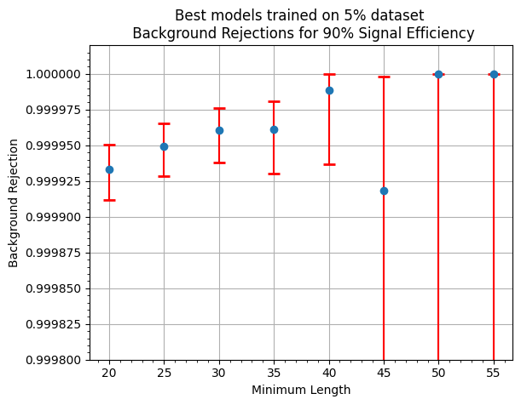
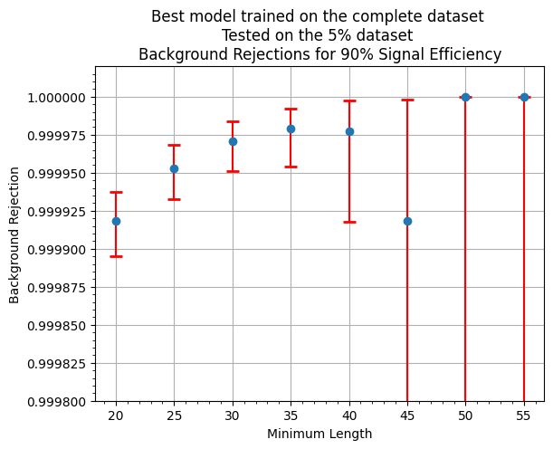
RESULTS
Rubustness Test
We turn off randomly a given amount of Herd’s cubes in order to simulate a possible in-flight problem
We test the model on a test set of the same size with
  5% dead cubes
  10% dead cubes
  15% dead cubes
Furhtermore we train again the whole set of models on the 5% and 10% datasets
We observe that the performance of the original model are constant on the three datsets
We observe that there is no performance gains in re-training the models specifically on the 5% and 10% datasets

Slide 17
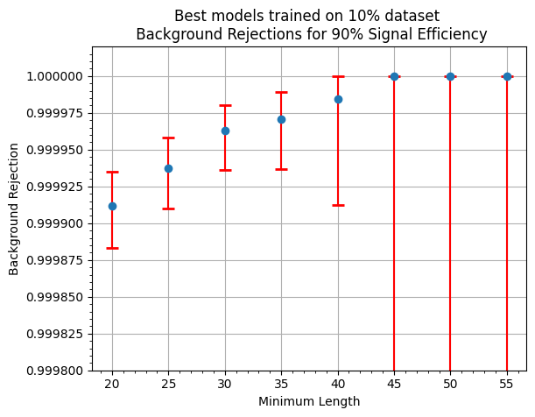
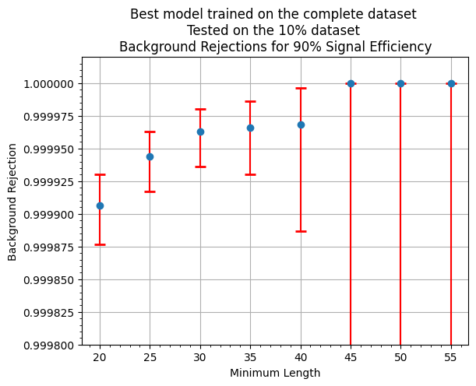
RESULTS
Rubustness Test
We turn off randomly a given amount of Herd’s cubes in order to simulate a possible in-flight problem
We test the model on a test set of the same size with
  5% dead cubes
  10% dead cubes
  15% dead cubes
Furhtermore we train again the whole set of models on the 5% and 10% datasets
We observe that the performance of the original model are constant on the three datsets
We observe that there is no performance gains in re-training the models specifically on the 5% and 10% datasets

Slide 18
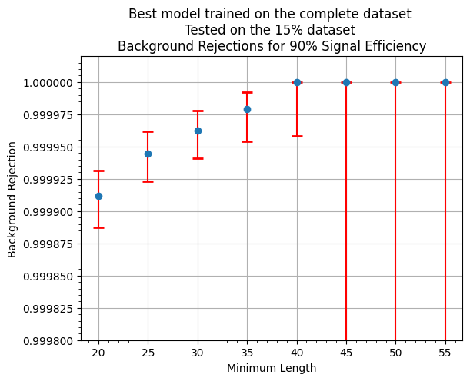
RESULTS
Rubustness Test
We turn off randomly a given amount of Herd’s cubes in order to simulate a possible in-flight problem
We test the model on a test set of the same size with
  5% dead cubes
  10% dead cubes
  15% dead cubes
Furhtermore we train again the whole set of models on the 5% and 10% datasets
We observe that the performance of the original model are constant on the three datsets
We observe that there is no performance gains in re-training the models specifically on the 5% and 10% datasets

