Slide 1


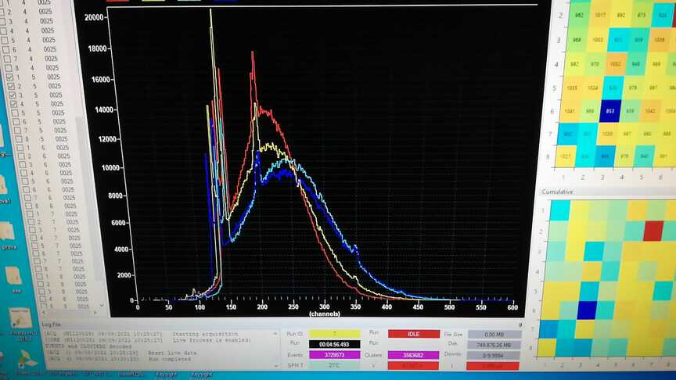
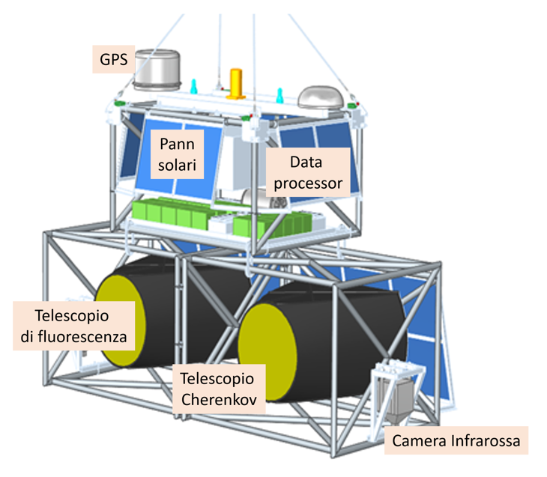
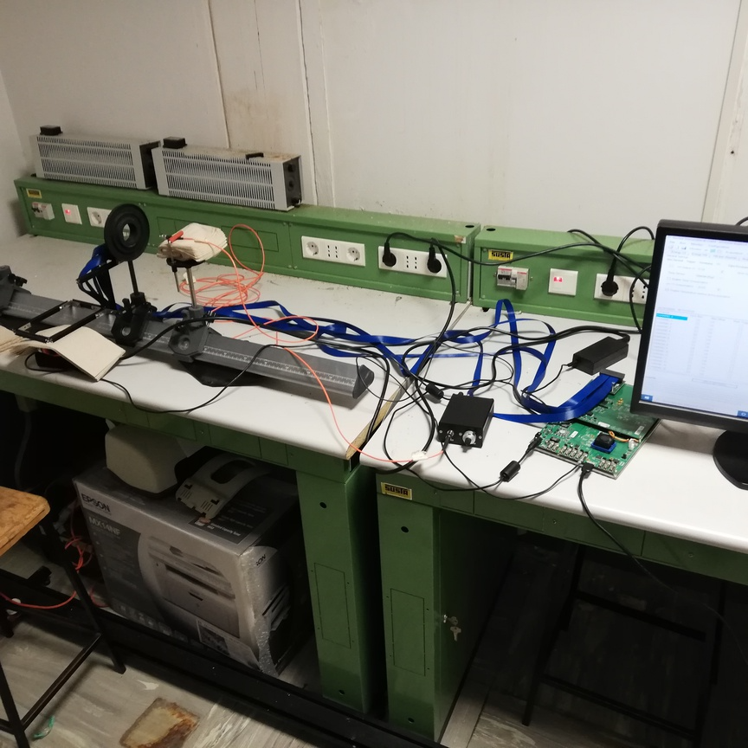
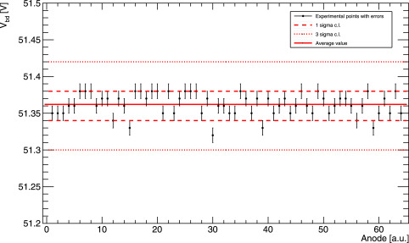
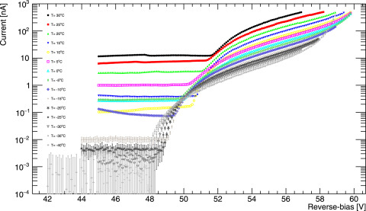
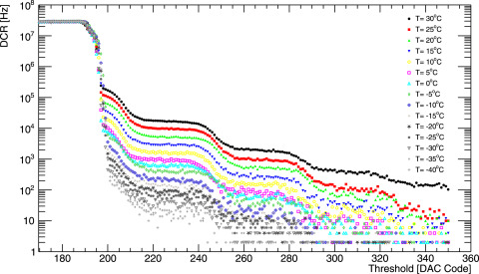
ASAPP 2025 Conferecence - POSTER#79
Study of performances and characterization of SiPMs (HamamatsuS13161-3050AE-08) for the next generation of telescopes in balloon-borne & space-based experiments
Rossella Caruso on behalf of the ASI/INFN_EUSO-SPB2 Project
Dipartimento di Fisica e Astronomia “Ettore Majorana”, University of Catania & INFN Catania Catania-Italy
WHAT IS THIS CONTRIBUTION ABOUT?
WHAT HAS BEEN DONE?
WHAT IS THE RESULT?
The development of detectors based on SiPM photosensors for acquisition of fast signals coming from Cherenkov and fluorescence emission started by astroparticle showers in the atmosphere, is the main goal of the current ASI/INFN Agreement n. 2021-8-HH.2-2022, named “EUSO-SPB2 (Extreme Universe Space Observatory – Super Pressure Balloon 2)” (P.I. G.Osteria) useful for the next generation of telescopes in balloon-borne and space-based experiments.
PARTNERS:
ASI
INFN : BA CT, NA, ROMA2, TO
SUB-PARTNERS:
University of CATANIA
University of TORINO
The protocol foresees to measure several parameters: breakdown voltage (Vbd) , quenching resistance (Rq), gain (G), dark count rate (DCR), probability of cross-talk (pCT) as function of temperature. Two different experimental configurations were adopted: 1) a picoammeter to measure accurately the leakage currents and the (I-V) curves in forward and reverse modes to determine both Vbd and Rq 2) a CAEN DT5202 read-out system to measure multi-photon spectrum to evaluate G, DCR and pCT, applied to Hamamatsu S13161-3050AE-08 SiPM (8 × 8) array in the (−40, +30)°C temperature (T) range. RESULTS:
foundation of a SiPMs Laboratory in University of Catania;
publication of a paper: Characterisation of Hamamatsu S13161-3050AE-08 SiPM (8x8) array at different temperatures with CAEN DT5202, Persiani R. NIMA 1057 (2023) 168732
THANKS the financial support of the ASI (ASI/INFN Agreement n. 2021-8-HH.2-2022).
WP4400: “Selection, characterization and test of SiPMs”
The main item of this R&D on of SiPMs is the definition of a procedure for characterising and selecting the SiPMs that best fit the experimental requirements. The study of performances of different SiPMs available on the market has been performed to identify the best sensors for space applications.
The protocol foresees to measure several parameters: breakdown voltage (Vbd) , quenching resistance (Rq), gain (G), dark count rate (DCR), probability of cross-talk (pCT) as function of temperature
nnnn

