Slide 1


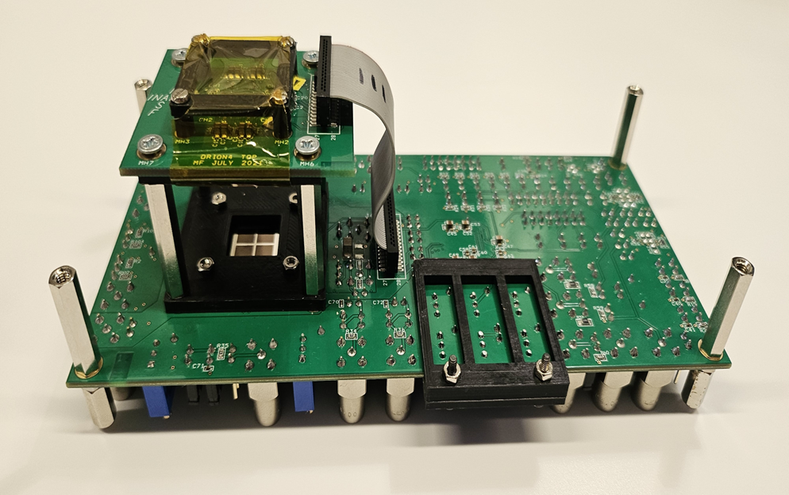
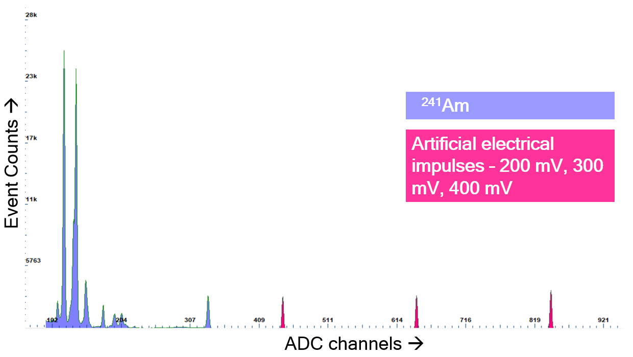
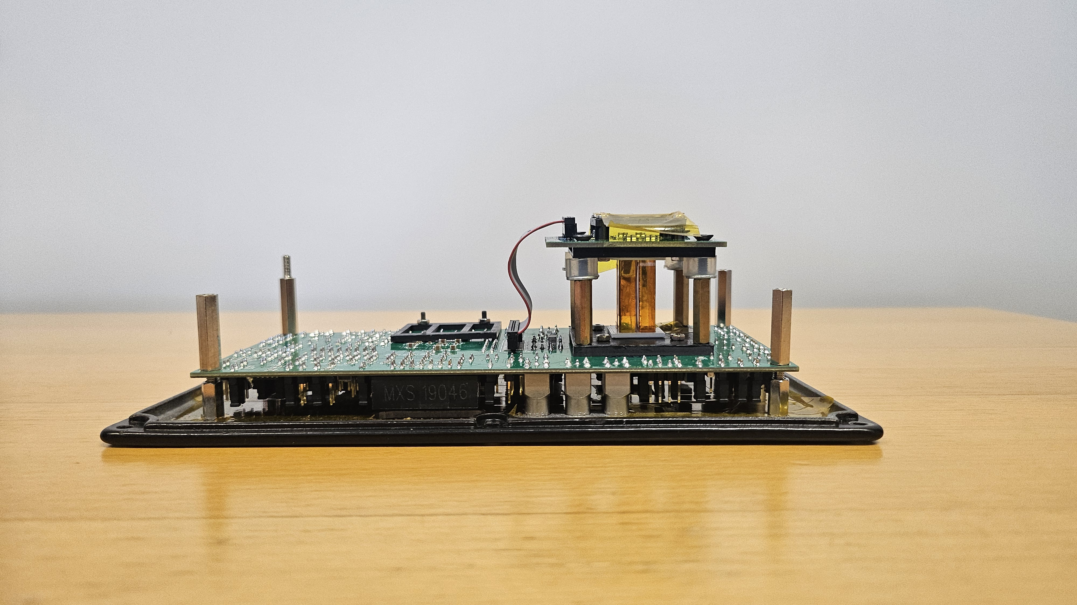
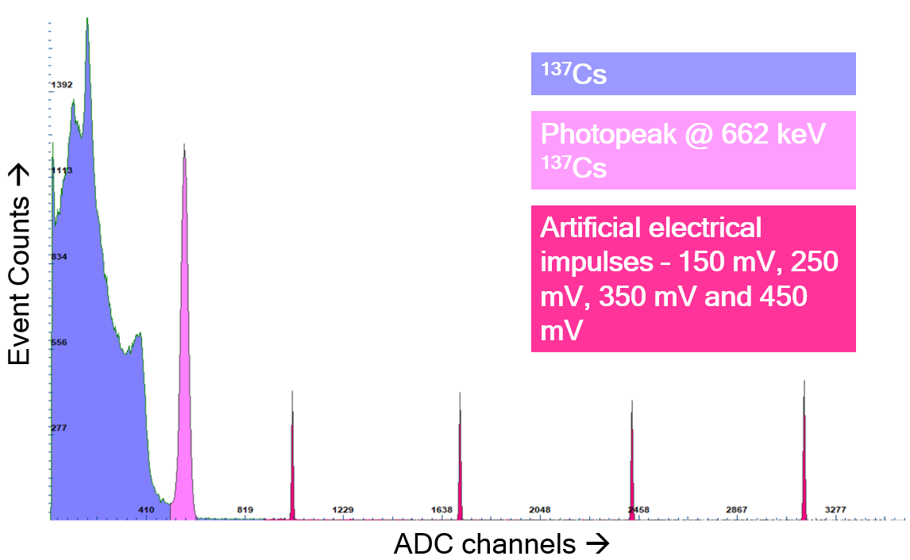






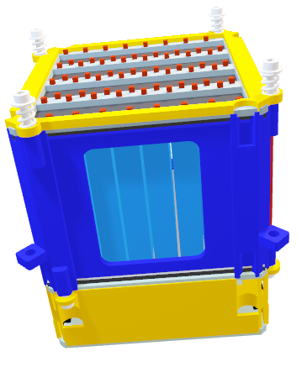
Testing and Characterization of XGIS detectors for THESEUS Mission
1
2
4-pixel ORION ASIC prototype + top + bottom SDDs
4
3
²⁴¹Am spectra + artificial electrical voltage impulses
1 XGIS Module = 64 pixels
4 -pixel ORION ASIC + top + bottom SDDs + CsI(Tl) Scintillators
¹³⁷Cs spectra + artificial electrical voltage impulses

