Slide 1
Precision X-ray spectroscopy of Muonic low-Z Atoms with
Metallic Magnetic Calorimeters
Aziza Zendour
CHIPP winter school of particle physics 22-01-2025

Slide 2
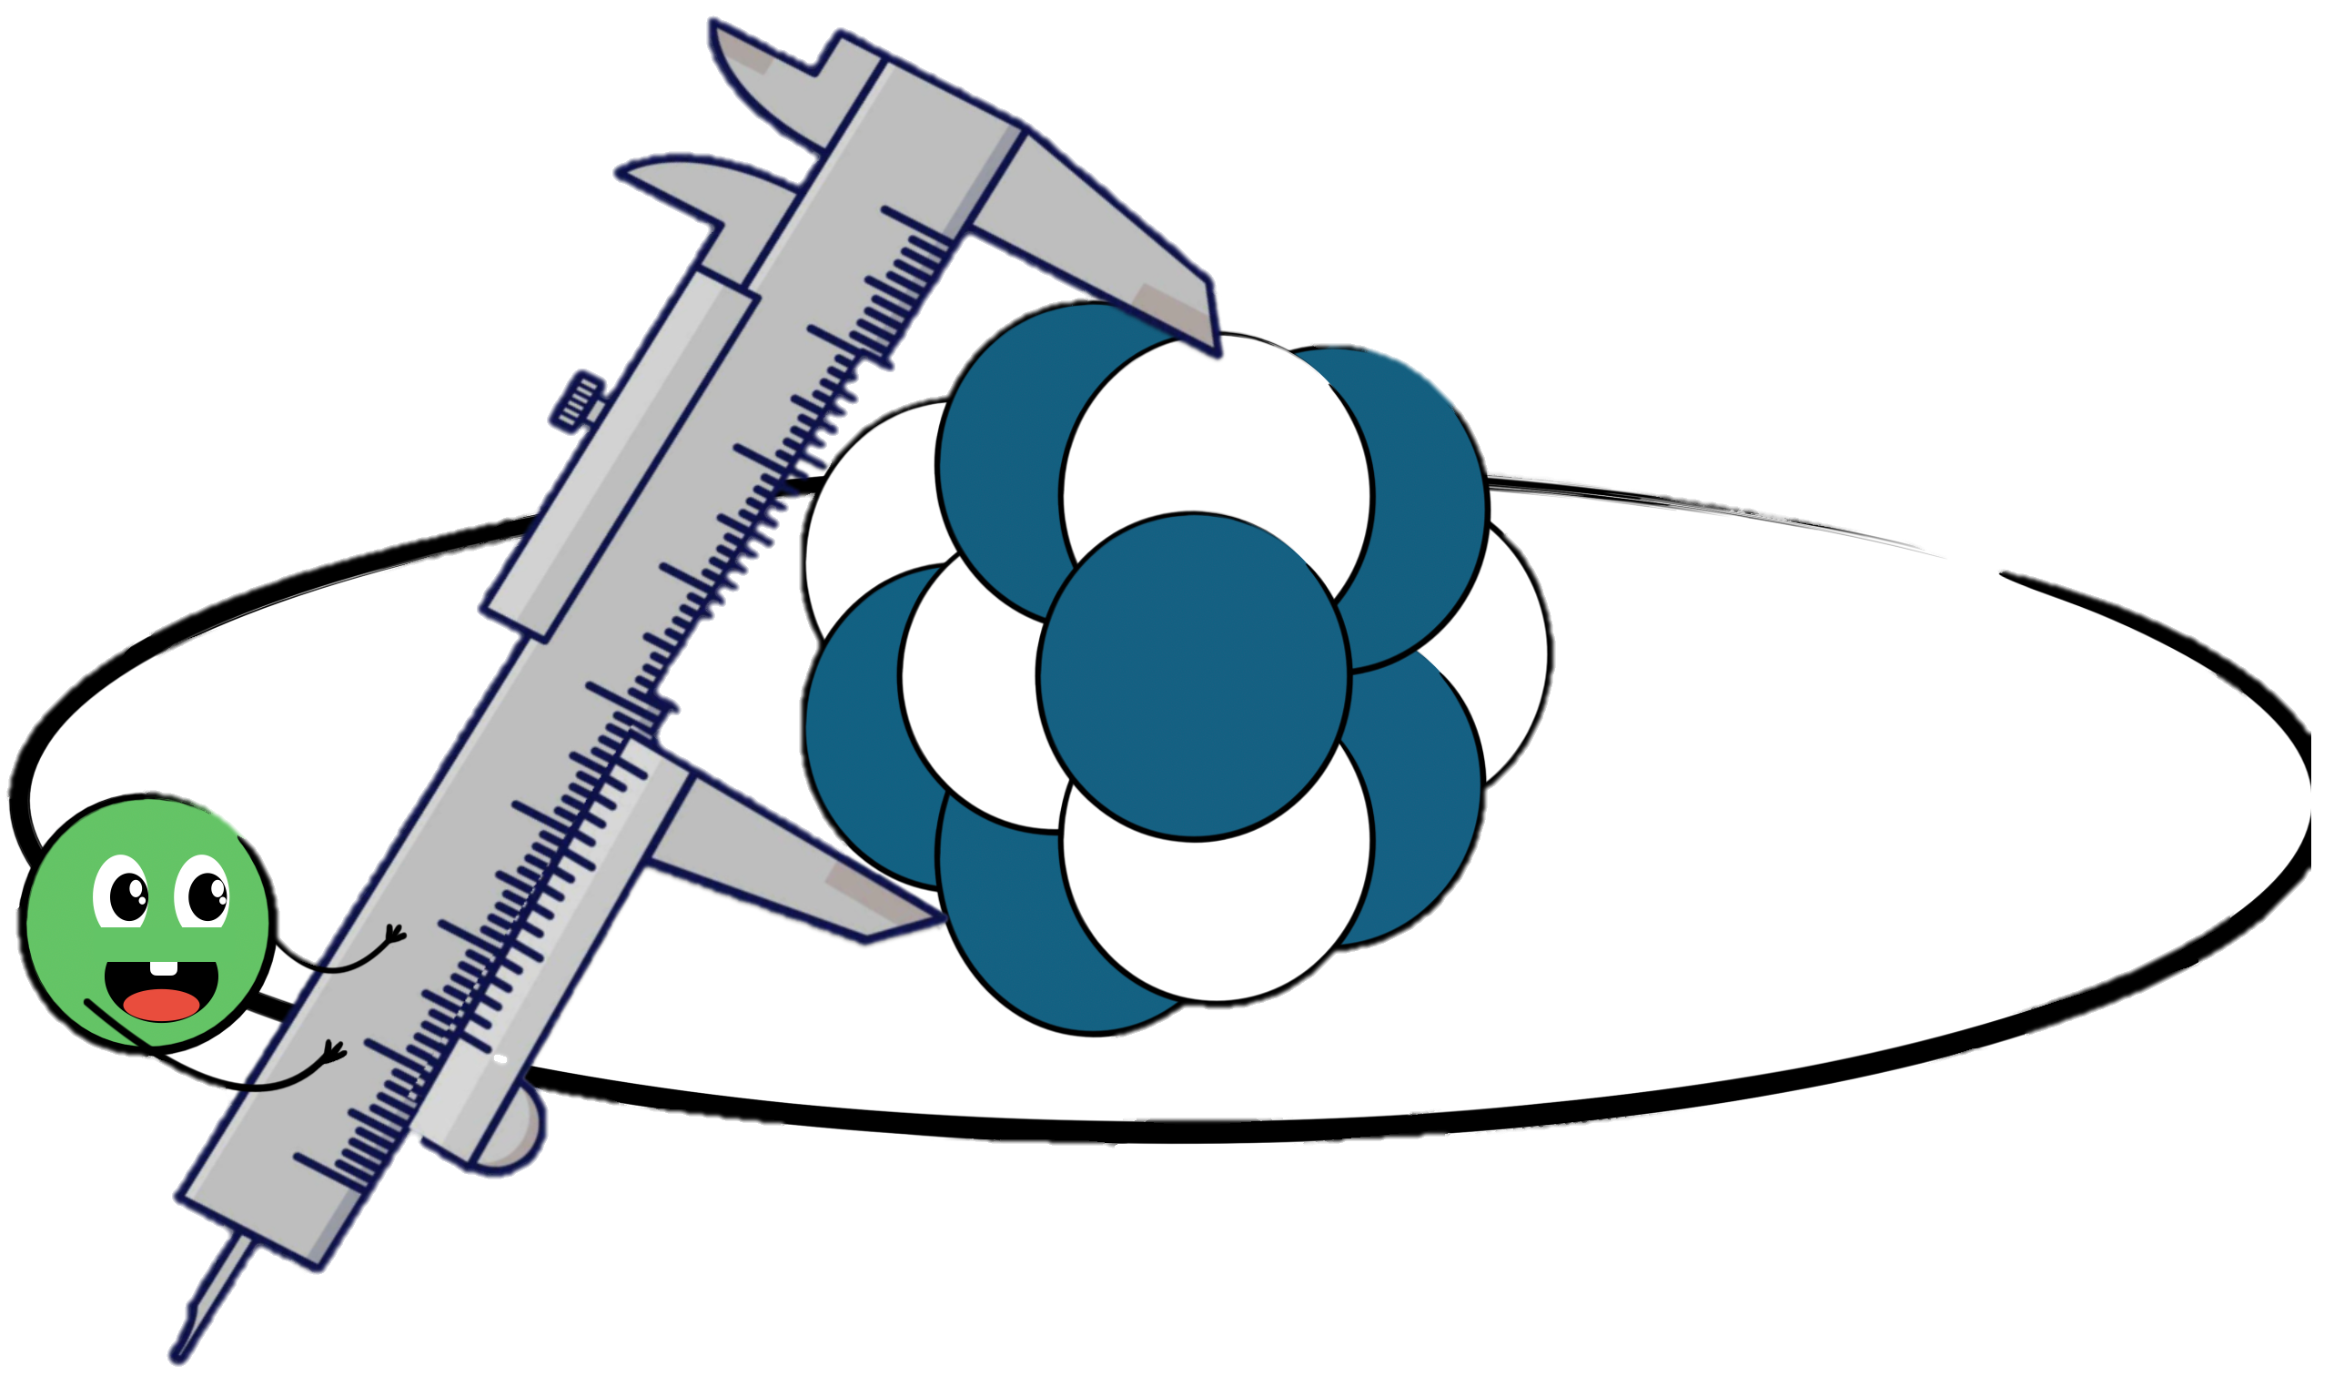
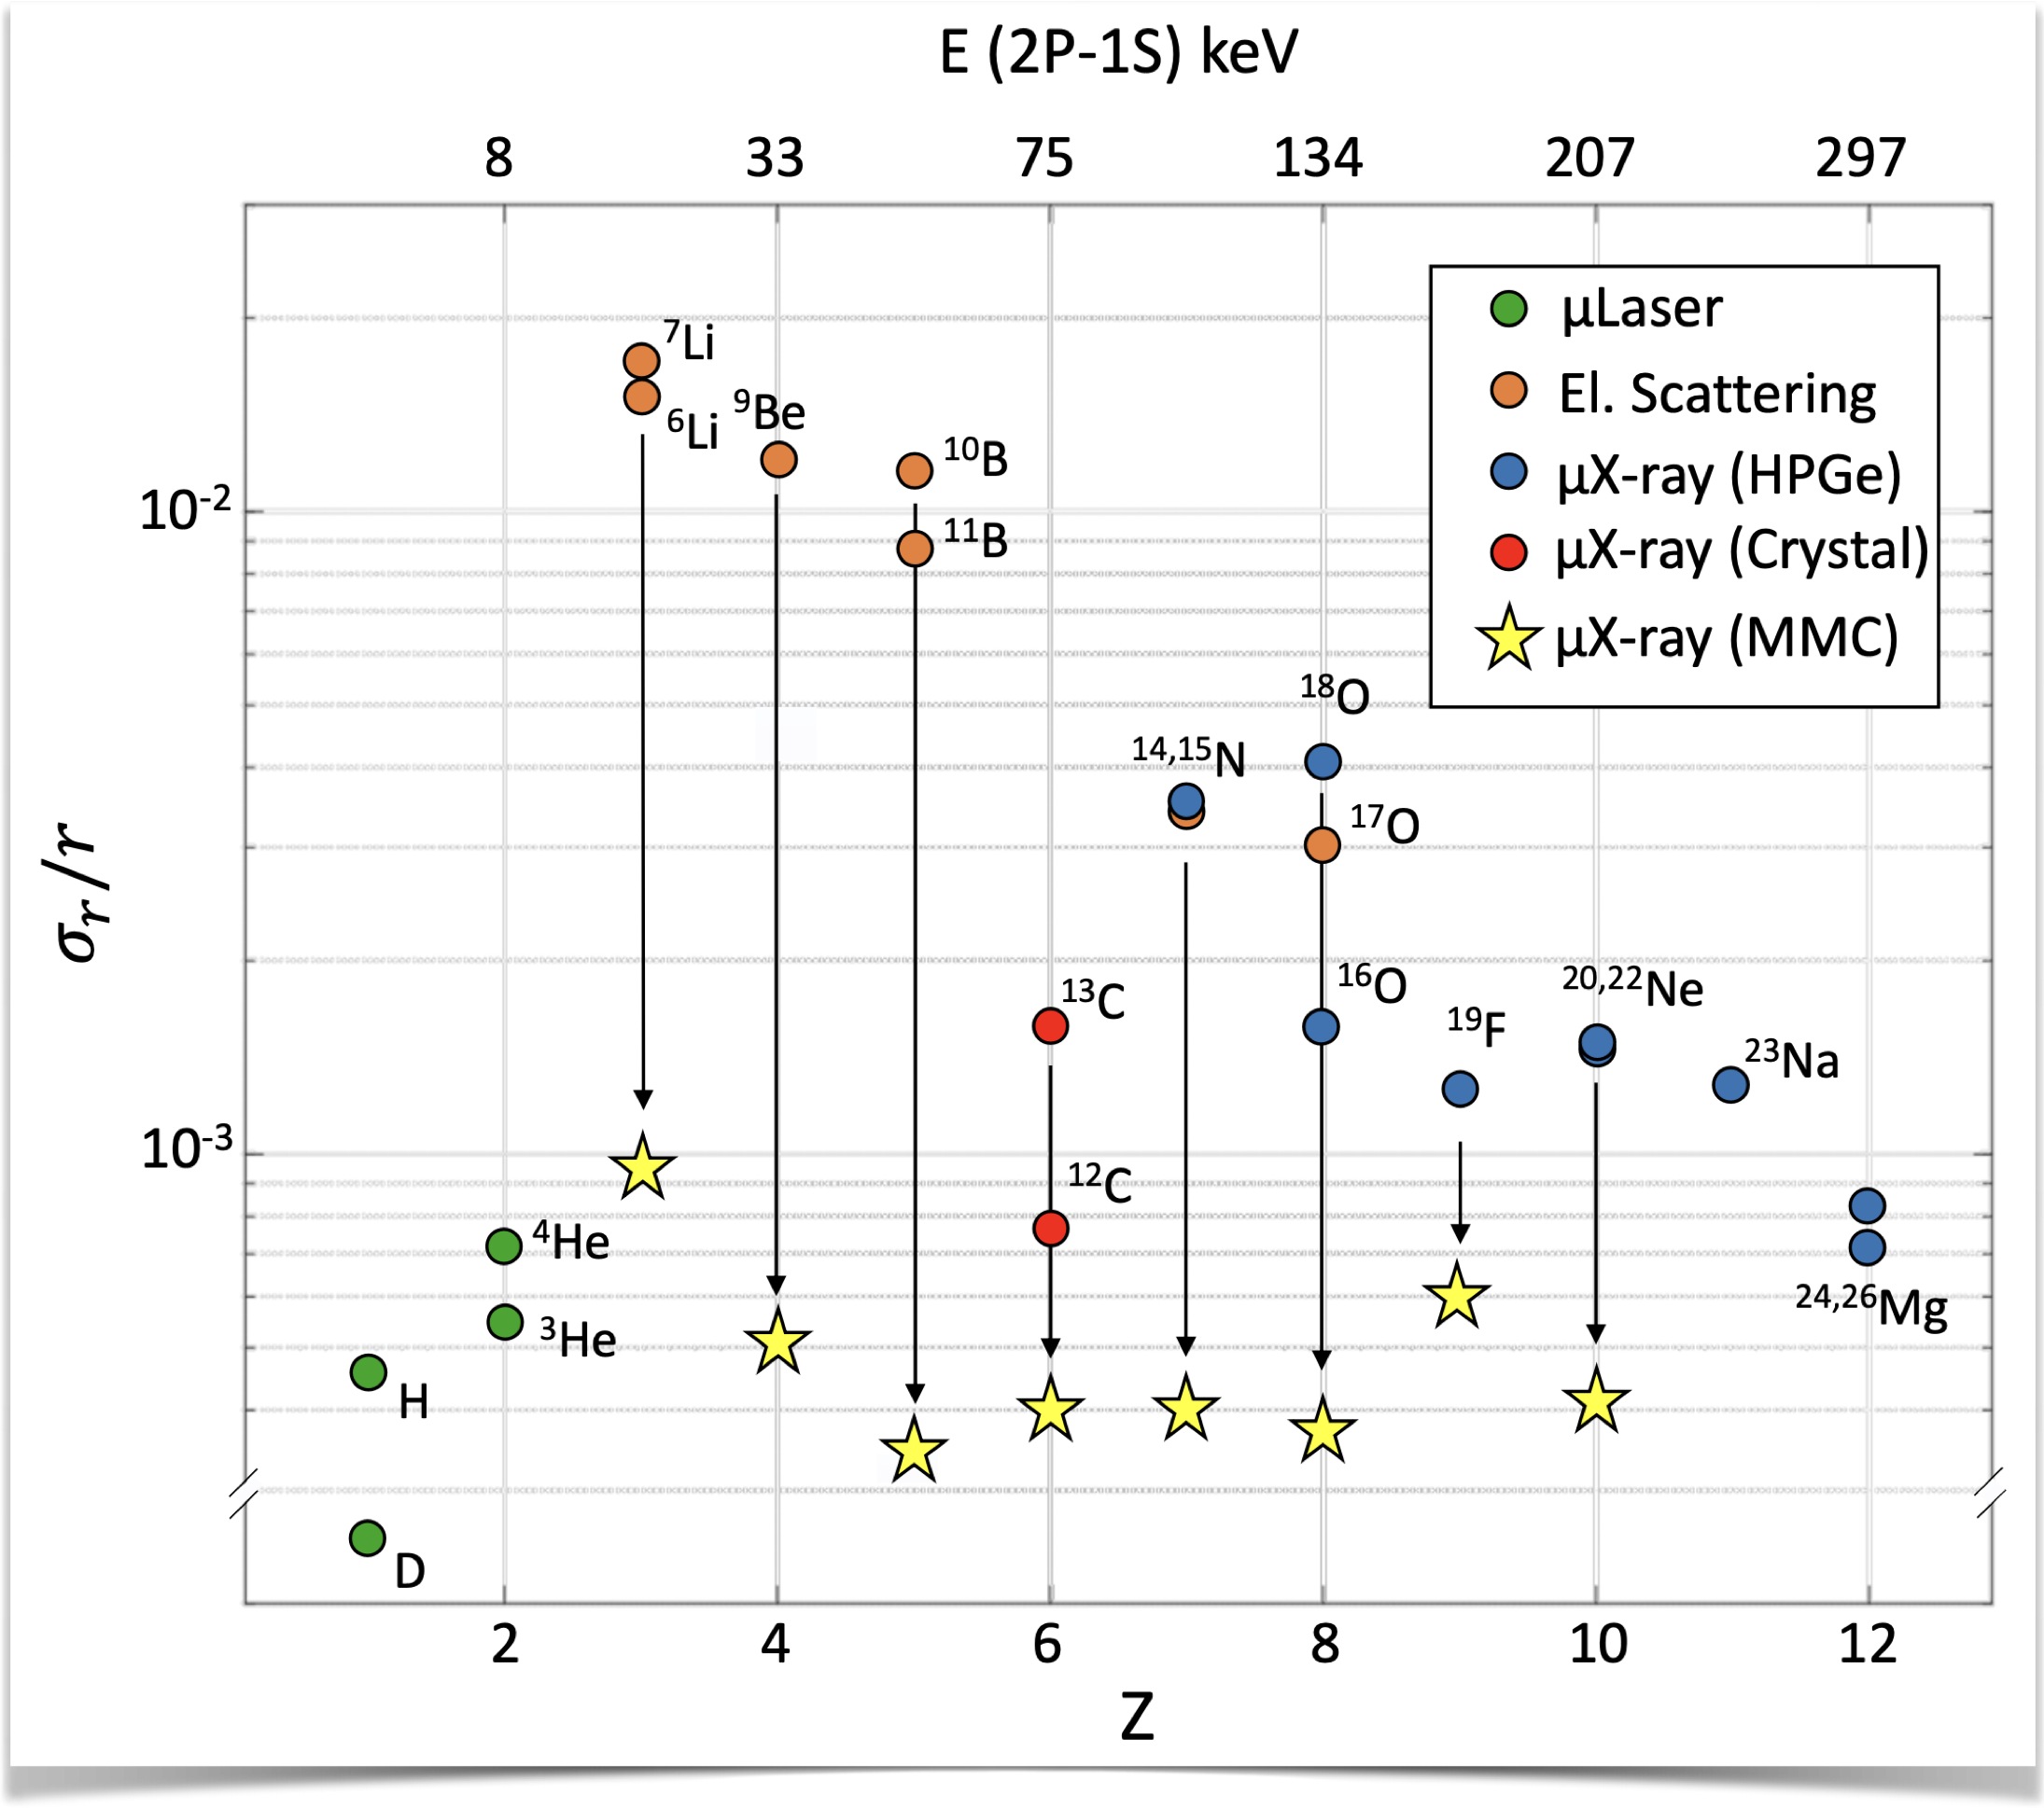
We want to
Determine absolute nuclear charge radii from muon transition energies.
Improve precision for stable nuclei
from Li to Ne.
This improves nuclear structure understanding and supports precise Standard Model tests, enhancing experimental and theoretical comparisons.

Slide 3
Muonic atom X-ray spectroscopy

Slide 4
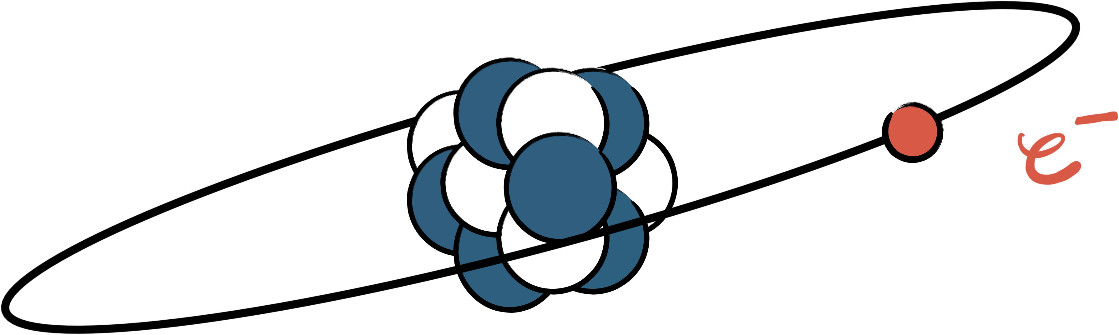

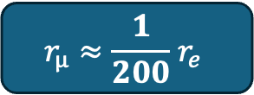
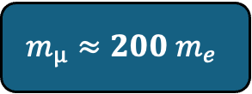
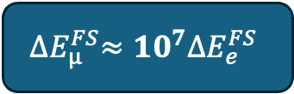
Muonic atom X-ray Spectroscopy
$$m_{µ}≈200 m_{e}$$
$$r_{µ}≈\frac{1}{200}{ r}_{e}$$
$${∆E}_{µ}^{FS}≈{10}^{7}{∆E}_{e}^{FS}$$
Smaller Bohr radius
More sensitive to the nuclear effects

Slide 5
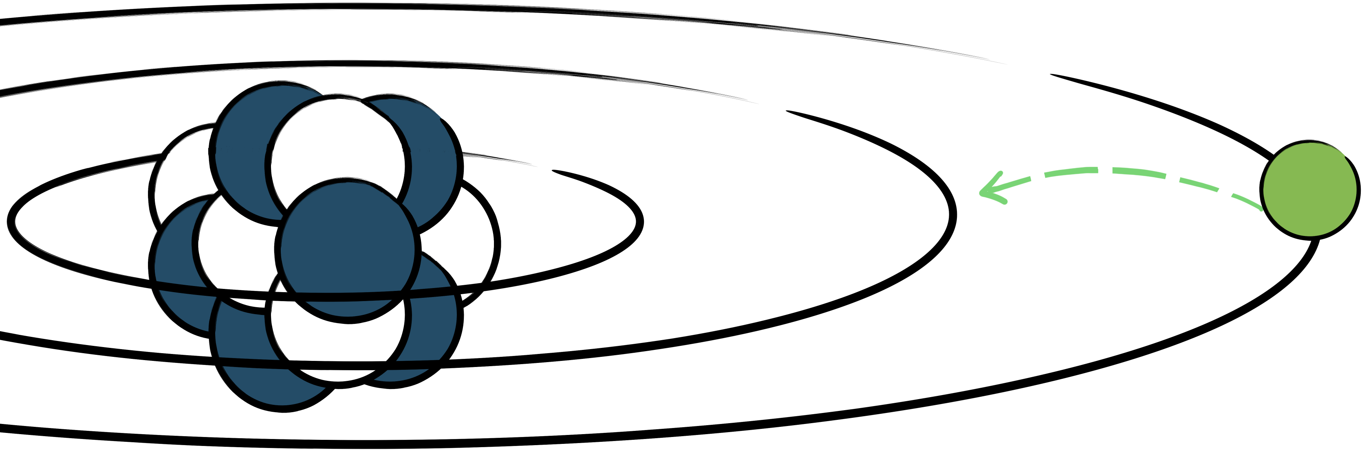


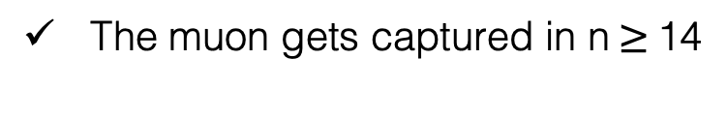
Muonic atom X-ray Spectroscopy
The muon gets captured in n $≥$14
$$μ^{−}$$
Targets of Interest

Slide 6
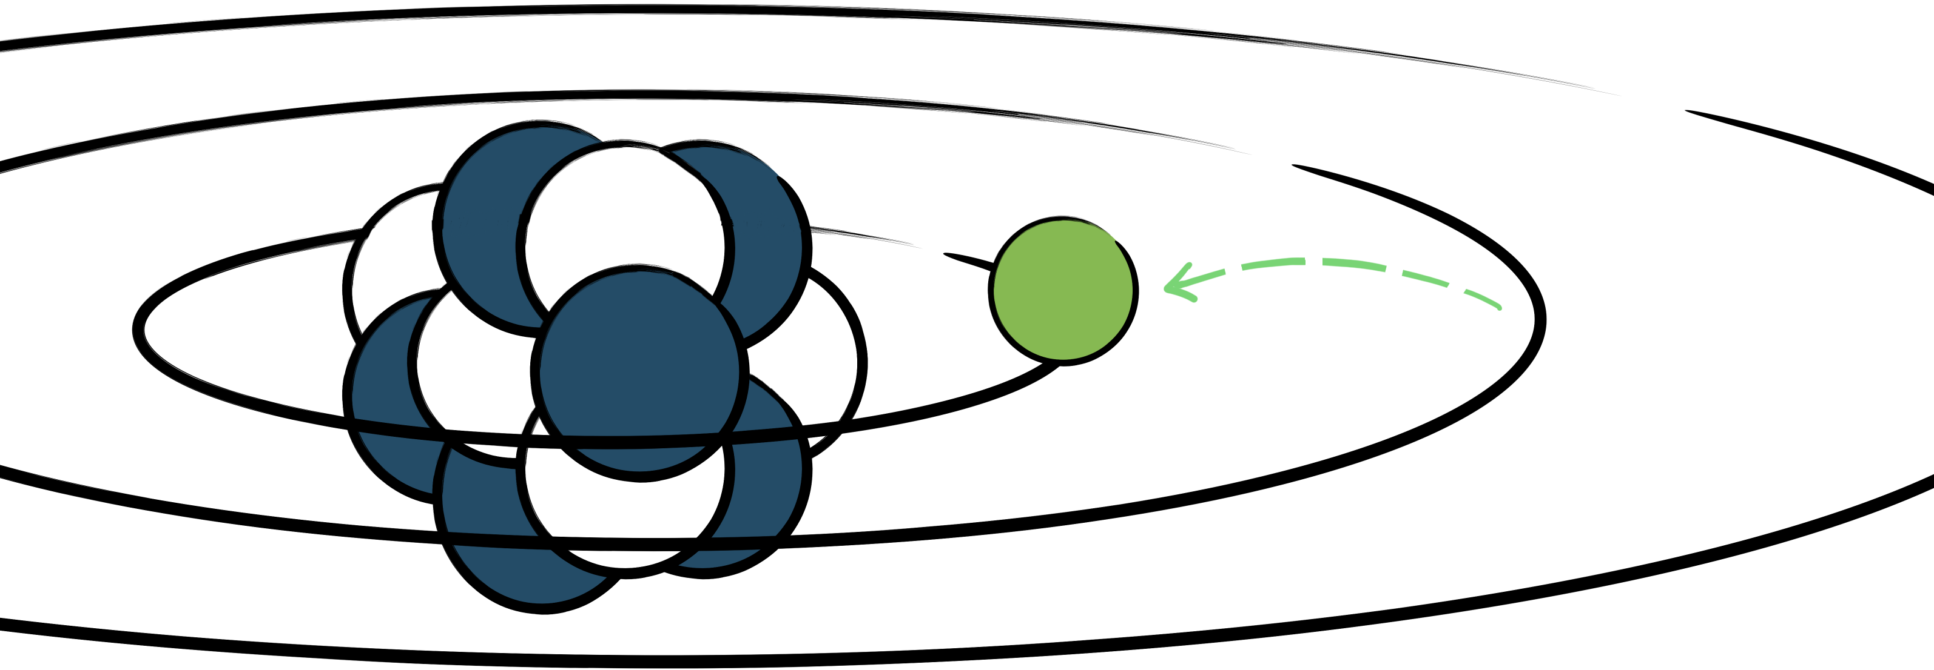
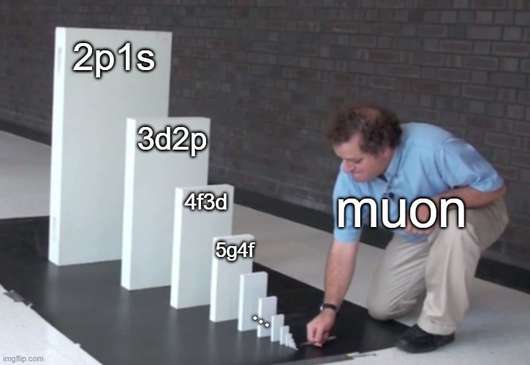


Muonic atom X-ray Spectroscopy
The muon gets captured in n $≥$14
Cascade down to 1s orbital
$$μ^{−}$$

Slide 7
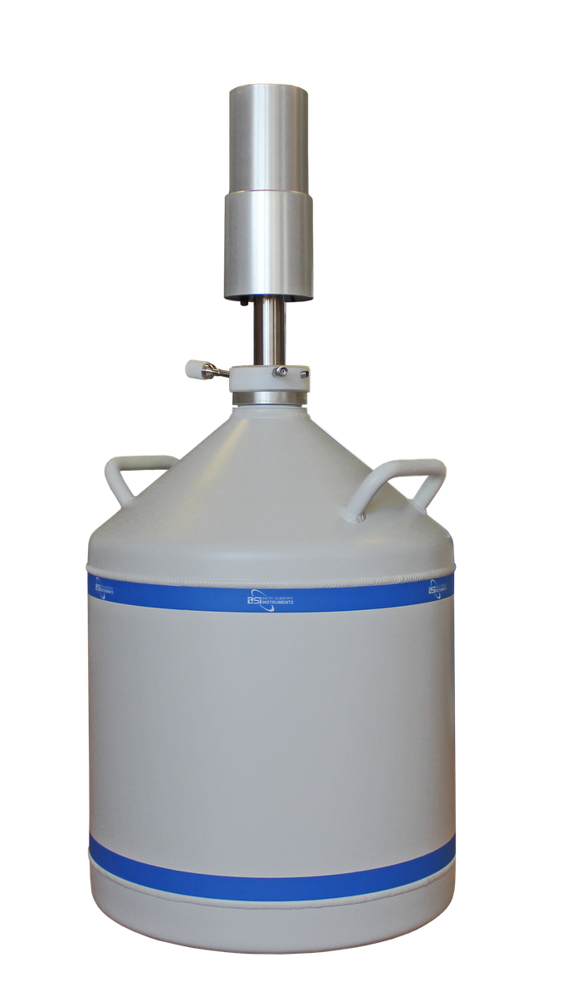
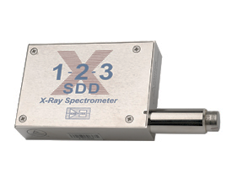


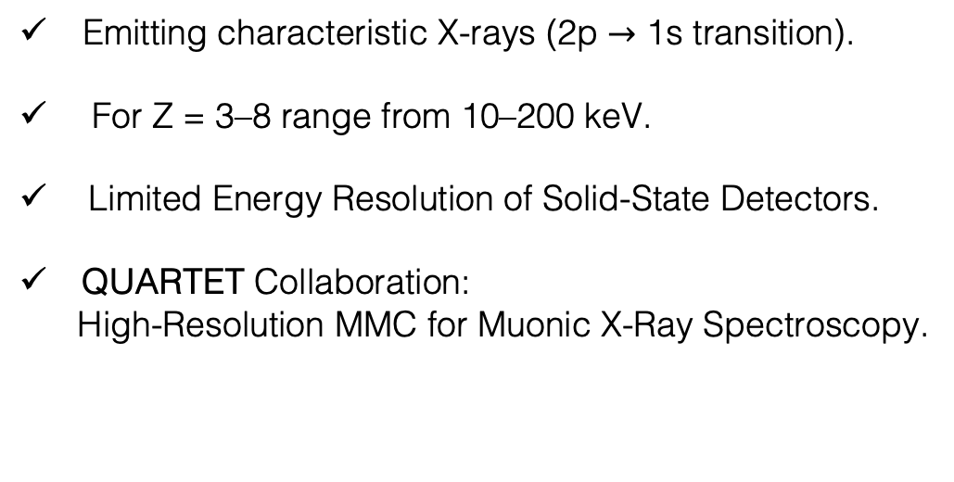
Muonic atom X-ray Spectroscopy
HPGe
Emitting characteristic X-rays (2p $→$ 1s transition).
For Z = 3–8 range from 10–200 keV.
Limited Energy Resolution of Solid-State Detectors.
QUARTET Collaboration:
High-Resolution MMC for Muonic X-Ray Spectroscopy.
X-Rays
2p→1s
$$μ^{−}$$

Slide 8
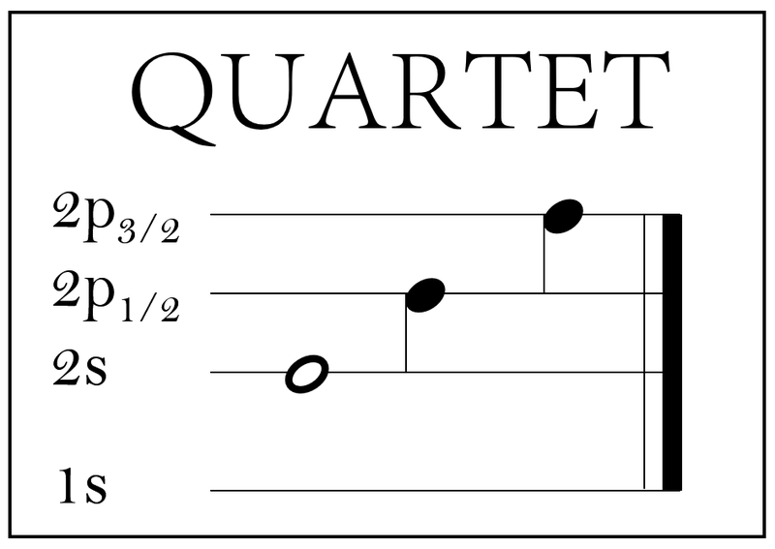






QUARTET Experiment

Slide 9
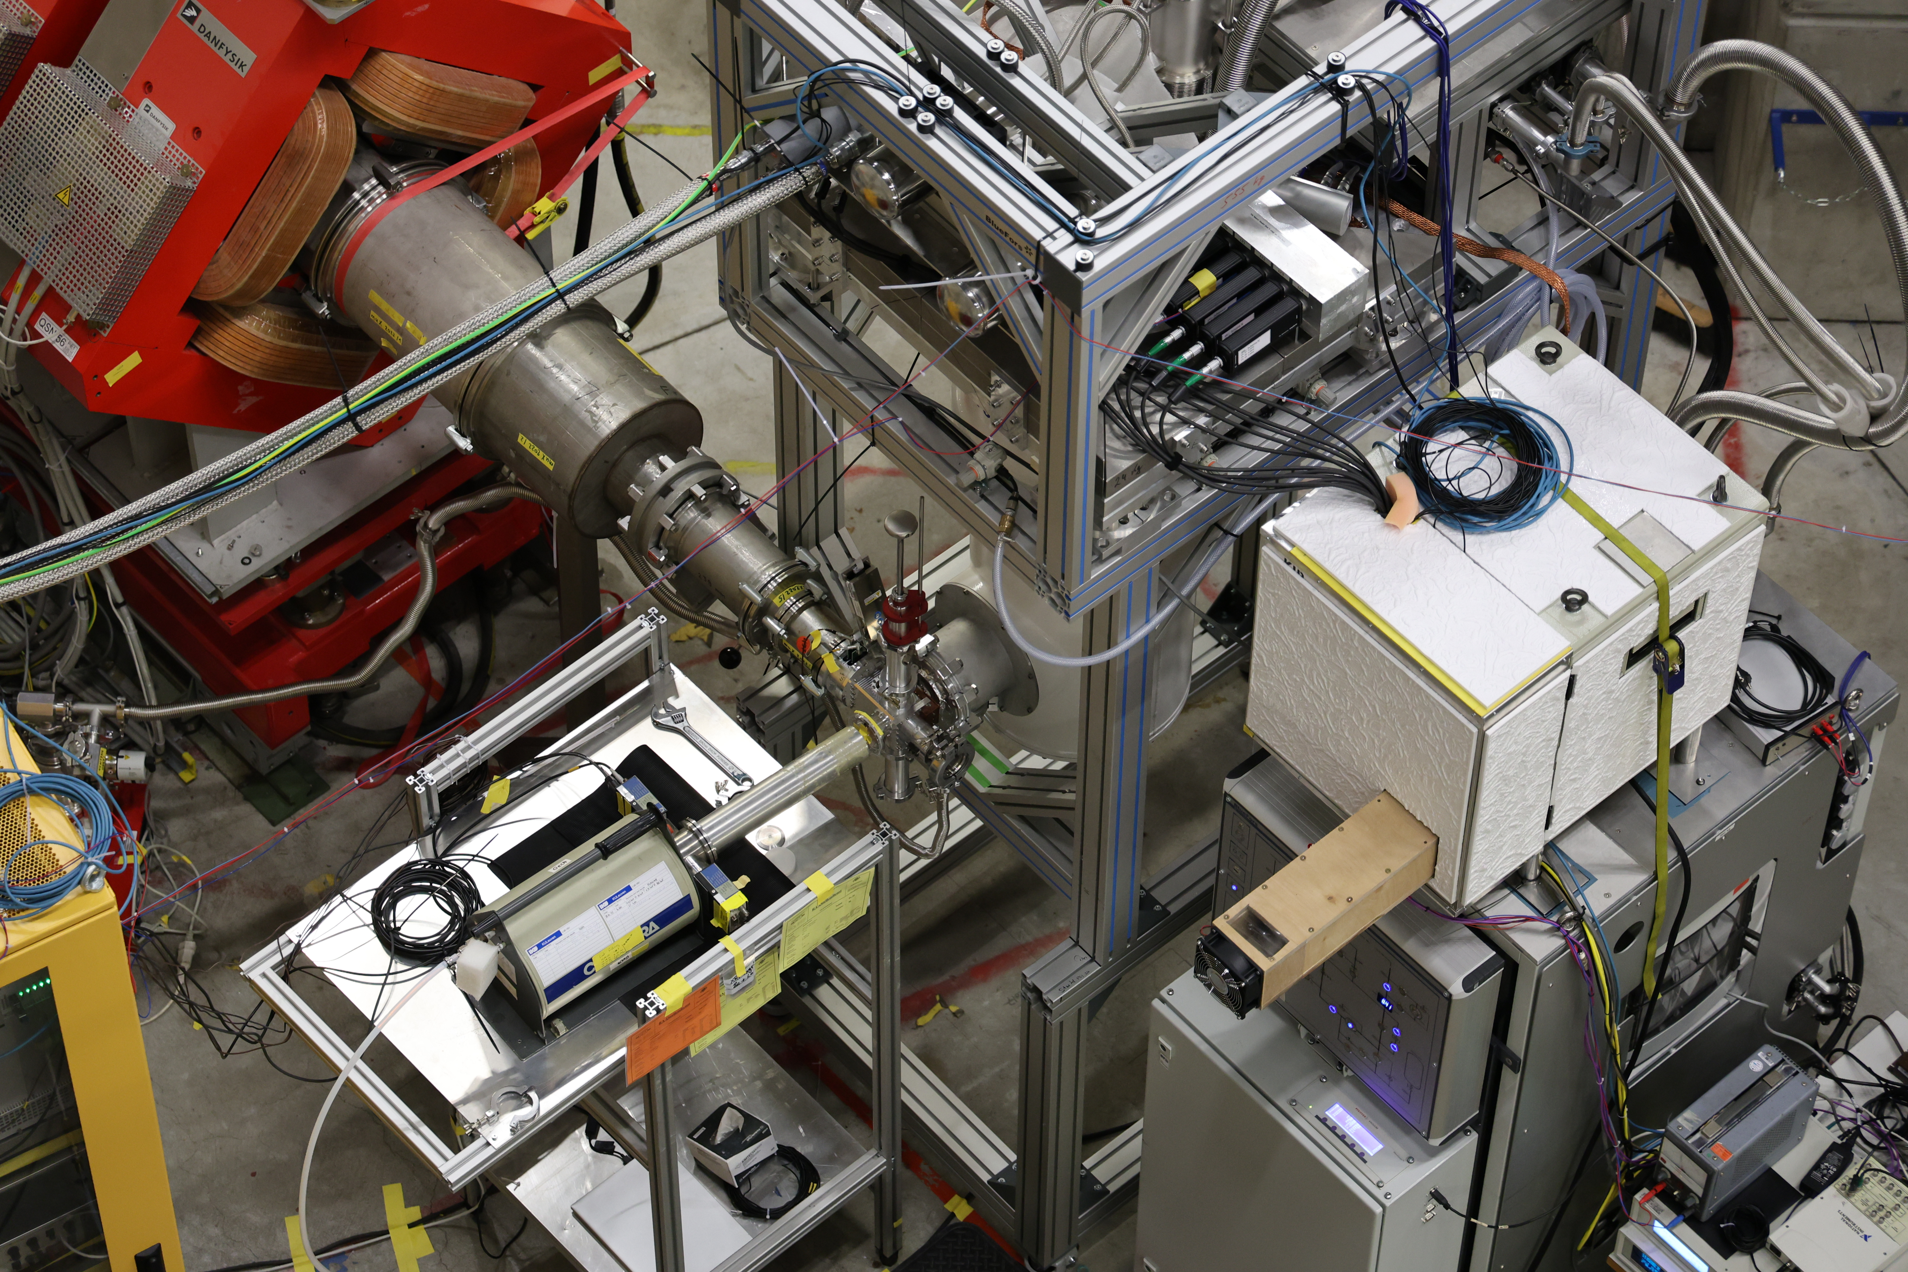
QUARTET Experiment

Slide 10
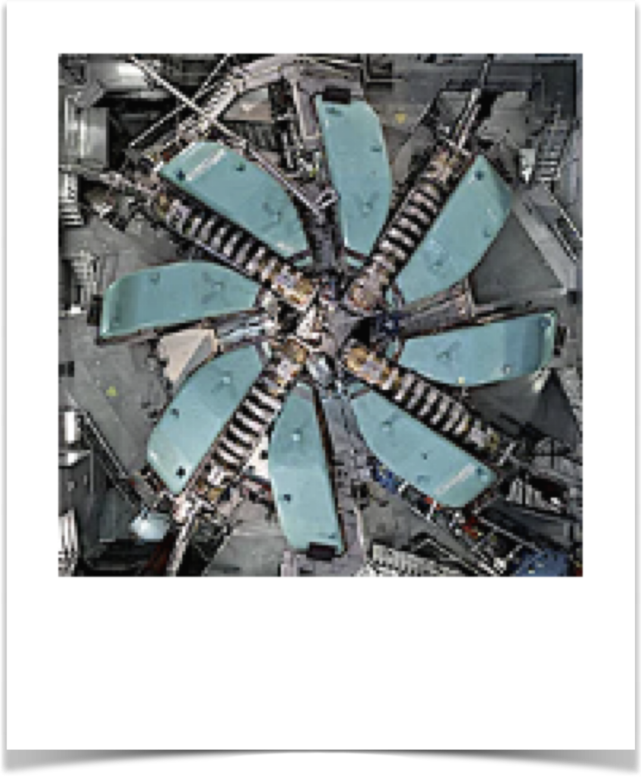

High-Intensity Proton Accelerator at PSI
High-intensity muon beam

Slide 11
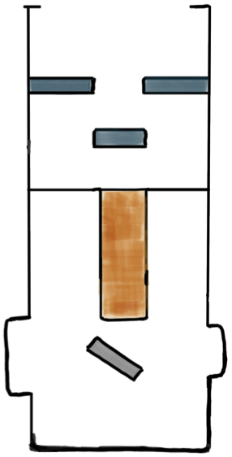


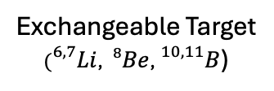
$$μ^{−}$$
Veto
scintillator
Entrance
scintillator
Radioactive sources
& XRF
for calibration
HPGe
MMC
Exchangeable Target
$({}_{}^{6,7}{Li}$, ${}_{}^{8}{Be}$, ${}_{}^{10,11}B$)

Slide 12
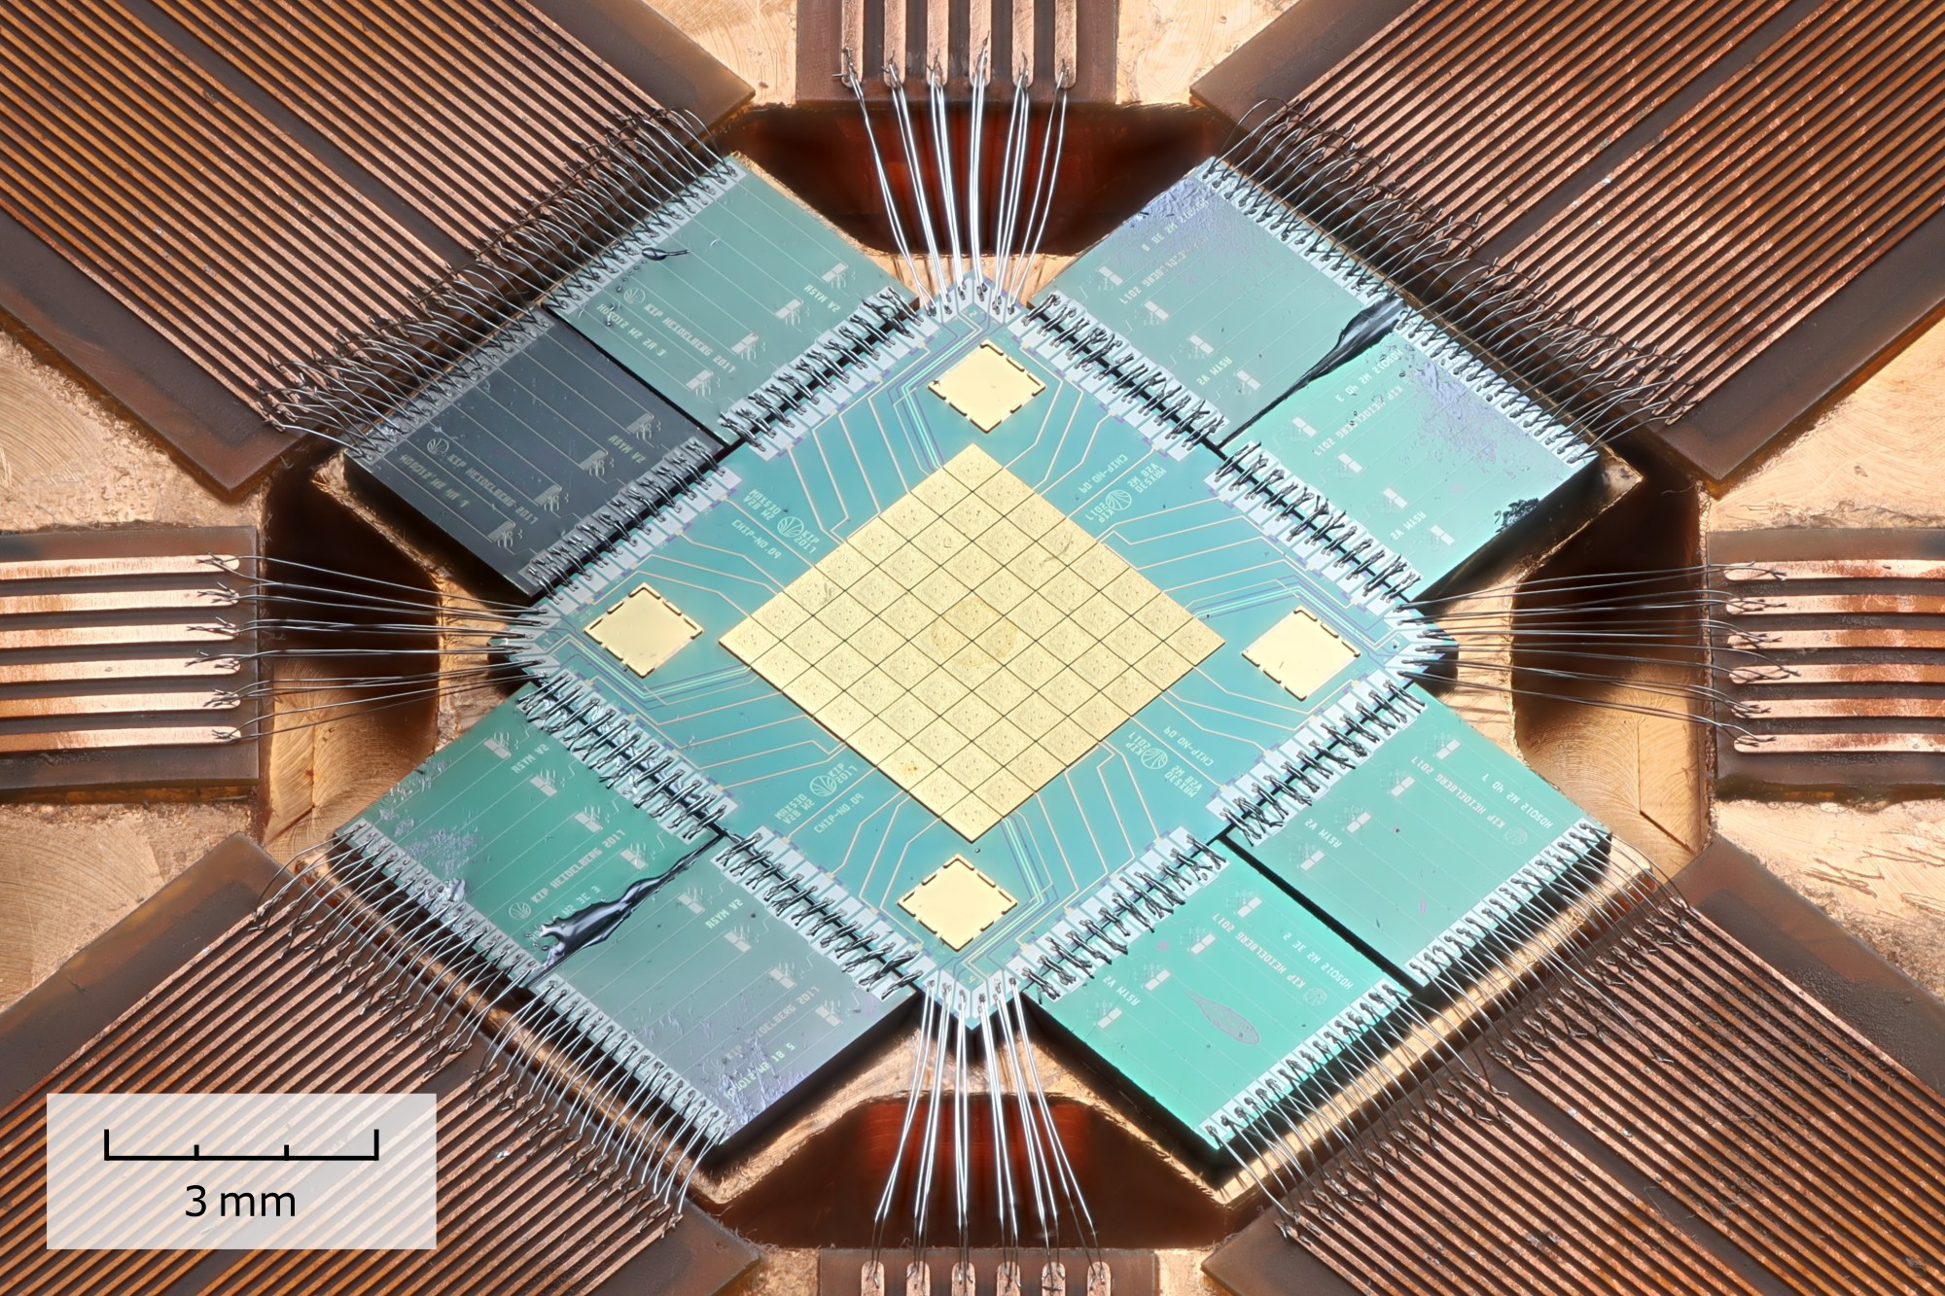
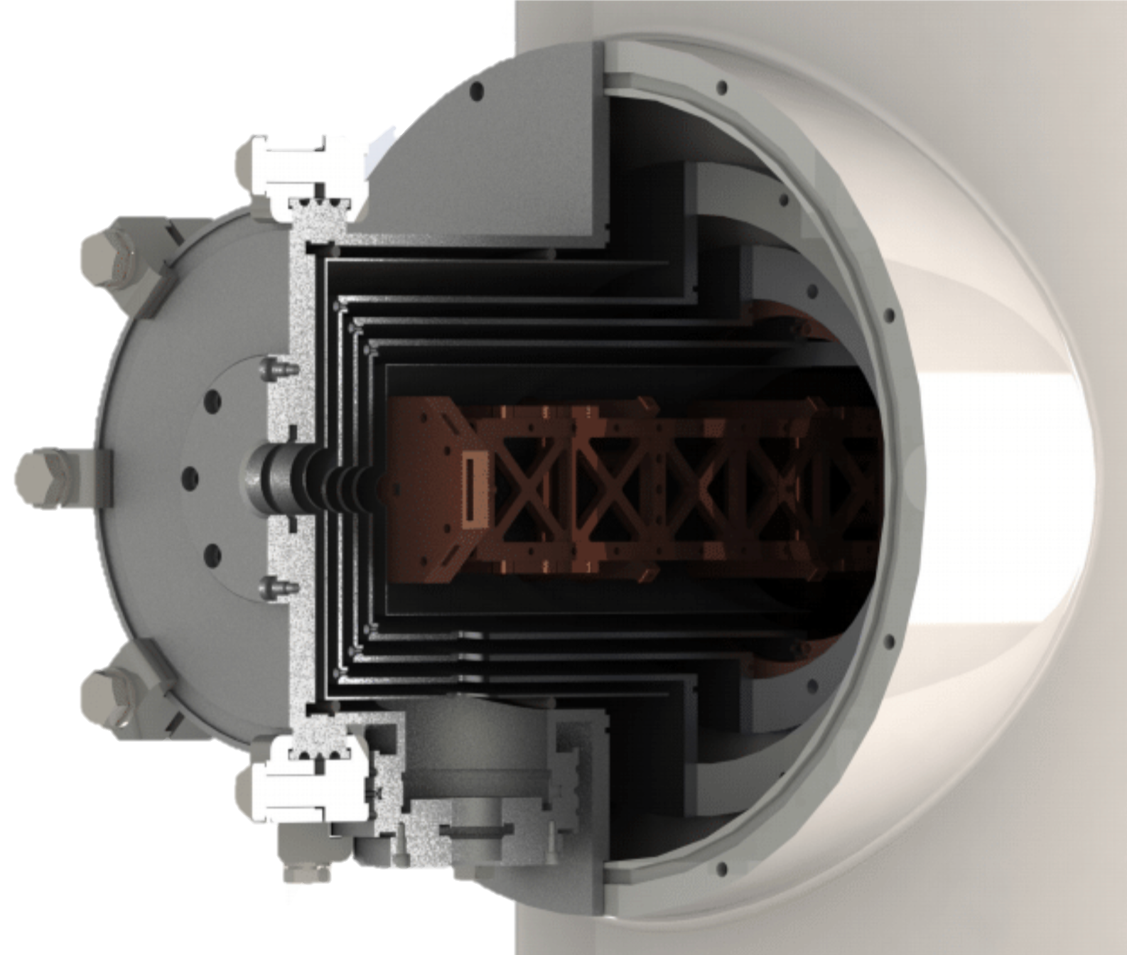

Metallic Magnetic Calorimeter
operated at approx. 20 mK
64 absorbers:
each 500 µm x 500 µm x 20 µm
max. rate per pixel $≲$1 Hz
coupled to 32 pairs
Cryostat arm multiple shields

Slide 13
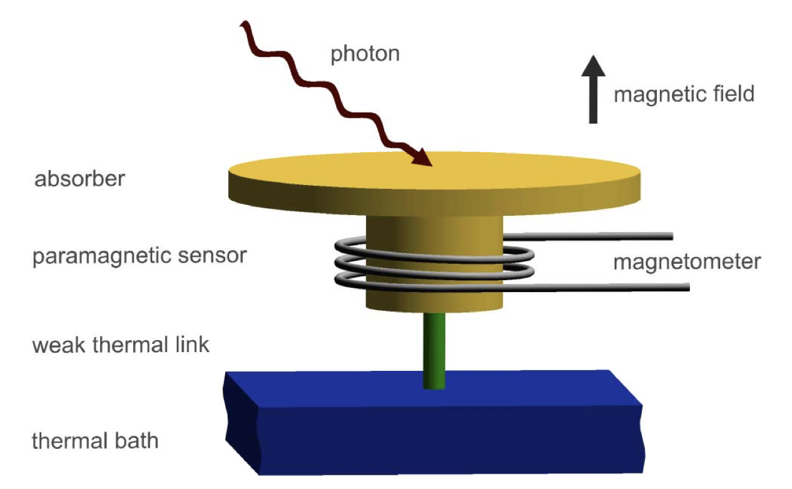
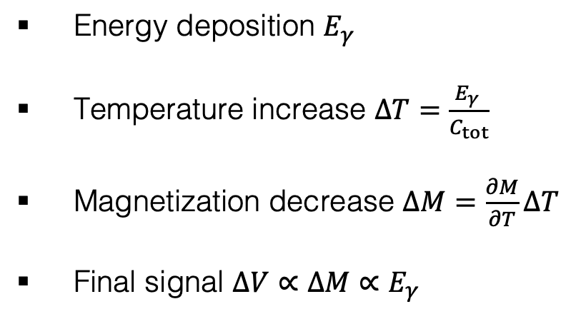

MMC working principle
$$E_{γ}$$
Energy deposition $E_{γ}$
Temperature increase $ΔT=\frac{E_{γ} }{C_{tot}}$
Magnetization decrease $ΔM=\frac{∂M}{∂T}ΔT$
Final signal $ΔV∝ΔM∝E_{γ}$

Slide 14
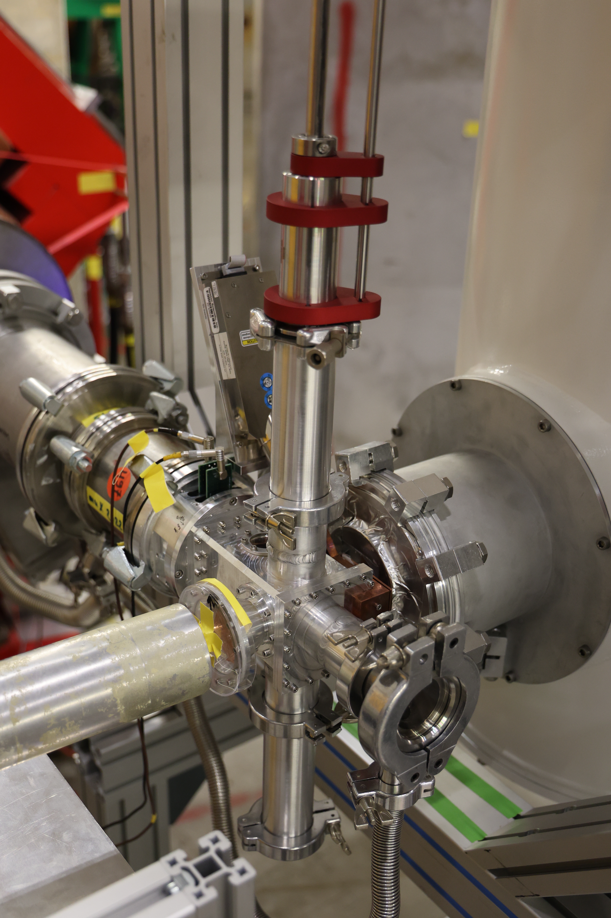
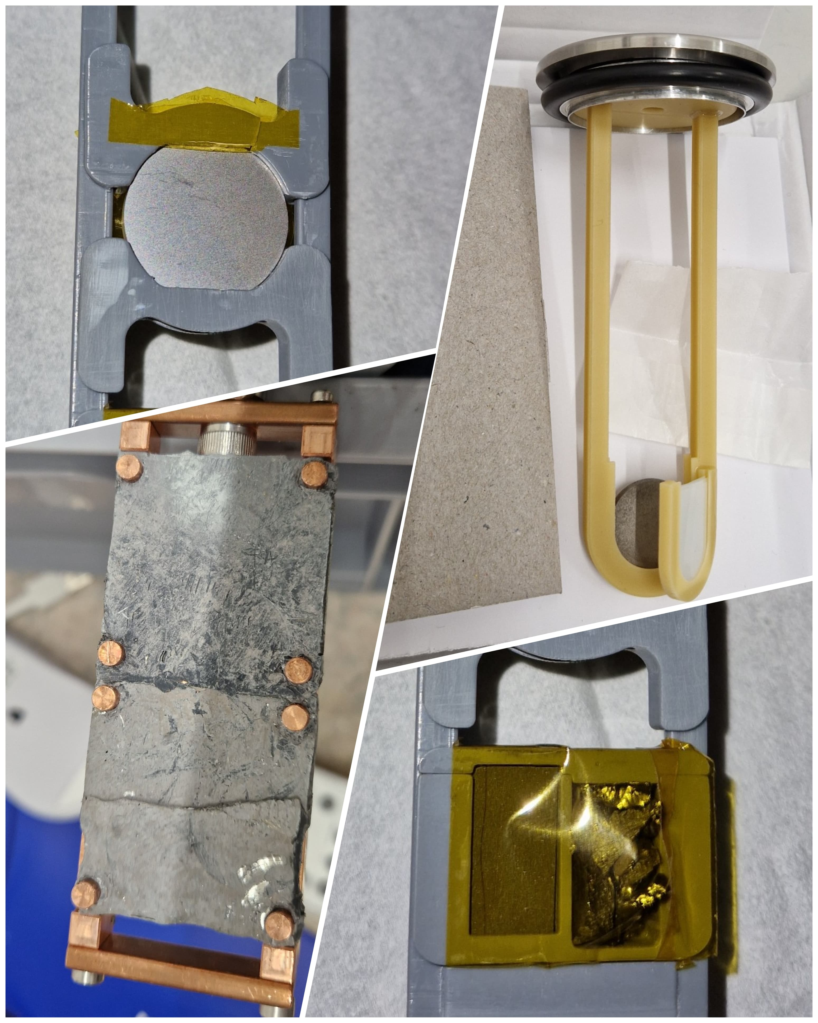

Next $→$Katharina Von Scholer Presentation
Be
Mn
B
Li

Slide 15
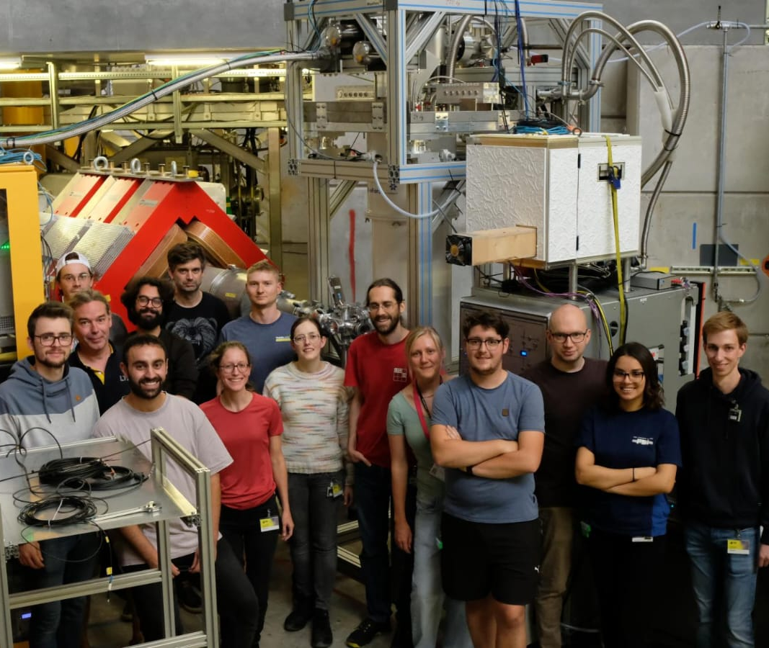
Thank you

