Slide 1

Muonic Atom Spectroscopy of ²³⁸U for the Extraction of Nuclear Properties
CHIPP Winter School of Particle Physics 2025
Anastasia Doinaki
on behalf of the muX collaboration
22/01/2025

Slide 2
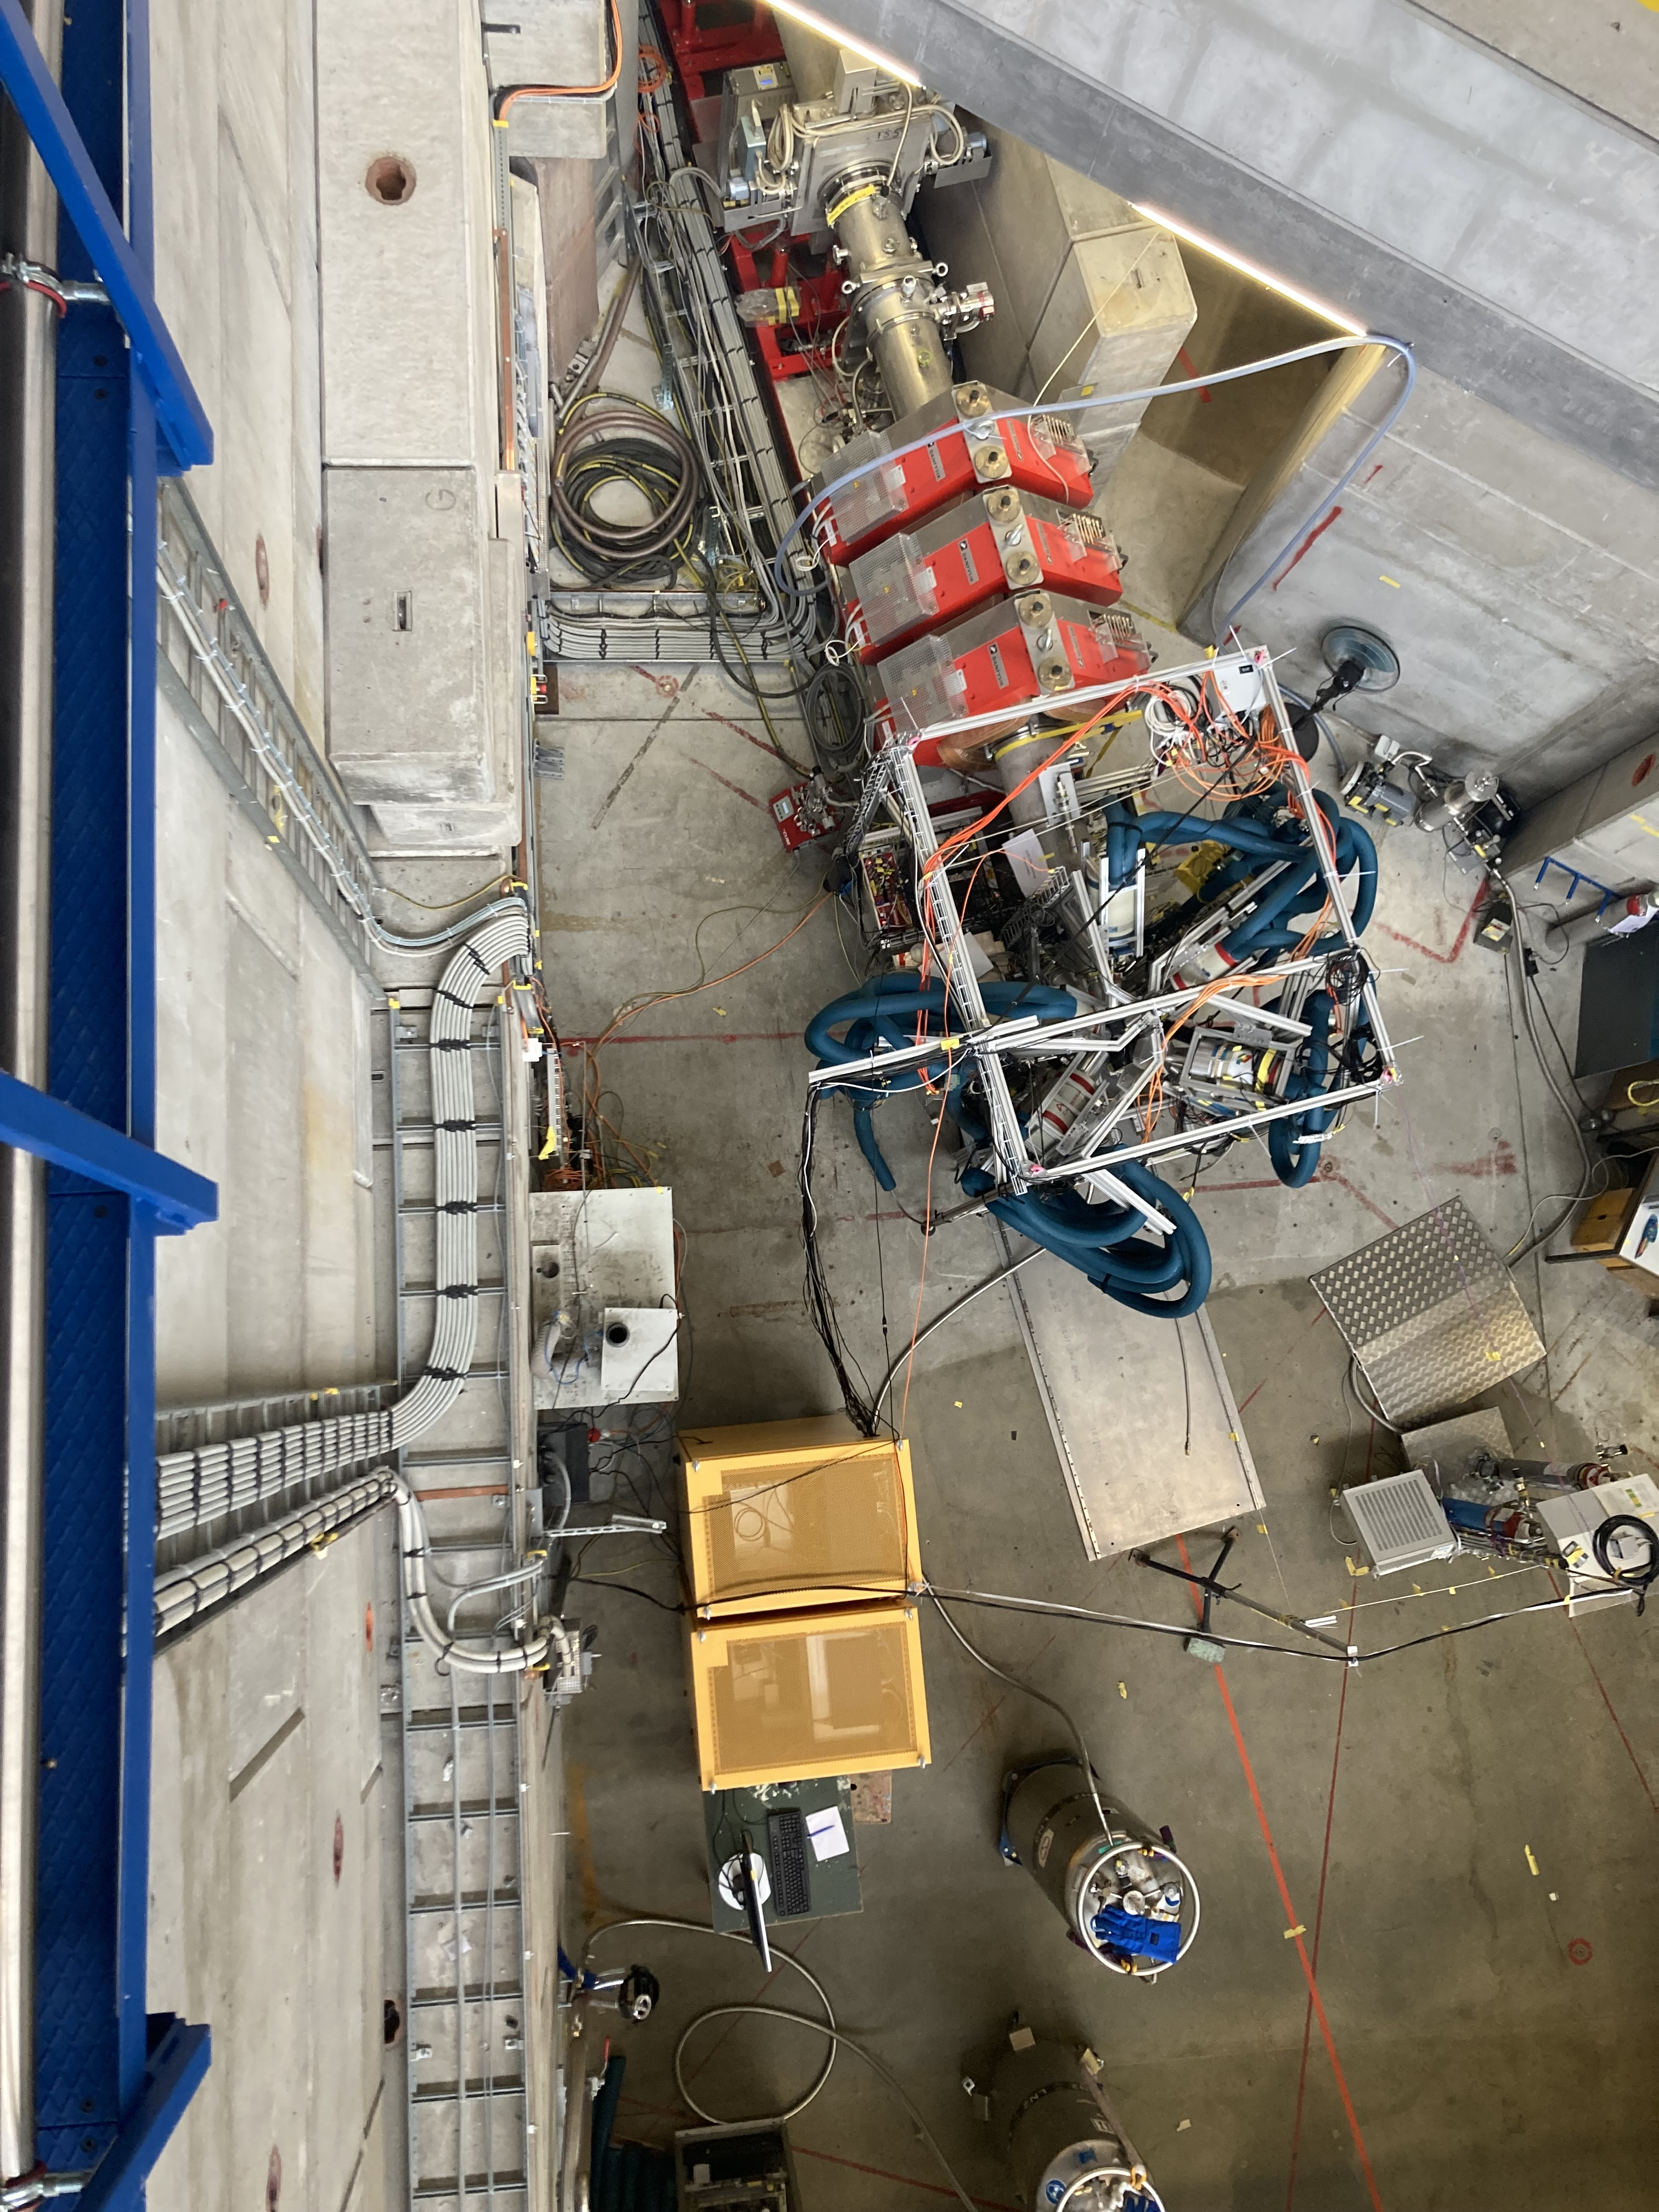
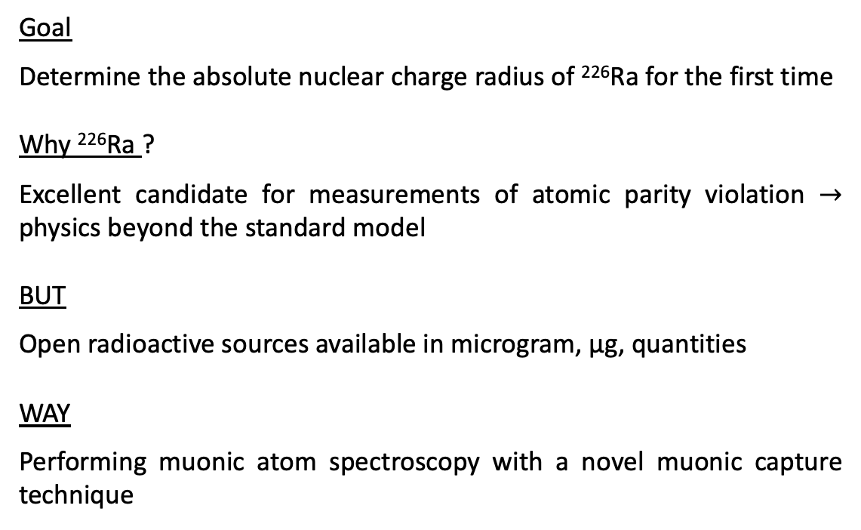
muX Collaboration
Goal
Determine the absolute nuclear charge radius of ²²⁶Ra for the first time
Why ²²⁶Ra ?
Excellent candidate for measurements of atomic parity violation $→$ physics beyond the standard model
BUT
Open radioactive sources available in microgram, μg, quantities
WAY
Performing muonic atom spectroscopy with a novel muonic capture technique
2

Slide 3
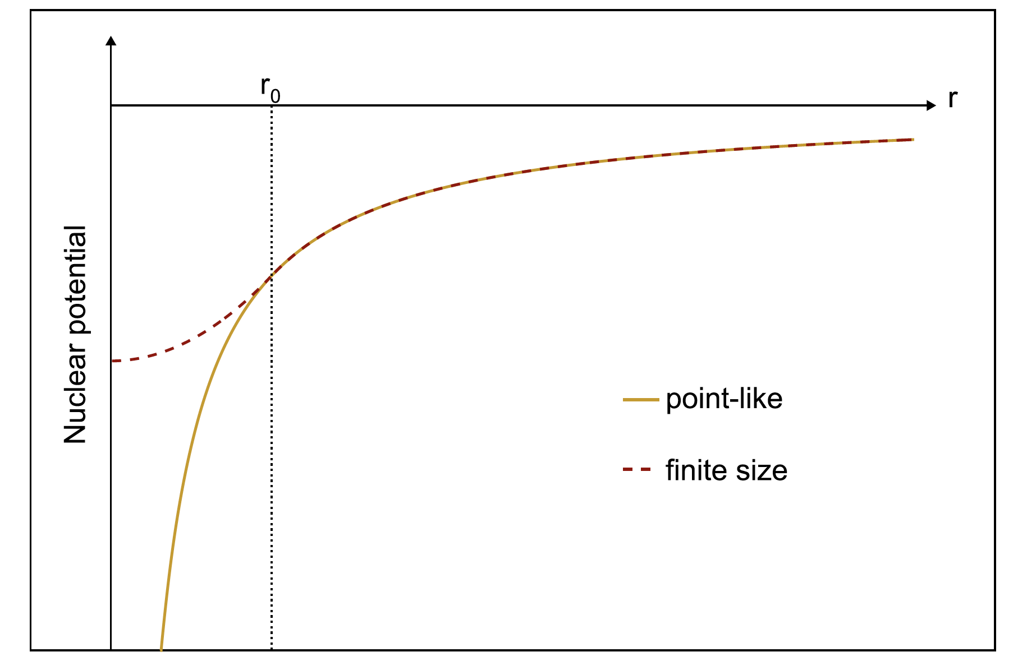
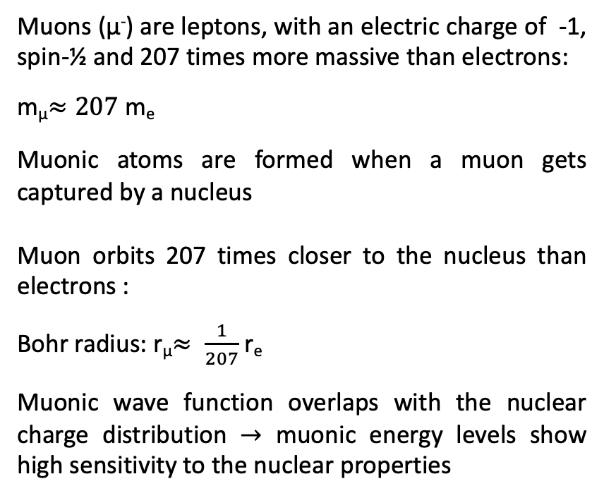
e⁻
Muonic Atoms
μ⁻
p
p
Muons (μ⁻) are leptons, with an electric charge of -1, spin-½ and 207 times more massive than electrons:
m_{μ}$≈207$ m_{e}
Muonic atoms are formed when a muon gets captured by a nucleus
Muon orbits 207 times closer to the nucleus than electrons :
Bohr radius: r_{μ}$≈ \frac{1}{207}$ r_{e}
Muonic wave function overlaps with the nuclear charge distribution $→$ muonic energy levels show high sensitivity to the nuclear properties

Slide 4
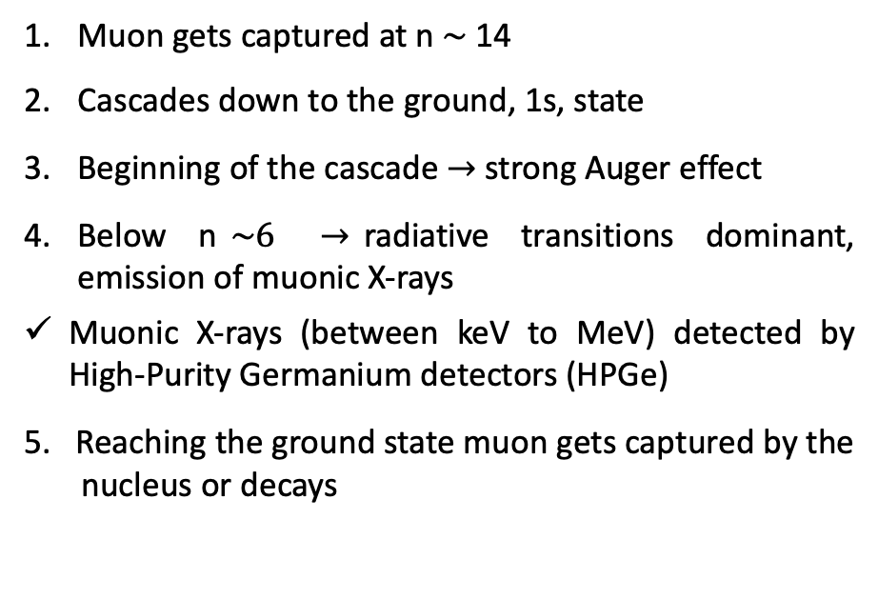
Muonic Atom Spectroscopy
Muon gets captured at n $\sim$14
Cascades down to the ground, 1s, state
Beginning of the cascade $→$ strong Auger effect
Below n$\sim 6$ $→$radiative transitions dominant, emission of muonic X-rays
Muonic X-rays (between keV to MeV) detected by High-Purity Germanium detectors (HPGe)
5. Reaching the ground state muon gets captured by the
nucleus or decays
Auger
n=14
X-rays
n=13
n=12
n=6
n=3
n=2
n=1

Slide 5
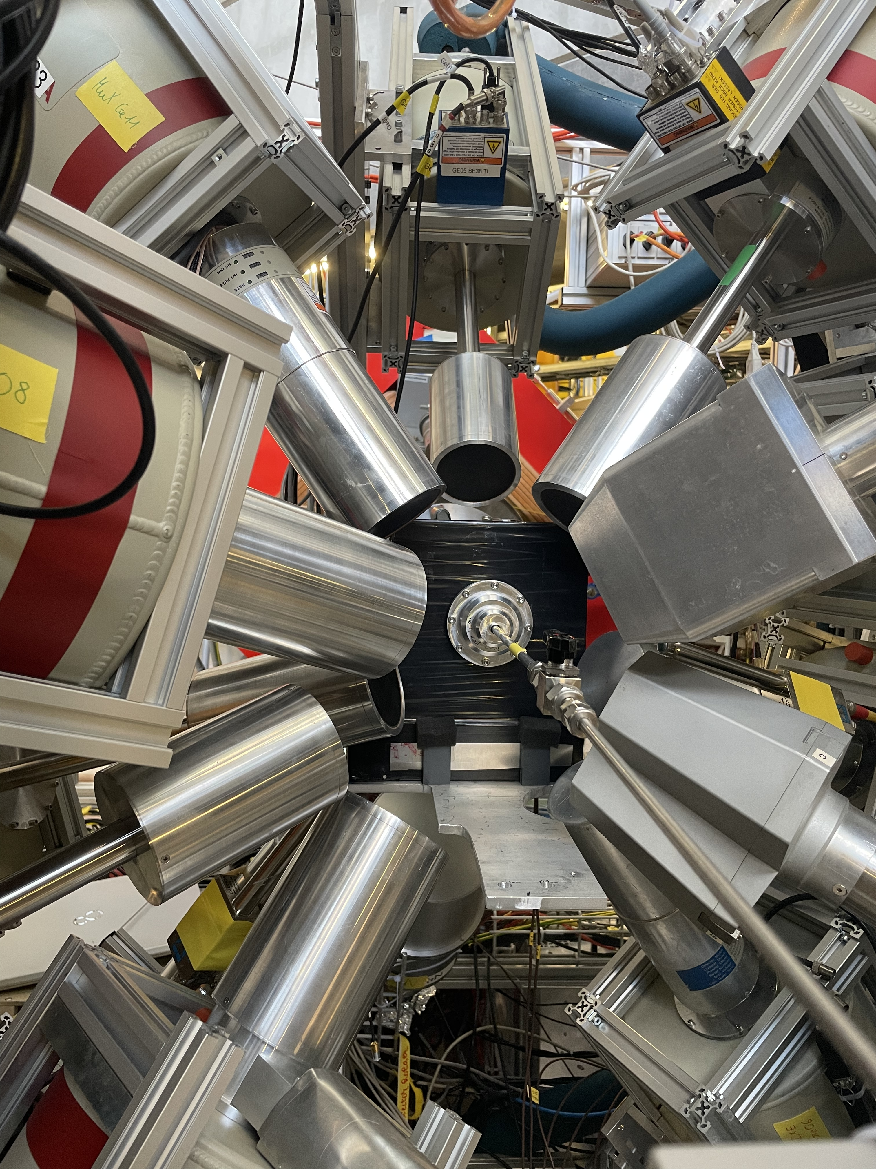
The muX Experimental Setup
HPGe Detector
Veto Detectors
Window
¹⁹⁷Au
Target
Muon beam
Gas Cell
Entrance Detector
22/01/2025

Slide 6
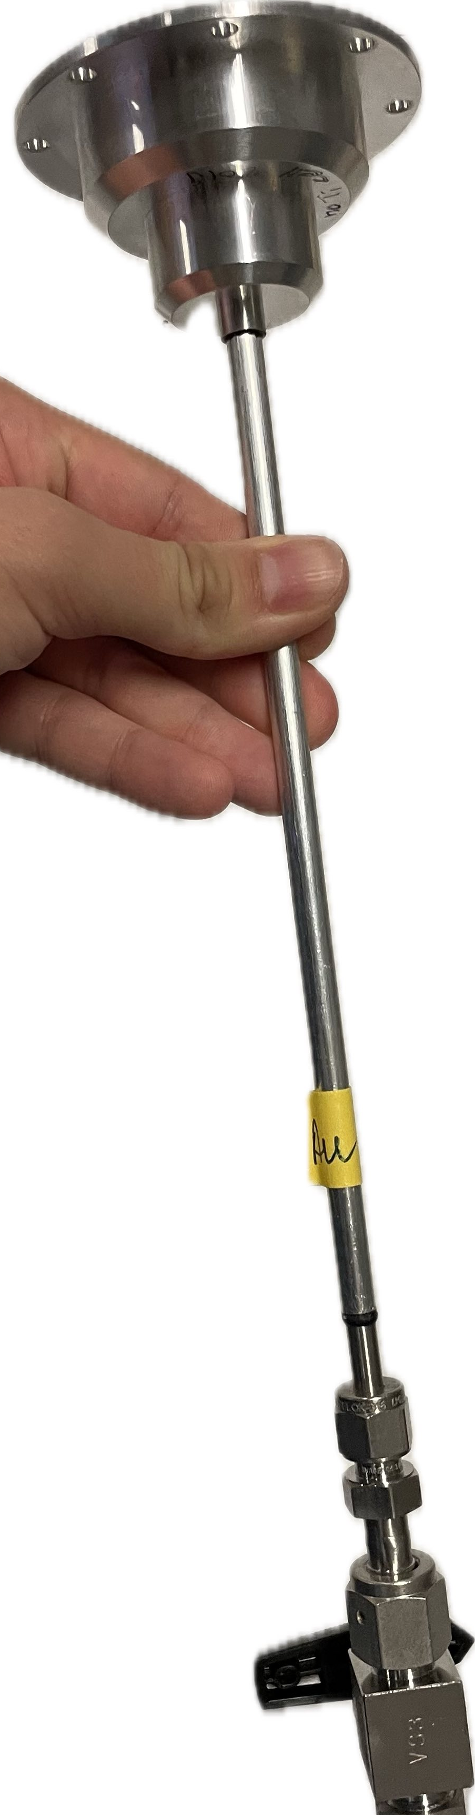
Transfer of Muons in a Gas Cell
The muon (μ⁻) enters the gas cell
Muon interacts with hydrogen (H₂) and forms muonic hydrogen (μp)
Muonic hydrogen (μp) interacts with deuterium (D₂) and forms muonic deuterium (μd)
Muonic deuterium (μd) gains kinetic energy of 45 eV (boosted)
Muonic deuterium scatters and gradually looses its kinetic energy
At 4 eV μd “blind” to H₂ (Ramsauer-Townsend effect)
Muon reaches and gets captured by the heavy-Z target material
_{μ}
Η₂
D₂
μp
μZ
μd
100 bar of H₂ and 0.25% admixture of D₂
22/01/2025

Slide 7
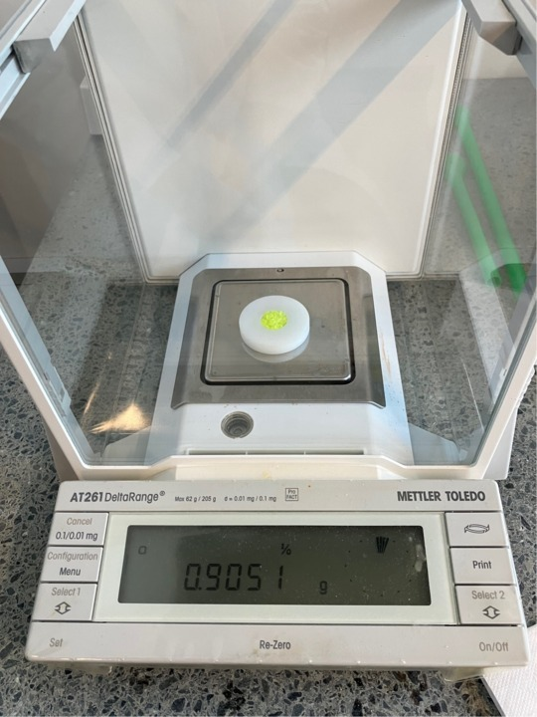
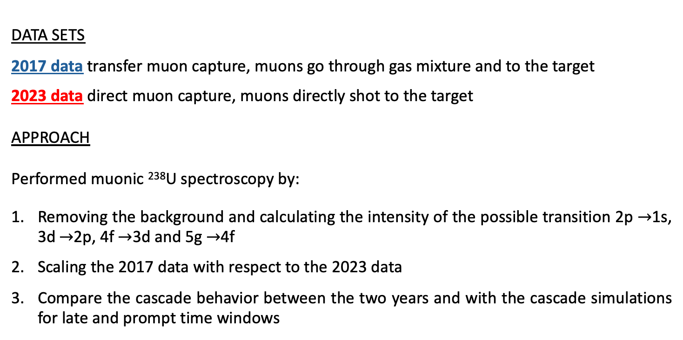
Muonic atom spectroscopy of ²³⁸U
Performed the muonic atom spectroscopy of ²³⁸U and examined the cascade behavior for direct and transfer muon capture.
DATA SETS
2017 data transfer muon capture, muons go through gas mixture and to the target
2023 data direct muon capture, muons directly shot to the target
APPROACH
Performed muonic ²³⁸U spectroscopy by:
Removing the background and calculating the intensity of the possible transition 2p $→$1s, 3d $→$2p, 4f $→$3d and 5g $→$4f
Scaling the 2017 data with respect to the 2023 data
Compare the cascade behavior between the two years and with the cascade simulations for late and prompt time windows
22/01/2025

Slide 8
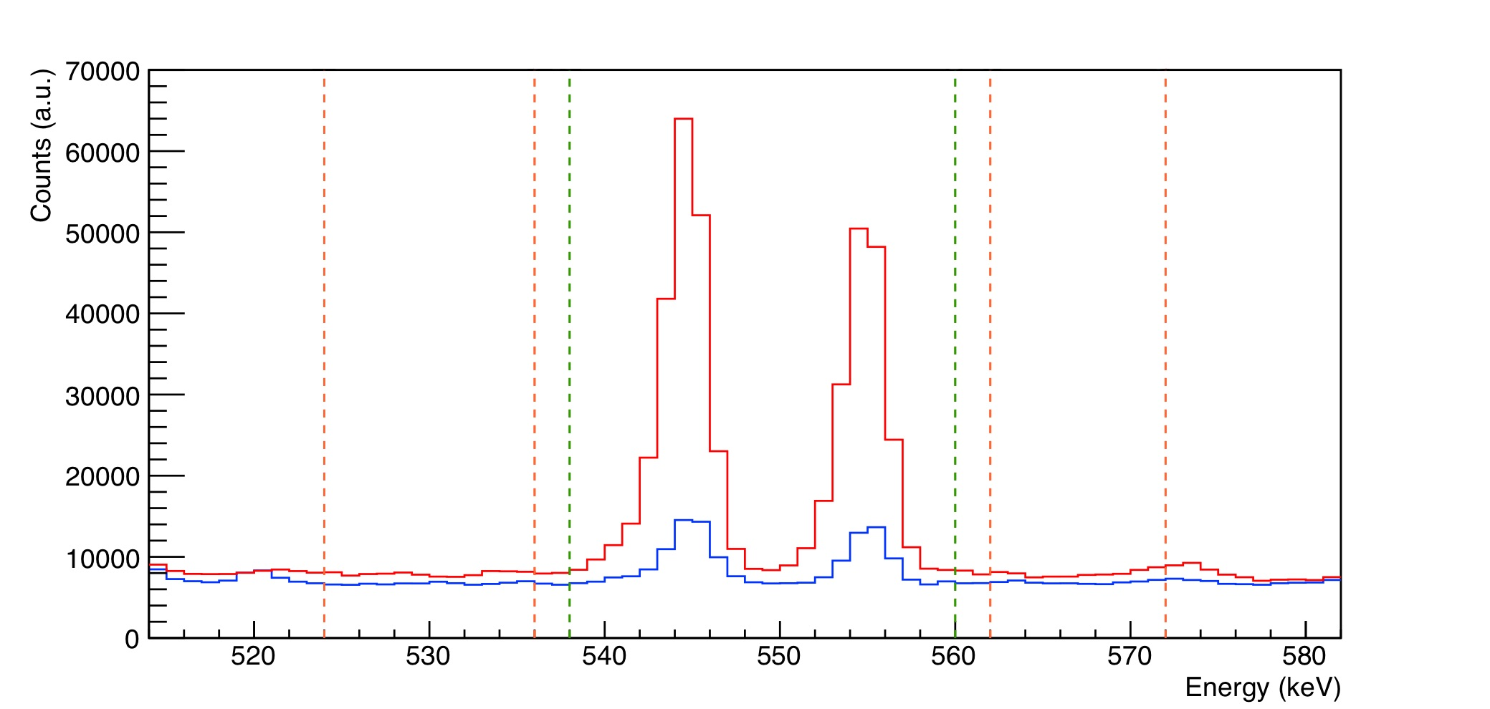
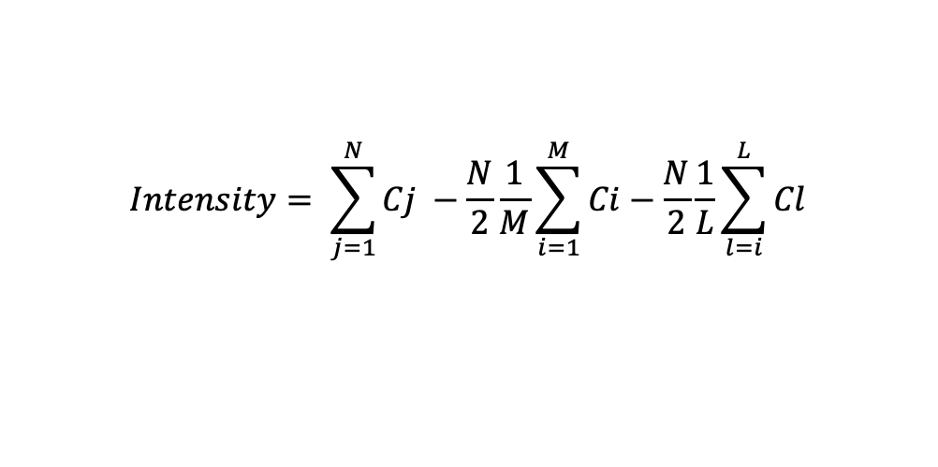
Transition Intensity and Background Removal
1. Transition Intensity without Background: Going at each transition/peak of the energy spectrum, calculate the integral underneath and remove the background based on the integrals of the neighbouring regions:
$$Intensity= \sum_{j=1}^{N}{Cj} −\frac{N}{2}\frac{1}{M}\sum_{i=1}^{M}{Ci}−\frac{N}{2}\frac{1}{L}\sum_{l=i}^{L}{Cl}$$
2017 data, transfer
2023 data, direct
5g->4f transition
544 keV
554 keV
22/01/2025

Slide 9
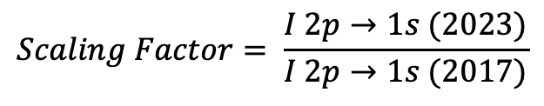
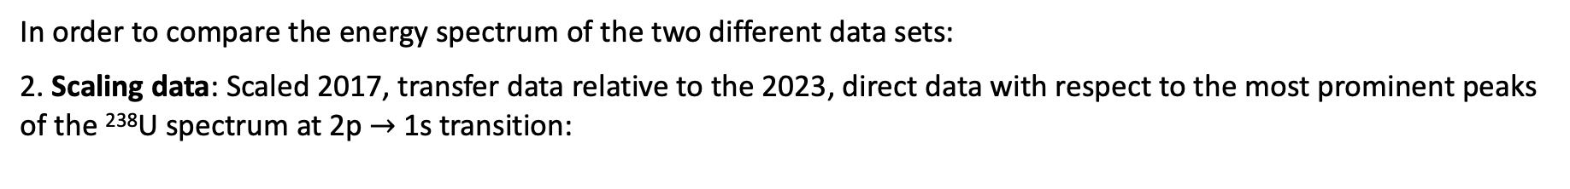
Data Scaling
In order to compare the energy spectrum of the two different data sets:
2. Scaling data: Scaled 2017, transfer data relative to the 2023, direct data with respect to the most prominent peaks of the ²³⁸U spectrum at 2p $→$1s transition:
$$Scaling Factor= \frac{I 2p→1s (2023)}{I 2p→1s (2017)}$$
2017 data, transfer
2023 data, direct
2023 data, for a prompt time interval (-50 to 50 ns)
2017 data, for a late time interval (+50 to 260 ns)
After scaling the two data sets overlap
22/01/2025

Slide 10
Transition 5g $→$4f, Direct versus Transfer Muon Capture
2017 data, transfer
2023 data, direct
2017 data, transfer
2023 data, direct
2023, direct data $\sim$ 5 times more intense peaks than 2017, transfer data
Matching predictions of the cascade simulations
22/01/2025

Slide 11
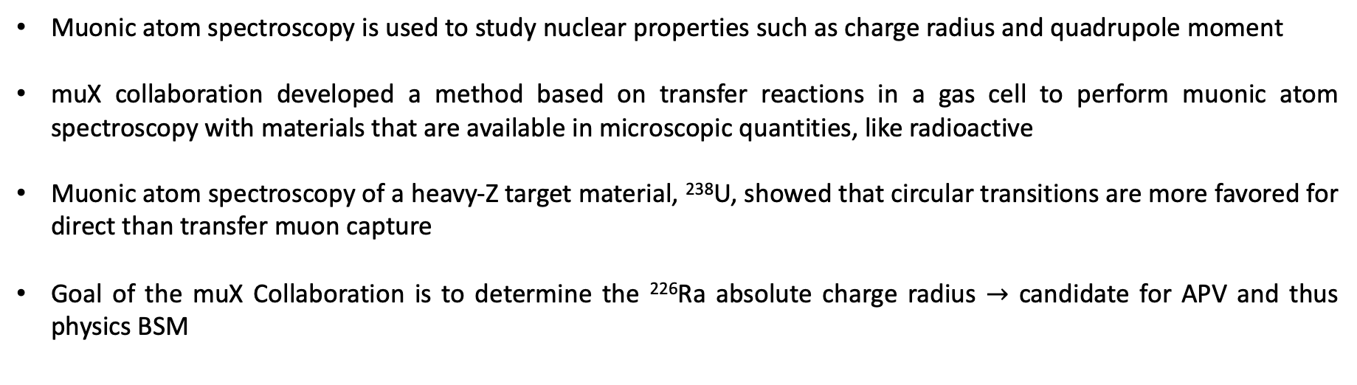
Conclusions
Muonic atom spectroscopy is used to study nuclear properties such as charge radius and quadrupole moment
muX collaboration developed a method based on transfer reactions in a gas cell to perform muonic atom spectroscopy with materials that are available in microscopic quantities, like radioactive
Muonic atom spectroscopy of a heavy-Z target material, ²³⁸U, showed that circular transitions are more favored for direct than transfer muon capture
Goal of the muX Collaboration is to determine the ²²⁶Ra absolute charge radius $→$ candidate for APV and thus physics BSM
22/01/2025

Slide 12
Thank you for your attention!
22/01/2025

Slide 13
BACKUP SLIDES
22/01/2025

Slide 14
Muon Capture Timing
DATA SETS
2017 data transfer muon capture, muons go through gas mixture
Prompt and late muon capture
Peak and long tail
2023 data direct muon capture, muons directly shot to the target
Pompt muon capture
Sharp peak
Time evolution for one of the 2p $→$1s transitions
2017 data, transfer
2023 data, direct
22/01/2025

Slide 15
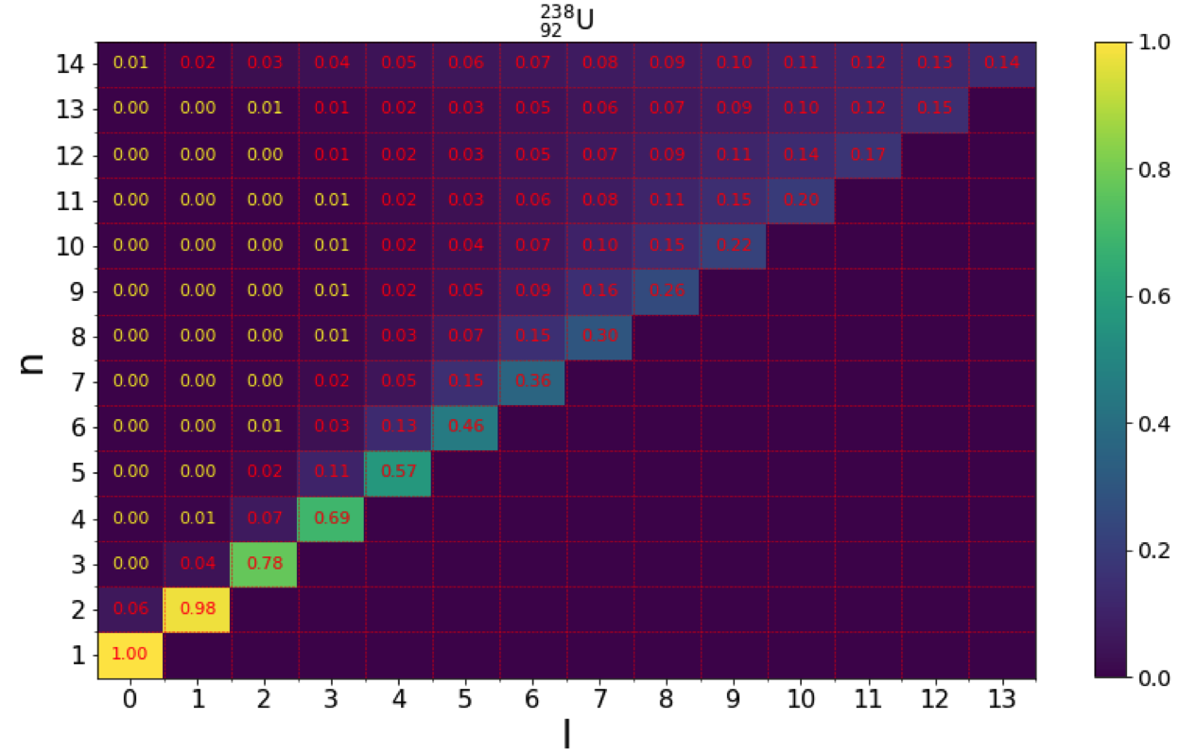
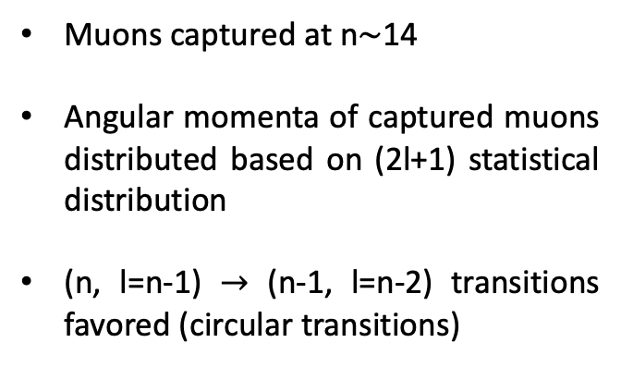
Direct Muon Capture
Target available in macroscopic quantities, more than 100 mg. Muons shot and directly stopped at the target.
Muon beam
Cascade simulation calculating the rates/probabilities for the Auger and X-ray transitions
²³⁸U Direct Muon Capture
Muons captured at n$\sim$14
Angular momenta of captured muons distributed based on (2l+1) statistical distribution
(n, l=n-1) $→$ (n-1, l=n-2) transitions favored (circular transitions)
22/01/2025

Slide 16
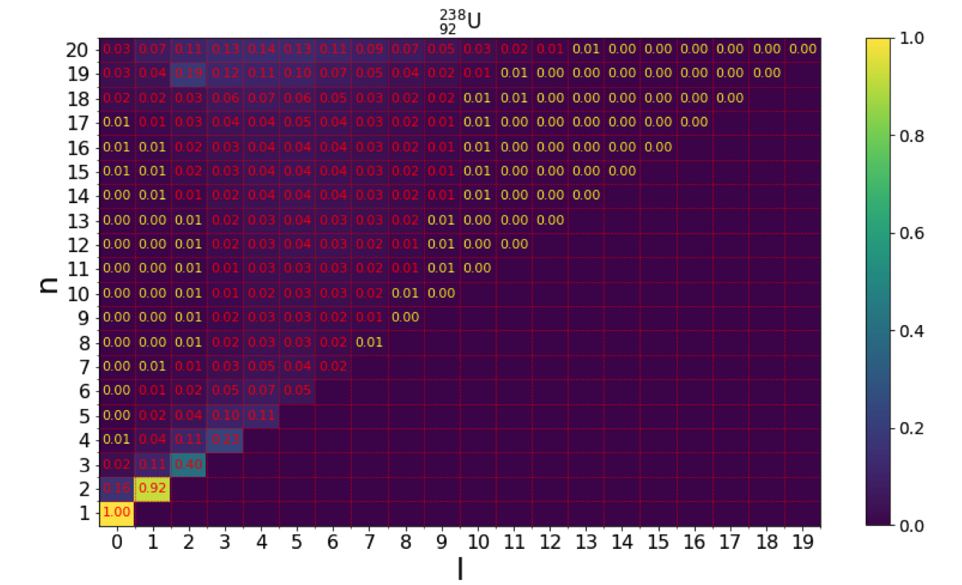
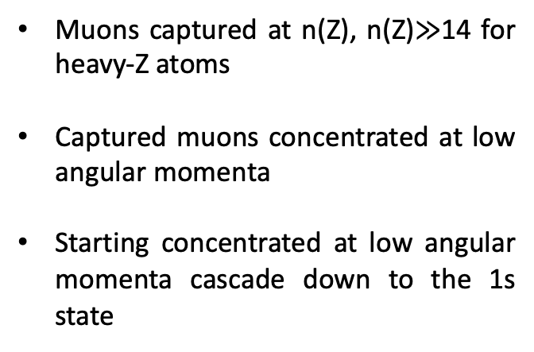
Transfer Muon Capture
Target available in microscopic quantities, in the order of μg. Muons transverse the gas cell, undergo a three-stage transfer process and get captured by target material.
Muon beam
Cascade simulation calculating the rates/probabilities for the Auger and X-ray transitions
²³⁸U Transfer Muon Capture
Muons captured at n(Z), n(Z)$≫$14 for heavy-Z atoms
Captured muons concentrated at low angular momenta
Starting concentrated at low angular momenta cascade down to the 1s state
22/01/2025

Slide 17
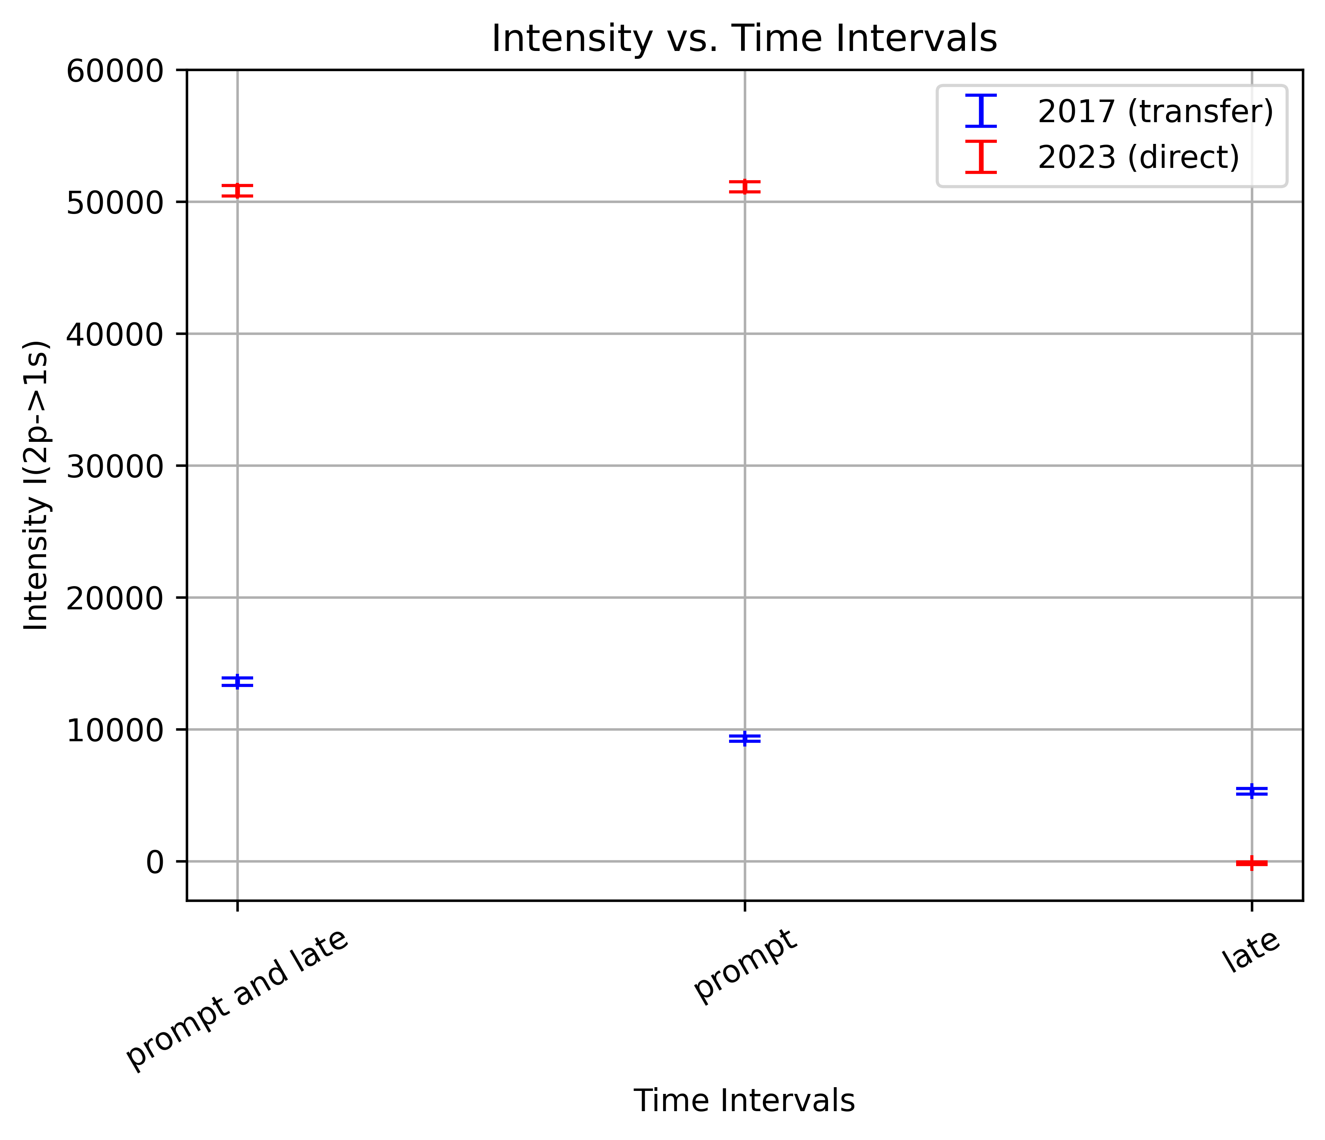
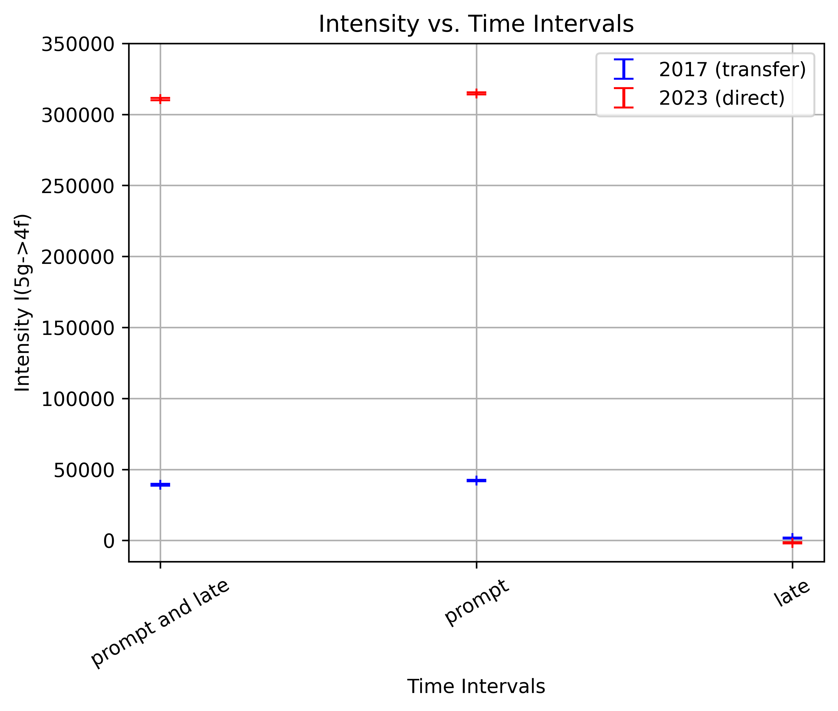
Intensity of Transitions 2p $→$1s and 5g $→$4f versus Time
2017 data, transfer muon capture at prompt and late time intervals
2023 data, direct muon capture at prompt time interval
22/01/2025

Slide 18
Transition 5g $→$4f, Direct Muon Capture
²³⁸U Direct Muon Capture
Direct muon capture: favors (n, l=n-1) $→$ (n-1, l=n-2) circular transitions
Circular transitions and thus 5g $→$4f transition favored for prompt, direct capture
22/01/2025

Slide 19
Transition 5g $→$4f, Transfer Muon Capture
²³⁸U Transfer Muon Capture
Transfer muon capture: starting concentrated at low angular momenta cascades down to the 1s state
Circular transitions and thus 5g $→$4f transition not favored for late, transfer capture
22/01/2025

Slide 20
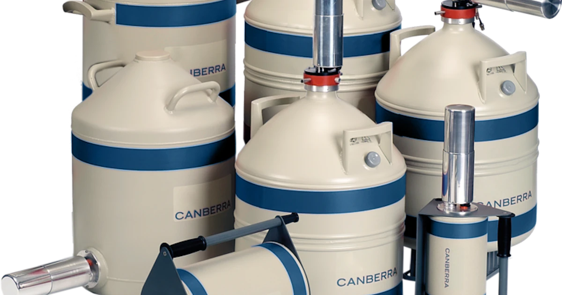
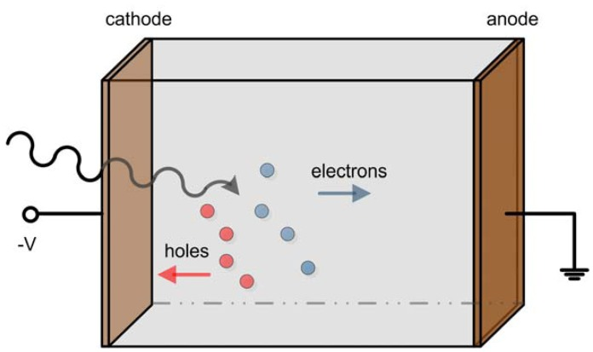
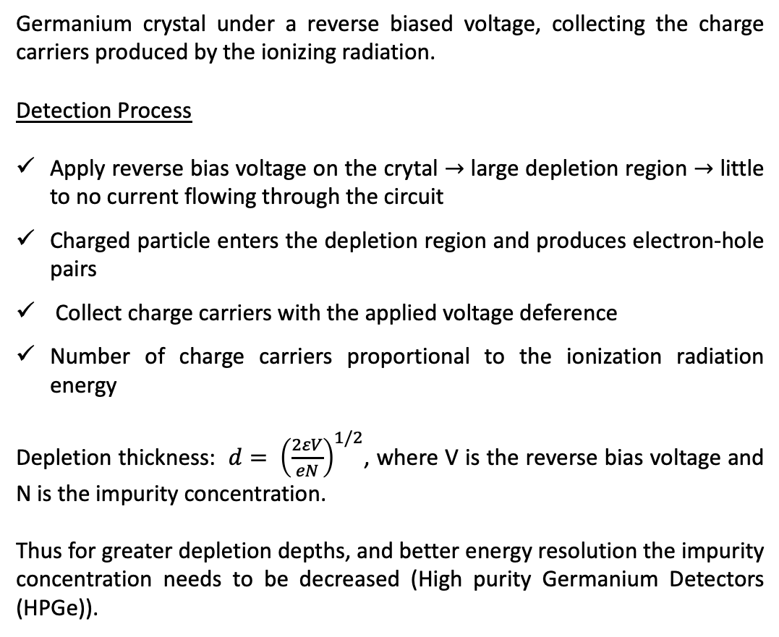
Germanium Detectors
Germanium crystal under a reverse biased voltage, collecting the charge carriers produced by the ionizing radiation.
Detection Process
Apply reverse bias voltage on the crytal $→$ large depletion region $→$ little to no current flowing through the circuit
Charged particle enters the depletion region and produces electron-hole pairs
Collect charge carriers with the applied voltage deference
Number of charge carriers proportional to the ionization radiation energy
Depletion thickness: $d= {\left(\frac{2εV}{eN}\right)}^{1/2}$, where V is the reverse bias voltage and N is the impurity concentration.
Thus for greater depletion depths, and better energy resolution the impurity concentration needs to be decreased (High purity Germanium Detectors (HPGe)).
22/01/2025

Slide 21
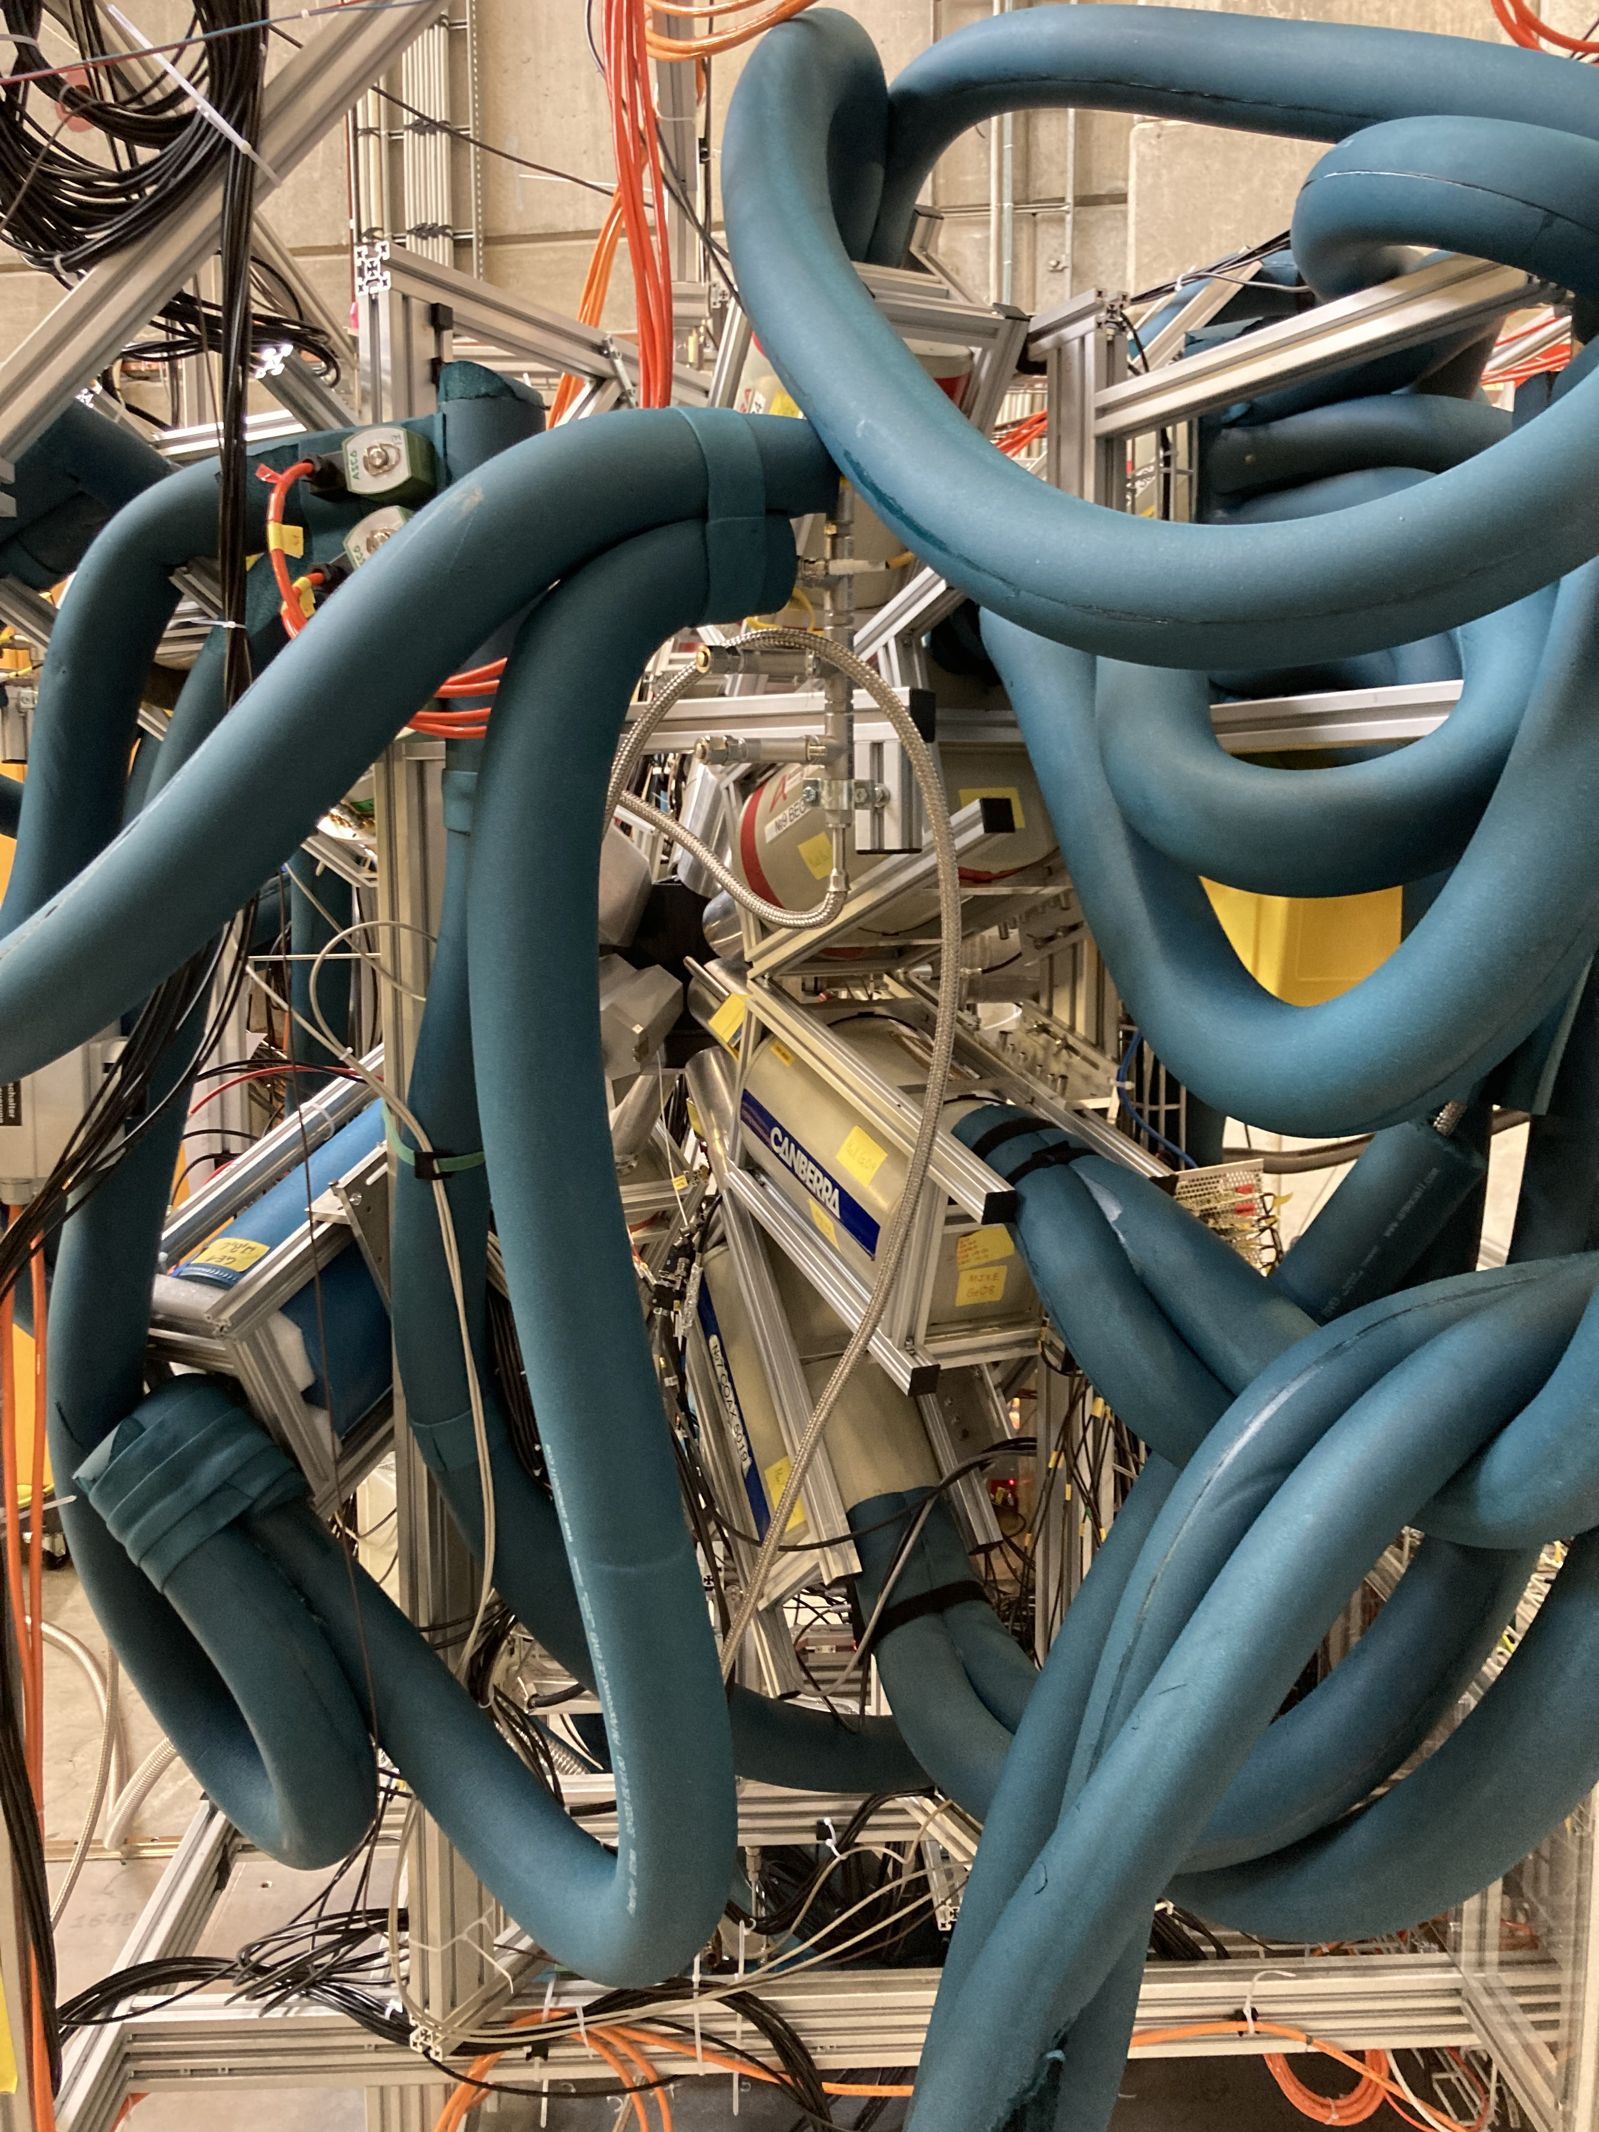
Germanium Detectors, Cooling
As the Germanium semiconductor has a small band gap, at room temperature electrons can move from the valence to the conduction band due to thermal excitations. This creates an unwanted current, called leakage current.
So we cool down Germanium detectors to avoid any thermal noise, with liquid nitrogen (77K)
22/01/2025

Slide 22
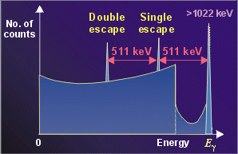
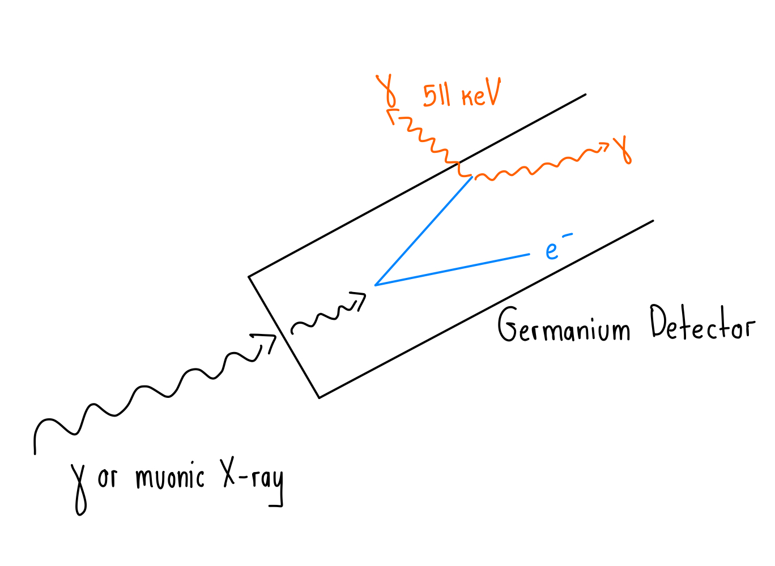



Single & Double Escape
Single & Double Escape
1. Gamma or muonic X-ray enters the Germanium Detector.
2. Interacts with the detector and produces an e⁻-e⁺ pair.
3. The positron interacts with one of the plenty Germanium detector electrons and produces two γ-rays. When one of them escapes we have Single Escape. When both of them escape we have Double Escape.
22/01/2025

Slide 23
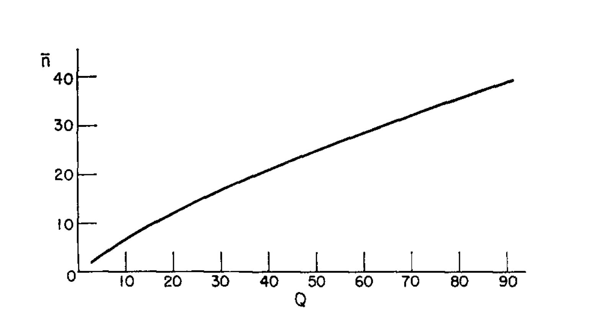
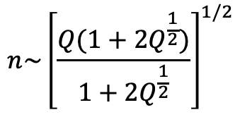
Principle Quantum Number for Transfer Muon Capture
For a heavy-Z material (Z=Q) the states n populated by muons after transfer capture are given by:
$$n\sim {\left[\frac{Q(1+2Q^{\frac{1}{2}})}{1+2Q^{\frac{1}{2}}}\right]}^{1/2}$$
22/01/2025

Slide 24
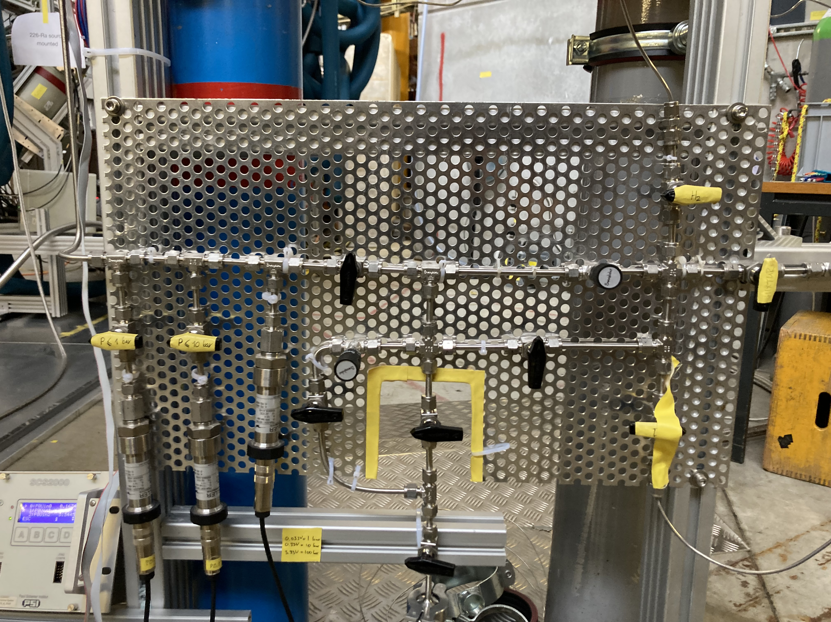
Flushing and Filling the gas cell
Interactions in the gas cell
μd interacts with hydrogen (small cross section but non-zero probability)
(pμd)⁺ decays via two muon catalyzed fusion channels
Filling circle of the gas cell
Pump the gas mixture from the gas cell
Flush with H₂ (10 cycles) up to 10 bars, ensuring no remaining gases
Flush with 100 bars of gas mixture
Fill with 100 bars of the gas mixture
22/01/2025

Slide 25

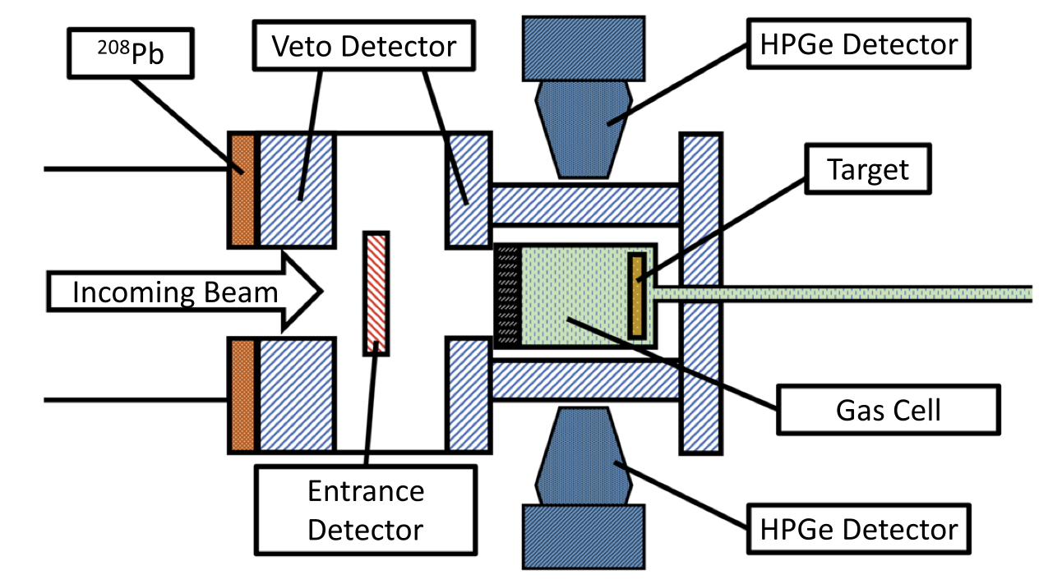
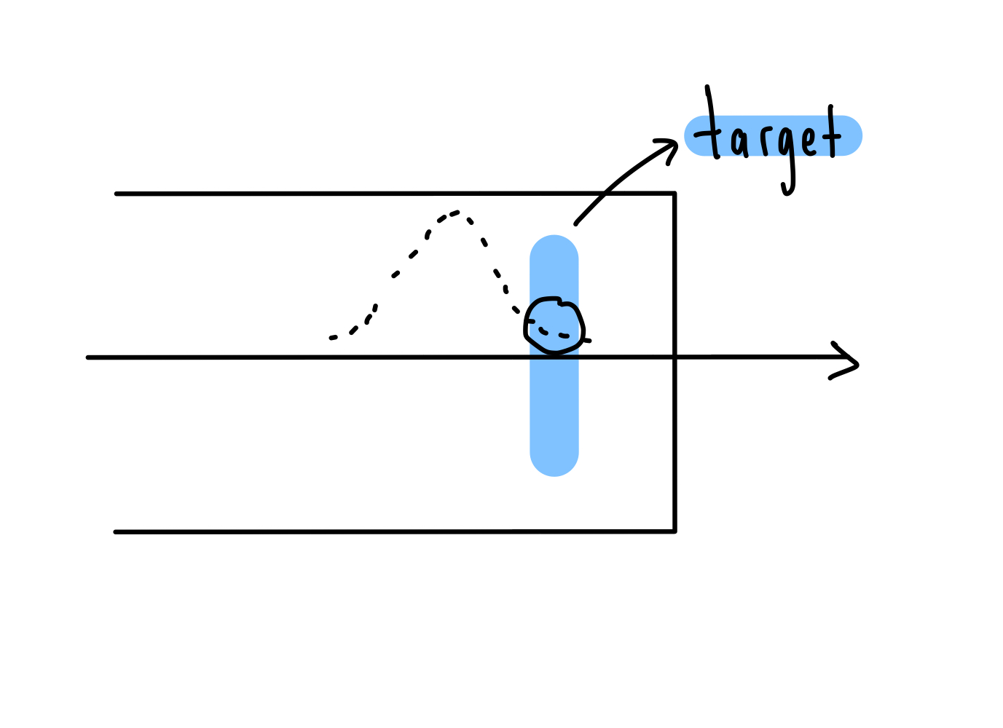
Thick and Thin ¹³⁷ Au Target
Au
Placed a thick gold and a thin gold sample in the target position to study direct and indirect capture.
The thicker the target the more the directly detected muons (bigger part of the muon tail detected),
Directly detected muons the rest of them get captured by the gas mixture.
22/01/2025

Slide 26
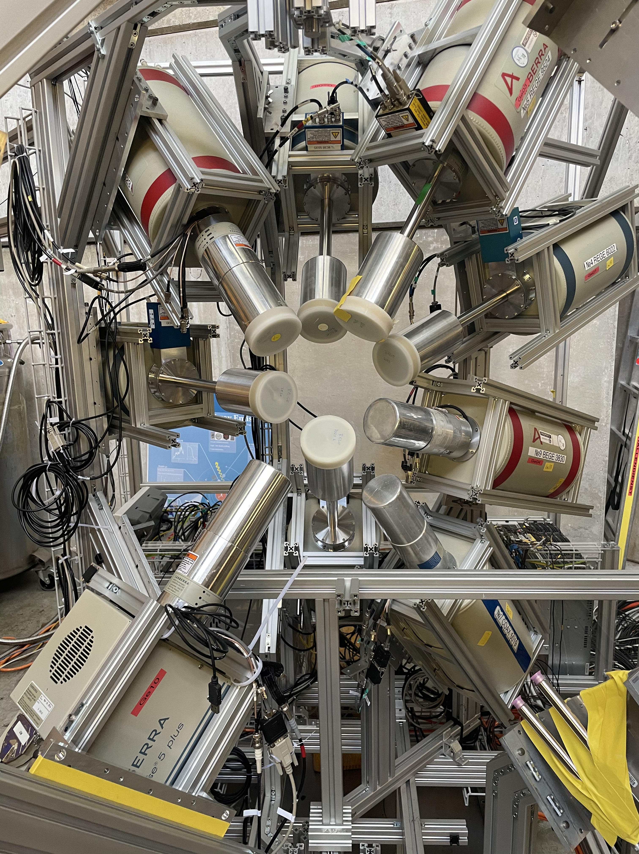
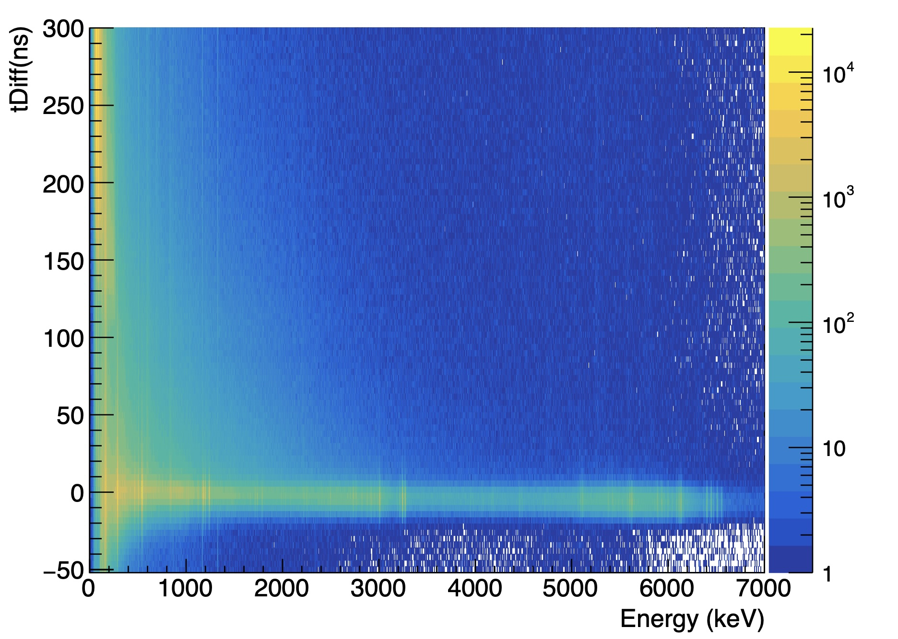
HPGe detectors, Direct Muon Capture
late
prompt
High Purity Germanium Detectors (HPGe) show bad time resolution at low energies
HPGE detectors resolution: 500-1000 eV at Energy < 100 keV
22/01/2025

Slide 27
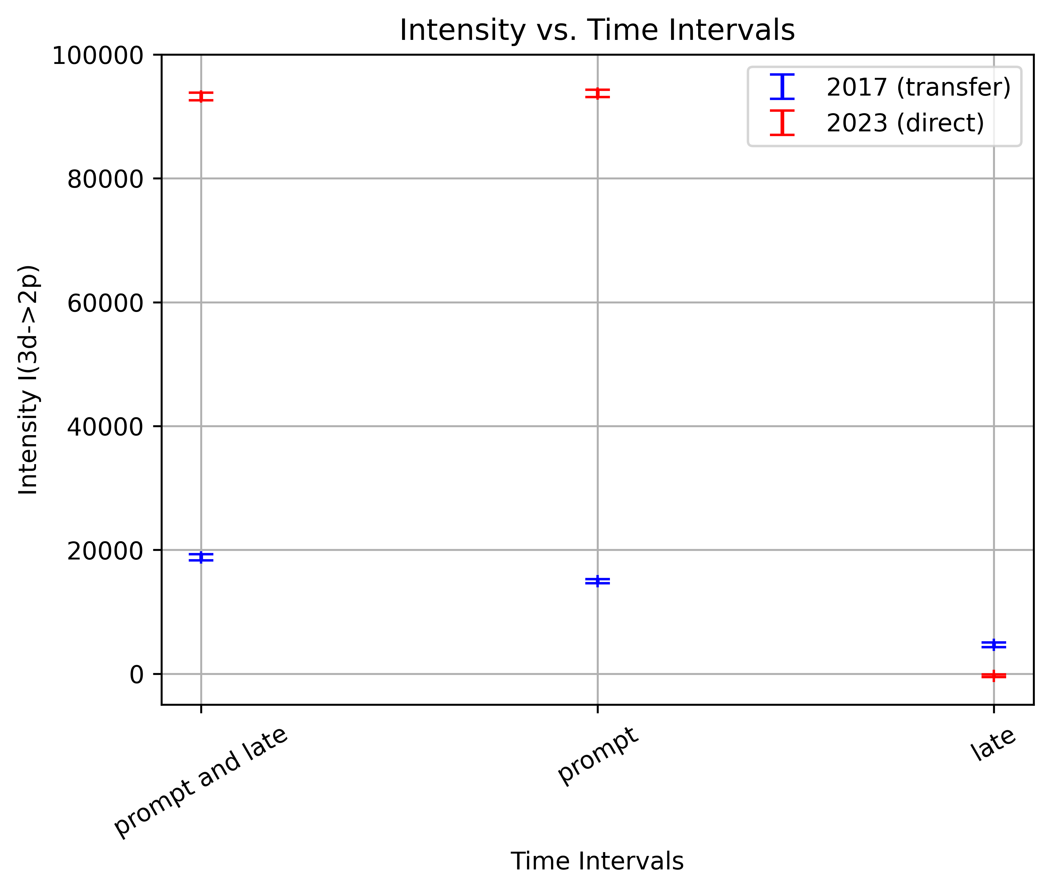
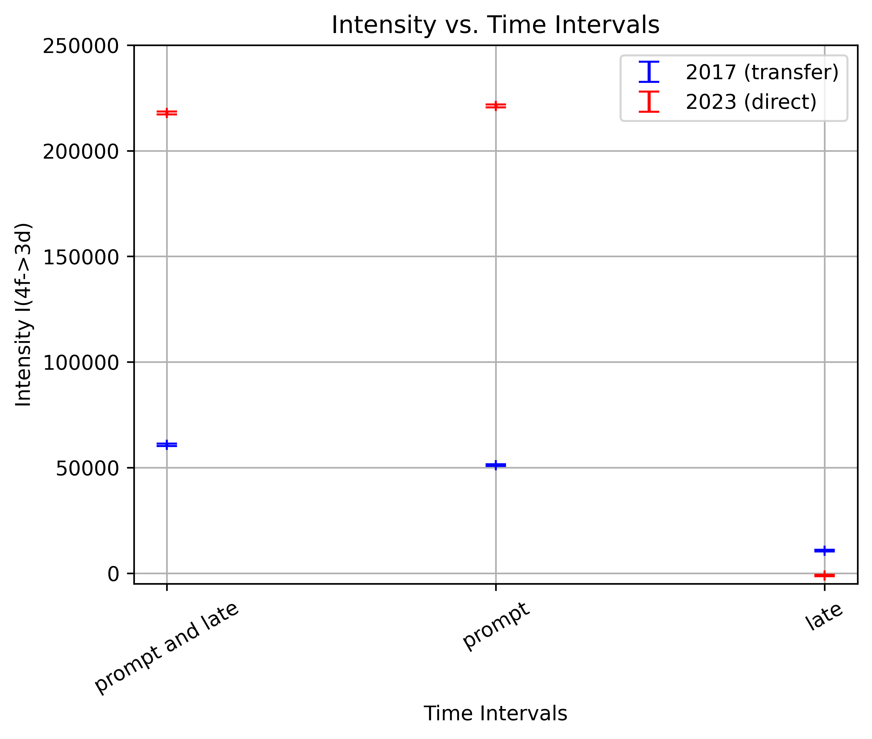
Intensity of 3d$→$ 2p and 4f $→$ 3d transitions versus Time
2017 data, transfer muon capture at a prompt and late time interval
2023 data, direct muon capture at a prompt time interval
22/01/2025

Slide 28
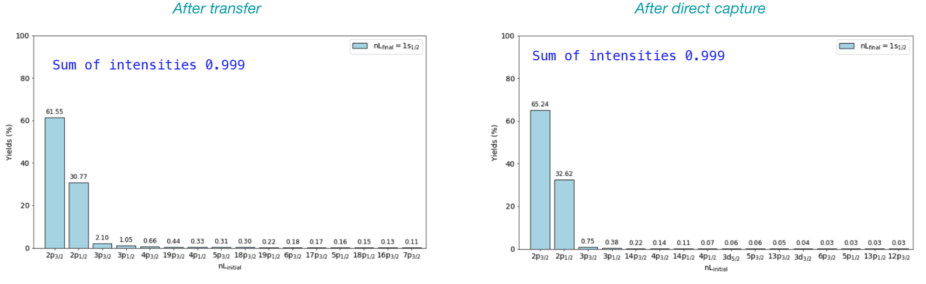
Results of Cascade Simulation for ²³⁸U: 2p $→$1s Transition
Capture | Transition | Yield (%)
Transfer | 2p_{3/2}->1s_{1/2} | 61.55
 | 2p_{1/2}->1s_{1/2} | 30.77
Direct | 2p_{3/2}->1s_{1/2} | 65.24
 | 2p_{1/2}->1s_{1/2} | 32.62
Capture | Transition | Yield (%)
Transfer | 2p->1s | 92.3
Direct | 2p->1s | 97.9
22/01/2025

Slide 29
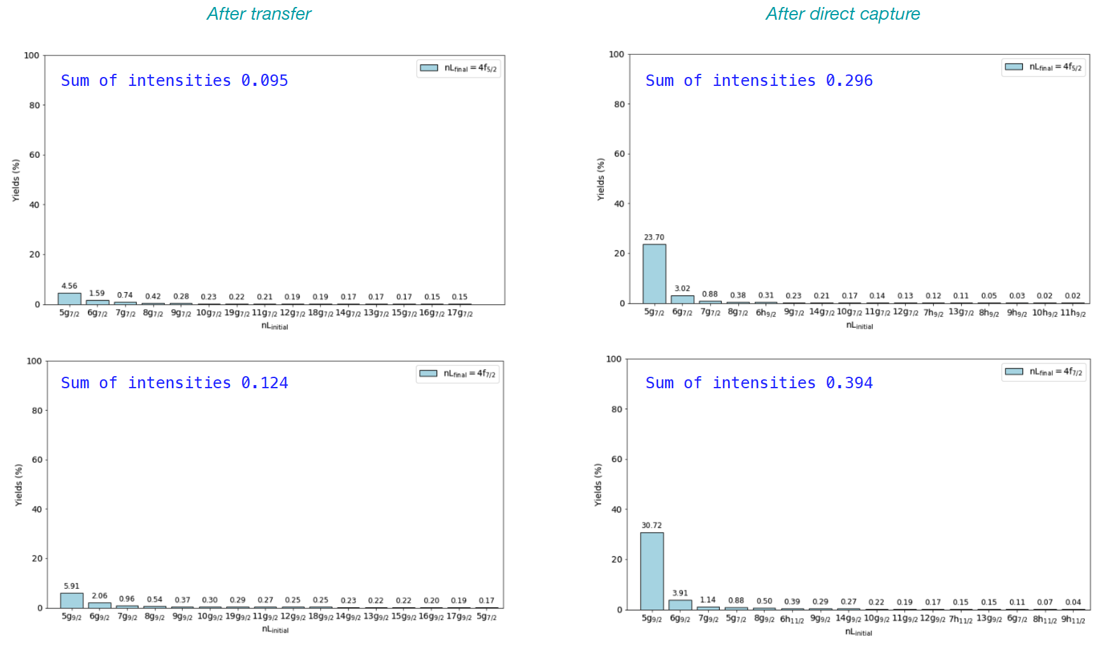
Results of Cascade Simulation for ²³⁸U: 5g $→$4f Transition
Capture | Transition | Yield (%)
Transfer | 5g_{7/2}->4f_{5/2} | 4.56
 | 5g_{9/2}->4f_{7/2} | 5.91
Direct | 5g_{7/2}->4f_{5/2} | 23.70
 | 5g_{9/2}->4f_{7/2} | 30.72
 | 5g_{7/2}->4f_{7/2} | 0.88
Capture | Transition | Yield (%)
Transfer | 5g->4f | 10.5
Direct | 5g->4f | 55.3
22/01/2025

Slide 30

5g $→$4f transition, Transfer vs Direct Muon capture
2017 data, transfer
2023 data, direct
2017 data, transfer
2023 data, direct
Capture | Transition | Yield (%)
Transfer | 2p->1s | 92.3
Direct | 2p->1s | 97.9
Capture | Transition | Yield (%)
Transfer | 5g->4f | 10.5
Direct | 5g->4f | 55.3
Normalized with respect to 2p->1s
Capture | Transition | Ratio
Transfer | (5g->4f) /(2p->1s) | 0.11
Direct | (5g->4f) /(2p->1s) | 0.56
x $\sim 5$
22/01/2025

Slide 31


2p $→$1s Transition: Removing Oxygen Background
We are breaking the 2p->1s transition into two integrals and we sum them up. This way we get rid of the oxygen region.
Oxygen region there is some ¹⁶O leaking in the gas mixture. Muons get captured by the oxygen nucleus and produce ¹⁵N*+n+ν, excited nucleus de-excites to its ground state and produces some γ-rays (peaks between the two integrals).
2017 data, transfer
2023 data, direct
22/01/2025

