Slide 1




Search for light dark matter :
TESSERACT Experiment
Presented by Leslie Juigne
1
CHIPP Winter School 2025 - January 2025

Slide 2
Introduction
Dark matter candidates
10⁻²²eV
keV
GeV
100 TeV
Mᴾˡ
10 M
⊙
"Ultralight" DM
"Light" DM
WIMPs
Composite DM
QCD axion
Primordial black holes
Wide range candidates and masses
Different Detection Approches
Direct detection of light dark matter
Detection methods can be Direct or Indirect or "Producing"
Masses between keV and GeV
2

Slide 3
Introduction
Dark matter candidates
LZ/XENONnT
TESSERACT
10⁻²²eV
keV
GeV
100 TeV
Mᴾˡ
10 M
⊙
"Ultralight" DM
"Light" DM
WIMPs
Composite DM
QCD axion
Primordial black holes
Wide range candidates and masses
Different Detection Approches
Direct detection of light dark matter
Detection methods can be Direct or Indirect or "Producing"
Masses between keV and GeV
2

Slide 4
Introduction
Dark matter direct detection
PHONONS/HEAT
Cryogenic bolometers with charge readout
Scintillating cryogenic bolometers
CHARGE
LIGHT
Liquid noble-gas dual-phase time projection chambers
3

Slide 5
Introduction
Dark matter direct detection
PHONONS/HEAT
TESSERACT
Cryogenic bolometers with charge readout
Scintillating cryogenic bolometers
CHARGE
LIGHT
Liquid noble-gas dual-phase time projection chambers
LZ/XENONnT
4

Slide 6

TESSERACT Experiment
Electronics
Pure ⁴He
Current Supply
Shielding
Dilution Fridge
Vacuum Can
300 K
  Cools down to mK temperatures
  Experimental Cell : 3 different targets
  TES (Transition Edge Sensor) on top of the cell
80 K
5 K
Magnetic Shield
1 K
Cold Plate
75 mK
Cold Plate
SQUID
50 mK
Mixing Chamber
8 mK
Experimental Cell
5

Slide 7
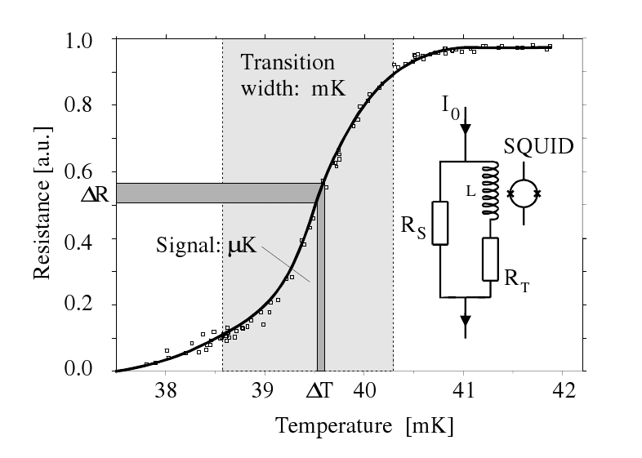
TESSERACT Experiment
Electronics
Pure ⁴He
Current Supply
Shielding
Dilution Fridge
Vacuum Can
300 K
  Cools down to mK temperatures
  Experimental Cell : 3 different targets
  TES (Transition Edge Sensor) on top of the cell
80 K
5 K
Magnetic Shield
1 K
Cold Plate
75 mK
Cold Plate
SQUID
50 mK
Low Background
Mixing Chamber
8 mK
  Modane Underground Laboratory (LSM) at 1600m underground
  Multiple layers shielding (Plastic, Stainless Steel, Pb and Cu)
Experimental Cell
Transition Edge Sensor
Si
LHe
5

Slide 8
TESSERACT Experiment
Electronics
Pure ⁴He
Current Supply
Shielding
Dilution Fridge
Vacuum Can
300 K
  Cools down to mK temperatures
  Experimental Cell : 3 different targets
  TES (Transition Edge Sensor) on top of the cell
80 K
5 K
Magnetic Shield
1 K
Cold Plate
75 mK
Cold Plate
SQUID
50 mK
Low Background
Mixing Chamber
8 mK
  Modane Underground Laboratory (LSM) at 1600m underground
  Multiple layers shielding (Plastic, Stainless Steel, Pb and Cu)
Experimental Cell
Transition Edge Sensor
Multi-Target Approach
Si
  Background Identification & Discrimination
  Different sensitivities for different types of DM interactions
LHe
5

Slide 9
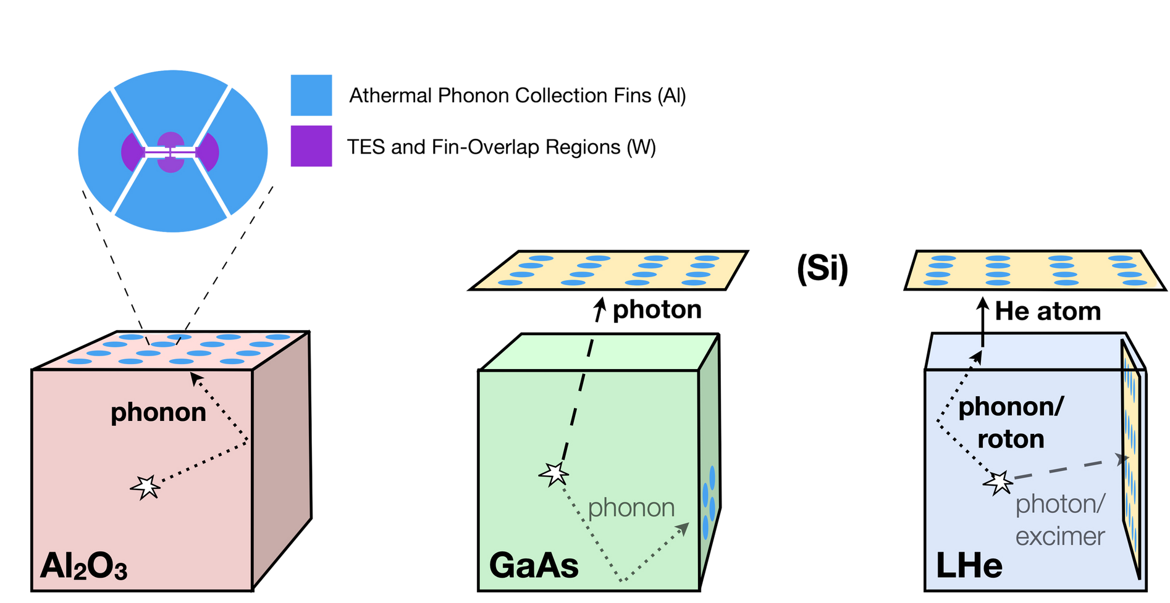



TESSERACT Experiment
TES
Multi-targets Approach
Si
Gallium Arsenide (GaAs)
  Cryogenic scintillator in the IR (930nm)
  High light output : ~ 100photons/keV
  Produces photons and phonons
TES
Athermal Phonon Collection Fins (Al)
6

Slide 10
TESSERACT Experiment
TES
Multi-targets Approach
Si
Gallium Arsenide (GaAs)
  Cryogenic scintillator in the IR (930nm)
  High light output : ~ 100photons/keV
  Produces photons and phonons
Sapphire (Al₂O₃)
  Athermal Phonon Production
  Phonon Band Structure: Extraction of almost maximum kinetic energy during scattering events.
  Low-Z Material: good sensitivity for NR
TES
Athermal Phonon Collection Fins (Al)
6

Slide 11
TESSERACT Experiment
TES
Multi-targets Approach
Si
Gallium Arsenide (GaAs)
  Cryogenic scintillator in the IR (930nm)
  High light output : ~ 100photons/keV
  Produces photons and phonons
Sapphire (Al₂O₃)
  Athermal Phonon Production
  Phonon Band Structure: Extraction of almost maximum kinetic energy during scattering events.
  Low-Z Material: good sensitivity for NR
Superfluid Helium
TES
  Low noise in mK temperatures
  Unique signals channels
  First target to be implemented
Athermal Phonon Collection Fins (Al)
6

Slide 12
Superfluid Helium - Signal Channels
Signal Channels
  Can be easily discriminated
  Photon and phonons signal productions
7

Slide 13
Superfluid Helium - Signal Channels
Signal Channels
  Can be easily discriminated
  Photon and phonons signal productions
4He
7

Slide 14
Superfluid Helium - Signal Channels
Quasiparticle
Signal Channels
  Can be easily discriminated
  Photon and phonons signal productions
4He
7

Slide 15
Superfluid Helium - Signal Channels
Quasiparticle
Signal Channels
  Can be easily discriminated
  Photon and phonons signal productions
4He
Quantum Evaporation
  Quasiparticle produced after interaction
7

Slide 16
Superfluid Helium - Signal Channels
Quasiparticle
Signal Channels
  Can be easily discriminated
  Photon and phonons signal productions
4He
Quantum Evaporation
  Quasiparticle produced after interaction
  Release of a 4He at the liquid surface
7

Slide 17
Superfluid Helium - Signal Channels
4He
Quasiparticle
Signal Channels
  Can be easily discriminated
  Photon and phonons signal productions
4He
Quantum Evaporation
  Quasiparticle produced after interaction
  Release of a 4He at the liquid surface
  Signal production when hitting the TES
7

Slide 18
Superfluid Helium - Signal Channels
4He
Quasiparticle
"Quantum evaporation”
Signal Channels
  Can be easily discriminated
  Photon and phonons signal productions
4He
Quantum Evaporation
  Quasiparticle produced after interaction
  Release of a 4He at the liquid surface
  Signal production when hitting the TES
  0.62 eV threshold
7

Slide 19
Superfluid Helium - Signal Channels
4He
Quasiparticle
"Quantum evaporation”
Signal Channels
  Can be easily discriminated
  Photon and phonons signal productions
4He
He₂*
Quantum Evaporation
  Quasiparticle produced after interaction
  Release of a 4He at the liquid surface
  Signal production when hitting the TES
  0.62 eV threshold
Scintillation
  Instable dimers production after interaction
7

Slide 20
Superfluid Helium - Signal Channels
4He
Quasiparticle
"Quantum evaporation”
Signal Channels
  Can be easily discriminated
  Photon and phonons signal productions
4He
He₂*
Quantum Evaporation
  Quasiparticle produced after interaction
  Release of a 4He at the liquid surface
  Signal production when hitting the TES
  0.62 eV threshold
Scintillation
  Instable dimers production after interaction
7

Slide 21
Superfluid Helium - Signal Channels
4He
Quasiparticle
"Quantum evaporation”
Signal Channels
  Can be easily discriminated
  Photon and phonons signal productions
+
4He
+
He₂*
4He
4He
photon
Quantum Evaporation
  Quasiparticle produced after interaction
  Release of a 4He at the liquid surface
  Signal production when hitting the TES
  0.62 eV threshold
Scintillation
  Instable dimers production after interaction
7

Slide 22
Superfluid Helium - Signal Channels
4He
Quasiparticle
"Quantum evaporation”
Signal Channels
  Can be easily discriminated
  Photon and phonons signal productions
+
Single scintillation ~<10ns
4He
+
He₂*
4He
4He
photon
Triple scintillation ~13ms
Quantum Evaporation
  Quasiparticle produced after interaction
  Release of a 4He at the liquid surface
  Signal production when hitting the TES
  0.62 eV threshold
Scintillation
  Instable dimers production after interaction
  Short-lived singlet state: emit 15.5 eV VUV photon
  Long-lived triplet state: decay at recoil site or propagate and de-excite at surfaces
7

Slide 23
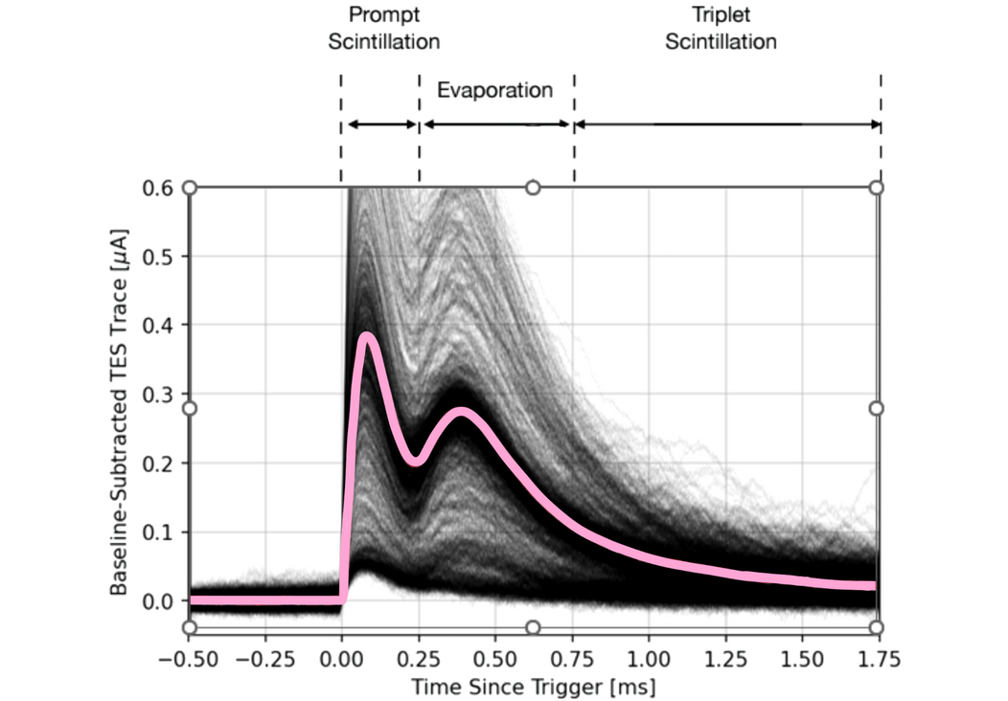
Superfluid Helium - Signal Channels
4He
Quasiparticle
"Quantum evaporation”
Signal Channels
  Can be easily discriminated
  Photon and phonons signal productions
+
Single scintillation ~<10ns
4He
+
He₂*
4He
4He
photon
Triple scintillation ~13ms
Quantum Evaporation
  Quasiparticle produced after interaction
  Release of a 4He at the liquid surface
  Signal production when hitting the TES
  0.62 eV threshold
Scintillation
  Instable dimers production after interaction
  Short-lived singlet state: emit 15.5 eV VUV photon
  Long-lived triplet state: decay at recoil site or propagate and de-excite at surfaces
4He waveforms from the calibration source 55Fe
7

Slide 24
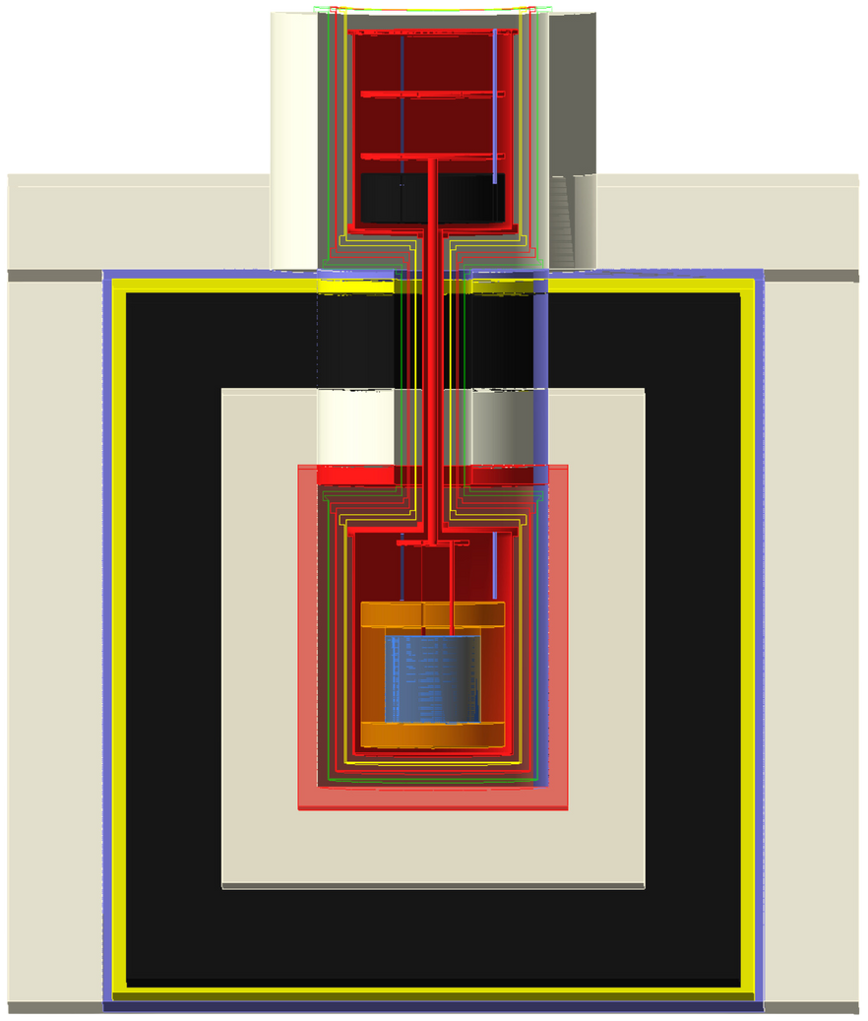
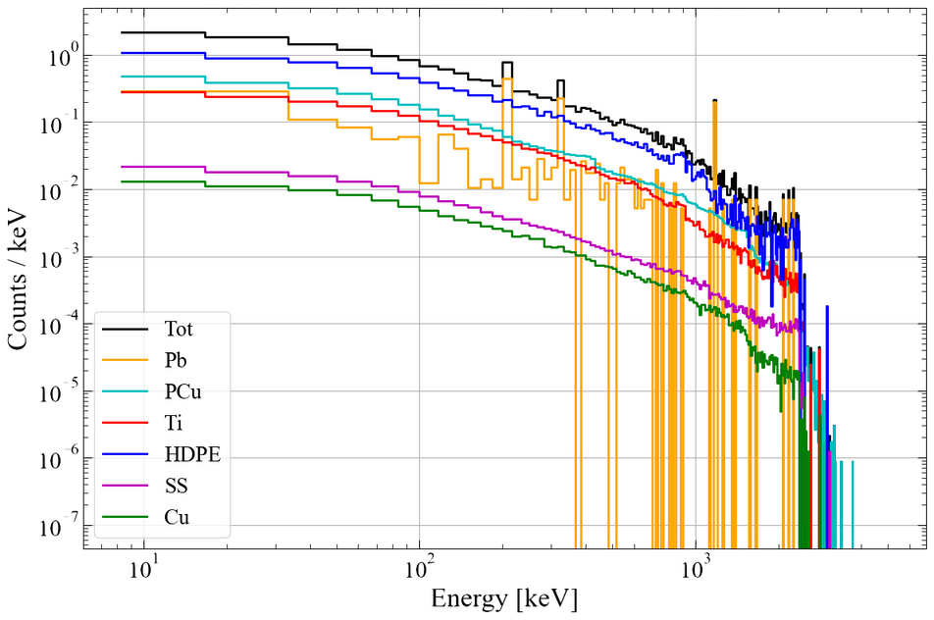
Background modeling
Background Simulations
  1st phase : Optimisation of the shielding
  2nd phase : Full detector modeling, estimation of its performances
Lead Plate
Shielding layers
Pure Copper
Cryostat
8

Slide 25
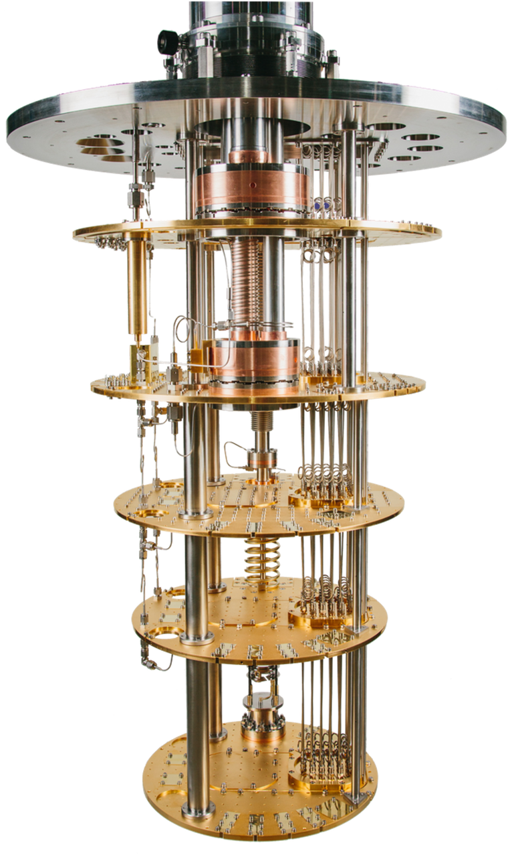
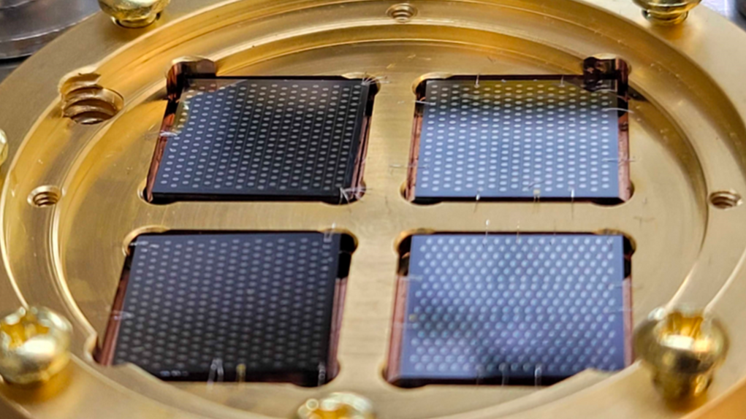
Sapphire Quantum Sensors
  Building + Characterisation of the sensors
  Resolution and photon collection efficiency
  NR/ER discrimination
  Creation and test of the procedure for the TESSERACT Experiment at the LSM
TES
Prototype of a TESSERACT detector operated at LBNL
9

Slide 26
Thank you for your attention!
10

Slide 27
References
Lin, Tongyan. (2019). Dark matter models and direct detection. 009. 10.22323/1.333.0009.
11

Slide 28
Background modeling
Optimisation of the shielding geometry
Lead Plate
Roman Lead
HDPE (Plastic)
Lead
Stainless Steel
Pure Copper
Cryostat
12

Slide 29
Introduction
What is dark matter?
  01
Invisible
  02
Massive
  03
Abundant and Fundamental
  04
~80% of the mass of the Universe
and 27% of the composition of the Universe
no electromagnetic interactions
interactions through gravity
2

Slide 30
Cryogenic bolometers
Superheated liquids
PHONONS/HEAT
Cryogenic bolometers with charge readout
Scintillating cryogenic bolometers
Germanium detectors
Scinitllating crystals
CHARGE
LIGHT
Directional detectors
Liquid noble-gas dual-phase time projection chambers
Liquid noble-gas detectors

Slide 31
PHONONS/HEAT
CHARGE
LIGHT

