Slide 1




Low Energy Physics
CHIPP winter school of particle physics 2025 – Gstaad
Wolfgang Lorenzon
University of Michigan
(23-Jan-2025)

Slide 2
The Standard Model
The Standard Model is remarkably
powerful and successful
  e-m, weak and strong interactions
  not gravity
established in 1970s, demonstrated
large predictive power
  W and Z bosons (1983)
  top quark (1995)
  τ neutrino (2000)
  Higgs boson (2012)
  various properties of weak neutral currents
The most successful theory?
Credit: Fermilab
Notes:
m_W = 80 GeV / m_Z = 91 GeV
m_Higgs = 125 GeV / m_top = 173 GeV

Slide 3
The Standard Model - Challenges
Standard Model is not complete
  Dark Matter?
  Dark Energy?
  baryon to anti-baryon asymmetry?
  neutrino masses, oscillations?
  CP violation?
  origin of families?
  gravity?
  ….
might need BSM physics to address these puzzles!
  where is the ‘new’ physics?
  what’s its mass and coupling? theory lecture!
  energy or intensity frontier?
Dark energy
68.3%
26.8%
4.9%
Dark
matter
Ordinary
matter

Slide 4
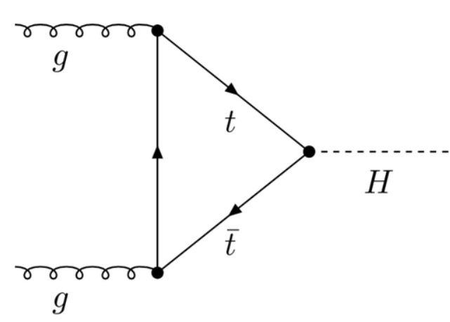
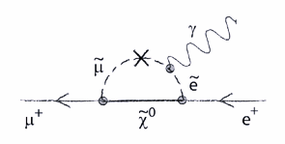
Search for BSM Physics
high energy frontier
high intensity / precision frontier
direct production of new particle
limited by collider energy (~TeV)
indirect search for “footprint” of virtual particle
rare or SM-forbidden decays
precision measurements of SM-allowed processes
g + g → H
μ⁺ → e⁺ + γ
Notes:
Complementary approaches

Slide 5
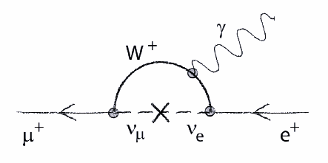
Ex: Muon Decay in SM vs SUSY
SM: LFV loop
SUSY loop
μ⁺ → e⁺ + γ
μ⁺ → e⁺ + γ
branching ratios:
if BR is 10⁻¹¹ → 10¹³ μ⁺ needed
not measurable
sensitivity to new particles is limited by the rarity of the process
→ excellent when SM process is (highly) suppressed!
plot inspired by A. Antognini
Notes:
μυ⁺ → e⁺ + γαμμα νοτ αλλοωεδ ιν ΣΜ: λεπτον φλαϖορ (νυμβερ) χονσερϖατιον
Βυτ: νευτρινο−μιξινγ γιϖεσ ρισε το ϖερψ σμαλλ ΒΡ (ΒΡ νοτ μεασυραβλε) − τηοσε αρε Διραχ νευτρινοσ
Νευτρινο χαν βε Διραχ (π νεθ αντι−π) ορ Μαϕορανα (π εθ αντι−π)
μ_Ω = 80 Γες / μ_Ζ = 91 Γες
μ_νυ ∼ 10 μες

Slide 6
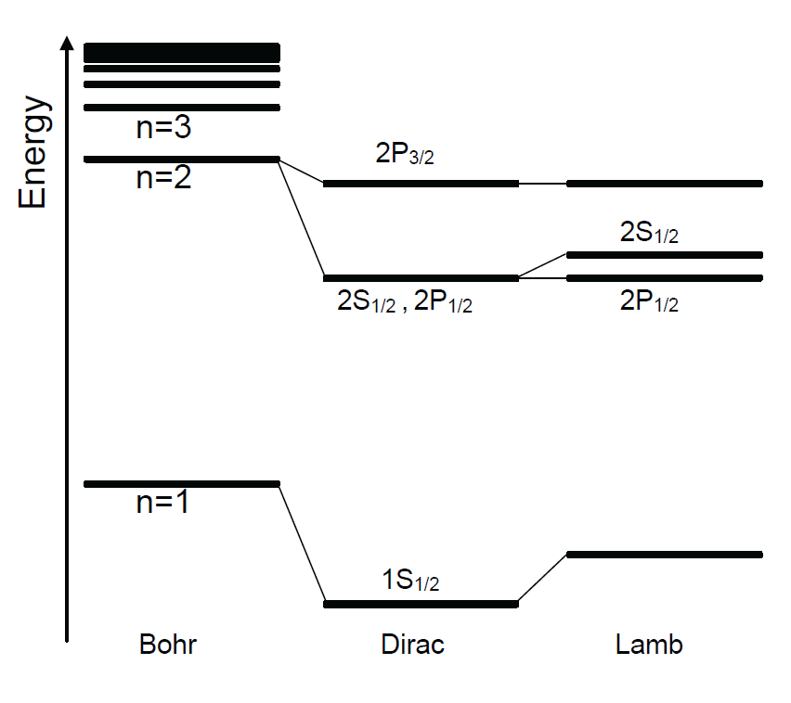
Hydrogen atom as precision probe
solve Schrödinger equation:
in the Coulomb potential:
(non-rel.) correction: need to take into account finite mass of proton by reduced mass:
principle eigenenergies are:

Slide 7
Bohr Hydrogen Atom
Bohr Model of the atom (1913)
  Electrons orbit the nucleus
  “Planetary system”
  Hydrogen: 1 electron + 1 proton
-
Electron
+
Proton
Bohr Model
Notes:
The Bohr model, invented in 1913, depicts the atom as a small, positively charged nucleus surrounded by electrons that travel in circular orbits around the nucleus—similar to the structure of the Solar System, but with attraction provided by electrostatic forces rather than gravity

Slide 8
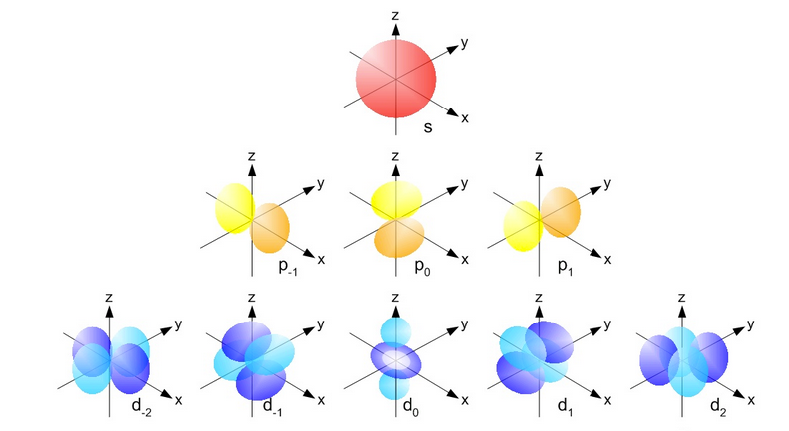
… is simply inaccurate…
Bohr model → Quantum Mechanics
“planetary orbits” → “wave function”
Hydrogen Wave Function
p-states: probability density: ZERO at origin

Slide 9
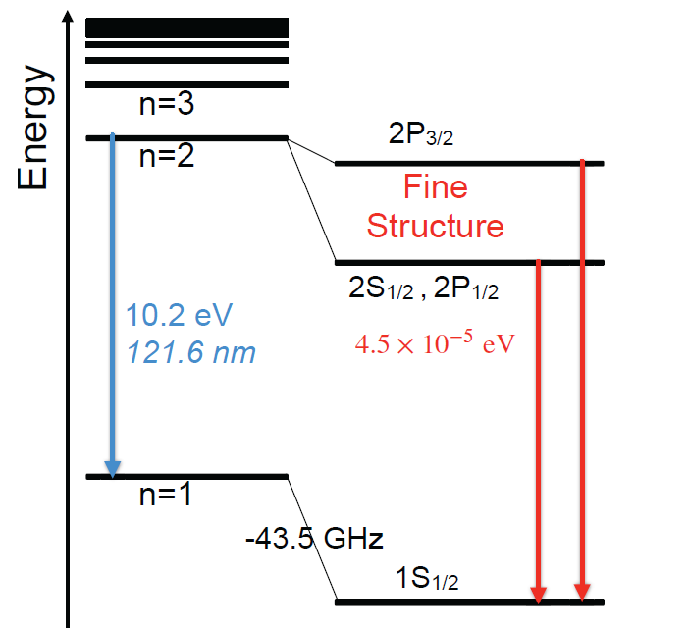
Relativistic Correction
Dirac introduces correction for relativistic treatment of electron KE and spin-orbit interaction:
relativistic effect leads to fine structure of H atom:
  2P_{3/2} and 2P_{1/2} split
  2S_{1/2} and 2P_{1/2} are same
rule:
  levels split with same n but different j (=l+s: OAM + spin)
remember: E(eV) • λ(nm) = 1240 eV nm
  4.5 x 10⁻⁵ eV splitting (→ Δλ = ?)
Notes:
43.5 GHz = 1.8 e-4 eV

Slide 10
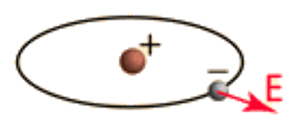
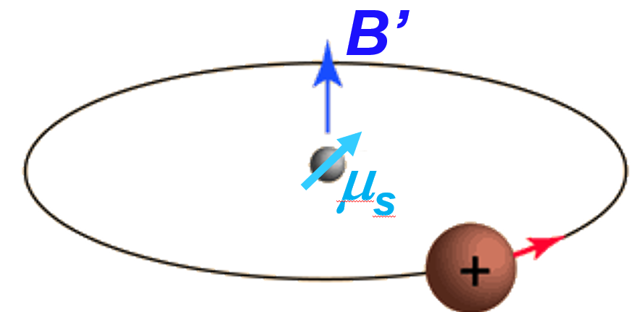
Spin-Orbit Interaction
Dirac equation unifies quantum mechanics and special relativity (APS article)
In QM, the spin-orbit interaction is a relativistic interaction
of a particle’s spin with its motion inside a potential
for H atom: In lab frame, e⁻ sees the electric (Coulomb)
field E from nucleus
In the e⁻ rest frame, electron sees an apparent magnetic
field B’ caused by the relative motion of the nucleus
→ e⁻ moving with (high) velocity v in the Coulomb field E of
the proton induces a magnetic field B’ in its rest frame:
the e⁻ magnetic moment μ_{s}, associated with its intrinsic spin
due to QM, interacts with this B’ field:
Note: μ_{s} is parallel to e⁻ spin angular momentum S, and B is parallel to e⁻ orbital angular momentum L: spin-orbit interaction, which leads to splitting of spectral lines
Notes:
spin-orbit interaction can be thought of as a Zeeman effect of two effects: the apparent magnetic field seen from the electron perspective due to special relativity and the magnetic moment of the electron associated with its intrinsic spin due to quantum mechanics.
APS article on Dirac: https://www.aps.org/apsnews/2024/11/mathematical-intuition-dirac-quantum-mechanics?utm_source=nov-amn&utm_medium=email&utm_campaign=nov-amn

Slide 11
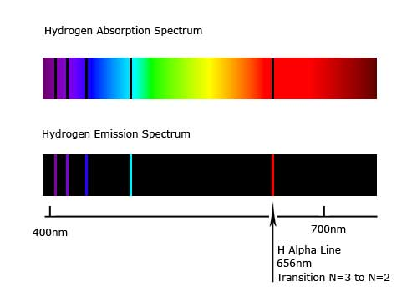
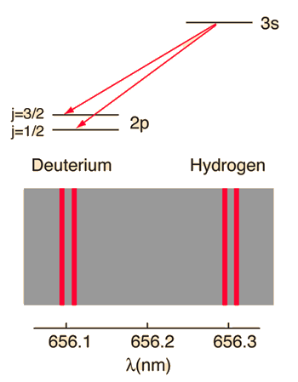
Splitting of Balmer lines
Hydrogen Absorption Spectrum
Hydrogen Emission Spectrum
Balmer α line: n=3 → n=2
ΔE=1.89 eV
(splitting is 0.016 nm, but increases for heavy nuclei)
Notes:
Δελτα E=1.89 eV for Balmer alpha line
Lamda 1 = 1240 / 1.89 = 656.085 nm
Lamda 2 = 1240 / (1.89+4.5e-5) = 656.069 nm
diff = 0.016 nm

Slide 12
Lamb’s Experiment
Lamb uses resonant spectroscopy → finds disagreement with Dirac
prediction
  2S_{1/2} and 2P_{1/2} in H split
  ΔE(2P_{3/2} − 2S_{1/2}) not as predicted
Dirac theory not sufficient:
  “BSM” physics needed
  leads to development of QED

Slide 13
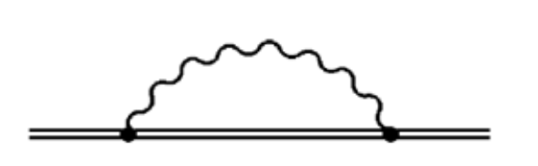

Lamb’s Experiment: start of QED
leading QED effect of Lamb shift in H atom is self energy
  virtual γ can be emitted and re-absorbed by bound e⁻
  perturbs e⁻ orbit → shifts energy levels
rule:
  levels split with same j but different l
sub-leading effect (in H) due to vacuum polarization
e⁻
e⁺

Slide 14
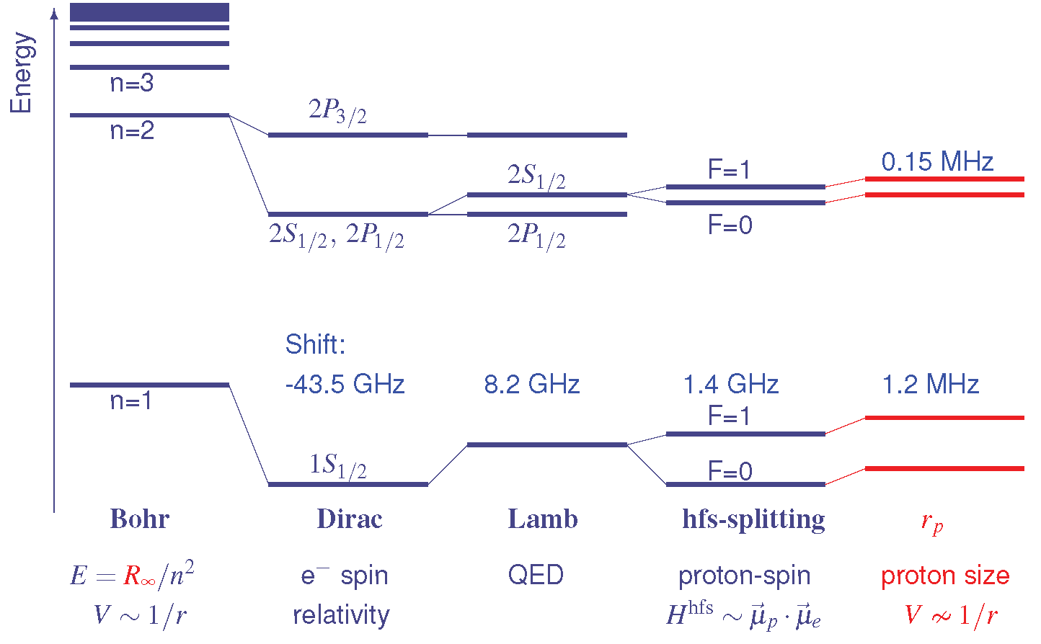
Hyperfine Splitting
next correction: account for proton spin
hfs-splitting originates from the interaction of the magnetic moments of the electron and proton due to their spin
defined by small shifts in otherwise degenerate electronic energy levels
F=I+J is total angular momentum, I is nuclear spin, J total e⁻ angular momentum

Slide 15
Hydrogen Energy Levels
including nuclear effects: finite size of the proton
can be turned around find the size of the proton

Slide 16
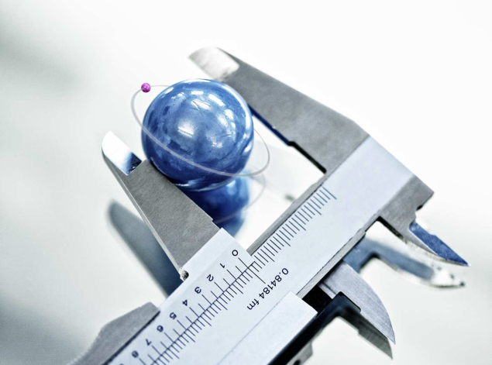
How do you measure size?
What is a radius (or size) of an object?
Well-defined for a macroscopic, hard object (ie. steel ball)
Credit: Nature
Notes:
Nature.com for proton size picture

Slide 17
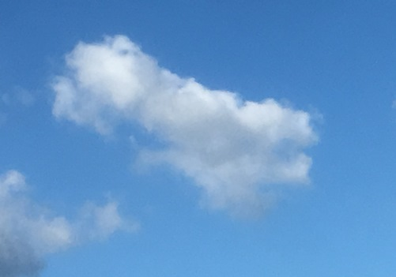
How do you measure size?
What is a radius (or size) of an object?
Less clear for a fuzzy object
Notes:
Tech Strategies, Inc for cloud picture

Slide 18
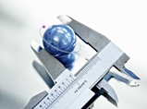
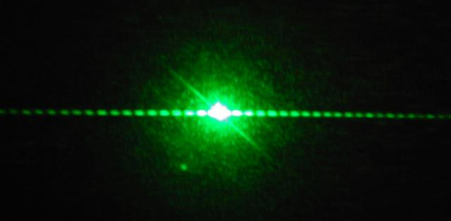
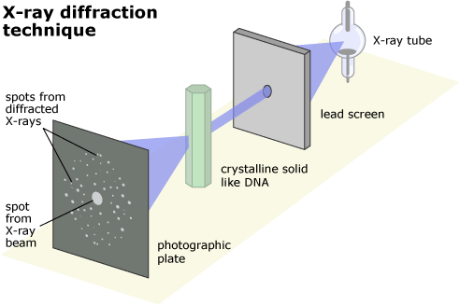
How do you measure size?
Object: Tool:
macroscopic: caliper
hard sphere (~5 cm)
small: laser
  hair (~60 μm)
  tiny: oil monolayer
  atom (~1Å) X-ray diffraction
Credit: undsci.berkeley.edu
Notes:
Nature.com for proton size picture
oil monolayer is classic experiment first done by Lord Rayleigh
undsci.berkeley.edu for x-ray diffraction

Slide 19
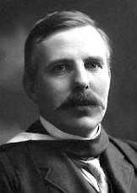
How do you measure something even smaller?
Ernest Rutherford (1871 - 1937)
half-life; α and β rays
1908: Nobel prize Chemistry:
  "for his investigations into the disintegration of the elements, and the chemistry of radioactive substances“
Notes:
In early work, Rutherford discovered the concept of radioactive half-life, the radioactive element radon, and differentiated and named alpha and beta radiation

Slide 20
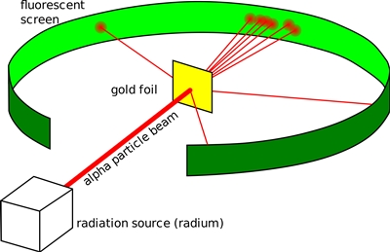
How do you measure something even smaller?
Ernest Rutherford (1871 - 1937)
half-life; α and β rays
1908: Nobel prize Chemistry:
  "for his investigations into the disintegration of the elements, and the chemistry of radioactive substances“
1911: Most α particles pass a thin gold foil undeflected
Source: Wikimedia Commons
Notes:
He performed his most famous work after receiving the Nobel prize, … Gold foil experiment and first “splitting of an atom (ie nuclear reaction),

Slide 21
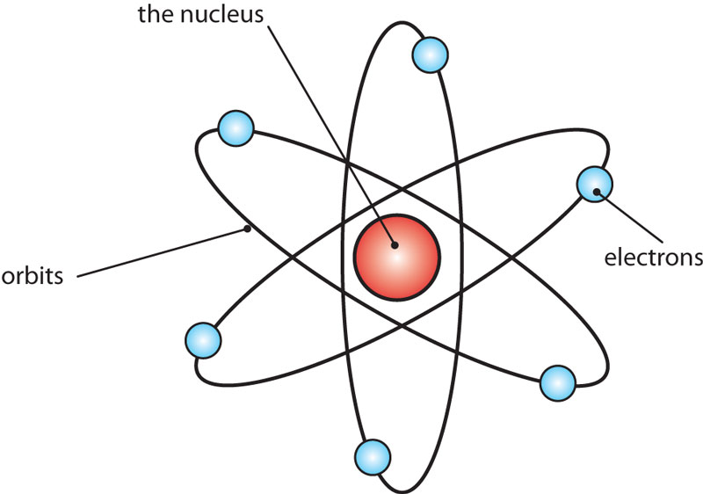
How do you measure something even smaller?
Ernest Rutherford (1871 - 1937)
half-life; α and β rays
1908: Nobel prize Chemistry:
  "for his investigations into the disintegration of the elements, and the chemistry of radioactive substances“
1911: Most α particles pass a thin gold foil undeflected
⇒ Atom = small, heavy, positive nucleus + electrons
Source: atomic.lindahall.org

Slide 22

How do you measure something even smaller?
Ernest Rutherford (1871 - 1937)
half-life: α and β rays
1908: Nobel prize Chemistry:
  "for his investigations into the disintegration of the elements, and the chemistry of radioactive substances“
1911: Most α particles pass a thin gold foil undeflected
⇒ Atom = small, heavy, positive nucleus + electrons
1917: Discovery of the proton
~1928: electron accelerators replace α particles
Notes:
He conducted research that led to the first "splitting" of the atom in 1917 in a nuclear reaction between nitrogen and alpha particles, in which he also discovered (and named) the proton (which is Greek for “first”
Many more particles were discovered after the p.
So in order to make sense of what was called the “particle zoo” …

Slide 23
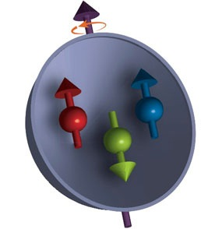
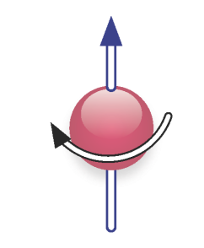
The Proton
size: (~1 fm)
Quark Model
(1964)
electric charge
u
u
d
proton is spin-1/2 particle
proton is not pointlike
(made of three constituents, called quarks)
Notes:
Murray Gelman (@Caltech) and George Zweig (@CERN, student of Feynman) invented the quark model independently

Slide 24
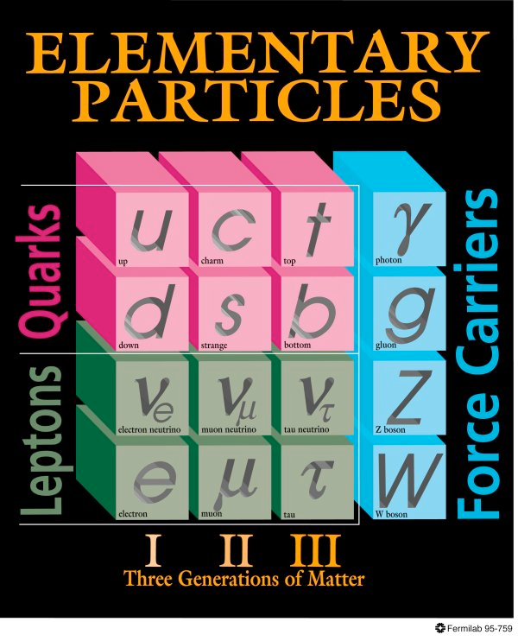
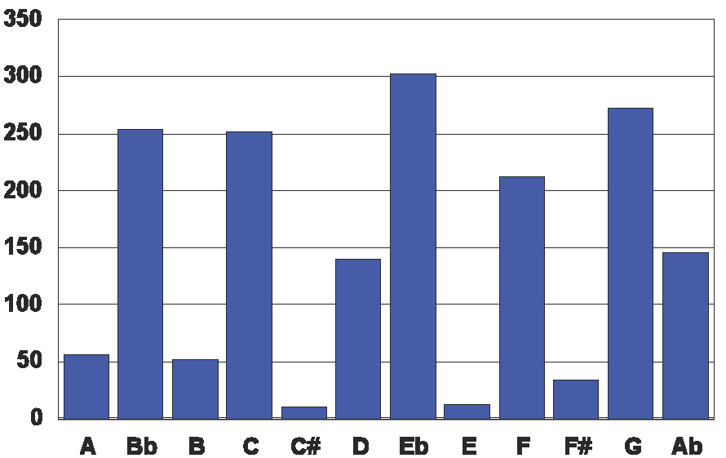
Proton - more than just constituents
Histogram of notes used in Beethoven’s 5th symphony
sum=1670
Both plots focus on constituents rather than interactions
Plot inspired by J. Arrington (ANL)
Notes:
Can we play a short piece of it? https://www.youtube.com/watch?v=wzBAd7OcDE4
Beethoven’s 5th has about 12 notes played 1670 times
Let me just play the first four notes w/o dynamics, then the real thing (now with dynamics)

Slide 25

Proton - more than just constituents
the 1st four notes
(G, E, F, D)
adding rhythmic variation
with full dynamics
Histogram of notes used in Beethoven’s 5th symphony
Both plots focus on constituents rather than interactions
Interactions are important - they create the dynamics
Plot inspired by J. Arrington (ANL):
Notes:
Let me just play the first four notes w/o dynamics, then the real thing (now with dynamics)

Slide 26
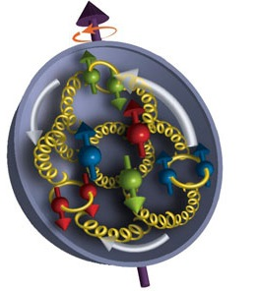
The Proton
quarks are held together by strong nuclear force, which arises when quarks exchange gluons
complex internal structure generated by interactions between pointlike constituents (quarks/partons).
Uncertainty Principle dictates: quarks must be in motion - at close to speed of light
→ proton is a strongly-coupled,
relativistic, infinite-body
system
Notes:
p > h_bar / x: for m_q = 350 MeV, and x = 1fm -> v > 0.6c
h_bar = 6.6 e-22 MeV s

Slide 27
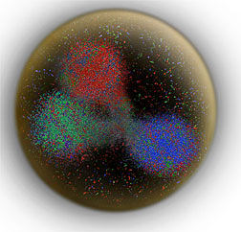
the proton
is fuzzy
So we average over the
density (to get an average
radius²)
It is hard to define a radius

Slide 28
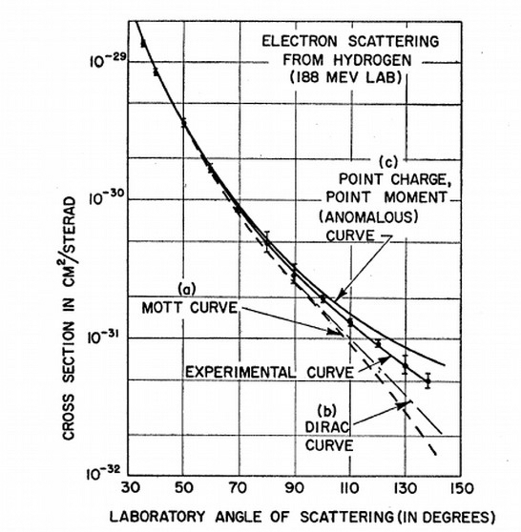
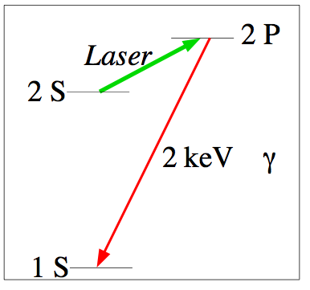
How do you measure proton radius?
Scattering experiments
(Hofstadter @ Stanford: 1950s - electron scattering)
Atomic Energy Levels
(extract from hydrogen spectroscopy)
- φ (0): e⁻ wave-fct at origin in coord. space
- correction to Lamb Shift: finite size of
proton changes hydrogen energy level
(only affects s states significantly, not p states!)
(Schwinger 1952)
28
Notes:
Non-relativistic QM calculation by Schwinger in 1952 :Phi is electron wave function at origin in coordinate space
Interestingly only depends on RMS proton radius squared and not on the detailed distribution of matter w/in proton
It turns out that the relativistic calculation gives precisely the same result where r_E is defined from the derivative of the electric form factor

Slide 29
How do you measure proton radius?
Scattering experiments
(Hofstadter @ Stanford: 1950s –extract from electron scattering)
equivalent
Atomic Energy Levels
(extract from hydrogen spectroscopy)
Notes:
It turns out that the relativistic calculation gives precisely the same result where r_E is defined from the derivative of the electric form factor

Slide 30
Extracting the radius from scattering data
Differential cross section
Mott cross section
Form Factor
will be measured
We extract this from the other two
We know this
Form factor G(Q²) is related to charge distribution ρ(r) in proton

Slide 31
Extracting the radius from scattering data
Slope of the form factor as a function of
momentum transfer
proton radius squared
E
evaluated at momentum transfer =0

Slide 32
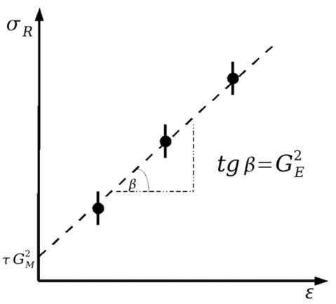
Electron Scattering Measurements
Cross section for ep scattering (Born approximation)
Classical Rosenbluth separation
  measure the reduced cross section
  at several values of ε (angle/beam
  energy combination) while keeping
  Q² fixed
  linear fit to get intercept and slope
Note: G_{M} is suppressed at low Q²
→ G_{E} dominates cross section at low Q²
Alternatively: direct fits of G_{M} (Q²) and
G_{E} (Q²) to experimental cross section data
σ _{R}
current density
charge distr.
Mott cross section is scattering of an unpolarized spin-½ electron from a point-like spin-0 target
Notes:
form factors are related to elastic e-p scattering cross section / ε is longitudinal photon polarization
G_E dominates cross section at low Q^2
But because of the ε/τ weighting of (G_E)^2 relative to (G_M)^2, the contribution from the
electric form factor to the cross section is suppressed at large Q2

Slide 33
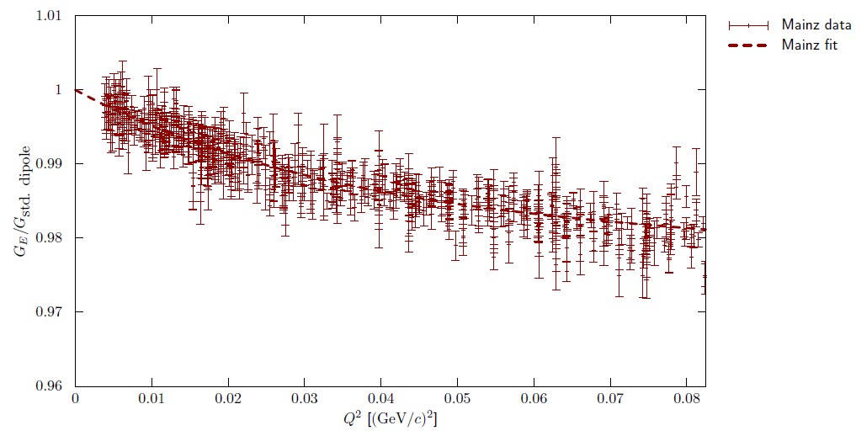
Extracting the proton radius
A sample G_{E} (Q²) behavior

Slide 34
Standard Dipole Form Factor
describes spatial distribution of charge or magnetization within a particle
serves as an approximation to model the way internal structure of a particle influences its interaction with e-m fields
Standard Dipole Approximation (functional form):
  Q²: squared four-momentum transfer in interaction, related to spatial resolution of probe
  Λ²: cutoff parameter related to the size of the particle
  “dipole”: form resembles potential of a dipole field in certain limits
  G(Q²) dependence implies a rapid fall-off of form factor at high Q², consistent with finite size of particle
simplifies theoretical calculations and provides a reasonable first-order approximation of the experimental data

Slide 35
Hydrogen Spectroscopy Measurements
The Proton Radius from H Lamb Shift
0.014% of the Lamb Shift!
comparing measurements with QED calculations that include corrections
for finite size of proton provide indirect but very precise value for ⟨r_{E}²⟩
Notes:
The Lamb shift in hydrogen’s atomic-energy levels is the splitting of the 2S1/2 and 2P1/2 levels. They are a result of the electron (or muon) interacting with the quarks inside a proton as described by quantum electrodynamics (QED). These shifts were first detected in regular hydrogen back in 1947 by the late Willis E. Lamb, J and named after him

Slide 36
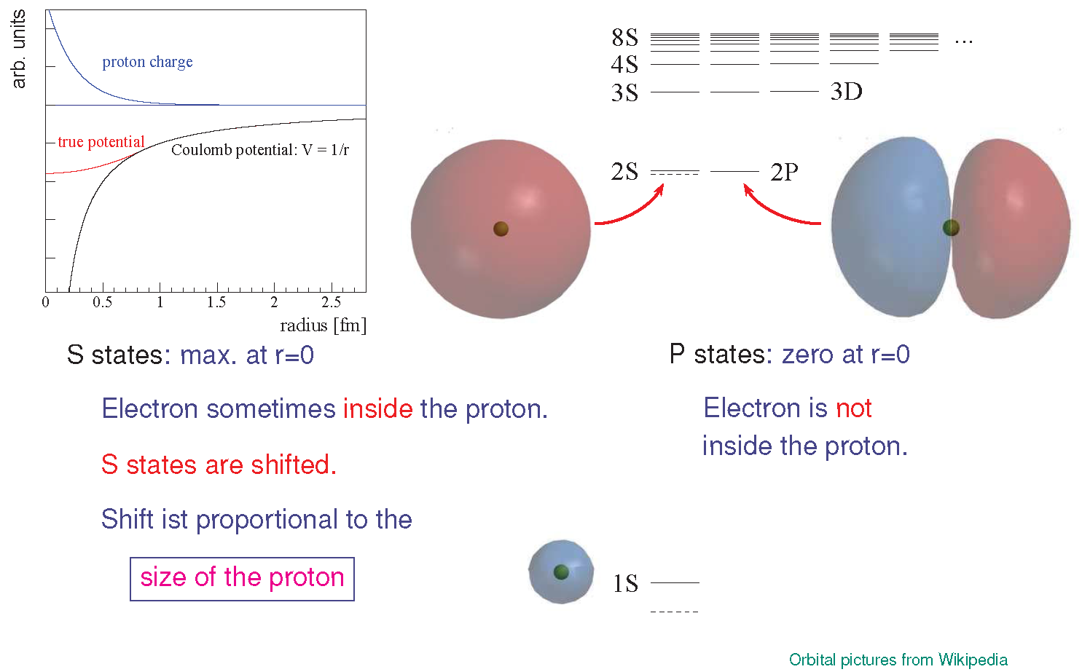
Finite-size shift of atomic energy levels
for point-like proton
Pictures: R. Pohl
36
Notes:
Modification of
Coulomb potential w.r.t. a point-like proton

Slide 37
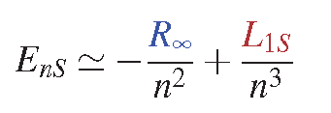
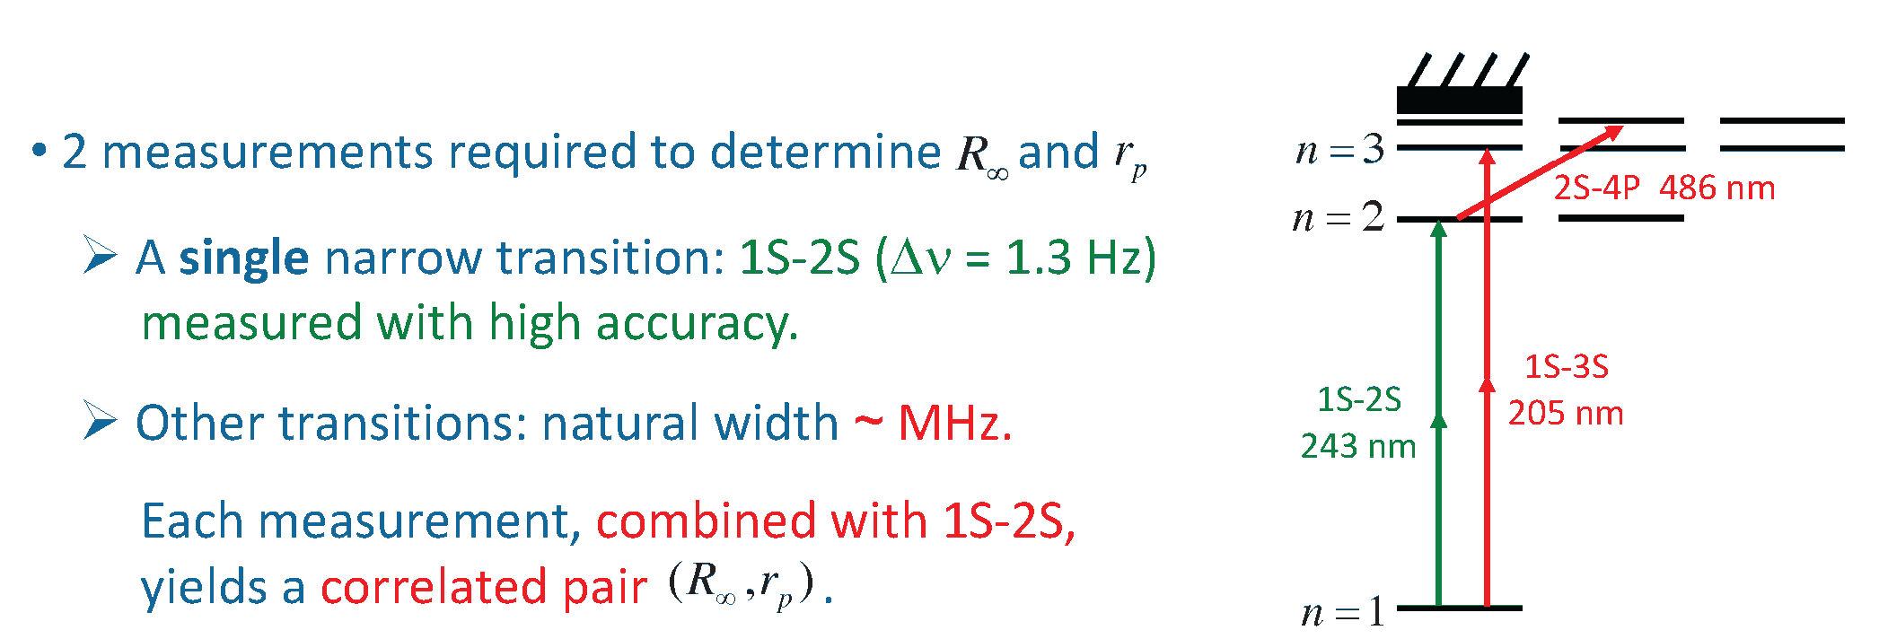
Hydrogen Atom Spectroscopy
37

Slide 38
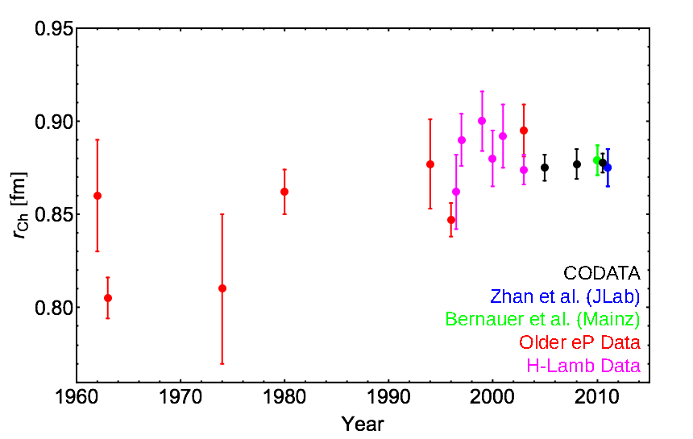
The Proton Radius from H Lamb Shift and ep
proton rms charge radius measured with electrons: 0.8770 ± 0.0045 fm
CODATA: Committee on Data for Science and Technology, the international group which publishes the recommended values for fundamental physical constants every four years.

Slide 39
The Proton Radius from H Lamb Shift and ep
All is good: scattering data and H-atom data agree very well
But can we do better? use Muonic Hydrogen

Slide 40
Why use Muonic Hydrogen?
In the standard model
the muon is just a
heavier version (~207
times) of the electron
The muon decays into an electron (and some
neutrinos) with a lifetime
of ~2.2 μs
It has exactly the same
interactions…

Slide 41
Why Measure with μH ?
Regular hydrogen:
electron e⁻ + proton p
Muonic hydrogen:
muon μ⁻ + proton p
muon mass m_{μ} = 207 m_{e}
Bohr radius a_{Β,μ} = 1/207 a_{Β,e}
electron
Probability for μ⁻ to be inside proton:
→ 207³ ≈ 8 million
muon
muon is much more sensitive
to proton radius
figure not to scale (r_atom / r_p ~ 50,000 (250) for e (mu)
Notes:
Probability for lepton to be inside proton = volume of p / volume of atom
Bohr radius: =ℏ/m_e α, 50 pm = 0.5 A = 50,000 fm

Slide 42
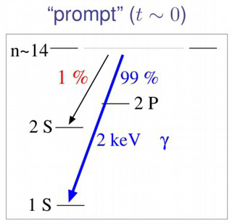
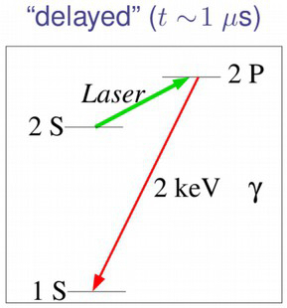
How to Measure with μH ?
beautifully simple, but technically challenging!
form μH*(n~14) by shooting μ beam on 1 mbar H₂ target
  99% decay to 1S, giving out fast γ pulse
  1% decay to longer-lived 2S state
  2S state excited to 2P state by tuned laser & decay with release of delayed γ
vary laser frequency to find transition peak → ΔE (2S to 2P) → r_{p}
Pictures: R. Pohl
Notes:
Electrons take an elevator that brings them down to the ground floor 99% of the time. But in 1% of the time, it gets stuck on the way down on the second floor. If you can now take a laser beam and shoot at these electrons while they are stuck on the 2nd floor, and you give them just the right energy, they can go to a slightly higher level. There another elevator is waiting to take them promptly to the ground floor. But since you need to have just the right energy in your laser, and you are not exactly sure what that energy is, you need to play around with it until you hit that right energy.

Slide 43
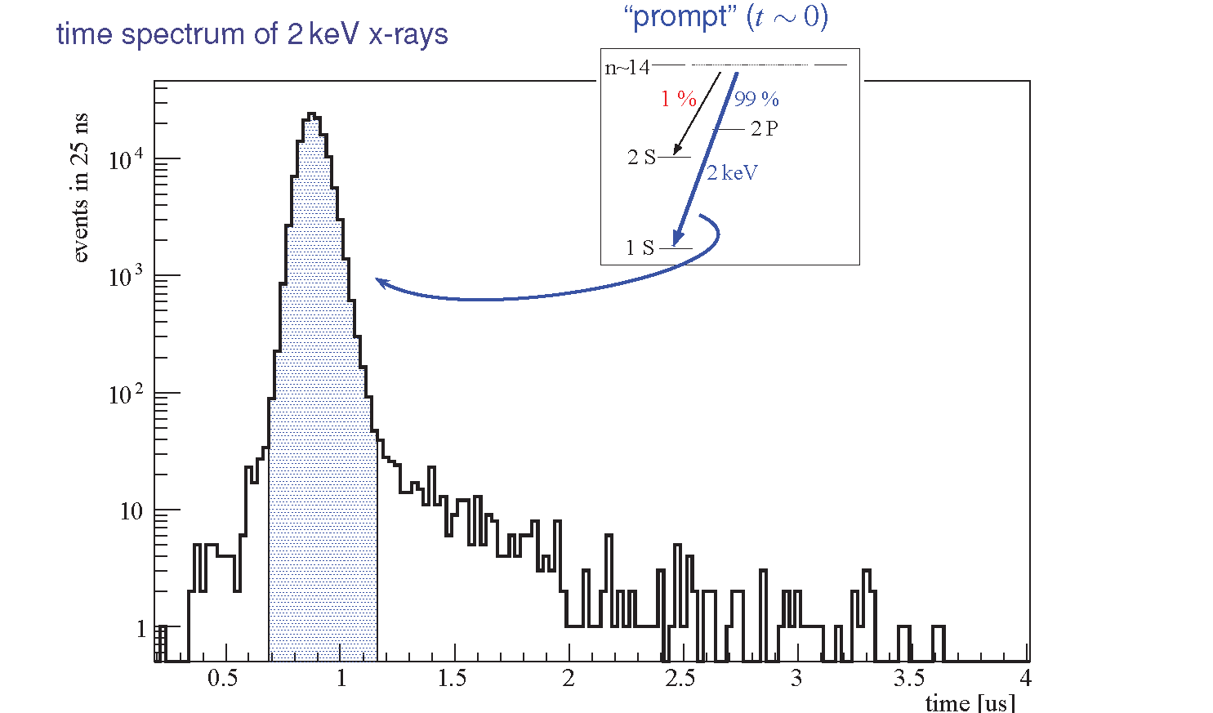
How to Measure with μH ?

Slide 44
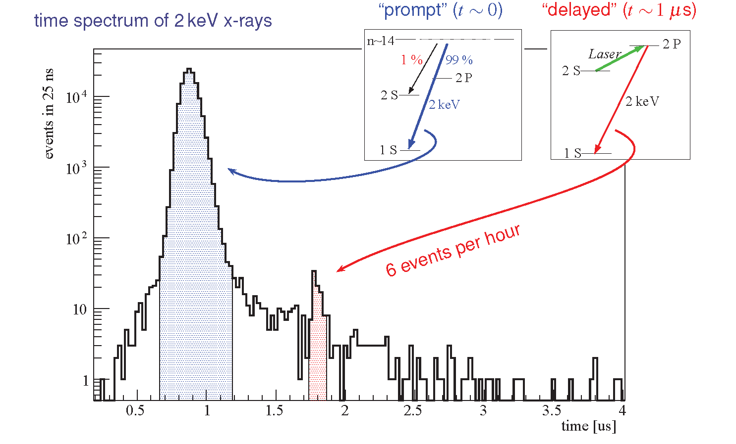
How to Measure with μH ?

Slide 45
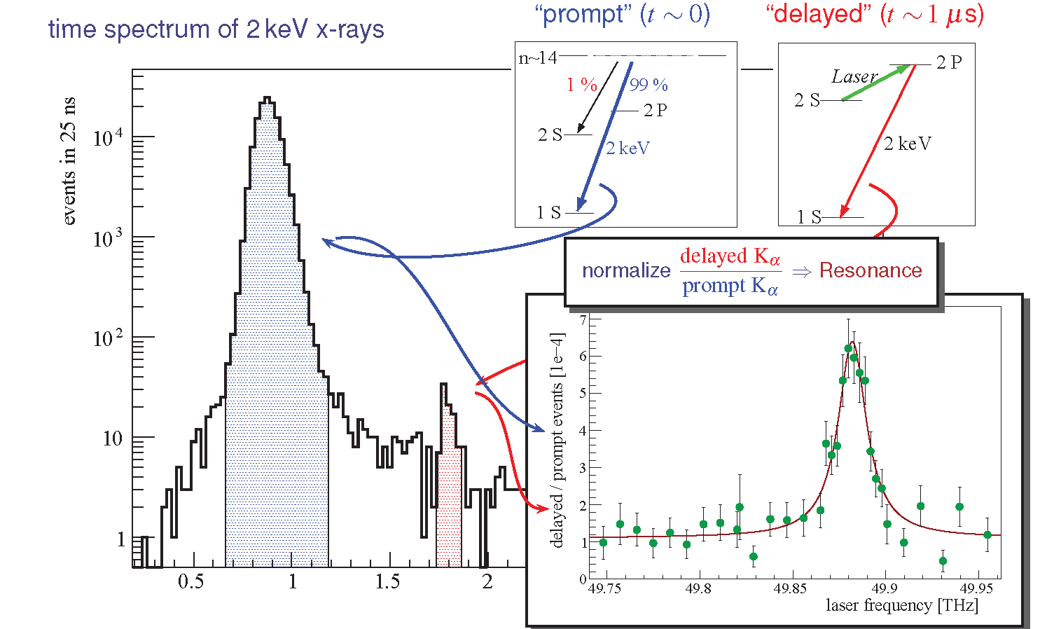
Proton Radius from μH
Take ratio of delayed to prompt as a function of laser frequency:
0.84184 ± 0.00067 fm

Slide 46
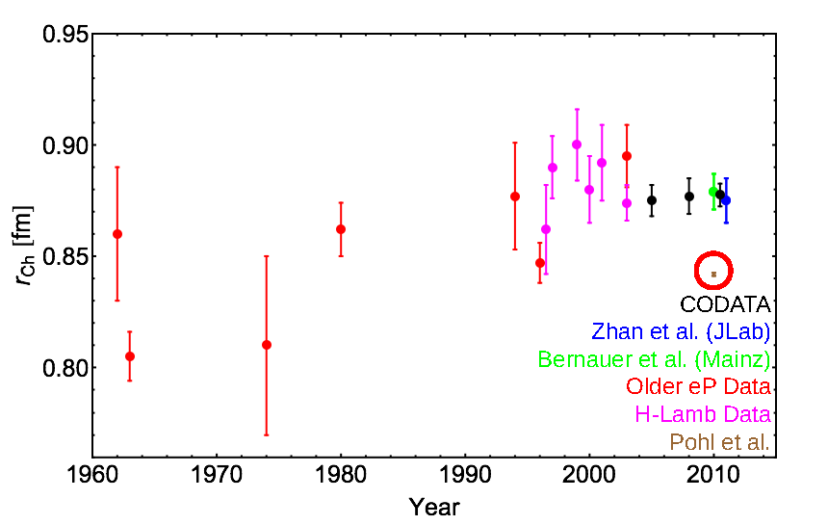
The Proton Radius from H & μH Lamb Shift and ep

Slide 47
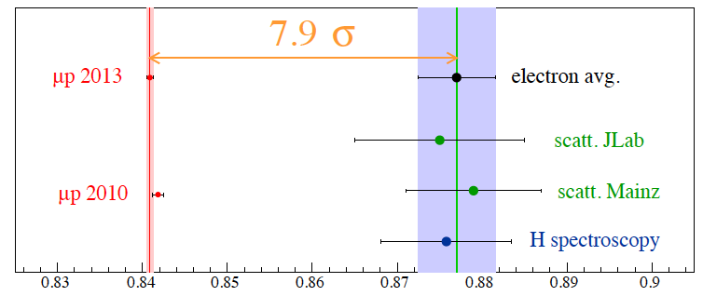
The Original Proton Radius Puzzle (2013)
Proton radius measured with
atomic physics and electron scattering: 0.8751 ± 0.0061 fm
muonic hydrogen: 0.8409 ± 0.0004 fm
Radius from Muonic Hydrogen 4% below previous best value
→ 12% smaller (volume), 12% denser than previously believed
Proton charge radius (fm)
47
Notes:
x sigma difference calc: (r1-r2)/sqrt(dr1^2 + dr2^2)
2010: R. Pohl
2013: A. Atognini

Slide 48
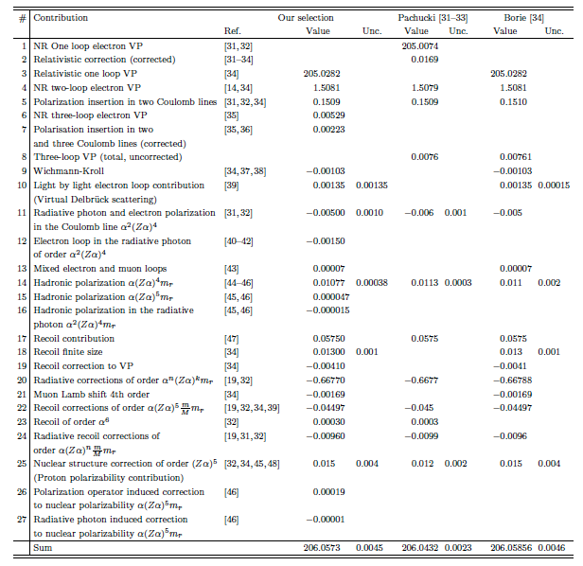
Why do the muon and electron give different proton radii?
Experimental error in μp measurement ?
  seems unlikely
Experimental error in ep measurements ?
  both scattering and H-spectroscopy are wrong?
  Rydberg constant off by 5σ?
  fit procedures not good enough?
  Q² not low enough, or structures in the form factors?
Theory Error?

Slide 49
Why do the muon and electron give different proton radii?
Experimental error in μp measurement ?
  seems unlikely
Experimental error in ep measurements ?
  both scattering and H-spectroscopy are wrong?
  Rydberg constant off by 5σ ?
  fit procedures not good enough?
  Q² not low enough, or structures in the form factors?
Theory Error?
  checked, rechecked, and checked again
  …. is framework wrong?
Everybody is correct ? New Physics !
  BSM Physics
    violation of lepton universality, light massive gauge bosons(s)
  Novel Hadronic Physics
    proton polarizability affects μ, but not e (effect ∝m_{l}⁴)
    two-photon exchange corrections (effects important at high Q²)
    Need More Data

Slide 50
The Puzzle Deepens: 2023 Status
black = CODATA
blue = ep scattering
red = μ-H spectroscopy
green = atomic-H spectroscopy
light blue = re-fitting of ep scattering
50

Slide 51
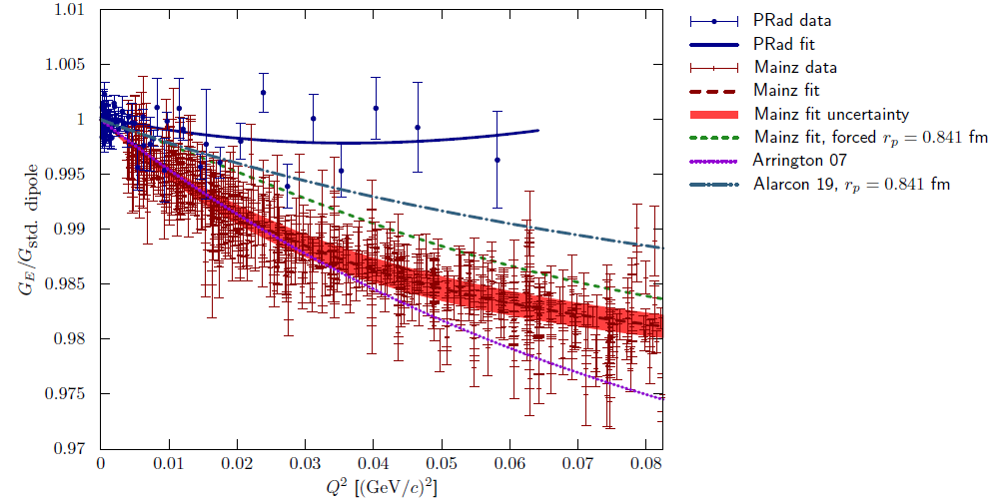
A closer look at Low-Q² Form Factor Measurements
cross sections and form factors of PRad are different - why?
  accuracy of radiative corrections?
  which result is to be preferred, and why?
  “higher” Q² data seems to affect the slopes at Q² → 0
need independents checks
  redoing electron scattering at lower Q²?
51

Slide 52
The Quest for New Data
Experiments include
→ redoing atomic hydrogen
- conflicting results: more careful systematics?
→ light muonic atoms for radius comparison in heavier systems
- puzzle seen in H & D, but not in He: (Z=1 radius puzzle?)
→ redoing electron scattering at lower Q²
- many efforts (backup slide)
- PRad (windowless H₂ gas flow target → removes major bkgds)
is consistent with μp results!
- PRad-II starting 2025
→ Muon (elastic) scattering!
- never been done with high precision!
- MUSE (first muon proton scattering experiment: 2023-2025)
- plans at AMBER (100 GeV SPS muon beam at CERN: 2025)
52

Slide 53

Motivation for μp scattering
Spectroscopy
Electronic hydrogen
Muonic hydrogen
0.8758 ± 0.0077
0.84087 ± 0.00039
Electron scattering
Muon scattering
0.8770 ± 0.0060
Scattering
???
53
Notes:
Possibly a smoking gun

Slide 54

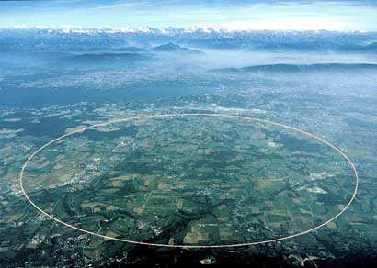

Swiss Muons
X
54
Notes:
Possibly a smoking gun

Slide 55
Swiss Muons
Paul Scherrer Institut
Villigen, Switzerland
55
Notes:
Possibly a smoking gun

Slide 56
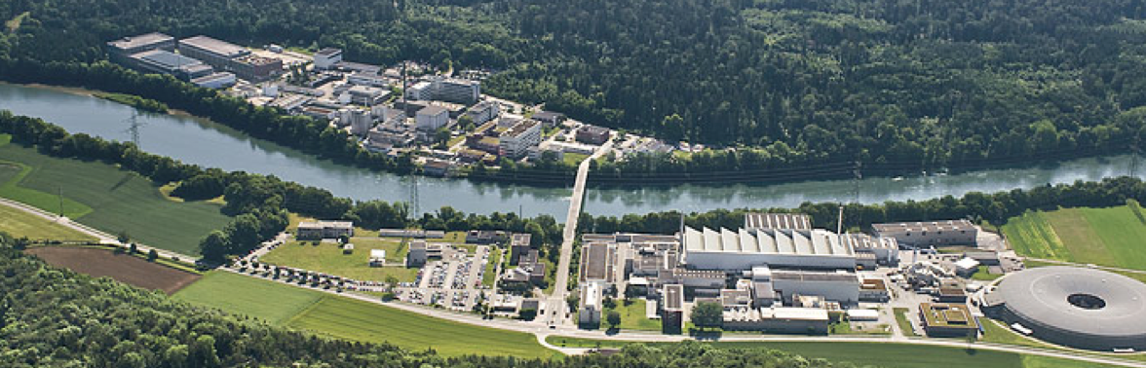
MUon Scattering Experiment (MUSE) at PSI
Paul Scherrer Institute
Villigen, Switzerland
Direct comparison of μp & ep scattering!
→ beam of e⁺/π⁺/μ⁺ or e⁻/π⁻/μ⁻ on LH₂ target
- separate particles by TOF, charge by magnets
→ charge reversal: test two photon effects
→ absolute cross sections for ep and μp
- use ratio to cancel (many) systematics
→ momenta: 115, 160, 210 MeV/c and scattering angles: 20º – 100º
- Q² = 0.0016 – 0.08 GeV²
56

Slide 57
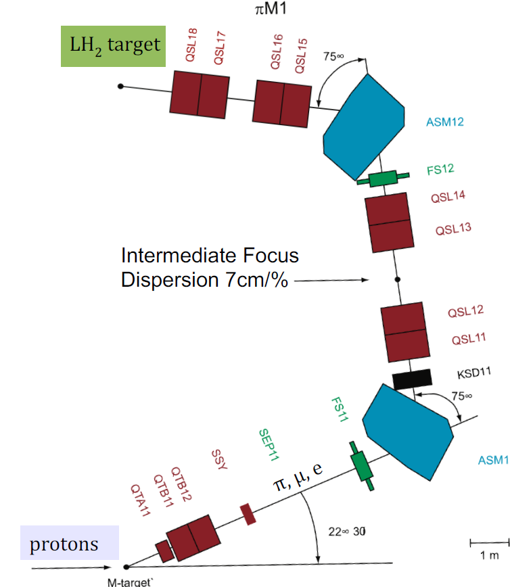
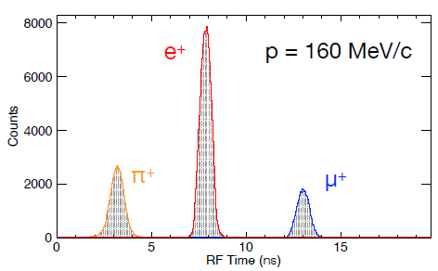
πM1 / MUSE beamline
πM1:
100−500 MeV/c RF+TOF
separated π, μ, e
with large emittance
we typically see many more electrons than muons
57

Slide 58
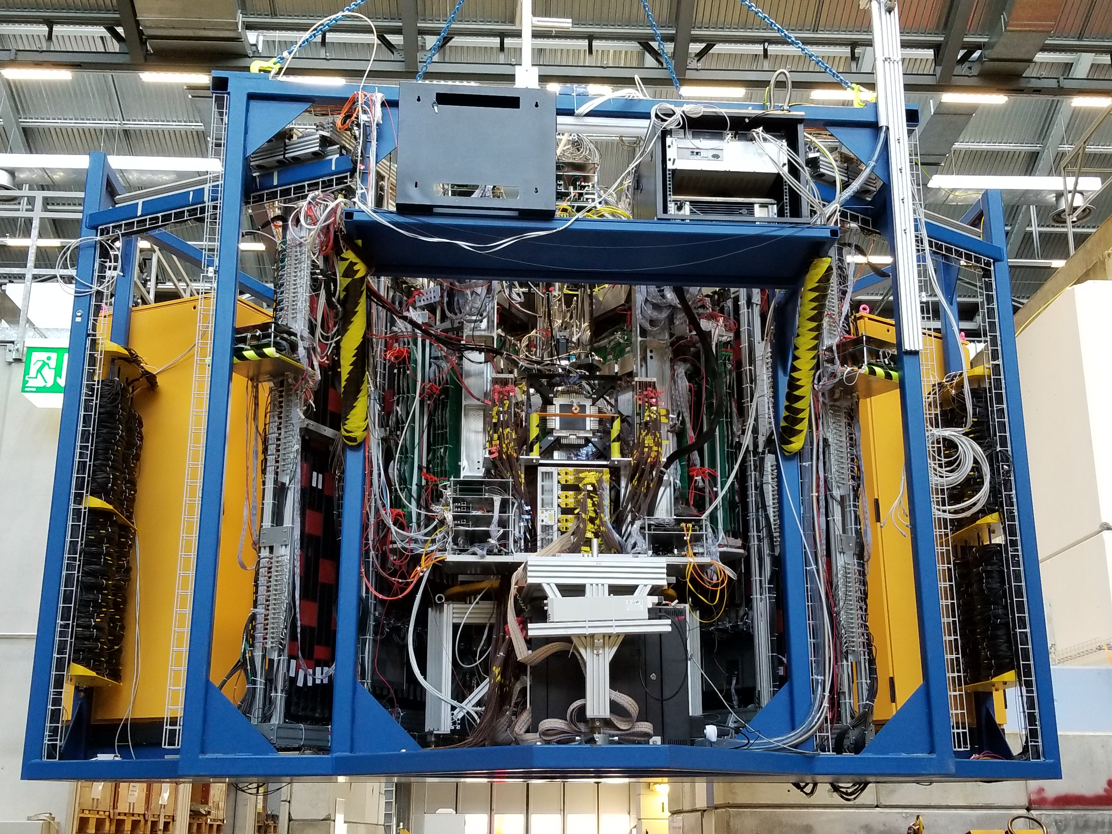
MUSE: an unusual Scattering Experiment
MUSE sits on a platform that can be craned in and out of πM1
58

Slide 59
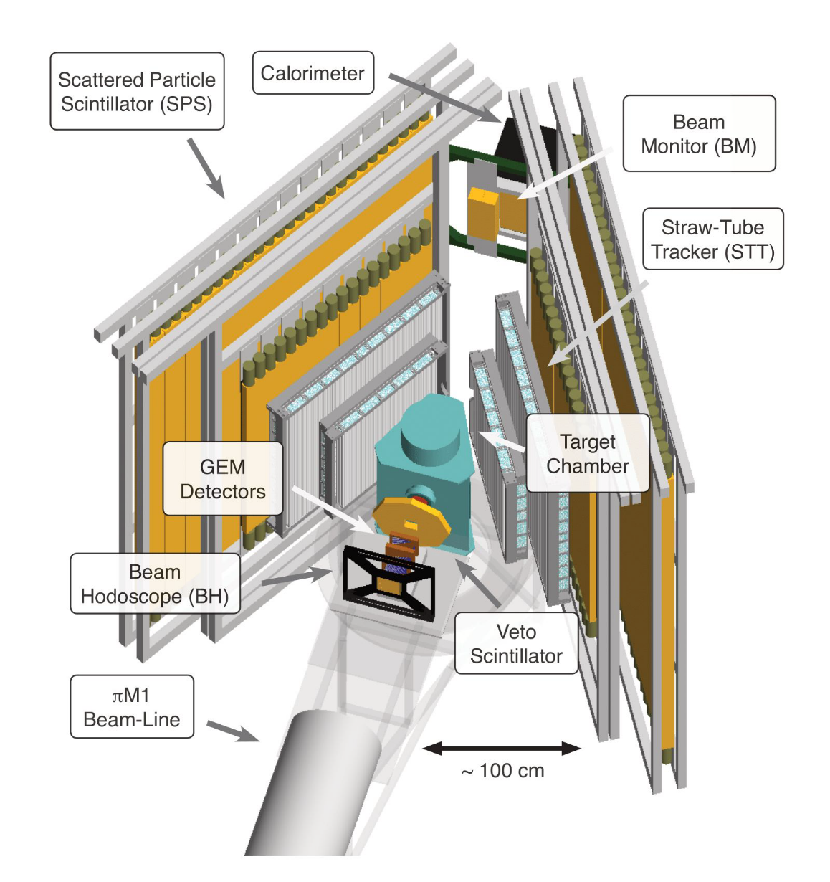
MUSE: an unusual Scattering Experiment
A closer look
Secondary beam → identify and track beam particles
Low beam flux (3 MHz)
→ large acceptance, non-magnetic spectrometer
Mixed beam → PID in trigger
Credit: Rachel Ratvasky
59

Slide 60
MUSE experiment layout
Detectors
Beamline detectors measure & monitor
incoming & unscattered particles
Scattering detectors measure scattered
particles
Credit: Rachel Ratvasky
60

Slide 61
MUSE experiment layout
Beamline detectors
Beam hodoscope scintillator detector which measures particle timing & identity
GEM detectors four Gas Electron Multipliers which track incoming beam particles
Beam veto annular scintillator detector which rejects in-flight scatters & in-flight decays upstream of target chamber
Beam monitor scintillator detector which measures beam flux & position, particle identity & time-of-flight
Calorimeter scintillator detector which measures unscattered particles (radiative corrections)
Credit: Rachel Ratvasky
61

Slide 62
MUSE experiment layout
Scattering detectors
Straw-Tube Tracker (STT) wire-centered e-drift-chamber detector which tracks scattered particles
Scattered Particle Scintillator (SPS)
scintillator detector which measures
scattered-particle timing & identity
Credit: Rachel Ratvasky
62

Slide 63
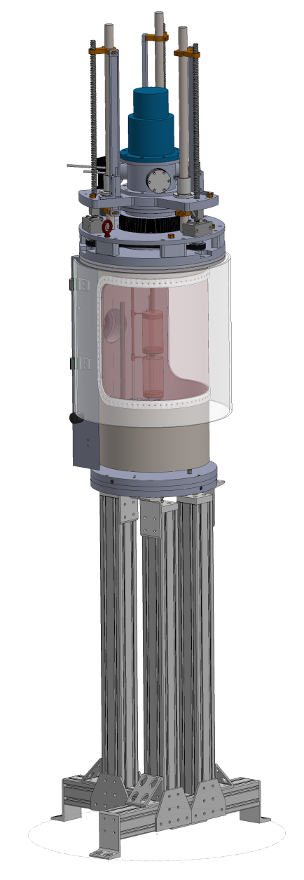

Example of an Experimental Challenge
MUSE Target Design:
Cryocooler
Lifting Mechanism
Recall angular acceptance:
20º – 100º
Two chamber designs have been considered
  Cylindrical chamber with a single wrap-around exit window
  Trapezoidal chamber with three discrete exit windows
Physicists prefer cylindrical chamber
Engineers prefer trapezoidal chamber
Bellows
Cylindrical
Chamber
Trapezoidal
Chamber
Targets
X,Y,Z Translation
Stand
63

Slide 64


Unsupported Windows form Pleats
127µm Kapton
127µm Kapton window deflecting inward about 2.5”
(6.35 cm) at about
0.5 atm
C785 sailcloth (258 µm Kapton equivalent) at
1 atm still forms pleats
Does not work
C785 sailcloth
Window Burst Shortly after Photo taken
64

Slide 65


Flat Windows don’t form Pleats
127µm Kapton
C785 sailcloth
No Pleats!
The Winner
window deforms 68 mm at 1atm
Mylar laminated on aramid fabric window deforms 27 mm at 1atm
65

Slide 66




Hydrogen Target
Target
cells
Target chamber
Target
cell destruction tests
66

Slide 67


Target Performance at 1st cooldown
Dec 2018
72 hr period
Target Temperature: 20.67 ± 0.01 K
  corresponds to a pressure of ~1.1 bar
Target density: 0.070 g/cm³ (stable to 0.02%)
Heat load from beam: ~7μW
  cannot see when beam is on or off target cell
67
Notes:
Stability: once equilibrium concentration of para (>99%) and ortho (<1%) hydrogen has been reached

Slide 68
MUSE Physics Coverage
First high precision measurement of elastic μp scattering
  at level necessary to inform proton radius puzzle (PRP)
First simultaneous measurement of elastic μp and ep scattering
  to reassess proton radius and remaining discrepancies
  to perform high precision test of two photon effects (TPE) at low Q²
  to test lepton universality
  to test radiative corrections
Low energy π p scattering important for χPT
Search for σ(π⁺p)/ σ(π⁻p) resonances
68

Slide 69

p radius extraction from muon scattering
0.01 fm radius change → 0.9% cross sec. change at highest Q²
good control of syst. uncertainties required to achieve goal of experiment
  largest MUSE syst uncertainty: radiative corrections for ep → ep
Dispersively improved chiral effective field theory:
F. Gil-DomÍnguez, J.M. Alarcón and C. Weiss, Phys. Rev. D 108, no.7, 074026 (2023)
69

Slide 70



MUSE two-photon exchange
High precision test of TPE for electron and muons at low Q²
TPE largest theor. uncertainty in
low-energy proton structure
expect sign change for e⁺/μ⁺ and e⁻/μ⁻
projected syst. uncertainty: 0.1% in δ_{2γ}
3.5 %
0.5 %
flat > 0.02
O. Tomalak, Few-Body Systems, 59, 87 (2018)
T. Engel, et al., Eur. Phys. J. A 59, 253 (2023) - McMule
P. Choudhary, et al., Eur. Phys. J. A 60, 69 (2024) - HBχPT
70
Notes:
TPE is the leading explanation for the proton form factor ratio discrepancy
McMULE calculated μ⁻p elastic TPE, assuming different values of Λ2 in dipole form factor. Note roughly flat prediction above Q2 = 0.02 GeV2.
HBχPT calculated μ⁻p TPE. Note strong increase in predicted effect size as a function of Q2.

Slide 71



MUSE projected cross section ratios
μ / e
stat. uncertainties shown
final syst. uncertainties <0.5%
71

Slide 72
MUSE projected form factor G_{E}
Cline et al. SciPost Phys. Proc. 5, 023 (2021)
MUSE anticipated form factor uncertainty
  arbitrarily placed at 0.96
72

Slide 73

Projected sensitivity for MUSE
absolute radius extraction uncertainty similar to current experiments
σ(r_{e}), σ(r_{μ}) ≈ 0.007 fm
radius difference: common uncertainties cancel
  comparison of μ to e, or μ⁺ to μ⁻
  insensitive to many syst. errors
σ(r_{e} − r _{μ}) ≈ 0.005 fm
inconsistent electron-scattering data inconsistent hydrogen-spectroscopy data
73

Slide 74
MUSE Current Status and Plans
74
MUSE proposed in 2012 (approved in 2013)
started production data taking for 12 beam months over 2 years in 2023
  → 2.7 × 10⁹ events (2023)
  → 4.8 × 10⁹ events (2024)
MUSE aims for ~12 billion events, with a 60/40 split between LH₂/empty cell scattering events
Aim to finish in 2025
MUSE uniquely suited to address the proton radius puzzle and much more

Slide 75
Proton Radius Puzzle Conclusions
We are still (possibly more) puzzled!
Proton radius puzzle
  discrepancy between muonic and electronic measurements has blurred
  but inconsistent electron-scattering data and inconsistent hydrogen-spectroscopy data remains a serious problem
  need new data with better control
Expect new results in the coming years
MUSE (w/ electron & muon scattering)
  give first precise muon scattering results
  will test existing values of radius
  will test two photon exchange & radiative corrections
  lepton universality
75

Slide 76




Other Topics we did not discuss
76
Exotic atoms
  Muonium (test fund. const: R∞, α, m_{μ} ) + test of QCD and fund. symmetries
  Positronium (pure onium: test of QED)
  Antihydrogen
Forbidden Decays
  MEG μ⁺ → e⁺ + γ (cLFV) PSI
  Mu3e μ⁺ → e⁺ + e⁻ + e⁺ PSI
  Mu2e μ⁻Ν→ e⁻Ν Fermilab, J-PARC
Electric Dipole Moments
  n2EDM (sensitive probe for CP-violation) PSI (UCN source)
  nEDM also at Munich, Gatchina, TRIUMF, LANL, SNS, J-PARC
  muEDM PSI
Others
  Muon g-2 (connection to dark photons?)
  Electron g-2 (most precisely measured quantity in EPP agrees with SM to 1/10¹²)
  ….

Slide 77
Thank you

Slide 78
Backup slides

Slide 79


Redoing electron scattering at lower Q²
Jlab: PRad (PRad-II approved)
  low intensity beam in Hall B @ JLab into windowless gas target (1.3 billion H events)
  G_{E} slope favors smaller radius
  PRad-II: planned total uncertainties 0.054%, reach Q² = 10⁻⁵ GeV²/c²
Mainz: ISR
  exploit information in radiative tail
  dominated by coherent sum of ISR and FSR
  investigate G_{E} down to Q² = 10⁻⁴ GeV²/c²
  results not precise enough → upgrades underway
LPSC, Grenoble: ProRad
  New accelerator to be built in France
  constrain Q²-dependence of G_{E}
  and extrapolation to zero
  non-magnetic spectrometer, frozen
  hydrogen wire / film target
79
Notes:
ISR: idea is that ISR degrades E of incoming e -> Q^2 to p can be quite low
Challenge: disentangle it from other rad corr.

