Slide 1

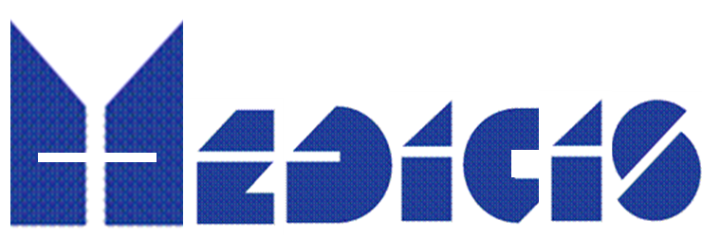
PRISMAP NEWS
13 MEDICIS Board
Thierry Stora, CERN
11 Dec 2024

Slide 2
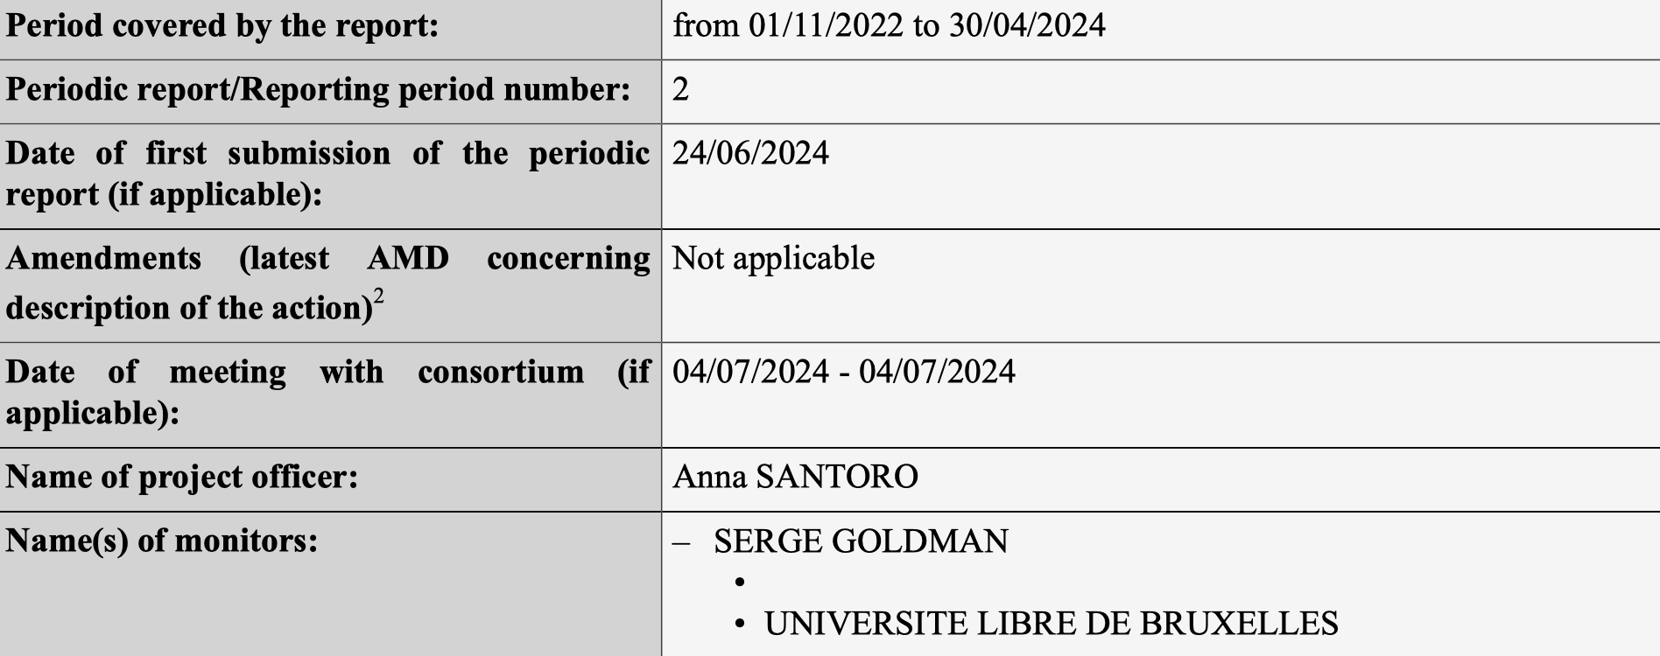
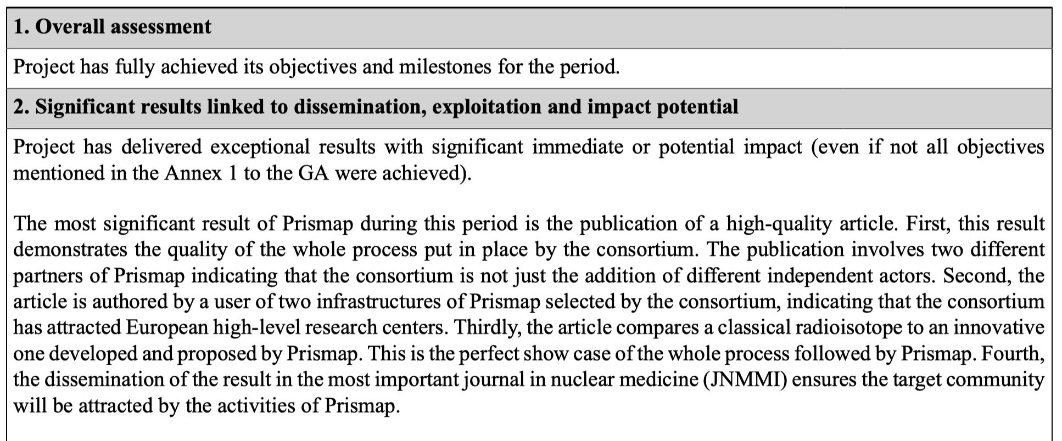
Outcome of 2nd review 4 July

Slide 3
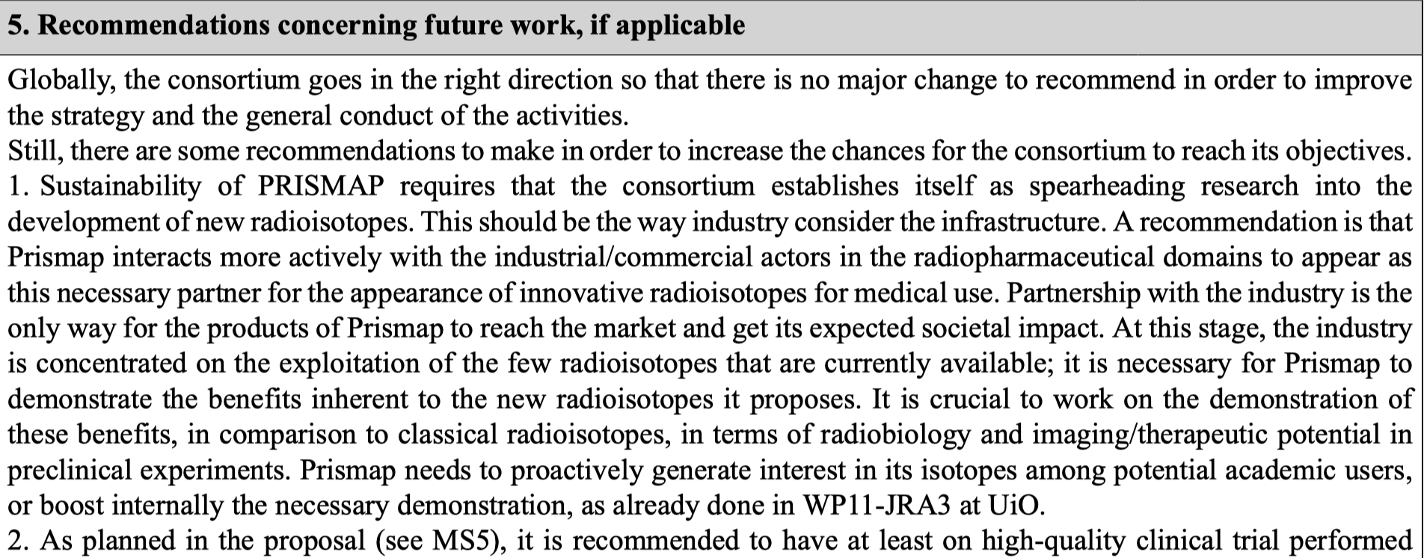
Outcome of 2nd review 4 July - Recommandation

Slide 4
Projects highlighted
Only 2 projects are aiming to get translated to the clinical phase :
P4 and P21 / stay tuned : reports will be provided this morning in the context of MED-032 (PRISMAP - P23 project):
  203/212Pb-mcp-D-PSMA for an improved tumor therapy: Preclinical evaluation, automatization and translation to clinical application and

Slide 5
PRISMAP objectives
Provide access to new radionuclides and new purity grades for medical research
Ongoing
Create a common entry port and web interface for the starting research community
Ongoing
Enhance clarity and regulatory procedures to promote research with radiopharmaceuticals
Ongoing
Unlock the biomedical research through better data on radionuclides
Ongoing
Ensure the long-term sustainability of PRISMAP (PRISMAP-PLUS)
Started (CM5, exec summary, ERVI stakeholder meeting, policy input)

Slide 6
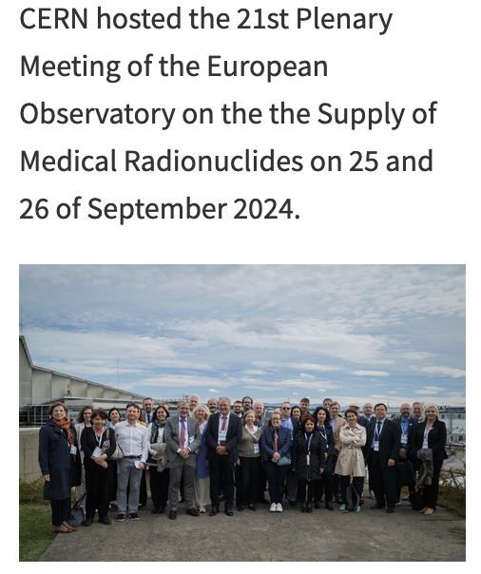
PRISMAP + announced as a targeted call in INFRADEV-20215-1 !
Announced by our Project Officer at CERN on 25 Sept:
Call open 1st May 2025 – Subm. Sept 2025
Prep meeting held in Nantes :
55 participants
5 Mi Euro overall budget
https://indico.cern.ch/event/1438450/
Intended to (slightly) extend the scope (geographical and thematic nodes,
and geographical cover)
2 emerging facilities made their 1st radionuclides : SPIRAL 2, SPES
Launch a Marie Curie ITN InnoMedRab – lead prof Cocolios
Involved in the ERVI process driven by DG-ENER:
Aiming at a high level committee which will discuss the follow-up of PRISMAP +
in the next multiannual Financial Framework (MFF) 2028-2034

