Slide 1


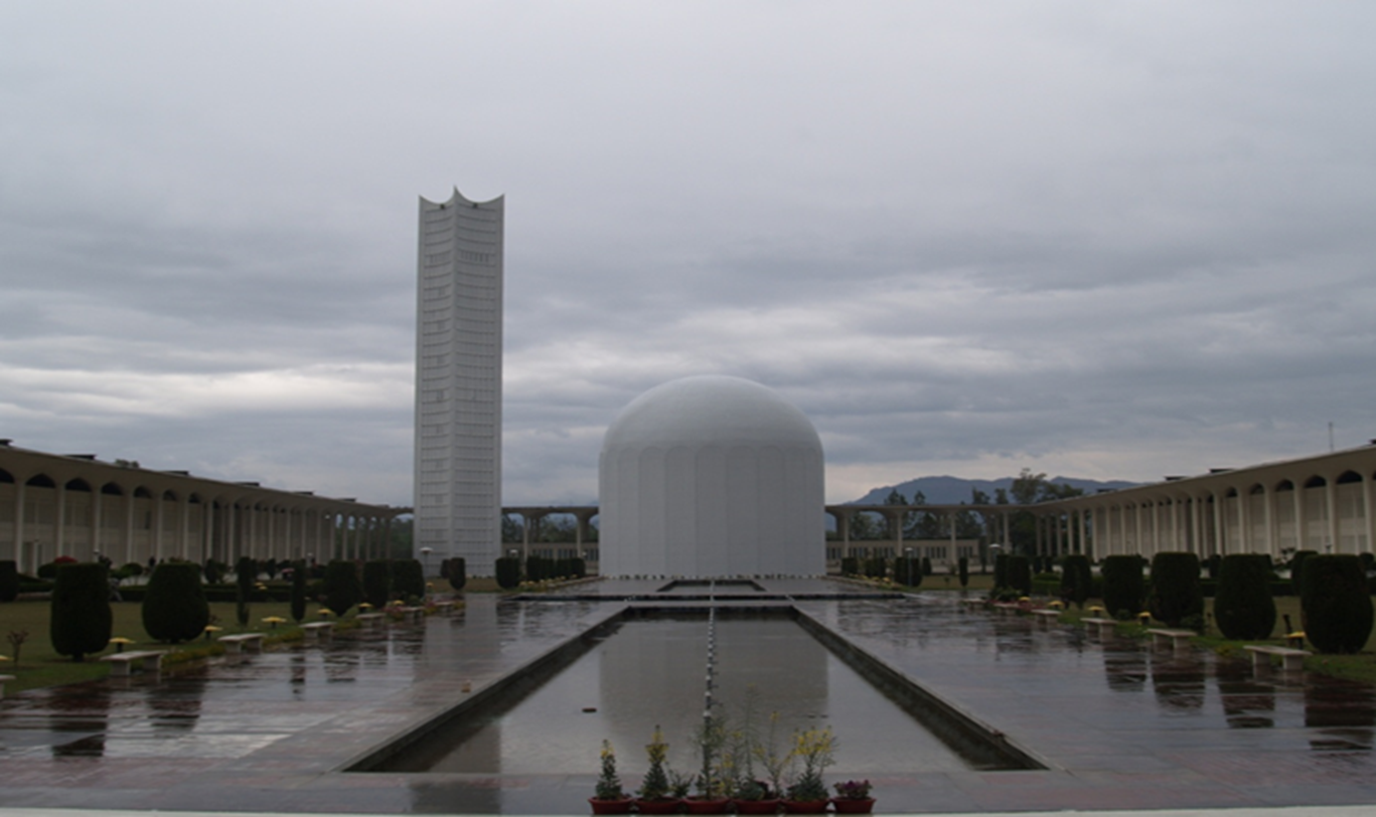

Clinical and Pre-clinical Evaluation of
Ac-225 Labeled Biomolecules for
Targeted Alpha Therapy(TAT)
Shakera Khatoon Rizvi
Research Coordinator
IPD, PINSTECH

Slide 2
Content
Overview of PINSTECH facility
PAEC(PINSTECH)- MEDICIS collaboration Introduction of Modern Radioligand Therapies
Objectives of the project
Clinical Transformation of Ac-225
  Methodology
  Results
  Future Work
Targeted Therapy with Tb-161

Slide 3

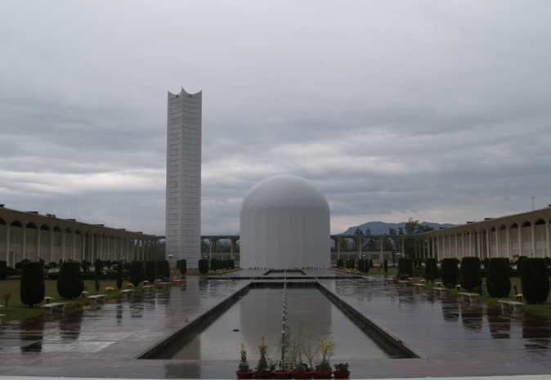
PAEC- PINSTECH
Our research reactor PARR-I at PINSTECH is the central facility to provide radiopharmaceuticals to all the public sector and private hospitals in the country
Mo-99m Production facility
^{99m}Mo/Tc99m Generator
I-131 production
GMP facility for production of cold kits
Established Quality Control Labs
  Gamma Spectrometry
  Alpha& Beta spectrometry
  Radio HPLC
  ITLC
  ICP-MS
Animal House

Slide 4
PINSTECH-MEDICIS Collaboration
  Radionuclide Production
    Cyclotron Production
    Reactor Production
  Radiochemistry
    Strong collaboration
    Mr. Irfan Tariq
  Clinical Transformation of Radionuclides
    GMP Production of Radiopharmaceuticals
      Radiolabeling of Radionuclides with Bio- molecules
      Quality Control
    Preclinical Studies
    Clinical Trials

Slide 5
Introduction
Cancer Research Advances
Decades of research have resulted into the development of theranostics
Integration of therapeutics and diagnostics in a single management approach
Diagnosis
Theranostic
Treatment
Single compound is used for a variety of applications in patient-centered care radiolabeled with different radionuclide
Theranostic Radiopharmaceuticals
Peptide Receptor Radionuclide Therapy (clinical success)
binding SSTRs, which are expressed on the cell surface of the tumor cell, followed by internalization of the radionuclide-peptide complex

Slide 6

Theranostic Radiopharmaceutical
Treatment monitoring
Treatment prognosis
Image guided
treatment planning
Imaging
Theranostic
⁶⁸Ga
68 min
Components
¹⁶¹Tb
6.9 d
1. Radionuclides
Short half lives
Higher diagnostic efficiencies
¹⁷⁷Lu
6.7 d
⁴⁴Sc
4.0 h
  2. CHELATOR
⁹⁰Y
2.7 d
3. Targeting vector
Radiochemistry
⁶¹Cu
3.3 h
²²⁵Ac
10 d
Longer half lives
Therapeutic potential
Lesser amount of pharmaceutical Maximum Therapeutic outcome

Slide 7
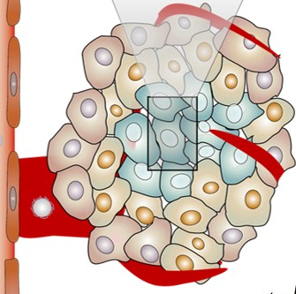
Clinical Transformation of Radionuclides
Targeted Radioligand Therapies
Radio Nuclide
  Production
  High specific Activity
  Purification
Radiopharmaceutical
  Targeted
  Stability in Vivo
  Retention Time
Oncological vector
    Overexpressed Receptors (SSTR,CD44 etc)
    Antibodies
    FAPI
  Targeting Systems
      Active
      Passive
Mix of Chemistry, Biology & Physics can help
Tumor Core
MDR
Hypoxia
Tumor Stroma
Receptors
Micro environment
Protiens,
pH,
EPR

Slide 8
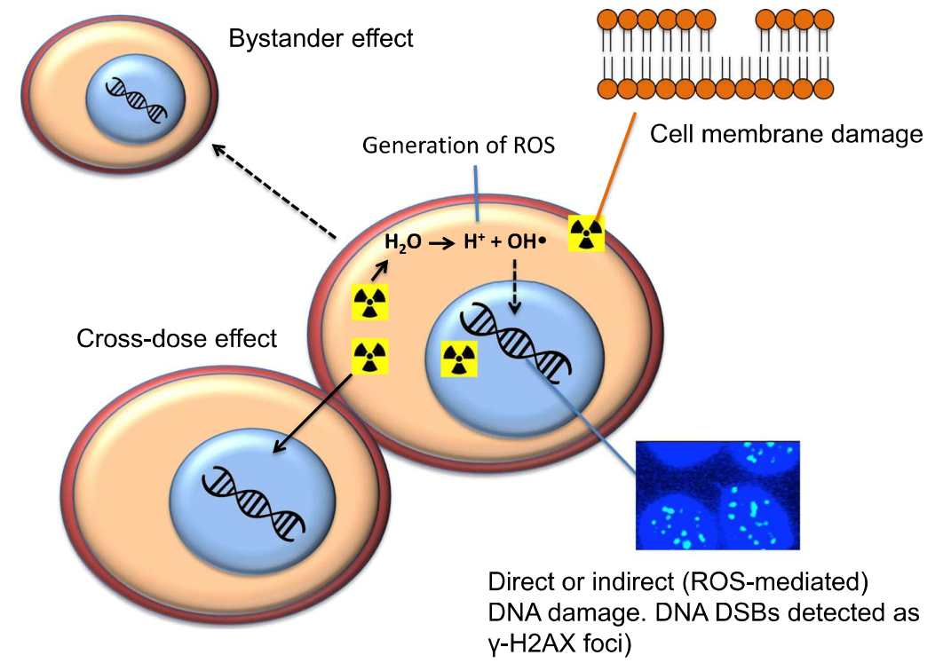
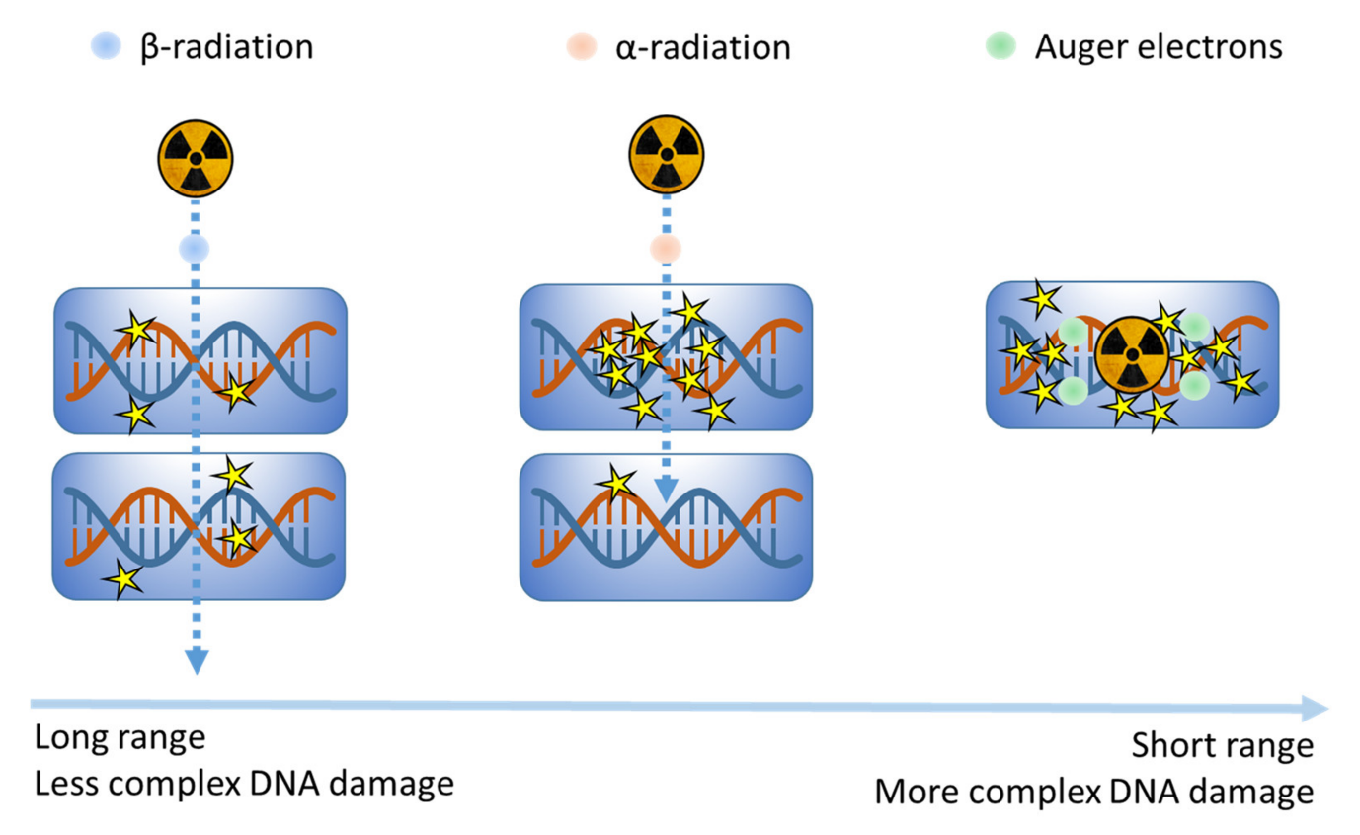
Targeted Alpha& Beta Therapies
Ku et al. EJNMMI Radiopharmacy and Chemistry (2019)
Cancers 2020, 12(8), 2098; https://doi.org/10.3390/cancers12082098
DNA is considered the main target for causing radiation-induced cell death and indeed, the greater the unrepaired DNA damage the higher the incidence of lethality
Notes:
AEs may cause DNA double-strand breaks (DSBs) by a direct effect or through an indirect effect mediated by free radicals due to interaction with water molecules.
AEs may also cause cell membrane damage leading to cell death.
There is a localised short-range “cross-dose” effect of AEs on cancer cells which are directly adjacent to targeted cells, and a longer range “bystander” effect on more distant cells

Slide 9
PRRT in Pakistan
¹⁷⁷Lu-DOTATATE for single patient dose has been optimized
with radionuchemical purity of 98 ± 2% at pH 5 with 2M acetate
buffer and 55mg of gensitic acid.
Ppetide content varied from 250-300µg depending on the specific activity.
Radiolabelling carried out by heating the mixture at 90ºC for 30minutes
50mg of Ascorbic Acid to avoid radiolysis
Total volume of the 740MBq dose is optimized at 2ml for dispensing at hospital pharmacy

Slide 10
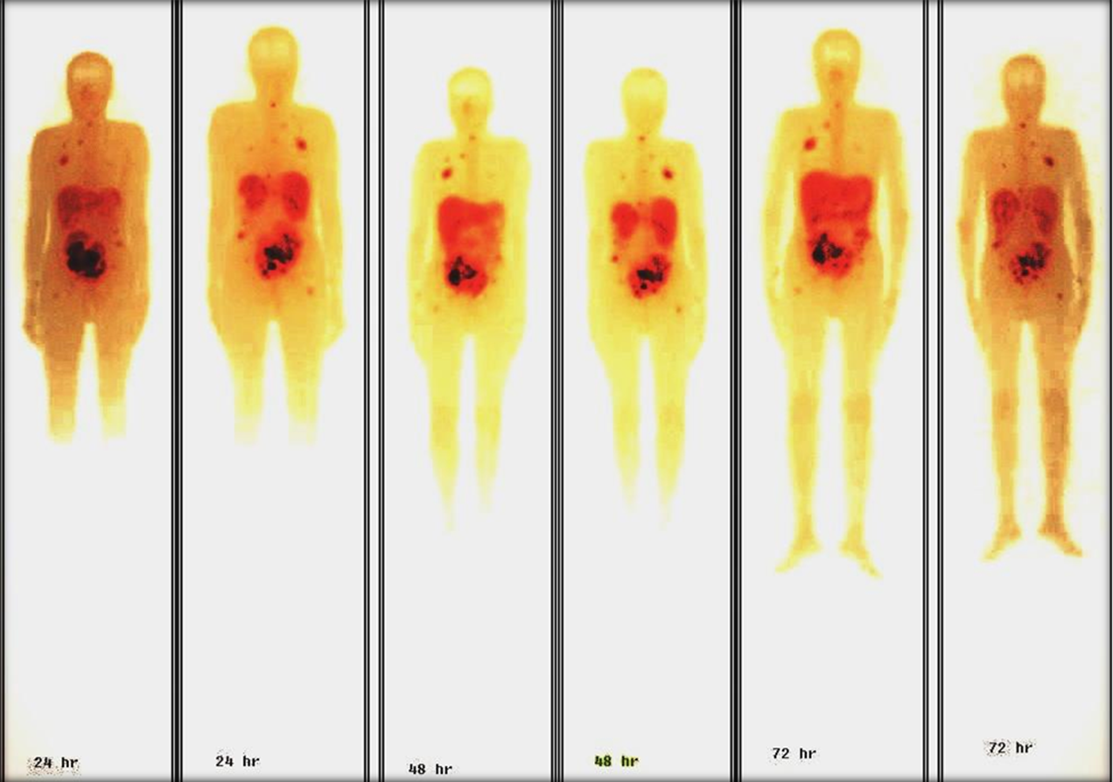
Theranostic radiopharmaceuticals in Pakistan
Development of theranostics pharmaceuticals started in 2017 with start of 1st national project for production of ¹⁷⁷Lu-DOTATATE for treatment of neuroendocrine tumors
Registered Product of PINTHERA [¹⁷⁷Lu][Lu-DOTATAE] & [¹⁷⁷Lu][Lu-PSMA]
More than 100 doses have been delivered to patients
180mCi ¹⁷⁷Lu-DOTATATE on 7/03/2020

Slide 11

Targeted Alpha Therapy
Clinical Transformation of AC-225

Slide 12
Objectives
Development and Optimization of Ac-225 Radiopharmaceuticals for targeting specific oncological targets.
Evaluate the stability, radiochemical purity and biological efficacy of Ac-225 labeled pharmaceuticals in vitro.
Preclinical Evaluation to assess bio distribution, pharmacokinetics, and therapeutic efficacy in animal models.
Determine the maximum tolerated dose (MTD) and dose-limiting toxicities (DLTs).
Clinical trials to evaluate safety, dosimetry, and preliminary efficacy in patients.

Slide 13
Ac-225 Pharmaceuticals
Decay cascade of six daughter Progeny
Substantial amount of energy
  Alpha & Beta combined
High Linear Energy Transfer
Suitable for micrometastasis
Lower radionuclide doses
Recurrence of resistant disease after treatment with β- emitter like Lu-177
²²⁵_{Ac}
10d
⁻ Emission Therapeutic | 4 α-particle per decay, 6MeV, 7Mev,6Mev, 3β⁻ 659 keV, 198 keV, 444 keV,
γ Emissions SPECT Imaging | 218.0 keV, 440 KeV,

Slide 14

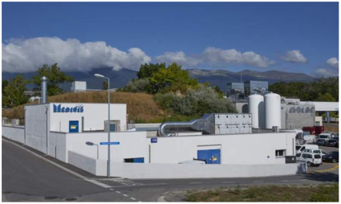


Production of Ac-225
Source Received at IPD
Ra-225 source
Chemical Separation
GMP Facility available
Purified
Ac-225 Source
Quality Control &
use for radiolabelling

Slide 15
[²²⁵Ac][Ac-Pharmaceutical] Production
Radiolabeling of Ac-225
In-vitro Studies
Stability Studies
Quality Control
Preclinical Studies
In-vivo
Clinical Studies
DOTATATE, DOTA-PSMA, FAPI, Hyaluronic Acid
PAEC Nuclear Medicine Hospitals
Cytotoxicity
Biodistribution
Dose Estimations

Slide 16
Results
Quality Control of Ac-225 Received from MEDICIS-CERN
Radionuclide Purity
Gamma spectrometry
Ac-225 eluted from Ra-225/AC-225 Generator at PINSTECH
Nuclide | Energy (KeV) | Gamma Abundance (%) | Efficiency | Activity (Bq) | Error
²²¹Fr | 218.12 | 11.4 | 0.76 | 4.02E+108 | 2.57E+112
²¹³Bi | 440.5 | 25.94 | 0.42 | 2.69E+72 | 1.33E+73
²²⁵Ac | 99.8 | 1.0 | 1.13 | 36468 | 4574
²²⁵Ac | 150.1 | 0.6 | 0.97 | 27016 | 3325
²²⁵Ac | 157.3 | 0.32 | 0.94 | 24174 | 4701
²²⁵Ac | 188 | 0.45 | 0.85 | 28611 | 1320
²²⁵Ra | 40 | 30 | 0.92 | 19 | 4

Slide 17
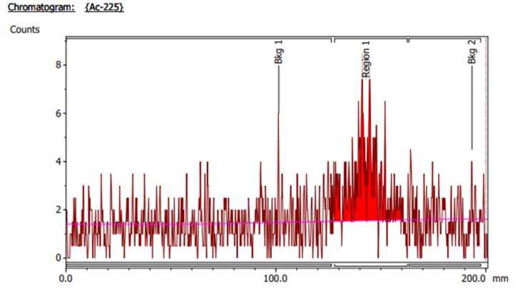
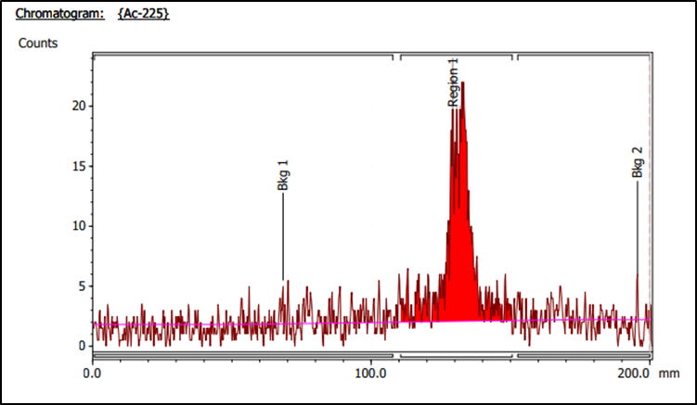
Radiochemical Purity
ITLC
ITLC-SG Chromatogram of Ac-225
Solvent: 0.1M Citrate Buffer, pH 5
Solvent: Aqueous Acetonitrile
Rf = 0.8 - 1

Slide 18
Preparation of [²²⁵Ac][Ac-DOTATATE]
Optimized conditions for preparation of [²²⁵Ac][Ac-DOTATATE] with
RCP >95%
30 KBq of Ac-225 in 100µl of 0.1M HCl
200µg of DOTA-TATE
2ml of Tris buffer pH 6.8
1M Sodium Ascorbate 100µl
Heating time: 120 minutes at 95ºC

Slide 19
Future Works
In Vitro studies
In vivo preclinical studies
Clinical Trial for TAT of neuroendocrine patients

Slide 20
Tb-Phramaceuticals
₆₅Tb
6.9 d
β⁻ Emission Therapeutic | E_{av.}154 KeV
γ Emissions SPECT Imaging | 25.65 (23%),48.91 (17%), 74.56 (10%)
Electron energies | ~ 12.4 e−, 46.5 keV per decay
161
155
γ
Tb
65
5.32 d
SPECT Imaging
Tb has four medically relevant isotopes, covering all major nuclear medicine modalities
Enable theranostics with chemically identical radiopharmaceuticals.
¹⁵⁵Tb and ¹⁶¹Tb may be more available

Slide 21
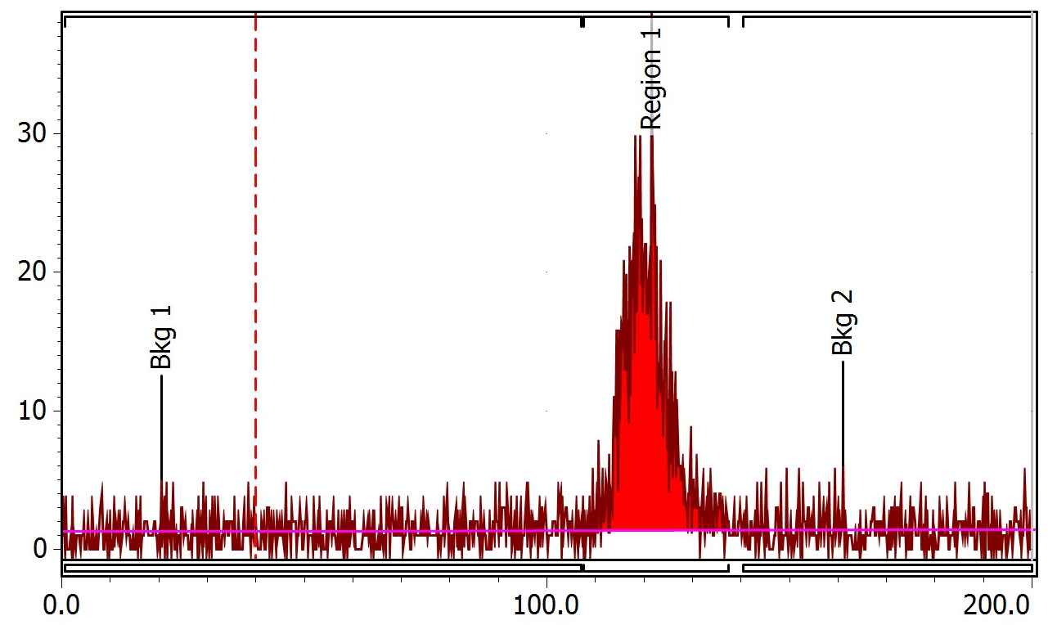
Quality Control [Radiochemical Purity Tb-161]
Radio Thin Layer Chromatogram of ¹⁶¹TbCl₃
Radiochemical purity of the ¹⁶¹TbCl₃ solution was determined through Radio Instant Thin layer Chromatography
Rf 0.8
Radiochemical purity achieved > 99%
The absence of the R_{f} 0 fraction
No species of Tb forming colloids in Solution
Only ¹⁶¹Tb³⁺ in the final product making complex with citrate
Counts [C/mm]
Position [mm]
Solvent System: 0.1 M sodium citrate (pH 5)

Slide 22
Thank You

