Slide 1
SVT geometry and integration issues
Georg Viehhauser

Slide 2
Introduction
Jim Curtis (LBNL) has started to import IB and OB geometries into a large SVT model
  Adam has provided input to this – first indirectly, but now directly
  Current input cleared with James, so that numbers are consistent
This model still has a support cone structure made of spokes
  But I think that LBNL finally got the message that the real challenge is the supply of air, and that once you sorted that, there is no need for much further support structure
    They will implement this now
Jim got a little excited about interferences early on, which was not useful, as he got other people excited…
  Some of those got cleaned up with our updated OB version, and IB service interferences were only caused because the Italians didn’t know where there envelopes ends
However, it is clear that the L3 stave end area, where also the first disk ends will be extremely tricky
L4 appears to look a bit more manageable, although we do not have services in (which will be 4 times as many…)
This will be the next thing to tackle
  Eric is now taking this serious enough that we are planning to have bi-weekly meetings on this (haven’t heard about a confirmation for this week yet…)

Slide 3
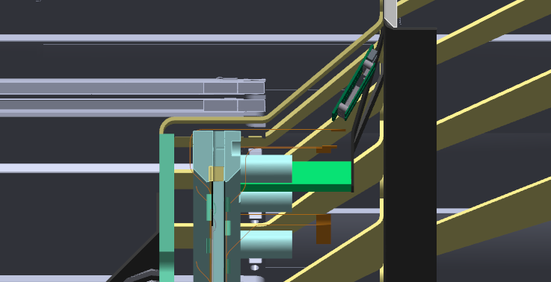
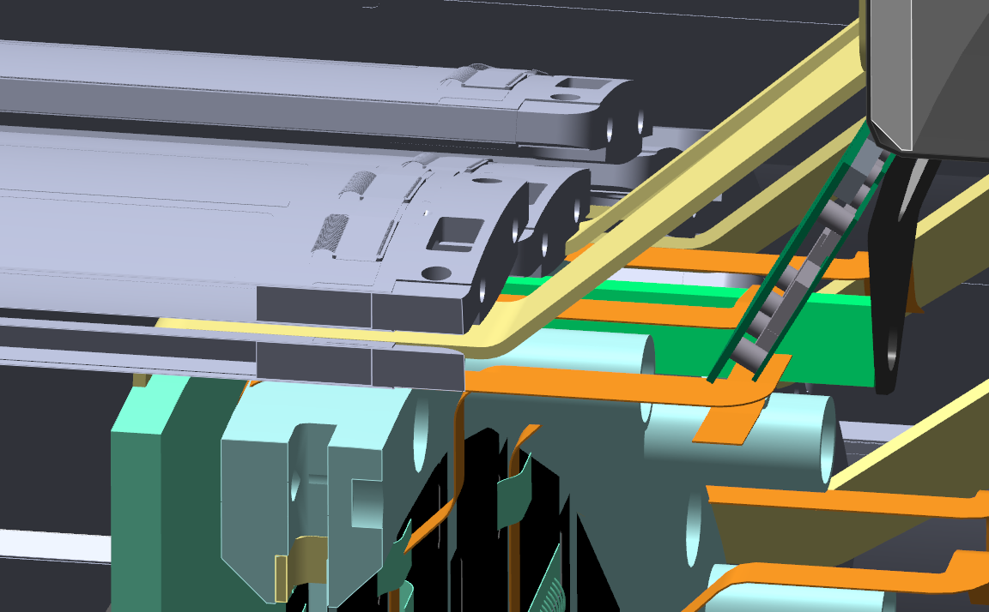
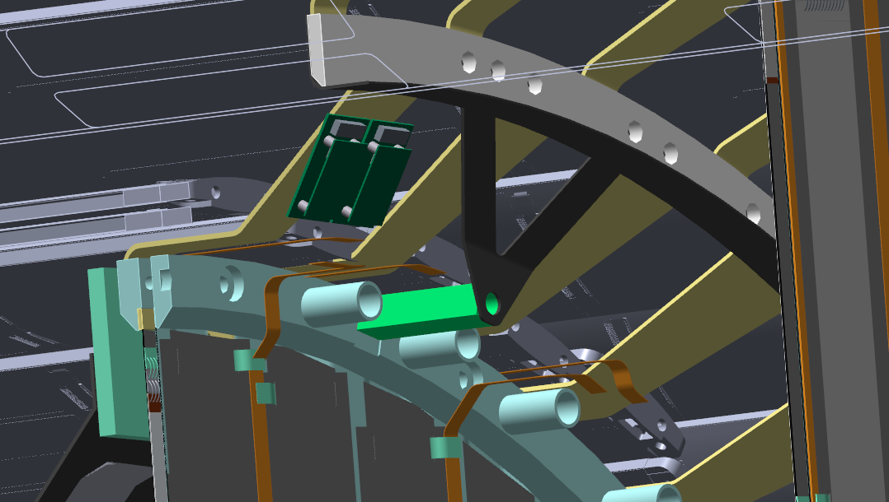
L3
L3 stave
L3 staves
D0 disk
Flange for
IB support
This stave model has the current end plug (~10 mm)
Support cones (spokes) not yet optimized
No detail on stave support and coupling of air channel
This support cone geometry does not work well for stave installation (would have to fiddle stave to behind the cylindrical section
RDOs

Slide 4
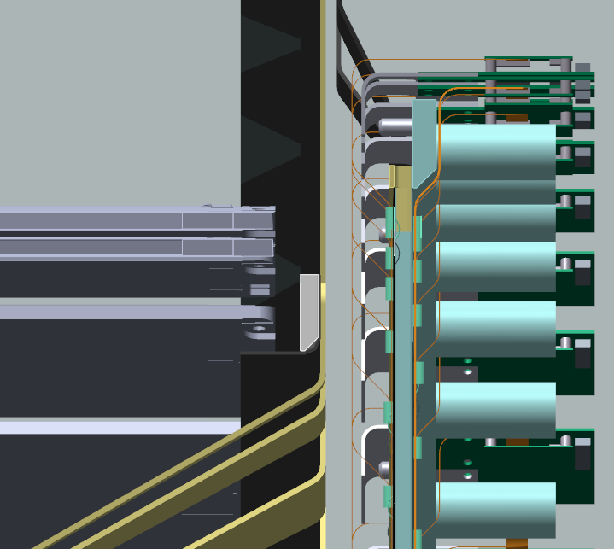
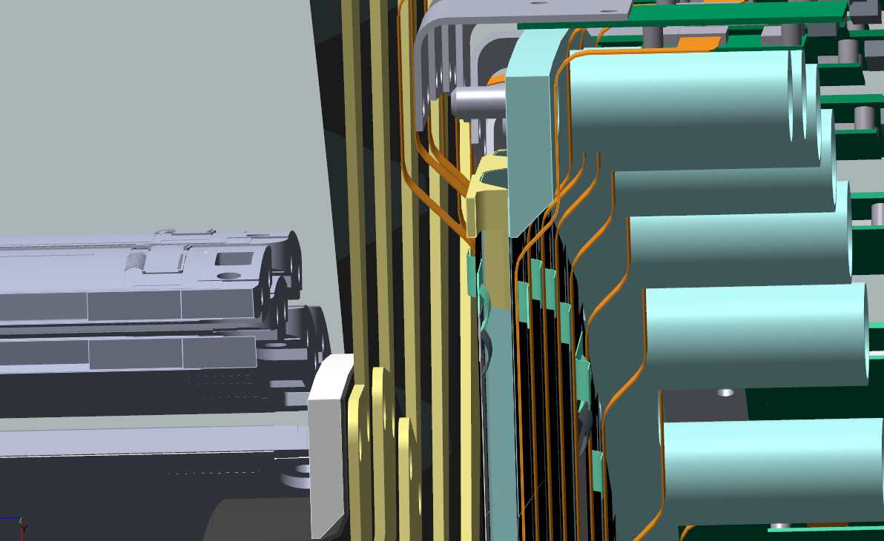
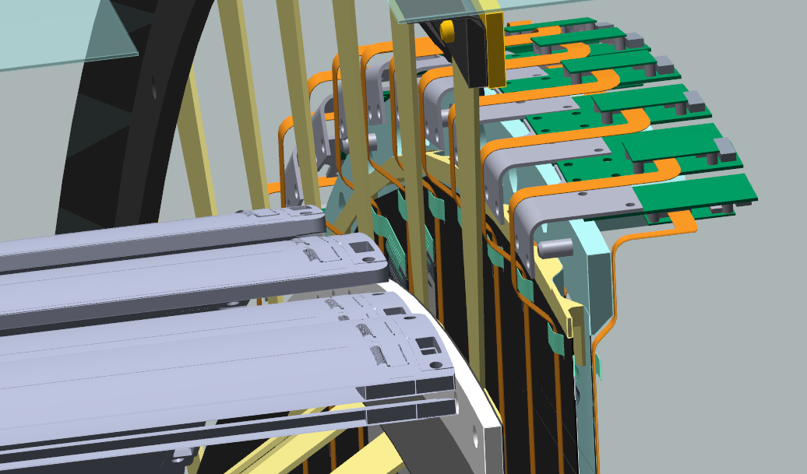
L4
D1 disk
L4 stave
It appears that L4 staves end well before D1
  Seems to be a comfortable amount of space
But, no airchannels, FPCs & RDOs in the model yet

