Slide 1
Spectra Logic User Group meeting – Welcome
Logistics:
  Emergency instructions
  Toilets
  Coffee breaks
  Lunch
  Parallel session in building 513
  Data Center tour

Slide 2
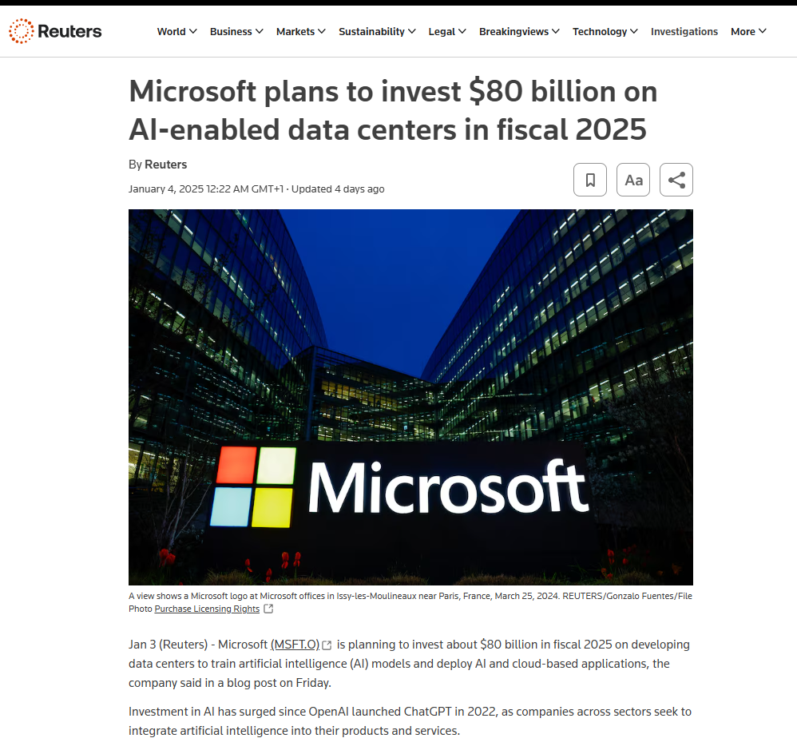
Spectra Logic User Group meeting – Why?
Source: Physical Tape Trends & IBM Market Position, Carlos Sandoval (IBM WW Physical Tape Product Manager), 6 June 2023

Slide 3
Spectra Logic User Group meeting – Who is here?
Purpose of the Introductions
Notes:
This is only a one day meeting so it is important similar customers quickly = who might have similar problems like me and what solutions they are looking at?

Slide 4
Company / Institute Name
Market Segment (e.g. research, financial, telecom, etc.)
Company / Institute
logo here
Person name

Slide 5
Installation overview
Data:
  Total amount: ? PB
  Expected annual growth: ? PB/year
Spectra Logic Hardware:
  Number and type of tape libraries: ? (e.g. 1 x TFinity, 2 x T950, etc.)
  Number and type of tape drives: ? (e.g. 20 x LTOx, 10 x IBM TS11x0, etc.)
  Tape cartridge slots in total: ?
  Other hardware: ?
Management software:
  Disk: ? (e.g.: Lustre, Ceph, etc)
  Tape: ? (e.g.: HPSS, Veeam, etc)
Notes:
Guidelines:
for DATA – consider total data stored at your site
for HARDWARE – consider only Spectra Logic related hardware
For SOFTWARE – consider the most important component to manage the data, but mention Spectra Logic product if used

Slide 6

CERN research
Vladimír Bahyl

Slide 7
Installation overview
Data:
  Total amount: 800 PB
  Expected annual growth: up to 300 PB/year
Spectra Logic Hardware:
  Number and type of tape libraries: 2 x TFinity, 1 x TFinity Plus
  Number and type of tape drives: 60 x LTO9
  Tape cartridge slots in total: 3 x 15000
Management software:
  Disk: EOS
  Tape: CTA (CERN Tape Archive)
Notes:
Guidelines:
for DATA – consider total data stored at your site
for HARDWARE – consider only Spectra Logic related hardware
For SOFTWARE – consider the most important component to manage the data, but mention Spectra Logic product if used

Slide 8

KIT / SCC education
Martin Beitzinger

Slide 9
Installation overview
Data:
  Total amount: 123 PB
  Expected annual growth: 25 PB/year
Spectra Logic Hardware:
  Number and type of tape libraries: 1 x TFinity
  Number and type of tape drives: 48 x IBM TS1160
  Tape cartridge slots in total: 11000
Management software:
  Disk: GPFS + dCache / xrootd
  Tape: HPSS
Notes:
Guidelines:
for DATA – consider total data stored at your site
for HARDWARE – consider only Spectra Logic related hardware
For SOFTWARE – consider the most important component to manage the data, but mention Spectra Logic product if used

Slide 10

IN2P3 Computing Centre research
Pierre-Emmanuel Brinette

Slide 11
Installation overview
Data:
  Total amount: 200 PB
  Expected annual growth: 60 PB/year
Spectra Logic Hardware:
  Number and type of tape libraries: 2 x TFinity Plus
  Number and type of tape drives: 2 x 48 IBM TS1160
  Tape cartridge slots in total: 2 x 6750
Management software:
  Disk: dCache / XRootD / iRODS / CEPH
  Tape: HPSS
Notes:
Guidelines:
for DATA – consider total data stored at your site
for HARDWARE – consider only Spectra Logic related hardware
For SOFTWARE – consider the most important component to manage the data, but mention Spectra Logic product if used

Slide 12

DKRZ research
Carsten Schmitt

Slide 13
Installation overview
Data:
  Total amount: 207 PB
  Expected annual growth: 25 PB/year
Spectra Logic Hardware:
  Number and type of tape libraries: 3 x TFinity, 1 x Cube
  Number and type of tape drives: 62 x LTO8, 6 x LTO9
  Tape cartridge slots in total: 34570
Management software:
  Disk: Stronglink
  Tape: Stronglink
Notes:
Guidelines:
for DATA – consider total data stored at your site
for HARDWARE – consider only Spectra Logic related hardware
For SOFTWARE – consider the most important component to manage the data, but mention Spectra Logic product if used

Slide 14

STFC – Rutherford Appleton Laboratory research
Tim Folkes
George Patargias

Slide 15
Installation overview
Data:
  Total amount: >320 PB
  Expected annual growth: >50 PB/year
Spectra Logic Hardware:
  Number and type of tape libraries: 2 x TFinity
  Number and type of tape drives: 17 x LTO8, 24 x LTO9, 42 x IBM TS1160,
  26 x IBM TS1170
  Tape cartridge slots in total: 14000 + 11800
Management software:
  Disk: Ceph
  Tape: CTA (CERN Tape Archive) & DMF
Notes:
Guidelines:
for DATA – consider total data stored at your site
for HARDWARE – consider only Spectra Logic related hardware
For SOFTWARE – consider the most important component to manage the data, but mention Spectra Logic product if used

Slide 16

ZDF TV media & entertainment
Marcus Dörhöfer
Jens Naffziger

Slide 17
Installation overview
Data:
  Total amount: 40 PB
  Expected annual growth: 1.8 PB/year
Spectra Logic Hardware:
  Number and type of tape libraries: 2 x TFinity
  Number and type of tape drives: 6 x LTO9, 34 x LTO7
  Tape cartridge slots in total: 2 x 5000 (1000 x LTO9 , 4000 x LTO7)
Management software:
  Disk: Telestream DIVA
  Tape: Telestream DIVA
Notes:
Guidelines:
for DATA – consider total data stored at your site
for HARDWARE – consider only Spectra Logic related hardware
For SOFTWARE – consider the most important component to manage the data, but mention Spectra Logic product if used

Slide 18
ECMWF weather forecast
Miguel Molowny

Slide 19
Installation overview
Data:
  Total amount: 1300 PB
  Expected annual growth: 250-300 PB/year
Spectra Logic Hardware:
  Number and type of tape libraries: 1 x TFinity
  Number and type of tape drives: 60 x IBM TS1160
  Tape cartridge slots in total: 4000
Management software:
  Disk: FC Disk 45 PB + Ceph 20 PB
  Tape: HPSS + P5
Notes:
Guidelines:
for DATA – consider total data stored at your site
for HARDWARE – consider only Spectra Logic related hardware
For SOFTWARE – consider the most important component to manage the data, but mention Spectra Logic product if used

Slide 20

European Synchrotron Radiation Facility research
Aidan Campbell

Slide 21
Installation overview
Data:
  Total amount: 50 PB
  Expected annual growth: 25 PB/year
Spectra Logic Hardware:
  Number and type of tape libraries: 2 x TFinity
  Number and type of tape drives: 56 x LTO9, 18 x LTO8
  Tape cartridge slots in total: 2 x 10000
  Other hardware: 4 x BlackPearl
Management software:
  Tape: Mediaflux, Atempo Time Navigator
Notes:
Guidelines:
for DATA – consider total data stored at your site
for HARDWARE – consider only Spectra Logic related hardware
For SOFTWARE – consider the most important component to manage the data, but mention Spectra Logic product if used

Slide 22

Friedrich Miescher Institute research
Stefan Grzybek

Slide 23
Installation overview
Data:
  Total amount: 12 PB
  Expected annual growth: 1.5 PB/year
Spectra Logic Hardware:
  Number and type of tape libraries: 2 x T950
  Number and type of tape drives: 5 x LTO7
  Tape cartridge slots in total: 800 + 850
Management software:
  Disk: SAM-QFS / SAN-Storage
  Tape: SAM-QFS
Notes:
Guidelines:
for DATA – consider total data stored at your site
for HARDWARE – consider only Spectra Logic related hardware
For SOFTWARE – consider the most important component to manage the data, but mention Spectra Logic product if used

Slide 24

CSCS / ETHZ research & education
?

Slide 25
Installation overview
Data:
  Total amount: ~40 PB
  Expected annual growth: ? TB/year
Spectra Logic Hardware:
  Number and type of tape libraries: 1 x TFinity
  Number and type of tape drives: 48 x LTO9
  Tape cartridge slots in total: 3550
  Other hardware: BlackPearl, SWARM Bridge (iSCSI)
Management software:
  Disk: Lustre, Ceph, NFS
  Tape: DMF, S3 (via BP)
Notes:
Guidelines:
for DATA – consider total data stored at your site
for HARDWARE – consider only Spectra Logic related hardware
For SOFTWARE – consider the most important component to manage the data, but mention Spectra Logic product if used

Slide 26
Summary
Amount of data: >3 EB
Expected annual growth: ~800 PB/year
Tape libraries: 20
Number of slots: ~170 000
Tape drives:

