Slide 1
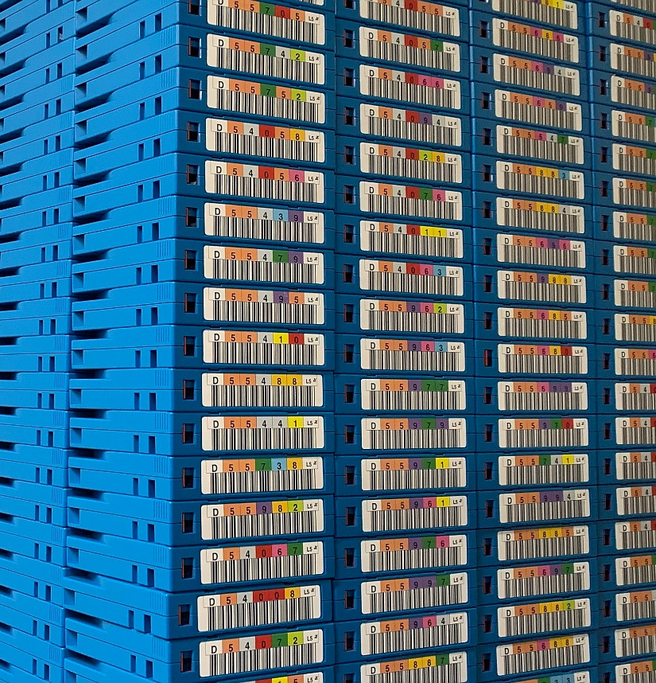
The Backbone of Data Management: Mediaflux and Spectra Logic at ESRF

Slide 2
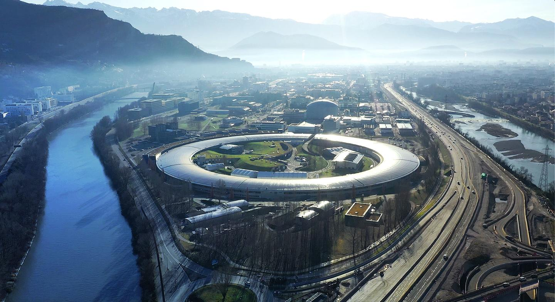
European Synchrotron Radiation Facility

Slide 3

ESRF at a Glance
Global Collaboration
An international collaboration of 22 partners
10,000 + visiting researchers every year
State-of-the-Art Technology
The Extremely Brilliant Source (EBS): 4th-generation synchrotron
Capable of nanometer-scale resolution
Scientific Impact
51 instruments enabling over 150 techniques
Facilitates 2,000+ experiments annually
Diverse scientific community: energy, materials, biology, health, cultural heritage

Slide 4
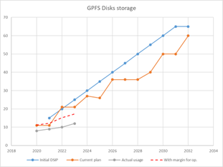
Data Production at ESRF: Insights and Infrastructure
Vast Data Volumes:
Data production is growing year-on-year, with ~13 PB estimated to be archived in 2024
Beamline and Technique Dependency:
Data volume varies significantly depending on beamline and experimental technique
Depends on detectors, sample size and processing software
GPFS Storage System:
Total capacity: ~25 PB of storage
Year | Data Archived (PB)
2024 | 21.2
2023 | 15.4
2022 | 11.8
2021 | 5
Year | Data Archived (PB)
2024 | ~13 (estimated)
2023 | 7.8
2022 | 6.5
2021 | 3.9

Slide 5
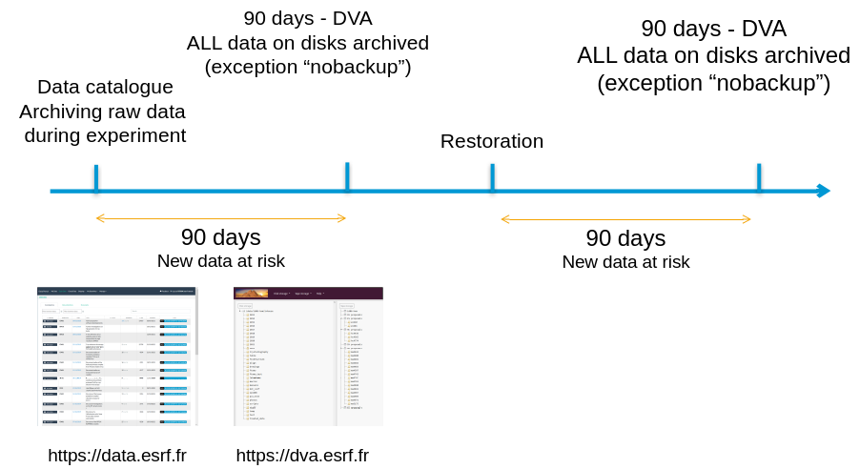
Challenges with Legacy Archiving Systems
DVA - Experimental Data Archiving
Bacula + custom Python code and databases
Dependency on custom Python scripts
Data isn’t written to tape until 90 days after experiment
Unable to restore single file

Slide 6


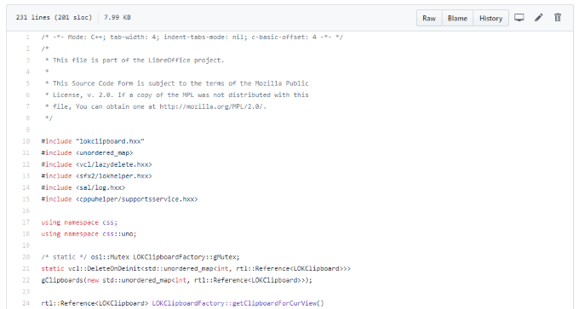


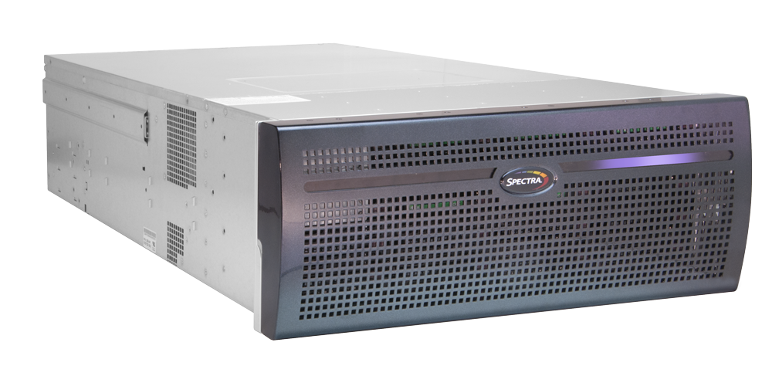
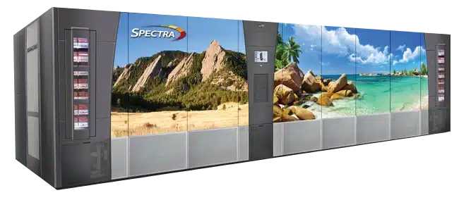
M@E: The Backbone of ESRF Data Management
M@E: Mediaflux @ ESRF

Slide 7
M@E: Mediaflux @ ESRF
Mediaflux handles backup of all main storage data
Backups done every few days
Backups duplicated in both tape libraries (2 data centers)
Mediaflux handles archiving of experiment data
Archiving = freezing last backup + delete data from disk
Archives can be restored, modified, and re-archived – all versions are kept in the archive
Mediaflux handles metadata on stored assets (files/directories)
Metadata definition is open to ESRF (defined by a document – several data types available)
Metadata can be used to select assets in backups/archives
Mediaflux is extensible by ESRF and can be tailored to ESRF needs
Concept of plugins (written in Java) – API available to interface with other components

Slide 8
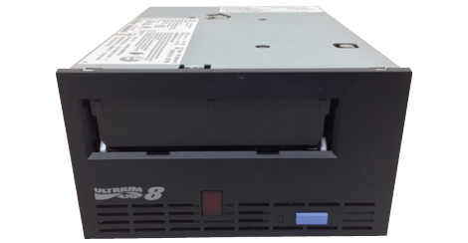
M@E Hardware Infrastructure
Mediaflux software
Disk storage
SpectraLogic BlackPearl object storage
& tape library gateways
SpectraLogic T-Finity
tape libraries
& drives

Slide 9
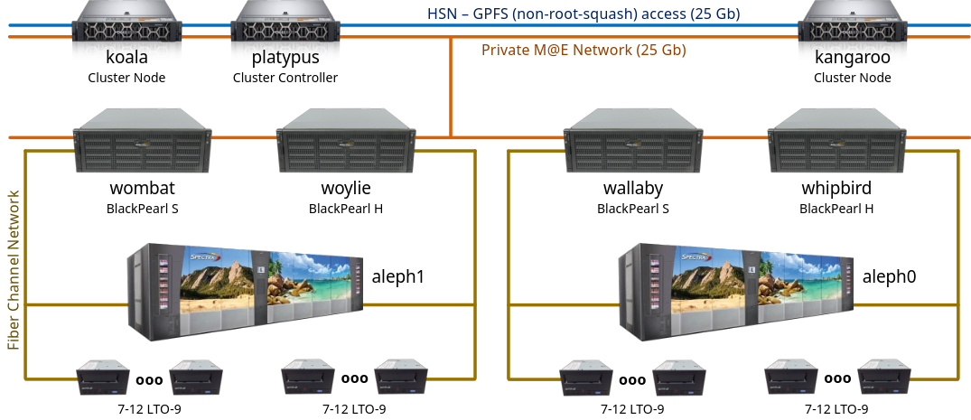
M@E Hardware Components

Slide 10
Changes Introduced by M@E
All experimental data is secured to tape soon after its production
Delay between disk write and tape backup is yet to be defined…
The goal is to secure data within less than one week, targeting 3 days
Future improvement: implement mechanisms to detect and secure raw data more quickly?
Optimisation of the overall data flow
Data is read only once from disk storage system (single-read-multi-write backup)
Archiving becomes almost instantaneous – disk storage resources are freed up more quickly
Partial restorations will reduce needs for disk storage resources
It will be possible to have differentiated retention periods (per beamline…)

Slide 11
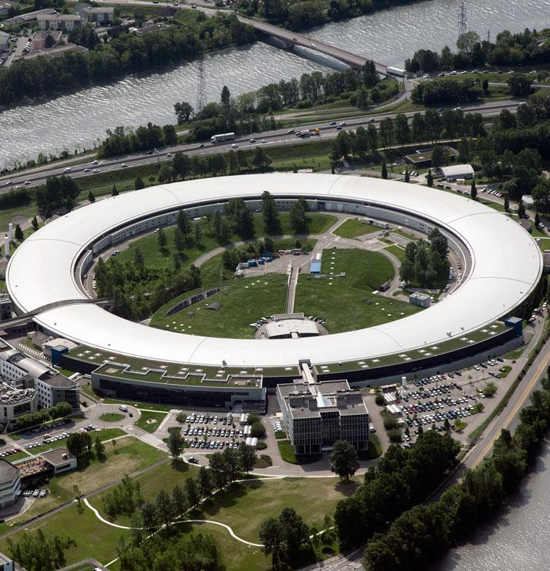
European Synchrotron Radiation Facility
Most Difficult Challenge ?
Large number of small files

Slide 12
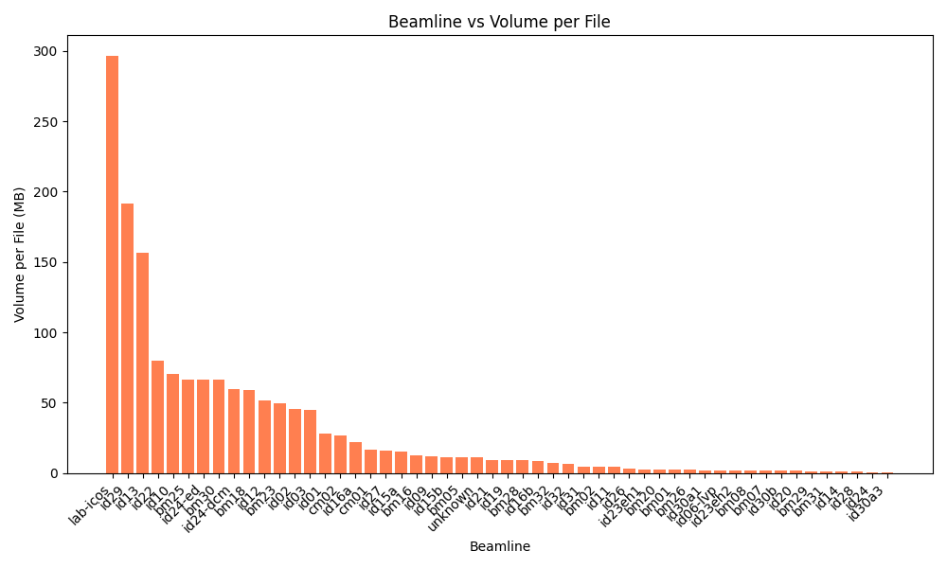
Overcoming the Challenge of Small Files at Scale
Problem
High Volume of Small Files
  Average file size: 13MB
  Worst case experiment: 77M files totaling 9.5TB
Impact
Data ingestion and processing bottlenecks
Unable to backup data faster than production
Solution
Aggregation - Consolidating small files into larger objects
  Initially 6M files/day, later 48M files/day

Slide 13
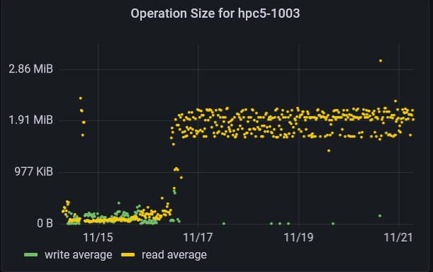
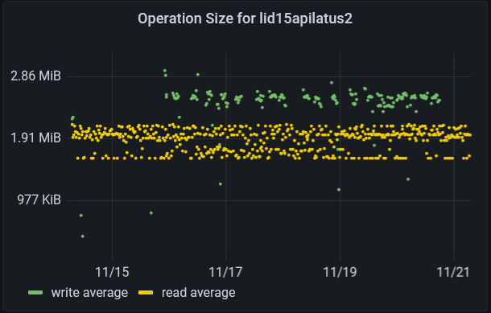
OPERATION SIZE - IMPORTANT OF SOFTWARE
Typical acquisition server able to use the full performance capacity by having 2-3 MB operation size.
HPC node, 2 different compute software in used:
The first one with numerous very small operations, very likely not delivering the expected performance.
The 2nd one is able to use the full performance capacity by having 2MB operation size.

Slide 14
Engaging with Future Data Policies
Archiving less
Data reduction during acquisition: lossless and lossy compression, data triage …
Data Processing: identify useless data.
Deleting archives:
10 years engagement
Some data will deserve a longer preservation
Contact with users before deletion
1B datasets, need for automation
How to identify the value of data (relation to scientific articles, nb of downloads, Scientific Prizes ...)
It could be better to replay the experiment in some case ?
Select the data to be preserved longer based on scientific articles value ?
How to identify the scientific value of the data?
Could we delete data, if no publication X years after the experiment ?

Slide 15
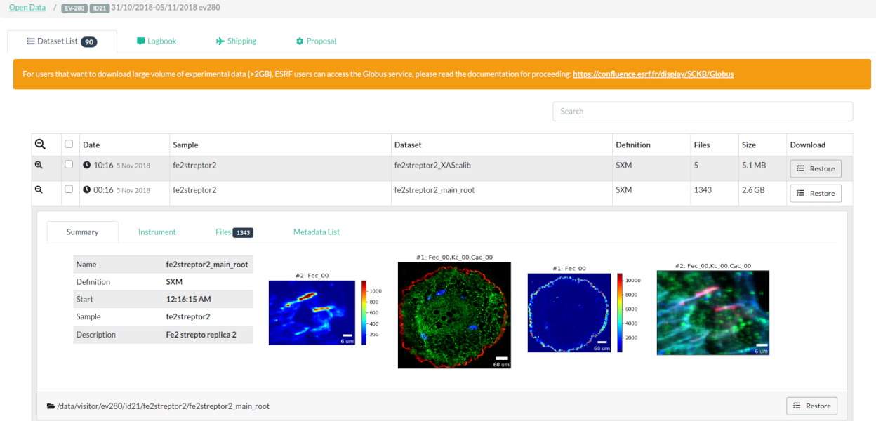
Key Achievements
Production Deployment:
Mediaflux and BlackPearl systems fully operational since October 2024.
Achieving aggregation of approximately 2M files/hour and writing 15TB/hour to tape.
Ongoing Efforts:
Transition from DVA to Mediaflux:
  Migrating archived experiments from the legacy system to Mediaflux.
Next Steps:
REST API Development
  Building a REST API for Mediaflux integration with the Data Catalogue portal.
  Enabling seamless automated restorations for user convenience.

