Slide 1

News | ESPPU | LS3
Conventional Beams WG Meeting
Markus Brugger, Johannes Bernhard (BE-EA)
10.10.2024

Slide 2
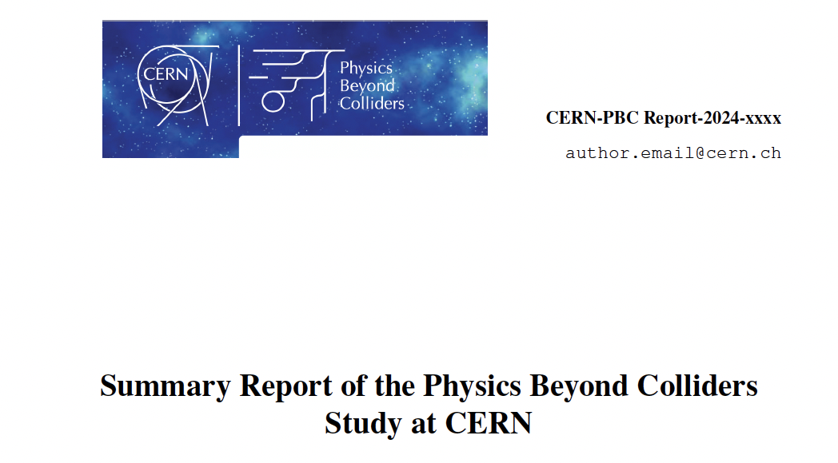

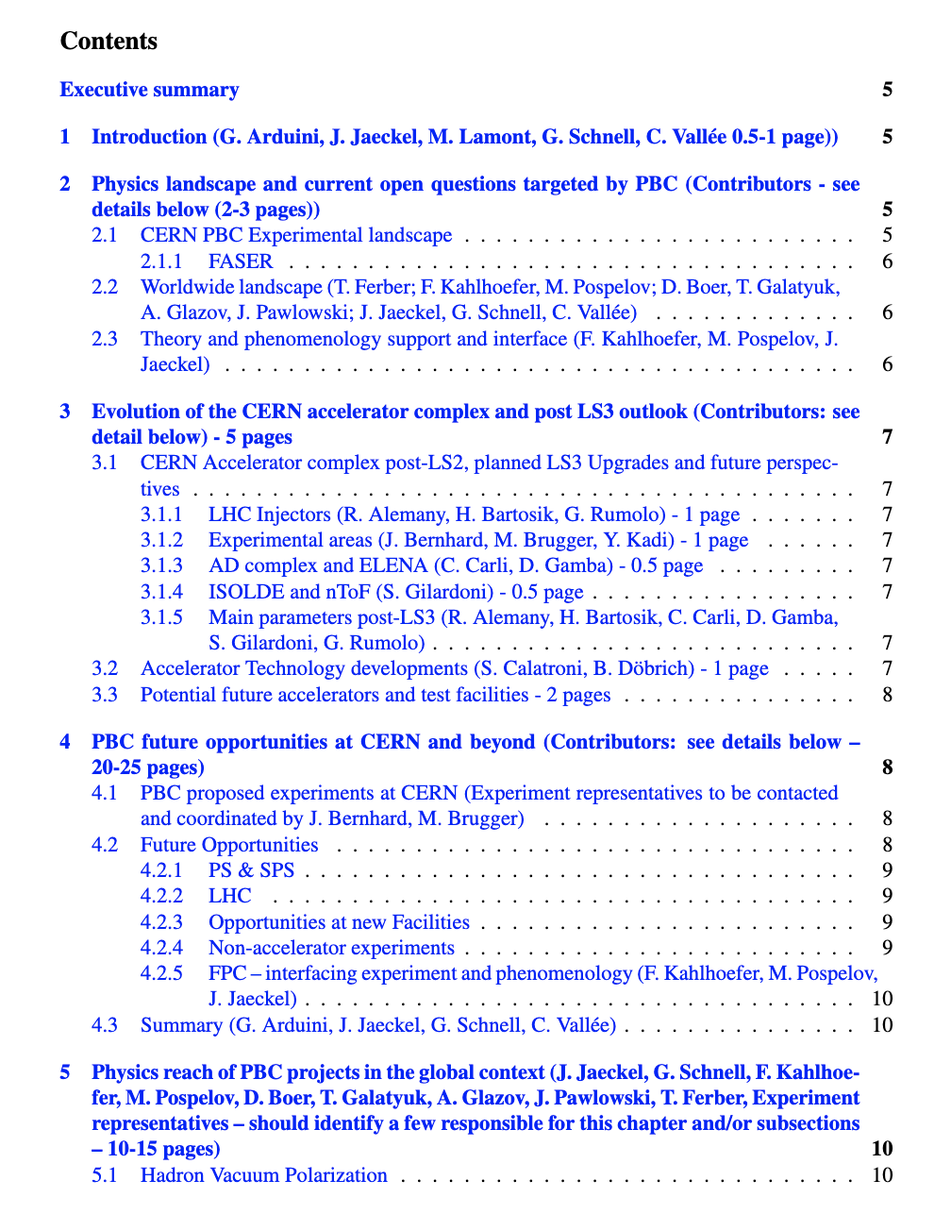
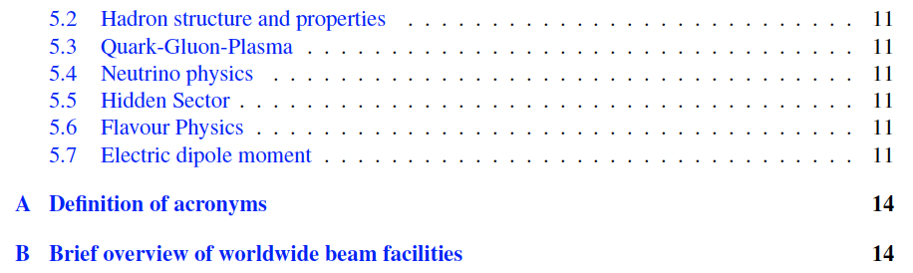
ESPPU
A central PBC document is being prepared by the convenors that will feature and summarise the PBC input to the next ESPPU. Please contribute (tight schedule, ideally by end of October!).
Work is ongoing for an updated CBWG report (3rd edition) that is planned to be finished by the end of the year. This will not serve as an ESPPU input, but rather be supplemental to the experiments input documents. Please cite if possible.
We are available to help for your ESPPU documents, please let us know.

Slide 3
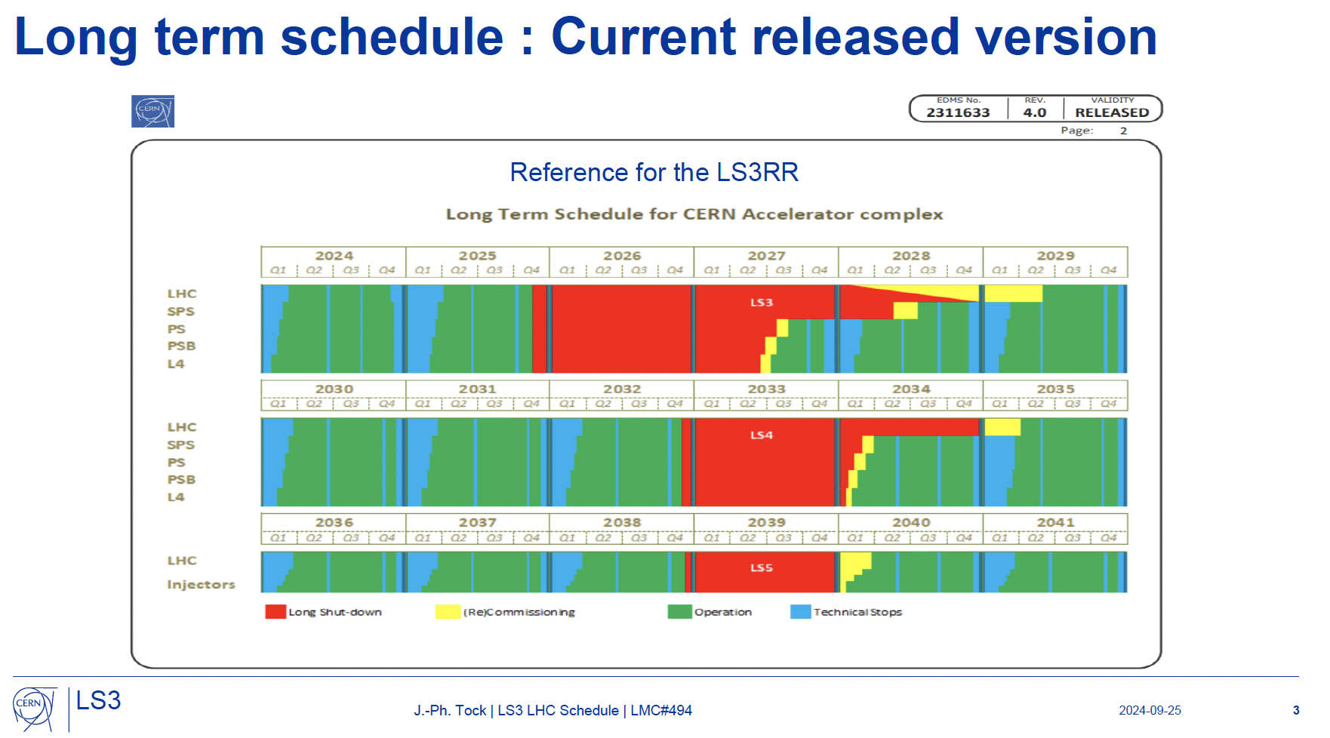
LS3 – Ongoing decision process

Slide 4
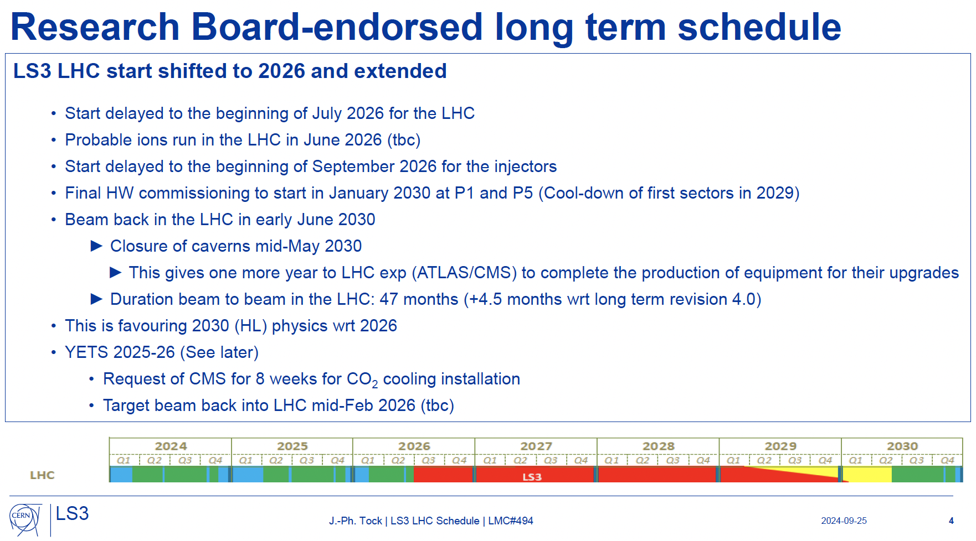
LS3 – Ongoing decision process
Ion run for NA to be discussed at next SPSC
That’s LHC, not injectors

Slide 5
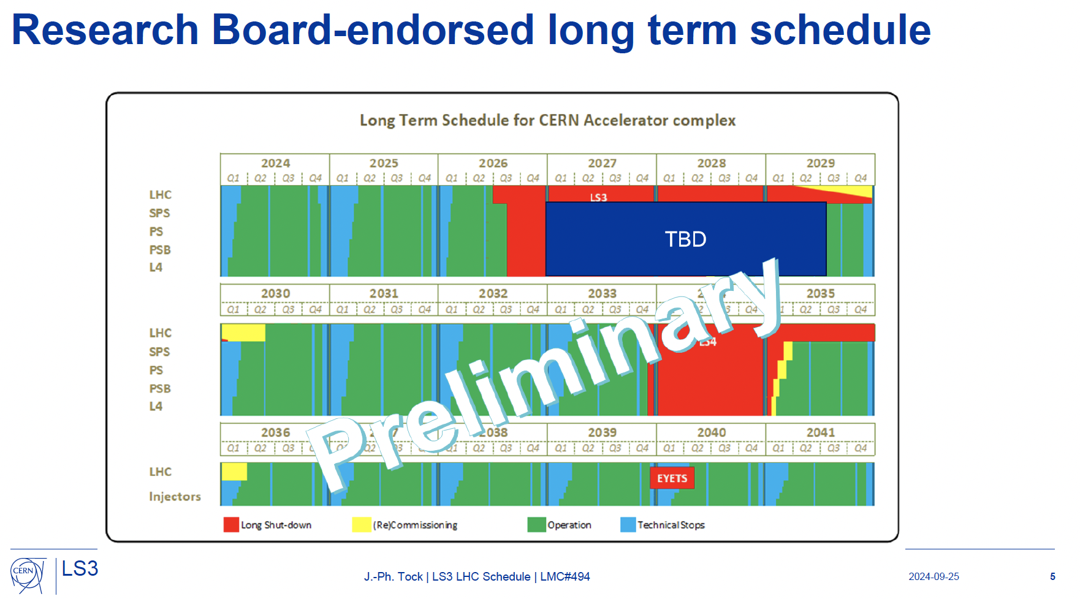
LS3 – Ongoing decision process
East Area likely to run again in 2028

Slide 6
Thank you very much for your attention!

