Slide 1
Summary of Requirements AMBER
Experiment | Workpackage | User requirment | Sub-work-packages | Planned for | Physics study status | Integration study status | ECR(s) status
AMBER | M2 under vacuum | EDMS 2719043 EDMS 3129053 | MBNV.X0610706 connection to vacuum | YETS 24/25 | Done | No need | EDMS 3169186 in circulation
 |  |  | XVC.X0610731 and XVC.X0610737 with 4 Al windows removal | YETS 24/25 | done | No need | EDMS 3169186 in circulation
 |  |  | MQNFB.X0610745 and MQNFB.X0610748 | YETS25/26 | done | No need | ECR to be done
 |  | EDMS 2798464 | All XCMs under vacuum | LS3 | done | To be done | ECR to be done
 |  | EDMS 2742301 | XCBV exchange with normal XCSV | LS3 | done | To be done | ECR to be done
 |  | EDMS 3012379 | XABS under vacuum (outside of MCWV) magnets | LS3 if budget approved | done | To be done | ECR to be done
 | High Intensity Hadrons |  | Shielding modifications at interface of EHN2/TT84, the access chicane of PPE211 | LS3 | done | done | EDMS 2868386 in circulation
 |  |  | Shielding around the target in EHn2 | LS3 | done | done | EDMS 2868386 in circulation
 |  |  | Additional collimator to be installed (DCUM 300 m) | LS3 | done | To be done | ECR to be done

Slide 2
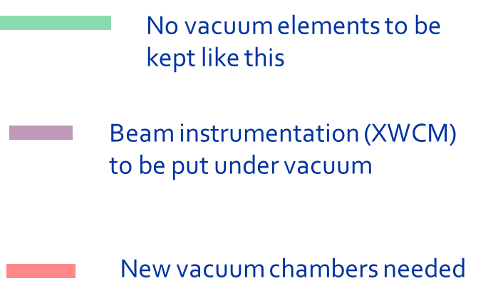
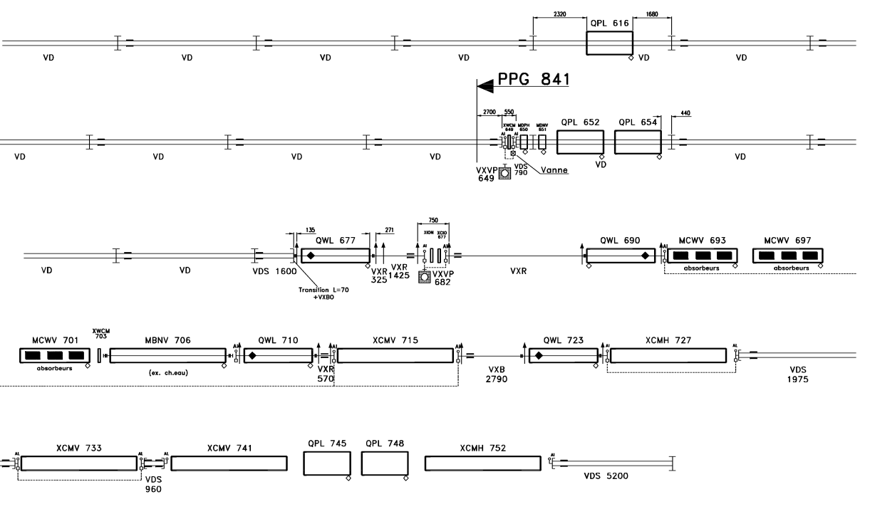
M2 -4th Part
Under vacuum in YETS24-25
Removed in YETS24-25
Under vacuum in YETS25-26
Vacuum flexible connection
All XCMs under vacuum in Ls3
XABS under vacuum in LS3? → to be confirmed

Slide 3
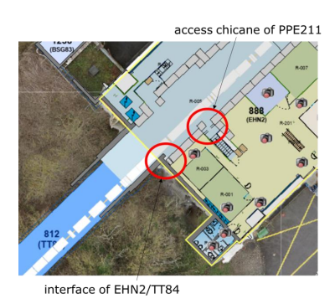
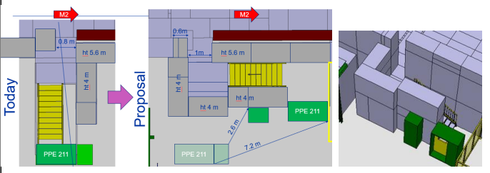
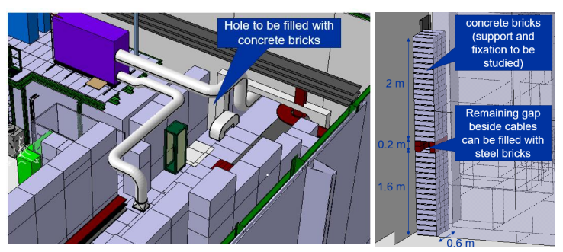
Shielding Modifications AMBER

Slide 4
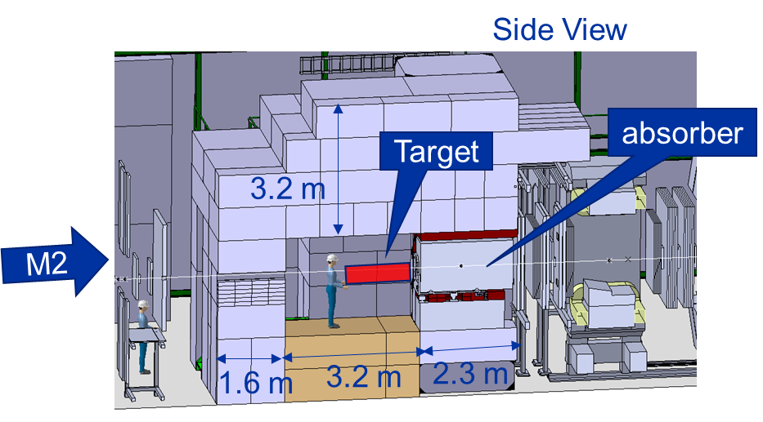
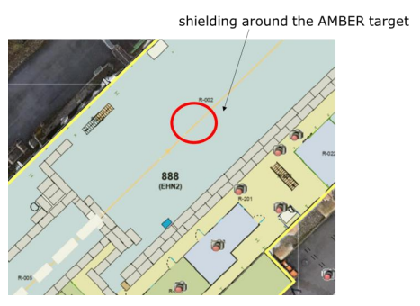
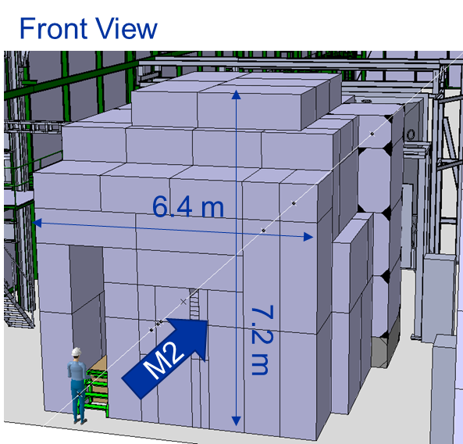
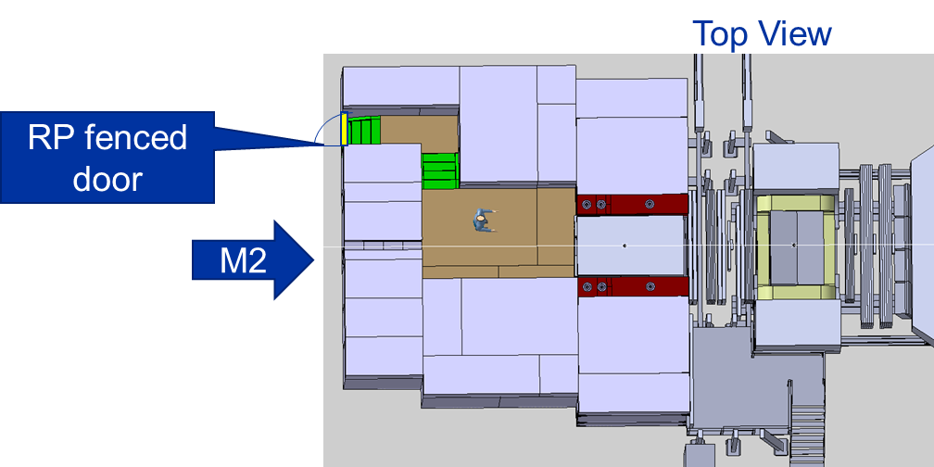
Shielding Modifications AMBER
Target Bunker

Slide 5
Thank you!

Slide 6
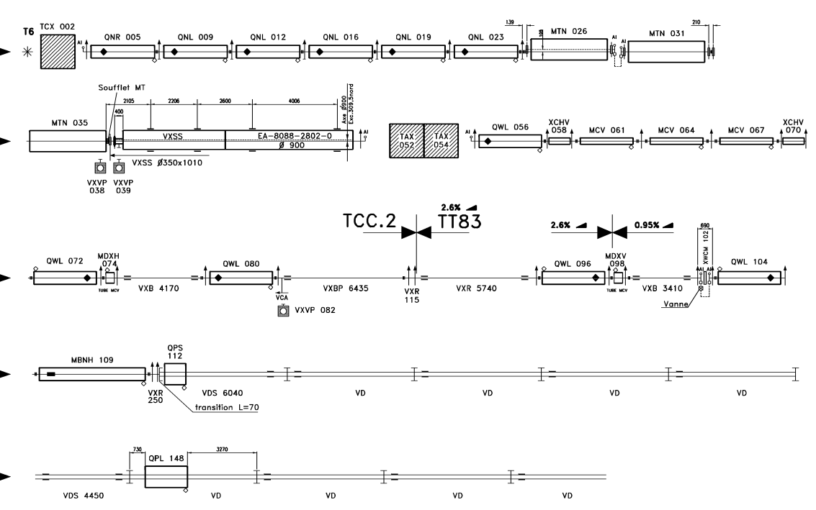
M2 – 1st Part
No vacuum elements to be kept like this
Beam instrumentation (XWCM) to be put under vacuum
New vacuum chambers needed
QPS 112 transition inox chambers to Al
In TCC2 nothing can happen before LS3

Slide 7
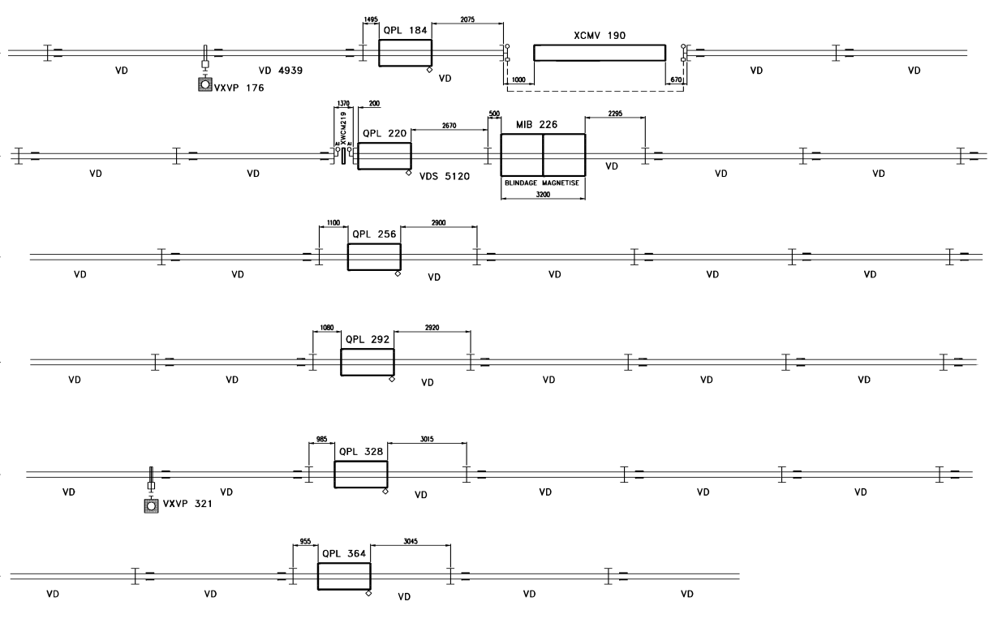
M2 – 2nd Part
XCMV 190 under vacuum in Ls3

Slide 8
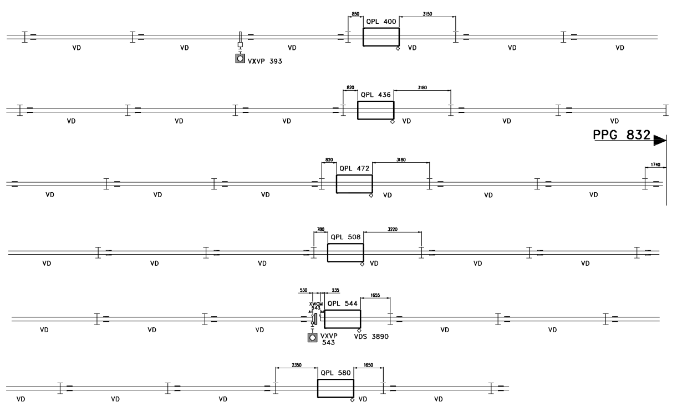
M2 -3rd Part
No vacuum elements to be kept like this
Beam instrumentation (XWCM) to be put under vacuum
New vacuum chambers needed

Slide 9
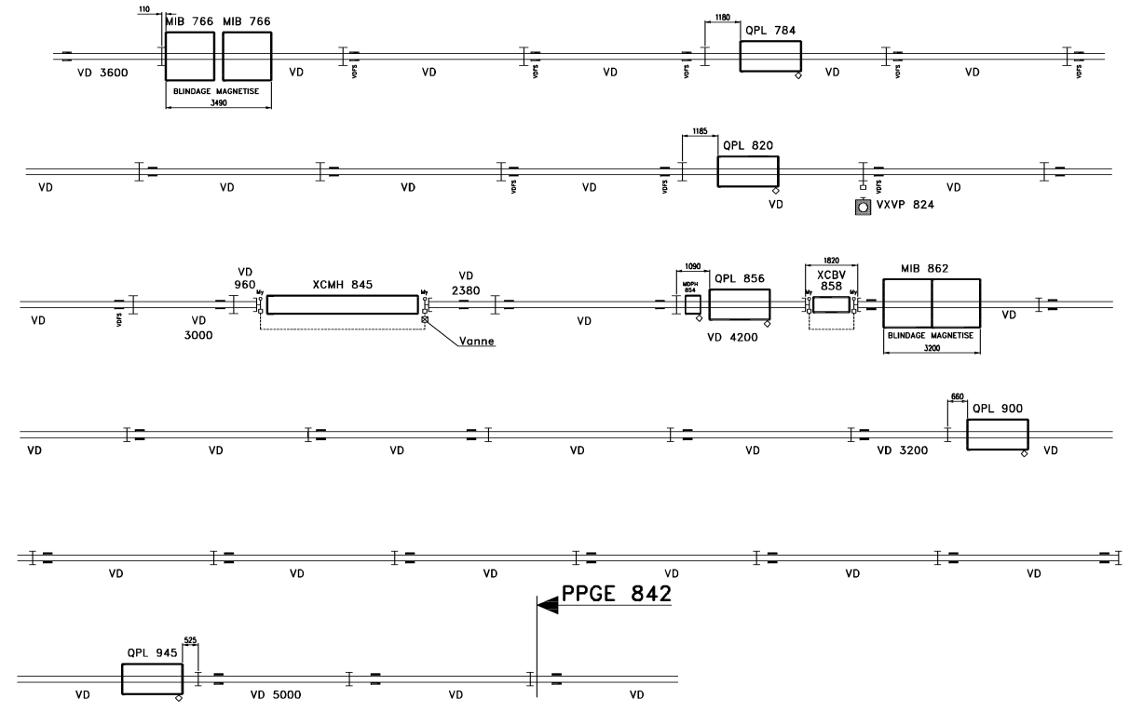
M2 -5th Part
XCMH 845 under vacuum in Ls3
XCBV 858 → exchange with XCSV normal on rails in LS3

Slide 10
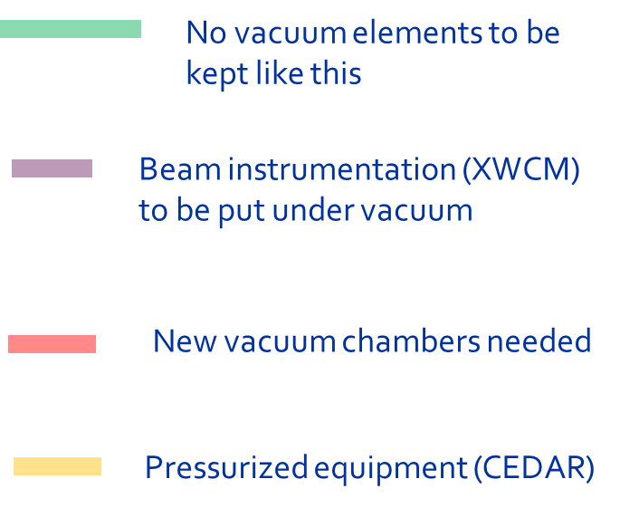
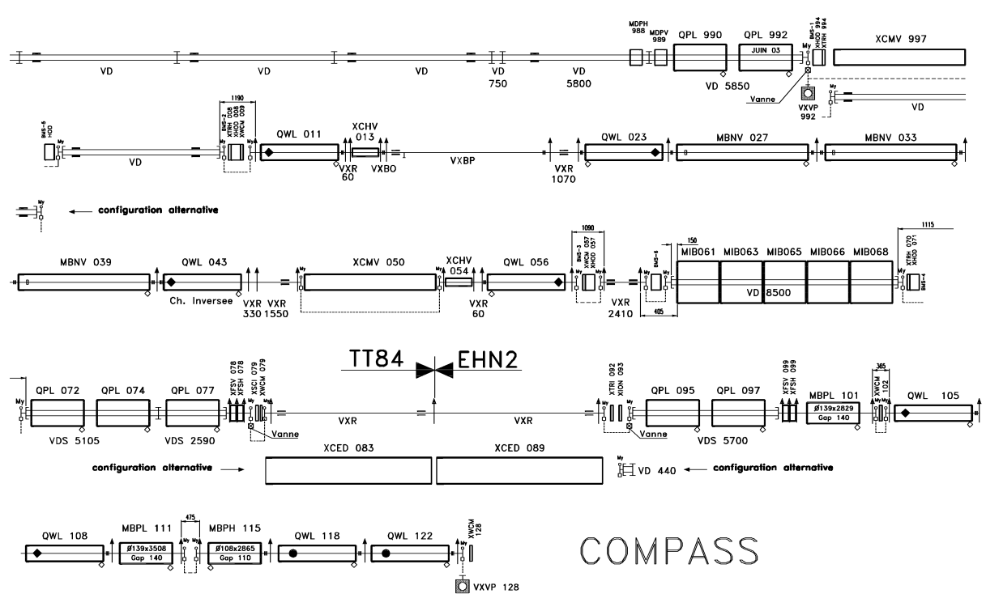
M2 – 6th Part
https://edms.cern.ch/document/706972/AC
All XCMs under vacuum in Ls3

Slide 11
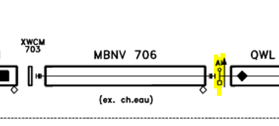
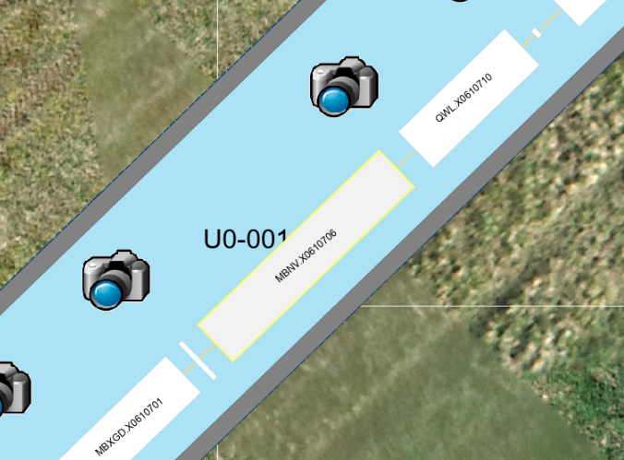
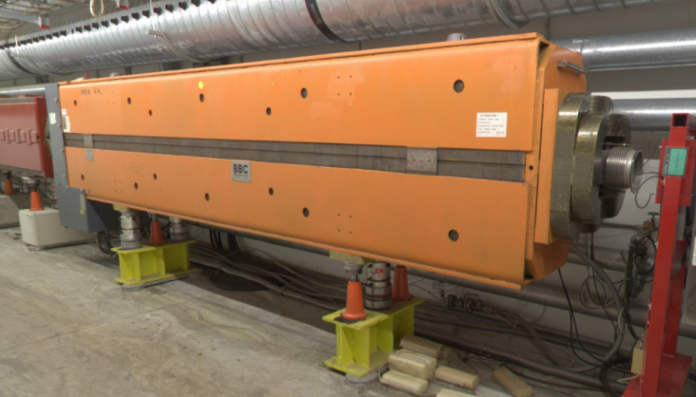
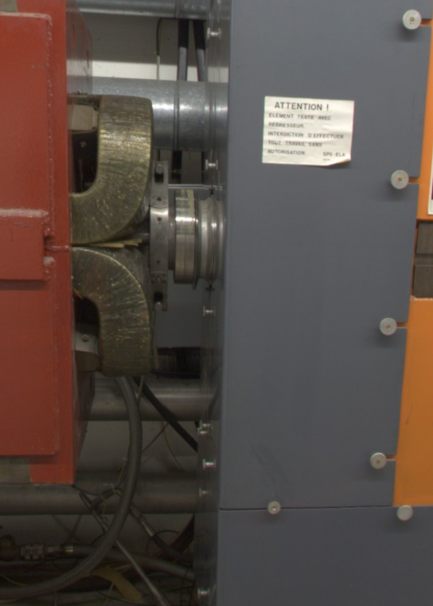
MBNV 706 - MBNV.X0610706
LINKS:
Panoramas (cern.ch)
Layout (cern.ch)
YETS 24-25:
Move window upstream (Al -> Mylar)
Clean the chamber
Place MBNV under vacuum

Slide 12
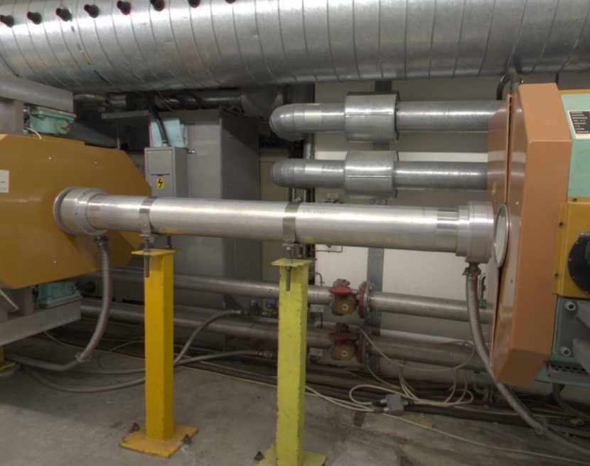
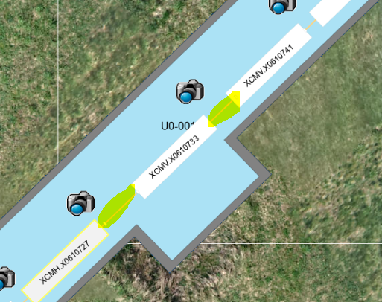
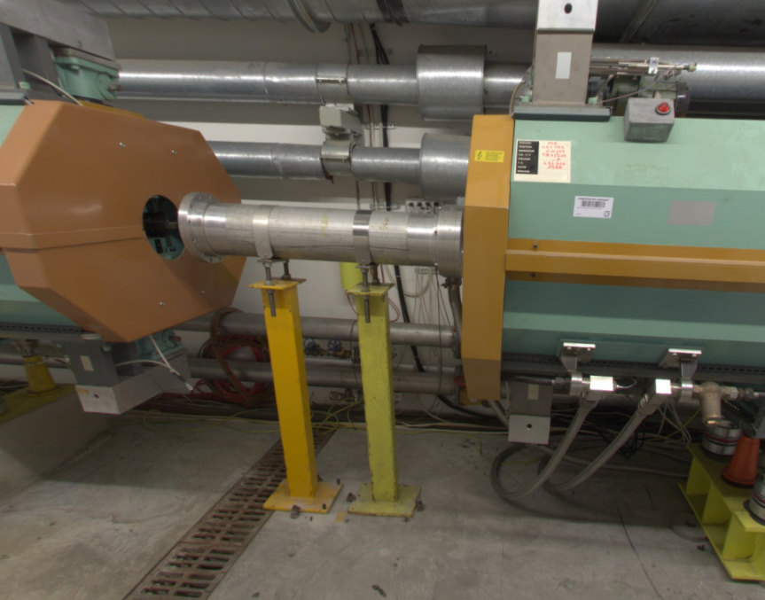
XVC.X0610731, XVC.X0610737 : removal in YETS24-25
XVC 731 L=1975 mm
XVC 737 L=960 mm
XCMV.X0610733 to be moved in YETS24-25 for EN-CV intervention ARR EDMS 3139745
Remove the chambers
remove 4 Al windows 0.2 mm thick (instead of 2.935 m of vacuum)
Vacuum flexible connection between QWL.X0610723 and XVC.X0610757 (around 31m)
Future installation of SS standard chamber in LS3
Links:
Layout (cern.ch)
Panoramas (cern.ch)

Slide 13
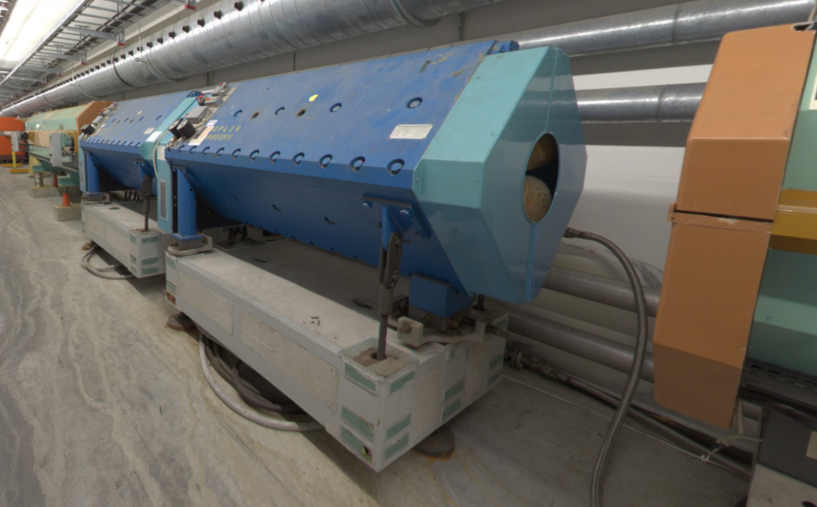
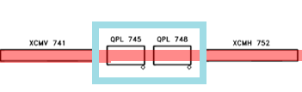
MQNFB.X0610745 and MQNFB.X0610748
Under vacuum in YETS25-26
QPL 745-QPL 748
Links:
Layout (cern.ch)
Panoramas (cern.ch)

