Slide 1
Present status of ELENA sources and possible modifications
Jose A. Ferreira, Alex Sinturel, Iker Lobato
14/10/2024

Slide 2
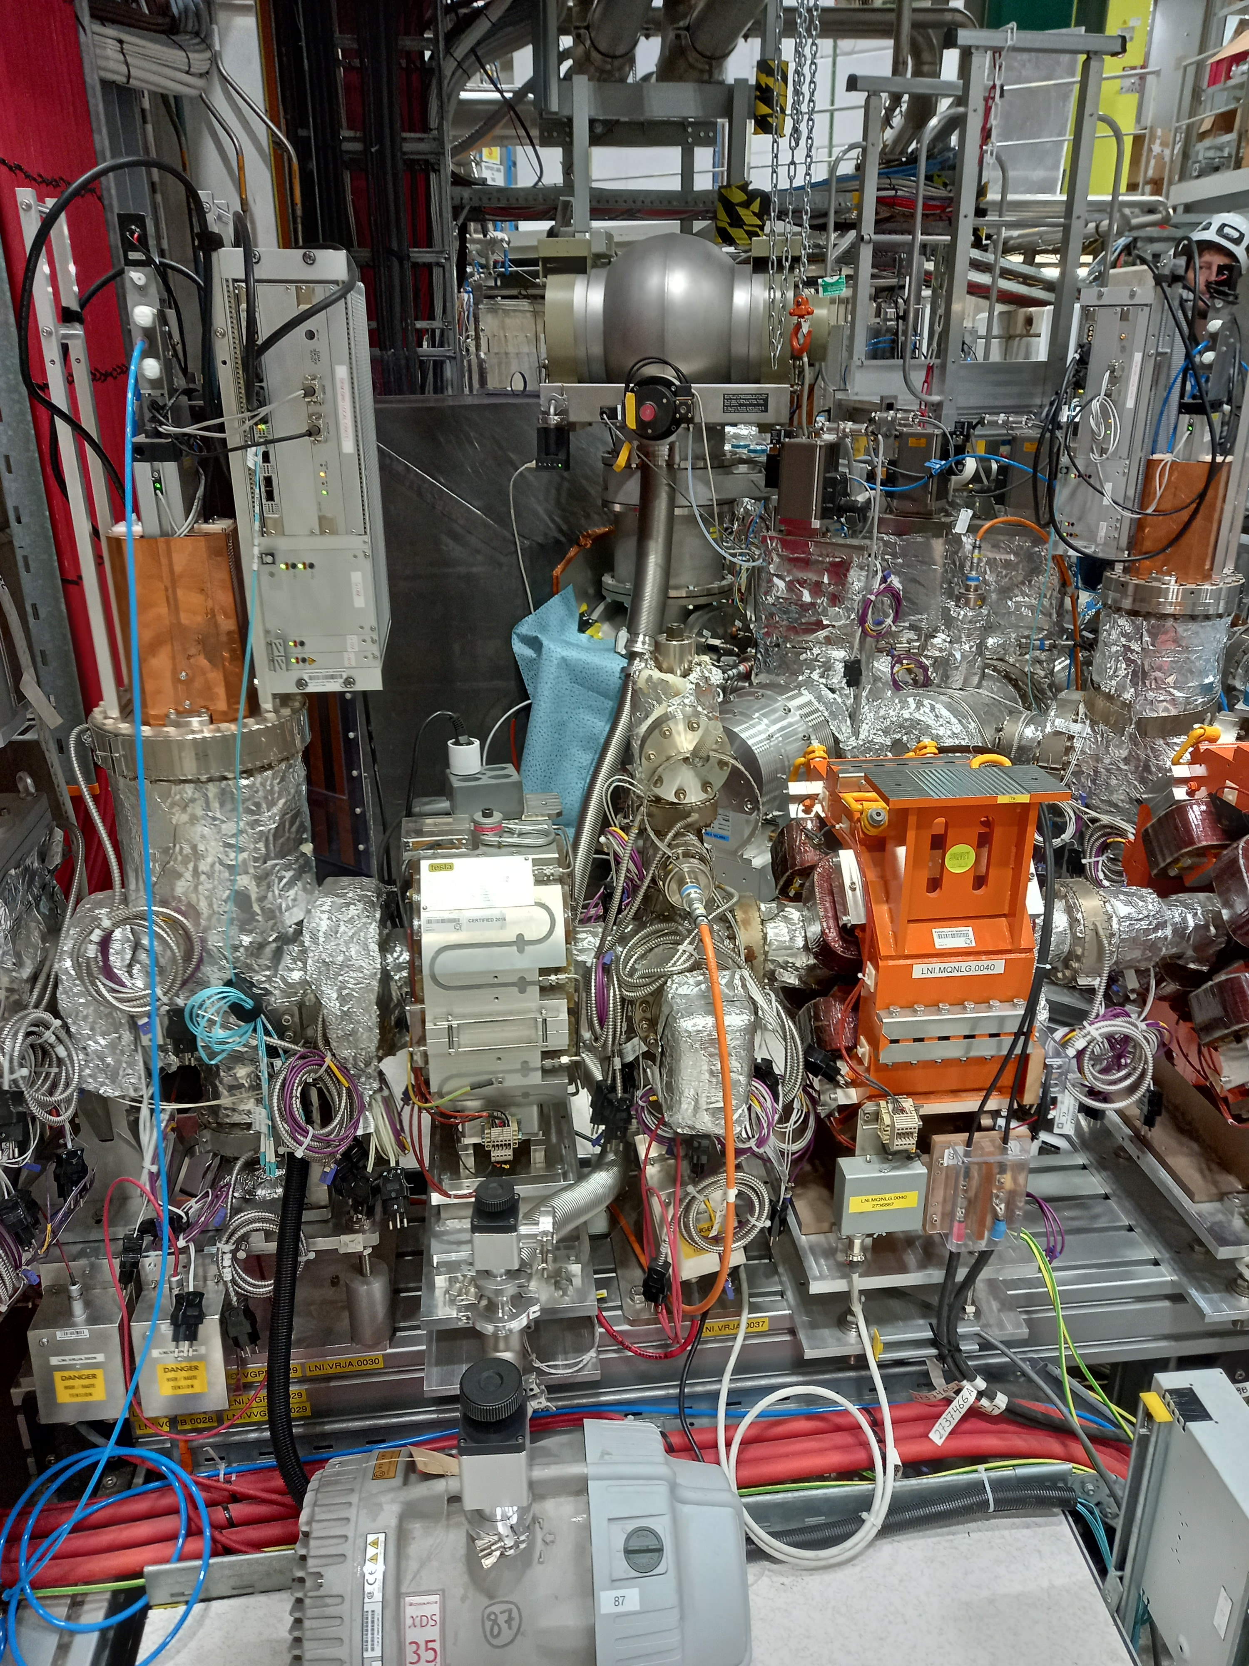
Present status
Primary pump supplied by TE-VSC
  XDS35i, Last service 2022
TMP: TPH 2200 (1 spare?)
  Last service 2021
  Controller TCP5000 (1 spare)
  Manual venting
Gauges Leybold
  TTR211 Pirani
  Penning vac
Valves
  DN250 ISO-F from VAT isolating the source
  Valve DN63 ISO-K isolating the primary pump
Controls
  Interface developed by Julich, not compatible with CERN remote system

Slide 3
Required modifications
Safety aspects linked to H₂ pumping must be addressed => Dilution and inert purge.
Integrate protections in case of vacuum failure (i.e. stop H₂ injection). Define interface with gas injection.
Integrate the vacuum equipment in VSC control and SCADA application
Standardize equipment with focusing on operational cost reduction (maintenance intensive design)

Slide 4
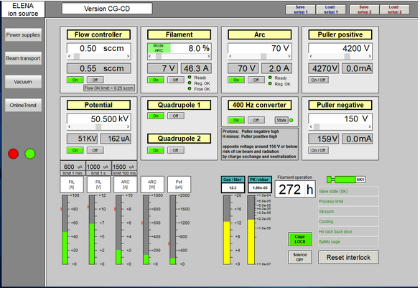
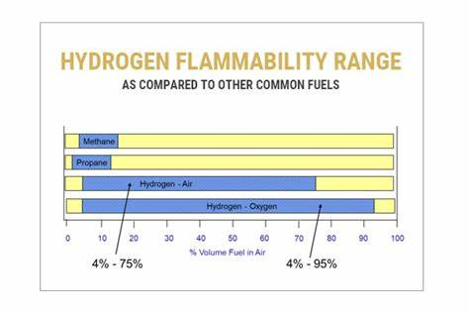
Required modifications
H₂ injection between 0.1 to 0.6 sccm -> <0.01 mbar×l/s => Minimum continuous inert purge (N₂) 0.25 mbar×l/s
Required pump with gas purge, i.e. ACP28 gas purge 3.7e3 sccm or explore option to run with ballast (1.2m³/h).
Inert gas pressure to be monitored in case required
HSE shall approve the solution

Slide 5
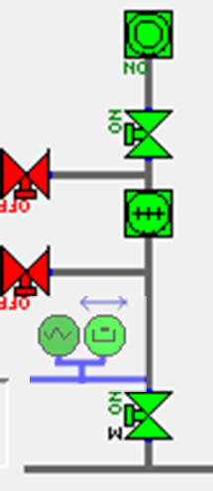
Required modifications
Dry primary pump, low maintenance and including H₂ dilution, i.e. ACP28G
Isolation, venting and leak detection valves.
TMP
  MAG 1300ip or Mag 2200iP with automatic venting
  Low maintenance and possible spare compatible with injection pumping groups.
Gauges and TPG300

Slide 6
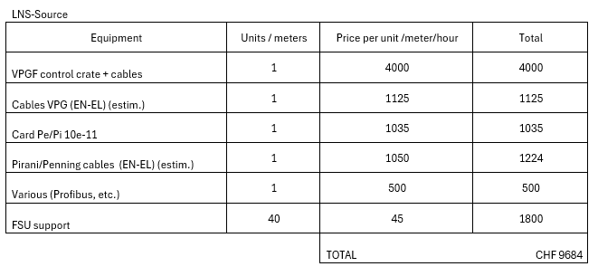
Budget
Mechanical parts
  Package 1:
    1 TMP Version 2200 + spare
  Package 2:
    1 TMP Version 2200
    Spare TMP from differential pumping
Controls
TOTAL:
  Package 1 + Controls : 65kCHF
  Package 2 + Controls : 47kCHF

Slide 7
Operation
Intervention shall be agreed with TE-VSC in advance (no calls the same day unless real unexpected issues)
Venting supervised by TE-VSC
Gas injection managed by BE-ABP or BE-OP with interfaces to VSC control system for safe operation (tbd)
This is the minimum proposal. If agreed final decision from Paolo => Modifications during LS3? Timing?

