Slide 1
ETO - Civil Engineering Update
ETO – CE Group:
Maria Marsella - INFN
Wissam Wahbeh - FHNW
Jonathan Bratanata - Nikhef

Slide 2
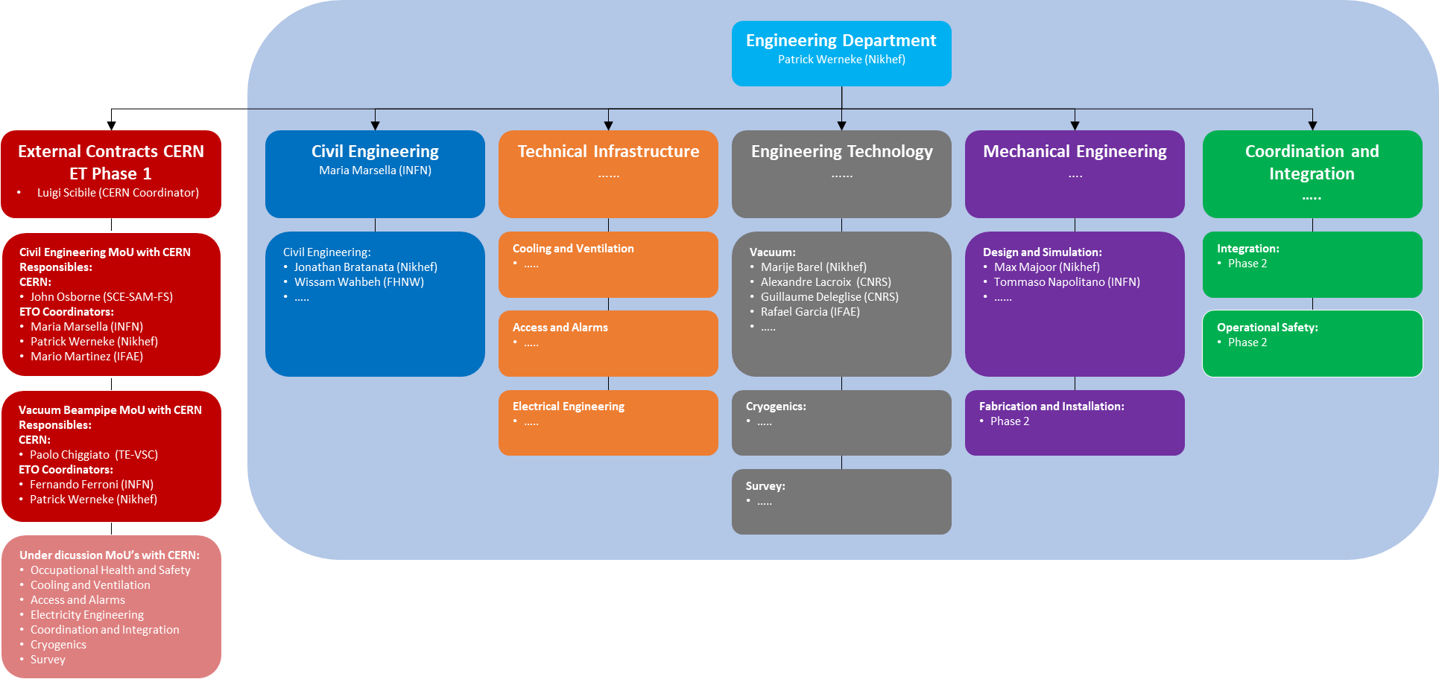

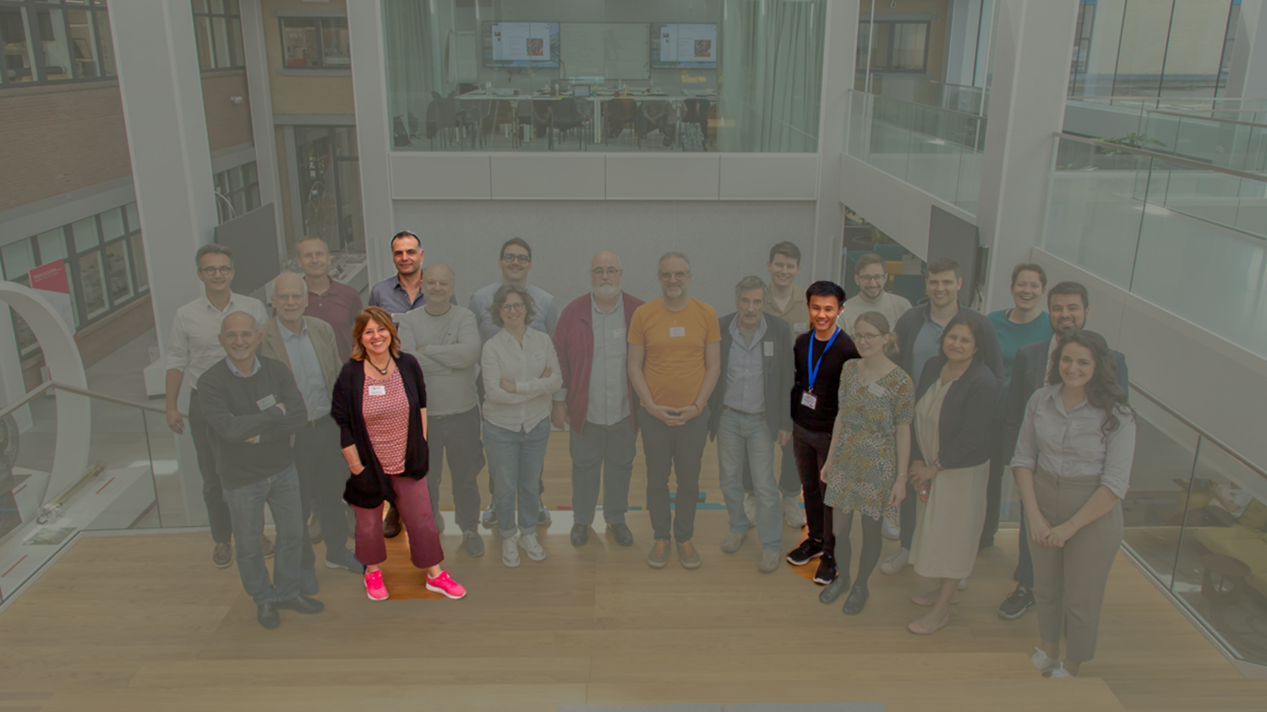
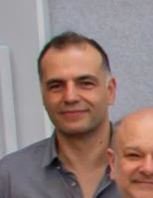



ETO Civil Engineering Overview
Wissam Wahbeh
Jonathan Bratanata
Maria Marsella

Slide 3
Outline of CE contribution to ET Phase 1 design
Identify CE deliverables to be provided by all the stakeholders and relative timelines (draft document distributed) to sketch the CE roadmap
Coordinate meetings with stakeholders (local teams, engineering department, CERN) to share activity plan and discuss relevant issues to reach coherent outcomes from local studies
Support to detector layout drawings and publication of the different versions (draft document distributed) to obtain reference detector layouts to be developed by local teams
Analyse different methodology for (CE) cost estimation (multi-criteria and parametric approaches), summarize existing estimates and unit costs to support the costing risk assessment (task force)

Slide 4
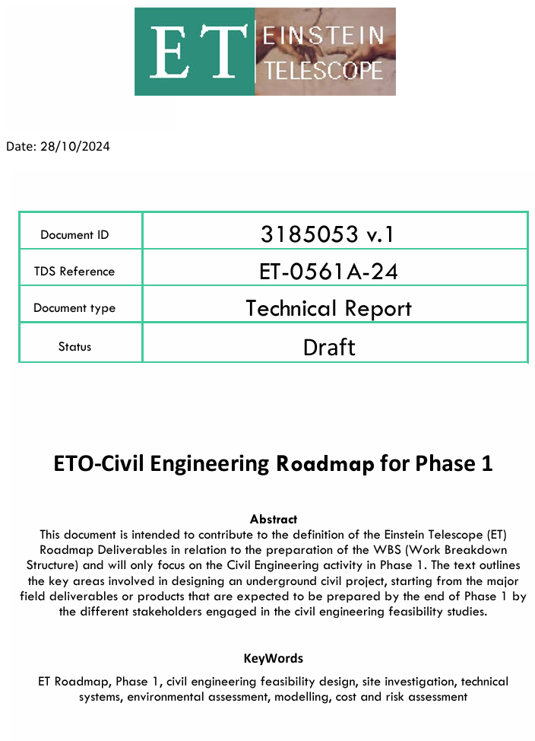
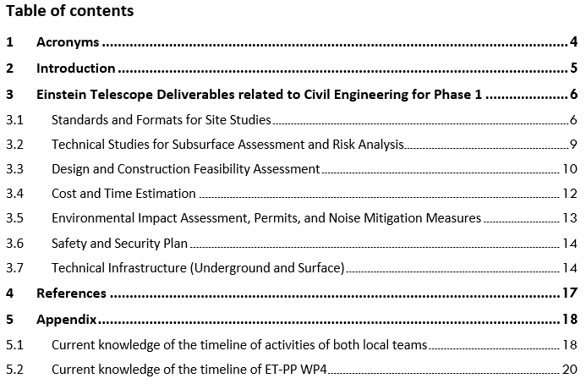
ETO-Civil Engineering Roadmap for Phase 1
Identifying potential gaps and defining responsibility roles for (CE related) deliverables
Assisting in coordinating activities with local teams involved in the site studies.
To be agreed upon not just by ETO, but also with the 2 (3?) local teams bidding for ET, both for the deliverables and also the non-aligned schedules of ETO, LTs & ET-PP?
Clarification on the approach of ETO-ED with local teams is also needed.
https://edms.cern.ch/document/3185053/1

Slide 5
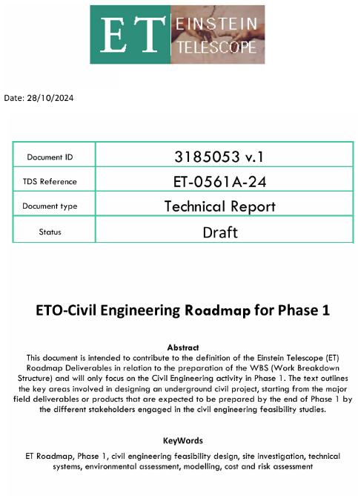
ETO-Civil Engineering Roadmap for Phase 1
Standards and Formats for Site Studies
Deliverable |  | Responsible Unit-Dept | Target Delivery Date | Intermediate actions | Prerequisite/ Input | Corresponding WBS Element
3.1.1 | Standards for data exchange formats, BIM Modelling guidelines, and ET Modelling Coordination including process for model changes and updates | ETO-CE | Q4 2024 | Consultation with ET-PP WP8 | Confirmed alignment with ET-PP WP8 | 3
3.1.2 | Model-based analysis methods (Cost estimation/verification, GIS-BIM combination, Take offs, …) | ETO-CE | Q1 2025? | ? | ? | 2.2
3.1.3 | Validation procedures/review procedures | ETO-PO, ETC (science case) | Q2 2025? | Consultation and approval from ETO needed before delivering any docs | ETO approval and ETC | 3
3.1.4 | Cost standards and validation methodology (CE related only) | ETO-CE | Q4 2024 | Ref.doc on methodology | CERN-CE MOU Additional CERN agreement (in preparation) alignment with ETO-PO | 7
3.1.5 | Risk standards and validation methodology (CE related only) | ETO-PO | Q2 2025? | Ref.doc on methodology | CERN-CE MoU specifically for geohazards? local & intl. code compliant | 10, 5
3.1.6 | Preliminary TDR CE underground infrastructure (from PBS ?) | ETO- CE | Q4 2026 | Overall agreement on the methodology is needed | PBS is fully reviewed sept. 24 CERN-MOU | 2.2
3.1.7 | Reference schedule for preparation, construction, and implementation of CE works (ROADMAP) | ETO-PO and ETO-CE | Q4 2024 | From timeline of LT | LT acceptance Timeline alignment? | 3
… | … | … | … | … | … | …
https://edms.cern.ch/document/3185053/1

Slide 6
ETO-Civil Engineering Roadmap for Phase 1
Design and Construction Feasibility Assessment
Deliverable |  | Responsible Unit | Target Delivery Date | Intermediate actions | Prerequisite/ Input | Corresponding WBS Element
3.3.1 | Report on positioning/Location Scenarios of underground design (Triangle and 2L) | LT | Q4 2025(TETI) / Q4 2026(EMR) | Conducted by LTs | Requirements, General ET layout | 2.2, 9
3.3.2 | Drawings and conceptual design of underground structure (including resulting surface structures) for: 1. Caverns, 2. Tunnels, 3. Intersurface connections (access tunnels/shafts, boreholes, etc.), 4. Technical rooms, 5. Dewatering, 6. Emergency exits, 7. Monitoring systems, 8. Other auxiliary structures | LT | Q4 2025(TETI) / Q4 2026(EMR) | Conducted by LTs | Requirements, ET reference layout, defined requested minimum level of detail | 2.2, 9
3.3.3 | Report on optimised construction solutions for the underground facility | LT | Q4 2025(TETI) / Q4 2026(EMR) | Conducted by LTs | Requirements, General ET layout | 2.2, 9
3.3.4 | Logistics plan during construction including: 1. Layout of the construction site(s), 2. Personnel, 3. Flow of equipment and material, 4. Transportation of structural components from surface to underground site level | LT | Q4 2025(TETI) / Q4 2026(EMR) | Conducted by LTs | ED input needed | 2.2, 9
3.3.5 | Construction risk assessment | LT | Q4 2025(TETI) / Q4 2026(EMR) | Conducted by LTs | ETO inputs | 2.2, 3.5, 9, 10
3.3.6 | Specific reports on the feasibility of construction solutions able to mitigate level of noise | LT | Q4 2025(TETI) / Q4 2026(EMR) | Conducted by LTs | ISB input needed, SPB | 2.2, 9
https://edms.cern.ch/document/3185053/1

Slide 7
ETO-Civil Engineering Roadmap for Phase 1
Cost and Time Estimation
Deliverable |  | Responsible Unit | Target Delivery Date | Intermediate actions | Prerequisite/ Input | Corresponding WBS Element
3.4.1 | Cost estimation report for the construction of underground and surface facilities | LT, WP4 | Q4 2025(TETI) / Q4 2026(EMR), 07/2026 (WP4) | Conducted by LTs with WP4 coordination | Defined requested minimal level of detail | 7.4
3.42. | Scheduling for construction underground and surface facilities (preparation, construction and implementation) | LT, WP4 | Q4 2025(TETI) / Q4 2026(EMR), 07/2026 (WP4) | Conducted by LTs with WP4 coordination | Roadmap defined | 3
3.4.3 | Scheduling for civil works permitting (authorizations, expropriations, and easements) | LT, WP4 | Q4 2025(TETI) / Q4 2026(EMR), 07/2026 (WP4) | Conducted by LTs with WP4 coordination | Ref. ET-PP WP4 | 3
https://edms.cern.ch/document/3185053/1

Slide 8
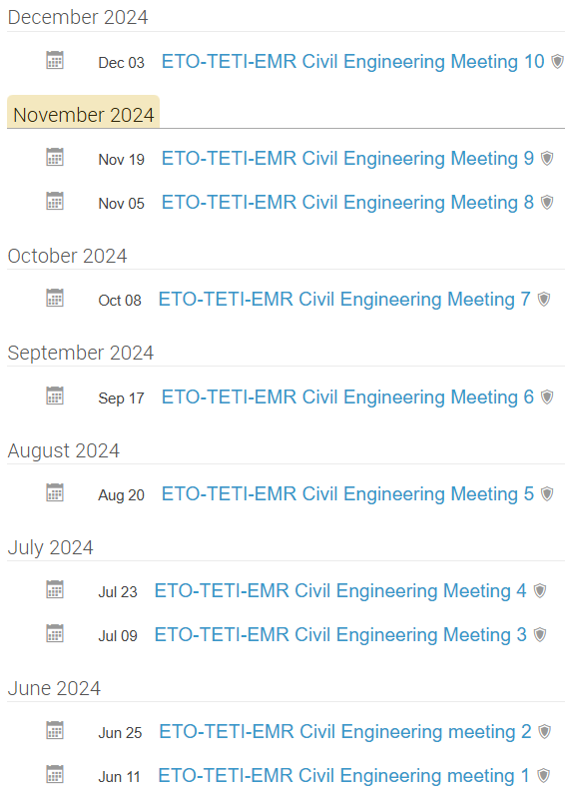
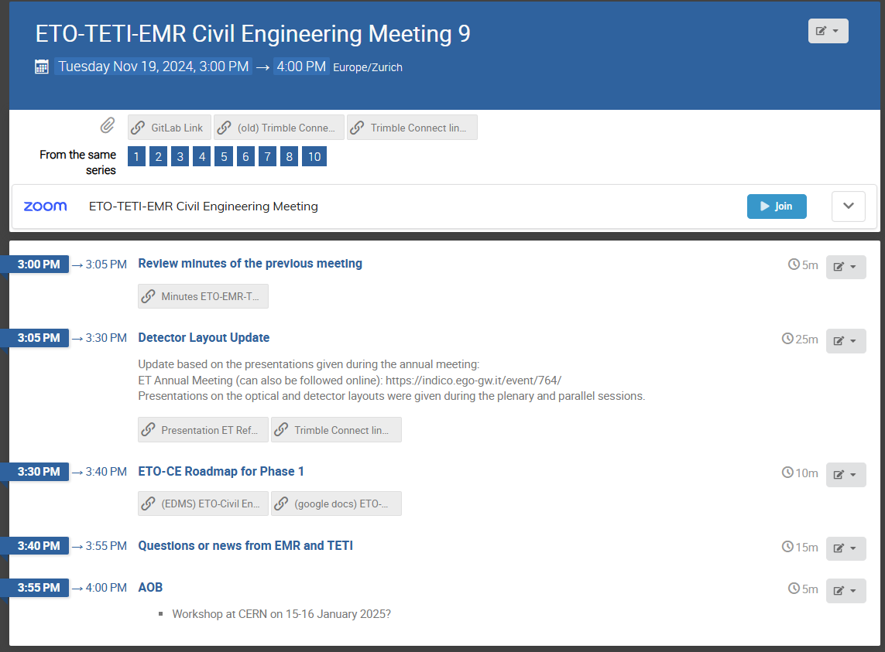
Bi-weekly Meetings with local teams
Current regular schedule is on Tuesday, 3-4pm
Typical current agenda is discussing the update on the Detector Layout, along with any news/questions from EMR/TETI
All minutes uploaded to EDMS
https://indico.cern.ch/category/17473/

Slide 9
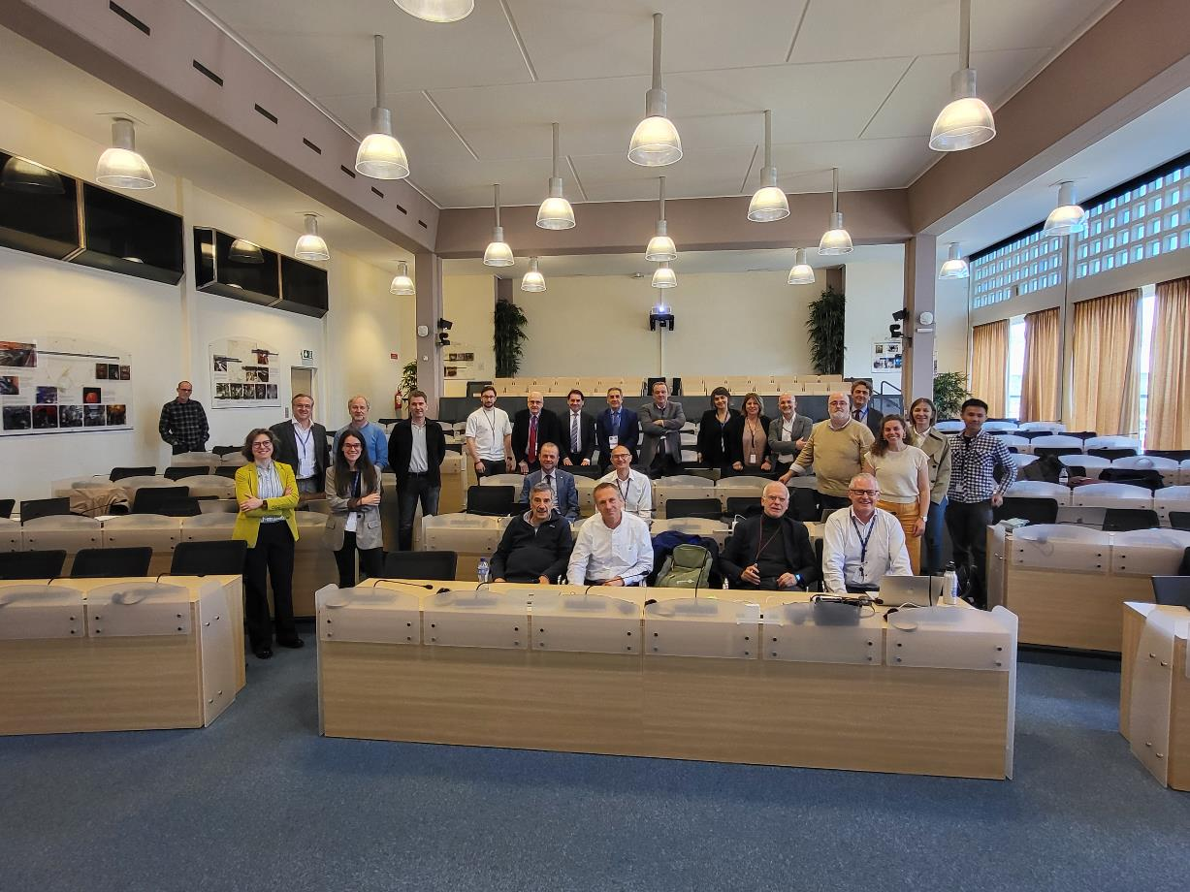
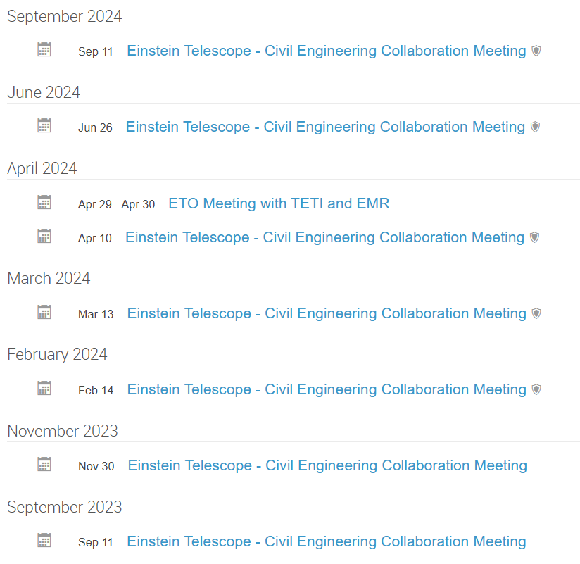
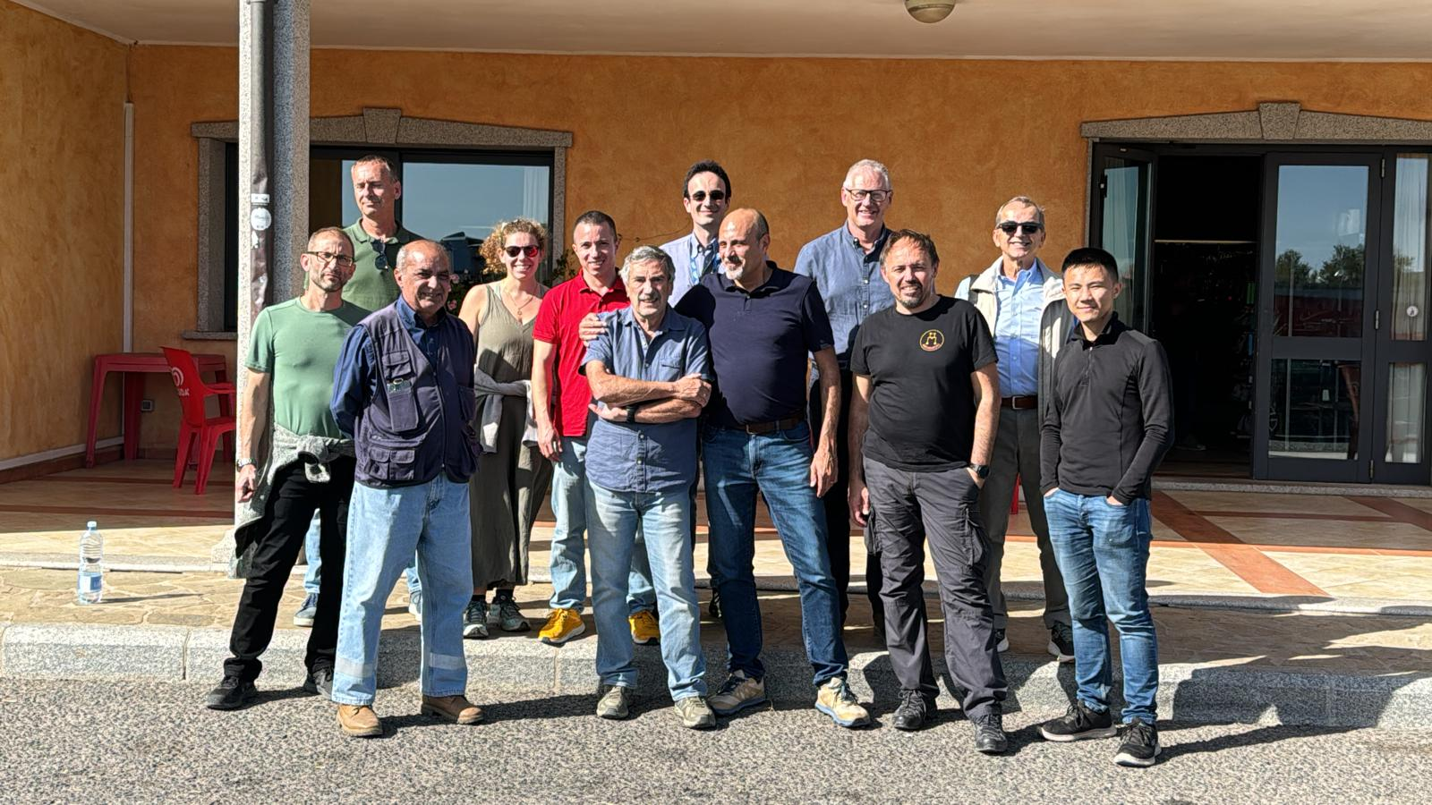
Activities with CERN
Regular meetings with CERN – CE group
1st workshop @CERN 29-30 April 2024
2nd workshop @CERN planned for 15-16 January 2025
Confirmed attendance by TETI & EMR representatives
Visit to Sardinia 15-16 Oct 2024 (ETO, CERN)
https://indico.cern.ch/category/13473/

Slide 10
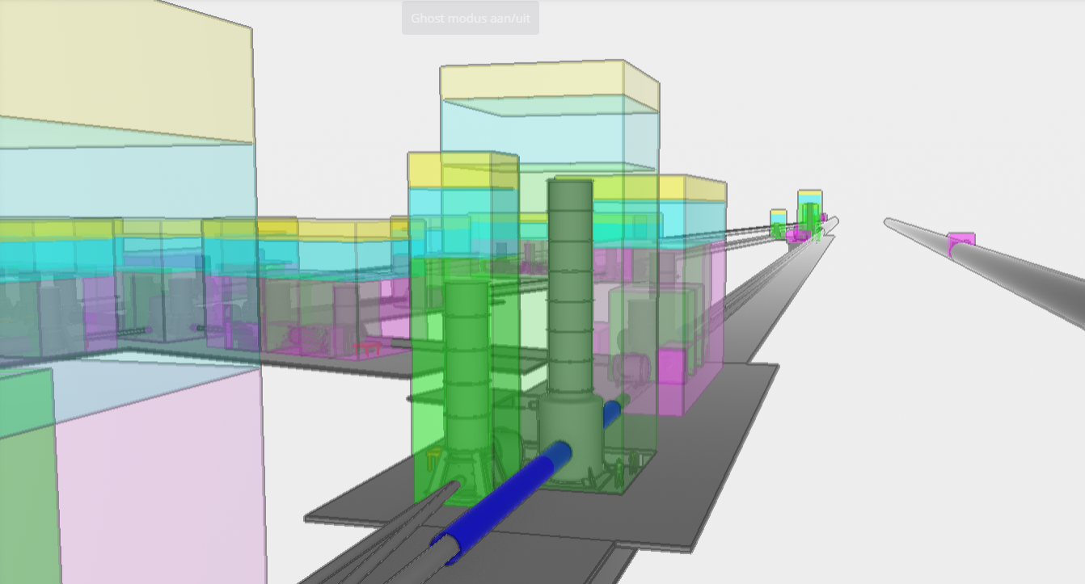
ET Reference Detector Layout
See Max’s Presentation!
Link to model available on the ET Wiki https://wiki.et-gw.eu/ED/WebHome

Slide 11
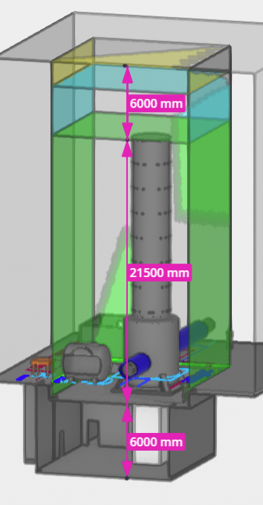
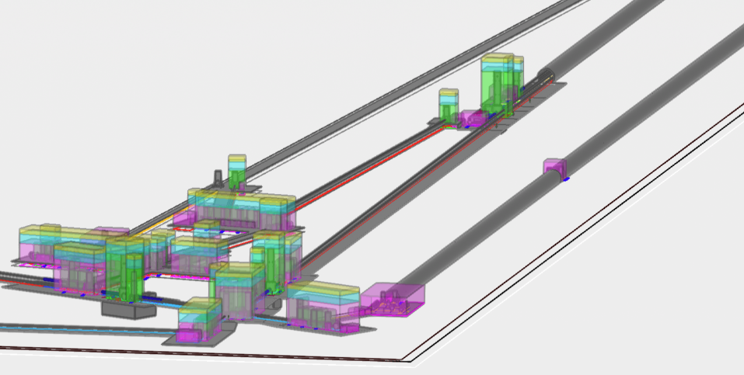
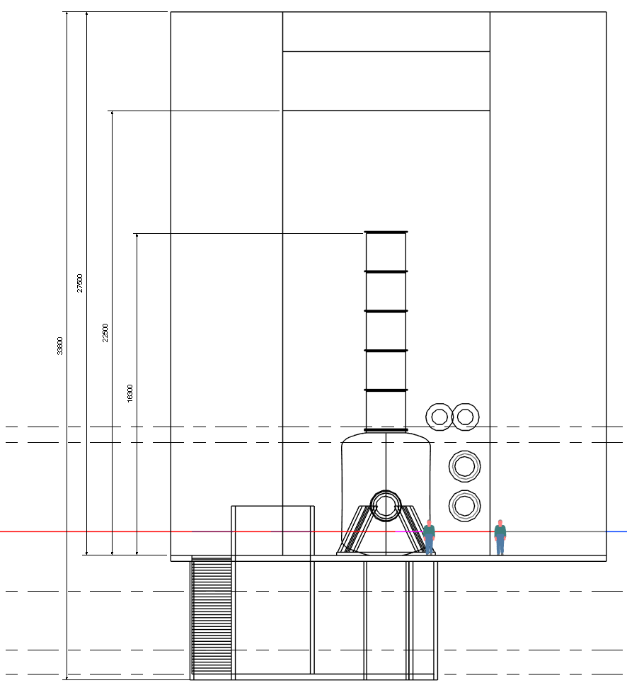
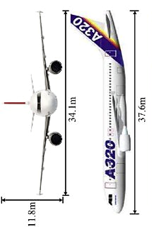
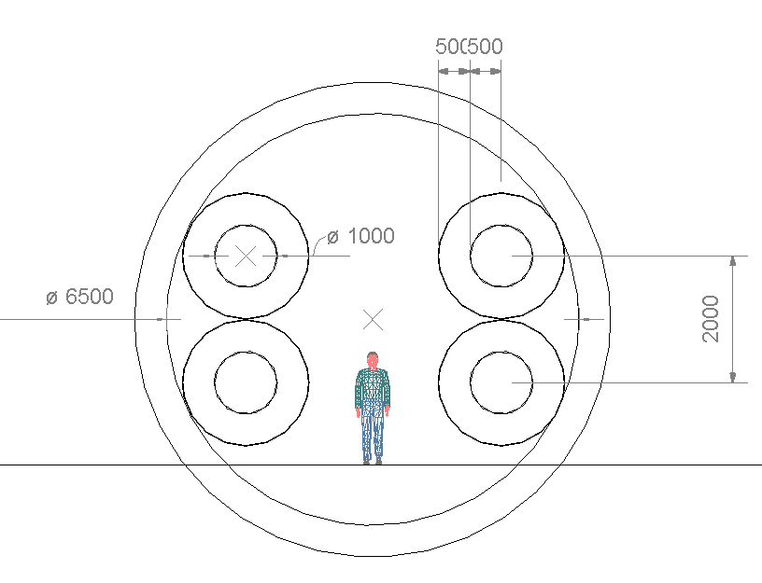
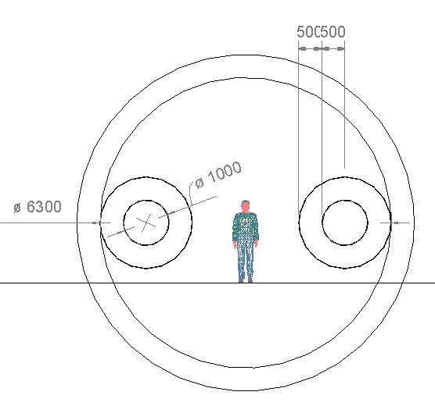
Issues with the “Baseline” design
Total height needed for a 17m super-attenuator tower
6m for crane and clearance
17m super-attenuator
33.8m*
12m super-attenuator
Main arm cavity ⌀6.5m
5km LF-FC cavity ⌀6.5m
*not yet taken into account is the additional excavation height needed for the cavern lining, cavern invert (floor) and other supports needed. This could lead to a total excavation height of >38m
Human for scale
Airbus A320
Lowering the height to the LF-ETM towers increases the construction feasibility and reduce construction costs (which are already ballooning out of control)
Additional 50% of TBM tunnels compared to previous 2020 CDR design. Due to the shear volume, this could lead to >30% extra construction costs

Slide 12
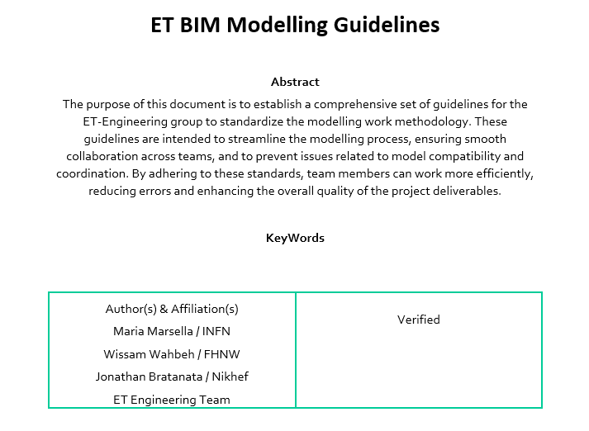
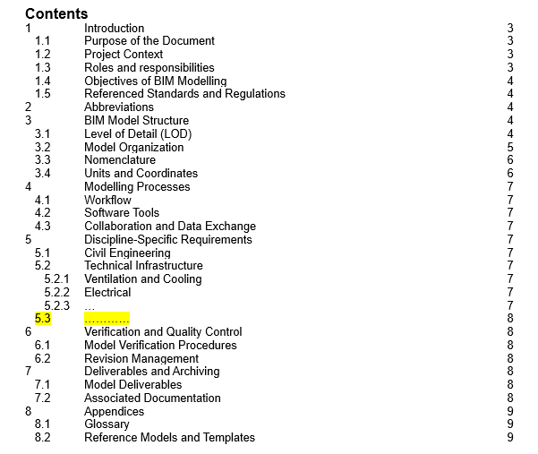
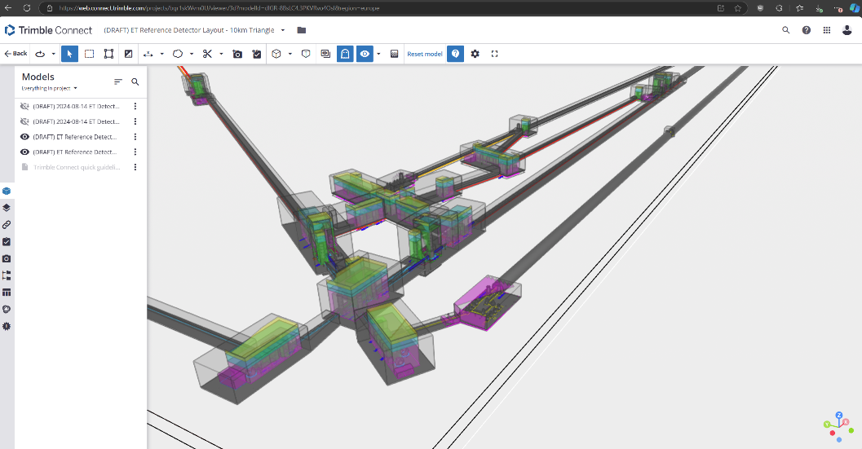
ET BIM Modelling Guidelines and Coordination
Proposed coordination approach for the BIM modelling activities
Intended to establish guidelines and processes to ensure effective collaboration and a well-coordinated model across all involved disciplines.
To prevent issues related to model compatibility and coordination

Slide 13
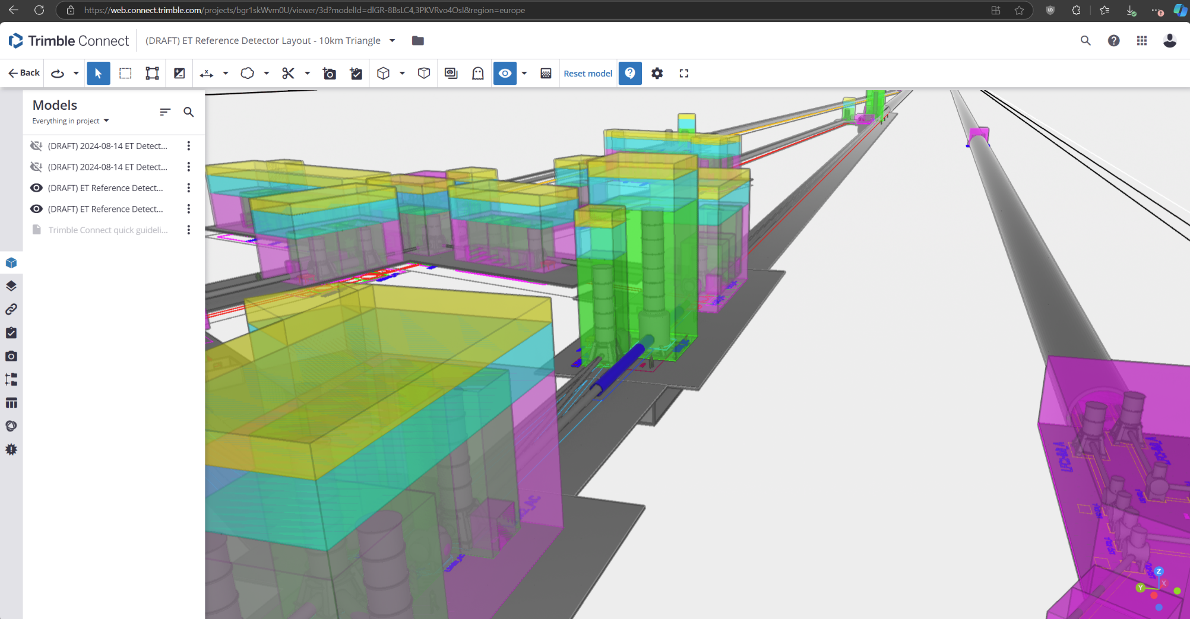
Trimble Connect platform for Modeling Coordination
Link to model available on the ET Wiki https://wiki.et-gw.eu/ED/WebHome

Slide 14
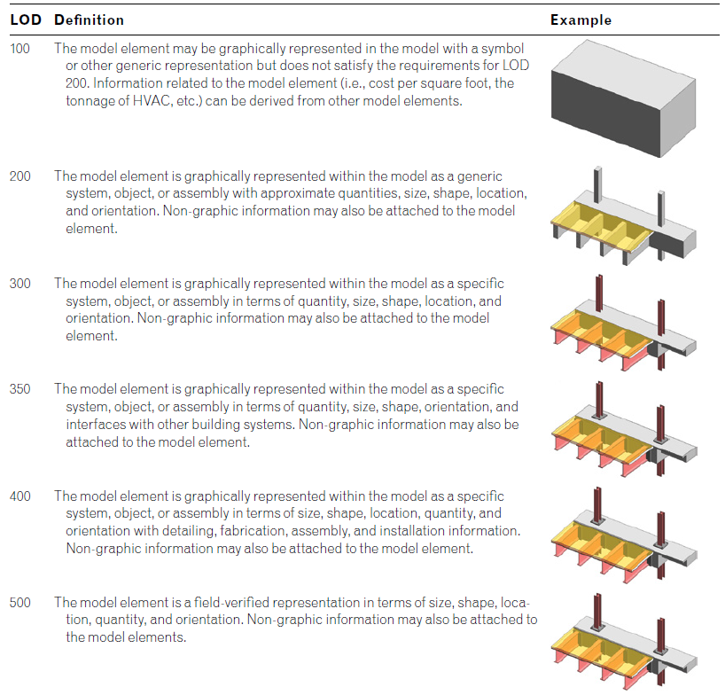
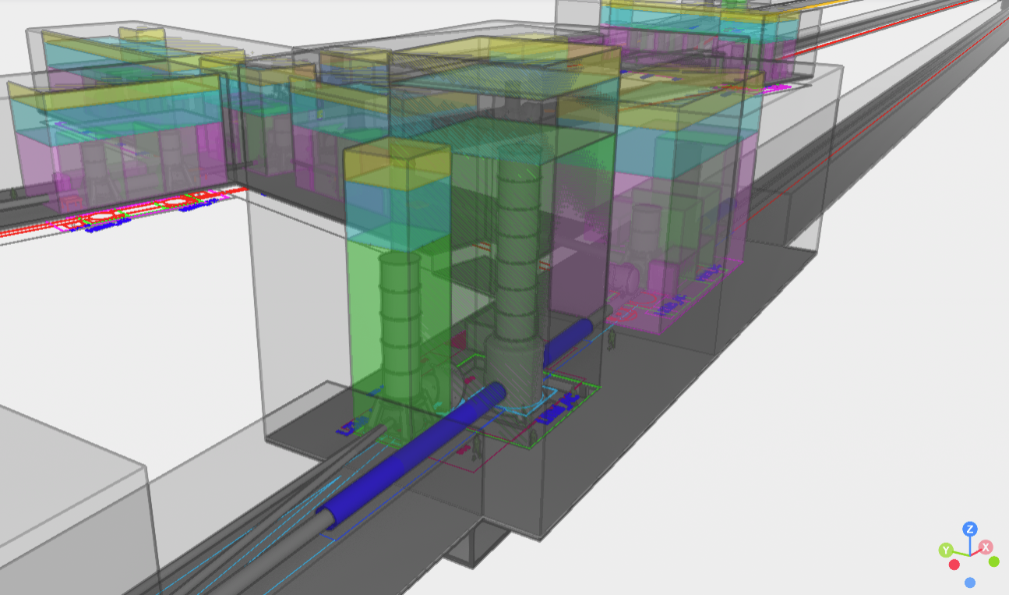
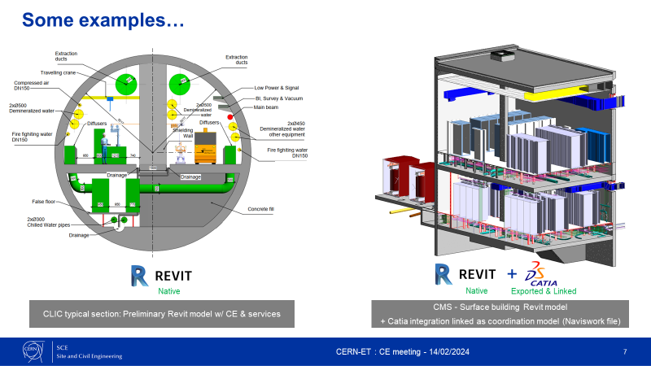
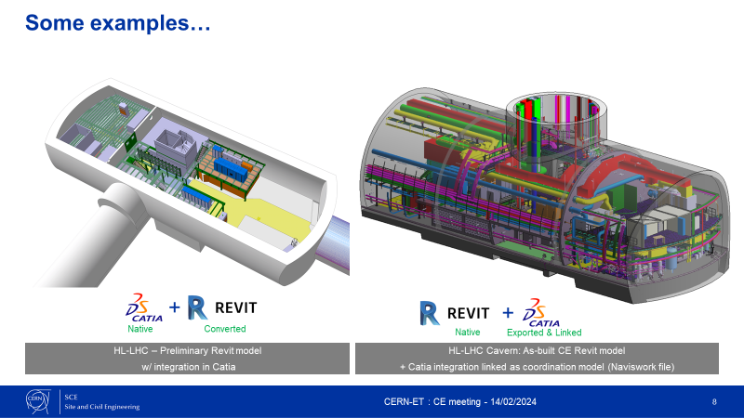
Level of Detail (LoD) expected from all disciplines
Expected min. LoD from all disciplines

Slide 15
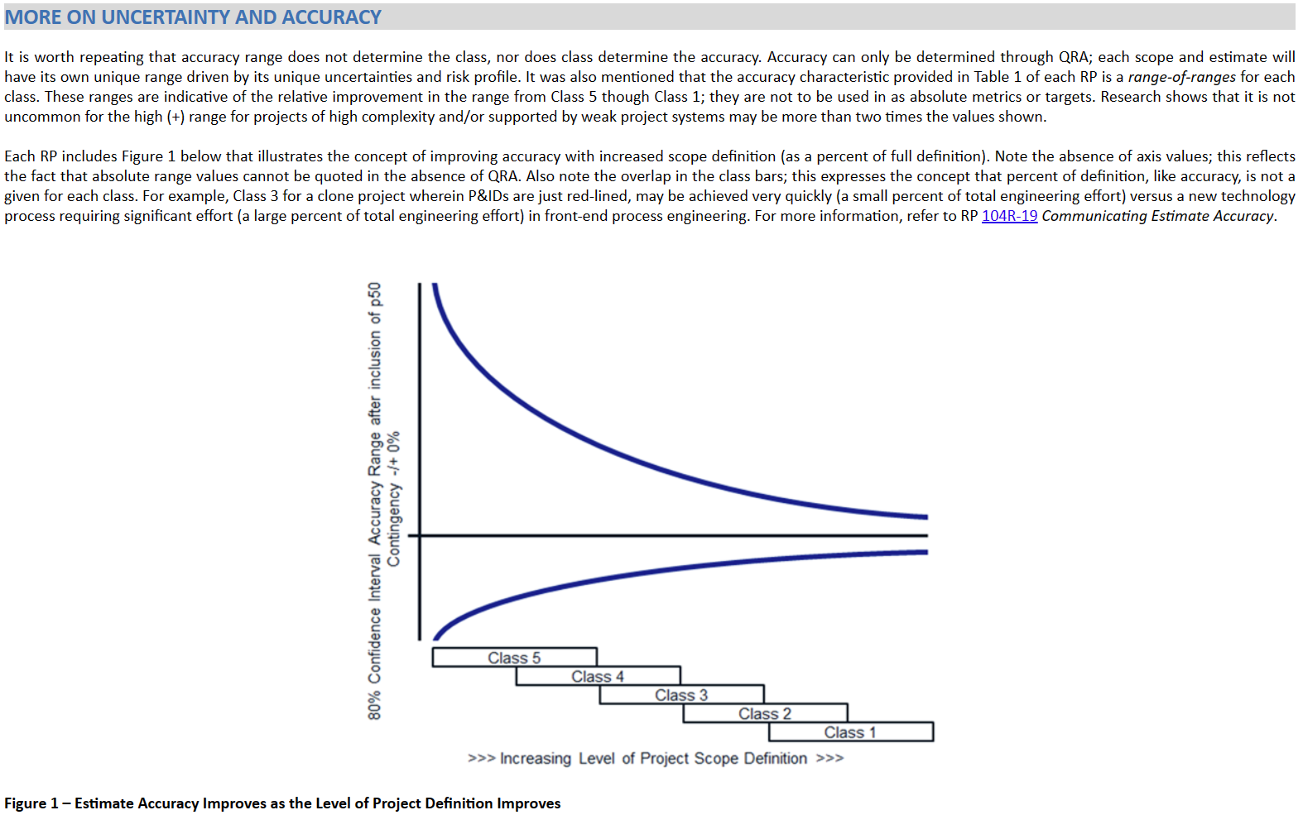
Cost Estimation Approach – Methodology & Preliminary Estimations?
AACE do not fully fits civil engineering estimate
Quality check estimation
Combine multiple Recommended Practice (RP)
Detail requirements, processes, methods, and plans
A Class is associated to a maturity level
Identify indicators/deliverables and a MATURITY MATRIX
Initial desired range for Phase 1
Setup Guidelines and Standards for ET (CE related) cost estimation
Discussion and approval in agreement with LTs of a checklist for the extent and maturity level (degree of completion) of expected deliverables
To make possible to compare the level of detail of the local teams’ cost estimates

Slide 16
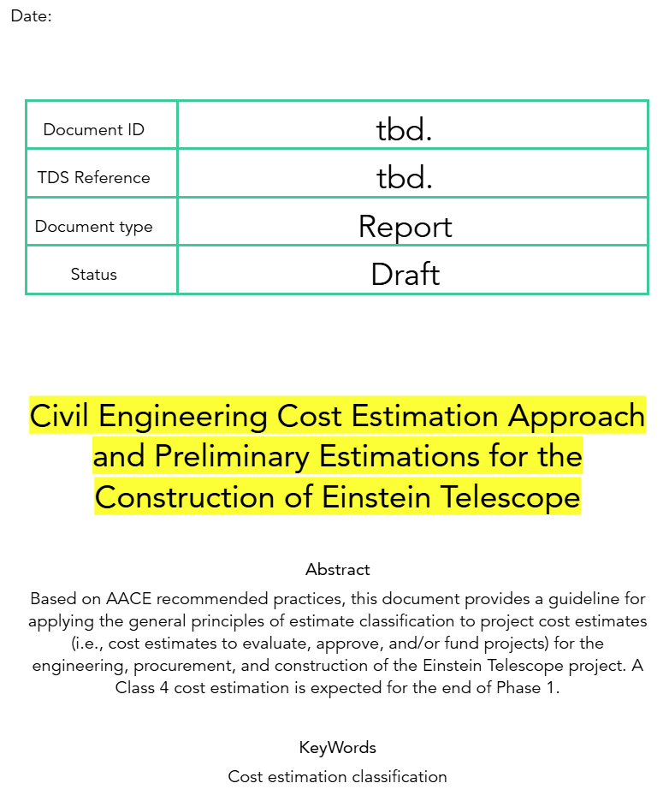
Cost Estimation Approach – Methodology & Preliminary Estimations?
The assessment of ET costing for the entire infrastructure requires preliminary estimates of CE impact.
CE costing estimates will gradually improve as local site investigations progress.
A significant portion of CE costs depends on construction solutions and site characteristics; therefore, the methodology should be consistent and comparable.
Provide a framework document outlining various methodologies to follow (e.g., AACE).
Include all existing assessments (such as CERN standards, local estimates, and various studies).
Highlight the main factors that contribute to and affect CE costs.
Provide an update on the estimates previously extracted for the old layout, expanding them to accommodate the new layout alternatives.

Slide 17
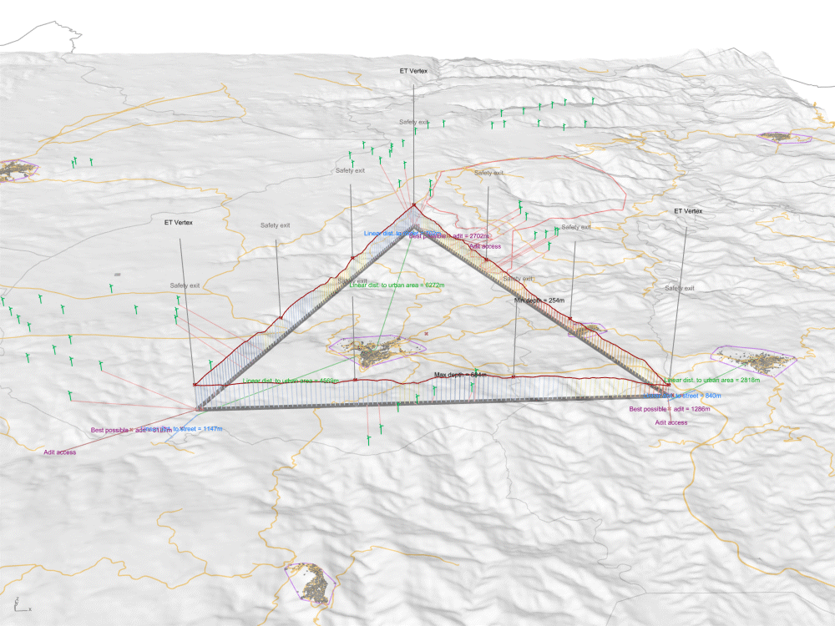
Outlook: Model-based parametric design and analysis
Parametric Design is a methodology used in civil engineering that employs parametric modeling techniques to create, analyze, and optimize designs. It integrates the use of a digital model with parameters and rules to define the geometry, behavior, and relationships of the design components.
We developed already in collaboration with the INFN a multi-criteria analysis tool to determine the optimal positioning of the infrastructure. This approach evaluates various criteria to ensure the location is defined based on: Environmental and contextual considerations and alignment with project objectives to reach Cost-effectiveness and feasibility.

Slide 18
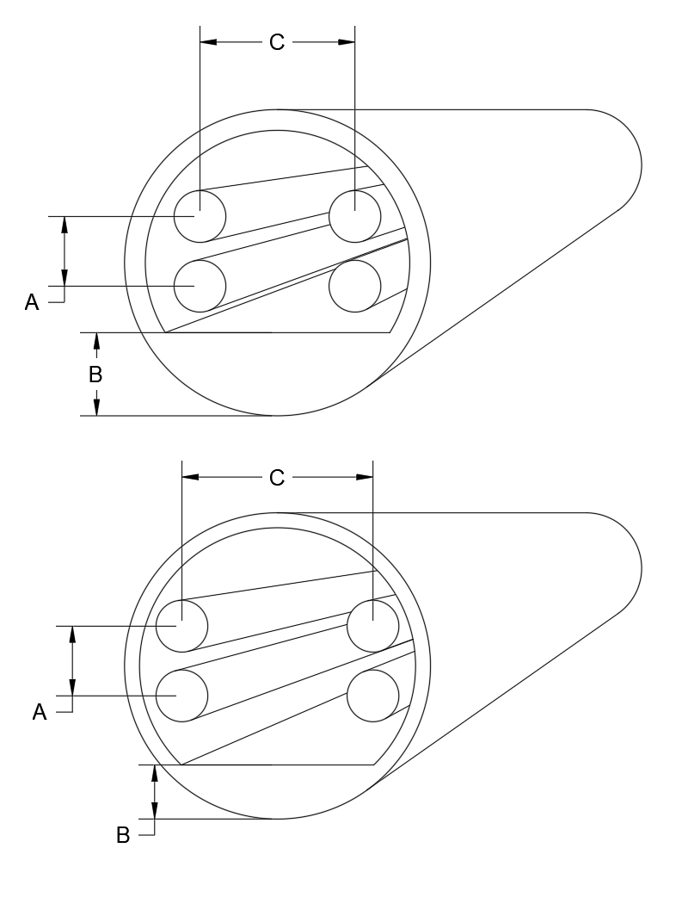





Outlook: Model-based parametric design and analysis
We propose to adapt parametric design methodology leveraging 3D models of the infrastructure not merely as a means of geometrical representation but as a versatile tool to:
Compare alternative scenarios and situations.
Perform real-time analyses (e.g., costs, quantities).
Automate solution generation where feasible.
This approach enhances efficiency, adaptability, and decision-making throughout the design process.
Option A
Cost
Parametric model
Real time Calculation
Parameters set 1
Comparison
Option X
Validation
Decision making
Parameters set 2
Multi objective optimization
Automatic fit models proposals
Criteria to be considered

Slide 19

Thank you!

Slide 20
Key issues
Interacting with various stakeholders is challenging.
Timelines are beyond our control.
Develop and utilize a temporary tool to manage information and datasets.
Focus on the details of the deliverables' content.

