Slide 1

ET Reference Detector Layout – 10km Triangle
M.B. Majoor
on behalf of
Einstein Telescope Organisation
in collaboration with
Vacuum & Cryogenics and Suspension Division

Slide 2
Strategy
Scope
Phases
Step-by-step breakdown

Slide 3
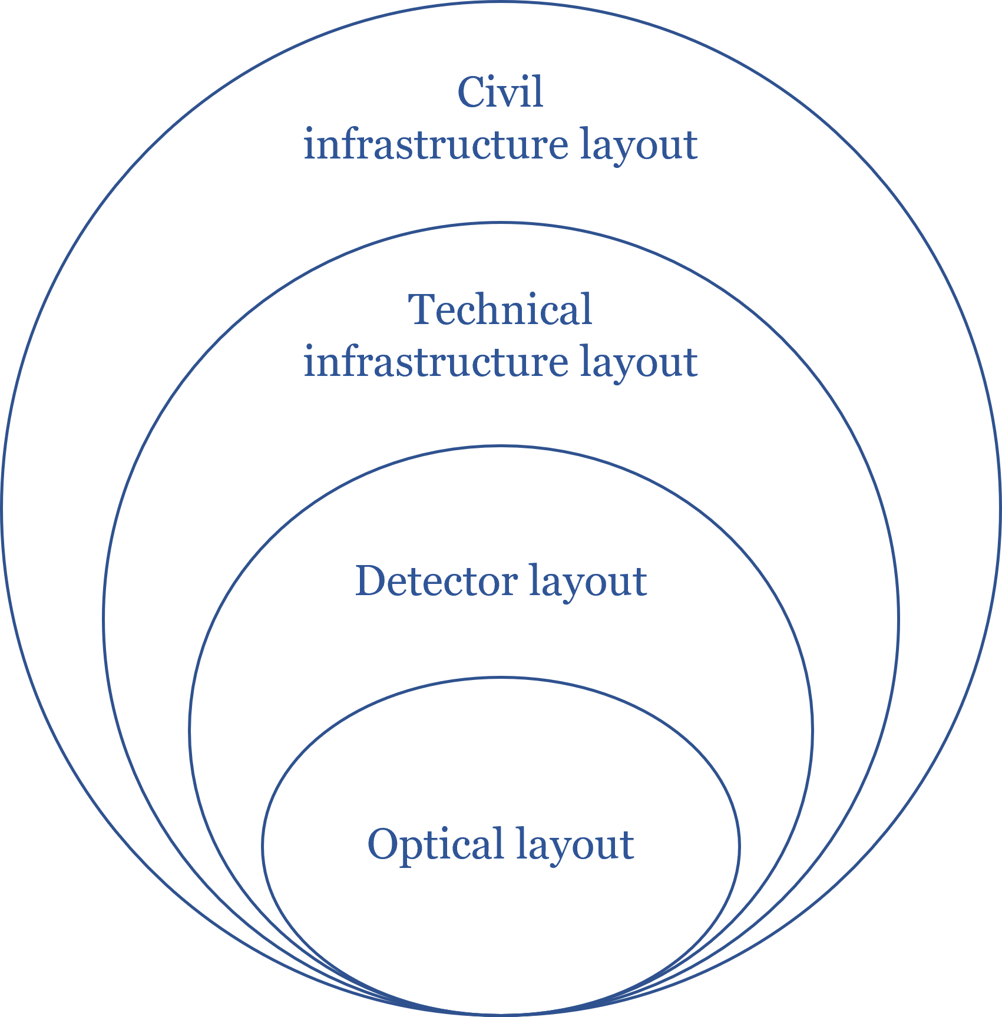
Scope + Aim
Detector layout
Optical layout
“The whole set of optical components, both core and auxiliary, with their locations and orientation.”

Slide 4
Scope + Aim
ASSUMPTIONS! PRELIMINARY!
Optical layout
Detector layout
Tower design (footprint, height, accessibility, etc.)
Auxiliary benches
Cleanroom requirements and footprint
Linking pipes, cryogenic pumping sections, gate valves
Logistics (volume envelope, entrance points, paths)
Infrastructure rooms (noisy, electronics, etc.)
Optical flexibility options (filter cavities, IMC-cavities)
Focus on inputs that have big impact on Civil Engineering
Does not discuss any technical design, only provides volume envelopes
1st ITERATION
“The whole set of optical components, both core and auxiliary, with their locations and orientation.”
“OL + volume claims for the suspension systems, vacuum envelopes, scaffolding, cleanrooms and auxiliary (un-isolated) optical tables”

Slide 5
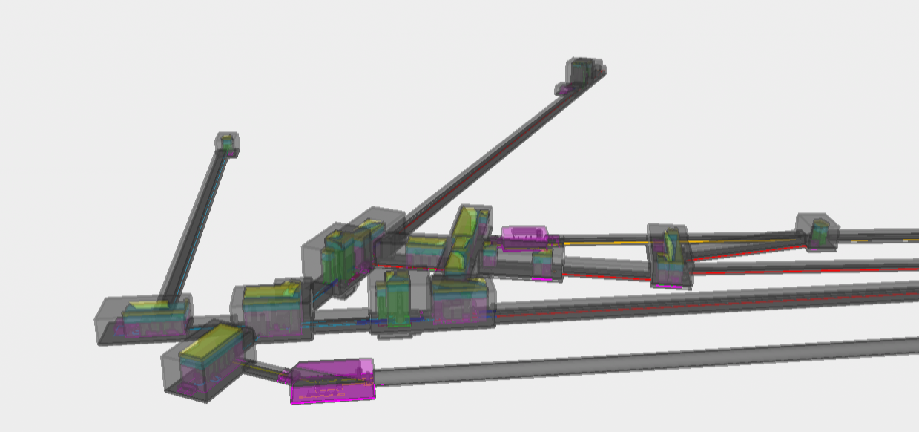
Scope + Aim

Slide 6
Phases
Following CERN approach from FCC Cost & Schedule Study
Phase 1: Objective = Baseline Design (Cost & Schedule)
  Collecting first inputs
  Resolving first clashes
  First try in mapping ET Detector -> Baseline (startpoint)
Phase 2: Objective = Alternative Designs (Cost & Schedule)
  Analyzing (review + studying different options)
  Optimizing
Phase 3: Objective = Detailed Design (Cost & Schedule)
  Analyzing
  Detailing
  Optimizing
Each phase consists of sub-phases (Phase N.n)

Slide 7
Phase 1 – Collecting inputs
Numerous meetings with Vac&Cryo Div.
  Discussions on tower access, cleanrooms, scaffolding, cryogenic pumping sections and noisy rooms
Joint activities with Susp Div.
  Preliminary suspension classification -> Susp MEMO
Interferometer Div
  Exploring optical flexibility envelope with Layout WP’s
  Effort in optimizing LF FC with Squeezing WP
  Assessing footprints of auxiliary benches with Aux. Opt. WP

Slide 8
Step-by-step breakdown
/ build-up
1) Optical layout provides positions (nodes) on which the detector layout is constrained

Slide 9
Step-by-step breakdown / build-up

Slide 10
Step-by-step breakdown / build-up

Slide 11
Step-by-step breakdown / build-up

Slide 12
Step-by-step breakdown / build-up
Tower volume involves:
Tower base footprint (ISB WP4.1)
Effort in categorizing tower base types (ongoing)
Tower height (ISB Susp. Div)
Effort in categorizing suspension types (Susp. MEMO)
S_{n}
B_{n}
P_{n}

Slide 13
Step-by-step breakdown / build-up

Slide 14
Step-by-step breakdown / build-up

Slide 15
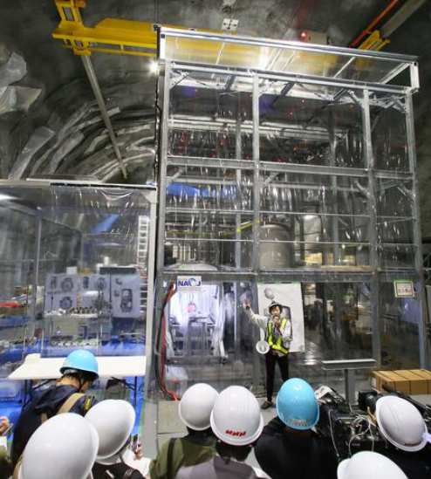
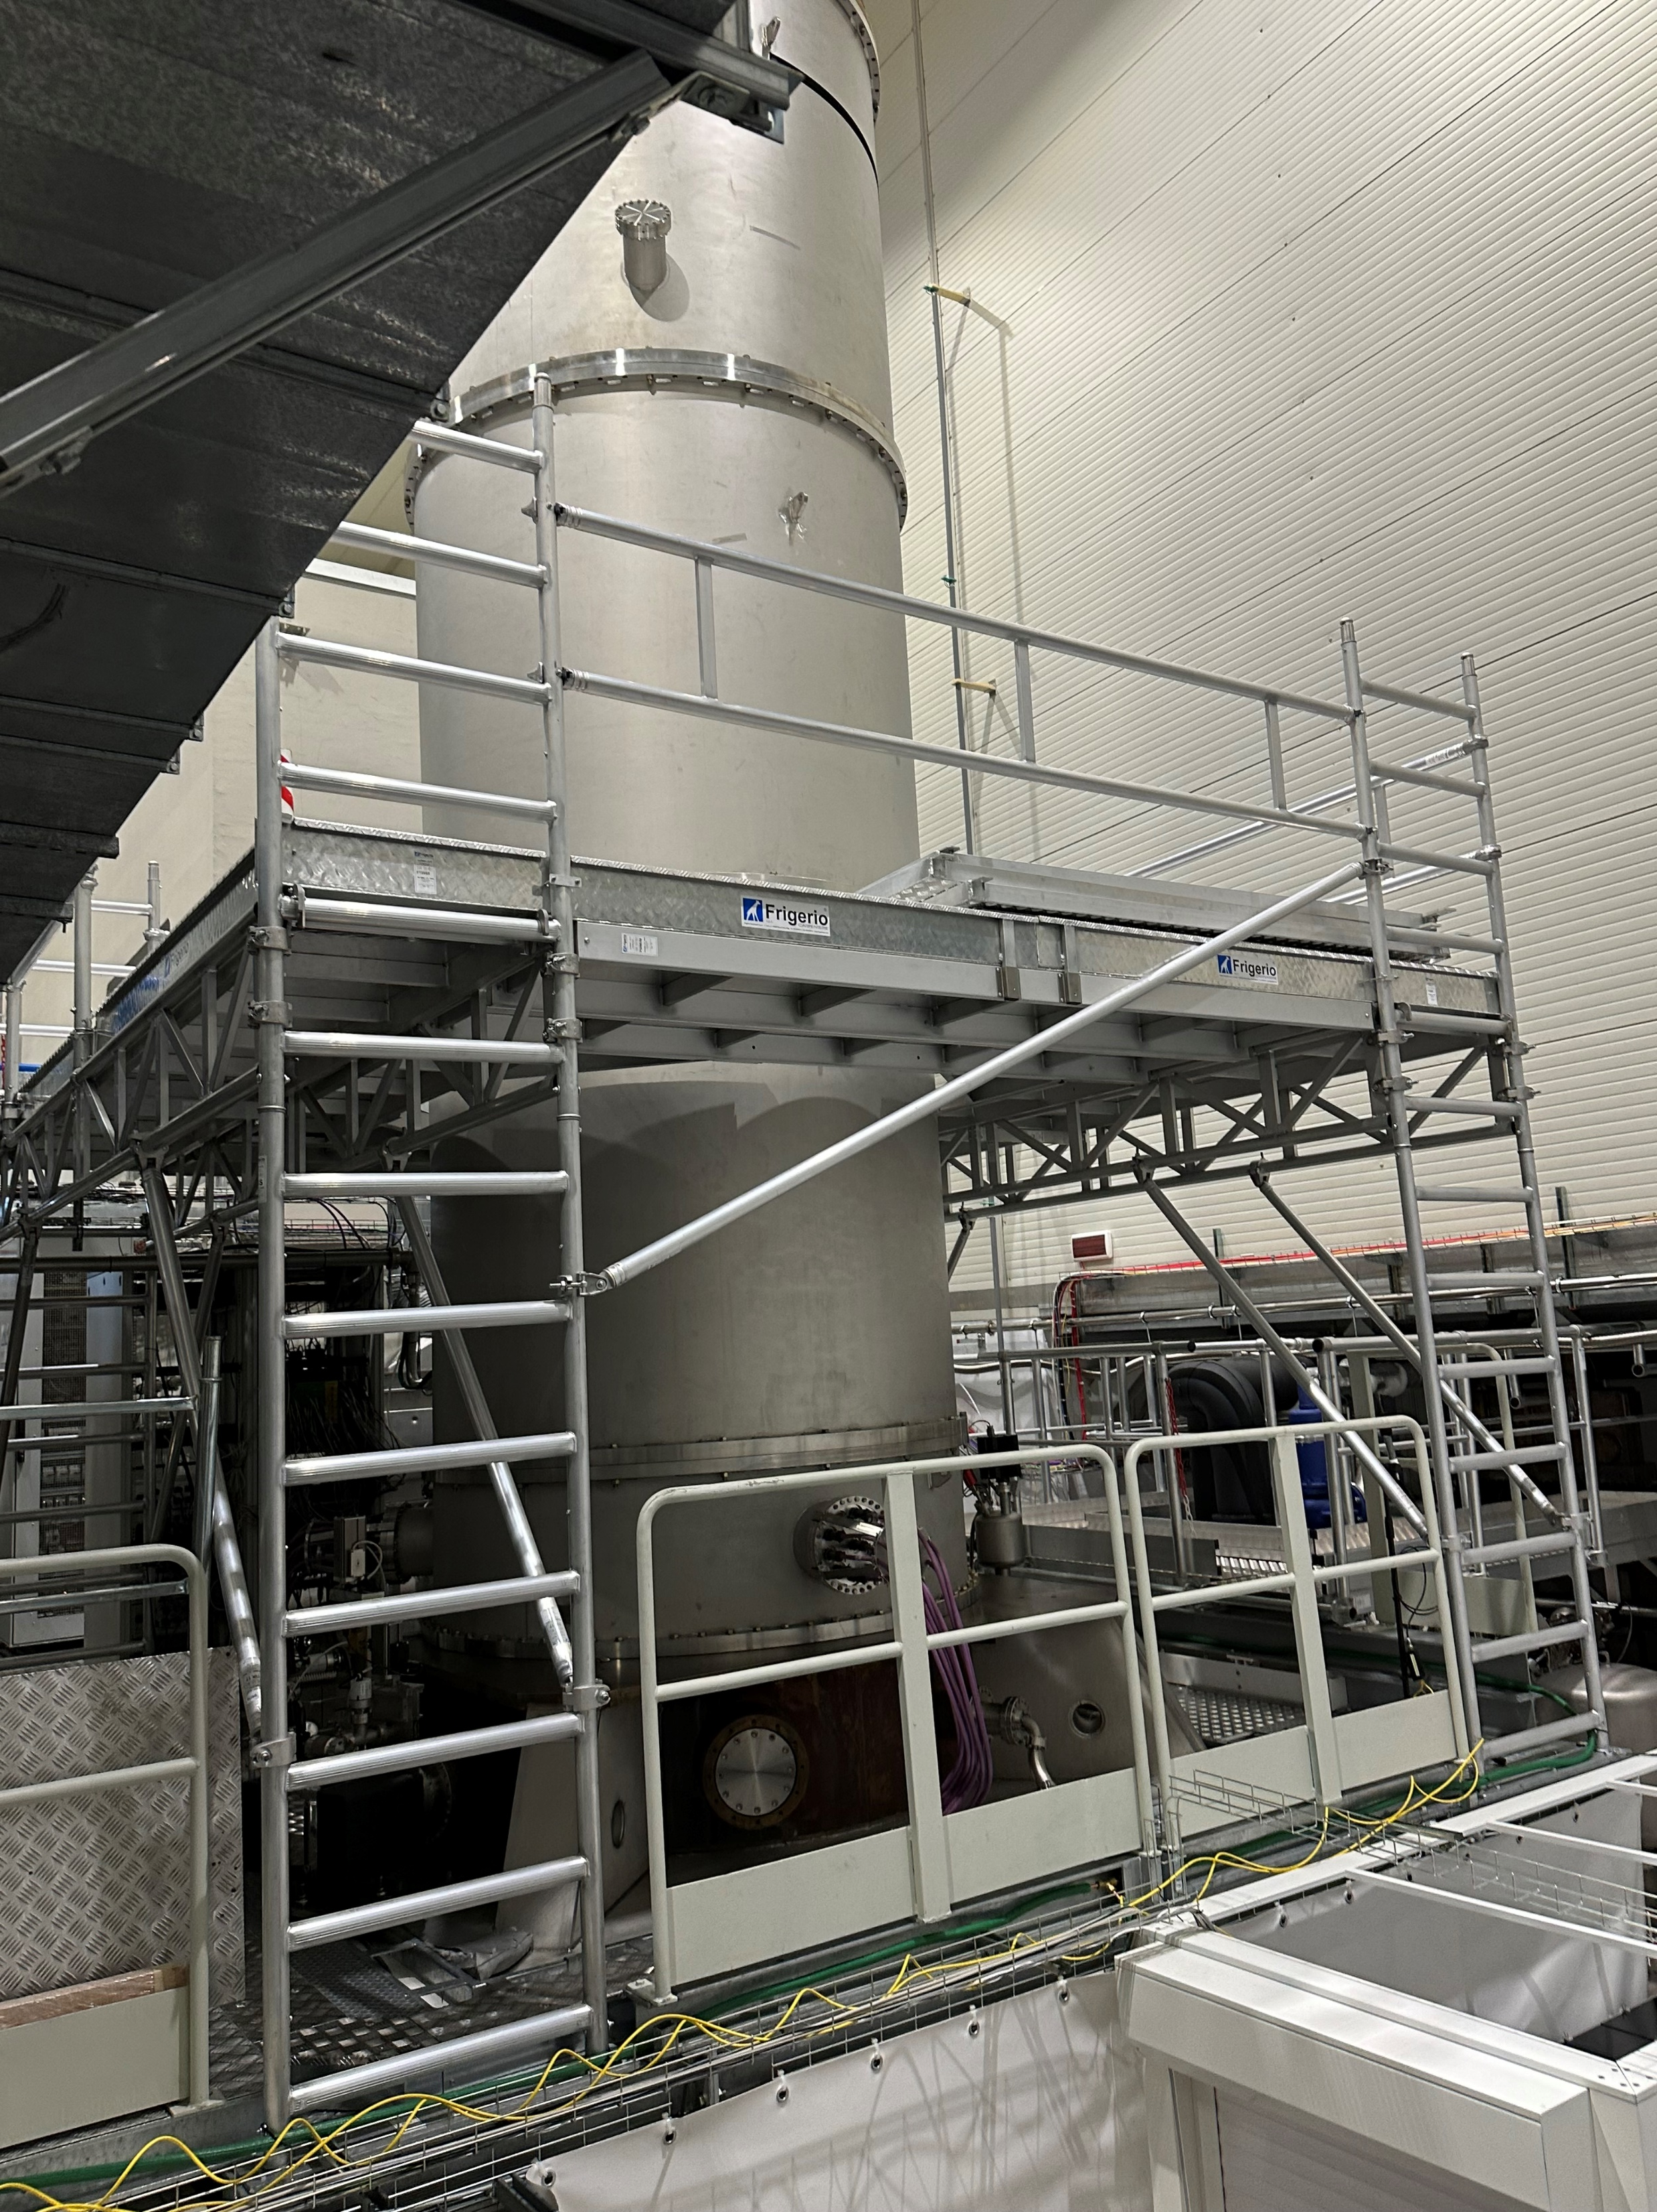
Step-by-step breakdown / build-up
Tower scaffolding
Footprint parametric to tower base
Height constrained by suspensions
Provides space for operation and possibly e-racks

Slide 16
Step-by-step breakdown / build-up
Xm
Xm
X+1m
X+3m
Tower scaffolding
Footprint parametric to tower base
Height constrained by suspensions
Provides space for operation and possibly e-racks
Can be combined for multiple tower vessels if distance between optics <10m

Slide 17
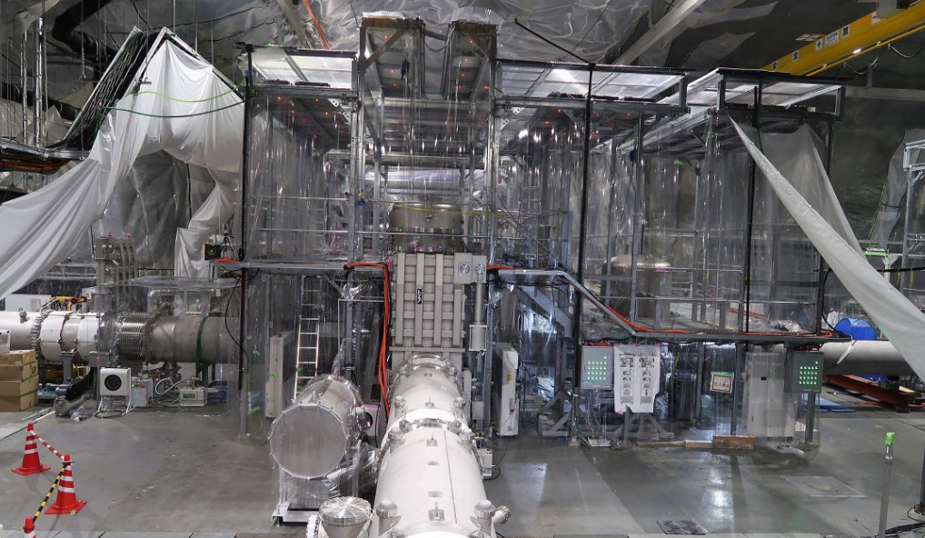
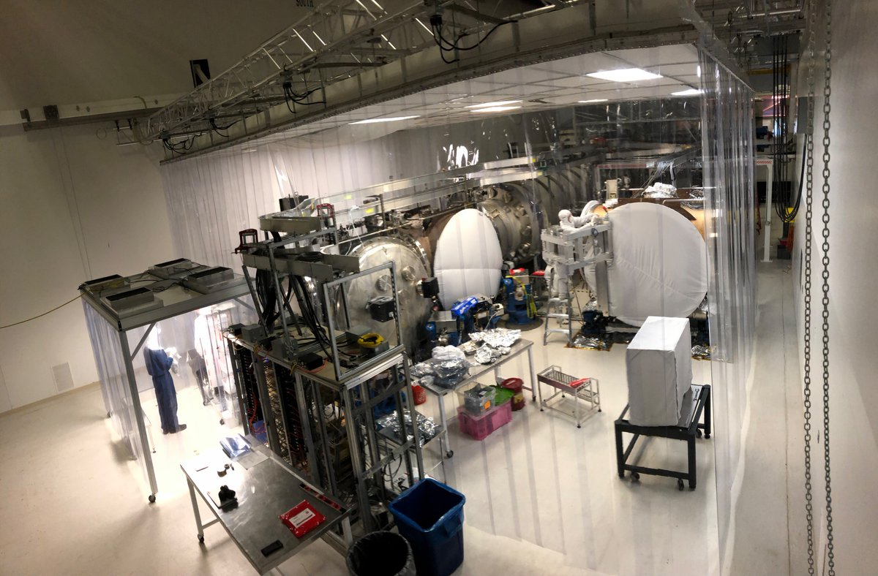
Step-by-step breakdown / build-up
Cleanroom;
ISO 5 lateral tower access, ISO 7 environment around tower scaffolding
Similar to a KAGRA-like solution

Slide 18
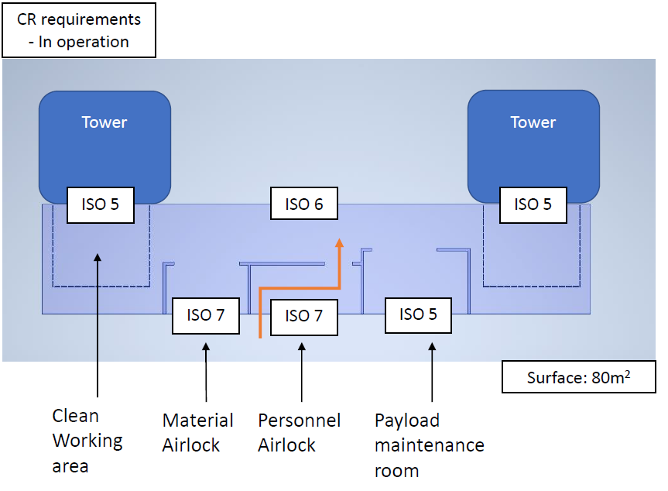
Step-by-step breakdown / build-up
Cleanroom;
ISO 5 lateral tower access, ISO 7 environment around tower scaffolding
Similar to a KAGRA-like solution

Slide 19
Step-by-step breakdown / build-up
Cleanroom;
ISO 5 lateral tower access, ISO 7 environment around tower scaffolding
Similar to a KAGRA-like solution
Can be combined for multiple tower vessels if distance between vessels <10m

Slide 20
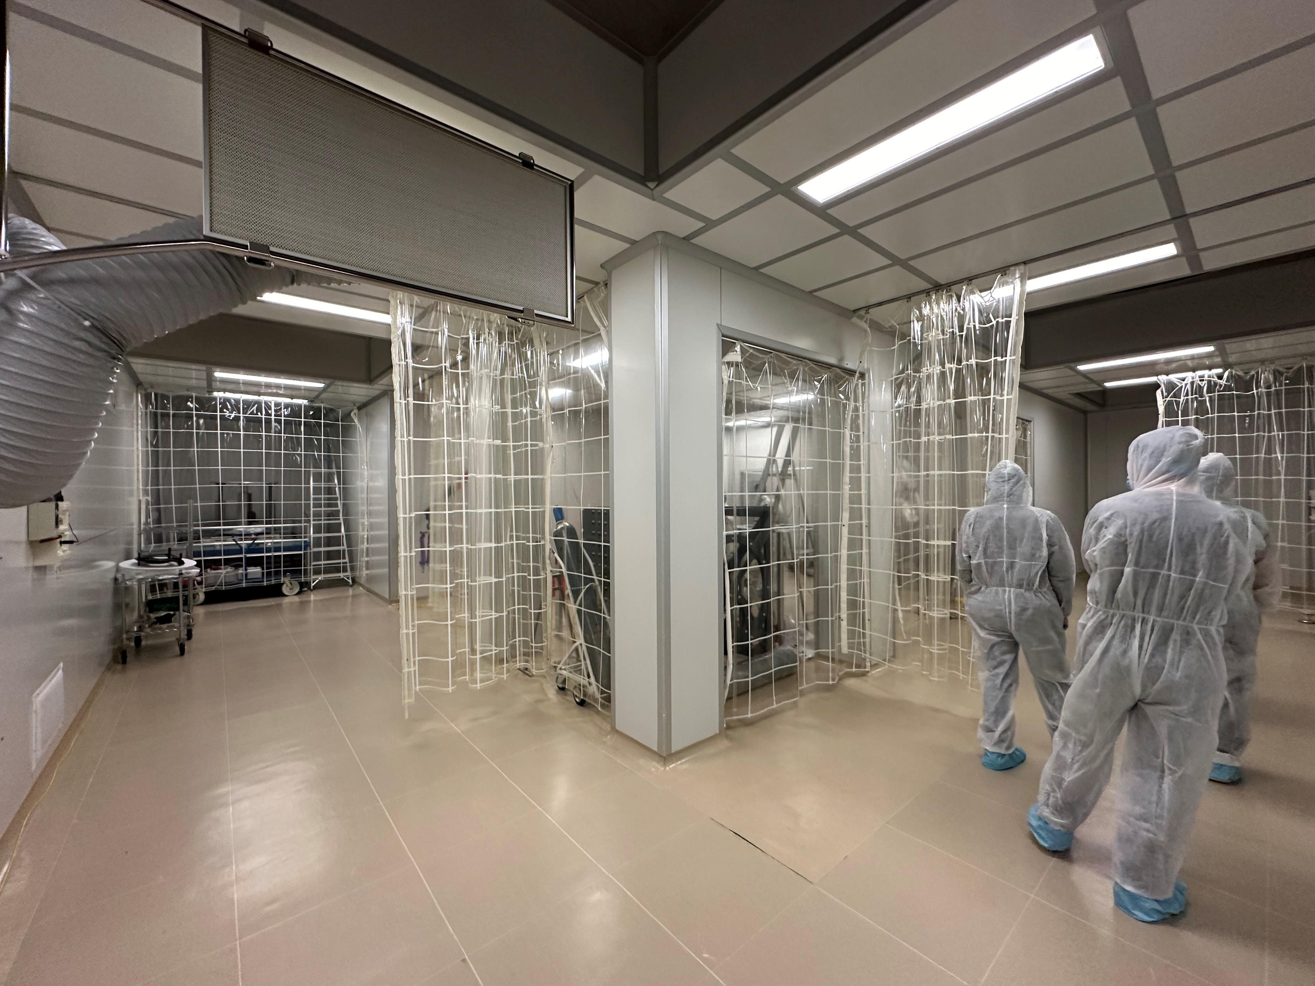
Step-by-step breakdown / build-up
Cleanroom;
ISO 5 bottom tower access, ISO 7 environment around tower scaffolding
Similar to a Virgo-like solution

Slide 21
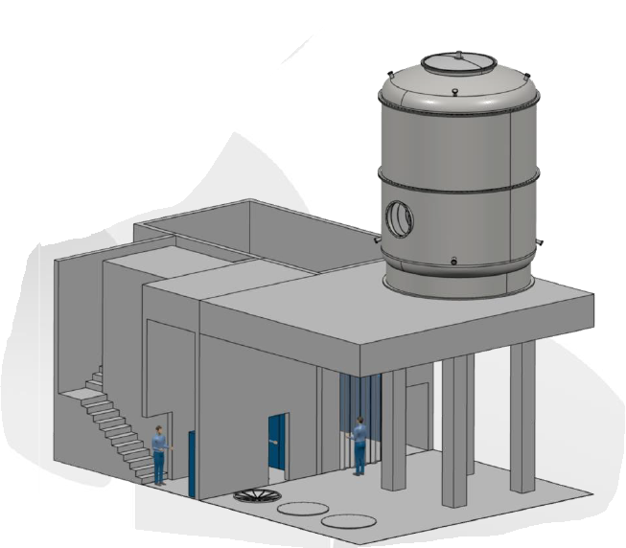
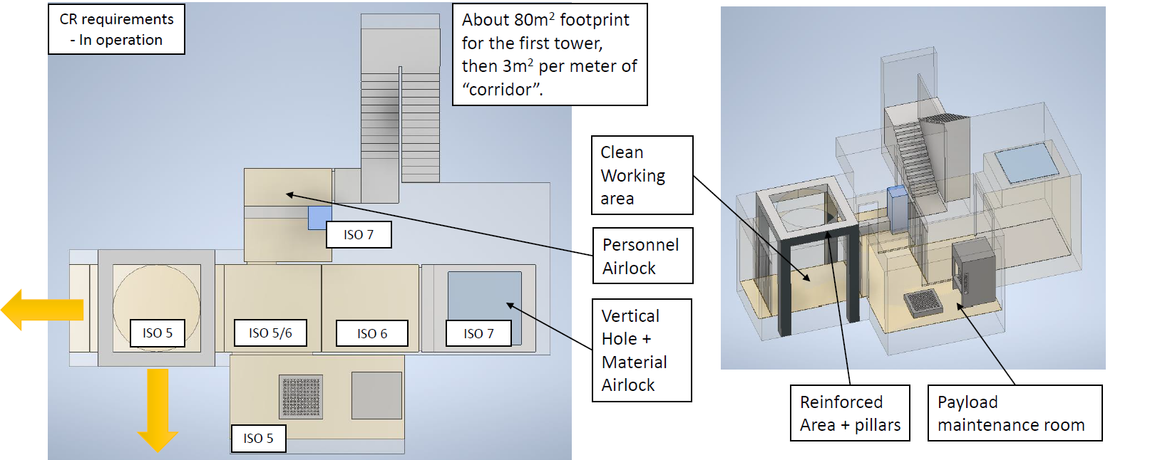
Step-by-step breakdown / build-up
Cleanroom;
ISO 5 bottom tower access, ISO 7 environment around tower scaffolding
Similar to a Virgo-like solution

Slide 22
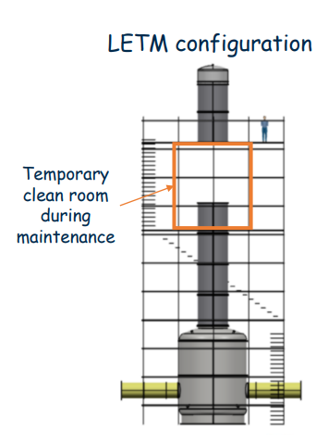
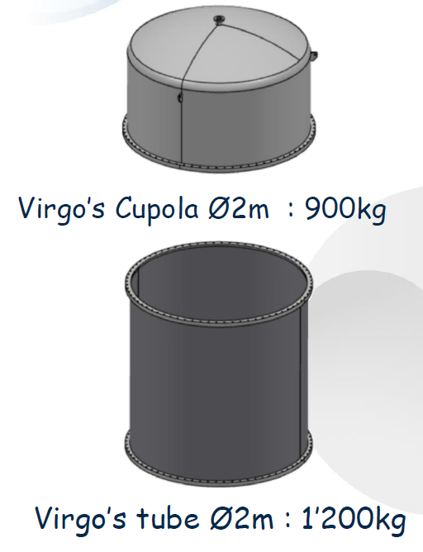
Step-by-step breakdown / build-up
Clearance for hoisting;
2x ring-height
Hring = 2m → 4m clearance
Source: G. Iaquaniello - ET-0439D-24

Slide 23
Step-by-step breakdown / build-up
Clearance for crane;
Assumed 2m
Volume envelope:
Height = Tower (suspension) + hoisting + crane
Footprint = tower (base) + scaffolding + cleanroom

Slide 24
Step-by-step breakdown / build-up
Clearance for crane;
Assumed 2m
Volume envelope:
Height = Tower (suspension) + hoisting + crane
Footprint = tower (base) + scaffolding + cleanroom
+ logistics
Largest volumes logistics:
Cryostat: 5.0x5.0x6.3m
Conical base: 4.0x4.0x3.0m
Beampipe segment: Ø1.3x20m

Slide 25
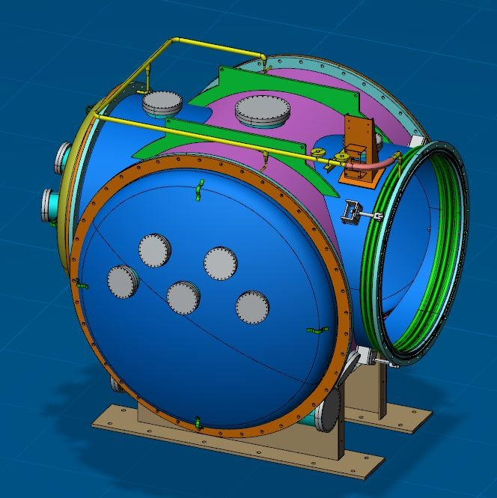
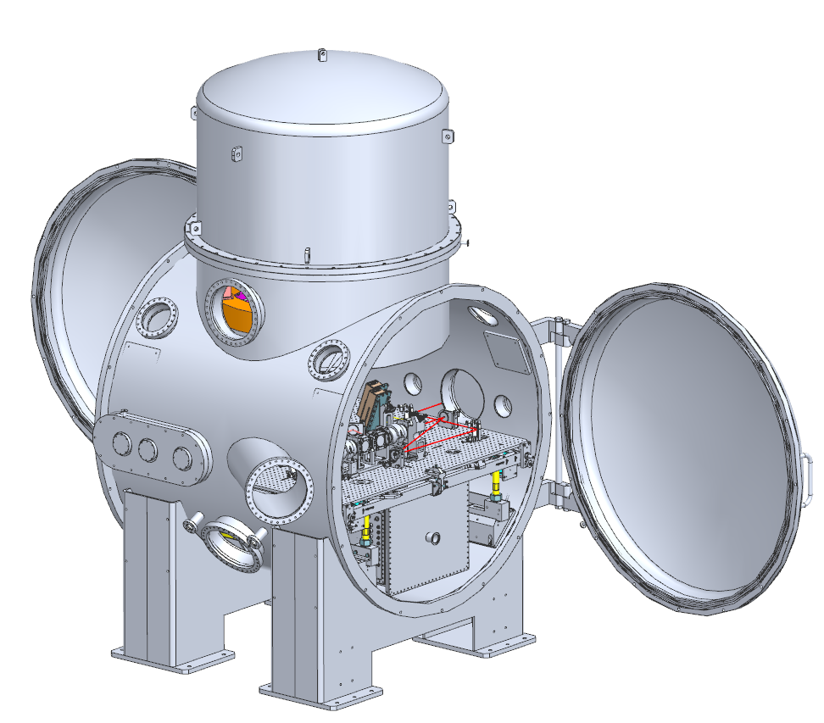
Step-by-step breakdown / build-up
Optical layout identifies 39 auxiliary benches per vertex
Only specifies estimate bench footprints
0.5x0.5m, 1.0x1.0m and 1.5x1.5m -> placeholder Virgo-like solution (in vacuum, suspended)
2.0x2.0m and 2.5x2.5m ->
placeholder LIGO-like solution (in vacuum, suspended)
In-air, not suspended TBD

Slide 26
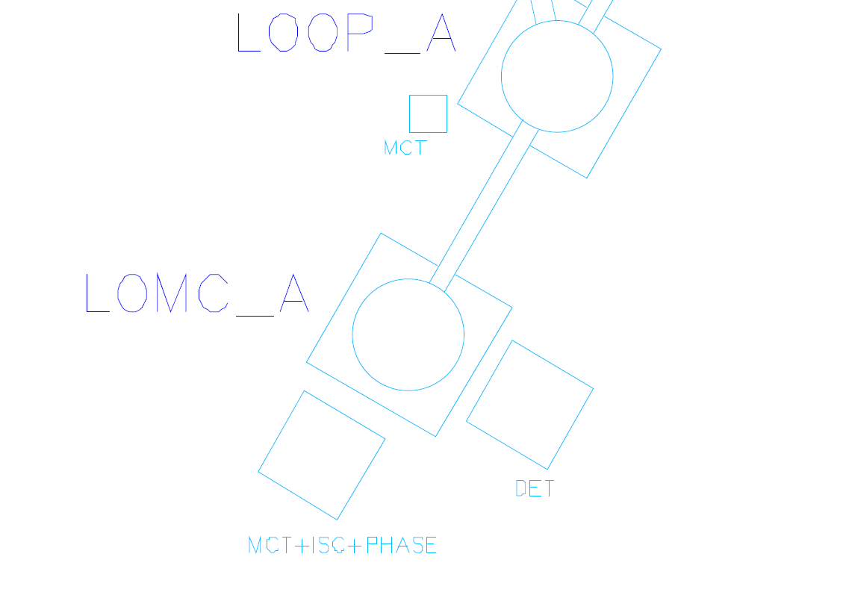
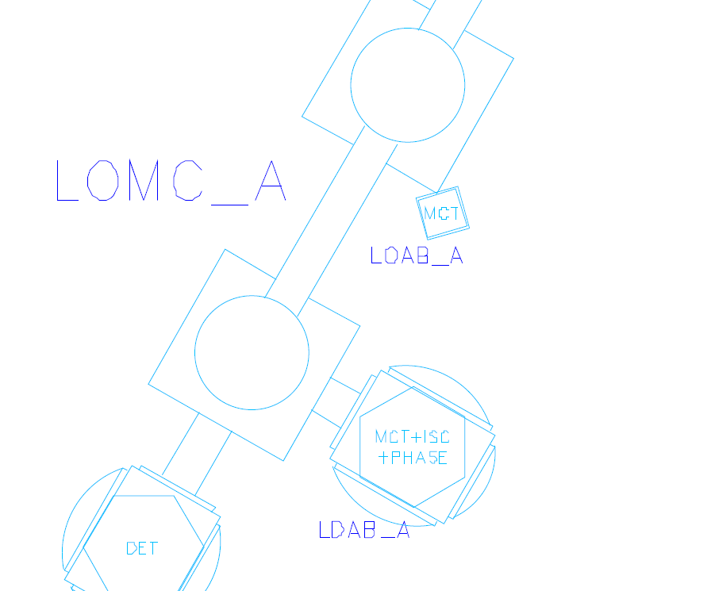
Step-by-step breakdown / build-up
→

Slide 27

Step-by-step breakdown / build-up
Linking pipe preliminary inner diameters (aperture) depending on beam radius
In-line telescopes request large aperture vacuum pipes
Cryogenic sections (except around TM’s) are TBD
Gate valves are TBD
Beam radius
Offset of laser wrt cavity long. axis
Clipping losses

Slide 28
Flexibility envelope

Slide 29
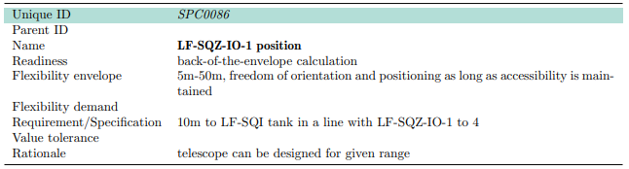
Flexibility envelope
Optical layout provides flexibility envelope
Used to (presumably) improve civil subsurface infrastructure stability
  Separation between caverns (correlated to the height of the cavern)
  Artificial limit on cavern span (25m) necessitates use of flexibility envelope
  Co-locating caverns
Differences between OL & DL nodes explained in DL report

Slide 30
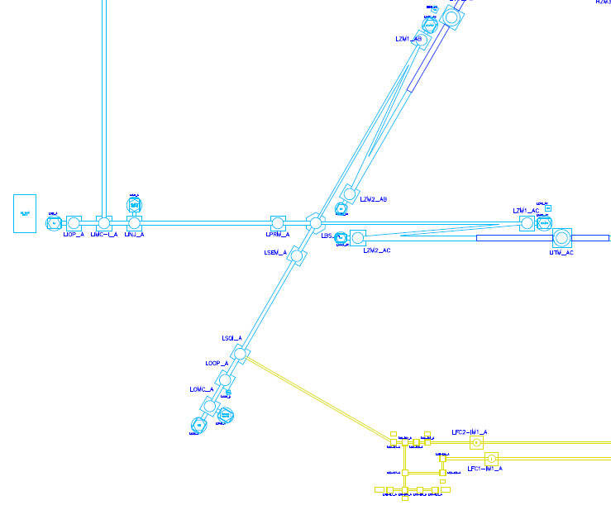
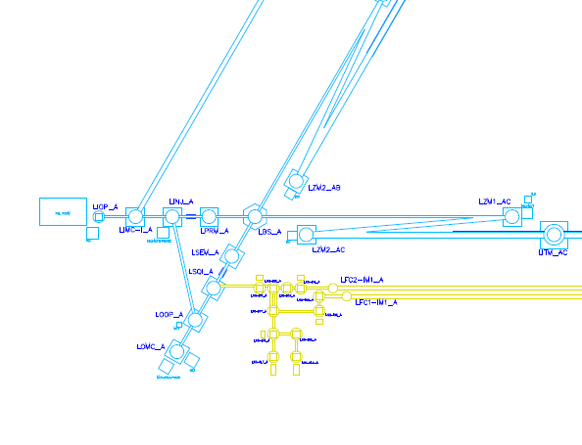
Flexibility envelope
Optical layout
Detector layout

Slide 31
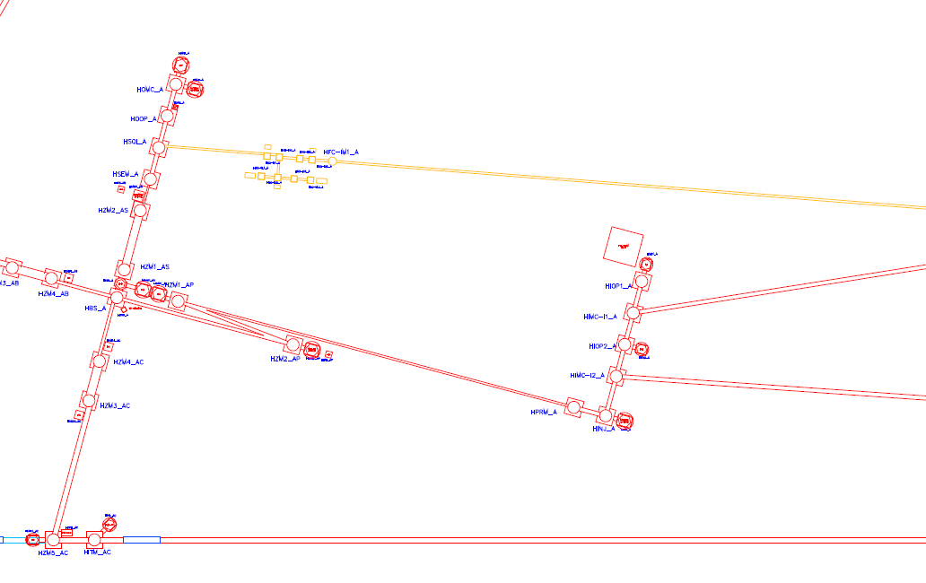
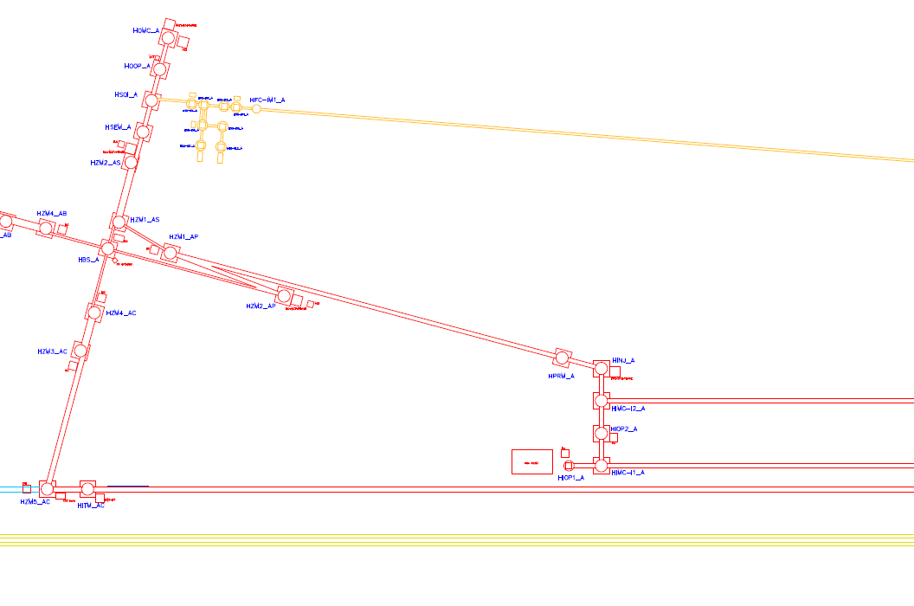
Flexibility envelope
Optical layout
Detector layout

Slide 32
Preliminary result

Slide 33
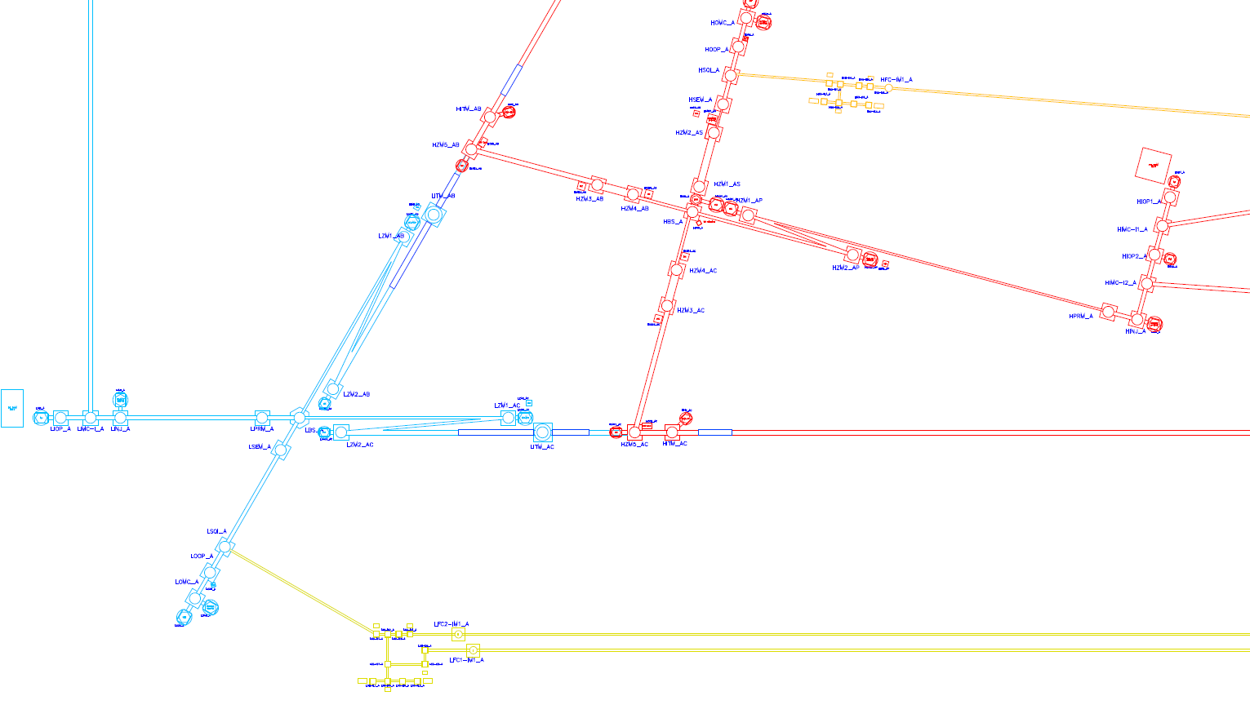
Lateral access version

Slide 34
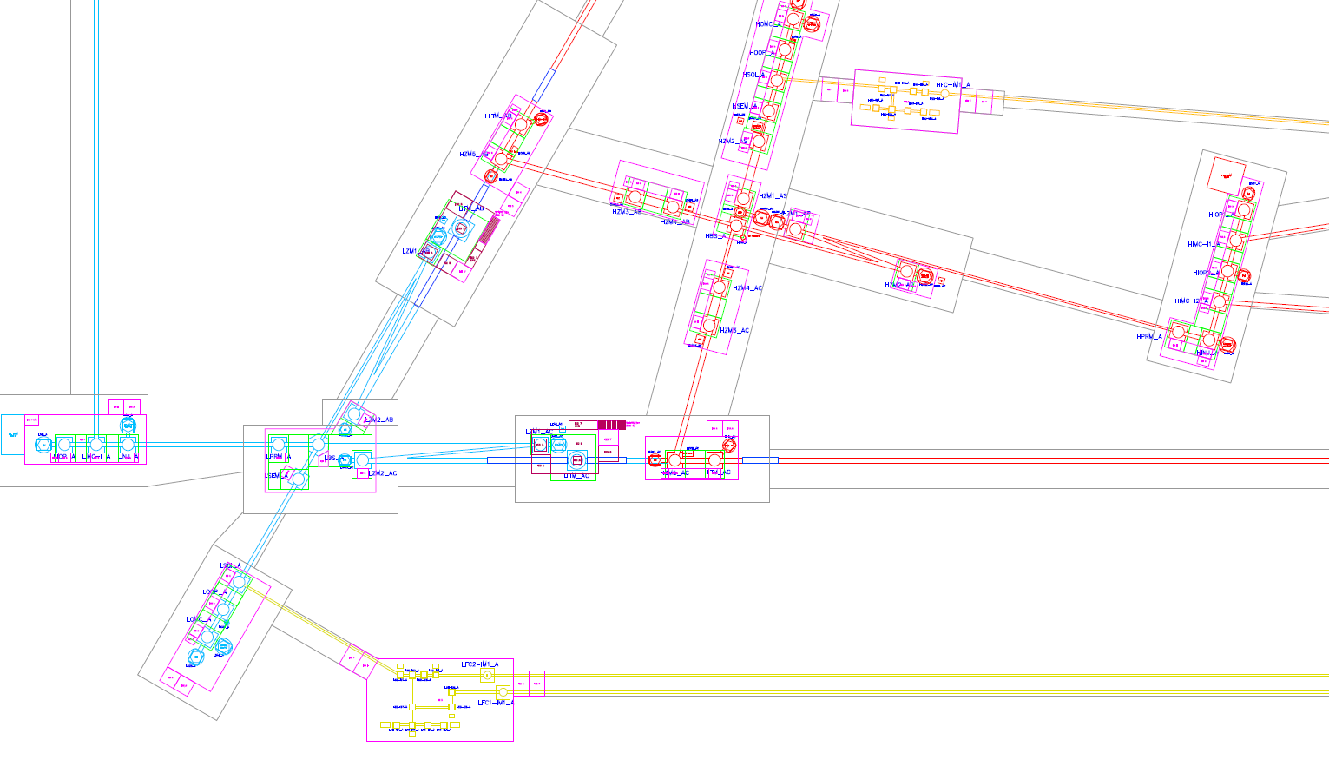
Lateral access version

Slide 35
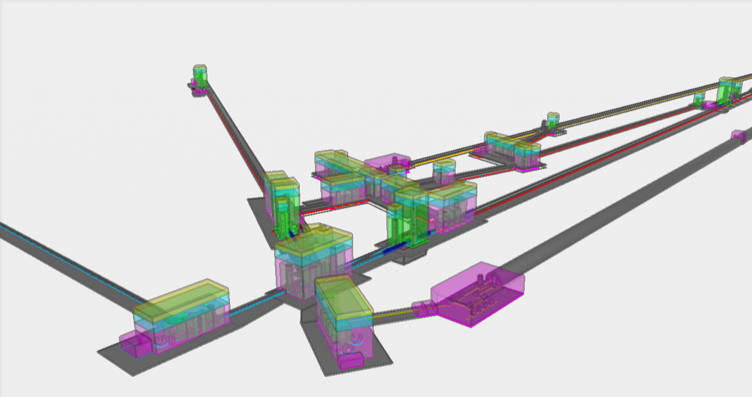
Lateral access version

Slide 36
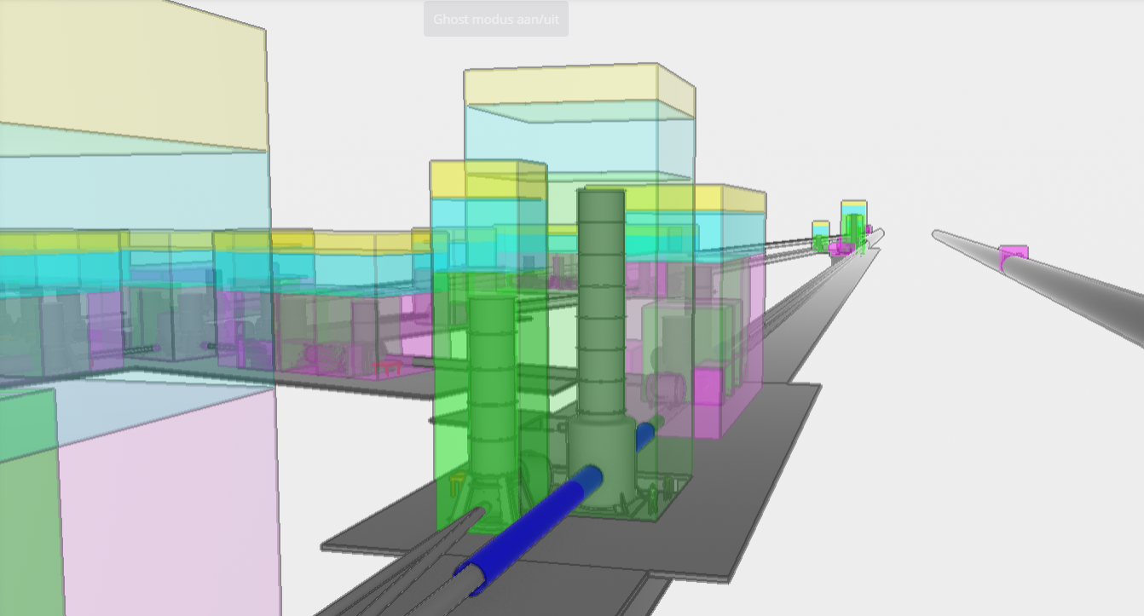
Lateral access version
Link to model available on the ET Wiki https://wiki.et-gw.eu/ED/WebHome

Slide 37
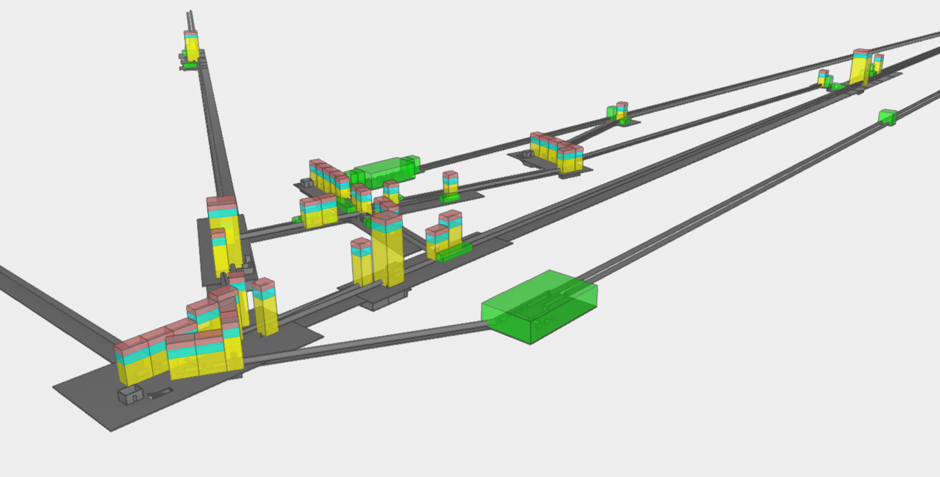
Bottom access version

Slide 38
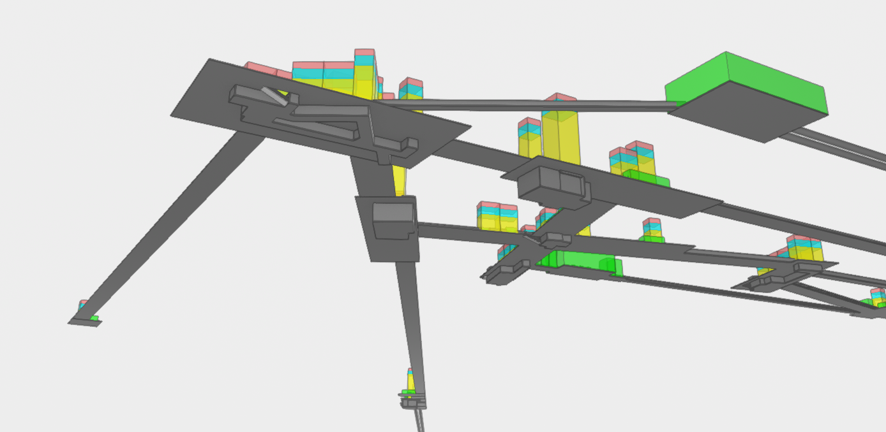
Bottom access version

Slide 39
Bottom access version
Lateral access version

Slide 40
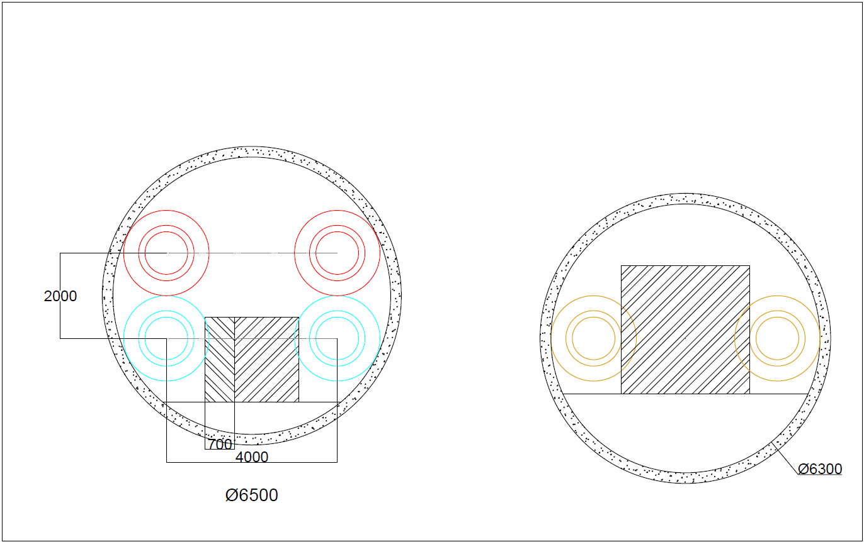
Tunnel cross-section
4m horizontal separation
2m vertical separation
0.7m safety clearance
[OSHA 1910.36(g)(2)]
1.5m transportation
Ø1.0m beampipe inner diameter [ET-0385A-24]
Ø1.3m beampipe outer diameter (rings + insulation)
0.5m welding clearance from Øinner (CERN)
1500

Slide 41
Tunnel cross-section
4m horizontal separation
2m vertical separation
0.7m safety clearance
(regulations!)
1.5m transportation
2m driven by HF tower
4m driven by LF TM
Ø6.5m tunnel envelope
Ø1.0m beampipe inner diameter
Ø1.3m beampipe outer diameter
0.5m welding clearance from Øinner
850
Supports are not included

Slide 42
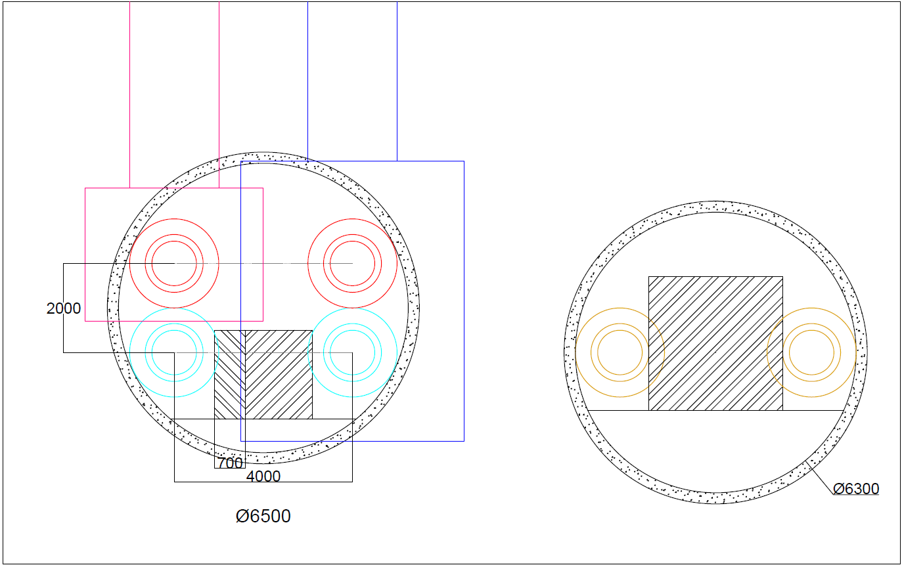
Tunnel cross-section
Ø1.0m beampipe inner diameter
Ø1.3m beampipe outer diameter
0.5m welding clearance from Øinner
3.0m transportation
through FC tunnel
Various options to reduce
volume
Higher uncertainty of
feasibility

Slide 43

Retrospective
Many discrepancies
Collaboration did not always go as smooth
Unresolved issues with this detector layout regarding envelope clashing
Feedback loop to optical layout required
Points of concern to be implemented in future studies
S_{n}
B_{n}
P_{n}

Slide 44
What’s next?
Review -> More iterations
CE Design
2L Detector Layout

Slide 45
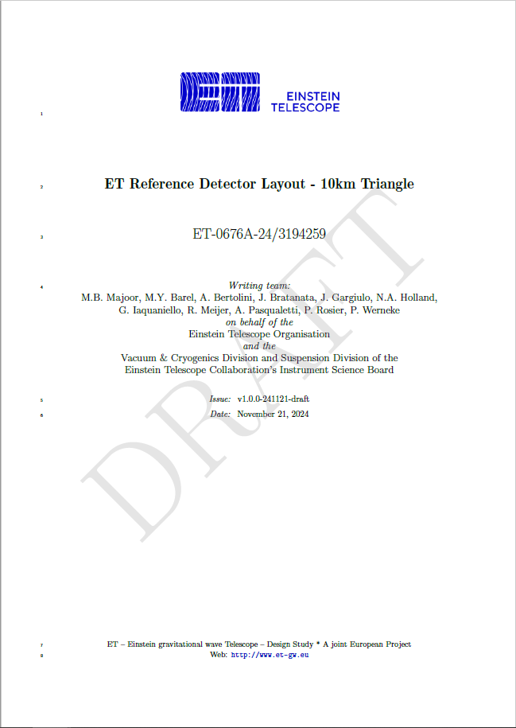
Review
Only a starting point for many iterations!
Review process!
  ETO internal
  ET Collaboration via Git-issues (similar to Optical Layout)
Implementing comments process to be organized
External review to be organized

Slide 46
CE Design
To be used by Local Teams for Civil Engineering Design
DL provides parametric envelopes, optical flexibilities can be exploited by LT
Design for construction feasibility
Cost analysis → indication for what to optimize

Slide 47
2L Detector layout
Do the exercise again
Utilizes the same input parameters
Learn from mistakes from Triangle DL
Lots of collaborating!

Slide 48
Questions?

Slide 49
Bonus slides

Slide 50
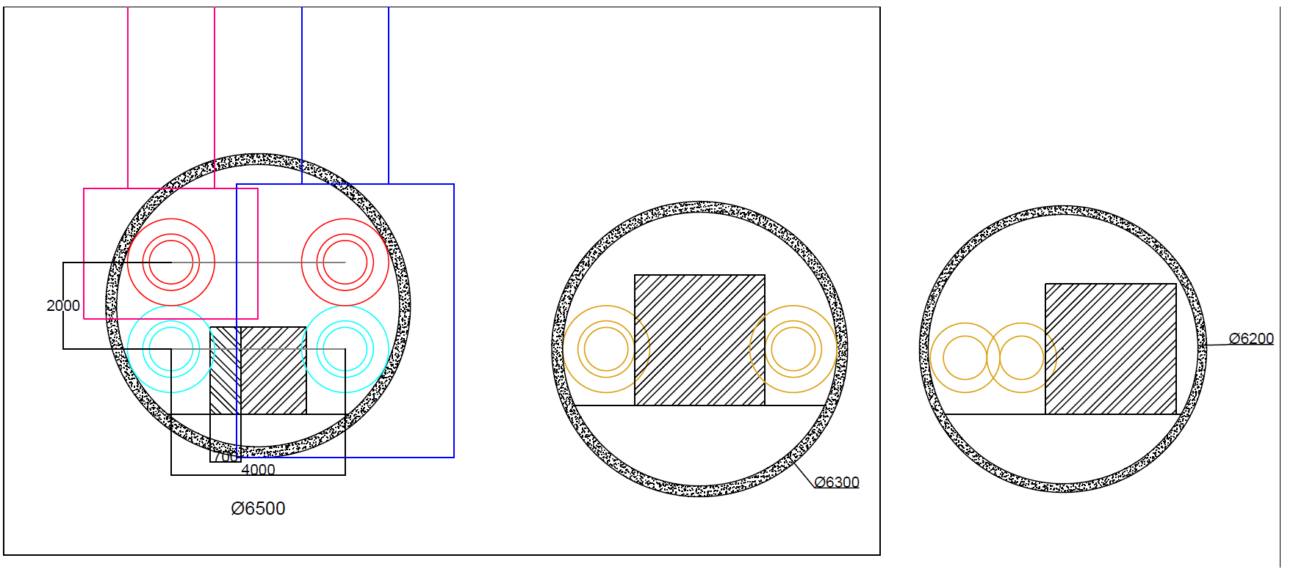
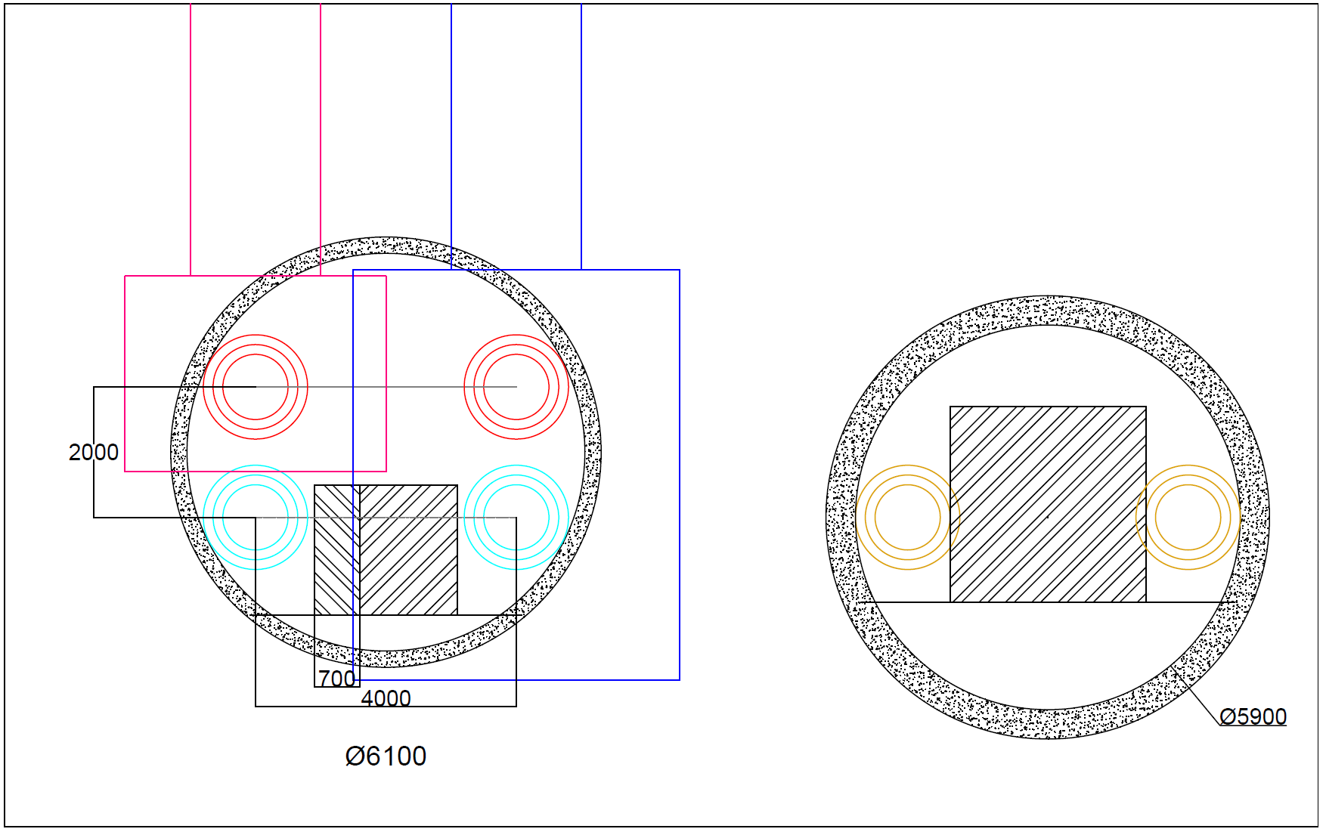
Alternative cross-sections
Ø1.0m beampipe inner diameter
Ø1.3m beampipe outer diameter
0.3m welding clearance from Øinner

Slide 51
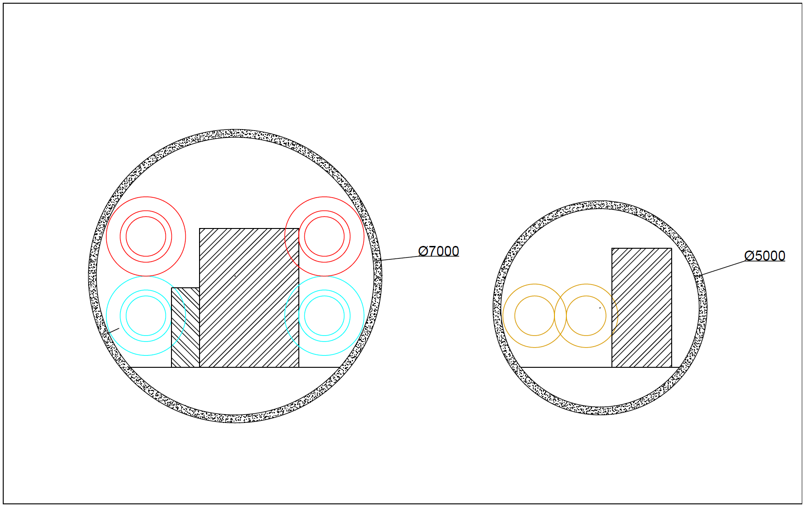
Alternative cross-sections
Ø1.0m beampipe inner diameter
Ø1.3m beampipe outer diameter
0.3m welding clearance from Øinner

Slide 52
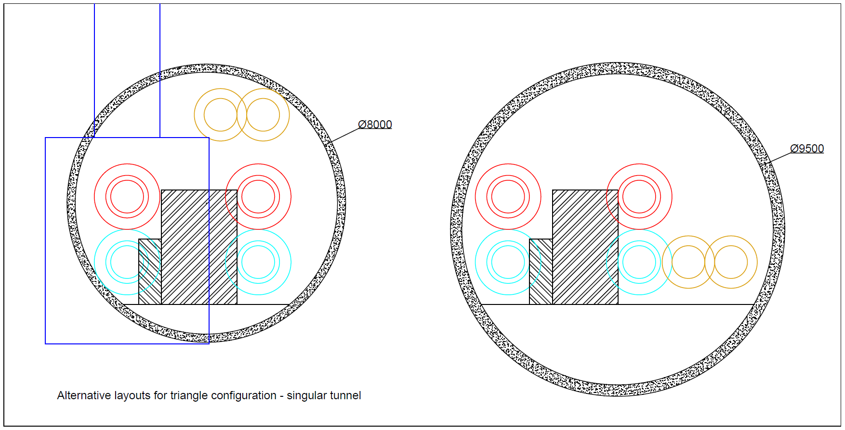
Alternative cross-sections
Ø1.0m beampipe inner diameter
Ø1.3m beampipe outer diameter
0.5m welding clearance from Øinner

Slide 53
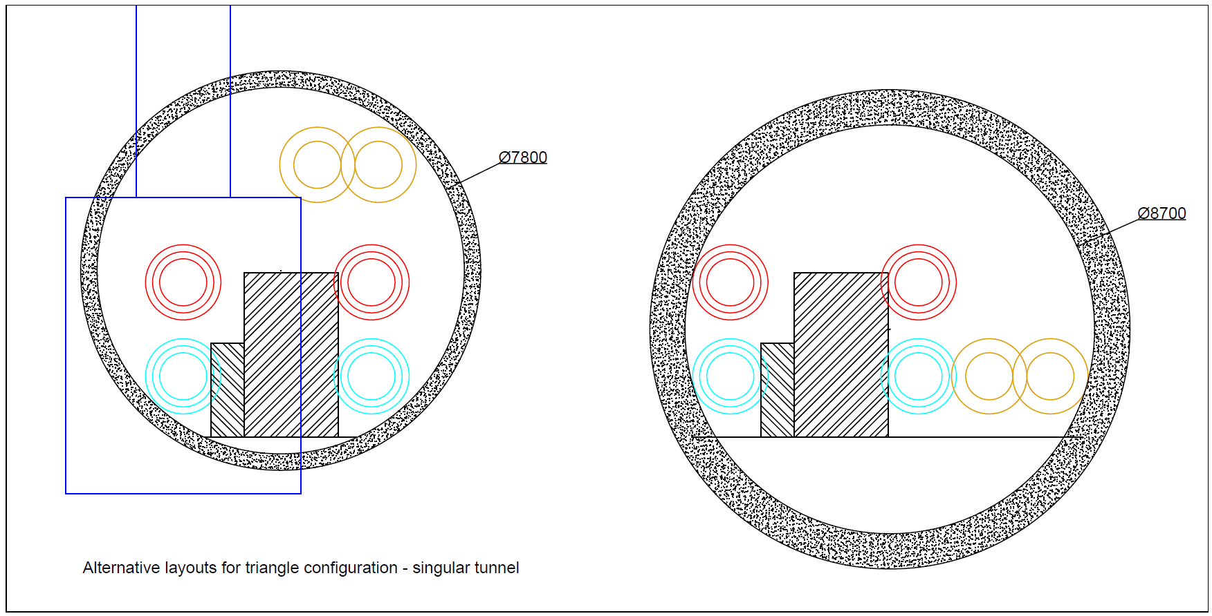
Alternative cross-sections
Ø1.0m beampipe inner diameter
Ø1.3m beampipe outer diameter
0.3m welding clearance from Øinner

Slide 54
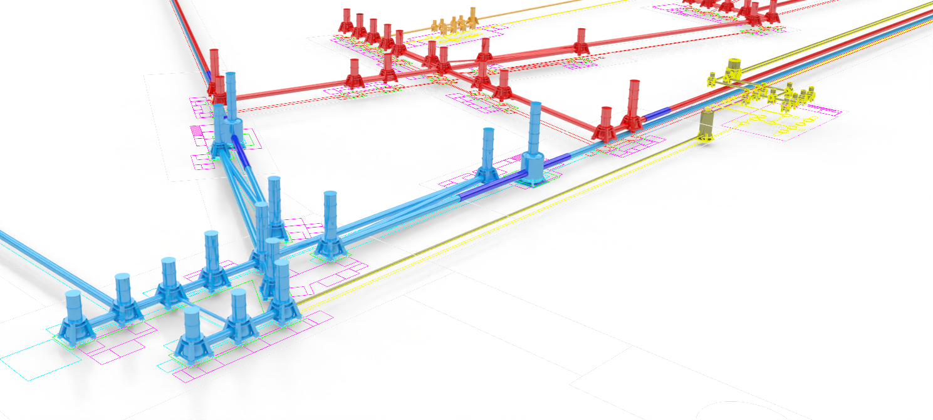
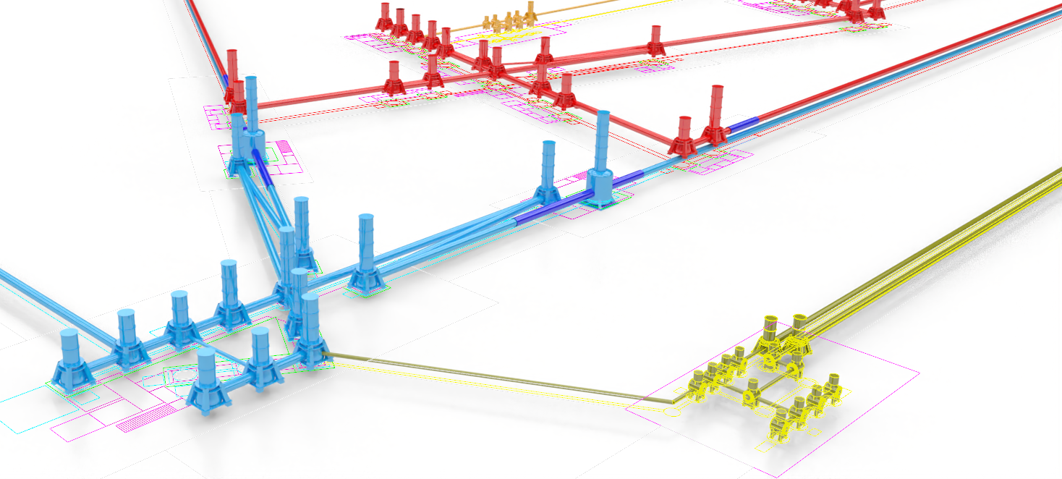
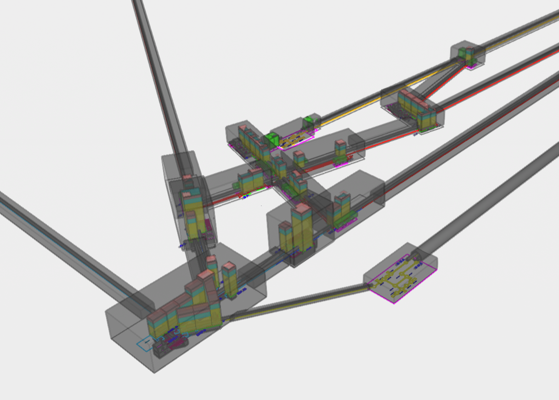
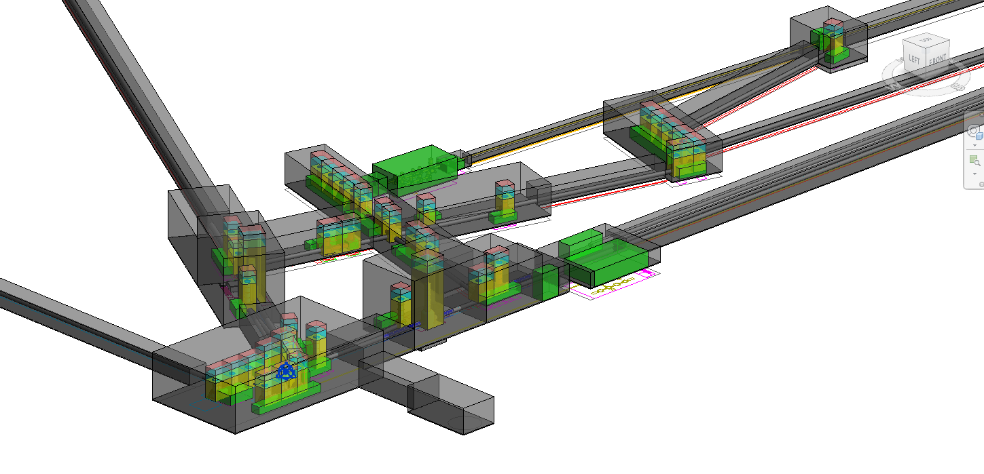
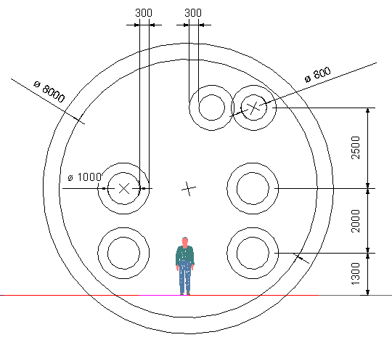
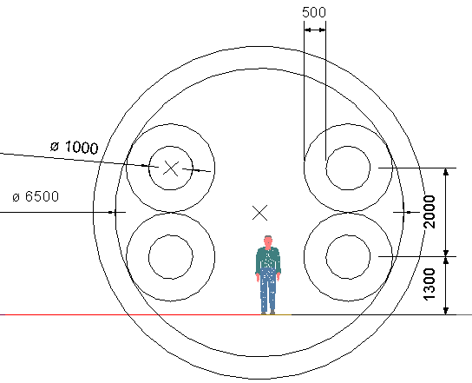
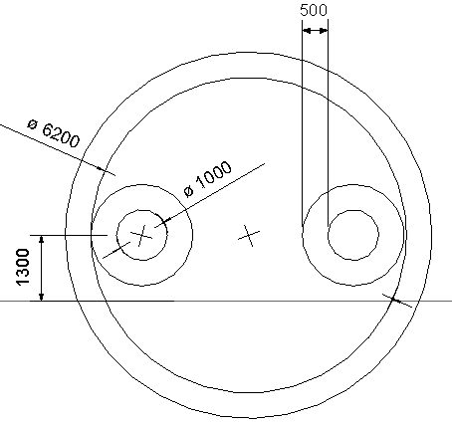
Civil Engineering: Alternative Detector Layouts are being studied
Lateral access cleanrooms to aid with flexibility,
LF filter cavity in a combined arm tunnel
Various bottom access cleanrooms in current design,
LF filter cavity in a separate 5km tunnel
PERFORMANCE AND
FEASIBILITY RISKS
VS
COSTS
Good arguments and finding additional uses for an extra tunnel are needed to justify the high additional costs
= minimum volume for the detector
(additional space needed for lining, accommodate cavern shape, etc.)
= cleanrooms
= tower + scaffolding
= clearance + crane
Main arm cavity ⌀6.5m
5km LF-FC tunnel ⌀6.2m

Slide 55
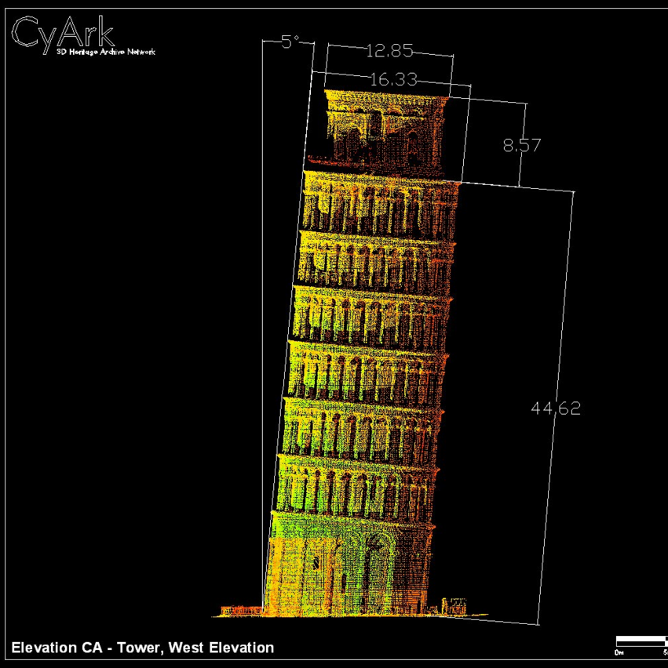
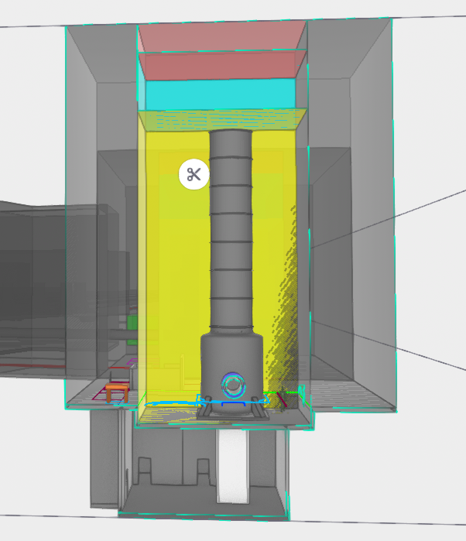
Bonus
33.2m

