Slide 1
CERN contribution to ET project
Luigi SCIBILE , Carlo SCARCIA (for vacuum), John Osborne and Tamara Bud (for civil engineering)
2nd ETO General Meeting - Rome, 27 - 28 November

Slide 2
Einstein Telescope Project
The Einstein Telescope (ET) project is a planned third-generation gravitational wave observatory that aims to detect gravitational waves from cosmic events with unprecedented sensitivity and accuracy.
The ET will have a triangular shape with three arms, each 10 kilometres long, arranged underground to minimize noise and seismic interference (currently also considering a 2 x 15km L option).
The ET will incorporate advanced technologies, including ultra-sensitive laser interferometers, cryogenic cooling for noise reduction, and state-of-the-art vacuum systems.
In 2021, ET entered the ESFRI Roadmap and the current project milestones are: a site selection by 2025, a TDR completed by 2026, a start of the construction in 2028-2030 and a start of scientific operation in 2035.
Some recent overviews:
  ET-PP INFRA-DEV 2024 Annual Meeting (https://indico.ifae.es/event/1930/): Report from ET Project Coordinators (https://indico.ifae.es/event/1930/contributions/8302/attachments/2626/4111/ETcoord-2024-ETPP-06-17-v2.pdf)
  CERN Colloquium 2023 - Einstein Telescope: the next generation Gravitational Wave observatory in Europe (https://indico.cern.ch/event/1329008/attachments/2763161/4812382/ET-CERN-Punturo.pdf)

Slide 3
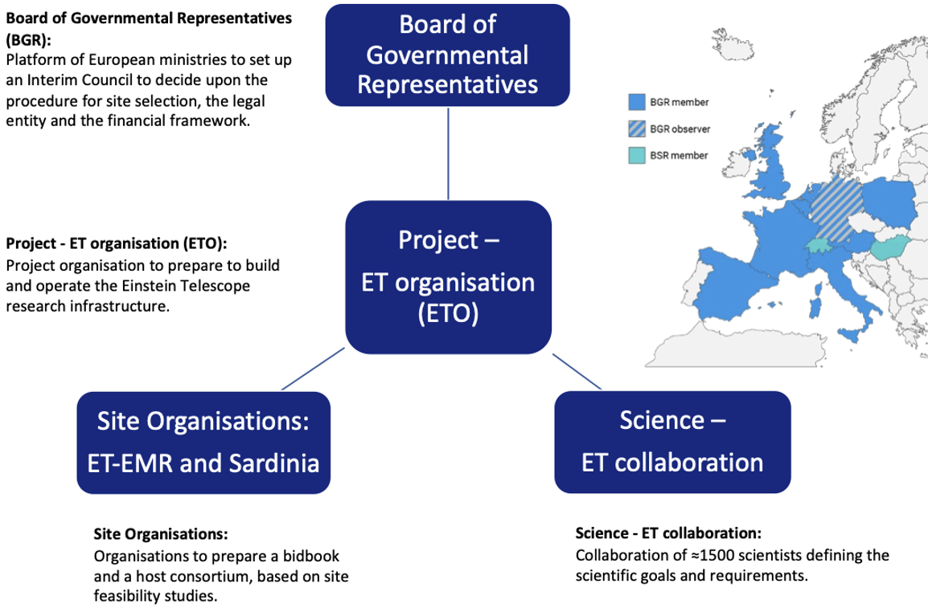
Einstein Telescope Governance
ET is a collaboration between several laboratory and has no legal entity yet.
ET is in the Preparatory Phase (ESFRI def.)
CERN is collaborating with ET Organisation (ETO) - KN5637.
(Ferroni & Freise)
Slide extracted from: https://indico.ifae.es/event/1930/contributions/8302/attachments/2626/4111/ETcoord-2024-ETPP-06-17-v2.pdf

Slide 4
CERN – ET collaboration: Current status.
In 2019, CERN established a collaboration agreement (KN4657) with the Lead Institutes (INFN and Nikkef), acting for the benefit of the Einstein Telescope (ET) Consortium.
In 2023, KN4657 was replaced by KN5637 to add IFAE to the list of Lead Institutes. All agreements are between CERN and the ET Consortium and are signed by the Lead Institutes (INFN, Nikkef, and IFAE). They act for the whole ET to maintain neutrality with respect to the site selection.
Ongoing CERN contributions:
  Vacuum technology, technical contact Paolo Chiggiato – KR5427 (1’133 kCHF).
  Civil engineering, technical contact John Osborne – KR5754 (328 kCHF).
External contributions in ()

Slide 5
CERN – ET collaboration: Evolutions.
The financial management of the ET Consortium is currently being re-organized and we should be receiving future contributions via IFAE (not yet settled).
In addition, BMBF is also willing to contribute financially to CERN for future ET activities.
Future CERN contributions:
  Extension of the scope and schedule of the vacuum technology studies – Amendment to KR5427 (1’675 kCHF).
  Support in the costing activities (only Methods and QA) – New KR6248 (280 kCHF).
  Development of the Safety and (infrastructure) Engineering Studies – New KR6246 (2’910 kCHF).
External contributions in ()

Slide 6
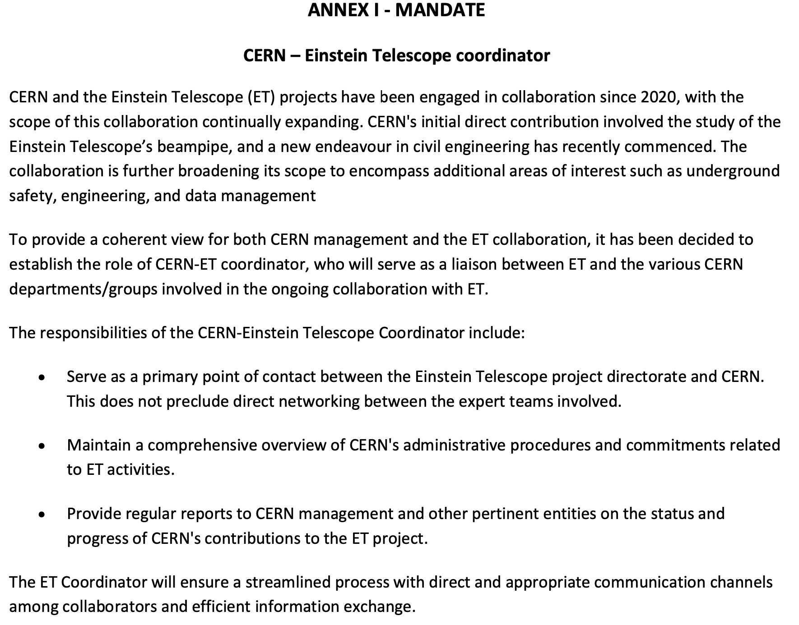
CERN - Einstein Telescope Coordinator - Since February 2024
  Coordinator: L. Scibile.
  Provide a coherent view.
  Serve as a primary point of contact.
  Maintain a comprehensive overview of CERN's administrative procedures and commitments.
  Provide regular reports.

Slide 7
Civil Engineering

Slide 8
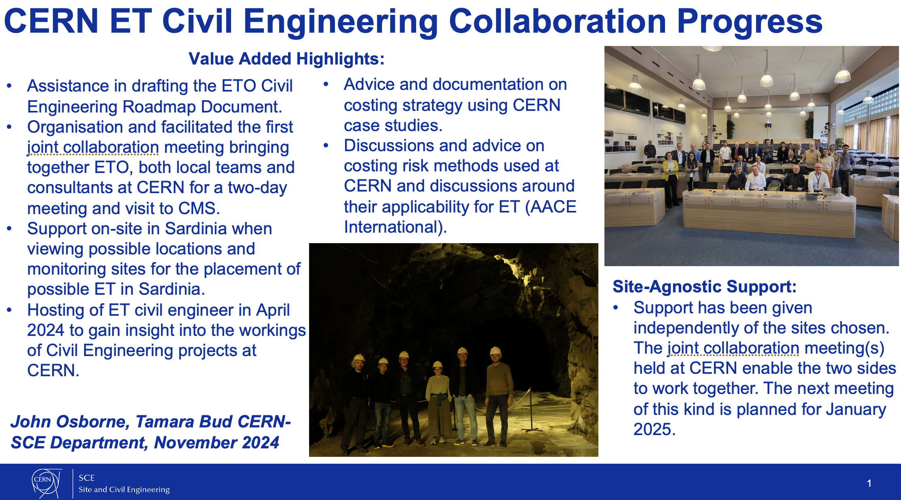

Slide 9
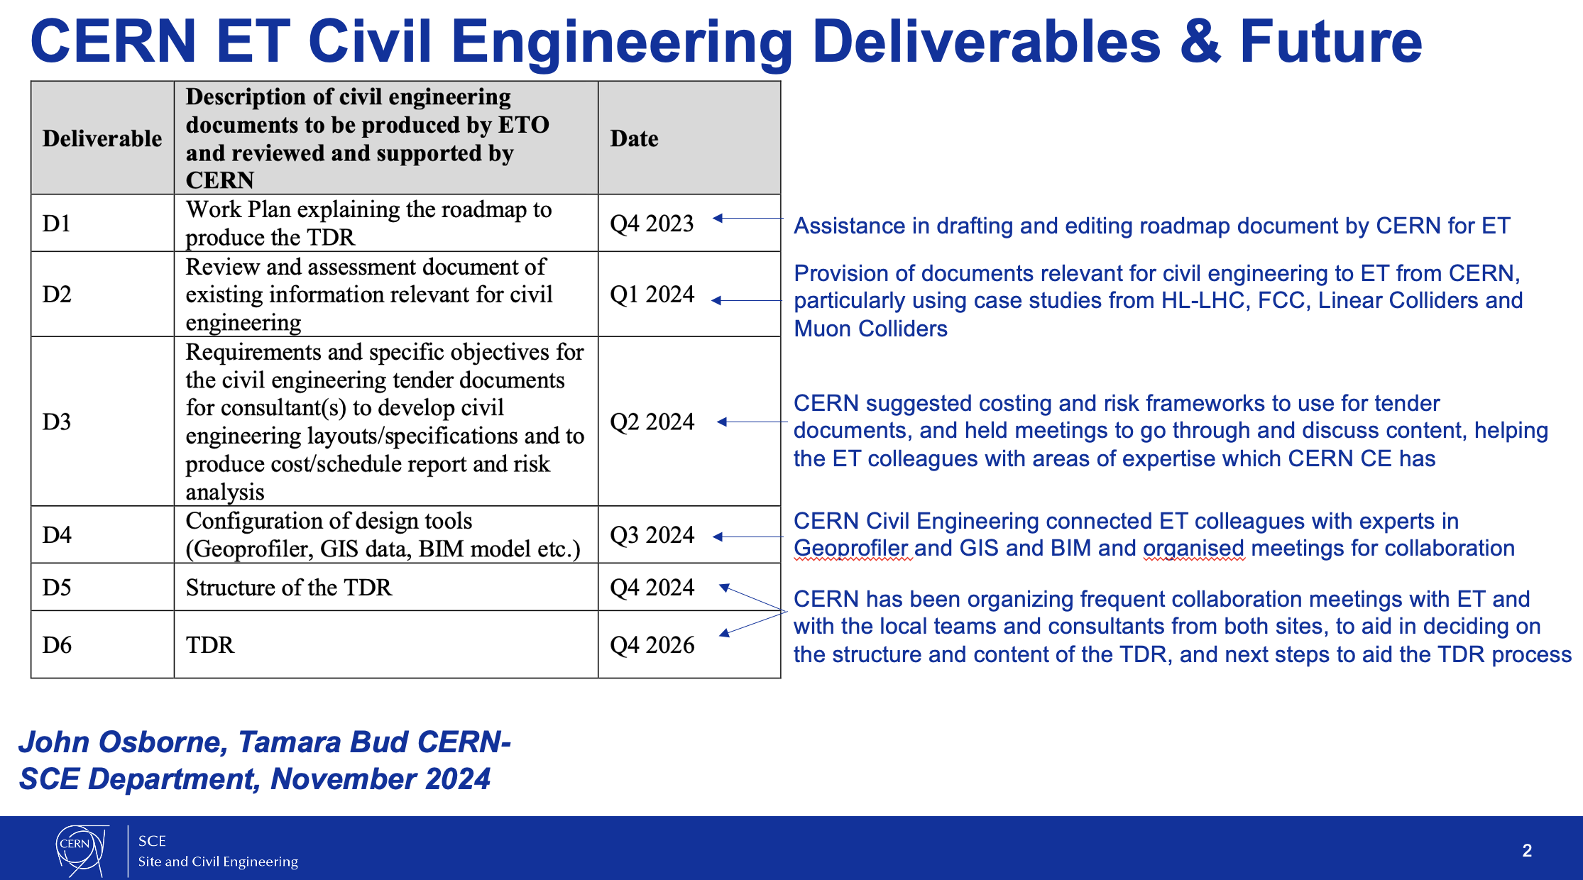

Slide 10
Vacuum

Slide 11
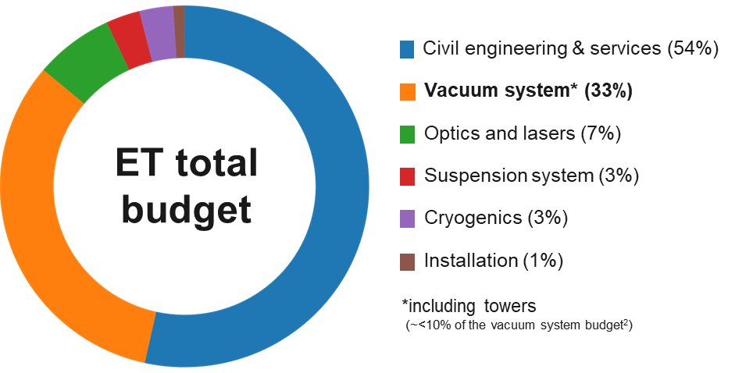
From where we started:
If VIRGO vacuum system costs are scaled to ET dimensions¹ :
VIRGO approach (2020 ET CDR)
Ø 1 m x 3 mm – 20 m stiffened straight pipes
304L air-baked (400°C, 5 days)
Production rate: 1 module/day
(limited by the air-bakeout: 0.8 module/day)
ET
16 years of production (~6000 modules)
Estimated² beampipe vacuum system cost: ~400 M€
¹ET collaboration, Einstein Telescope preliminary cost book, 2020
²ET Science Team, Einstein gravitational wave Telescope conceptual design study, 2011

Slide 12
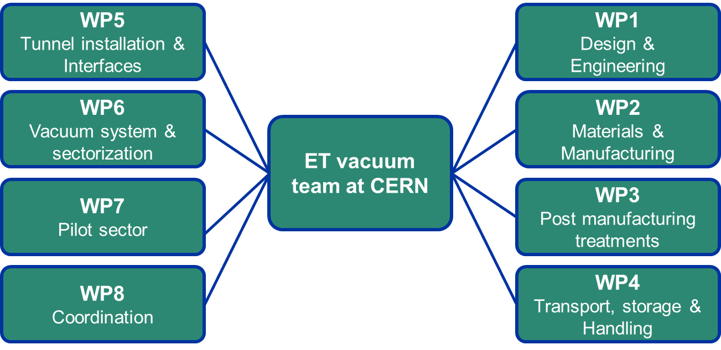
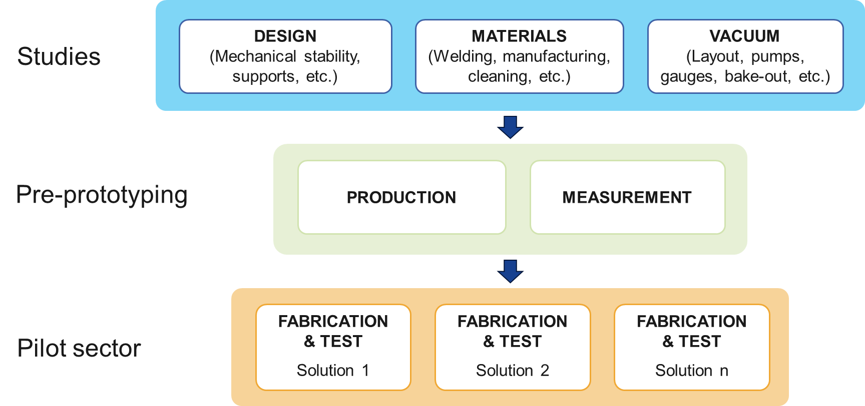
CERN technical involvement
How we structure ourselves/to whom we communicate:
How we structured our work:
ETO - Directorate
ET-PP
ETO - ED
ETC - ISB
Monthly updates on activities
ETC: Aniello Grado, Nick Van Remortel
ETO: Patrick Werneke, Fernando Ferroni (Giovanni Bisoffi), Andreas Freise, Mario Martinez

Slide 13
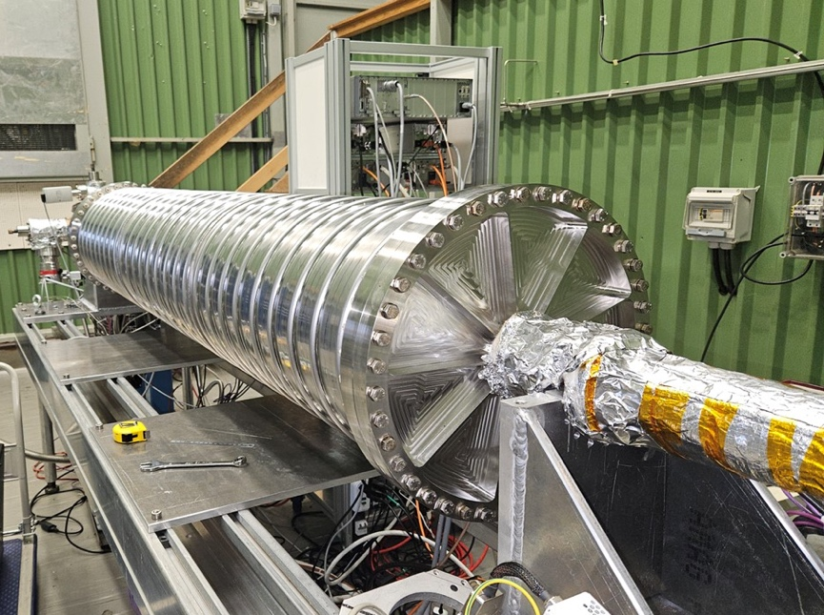
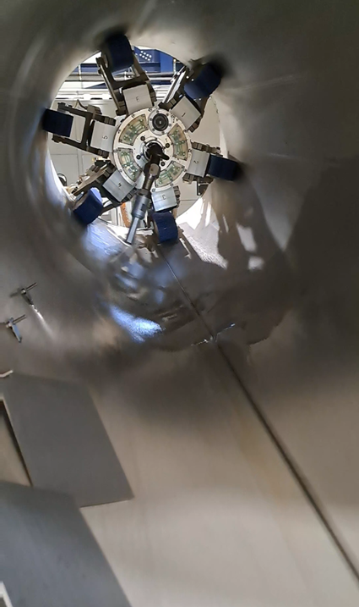
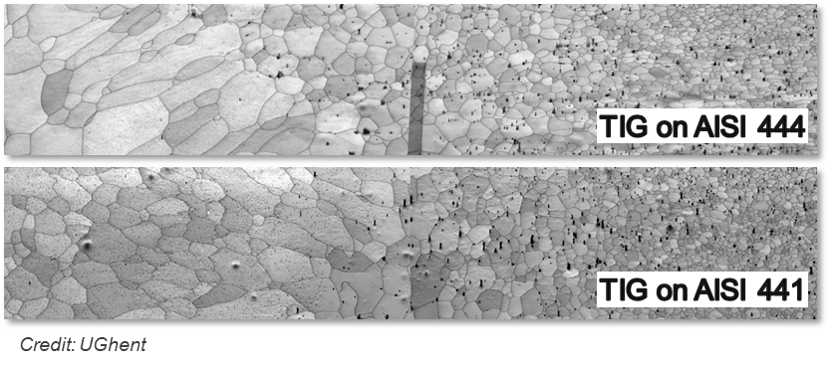
Completed ET beampipe studies
Examples of completed studies
(not exhaustive list)
Design
Corrugated beampipe profile design
Supporting system and transfer function
Materials
UHV characterisation of ferritic alloys
Welding parameters optimisation
Magnetic properties of ferritic alloys
Corrosion studies (ongoing with UGhent)
Post-manufacturing treatments
Industrial facilities cleanliness assessment
Robot cleaning performance
Vacuum
Bakeout simulation and optimisation
Insulation performance studies
Preliminary vacuum system design

Slide 14
What did we learn up to now
Materials
Design
Vacuum layout & operations
AISI 304L
Raw material: ~4 €/kg
Requires HTT to meet ET requirements
(e.g. vacuum firing or air bakeout)
Straight pipes (3-4 mm)
Requires bellows & stiffeners
Discontinuous manufacturing flow
Pumping groups every 500 m
20 cm thick insulation
Yearly maintenance
No sectorization
2020 ET
CDR
AISI 441 (ferritic)
Raw material: ~2 €/kg (-50%)
Native outgassing rate comparable (if not better) than HTT AISI 304L
Corrugated pipes (1-2 mm)
No bellows & stiffeners
30% less current joule bakeout*
~60% lighter modules [kg/m]
Continuous manufacturing flow
Requires uniform support
Production to be industrialised
CERN
proposal
Pumping groups every 1000 m
10 cm thick insulation
No maintenance in decades
Sectorised
Design and commissioning phases parametrized.
*DC bakeout with the same insulation material

Slide 15
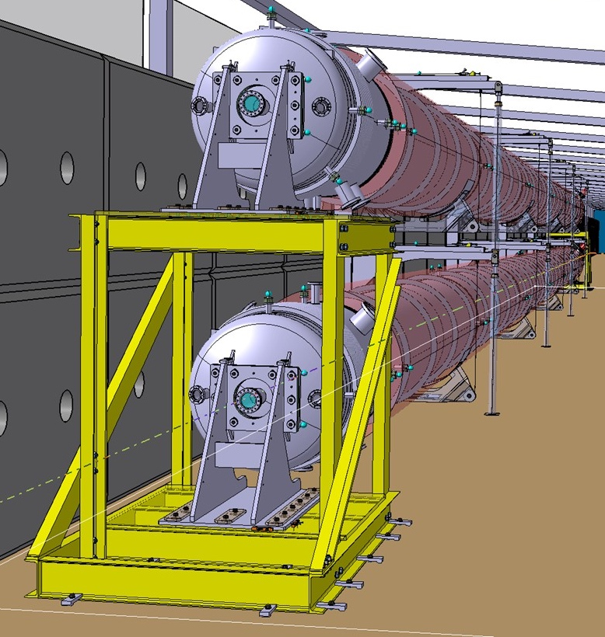
The ET Pilot Sector (ET-PS)
The pilot sector aims to test the design, fabrication, installation and commissioning of the proposed beam pipes and support system solutions.
Q1 2024 (January)
Project peer reviewed (international experts panel).
Material and vacuum system validated.
Q2-Q4 2024
Manufacturing and procurement of the ancillary components/equipment.
From Q4 2024/Q1 2025
Start of installation of a
AISI 441 VIRGO-like pipe Ø 1.08 m x 4 mm x 36 m

Slide 16
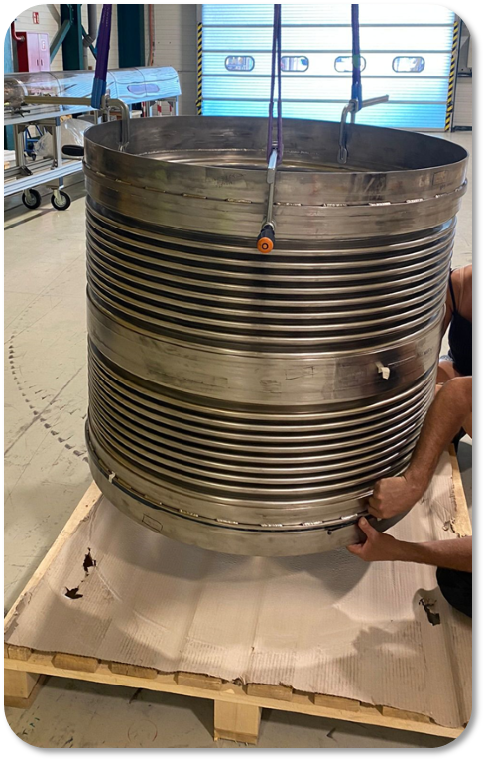
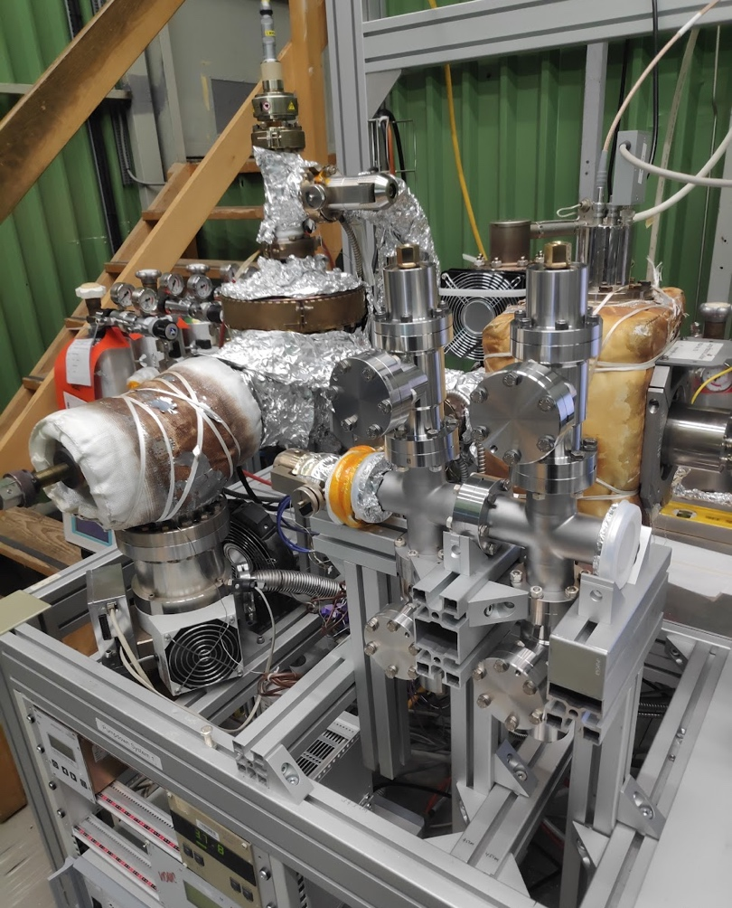
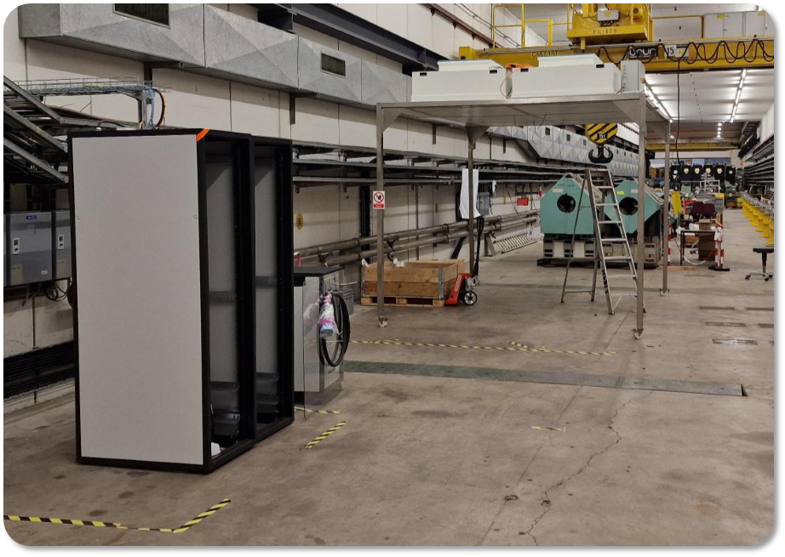
The ET Pilot Sector (ET-PS) - Status
The procurement of components is completed, and productions are launched.
All raw materials and ancillary vacuum components are at CERN.
The premises have been serviced (Wi-Fi, bakeout returning cables, cleaning etc.) and will be available from Dec. 2024.
Site (TT4 preparation
DN1000 AISI 316L bellows
(internal convolutions)
Ancillary vacuum components acceptance test / conditioning

Slide 17
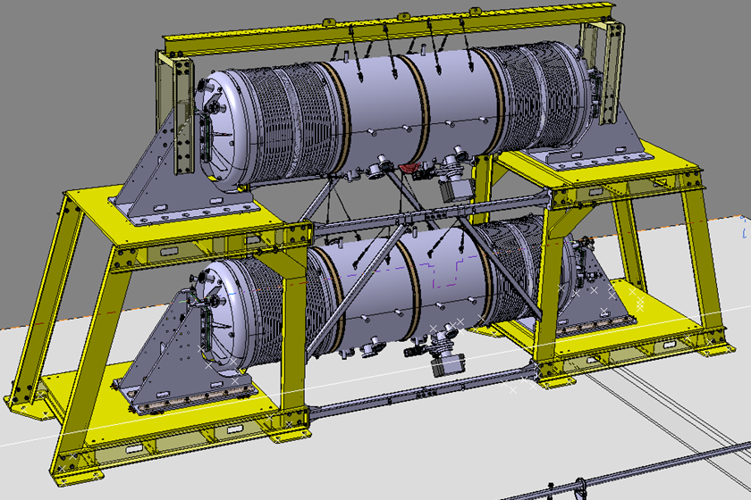
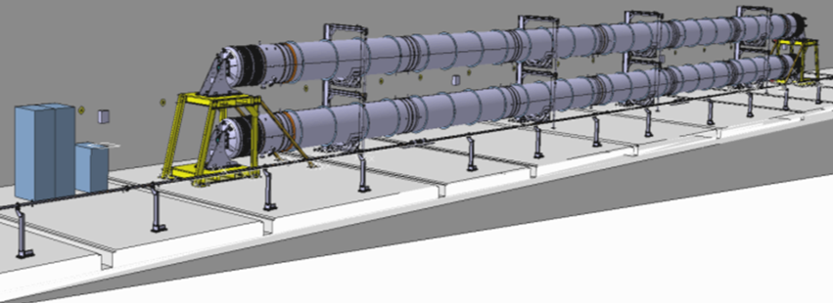
The ET Pilot Sector (ET-PS) - Master schedule
2024 | 2025
Q4 | Q1 | Q2 | Q3 | Q4
Assembly and leak detection
Test programme
Extended TDR writing
Phase 2
Beampipe measurements
Phase 1
“Background” measurements

Slide 18
The ET Pilot Sector (ET-PS) - Extended schedule
2024 | 2025 |  |  |  | 2026 |  |  |  | 2027
Q4 | Q1 | Q2 | Q3 | Q4 | Q1 | Q2 | Q3 | Q4 | Q1 | Q2 | Q3 | Q4
Assembly and leak detection
Test programme
Extended TDR writing
Extended test programme
Final TDR writing
The extended test programme aims to test alternative solutions not included in the first amendment:
New insulation materials.
Different pumping schemes.
Leak detection tools.
Alternative beampipe manufacturing solutions (continuous welded pipe from Aachen, corrugated beampipe from NL consortium, etc..).
Test of large sector valves.
Venting and tube section dismounting impact on dust content.

Slide 19
Technical Design Report (TDR)
Preminary TDR (Q4 2024) [ET-PP] – DELIVERED
Description of the system, materials, assembly, commissioning and risks identification.
New schedule allows the TDR to be updated for changes:
Extended TDR (Q4 2025)
Detailing of all the chapters of the preliminary version (with in-depth reports). Logistics and sustainability further investigated. Preliminary cost estimation. Integration with civil engineering.
Final TDR (Q4 2027)
Final version with optimal solutions. Full detailing of chapters. Full integration with civil engineering considering all the other services (HVAC, fire safety, …).

