Slide 1


AdaptivePerf: an architecture-agnostic code profiler
Maksymilian Graczyk, Stefan Roiser
(CERN, IT-FTI-PSE)

Slide 2
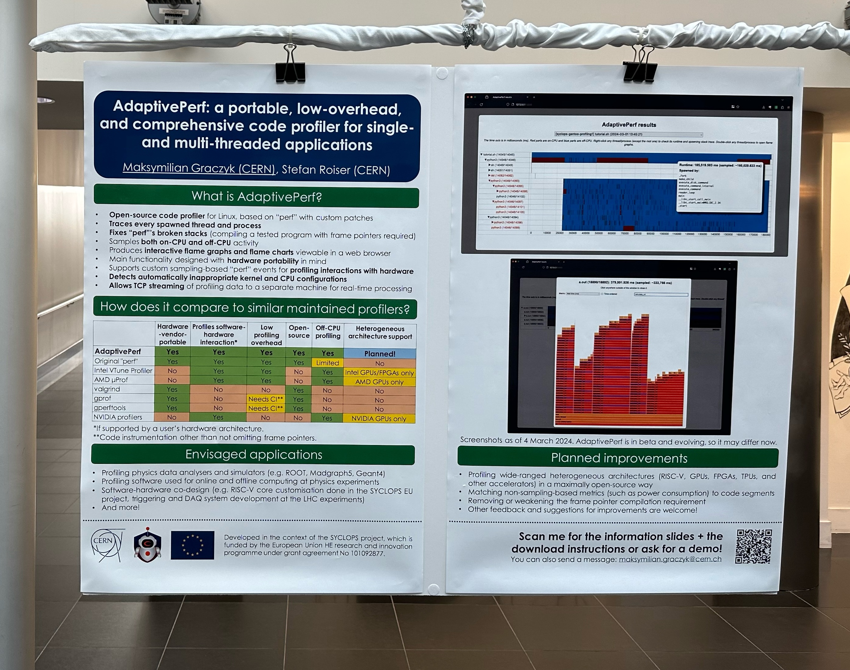
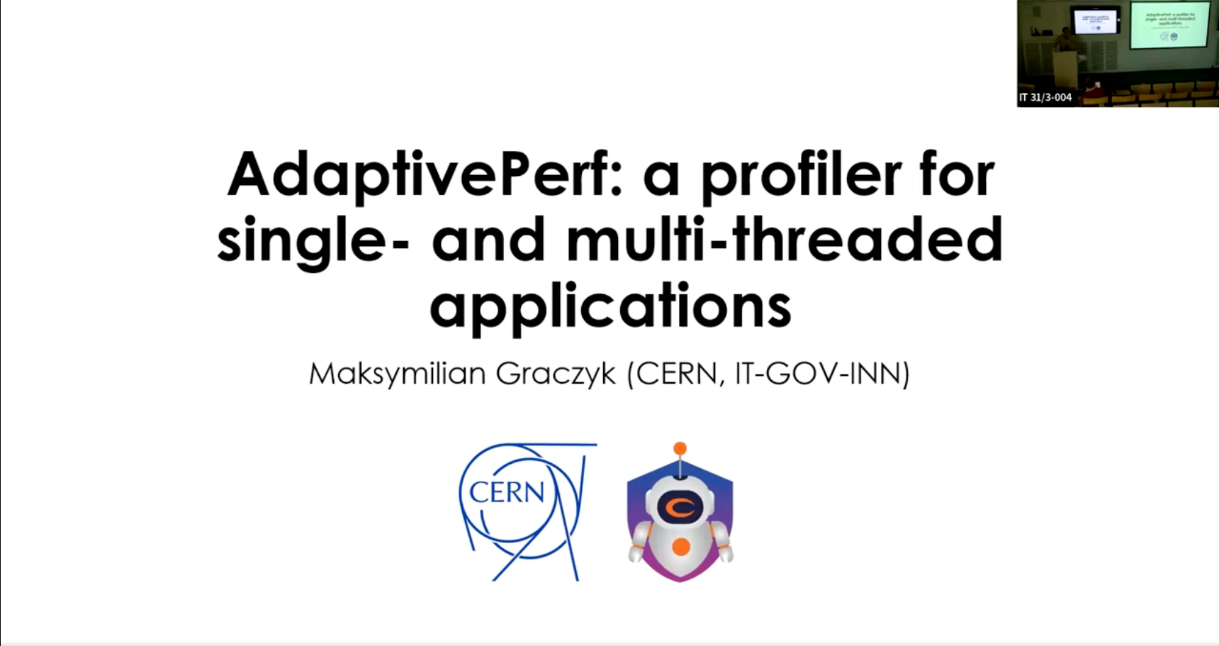
You may have heard this before…
This year: ACAT, CERN Compute & Accelerator Forum (CAF), RISC-V Summit Europe, …
If that’s the case for you, there have been a few significant updates, so stay tuned for this talk!
Updates are coloured in green.
CAF
ACAT

Slide 3
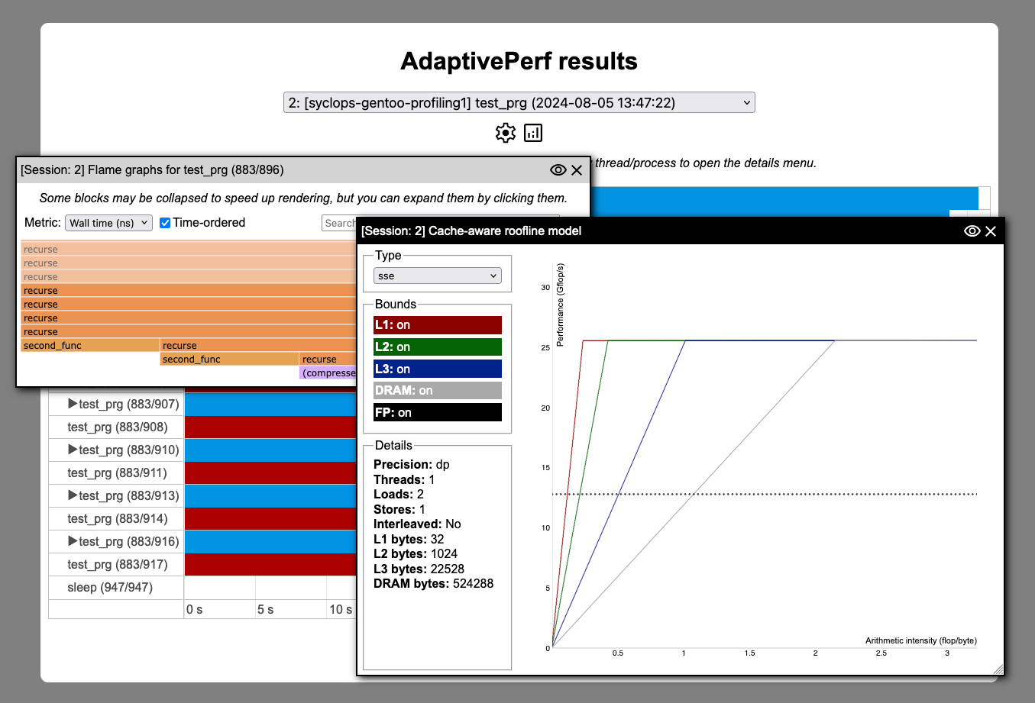
What is AdaptivePerf?
NB: AdaptivePerf is not a continuous profiler! It profiles single commands and is not meant for 24/7 monitoring.
The main target audience is SW and HW developers optimising their software and/or hardware, also as part of software-hardware co-design for specific applications.
Open-source code profiler for Linux, based on "perf" with custom patches
Samples both on-CPU and off-CPU activity
Traces every spawned thread and process
Minimises risk of broken profiled stacks for programs compiled with frame pointers by detecting inappropriate kernel and CPU configurations automatically
Produces data for rendering interactive flame graphs and charts in a web browser with a new GUI and cache-aware roofline plots produced by the CARM tool from INESC-ID
Main functionality designed with hardware portability in mind (tested on x86-64, arm64, and RISC-V)
Supports custom sampling-based "perf" events for profiling interactions with hardware
Allows TCP streaming of profiling data to a separate machine for real-time processing

Slide 4
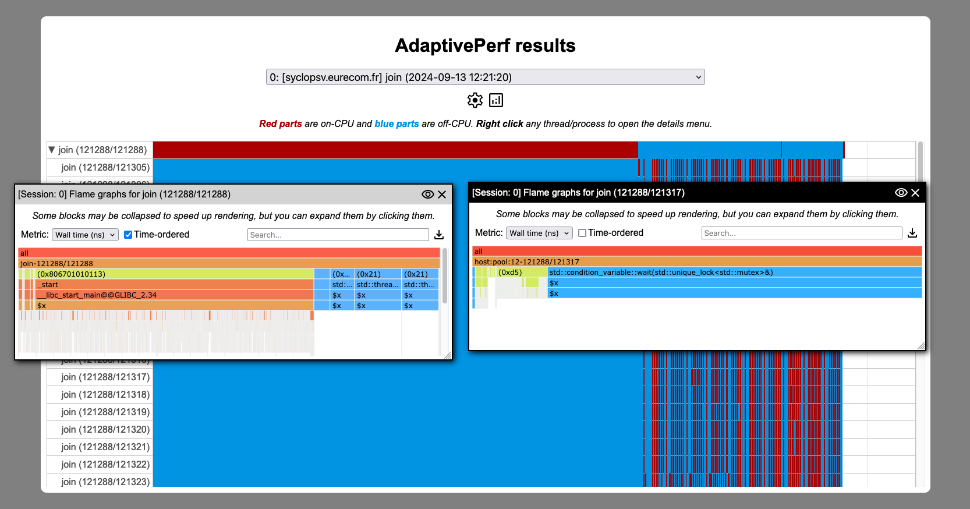
How does AdaptivePerf work under the hood?
AdaptivePerf frontend
configures and runs
perf
Other profilers and metric-reading programs*
streams data via either TCP or file descriptors through Python API
stream data*
displays
adaptiveperf-server (backend)
post-processes results and produces data for
AdaptivePerfHTML
SQL database*
Can be run on a different machine without the profiled programs and debug info!
*Mostly implemented and therefore coming very soon.
Notes:
Remember to add that post-processing has been moved to adaptiveperf-server written in C++ which accepts events on-the-go through TCP.

Slide 5

What is SYCLOPS?
A project funded from the European Union HE research and innovation programme (grant agreement No 101092877) about hardware acceleration with open standards using SYCL and RISC-V: https://www.syclops.org
CERN project tasks:
  Implementing SYCL support in ROOT and cling + demonstrating it on a Lorentz vector calculation example.
  Benchmarking and profiling + integration testing of all use cases envisaged in SYCLOPS (ROOT, genomics analysis, and autonomous systems).
AdaptivePerf is part of task 2, but its applications and development plans extend beyond SYCLOPS!

Slide 6
How to download AdaptivePerf?
It's open-source and you can get it for free from our GitHub: https://github.com/AdaptivePerf.
AdaptivePerf is available as an early development version, in form of a source code, a Gentoo-based VM image, and Docker + Apptainer images with frame pointers. DEB + RPM, a CVMFS setup, and non-Linux server binaries will follow soon.
There are 2 parts:
  AdaptivePerf: the main program which is the command-line profiling tool (frontend) and server (backend), licensed under GNU GPL v2 only. It also includes the patched “perf”.
  AdaptivePerfHTML: the web server for displaying profiling results as an interactive website, licensed under GNU GPL v3.

Slide 7
Quick start with AdaptivePerf
Run adaptiveperf -- <command to be profiled> and wait until it finishes and produces the "results" directory. The command doesn’t need to be quoted and under certain circumstances, root rights are not required. Partial profiling will also be possible very soon!
Set the FLASK_PROFILING_STORAGE environment variable to the "results" path.
Run Flask (a Python web framework) and point it to AdaptivePerfHTML: adaptiveperf.app:app.
Open the website in your web browser. Done!

Slide 8
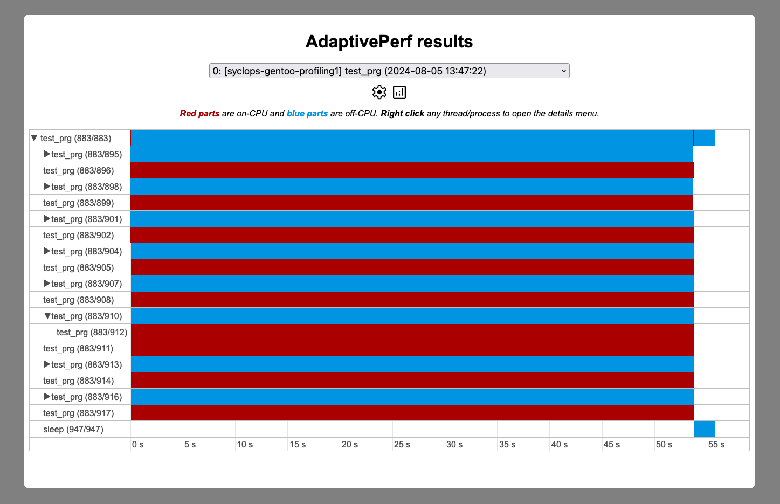
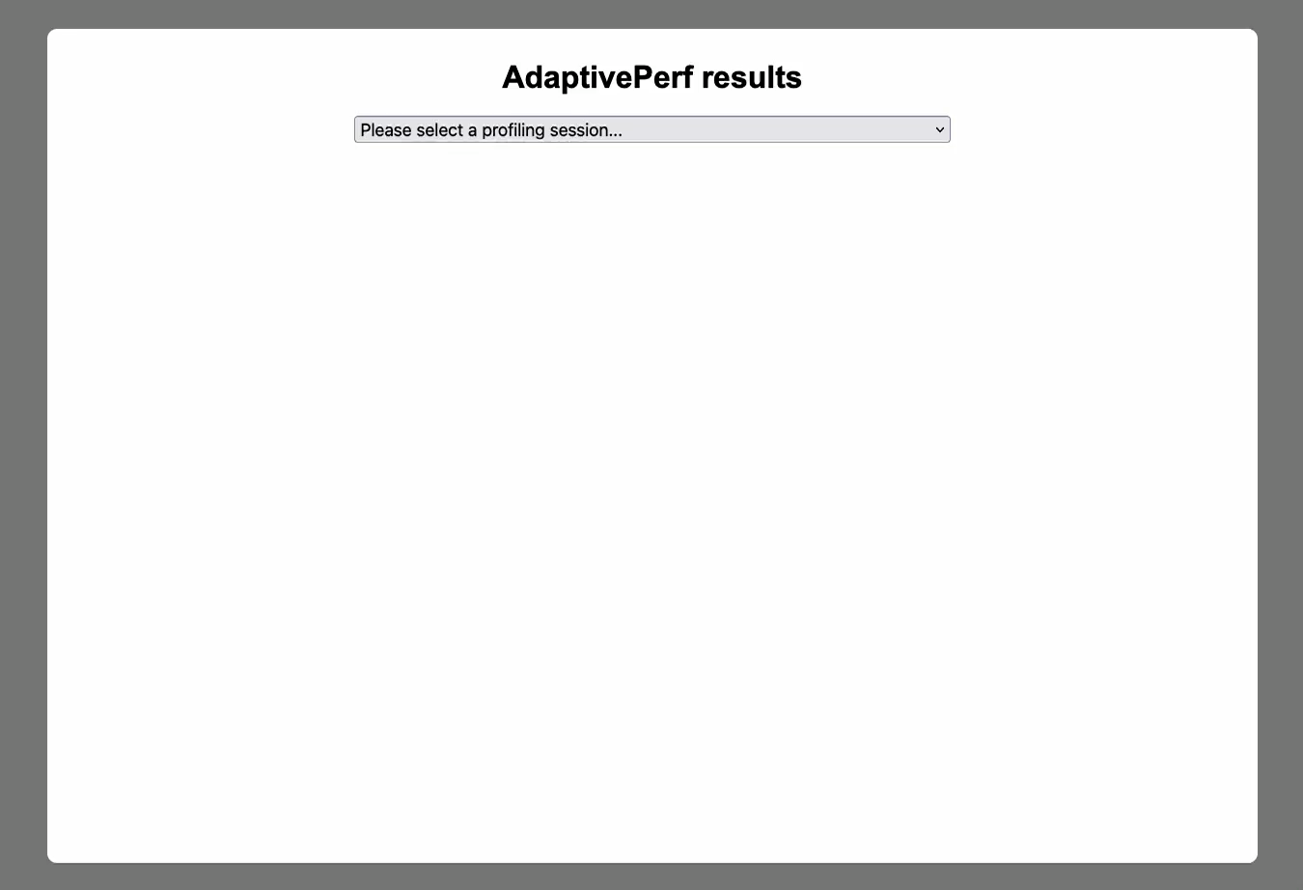
Demo

Slide 9
Work in progress: profiling heterogeneous and custom architectures
In the context of the changing technological landscape, we want AdaptivePerf to help push forward computing at CERN and other physics experiments and therefore allow more scientific discoveries.
Given the variety of platforms (CPUs with different ISAs, GPUs, FPGAs, ASICs etc.), the goal of AdaptivePerf is delivering a single profiling-based platform for comparing and customising software and hardware architectures scaling from embedded/edge to exascale.
This is how we envisage profiling heterogeneous and custom computer systems in AdaptivePerf:

Slide 10
Work in progress: profiling heterogeneous and custom architectures
APF: AdaptivePerf frontend instance
Node: arbitrary hardware unit defined by a user or detected automatically
Entity: group of nodes where APF is deployed
Gray arrows: connections between nodes and entities, defined by a user or detected automatically
*using built-in methods or methods defined by a user
Node
Node
Node
Node
APF
APF
Results
profiles*
Entity
Entity
profiles*
produces
streams data to
Server
Node
Node
streams data to
Your input is important here!
APF
profiles*
Entity
streams data to

Slide 11
Future plans
Looking into profiling memory usage by threads/processes
Adding profiling on a lower level and with more debug info, e.g. showing line numbers, going down to LLVM IR / MLIR / assembly etc.
Downloading debug symbols automatically if not present
Removing or weakening the frame pointer compilation requirement

Slide 12
Thank you!
Any questions or comments?
Feel free to reach out to me at the conference or by e-mail: maksymilian.graczyk@cern.ch

Slide 13
Extra slides

Slide 14
How does AdaptivePerf compare to other similar and maintained profilers?
 | Hardware-vendor-portable | Runs on RISC-V | Profiles software-hardware interaction* | Low profiling overhead | Open-source | Off-CPU profiling | Heterogeneous architecture support
AdaptivePerf | Yes | Yes | Yes | Yes | Yes | Yes | Work in progress!
Original "perf" | Yes | Yes | Yes | Yes | Yes | Limited | No
Intel VTune Profiler | No | No | Yes | Yes | No | Yes | Intel GPUs/FPGAs only
AMD μProf | No | No | Yes | Yes | No | Yes | AMD GPUs only
valgrind | Yes | Yes, as a fork | No | No | Yes | No | No
gprof | Yes | Yes | No | Needs CI** | Yes | No | No
gperftools | Yes | Yes | No | Needs CI** | Yes | No | No
NVIDIA profilers | No | No | Yes | No | No | Yes | NVIDIA GPUs only
*If supported by a user’s hardware architecture.
**Code instrumentation other than not omitting frame pointers.

Slide 15
How to tackle the frame pointer compilation requirement?
For example, by DWARF processing whenever frame pointers cannot be used, see: https://www.polarsignals.com/blog/posts/2022/11/29/profiling-without-frame-pointers (this is more compact than what “perf” currently does).
Full removal may be unnecessary, see: https://brendangregg.com/blog/2024-03-17/the-return-of-the-frame-pointers.html.

