Slide 1

A fundamental research infrastructure in nuclear physics, opening to industry for measuring the effects of radiation on electronic systems

Slide 2
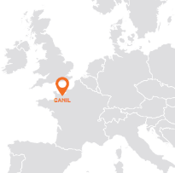
Two equipments for studying the heart of matter
Caen
Normandie

Slide 3
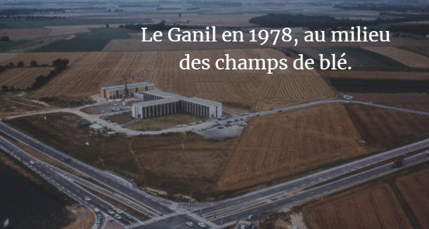
Administrative structure
Creation of GIE in 1976
CEA/CNRS Economic Interest Group
Initially established for 30 years, extended until 2046
Management rotates every 5 years
2022 – 2026
  Director: Patricia ROUSSEL CHOMAZ (CEA)
  Deputy Director: Fanny FARGET (CNRS)
Basic nuclear installation
Controled by ASNR
(Nuclear Safety and Radiation Protection Authority)
Restricted regime zone
Controlled by Prefecture
Research infrastructure*
Defined in the roadmap of the Ministry of National Education, Research and Higher Education
GANIL in 1978,
in the middle of corn fields

Slide 4
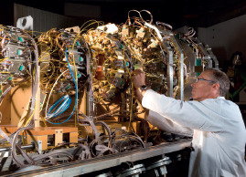
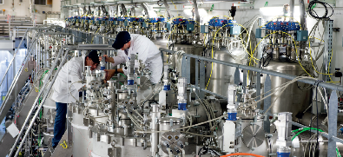
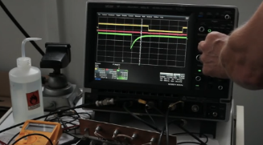
Host laboratory
Goal
Put together the know-how and technical resources of its members, with a view to enabling them to design, carry out and succeed in scientific experiments and projects in nuclear physics as well as in multidisciplinary fields using ion beams (radiotherapy and hadrontherapy, materials physics, atomic physics, etc.).
A user facility
700 researchers
From 65 laboratories
From 30 countries
5000 beam hours per year
Multidisciplinary teams
230 CEA/CNRS staff + ~80 no-permanent staff
  Very high scientific, technical and administrative skills
80 interns – from all levels

Slide 5
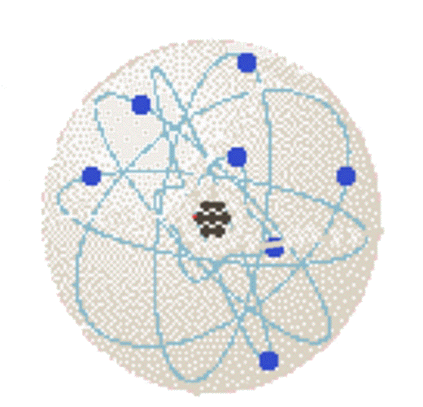
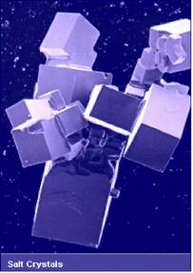
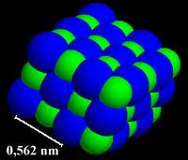

The atomic nucleus
1 mm / 100
An ion: an atom that gained or lost one or more electrons
1 mm / 1000
1 mm / 10 000 000
1 mm / 100 000 000 000
neutron
Σ
A
X
Salt crystals
A regular arrangement of sodium “Na” and chlorine “Cl” atoms
proton
Z
The atom: a compact heart (the nucleus) surrounded by electrons
Chemical symbol
The atomic nucleus: a collection of protons and neutrons (nucleons)

Slide 6
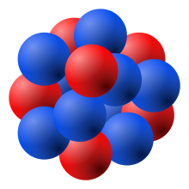
The atomic nucleus
proton: stable
deuteron: stable
neutron: T_{1/2}= 611.9 s
Density : 200 millions tons/cm³
Temperature : ~a few million °C (1 MeV)
The atomic nucleus: an assembly of protons and neutrons, stable or unstable
Which is synthesized in stars by successive fusion/capture reactions followed by decay
Giving birth to the visible nuclear matter
Forces :
Coulomb
Strong nuclear force (binding)
Weak nuclear force (β radioactivity)

Slide 7
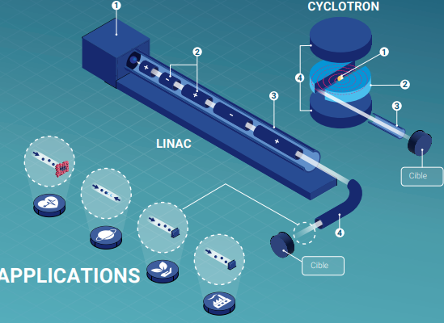
A particle accelerator
Accelerators produce and accelerate beams of charged particles: ions for GANIL
1
A source for producing heavy ions
2
A complex device that increases the energy of particles using electromagnetic fields
Target
A serie of metal tubes under vacuum that allow the particles to move without encountering obstacles that could scatter the beam
3
Target
4
Electromagnetic elements and diagnostics that allow the trajectory of ions to be controlled
Source : Agence Internationale de l’énergie atomique
Evperimental devices in which ions are propelled onto a target to study matter
5

Slide 8
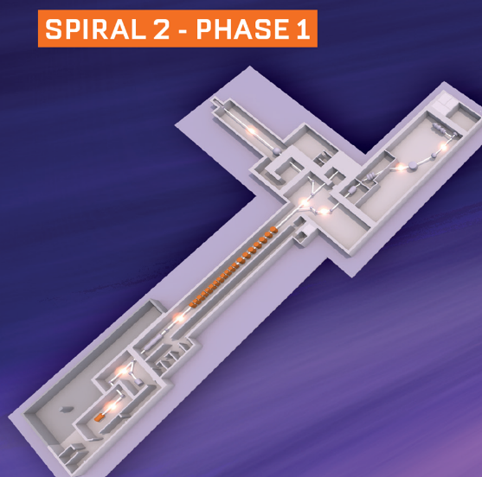
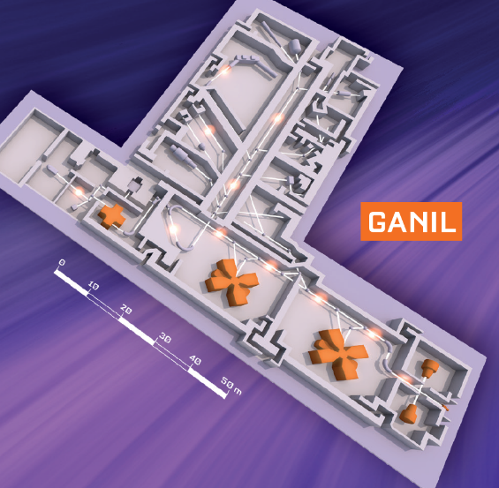
The accelerators of GANIL
Areas to perform experiments/irradiations
An accelerator that increases the energy of particles
Sources to produce various heavy ions
1

Slide 9
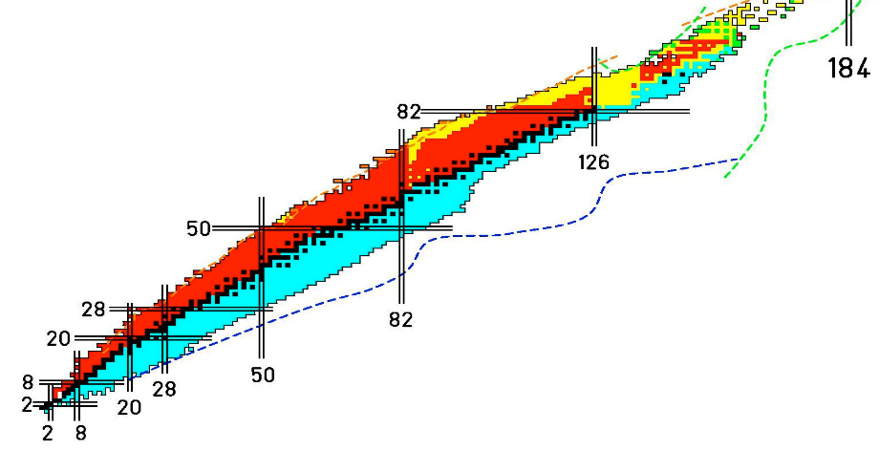
For research in nuclear physics…
Decay modes and properties
Limits of existence (driplines, superheavy elements)
Origin of the elements
Reaction mechanisms
Equation of state of nuclear matter
Nuclear forces
Structures, shapes
Excitation modes
Fundamental interactions
Limits of existence?
Radioactive nuclei
Protons
Stable nuclei
Neutrons

Slide 10
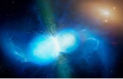


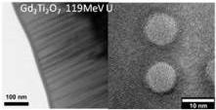
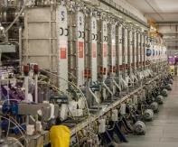

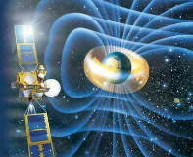
…but not only that!
Pushing the boundaries of knowledge ever further
Nuclear Astrophysics
Astrochemistry
Radiobiology
Materials under irradiation
Nanostructuration
Science and technology of detectors and accelerators
Industrial applications
Technology serving the understanding of nature

Slide 11

Industrial applications
Ensuring the success of space missions by ensuring the reliability of electronic components
Determine the radiation environment of the space mission
Cumulative effects (ionizing or non-ionizing dose)
Singular effects (destructive or non-destructive)
Select sufficiently robust components
Verify their robustness
Identify and test failure modes to
design tolerant architectures
Using particle accelerators
Checking the performance of components exposed to radiation
Monitoring reactions to radiation stress
Source : CNES – F. Bezerra

Slide 12
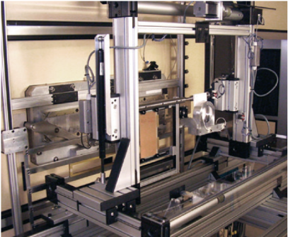
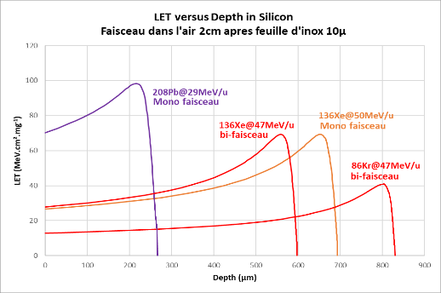
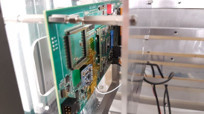
Heavy Ions GANIL facility
GANIL - G41 Beam Line
Ion
beams
© CNES
Test card
GANIL Strengths
Dedicated industrial beamline and team
LET tests possible between 18 and 80 MeV.cm²/mg
Penetration in silicon 200µm and more
Irradiation in air
Adjustable flux between 10 and 10⁴ pps/cm²
GANIL Weaknesses
Limited rapid LET change
No LET<18
Administrative formalities for a Basic Nuclear Installation
Installation optimized for research

Slide 13
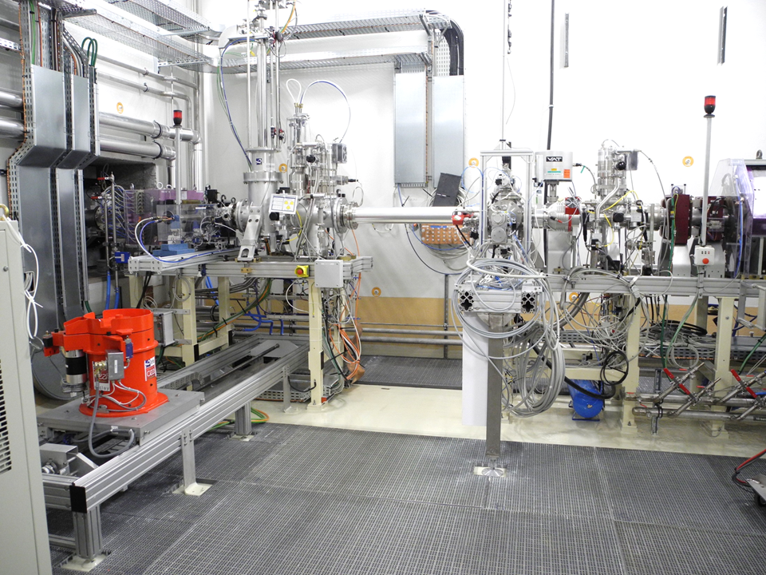
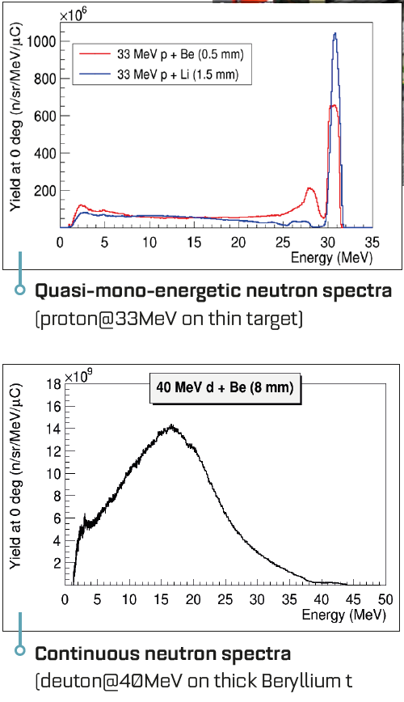
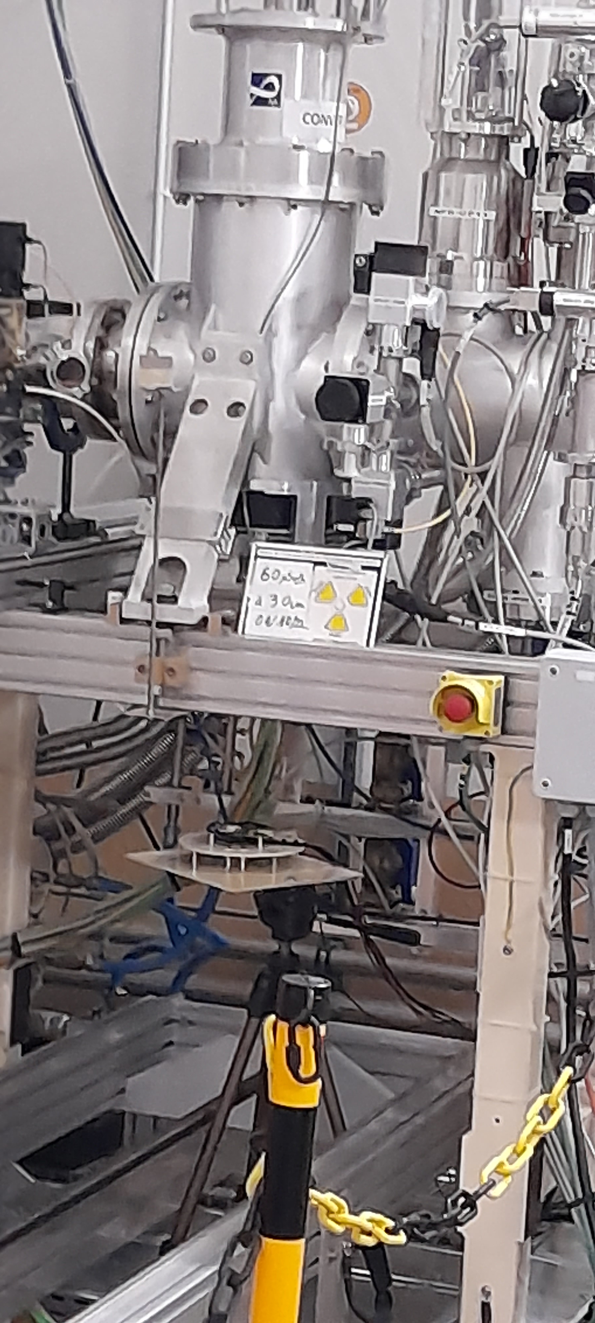
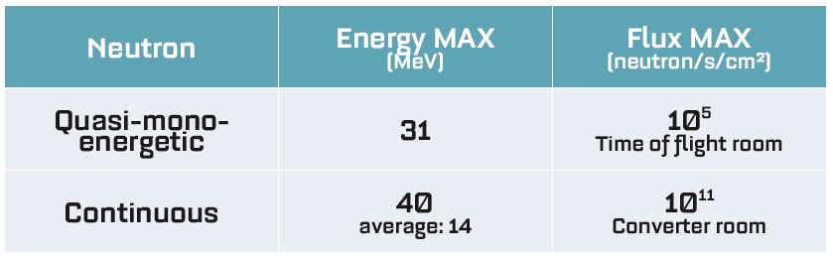
Neutrons SPIRAL2 facility
GANIL – NFS beam line
Neutron
Convertors
Ions beam
© CEA/DAM
Test card
GANIL Strengths
Continuous neutron spectra
Adaptative quasi-mono-energetic neutron spectra (3-31MeV)
Several parallel tests possible
Very high flux (until 10¹¹ neutron/s/cm²)
Irradiation in air
GANIL Weaknesses
Complex accessibility in the room
No dedicated Sample changer
No Atmospheric or Thermal Neutron
Administrative formalities for a Basic Nuclear Installation

Slide 14

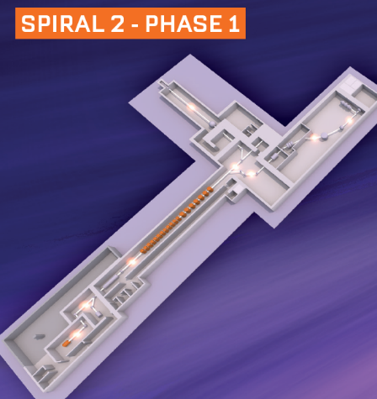
Planned developments
Double the current beamline
« high »
Improve the current beamline
« high »
Neutrons
Increase the available intensities
« low »
Offer neutrons
Medium energy
Heavy Ions
Offer LET « cocktails »
« medium »
Offer protons &
Improve the neutron proposal
Medium energy

Slide 15


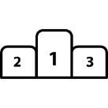






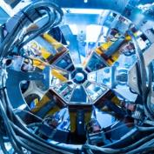


SAGA project (Space Applications at Ganil Accelerators)
Improve GANIL facilites to
better serve the industrial and
academic electronic radiation
testing community.
Increase the commercial valuation of the research platform
€
Develop a strong national partnership policy
A National Research Infrastructure to support the competitiveness and sovereignty of the French space industry
Establish GANIL in the socio-economic environment
Highlight the french
scientific influence

Slide 16




Thursday
Visit instructions
Your guides:
Alexis Lefevre
Cecile Barthe-Dejean
Stéphanie Pupin
Eloïse Dessay
BLEU
ROUGE
JAUNE
VERT

Slide 17

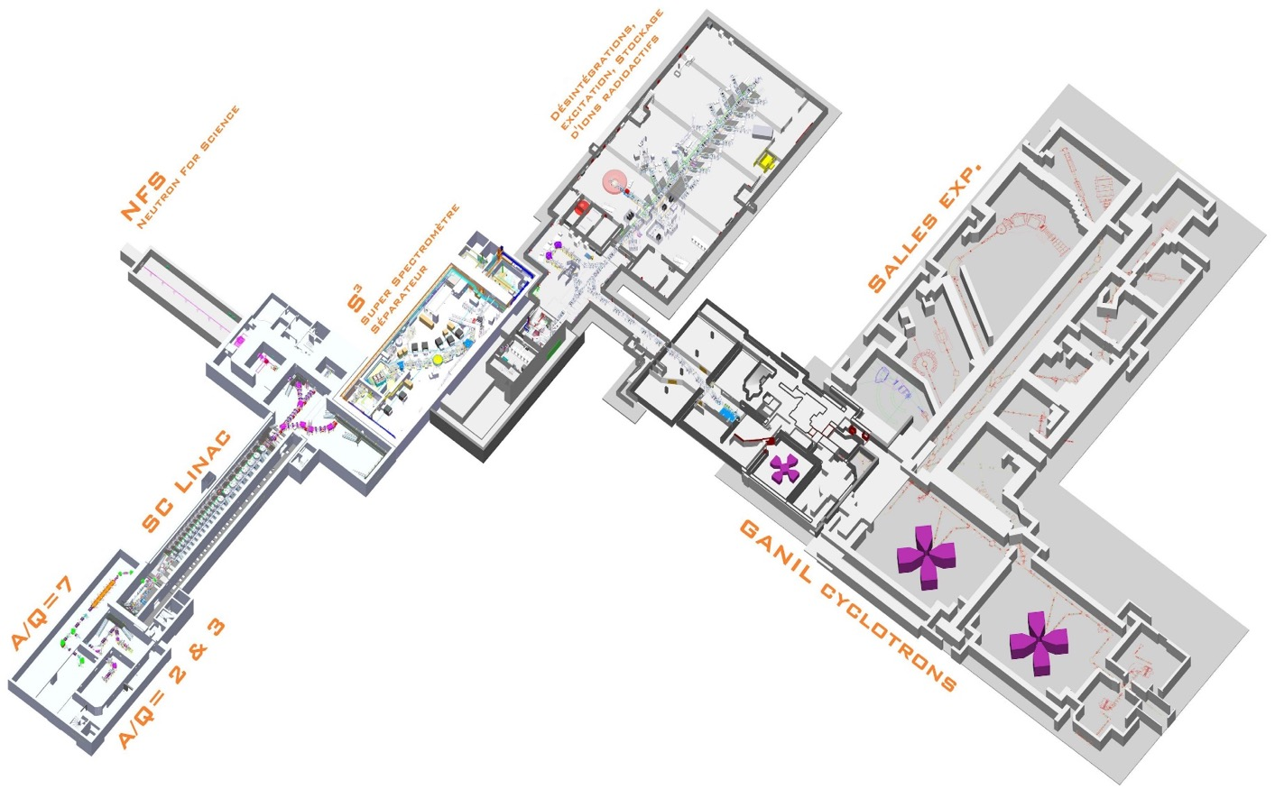


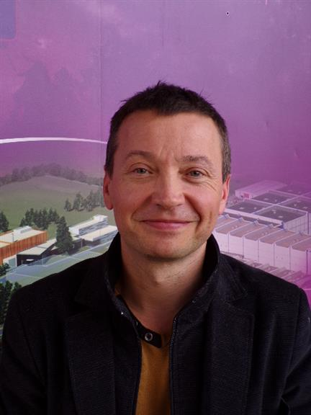

Sebastien Gautrot
SEE tests facility
Xavier Ledoux
Neutron detection
Maria Fisichella
Nuclear physic detection
Bertrand Jacquot
Cyclotron technology
Mathieu Lalande
LINAC technology

Slide 18

Alexis Lefevre
Cecile Barthe-Dejean
BLEU
ROUGE
Stéphanie Pupin
Eloïse Dessay
JAUNE
VERT

Slide 19
Thank you for your attention
Eloïse Dessay
Technology Transfer & Industrial Partnerships
SAGA Project leader
T. +33 (0)2 31 45 46 79
P. +33 (0)6 72 83 02 08
dessay@ganil.fr | www.ganil-spiral2.eu

