Slide 1

Surrogate Test Approaches: Enabling Capabilities for Predictive Testing Using Pulsed Lasers and Other Methods
Dale McMORROW,¹ Joel Hales^{1,2}, Adrian Ildefonso³,
Ani Khachatrian¹, and Stephen Buchner^{1,2}
¹US Naval Research Laboratory, Washington, DC
²Amentum, Chantilly, VA
³Indiana University, Bloomington, IN
Distribution Statement A. Approved for public release; distribution is unlimited

Slide 2
Outline
Where we’ve been
  PL SEE background and some examples
Where we’re going
  SEL screening approach
  ASSERT Program
    Pulsed focused X-ray
    Pulsed focused e-beam
Notes:
No annotation necessary

Slide 3
Pulsed Laser Single-Event Effects
Pulsed-laser SEE has been used for:
  Basic mechanisms studies – single transistors
  Sensitive node identification/characterization - circuits
  SEU mapping of sensitive areas
  Digital single-event transient characterization and mitigation
  Laser-induced latch-up screening/mitigation
  Analog single-event transient screening (ASETs)
  Hardened circuit (RHBD and RHBP) verification
  Dynamic SEE testing
  Complex circuit evaluation/error signature identification
  Experimental test setup verification
Notes:
Description of advantages of using the pulsed laser for SEE studies

Slide 4
Pulsed Laser Single-Event Effects
Common Underlying Theme:
  Spatial selectivity
Notes:
Description of advantages of using the pulsed laser for SEE studies

Slide 5
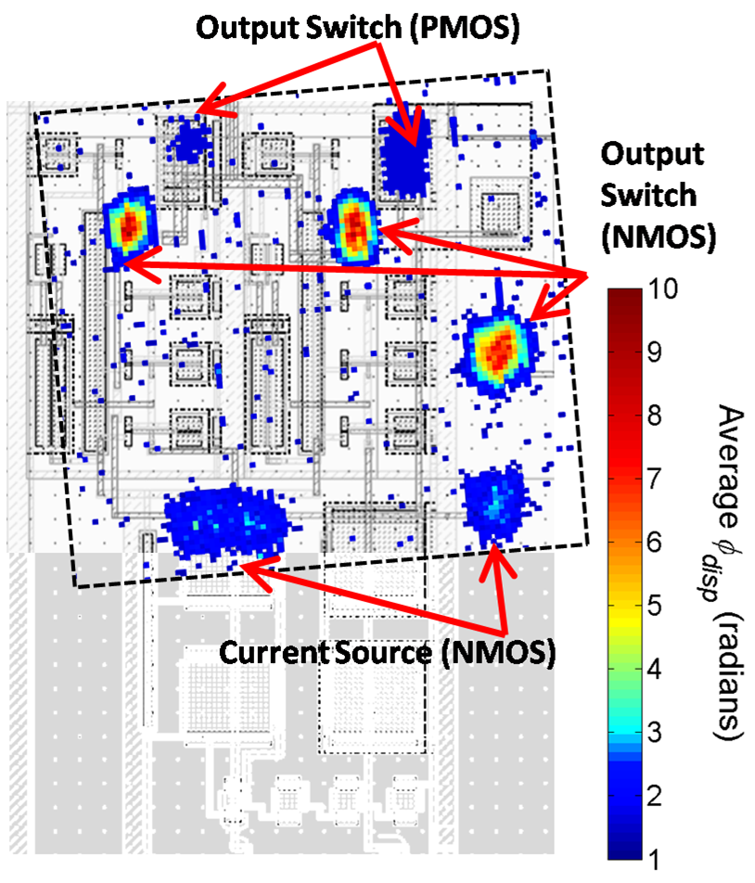
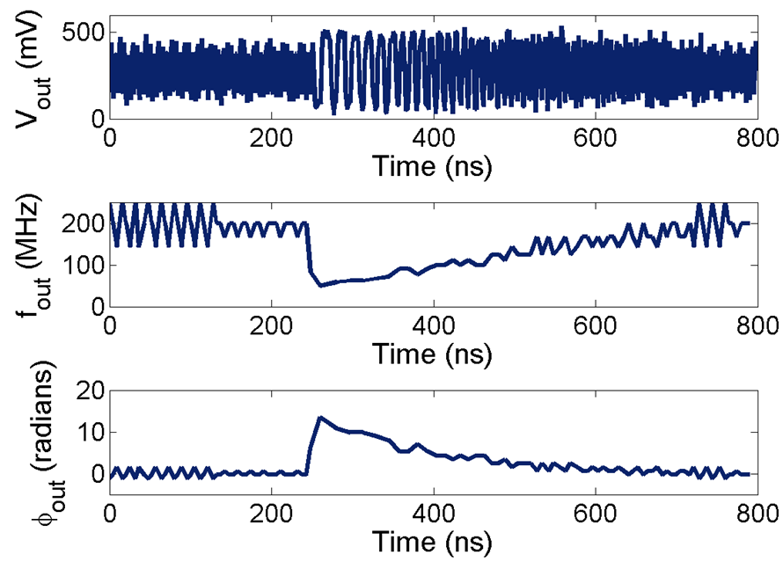
Taking Advantage of PL SEE Spatial Selectivity:
Sensitive Node Identification and SET Mapping.
Commercial PLL Charge Pump
Loveless, et al., IEEE TNS 57, 2933 (2010)
Loveless, et al., IEEE TNS 67, 99 (2020)

Slide 6
Motivation: Need and Opportunity
U. Saskatchewan
Boeing
Intel
Allied Scientific
MSU
SEAKR
NGC
APL
BNL
RTS
NRL
LBNL
SNL
Vanderbilt
JPL
Analog Devices
LANL
UTD
Aerospace
Pulsed-Laser Testing
Heavy-Ion Testing
TAMU
Renesas

Slide 7
Global Laser SEE Testing Facilities

Slide 8

Linear and Nonlinear Optical Absorption in Silicon
Optical Absorption Spectrum of Silicon
μ
μm
1.06 μm
1.55 μm
1.3 μm
Notes:
Series of slides illustrating the differences between the charge deposition profile for single-photon and two-photon absorption. 590 nm.

Slide 9
Optical Excitation of Carriers in Silicon
590 nm
1-Photon
2-Photon
-
-
Ec
Ec
630 nm
1260 nm
E_{g}=1.1eV
Ev
-
-
-
Ev
-
-
-
+
+
Single photon absorbed
By the material (silicon)
Creates a single e-h pair
Two photons absorbed
By the material (silicon)
Simultaneously
Creates a single e-h pair
Notes:
Series of slides illustrating the differences between the charge deposition profile for single-photon and two-photon absorption. 590 nm.

Slide 10
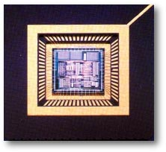
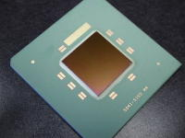
Practical Consideration: Front-Side vs. Backside Illumination
Microscope
objective
Sensitive
volume
Microscope
objective
Sensitive
volume
2w₀
2w₀
Laser beam
Laser beam
Lewis, et al., IEEE TNS 48, 2193 (2001)
substrate
n_{o}≈3.5
Front side
Backside

Slide 11
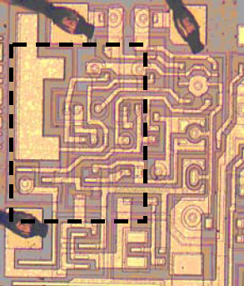
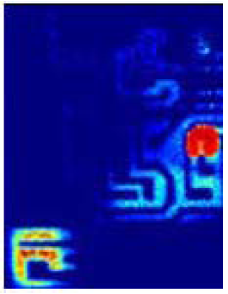
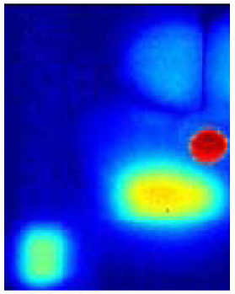
1064 nm Front Side vs. Backside Illumination
SPA ASET Mapping – LM124
Front side
1064 nm
Backside
1064 nm
LM124
Plots illustrate the spatial distribution of the SET amplitude
Sensitive areas clearly identified
Effects of metalization evident
Lewis, et al., IEEE TNS 48, 2193 (2001))

Slide 12
PL SEE Using Axicon -- Quasi-Bessel Beam (QBB)
Spherical Lens vs. Axicon TPA Charge Generation in Silicon
Hales, et al., IEEE TNS 67, 81 (2020)
Notes:
No annotation necessary

Slide 13
PL SEE Using Axicon -- Quasi-Bessel Beam (QBB)
Constant LET
Hales, et al., Optics Express 27, p37652 (2019)
Notes:
No annotation necessary

Slide 14
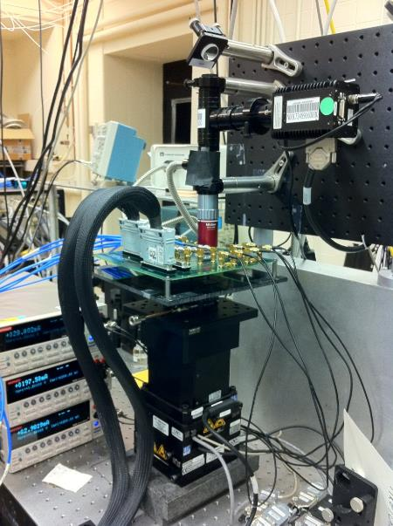
Pulsed Laser Single-Event Effects
45 nm RHBD
PLL test

Slide 15
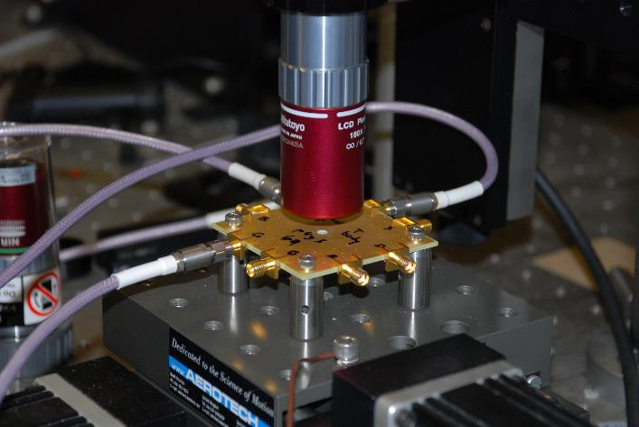
Pulsed Laser Single-Event Effects
High-speed SiGe test

Slide 16
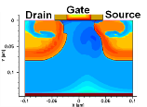

Laser/Ion Correlation/Prediction:
Description of the Challenge
Technology diversity
  CMOS, HBT, Bulk, Epitaxial, SOI, III-V, Heterojunction, FinFET, etc.
Incident laser pulse parameters
    Instrument characterization and calibration (reproducibility)
    Laser pulse energy, spot size, pulse width
  Accurate modeling of the charge deposition
Bulk Diode
Bulk Transistor
CMOS SOI
10⁸
10⁶
10⁴
10²
10⁰
10⁻²
10⁻⁴
10⁻⁶
Size ratio of sensitive volume to charge profile
16

Slide 17
  Two Examples of Spatial Selectivity
17

Slide 18
Spatial Selectivity: Direct Measurement of SET
Pulses in Chains of Inverters
800 inverters, 130 nm partially depleted SOI
Ferlet-Cavrois, et al., IEEE TNS Dec. 2007; Dec 2008

Slide 19
Spatial Selectivity: Direct Measurement of SET
Pulses in Chains of Inverters
4 rows of 200 inverters
Row1
IN
Row2
Row3
Row4
OUT
Laser strike positions
1.2 µm
Ferlet-Cavrois, et al., IEEE TNS Dec. 2007; Dec 2008

Slide 20
IN
OUT
SET width is shorter than 200 ps for laser strikes close to the chain output
SOI
W_{N} 0.3µm
Ferlet-Cavrois, et al., IEEE TNS
Dec. 2007; Dec 2008

Slide 21
IN
OUT
SET width is shorter than 200 ps for laser strikes close to the chain output
Transient widths increase for laser strikes far from the chain output
SOI
W_{N} 0.3µm
Ferlet-Cavrois, et al., IEEE TNS
Dec. 2007; Dec 2008

Slide 22
IN
OUT
SET width is shorter than 200 ps for laser strikes close to the chain output
Transient widths increase for laser strikes far from the chain output
SOI
W_{N} 0.3µm
Ferlet-Cavrois, et al., IEEE TNS
Dec. 2007; Dec 2008

Slide 23
IN
OUT
SET width is shorter than 200 ps for laser strikes close to the chain output
Transient width gets very large close to the chain input (1.8 ns)
SOI
W_{N} 0.3µm
Ferlet-Cavrois, et al., IEEE TNS
Dec. 2007; Dec 2008

Slide 24
Propagation-Induced Pulse Broadening (PIPB)
SOI
W_{N} 0.3µm
Propagation-Induced Pulse Broadening
• 2 ps/inverter
Ferlet-Cavrois, et al., IEEE TNS Dec. 2007; Dec 2008

Slide 25
PIPB Implications
  Interpretation and significance of existing data
  SET mitigation approaches ($$)
  Test methodologies
Ferlet-Cavrois, et al., IEEE TNS Dec. 2007; Dec 2008

Slide 26
Latch-Up Screening of COTS Parts for Space Missions
The pulsed laser permits the rapid and accurate location of SEU and SEL sensitive regions of COTS parts with sub-micron precision
This example: two Resolver-to-Digital Converters were screened for latchup for a NASA space mission
DDC RDC19220

Slide 27
Latch-Up Screening of COTS Parts for Space Missions
The latch-up sensitive areas for one of the parts is shown here
Based solely on these laser results, this part was eliminated from consideration for this and future NASA missions
SEL sensitive areas in COTS RDC
Buchner, et al., TNS, 46, 1445 (1999).
(DDC RDC19220)

Slide 28
Latch-Up Screening of COTS Parts for Space Missions
The latch-up sensitive areas for one of the parts is here
Based solely on these laser results, this part was eliminated from consideration for this and future NASA missions
The other part, it turned out, was latch-up free and, eventually, was deemed acceptable for the mission in question
Part Screening to Reject
SEL sensitive areas in COTS RDC
Buchner, et al., TNS, 46, 1445 (1999).
(DDC RDC19220)

Slide 29
Latch-Up Screening of COTS Parts for Space Missions
Can SEL screening be quantitative?
Early example of laser/ion correlation
0.8 μm bulk technology node
This example:
        2.8 pJ latchup threshold (590 nm)
        1.4 pC deposited charge
        LET_{th}: 8 MeV·cm²/mg
        HI LET threshold: 5-15 MeV·cm²/mg
Buchner, et al., TNS, 46, 1445 (1999).

Slide 30
Current Focus
Laser/Ion correlation
-vs-
Laser-based prediction of HI LET

Slide 31

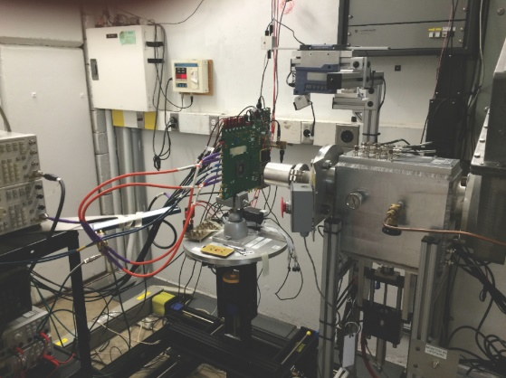
Current Focus: Moving from Laser/Ion Correlation to Prediction
Correlation Approaches
  Rely on existing accelerator data on a given DUT to inform test conditions
  Parameters are chosen to reproduce the known heavy-ion responses
  Depending on the source, this parameter space can be large
  Much more difficult to achieve for emerging 3DHI technologies
Predictive Approaches
  Do NOT rely on pre-existing accelerator data
  Parameters are chosen to produce specified charge generation within the DUT
  Generates an equivalent LET
Correlate
Predict
Pulsed-laser testing
Heavy-ion testing
Notes:
No annotation necessary

Slide 32
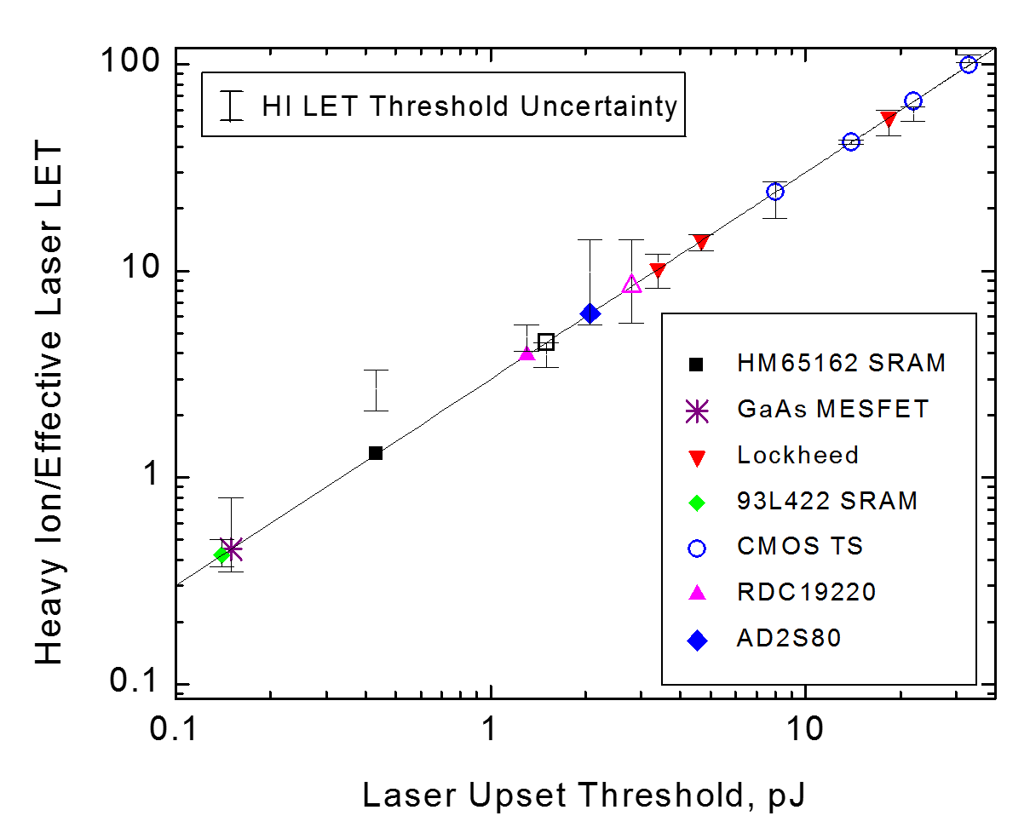

Empirical Laser/Ion Correlation Approach
Correlation Approach
Threshold Laser Energy
Threshold Ion LET
Functional Correlation
LET Prediction
$LET=$ $3×E$
Use for Measurements
D. McMorrow, et al., TNS, vol. 47, Jun, 2000.

Slide 33
Predictive Laser/Ion Approach
Measured SETs for LM124
Predictive Approach
Use laser focusing that resembles charge profile of an ion
LET Calculation
Use for Measurements
J. M. Hales, et al., TNS, vol. 70, Apr, 2023.

Slide 34
PL SEE Using Axicon -- Quasi-Bessel Beam
Constant LET
Hales, et al., Optics Express 2019
Notes:
No annotation necessary

Slide 35
LM124 SET Prediction Using QBB
QBB transients measured prior to heavy-ion measurements
QBB tuned to LET = 59 MeV·cm²/mg
Heavy-ion measurements subsequently performed at BNL, tuned to LET = 59 MeV·cm²/mg
Worst case transients chosen and compared directly to QBB transients;
  No adjustable parameters
  No curve fitting
Agreement is exceptional
Notes:
No annotation necessary

Slide 36
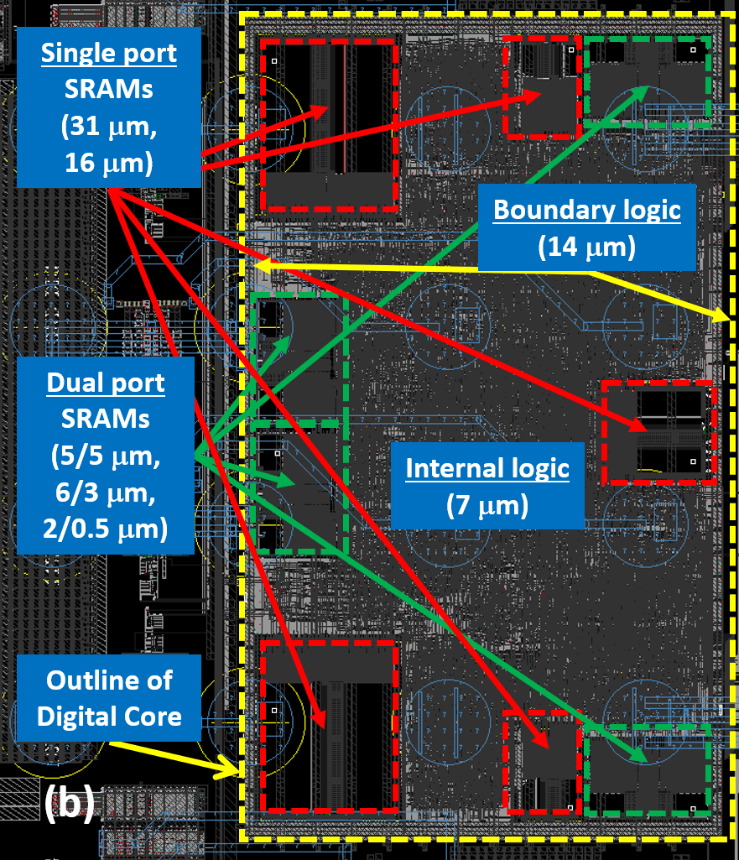
Empirical Correlation for SEL LET Thresholds
Mixed-signal 180 nm bulk (Jazz) ASIC using TPA-based laser testing.
Heavy-ion measurements performed on ASIC. LET_{th} = 0.9 MeV∙cm²/mg
Empirical correlation used to provide quantitative estimates of the LET threshold at various circuit locations in an ASIC
Big Story: this procedure quantified the SEL threshold dependence on design parameters -- follow-on ASIC design showed a 50-fold improvement in the SEL threshold compared to the original design
Hales, et al, TNS, 69, 429-435 (2022)

Slide 37
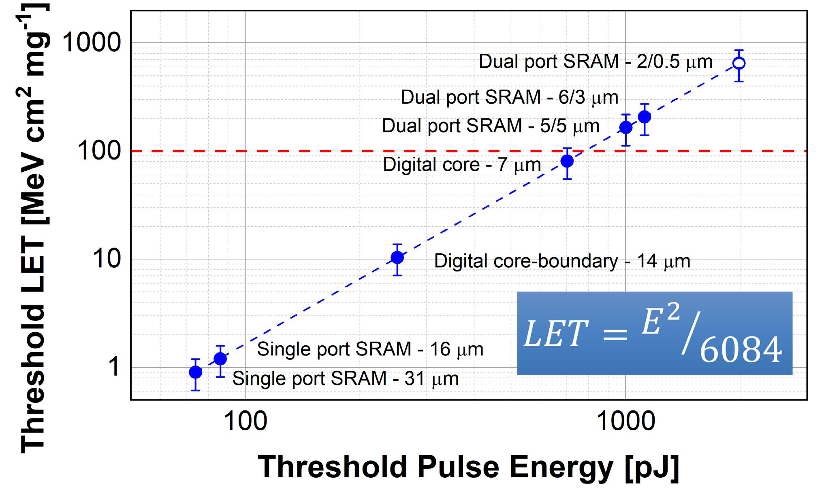
Empirical Correlation for SEL LET Thresholds
Mixed-signal 180 nm bulk (Jazz) ASIC using TPA-based laser testing.
Heavy-ion measurements performed on ASIC. LET_{th} = 0.9 MeV∙cm²/mg
Empirical correlation used to provide quantitative estimates of the LET threshold at various circuit locations in an ASIC
Big Story: this procedure quantified the SEL threshold dependence on design parameters -- follow-on ASIC design showed a 50-fold improvement in the SEL threshold compared to the original design
Anchor
Hales, et al, TNS, 69, 429-435 (2022)

Slide 38
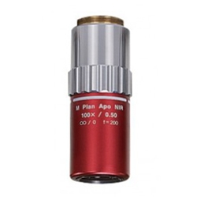
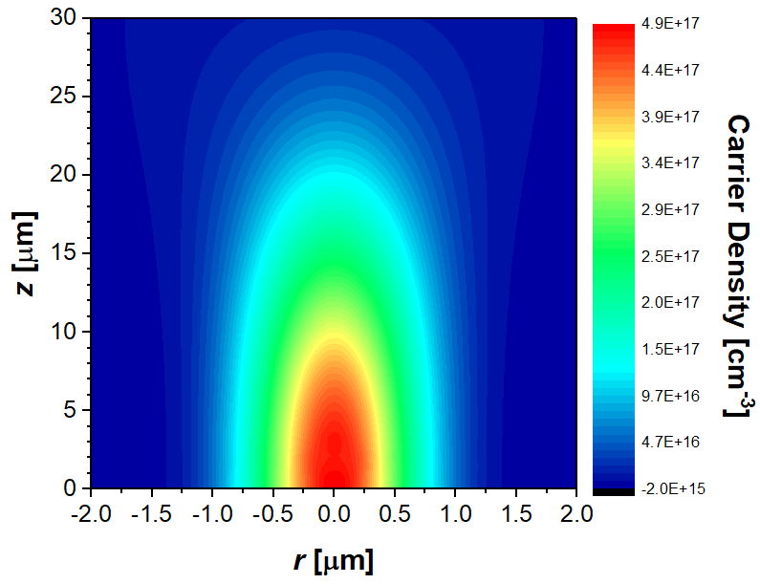
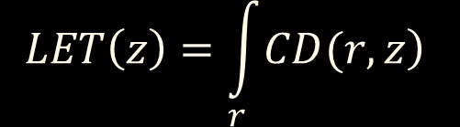
Calculational Laser/Ion Correlation (LIC) Approach
$$LET\left(z\right)=\int_{r}{\left.CD(r,z\right)}$$
Careful characterization of laser parameters and validated optical modeling approaches ensure that laser-equivalent LET, or LET_{L}, can be accurately determined

Slide 39
Calculational LIC – Prediction of SEL Thresholds
Calculational approach uses measured experimental parameters and laser energy threshold to calculate LET_{L}
Good agreement with LET values determined empirically
Bigger Story: Calculational estimates use laser testing only; approach holds promise as a predictive tool for SEL threshold determination
Hales, et al, TNS, 69, 429-435 (2022)

Slide 40
CHALICE
CHALICE went Live on January 1, 2025 and is available to the radiation effects community on the nanoHUB website: https://nanohub.org/resources/chalice
Instruction manual on nanoHUB
Introduced at the 2024 SEE Symposium

Slide 41
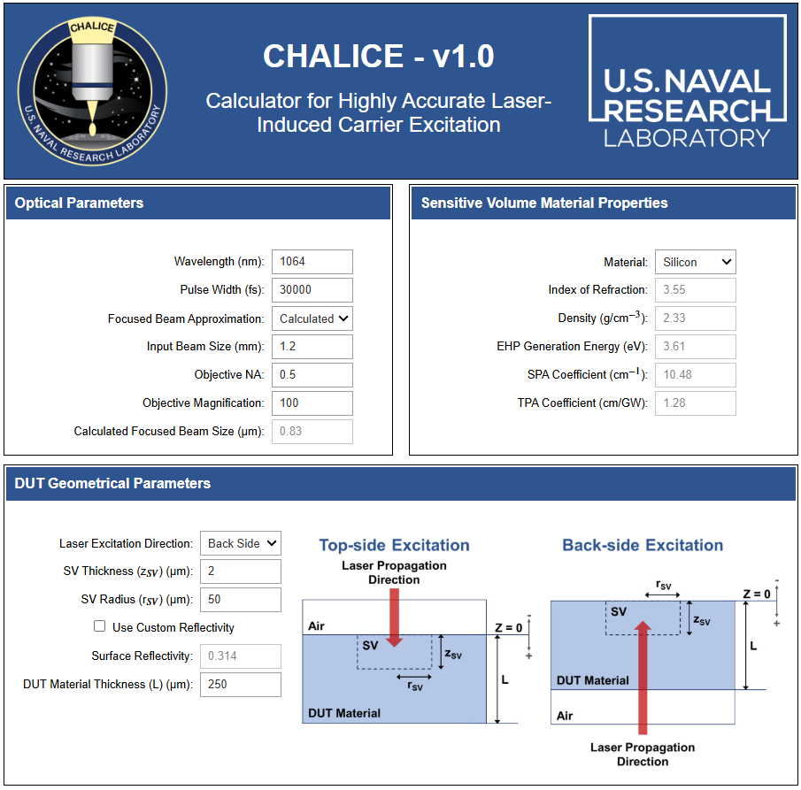
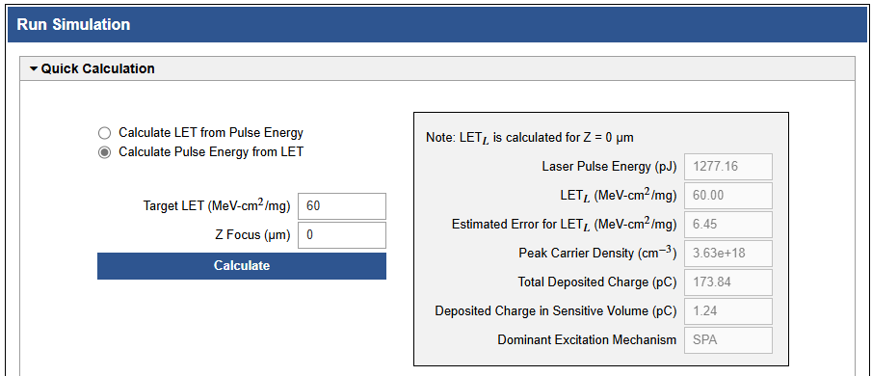
CHALICE
CHALICE can be used to calculate the laser pulse energy needed for screening
A. Ildefonso, SEE Symposium, 2024

Slide 42
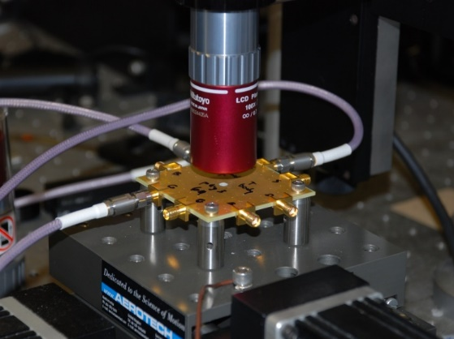
Predictive Laser SEE – Current Status
Accurate SET prediction in complex devices has been demonstrated
  SEL in mixed-signal ASIC using calculational approach
  SET in an operational amplifier using QBB
Investigation in wider variety of devices being targeted
Correlate
Predict
Pulsed-laser testing
Heavy-ion testing

Slide 43
Current Focus:
Laser-based prediction, screening, and alternative sources

Slide 44
Single-Event Latchup Screening
SEL screening is routinely used for part rejection in different laboratories to eliminate parts from consideration for space missions and to minimize the amount of heavy-ion testing required (NASA, JPL, NRL, TRAD, others)
  Standard approaches currently do not exist
In contrast, SEL screening is rarely used for part acceptance, but that landscape is changing
Our challenge: to develop standard, quantifiable procedures for the SEL screening process that can be adopted by space programs and used by the various laser test facilities (and trusted by PMs)

Slide 45
PL SEL Screening: Goal and Risk Reduction
Goal: Develop a PL screening approach that determines whether a DUT will undergo SEL when operating in a specified heavy-ion radiation environment
Minimizing the risk associated with PL SEL screening
To minimize the need for HI testing
Relieve stress on test infrastructure
Choice of laser wavelength
Focused beam size
Scanning parameters
Choice of operating point (LET_{L})
Limited acceptance screening

Slide 46
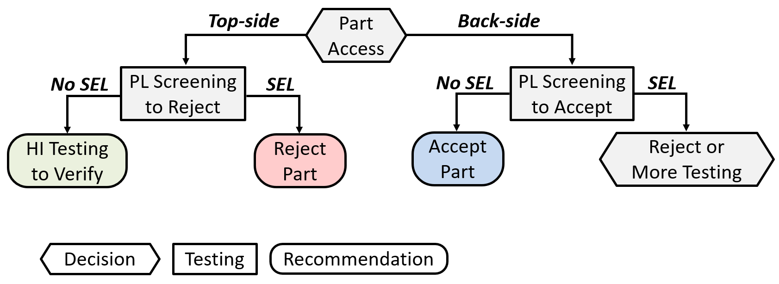
PL SEL Screening: Decision Tree (partial)
Includes decision points, specific testing approaches, and recommendations
Pathway depends explicitly on optical access options for the part

Slide 47
PL SEL Screening: Approach
During testing, a part’s sensitivity to SEL depends on its LET_{th} relative to the LET_{L}
Note that screening is binary: it’s a pass/fail test
LET_{L}
LET_{th} – LET threshold of DUT
LET_{L} – operational set point
Positive / SEL:
LET_{th} < LET_{L}
∞
Negative / No SEL:
LET_{th} > LET_{L}
LET [MeV cm² mg⁻¹]

Slide 48
PL SEL Screening: Approach
Setting LET_{L} = LET_{tar} can lead to false positives and false negatives
Key goal for screening is to reduce false positives and eliminate false negatives
LET_{tar}
LET_{L} ± ΔLET_{L}
True positives:
LET_{th} < LET_{tar}
LET_{th} – LET threshold of DUT
LET_{L} – operational set point
ΔLET_{L} – accuracy error of LET_{L}
LET_{tar} – target program metric
False positives:
LET_{th} > LET_{tar}
∞
True negatives:
LET_{th} > LET_{tar}
False negatives:
LET_{th} < LET_{tar}
LET [MeV cm² mg⁻¹]

Slide 49
PL SEL Screening: Acceptance
For back-side parts, setting LET_{L} = LET_{tar} could still lead to false negatives
Set LET_{L} = LET_{tar} + 3*ΔLET_{L} to establish high likelihood of avoiding false negatives
LET_{tar}
LET_{L} ± ΔLET_{L}
∞
True negatives:
LET_{th} > LET_{tar}
False negatives:
LET_{th} < LET_{tar}
LET [MeV cm² mg⁻¹]

Slide 50
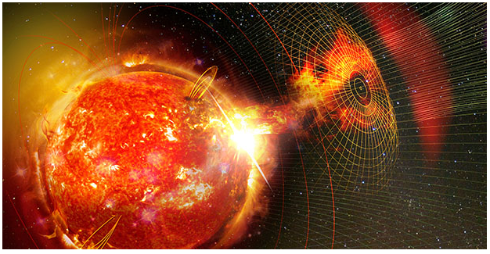

Advanced Sources for Single-Event Effects Radiation Testing (ASSERT)
DARPA Microsystems Technology Office (DARPA MTO)
Kicked-off September 2024
“The ASSERT program seeks to develop novel, compact SEE test sources and techniques to enable the radiation-hardness characterization of advanced 3D components, inform new device designs and selection, update radiation-hardening-by-design (RHBD) rules, and validate new computational models and simulation tools. ASSERT sources will be used to characterize mixed-signal devices containing a multiplicity of materials including but not limited to silicon, GaAs, wide bandgap materials such as SiC and GaN, and emerging ultrawide bandgap materials such as cubic boron nitride, gallium oxide, and silicon nitride.”
Advanced Sources for Single-event
Effects Radiation Testing (ASSERT)
**From DARPA ASSERT BAA

Slide 51
Advanced Sources for Single-Event Effects Radiation Testing (ASSERT)
**
**From DARPA ASSERT BAA

Slide 52
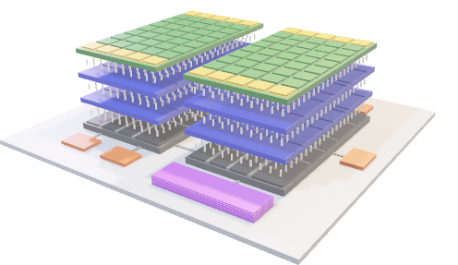
Advanced Sources for Single-Event Effects Radiation Testing (ASSERT)
Additional Requirements**
Beam penetration through metallization and packaging without de-lidding, substrate thinning, backside illumination, etc.
Beam position accuracy ±1 μm at the surface of the DUT (Phase 2); ± 0.2 μm at 5 mm penetration into the DUT (Phase 3) [Note 1]
Maximum pulse width of 2 ps FWHM (full-width half max)
Pulse repetition frequency (PRF) of 1,000 Hz (minimum) [Note 2]
Overall system volume <61 m³ (i.e., the interior volume of a 40-foot shipping container (11.2 m × 2.2 m × 2.3 m) [Note 3]
ASSERT beam
Spatial selectivity enables fault isolation
**From DARPA ASSERT BAA

Slide 53
Advanced Sources for Single-Event Effects Radiation Testing (ASSERT)
Pulsed-Laser SEE (PL SEE) testing techniques have been in use for decades
    Both qualitative and quantitative data have contributed to the field
    Decades-long history of source development (beam delivery, characterization, testing requirements, etc.)
    Correlation and Predictive capabilities have been relevant topics from the start
  Lasers cannot penetrate metal layers, limiting their utility for 3DHI technologies
  But... we can leverage lessons learned over decades of developing correlation and predictive testing approaches using PL to develop new sources better equipped to characterize 3DHI technologies

Slide 54
Advanced Sources for Single-Event Effects Radiation Testing (ASSERT)
Role of Independent Verification and Validation (IV&V) Team
  Serve as technical advisors to the DARPA Program Manager (PM)
  Evaluate technical reports and data to provide feedback to DARPA PM
  Select target DUTs that have a range of complexity and SEE types, and provide information to performers
  Acquire benchmark SEE data that will be provided as Government Furnished Information (GFI) to verify correlation metrics
  Determine protocols for assessing response agreement
Performers will be expected to
  Deliver designs, simulation results, experimental demonstrations and test data (if applicable) to the IV&V team

Slide 55
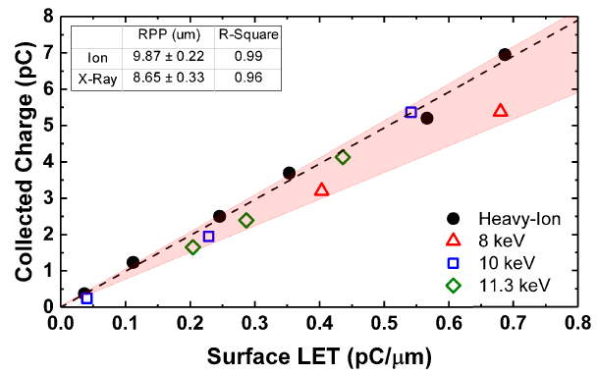
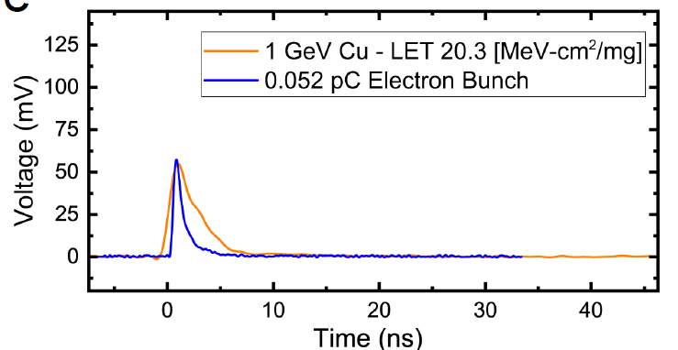
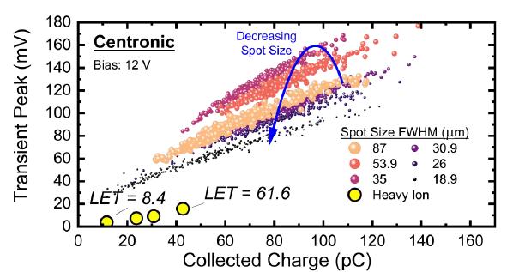
ASSERT performers and approaches
Pulsed electrons (Northrop Grumman, NASA JPL)
Pulsed X-rays (RadiaBeam Technologies)
Prior work demonstrates
pulsed electrons producing single-event transients in
large-area photodiode
Prior work demonstrates use of
pulsed X-rays to generate SEEs
in SiGe HBTs
Thorlabs FD010
G. Tzintzarov, SEE/MAPLD 2023
D. Nergui, et al., IEEE TNS 2020
Spot size found to be
critical in correlating
electron SEEs to heavy ions
D. Monahan, SEE/MAPLD 2024
Inverse Compton Scattering source will generate monochromatic,
tunable high-energy X-rays (20-50 keV) in compact footprint
G. Tzintzarov, SEE/MAPLD 2024
Precision dosimetry (SLAC National Accelerator Laboratory)
Nano-strip sensors for sub-micron resolution dosimetry and sub-ns bunch discrimination for high precision particle tracking
Distribution Statement A - Approved for Public Release, Distribution Unlimited
Notes:
Upper Left: G. Tzintzarov, presented at 2023 SEE Symposium, available online (https://www.seemapld.org/archive.php)
Bottom Left: G. Tzintzarov, presented at 2024 SEE Symposium, not yet available online (https://www.seemapld.org/program.php#day2)
Upper Right: D. Nergui, Available online (https://ieeexplore.ieee.org/abstract/document/8933079)
Lower Right: D. Monahan, presented at 2024 SEE Symposium, not yet available online (https://www.seemapld.org/program.php#day2)

Slide 56
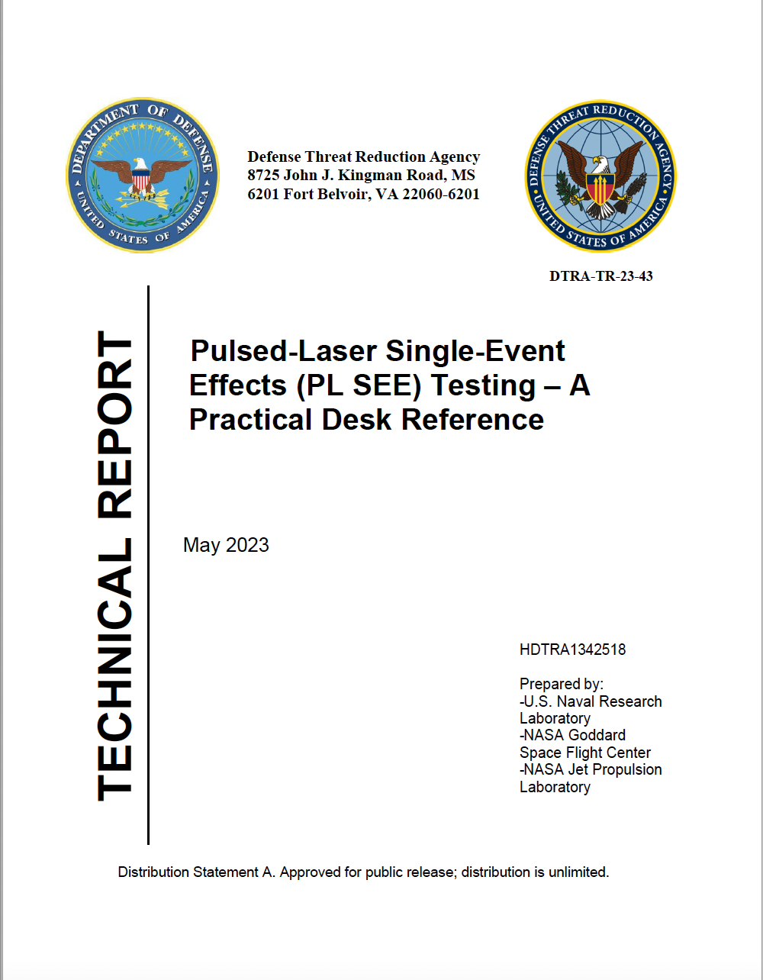
PL SEE Desk Reference (2023)
Can be found at:
https://apps.dtic.mil/sti/citations/trecms/AD1204115
Accession Number: AD1204115
Or go to the DTIC Website and search:
“Pulsed Laser Single-Event Effects”

Slide 57
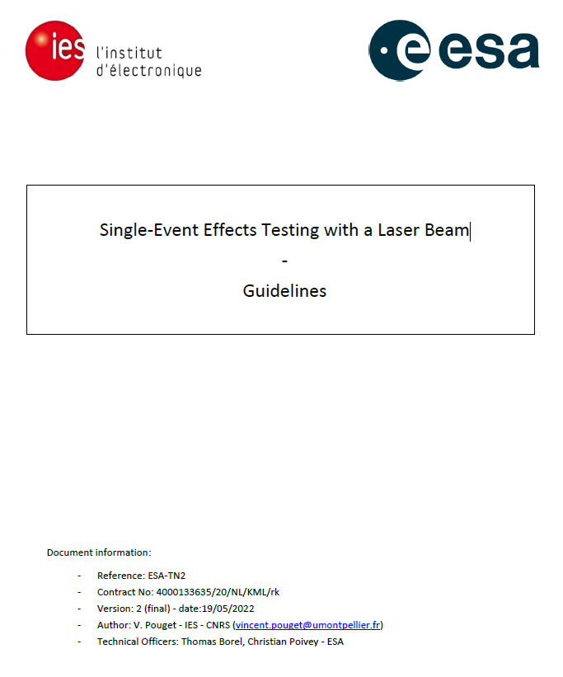
PL SEE Desk Reference (2023)
PL SEE Testing – A Practical Desk Reference
SEE Testing with a Laser Beam – Guidelines

Slide 58
Summary and Conclusions
Overview of PL SEE
Spatial selectivity – specific examples
Current status of SEE correlation and prediction
Interesting things moving forward
  Laser/ion correlation
  Advances in LET prediction
  Axicon-based SEE
  PL SEE Part Screening
  Alternative Sources for SEE
Notes:
No annotation necessary

