Slide 1
Sizing and Desizing of Glass and Ceramic Materials at CERN
Javier Osuna
30 October 2024

Slide 2
Acknowledgements
Materials Testing:
  P.A Contat, F.O. Pincot, D. Polvani, J.S. Rigaud C. Urscheler, B. Verma
Preparation of Samples, Parts and Equipment:
  A. Benfkih, S. Clément, P.O. Coste, D. Cote, B. Fornes, G. Maury, N. Peray, R. Perdrix, P.A. Rizzo
General Guidance:
  R. Piccin, C. Scheuerlein, B. Teissandier, D. Tommasini, A. Brem, A. Devred

Slide 3
Outline
Context/Motivation
Desizing for Insulation Robustness
Further Work

Slide 4
Context/Motivation

Slide 5
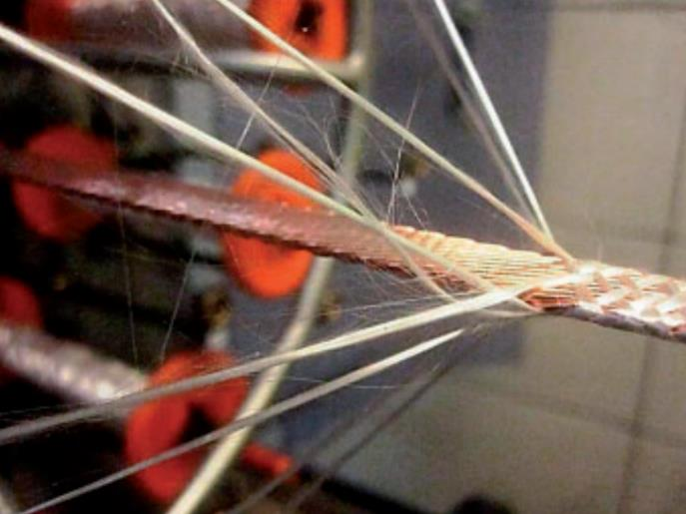
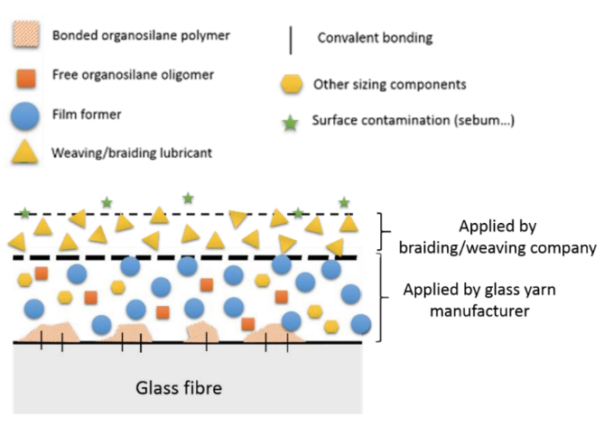

Sizings on Continuous Filaments
Difficult to remove!
The sizing on continuous filaments has a number of uses, such as:
Lubrication
Antistatic Agent
Improved Wetting for Impregnation
Coupling Agent for Fibre-Matrix Interface
This means that there may be multiple components in the sizing of a particular fibre. Furthermore, the exact composition is a trade-secret.
Image from Roy, S. S. et al. Braiding Ultrathin Layer for Insulation of
Superconducting Rutherford Cables (2018) (sagepub.com)
AGY S-2 Glass Sizings Components (Data and Confidence Levels from S. Gayot CERN Report) - EDMS 1828310
In the S2-Glass insulation of Nb₃Sn magnets at CERN, three different fibre sizings are currently used.
These are chosen depending on location and function of the insulation.
AGY SIZING REFERENCE | COUPLING AGENT | LUBRICANT | FILM FORMER
636 (Starch-Oil) | None (by logic) | Vegetal Oil (Possibly Triglycerides) | Starch or Derivative
933 (Inorganic) | Aminosilanes | Polypropylene Glycol (PPG) | Aliphatic Polyurea
493 (Resin) | Aminosilanes | Vegetal Oil (Possibly Triglycerides) | Bisphenol-A Epoxy
Analysis performed using FTIR, SEM, XPS and Colorimetry
- Medium Confidence
- High Confidence
Notes:
https://www.mdpi.com/1996-1944/11/3/403/htm (diagram)

Slide 6
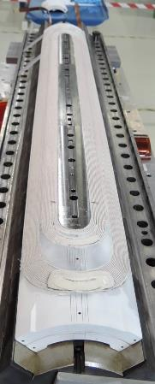
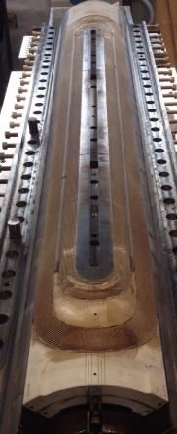
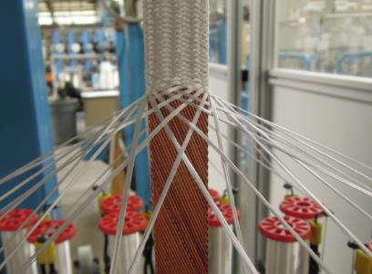
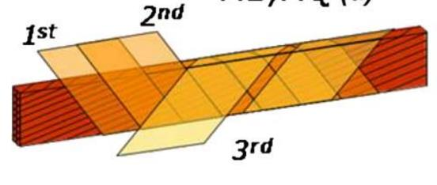
HFM WP4.3: Insulation Materials for Magnet Coils and Conductors
The cable and conductors in the HFM magnets should contain a robust electrical insulation.
Nb₃Sn Coil
Challenge | Example | Ref.
High Voltage | 900V Coil to Ground during quenches | [1]
Thermal Cycles | 1.9K, 300K | [2]
Radiation Environment | ~25MGy for quadrupoles in Inner Triplet (IT) Region | [3]
Nb₃Sn Reaction Cycle | 665°C for 50h in Argon | [2]
Mechanical Loads | Up to 200MPa Pre-Stress | [2]
Braiding | Yarns should not break or undergo filamentation | [4]
The currently applied route for Nb₃Sn coil manufacturing is Wind and React.
The insulation materials within the coil pack (e.g. cable, interlayer) must undergo a 650°C heat treatment in argon.
Polyimide has been replaced by an S2-Glass braid, which is later impregnated with CTD101K.
The S-2 Glass fibre braid:
  Provides a continuous conductor spacing.
  Facilitates impregnation by wetting phenomena.
  Limits crack propagation in resin.
The CTD101K Epoxy Resin:
  Confers a rigid shape to the coil during manufacturing.
  Provides a high dielectric strength (>100kV/mm) to the turn-to-turn insulation
After Winding
After Reaction Cycle
Courtesy of G. Campagna
Table References:
[1] Ambrosio, G. et al. MQXFA Electrical Design Criteria (2020) (fnal.gov)
[2] Ambrosio, G. et al. MQXFA FInal Design Report (2022) CERN Document Server
[3] Polinski, J. et al. Certification of the Radiation Resistance of Coil Insulation Material (2014) EuCARD
[4] Roy, S. S. et al. Braiding Ultrathin Layer for Insulation of Superconducting Rutherford Cables (2018) (sagepub.com)
Polyimide Insulation Scheme Applied for Nb-Ti Cables in the LHC
Fessia et al. Electrical and Mechanical Performance of an Enhanced Cable Insulation Scheme for Superconducting Magnets (2010)
Nb₃Sn (Precursor) Cable Insulation being Braided
P. Ferracin, et al., “QXF cable insulation at CERN.” Joint LARP/CM20 HiLumi meeting Napa Valley, CA, USA, April 2013.
Notes:
Fessia et al. “Electrical and Mechanical Performance of an Enhanced Cable Insulation Scheme for Superconducting Magnets” (2010)
M.G. Lopes - Glass Fiber / Binder Characterization – TE-MSC 2014 - EDMS 1405346

Slide 7
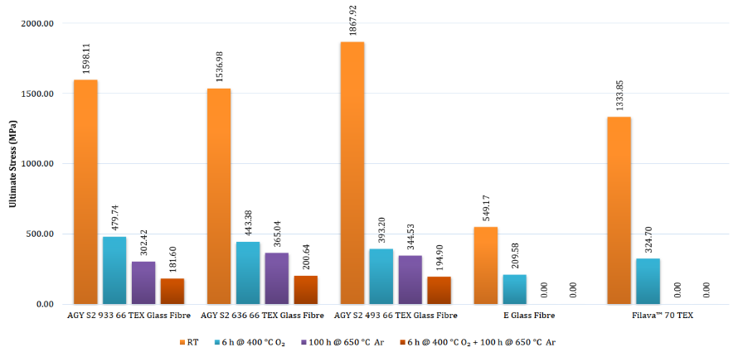
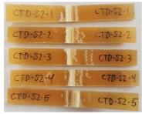
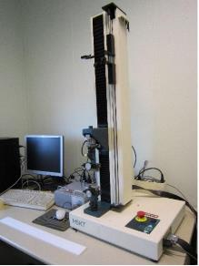
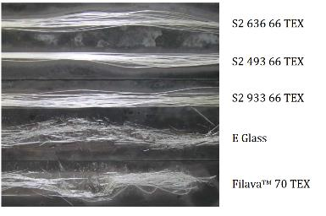
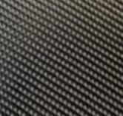
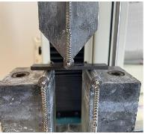
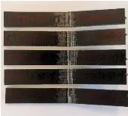
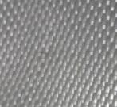
Nb₃Sn Reaction Cycle Effects on Fibre Mechanical Properties
Tensile Tests on Fibres Only
Flexural Tests on Fibres + CTD101K
As-Received
The Reaction Cycle in Argon appears to deteriorate the mechanical properties of the insulation materials.
Research on alternative fibres was started by C. Urscheler, including on:
Reacted
As-Received
Basalt
Tensile Testing Machine
3 Point Bend Configuration
Quartzel
Reacted
M.G. Lopes - Glass Fiber / Binder Characterization – TE-MSC 2014 - EDMS 1405346
C. Scheuerlein, MQXF interlayer mechanical properties – TE-MSC 2022 - EDMS 2735359

Slide 8
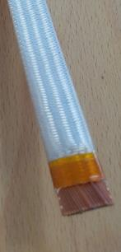
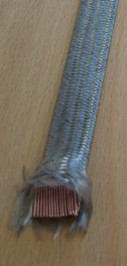
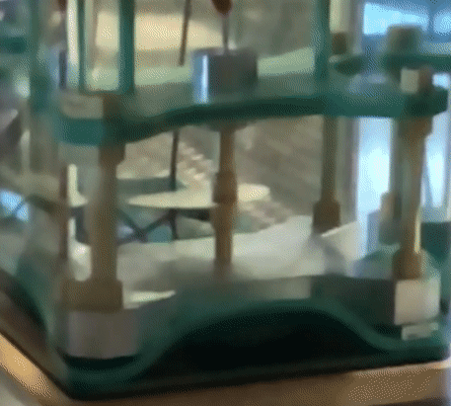
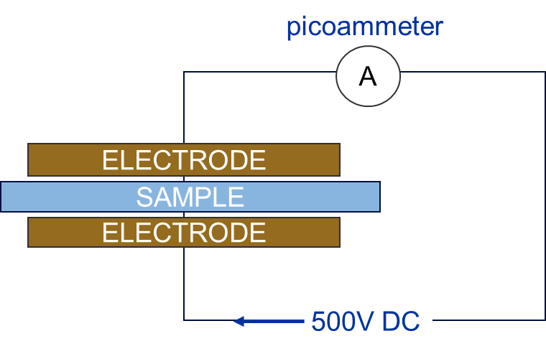
Nb₃Sn Reaction Cycle Effects on Electrical Properties of Insulation Materials
Nb₃Sn Precursor Cable Insulated with S-2 Glass Before (Left) and After (Right) Nb₃Sn Reaction Cycle
(Courtesy of C. Urscheler)
Osuna, J. Influence of 650°C Thermal Cycle on the Dielectric Strength of CTD101K Epoxy Resin Laminates, EDMS 3004067 (2023)
(493 Sizing)
It is believed that the reaction cycle produces conductive residue on fibres due to pyrolysis of the fibres’ organic sizing in the absence of oxygen.
In the case of S-2 Glass composite, this conductive residue affects the insulating properties of the composite dramatically.
Similar effects have been observed for Quartz and Basalt fibre composites.
(493 Sizing)
Notes:
https://www.mdpi.com/1996-1944/11/3/403/htm (diagram)

Slide 9
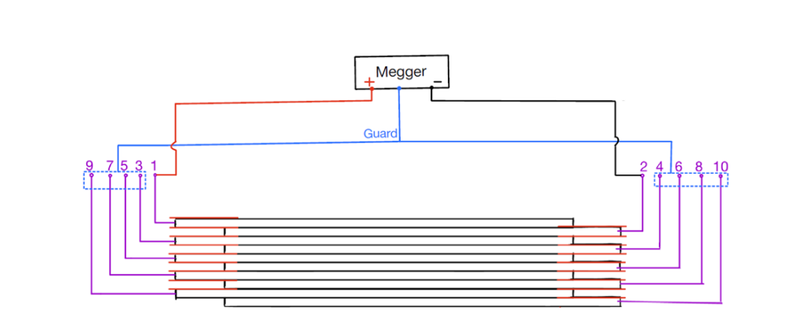
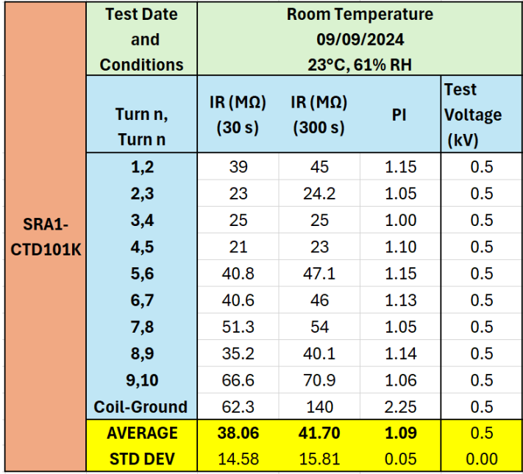
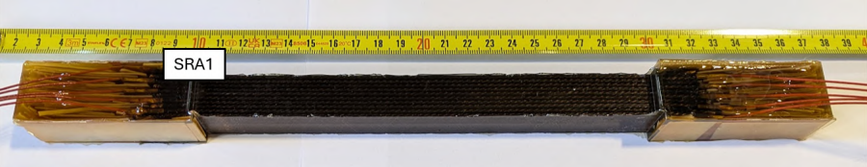
Nb₃Sn Reaction Cycle Effects on Electrical Properties of Insulation Materials
Turn-to-Turn Electrical Tests on 10-Stacks with MQXF Cable (S2 Glass, 933 Sizing)
These effects were also confirmed when testing turn-to-turn insulation of a 10-stack of cables, which is a more representative set-up of magnet coil geometry.
Polvani, D. Towards Novel Electrical Insulation Systems for Nb₃Sn High Field Magnets, EDMS 3168202 (2024)
Notes:
https://www.mdpi.com/1996-1944/11/3/403/htm (diagram)

Slide 10
Desizing for Insulation Robustness

Slide 11
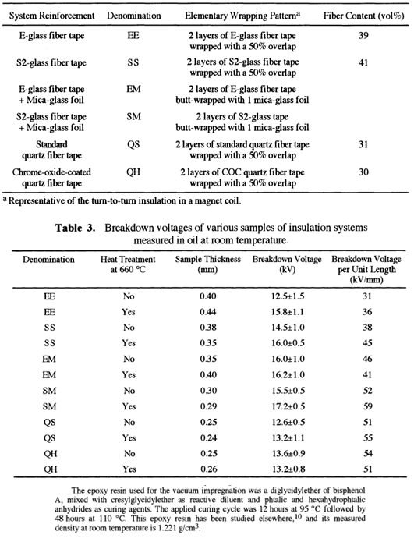
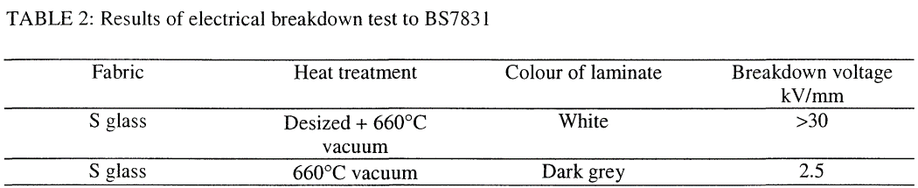
Desizing in the Literature
(Electrical Properties)
Dielectric Tests on Desized Fibre Laminates – Devred et al.
Desizing is reported to allow the fibres to largely retain their insulating properties following the thermal cycle.
Dielectric Tests on 0.4mm-thick Laminates with DGEBF Epoxy Resin + DETDA Curing Agent – Canfer et al.
Canfer, S.J. (2006) ‘Insulation development for the next European dipole’, AIP Conference Proceedings [Preprint]. doi:10.1063/1.2192364
  Devred, A et al. (2000). Insulation Systems for NB3SN Accelerator Magnet Coils Fabricated by the “Wind and React” Technique. In: Balachandran, U.B., Hartwig, K.T., Gubser, D.U., Bardos, V.A. (eds) Advances in Cryogenic Engineering Materials . Springer, Boston, MA. https://doi.org/10.1007/978-1-4615-4293-3_18

Slide 12
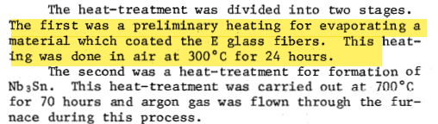
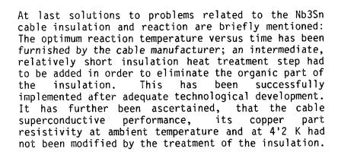
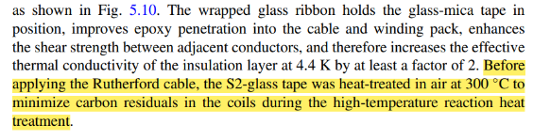
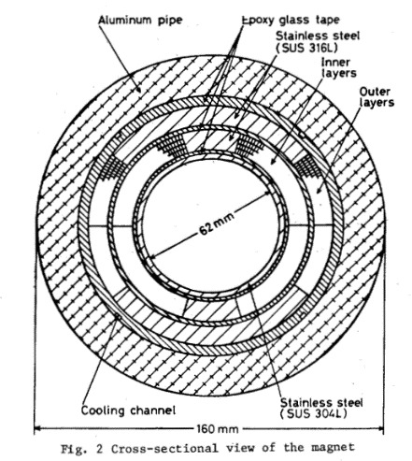
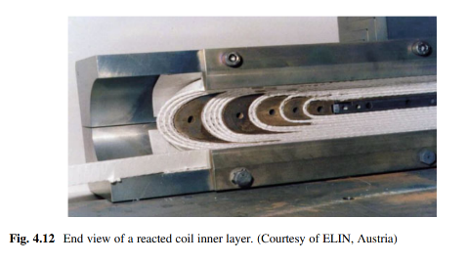
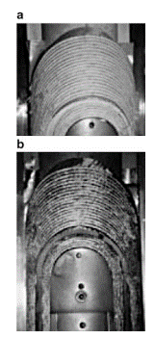
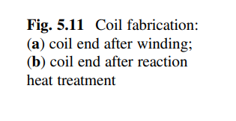
Desizing in the Literature
(Applicability for W&R Nb₃Sn Magnets)
KEK - Toshiba Small-Scale Nb3Sn Dipole (1980)
Heat Cleaning E-Glass air at 300°C for 24h
CERN-ELIN Nb3Sn Dipole Model (1989)
Heat-cleaning mica-glass insulation by firing dry air at 600C for 30 minutes
UT-CERN Cos-theta LHC-Type Nb3Sn Dipole Magnet (1991)
Heat-cleaning glass insulation by heat treating in air 300°C
S. Wenger, F. Zerobin and A. Asner, "Towards a 1 m high field Nb/sub 3/Sn dipole magnet of the ELIN-CERN collaboration for the LHC-project-development and technological aspects," in IEEE Transactions on Magnetics, vol. 25, no. 2, pp. 1636-1639, March 1989, doi: 10.1109/20.92613
Schoerling, D., Zlobin, A. (eds) Nb3Sn Accelerator Magnets. Particle Acceleration and Detection. Springer, Cham. https://doi.org/10.1007/978-3-030-16118-7_4
Perin, R. (2019). CERN–ELIN Nb3Sn Dipole Model. In: Schoerling, D., Zlobin, A. (eds) Nb3Sn Accelerator Magnets. Particle Acceleration and Detection. Springer, Cham. https://doi.org/10.1007/978-3-030-16118-7_4
K. Ishibashi, M. Koizumi, K. Hosoyama, M. Kobayashi and T. Horigami, "Nb3Sn dipole magnet by wind and react process," in IEEE Transactions on Magnetics, vol. 17, no. 1, pp. 428-431, January 1981, doi: 10.1109/TMAG.1981.1061080

Slide 13
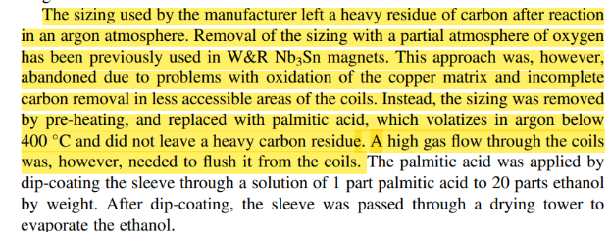
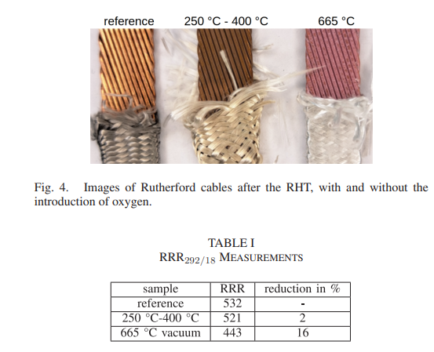
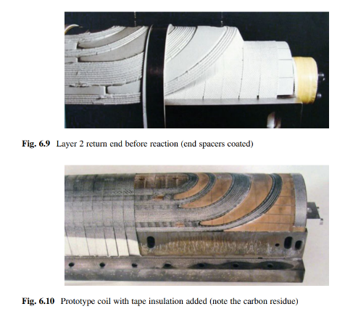
Desizing in the Literature
(Applicability for W&R Nb₃Sn Magnets)
LBNL Cos-theta Nb3Sn Dipole Magnet D20 (1990s)
Heat-cleaning and resizing with palmitic acid
PSI (2024)
Heat Cleaning S2 Glass using Oxygen Pulses
(Chemical Desizing also applied in BOX Tests)
A. Brem et al., "From Hot to Cold: Advanced Materials and Processes for NbSn Based Magnets," in IEEE Transactions on Applied Superconductivity, vol. 34, no. 5, pp. 1-5, Aug. 2024, Art no. 7700105, doi: 10.1109/TASC.2023.3338588.
Schoerling, D., Zlobin, A. (eds) Nb3Sn Accelerator Magnets. Particle Acceleration and Detection. Springer, Cham. https://doi.org/10.1007/978-3-030-16118-7_4

Slide 14

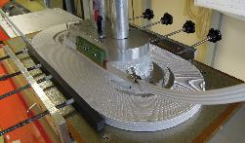
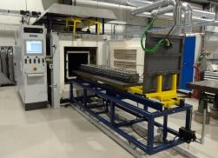
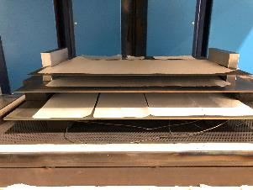
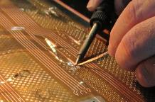
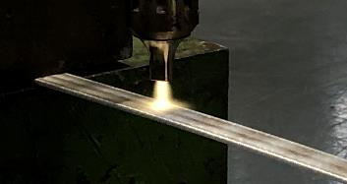
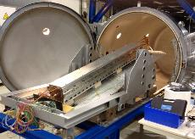
Recent Desizing at CERN
1. Braiding
2. Winding/Binder
3. Reaction
5. Impregnation
4. Instrumentation
The sizing on the fibres is fundamental to the braiding process. If the insulation is de-sized, the yarns will undergo filamentation and possibly break.
Therefore, the desizing process seems only feasible after braiding.
Three strategies currently being investigated:
Thermal Desizing
  Injection of Air during coil reaction
Plasma Desizing
  In-line plasma treatment
  during winding
Chemical Washing
  In-line washing during spooling
  Rinsing of wound coil
Plasma/Chemical Desizing
Thermal/Chemical Desizing
Images Courtesy of G. Campagna and P. Ferracin

Slide 15
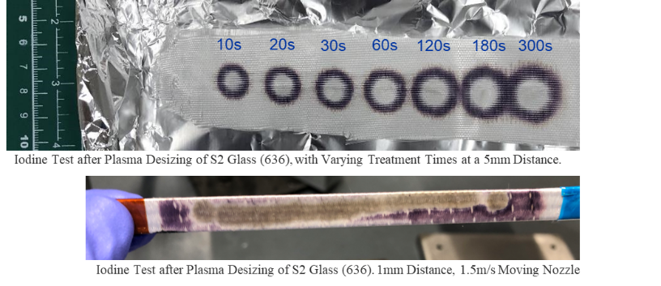
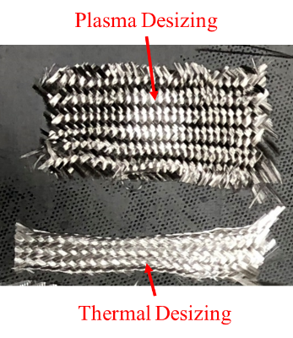
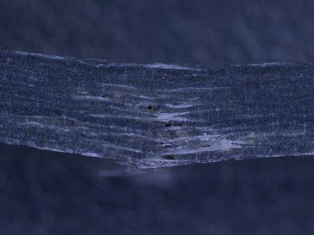
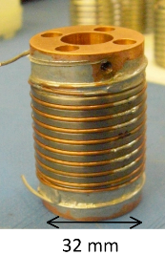
Assessment of Desizing Effectiveness
Thermogravimetry
2. Iodine Tests (For starch-based sizing)
5. Effects on Cable Conductor
Residual Resistivity Ratio (RRR)
Critical Current, I_{c}
Nb-Ti VAMAS Sample
Jérome Fleiter «Round Robin Test for Ic Measurements of Nb-Ti and YBCO Conductors» (2010)
4. Composite Properties
  Electrical, mechanical, adhesion
3. Visual

Slide 16
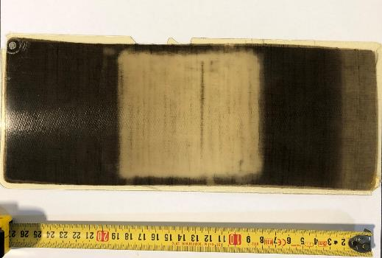
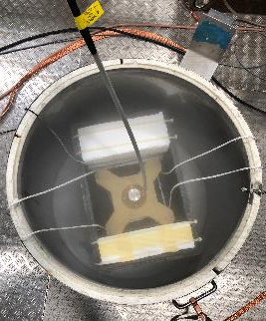
DC Breakdown Tests of Laminates in Liquid Nitrogen
Desized area
0.5mm plate of CTD101K + Plasma Desized, Heat-Treated Quartzel Composite
J. Osuna et al. Advanced Composite Insulation Systems in Nb₃Sn Superconducting Magnets for Accelerators: Electrical Characterization of Laminates at Cryogenic Temperatures (2024)
Testing at cryogenic temperatures is more representative of the magnet’s operating conditions.
When tested in liquid nitrogen at 77K, the performance of the composites appears to improve.
Thermal desizing appears more reliable than plasma desizing. However, in both cases, an improvement was achieved relative to the untreated samples.
DC Breakdown Setup in Liquid Nitrogen
Notes:
https://www.mdpi.com/1996-1944/11/3/403/htm (diagram)

Slide 17
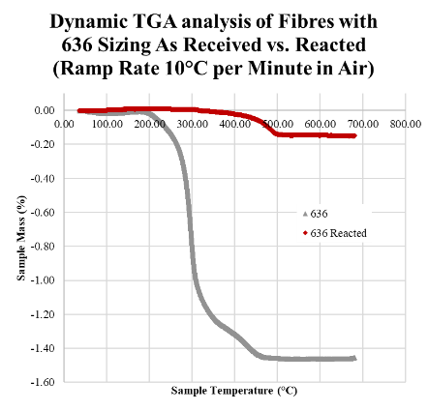
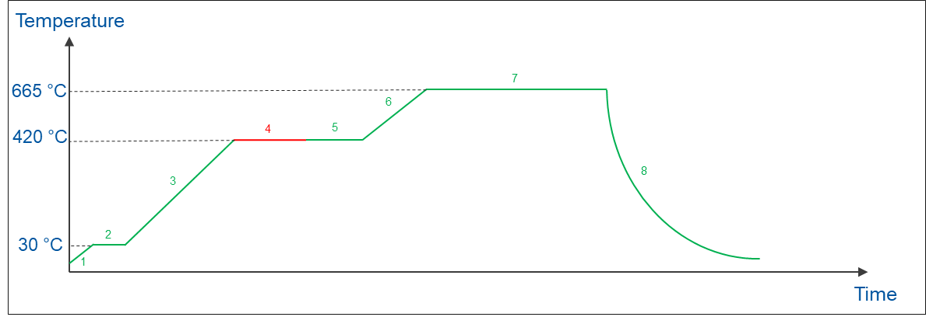
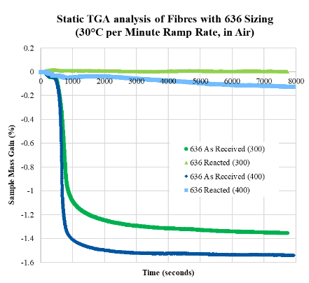
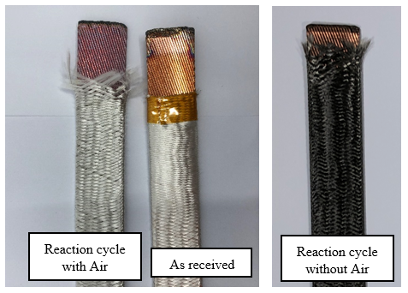
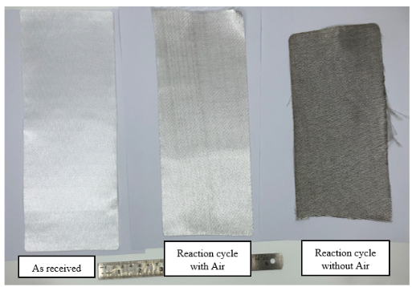
Optimization of Heat-Cleaning Procedure using TGA
Modified Nb₃Sn reaction cycle with desizing step.
Osuna, J. Modified nb3sn reaction cycle with air for desizing S2 glass and Quartzel fibers, EDMS 3175024 (2024)
Osuna, J. TGA Analysis of S2 Glass Fibres with 636 Sizing for Thermal Desizing Study, EDMS 3165822 (2024)
Nb₃Sn Cable with S2 Glass 933 Insulation
Quartzel Fibre Fabric
Notes:
https://www.mdpi.com/1996-1944/11/3/403/htm (diagram)

Slide 18







Other Ongoing Efforts
2. Chemical washing and effects on cable conductor
Alconox
  Designed for applications where minimal corrosiveness/residue is wanted.
  Suggested by Andre (PSI) and used for BOX samples.
Methyl Ethyl Ketone
  Recommended by a supplier for fibre desizing.
More aggressive cleaning agents:
  Alcojet (also suggested by Andre, PSI)
  Citranox
1. Parameter optimization of plasma treatment on Nb₃Sn cables and effects on cable conductor.
Spot Desizing
(1 sec, 2 sec, 5 sec, 10 sec, 30 sec, 60 sec)
Moving Nozzle
(0.3m/min. , 0.6 m/min. , 1.2m/min. , 1.8m/min.)
Cable conductor after plasma treatments above
Insulation After Plasma Treatment and Nb3Sn Reaction Cycle
1. Ultrasonication
2. Rinse in Ethanol
4. Dry at 60 °C
3. Rinse in dH₂O
Collaborating with plasma technology suppliers for the testing of rotary nozzle technology. Example nozzle shown left.
Ultrasound bath with fibres.
Picture from: https://www.henkel-adhesives.com/us/en/products/industrial-sealants/gasketing/potting.html
Cable conductor after plasma treatments above
Notes:
https://www.mdpi.com/1996-1944/11/3/403/htm (diagram)

Slide 19
Future Work

Slide 20
Conclusions and Further Work
The robustness (from an electrical standpoint) of the Nb₃Sn coil and cable insulation can be improved by preventing the formation of conductive residue on fibres.
Thermal desizing and plasma desizing appear effective for desizing cable insulation, and thus for minimizing the formation of conductive residue. Results for chemical desizing are in progress.
The removal of sizing will likely affect the mechanical properties of the composite, due to the role of sizing in forming the fiber matrix interface.
Further research on desizing will be aimed at:
  Performing de-sizing and electrical tests on 10-stacks, which are more representative of coil geometry.
  Comparing the mechanical properties of reacted fibres with and without sizing (flexural strength/ILSS).
  Better understanding the effects of thermal, plasma and chemical treatments on RRR and I_{c} when applied on a cable insulation.
  Improving the reproducibility of plasma treatment and ensuring it works for different sizings and fibre materials.
Notes:
Mention Thierry

Slide 21
Additional Slides

Slide 22

Function of Insulation in Superconducting Magnets
Insulator (electrical): A material with a large energy gap between the valence and conduction band, which does not readily permit electrons to carry an electrical current under the application of an electric field.
Insulating materials help fulfill a number of critical functions:
  Provide conductor spacing and if possible facilitate resin impregnation.
  Prevent short circuits and arcing between conducting parts of magnet and from magnet to ground.
  Have a well-defined thickness to preserve magnetic field quality.
  Confer a rigid shape to the coils.
Magnet Insulation Components (MQXF)
Cu Wedge
End Spacer
Ground
Turn-to-Turn
Cold Bore
Interlayer
Pole Separation
Magnet Aperture

Slide 23



Atmospheric Plasma Cleaning
Plasma which does not require a vacuum, and can realistically take place at low temperatures (below 200 °C).
Physicochemical process, involving the simultaneous action of:
  UV Light
  Free-Radicals
  Ions
  Temperature
Air plasma to be applied on top and bottom of cable simultaneously during a spooling process.
https://plasmatreatment.co.uk/images/plasma-technology/plasma-tech-overview/PlasmaCleaning_02.jpg
https://www.afs.biz/en/
Example Plasma Treatment on a Nb₃Sn Cable

Slide 24




Electrical Tests Performed of Fibre Insulation
DC Breakdown Tests:
  Power Supply:
    0.5mA, 150kV FUG HCP 140-150000
    5mA, 65kV FUG HCP 350-65000
  Ramp Rate: 500V/s
  Testing Medium: Oil, Air, Liquid Nitrogen
25mm Diameter
Brass Electrode
Volume Resistivity Tests:
  Guarded Electrode Configuration
  Power Supply: Keithley 2260B-800-1 360W
  Picoammeter: Keithley 6485 Picoammeter
  Test Voltage: 500VDC*
  Testing Medium: Air
  *Lower voltages were used for samples that were not insulating.
800V Power Supply
Top Electrode
Picoammeter
Bottom Electrode

Slide 25


MQXF Interlayer Study (EDMS 2735359)
C. Scheuerlein, MQXF interlayer mechanical properties – TE-MSC 2022
The flexural strength of CTD101K composite samples decreases significantly following the Nb₃Sn reaction cycle in Argon.
The presence of ceramic binder appears to exacerbate this effect.
3 Point Bend Configuration
Formation of Silicon Oxicarbide during 650°C Reaction Cycle in Argon
(493 Sizing)
D. Ternova, FTIR and XRF analysis of the S2 TEX glass-fibre with the CTD-1202 ceramic binder after several treatments, TE- VSC 2022 - EDMS 2732657

Slide 26

Binder Effects on Electrical Properties of Insulation Materials
The use of ceramic binder appears to partially maintain the insulating behaviour of the epoxy + S2-Glass composite following the Nb₃Sn reaction cycle.
Notes:
https://www.mdpi.com/1996-1944/11/3/403/htm (diagram)

Slide 27



Thermal Desizing Experiment
Another experiment is being performed to remove sizing from a fiberglass fabric by the graphitization method.
Various fiberglass fabrics have been placed in an oven for four hours at 400°C, in air.
The iodine test was performed on the fabric containing the 636 sizing.
Because the other fabrics do not contain 636 sizing, the iodine test cannot be performed to monitor the removal of sizing.
933
493
636
933
4 hours at 400°C (air)

Slide 28




Results of Plasma Desizing Experiment
The starch test is positive for 25mm nozzle distance and negative for 5mm.
This is evidence that the sizing can be removed when treating for 5 minutes at 5mm.
The results also indicate that treatment is strongly dependent on distance.
Even before performing the test, there is a visible change in appearance of the treated surface for the 5mm treatment.
Appearance following Plasma Treatment
Nozzle at 25mm
Nozzle at 5mm
Iodine Test

Slide 29


Thermal Desizing Experiment – 636 Sizing Results
Appearance following Thermal Desizing
Iodine Test
The starch test is negative for the fibre tissue following the thermal desizing.
This is evidence that the sizing can be removed with a thermal cycle in oxygen at 400°C for 4 hours.
The starch was not detected anywhere on the surface of the sample. The sizing appears to be removed throughout the whole sample.

Slide 30



Results of Plasma Desizing Experiment (II)
10s
20s
30s
60s
120s
180s
300s
Untreated Zone
Partially Treated Zone
Fully Treated Zone
The absence of starch is noticeable after 10 seconds of plasma treatment.
The diameter of the treated area has a higher rate of increase in the first ~60 seconds of plasma treatment.
The wettability of the fabric with iodine solution was also observed to increase with treatment time.
Initial appearance of Iodine solution when applied to fabric.
Close-up of Iodine test result.

Slide 31
Literature – Desizing
Two general approaches to de-sizing:
Solvent Removal
  Graphitisation (Burning) in air
Reference | Desizing Method | Fiber Material
Greenhalgh et al. [6] | Graphitisation (350°C for 16h in air) | S-Glass/Quartz, organic sizing assumed
Fabian et al. [4] | Graphitisation (400°C for 4h, assumed in air) | S-2 Glass, 6781, 8-harness satin weave, silane finish
Roy et al. [9] | Graphitisation (350°C, time not mentioned, in air) | HYBON 2001 E-Glass, organic sizing assumed
Arkan et al. [1] | Graphitisation (Various temperatures for 3h in air, one test for 16h) | S-2 Glass, starch/oil-based sizing (Owen-Corning designation: 636)
Devred et al. [3] | Graphitisation (350°C overnight in air, with prior desizing in air at 700°C for 10-15 minutes in the case of quartz only.) | E-Glass, S-2 Glass, Quartz and Mica with organic sizing
Gayot, Sarah (CERN Test Report) [5] | Solvent Removal 3-Stage rinsing in n-hexane Soxhlet extraction in acetone | S-2 Glass (Various sizings/Weaves)
Li et al. [8] | Solvent Removal Acid Desizing (Boiling Water followed by 0.24M H₂SO₄) Oxidant Desizing (4mL/L H2O2, 2 g/L NaOH and 2 g/L JFC) | Cotton fibers with starch-based sizing
Ul-Haq et al. [10] | Solvent Removal (Enzymatic Desizing with amylase) | Cotton fibers with starch-based sizing

Slide 32



Sizings at High Temperatures
FTIR Results of 933 and 636 Sizings after Heat Treatment – Sarah Gayot CERN Report [5]
Determination of Desizing Efficiency – Roy et al. [9]
Studying Ideal Temperature for Graphitisation – Arkan et al. [1]

Slide 33
References for Slides 31-32
  [1] Arkan, T.T. et al. (1998), Studies on S-2 Fiber Glass Insulation for Nb3Sn Cable
  https://lss.fnal.gov/archive/vlhc/fermilab-vlhcpub-197.pdf
  [2] Canfer, S.J. (2006) ‘Insulation development for the next European dipole’, AIP Conference Proceedings [Preprint]. doi:10.1063/1.2192364.
  [3] Devred, A et al. (2000). Insulation Systems for NB3SN Accelerator Magnet Coils Fabricated by the “Wind and React” Technique. In: Balachandran, U.B., Hartwig, K.T., Gubser, D.U., Bardos, V.A. (eds) Advances in Cryogenic Engineering Materials . Springer, Boston, MA. https://doi.org/10.1007/978-1-4615-4293-3_18
  [4] Fabian, P.E., et al.(1994). Properties of Candidate ITER Vacuum Impregnation Insulation Systems. In: Reed, R.P., Fickett, F.R., Summers, L.T., Stieg, M. (eds) Advances in Cryogenic Engineering Materials . An International Cryogenic Materials Conference Publication, vol 40. Springer, Boston, MA.
  https://doi.org/10.1007/978-1-4757-9053-5_128
  [5] Gayot, Sarah (2017), Chemical characterisation and comparison of glass fibre sizings for MQXFS insulation scheme https://edms.cern.ch/document/1828310/1.1
  [6] Greenhalgh, R.J.S. et al. (2008) ‘Fracture measurements on insulation for high-field superconducting magnets: Relationship to processing regimes and test temperature’, Engineering Fracture Mechanics, 75(9), pp. 2642–2650. doi:10.1016/j.engfracmech.2007.03.003.
  [7] Gonçalves Lopes, Marco (2014) Glass Fibre/Binder Characterization https://edms.cern.ch/document/1405346/1
  [8] Li, W. et al. (2022) ‘Quaternization-butyrylation to improve the viscosity stability, adhesion to fibers, film properties and desizability of starch for warp sizing’, International Journal of Biological Macromolecules, 204, pp. 500–509. doi:10.1016/j.ijbiomac.2022.02.021.
  [9] Roy, SS et al. (2018) Braiding ultrathin layer for insulation of superconducting Rutherford cables. Journal of Industrial Textiles. 2018;48(5):827-847. doi:10.1177/1528083716661204
  [10] Ul‐Haq, N. and Nasir, H. (2011) ‘Cleaner production technologies in desizing of cotton fabric’, Journal of the Textile Institute, pp. 1–8.
  doi:10.1080/00405000.2011.570045.

