Slide 1
IT Project Management Best Practices
Sonia Méntrida Calleja
(on behalf of the IT PMO team)
11.12.2024

Slide 2
Content
IT PMO (Project Management Office)
Project Management Methodologies across IT
IT Project Documentation - templates
IT Project Catalogue
Q&A

Slide 3
IT PMO (Project Management Office)
Created: 3 years ago
Aiming of:
  having a global view of the portfolio and to track all projects in the department
  providing support to navigate the project lifecycle
  to increase clarity on processes and promote transparency
  promoting best practices
  facilitating resource allocation.
High diversity of projects:
    Several types of projects: with in the department, in collaboration with other departments, organizations and companies (through openlab)
    Several source of funding: internal, central, from KT, QTI, EC and other organizations
    Total around 60 ongoing projects

Slide 4
Project Management methodologies across IT
Methodologies used:
  mainly Agile methodology for software development and project management
  Kanban and Scrum are equally used
It is up to the project managers to choose the methodology that better fulfil their needs
Tools used for managing the project timelines and tasks are:
  JIRA
  GitHub (mainly for software developers)
  GitLab for medium term planning
  MS Project

Slide 5
Project lifecycle
Purpose:
To provide a well-defined structure, with clearly defined phases, required documentation, and approval boards to transition to the next phase.
This helps Project Managers properly define and plan the project to achieve its goals, while incorporating review steps for feedback and rescoping when necessary.
Phases | Initiation | Planning | Execution | Closing
What to do: | Produce charter | Create project plan (milestones, deliverables) | Execute & track progress | Produce impact report Present in ITTF

Slide 6
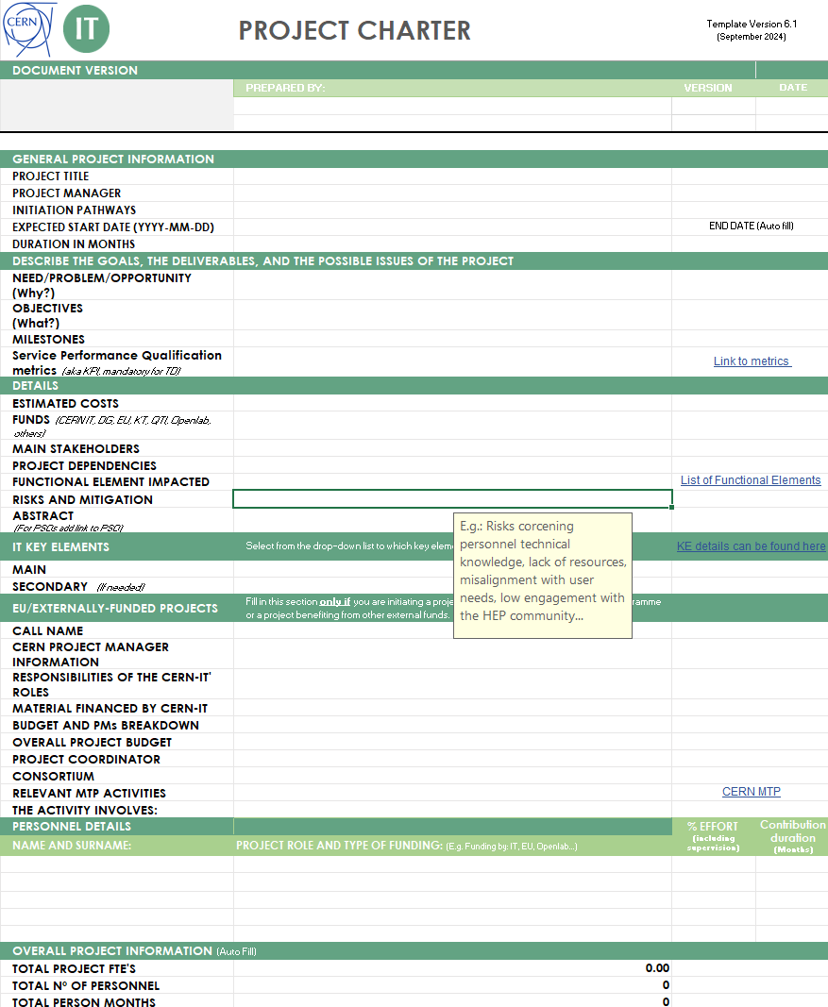
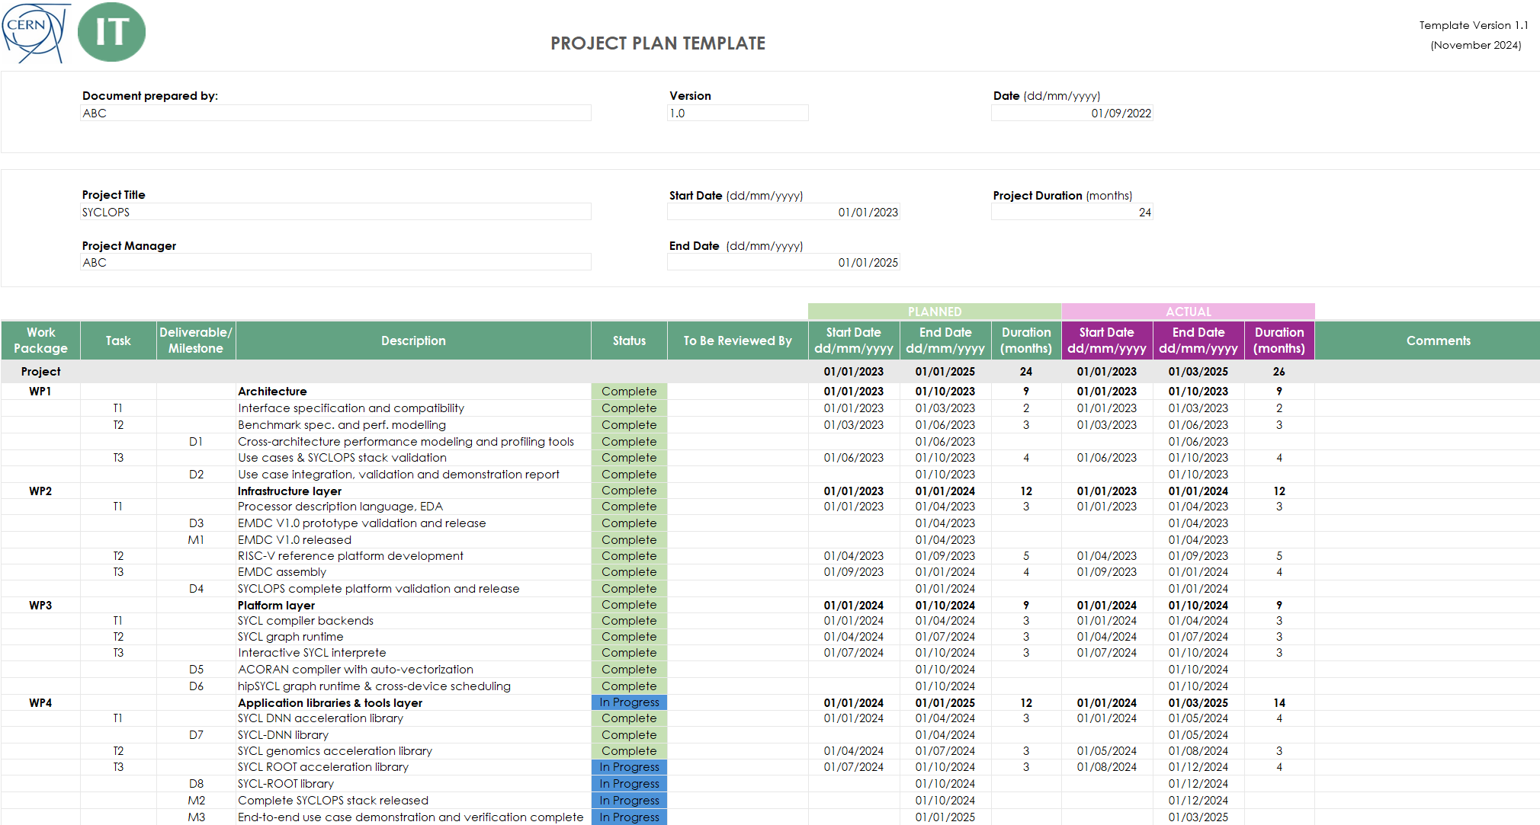
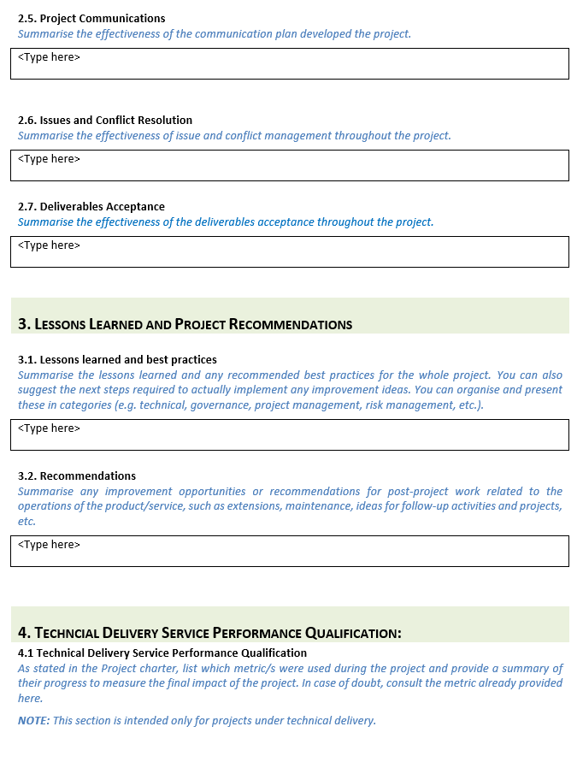
IT Project Documentation - Templates
PROJECT CHARTER
WHY?
Provides a clear outline of its objectives, scope, and key stakeholders.
It serves as a high-level agreement and ensuring alignment and clarity from the beginning.
CONTENT:
Purpose and objectives
Expected outcomes
Alignment with the IT strategy
Risks and mitigation measures
Costs and required resources
PROJECT PLAN
WHY?
It serves as a roadmap for the project team and stakeholders, ensuring the project stays on track to achieve its goals.
Sets baseline for measuring progress.
CONTENT:
Project's deliverables, milestones, and timeline
Contains a Gantt Chart
IMPACT REPORT
WHY?
It serves to communicate and assess the impact of a project, and outcomes.
It captures important lessons learned, thus facilitates knowledge transfer across the department.
CONTENT:
Summary of project’s outcomes
Project impact
Lessons learned
Future Recommendations

Slide 7
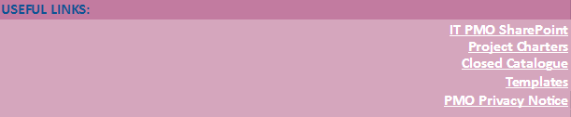
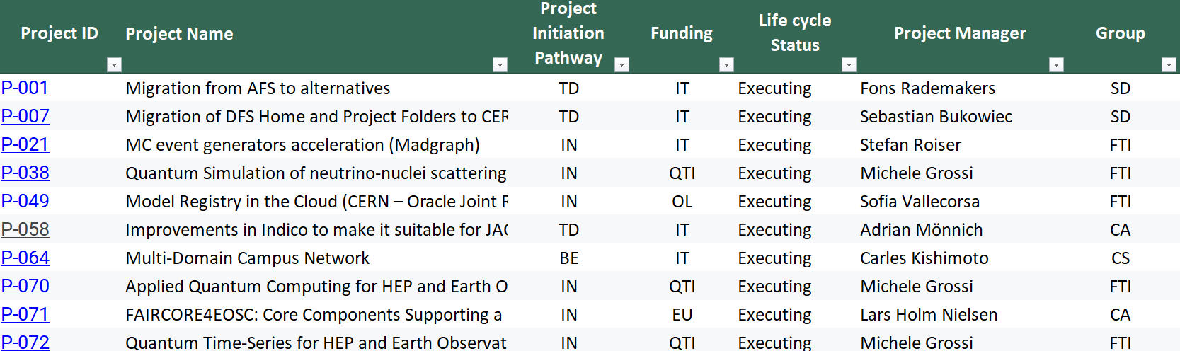
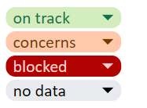
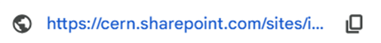
IT Project Catalogue
It serves as a centralized overview of projects information, including personnel and documentation, promoting transparency and share of knowledge and allowing to easily access to metrics and reports. Helping teams, stakeholders, and decision-makers stay informed and aligned.

Slide 8
Thank you
Any questions?

