Slide 1



IT Project Portfolio Overview
Shahzaib Aamir, IT-RM

Slide 2
The Need For a Project Portfolio in IT
The Project Portfolio is essential for monitoring key ongoing activities in IT and to provide a comprehensive view of projects, resources and overall departmental efforts
The primary goal is to enhance clarity and accountability, helping the department maintain optimal resource utilization and maximize value delivered to stakeholder groups.

Slide 3
Project Initiation Governance
For a project to be included in our tracking, it must first be fully endorsed by its Initiation Pathway and second by the overarching ITSC (Steering Committee)
The 3 Pathways which initiate projects:
Business Engagement (BE) - Manages engagement channels for CERN’s internal collaborations, with each sector (ATS, RCS, FHR) i.e. ATS-IT Support of Linux distributions
Innovation (IN) - Oversees new initiatives that differ from current operations and drive innovation i.e. EC projects, openlab, Next Generation Triggers
Technical Delivery (TD) - Overseas service evolution i.e. Drupal to Wordpress Migration

Slide 4
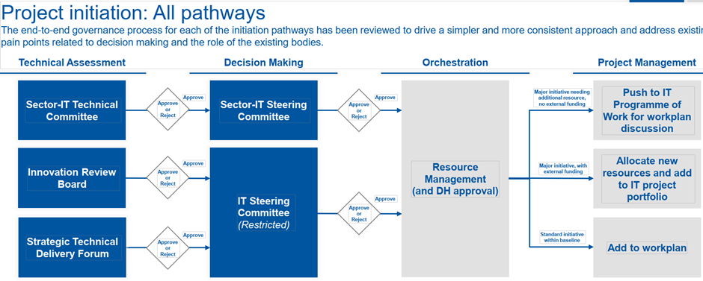
Notes:
Technical Delivery if feasible -> Decision making -> orchestration -> project management

Slide 5
Project Portfolio Lifecycle - Inspired by PM² Methodology
Phases | Initiation | Planning | Execution | Closing
To Do | Produce charter/PSO Get endorsement | Create project plan (milestones, deliverables) | Execute & track progress | Produce impact report summary (ITSC) Present in ITTF
Gate | ITSC/Sector-IT committee | Resource allocation with RM team | Reviews by IP Boards & PMO Completion of milestones | IP Board & ITSC Approval
Notes:
Technical Delivery if feasible -> Decision making -> orchestration -> project management

Slide 6
Types of Projects in the Portfolio
Project is any time-bound activity with a well-defined scope, producing a deliverable(s), requiring additional resources (material and/or personnel)
Internal Projects: Funded with IT budget and personnel
Service Evolution: Activities to improve ongoing IT Services
External Projects: Projects funded by external sources (E.C. projects, private companies)

Slide 7
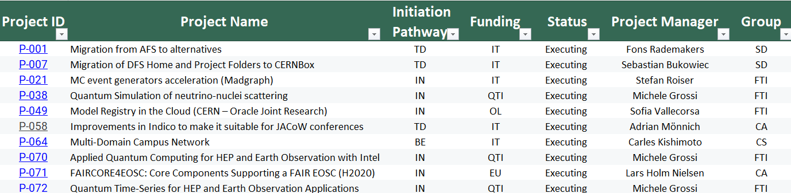
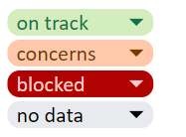
The Project Catalogue - Information That Matters
Notes:
The Project Catalogue is a centralized record of ongoing projects in the CERN IT department, mainly focusing on the ones outside of baseline operations or requiring heightened visibility.It provides key details such as:
Project Name
Funding Information
Current Status
Responsible Group/Section
Involved Personnel
Full-Time Equivalents (FTEs)

Slide 8
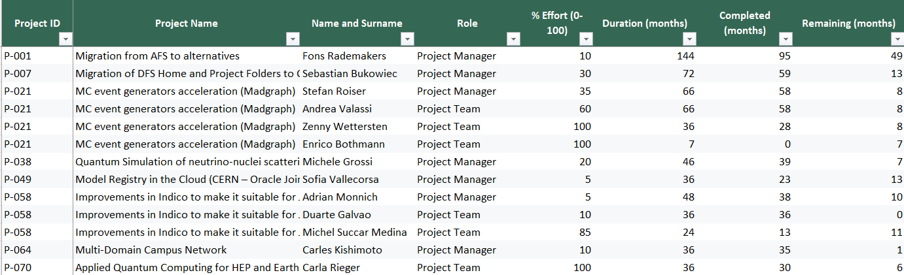
The Project Catalogue - Resources/Personnel
Notes:
The Personnel tab, offers a deeper breakdown of the people involved in each project. Mainly team members, with their percentage effort and estimated duration. We at the PMO track this and make sure it is up-to-date as much as we can.
For data privacy reasons, contract titles are hashed and hidden. The catalogue is dynamic and highly filterable, allowing users to sort by groups, sections, project managers, and more.

Slide 9
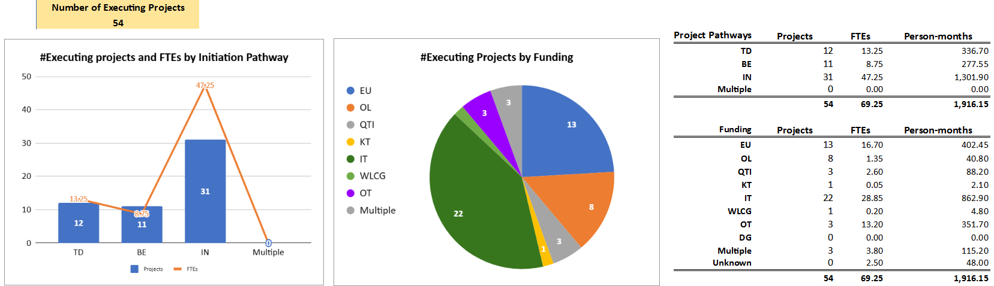
Data Collection & Reporting

Slide 10
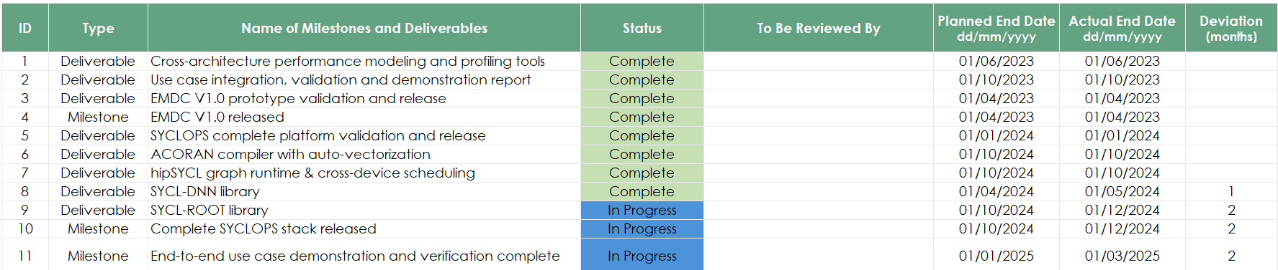
Key Data Collected - Milestones and Deliverables

Slide 11
The Purpose of the Catalogue
Centralized Information Hub
Ensure Information is easily accessible in one place - Reports, Details, FTE’s
Improved Resource Management
Identify Personnel Assigned to Projects - To Aid in Decision Making on Staffing
Up-To-Date View on CERN IT’s Capacity & Priorities
Historical & Current Records Can Assist in Future Planning
Visibility & Transparency on Work as Demand Grows
Alignment with Department Objectives, Improvements in Collaboration
Notes:
Having all this helps with the visibility in the department as demand grows.
Having a structured approach can help with the growing demand of the IT department

Slide 12
How Management Leverages Portfolio Data
Monthly Reports are submitted to the IT Steering Committee - detailing developments of key projects and recent updates:
Recently endorsed projects
Extension of timelines
Recently completed projects
Significant changes in FTEs
Relevant Statistical Data for Holistic Viewpoint
Management will review and evaluate FTEs to assess staffing needs, assess ongoing projects to align future strategies with departmental objectives.

Slide 13
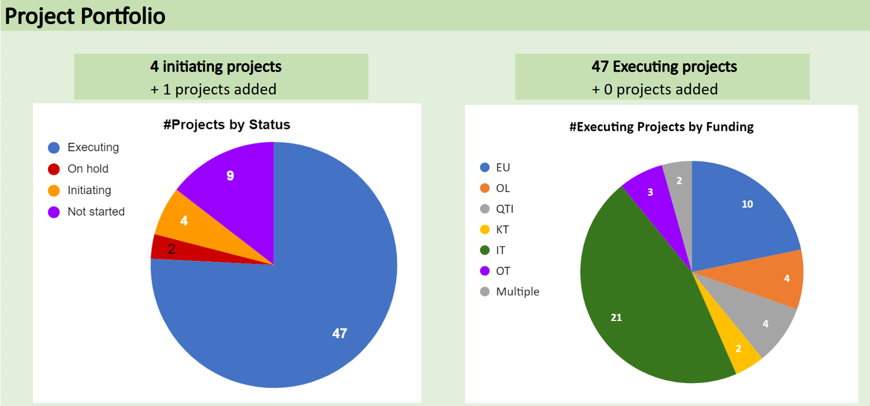
How Management Leverages Portfolio Data - Stats to ITSC

Slide 14
Final Thoughts
IT PPM main focus is on Timelines and Resources
We assess how our resources are distributed across the dept.
We conduct internal reviews to track progress and identify whether additional support is needed.
Through our refined governance process, project and catalogue management: we can effectively monitor achievements, value delivered and overall department objectives.

