Slide 1



Slide 2
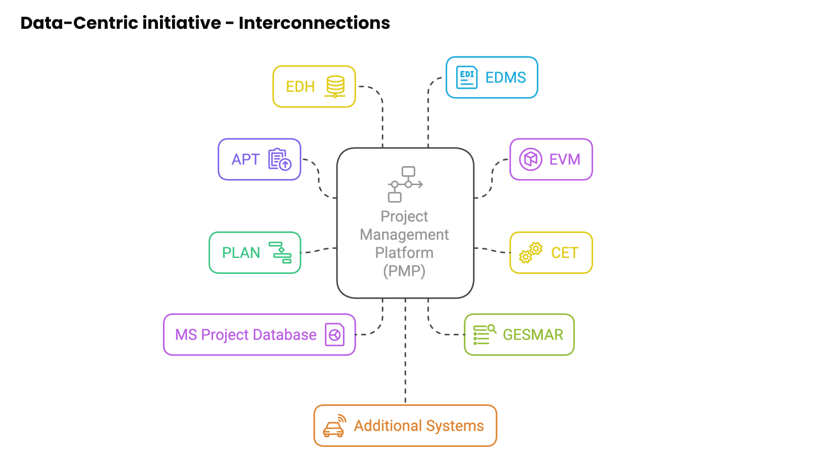

Slide 3
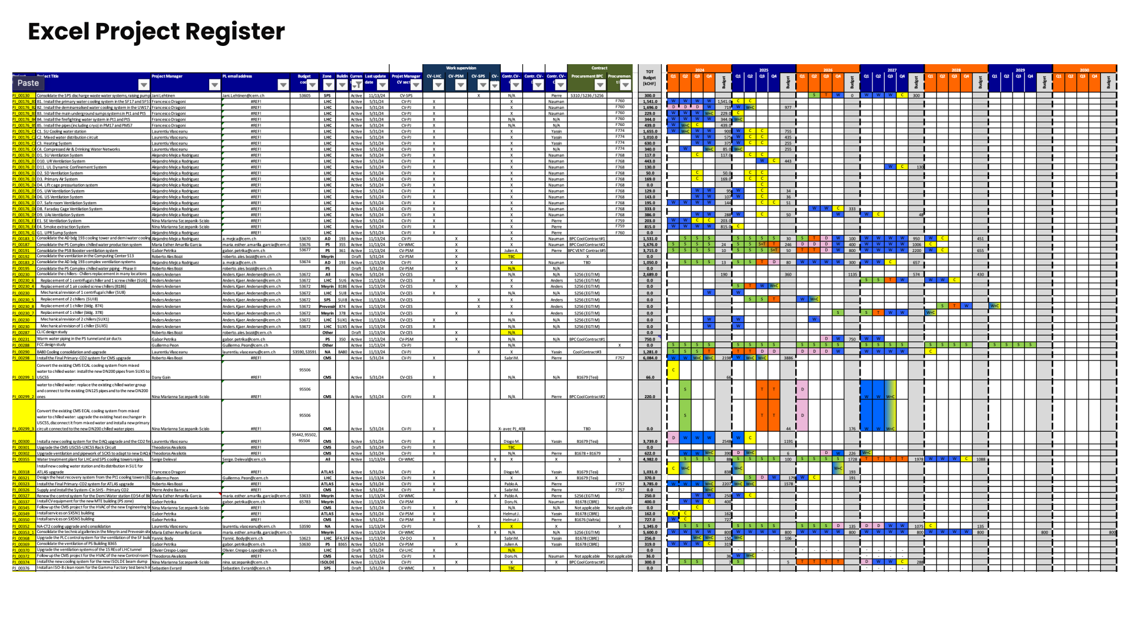

Slide 4
Let’s give a look to the real tool

Slide 5
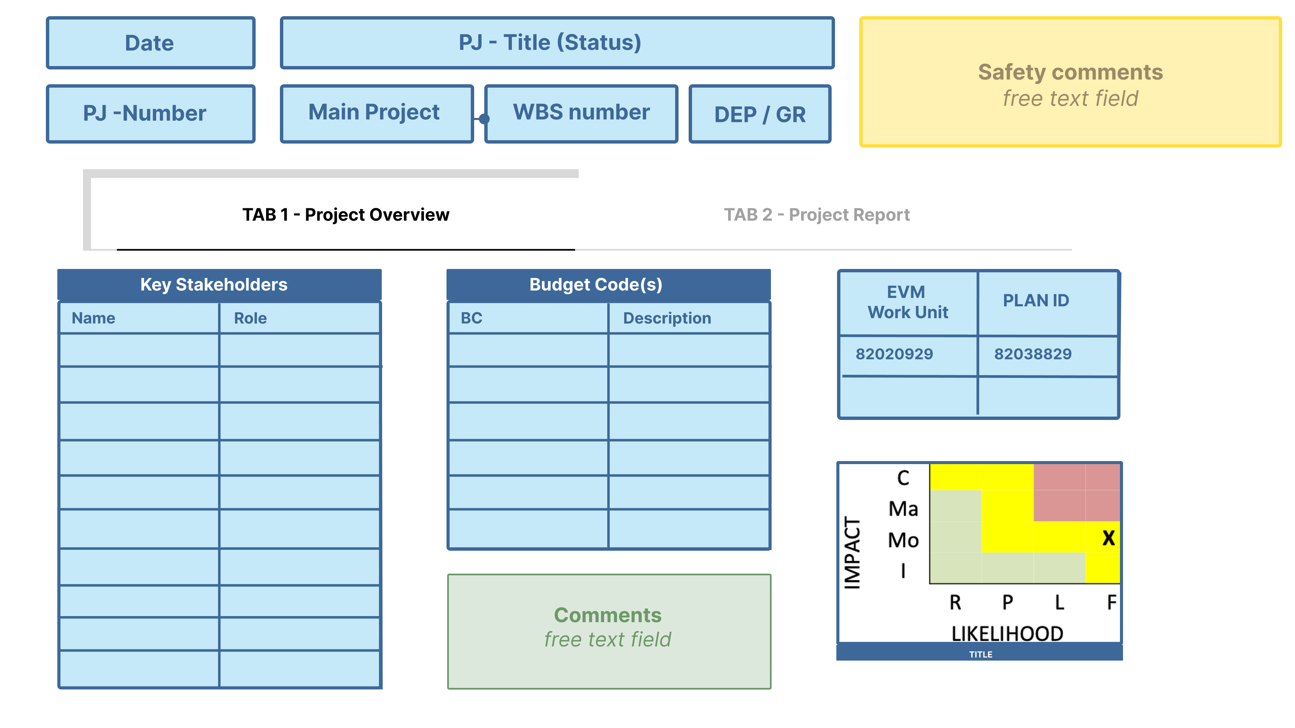

Slide 6
