Slide 1
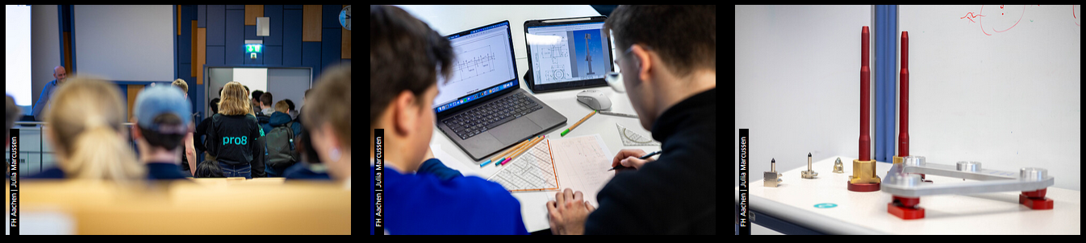

Aachen Student Project
WP8 delivered problem case to pro8 2025
O. Boettcher - on behalf of WP8 (Collider-Experiment Interface)
Special thanks for the participation to Antonio Alonso and
for the support to Francisco Sanchez Galan !!!
CERN, Project Management Meet Up! (2) – 07/05/2025 – Indico contribution 6467808

Slide 2
Motivation of this Meet Up Talk
Students are highly motivated to work on real world and yet unsolved problem cases. Universities often look for these!
CERN has a very good reputation among young people.
Delivering problem cases creates opportunities to build up contacts and is a win-win for everybody!
Education in technical sciences evolves and exciting pedagogic approaches exist, from which we can learn a lot!
Share my experience with a successful Teamwork format
(considering stress, pressure to deliver and diversity).

Slide 3
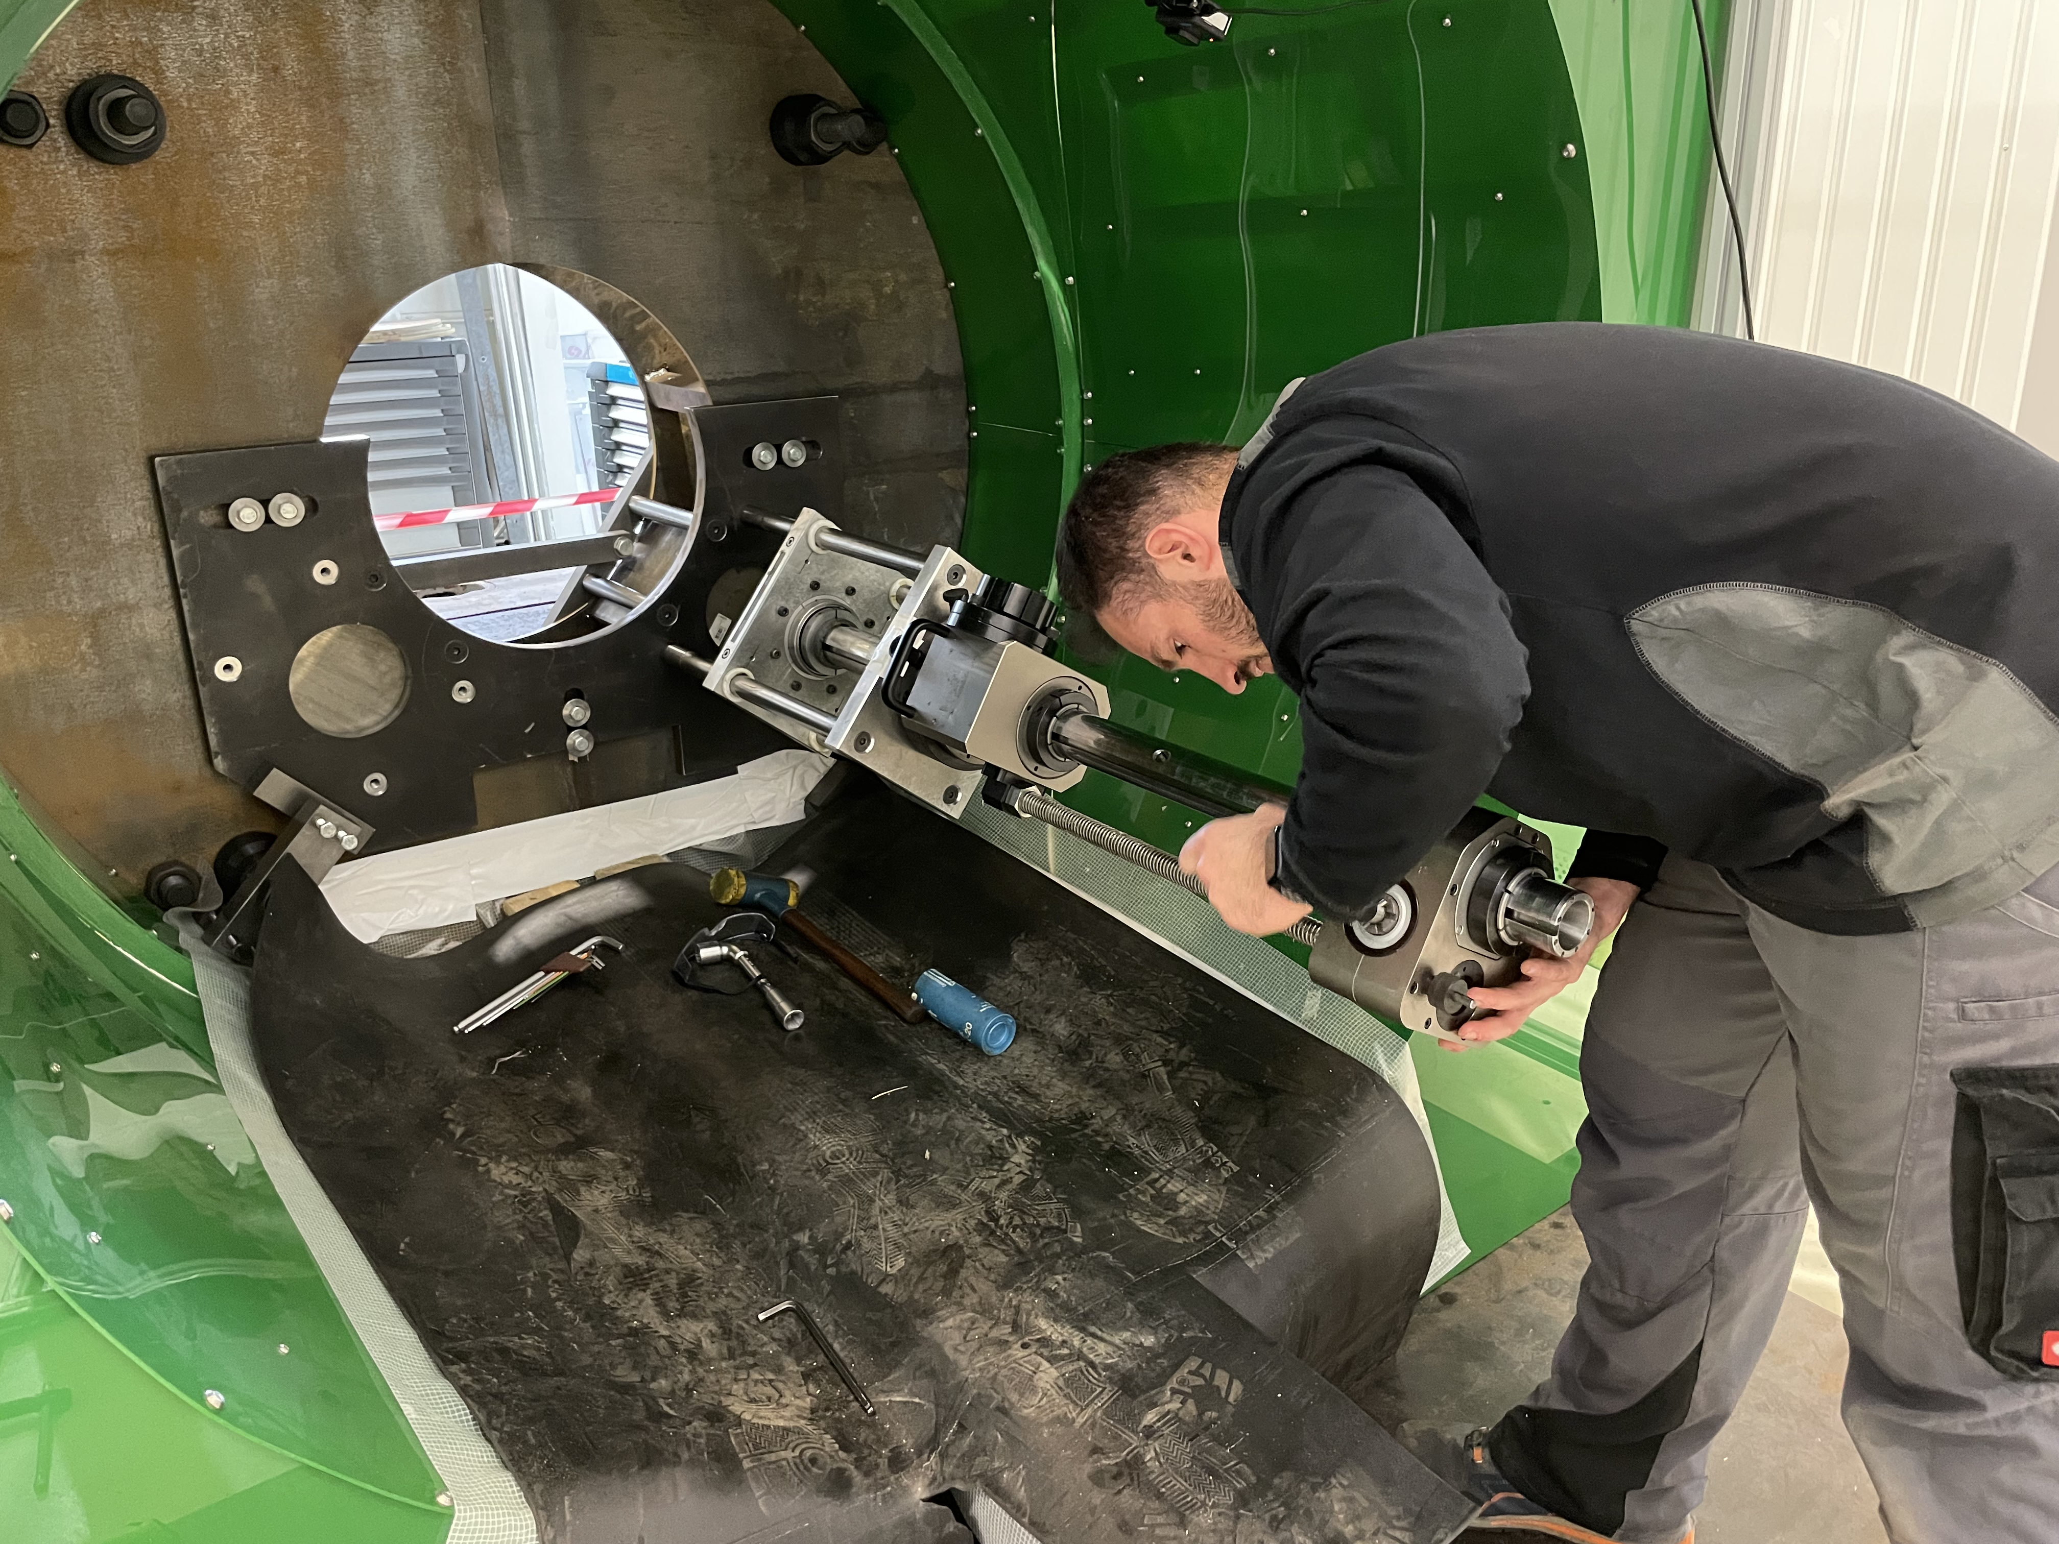
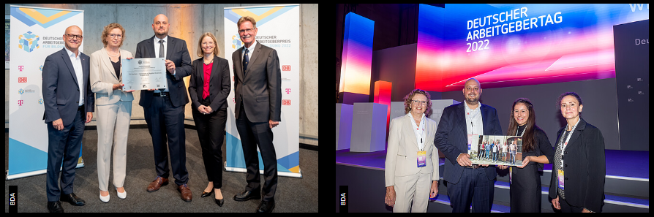
All started with a job realized by a small German company
A junior chef of a family-owned company used a CERN job for his bachelor thesis.
He shared that his professor is fascinated of the task. His university looks for a problem case from industry partners for a special education module called “pro8” taking place every year at the FH Aachen.
The Faculty of Mechanical Engineering and Mechatronics at FH Aachen applied with the pro8 project in 2022 and won the German Employer Award for Education in the “Higher Education” category
(see FH Aachen press release).

Slide 4

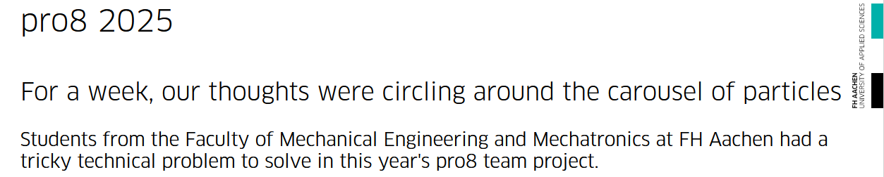
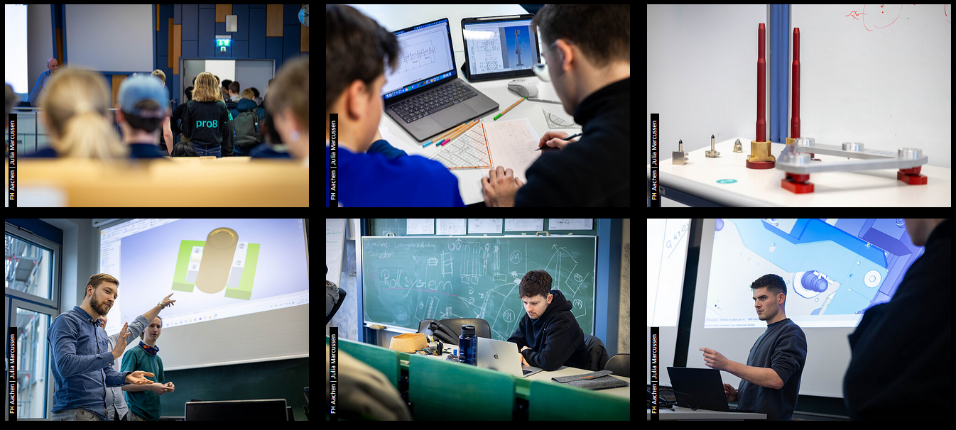
pro8 2005 LinkedIn Video
(go to article)

Slide 5
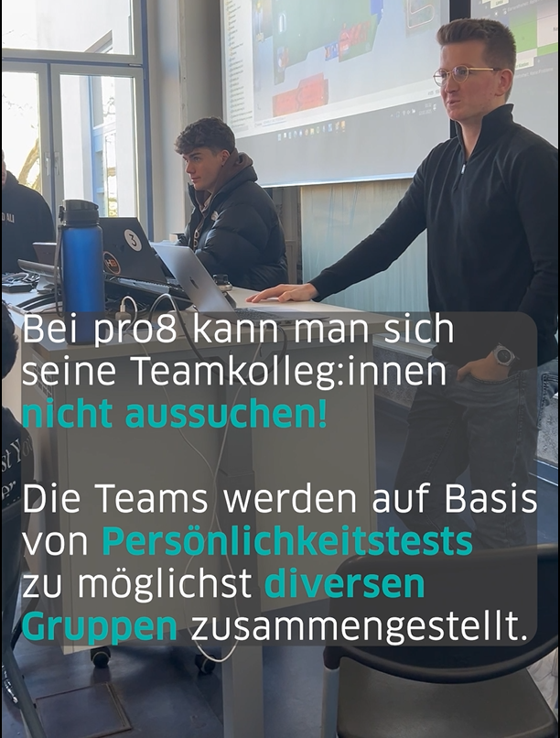
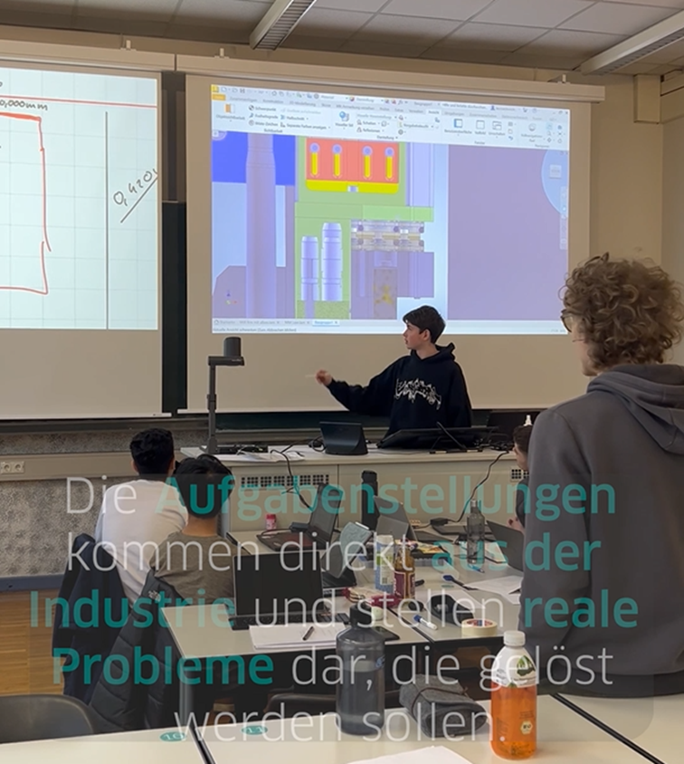
pro8 – main elements of the format
At pro8 there is no choose of teammates!
The teams are put together into groups that are as diverse as possible on the basis of personality tests.
The tasks come directly from industry and represent real problems that need to be solved.

Slide 6
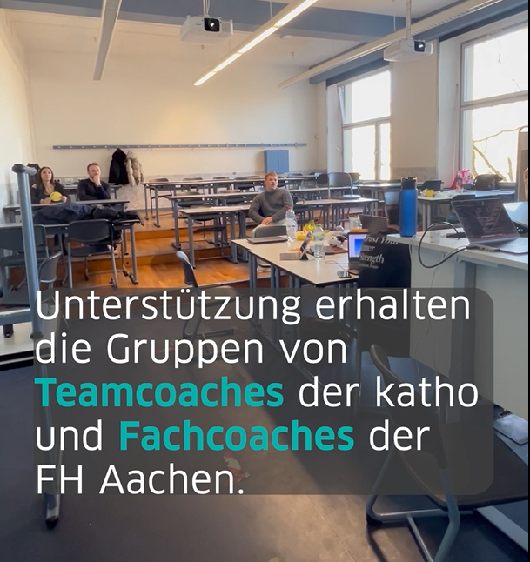
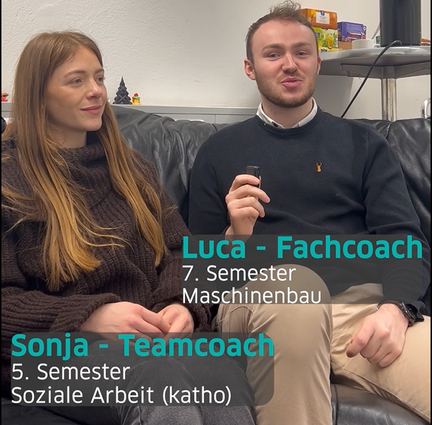
pro8 – main elements of the format
The groups are supported by team coaches from “katho” and specialist coaches from FH Aachen.

Slide 7
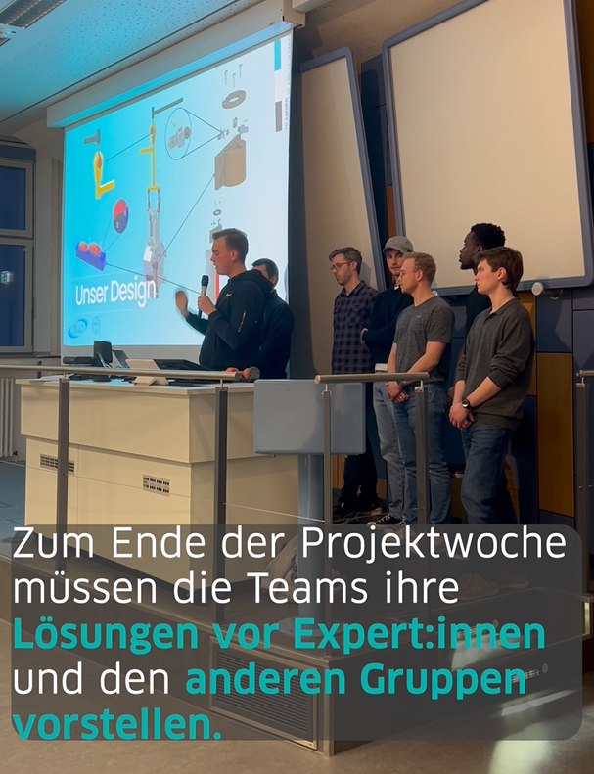
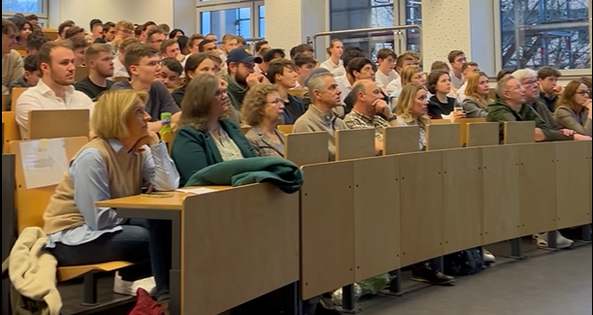
pro8 – main elements of the format
At the end of the project week, the teams have to present their solutions to experts and the other groups.

Slide 8
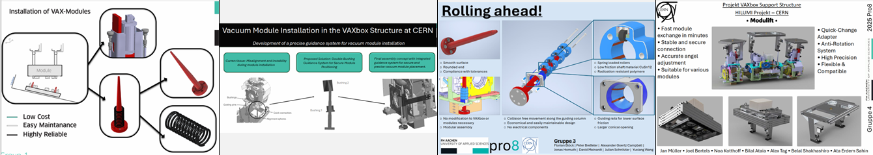
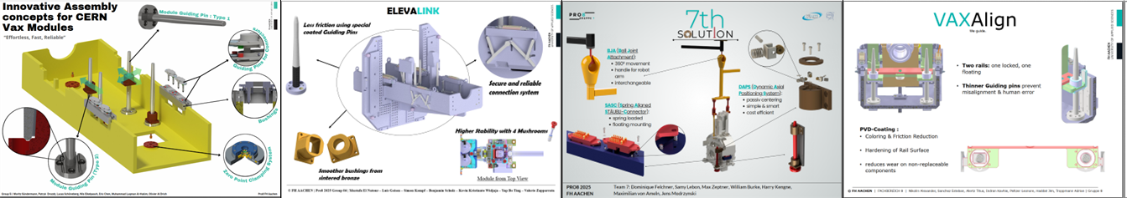
Impressive results – after 1 week of work

Slide 9
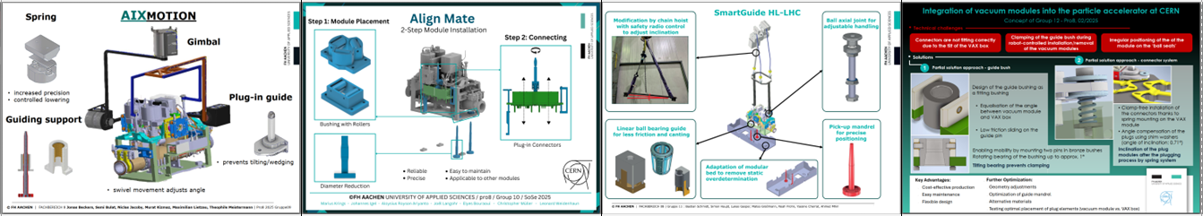
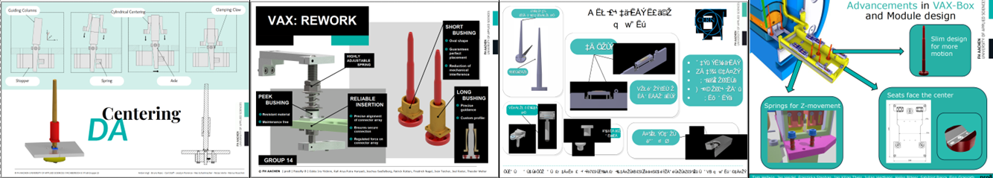
Impressive results – after 1 week of work

Slide 10
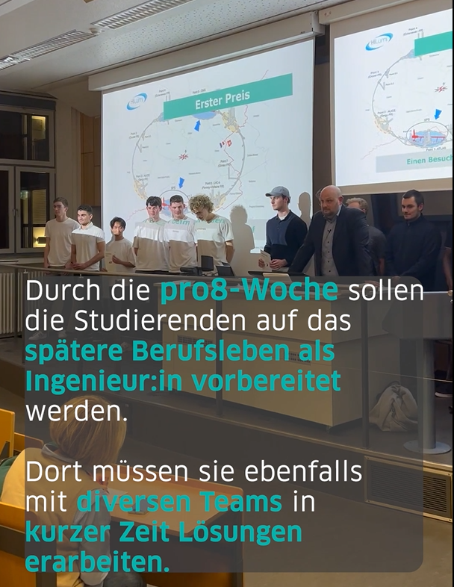
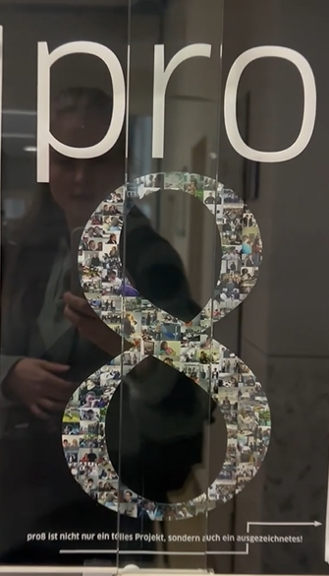
pro8 – resume
The pro8 week is designed to prepare students for their future careers as engineers.
There, they also have to develop solutions with various teams under timely constraints.
pro8 is not only a great project but also an awarded one!

Slide 11
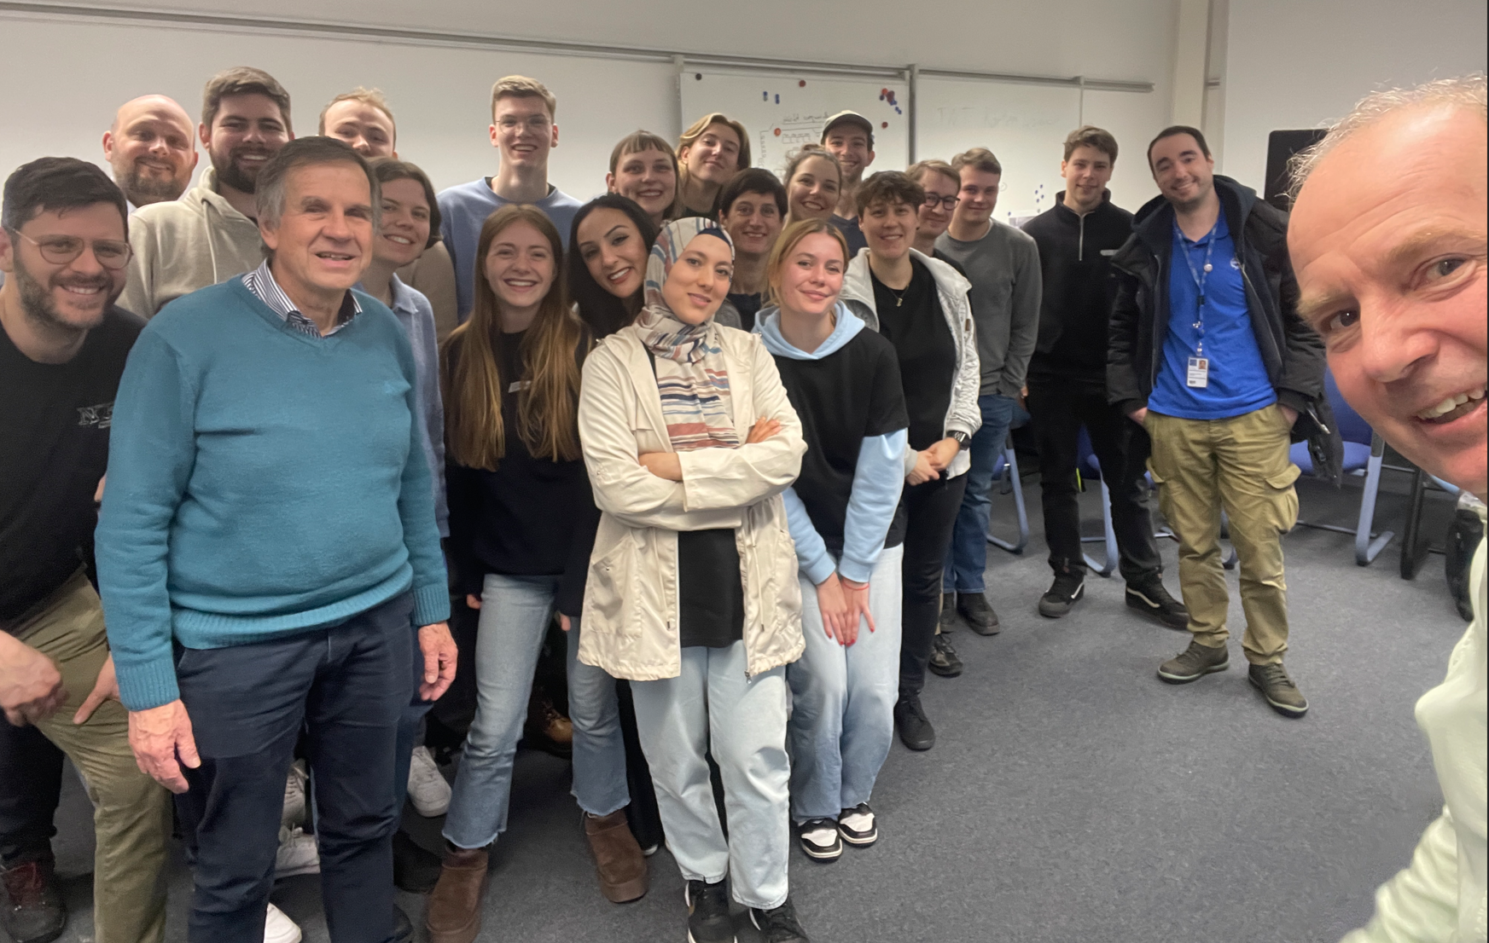
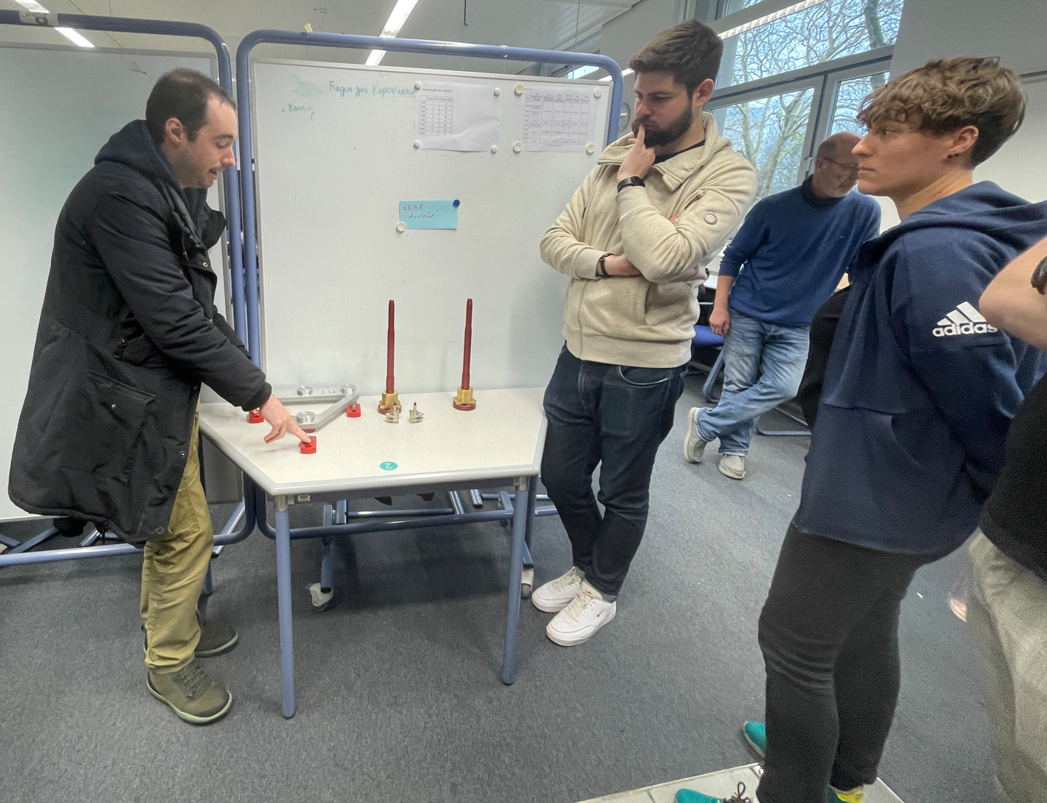
Thanks for your attention !
Please don’t hesitate to contact me, if you like to know more!

