Slide 1


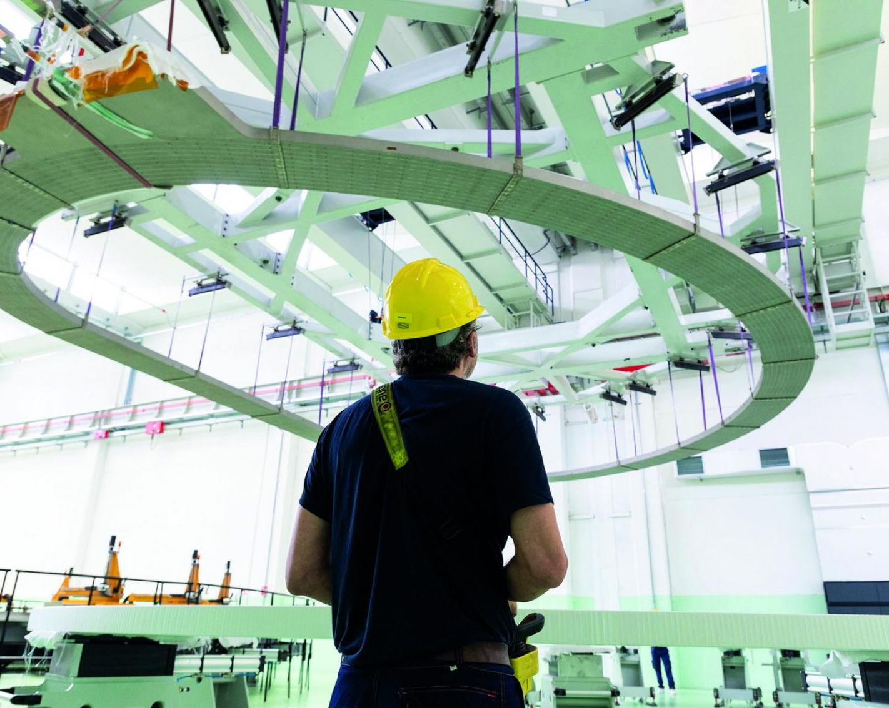
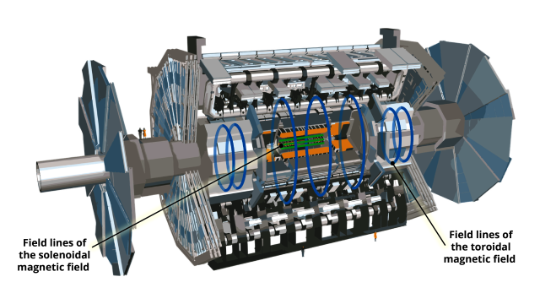
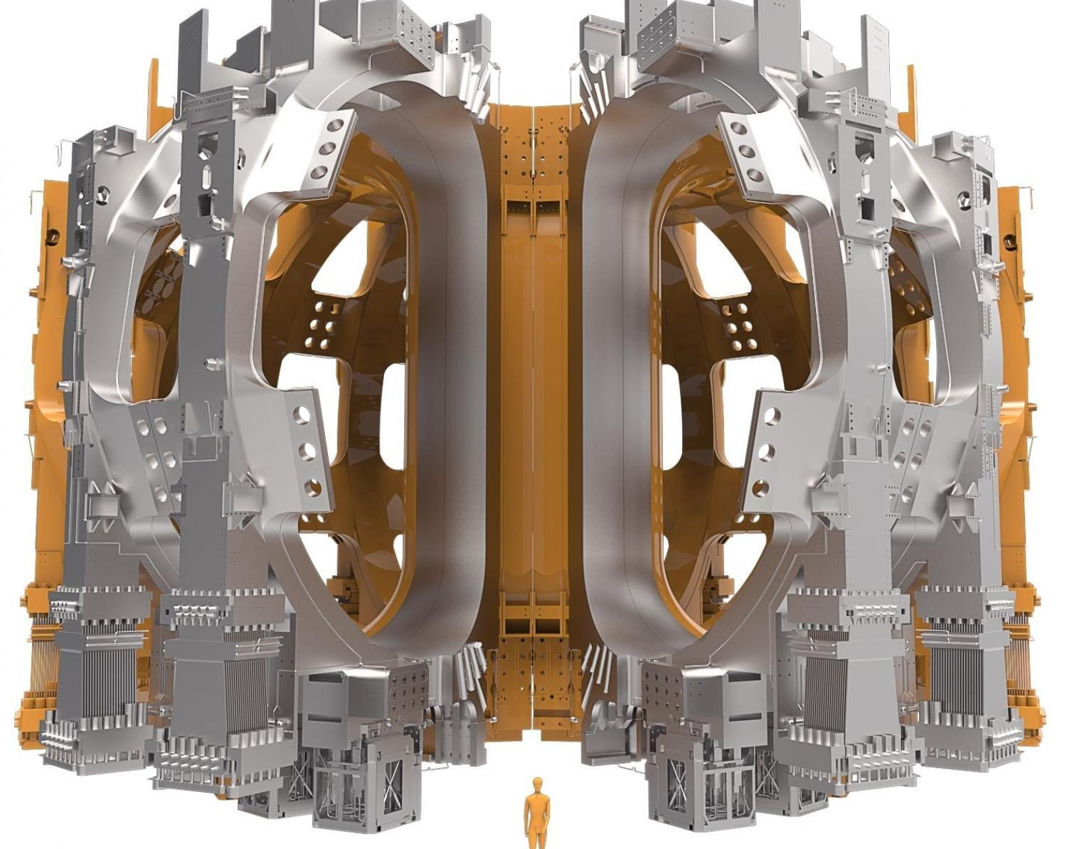
PM & leadership pitfalls in a nutshell from CERN ATLAS to ITER. .
Arnaud Foussat
(TE/MSC)
May2025
DISCLAIMER: The characters in this story are purely fictional. Any resemblance to real individuals is entirely coincidental. 😇
Notes:
Today, I'll take you on a lightning tour through the leadership minefield
that defined two of science's most ambitious megaprojects: CERN's ATLAS and ITER.

Slide 2
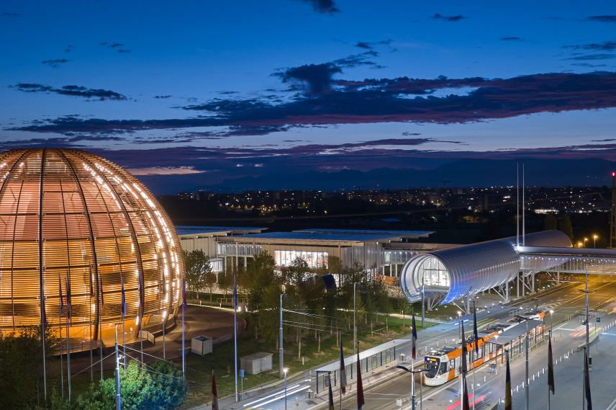
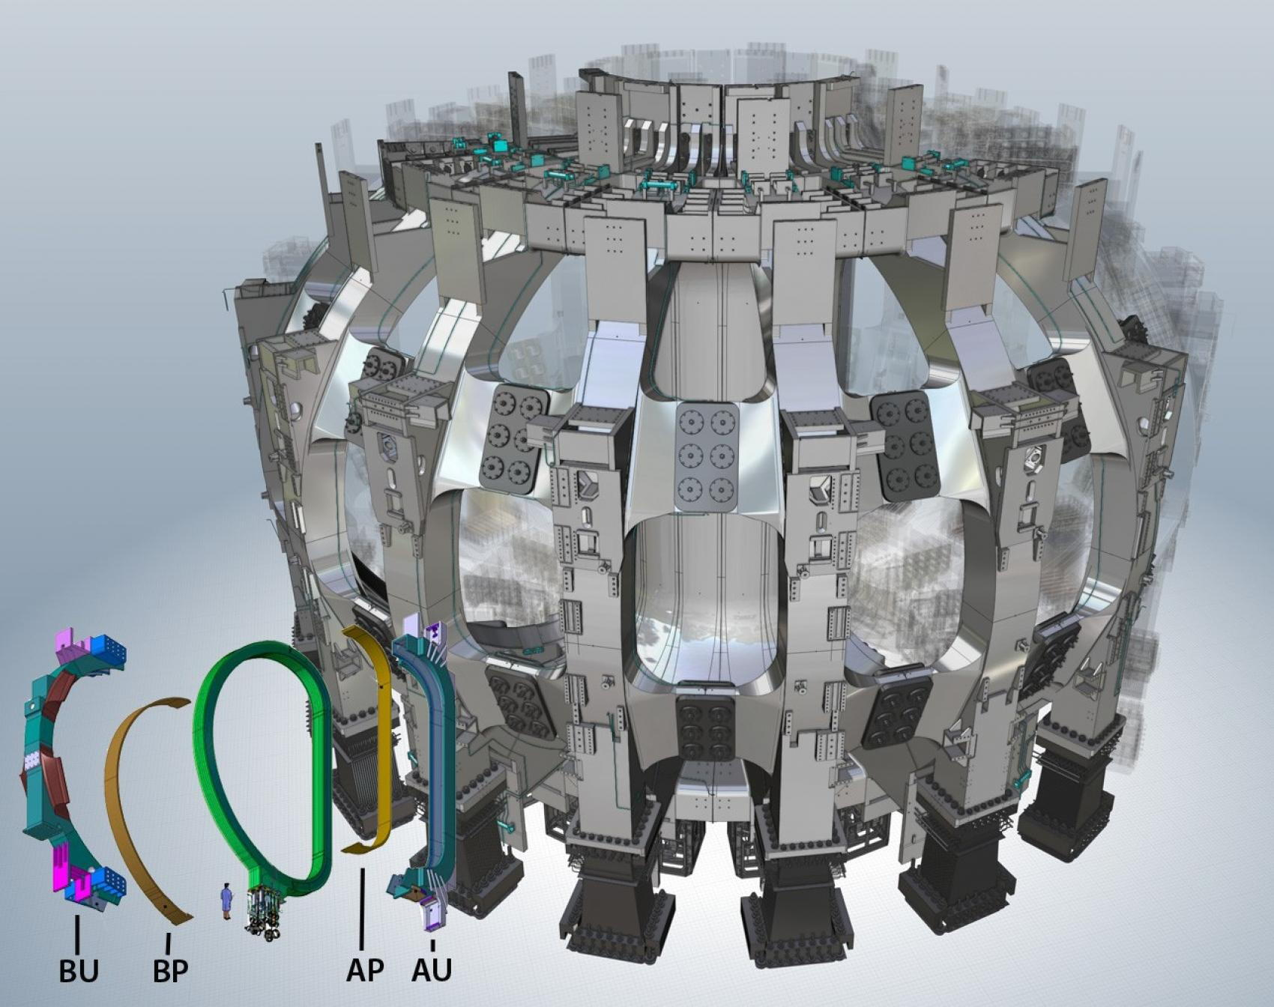
Outline
PM pitfalls case studies: ATLAS & ITER construction projects examples
Takeaways
2000-2007
2008-2032
Notes:
These aren't just engineering marvels; they're case studies in how leadership makes or breaks complex endeavors.
As we navigate from 2000 to the present day, I'll highlight critical management pitfalls that can derail even the most promising projects
These pitfalls lessons stem from practical experience during the construction and management of large experiments like ATLAS and ITER, where technical and organizational adaptability proved crucial.

Slide 3
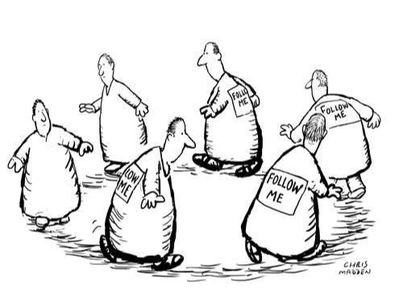
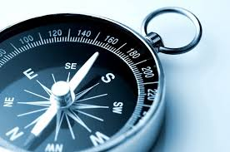
Leadership as a project rudder ….
The ITER or ATLAS Magnet projects represent one of most complex technological and integration challenges.
Easy for « a project to become complicated and difficult to navigate, leading to a variety of problems »
…How effective leadership and management can determine the success or failure of the project.
Notes:
Leadership isn't just about authority—it's the rudder steering these massive technological ships through uncharted waters.

Slide 4

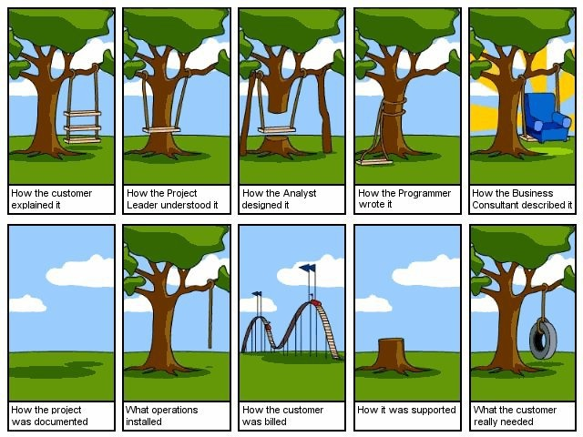
So, what is the secret of delivering successful projects ? …most likely through streamlined communication between stakeholders…
CERN PM ID² forum, 05-2025
Notes:
Both ATLAS and ITER represent unprecedented integration challenges where success hinges on one critical element: streamlined communication between stakeholders.
When projects become labyrinthine and difficult to navigate, it's not the technology that fails first—it's the communication structure.
The secret to delivering successful projects isn't found in technical specifications, but in how effectively information flows between teams, partners, and leadership.

Slide 5
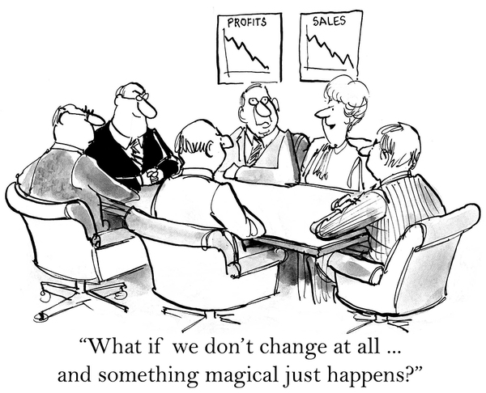
Pitfall #01- Rigid management of technical specifications vs. innovative adaptation
➱ Locking oneself into initial technical specifications with no ability to adapt to unforeseen challenges.
*Manager behavior*:
- Strictly adheres to the initial technical specifications with deviations sanctions
*Leader's Solution*:
- Encourages teams to propose technical adjustments based on test results, facilitates communication between theorists and engineers
- Adapts objectives without compromising the overall performance
CERN PM ID² forum, 05-2025
Notes:
The first major pitfall is technical inflexibility—locking yourself into initial specifications with no ability to adapt. In these massive scientific endeavors, unforeseen challenges aren't exceptions; they're guaranteed.
When leaders grip too tightly to original plans, they create brittleness in systems designed to be resilient.
The most successful project phases across both ATLAS and ITER weren't those that executed the original plan flawlessly—they were those that adapted intelligently when reality didn't match the blueprint. Flexibility isn't a weakness in project management; it's a survival mechanism.

Slide 6
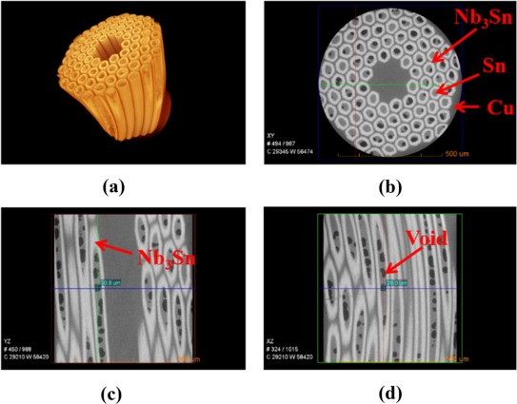
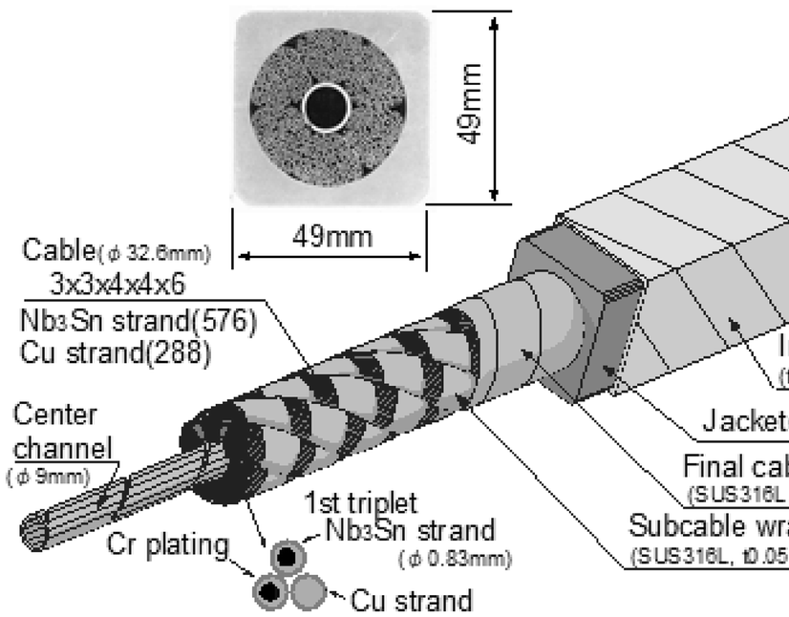
#01 case - SC electrical joints case:
When an unforeseen fragility was discovered in the connection joints of Nb₃Sn coils, the leader organized a collaborative workshop between metallurgists and engineers to develop a new joining method, while a manager reportedly imposed multiple hierarchical validation cycles
Notes:
Nice applied case of the SC electrical joint

Slide 7
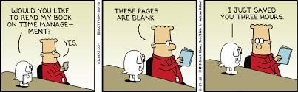
Pitfall #02- Focus on Timeframes vs. Long-Term Risk Management
➱ Prioritizing strict adherence to deadlines at the expense of the reliability of magnets.
*Manager behavior*:
- Imposes rigid deadlines based on the initial schedule
- Neglects warning signs about material quality, reduces tests
*Leader's Solution*:
- Prioritizes the reliability of critical components such as superconducting cables
- Adjusts and communicate the schedule based on the results of the qualification tests,
Notes:
Perhaps the most dangerous temptation is prioritizing arbitrary deadlines over long-term reliability.
We've seen managers impose rigid timelines based on initial schedules, neglecting warning signs about material quality and reducing critical testing phases—particularly with superconducting magnets where failure isn't an option.
True leadership takes a different approach—prioritizing the reliability of critical components and adjusting schedules based on qualification test results.
This isn't about missing deadlines; it's about acknowledging that some deadlines were misconceived from the start.
In both ATLAS and ITER, the projects that redefined success criteria survived; those that didn’t, often failed spectacularly and expensively

Slide 8
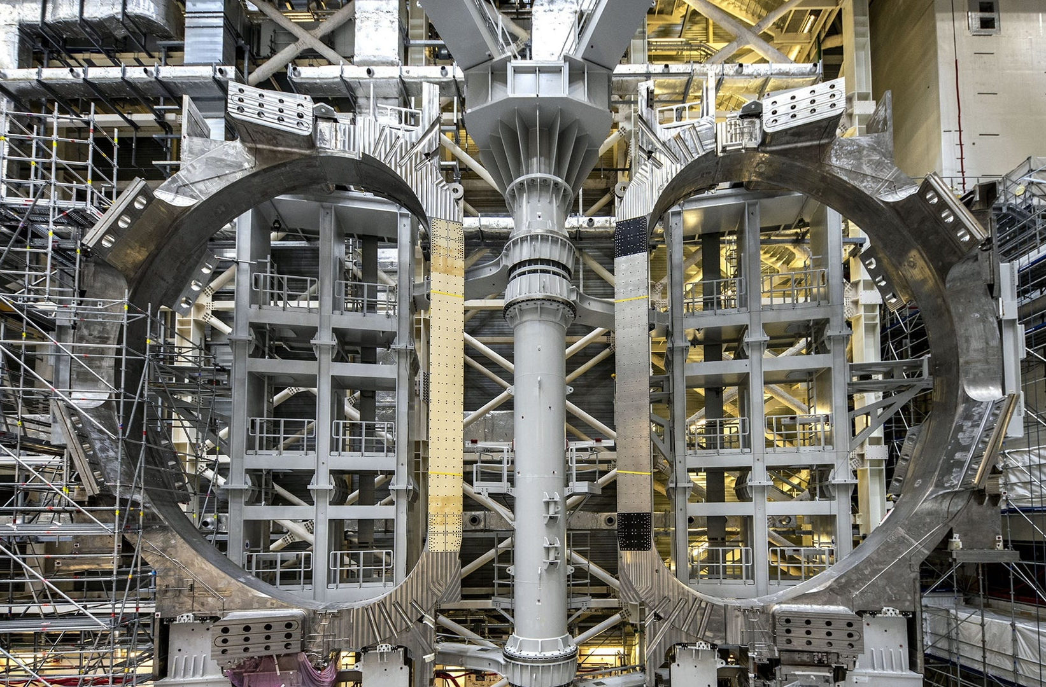
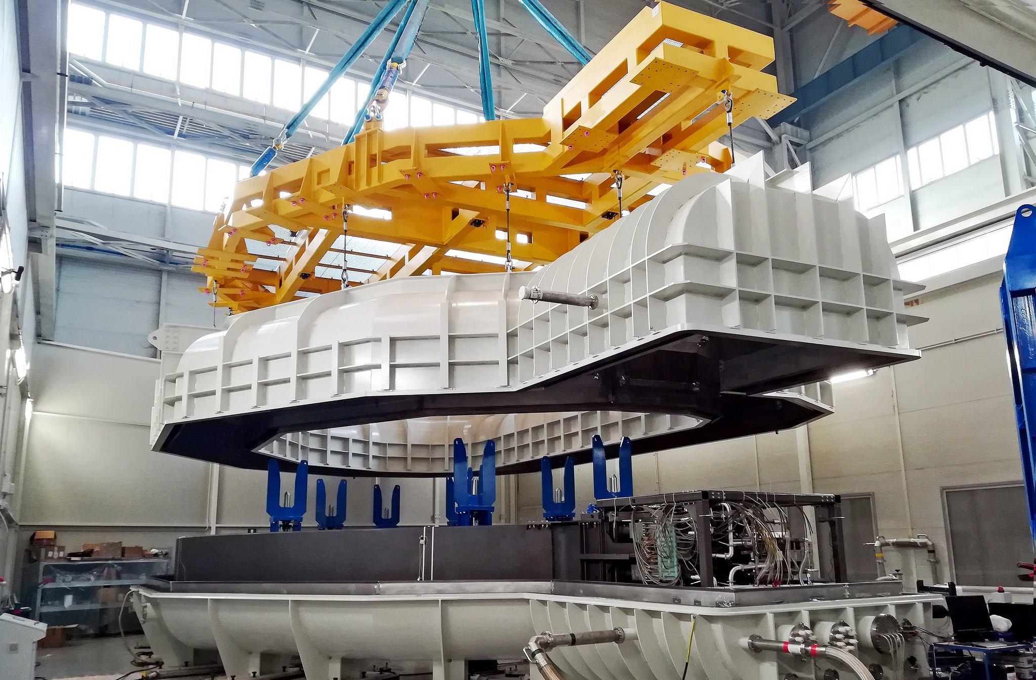
#02 case: Magnet cold testing
Faced with suboptimal results, the leader delayed the production phase to allow for a partial redesign, re test of the magnet system
Manager would have likely continued according to the original schedule to avoid any documented delays.

Slide 9



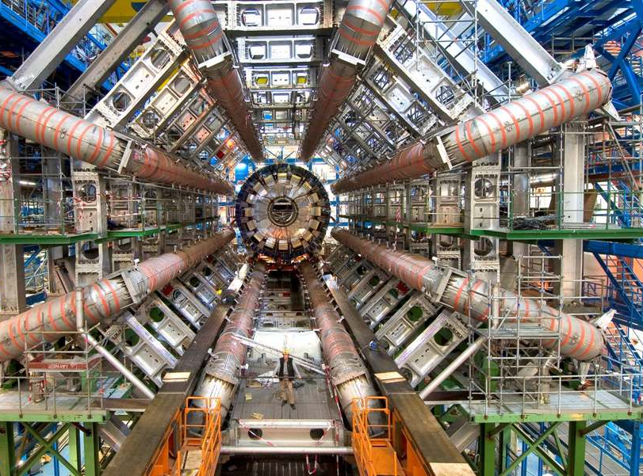
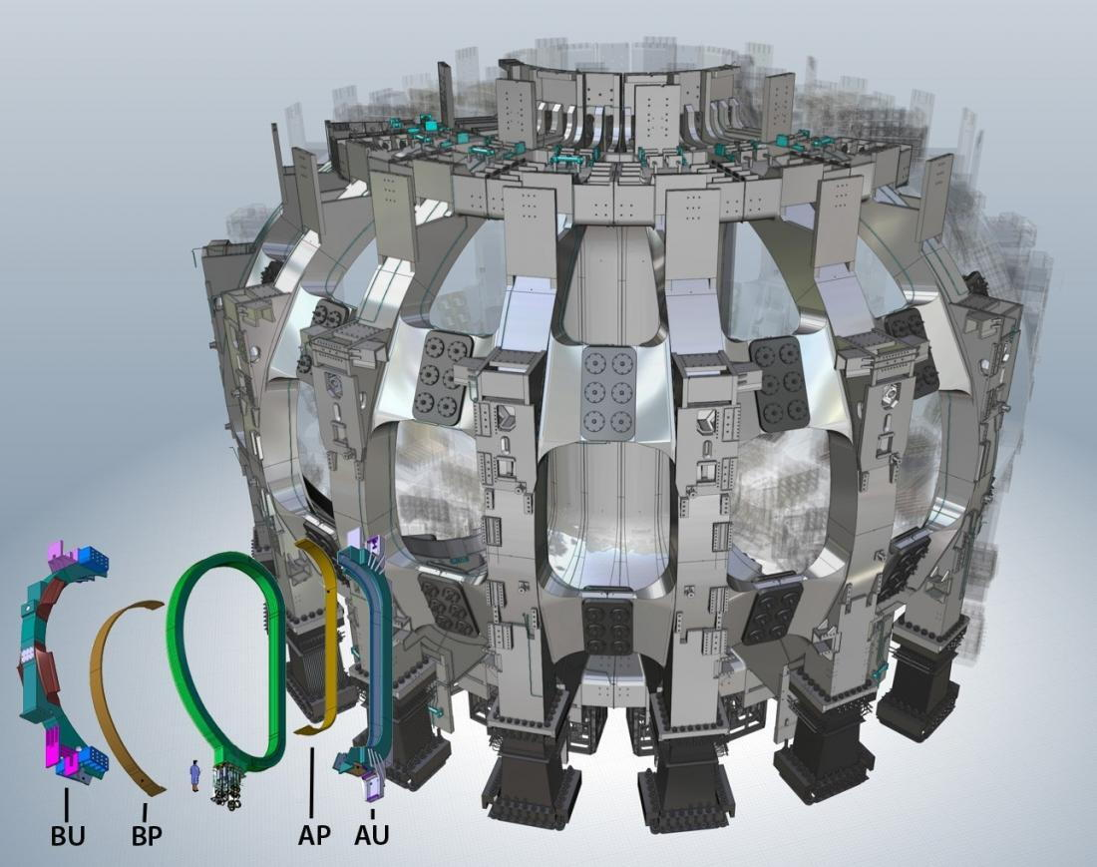
Take-aways
controlling versus shaping the plan…
Being in a position of authority might decrease one's ability to see and hear others.
Large complex projects cannot succeed only with a single managerial approach.
Allowing the space for trusted people to call out their flaws, or accountability, is key.
Thank you for your attention
looking forward to discussing it !
Notes:
What we've observed is that increased authority often correlates with decreased listening.
Those in leadership positions become gradually less able to see and hear others—precisely when they need outside perspective most.
Large, complex projects cannot succeed with a single managerial approach.
The technical complexity demands leadership diversity—different styles for different challenges.
Most critically, leadership must create space for trusted team members to call out flaws without fear. This accountability mechanism isn't just nice to have—it's essential infrastructure for project success.

Slide 10
EXTRA SLIDES

Slide 11
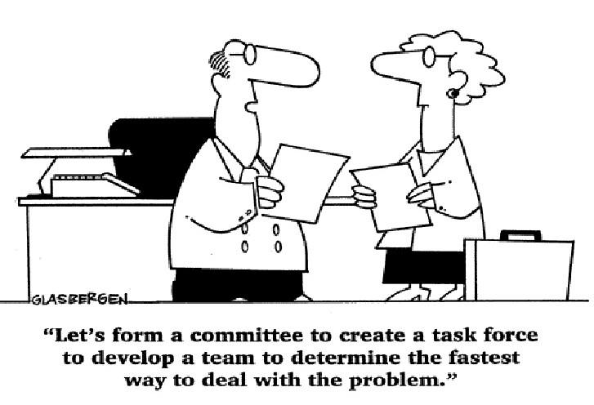
Pitfall #03- Siloed communication vs. the integration of international expertise
➱ Maintain communication silos between the different international teams working on magnet components. "Divide et impera"
Manager behavior *:
- Rigid communication structure following the official organizational chart
- Formal meetings limited to department heads
- Standardized documentation without adaptation to cultural contexts
- Handling technical issues only within the relevant team
*Leader's Solution*:
- Creates cross-functional working groups integrating experts from different countries
- Establishes protocols for knowledge sharing between manufacturing teams
- Organizes problem-solving sessions that include diverse perspectives
- Values and exploits the diversity of international scientific approaches

Slide 12
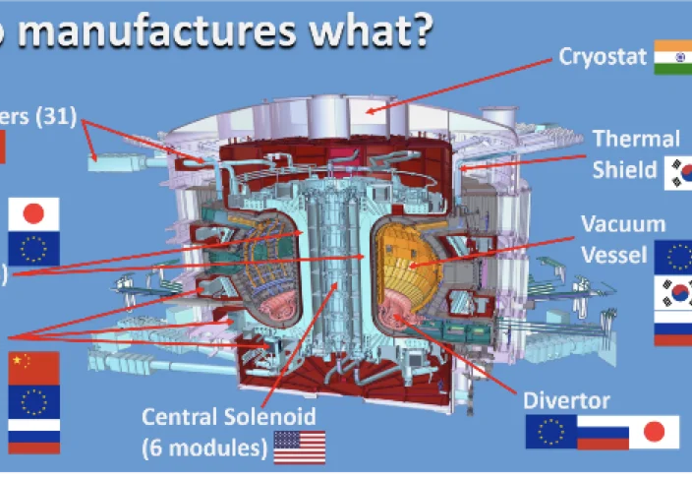
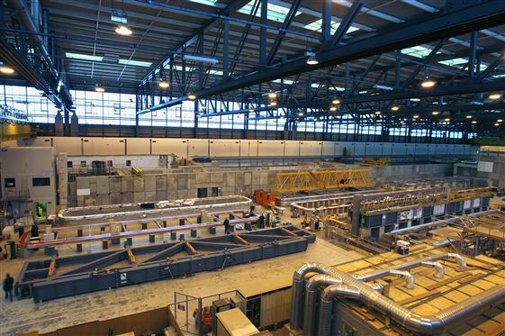
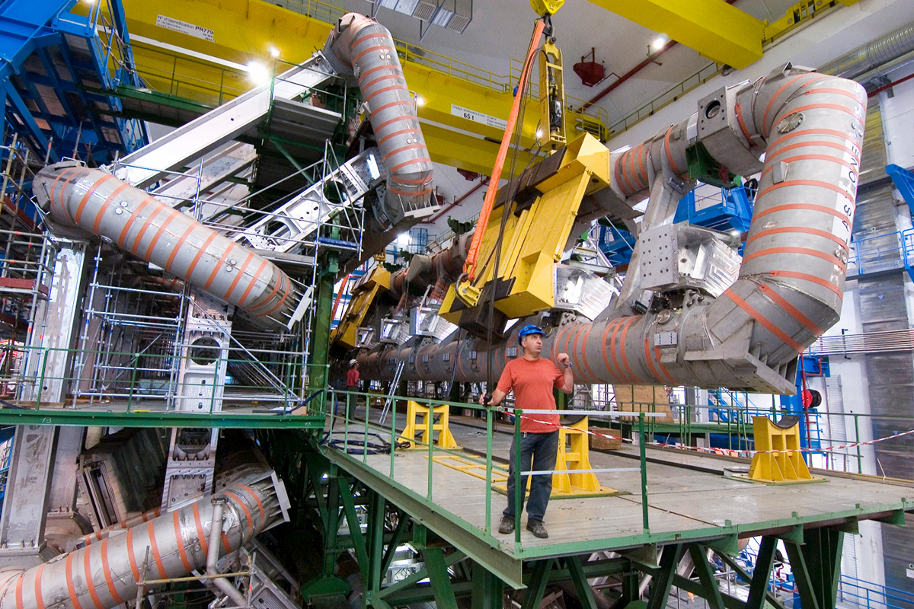
#03 case : extended international collaboration
A- To solve a recurring problem of ITER SC cable thermal stability in tested coils, the leader organized a permanent virtual forum connecting Japanese materials specialists, European cryogenics experts and US electromagnetics engineers, resulting in a hybrid solution that no team could have developed in isolation.
B- Unique transversal self-organisation of ATLAS Magnet assembly at CERN with JINR, CEA, INFN expert resources in extensive on-site collaboration

