Slide 1
PMMU
Fieldwire as a WSS tool
A. Méjica – EN-CV-PJ
07/05/2025

Slide 2
Agenda
01 | Why a WSS Tool?
02 | Fieldwire

Slide 3





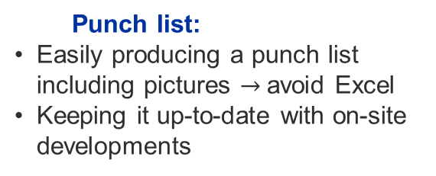
Why a WSS Tool?
  Communication gaps:
Multiple people to keep informed
Hard to keep track of project activities, changes and updates
Email inefficiencies:
Email often leads to lost or overlooked Information
Sending emails is time consuming
Not suitable for sharing pictures & drawings
Task tracking:
Following tasks
Ensure accountability
Access to drawings:
Fast and easy access to latest drawings and P&IDs
Punch list:
Easily producing a punch list including pictures $→$avoid Excel
Keeping it up-to-date with on-site developments

Slide 4

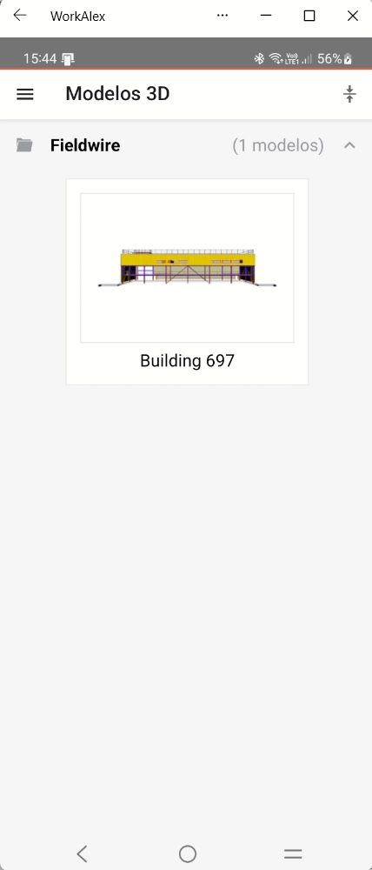

Fieldwire
Task management – Kanban board
Blueprint management
Reporting
Viewing of 3D models
Other features:
  Creation of forms
  Quick links to Project Specifications
  Integration with external tools
Report
Notes:
HOW TO GET FIELDWIRE RUNNING

