Slide 1
Practical Project Management Techniques for Detector Projects
Project Management Meet Up! - Ideasquare! Projects Speed dating (2)
https://indico.cern.ch/event/1464469
Joao Batista Lopes
CERN 7 May 2025

Slide 2
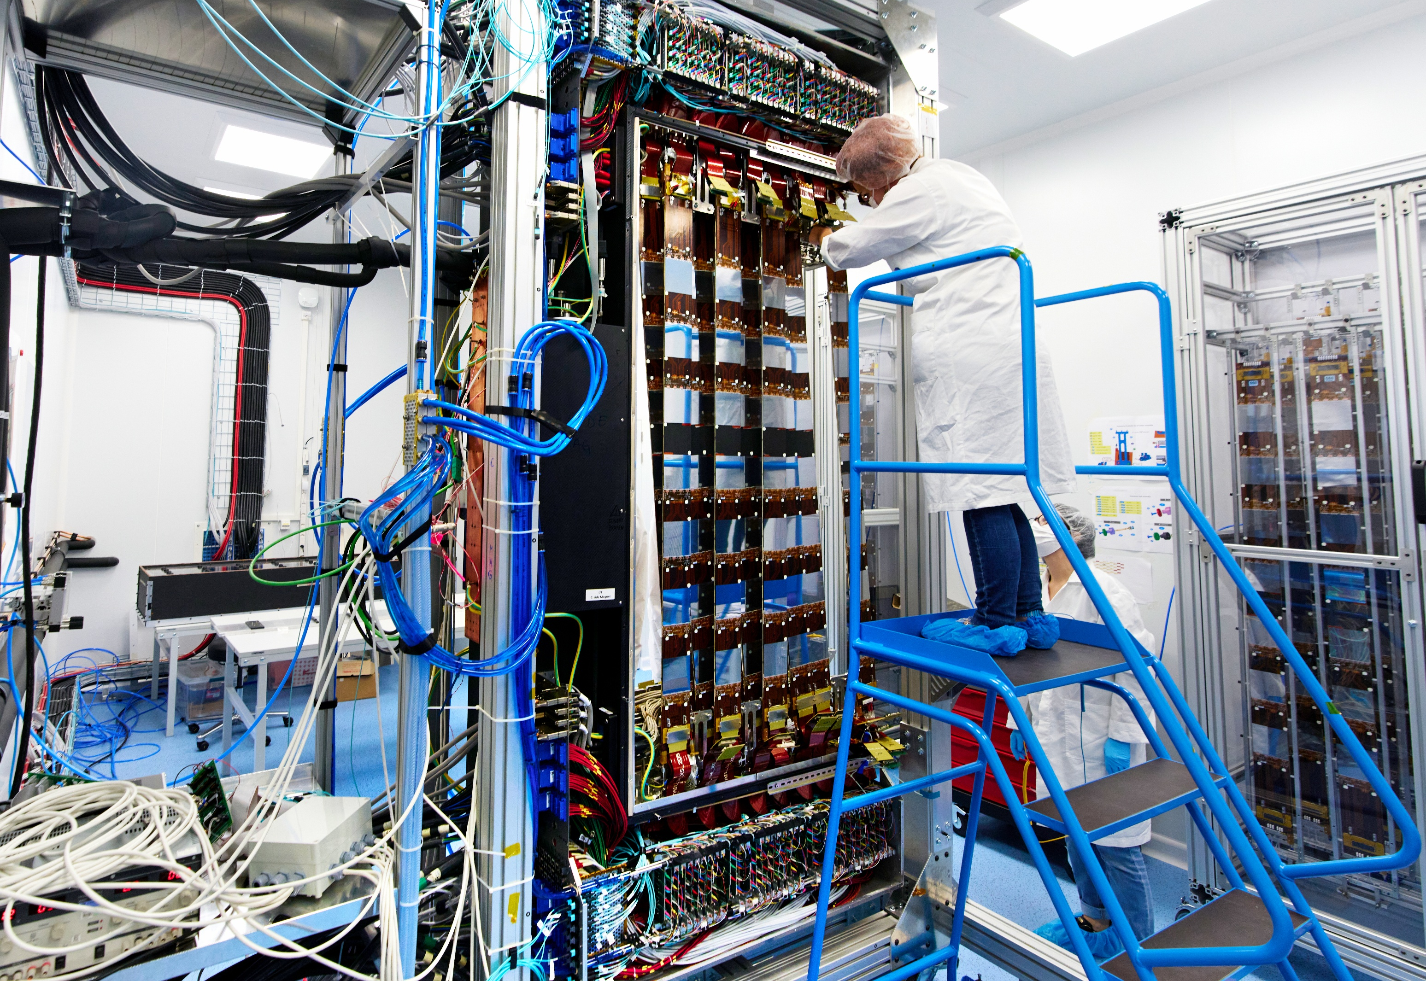
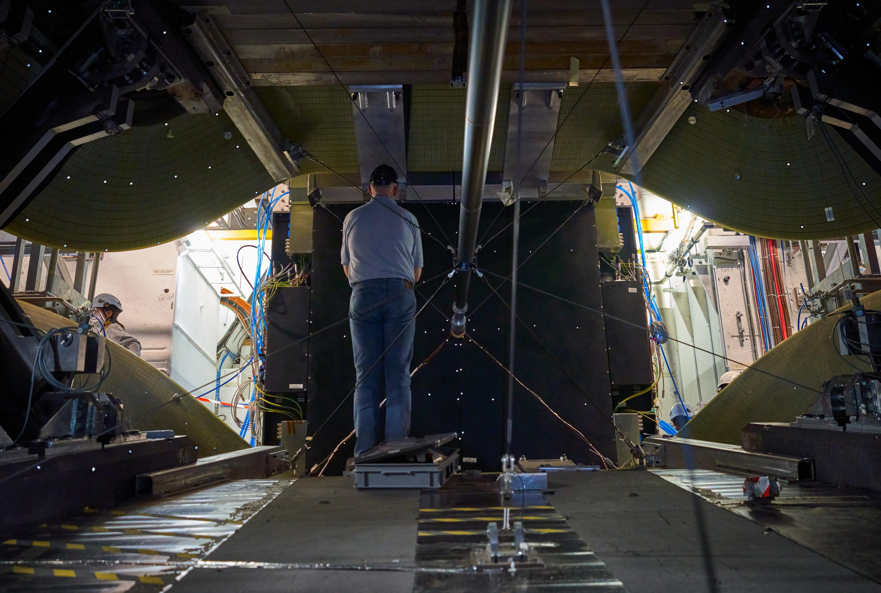
Introduction
LHCb Upstream Tracker (UT) assembly
LHCb Upstream Tracker (UT) installed in cavern
Example from my experience that illustrate how project management techniques can support coordination, planning, and traceability in technical environments:
Coordination design, assembly, and commissioning activities for a tracking detector.

Slide 3
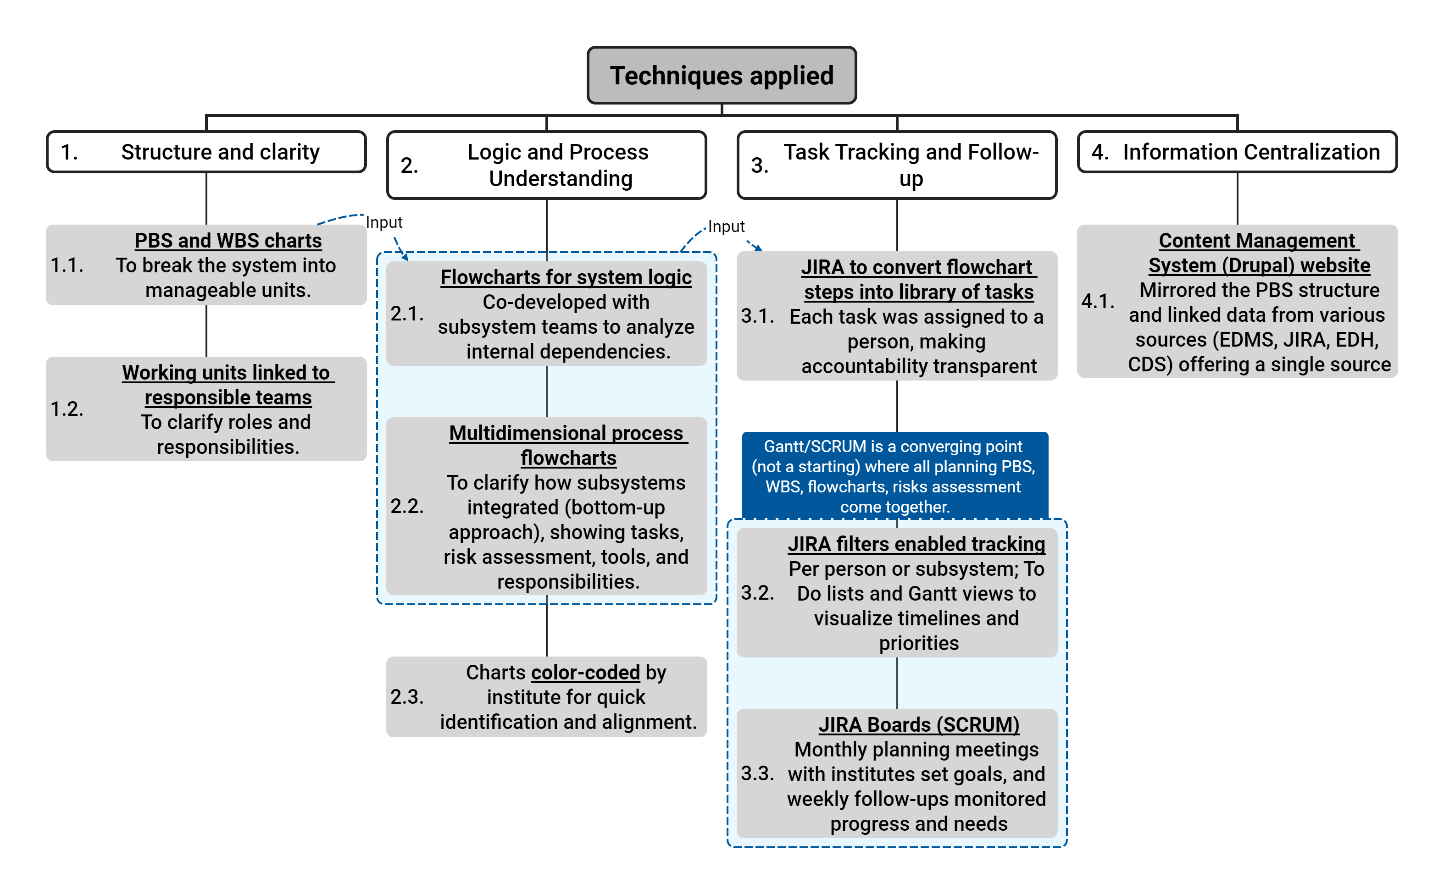
Managing a Detector Integration Project
Context
Coordination of a project involving multidisciplinary teams for the design, assembly, installation, and commissioning of a detector.
While I wasn't the direct supervisor, I was responsible for coordinating work across teams with diverse skills from different institutes.

Slide 4
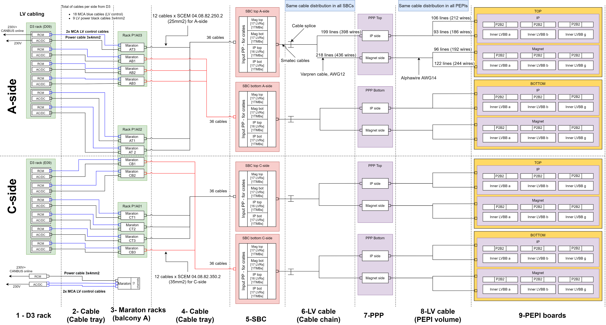
Detector LV system logic

Slide 5
Stage: Mechanics, Cooling, Cabling, Electronics, Detector
Process Flowchart : Detector assembly and commissioning
Input documents
Preventive measures
Steps
Checks
Corrective measures
Special tools
Manpower Services
Output documents

Slide 6
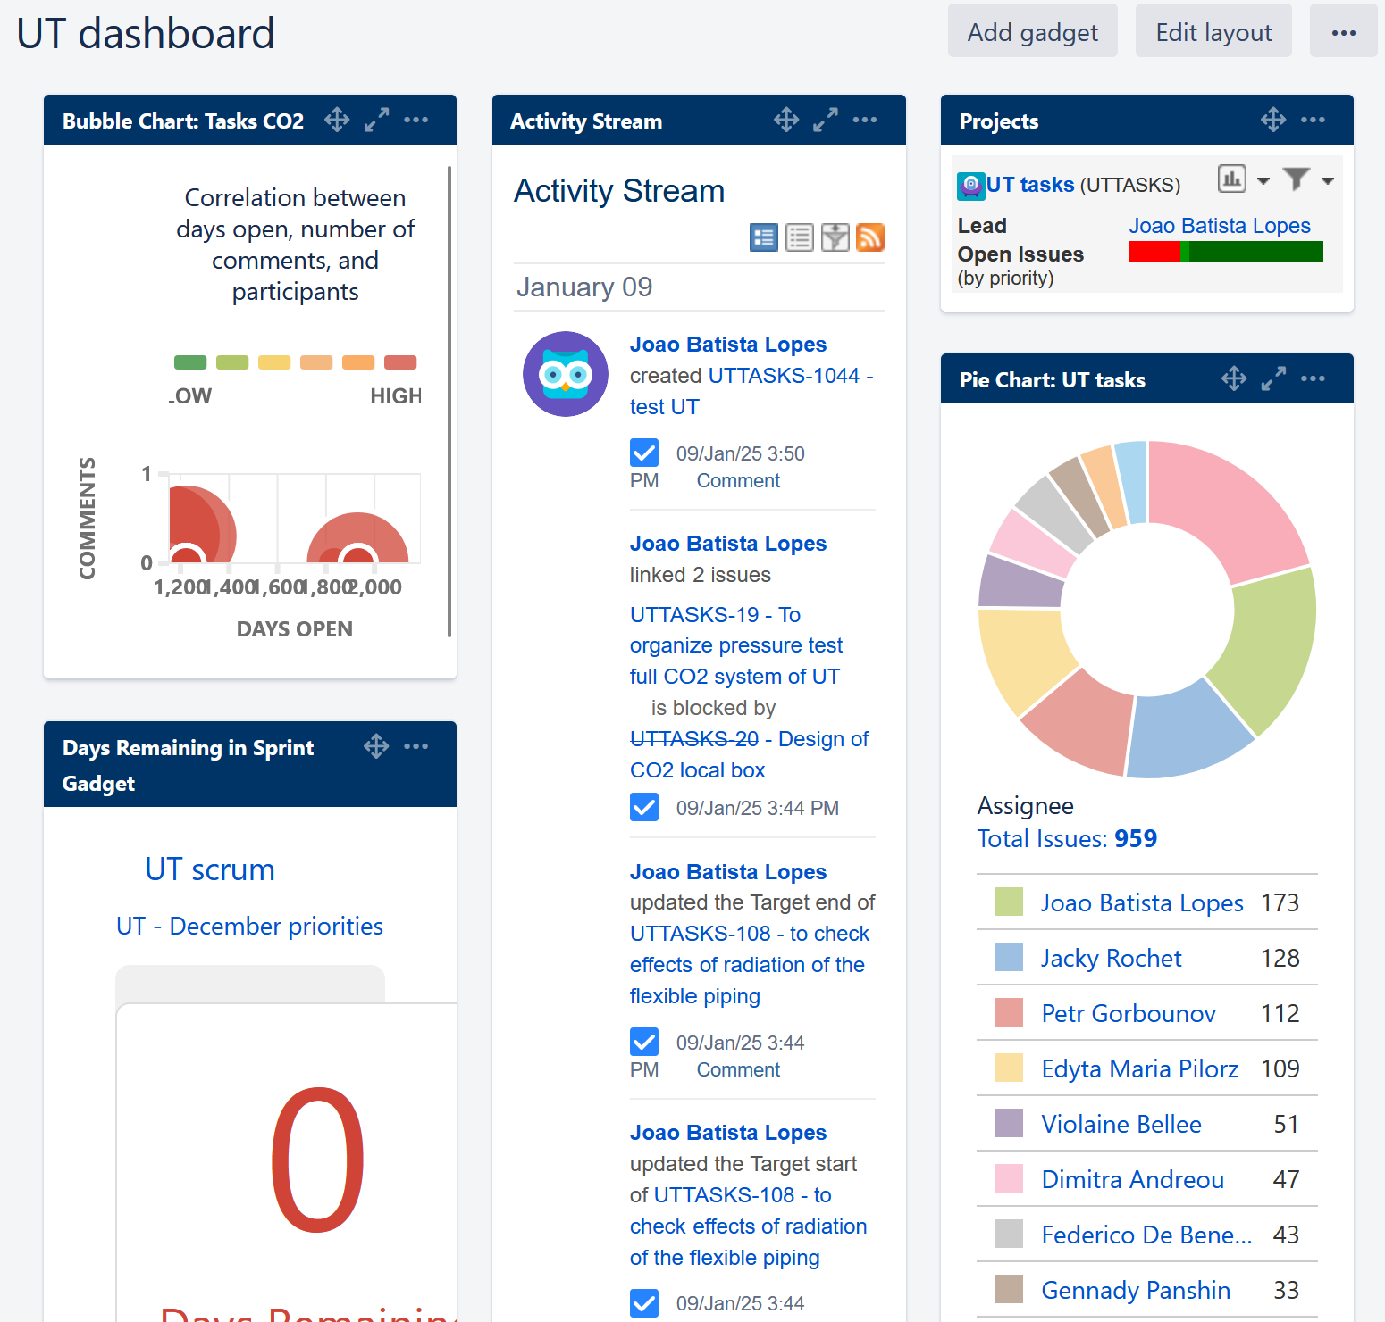
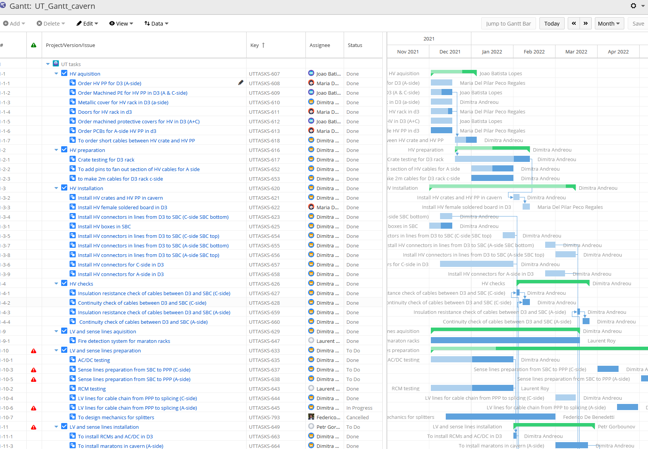

Task Follow-up

Slide 7
Conclusion
PBS and WBS
Provide the foundation for understanding scope and responsibilities
System logic and process Flowcharts
Translate systems and processes into understandable logic and clear sequences
Effective and efficient communication tool (people don’t read documents)
Digital tools
JIRA and CMS websites (Drupal) make management visible, interactive, and shareable
Memory of the project management
When applied together, these techniques enable effective coordination, transparent communication, and better decision-making.
In summary, clarity, traceability, and structure are the pillars of successful project management in complex, multi-institutional environments.

