Slide 1
Project Management – some difficulties that could be encountered
Antonio PERILLO MARCONE

Slide 2
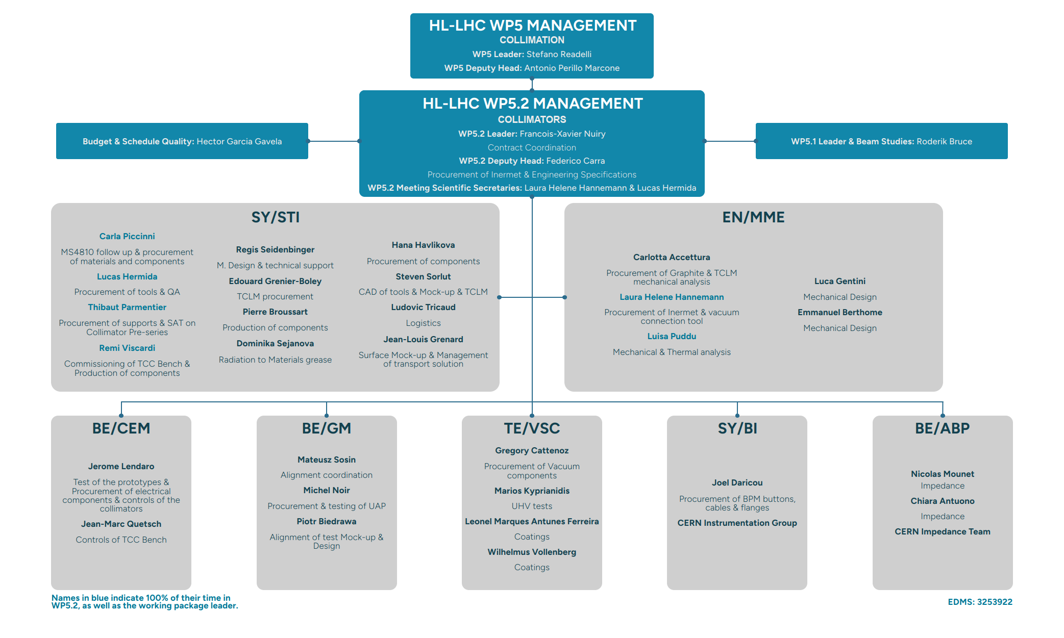
Example of a project structure

Slide 3
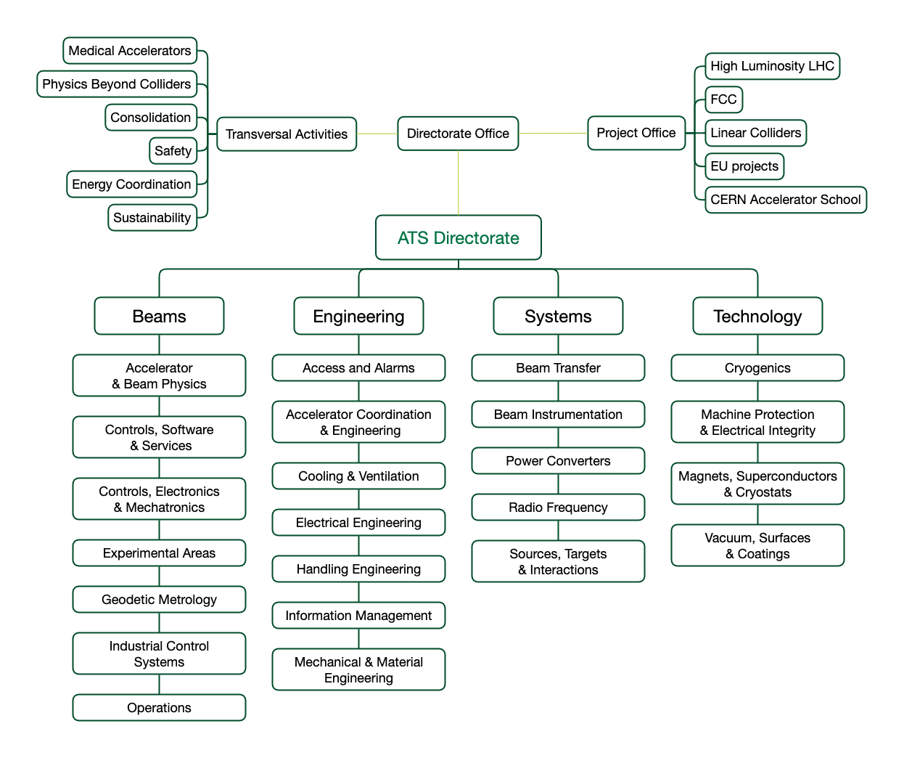
ATS Sector

Slide 4
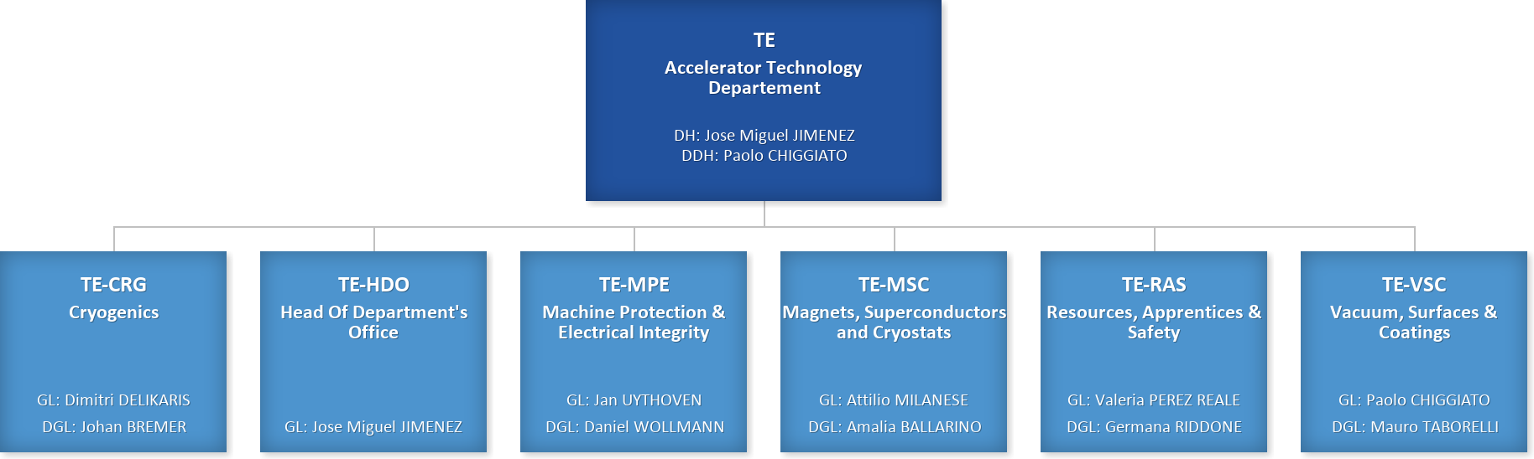
Technology Department

Slide 5
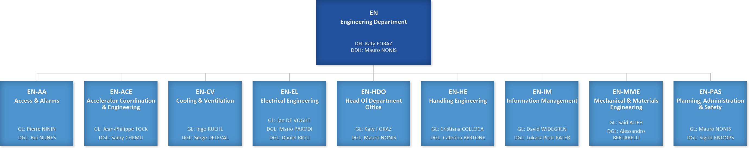
Engineering Department

Slide 6
Accelerator Systems Department

Slide 7
Beams Department

Slide 8
Resources allocated by Departments, Groups, Sections…

Slide 9
Conclusion
Project culture needs to be accepted at all levels
Human resources working for projects but reporting to their hierarchy
This could generate conflicts and issues.
Clear responsibilities and project roles are key
Good project function depends on cooperation of Groups/Sections

