Slide 1
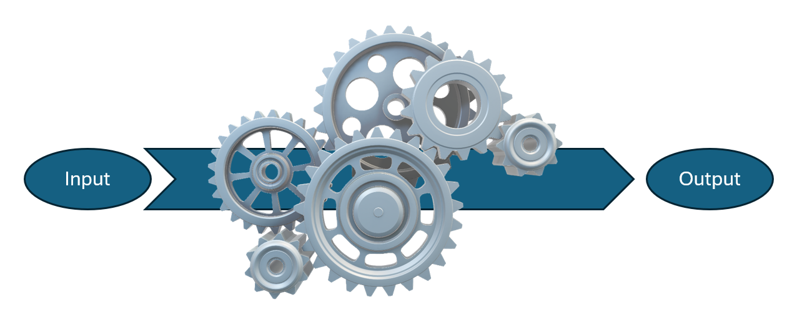
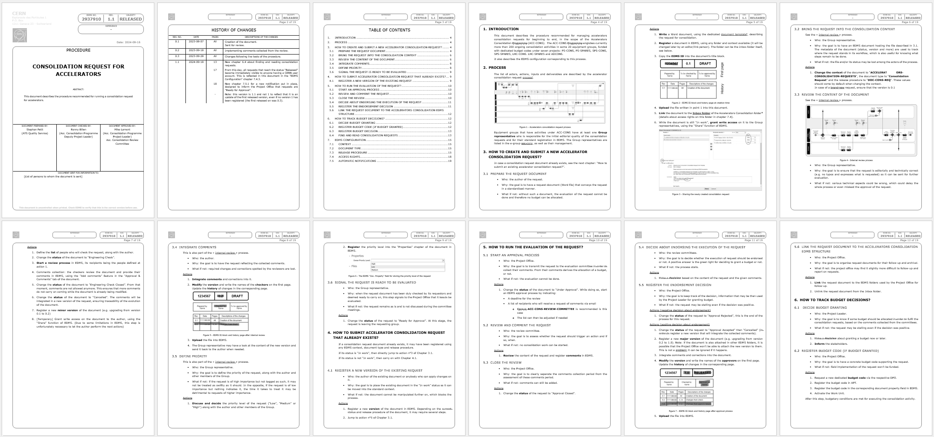
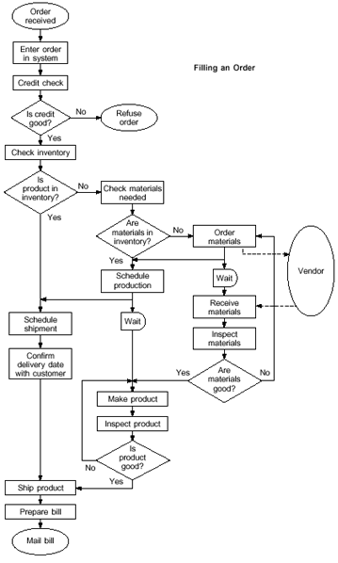
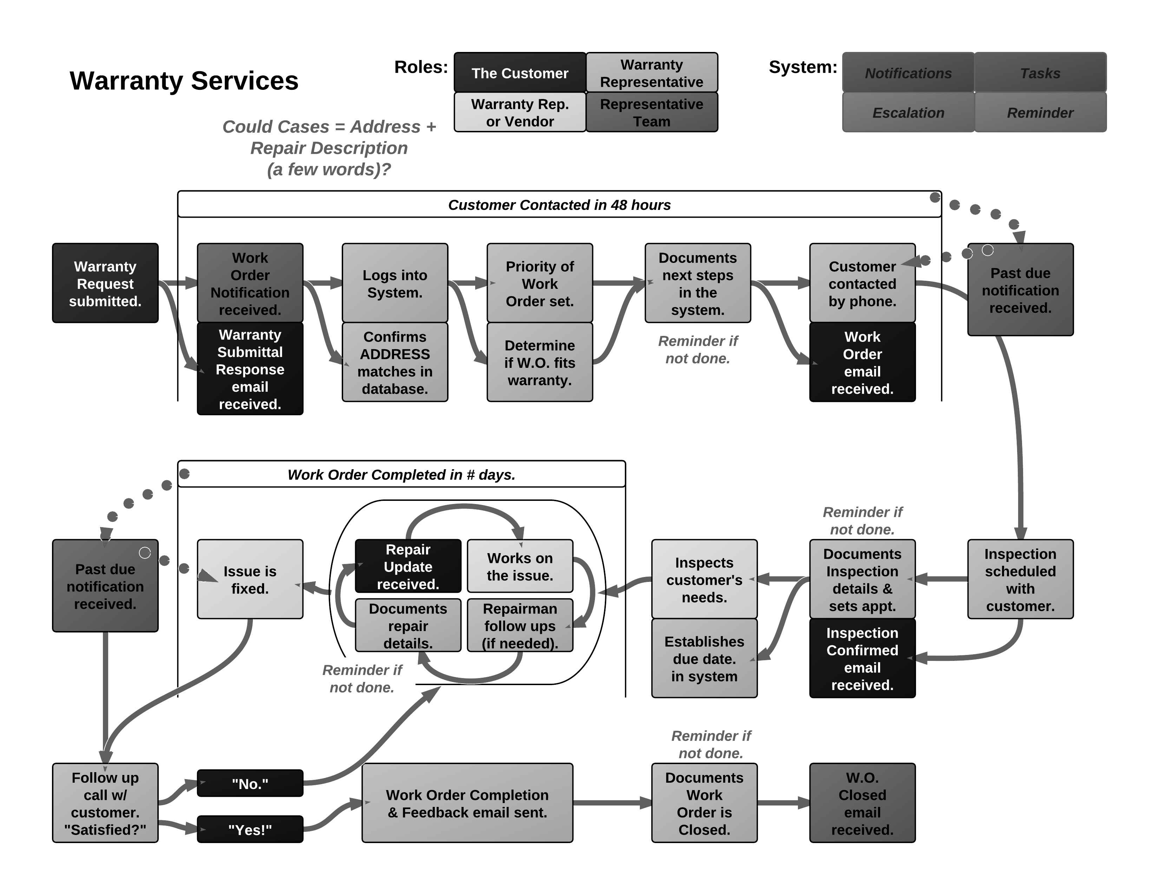
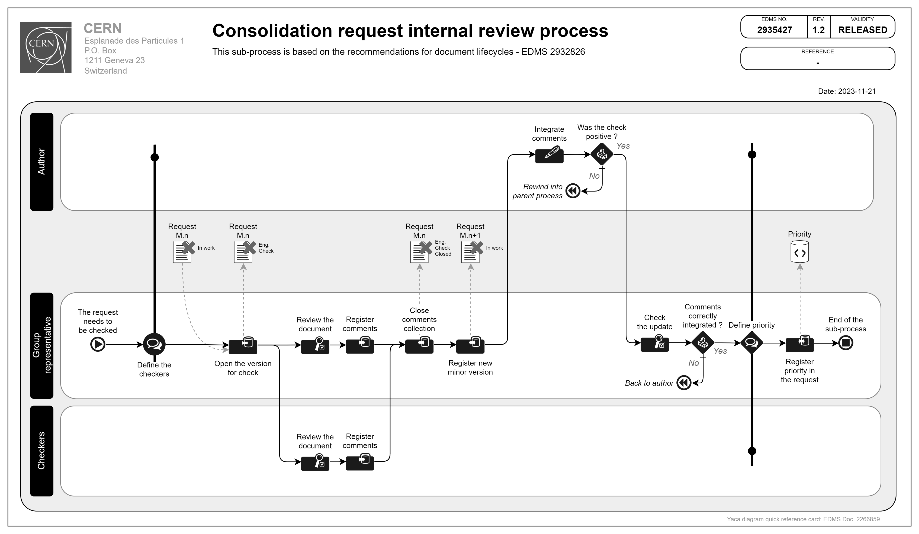
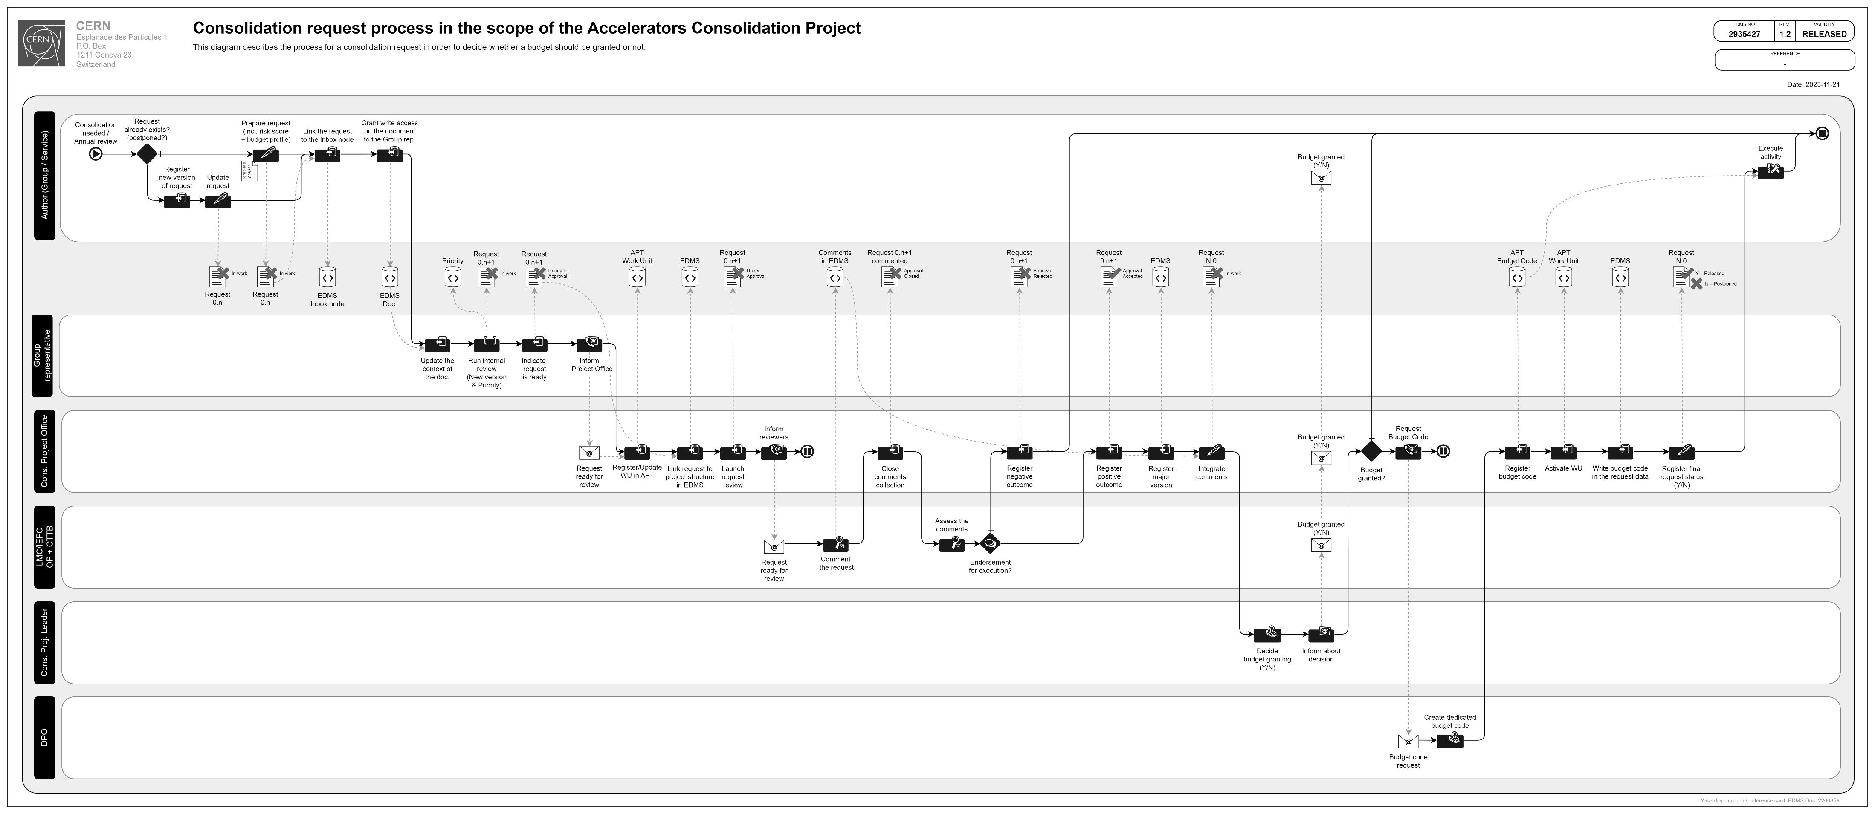
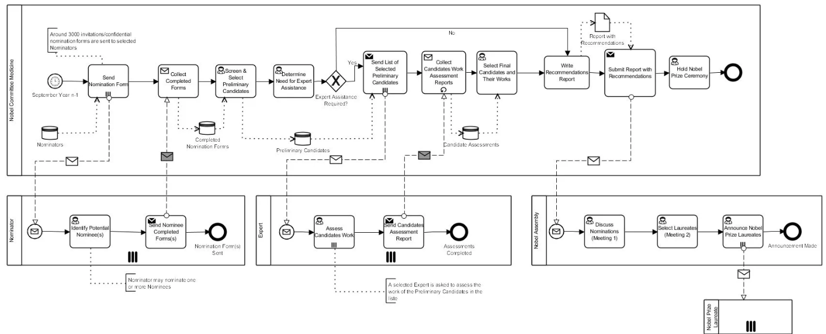
PROCESS DIAGRAMMING
PMMU June 2025

Slide 2

Unanounced presentations ?

Slide 3
Process
WHAT ?

Slide 4

Documenting processes
WHY ?

Slide 5

Benefits from documenting processes
Process documentation
Existing processes
Future processes
Collecting and sharing knowledge
Training newcomers
Harmonising ways of working
Improving by spotting weak spots and bottlenecks
Checking common understanding
Planning deployment of new activities
Preparing integration into an existing framework
Estimating required resources
Checking common understanding

Slide 6
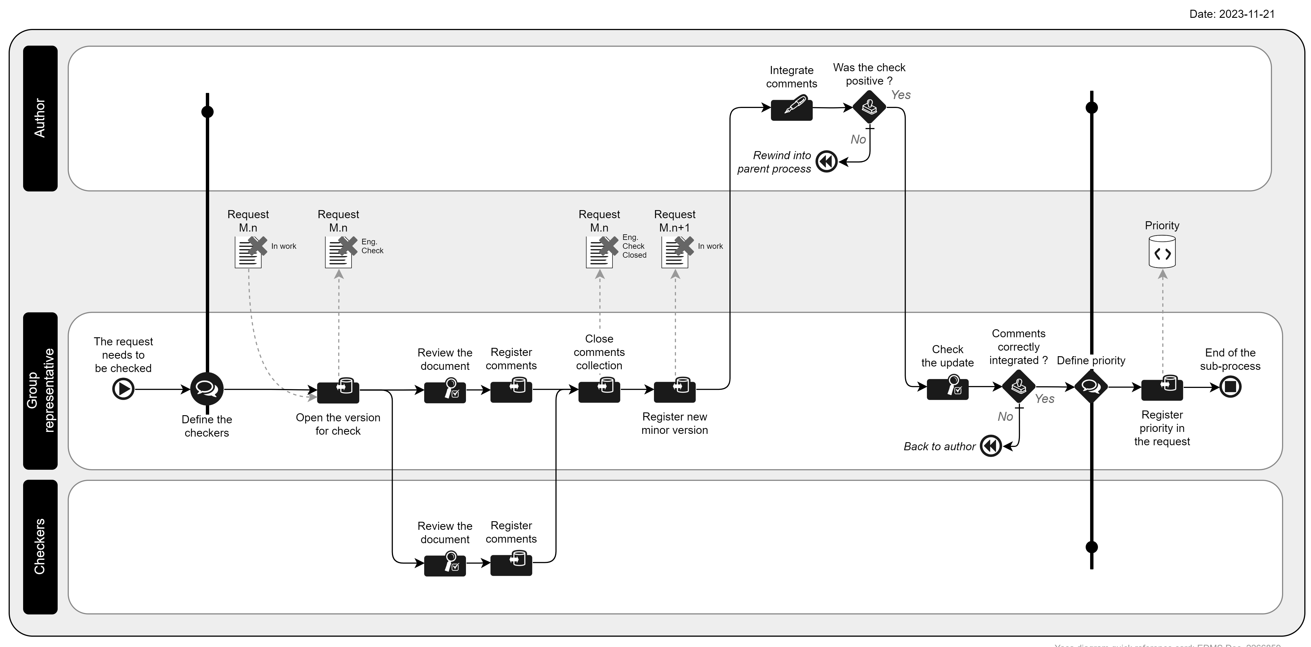
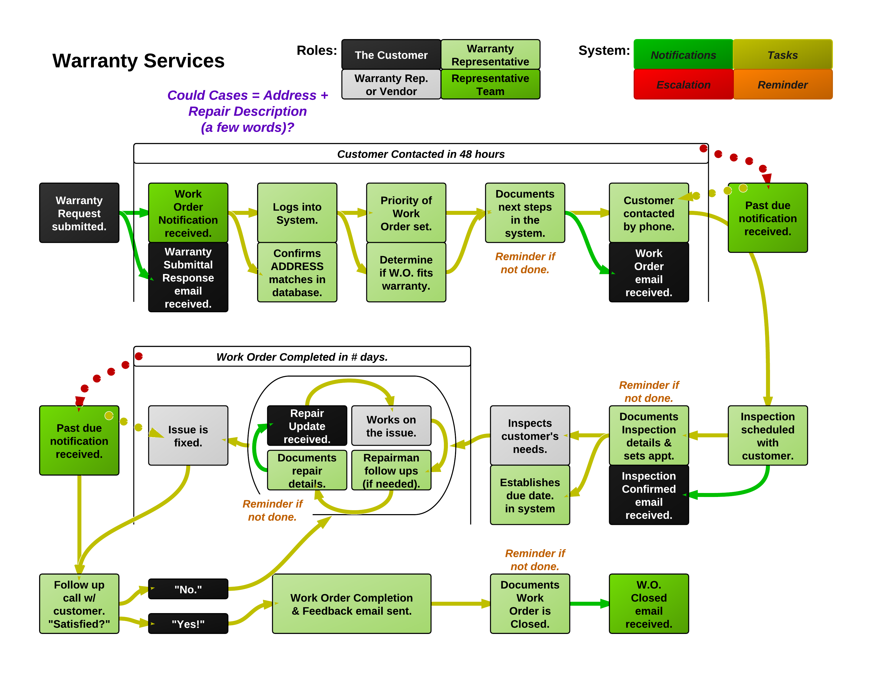
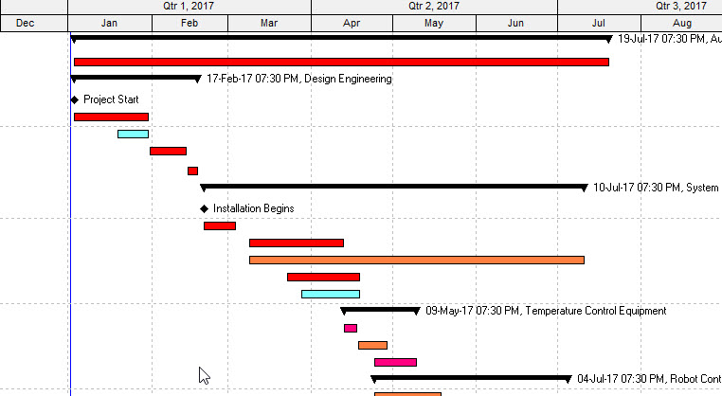
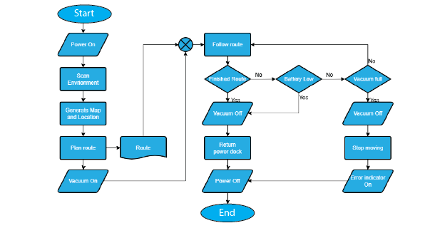
Documenting processes
HOW ?

Slide 7

Process Diagramming - Your experience ?

Slide 8

Process Diagramming - Your wishes / needs ?

Slide 9
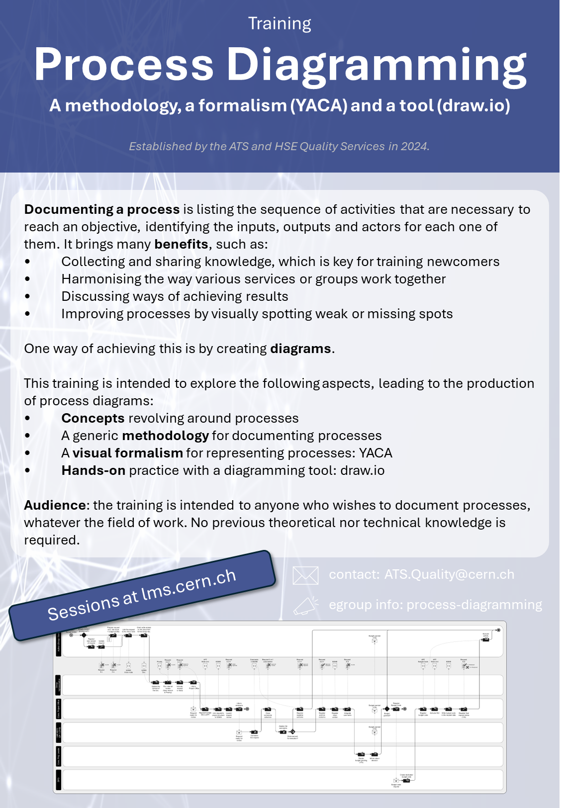

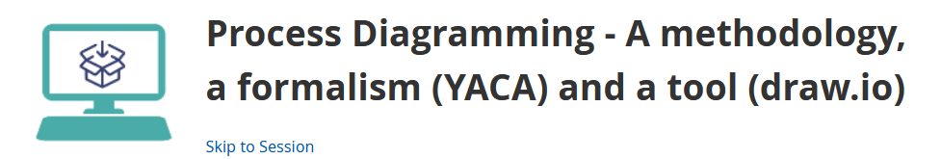
Process Diagramming - A training course !
This training is intended to explore the following aspects, leading to the production of process diagrams:
• Concepts revolving around processes
• A generic methodology for documenting processes
• A visual formalism for representing processes: YACA
• Hands-on practice with a diagramming tool: draw.io
Sessions at lms.cern.ch

Slide 10


Process Diagramming - Info & Contact
process-diagramming
Information
e-group
ats.quality@cern.ch
Contact
Support

Slide 11


PMMU - 2025/26 ?
2024/25
2025/26
We are here
? ? ?
Stay tuned !
CERN-Project-Management-Community
Information
e-group
> CERN-Project-Management-Community-Administrator@cern.ch

Slide 12

THANK YOU ISABEL !

