Slide 1
Modeling resonance spectra in heavy-ion collisions at HADES
Szymon Harabasz (IJCLab Orsay) for the HADES Collaboration
XVII Polish Workshop on Relativistic Heavy-Ion Collisions (Warsaw 2024)

Slide 2
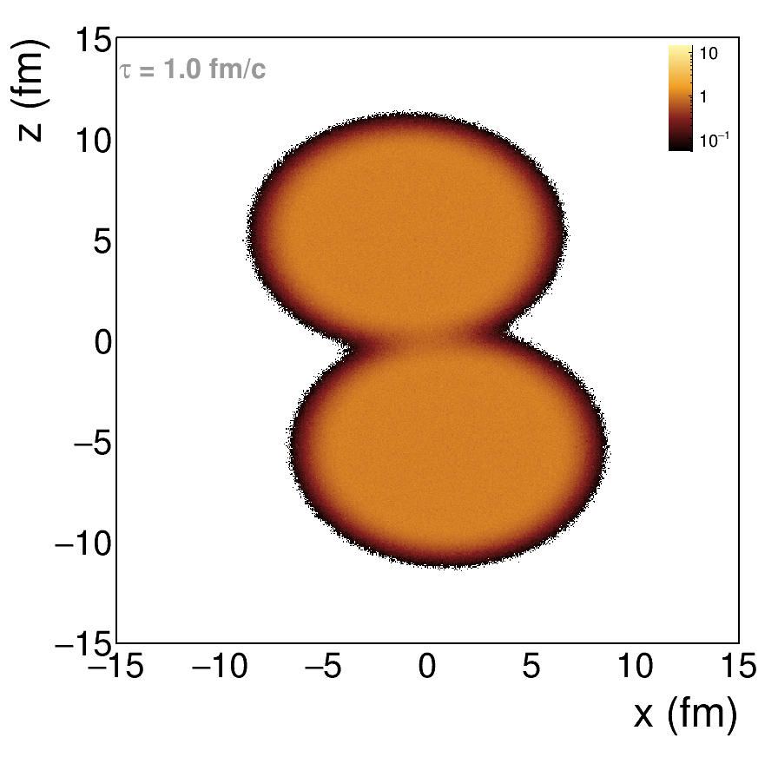
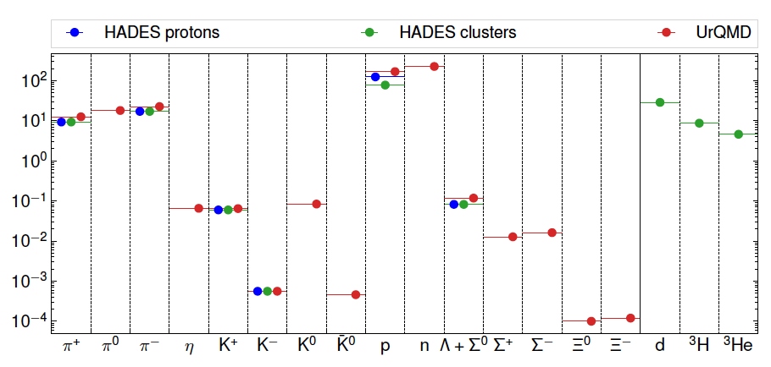

Low Energy edge
ρ_{B}/ρ₀, UrQMD
A. Motornenko et al., PLB 822 (2021) 136703
Au-Au $\sqrt{s_{NN}}$=2.42 GeV, 0-10% centrality
Not so strong Lorentz contraction but low transparency
We detect mostly nucleons:
  Incoming nuclei
  Decays of baryonic resonances
  Baryon-dominated matter

Slide 3
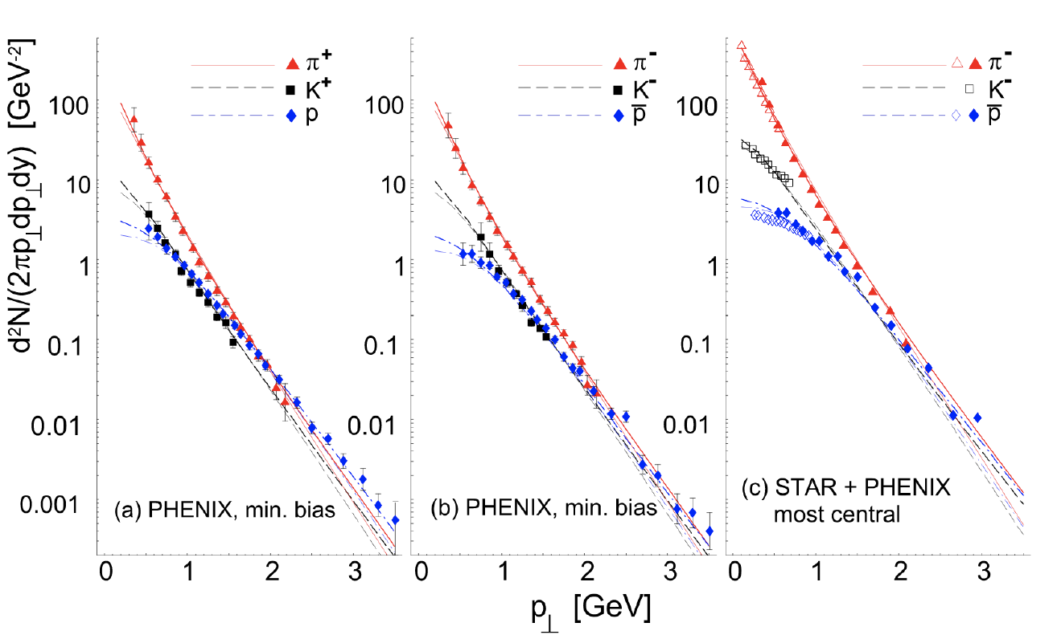
Single freeze-out scenario at RHIC energies
W. Broniowski and W. Florkowski, PRL 87 (2001) 272302
Chemical (= particle abundances fixed) and kinetic (= particle momenta fixed) freeze-outs coincide
Hadron yields are given by the integrals of hadron spectra
Feed-down from resonance decays included
Implemented in the event generator Therminator 2
Successful at RHIC, does it work at SIS18 energies?

Slide 4
Thermal Event Generator (Therminator 2)
Ingredients of the method:
Fix parameters with particle multiplicity ratios:
  Six equations for six parameters:
M. Chojnacki et al., Comput. Phys. Comm. 103 (2012) 746-773
SH, W. Florkowski, T. Galatyuk et al., PRC 102 (2020) 5, 054903
SH, W. Florkowski, T. Galatyuk et al., PRC 107 (2023) 3, 034917
protons (incl. those bound in light nuclei): 124.1
π⁺: 9.3
π⁻: 17.1
K⁺: 0.0598
K⁻: 0.00056
Λ: 0.0822
T μ_{B} μ_{I3} μ_{S} γ_{S} R
H in Hubble-like expansion v = tanh(Hr)
δ - eccentricity parameter for the spheroid
in the momentum space
m_{T} spectra of p and π in five rapidity bins
ε - eccentricity parameter for the spheroid
in the position space
Femtoscopic radii

Slide 5
Hadron spectra
HADES data:
M. Szala, Springer Proc.Phys. 250 (2020) 297-301
EPJA 56 (2020) 10, 259
PLB 778 (2018) 403-407
PLB 793 (2019) 457-463
π⁺
proton
SH et al., PRC 102 (2020) 5, 054903, PRC 107 (2023) 3, 034917
Parameter | Value
T (MeV) | 70.3
R (fm) | 6.06
μ_{B} (MeV) | 876
H (GeV) | 0.0225
δ | 0.4
Good agreement for such a simple model
Extracting prolateness of the fireball (in momentum space)

Slide 6
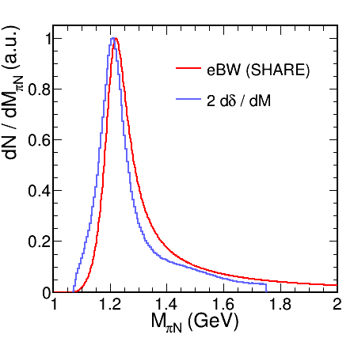
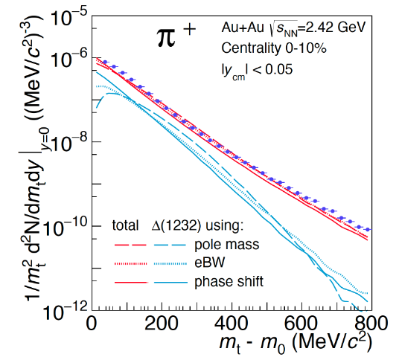

Resonance treatment
R. Dashen, S. K. Ma and H. J. Bernstein, Phys. Rev. 187 (1969) 345 (1969)
R.Venugopalan, and M. Prakash, NPA 546 (1992) 718
W. Weinhold, and B. Friman, PLB 433 (1998) 236
Pok Man Lo, EPJC 77 (2017) no.8, 533
πN phase shift in the P₃₃ channel
Spectral function: $B_{l}\left(M\right)=2\frac{d}{dM}δ_{l}$
Sensitivity of hadron spectra
Pok Man Lo et al., PRC 96, 015207
GW WI08: R.L. Workman et al. PRC 86, 035202

Slide 7
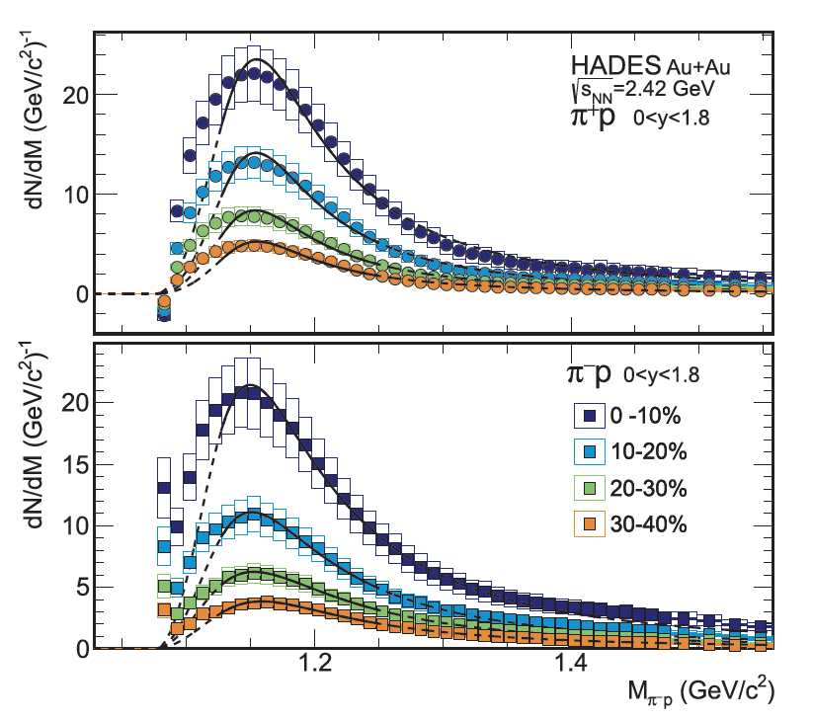
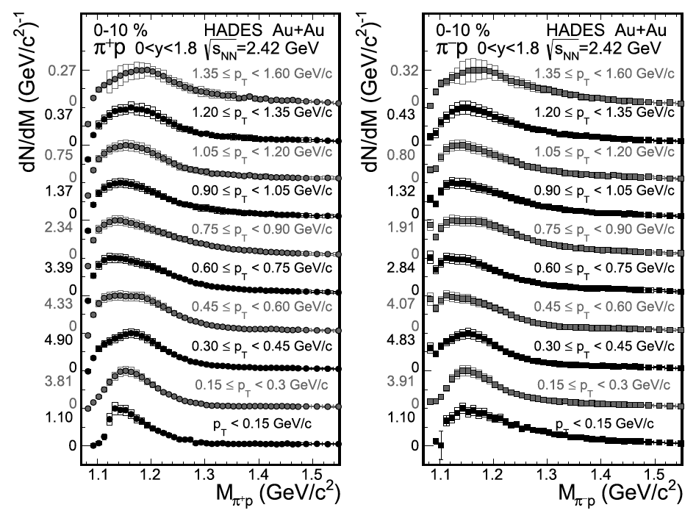
Extracting Broad Signals in Experimental Data
Unprecedented statistical and systematic precision, allowing for multi-differential analysis
G. Kornakov, T. Galatyuk., EPJA 55 (2019) 11, 204
HADES, PLB 819 (2021) 136421

Slide 8
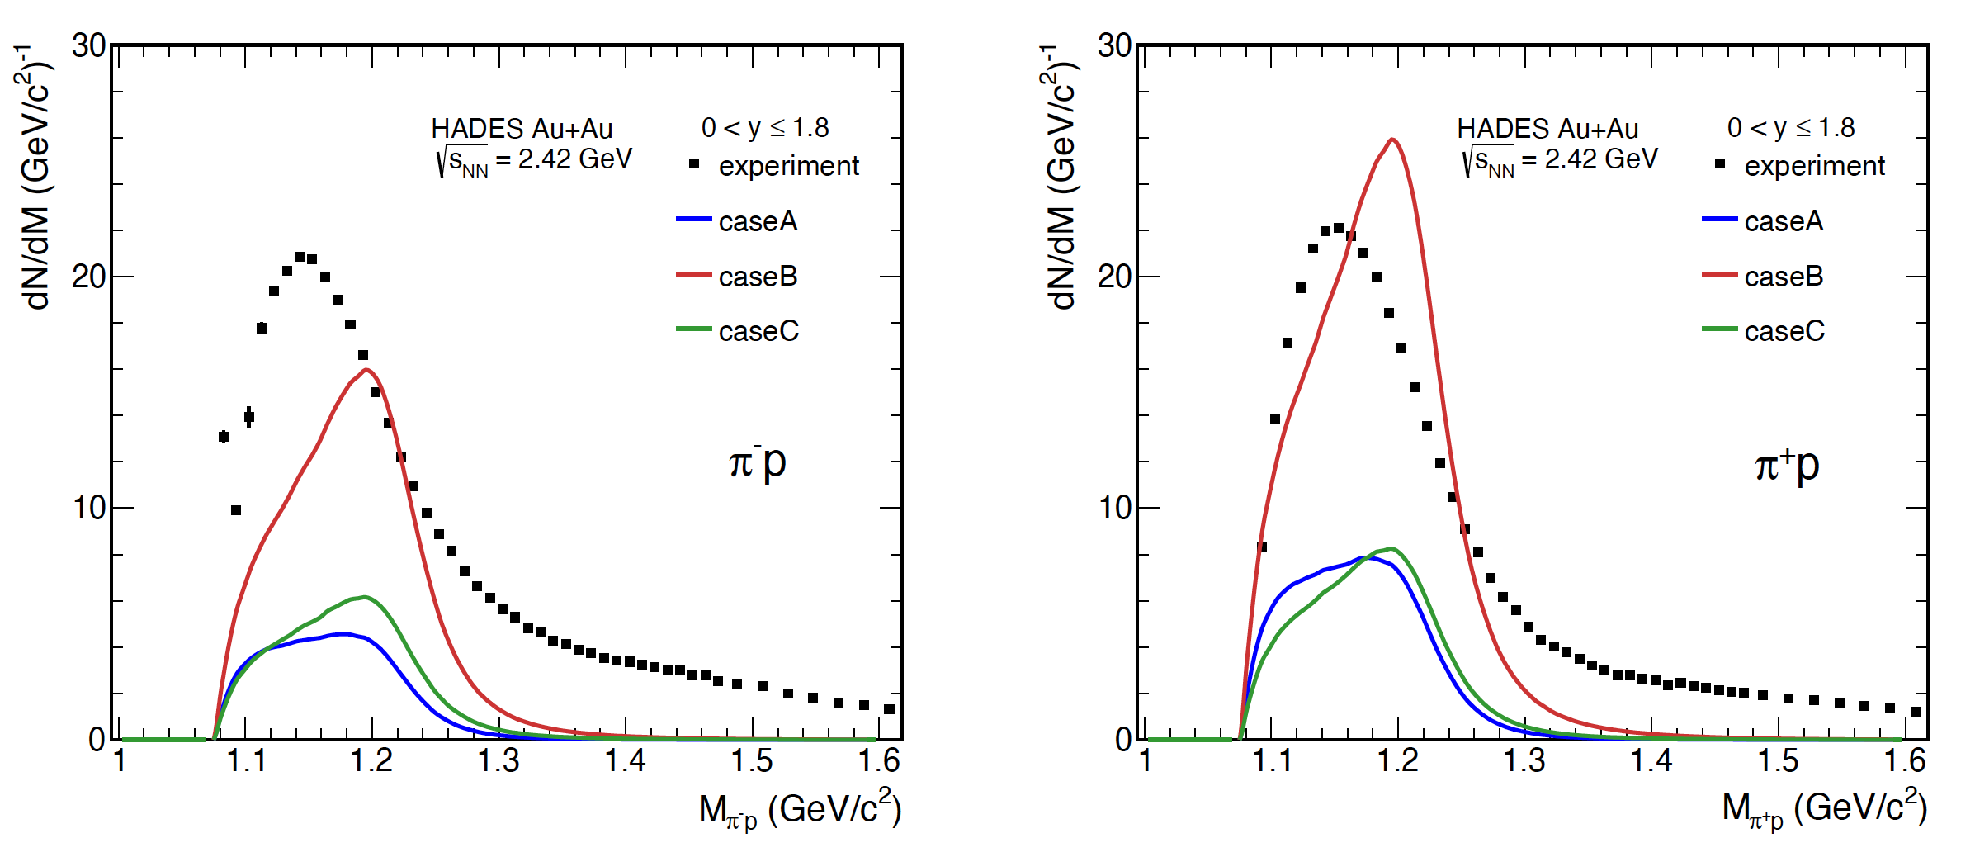
Comparison to thermal model
M. Kurach, Master’s thesis, Warsaw University of Technology (2024)
Interplay of freeze-out parameters:
  caseA: low T, low μ_{B}, large volume (clusters produced by coalescence, first minimum)
  caseB: high T, high μ_{B}, small volume (clusters produced by coalescence, other minimum)
  caseC: medium T, low μ_{B}, medium volume (clusters produced thermally, unique, but bad, minimum)
Phase shift corresponds to vacuum spectral function
Particle production at the freeze-out only

Slide 9
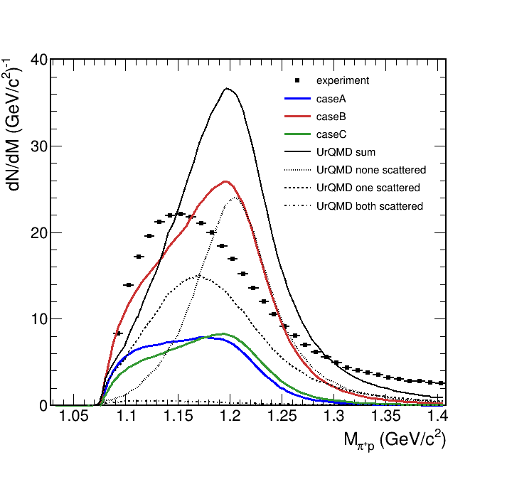
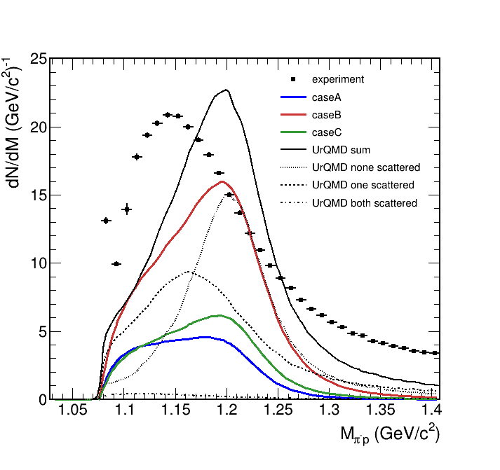
Adding Kinetic transport model
HADES data: PLB 819 (2021) 136421
Thermal model: M. Kurach, Master’s thesis, Warsaw University of Technology (in preparation)
UrQMD: T. Reichert et al., J. Phys G 46 (2019) 105107
Calculation with public UrQMD version 3.4
If one of the daughter particles rescatters, the shape starts to resemble experimental data
  Dashed line
  Effect still too weak
  In most cases, none of the daughters rescatter
Shape without scattering similar to the thermal model
  Enhancement of thermal model at low mass
  Role of the thermal factor?
  Non-resonant part of the phase shift?
In-medium effects are too small in the kinetic transport.

Slide 10
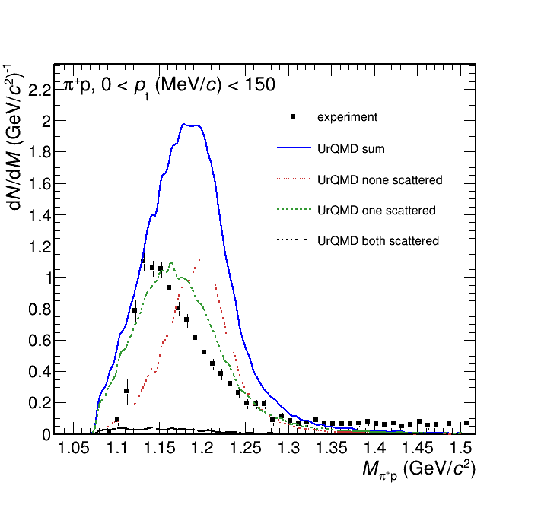
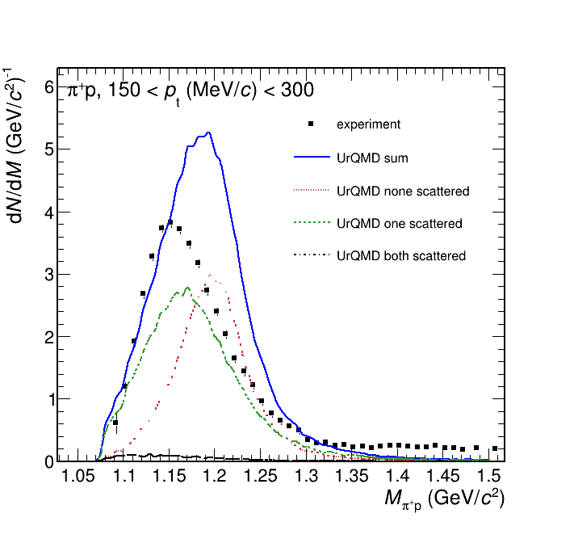

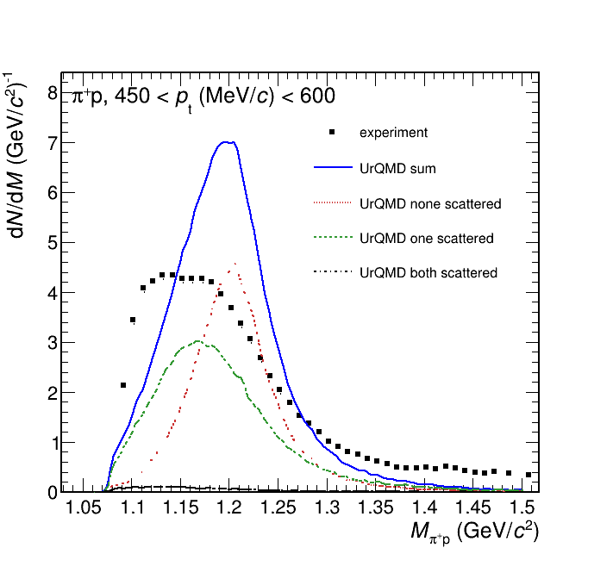
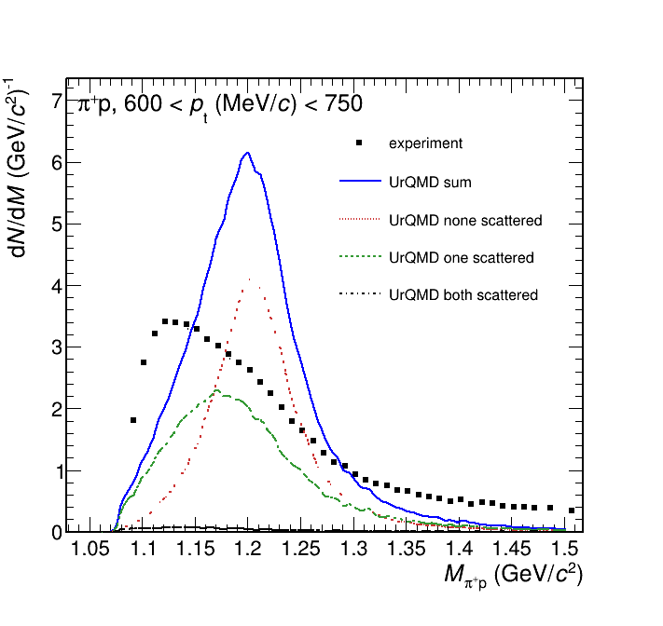
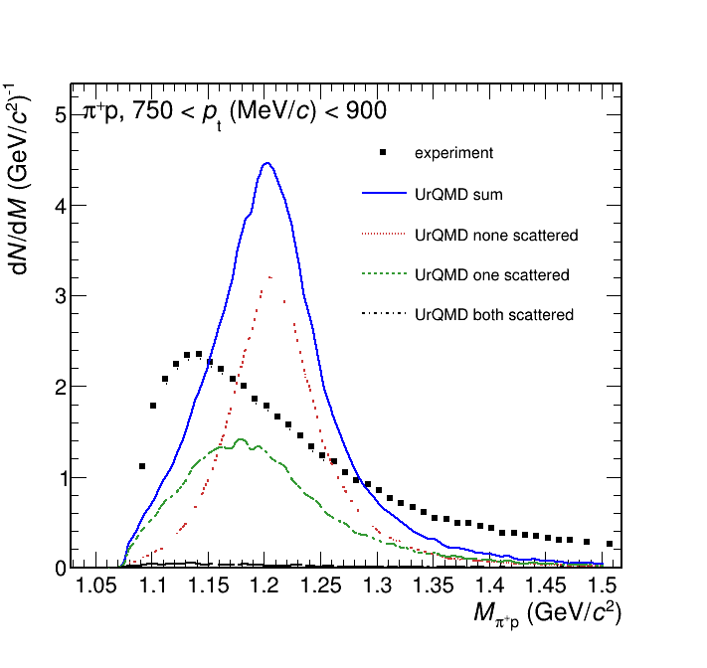
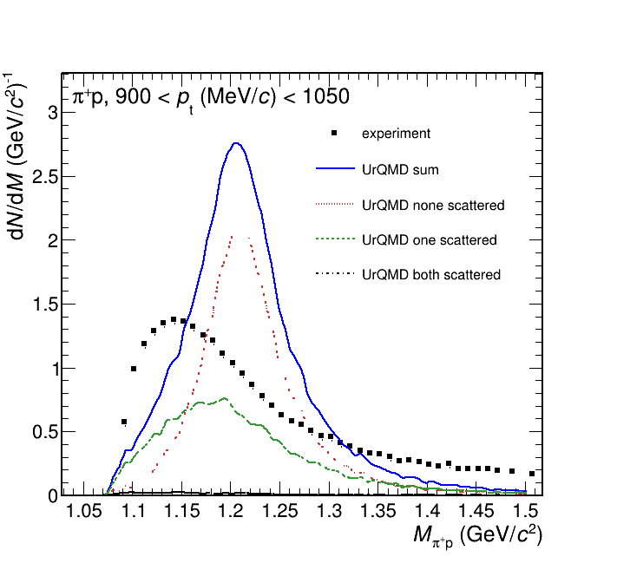
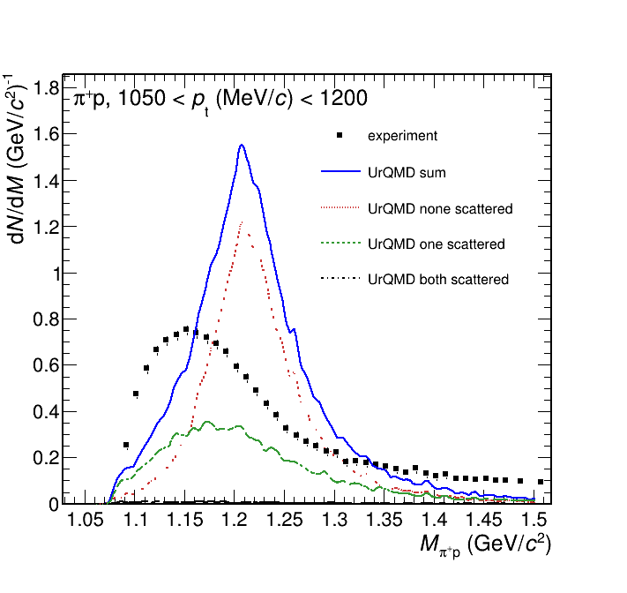
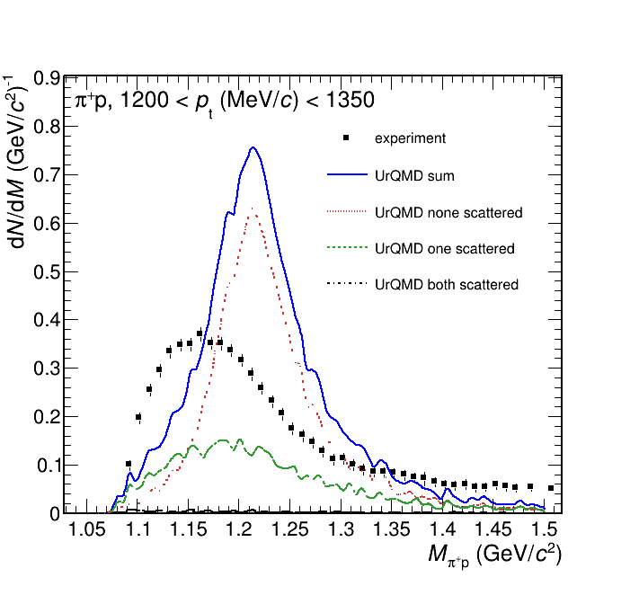
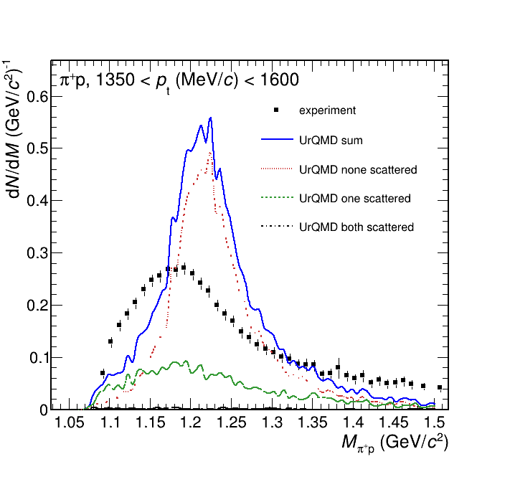
Multi-Differential Spectra vs. Transport
π⁺p
Larger discrepancy at higher pair transverse momenta

Slide 11
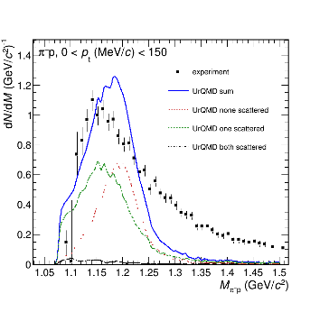
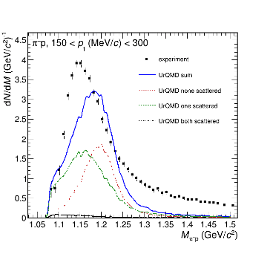
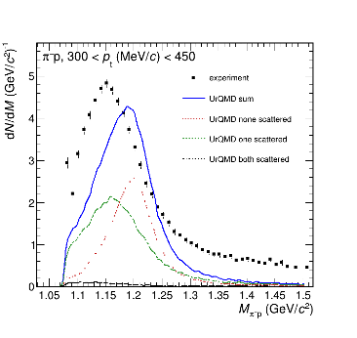
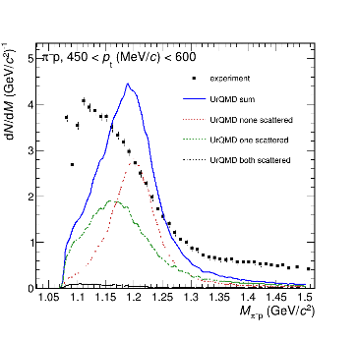
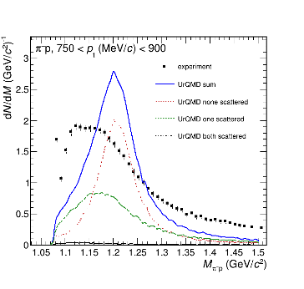
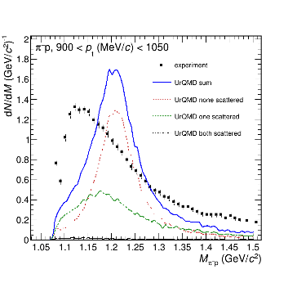
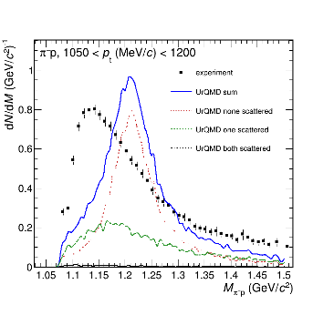
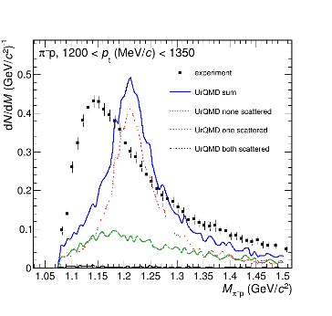
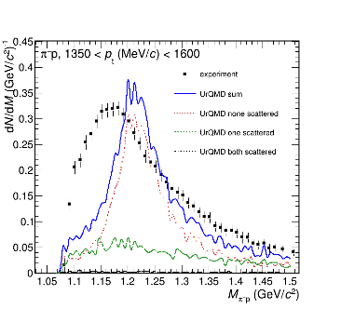
Multi-Differential Spectra vs. Transport
π⁻p
Larger discrepancy at higher pair transverse momenta

Slide 12
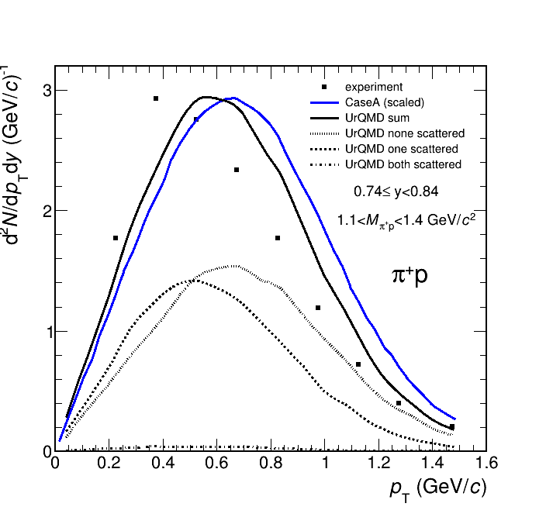
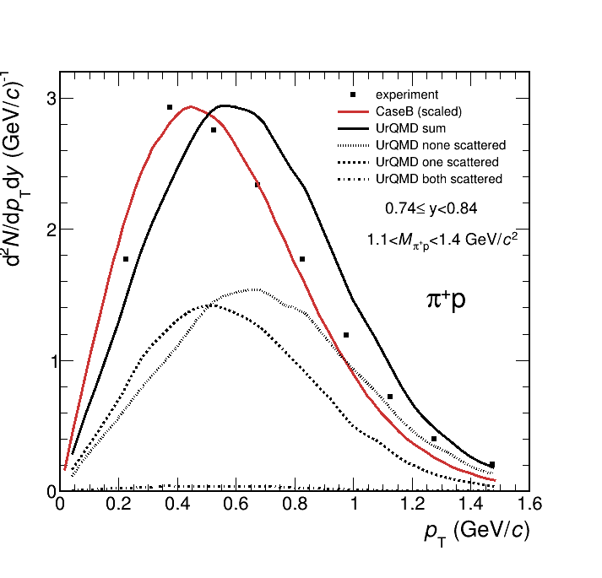
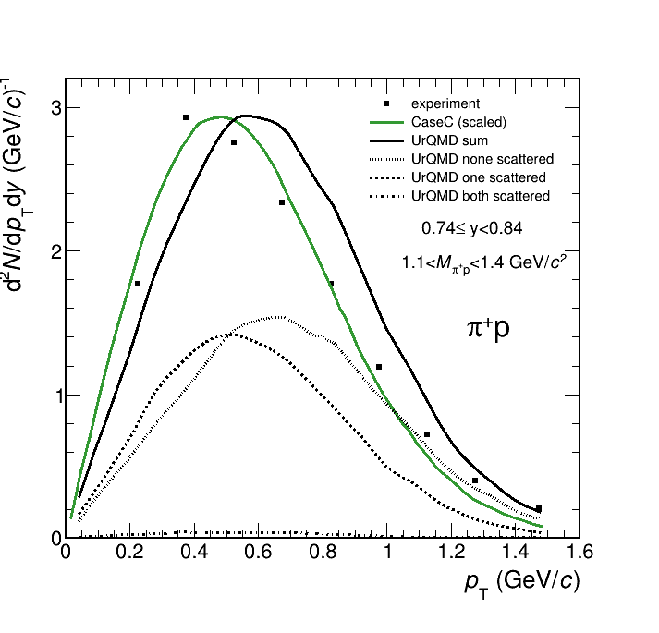
Transverse Momentum Spectra
Low temperature (CaseA): resonances have higher transverse momentum than in experiment:
  But it is closest to the contribuition ”without scattering” in transport
Scattering reduces resonance transverse momentum in transport
Again, the contribution of cases “with scattering” has:
  Too low yield
  The week shift in energy/momentum

Slide 13
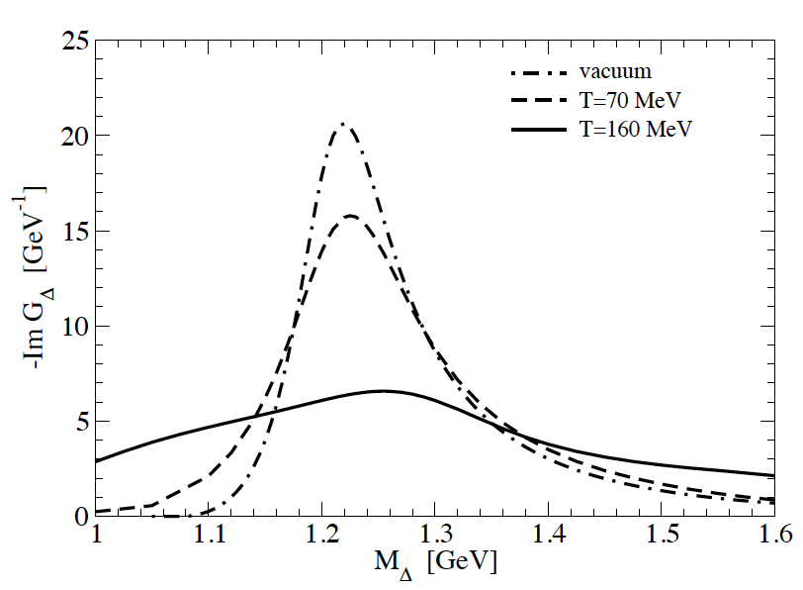
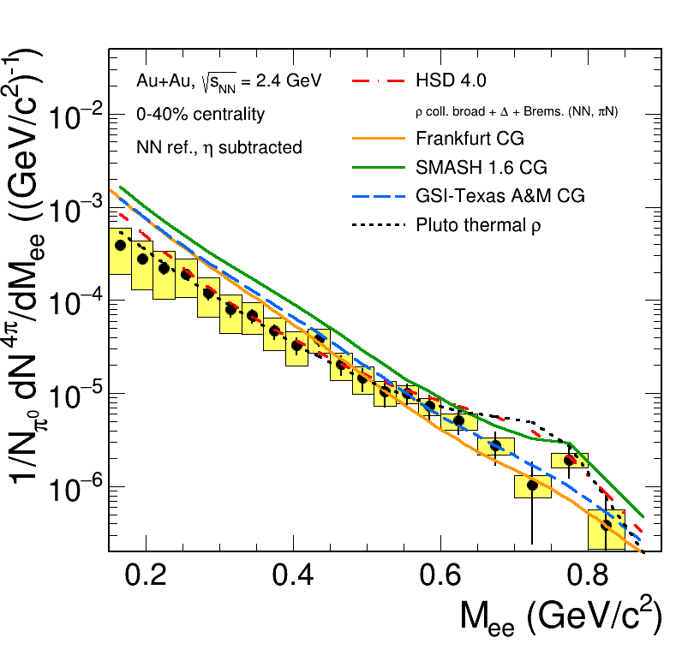
Hints from Dileptons
Collisional broadening and Bremsstrahlung not effective enough in “melting” ρ meson
Possible perspective:
using in-medium Δ spectral function
H. van Hees and R. Rapp, PLB 606 (2005) 59-66
Many-body calculation of ρ spectral function + CG (local thermal equilibrium) + thermal dilepton emmission rates:
→ Practically structureless spectrum

Slide 14
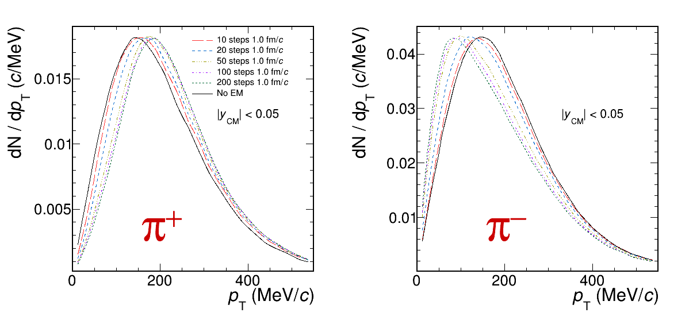
Solver for “Coulomb” Interaction After Freeze-Out
In experimental data:​
  π⁺ shifted to a higher momentum​
  π⁻ shifted to a lower momentum​
Interaction with the positive-charged fireball
Implemented with propagating particles in Liénard-Wiechert potentials
How long the simulation should run?
  No big change in the spectra after 100 fm/c

Slide 15
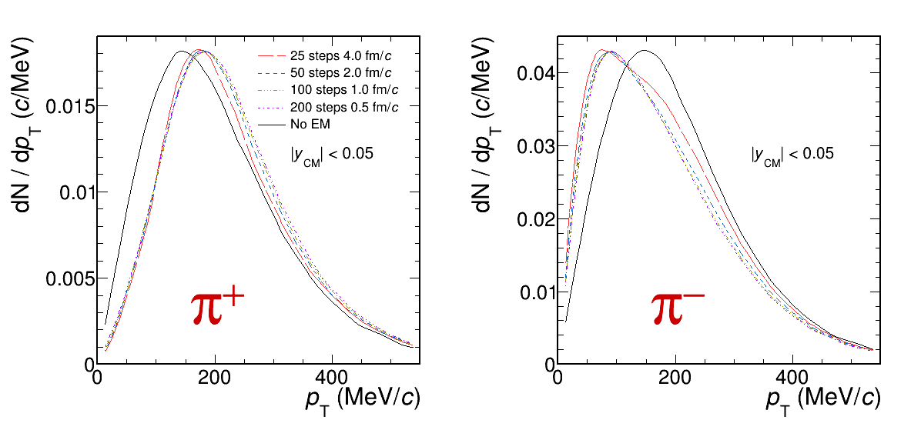
Solver for “Coulomb” Interaction After Freeze-Out
Other check: what is the maximal useful
  4.0 fm/c is already too long
  1.0 fm/c will be used later on

Slide 16
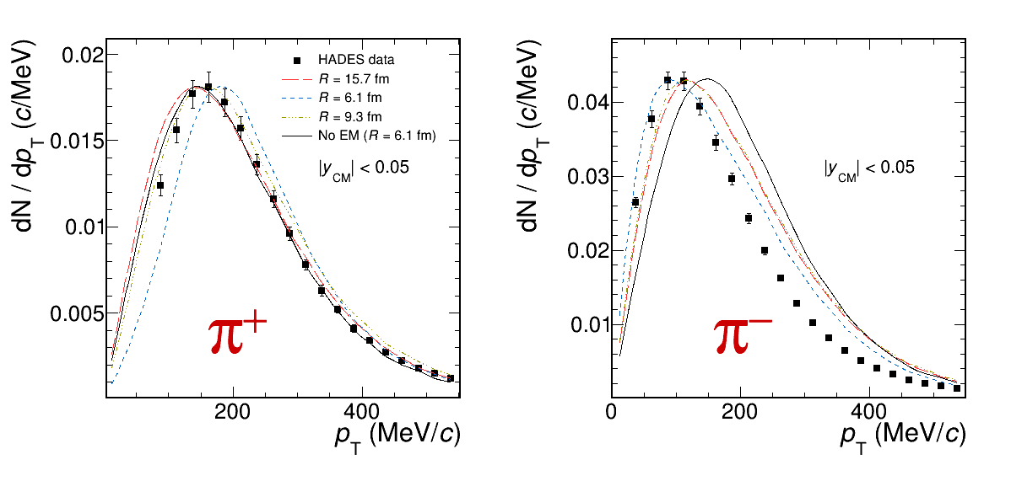
Comparison to Experimental Data
Influence of the “Coulomb” interaction on the data reproduced qualitatively
Different sets of parameters (“cases”) represented by the fireball radius
Which of them is preferred, depends on pion charge and momentum:
  More sophisticated picture is needed than “single freeze-out”

Slide 17
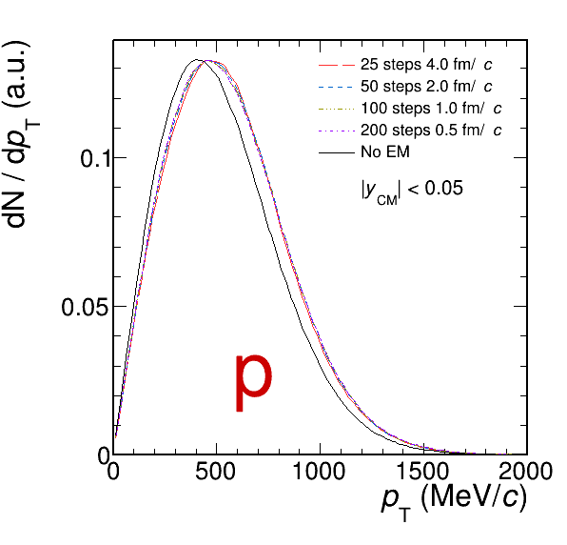
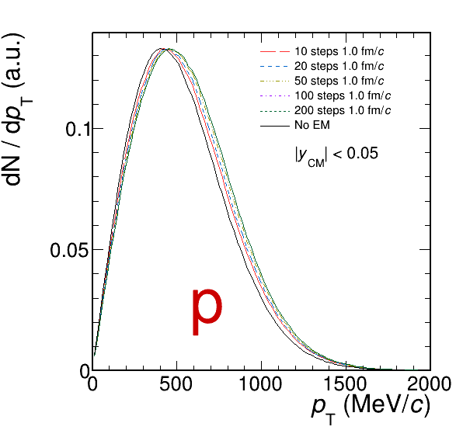
Not Only Light Particles
Protons spectra are also affected
Effect visible thanks to the representation of transverse momentum without any weight
Outlook: compare to final HADES data when published

Slide 18
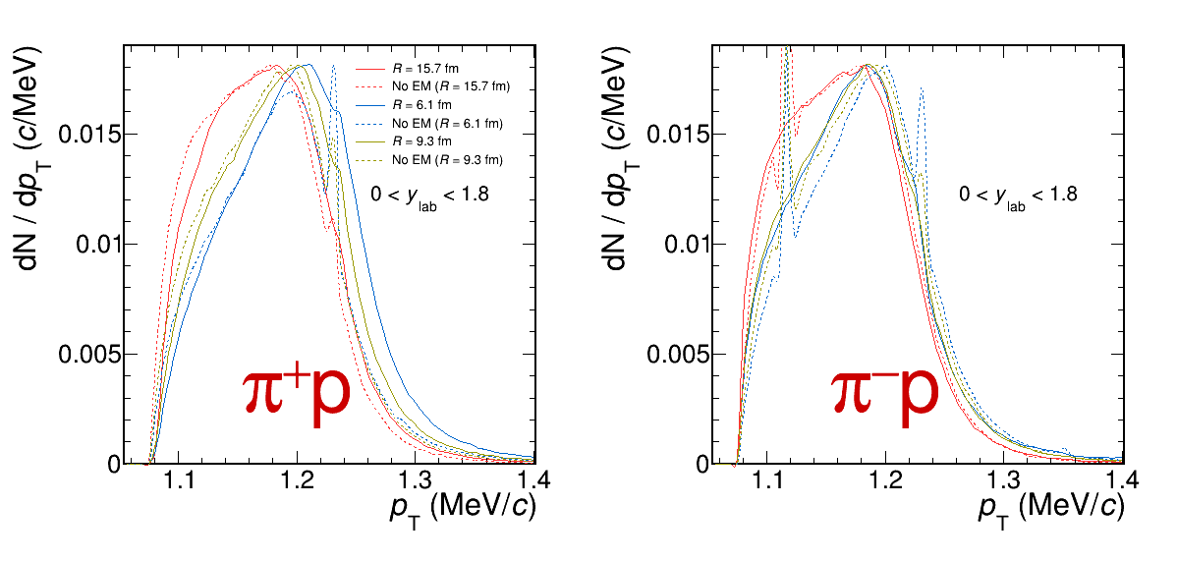
Modification of Resonance Spectra
Stronger effect for pairs of the same sign
Outlook: merge “Coulomb” and “improved resonances” code branches

Slide 19
Summary and Outlook
Heavy-ion collisions study QCD matter at extreme temperatures and densities
At relatively low energy, the system is dominated by baryons
Baryonic resonances and their interactions play an important role in the dynamics
  Their understanding is essential even for most common observables
HADES experiment offers a rich data set of pion-proton resonances reconstructed in Au-Au collisions
Current models are not sufficient to explain the data
One should use in-medium spectral function of Δ?
Implementation of “Coulomb” effect is available
  Now used for interaction of one particle with the fireball, but can also be applied to correlation analysis

