Slide 1
Observers' feedback
Oumar Ka, Peter Jenni, and Claire lee

Slide 2
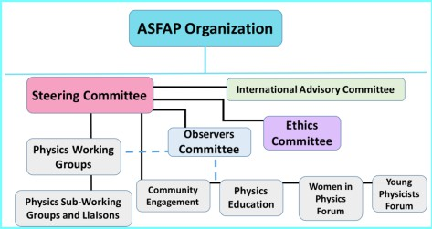
THE COMMITTEE
An intermediate body providing an additional link between the working groups and fora, and the Steering Committee.
Members of this committee are people with experience in long term planning but also an outstanding involvement with projects in and with Africa.
Members participate in WG discussions, they help to review papers, attend meetings and participate in the editing of the reports together with the WGs they are assigned to follow.

Slide 3
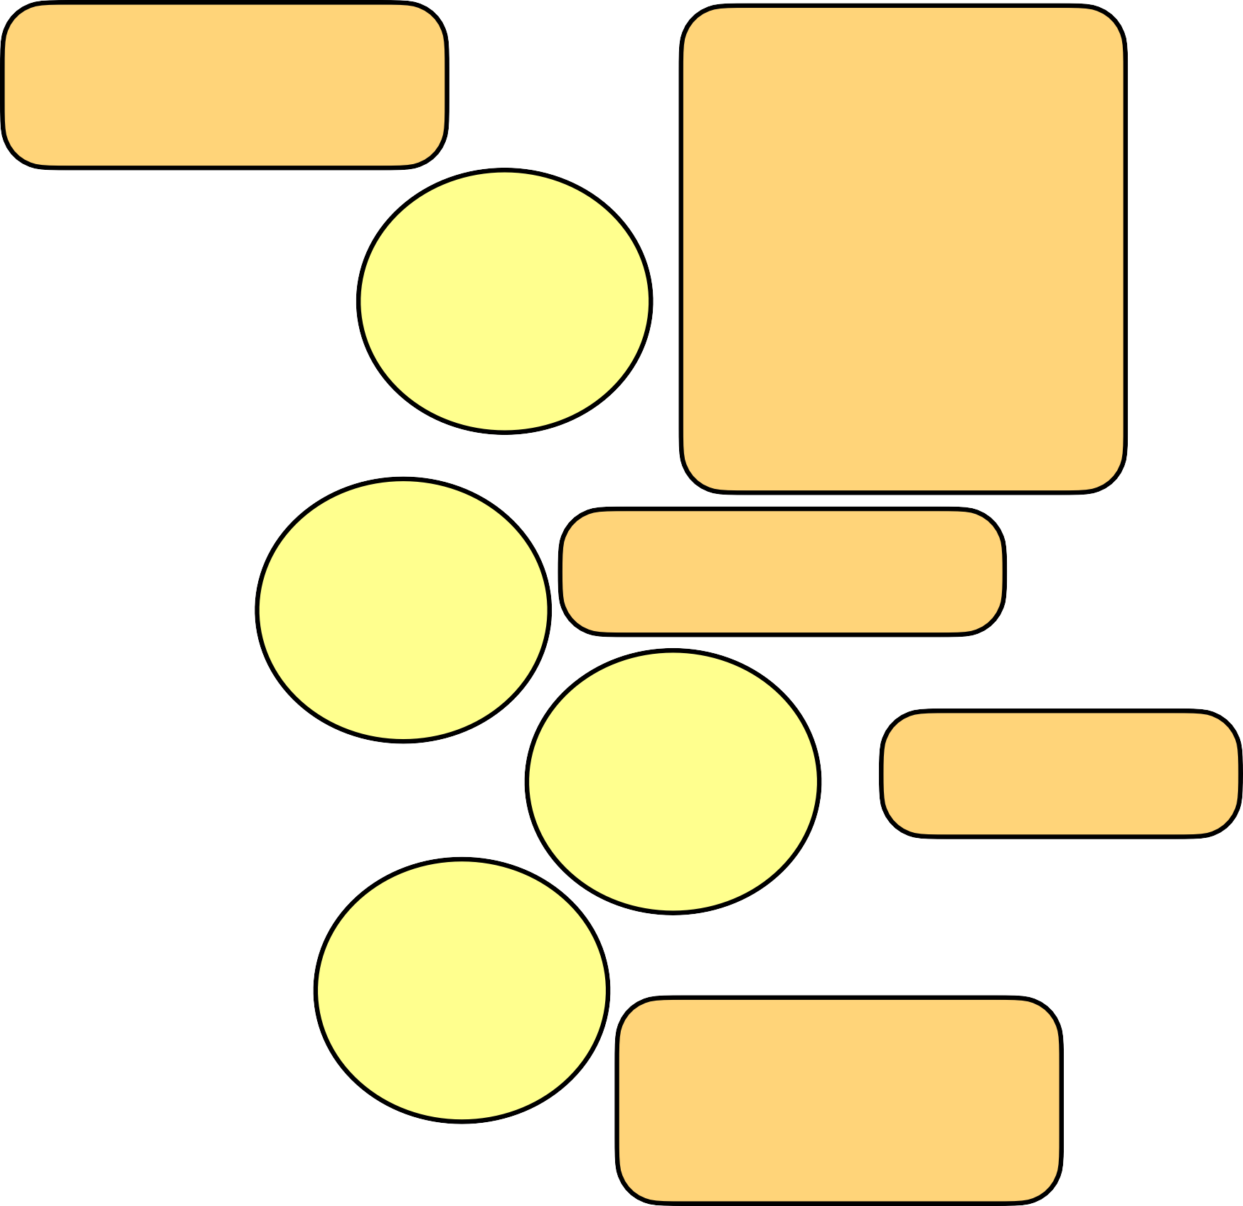
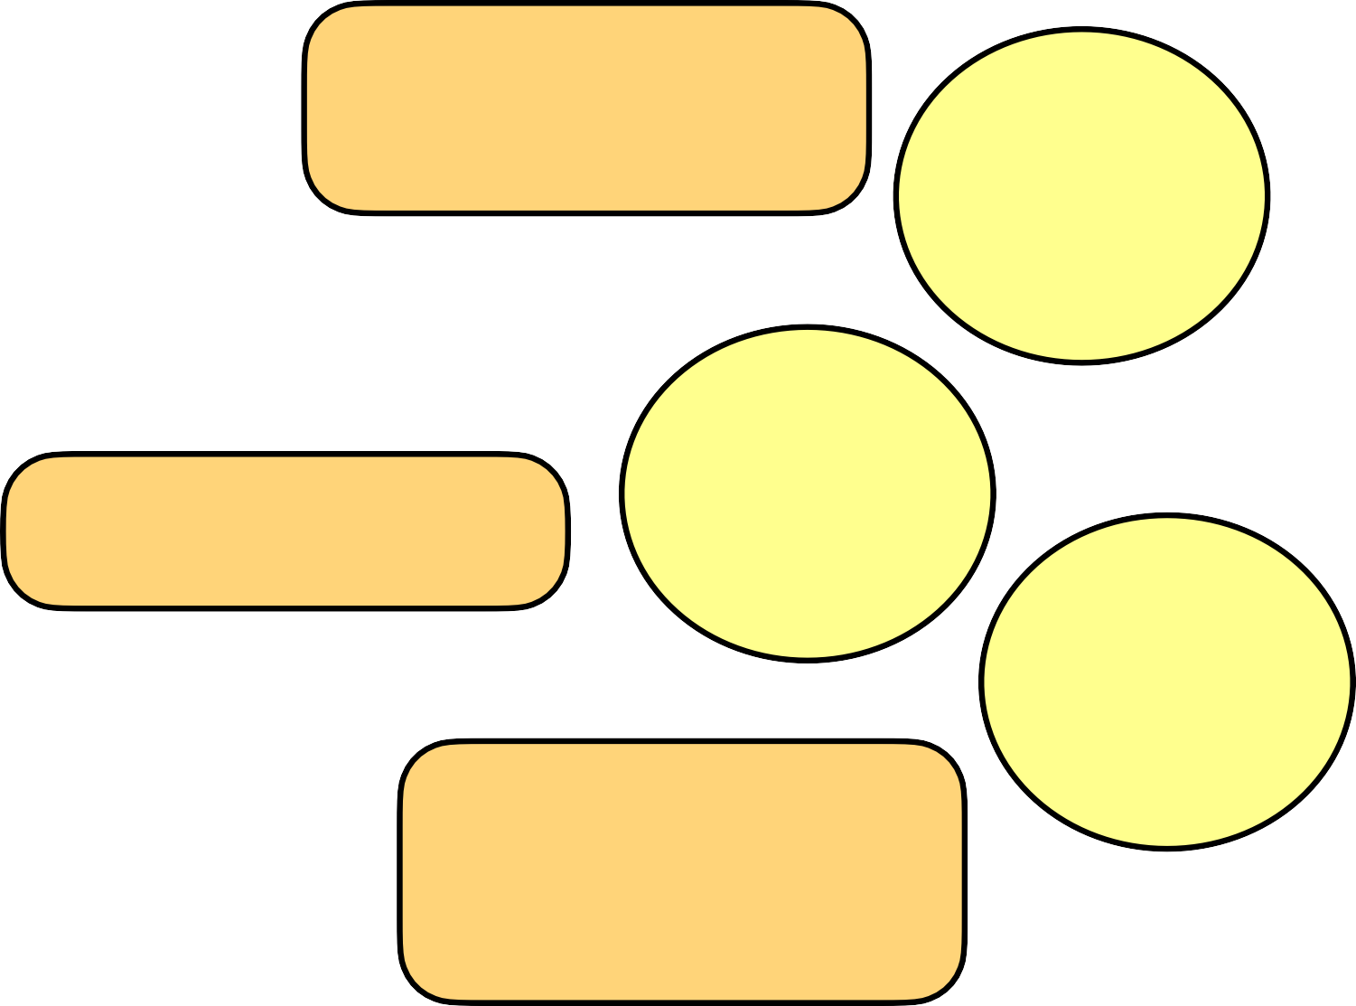
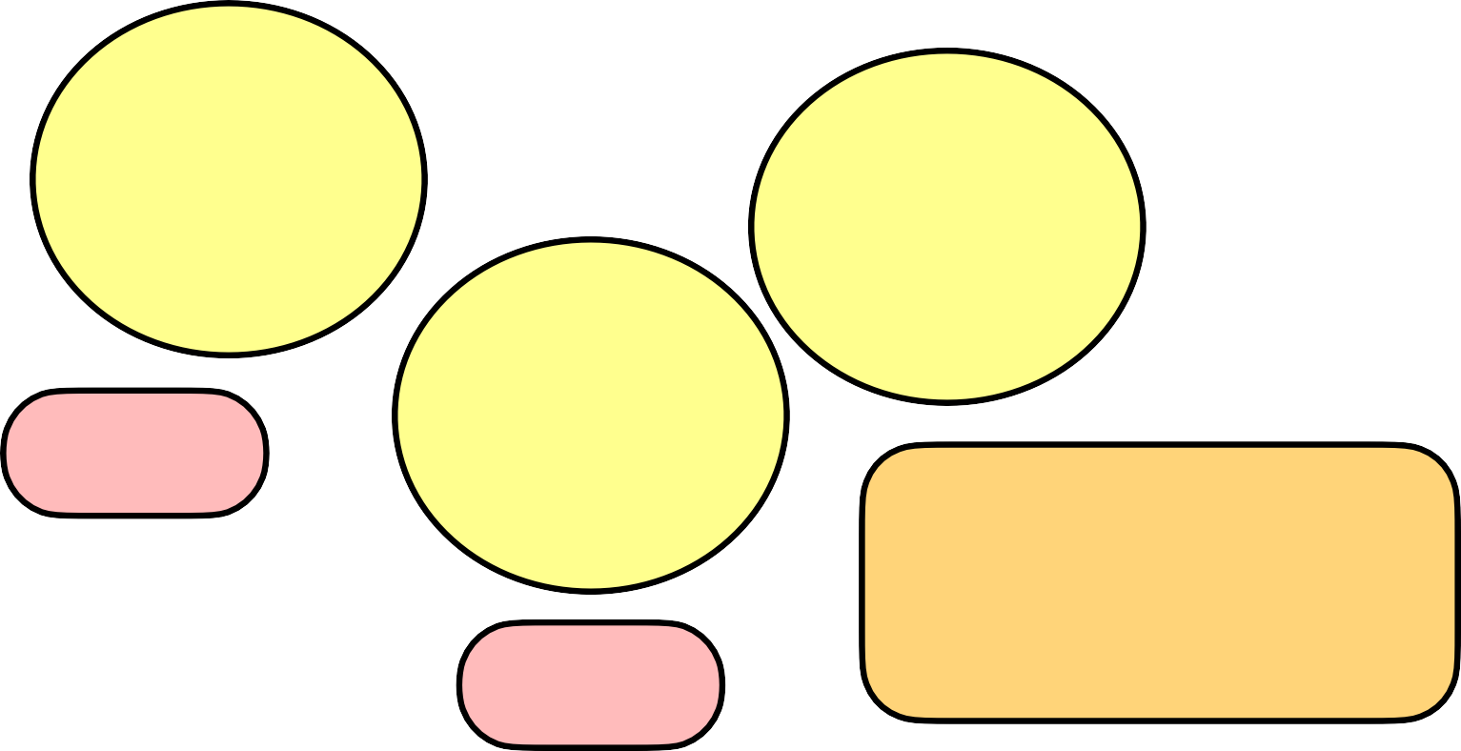
Dr. Claire Lee
Prof. Peter Jenni
Dr. Claire Lee
Dr. Claire Lee
Theoretical and Applied Mechanics
Astrophysics and Cosmology
Optics and Photonics
Particle Physics
Accelerators
Atomic and Molecular Physics
Nuclear Physics
Observers Committee x
Physics Working Groups
Medical physics
Biophysics
Materials Physics
Computing and 4IR
Prof. Oumar Ka
Energy
Instrumentatio n & Detectors
Light Sources
Earth Science
Fluid and Plasma
Prof. Peter Jenni

Slide 4
Prof. Peter Jenni
Dr. Claire Lee
Community Engagement
Prof. Oumar Ka
Observers Committee x
Young Physicists Forum
Dr. Claire Lee
Physics Education
Engagement Fora
Dr. Claire Lee
Women In Physics

Slide 5
Needs
First stage : to help the working groups get running efficiently and smoothly.
Next stage : to help review LOIs and White Papers, and with the editing of the Group Reports.
During that stage, the Observers Committee is expected to bring its know-how to the project through the reviewing of the different documents that have been produced by the Working Groups for the final report.

Slide 6
OBSERVATIONS
The interaction between the Observers Committee and the WGs was reduced to a minimum.
Main reason : lack of visibility in the importance of an Observers Committee in such a major initiative.
In some specific cases, especially in the beginning of the ASFAP process, members of the Observer Committee facilitated initial contacts between the WG convenors and senior colleagues in their respective communities (the most tangible benefit from the scheme, as at least perceived by individual Observers).

Slide 7
The Observers did not interact formally among themselves.
As a result :
- no common actions were developed
- no internal motivation generated
The Observer Committee actions remained with the initiatives of its individual members, both with respect to their assigned WGs as well as with the Steering Committee.

Slide 8
CONCLUSION
The concept of inviting independent Observers with a broad background in science strategies is a very interesting approach but its effectiveness remained rather short of the initial expectations.
It has to be rethought for future strategy plans.
Nevertheless, some overall positive contributions can be underlined thanks to the commitment of individual Observers.
Committee email: ASFAP-Observers@cern.ch

Slide 9
Reference
https://indico.cern.ch/event/1039315/contributions/4365534/attachments/2282501/3878422/African%20Strategy%20Town%20Hall%20-%20Observers%20Committee%20Talk%20-%20CA%20Lee%20v2.pdf

