Slide 1
Physics Education Working Group
Sam Ramaila, University of Johannesburg, South Africa
Ulrich Raich, retired from CERN, Geneva, Switzerland
Bertrand Tschanche Fankam, Alioune Diop University, Senegal

Slide 2
Context
ASFAP initiative brought together physicists from Africa and beyond to address critical issues in physics education across the continent.
A series of meetings held within the physics education group.
Letters of Intent (LOIs) were submitted.
Several strategic proposals emerged from discussions and LOIs.

Slide 3
Proposed Initiatives
Build stronger educational frameworks
Increase access to resources
Promote innovation in teaching and research
Contributing to the growth of physics education and scientific advancement in Africa

Slide 4
Physics Education Goals
Cultivating Scientific and Technological Literacy
Developing 21st-Century Skills
Enhancing Africa’s Capacity for Innovation
Promoting Sustainable Development
Addressing the STEM Gender Gap
Supporting Teacher Training and Professional Development
Fostering International Collaboration and Knowledge Exchange
Bridging the Gap Between Education and Industry
Leveraging Technology for Inclusive Education

Slide 5
Physics as a Catalyst for Africa’s Future
ASFAP envisions physics education as a catalyst for Africa’s scientific, technological, and economic future
Physics education to play a transformative role in achieving the continent’s long-term goals
Concerted effort to reform physics education
Addressing structural challenges
Ensuring that every African student can engage with and excel in the subject
Africa is poised to become a global leader in fundamental and applied physics
Driving innovation and progress for generations to come

Slide 6
Learning Approach and Challenges for Physics Education
Learning Approach
Challenges
Contextualized and Culturally Relevant Pedagogy
Inquiry-Based Learning and Hands-On Experiments
Leveraging Technology for Physics Education
Collaboration and Professional Development for Educators
Active Learning
Resource Constraints and Infrastructure Deficits
Teacher Shortages and Capacity Building
Gender Disparities in STEM Education
Curriculum Rigidities and Examination Pressures
Language Barriers and Cognitive Load
Inequitable Access to Technology

Slide 7
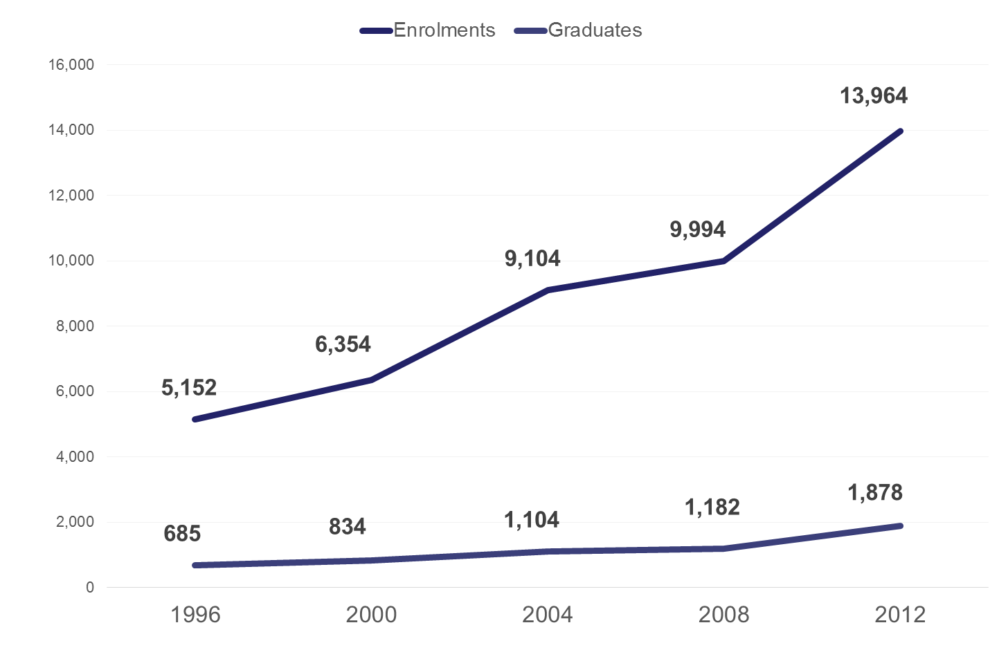
PhD enrolments and graduates in SA: 1996-2012 [Source: DHET (2013)]

Slide 8
Doctoral enrolments, doctoral graduates and research publications in SA

Slide 9

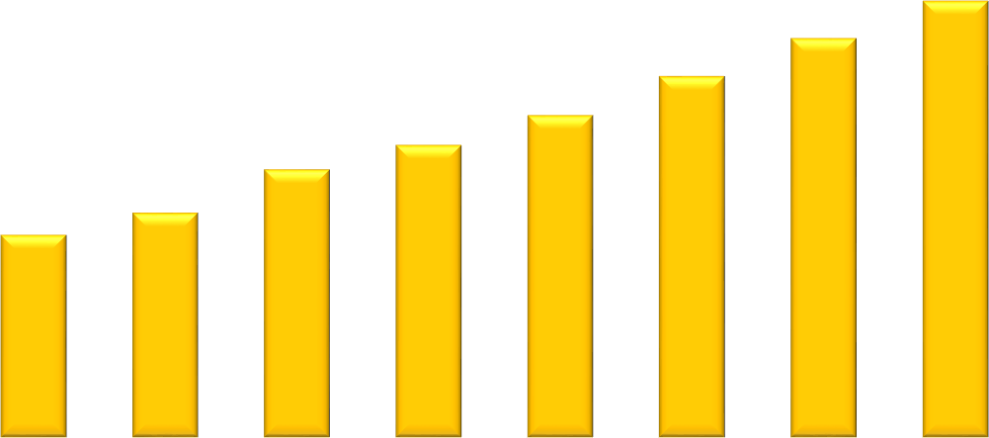
Number of doctoral degree graduates in South African universities, 2010 – 2017
(Source: Statistics on Post-School Education and Training in South Africa, 2017)
Number of doctoral degrees graduates
3,500
3 057
3,000
2 797
2 530
2,500
2 258
1 879
2 051
2,000
1 421
1 576
1,500
1,000
500
0
2010
2011
2012
2013
2014
2015
2016
2017

Slide 10
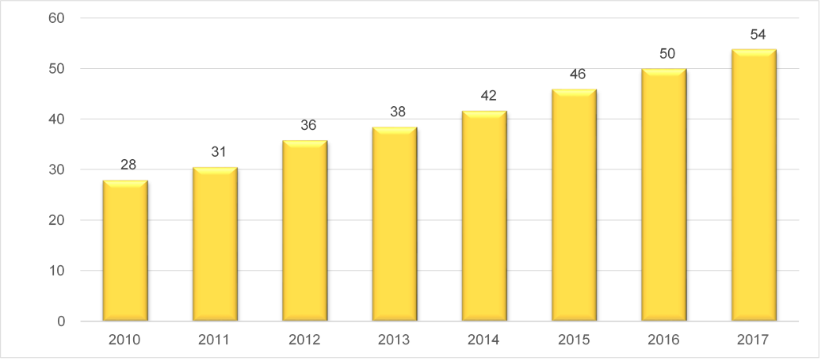
Number of doctoral degree graduates per million of population per year, 2010 – 2017
(Source: DHET, 2017)
Number of doctoral graduates per million

Slide 11
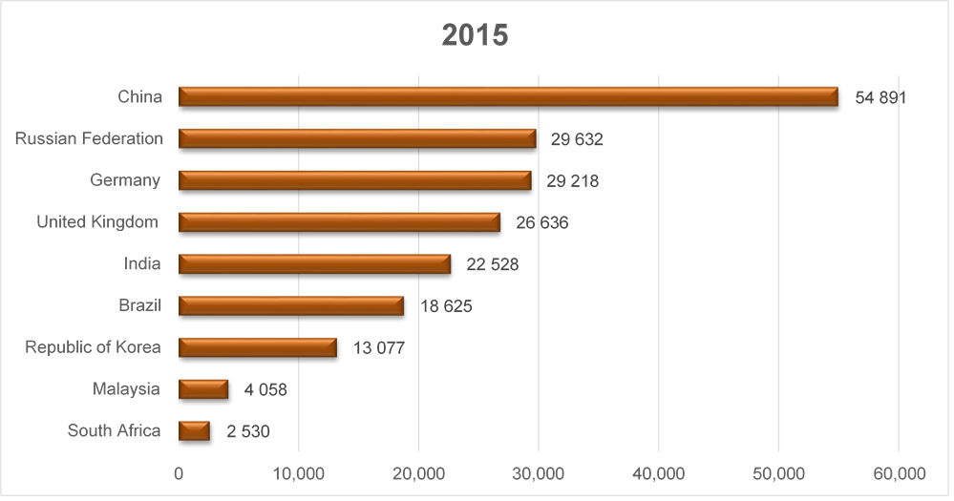
Number of doctoral degree graduates by country, 2015
(Source: UNESCO Institute for Statistics)

Slide 12

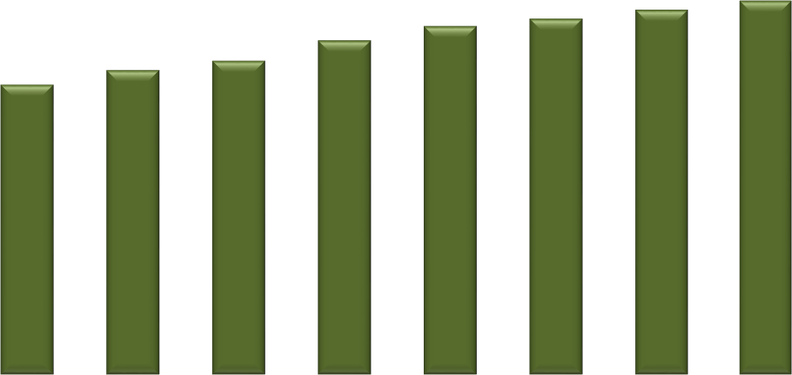
Share of academic staff with a PHD in South African universities, 2010 – 2017
(Source: DHET HEMIS database, 2010-2017)
Share of academic staff
50.0%
44.9%
46.0%
45.0%
41.1%
42.9%
43.8%
40.0%
35.7%
37.5%
38.6%
35.0%
30.0%
25.0%
20.0%
15.0%
10.0%
5.0%
0.0%
2010
2011
2012
2013
2014
2015
2016
2017

Slide 13
Physics Education on an International Level
Leveraging Global Best Practices in Physics Education
Fostering International Collaboration and Research Partnerships
Addressing Global Challenges through Physics Education
Promoting Mobility and Knowledge Exchange
Aligning with Global Standards in Physics Education
Enhancing Digital Learning and Open Science Initiatives
Supporting Teacher Development through Global Professional Networks
Encouraging International Recognition of African Contributions to Physics
Facilitating Global Engagement in Space and High-Energy Physics
Addressing the Global STEM Gender Gap

Slide 14
Africa as a Global Contributor to Physics Education
Africa is an active participant in the global physics community
Contributing to and benefiting from international advancements in science and education
Encouraging the mobility of students and researchers
Positioning Africa as a key player in the global scientific arena
Contribute to solving global challenges through the power of physics

Slide 15
Tackling Challenges for a Stronger Physics Education Ecosystem
Physics Laboratories in High Schools
Importance of Laboratories in Physics Education
Current Challenges Facing High School Physics Laboratories in Africa
Recommendations for Improving Physics Laboratories in High Schools
The Role of Laboratories in Promoting Careers in Physics

Slide 16
Existing interventions

Slide 17
SAIP Teacher Development Project

Slide 18
SAIP Teacher Development Project Accreditation
Accredited by South African Council for Educators (SACE)
Continuous Professional Development (CPD) Points
Career enhancement

Slide 19
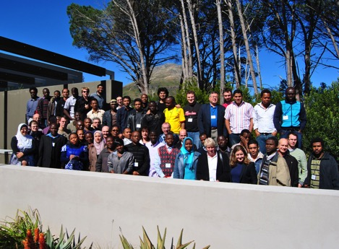
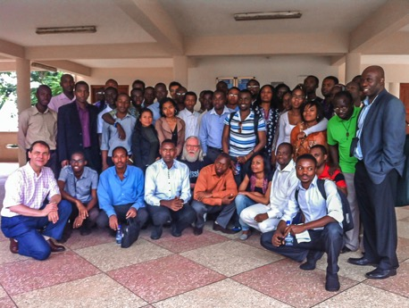
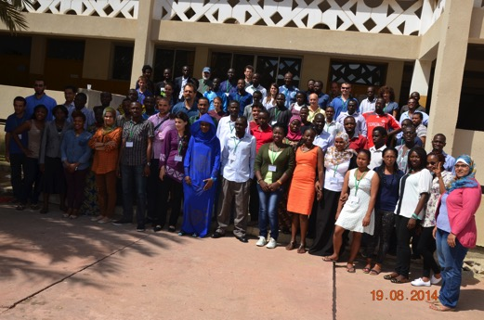
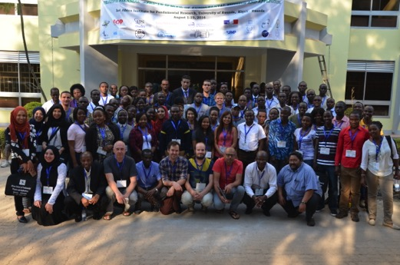
Beyond Capacity Building – reverse the African Science Diaspora
African School of Fundamental Physics and Applications
South Africa 2010
Ghana 2012
Senegal 2014
The students progress successfully.
Where are the students now?
..... For some ... The African Science Diaspora
Rwanda 2016

Slide 20
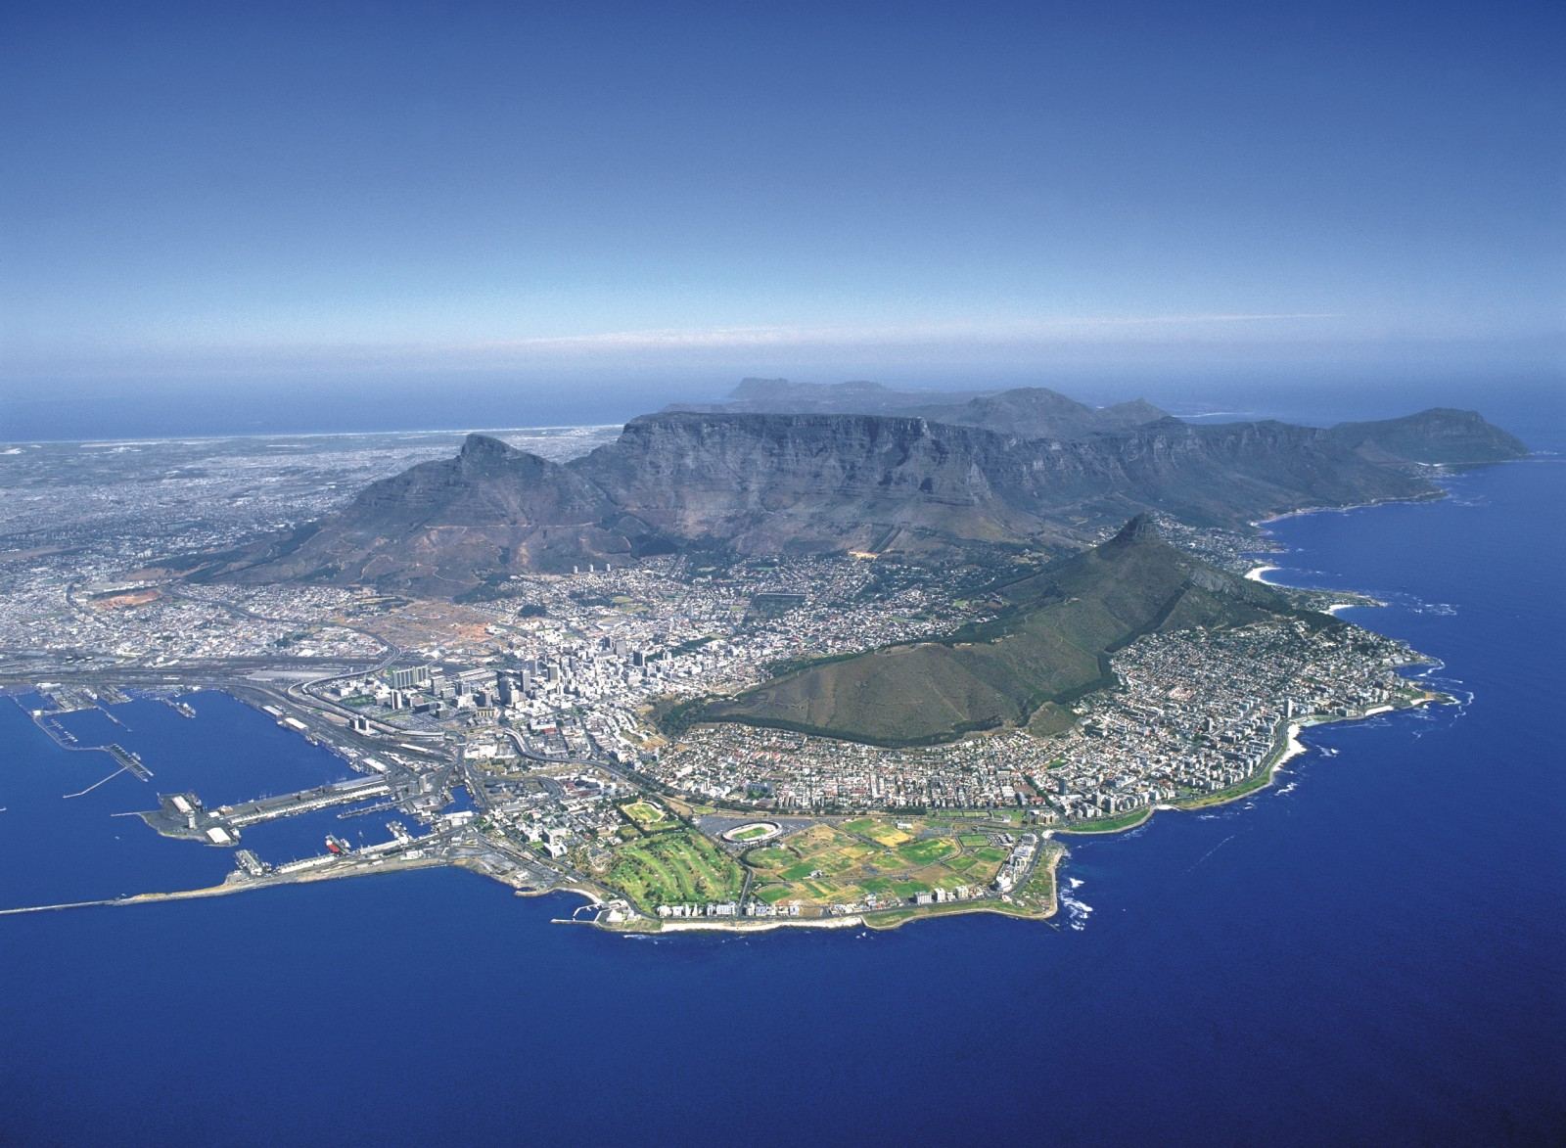
Thank You

