Slide 1
ASFAP Final Report Workshop 15 – 17 December 2024
Community Engagement Contribution
Dr. Marie Clémentine Nibamureke* (South Africa); Prof. Ndeye Arame Boye Faye (Senegal); Dr. Iroka Chidinma Joy (Nigeria); Prof. Jamal Mimouni (Algeria)

Slide 2
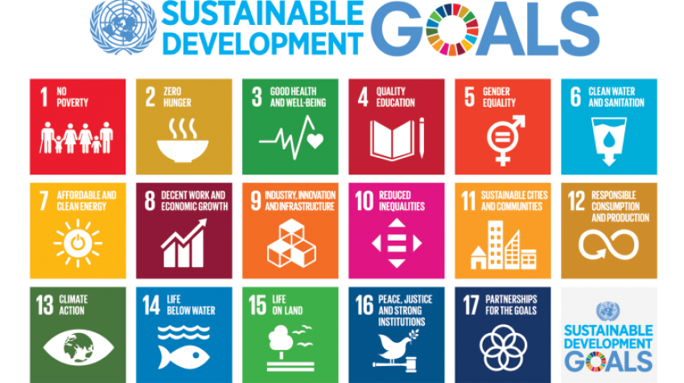
INTRODUCTION
In 2015, countries adopted the UN 2030 Sustainable Development Goals to end poverty.
Poverty is a major challenge in Africa, with 80% of those in extreme poverty located in Sub-Saharan Africa.
Africa has the potential to end poverty due to its young population and vast natural resources. (Coulibaly & Golubski, 2020).
https://www.un.org/en/sustainable-development-goals

Slide 3
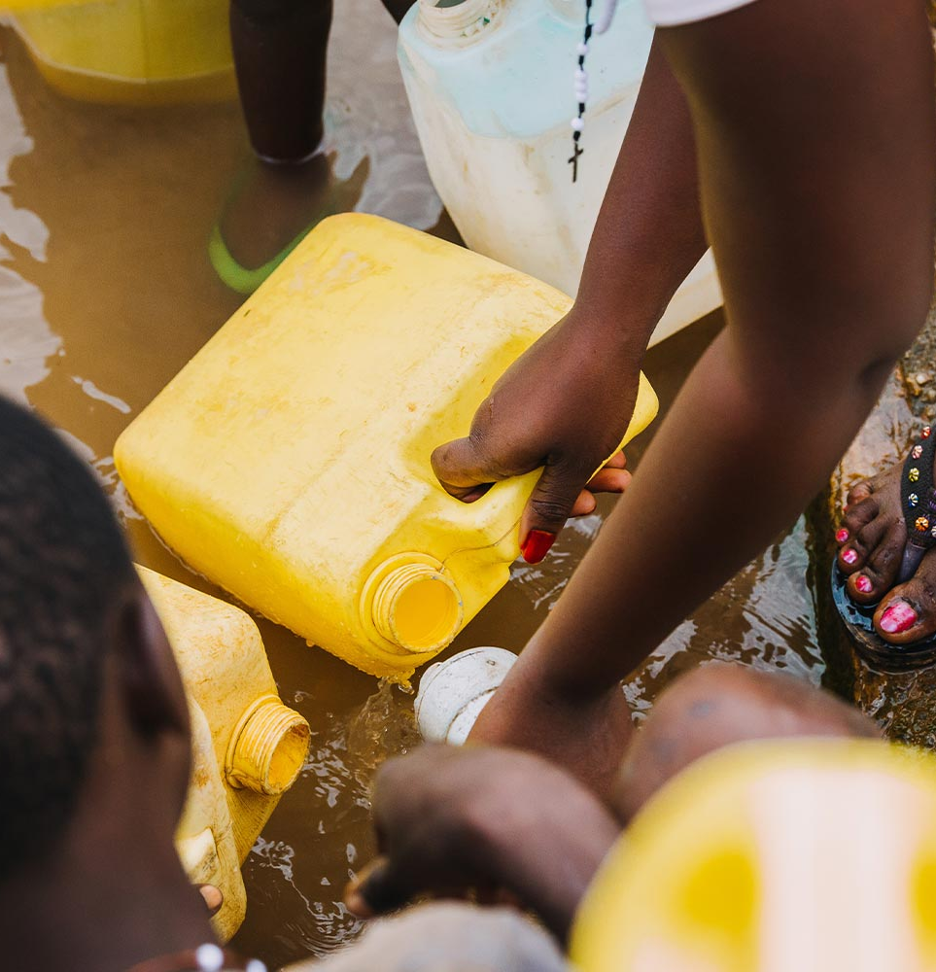
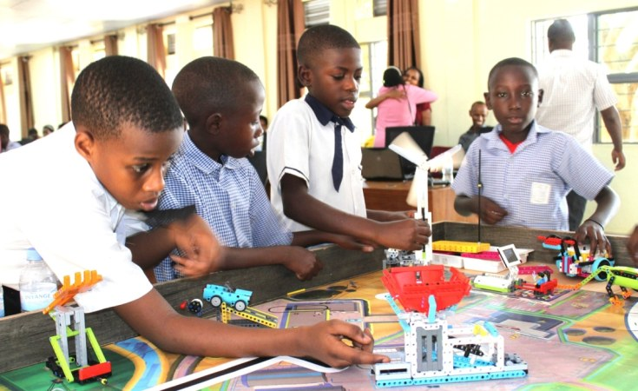
INTRODUCTION
Factors contributing to poverty in Africa:
Inadequate infrastructure & resource management.
Water pollution; climate change; etc.
Poor education systems. (Heckman, 2004)
Inadequate science and technology education.
Adequate education in STEM subjects is essential to unlock sustainable development.
We need to address the gaps in science and technology skills.
Improving the teaching and learning of Physics. (Babalola and Folasade, 2022)
https://ultranode.ca/wp-content/uploads/2022/06/water-pollution-in-Africa.jpg
https://cdn08.allafrica.com/download/pic/main/main/csiid/00631855:781626d66db0b3cddfa4a9475efe1547:arc614x376:w735:us1.jpg

Slide 4
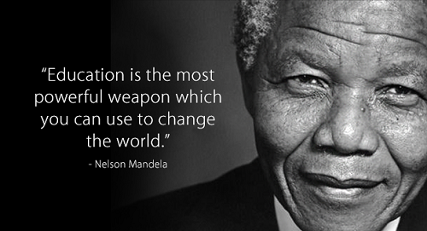
Importance of STEM education in Africa
Adequate STEM education is essential for sustainable development.
Investing in education has a payoff in terms of income. (Heckman, 2006)
Improving Physics education can help break the cycle of poverty in Africa.
by addressing social and environmental issues such as:
Water pollution
Climate change
Food shortage
etc.
https://artsculturesa.wordpress.com/2014/06/05/the-10-most-powerful-nelson-mandela-quotes/
https://cdn08.allafrica.com/download/pic/main/main/csiid/00631855:781626d66db0b3cddfa4a9475efe1547:arc614x376:w735:us1.jpg

Slide 5
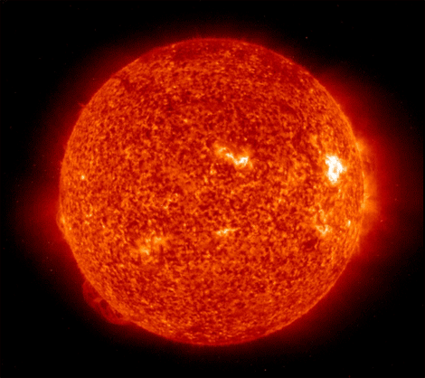
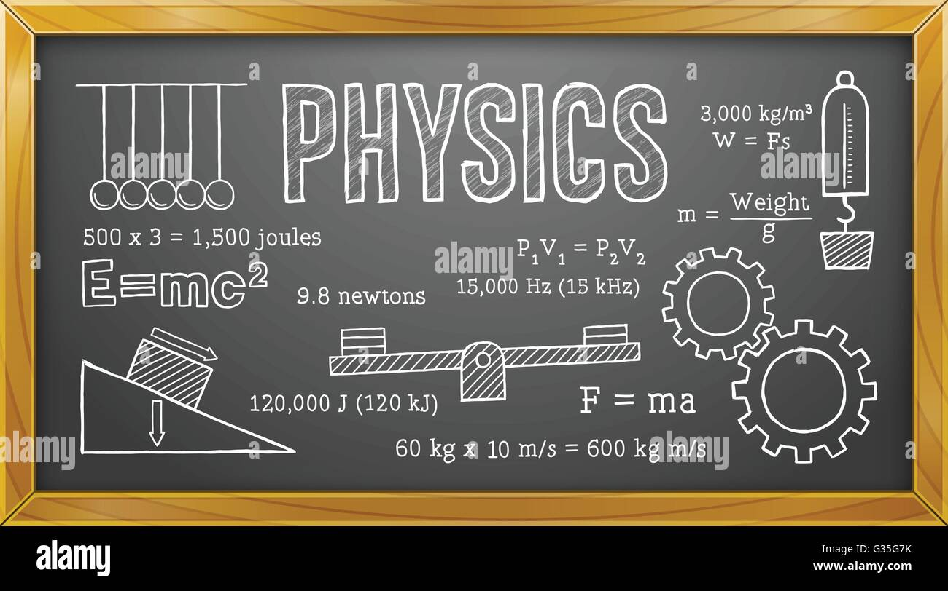
Why Physics Education?
Physics is a fundamental science; it tries to explain fundamental concepts that govern the universe.
Whatever we do, physics is involved:
For everyday living
All the technologies exploit the rules of physics: mechanical devices, transportation, communications, telematics, food technology, etc.
It is considered as the foundation of many other disciplines:
The Material Sciences
The Earth Sciences
The Biological Sciences
The Sciences of the Universe
Engineering, etc.
https://visibleearth.nasa.gov/images/45072/solar-storm-on-august-1-2010
https://c8.alamy.com/comp/G35G7K/physics-science-school-education-blackboard-G35G7K.jpg
Notes:
Evidences shows that, on average, each additional year of education boosts a person’s income by 10 percent and increases a country’s GDP by 18 per cent.
Some researchers estimate that if every child learn to read, around 170 million fewer people would live in poverty. (UNICEF Blog)

Slide 6
Importance of Physics in development
Physics can help break the cycle of perpetual poverty in Africa
Physics is a cross-cutting discipline with applications in many economic development sectors:
Health (e.g. cancer treatment),
Agriculture,
Environment (climate change; water pollution; etc.),
Energy (renewable energy),
Information technology, etc.
“Physics improves our quality of life by providing the basic understanding necessary for developing new instrumentation and techniques for medical applications, such as computer tomography, magnetic resonance imaging, positron emission tomography, ultrasonic imaging, and laser surgery.”
Statement adopted by IUPAP, March 1999

Slide 7

Potential Contribution of Physics to Meet Development Objectives
Agriculture
Agriculture accounts for 32% of Africa’s GDP. The sector offers the greatest potential for poverty reduction and job creation:
Digital agriculture: IoT can be important in introducing “Smart Agriculture” to farmers (automating the irrigation system, monitoring the fields with sensors, etc.).
Agrophysics: one of the branches of natural sciences dealing with applying physics in agriculture. It can help limit hazards to agricultural objects and the environment. It uses different tools, from electron microscopes to satellites.
Using ZnO-Nanomaterials for Enhancing Value-Added Agricultural Products,
Using ion beams generated by a compact low-energy ion accelerator to induce rice mutants.
“To transform Africa from simply being a raw materials supplier for the rest of the world to a continent that actively uses its own resources to ensure the economic development of Africans.”
The African Union's Agenda 2063
Notes:
IoT = Internet of Things

Slide 8
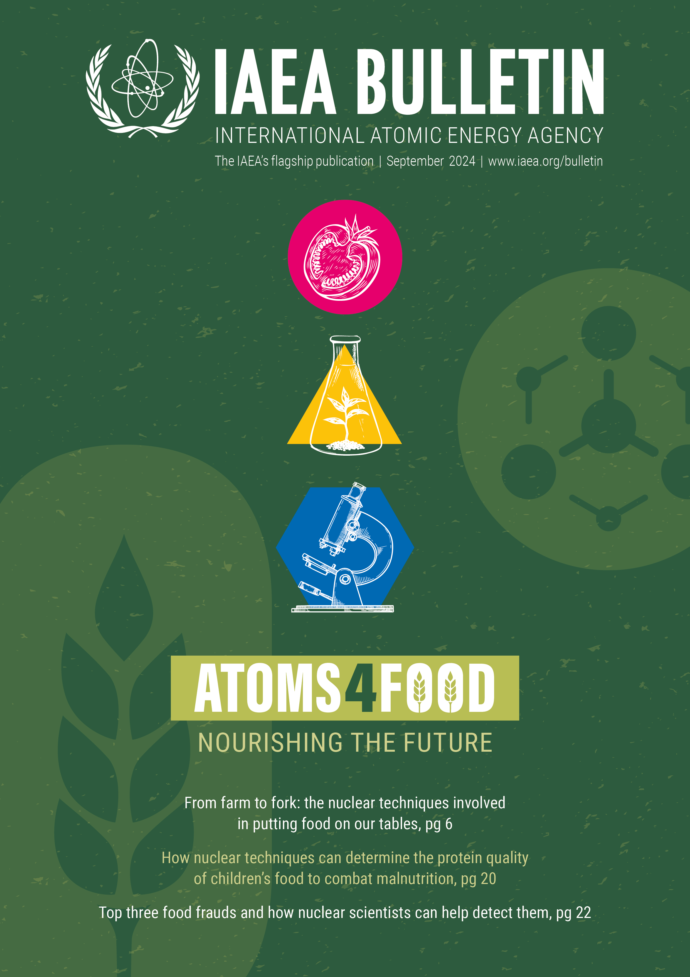
Potential Contribution of Physics to Meet Development Objectives
Nuclear technology
Can be used to improve agricultural practices
Using isotopes or radiation techniques to control pests and diseases, increase crop production, protect land and water resources and ensure food safety.
Launch of a new initiative, ”Atoms4food”, by the AIEA and FAO in 2023.
The World Bank, under the West Africa Agricultural Transformation Project, is using nuclear technology to combat disease-causing pests as part of its Pest Management Plan (PMP) to increase food security nationwide.
Using stable isotopes for fertilizers to improve soil and water management and monitor fertilizer uptake.
Plant Breeding and Genetics: seeds can be irradiated with gamma rays, X-rays, ions or electron beams to initiate genetic changes.
https://www.iaea.org/services/key-programmes/atoms4food
Notes:
Launched in 2023, by the IAEA and the Food and Agriculture Organization of the United Nations (FAO), Atoms4Food was created to help countries boost food security and tackle hunger. It provides countries with tailored solutions to enhance their agricultural productivity, reduce food loss, ensure food safety, improve nutrition and adapt to climate change.
At the heart of Atoms4Food is nuclear science. It brings a level of precision, accuracy and predictability rarely seen in the world of food production, where the large number of unpredictable variables — including seeds, weather and soil — can make it difficult to achieve reliable outcomes. https://www.iaea.org/services/key-programmes/atoms4food

Slide 9
Potential Contribution of Physics to Meet Development Objectives
Energy: From energy generation, conversion and storage to sustainability and resources, physicists play a key role:
Photovoltaic and solar fuel sciences; Wind/ wave/ tidal/ oceanic/ hydro-based power sources;
Energy harvesting and storage technologies; Hydrogen production and fuel cells;
Geothermal power and heat pumps; Nuclear-sciences-based power cycle;
Desalination and water treatment; Carbon-capture sciences;
Recyclable, biodegradable, low-toxicity and sustainable materials.
A new generation of far smaller and cheaper nuclear technologies may offer more appropriate options for African countries to accelerate the deployment of reliable, low-carbon electricity (Small Modular Reactors (SMRs) and microreactors).
Ion-based quantum computers could boost battery performance: How fuel cells are decarbonizing energy. ‘’Physics World’’, Weekly Podcast, February 10, 2022)
Combining Artificial Intelligence with Physics-Based Methods for Probabilistic Renewable Energy Forecasting. Energies 2020, 13(8), 1979. https://doi.org/10.3390/en13081979
Notes:
Ion-based quantum computers could boost battery performance, how fuel cells are decarbonizing energy – Physics World
Abstract:
A modern renewable energy forecasting system blends physical models with artificial intelligence to aid in system operation and grid integration. This paper describes such a system being developed for the Shagaya Renewable Energy Park, which is being developed by the State of Kuwait. The park contains wind turbines, photovoltaic panels, and concentrated solar renewable energy technologies with storage capabilities. The fully operational Kuwait Renewable Energy Prediction System (KREPS) employs artificial intelligence (AI) in multiple portions of the forecasting structure and processes, both for short-range forecasting (i.e., the next six hours) as well as for forecasts several days out. These AI methods work synergistically with the dynamical/physical models employed. This paper briefly describes the methodology used for each of the AI methods, how they are blended, and provides a preliminary assessment of their relative value to the prediction system. Each operational AI component adds value to the system. KREPS is an example of a fully integrated state-of-the-science forecasting system for renewable energy.
Haupt SE, McCandless TC, Dettling S, Alessandrini S, Lee JA, Linden S, Petzke W, Brummet T, Nguyen N, Kosović B, et al. Combining Artificial Intelligence with Physics-Based Methods for Probabilistic Renewable Energy Forecasting. Energies. 2020; 13(8):1979. https://doi.org/10.3390/en13081979

Slide 10
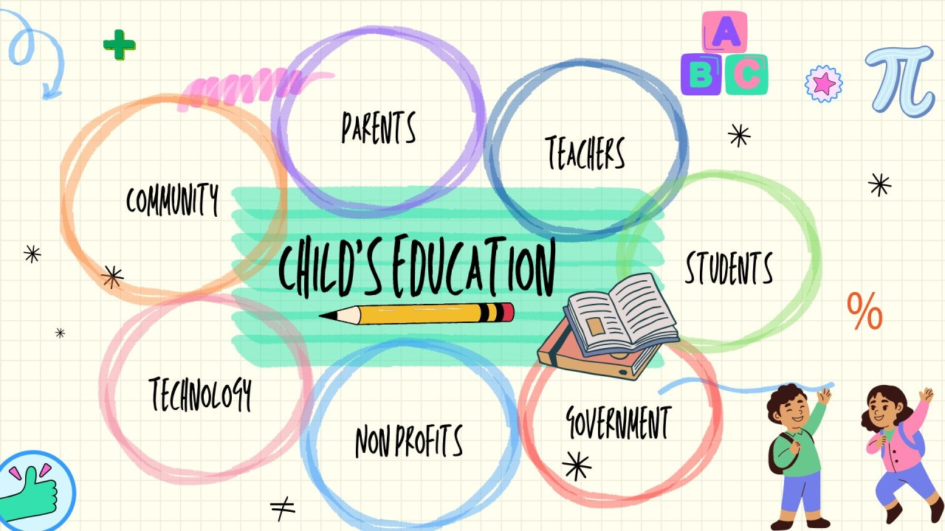
Problem with Physics Education in Africa
The main problems hindering physics education in Africa are:
Low enrollment in Physical Sciences (high school & university.
Lack of proper facilities & equipment
To mitigate this, we need collaboration among all stakeholders:
local communities,
scientists,
policymakers,
international partners. (Sa’id et al., 2020)
https://media.licdn.com/dms/image/D5612AQEg2Z1AolYdEA/article-cover_image-shrink_720_1280/0/1692354706286?e=2147483647&v=beta&t=XNiVx-g08Qmd90rWQe_JLqjzLBMZnqDRY0LmClEhiwk

Slide 11

Community Engagement and STEM Education
What is community engagement?
“A process of working collaboratively with and through groups of people affiliated by geographic proximity, special interest, or similar situations to address issues affecting their well-being.” (CDC, 1997)
Community engagement initiatives can help to enhance STEM education by providing real-world applications.
These initiatives can empower the youth and make STEM subjects more accessible and interesting.
https://www.redcliffeandtemplebid.co.uk/wp-content/uploads/2023/01/Untitled-design-3-e1673257974711.png
Notes:
The STEM Ambassador is a community programme that supports a network of thousands of amazing volunteers to bring real-life examples of STEM careers into schools, colleges, and universities across the UK. They help to break stereotypes and offer engaging activities to inspire the next generation into the infinite possibilities of STEM pathways. STEM Ambassadors
The STEM Ambassador programme is powered by STEM Learning and funded by UK Research and Innovation.

Slide 12
Community Engagement and Physics Education
Community engagement initiatives are “powerful vehicles for bringing about environmental and behavioral changes” (CDC, 1997)
“Communities count; they are key to improving everything from education and economic development to health care and race relations.” (Mattews, 2008)
In physics education, community engagement initiatives can help:
Improve the understanding and practice of Physics
Mobilize resources and influence systems
Change policies and programs
Mobilise people on environmental problems
Break cultural bias on girls’ education.

Slide 13
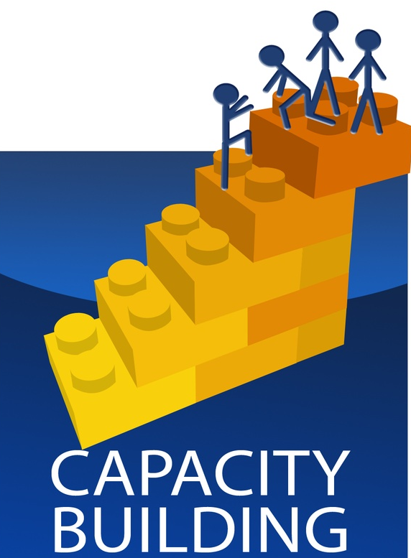

Community Engagement & Capacity Building
Each community engagement initiative involves capacity building of the concerned community.
Community engagement and capacity building are intertwined in their efforts to:
empower individuals,
promote collaborative learning
foster sustainable development.
By combining these approaches,
communities can harness their collective potential
drive positive change in Physics education in Africa.
Community Capacity-Building Clip Art - Search
Community Building Activities Clip Art - Search Images
Notes:
In summary, community engagement and capacity building are intertwined in their efforts to empower
individuals, promote collaborative learning, and foster sustainable development. By combining these two
approaches, communities can harness their collective potential and drive positive change in various aspects
of Physics education in Africa.

Slide 14
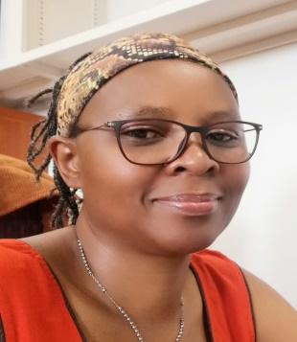
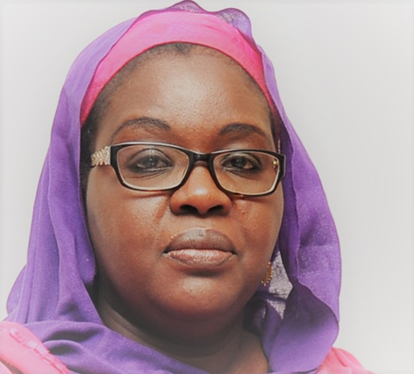
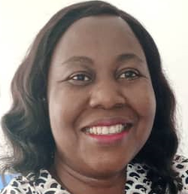

The ASFAP Community Engagement Working Group
Dr. Marie Clémentine Nibamureke
University of Venda (South Africa)
Prof. Ndeye Arame Boye Faye
Cheikh Anta Diop University (Senegal)
Dr. Iroka Chidinma Joy
National Space Research and Development Agency (NASRDA), Nigeria
Prof. Jamal Mimouni
University of Constantine -1, Constantine, (Algeria)

Slide 15
The ASFAP Community Engagement Working Group
Objective:
To draw a broader engagement and participation of communities in the development of the African Strategy.
To address issues of physics education and research collaborations.
We had 12 working topics; we were able to identify seven potential areas of possible common action:
Physics communication and outreach
Technology transfer; internet connectivity/ internet start-up resources applications and industry
E-lab & e-learning
Business development and entrepreneurism
Public education and outreach; diversity, inclusion and equity
Government engagement and public policy
Career pipelines & development; retention; capacity development.

Slide 16
Physics at the service of communities
The C.E Group discussed some areas where the community can be involved in using physics to solve societal problems.
Fight environmental pollution & climate change
Education outreach activities
Introduce astronomy to the people/communities
Introduce the ASFAP initiative to local governments
Invest in open science?

Slide 17
Physics and environmental problems
How can we use physics to resolve the problems of environmental pollution and climate change?
Physics can be used to find solutions to reduce plastic and pharmaceutical pollution.
Recycling methods for plastics
Waste burning facilities (e.g., incineration of pharmaceutical wastes)
Pharmaceuticals return to pharmacists or clinics
Special collection programs for pharmaceutical waste (old and unused)
Education and Awareness campaigns on the safe disposal of plastics and pharmaceutical
Physics can be used to fight climate change?

Slide 18
Physics outreach and education
To create awareness and broaden the community’s understanding of Physics
Survey on the views of physics teachers in Africa
Periodic Training of physics teachers in Africa
Virtual Physics laboratories: for those schools where there is no access to laboratories (+ internet access): classroom demonstrations for teachers and students;
Annual Physics community fairs: to show the local community how Physics can help them in everyday life and introduce children to the fun of Physics;
Campus visits for high school children to observe some fun physics experiments; Weekend and holiday science classes

Slide 19

Bring astronomy to local communities
The cosmos is the largest laboratory in the World
It is a great stage to use various physics branches to illustrate its cognitive.
Local facilities such as community telescopes can bring physics to people so they can observe the universe.
Astronomy can be used to help people with mental health problems.
https://science.nasa.gov/mission/hubble/impacts-and-benefits/astronomical-community-impacts/

Slide 20
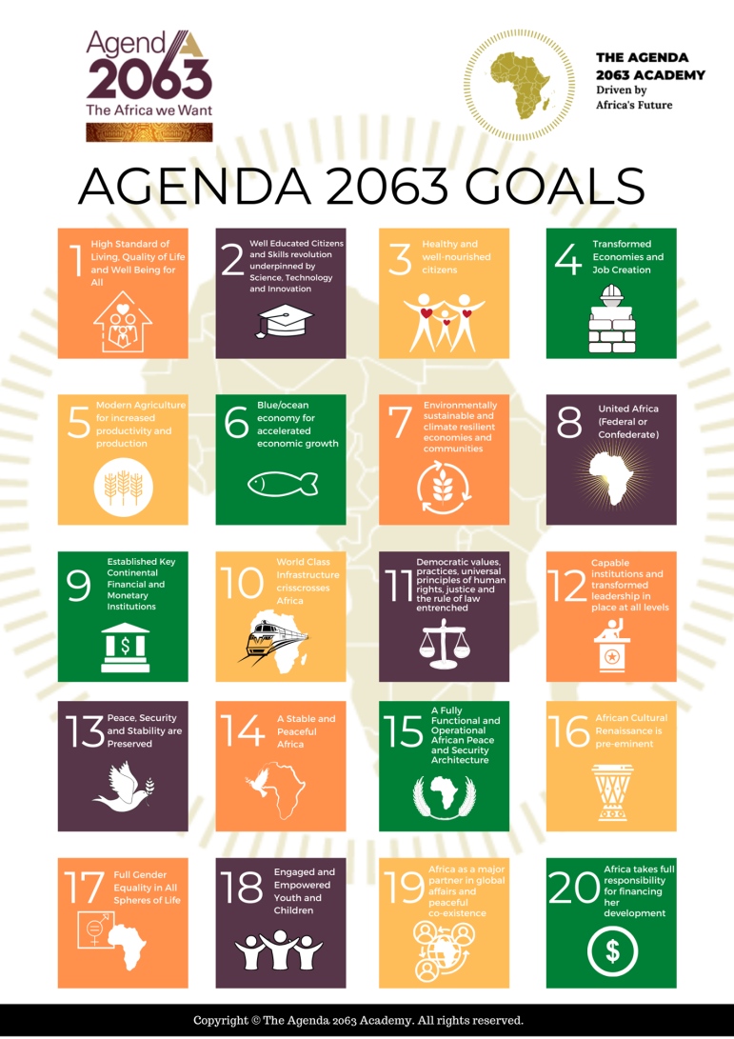
Introduce the ASFAP initiative to local governments
Develop a blueprint for engaging various physicist bodies or governments at in each country.
This task needs strong connections, and we did not attempt to engage with those important actors as it needs members in various countries and regions we did not have.
The ASFAP initiative should inform the African Agenda 2063 Goals.

Slide 21

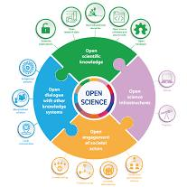
Community Goals and Priorities
The C.E received letters of intent (LOIs) identifying Key community goals to focus on for promoting Physics Education in Africa:
Accessible and inclusive education.
Local relevance of Physics education.
Teacher training and professional development.
Gender equity and inclusion.
Practical learning and laboratories.
Collaboration with local industries.
Public awareness and outreach activities.
Scholarships and financial support.
Research and innovation.
Sustainable development.
Stopping the brain drain.
Open Science
https://thelawyer.africa/2024/02/22/problems-hindering-realization-of-agenda-2063/
https://en.wikipedia.org/wiki/Open_science
Notes:
UNESCO on Open Science:
Open science has the potential of making the scientific process more transparent, inclusive and democratic.
Open science:
increases scientific collaborations and sharing of information for the benefits of science and society;
makes multilingual scientific knowledge openly available, accessible and reusable for everyone; and
opens the processes of scientific knowledge creation, evaluation and communication to societal actors beyond the traditional scientific community.
Our interconnected world needs open science to help solve complex social, environmental, and economic challenges and achieve the Sustainable Development Goals.
By promoting science that is more accessible, inclusive and transparent, open science furthers the right of everyone to share in scientific advancement and its benefits as stated in Article 27.1 of the Universal Declaration of Human Rights.
https://www.unesco.org/en/open-science/about?hub=686

