Slide 1

ASFAP MEETING: TOWARDS THE FINAL REPORT
Zewail City of Science, Cairo, Egypt
Stephane Kenmoe and Obinna Abah
Tuesday, December 17th 2024

Slide 2
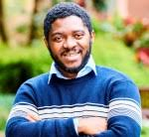
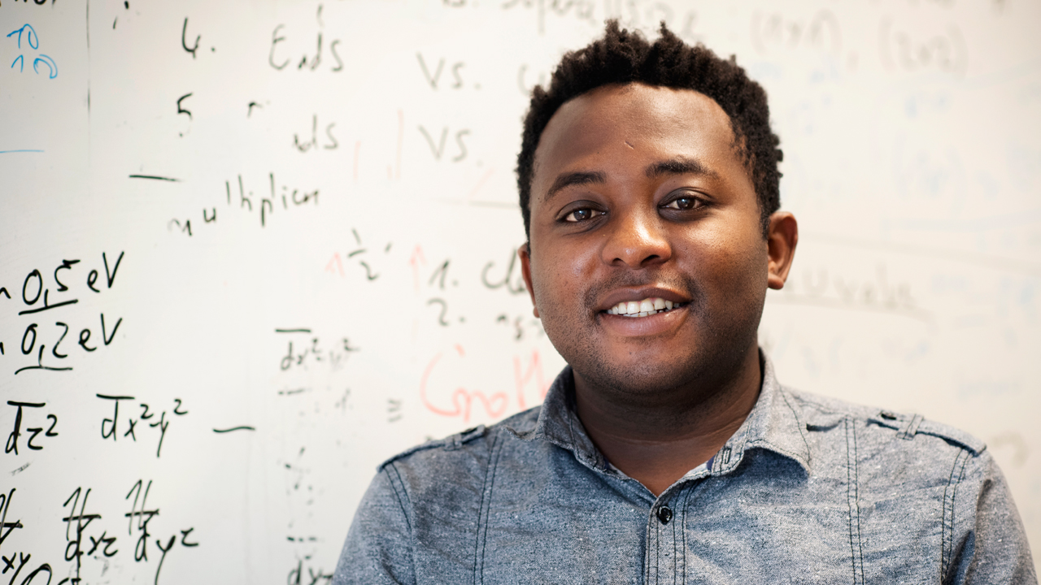
ATOMIC AND MOLECULAR PHYSICS WG
Obinna Abah, Nigeria
Theoretical Physics
Newcastle University
England
Stephane Kenmoe, Cameroon
Computational Physical chemistry
University of Duisburg-Essen,
Essen, Germany
Quantum thermodynamics and
quantum control for technologies
Energy and fuels production
from molecules decomposition

Slide 3
  Rationale

Slide 4
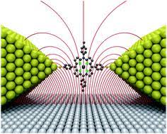
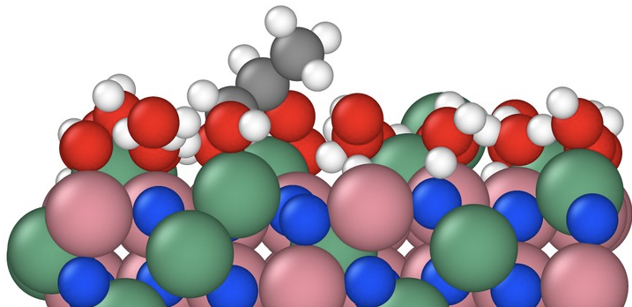

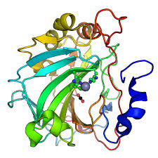

Interacting matter in the eV range
Chemically bound
Atomic physics
Molecular physics
Quantum mechanics
Quantum electrodynamics
Electronic structure
Quantum physics and chemistry
Dynamics, Spectroscopy
Biology, Medecine, Electronics, spintronics, heterogeneous catalysis…
Drug design
Electronic devices
Single molecule
transistor
Chemicals production, Energy,
Atmospheric, astrophysics
Agriculture
Biology & medicine

Slide 5
  2. Working circumference

Slide 6
Biophysics
Astrophysics
Atomic & Molecular Physics
Energy
Computing & 4IR
Condensed Matter physics

Slide 7
  3. Education & Research landscape

Slide 8
  3.1 The challenge of experimental physics

Slide 9
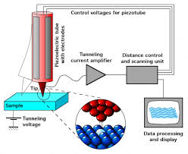
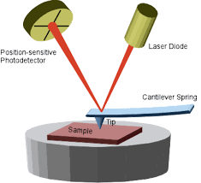
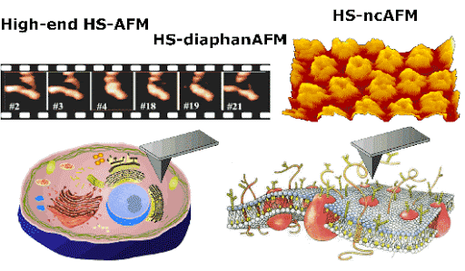
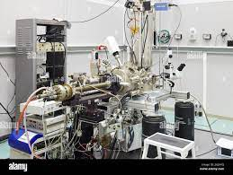
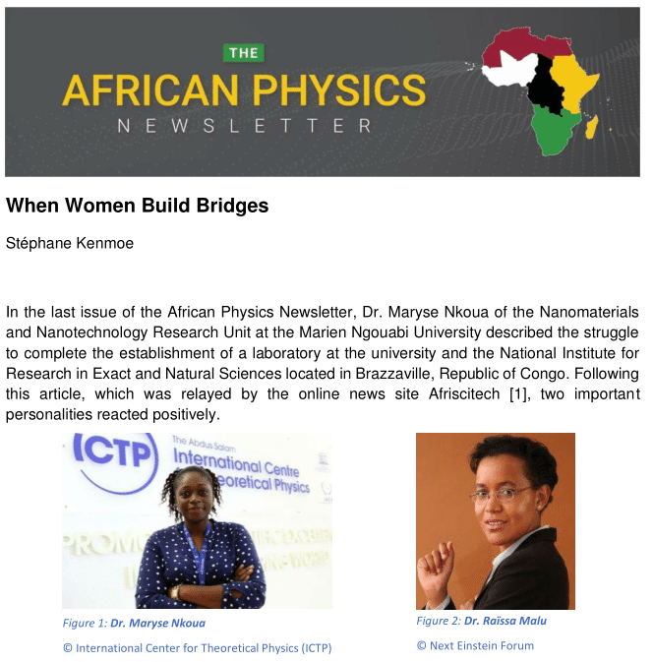
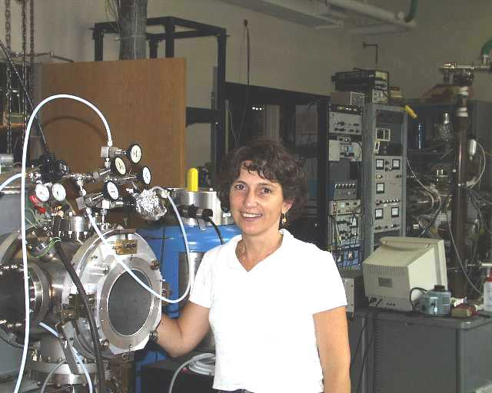
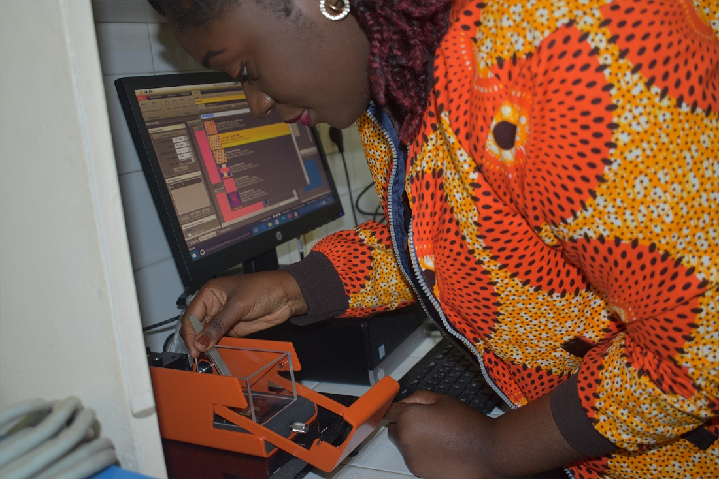
Probing matter at the atomic scale
More SPM are needed in Africa: STM, AFM,…
Scanning Tunneling Microscope (STM)
Atomic Force Microscope (AFM)
Structure of living cells from AFM
Loredana Casalis,
Elletra,Trieste Italy
Maryse Nkoua setting an
experiment with AFM

Slide 10
The Atomic Molecular Spectroscopy and Applications Laboratory of the
University of Tunis-El Manar: the pride of Tunisia
Fluorescence Spectroscopy to study the impact of environmental conditions on herbal drug integrity in Cape Coast Ghana
The Africa Microscopy Initiative in Cape Town South Africa
Challenge for low-cost experimental physics in Cameroon
A burst of pride in the Republic of Congo: the laboratory for nanomaterials
and nanotechnologies

Slide 11
  3.2 Commendable efforts at the theoretical level

Slide 12
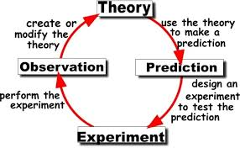

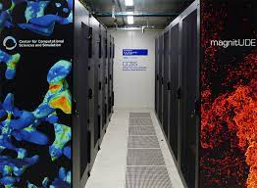
THEORY: WHICH SCHRODINGER EQUATION FOR AFRICA ?
Resources
ICTP, South Africa, Egypt, Morocco
Tunisia, Algeria
Ivory Coast, Rwanda?
High performance computing

Slide 13
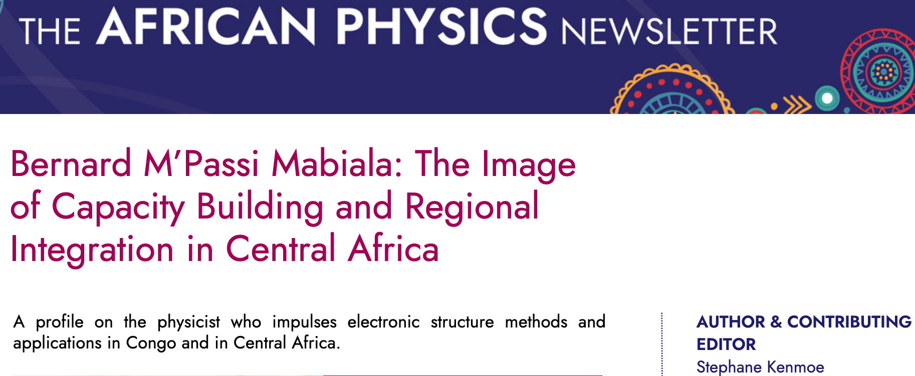
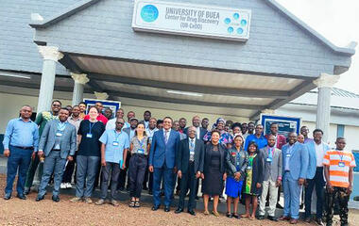
Cameroon & Congo take the lead in sub-Saharan Africa
Douala
Brazzaville
Buea
Nigeria, Ghana & Kenya on the track (Abeokuta, Nairobi)

Slide 14
  3.3 Intra-continental synergies

Slide 15
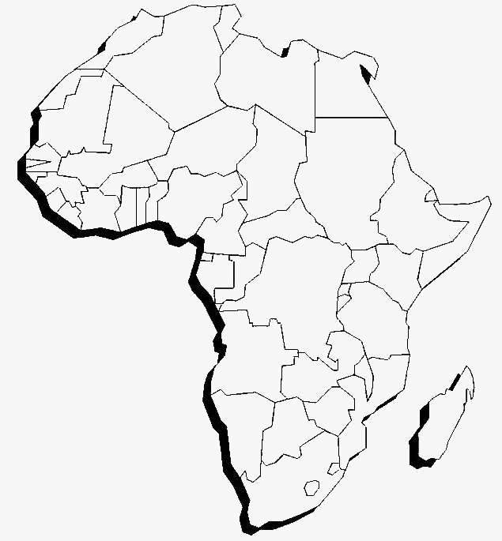
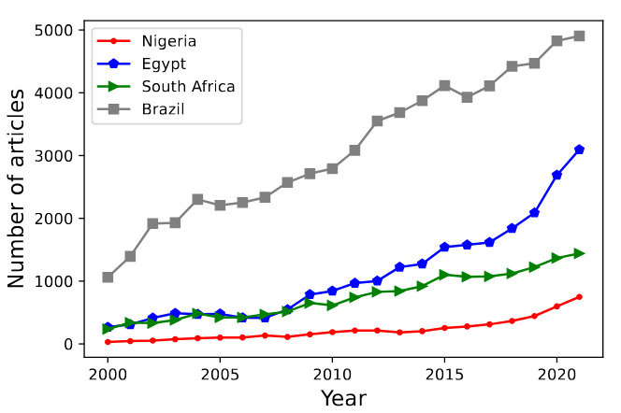
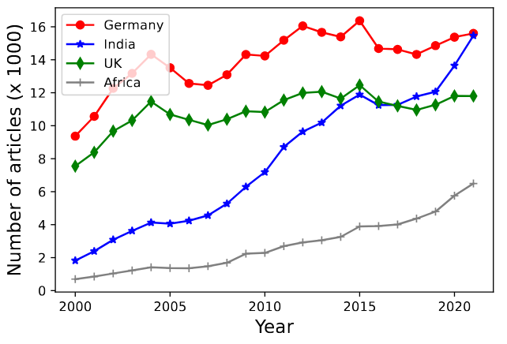
Number of articles published by some African countries (Egypt, Nigeria, South Africa) compared to Brazil
Meridional flow
Total articles published by African scientists (Algeria, Cameroon, Congo, Egypt, Ethiopia, Ghana, Kenya, Morocco, Nigeria, South Africa, Tunisia) compared western countries (Germany and UK) and India.
Source: Scopus – accessed October 8, 2022

Slide 16
  3.4 Capacity building:
  regional and continental initiatives

Slide 17
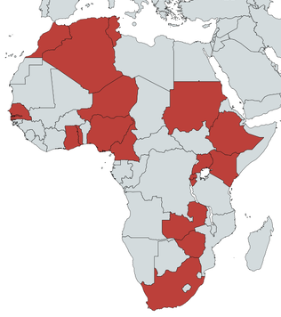
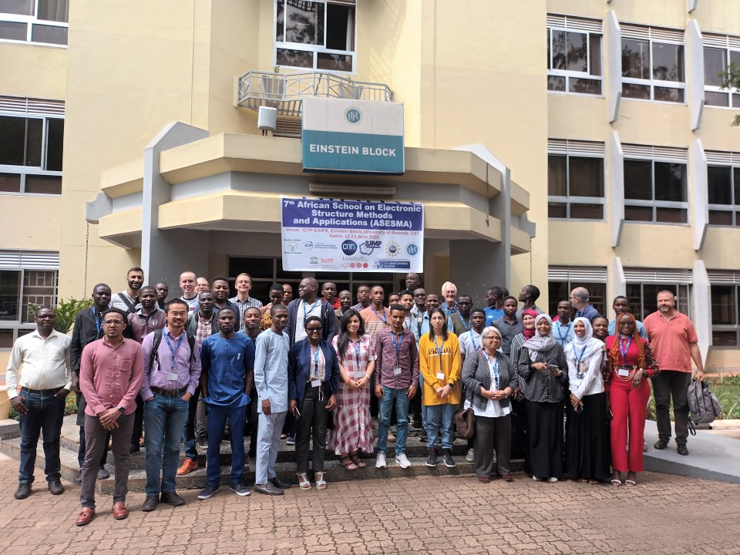
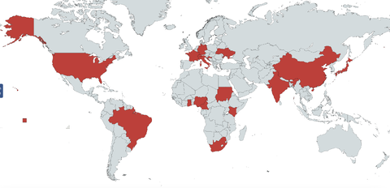
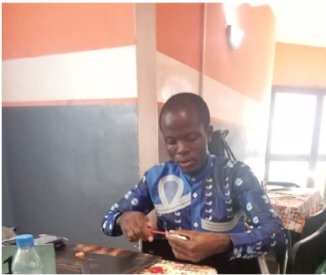
The ASESMA and ASESMANET initiatives
Map participants
Credit: Nicola Seriani
ASESMA 2023
Map of tutors and participants
The pivotal role of CEPAMOQ
The CASESMA initiative as a remarkable multiplier
A screw-driver to solve the
Schoedinger equation !!!

Slide 18
  3.5 Supercomputers and High-performance computing in sub-Saharan Africa: an imperative need

Slide 19
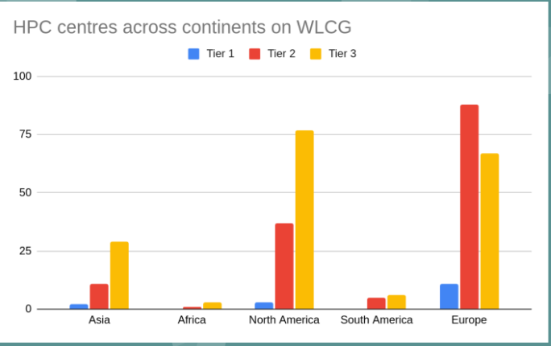
Where do we run calculations?
Credit: B.J. Odetayo, CERN
???
Centre for High Performance Computing (CHPC),
in Cape Town, South Africa: Lengau Cluster.
University Mohammed VI Polytechnic (UM6P) Morocco: Toubkal supercomputer.

Slide 20
  4. Call for action: recommendations

Slide 21
More regional centers like CEPAMOQ or the UB-CeDD as well as more frequent
capacity building initiatives like CASESMA in other regions are needed.
2. Replicate the Tunisian AMOP laboratory and implement its model of
collaboration throughout the continent.
3. Experimental facilities: STM, AFM, FTIR, spectrometers and other probes.
Capacity building for instrument usage.
Supercomputers & HPC centers: high peak density in South Africa.
Each region should have at least one computing infrastructure.

Slide 22
5. Promote complementary research particularly in sub-Saharan Africa to rationalize experimental research
6. Establish Collaborative Research Centers (CRC) e.g. via transregional research projects between theoretical centers in Cameroon and experimental groups in Ghana.
7. Align research to local needs: earth abundant hard and soft matter: heterogeneous catalytic supports, plants, dyes and others chemical compounds relevant for heath, pharmaceutical chemistry, agriculture or energy.
8. Promote locally funded research via tax incentives: this will allow making good use of the young scientists trained during regional and continental events and limit the brain drain.

Slide 23
THANK YOU

